Slide 1
CC7220-1
La Web de Datos
Primavera 2025
Lecture 10: Linked Data
Aidan Hogan
aidhog@gmail.com

Slide 2
Previously …

Slide 3











Semantic Web: Data, Logic, Query
* More or less

Slide 4
But we have not spoken much about …
CC7220-1
La Web de Datos
Primavera 2025
… how do we use RDF(S)/OWL/SPARQL
to build a “Web of Data”?

Slide 5
Semantic Web: Data, Logic, Query
* More or less
What are we missing from here to build a Web of Data?

Slide 6
Semantic Web: Data, Logic, Query, Links
* More or less
How can we add links to this picture?

Slide 7
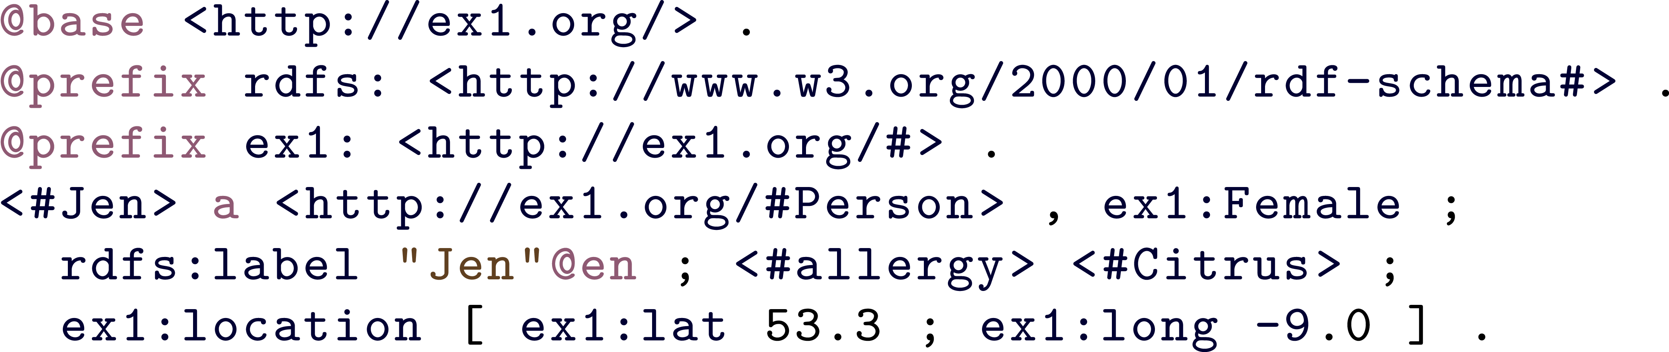
RDF filled with IRIs!
… any IRI could be a link!

Slide 8
Pre-Linked Data …

Slide 9
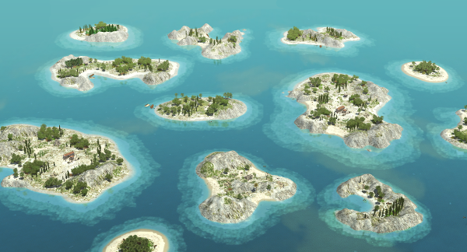

Semantic Web, early days (pre-2006)
Lots of dumps of RDF
Big OWL ontologies (difficult to re-use)
No reuse of IRIs ... no links … no Web!

Slide 10
Linked Data …

Slide 11

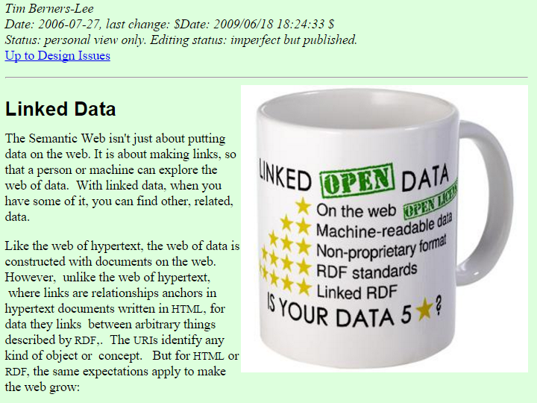
Linked Data … 2006
http://www.w3.org/DesignIssues/LinkedData.html

Slide 12
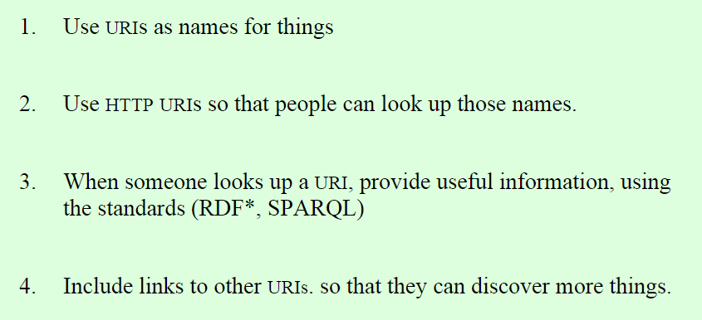
Four Principles of Linked Data
http://www.w3.org/DesignIssues/LinkedData.html

Slide 13
Linked Data examples ...

Slide 14


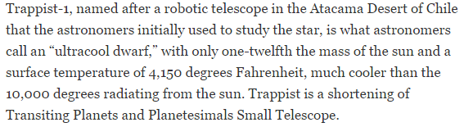

Slide 15
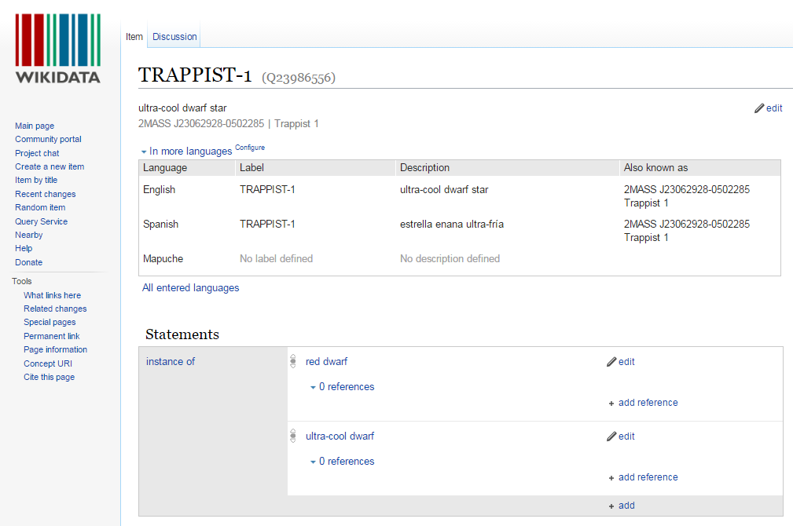

Slide 16

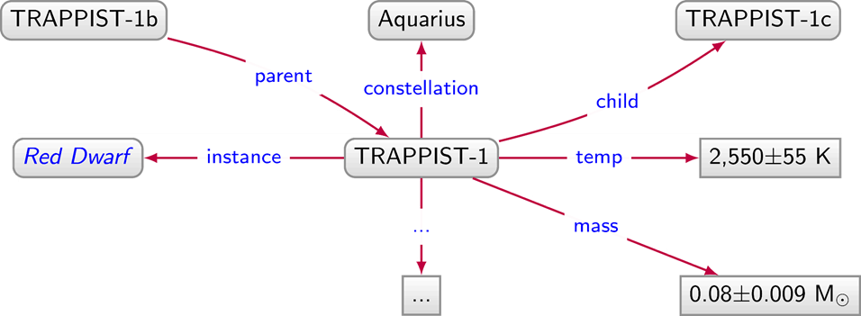
Linked Data Document
http://ex.org/data/TRAPPIST-1

Slide 17
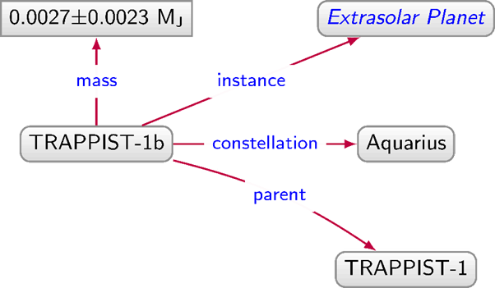
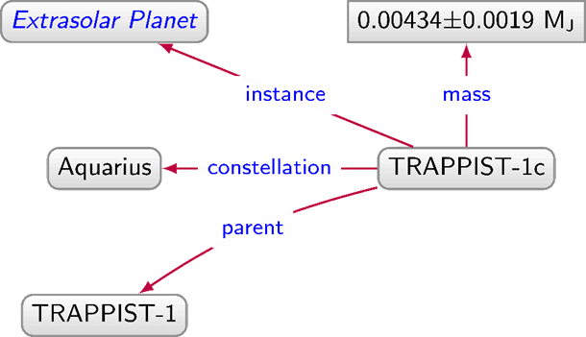
Linked Data Graph
http://ex.org/data/TRAPPIST-1b
http://ex.org/data/TRAPPIST-1c
http://ex.org/data/TRAPPIST-1

Slide 18
Linked Data Graph
http://ex.org/data/TRAPPIST-1b
http://ex.org/data/TRAPPIST-1c
http://ex.org/data/TRAPPIST-1

Slide 19
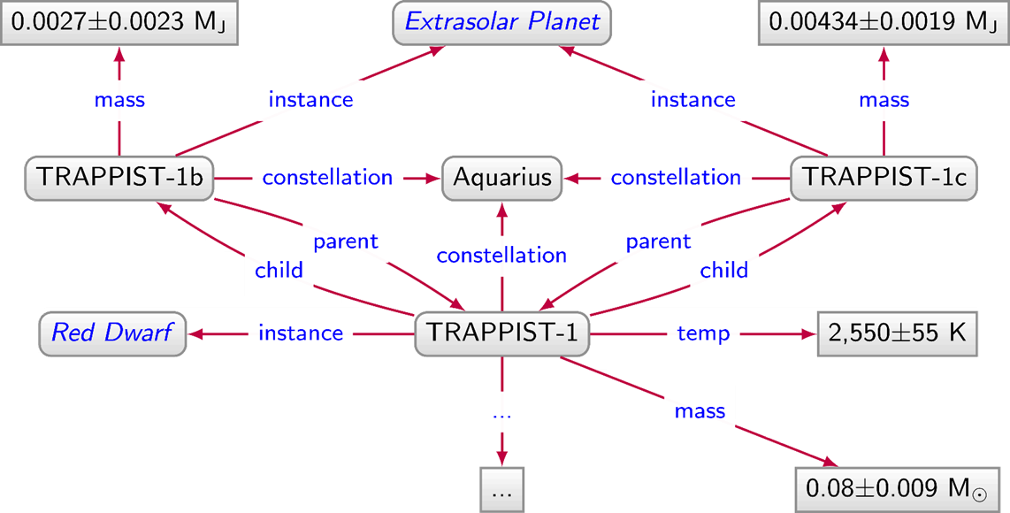
Linked Data Graph

Slide 20
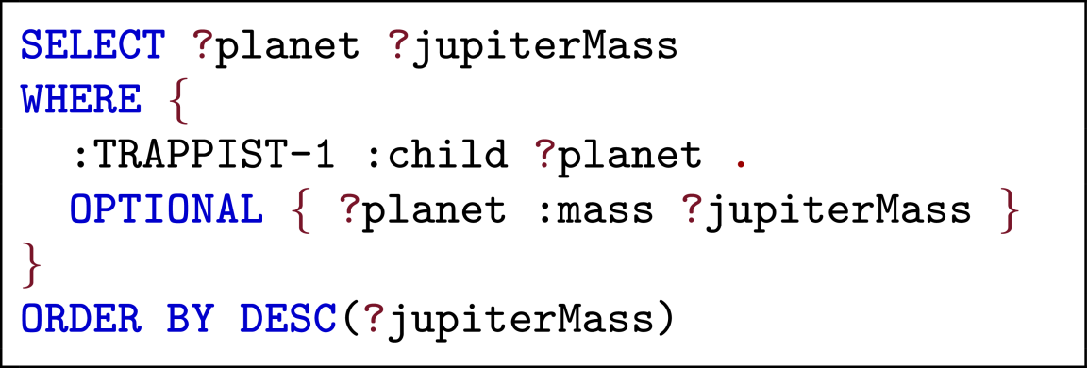
Answer queries over Linked Data using SPARQL

Slide 21


Linked Data Graph
http://ex.org/data/TRAPPIST-1b
http://ex.org/data/TRAPPIST-1c
http://ex.org/data/TRAPPIST-1
How can we implement these links (called "dereferencing")?

Slide 22
Implementing Linked Data…

Slide 23
Three recipes for dereferencing
URL Recipe
  Use document URLs to identify things
Hash Recipe
  Use fragment identifiers to identify things
Slash Recipe
  Use special redirects to identify things

Slide 24
URL Recipe
http://ex.org/data/TRAPPIST-1b
http://ex.org/data/TRAPPIST-1c
http://ex.org/data/TRAPPIST-1
http://ex.org/data/TRAPPIST-1b
http://ex.org/data/TRAPPIST-1c
Easy-peasy. So what's the problem?

Slide 25
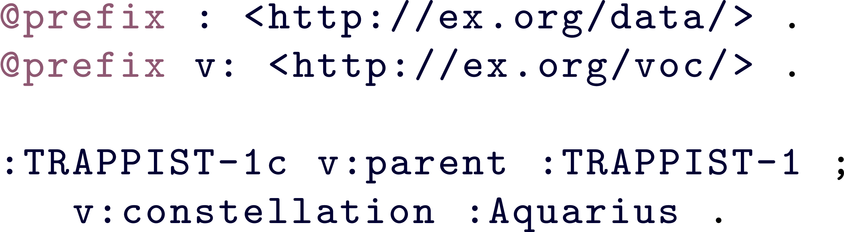

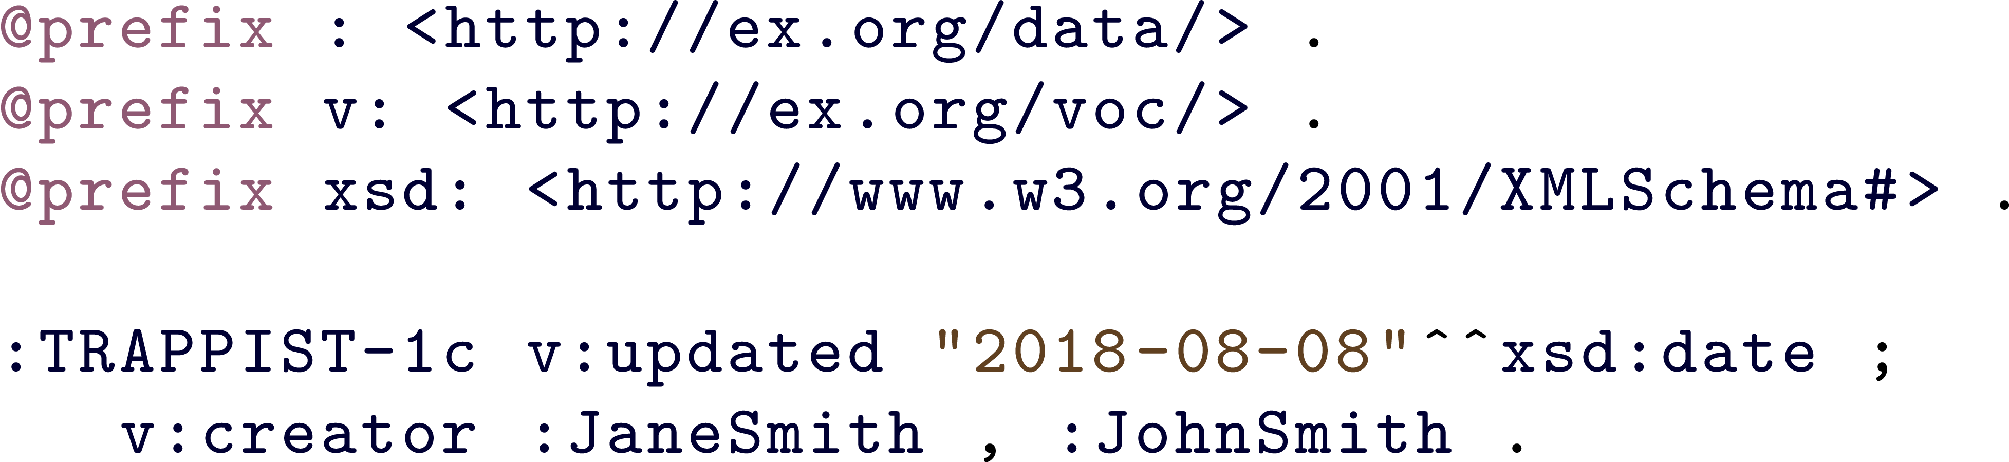

URL Recipe: The Problem

Slide 26
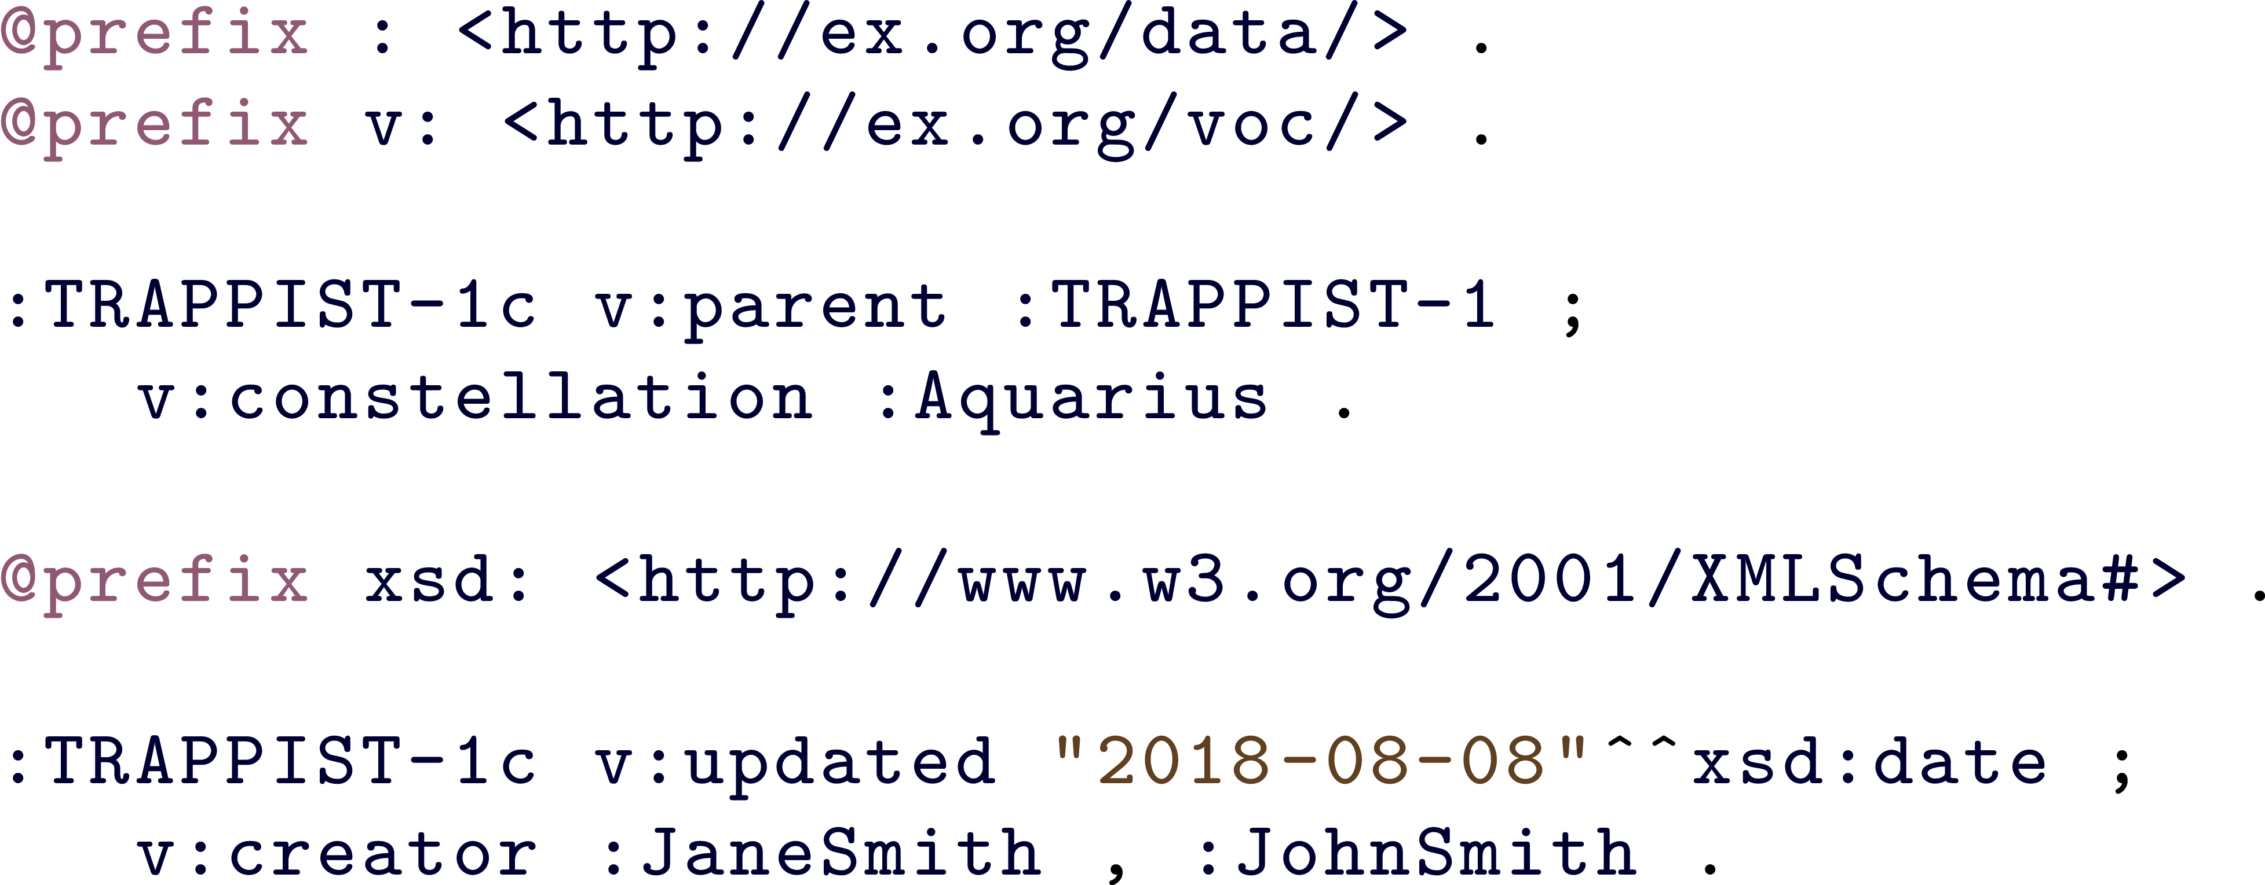
URL Recipe: The Problem
Document URLs should only identify documents!

Slide 27
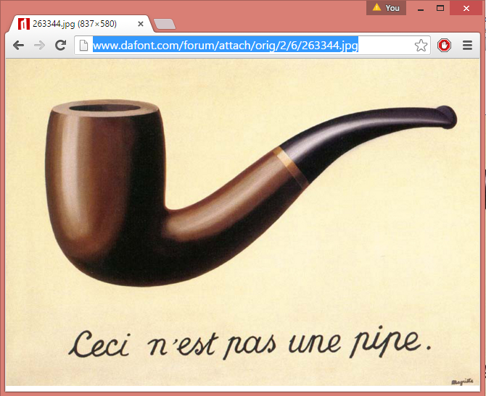
HTTP URLs for documents, not pipes

Slide 28

Three recipes for dereferencing
URL Recipe
  Use document URLs to identify things
documents
Hash Recipe
  Use fragment identifiers to identify things
Slash Recipe
  Use special redirects to identify things

Slide 29
Hash Recipe
http://ex.org/data/TRAPPIST-1b
http://ex.org/data/TRAPPIST-1c
http://ex.org/data/TRAPPIST-1
http://ex.org/data/TRAPPIST-1b#this
http://ex.org/data/TRAPPIST-1c#this

Slide 30


Hash Recipe
http://ex.org/data/TRAPPIST-1c
  Identifies the document
http://ex.org/data/TRAPPIST-1c#this
  Identifies the planet
  Look it up, you get the document
  GET: http://ex.org/data/TRAPPIST-1c#me
  200 OK: http://ex.org/data/TRAPPIST-1c

Slide 31

Three recipes for dereferencing
URL Recipe
  Use document URLs to identify things
documents
Hash Recipe
  Use fragment identifiers to identify things
Slash Recipe
  Use special redirects to identify things

Slide 32
Slash Recipe
http://ex.org/data/TRAPPIST-1b
http://ex.org/data/TRAPPIST-1c
http://ex.org/data/TRAPPIST-1
http://ex.org/entity/TRAPPIST-1b
http://ex.org/entity/TRAPPIST-1c

Slide 33
Slash Recipe
http://ex.org/data/TRAPPIST-1c
  Identifies the document
http://ex.org/entity/TRAPPIST-1c
  Identifies the planet
  Look it up, redirects to the document
  GET: http://ex.org/entity/TRAPPIST-1c
  303 See Other: http://ex.org/data/TRAPPIST-1c
  GET: http://ex.org/data/TRAPPIST-1c
  200 OK: http://ex.org/data/TRAPPIST-1c

Slide 34
Three recipes for dereferencing
URL Recipe
  Use document URLs to identify things
documents
Hash Recipe
  Use fragment identifiers to identify things
Slash Recipe
  Use special redirects to identify things

Slide 35
Hash vs. Slash
  GET: http://ex.org/data/TRAPPIST-1c#this
  200 OK: http://ex.org/data/TRAPPIST-1c
Which is better, hash or slash?
Well, hash has half the number of requests!
  GET: http://ex.org/entity/TRAPPIST-1c
  303 See Other: http://ex.org/data/TRAPPIST-1c
  GET: http://ex.org/data/TRAPPIST-1c
  200 OK: http://ex.org/data/TRAPPIST-1c

Slide 36
Hash vs. Slash
  GET: http://ex.org/data/TRAPPIST-1c#this
  200 OK: http://ex.org/data/TRAPPIST-1c
Which is better, hash or slash?
But slash decouples document URLs from entity IRIs
  GET: http://ex.org/entity/TRAPPIST-1c
  303 See Other: http://ex.org/data/TRAPPIST-1c
  GET: http://ex.org/data/TRAPPIST-1c
  200 OK: http://ex.org/data/TRAPPIST-1c

Slide 37

Content negotiation with hash
  ACCEPT: application/rdf+xml
  GET: http://ex.org/data/TRAPPIST-1c#this
  200 Okay: http://ex.org/data/TRAPPIST-1c.rdf
  ACCEPT: text/html
  GET: http://ex.org/data/TRAPPIST-1c#this
  200 Okay: http://ex.org/data/TRAPPIST-1c.html
Can also choose from different RDF formats; e.g., Turtle, RDFa, etc.
(if supported by the server that is!)

Slide 38
Content negotiation with slash
  ACCEPT: application/rdf+xml
  GET: http://ex.org/entity/TRAPPIST-1c
  303 See Other: http://ex.org/data/TRAPPIST-1c.xml
  GET: http://ex.org/data/TRAPPIST-1c.xml
  200 Okay: http://ex.org/data/TRAPPIST-1c.xml
  ACCEPT: text/html
  GET: http://ex.org/entity/TRAPPIST-1c
  303 See Other: http://ex.org/data/TRAPPIST-1c.html
  GET: http://ex.org/data/TRAPPIST-1c.html
  200 Okay: http://ex.org/data/TRAPPIST-1c.html

Slide 39
Linking Open Data

Slide 40


Open Data ...
We’ve got all these people who want to publish Open Data but how should they publish it on the Web?
We’ve got this new way of publishing Linked Data on the Web but no data to publish …
... meets Linked Data

Slide 41
Linked Open Data
We’ve got this new way of publishing Linked Data on the Web but no data to publish …
Linked Open Data
We’ve got all these people who want to publish Open Data but how should they publish it on the Web?

Slide 42
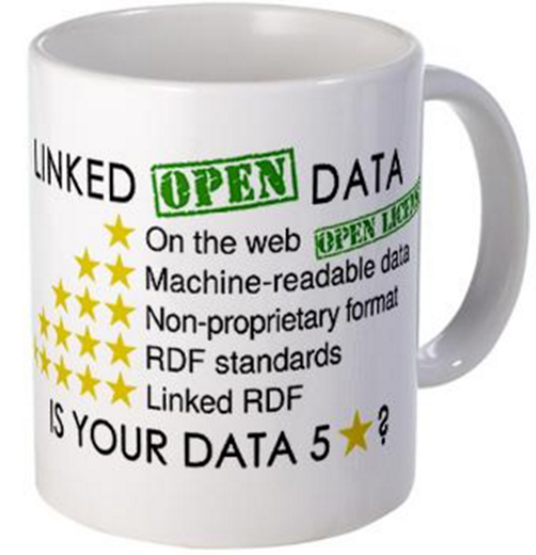
The 5 ★’s of Linked Open Data
★★★★★ Publish data under open licence
★★★★★ Make the data “machine readable”
    e.g., a Spreadsheet better than a PDF table
★★★★★ Use non-proprietary formats
    e.g., a CSV text file better than Excel
★★★★★ Use URIs to name your stuff (hint: RDF)
    use unambiguous identifiers that can be linked/looked up
★★★★★ Provide links to other content (hint: Linked Data)
    so consumers can follow links to find out more

Slide 43
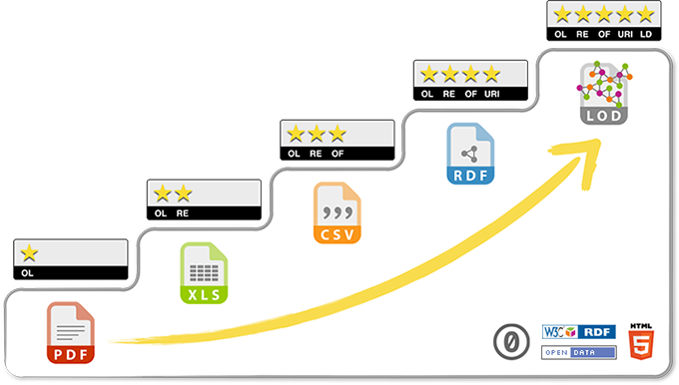
Each star improves interoperability of data

Slide 44
Linked Open Datasets

Slide 45
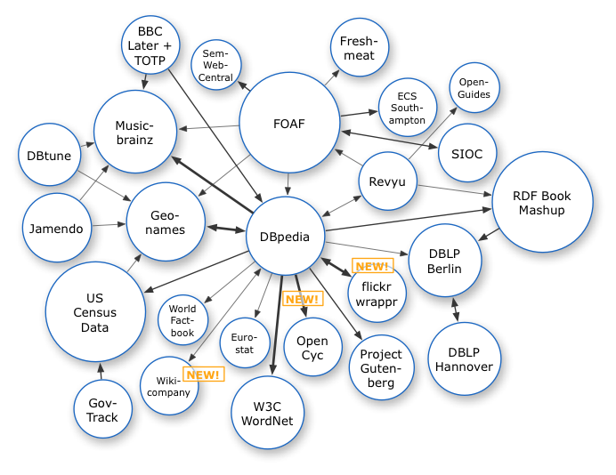
The LOD cloud
Oct. 2007

Slide 46
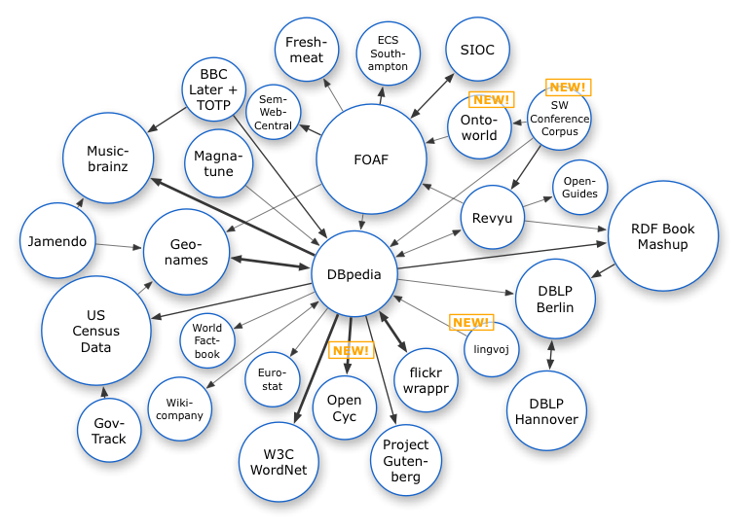
The LOD cloud
Oct. 2007
Nov. 2007

Slide 47
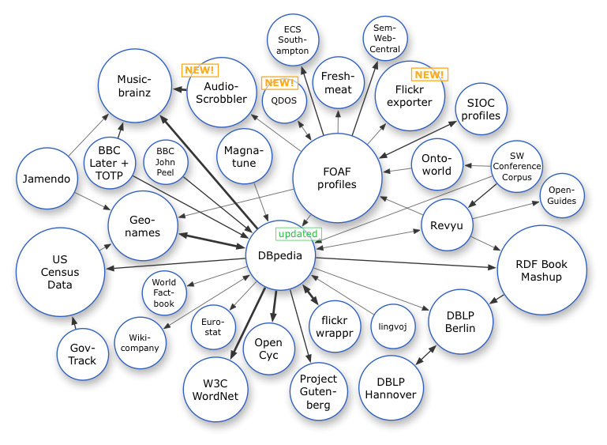
The LOD cloud
Oct. 2007
Nov. 2007
Feb. 2008

Slide 48
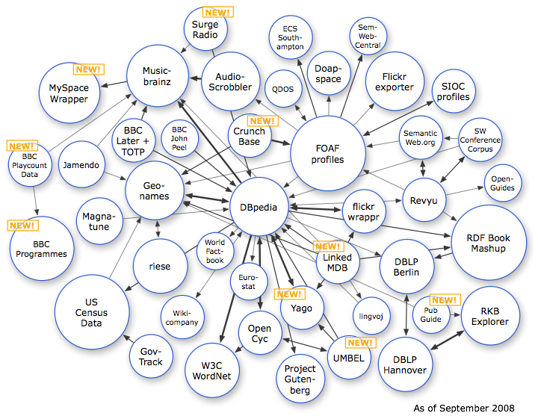
The LOD cloud
Oct. 2007
Nov. 2007
Feb. 2008
Sep. 2008

Slide 49
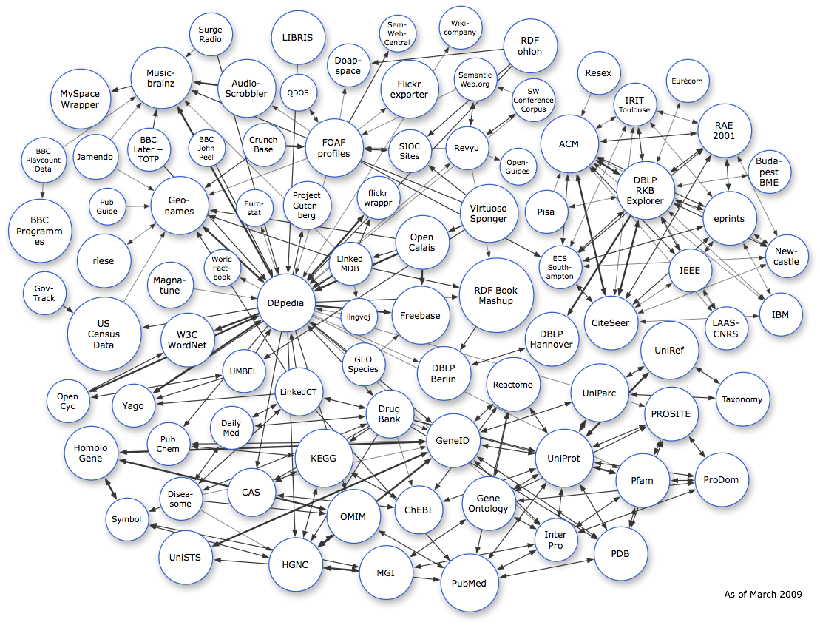
The LOD cloud
Oct. 2007
Nov. 2007
Feb. 2008
Sep. 2008
Mar. 2009

Slide 50
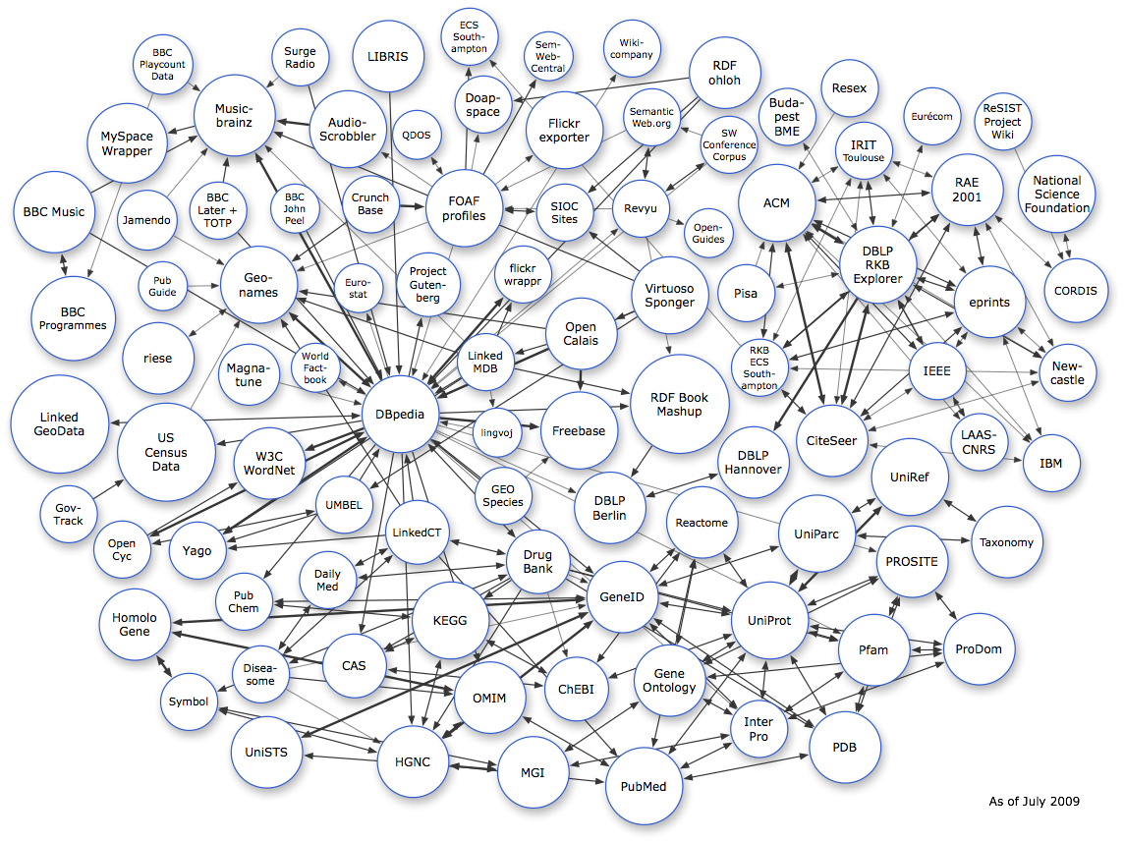
The LOD cloud
Oct. 2007
Nov. 2007
Feb. 2008
Sep. 2008
Mar. 2009
July 2009

Slide 51
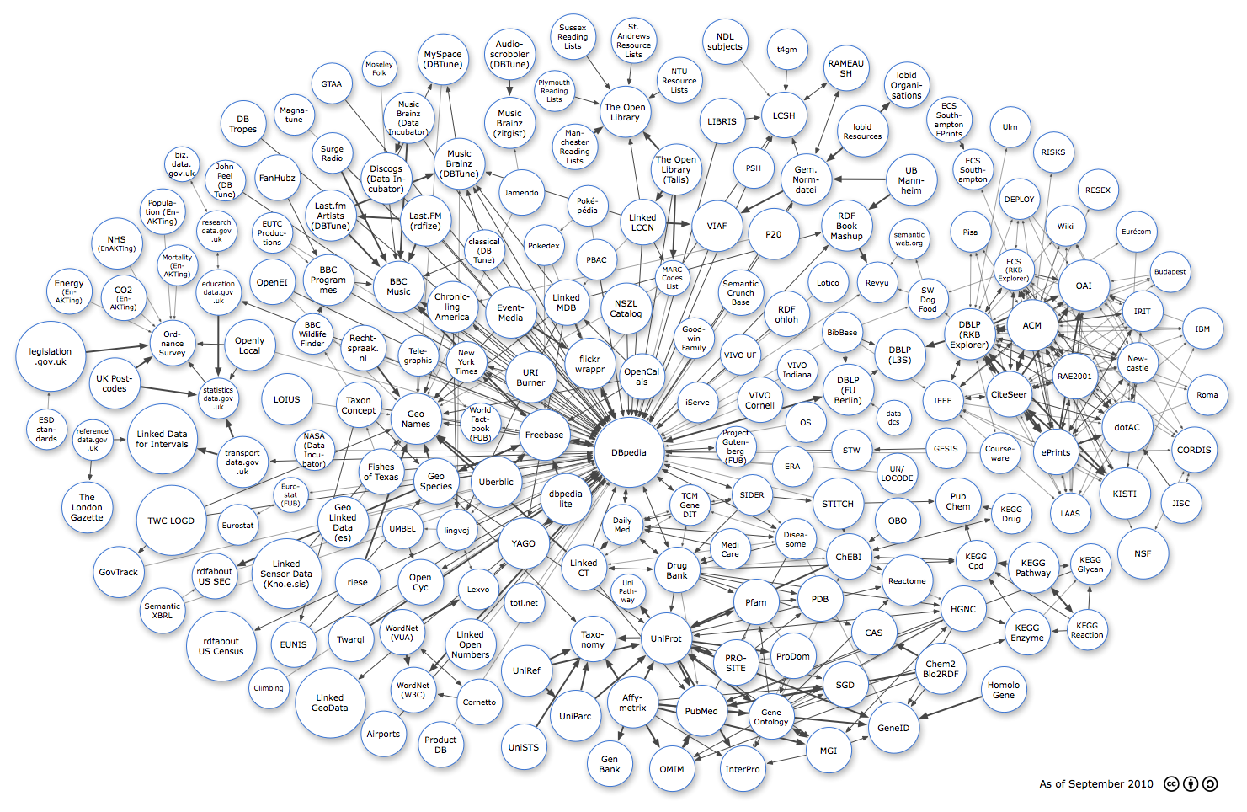
The LOD cloud
Oct 2007
Oct. 2007
Nov. 2007
Feb. 2008
Sep. 2008
Mar. 2009
July 2009
Sept. 2010

Slide 52
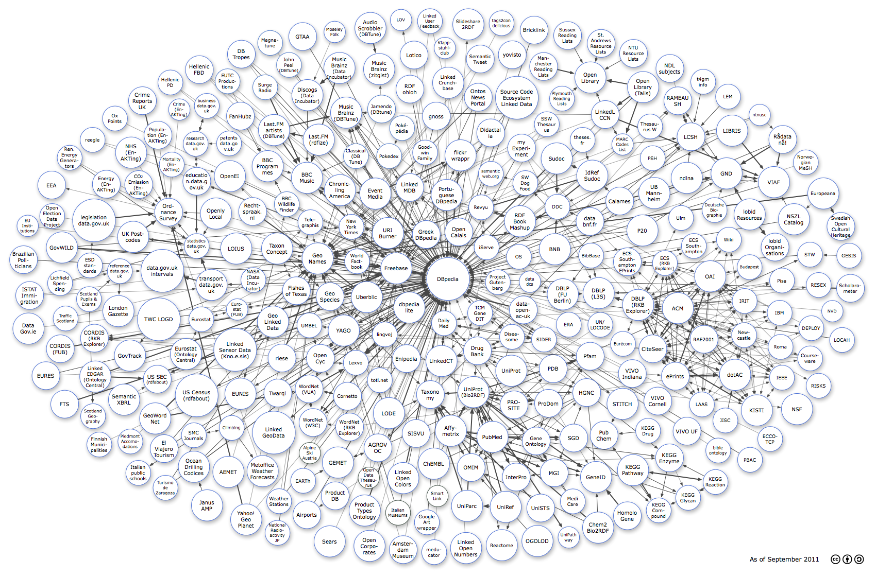
The LOD cloud
Oct. 2007
Nov. 2007
Feb. 2008
Sep. 2008
Mar. 2009
July 2009
Sept. 2010
Sept. 2011

Slide 53
The LOD cloud
Oct. 2007
Nov. 2007
Feb. 2008
Sep. 2008
Mar. 2009
July 2009
Sept. 2010
Sept. 2011
Sept. 2012

Slide 54
The LOD cloud
Oct. 2007
Nov. 2007
Feb. 2008
Sep. 2008
Mar. 2009
July 2009
Sept. 2010
Sept. 2011
Sept. 2012
Sept. 2013

Slide 55
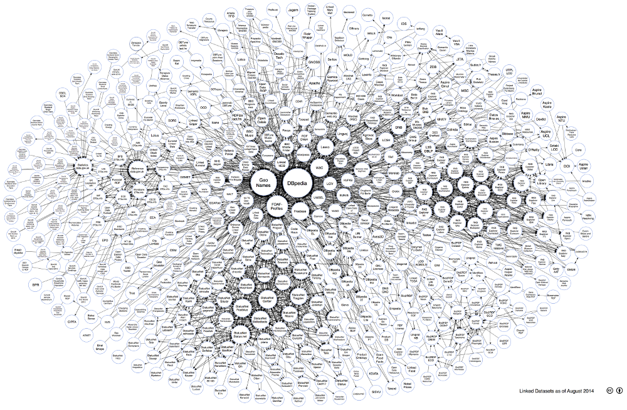
The LOD cloud
Oct. 2007
Nov. 2007
Feb. 2008
Sep. 2008
Mar. 2009
July 2009
Sept. 2010
Sept. 2011
Sept. 2012
Sept. 2013
Aug. 2014

Slide 56
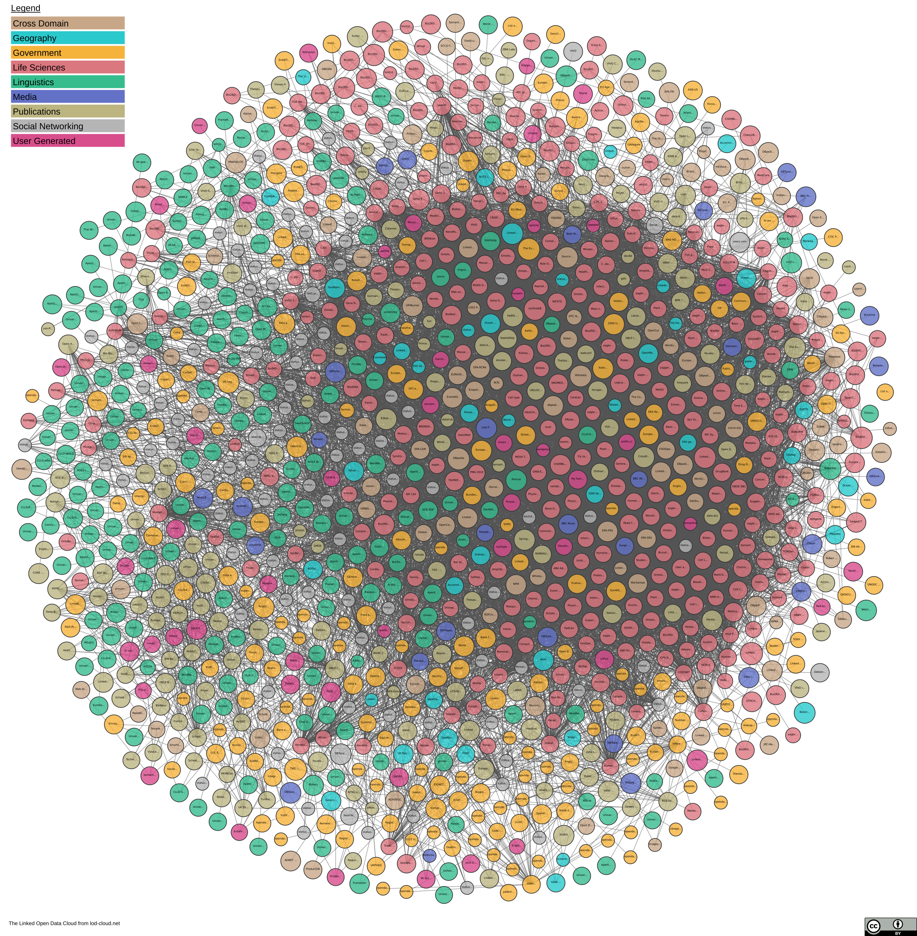
The LOD Cloud
Oct. 2007
Nov. 2007
Feb. 2008
Sep. 2008
Mar. 2009
July 2009
Sept. 2010
Sept. 2011
Sept. 2012
Sept. 2013
Aug. 2014
Nov. 2018

Slide 57
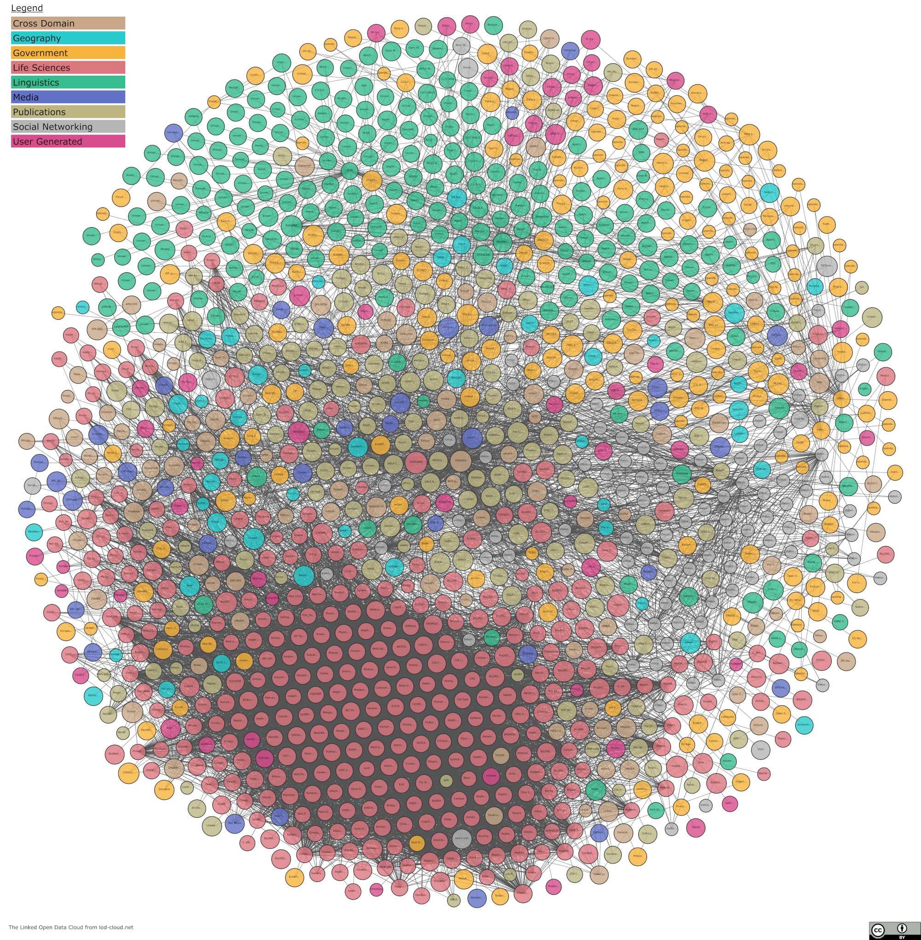
The LOD Cloud
Oct. 2007
Nov. 2007
Feb. 2008
Sep. 2008
Mar. 2009
July 2009
Sept. 2010
Sept. 2011
Sept. 2012
Sept. 2013
Aug. 2014
Nov. 2018
May 2020

Slide 58
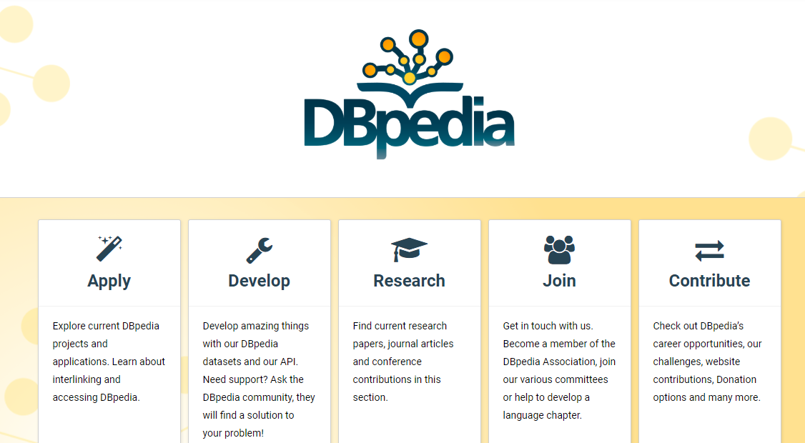
Cross-Domain

Slide 59
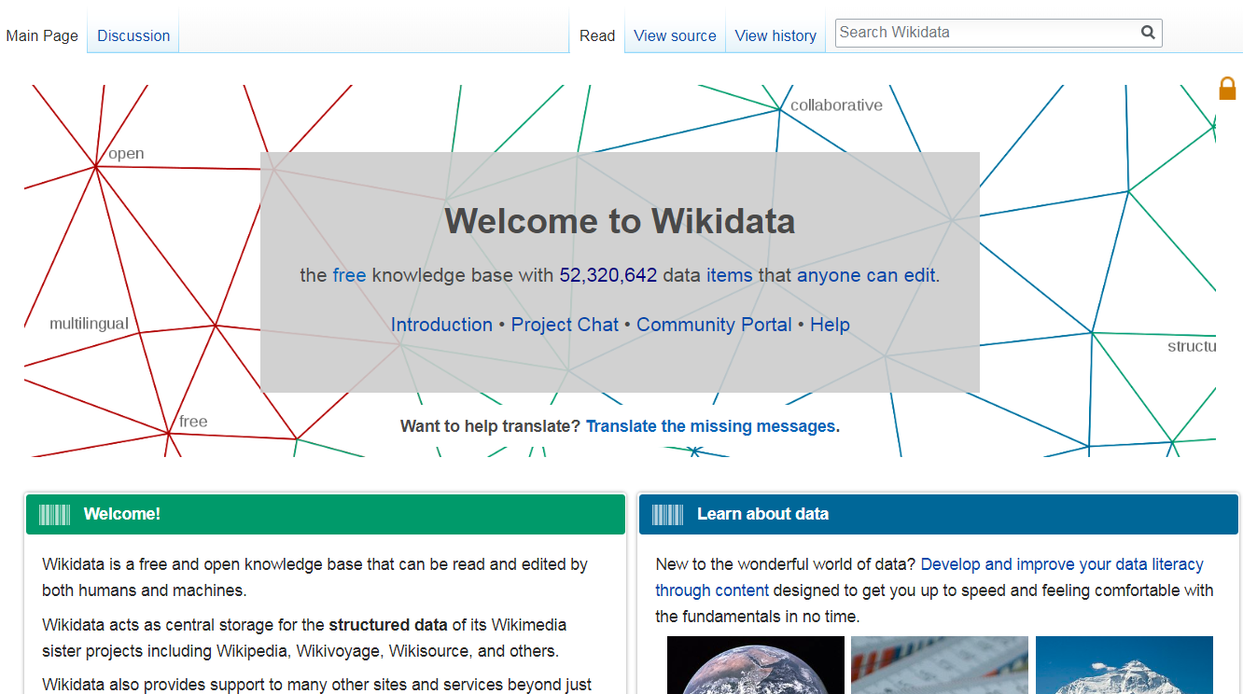
Cross-Domain

Slide 60
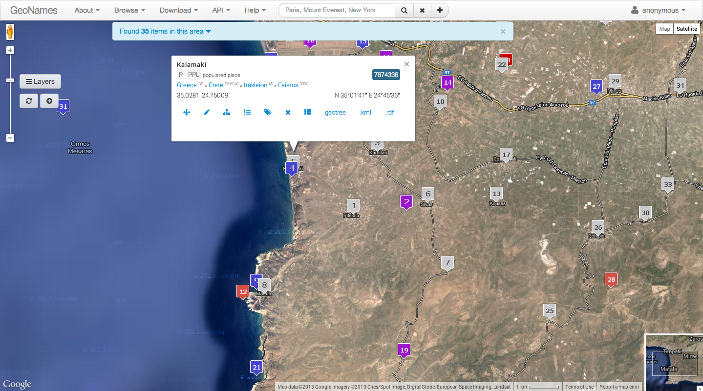
Geographic

Slide 61
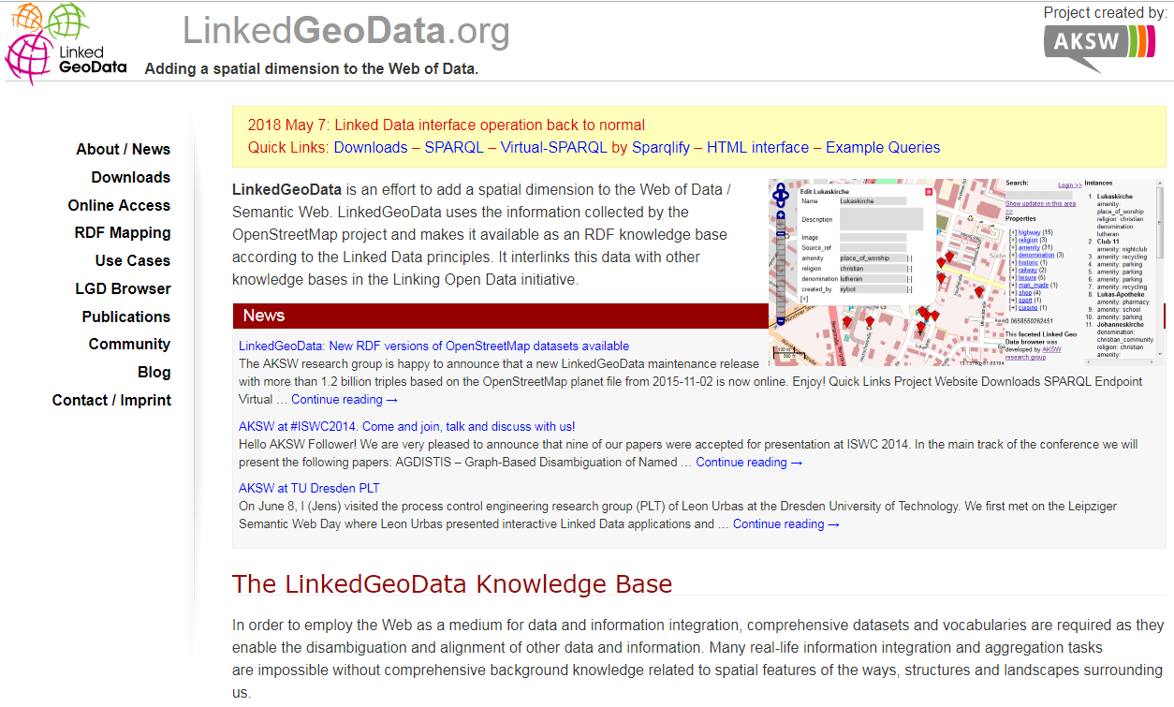
Geographic

Slide 62
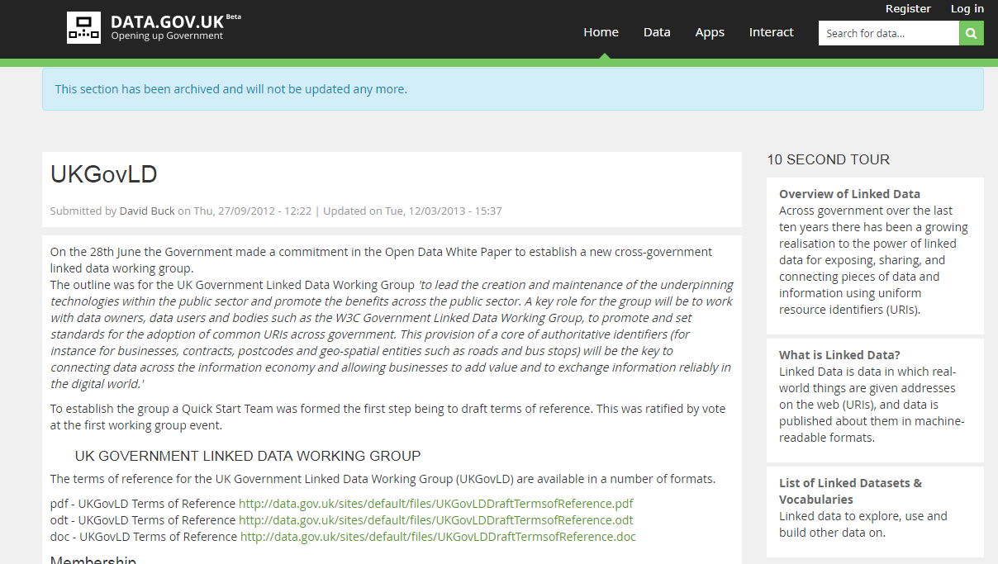
Governmental

Slide 63
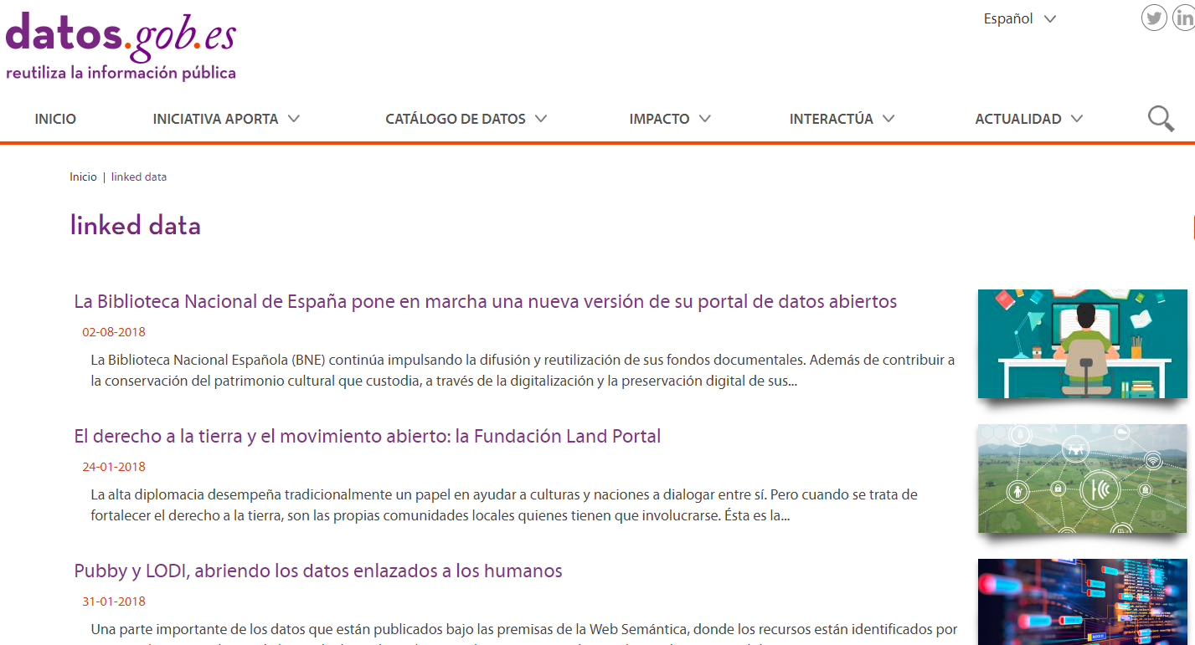
Governmental

Slide 64
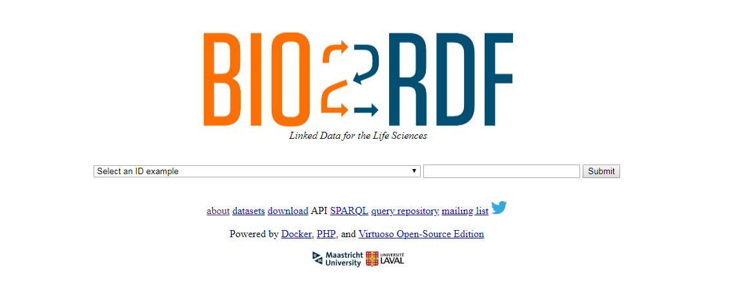
Life Sciences

Slide 65
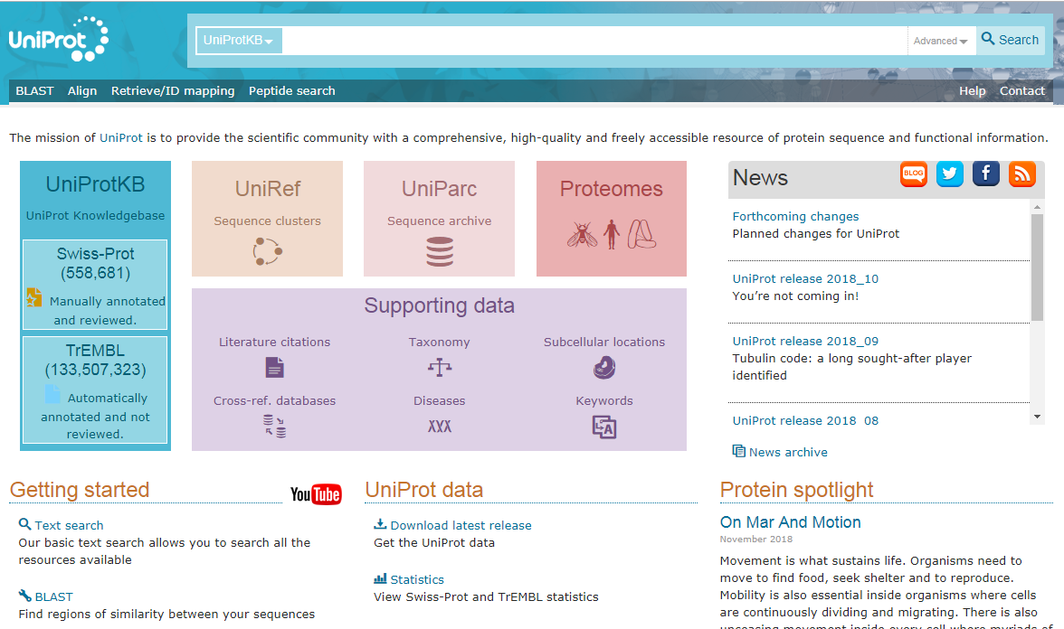
Life Sciences

Slide 66
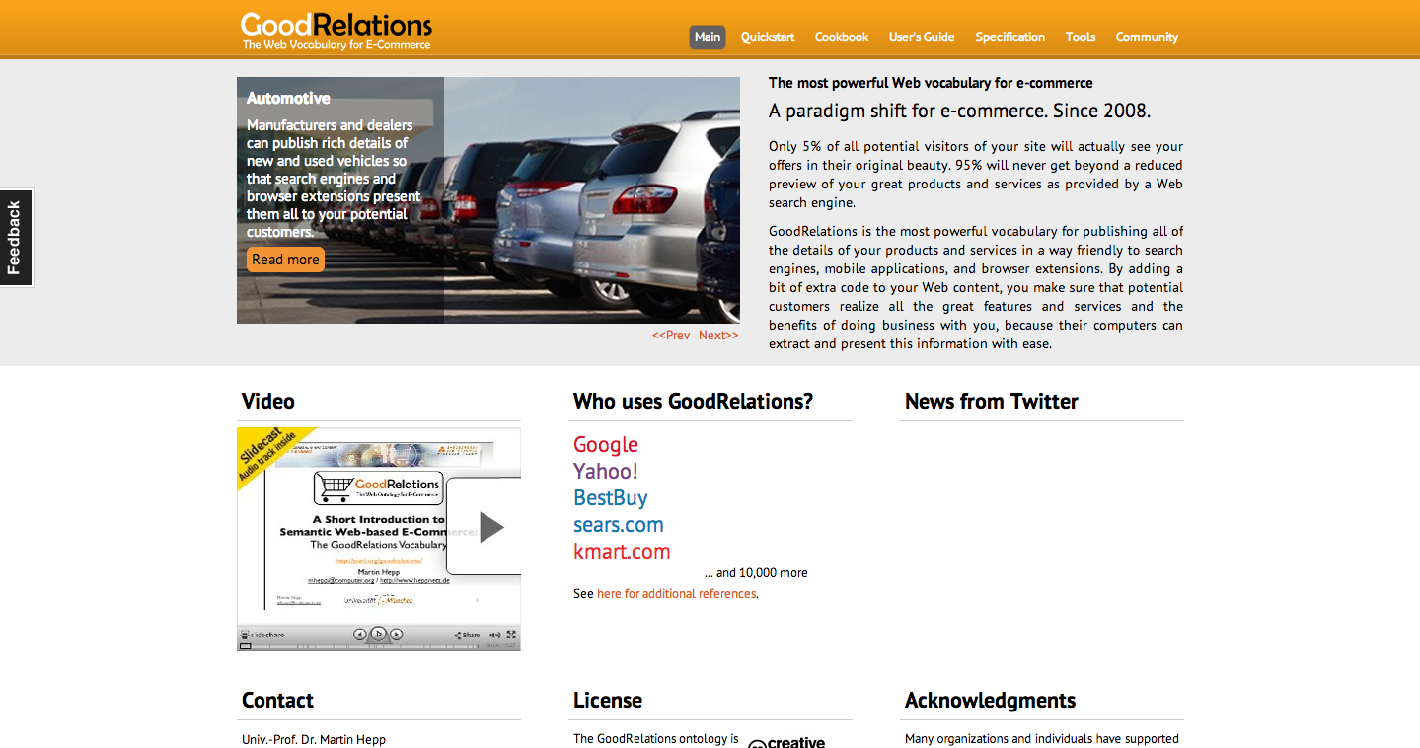
E-Commerce

Slide 67
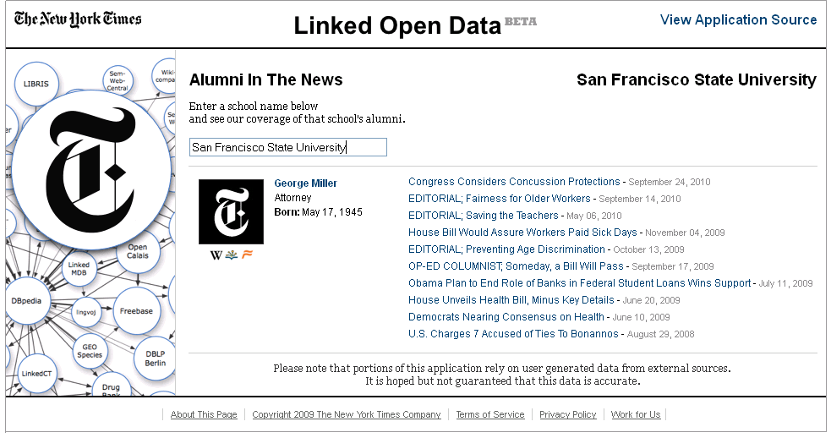
Media

Slide 68
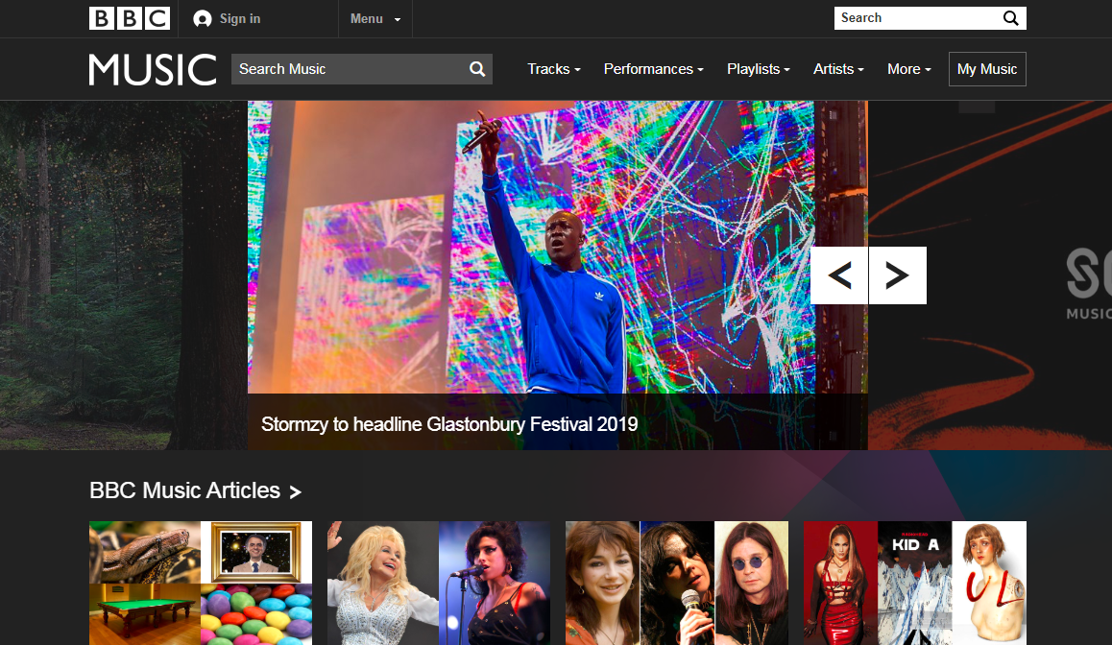
Media

Slide 69

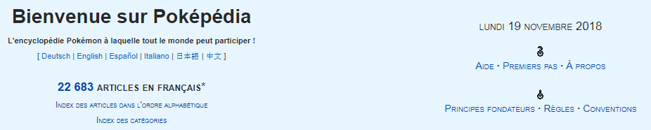

Pokémon

Slide 70
But if every dataset describes data with their own vocabulary
the datasets will be impossible to integrate and query.
How could we address this issue?
Oct. 2007
Nov. 2007
Feb. 2008
Sep. 2008
Mar. 2009
July 2009
Sept. 2010
Sept. 2011
Sept. 2012
Sept. 2013
Aug. 2014
Nov. 2018
May 2020

Slide 71
Linked Open Vocabularies

Slide 72
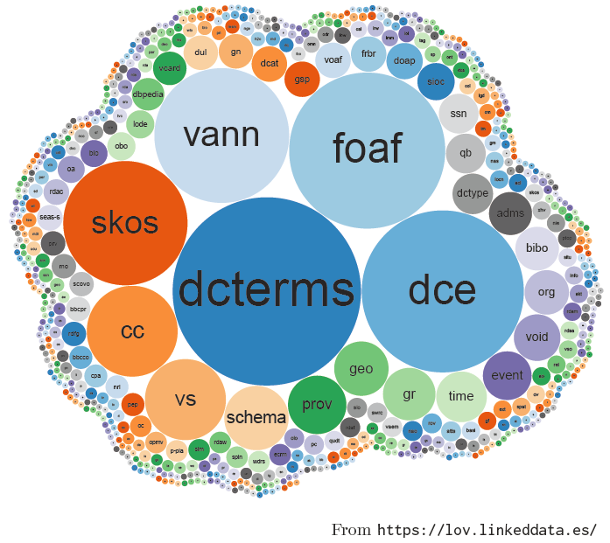
Linked Open Vocabularies
Indexes vocabularies for re-use

Slide 73
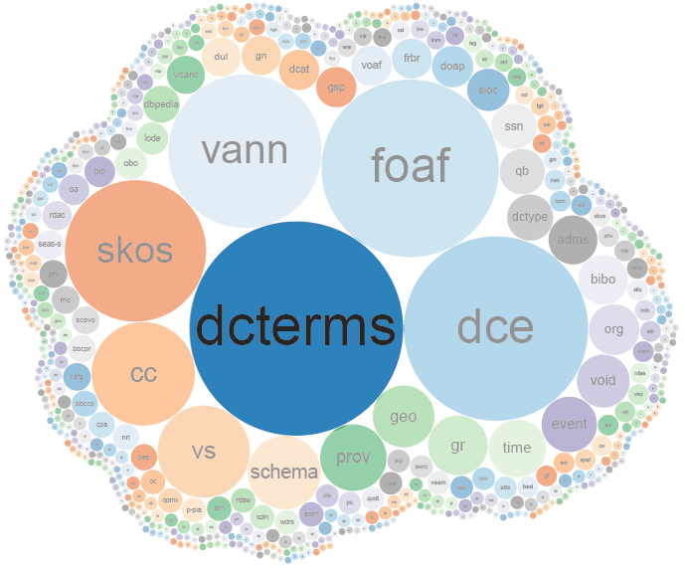
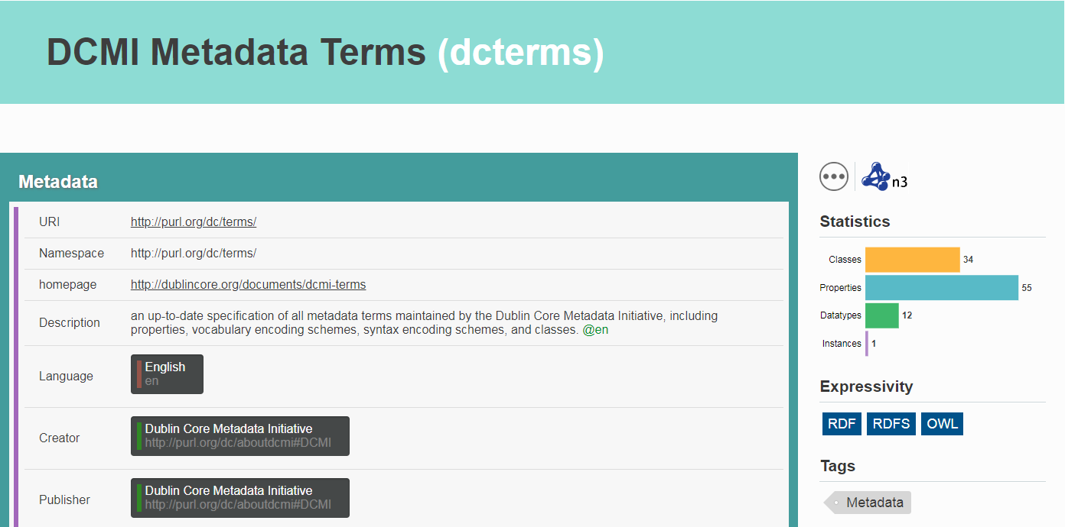
DCTERMS
Describes documents

Slide 74
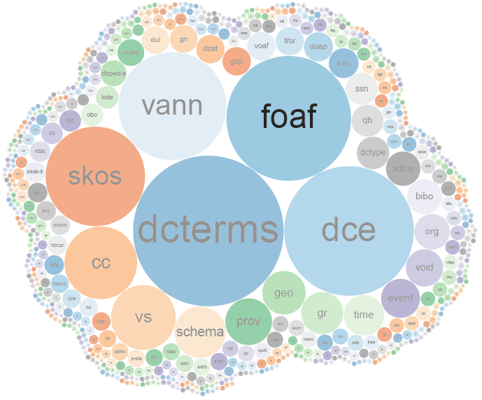
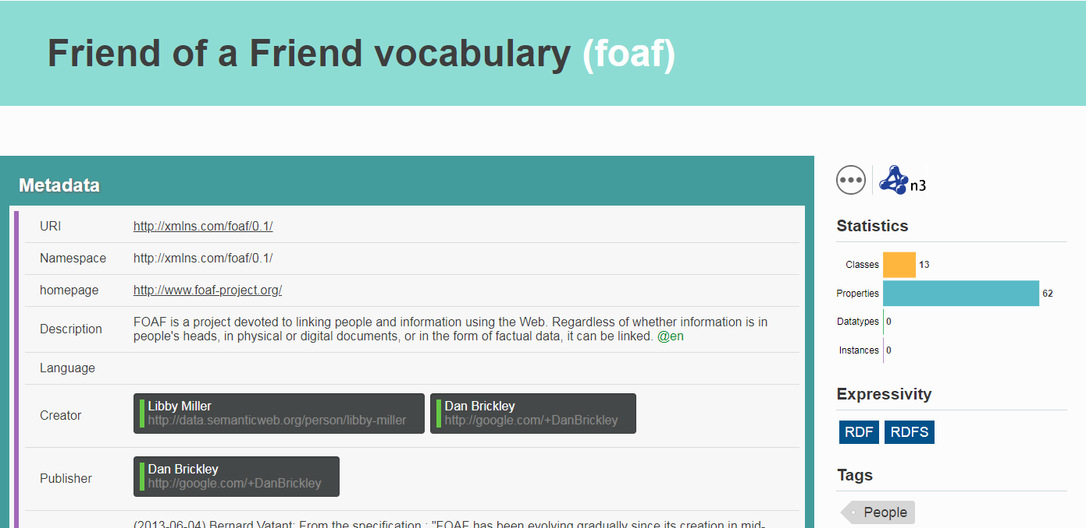
FOAF
Describes people

Slide 75
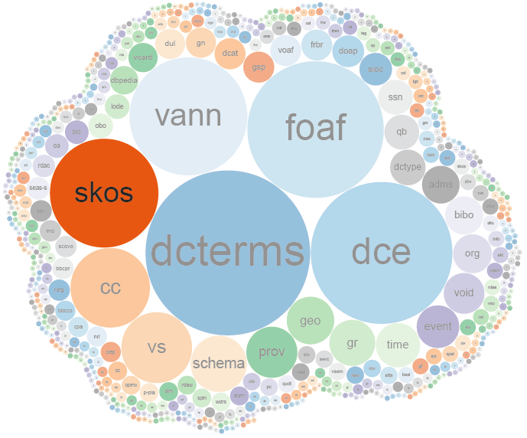
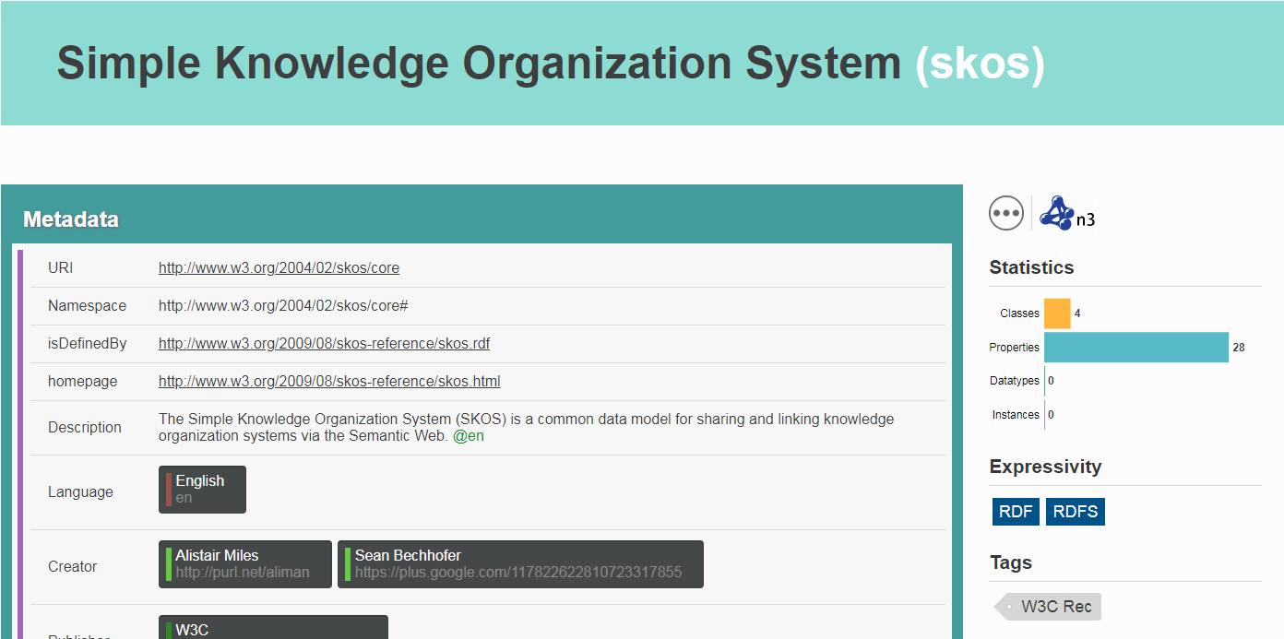
SKOS
Describes taxonomies

Slide 76
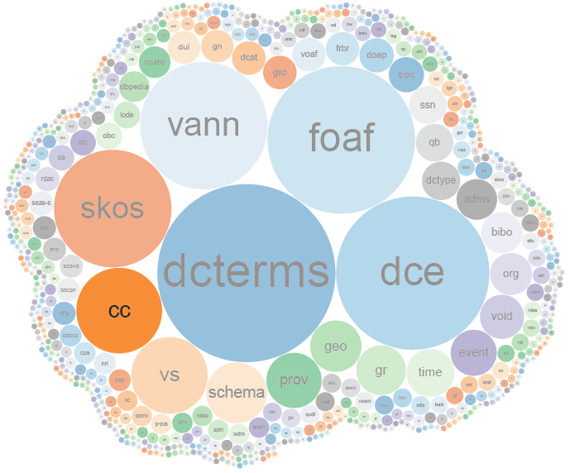
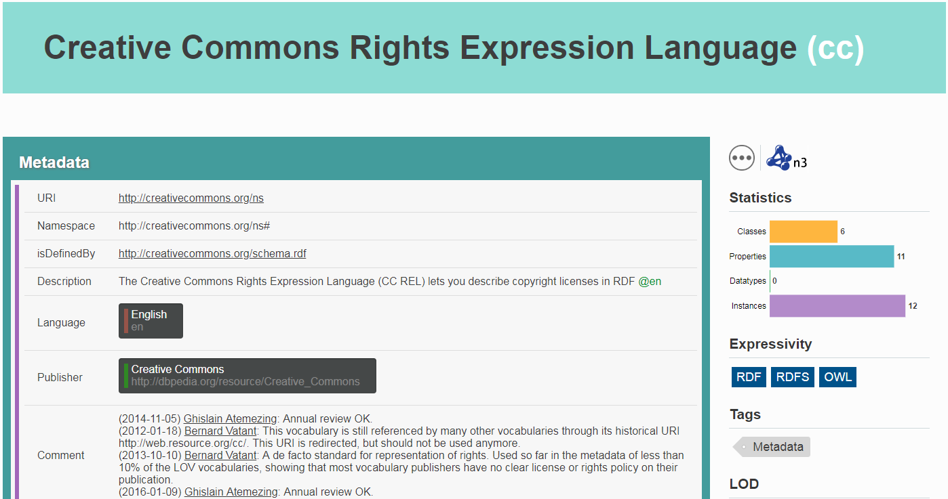
CC
Describes licencing

Slide 77
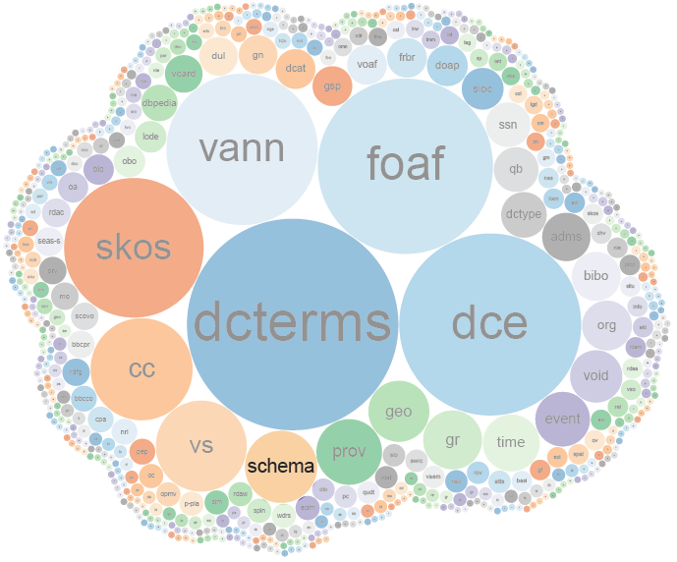

SCHEMA
Describes everything

Slide 78

SCHEMA
Describes everything

Slide 79


Slide 80

TAKING OFF

Slide 81
So who is using these datasets (and for what)?
Oct. 2007
Nov. 2007
Feb. 2008
Sep. 2008
Mar. 2009
July 2009
Sept. 2010
Sept. 2011
Sept. 2012
Sept. 2013
Aug. 2014
Nov. 2018
May 2020

Slide 82

Success stories
http://aidanhogan.com/docs/semantic-web-now.pdf

Slide 83


Wikidata

Slide 84

Wikidata

Slide 85

Google’s rich snippets …

Slide 86







Slide 87

Google’s Knowledge Graph

Slide 88


Google’s Knowledge Panel

Slide 89





Schema.org

Slide 90



Facebook’s Open Graph

Slide 91


Embedded structured data
https://w3techs.com/technologies/overview/structured_data

Slide 92

Embedded structured data
https://w3techs.com/technologies/history_overview/structured_data/all/y

Slide 93


Biomedical ontologies

Slide 94


Biomedical ontologies

Slide 95
Linked Open Data
5-Star Linking Open Data Scheme

Slide 96

Linked Open Vocabularies

Slide 97

Social Linked Data: SOLID

Slide 98


Entering Unknown Territory:
Open Research Questions!

Slide 99
Open Issue:
Linked Data Integration

Slide 100




Need for Integration
http://dbpedia.org/resource/Bill_Clinton
http://rdf.freebase.com/ns/en.bill_clinton
http://data.nytimes.com/clinton_bill_per
http://www.bbc.co.uk/music/artists/…
How could OWL help here?
owl:sameAs

Slide 101
Open Issue:
Diverse Vocabularies

Slide 102

Diverse vocabularies
How can we integrate and write queries against Linked Data from different sources?

Slide 103
Open Issue:
Linked Data Access

Slide 104



Access Methods
D
Q
D
D
Q
Q
D
Q
Multiple clients / multiple servers (blurred)
Remote, decentralised, uncoordinated
Web scale

Slide 105
Open Issue:
Linked Data quality

Slide 106

Can’t trust everything you read on the Web
The same is true for on the Web

Slide 107
Open Issue:
Legacy data

Slide 108






Most Web (meta-)data in …
… and so on …

Slide 109

From ★★★ to ★★★★ is a big step!!

Slide 110
Open Issue:
Usability

Slide 111


Usability
What kinds of interfaces can help non-expert users to better interact with Linked Data?

Slide 112


Slide 113

Ongoing research in Chile

Slide 114






Questions?

