Slide 1
CC7220-1
La Web de Datos
Primavera 2025
Lecture 7: Web Ontology Language (OWL) [II]
Aidan Hogan
aidhog@gmail.com

Slide 2
Last time …

Slide 3







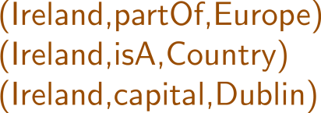



Semantic Web: Logic
* More or less

Slide 4





Slide 5



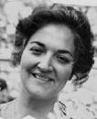

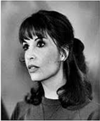
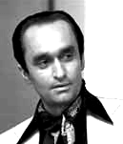




Family Relations in OWL
:Vito
:Carmela
:Sonny
:Connie
:Fredo
:Michael
:Vincent
:Mary

Slide 6
Today's Topic

Slide 7
An ontology is just some definitions …
:hasDaughter rdfs:subPropertyOf :hasChild .
:hasChild rdf:type owl:AsymmetricProperty ; owl:inverseOf :hasParent ;
rdfs:subPropertyOf :ancestorOf .
:ancestorOf rdf:type owl:TransitiveProperty .
ex:Carmela :hasChild ex:Michael .
ex:Michael :hasDaughter ex:Mary .
ex:Mary a :Person .
:Person owl:equivalentClass
[ owl:qualifiedCardinality 2 ;
owl:onProperty :hasParent ;
owl:onClass :Person ] .
… but what do they mean?
… and what can we do with ontologies?

Slide 8
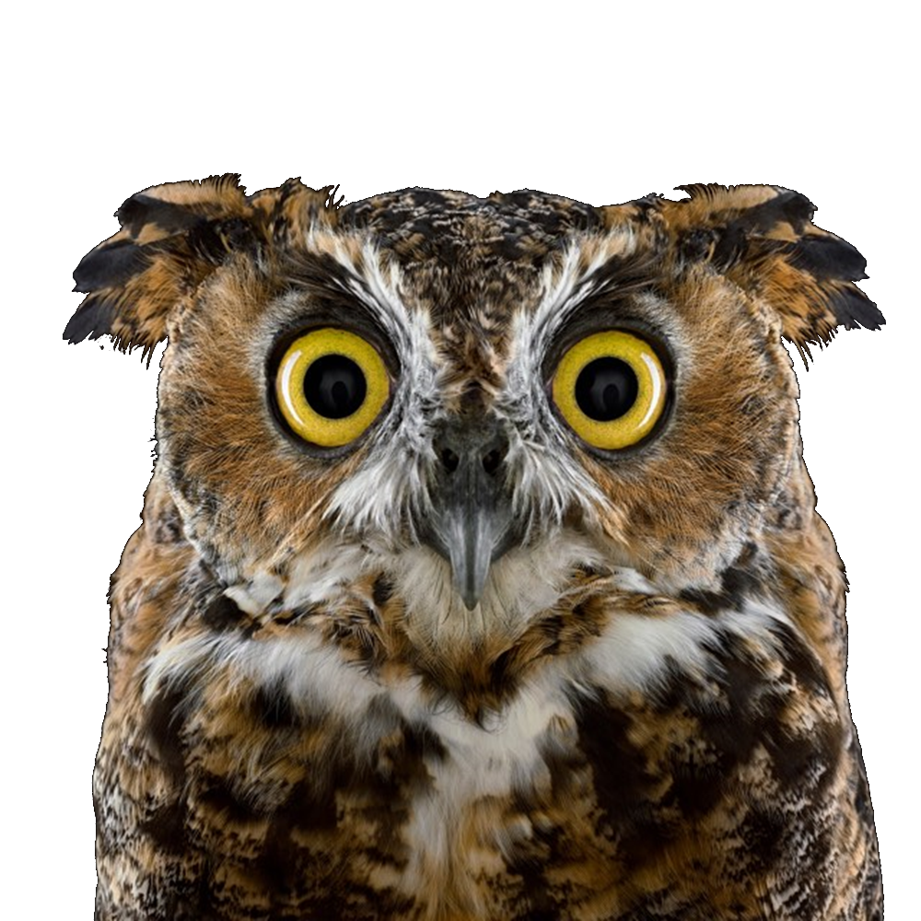
Capture the main ideas of OWL
Fig 1. OWL according to the standard
Fig 2. OWL according to this class

Slide 9


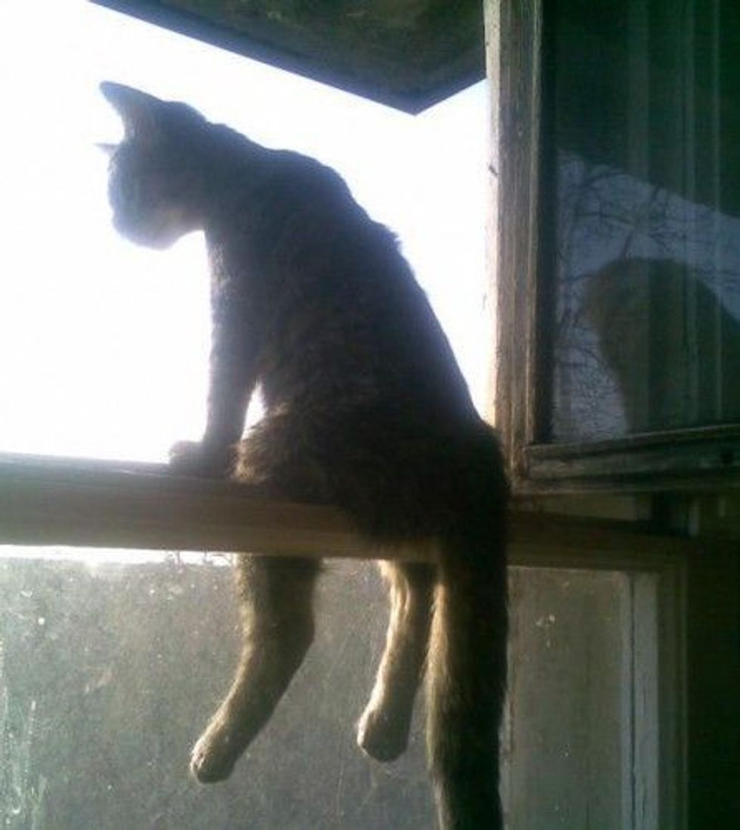



Slide 10
Defining OWL

Slide 11

owl:oneOf ({})
:Godfather owl:equivalentClass [ owl:oneOf (:Vito :Michael :Vincent) ]
≡
{
}
,
,
:Godfather
:Vito
:Michael
:Vincent
How can we formally define what this means?

Slide 12
owl:oneOf ({})
:Godfather owl:equivalentClass [ owl:oneOf (:Vito :Michael :Vincent) ]
≡
{
}
,
,
:Godfather
:Vito
:Michael
:Vincent
rdf:type
rdf:type
rdf:type
We could try with rules like:
  ?c owl:equivalentClass [ owl:oneOf (?x1 <...> ?xn) ]
  → ?x1 a ?c . <...> ?xn a ?c .

Slide 13
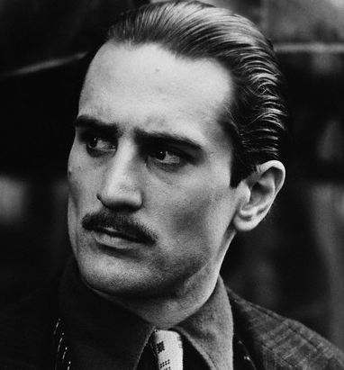
owl:oneOf ({})
:Godfather owl:equivalentClass [ owl:oneOf (:Vito :Michael :Vincent) ]
≡
{
}
,
,
:Godfather
:Vito
:Michael
:Vincent
owl:sameAs
owl:differentFrom
owl:differentFrom
rdf:type
:VitoYoung
How do we define a rule for this case?
We could try a rule like:
  ?c owl:equivalentClass [ owl:oneOf (?x1 <...> ?xn) ] . ?x a ?c .
  ?x owl:differentFrom ?x2 , <...> , ?xn . → ?x owl:sameAs ?x1 .

Slide 14
owl:oneOf ({})
:Godfather owl:equivalentClass [ owl:oneOf (:Vito :Michael :Vincent) ]
≡
{
}
,
,
:Godfather
:Vito
:Michael
:Vincent
owl:sameAs
owl:differentFrom
owl:differentFrom
rdf:type
:VitoYoung
How do we define a rule for this case?
What if it's not the first element?
Have we considered all possible cases like this?

Slide 15
owl:oneOf ({})
:Godfather owl:equivalentClass [ owl:oneOf (:Vito :Michael :Vincent) ]
≡
{
}
,
,
:Godfather
:Vito
:Michael
:Vincent
owl:sameAs
owl:differentFrom
owl:differentFrom
rdf:type
:VitoYoung
How do we define a rule for this case?
What if it's not the first element?
A finite set of rules may not be able to define everything we need in OWL!
Have we considered all possible cases like this?

Slide 16

owl:oneOf ({})
:Godfather owl:equivalentClass [ owl:oneOf (:Vito :Michael :Vincent) ]
≡
{
}
,
,
:Godfather
:Vito
:Michael
:Vincent
How can we begin to formally define what classes mean?
Use set theory:
There is a set of individuals (like , etc.).
There is a set of classes (like , etc.)
Classes map to sets of individuals (like ↦ { , , })
Names map to individuals (like :Vito ↦ )
Other names map to classes (like :Godfather ↦ )

Slide 17


owl:SymmetricProperty
:sibling rdf:type owl:SymmetricProperty .
:sibling
:sibling
:Connie
:Fredo
How can we begin to formally define what properties mean?
Extend the set theory:
There is a set of individuals. Classes map to sets of individuals.
There is a set of properties (like , etc.).
Properties map to sets of pairs of individuals (like ↦ { ( , ) , ... })
Names map to individuals, classes and or properties (like :sibling ↦ )

Slide 18
The Universe

Slide 19


Slide 20

To Simplify matters
Define the universe as a set:
  Set of everything: U

Slide 21


To Simplify matters
Define the universe as a set:
  Set of everything: U
{ , , , , , , , , ... }
What about classes and properties?
Classes refer to (sub)sets of U
Properties refer to sets of pairs from U

Slide 22
Vocabulary / Data

Slide 23
Need to name/describe things in the universe
Vocabulary (IRIs): V
Triples (RDF): V × V × V
  For brevity, we skip literals and blank nodes
Graph (RDF): 2^{V × V × V}
How do we relate the data to the universe?

Slide 24
Interpretations

Slide 25
Interpretation of a vocabulary
Interpretation ℐ of vocabulary V: ℐ(V) = (U,I,C,P)
  U: Universe / Set of everything (in the interpretation)
{ , , , , , , , , ... }

Slide 26
Interpretation of a vocabulary
Interpretation ℐ of vocabulary V: ℐ(V) = (U,I,C,P)
  U: Universe / Set of everything (in the interpretation)
  I: Maps a vocabulary term v ∈ V to an element of U
  (interpretation of Individuals)
I(:Mary) =
I(:Fredo) =
I(:Vito) =
I(:Italy) =
I(:Oscar) =
I(:Sonny) =
...

Slide 27
Interpretation of a vocabulary
Interpretation ℐ of vocabulary V: ℐ(V) = (U,I,C,P)
  U: Universe / Set of everything (in the interpretation)
  I: Maps a vocabulary term v ∈ V to an element of U
  (interpretation of Individuals)
  C: Maps a vocabulary term v ∈ V to a subset of U
  (interpretation of Classes)
C(:Person) =
{ , , , , , , ... }
C(:Godfather) =
{ , , , ... }
...

Slide 28
Interpretation of a vocabulary
Interpretation ℐ of vocabulary V: ℐ(V) = (U,I,C,P)
  U: Universe / Set of everything (in the interpretation)
  I: Maps a vocabulary term v ∈ V to an element of U
  (interpretation of Individuals)
  C: Maps a vocabulary term v ∈ V to a subset of U
  (interpretation of Classes)
  P: Maps a vocabulary term v ∈ V to a set of pairs from U
  (interpretation of Properties)
P(:parent) =
{ ( , ), ( , ), ... }
P(:sibling) =
{ ( , ), ( , ), ... }
...

Slide 29
Interpretation of a vocabulary
Interpretation ℐ of vocabulary V: ℐ(V) = (U,I,C,P)
  U: Universe / Set of everything (in the interpretation)
  I: Maps a vocabulary term v ∈ V to an element of U
  (interpretation of Individuals)
  C: Maps a vocabulary term v ∈ V to a subset of U
  (interpretation of Classes)
  P: Maps a vocabulary term v ∈ V to a set of pairs from U
  (interpretation of Properties)
How do we interpret data/graphs and not just terms?

Slide 30
Model theory

Slide 31
Models
Let G be an RDF graph using vocabulary V
Let ℐ be an interpretation of vocabulary V:
  ℐ(V) = (U,I,C,P)
ℐ is a model of G if and only if:
  If (s,p,o) ∈ G then (I(s), I(o)) ∈ P(p)
How do we define the semantics of types?

Slide 32
Models (with classes/type/subclass)
Let G be an RDF graph using vocabulary V
Let ℐ be an interpretation of vocabulary V:
  ℐ(V) = (U,I,C,P)
ℐ is a model of G if and only if:
  If (s,p,o) ∈ G then (I(s), I(o)) ∈ P(p)
  If (I(s), I(o)) ∈ P(rdf:type) then I(s) ∈ C(o)
How do we define the semantics of sub-class?

Slide 33
Models (with RDFS semantics)
Let G be an RDF graph using vocabulary V
Let ℐ be an interpretation of vocabulary V:
  ℐ(V) = (U,I,C,P)
ℐ is a model of G if and only if:
  If (s,p,o) ∈ G then (I(s), I(o)) ∈ P(p)
  If (I(s), I(o)) ∈ P(rdf:type) then I(s) ∈ C(o)
  If (I(s), I(o)) ∈ P(rdfs:subClassOf) then C(s) ⊆ C(o)
How do we define the semantics of sub-property?

Slide 34
Models (with RDFS semantics)
Let G be an RDF graph using vocabulary V
Let ℐ be an interpretation of vocabulary V:
  ℐ(V) = (U,I,C,P)
ℐ is a model of G if and only if:
  If (s,p,o) ∈ G then (I(s), I(o)) ∈ P(p)
  If (I(s), I(o)) ∈ P(rdf:type) then I(s) ∈ C(o)
  If (I(s), I(o)) ∈ P(rdfs:subClassOf) then C(s) ⊆ C(o)
  If (I(s), I(o)) ∈ P(rdfs:subPropertyOf) then P(s) ⊆ P(o)

Slide 35
Models (with RDFS semantics)
Let G be an RDF graph using vocabulary V
Let ℐ be an interpretation of vocabulary V:
  ℐ(V) = (U,I,C,P)
ℐ is a model of G if and only if:
  If (s,p,o) ∈ G then (I(s), I(o)) ∈ P(p)
  If (I(s), I(o)) ∈ P(rdf:type) then I(s) ∈ C(o)
  If (I(s), I(o)) ∈ P(rdfs:subClassOf) then C(s) ⊆ C(o)
  If (I(s), I(o)) ∈ P(rdfs:subPropertyOf) then P(s) ⊆ P(o)
  If (I(s), I(o)) ∈ P(rdfs:domain) then π₁(P(s)) ⊆ C(o)
  If (I(s), I(o)) ∈ P(rdfs:range) then π₂(P(s)) ⊆ C(o)
(π_{n} : project n^{th} element)

Slide 36
Models (with OWL semantics)
ℐ is a model of G if and only if:
  If (s,p,o) ∈ G then (I(s), I(o)) ∈ P(p)
  If (I(s), I(o)) ∈ P(rdf:type) then I(s) ∈ C(o)
  If (I(s), I(o)) ∈ P(rdfs:subClassOf) then C(s) ⊆ C(o)
  If (I(s), I(o)) ∈ P(rdfs:subPropertyOf) then P(s) ⊆ P(o)
  If (I(s), I(o)) ∈ P(rdfs:domain) then π₁(P(s)) ⊆ C(o)
  If (I(s), I(o)) ∈ P(rdfs:range) then π₂(P(s)) ⊆ C(o)
What about OWL semantics?
How do we define the semantics of same-as/different-from?

Slide 37
Models (with OWL semantics)
ℐ is a model of G if and only if:
  If (s,p,o) ∈ G then (I(s), I(o)) ∈ P(p)
  If (I(s), I(o)) ∈ P(rdf:type) then I(s) ∈ C(o)
  If (I(s), I(o)) ∈ P(rdfs:subClassOf) then C(s) ⊆ C(o)
  If (I(s), I(o)) ∈ P(rdfs:subPropertyOf) then P(s) ⊆ P(o)
  If (I(s), I(o)) ∈ P(rdfs:domain) then π₁(P(s)) ⊆ C(o)
  If (I(s), I(o)) ∈ P(rdfs:range) then π₂(P(s)) ⊆ C(o)
  If (I(s), I(o)) ∈ P(owl:sameAs) then I(s) = I(o)
  If (I(s), I(o)) ∈ P(owl:differentFrom) then I(s) ≠ I(o)
How do we define inverse properties?

Slide 38
Models (with OWL semantics)
ℐ is a model of G if and only if:
  If (s,p,o) ∈ G then (I(s), I(o)) ∈ P(p)
  If (I(s), I(o)) ∈ P(rdf:type) then I(s) ∈ C(o)
  If (I(s), I(o)) ∈ P(rdfs:subClassOf) then C(s) ⊆ C(o)
  If (I(s), I(o)) ∈ P(rdfs:subPropertyOf) then P(s) ⊆ P(o)
  If (I(s), I(o)) ∈ P(rdfs:domain) then π₁(P(s)) ⊆ C(o)
  If (I(s), I(o)) ∈ P(rdfs:range) then π₂(P(s)) ⊆ C(o)
  If (I(s), I(o)) ∈ P(owl:sameAs) then I(s) = I(o)
  If (I(s), I(o)) ∈ P(owl:differentFrom) then I(s) ≠ I(o)
  If (I(s), I(o)) ∈ P(owl:inverseOf) then ∀x,y : (x,y) ∈ P(s)
  if and only if (y,x) ∈ P(o)
How do we define transitive properties?

Slide 39
Models (with OWL semantics)
ℐ is a model of G if and only if:
  If (s,p,o) ∈ G then (I(s), I(o)) ∈ P(p)
  If (I(s), I(o)) ∈ P(rdf:type) then I(s) ∈ C(o)
  If (I(s), I(o)) ∈ P(rdfs:subClassOf) then C(s) ⊆ C(o)
  If (I(s), I(o)) ∈ P(rdfs:subPropertyOf) then P(s) ⊆ P(o)
  If (I(s), I(o)) ∈ P(rdfs:domain) then π₁(P(s)) ⊆ C(o)
  If (I(s), I(o)) ∈ P(rdfs:range) then π₂(P(s)) ⊆ C(o)
  If (I(s), I(o)) ∈ P(owl:sameAs) then I(s) = I(o)
  If (I(s), I(o)) ∈ P(owl:differentFrom) then I(s) ≠ I(o)
  If (I(s), I(o)) ∈ P(owl:inverseOf) then ∀x,y : (x,y) ∈ P(s)
  if and only if (y,x) ∈ P(o)
  If I(s) ∈ C(owl:TransitiveProperty) then ∀x,y,z : (x,y) ∈ P(s) and (y,z) ∈ P(s) imply (x,z) ∈ P(s)
How do we define disjoint classes?

Slide 40
Models (with OWL semantics)
ℐ is a model of G if and only if:
  If (s,p,o) ∈ G then (I(s), I(o)) ∈ P(p)
  If (I(s), I(o)) ∈ P(rdf:type) then I(s) ∈ C(o)
  If (I(s), I(o)) ∈ P(rdfs:subClassOf) then C(s) ⊆ C(o)
  If (I(s), I(o)) ∈ P(rdfs:subPropertyOf) then P(s) ⊆ P(o)
  If (I(s), I(o)) ∈ P(rdfs:domain) then π₁(P(s)) ⊆ C(o)
  If (I(s), I(o)) ∈ P(rdfs:range) then π₂(P(s)) ⊆ C(o)
  If (I(s), I(o)) ∈ P(owl:sameAs) then I(s) = I(o)
  If (I(s), I(o)) ∈ P(owl:differentFrom) then I(s) ≠ I(o)
  If (I(s), I(o)) ∈ P(owl:inverseOf) then ∀x,y : (x,y) ∈ P(s)
  if and only if (y,x) ∈ P(o)
  If I(s) ∈ C(owl:TransitiveProperty) then ∀x,y,z : (x,y) ∈ P(s) and (y,z) ∈ P(s) imply (x,z) ∈ P(s)
  If (I(s), I(o)) ∈ P(owl:disjointWith) then C(s) ∩ C(o) = Ø
... and so on.

Slide 41
Aside:
If-then vs. If-and-only-if semantics

Slide 42
If-then semantics
ℐ is a model of G if and only if:
  If (s,p,o) ∈ G then (I(s), I(o)) ∈ P(p)
  If (I(s), I(o)) ∈ P(rdf:type) then I(s) ∈ C(o)
  If (I(s), I(o)) ∈ P(rdfs:subClassOf) then C(s) ⊆ C(o)
  If (I(s), I(o)) ∈ P(rdfs:subPropertyOf) then P(s) ⊆ P(o)
  If (I(s), I(o)) ∈ P(rdfs:domain) then π₁(P(s)) ⊆ C(o)
  If (I(s), I(o)) ∈ P(rdfs:range) then π₂(P(s)) ⊆ C(o)
  If (I(s), I(o)) ∈ P(owl:sameAs) then I(s) = I(o)
  If (I(s), I(o)) ∈ P(owl:differentFrom) then I(s) ≠ I(o)
  If (I(s), I(o)) ∈ P(owl:inverseOf) then ∀x,y : (x,y) ∈ P(s)
  if and only if (y,x) ∈ P(o)
  If I(s) ∈ C(owl:TransitiveProperty) then ∀x,y,z : (x,y) ∈ P(s) and (y,z) ∈ P(s) imply (x,z) ∈ P(s)
  If (I(s), I(o)) ∈ P(owl:disjointWith) then C(s) ∩ C(o) = Ø
Some data condition
⇒
Some set condition

Slide 43
If-and-only-if semantics
ℐ is a model of G if and only if:
  if (s,p,o) ∈ G then (I(s), I(o)) ∈ P(p)
  (I(s), I(o)) ∈ P(rdf:type) if and only if I(s) ∈ C(o)
  (I(s), I(o)) ∈ P(rdfs:subClassOf) if and only if C(s) ⊆ C(o)
  (I(s), I(o)) ∈ P(rdfs:subPropertyOf) if and only if P(s) ⊆ P(o)
  (I(s), I(o)) ∈ P(rdfs:domain) if and only if π₁(P(s)) ⊆ C(o)
  (I(s), I(o)) ∈ P(rdfs:range) if and only if π₂(P(s)) ⊆ C(o)
  (I(s), I(o)) ∈ P(owl:sameAs) if and only if I(s) = I(o)
  (I(s), I(o)) ∈ P(owl:differentFrom) if and only if I(s) ≠ I(o)
  (I(s), I(o)) ∈ P(owl:inverseOf) if and only if ∀x,y : (x,y) ∈ P(s)
  if and only if (y,x) ∈ P(o)
  I(s) ∈ C(owl:TransitiveProperty) if and only if ∀x,y,z : (x,y) ∈ P(s) and (y,z) ∈ P(s) imply (x,z) ∈ P(s)
  (I(s), I(o)) ∈ P(owl:disjointWith) if and only if C(s) ∩ C(o) = Ø
Some data condition
⇔
Some set condition

Slide 44
What's the difference?
G = {(x,rdfs:subClassOf,y),(y,rdfs:subClassOf,z)}
  ⇒ (I(x), I(y)) ∈ P(rdfs:subClassOf) ⇒ C(x) ⊆ C(y)
  ⇒ (I(y), I(z)) ∈ P(rdfs:subClassOf) ⇒ C(y) ⊆ C(z)
  ⇒ C(x) ⊆ C(z)
  ⇒ (I(x), I(y)) ∈ P(rdfs:subClassOf) ⇒ C(x) ⊆ C(y)
  ⇒ (I(y), I(z)) ∈ P(rdfs:subClassOf) ⇒ C(y) ⊆ C(z)
  ⇒ C(x) ⊆ C(z)
  ⇒ (I(x), I(z)) ∈ P(rdfs:subClassOf)
If-then semantics
If-and-only-if semantics

Slide 45
(Back to) Models

Slide 46
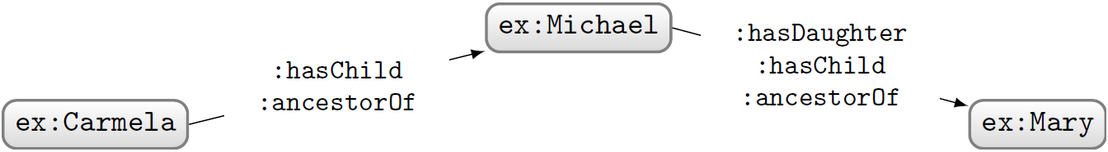




Models of graphs/ontologies
A model is any world that an ontology might describe
:hasDaughter rdfs:subPropertyOf :hasChild .
:hasChild rdfs:subPropertyOf :ancestorOf .
:ancestorOf rdf:type owl:TransitiveProperty .
ex:Carmela :hasChild ex:Michael .
ex:Michael :hasDaughter ex:Mary .
Is this a model of the ontology?
No, since (ex:Carmela) needs to be an (:ancestorOf) (ex:Mary)

Slide 47
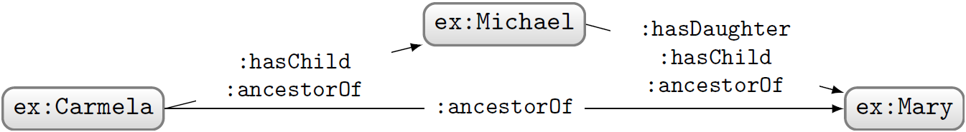
Models of ontologies
A model is any world that an ontology might describe
:hasDaughter rdfs:subPropertyOf :hasChild .
:hasChild rdfs:subPropertyOf :ancestorOf .
:ancestorOf rdf:type owl:TransitiveProperty .
ex:Carmela :hasChild ex:Michael .
ex:Michael :hasDaughter ex:Mary .
Now we have a model of the ontology (for the given semantics).

Slide 48

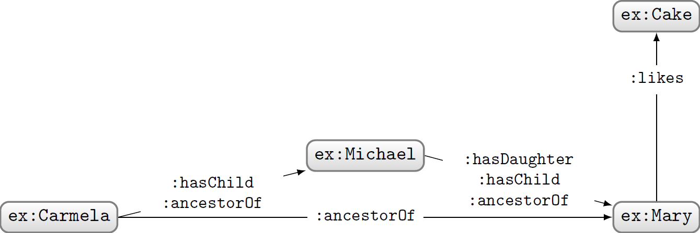

Models of ontologies
A model is any world that an ontology might describe
:hasDaughter rdfs:subPropertyOf :hasChild .
:hasChild rdfs:subPropertyOf :ancestorOf .
:ancestorOf rdf:type owl:TransitiveProperty .
ex:Carmela :hasChild ex:Michael .
ex:Michael :hasDaughter ex:Mary .
Is this a model of the ontology?
This is also a model (given the Open World Assumption)!

Slide 49




Mapping of names to things is part of the model
A different mapping would mean a different model.

Slide 50
Entailment …

Slide 51
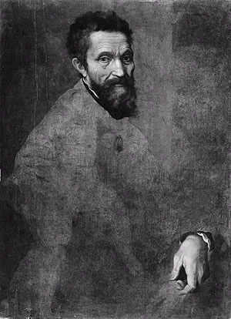
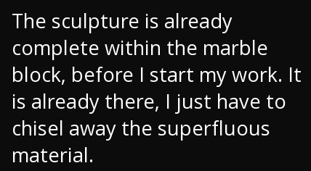
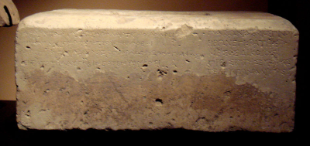
Axioms remove models
At the start (almost) any world is possible!
As we add axioms, fewer worlds are possible
—Michelangelo Buonarroti

Slide 52
Ontology O entails O′ (O ⊧ O′)
:hasDaughter rdfs:subPropertyOf :hasChild .
:hasChild owl:inverseOf :hasParent ; rdfs:subPropertyOf :ancestorOf .
:ancestorOf rdf:type owl:TransitiveProperty .
ex:Carmela :hasChild ex:Michael .
ex:Michael :hasDaughter ex:Mary .
ex:Michael :hasParent ex:Carmela .
ex:Michael :hasChild ex:Mary .
ex:Carmela :ancestorOf ex:Mary .
Any model of O is a model of O′
(O′ has a superset of the models of O)
(O′ says nothing new over O)

Slide 53

Entailment symbol: ⊧

Slide 54
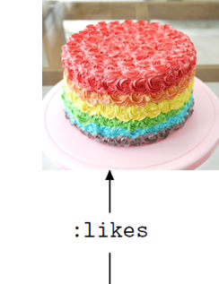
Ontology Entailment
ex:Carmela :hasChild ex:Michael .
ex:Michael :hasChild ex:Mary .
ex:Carmela :ancestorOf ex:Mary .
ex:Carmela :ancestorOf ex:Mary .
ex:Mary :likes ex:Cake .
Does O entail O′ (O ⊧ O′)?
No! There are models of O that are not models of O′ …
Mary doesn’t like cake here

Slide 55
Reasoning Tasks …

Slide 56
Materialisation: Write down entailments
:hasDaughter rdfs:subPropertyOf :hasChild .
:hasChild rdf:type owl:AsymmetricProperty ; owl:inverseOf :hasParent ;
rdfs:subPropertyOf :ancestorOf .
:ancestorOf rdf:type owl:TransitiveProperty .
ex:Carmela :hasChild ex:Michael .
ex:Michael :hasDaughter ex:Mary .
ex:Michael :hasParent ex:Carmela .
ex:Michael :hasChild ex:Mary .
ex:Carmela :ancestorOf ex:Mary .
…
Any problems with this?

Slide 57
Materialisation: Write down entailments
:hasDaughter rdfs:subPropertyOf :hasChild .
:hasChild rdf:type owl:AsymmetricProperty ; owl:inverseOf :hasParent ;
rdfs:subPropertyOf :ancestorOf .
:ancestorOf rdf:type owl:TransitiveProperty .
ex:Carmela :hasChild ex:Michael .
ex:Michael :hasDaughter ex:Mary .
ex:Mary a :Person .
:Person owl:equivalentClass
[ owl:qualifiedCardinality 2 ;
owl:onProperty :hasParent ;
owl:onClass :Person ] .
ex:Michael :hasParent ex:Carmela .
ex:Michael :hasChild ex:Mary .
ex:Carmela :ancestorOf ex:Mary .
…
ex:Mary :hasParent _:parent1 . _:parent1 a :Person .
ex:Mary :hasParent _:parent2 . _:parent2 a :Person .
_:parent1 :hasParent _:parent11 . _:parent11 a :Person .
_:parent1 :hasParent _:parent12 . _:parent12 a :Person . ...

Slide 58
Materialisation: Write down entailments
:hasDaughter rdfs:subPropertyOf :hasChild .
:hasChild rdf:type owl:AsymmetricProperty ; owl:inverseOf :hasParent ;
rdfs:subPropertyOf :ancestorOf .
:ancestorOf rdf:type owl:TransitiveProperty .
ex:Carmela :hasChild ex:Michael .
ex:Michael :hasDaughter ex:Mary .
ex:Mary a :Person .
:Person owl:equivalentClass
[ owl:qualifiedCardinality 2 ;
owl:onProperty :hasParent ;
owl:onClass :Person ] .
ex:Michael :hasParent ex:Carmela .
ex:Michael :hasChild ex:Mary .
ex:Carmela :ancestorOf ex:Mary .
…
:Person rdfs:subClassOf [ owl:maxQualifiedCardinality 2 ; owl:onProperty :hasParent ; owl:onClass :Person ] .
:Person rdfs:subClassOf [ owl:maxQualifiedCardinality 3 ; owl:onProperty :hasParent ; owl:onClass :Person ] . ...

Slide 59
Materialisation: Write down entailments
:hasDaughter rdfs:subPropertyOf :hasChild .
:hasChild rdf:type owl:AsymmetricProperty ; owl:inverseOf :hasParent ;
rdfs:subPropertyOf :ancestorOf .
:ancestorOf rdf:type owl:TransitiveProperty .
ex:Carmela :hasChild ex:Michael .
ex:Michael :hasDaughter ex:Mary .
ex:Mary a :Person .
:Person owl:equivalentClass
[ owl:qualifiedCardinality 2 ;
owl:onProperty :hasParent ;
owl:onClass :Person ] .
ex:Michael :hasParent ex:Carmela .
ex:Michael :hasChild ex:Mary .
ex:Carmela :ancestorOf ex:Mary .
…
:Person rdfs:subClassOf [ owl:maxQualifiedCardinality 2 ; owl:onProperty :hasParent ; owl:onClass :Person ] .
:Person rdfs:subClassOf [ owl:maxQualifiedCardinality 3 ; owl:onProperty :hasParent ; owl:onClass :Person ] . ...

Slide 60
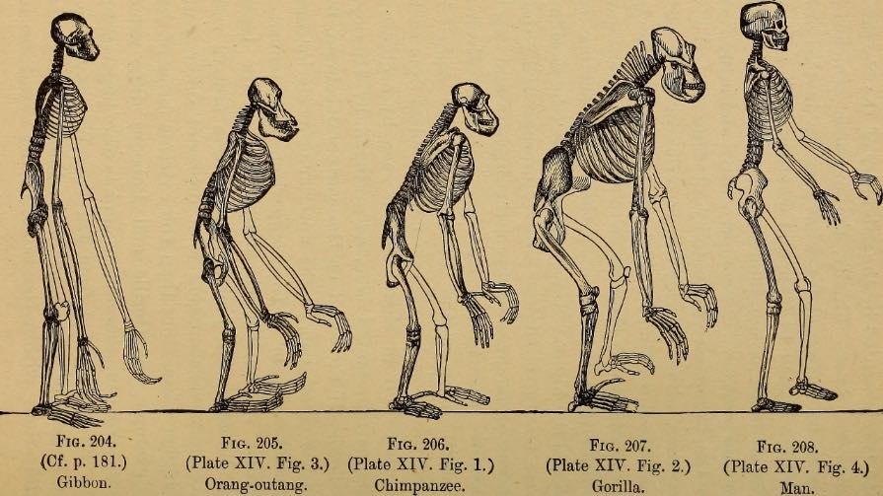
Ontology Satisfiability: Does O have a model?
:Person owl:equivalentClass
[ owl:qualifiedCardinality 2 ; owl:onProperty :hasParent ;
owl:onClass :Person ] .
Anything wrong with this?

Slide 61



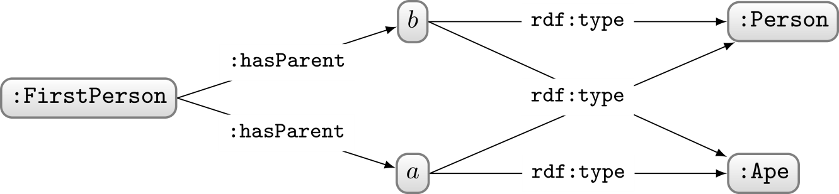



Ontology Satisfiability: Does O have a model?
:Person owl:equivalentClass
[ owl:qualifiedCardinality 2 ; owl:onProperty :hasParent ;
owl:onClass :Person ] .
:FirstPerson a :Person ,
[ owl:qualifiedCardinality 2 ; owl:onProperty :hasParent ;
owl:onClass :Ape ] .
Does O have any model?
∈
Not shown: parents of a and b, and their parents, recursively
∈
∈
YES! Ontology O is Satisfiable!

Slide 62

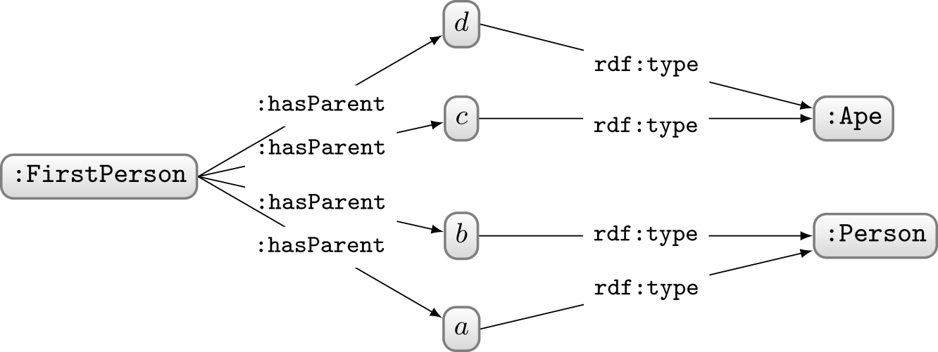







Ontology Satisfiability:
Does O have a “model”?
:Person owl:equivalentClass
[ owl:qualifiedCardinality 2 ; owl:onProperty :hasParent ;
owl:onClass :Person ] .
:FirstPerson a :Person ,
[ owl:qualifiedCardinality 2 ; owl:onProperty :hasParent ;
owl:onClass :Ape ] .
:Ape owl:disjointWith :Person .
So does O have a model now?
∈
Not shown: parents of a and b, and their parents, recursively
∈
∈
∈
YES! Ontology O is still Satisfiable!

Slide 63
Ontology Satisfiability:
Does O have a “model”?
:Person owl:equivalentClass
[ owl:qualifiedCardinality 2 ; owl:onProperty :hasParent ;
owl:onClass :Person ] .
:FirstPerson a :Person ,
[ owl:qualifiedCardinality 2 ; owl:onProperty :hasParent ;
owl:onClass :Ape ] .
:Ape owl:disjointWith :Person .
What more would we have to add to O to make it Unsatisfiable?
:Person rdfs:subClassOf
[ owl:cardinality 2 ; owl:onProperty :hasParent ] .
OR
:Person owl:equivalentClass
[ owl:allValuesFrom :Person ; owl:onProperty :hasParent ] .
OR
:FirstPerson a :Ape .
OR
:FirstPerson a owl:Nothing .
OR …

Slide 64

Ontology Satisfiability:
Does O have a “model”?
:Person owl:equivalentClass
[ owl:qualifiedCardinality 2 ; owl:onProperty :hasParent ;
owl:onClass :Person ] .
:FirstPerson a :Person ,
[ owl:qualifiedCardinality 2 ; owl:onProperty :hasParent ;
owl:onClass :Ape ] .
:Ape owl:disjointWith :Person .
An unsatisfiable ontology cannot model any world!
It is inconsistent!
What more would we have to add to O to make it Unsatisfiable?
:Person rdfs:subClassOf
[ owl:cardinality 2 ; owl:onProperty :hasParent ] .
OR
:Person owl:equivalentClass
[ owl:allValuesFrom :Person ; owl:onProperty :hasParent ] .
OR
:FirstPerson a :Ape .
OR
:FirstPerson a owl:Nothing .
OR …

Slide 65
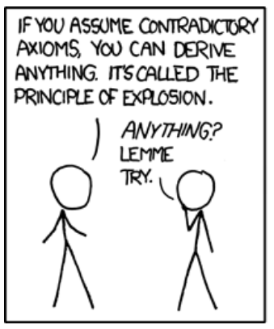
Entailment checking: Does O entail O′?
:hasDaughter rdfs:subPropertyOf :hasChild .
:hasChild rdf:type owl:AsymmetricProperty ;
owl:inverseOf :hasParent ;
rdfs:subPropertyOf :ancestorOf .
:ancestorOf rdf:type owl:TransitiveProperty .
ex:Carmela :hasChild ex:Michael .
ex:Michael :hasDaughter ex:Mary .
ex:Michael :hasParent ex:Carmela .
ex:Michael :hasChild ex:Mary .
ex:Carmela :ancestorOf ex:Mary .
Alternatively: Are all models of O models of O′ too?

Slide 66
Entailment checking: Does O entail O′?
ex:Connie owl:sameAs ex:Constanza .
ex:Connie owl:differentFrom ex:Constanza .
ex:Aidan ex:deserves ex:Raise .
Alternatively: Are all models of O models of O′ too?

Slide 67
Reasoning …

Slide 68
How can we perform reasoning?
Does Ontology O entail O′?
Could instead ask: is “O ∪ ¬o′” unsatisfiable for some o′ ∈ O′?
Can reduce entailment to unsatisfiability!
:hasDaughter rdfs:subPropertyOf :hasChild .
ex:Michael :hasDaughter ex:Mary .
ex:Michael :hasChild ex:Mary .
:hasDaughter rdfs:subPropertyOf :hasChild .
ex:Michael :hasDaughter ex:Mary .
[] owl:sourceIndividual ex:Michael ;
owl:assertionProperty :hasChild ;
owl:targetIndividual ex:Mary .

Slide 69


So how do we test unsatisfiability then?

Slide 70
Undecidability …

Slide 71
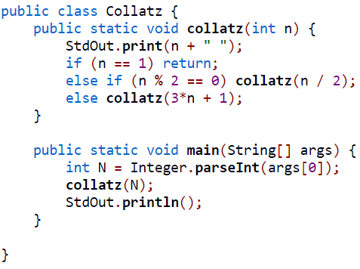
A simple Java program …
In:
6
3
10
5
16
8
4
2
1
(end)
Does this Java program terminate
on all possible (positive) inputs?

Slide 72
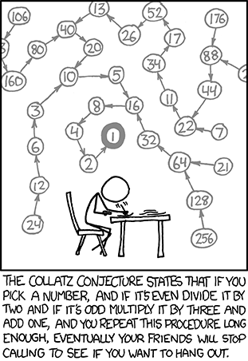
A simple Java program …
Collatz conjecture: an unsolved problem in mathematics
If we knew that this program terminates or does not terminate on all natural numbers (not just ints), this problem would be solved!

Slide 73
Halting Problem
Input: a program and an input to that program
Output:
  true if the program halts on that input
  false otherwise
UNDECIDABLE: a general algorithm to solve the Halting Problem does not exist!
  It will not halt for all program–input pairs!
  It may halt for some program–input pairs

Slide 74
A quick sketch of Halting Problem proof
true
halt(this) ?
false
halt

Slide 75
Problem: Consecutive ‘1’s in π
Input: A natural number n
Output:
  true if π contains n consecutive ‘1’s
  false otherwise
Is this problem DECIDABLE or UNDECIDABLE?
… i.e., does there exist a program that halts (with the correct answer) for all n?
What if we knew the maximum sequence of consecutive ‘1’s in π?
if (n ≤ MAX) return true; else return false;
• there must exist a MAX sequence of consecutive ‘1’s in π (even if it’s ∞)
∴ there must exist a correct program that halts (even if we don’t know its details)
∴ problem is DECIDABLE!

Slide 76
Problem: Collatz Halting Problem (Aside)
Input: [none]
Output:
  true if Collatz program halts on all inputs
  false otherwise
Is this problem DECIDABLE or UNDECIDABLE?
(P1) return true;
(P2) return false;
• either (P1) or (P2) must be correct
∴ there must exist a correct program that halts (even if we don’t know it)
∴ problem is DECIDABLE!
Halting Problem UNDECIDABLE in the general case
(for all programs and inputs)

Slide 77
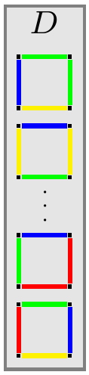
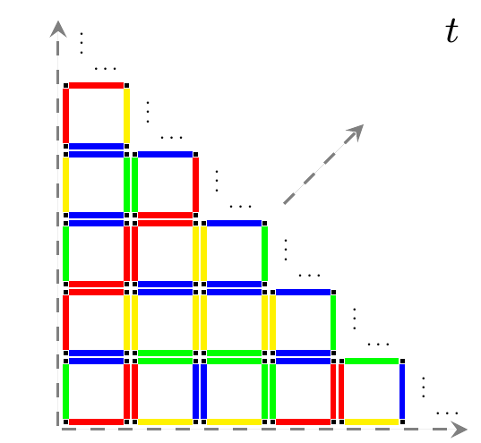
Domino Tiling Problem
Is this problem DECIDABLE or UNDECIDABLE?
Input: A set of Dominos (like D)
Output:
  true if there exists a valid infinite tiling (like t)
  false otherwise

Slide 78
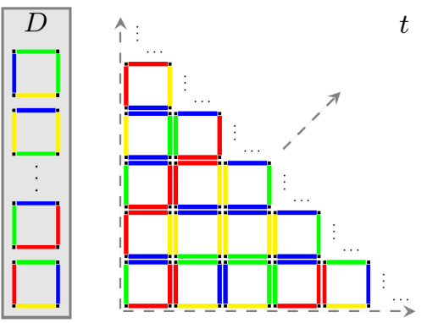
Can reduce from Halting to Tiling
true
halt(this) ?
Turing reduction
false
halt
It has been shown that there exists a program that can reduce any Halting problem instance into a Domino Tiling problem instance
Now is the Domino Tiling problem DECIDABLE or UNDECIDABLE?
halts(p,in) {
D = reduce(p,in);
return hasTiling(D);
}
• assume that reduce(p,in) is a Turing reduction
∴ if hasTiling(D) were DECIDABLE, then halts(p,in) would be DECIDABLE
• but halts(p,in) is UNDECIDABLE
∴ hasTiling(D) must be UNDECIDABLE!
If we have a Turing reduction from an UNDECIDABLE problem A
to another problem B, then B must be UNDECIDABLE

Slide 79
Can reduce from Halting to Tiling
true
halt(this) ?
Turing reduction
false
halt
It has been shown that there exists a program that can reduce any Halting problem instance into a Domino Tiling problem instance
Thus the Tiling Problem is UNDECIDABLE

Slide 80




Reduce from Tiling to OWL entailment?
Turing reduction
Does D have an infinite tiling?
Does OWL ontology O entail O′?
How can we encode a Domino Tiling question into an OWL ontology entailment question?

Slide 81
Reading groups

Slide 82

Reading groups
Task: Find and present a paper relating to the topic of the course
  Goal: Get an overview of ongoing research topics
  Work in groups of maximum 3
  Conference/journal paper in Sem. Web area
  Cannot be selected by another group

Slide 83






Questions?

