Slide 1
CC7220-1
La Web de Datos
Primavera 2025
Lecture 5: SPARQL [1.1]
Aidan Hogan + Camila Jáuregui
aidhog@gmail.com

Slide 2
Previously …

Slide 3
First SPARQL (1.0)
Then SPARQL 1.1

Slide 4
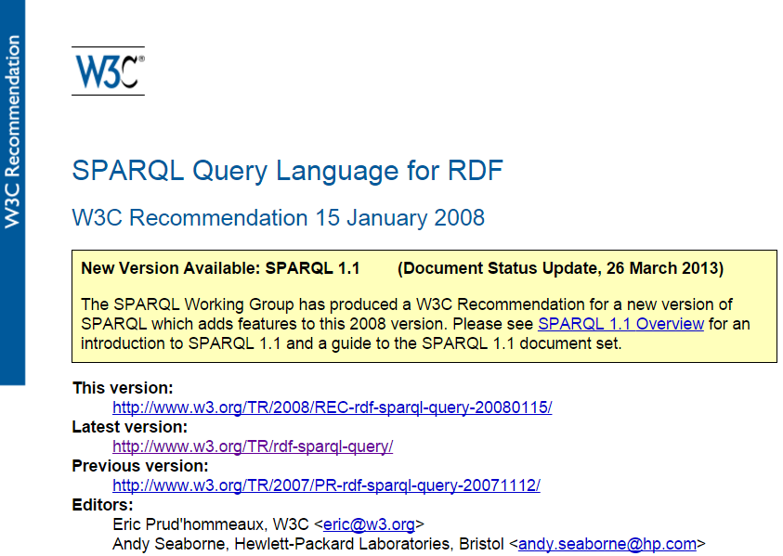
Covered SPARQL 1.0
http://www.w3.org/TR/rdf-sparql-query/

Slide 5
Today:
SPARQL 1.1

Slide 6
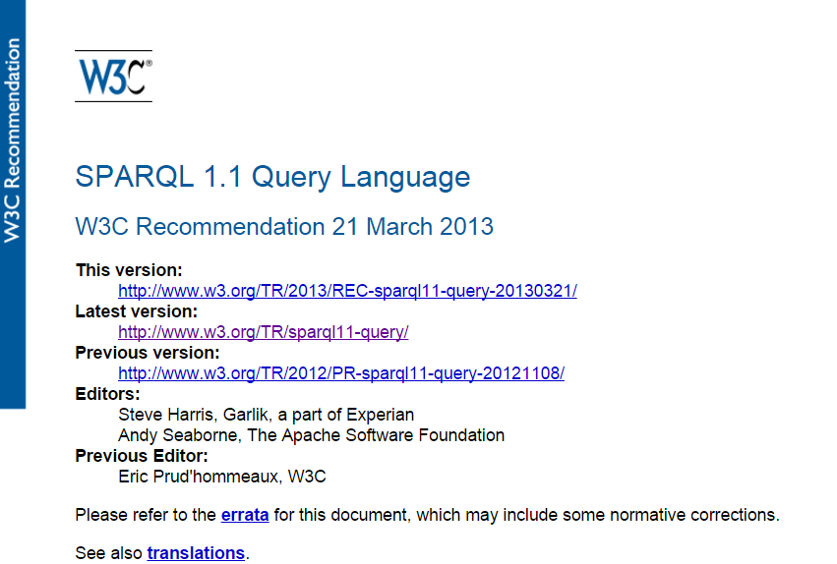
A Web standard
http://www.w3.org/TR/sparql11-query/

Slide 7
Query feature:
Negation

Slide 8
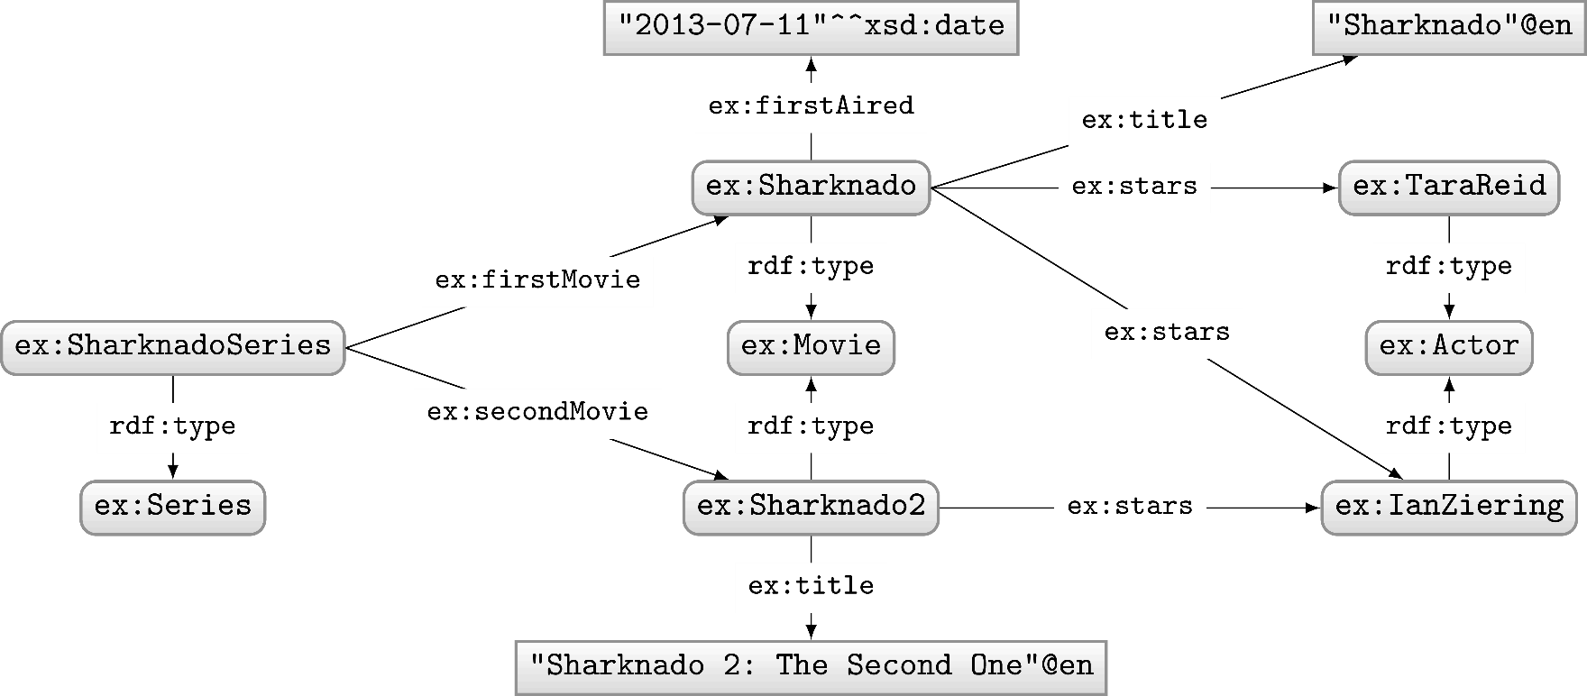
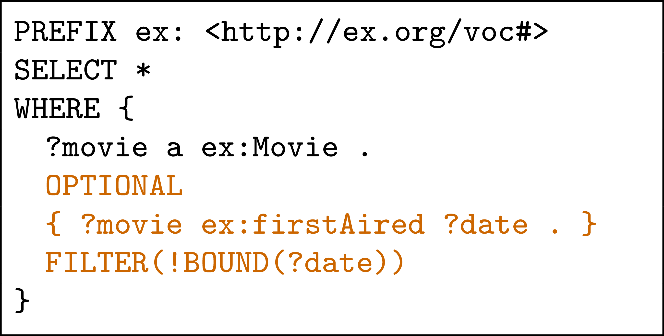
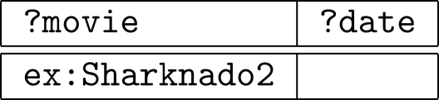
SPARQL 1.0: Negation possible w/ a trick!
Query:
What solutions would this query return?
Solutions:
Can do a closed-world style of negation!

Slide 9
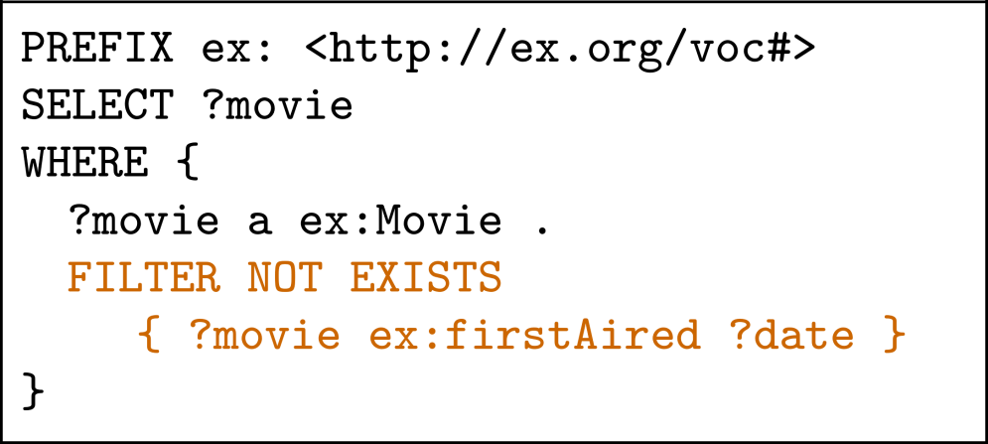
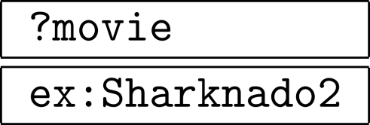
SPARQL 1.1: (NOT) EXISTS
Query:
Solutions:

Slide 10
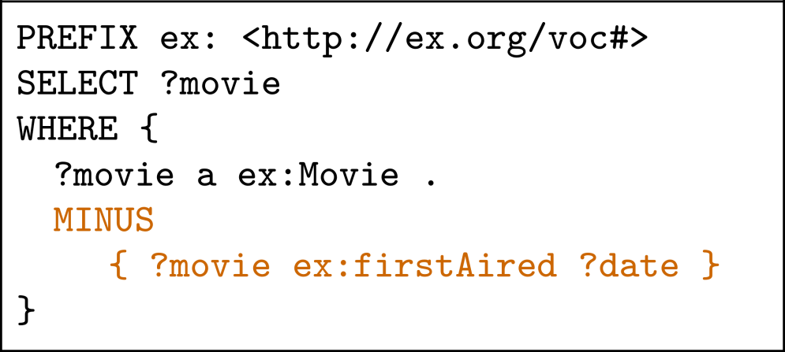
SPARQL 1.1: MINUS
Query:
Solutions:

Slide 11

Difference between MINUS and NOT EXISTS?

Slide 12
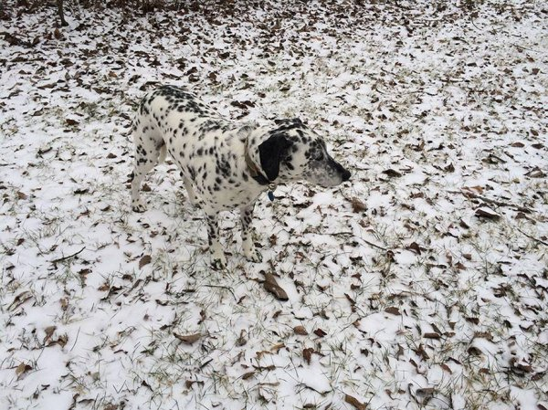
Difference between MINUS and NOT EXISTS?
NOT EXISTS: Returns results if the pattern on the right has no matches when replacing variables from the left (actually not well-defined)
MINUS: Removes solutions from the left that join on the right (with at least one variable)

Slide 13
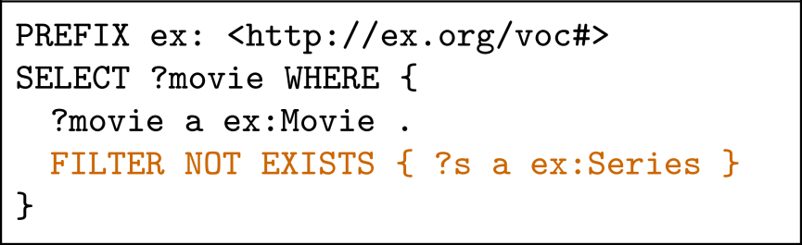
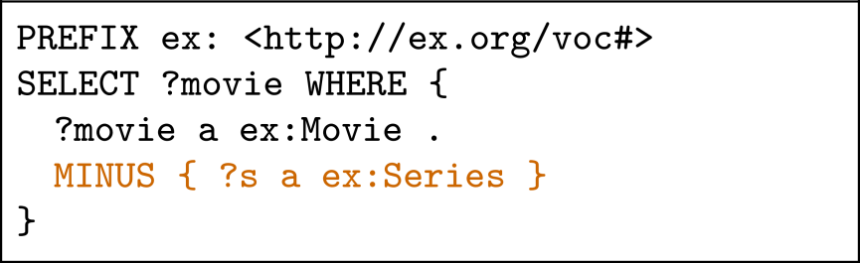

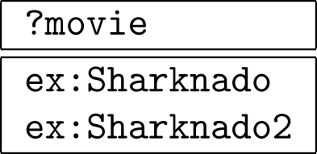
Difference between MINUS and NOT EXISTS?
There is a match!
Therefore no results!
There is no join variable between both!
Therefore nothing removed!

Slide 14
New query feature:
Property paths

Slide 15
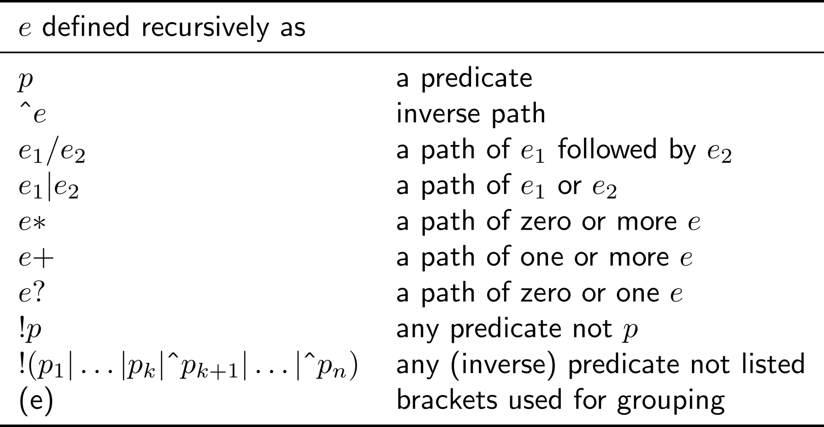
Property paths: regular expressions
Only these features cannot be rewritten to something else. These features are “new”, offering arbitrary length paths!

Slide 16
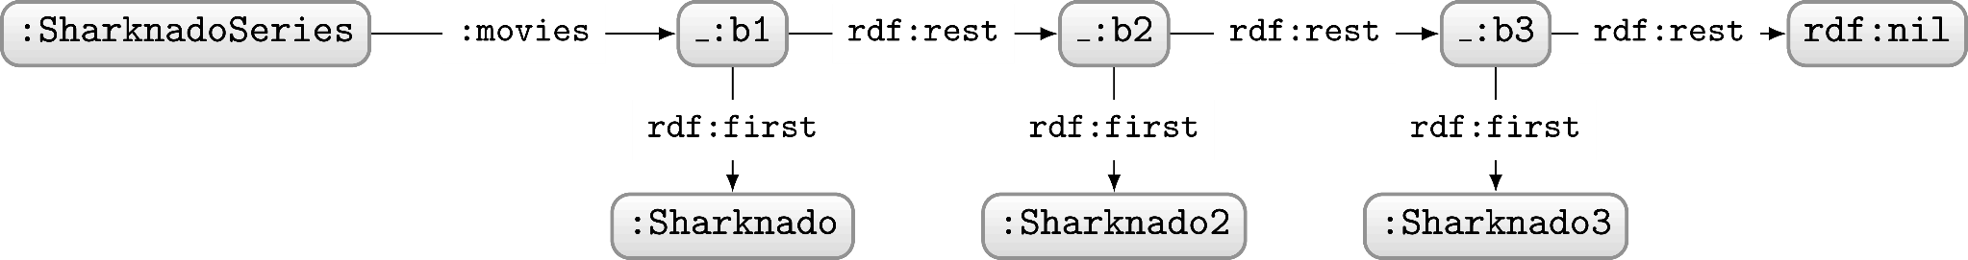
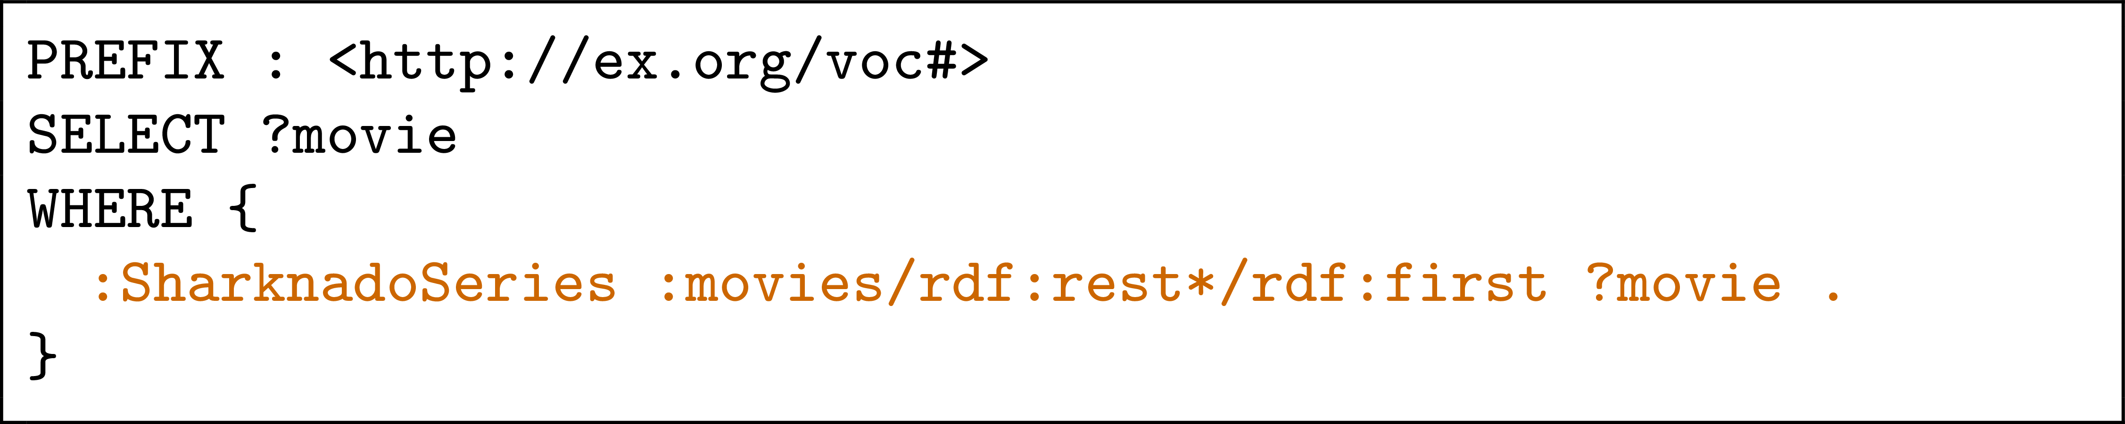
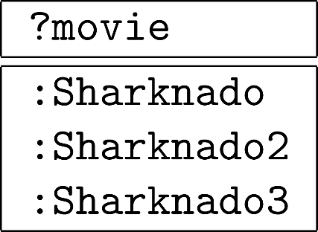
Property paths example: RDF list
How to ask: “Which movies are in the Sharknado series?”
Query:
Solutions:

Slide 17
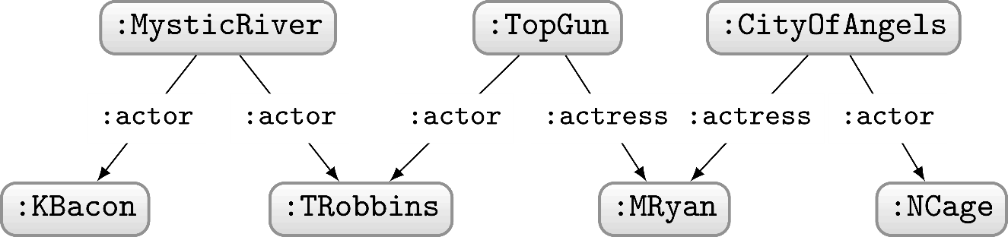
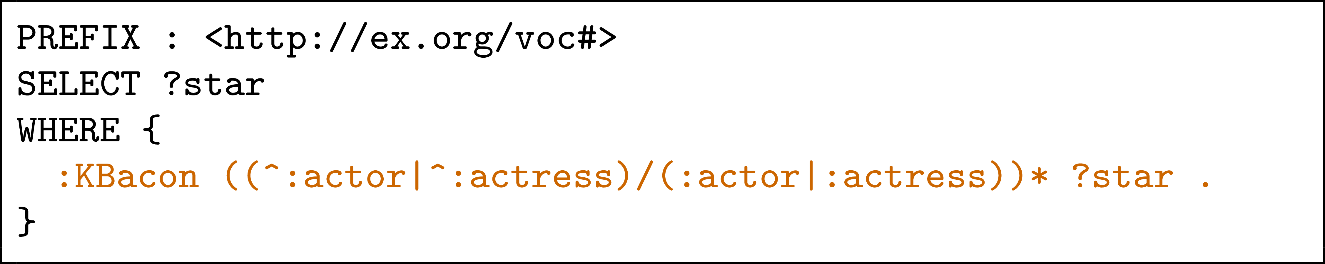
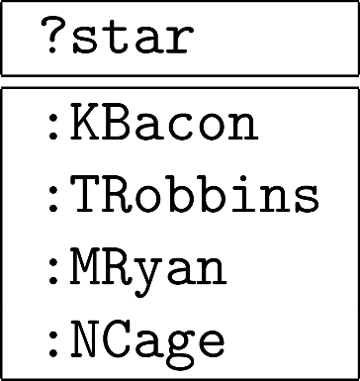
Property paths example: Finite Bacon number
How to ask: “Who has a finite Bacon number?”
Query:
Solutions:
We cannot get the actual Bacon number (path length) for arbitrary length paths

Slide 18
New query feature:
Assignment

Slide 19
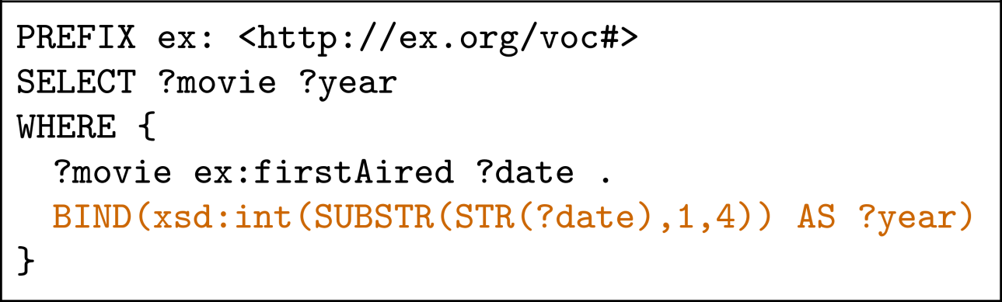
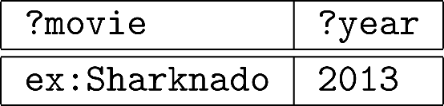
Assignment with BIND
Query:
Solutions:

Slide 20
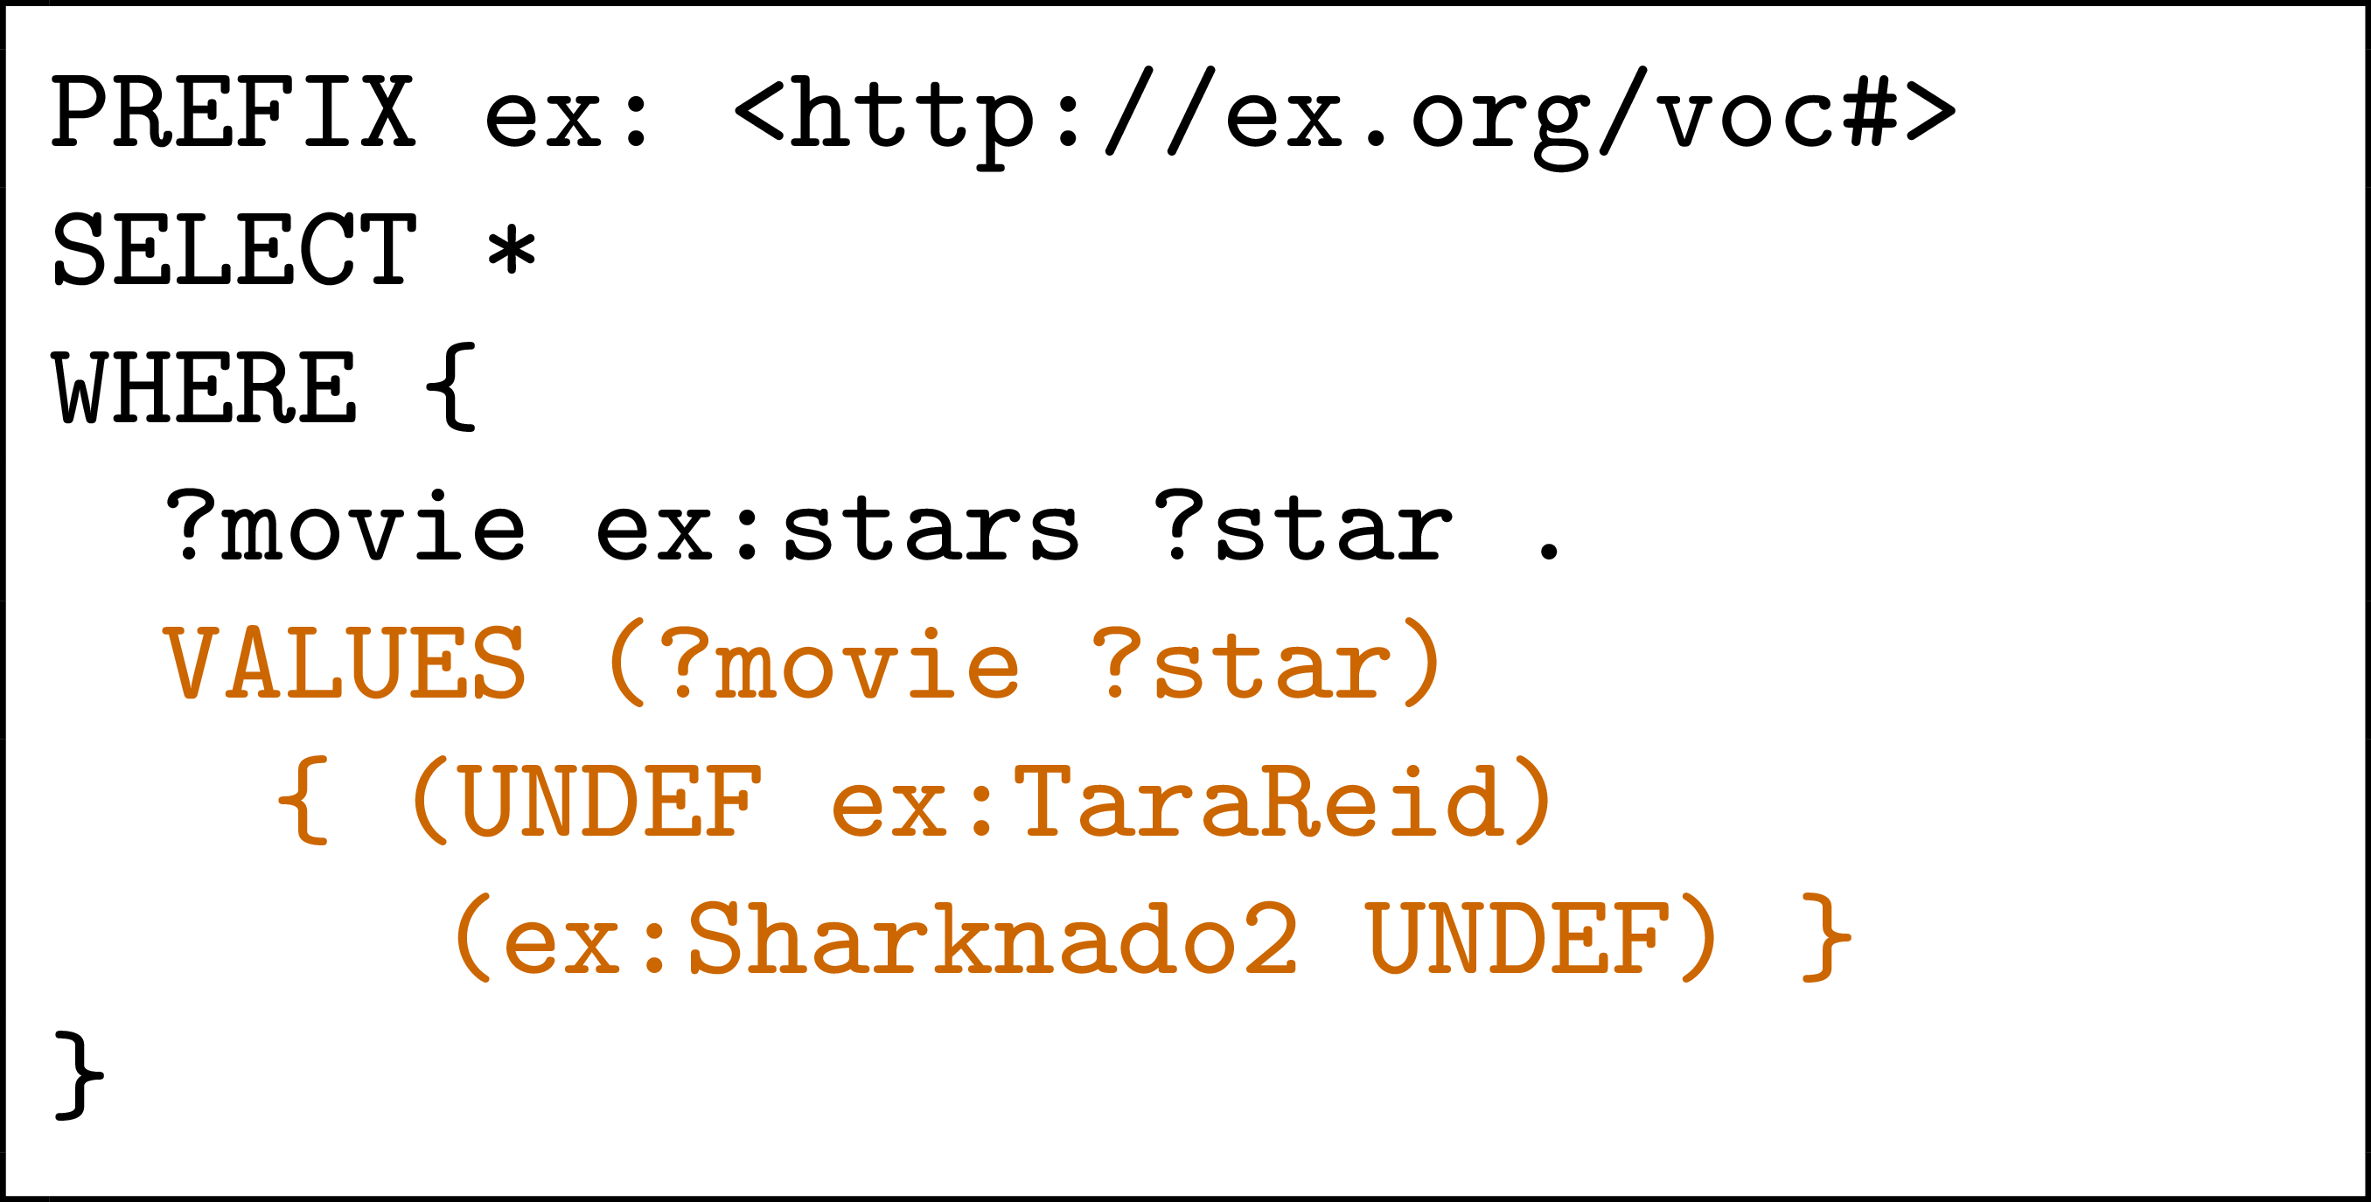
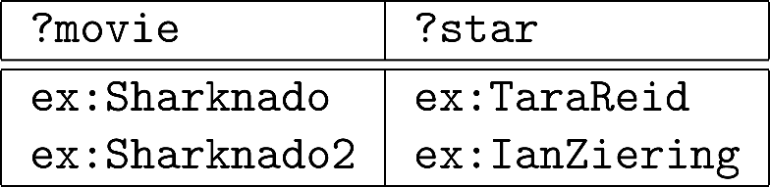
Assignment with VALUES
Query:
Solutions:
No result for
ex:Sharknado ex:IanZiering!

Slide 21
New query feature:
Aggregates

Slide 22
Aggregates
How to ask: “How many movie stars are in the data?”

Slide 23
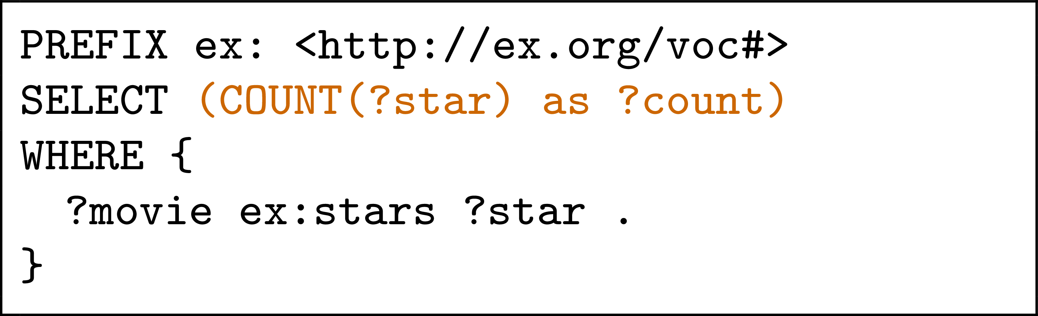
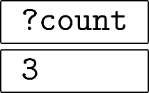
Aggregates: COUNT
Query:
Solutions:

Slide 24
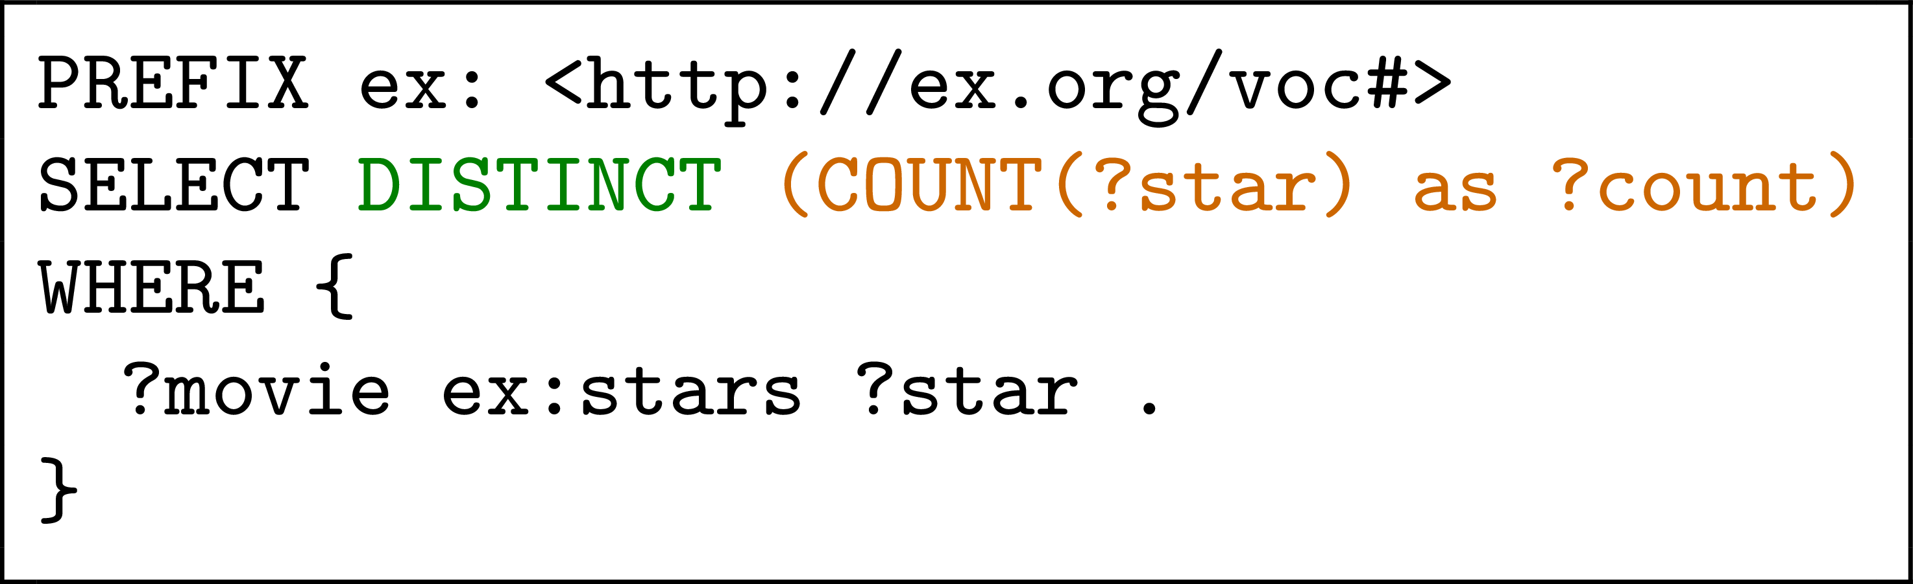
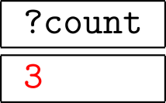
Aggregates: COUNT
Query:
Solutions:
DISTINCT applied after COUNT!

Slide 25
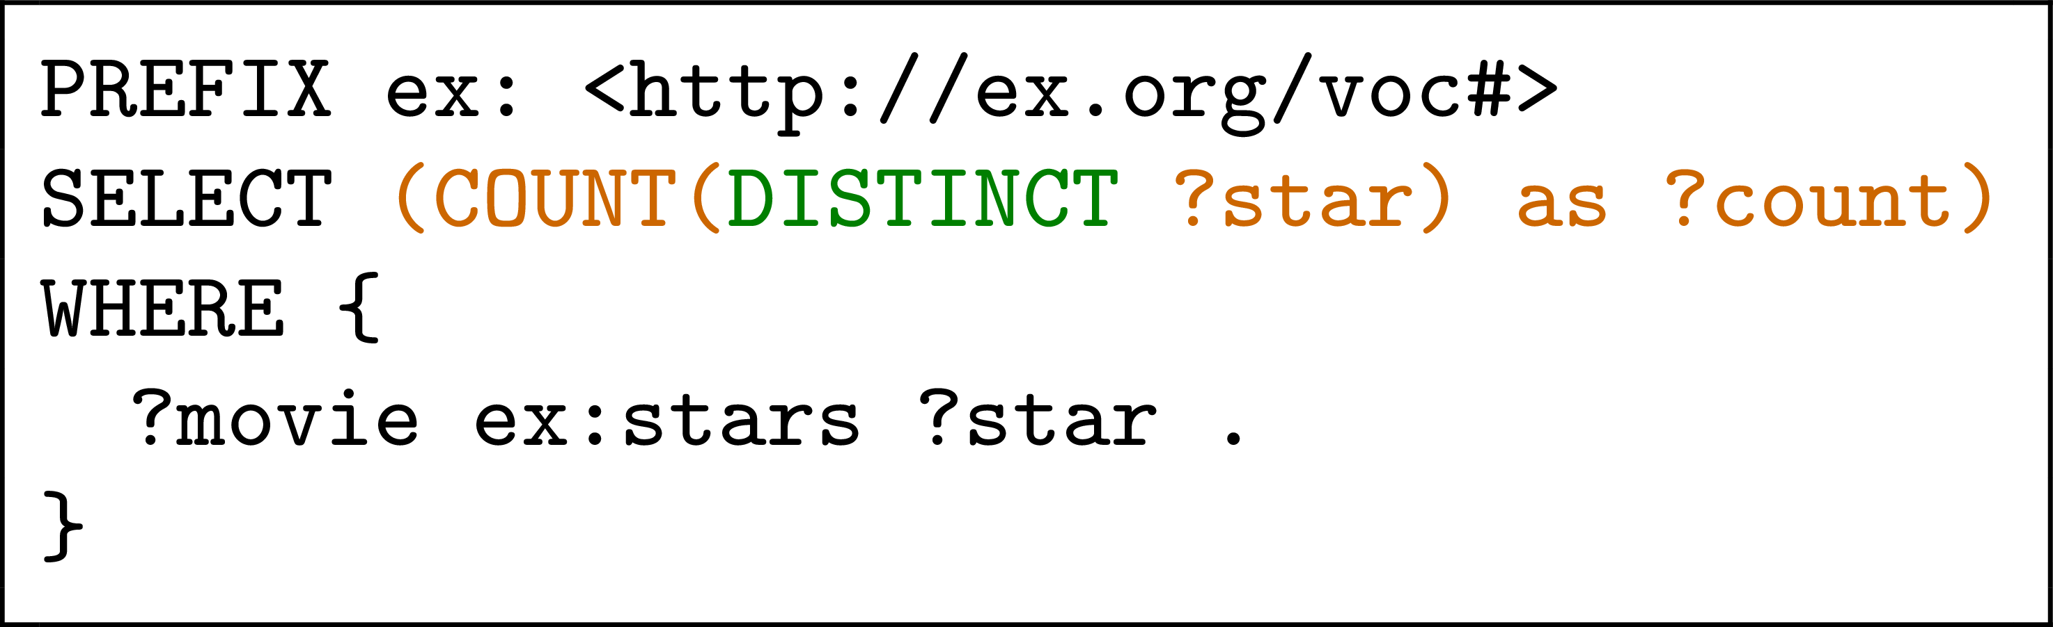
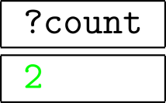
Aggregates: COUNT
Query:
Solutions:

Slide 26
Aggregates
How to ask: “How many stars does each movie have?”

Slide 27
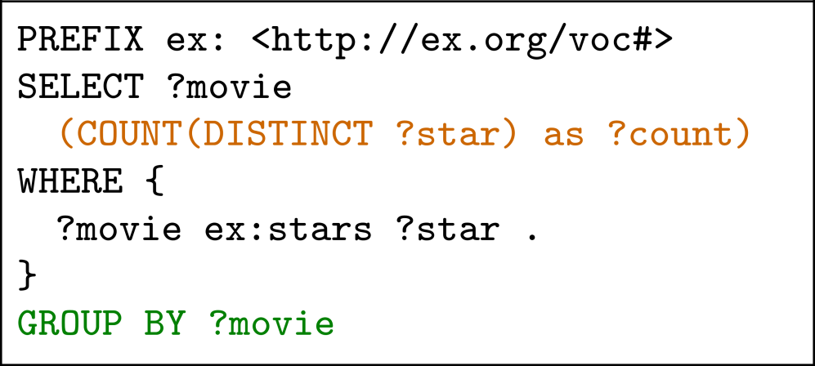
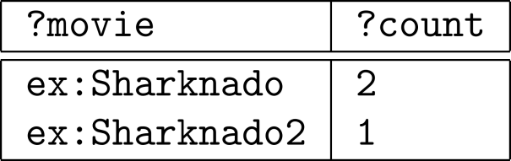
Aggregates: COUNT with GROUP BY
Query:
Solutions:

Slide 28
Aggregates
How to ask: “Give me movies with more than 1 star?”

Slide 29
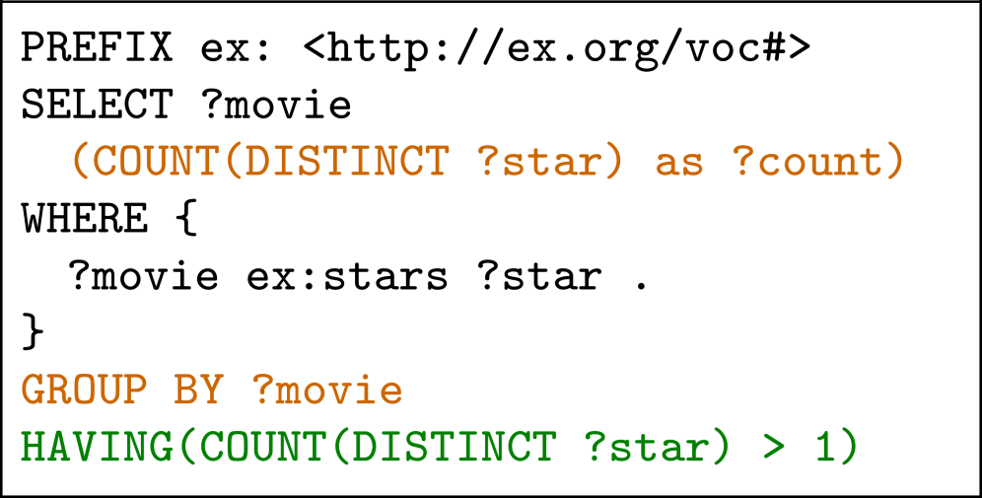
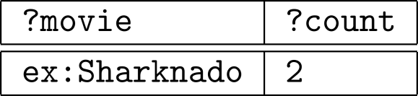
Aggregates: COUNT, GROUP BY, HAVING
Query:
Solutions:
HAVING is like a FILTER for aggregates

Slide 30
Aggregates in SPARQL 1.1
COUNT: Count values
SUM: Sum a set of values
MIN: Find the lowest value
MAX: Find the highest value
AVG: Get the average of values
GROUP_CONCAT: String-concat values
SAMPLE: Select a value (pseudo-randomly)

Slide 31
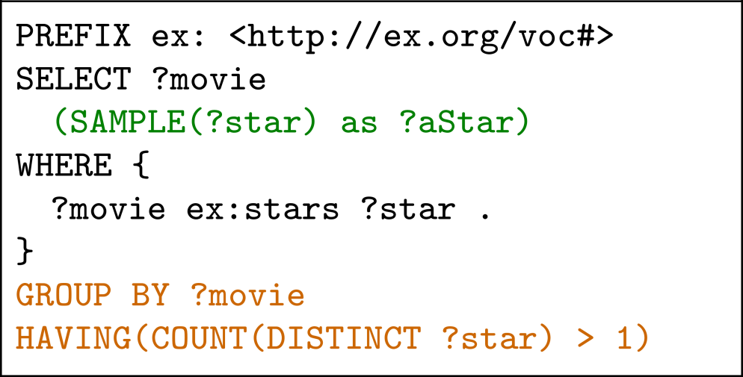
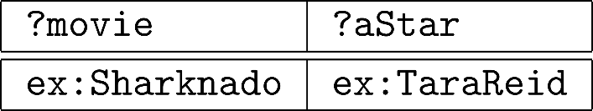
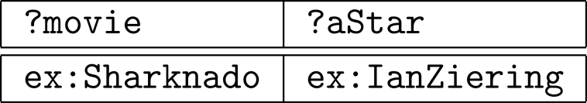
One more aggregates example: SAMPLE
Query:
Solutions:
OR

Slide 32
Quick note on semantics

Slide 33
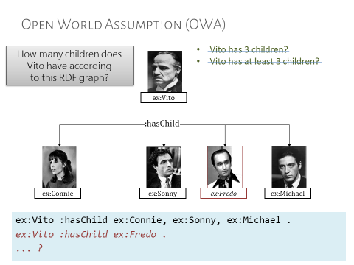
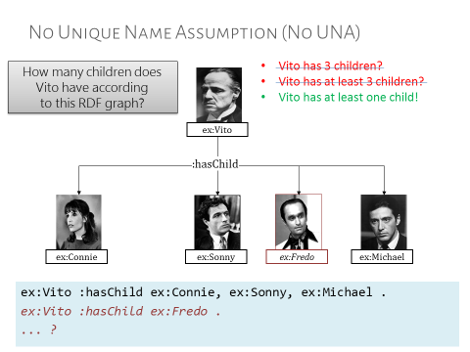
Recall from OWL: OWA and lack of UNA

Slide 34

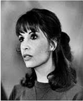



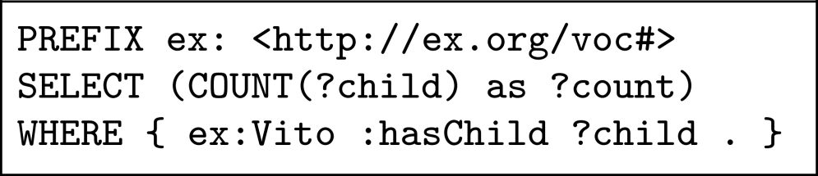
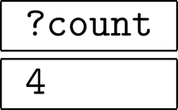
But in SPARQL …
Looks like SPARQL has a UNA and a CWA …
But SPARQL does not have “worlds”.
It does not interpret “real people”.
SPARQL works on data.
SPARQL counts RDF terms, not children.
ex:Vito
:hasChild
ex:Connie
ex:Sonny
ex:Fredo
ex:Michael
Query:
Solutions:

Slide 35
New query feature:
Subqueries

Slide 36
Subqueries
How to ask: “How many stars does a movie have on average?”

Slide 37
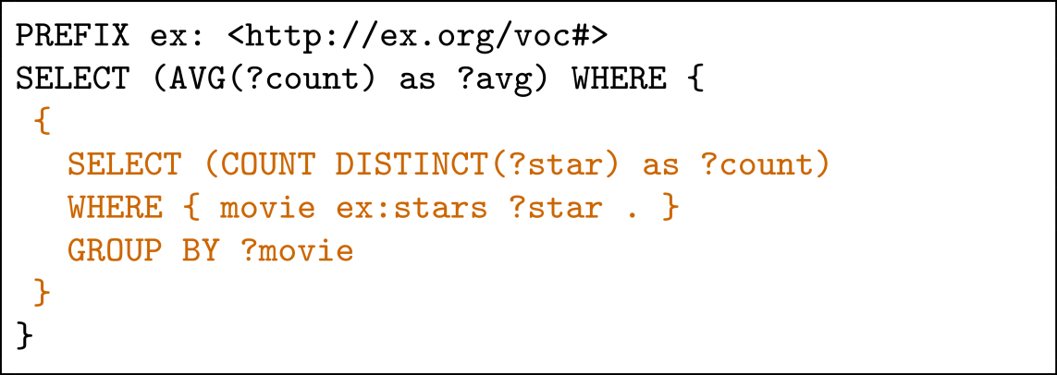
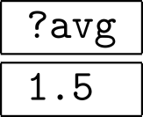
Subqueries
Query:
Solutions:
Sub-queries useful when you need solution modifiers or aggregates in the middle of a more complex query.

Slide 38
Subqueries
How to ask: “Which movies have more stars than average?”

Slide 39
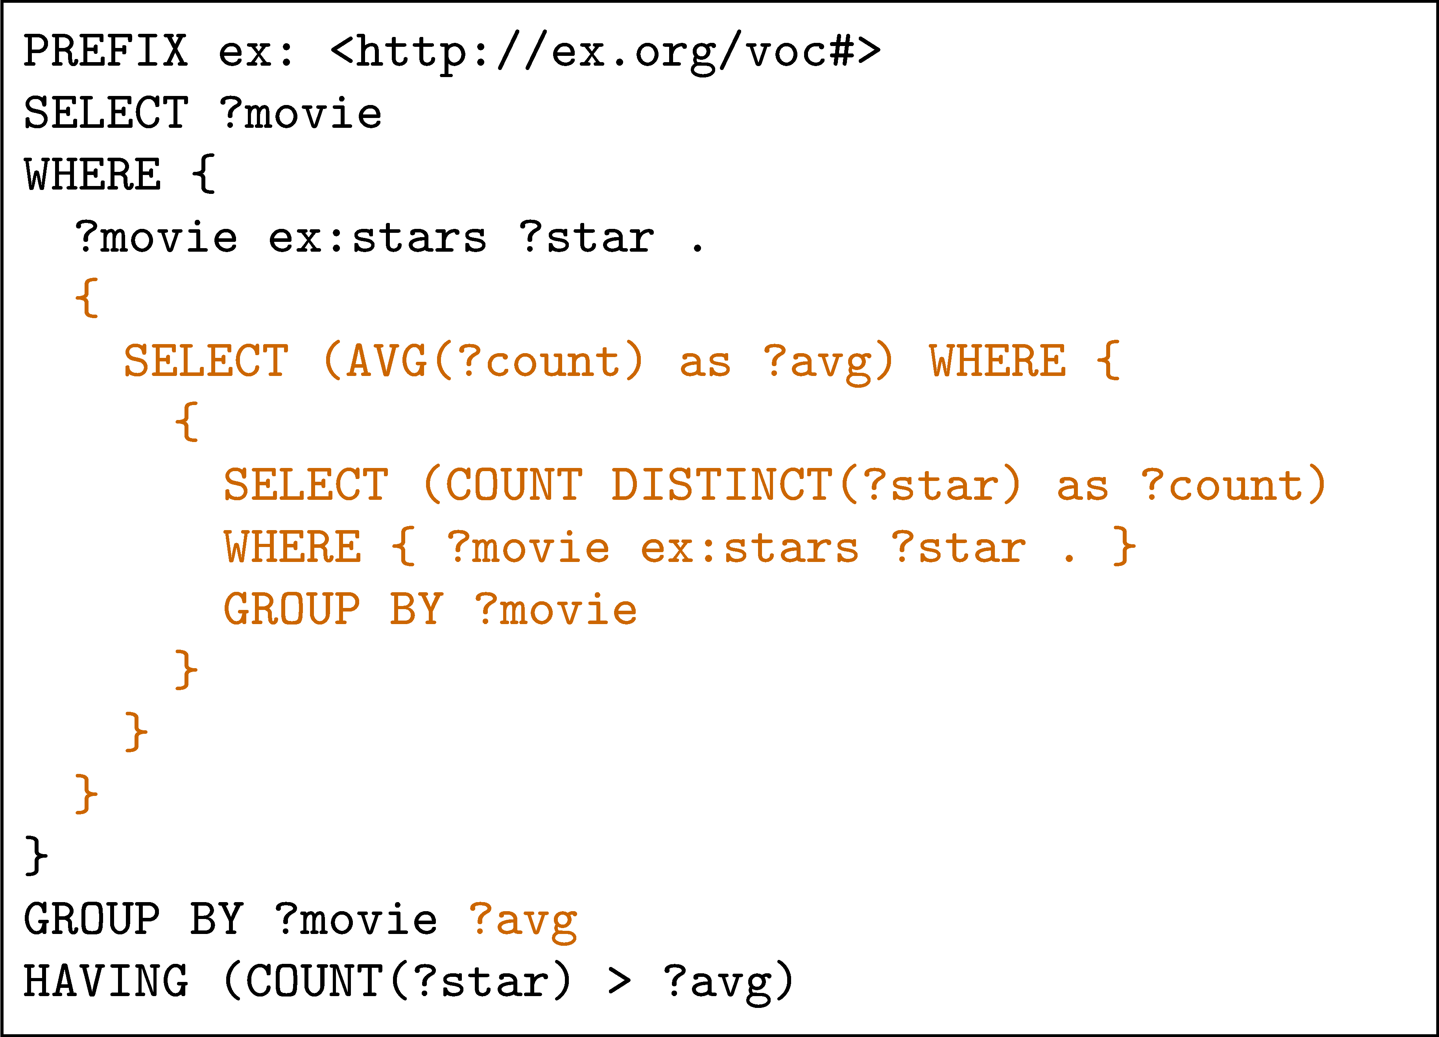
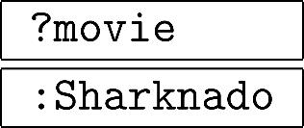
Subqueries
Query:
Solutions:
?movie in the sub-query is not correlated with ?movie in the outmost query

Slide 40
New query feature:
Federation

Slide 41
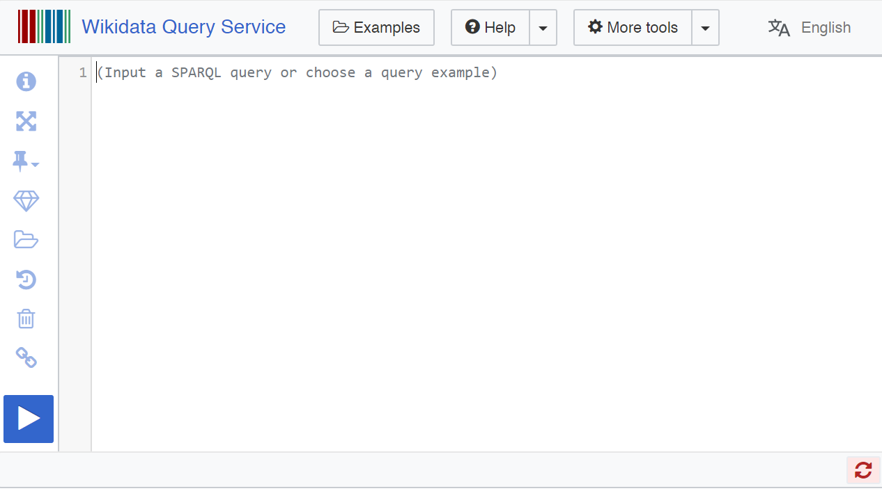
Endpoints often made public/online

Slide 42
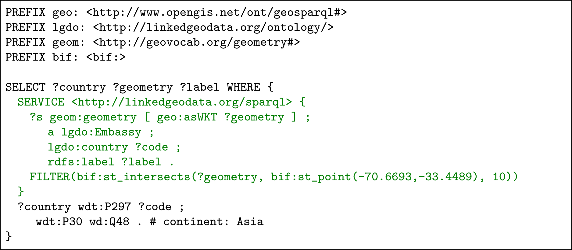
Federation: execute sub-query remotely
Finds Asian embassies within 10 km of Santiago centre.
Embassies from LinkedGeoData.
Continents from Wikidata.

Slide 43
(Hidden slide)
#defaultView:Map{"hide":["?country","?geometry"], "layer": "?label"}
PREFIX geo: <http://www.opengis.net/ont/geosparql#>
PREFIX lgdo: <http://linkedgeodata.org/ontology/>
PREFIX geom: <http://geovocab.org/geometry#>
PREFIX bif: <bif:>
SELECT ?country ?geometry ?label WHERE {
SERVICE <http://linkedgeodata.org/sparql> {
?s geom:geometry [ geo:asWKT ?geometry ] ;
a lgdo:Embassy ;
lgdo:country ?code ;
rdfs:label ?label .
FILTER(bif:st_intersects(?geometry, bif:st_point(-70.6693,-33.4489), 10))
}
?country wdt:P297 ?code ;
wdt:P30 wd:Q48 . # continent: Asia
}
https://query.wikidata.org/

Slide 44
New language:
SPARQL 1.1 Update

Slide 45
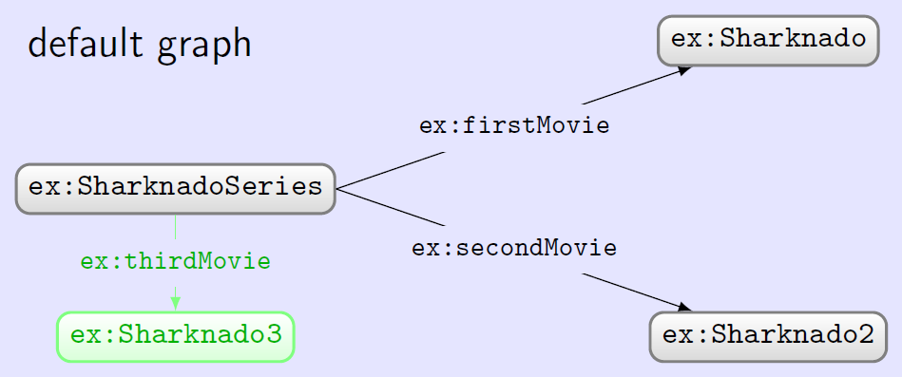
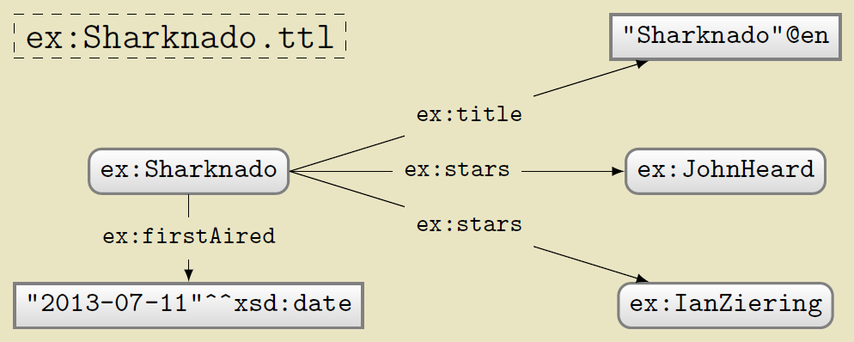
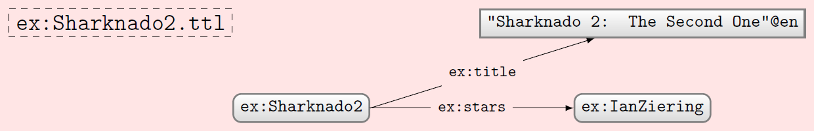

INSERT DATA default graph

Slide 46



INSERT DATA named graph

Slide 47


DELETE DATA

Slide 48


INSERT/DELETE with WHERE

Slide 49

Combining INSERT/DELETE
Solutions for WHERE generated before insertions/deletions
Deletions performed before insertions.

Slide 50

Set default update graph: WITH

Slide 51


Simple DELETE WHERE
Equivalent to …

Slide 52
Managing named graphs: LOAD
LOAD a graph from the Web
  SILENT: If load fails, suppress error
  IRI-from: location of graph online
  IRI-to: local named graph to load into
    If not given, default graph will be appended
Destination graph created if it does not exist (otherwise data are appended)
Will fail if RDF cannot be extracted from source graph (unless silent is specified)

Slide 53
Managing named graphs: CLEAR
CLEAR all triples from some graph(s)
  SILENT: If clear fails, suppress error
  GRAPH IRI: clear specific named graph
  DEFAULT: clear default graph
  NAMED: clear all named graphs
  ALL: clear all graphs
Will fail if graph does not exist (unless silent is specified)

Slide 54
Managing named graphs: CREATE
CREATE a new blank named graph
  SILENT: If create fails, suppress error
  GRAPH IRI: name of graph to create
Will fail if graph already exists (unless silent is specified)
Existing graphs cannot be affected

Slide 55
Managing named graphs: DROP
DROP (remove) some graph(s)
  SILENT: If drop fails, suppress error
  GRAPH IRI: name of graph to drop
  DEFAULT: drop default graph
  NAMED: drop all named graphs
  ALL: drop all graphs
Will fail if graph does not exist (unless silent is specified)
An engine must have a default graph: DROP DEFAULT same as CLEAR DEFAULT

Slide 56
Managing named graphs: COPY
COPY one graph to another
  SILENT: If copy fails, suppress error
  IRI-from: name of graph to copy from
  IRI-to: name of graph to copy to
  DEFAULT: copy from/to default graph
May fail if source graph does not exist (unless silent is specified)
Destination graph will be created or cleared before the copy is done
Source graph unaffected

Slide 57
Managing named graphs: MOVE
MOVE one graph to another
  SILENT: If move fails, suppress error
  IRI-from: name of graph to move
  IRI-to: name of graph to move to
  DEFAULT: move from/to default graph
May fail if source graph does not exist (unless silent is specified)
Destination graph will be created or cleared before the copy is done
Source graph dropped after the move.

Slide 58
Managing named graphs: ADD
ADD data from one graph to another
  SILENT: If add fails, suppress error
  IRI-from: name of graph to add
  IRI-to: name of graph to add to
  DEFAULT: add from/to default graph
May fail if source graph does not exist (unless silent is specified)
Destination graph created if it does not exist (otherwise data are appended)
Source graph unaffected

Slide 59
New feature:
SPARQL 1.1 Entailment Regimes

Slide 60
What’s new in SPARQL 1.1?
New query features
An update language
Support for RDFS/OWL entailment
New output formats

Slide 61

SPARQL 1.1 Entailment Regimes
States how entailments can be included in SPARQL results
Support for RDFS / sublanguages of OWL
Not well supported (to best of my knowledge)
Not going to cover it
If interested, check out the book chapter or
  http://www.w3.org/TR/sparql11-entailment/

Slide 62
New feature:
SPARQL 1.1 Output Formats

Slide 63
What’s new in SPARQL 1.1?
New query features
An update language
Support for RDFS/OWL entailment
New output formats

Slide 64
SPARQL 1.1 Output Formats
SELECT, ASK (non-RDF):
  XML (1.0), JSON (1.1), CSV/TSV (1.1)
CONSTRUCT, DESCRIBE (RDF)
  Standard RDF syntaxes: RDF/XML, Turtle, etc.

Slide 65
Quick mention:
SPARQL 1.1 Protocol

Slide 66
Defines a HTTP protocol
How to issue queries/update over HTTP
  GET / POST
How different output formats can be requested
  Accept: text/turtle, application/rdf+xml
What response codes should be returned; e.g.
  200 if successful
  4XX if SPARQL query is invalid
  5XX if query was okay but server failed to answer
    … etc. See more details:
      http://www.w3.org/TR/sparql11-protocol/

Slide 67



SPARQL endpoints on the Web!

Slide 68


SPARQL endpoints on the Web!

Slide 69
(Hidden slide)
PREFIX wd: <http://www.wikidata.org/entity/>
PREFIX wdt: <http://www.wikidata.org/prop/direct/>
PREFIX p: <http://www.wikidata.org/prop/>
PREFIX ps: <http://www.wikidata.org/prop/statement/>
PREFIX pq: <http://www.wikidata.org/prop/qualifier/>
PREFIX rdfs: <http://www.w3.org/2000/01/rdf-schema#>
SELECT DISTINCT ?laureateName ?awardYear ?warName ?warYear
WHERE {
?laureate p:P166 ?award . # Winner of some prize
?award ps:P166 wd:Q37922 . # Prize is Nobel Pr. in Lit.
?award pq:P585 ?awardDate . # Get the date of the award
BIND(YEAR(?awardDate) as ?awardYear) # Get the year of the award
?laureate wdt:P607 ?war . # Find war(s) laureate was in
?war rdfs:label ?warName . # Get name(s) of war(s)
?war wdt:P580 ?warStart . # Get year the war started
BIND(YEAR(?warStart) as ?warYear)
?laureate rdfs:label ?laureateName . # Get name of laureate
FILTER(lang(?warName)="en" # Filter for English
&& lang(?laureateName)="en") # ... names only
} ORDER BY ?awardYear # Order by year or award
https://query.wikidata.org/

Slide 70






Questions?

