Slide 1
CC7220-1
La Web de Datos
Primavera 2025
Lecture 3: RDF Schema (RDFS) and Semantics
Aidan Hogan
aidhog@gmail.com

Slide 2
Last time …

Slide 3







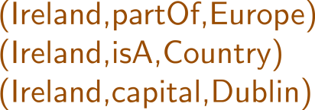



Semantic Web: Data
* More or less

Slide 4
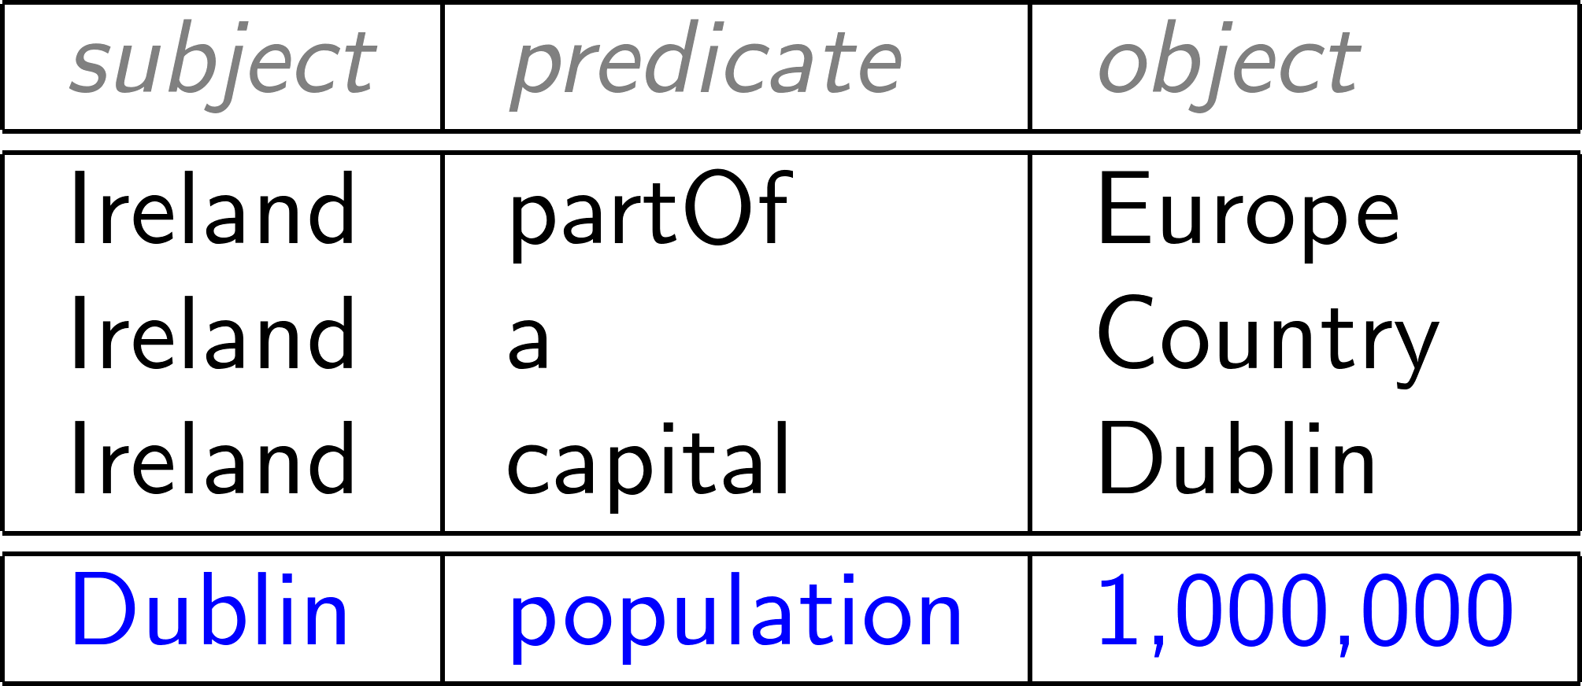

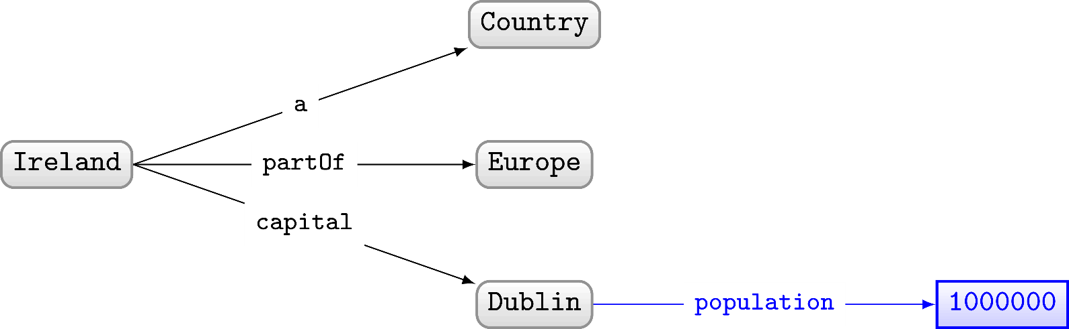
RDF often drawn as a (directed, labelled) graph

Slide 5
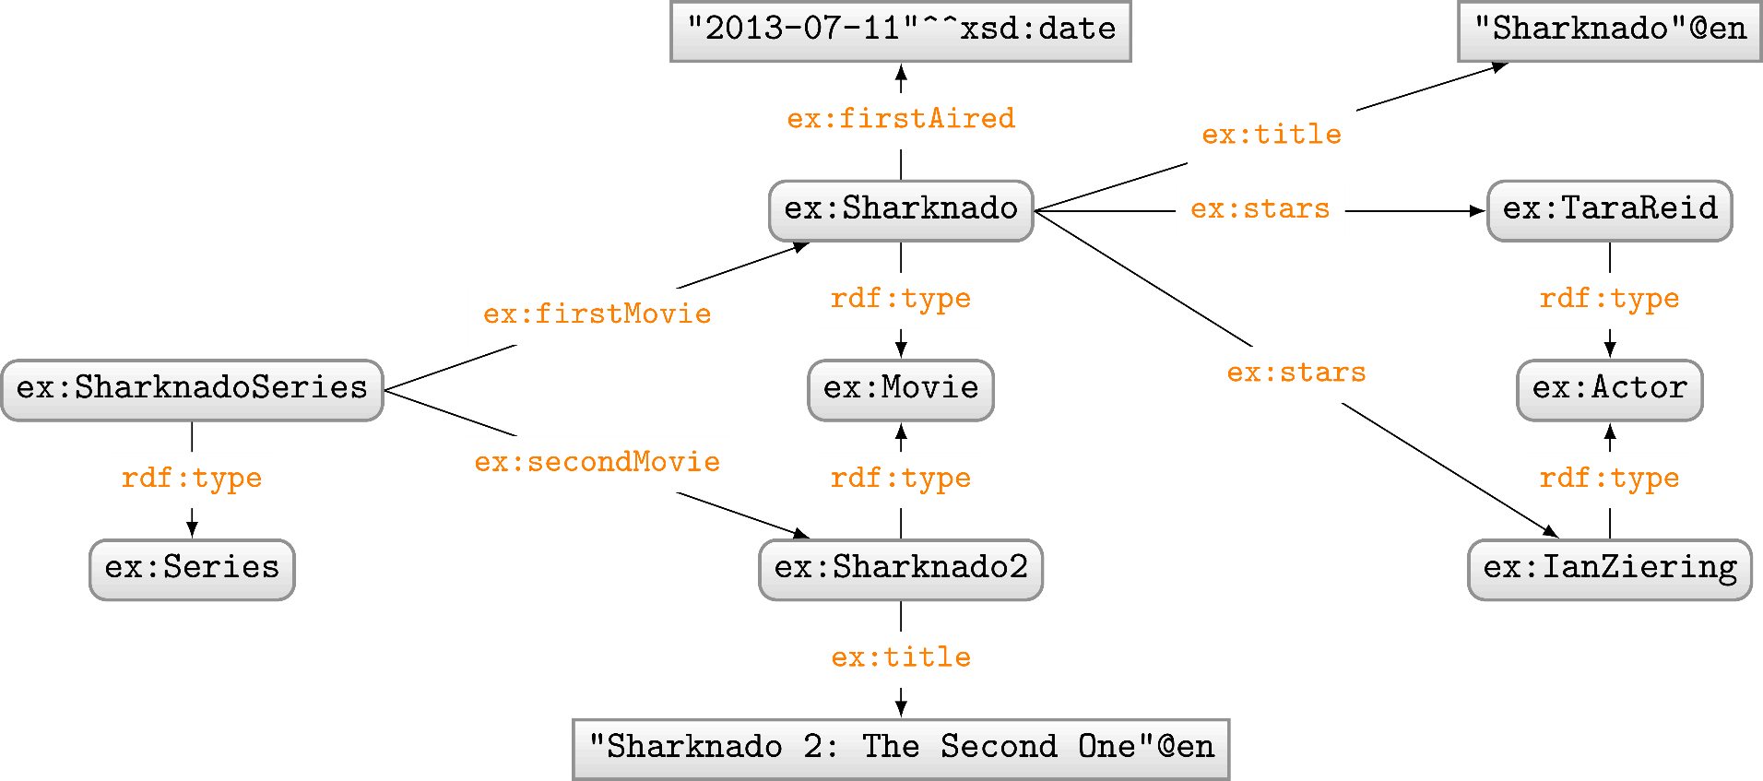
RDF Properties
RDF Terms used as predicate
  rdf:type, ex:firstMovie, ex:stars, etc.

Slide 6
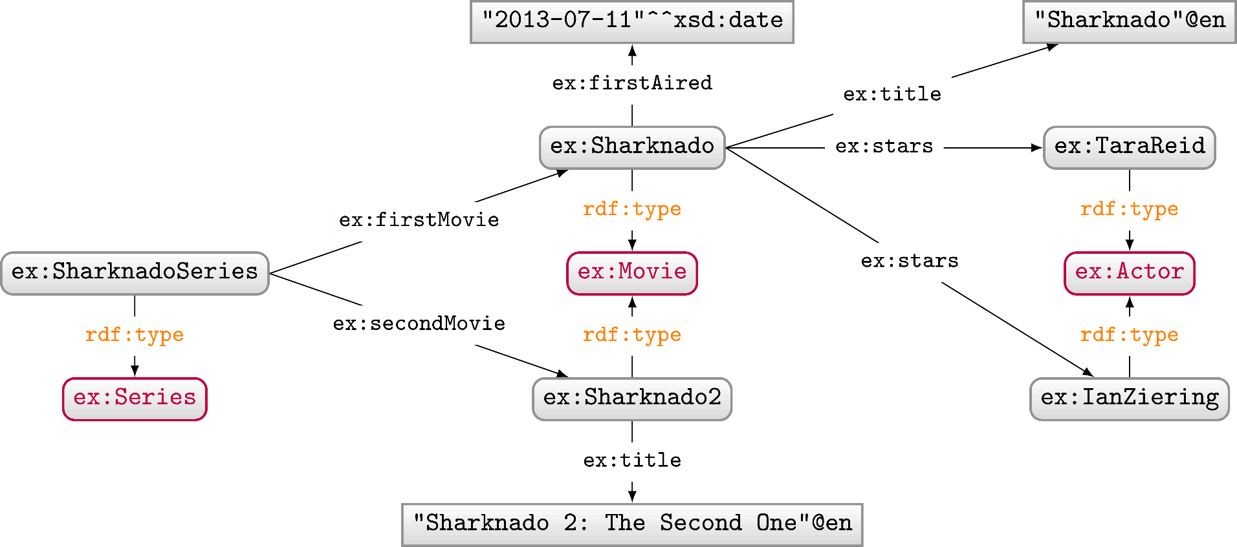
RDF Classes
Used to conceptually group resources
  ex:Movie, ex:Actor, ex:Series, etc.
  Uses predicate rdf:type to type a resource

Slide 7
Today's topic ...

Slide 8
Semantic Web: Logic
* More or less

Slide 9
How to capture logic?
How should we capture logic on the Semantic Web?

Slide 10











Semantic Web Answer: Schema/Ontologies
Instead of rules, we can use RDF!
Define relationships between classes and properties
What sorts of relationships might be useful to define between the following classes and properties?

Slide 11
Class hierarchy
Class c is a sub-class of Class d
  If (x,rdf:type,c) then (x,rdf:type,d),
Example: if ex:CapitalCity sub-class of ex:City
  and if (ex:Dublin,rdf:type,ex:CapitalCity)
  then (ex:Dublin,rdf:type,ex:City)
Which classes would be sub-classes of each other?

Slide 12
Property hierarchy
Property p is a sub-property of q
  If (x,p,y) then (x,q,y)
Example: if ex:hasCapitalCity sub-property of ex:hasCity
  and if (ex:Ireland,ex:hasCapitalCity,ex:Dublin)
  then (ex:Ireland,ex:hasCity,ex:Dublin)
Which properties would be sub-properties of each other?

Slide 13
Domain of properties
Property p has domain class c
  If (x,p,y) then (x,rdf:type,c)
Example: if foaf:familyName has domain foaf:Person
  and if (ex:Aidan,foaf:familyName,"Hogan")
  then (ex:Aidan,rdf:type,foaf:Person)
Which properties would have which classes as domain?

Slide 14
Range of properties
Property p has range class c
  If (x,p,y) then (y,rdf:type,c)
Example: if ex:hasCity has range ex:City
  and if (ex:Ireland,ex:hasCity,ex:Dublin)
  then (ex:Dublin,rdf:type,ex:City)
Which properties would have which classes as range?

Slide 15
Trade-off: More Specific / Less Reusable
More specific → more conclusions
Less specific → more reusable
Example: ex:hasCapitalCity has domain ex:Country
PRO: Know that anything that has a capital city is a country
CON: Cannot use for capitals of states, regions, etc.

Slide 16
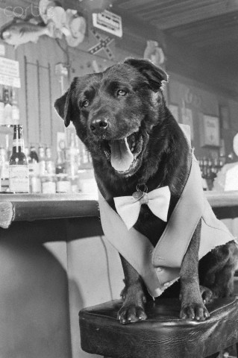
Trade-off: More Specific / Less Reusable
Another example:
  ex:Mayor sub-class of foaf:Person
Bosco the dog
Mayor of Sunol, California
1981–1994
R.I.P.

Slide 17


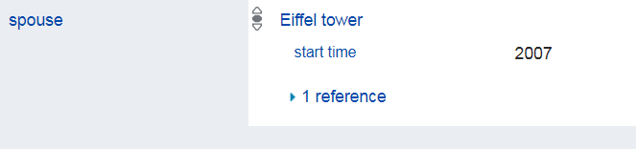
Trade-off: More Specific / Less Reusable
Another example:
  ex:spouse has domain/range foaf:Person
Erika Eiffel
Married Eiffel Tower in 2007
...

Slide 18

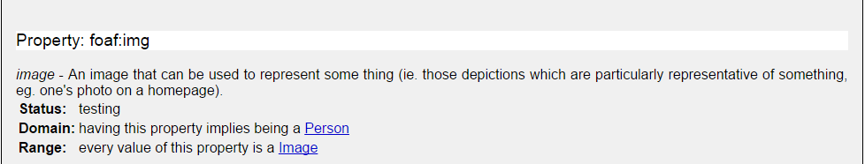
Beware of “hidden” definitions!
Any potential problems here?
(ex:Dublin,foaf:img,ex:Dublin_night.jpg)
Choose names of properties/classes carefully!

Slide 19
RDFS: RDF Schema

Slide 20
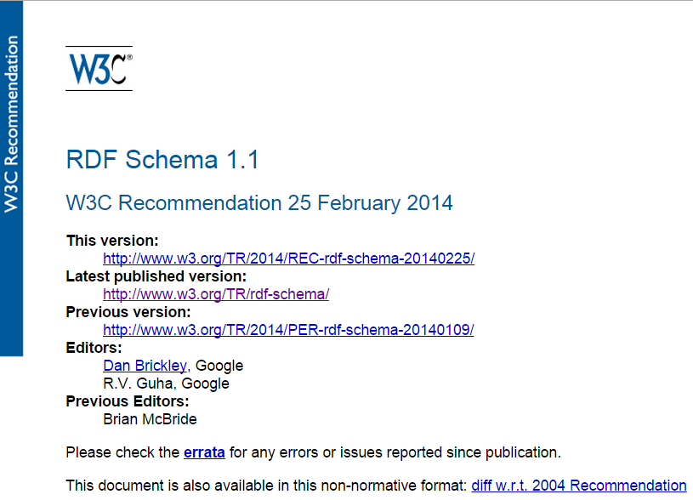
RDFS (1.1): A Web Standard
http://www.w3.org/TR/rdf-schema/

Slide 21
RDFS: Describe “schema” in RDF
@prefix rdfs: <http://www.w3.org/2000/01/rdf-schema#>.
Sub-class
  ex:CapitalCity rdfs:subClassOf ex:City .
Sub-property
  ex:hasCapitalCity rdfs:subPropertyOf ex:hasCity .
Domain
  foaf:familyName rdfs:domain foaf:Person .
Range
  ex:hasCapitalCity rdfs:range ex:CapitalCity .
  foaf:familyName rdfs:range xsd:string .

Slide 22
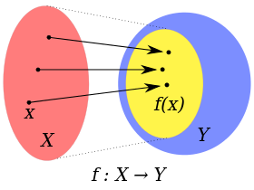
Note: Why called “domain” and “range”?
f : X → Y
X : domain of the function
Y : co-domain of the function
{ f(x) | x ∈ X }: image or range of the function
Any guesses why RDFS calls these "domain" and "range"?

Slide 23
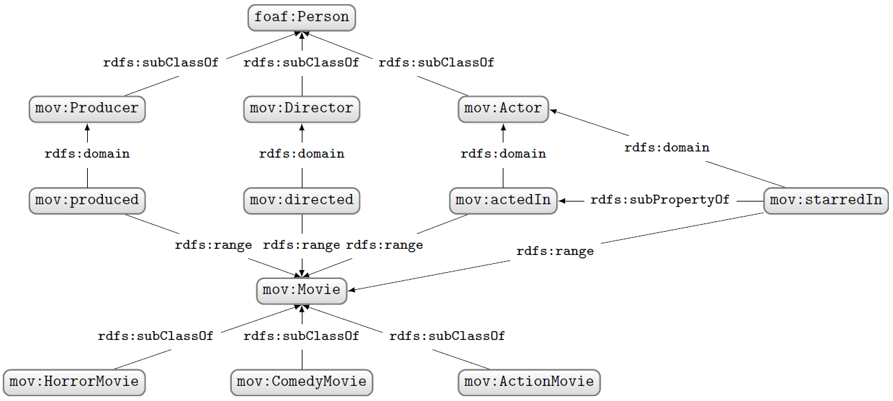
So let’s build an RDF Schema …
Let’s model an RDF Schema for movies, including different types of movies (horror, comedy, action), some different types of people involved (actor, producer, director), and how they are related.
(an example)

Slide 24


But what, e.g., is the domain of … ?

Slide 25

But what, e.g., is the domain of … ?
rdfs:Resource the class of everything!
  Yes, even itself!
    (rdfs:Resource,rdf:type,rdfs:Resource)
(Giving domain/range/sub-class as rdfs:Resource says nothing new!)

Slide 26
Some meta-classes …
rdf:Property: class of all properties
  (ex:hasCity,rdf:type,rdf:Property)
rdfs:Class: class of all classes
  (ex:City,rdf:type,rdfs:Class)

Slide 27

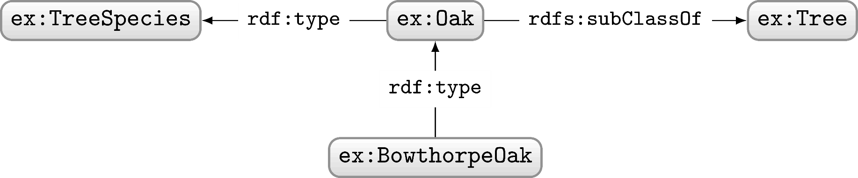
Note: Class or instance?
Would you define ex:Oak ("roble"@es)
as a class or an instance?
Classes can also "act" as instances: no strong distinction
rdf:type is akin to ∈, rdfs:subClassOf is akin to ⊆ *
Which is transitive: rdf:type or rdfs:subClassOf?
rdfs:subClassOf
* Slight but useful simplification for now as classes are not quite sets; we will return to this topic later.

Slide 28
Reasoning with RDFS

Slide 29

What is “Reasoning”?
What general kinds of logical reasoning can we consider?

Slide 30

What is “Reasoning”?
All movie directors are human.
Anthony C. Ferrante is a movie director.
∴ Anthony C. Ferrante must be human.
Deductive Reasoning: Make logical conclusion from rules/premises

Slide 31

What is “Reasoning”?
The first three Sharknado movies were great.
∴ Sharknado 4 will probably be great too.
Inductive Reasoning: Learn approximate rule(s) from premises

Slide 32

What is “Reasoning”?
Fred saw a movie with sharks in tornados.
All Sharknado movies have sharks in tornados.
∴ Fred may have seen a Sharknado movie.
Abductive Reasoning: Guess a premise/explanation

Slide 33
Reasoning: Summary
If (x,rdf:type,ex:SharknadoMovie) then (x,ex:depicts,ex:SharksInTornados)
(ex:ItsAboutTime,rdf:type,ex:SharknadoMovie)
(ex:ItsAboutTime,ex:depicts,ex:SharksInTornados)
Deductive Reasoning: Given (1,2), conclude (3).
Inductive Reasoning: Given (2,3) (and similar such examples), propose (1).
Abductive Reasoning: Given (1,3), propose (2).
???
???

Slide 34
Reasoning: Summary
If (x,rdf:type,ex:SharknadoMovie) then (x,ex:depicts,ex:SharksInTornados)
(ex:ItsAboutTime,rdf:type,ex:SharknadoMovie)
(ex:ItsAboutTime,ex:depicts,ex:SharksInTornados)
Deductive Reasoning: Given (1,2), conclude (3).
Inductive Reasoning: Given (2,3) (and similar such examples), propose (1).
Abductive Reasoning: Given (1,3), propose (2).

Slide 35
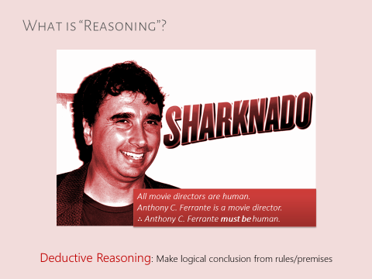
... the only form of reasoning here that is "certain"
RDFS reasoning is deductive ...

Slide 36
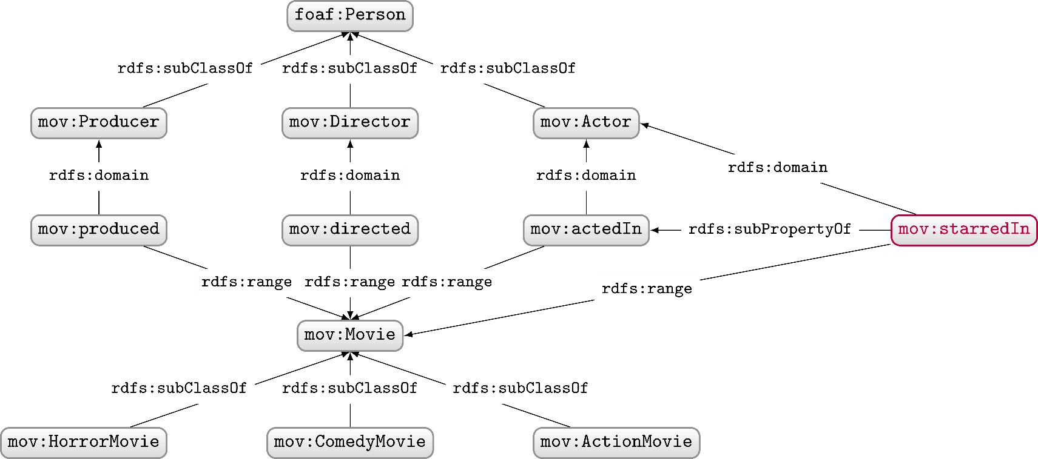
What conclusions can we deduce?
Given the above schema, what can we deduce from ...

Slide 37
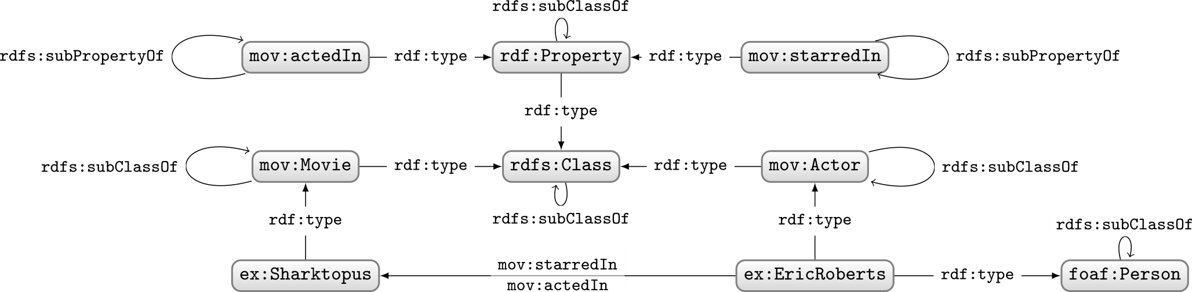
Some of the conclusions …
Not shown (for the sake of my/our sanity):
  Everything is of type rdfs:Resource
  All classes are sub-class of rdfs:Resource
  RDF/RDFS properties are of type rdf:Property

Slide 38

Sharktopus just one movie …

Slide 39
RDFS definitions apply to any movie ...
Given the above schema, what can we deduce from ...

Slide 40
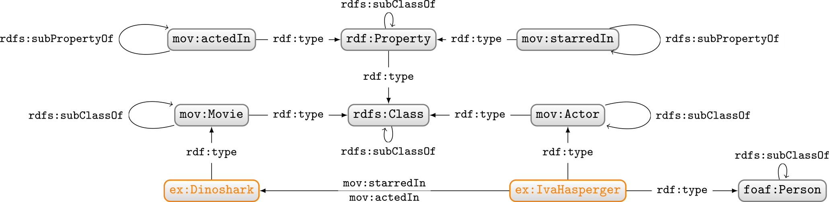
RDFS definitions apply to any movie ...
Not shown (for the sake of my/our sanity):
  Everything is of type rdfs:Resource
  All classes are sub-class of rdfs:Resource
  RDF/RDFS properties are of type rdf:Property

Slide 41
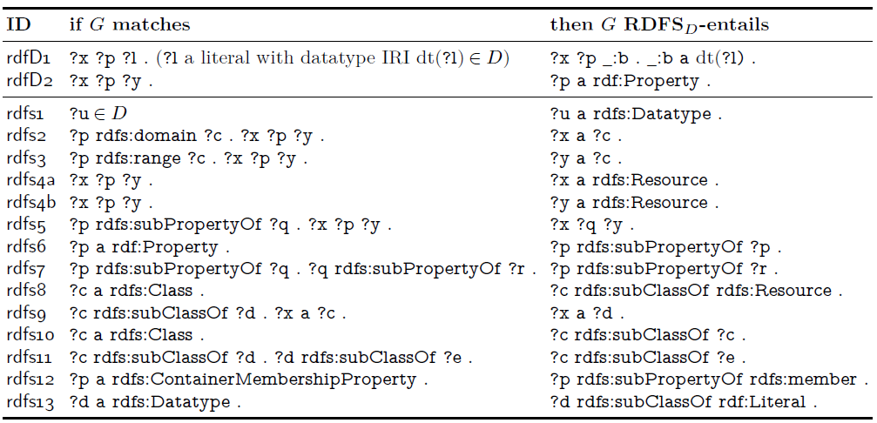
Apply RDFS reasoning using “rules”
???
???
???
(Don’t worry about rdfD1, rdfs1, rdfs12, rdfs13)

Slide 42
Apply RDFS reasoning using “rules”
(Don’t worry about rdfD1, rdfs1, rdfs12, rdfs13)

Slide 43
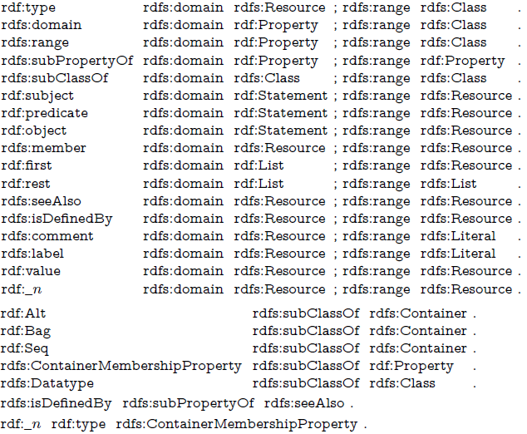
Axiomatic triples: Always true in RDFS
(Don’t worry about greyed-out triples)

Slide 44
Reasoning in RDFS over RDF graph G
Add axiomatic triples to G
Apply rules exhaustively, adding conclusions to G, until nothing new found
Will this always finish? Or can it run forever?
So long as we do not “invent” new terms, and axiomatic triples are finite, the process must end once G has all possible combinations of terms as triples (or before).

Slide 45
Semantic Web: Logic
* More or less

Slide 46
RDFS (1.1): A Web Standard
http://www.w3.org/TR/rdf-schema/

Slide 47






Questions?

