Slide 1
CC7220-1
La Web de Datos
Primavera 2025
Lecture 2: RDF Model and Syntax
Aidan Hogan
aidhog@gmail.com

Slide 2





The “Semantic Web”

Slide 3







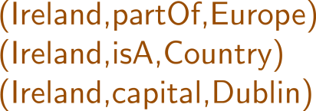



Semantic Web: Data, Logic, Query
* More or less

Slide 4
RDF:
Resource Description Framework

Slide 5
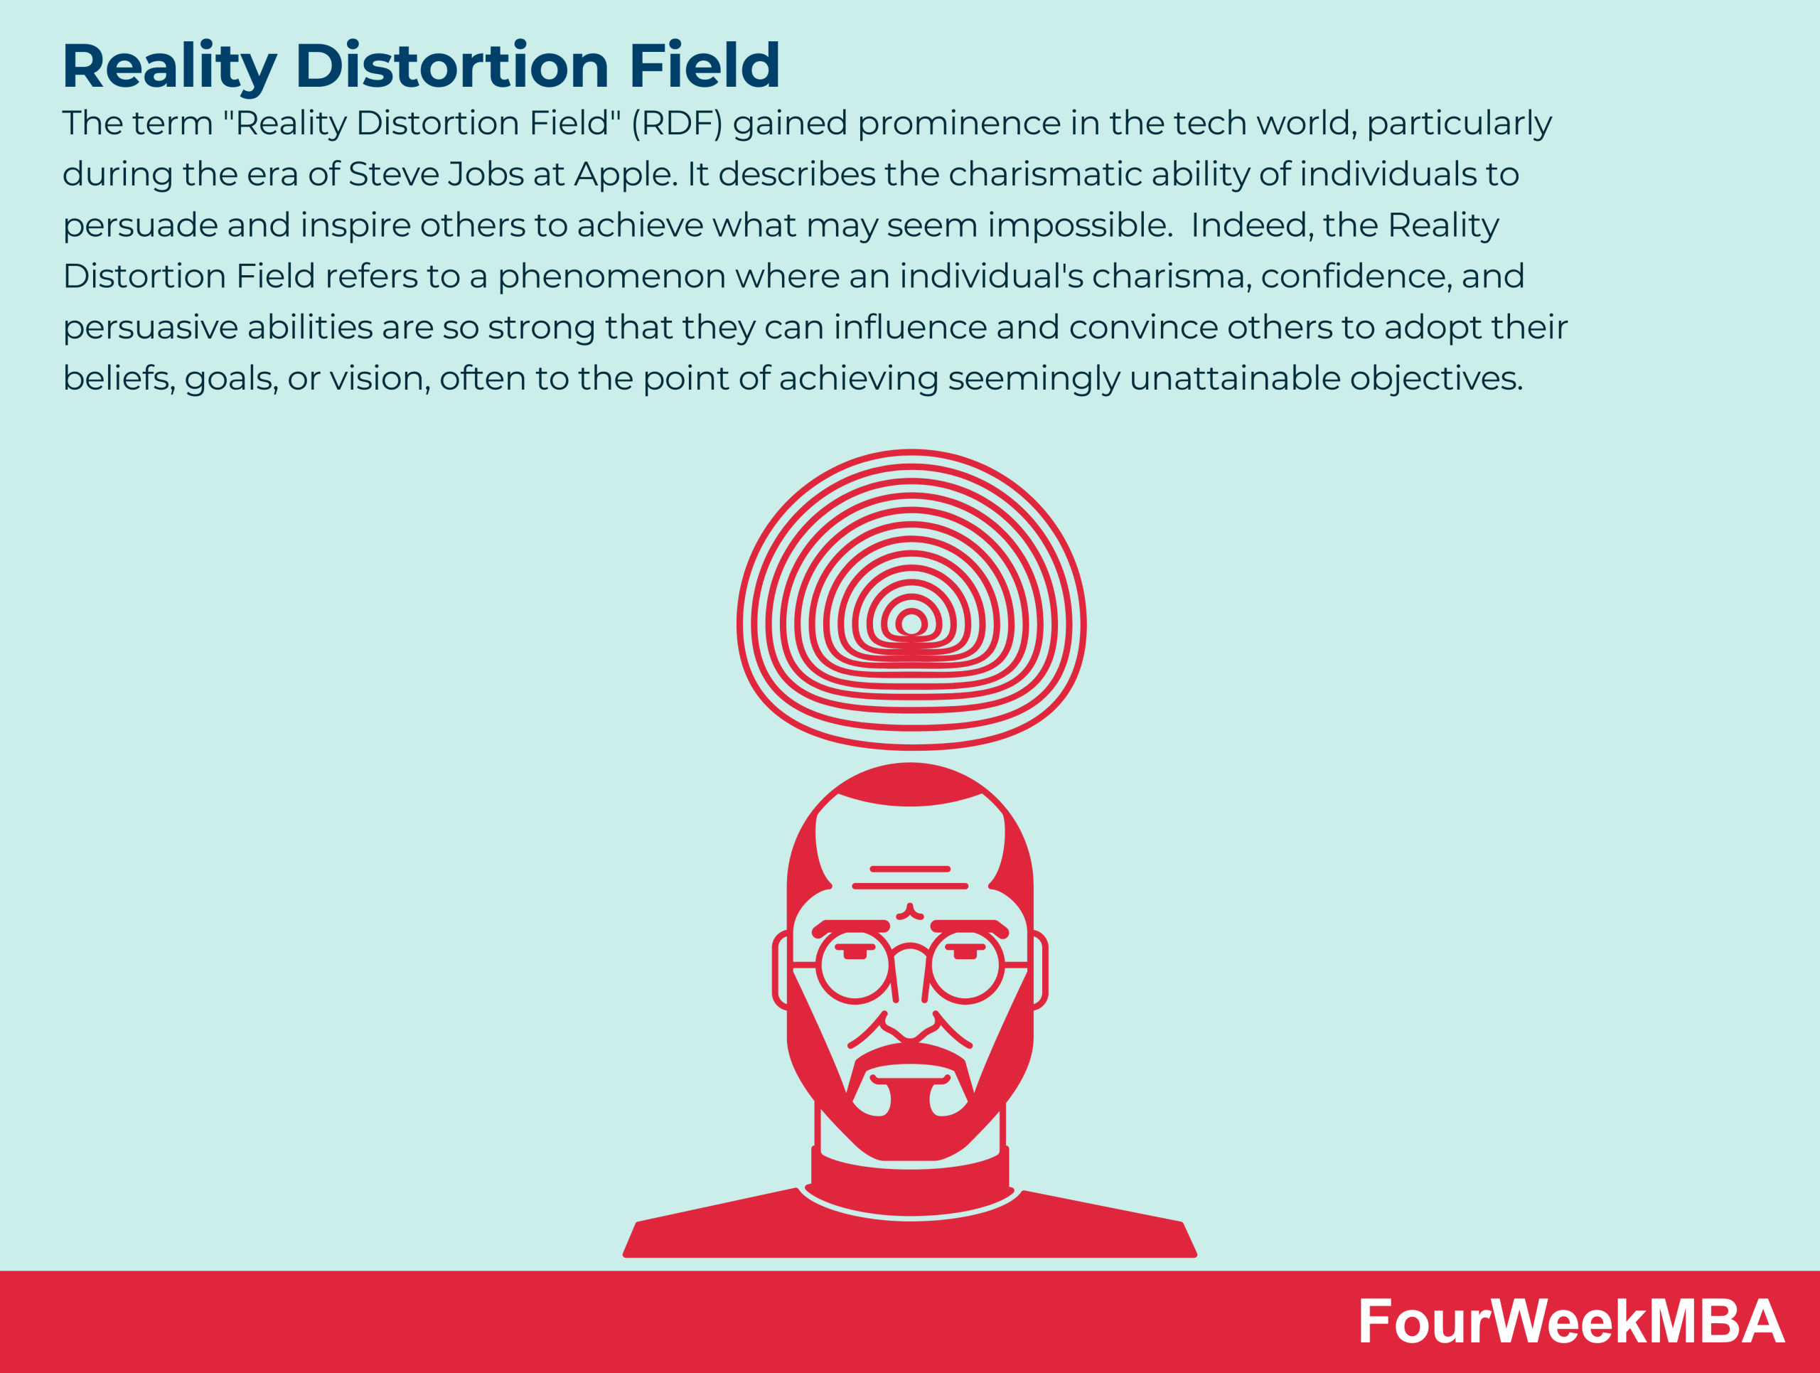

RDF
Source: https://fourweekmba.com/reality-distortion-field/

Slide 6
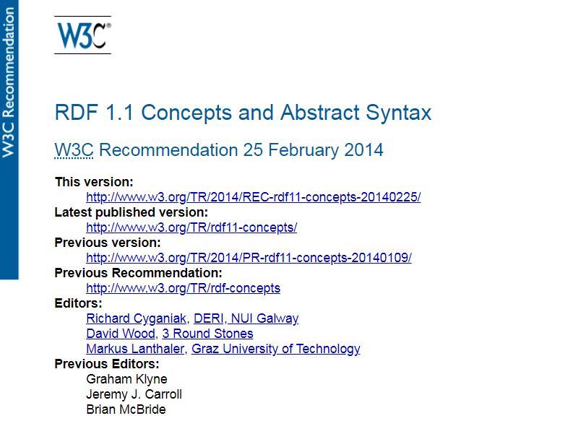
RDF (1.1): A Web Standard

Slide 7
Semantic Web: Data
* More or less

Slide 8

Semantic Web: Data

Slide 9
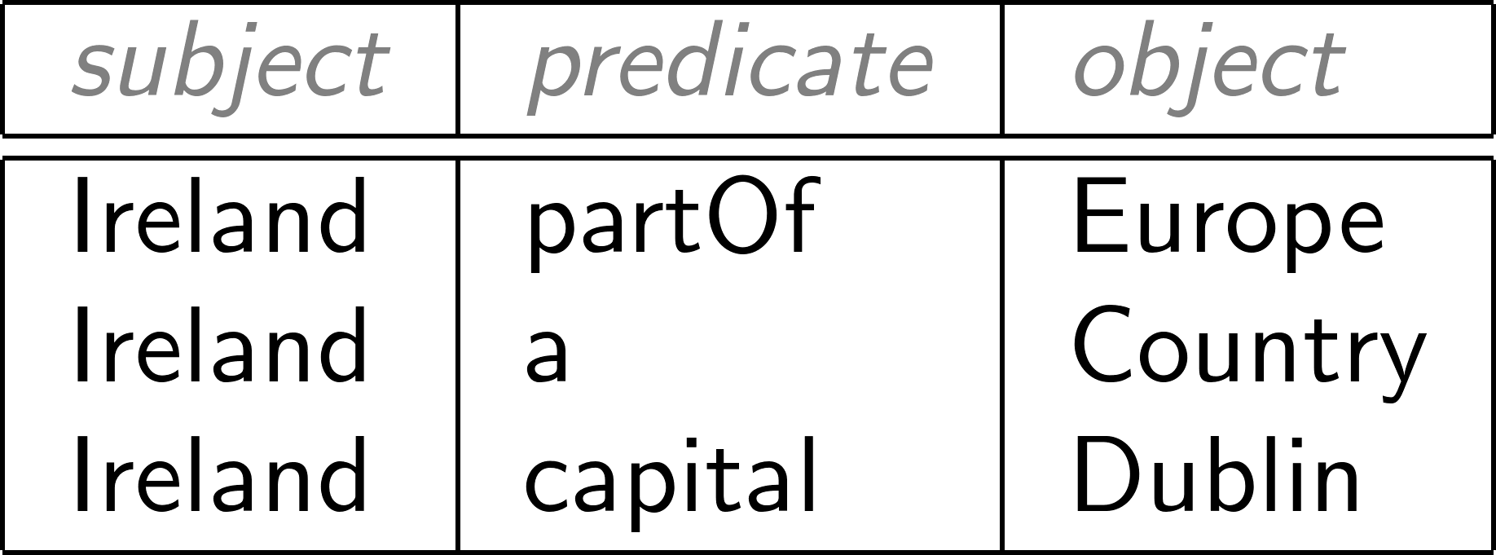
Modelling the world with triples

Slide 10
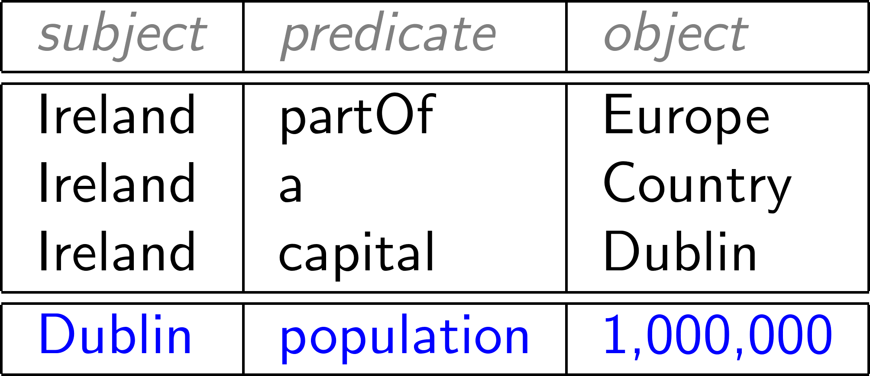
Concatenate to “integrate” new data

Slide 11

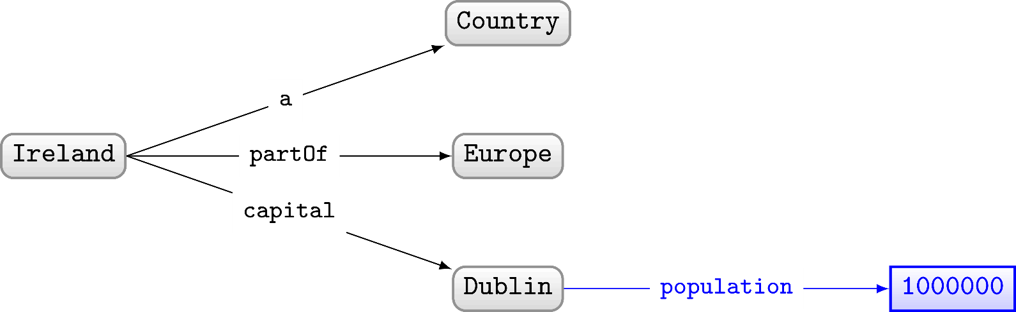
RDF often drawn as a (directed, labelled) graph

Slide 12
Set of triples thus called an “RDF Graph”

Slide 13
But why triples?

Slide 14
But why triples?
Why not pairs?

Slide 15
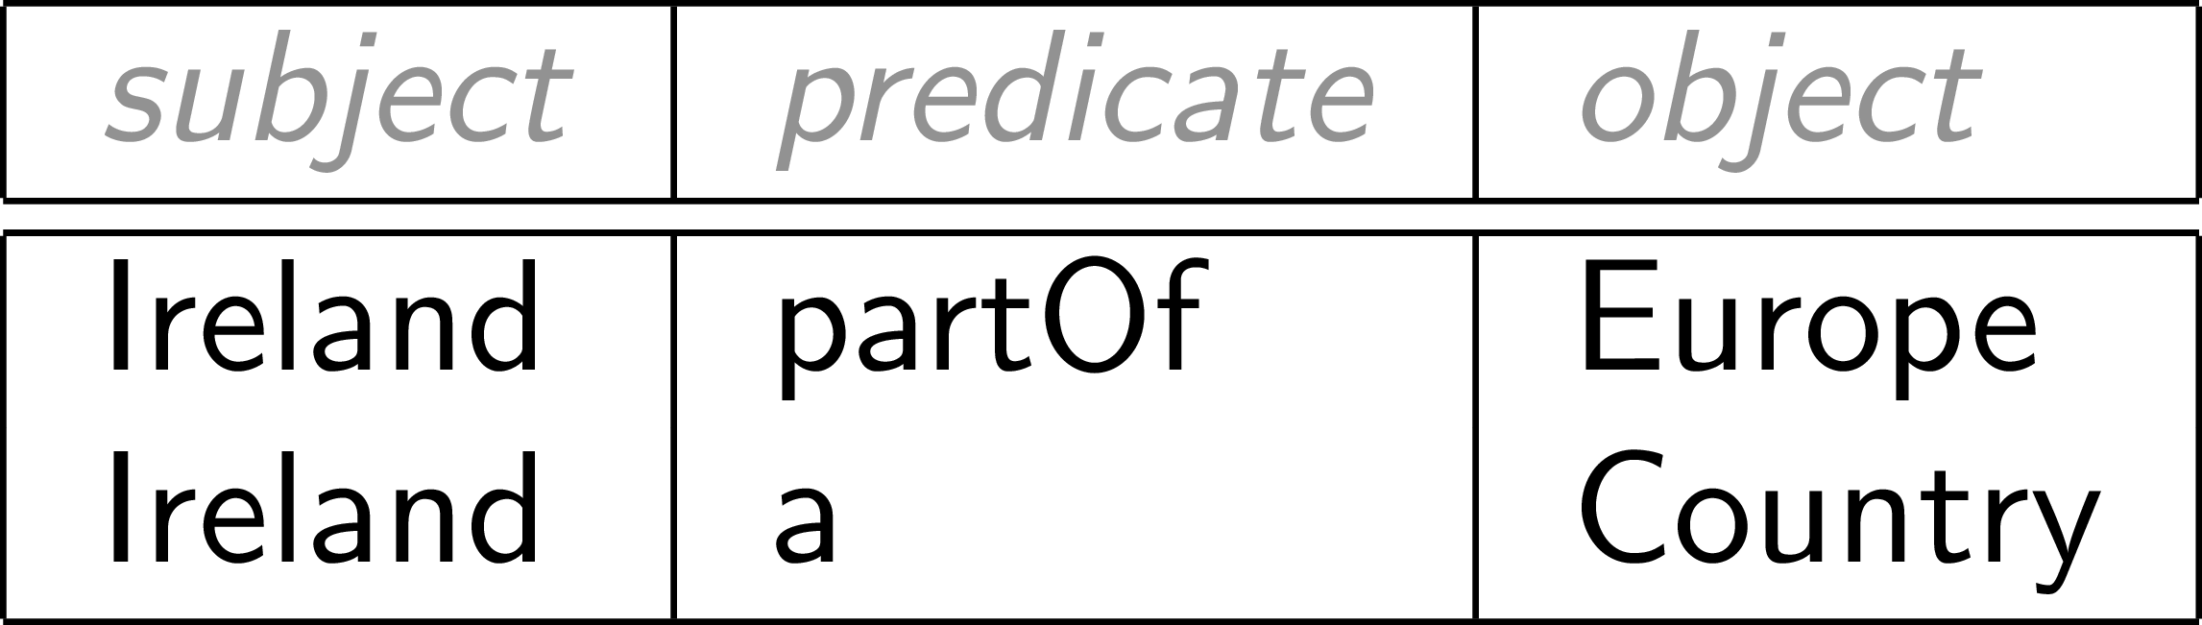
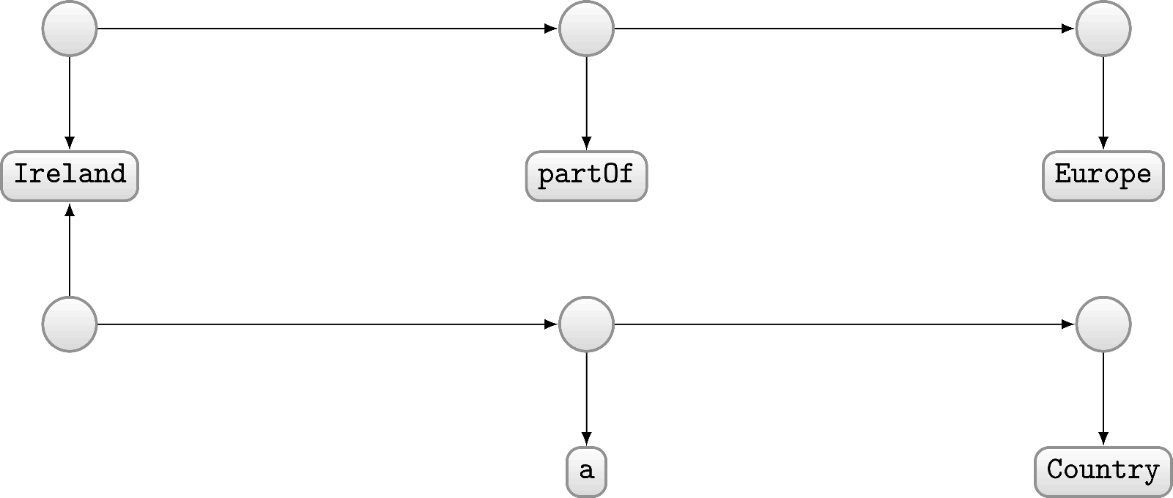

Modelling with pairs (directed unlabelled graph)?
Modelled as pairs?

Slide 16
But why graphs?
Why not (e.g.) tables?

Slide 17
Graphs are flexible

Slide 18
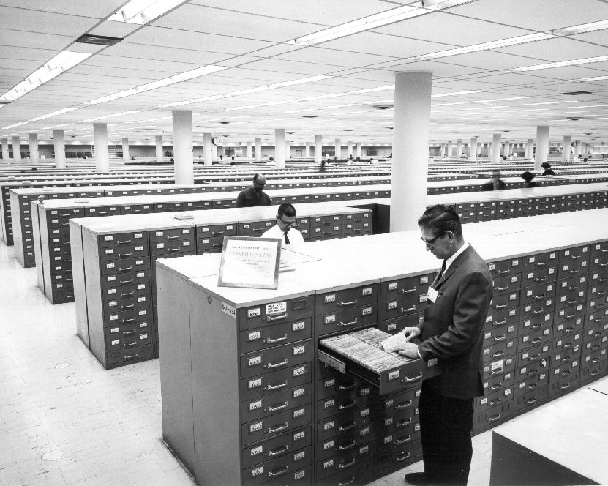
Relational Databases …

Slide 19
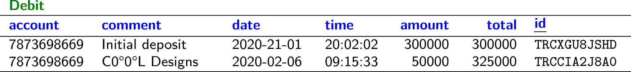
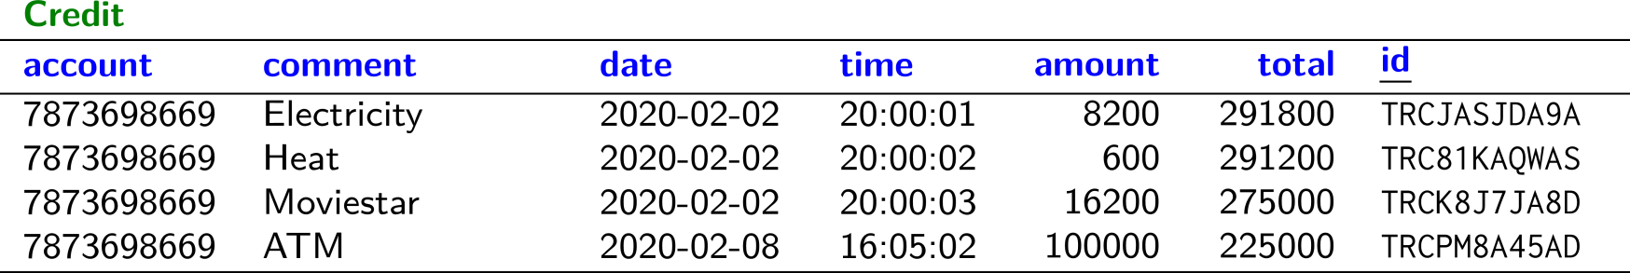
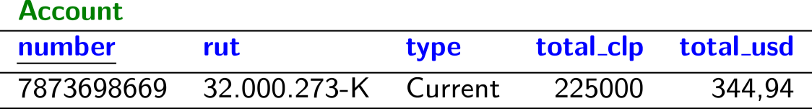
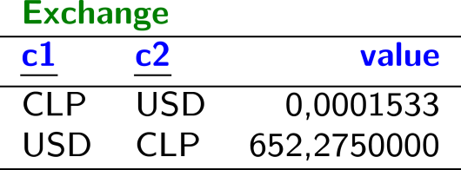
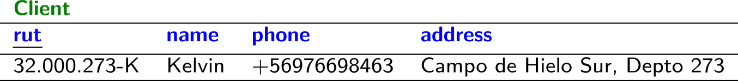
Relational Databases …

Slide 20

Planets / Relational Data

Slide 21
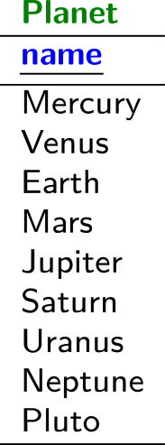
Planets / Relational Data

Slide 22
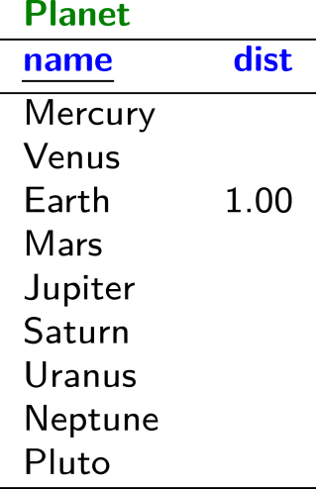
Planets / Relational Data

Slide 23

Planets / Relational Data

Slide 24
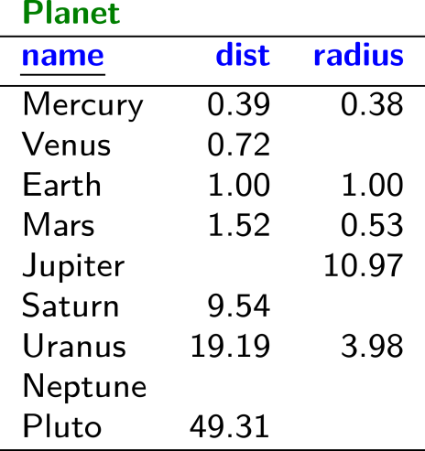
Planets / Relational Data

Slide 25
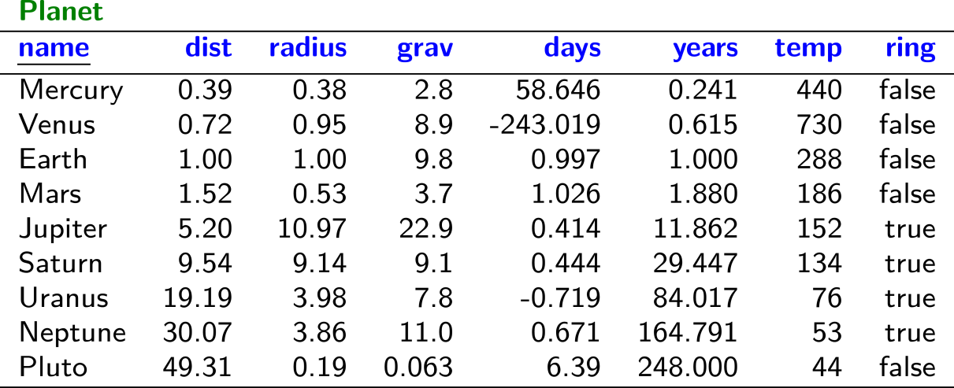
Planets / Relational Data

Slide 26
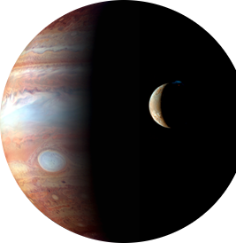

Planets / Relational Data

Slide 27
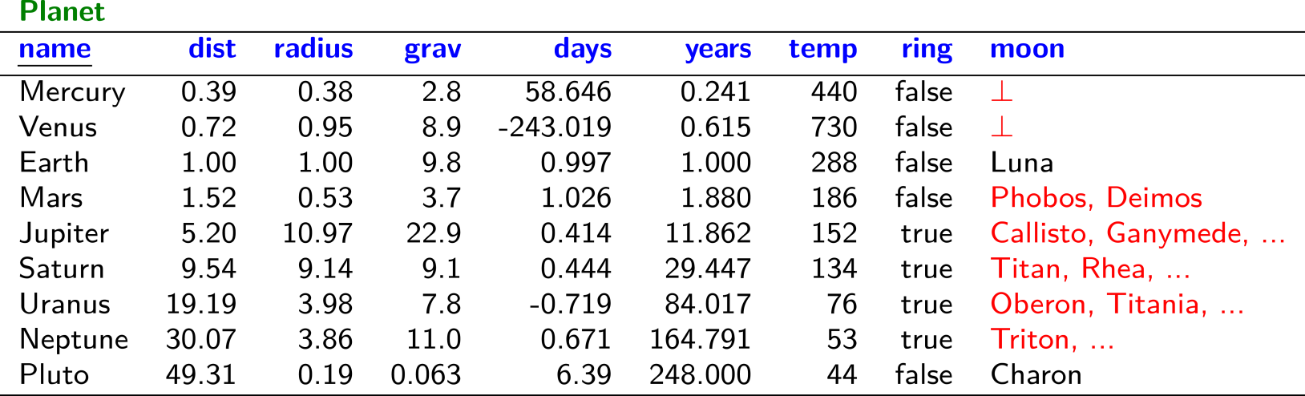
Planets / Relational Data

Slide 28
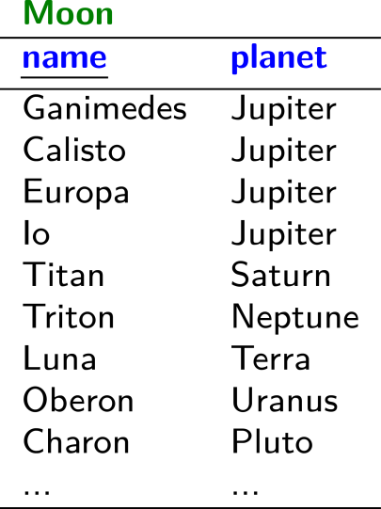
Planets / Relational Data

Slide 29
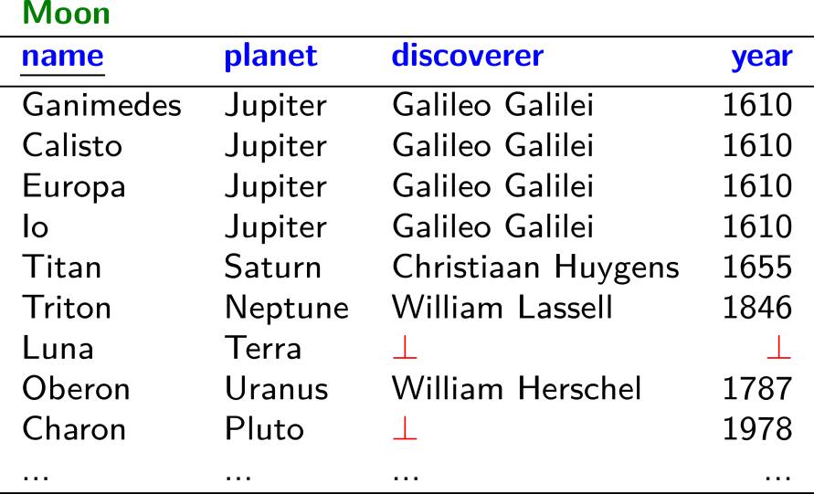
Planets / Relational Data

Slide 30
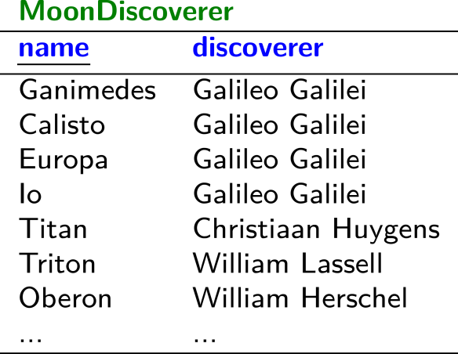
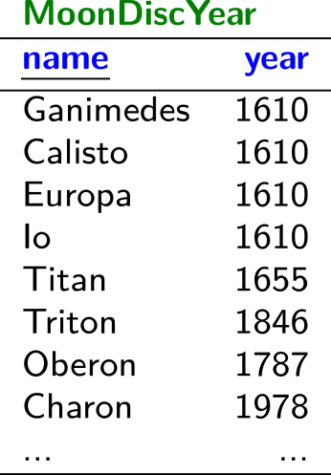
Planets / Relational Data

Slide 31
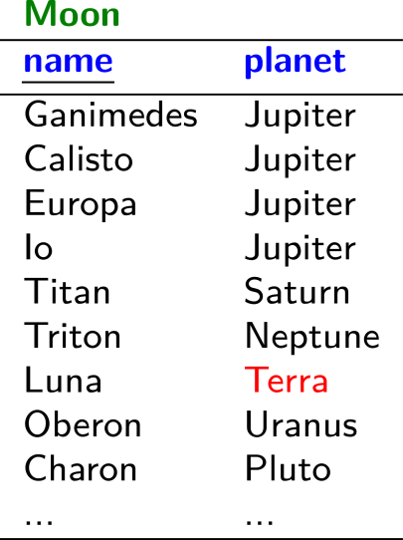
Planets / Relational Data

Slide 32

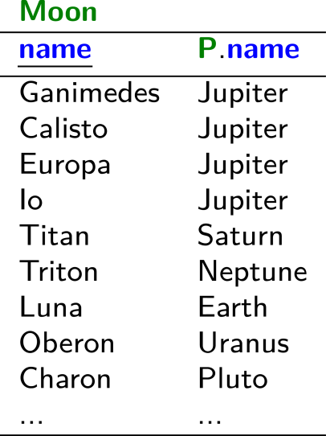
Planets / Relational Data

Slide 33
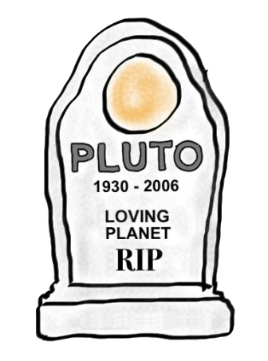
Planets / Relational Data

Slide 34
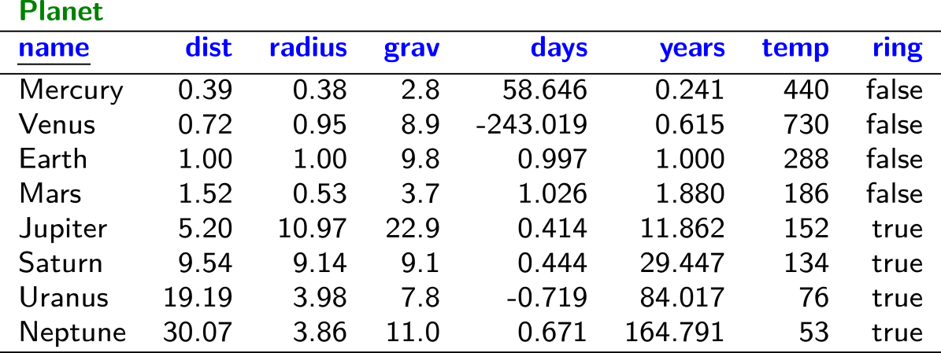
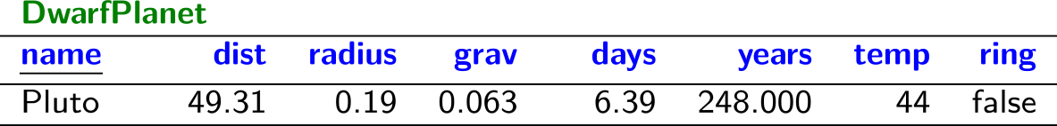
Planets / Relational Data

Slide 35
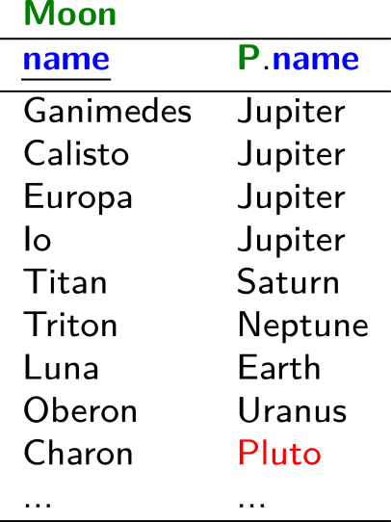
Planets / Relational Data

Slide 36
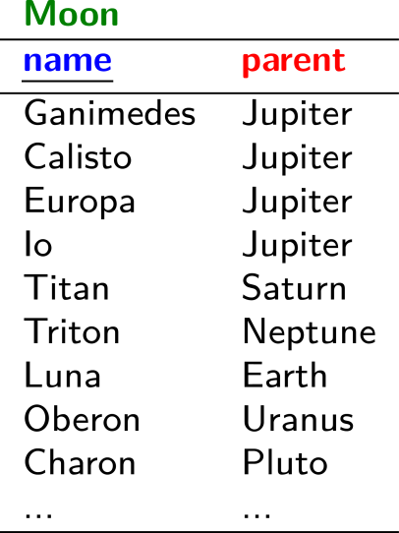
Planets / Relational Data

Slide 37

Planets / Relational Data

Slide 38
Planets / Relational Data
(╯°□°)╯︵ ┻━┻

Slide 39
Planets / Graph Data

Slide 40

Planets / Graph Data

Slide 41
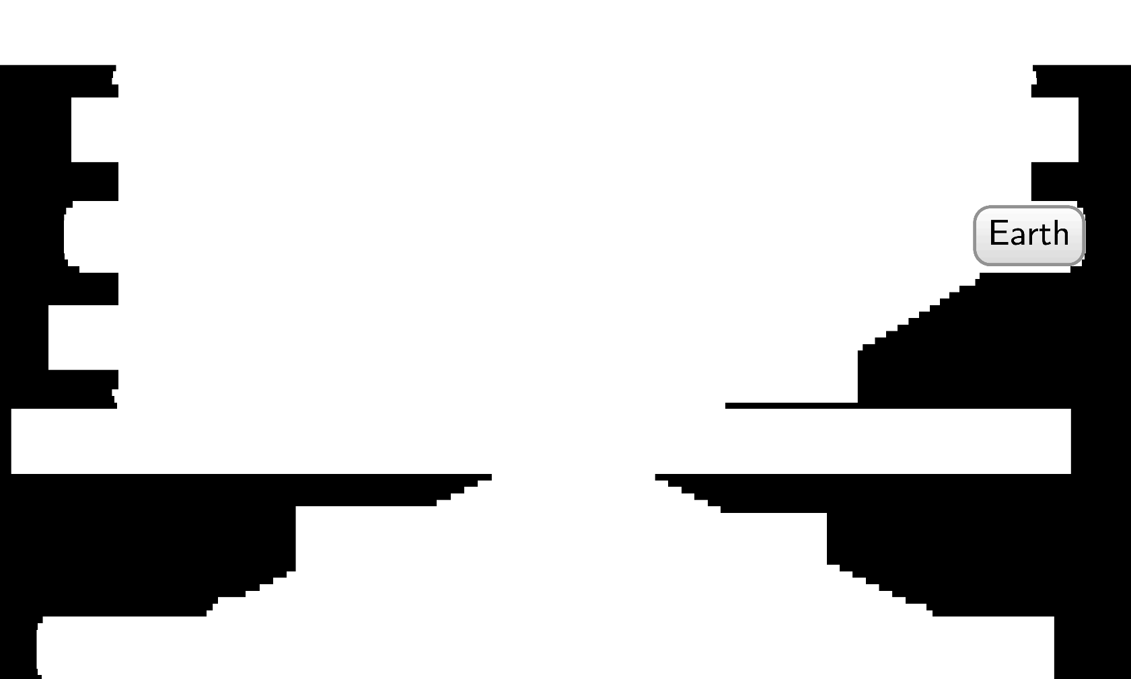
Planets / Graph Data

Slide 42

Planets / Graph Data

Slide 43
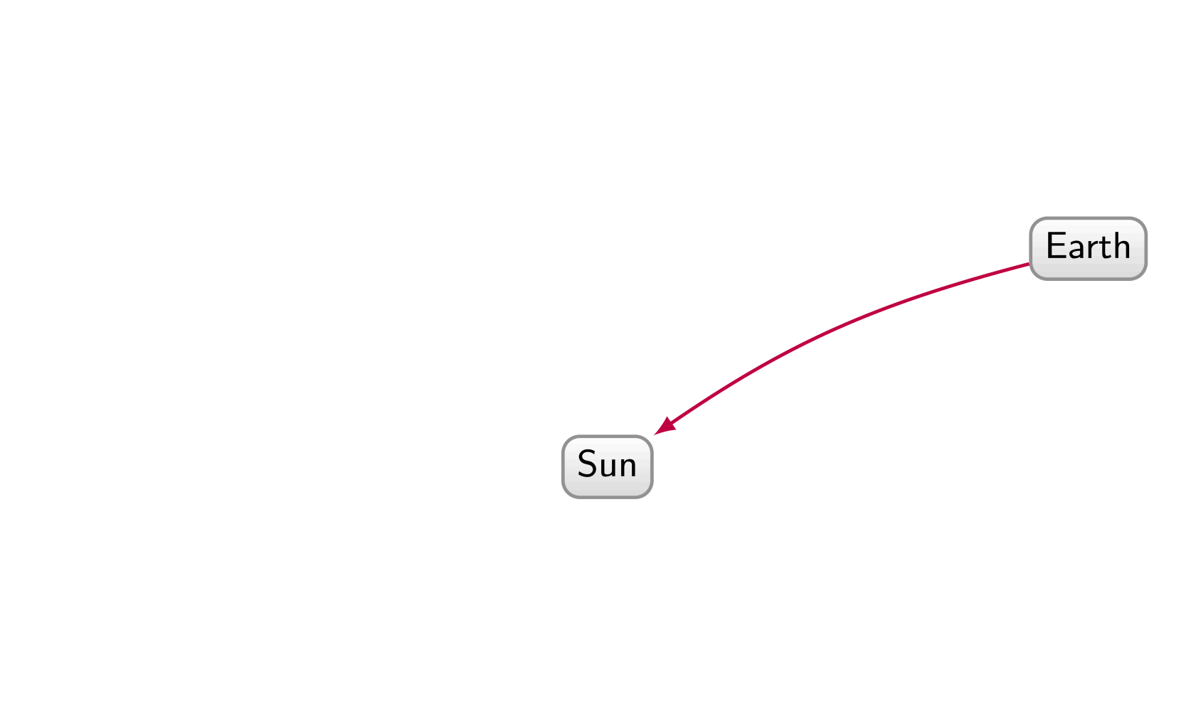
Planets / Graph Data

Slide 44
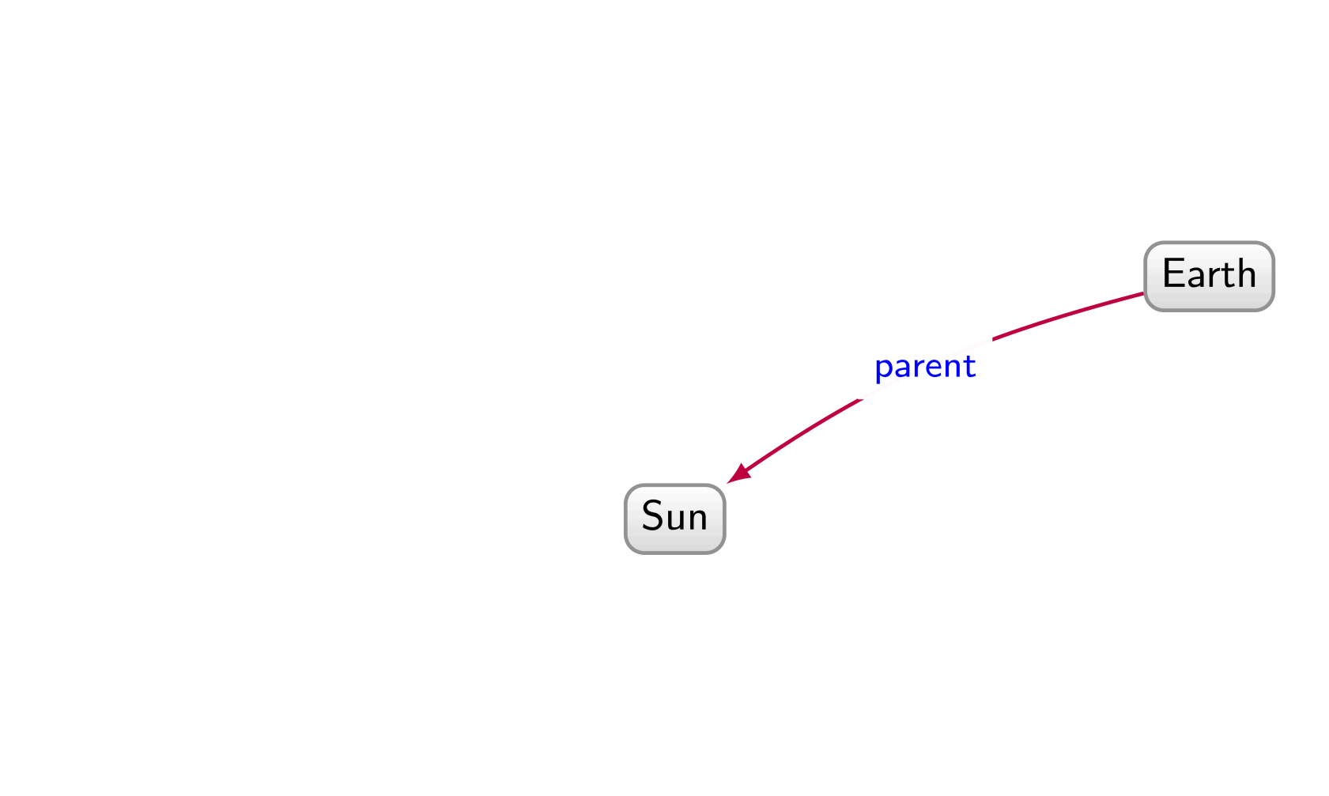
Planets / Graph Data

Slide 45
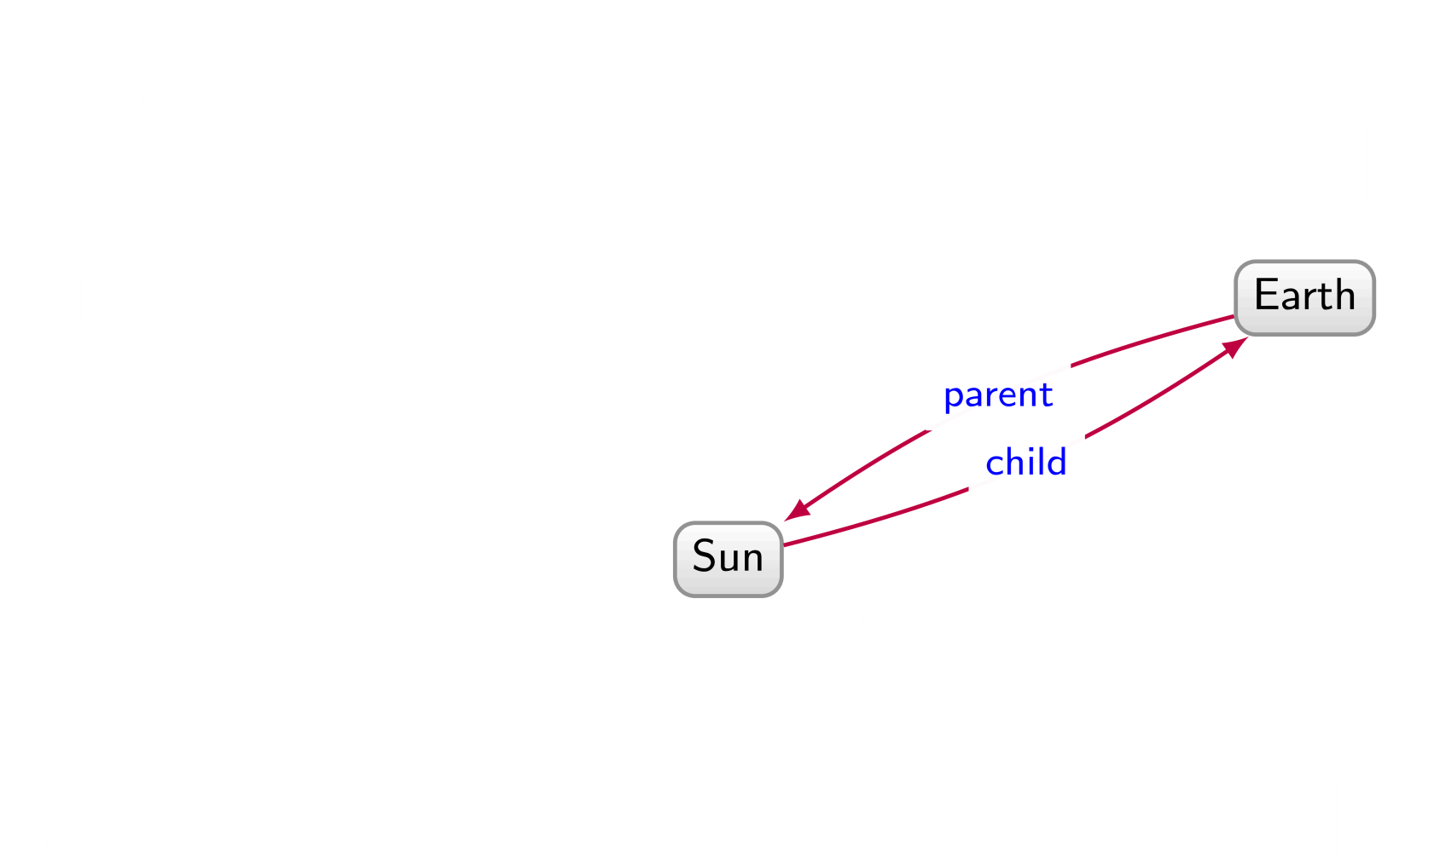
Planets / Graph Data

Slide 46
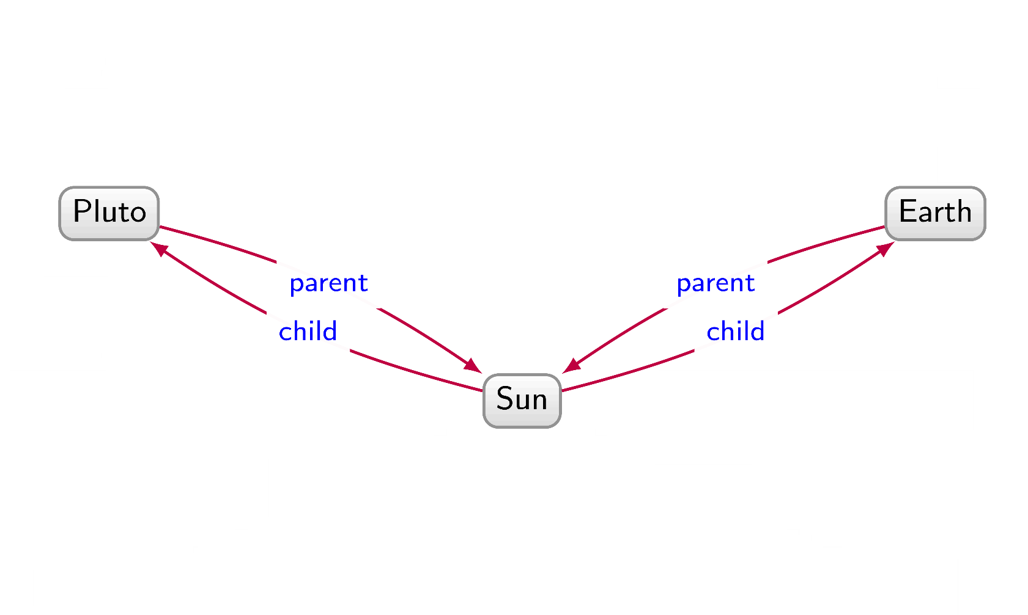
Planets / Graph Data

Slide 47
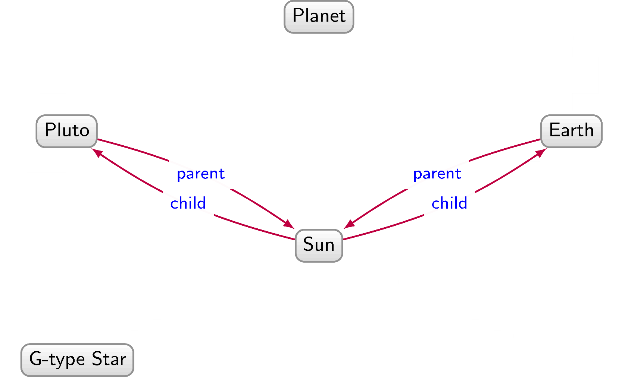
Planets / Graph Data

Slide 48
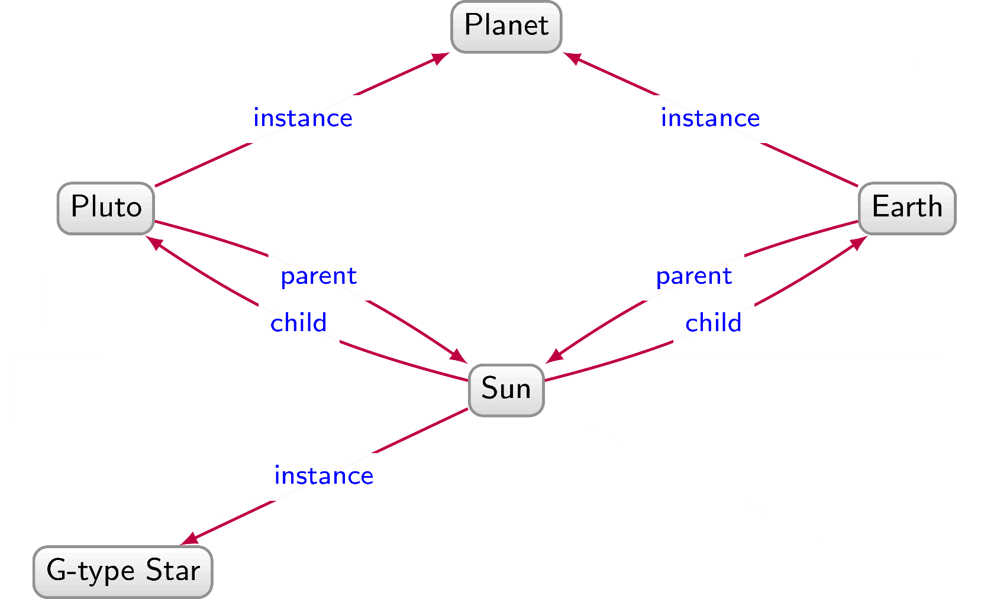
Planets / Graph Data

Slide 49
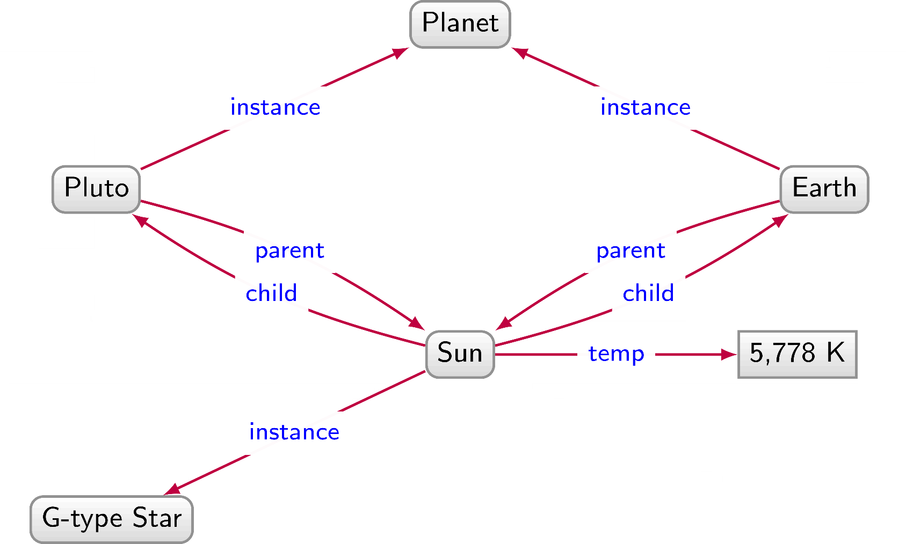
Planets / Graph Data

Slide 50
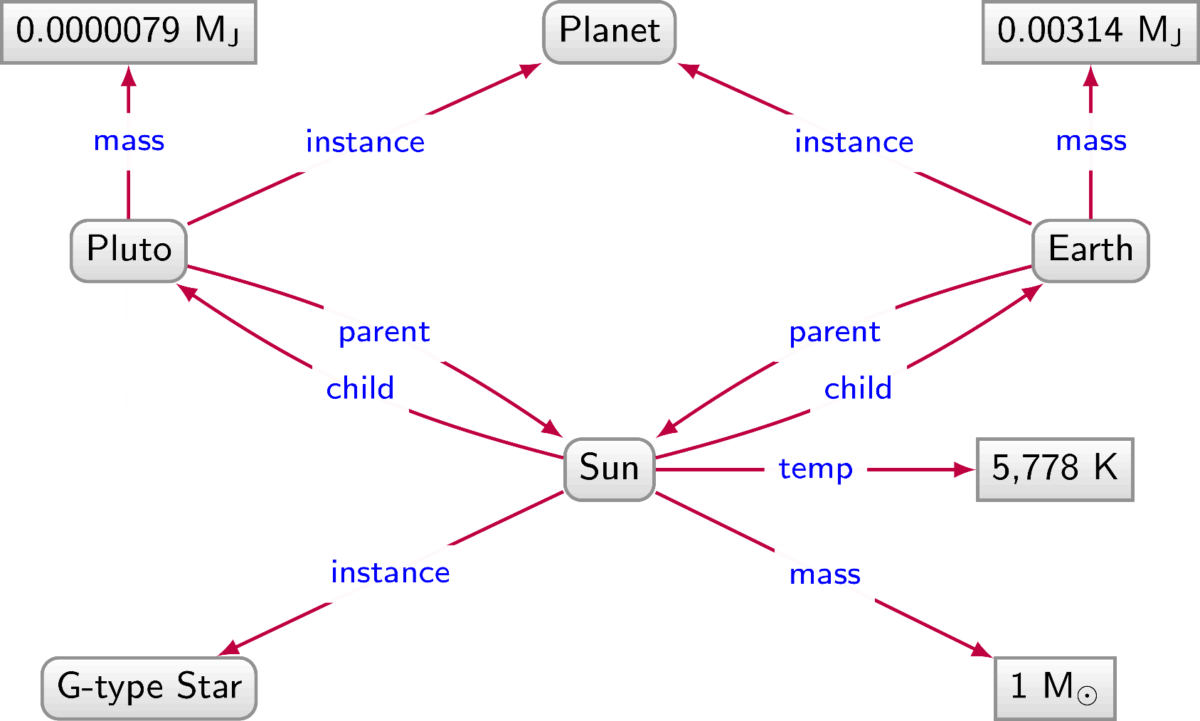
Planets / Graph Data

Slide 51
Planets / Graph Data

Slide 52
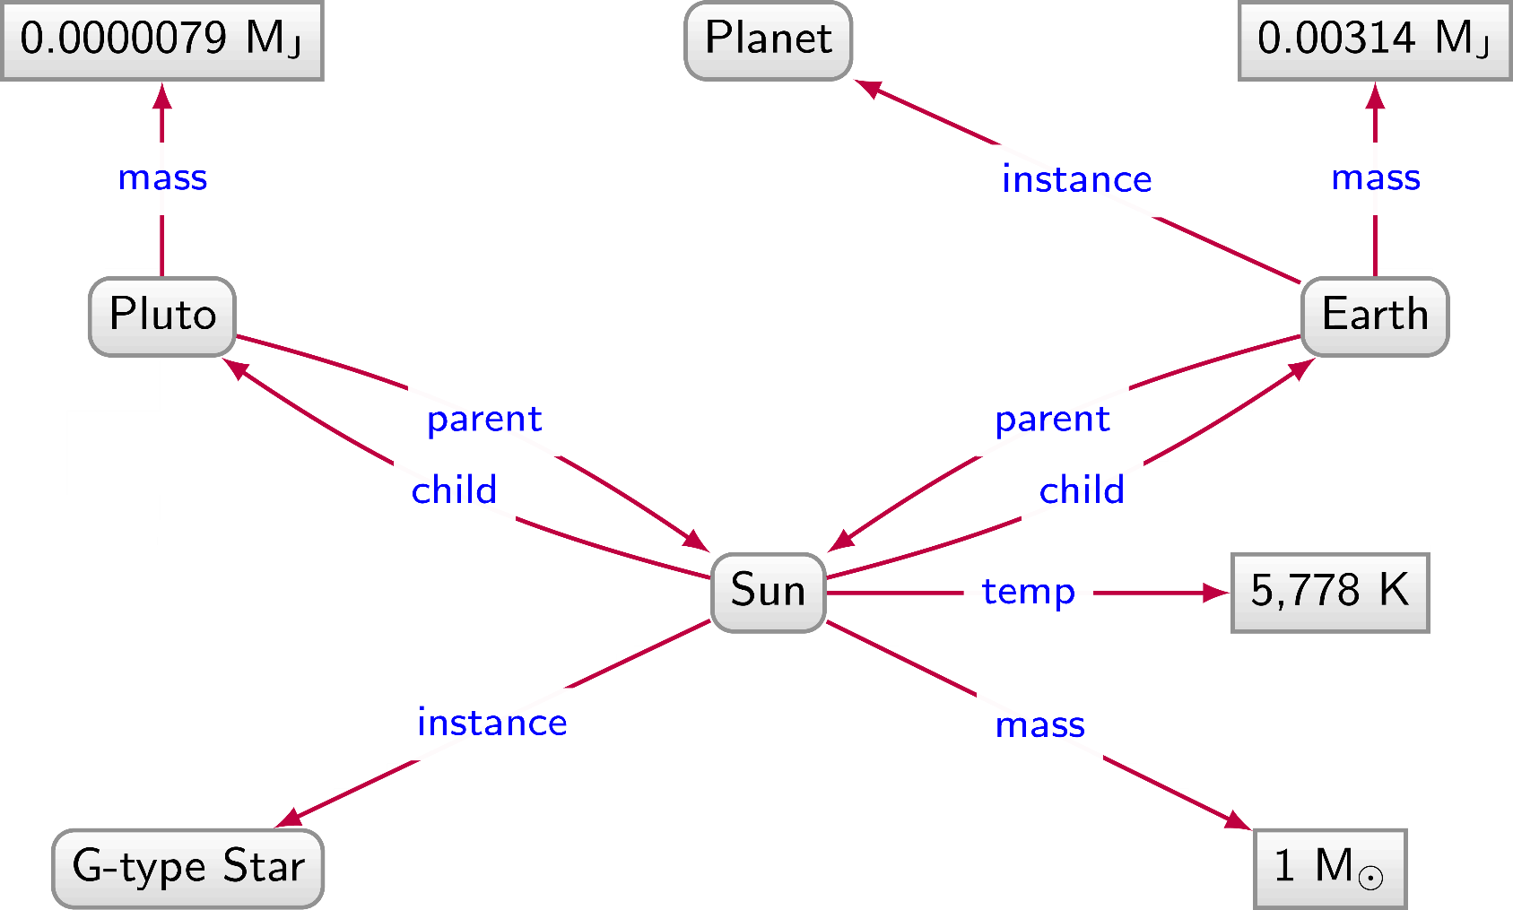
Planets / Graph Data

Slide 53
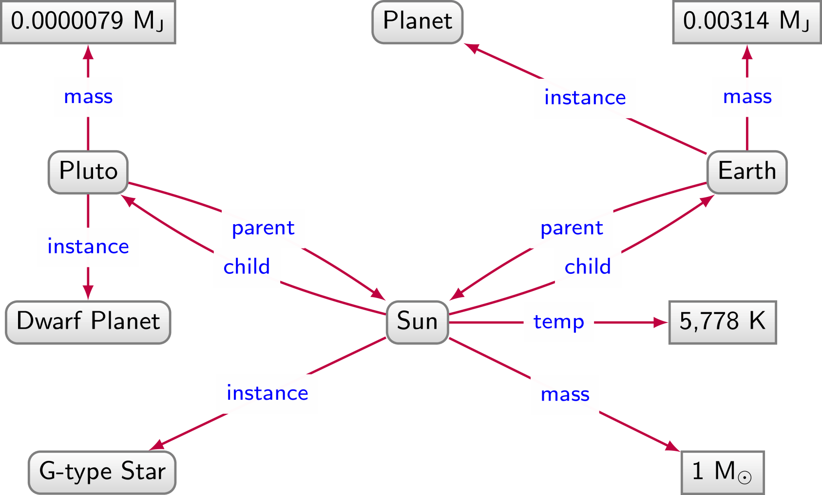
Planets / Graph Data

Slide 54
Planets / Graph Data

Slide 55
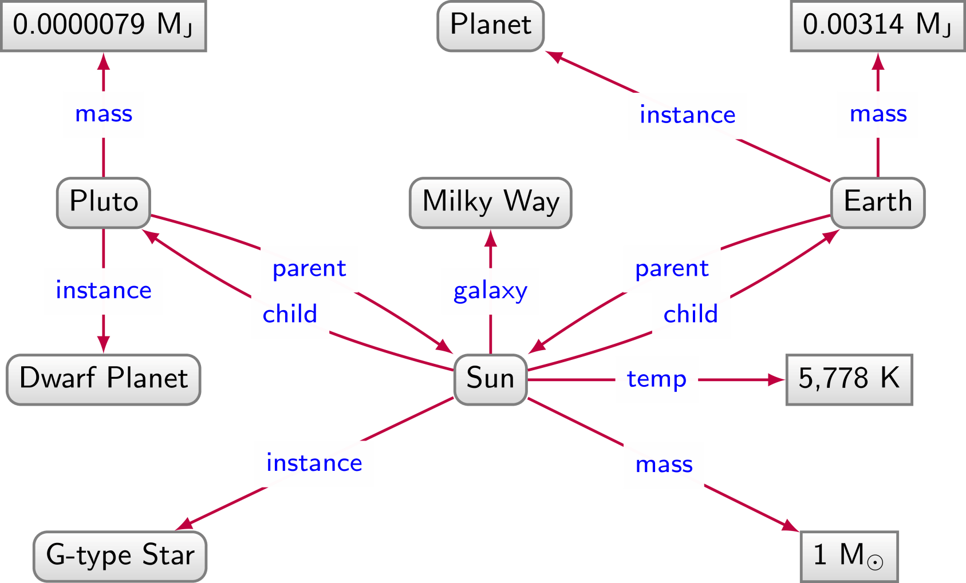
Planets / Graph Data

Slide 56
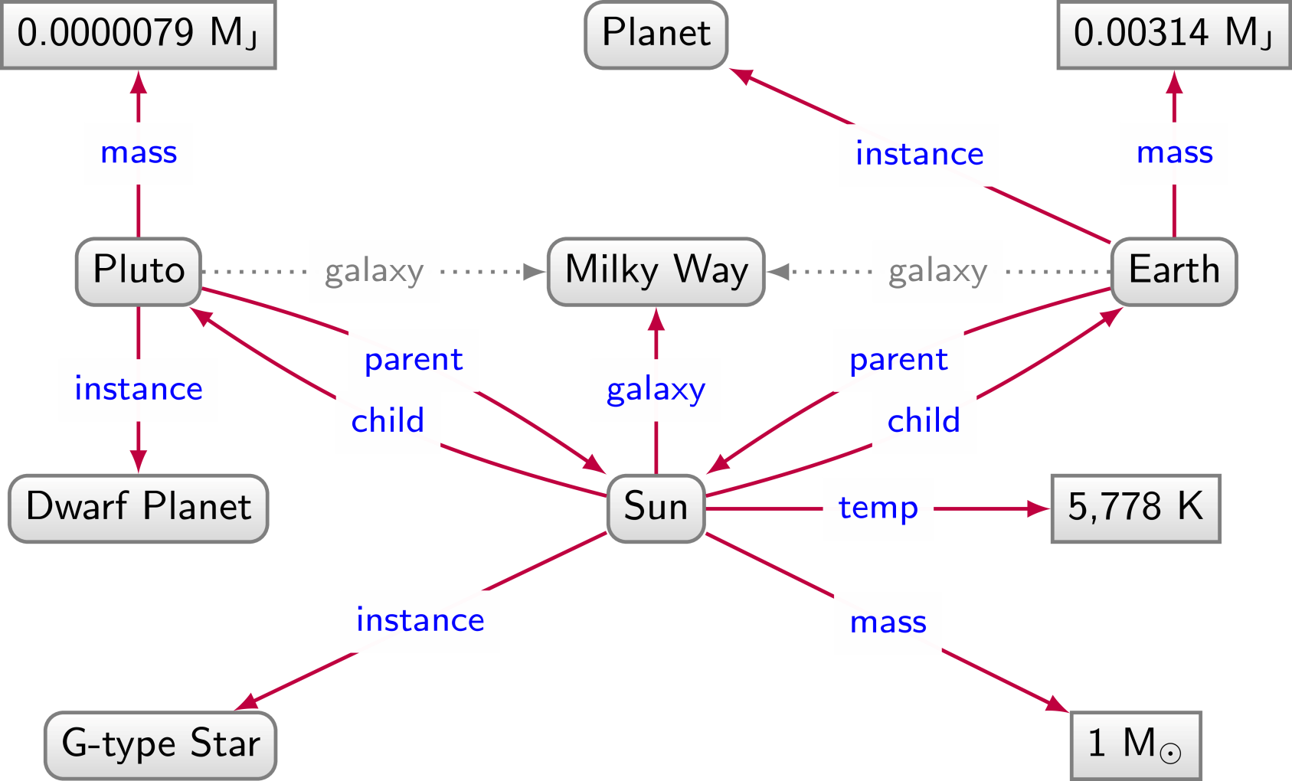
Planets / Graph Data

Slide 57
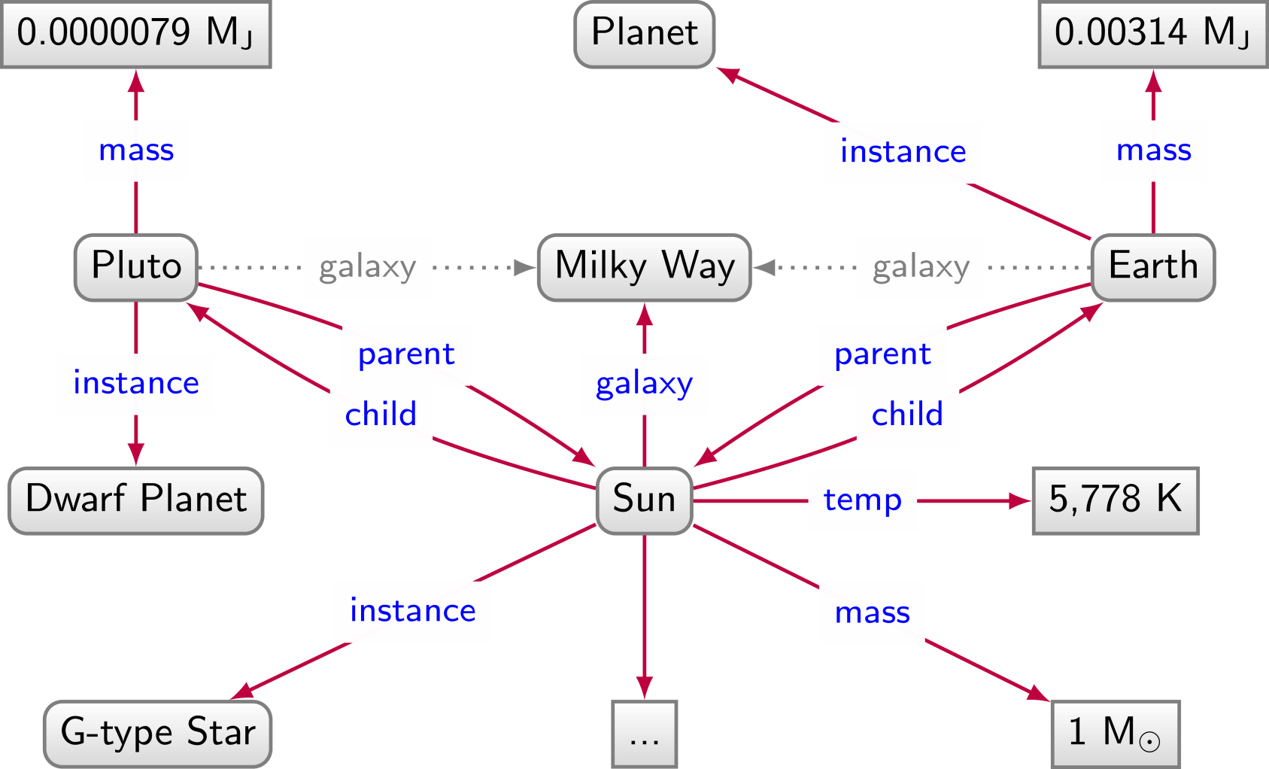
Planets / Graph Data

Slide 58


Relational data: Pros and Cons
We have to impose a
structure (schema)
from the start
We have a
structure (schema) imposed from the start

Slide 59
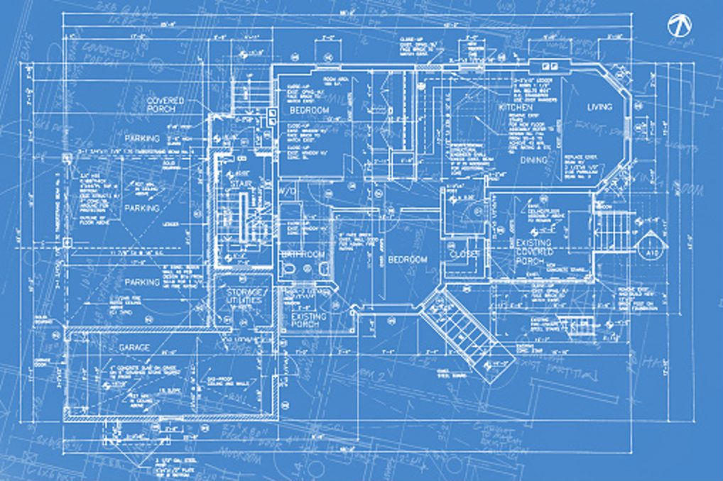

Slide 60
Graph Data: Pros and Cons
We don't have to impose a
structure (schema)
from the start
We don't have a
structure (schema) imposed from the start

Slide 61
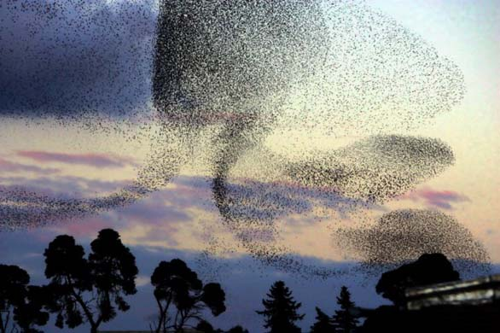

Slide 62
Naming things

Slide 63
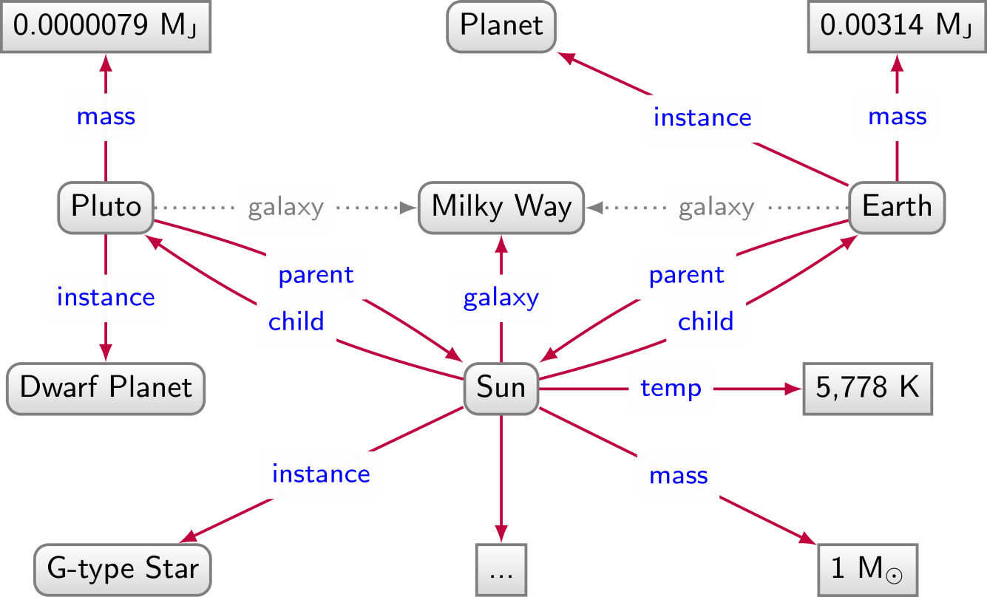

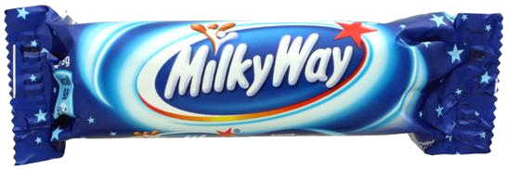
Naming things: Strings not enough

Slide 64
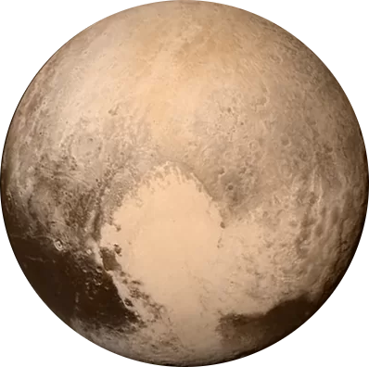

Naming things: Strings not enough

Slide 65

Naming things: Strings not enough

Slide 66
Naming things: Strings not enough

Slide 67


Naming things: Strings not enough

Slide 68
Naming things in RDF: IRIs

Slide 69
Need unambiguous symbols/identifiers
Since we’re on the Web … use Web identifiers
URL: Uniform Resource Location
  The location of a resource on the Web
  http://ex.org/Dubl%C3%ADn.html
URI: Uniform Resource Identifier (RDF 1.0)
  Need not be a location, can also be a name
  http://ex.org/Dubl%C3%ADn
IRI: Internationalised Resource Identifier (RDF 1.1)
  A URI that allows Unicode characters
  http://ex.org/Dublín

Slide 70

We will use IRIs with prefixes
  http://ex.org/Dublín ↔ ex:Dublín
    “ex:” denotes a prefix for http://ex.org/
    “Dublín” is the local name
Frequently used prefixes:

Slide 71

From strings …

Slide 72


… to IRIs …

Slide 73
Naming things in RDF: Literals

Slide 74
What about numbers?
Should we assign IRIs to numbers, booleans, etc.?

Slide 75



RDF allows “literals” in object position
Literals are for datatype values, like strings, numbers, booleans, dates, times
Only allowed in object position

Slide 76
Datatype literals
"[lexical-string]"^^[datatype-IRI]
  "200"^^xsd:int
  "2014-12-13"^^xsd:date
  "true"^^xsd:boolean
  "this is a string"^^xsd:string
If the datatype is omitted, it’s a string
  "this is a string"
  "200" is a string, not a number!

Slide 77

Many datatypes borrowed from XML Schema

Slide 78


Slide 79


Boolean datatype

Slide 80


Numeric datatypes

Slide 81


Temporal datatypes

Slide 82


Text/string datatypes

Slide 83

Language-Tagged Strings
Specify that a string is in a given language
  "string"@lang-tag
No datatype!

Slide 84
(Not) Naming Things in RDF:
Blank Nodes

Slide 85

Having to name everything is hard work

Slide 86

For this reason, RDF gives blank nodes
Syntax: _:blankNode
Represents existence of something
  Often used to avoid giving an IRI (e.g., shortcuts)
Can only appear in subject or object position
(More later)

Slide 87
RDF Terms: summary

Slide 88

A Summary of RDF Terms
IRIs (Internationalised Resource Identifiers)
  Used to name generic things
Literals
  Used to refer to datatype values
  Strings may have a language tag
Blank Nodes
  Used to avoid naming things
  A little mysterious right now

Slide 89
Modelling data in RDF

Slide 90


Let’s model something in RDF …
Model the following in RDF:
“Sharknado is the first movie of the Sharknado series. It first aired on July 11, 2013. The movie stars Tara Reid and Ian Ziering. The movie was followed by another called ‘Sharknado 2: The Second One’.”

Slide 91


Things not strings …
Model the following in RDF:
“Sharknado is the first movie of the Sharknado series. It first aired on July 11, 2013. The movie stars Tara Reid and Ian Ziering. The movie was followed by another called ‘Sharknado 2: The Second One’.”

Slide 92

RDF Properties
RDF Terms used as predicate
  rdf:type, ex:firstMovie, ex:stars, …

Slide 93

RDF Classes
Used to conceptually group resources
  ex:Movie, ex:Actor, ex:Series, etc.
  Uses property rdf:type to type a resource

Slide 94
Modelling in RDF not always so simple
Model the following in RDF:
“Sharknado stars Tara Reid in the role of ‘April Wexler’."

Slide 95

Modelling in RDF not always so simple
Model the following in RDF:
“'Batman Returns' stars Michael Keaton in the role of 'Batman'."

Slide 96

Modelling in RDF not always so simple
Model the following in RDF:
"'Batman Returns' stars Michael Keaton in the role of 'Batman'."
"'Batman Begins' stars Christian Bale in the role of 'Batman'."
Problem?

Slide 97

Modelling in RDF not always so simple
Model the following in RDF:
"'Batman Returns' stars Michael Keaton in the role of 'Batman'."
"'Batman Begins' stars Christian Bale in the role of 'Batman'."
Problem?

Slide 98
Modelling in RDF not always so simple
Model the following in RDF:
"'Batman Returns' stars Michael Keaton in the role of 'Batman'."
"'Batman Begins' stars Christian Bale in the role of 'Batman'."
Problem?

Slide 99

Modelling in RDF not always so simple
Model the following in RDF:
"'Batman Returns' stars Michael Keaton in the role of 'Batman'."
"'Batman Begins' stars Christian Bale in the role of 'Batman'."
"'Batman Returns' stars Christian Bale in the role of 'Robin'."*
"'Batman Begins' stars Michael Keaton in the role of 'Robin'."*
* hypothetical ☺
Who played which character in which movie?

Slide 100

Modelling n-Ary Relations
Model the following in RDF:
"'Batman Returns' stars Michael Keaton in the role of 'Batman'."
"'Batman Begins' stars Christian Bale in the role of 'Batman'."

Slide 101

Modelling in RDF not always so simple
Model the following in RDF:
"The first movie in the Sharknado series is ‘Sharknado’.
The second movie is ‘Sharknado 2: The Second One’.
The third movie is ‘Sharknado 3: Oh Hell No!’."
More general way to represent lists as a graph?

Slide 102

RDF Collections: Model Ordered Lists
Standard way to model (linked) lists in RDF
  Use rdf:rest to link to rest of list
  Use rdf:first to link to current member
  Use rdf:nil to end the list

Slide 103



RDF Collections: Generic Modelling
Not just for Sharknado series

Slide 104

RDF Collections: Generic Modelling
Which modelling is better?
If the order of ingredients matters, the collection above is needed.*
Otherwise, the graph below is much simpler (and better).
* Sometimes collections are used for unordered elements to indicate a closed set, but this is not something recommended in general.

Slide 105
Blank nodes add complexity

Slide 106



Blank nodes are local identifiers
How should we combine these two RDF graphs?

Slide 107


Blank nodes are local identifiers
How should we combine these two RDF graphs?

Slide 108


Blank nodes names aren’t important …
(Isomorphic)

Slide 109


Blank nodes names aren’t important …
(Not Isomorphic!)

Slide 110


Are two RDF graphs the “same”?

Slide 111



Are two RDF graphs the “same”?

Slide 112


Are two RDF graphs the “same”?

Slide 113
Are two RDF graphs the “same”?

Slide 114
RDF Syntaxes:
Writing RDF down

Slide 115


N-Triples
Line delimited format
No shortcuts

Slide 116

RDF/XML
Legacy format
Difficult to read

Slide 117

RDFa
Embed RDF into HTML
Not so intuitive

Slide 118

JSON-LD
Embed RDF into HTML
Not completely RDF

Slide 119





Turtle
Readable format

Slide 120



Turtle: Collections Shortcut

Slide 121
RDF …

Slide 122
Semantic Web: Data

Slide 123

Broadly adopted
RDF(ish)
https://w3techs.com/technologies/overview/structured_data

Slide 124

Open Graph (RDFa)

Slide 125

Open Graph (RDFa)
https://www.ted.com/talks/gary_marcus_the_urgent_risks_of_runaway_ai_and_what_to_do_about_them

Slide 126

Twitter Cards (RDFa-ish)

Slide 127

Twitter Cards (RDFa-ish)
https://www.triathlon.org/news/article/first_olympic_spots_up_for_grabs_on_the_paris_test_event

Slide 128

JSON-LD (Schema.org)

Slide 129

JSON-LD (Schema.org)
https://www.imdb.com/title/tt2724064/

Slide 130

Questions?

