Slide 1
CC7220-1 La Web de Datos Primavera 2019 Lecture 10: RDB2RDF
Aidan Hogan
aidhog@gmail.com

Slide 2
Previously …

Slide 3
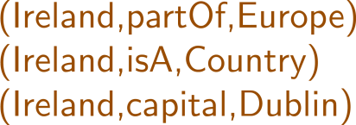
Semantic Web: Data, Logic, Query, Links
* More or less

Slide 4
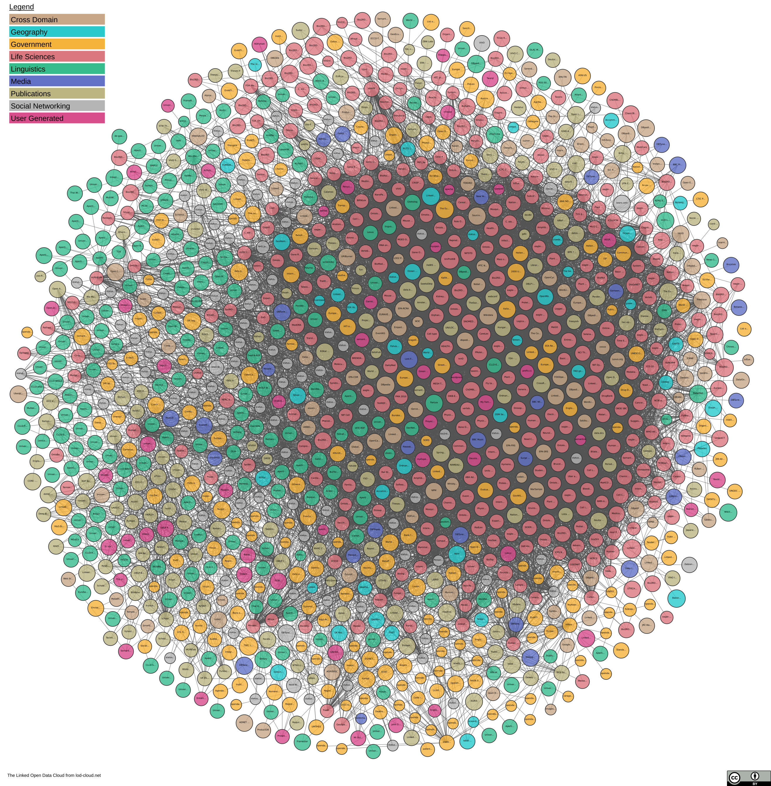
The LOD Cloud

Slide 5
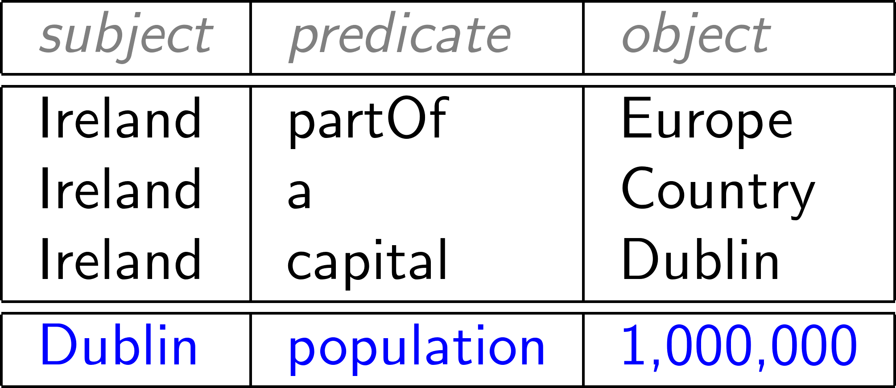
RDF: Proposed model for a Web of Data

Slide 6
RDF: Proposed model for a Web of Data
But where should this RDF come from?
Most legacy data on the Web not in RDF!
So what legacy formats are common on the Web?

Slide 7
LAMP: Linux, Apache, MySQL, PHP

Slide 8
3-Tier Web Applications

Slide 9
Deep Web
Surface Web
Deep Web

Slide 10
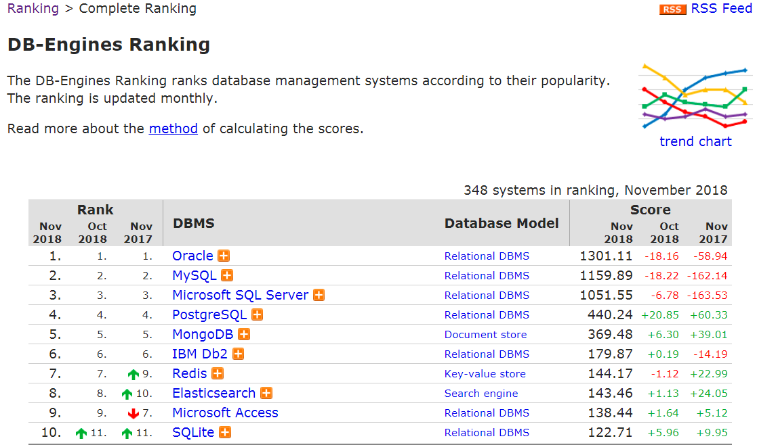
Lots of data in relational databases …
http://db-engines.com/en/ranking

Slide 11
Lots of data in relational databases …
Out of top 10 databases, 7 are relational databases.
Out of 348 databases, any idea in what position the first SPARQL engine would be?
http://db-engines.com/en/ranking

Slide 12
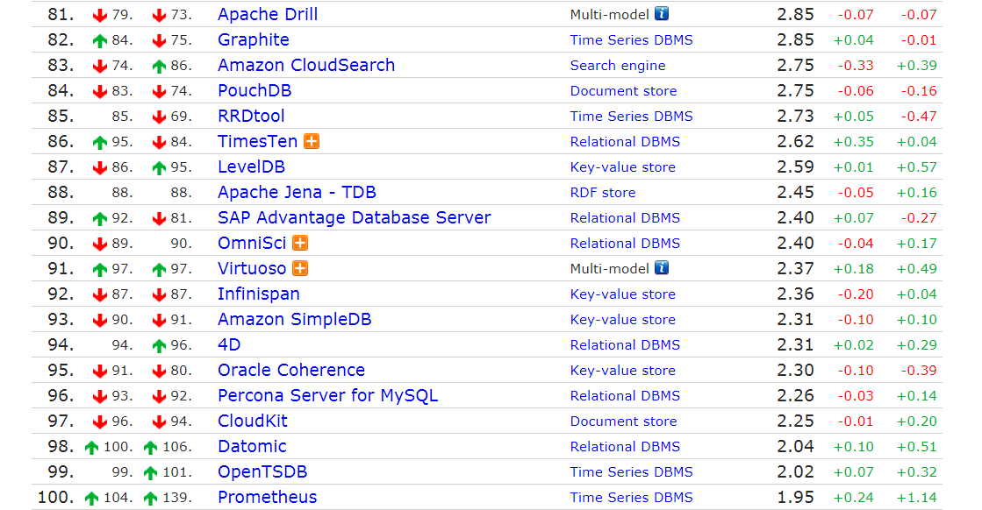
Top SPARQL engine is …

Slide 13
RDB2RDF: Relational DataBases to RDF

Slide 14
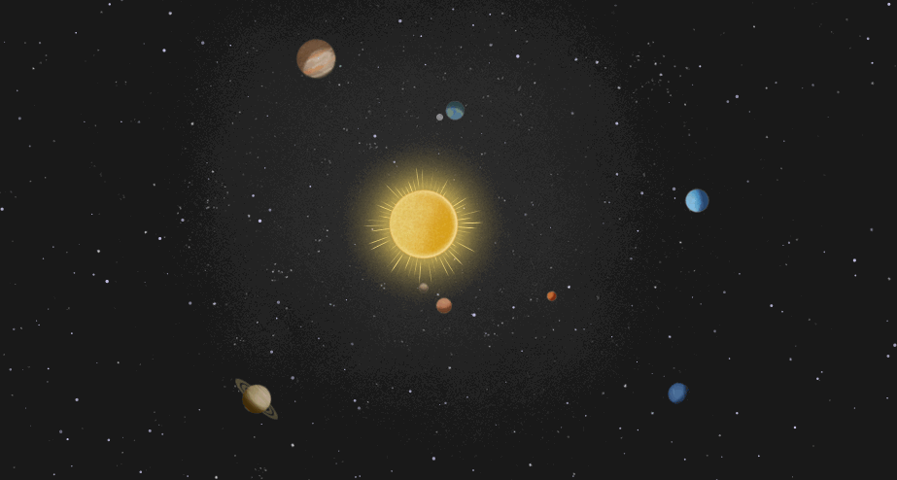
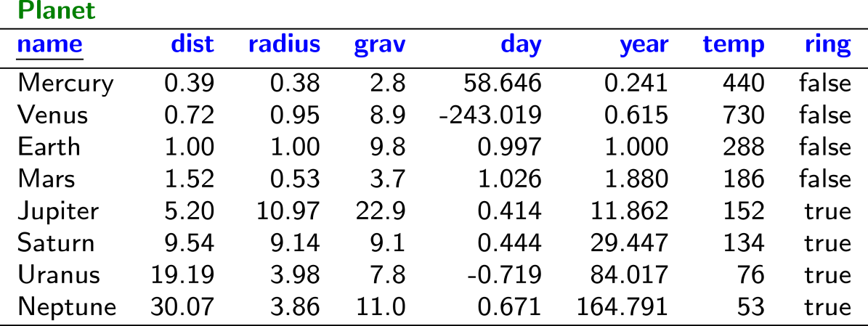
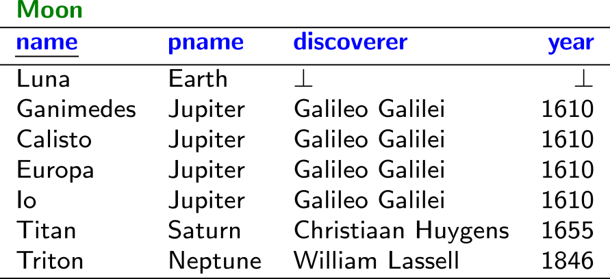
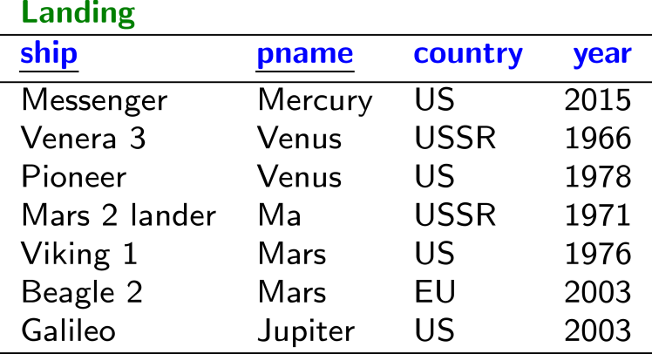
Some relational tables about planets …

Slide 15
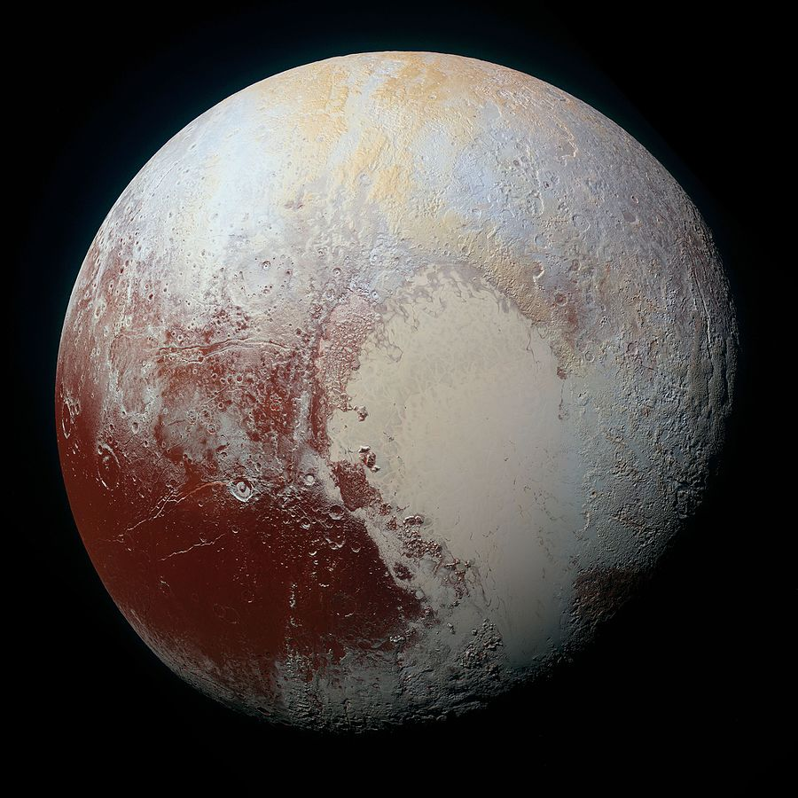
Meanwhile on Pluto …

Slide 16
RDB2RDF?
How might we automatically convert this table to RDF?

Slide 17
Direct Mapping: Automatic RDB2RDF mapping

Slide 19
Direct Mapping

Slide 20
Direct Mapping
Each table name is a type
Each row is a subject
Each attribute a predicate
Each value an object
But what about RDF terms (IRIs/literals/blank nodes)?

Slide 21
Direct Mapping: Identifying Rows
How can we identify Row1?
If the table has a primary key (pk₁,…,pk_{n}):
http://ex.org/TableName/pk1=v1;...;pkn=vn
(Base IRI http://ex.org/ given as input)
If not: use a fresh blank node.
So Row1 would be …?
http://ex.org/Planet/name=Mercury

Slide 22
Direct Mapping: Identifying Tables
How can we identify the table?
http://ex.org/Planet

Slide 23
Direct Mapping: Identifying Columns
How can we identify the attributes?
http://ex.org/Planet#ring
http://ex.org/Planet#dist
http://ex.org/Planet#...

Slide 24
Direct Mapping: Identifying Values
How can we identify values?
“Mercury”
“0.39”^^xsd:float
“false”^^xsd:boolean

Slide 25
Direct Mapping: Final RDF

Slide 26
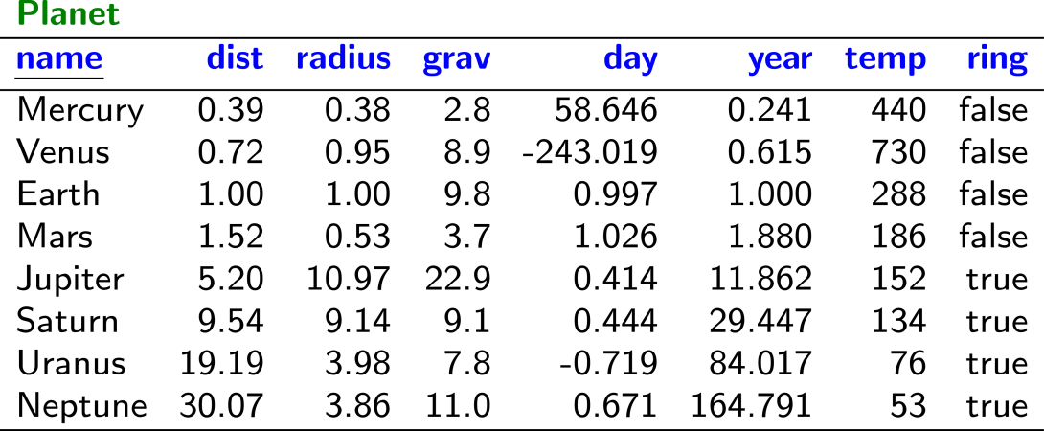
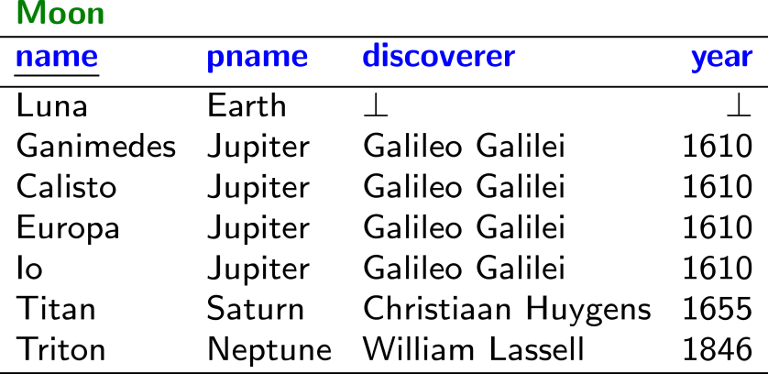
Direct Mapping: Multiple Tables
Anything missing here?
If we assume that pname is a foreign key
for Planet.name, then ...

Slide 27
Direct Mapping: Foreign Key References

Slide 28
Direct Mapping: Foreign Key References
If table T₁ has a foreign key to table T₂: (fk₁,…,fk_{n}):
Link with predicate: http://ex.org/T1#ref-fk1;...;fkn
(Base IRI http://ex.org/ given as input)
Example: http://ex.org/Moon#ref-pname

Slide 29
Direct Mapping
Anything else missing here?
What should we do with NULL (⊥)??

Slide 30
Direct Mapping: NULL (⊥)
No triples generated for NULL (⊥).
(Semantics of NULL often not clear)

Slide 31
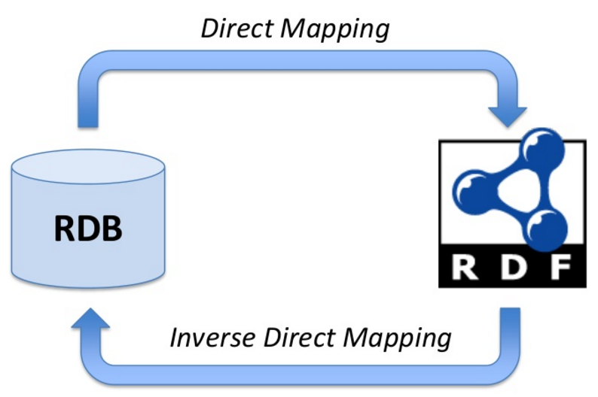
Direct Mapping: Information Preservation

Slide 32
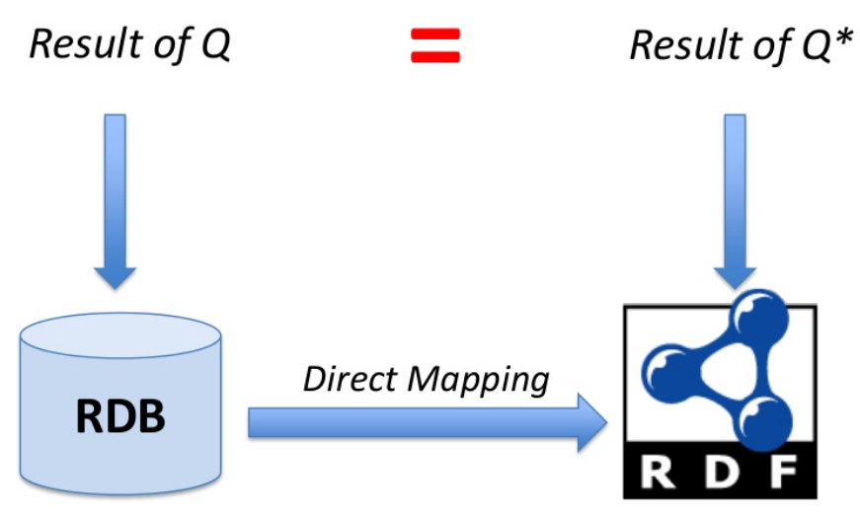
Direct Mapping: Query Preservation

Slide 33
Direct Mapping: Customisation?
What if we want to customise the mapping, e.g., to create a node for people?

Slide 34
R2RML: Custom RDB2RDF mappings

Slide 36
R2RML: In a nutshell
RDB
R2RML
Mapping
What should we use to specify this R2RML mapping?

Slide 37
R2RML Example: The Direct Mapping

Slide 38
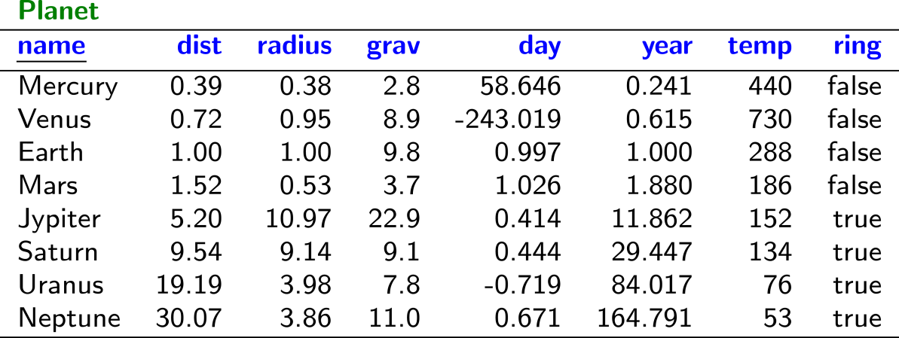
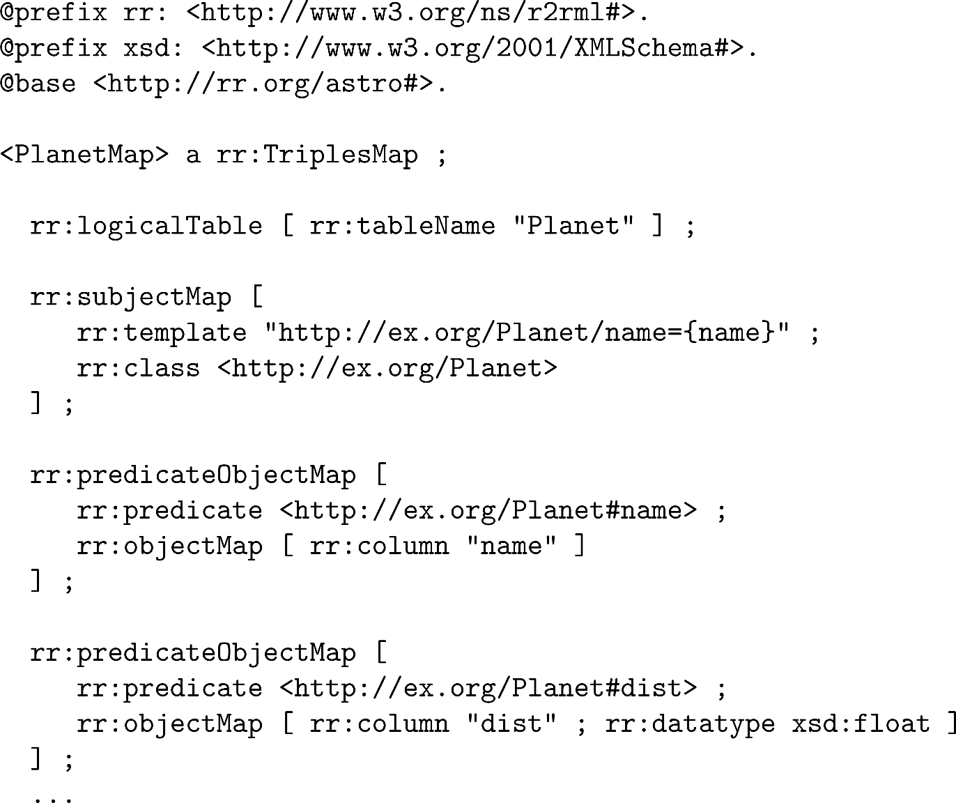
R2RML Example: The Direct Mapping
Triple Mapping
Source Table
Subject Mapping
Predicate-Object Mapping
Predicate-Object Mapping
…

Slide 39
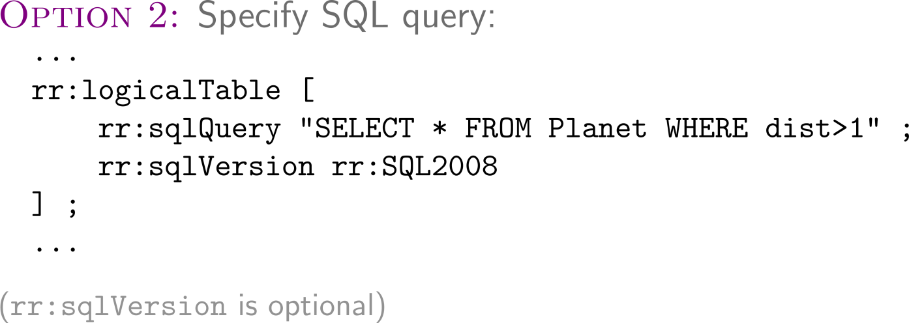
R2RML: Selecting a Logical Table
Triple Mapping
Source Table
Subject Mapping
Predicate-Object Mapping
Predicate-Object Mapping
…

Slide 40
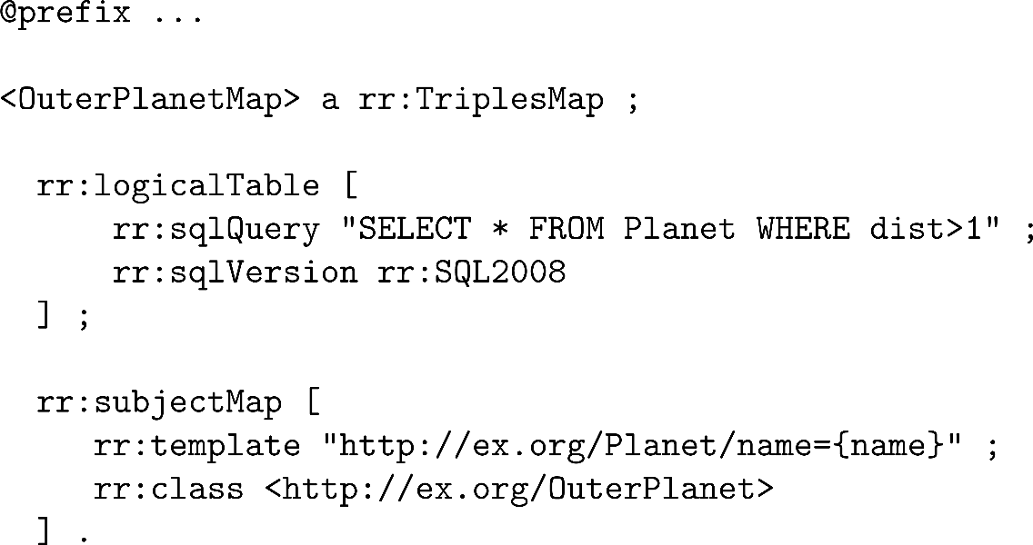
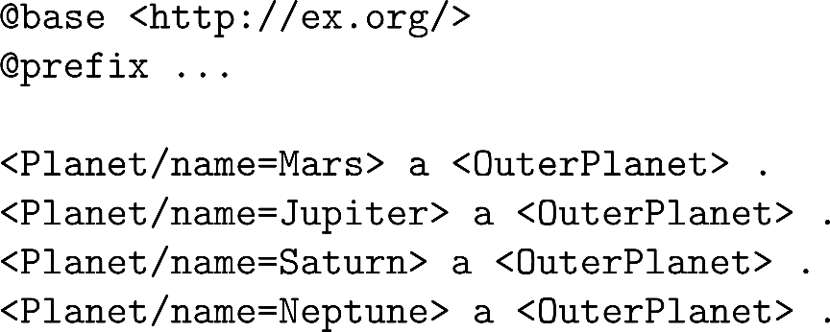
R2RML: Example with SQL Query

Slide 41
R2RML Term Maps: Creating RDF Terms
Triple Mapping
Source Table
Subject Mapping
Predicate-Object Mapping
Predicate-Object Mapping
…

Slide 42
R2RML Term Maps: Creating RDF Terms

Slide 43
R2RML Term Maps: Constants

Slide 44
R2RML Term Maps: Columns

Slide 45
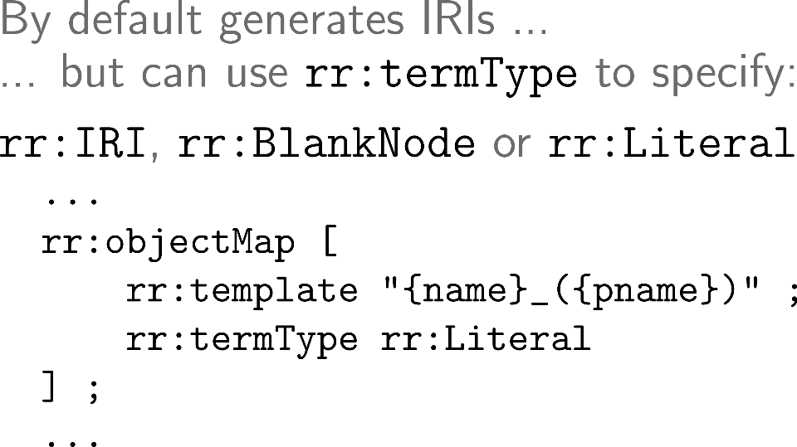
R2RML Term Maps: Templates

Slide 46
R2RML Term Maps

Slide 47
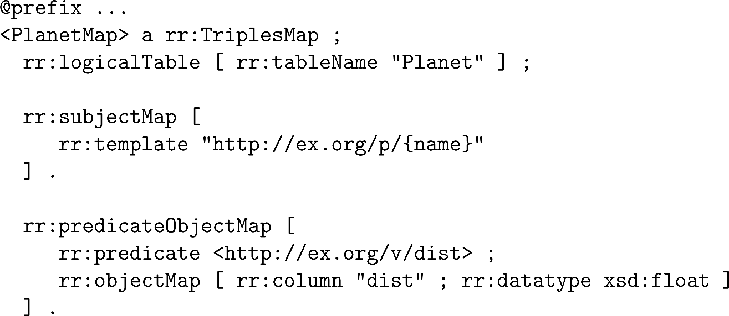
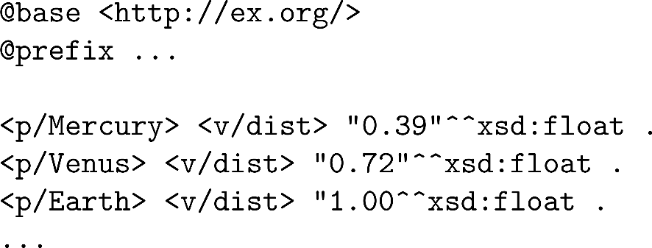
R2RML Term Maps: Example

Slide 48
R2RML: Subject Map
Triple Mapping
Source Table
Subject Mapping
Predicate-Object Mapping
Predicate-Object Mapping
…

Slide 49
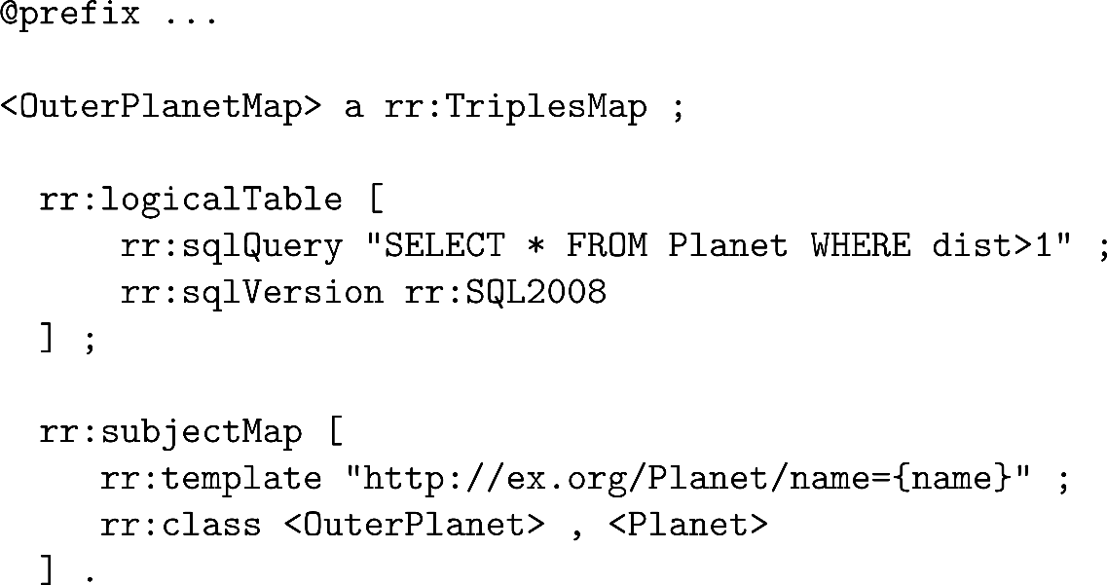
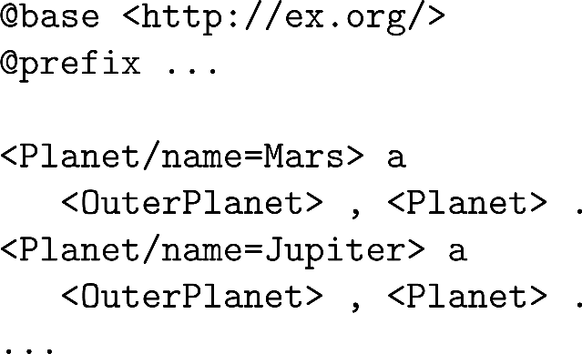
R2RML: Example with multiple types

Slide 50
R2RML: Predicate–Object Map
Triple Mapping
Source Table
Subject Mapping
Predicate–Object Mapping
Predicate–Object Mapping
…

Slide 51
R2RML: Predicate–Object Map
Triple Mapping
Source Table
Subject Mapping
Predicate–Object Mapping
Predicate–Object Mapping
…

Slide 52
R2RML: Reference Object Map

Slide 53
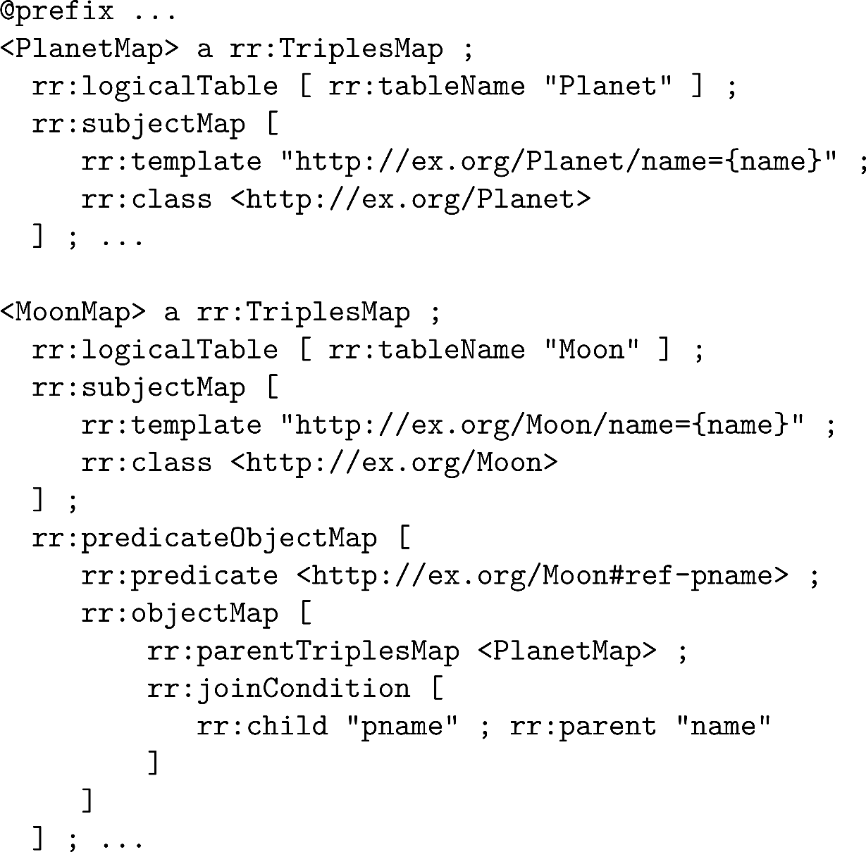
R2RML: Reference Object Map

Slide 54
R2RML: Reference Object Map

Slide 55
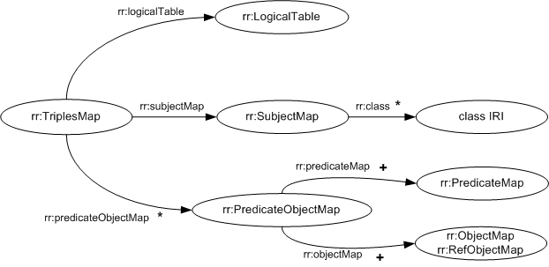
Summary of Triple Map Structure
* zero or more
+ one or more
(otherwise, precisely one)

Slide 56
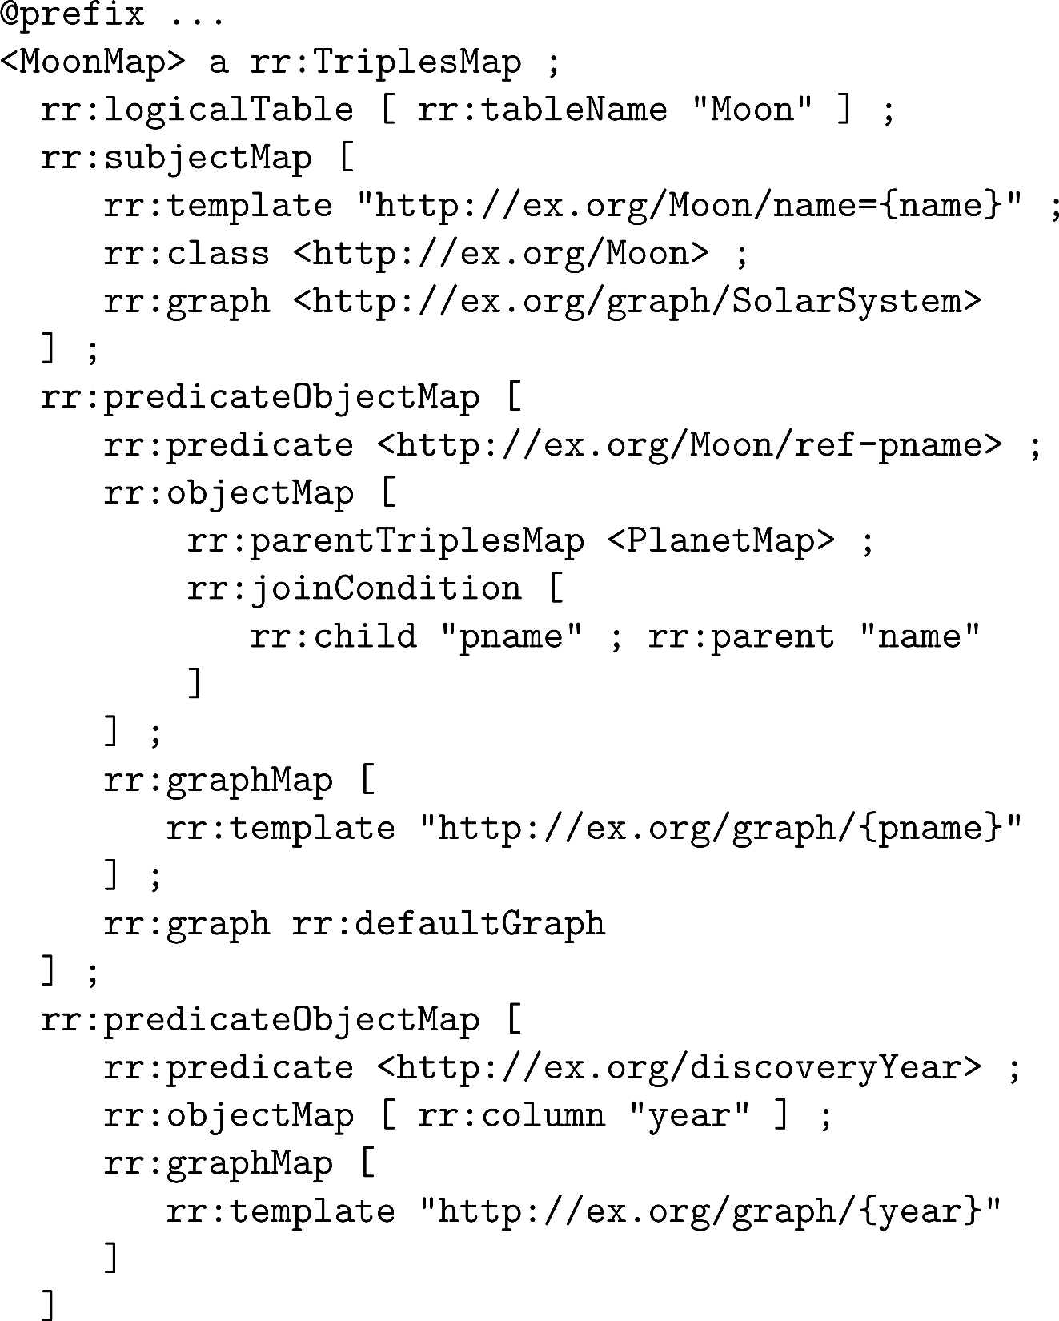
R2RML: Graph Maps

Slide 57
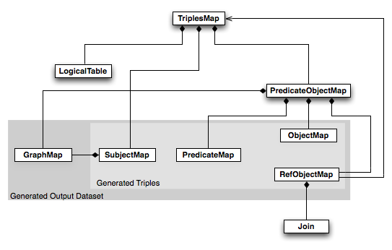
R2RML …

Slide 58
RDB2RDF

Slide 59
RDB2RDF: Surfacing (some of) the Deep Web
Surface Web
Deep Web

Slide 60
Questions?

