Slide 1
CC7220-1 La Web de Datos Primavera 2019 Lecture 2: RDF Model and Syntax
Aidan Hogan
aidhog@gmail.com

Slide 2
The “Semantic Web”

Slide 3
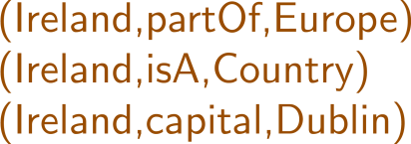
Semantic Web: Data, Logic, Query
* More or less

Slide 4
RDF: Resource Description Framework

Slide 5
RDF (1.1): A Web Standard

Slide 6
Semantic Web: Data
* More or less

Slide 7
Semantic Web: Data

Slide 8
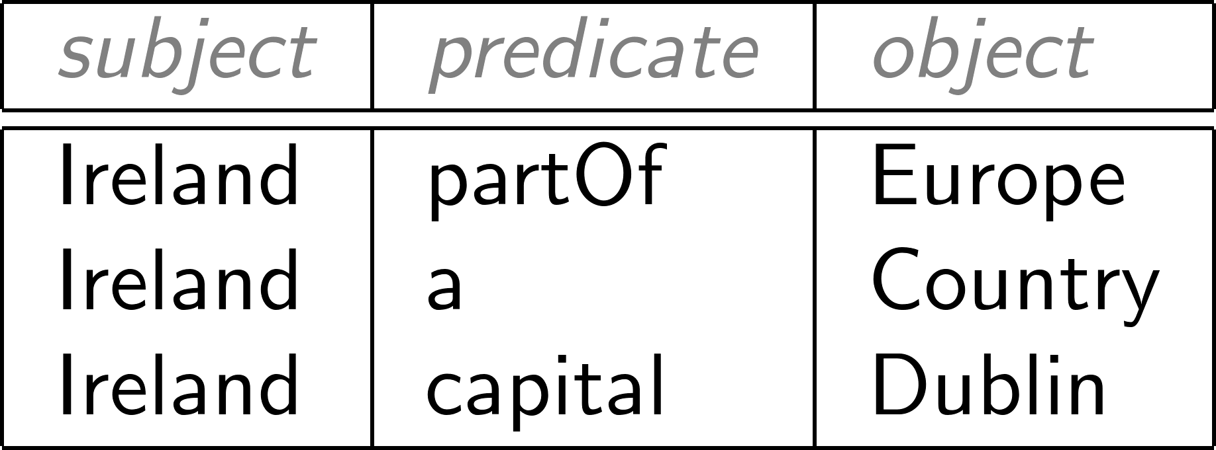
Modelling the world with triples

Slide 9
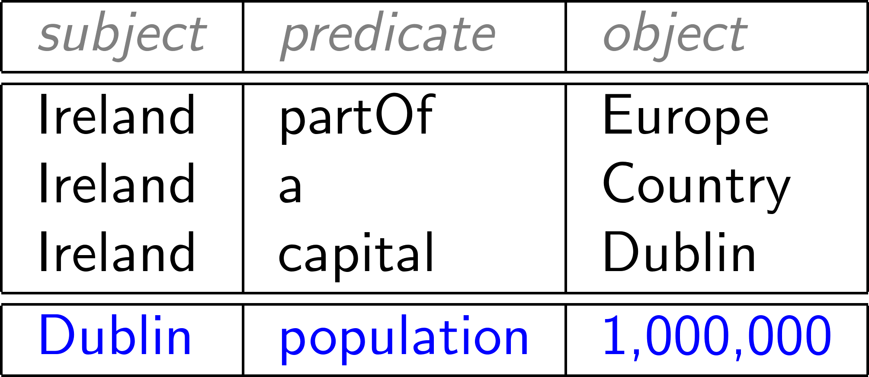
Concatenate to “integrate” new data

Slide 10
RDF often drawn as a (directed, labelled) graph

Slide 11
Set of triples thus called an “RDF Graph”

Slide 12
But why triples?
Why not pairs?

Slide 13
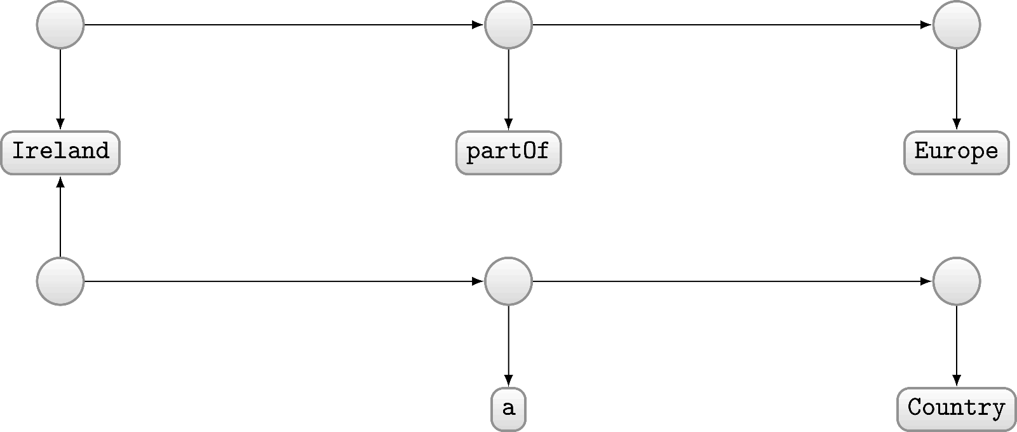
Modelling with pairs (directed unlabelled graph)?
Modelled as pairs?

Slide 14
But why graphs?
Why not (e.g.) tables?

Slide 15
Graphs are flexible

Slide 16
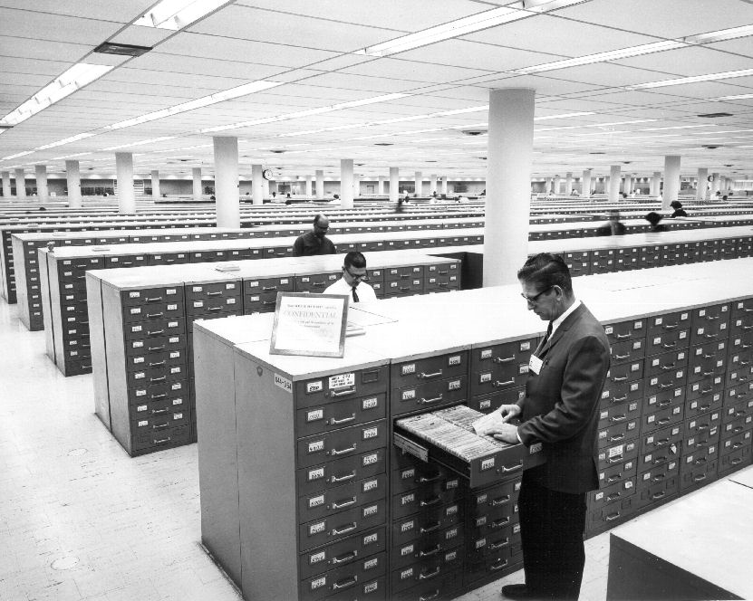
Relational Databases …

Slide 17
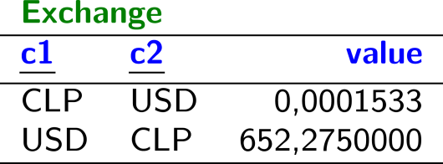
Relational Databases …

Slide 18
Planets / Relational Data

Slide 19
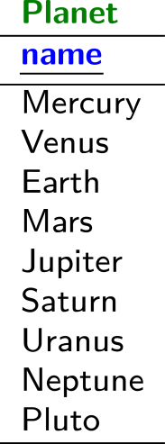
Planets / Relational Data

Slide 20
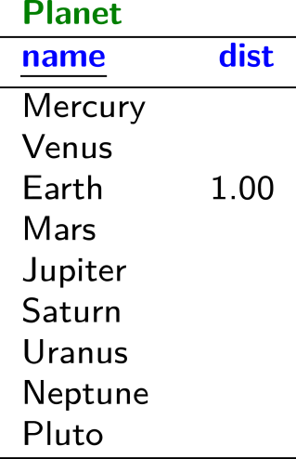
Planets / Relational Data

Slide 21
Planets / Relational Data

Slide 22
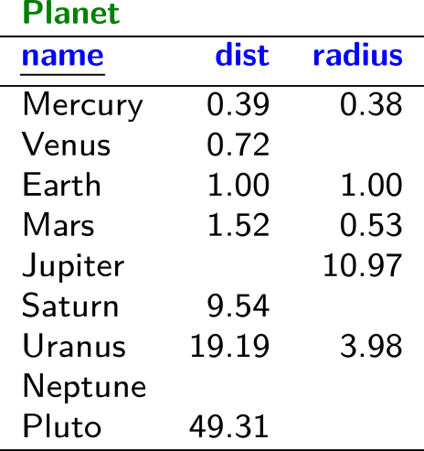
Planets / Relational Data

Slide 23
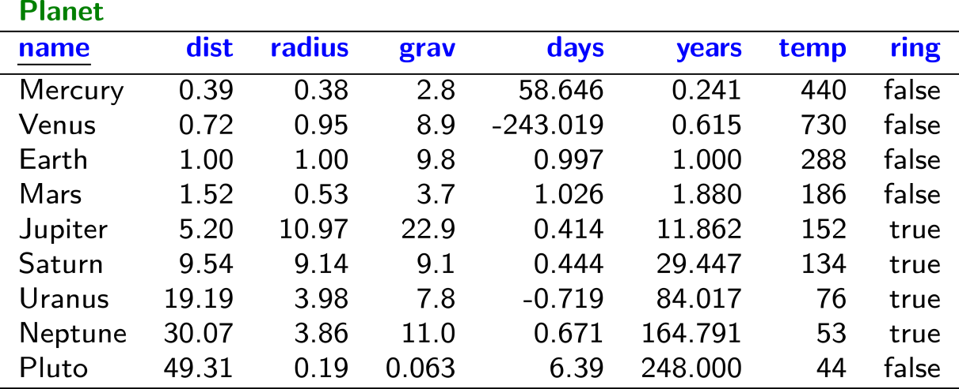
Planets / Relational Data

Slide 24
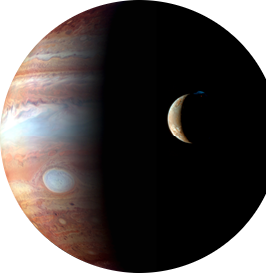
Planets / Relational Data

Slide 25
Planets / Relational Data

Slide 26
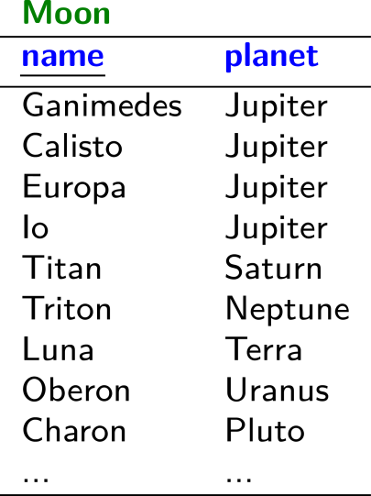
Planets / Relational Data

Slide 27
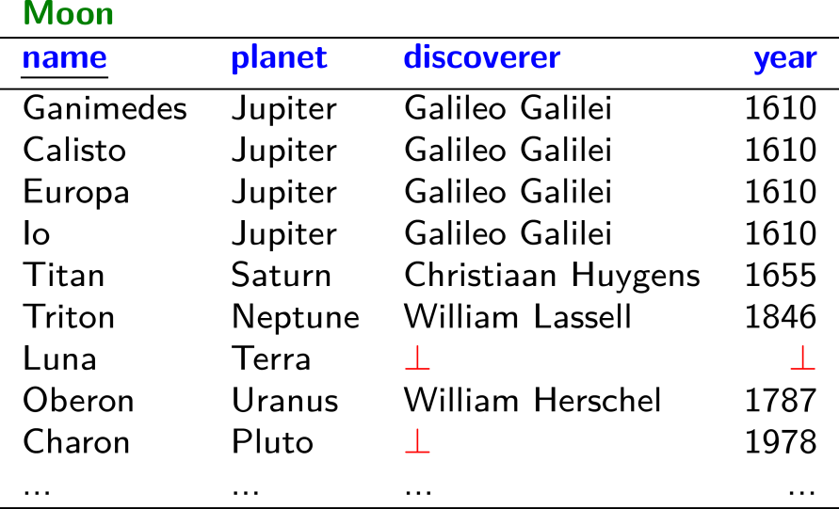
Planets / Relational Data

Slide 28
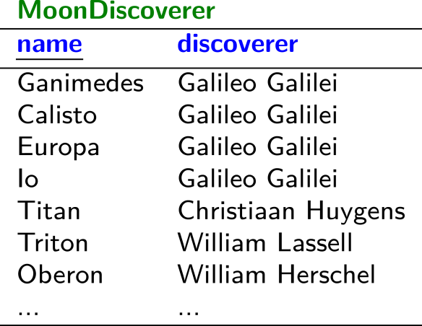
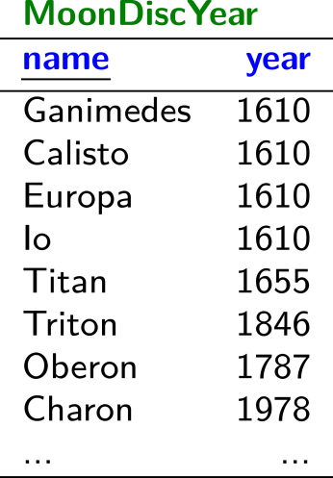
Planets / Relational Data

Slide 29
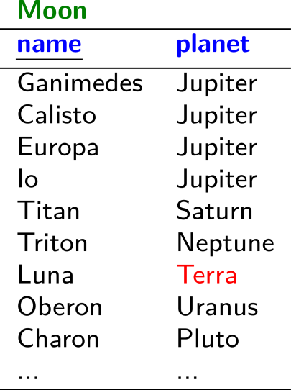
Planets / Relational Data

Slide 30
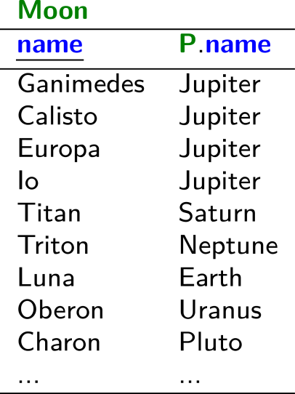
Planets / Relational Data

Slide 31
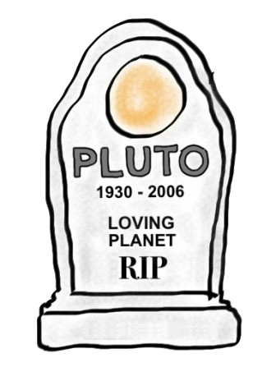
Planets / Relational Data

Slide 32
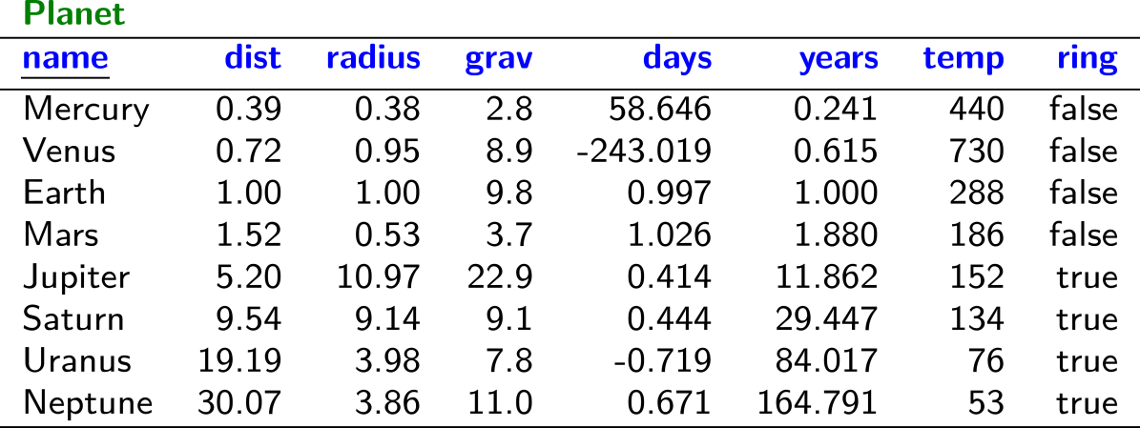
Planets / Relational Data

Slide 33
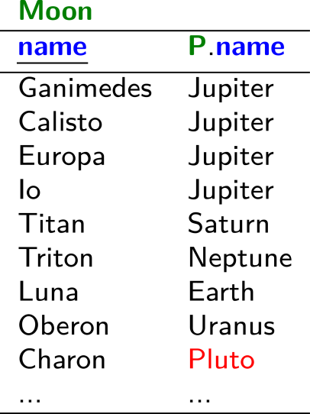
Planets / Relational Data

Slide 34
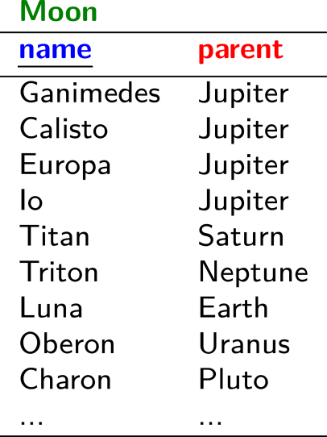
Planets / Relational Data

Slide 35
Planets / Relational Data

Slide 36
Planets / Relational Data
(╯°□°)╯︵ ┻━┻

Slide 37
Planets / Graph Data

Slide 38
Planets / Graph Data

Slide 39
Planets / Graph Data

Slide 40
Planets / Graph Data

Slide 41
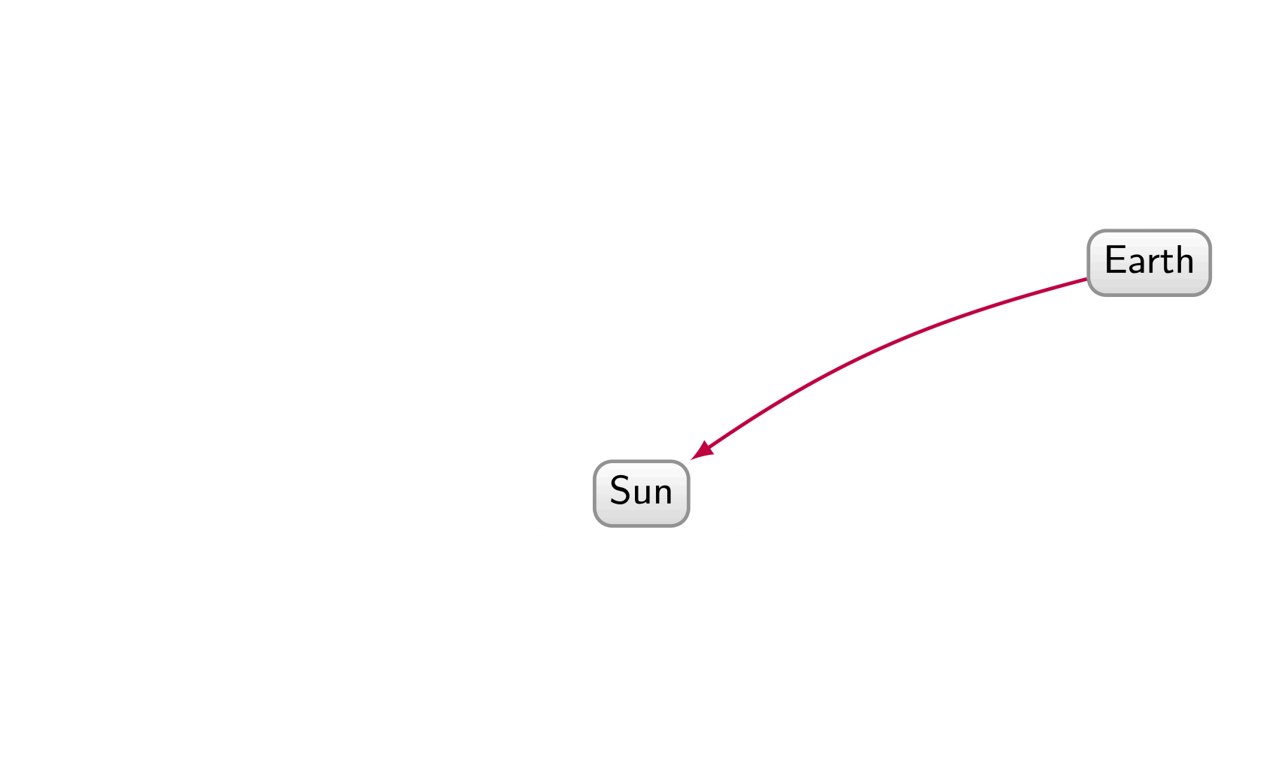
Planets / Graph Data

Slide 42
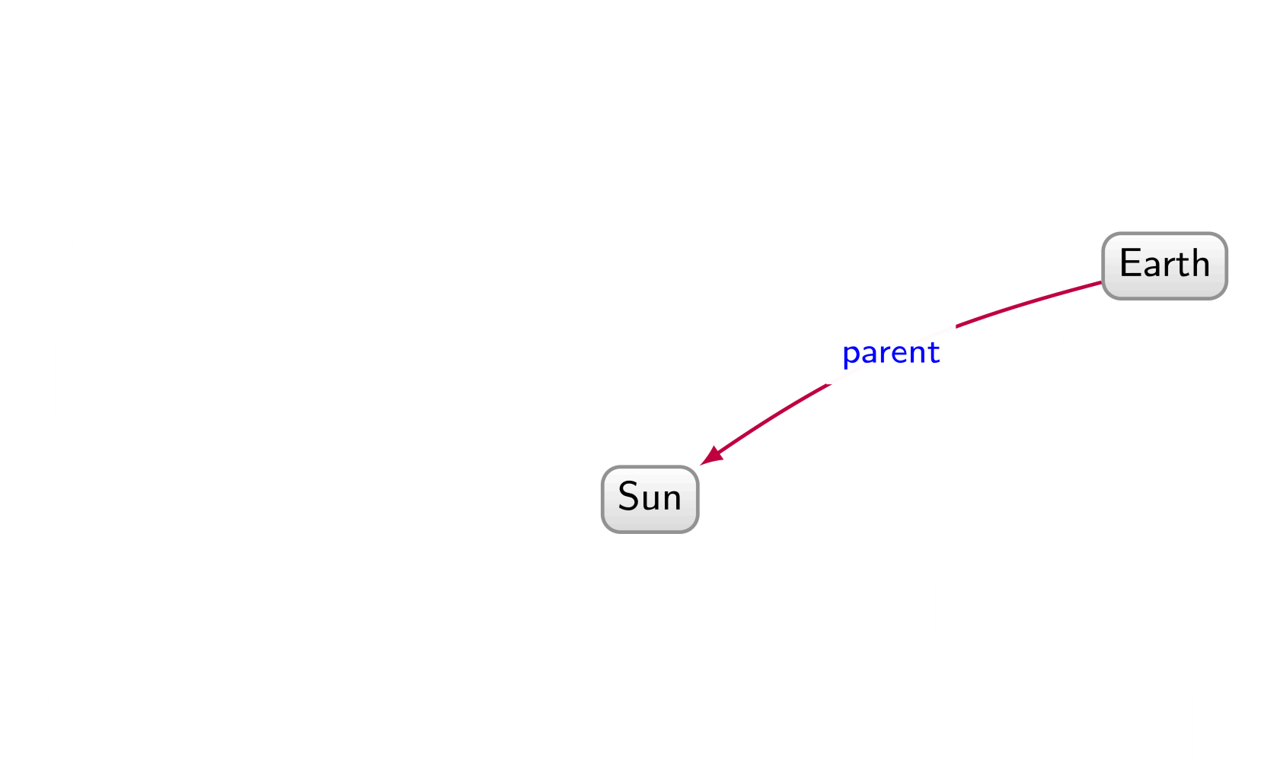
Planets / Graph Data

Slide 43
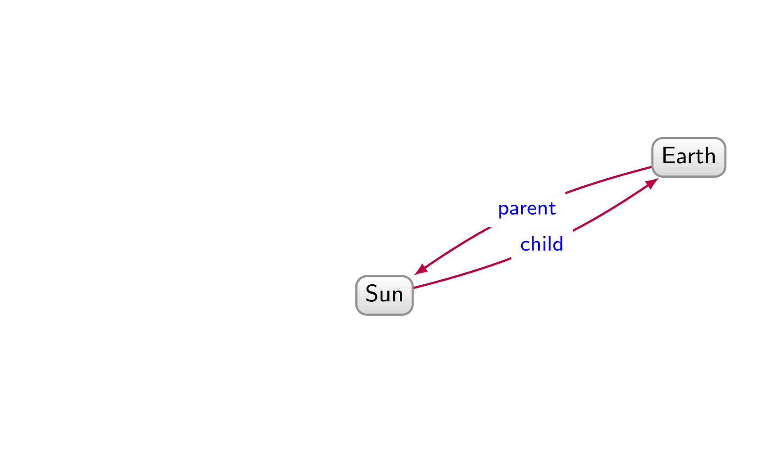
Planets / Graph Data

Slide 44
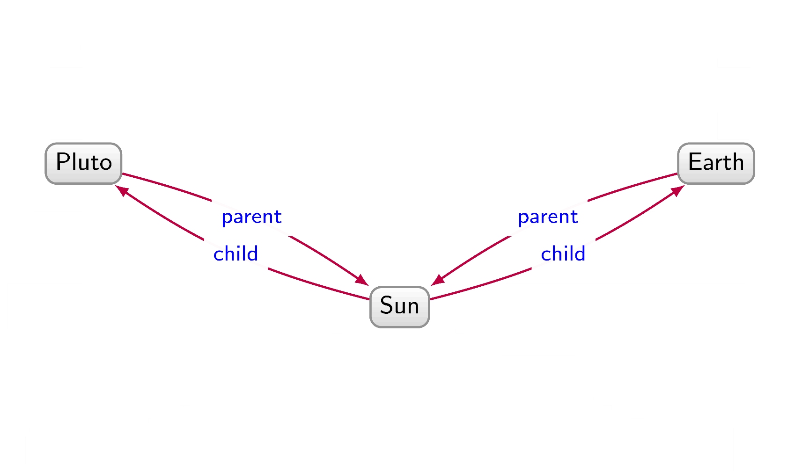
Planets / Graph Data

Slide 45
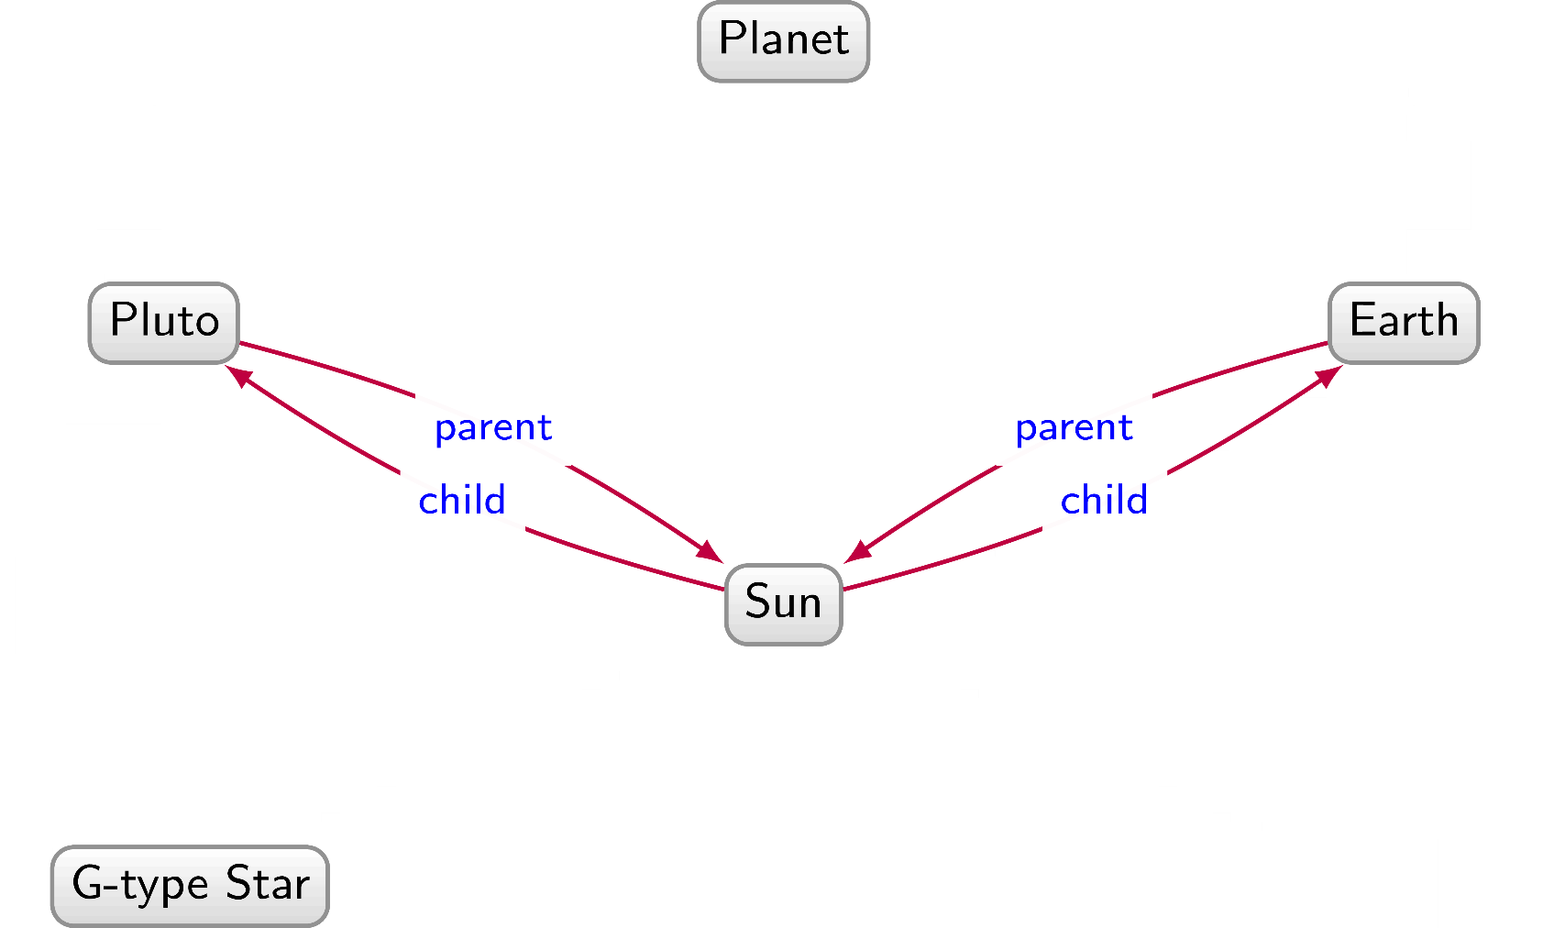
Planets / Graph Data

Slide 46
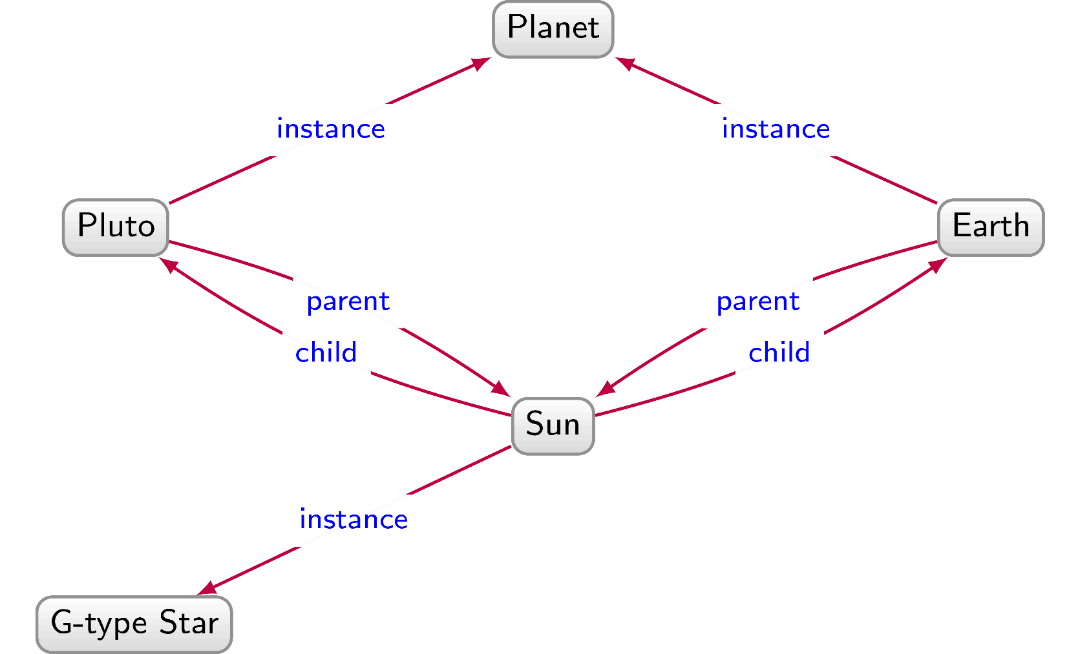
Planets / Graph Data

Slide 47
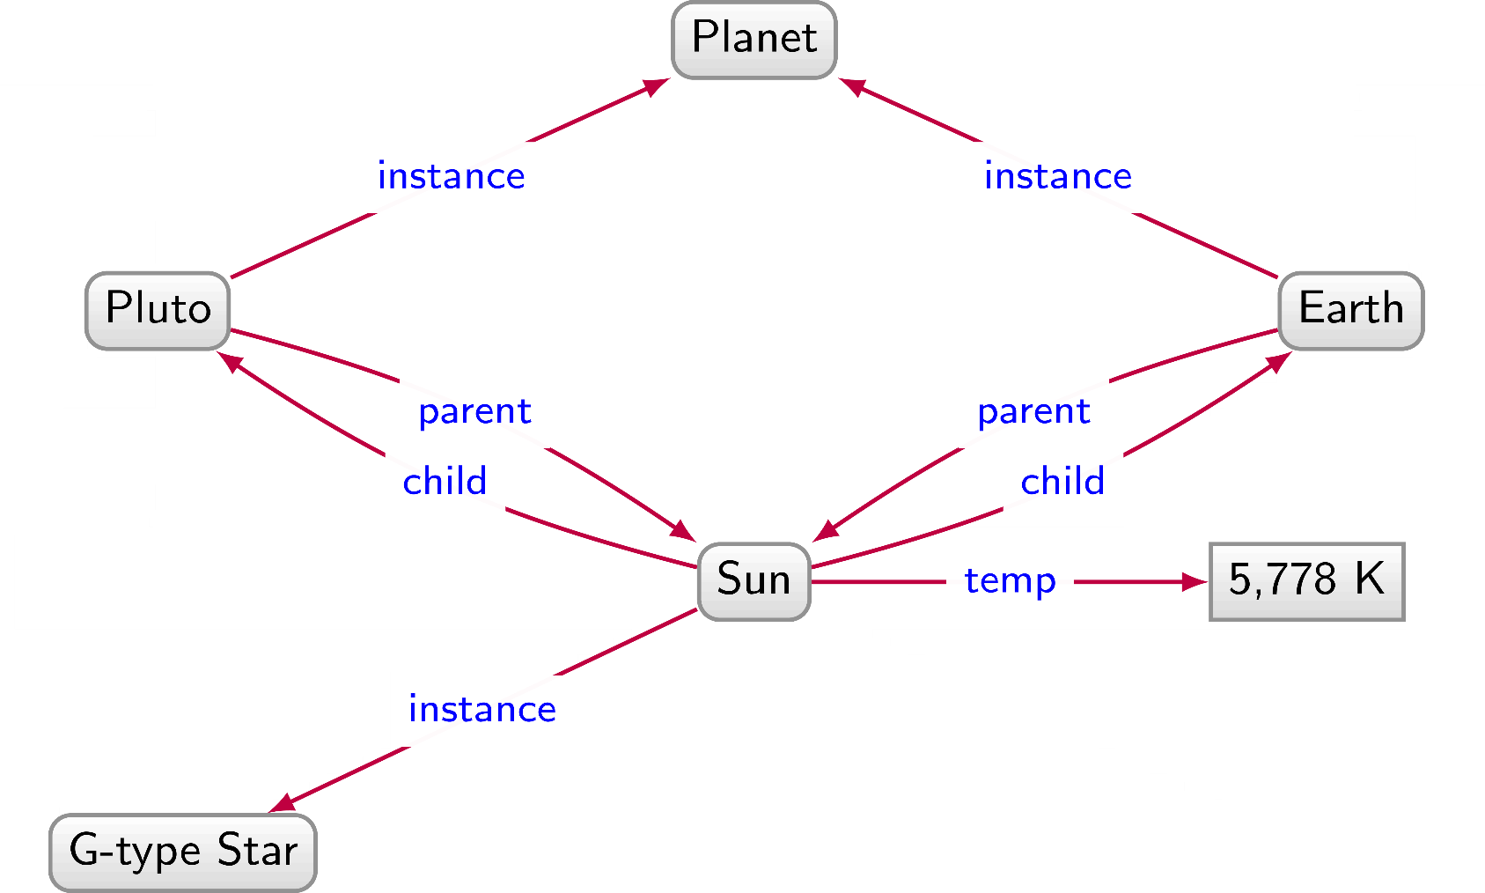
Planets / Graph Data

Slide 48
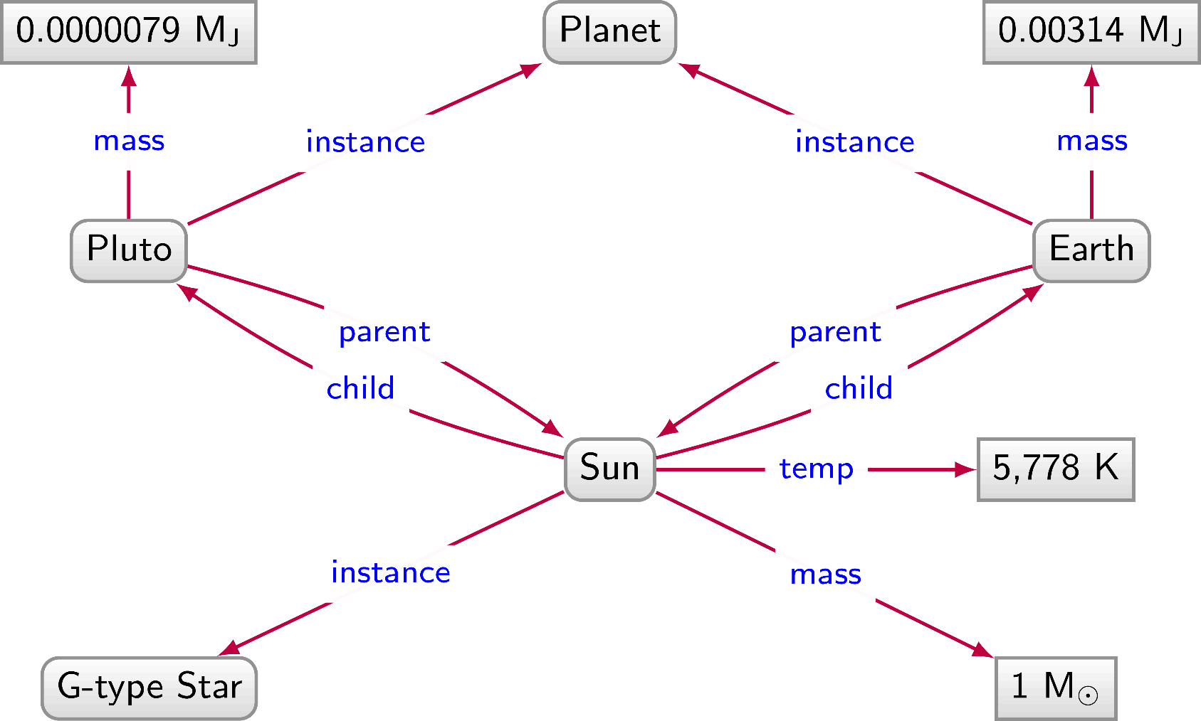
Planets / Graph Data

Slide 49
Planets / Graph Data

Slide 50
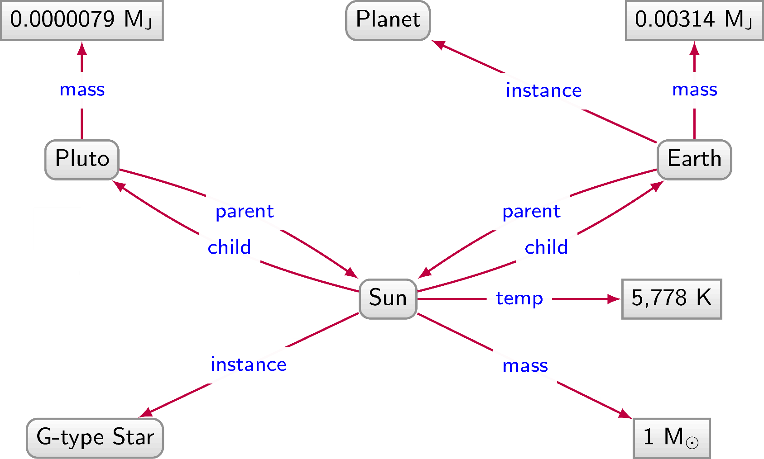
Planets / Graph Data

Slide 51
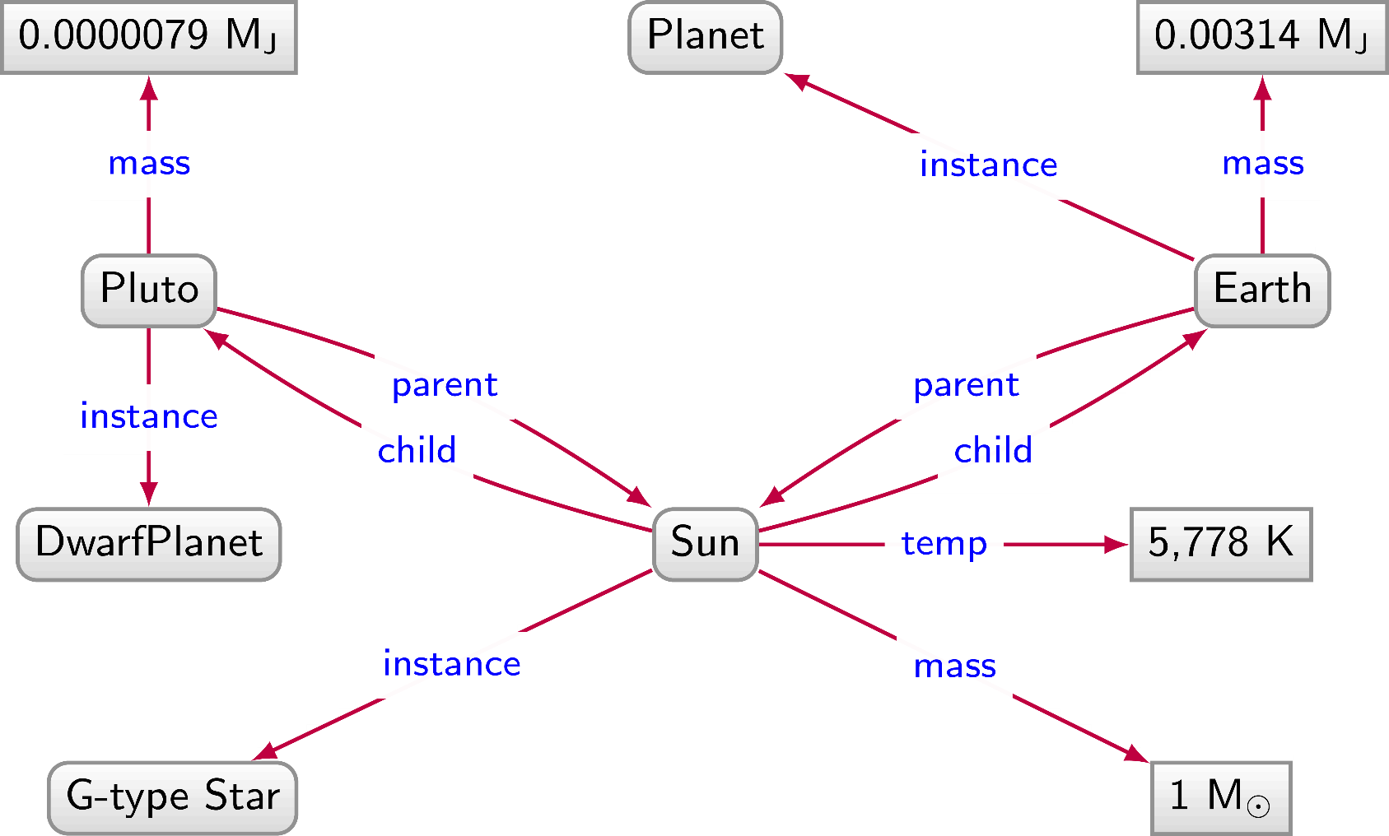
Planets / Graph Data

Slide 52
Planets / Graph Data

Slide 53
Planets / Graph Data

Slide 54
Planets / Graph Data

Slide 55
Planets / Graph Data

Slide 56
Relational data: Pros and Cons
We have to impose a
structure (schema)
from the start
We have a
structure (schema) imposed from the start

Slide 57
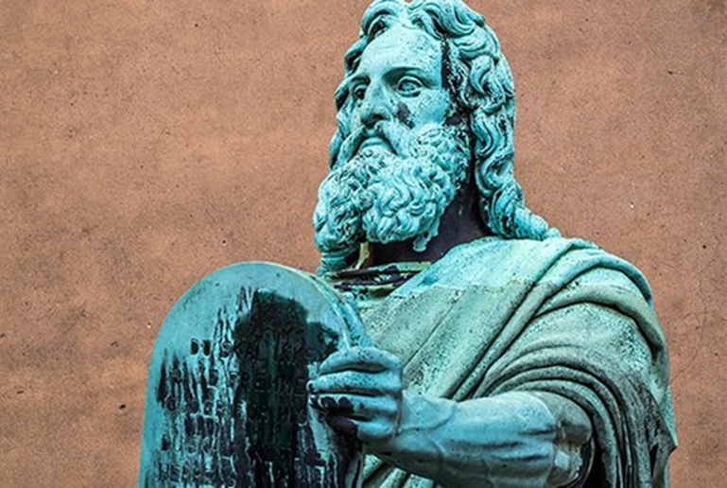

Slide 58
Graph Data: Pros and Cons
We don't have to impose a
structure (schema)
from the start
We don't have a
structure (schema) imposed from the start

Slide 59
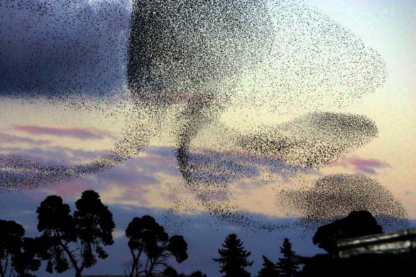

Slide 60
Naming things

Slide 61
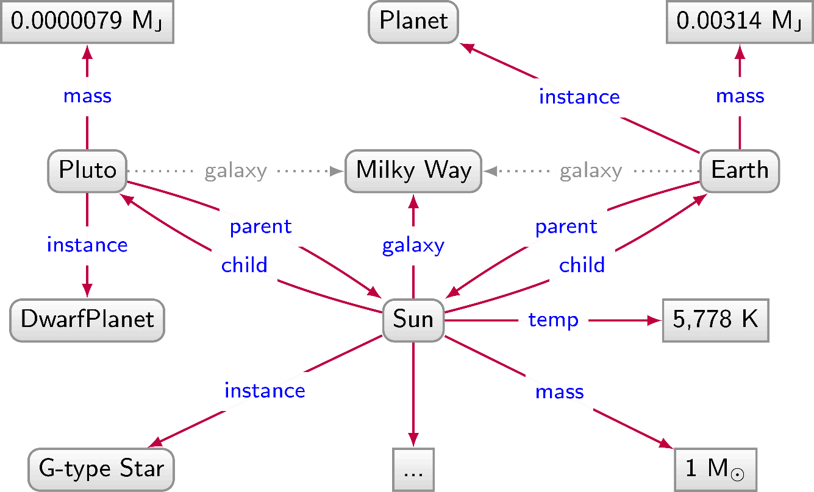
Naming things: Strings not enough

Slide 62
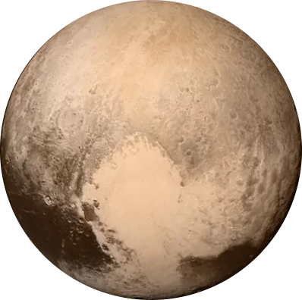
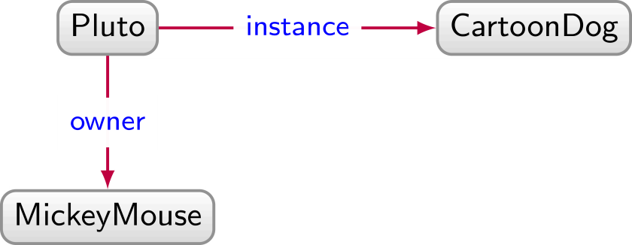
Naming things: Strings not enough

Slide 63
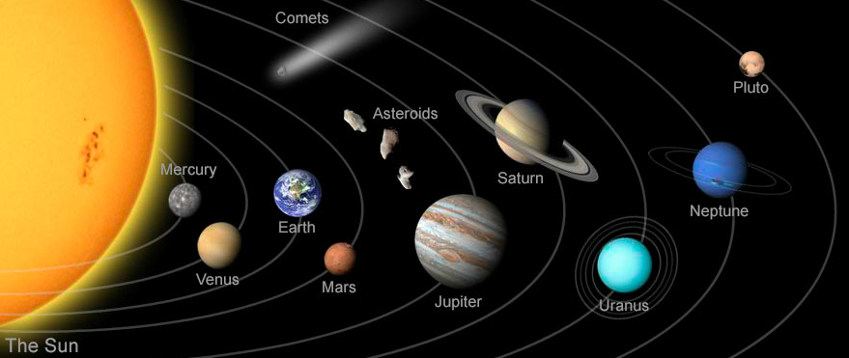
Naming things: Strings not enough

Slide 64
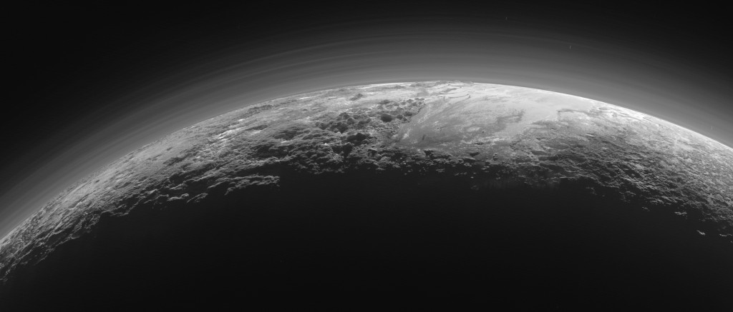
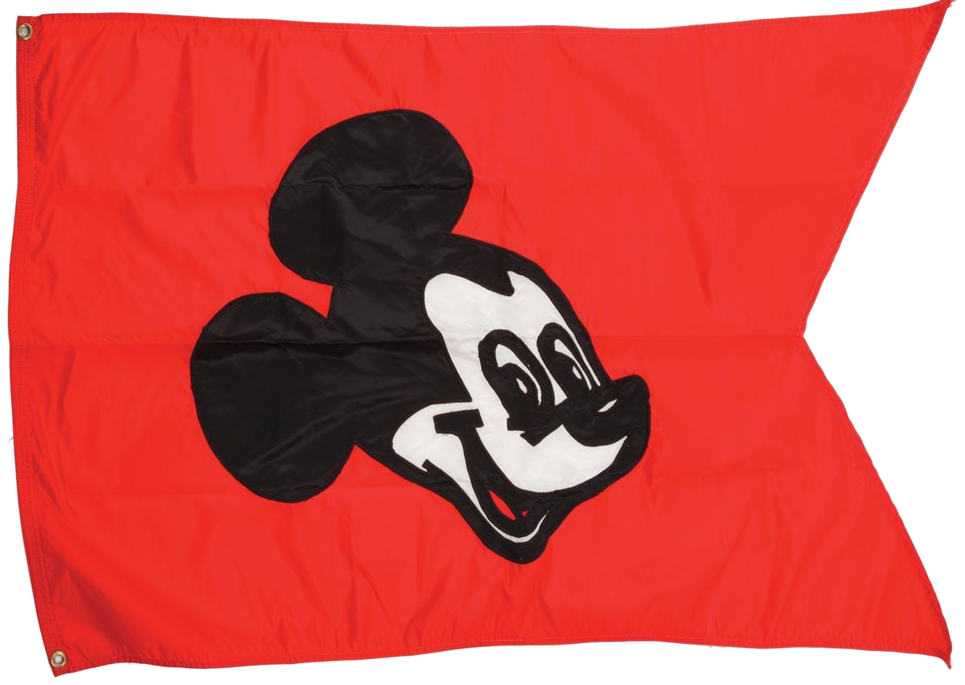
Naming things: Strings not enough

Slide 65
Naming things in RDF: IRIs

Slide 66
Need unambiguous symbols/identifiers
Since we’re on the Web … use Web identifiers
URL: Uniform Resource Location
The location of a resource on the Web
http://ex.org/Dubl%C3%ADn.html
URI: Uniform Resource Identifier (RDF 1.0)
Need not be a location, can also be a name
http://ex.org/Dubl%C3%ADn
IRI: Internationalised Resource Identifier (RDF 1.1)
A URI that allows Unicode characters
http://ex.org/Dublín

Slide 67
We will use IRIs with prefixes
http://ex.org/Dublín ↔ ex:Dublín
“ex:” denotes a prefix for http://ex.org/
“Dublín” is the local name
Frequently used prefixes:

Slide 68
From strings …

Slide 69
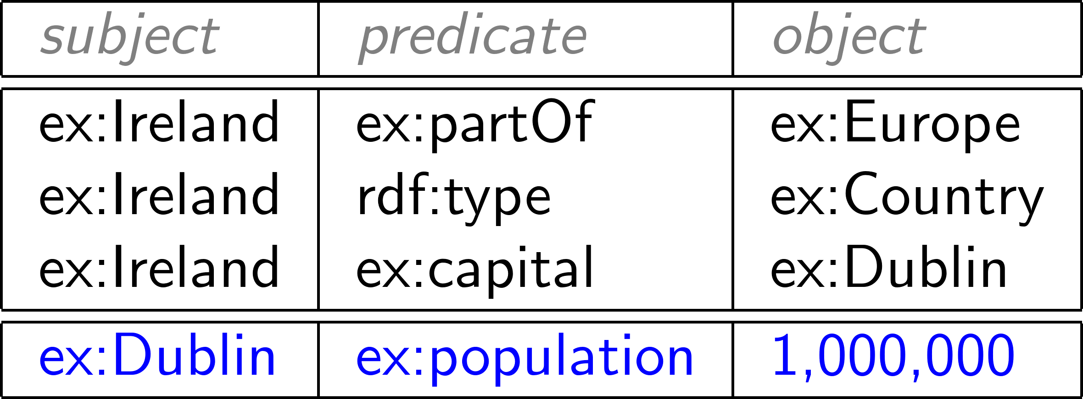
… to IRIs …

Slide 70
Naming things in RDF: Literals

Slide 71
What about numbers?
Should we assign IRIs to numbers, booleans, etc.?

Slide 72
RDF allows “literals” in object position
Literals are for datatype values, like strings, numbers, booleans, dates, times
Only allowed in object position

Slide 73
Datatype literals
“[lexical-string]”^^[datatype-IRI]
“200”^^xsd:int
“2014-12-13”^^xsd:date
“true”^^xsd:boolean
“this is a string”^^xsd:string
If the datatype is omitted, it’s a string
“this is a string”
“200” is a string, not a number!

Slide 74
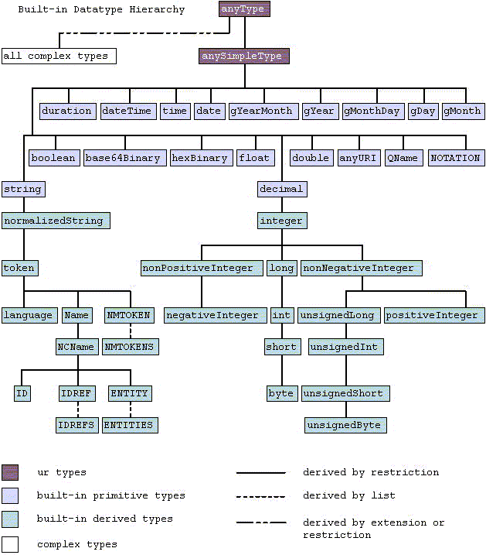
Many datatypes borrowed from XML Schema

Slide 75
Boolean datatype

Slide 76
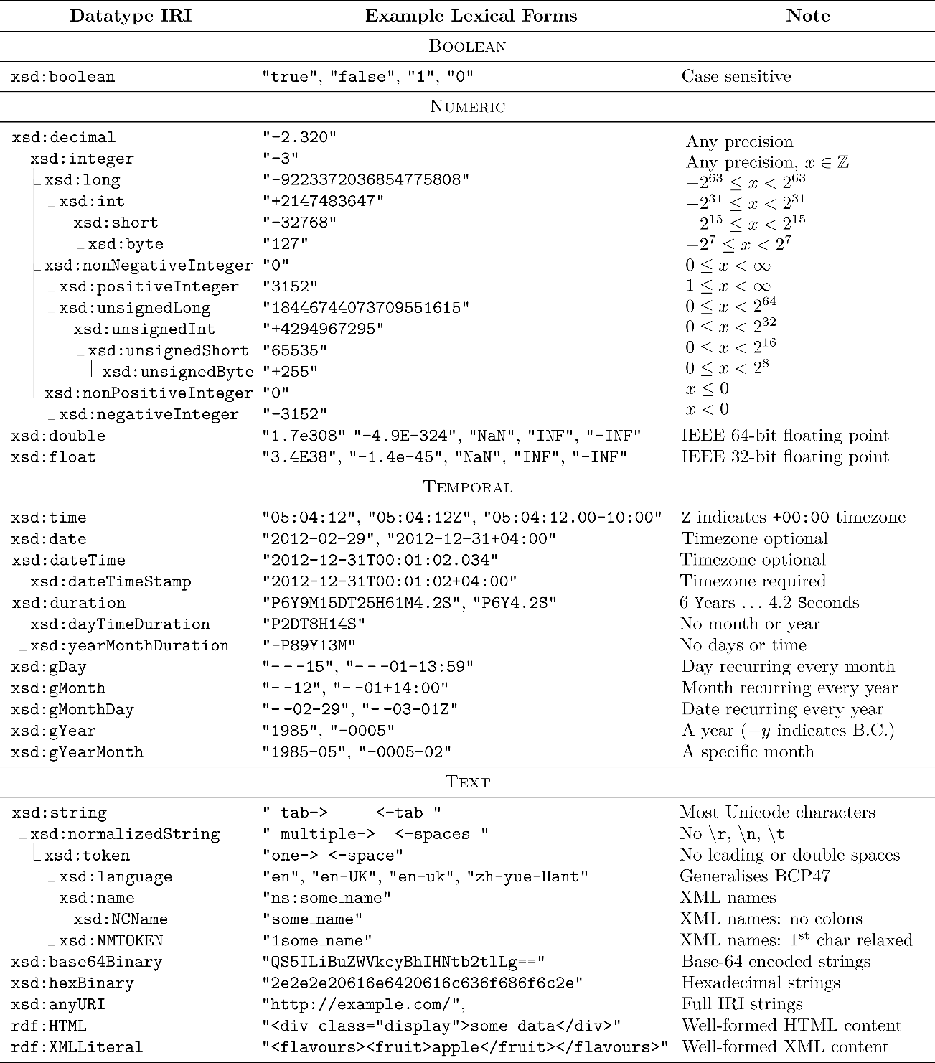

Slide 77
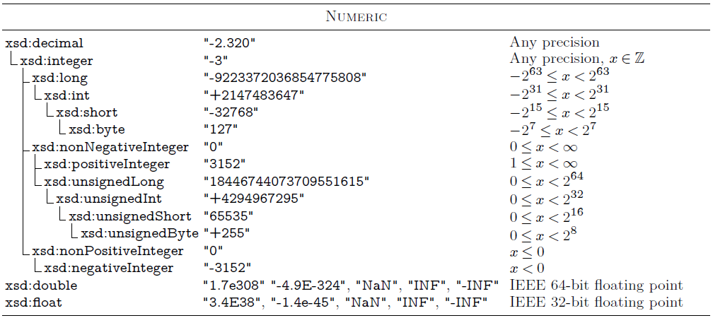
Numeric datatypes

Slide 78
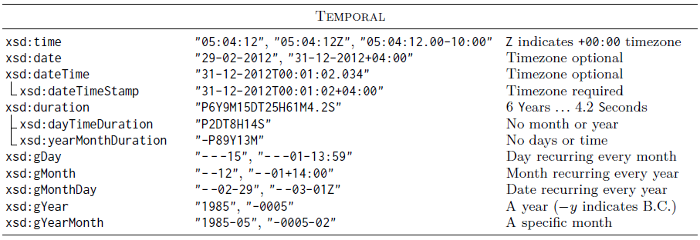
Temporal datatypes

Slide 79
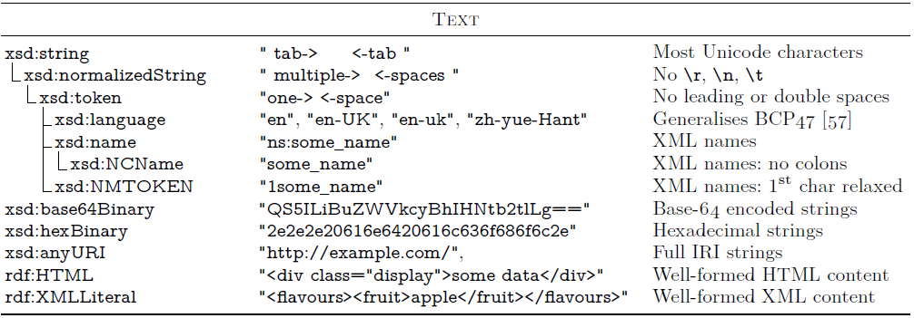
Text/string datatypes

Slide 80
Language-Tagged Strings
Specify that a string is in a given language
“string”@lang-tag
No datatype!

Slide 81
(Not) Naming Things in RDF: Blank Nodes

Slide 82
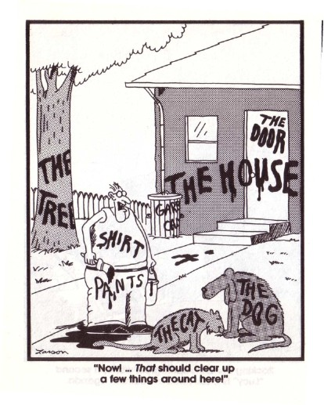
Having to name everything is hard work

Slide 83
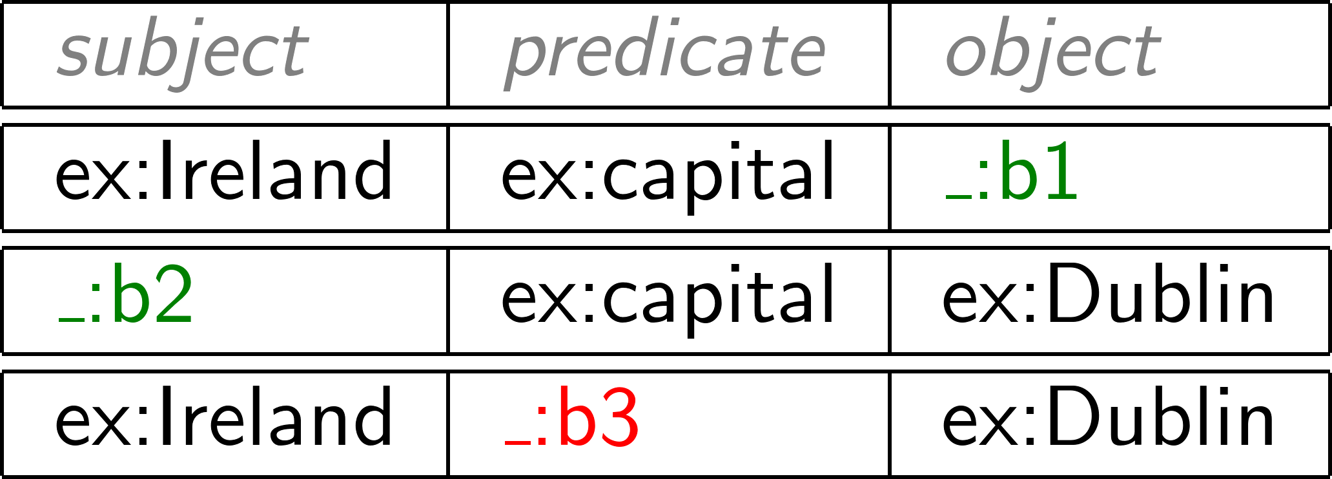
For this reason, RDF gives blank nodes
Syntax: _:blankNode
Represents existence of something
Often used to avoid giving an IRI (e.g., shortcuts)
Can only appear in subject or object position
(More later)

Slide 84
RDF Terms: summary

Slide 85
A Summary of RDF Terms
IRIs (Internationalised Resource Identifiers)
Used to name generic things
Literals
Used to refer to datatype values
Strings may have a language tag
Blank Nodes
Used to avoid naming things
A little mysterious right now

Slide 86
Modelling data in RDF

Slide 87
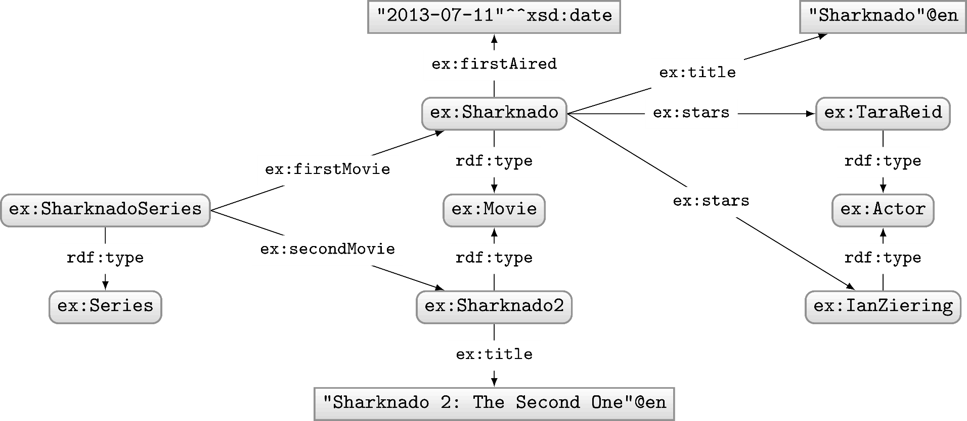
Let’s model something in RDF …
Model the following in RDF:
“Sharknado is the first movie of the Sharknado series. It first aired on July 11, 2013. The movie stars Tara Reid and Ian Ziering. The movie was followed by another called ‘Sharknado 2: The Second One’.”

Slide 88
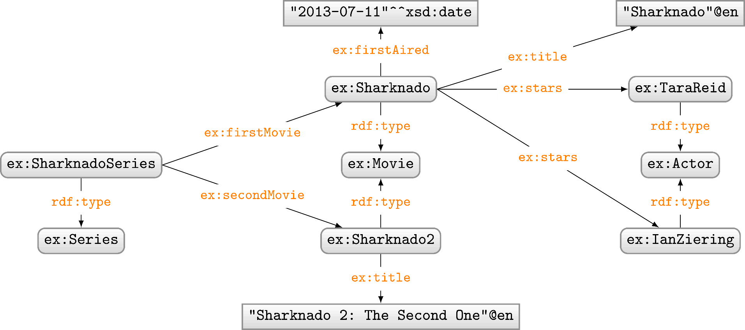
RDF Properties
RDF Terms used as predicate
rdf:type, ex:firstMovie, ex:stars, …

Slide 89
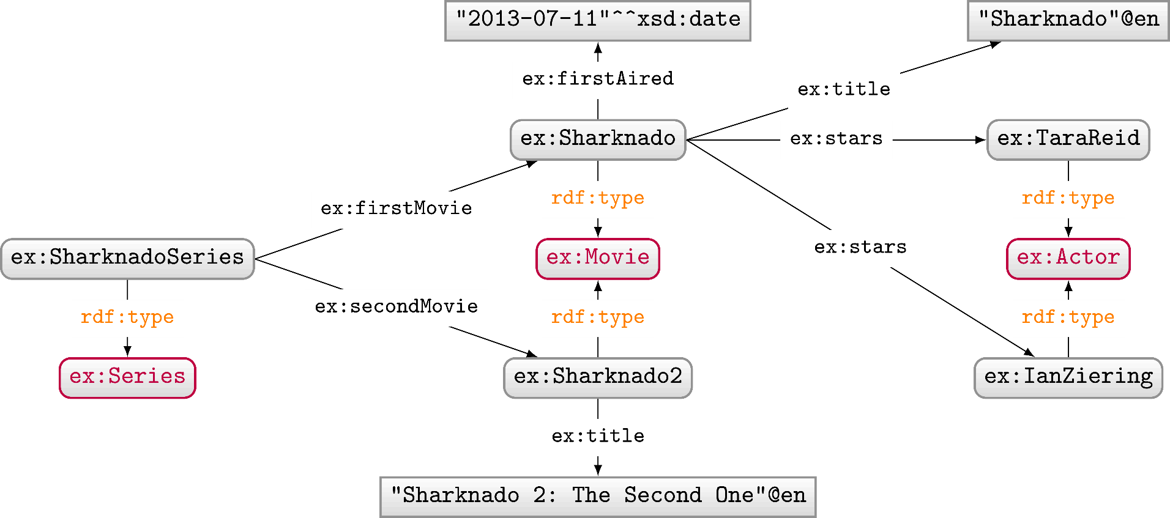
RDF Classes
Used to conceptually group resources
ex:Movie, ex:Actor, ex:Series, etc.
Uses predicate rdf:type to type a resource

Slide 90
Modelling in RDF not always so simple
Model the following in RDF:
“Sharknado stars Tara Reid in the role of ‘April Wexler’."

Slide 91
Modelling in RDF not always so simple
Model the following in RDF:
“'Batman Returns' stars Michael Keaton in the role of 'Batman'."

Slide 92
Modelling in RDF not always so simple
Model the following in RDF:
"'Batman Returns' stars Michael Keaton in the role of 'Batman'."
"'Batman Begins' stars Christian Bale in the role of 'Batman'."
Problem?

Slide 93
Modelling in RDF not always so simple
Model the following in RDF:
"'Batman Returns' stars Michael Keaton in the role of 'Batman'."
"'Batman Begins' stars Christian Bale in the role of 'Batman'."
Problem?

Slide 94
Modelling in RDF not always so simple
Model the following in RDF:
"'Batman Returns' stars Michael Keaton in the role of 'Batman'."
"'Batman Begins' stars Christian Bale in the role of 'Batman'."
Problem?

Slide 95
Modelling in RDF not always so simple
Model the following in RDF:
"'Batman Returns' stars Michael Keaton in the role of 'Batman'."
"'Batman Begins' stars Christian Bale in the role of 'Batman'."
"'Batman Returns' stars Christian Bale in the role of 'Robin'."*
"'Batman Begins' stars Michael Keaton in the role of 'Robin'."*
* hypothetical ☺
Who played which character in which movie?

Slide 96
Modelling n-Ary Relations
Model the following in RDF:
"'Batman Returns' stars Michael Keaton in the role of 'Batman'."
"'Batman Begins' stars Christian Bale in the role of 'Batman'."

Slide 97
Modelling in RDF not always so simple
Model the following in RDF:
"The first movie in the Sharknado series is ‘Sharknado’.
The second movie is ‘Sharknado 2: The Second One’.
The third movie is ‘Sharknado 3: Oh Hell No!’."
More general way to represent lists as a graph?

Slide 98
RDF Collections: Model Ordered Lists
Standard way to model (linked) lists in RDF
Use rdf:rest to link to rest of list
Use rdf:first to link to current member
Use rdf:nil to end the list

Slide 99
RDF Collections: Generic Modelling
Not just for Sharknado series

Slide 100
RDF Syntaxes: Writing RDF down

Slide 101
N-Triples
Line delimited format
No shortcuts

Slide 102
RDF/XML
Legacy format
Horrible

Slide 103
RDFa
Embed RDF into HTML
Not so intuitive

Slide 104
JSON-LD
Embed RDF into HTML
Not completely RDF

Slide 105
Turtle
Readable format

Slide 106
Turtle: Collections Shortcut

Slide 107
Blank nodes add complexity

Slide 108
Blank nodes are local identifiers
How should we combine these two RDF graphs?

Slide 109
Blank nodes are local identifiers
How should we combine these two RDF graphs?

Slide 110
Blank nodes names aren’t important …
(Isomorphic)

Slide 111
Blank nodes names aren’t important …
(Not Isomorphic!)

Slide 112
Are two RDF graphs the “same”?

Slide 113
Are two RDF graphs the “same”?

Slide 114
Are two RDF graphs the “same”?

Slide 115
Are two RDF graphs the “same”?

Slide 116
RDF …

Slide 117
Semantic Web: Data

Slide 118
Questions?

