Slide 1
CC6202-1 La Web de Datos Primavera 2016 Lecture 10: RDB2RDF
Aidan Hogan
aidhog@gmail.com

Slide 2
PREVIOUSLY …

Slide 3
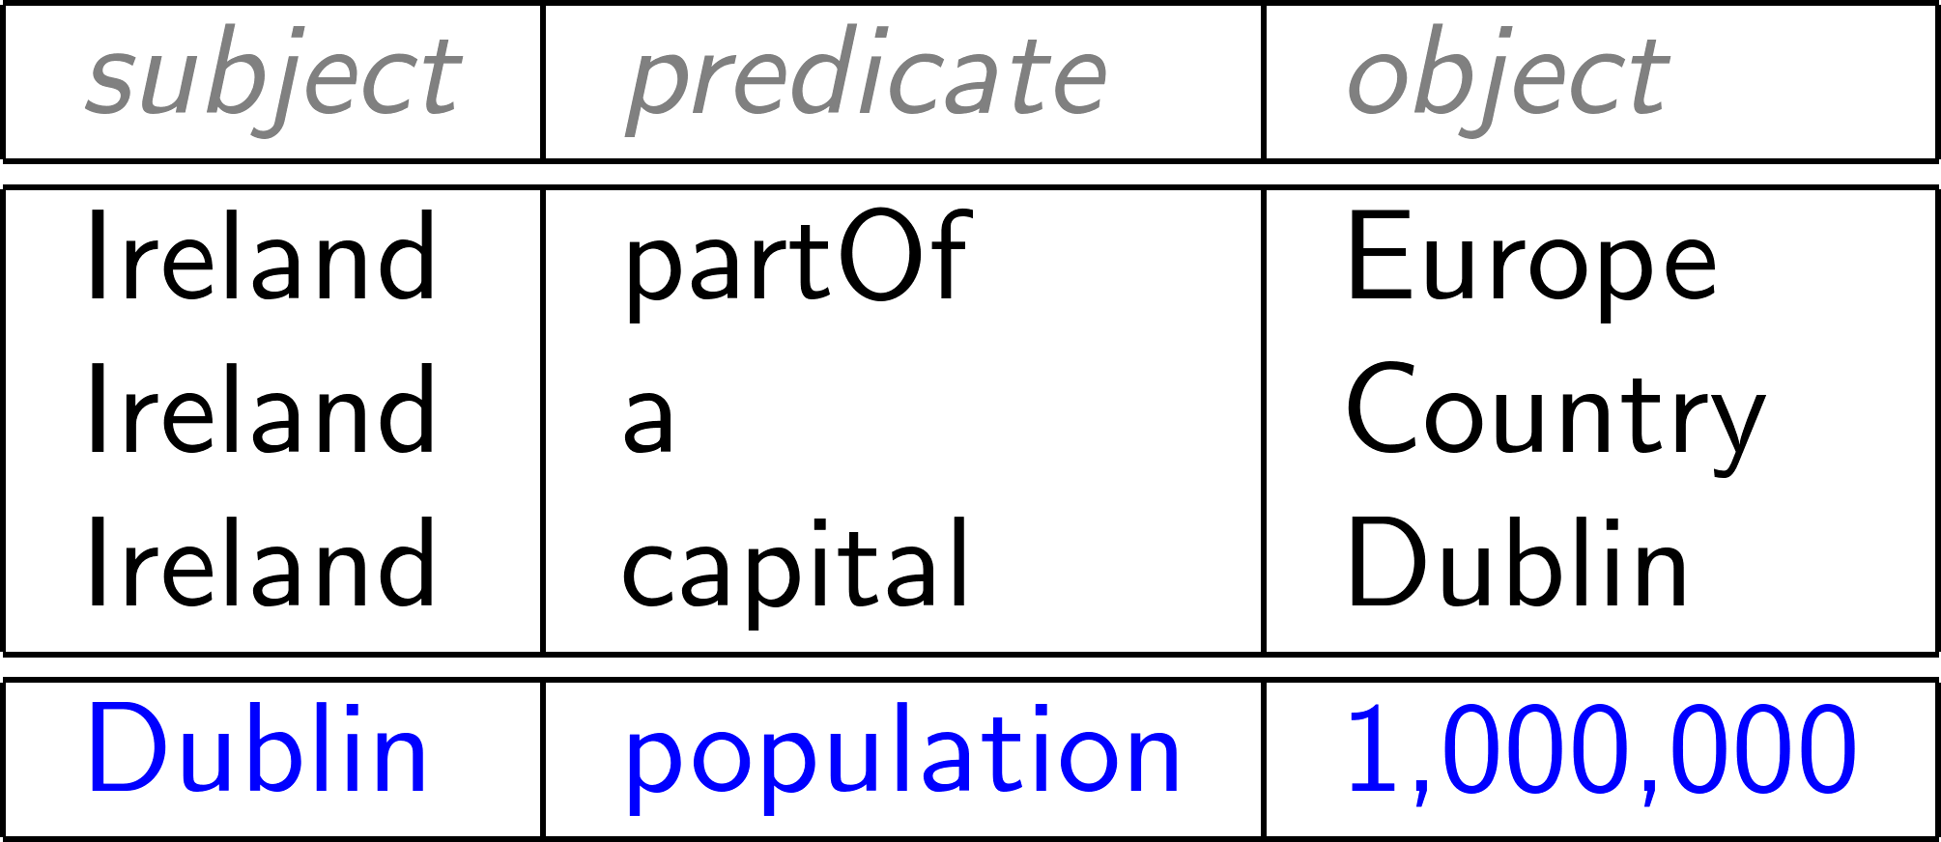
RDF: Proposed model for a Web of Data

Slide 4
RDF: Proposed model for a Web of Data
But where should this RDF come from?
Most legacy data on the Web not in RDF!!
So what legacy formats are common on the Web?

Slide 5
LAMP: Linux, Apache, MySQL, PHP

Slide 6
3-Tier Web Applications

Slide 7
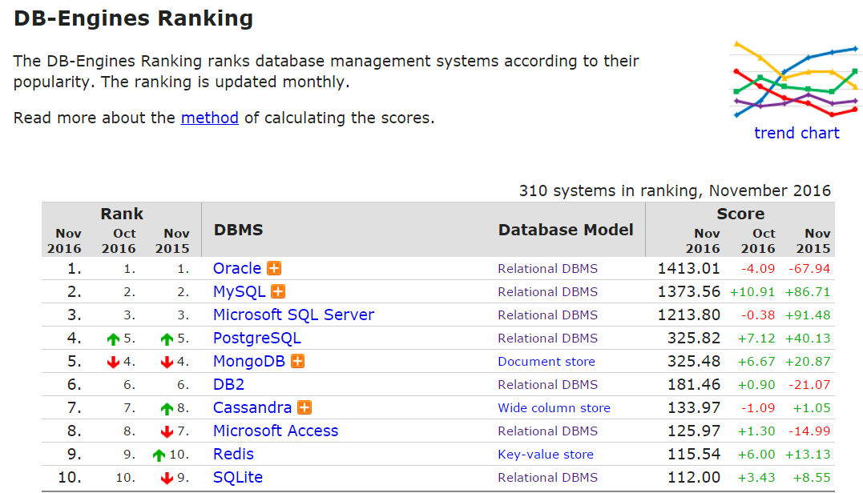
Lots of data in relational databases …
http://db-engines.com/en/ranking

Slide 8
Lots of data in relational databases …
Out of top 10 databases, 7 are relational databases.
Out of 310 databases, any idea in what position the first SPARQL engine would be?
http://db-engines.com/en/ranking

Slide 9
Top SPARQL engine is …

Slide 10
RDB2RDF: relational Databases to RDF

Slide 11
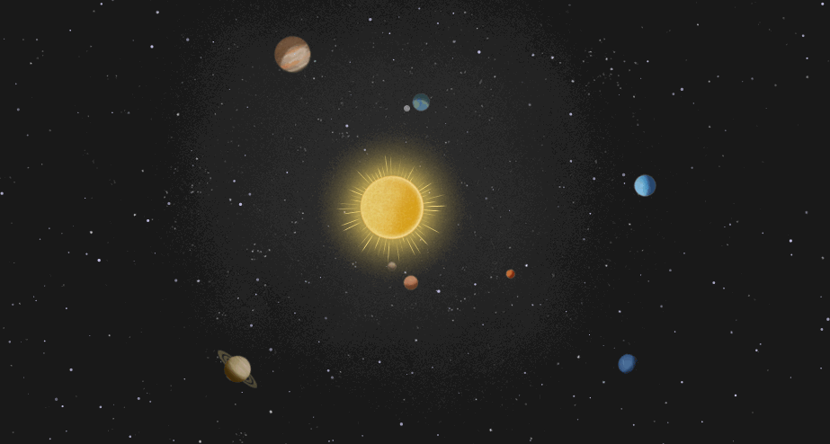
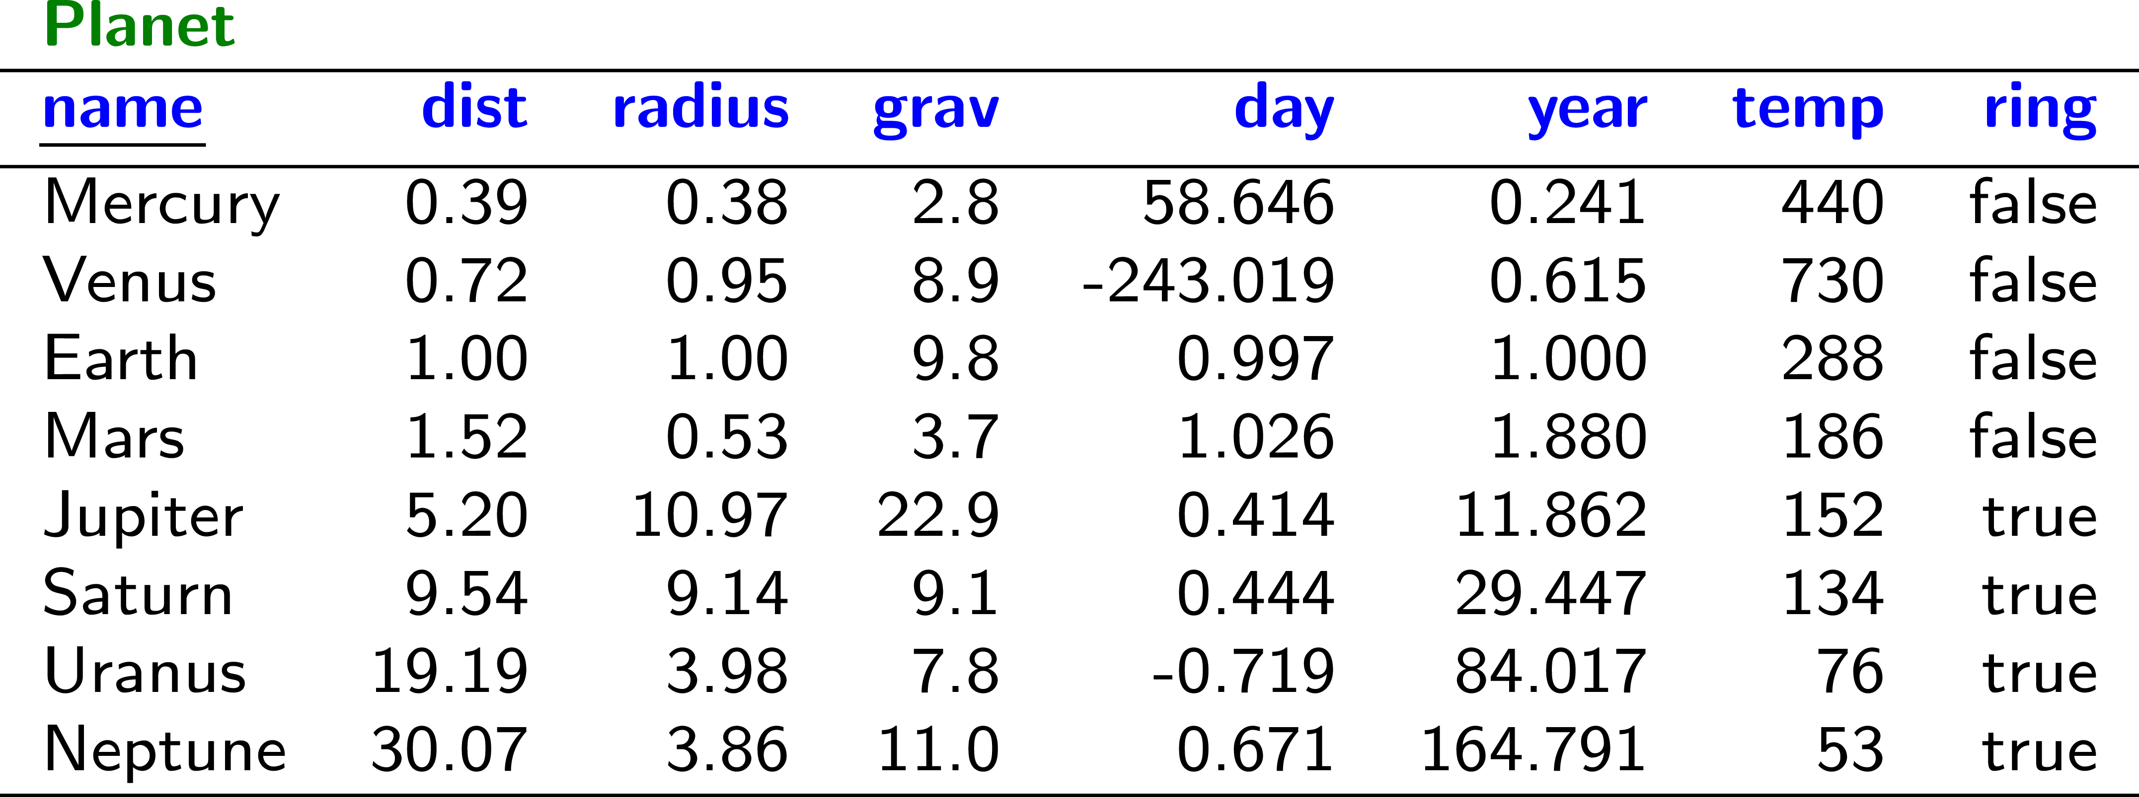
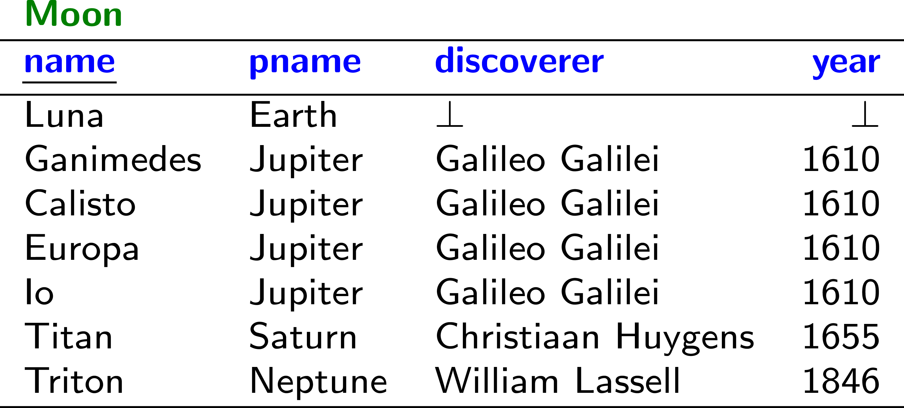
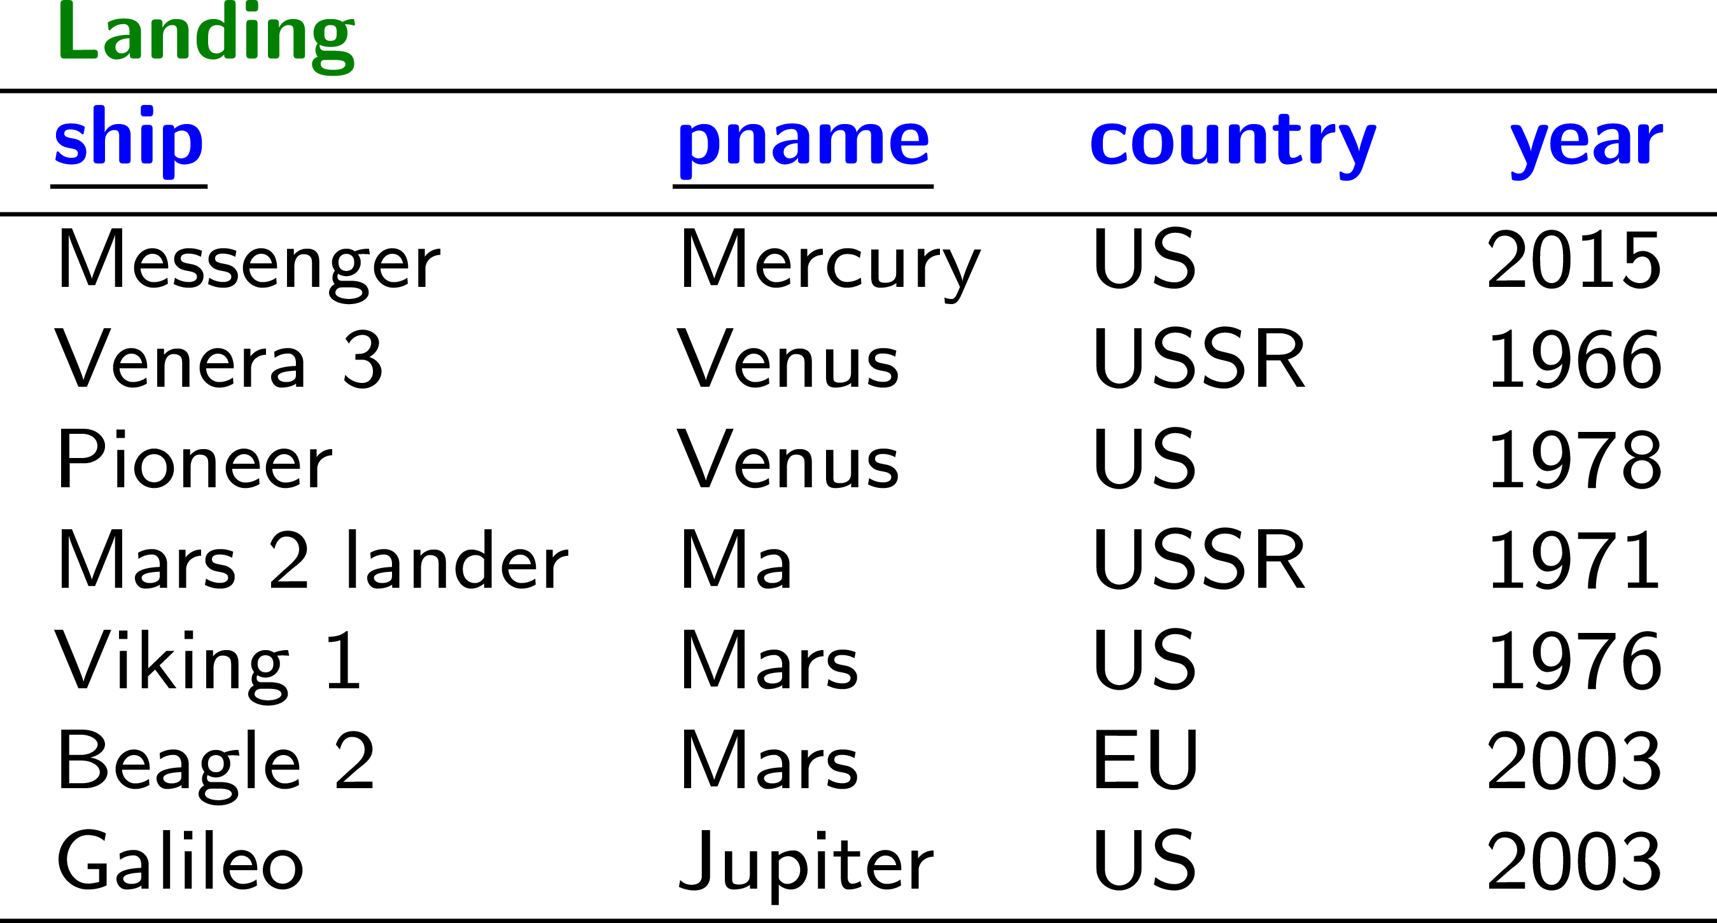
Some relational tables about planets …

Slide 12
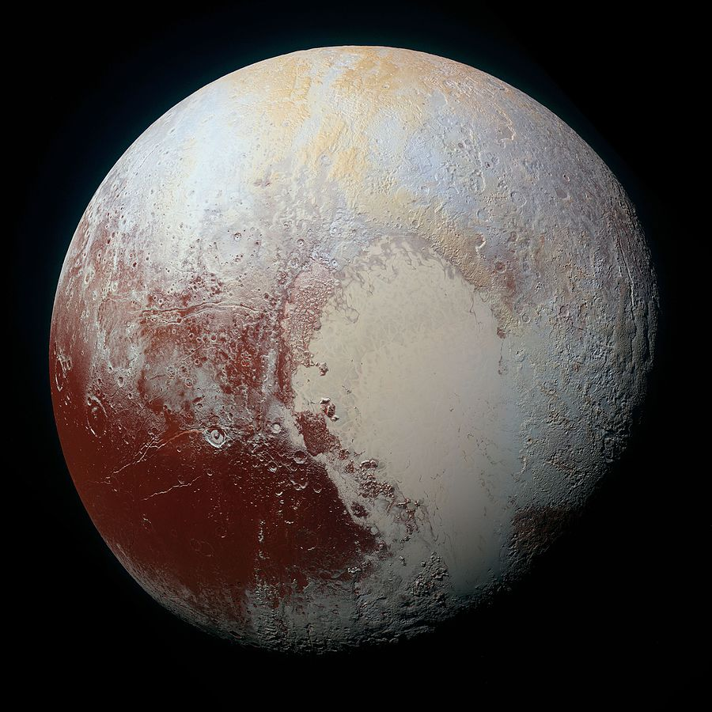
Meanwhile on Pluto …

Slide 13
RDB2RDF?
How might we automatically convert this table to RDF?

Slide 14
RDB2RDF: THE DIRECT MAPPING

Slide 16
Direct Mapping

Slide 17
Direct Mapping
Each table name is a type
Each row is a subject
Each attribute a predicate
Each value an object
But what about RDF terms (IRIs/literals/blank nodes)?

Slide 18
Direct Mapping: Identifying Rows
How can we identify Row1?
If the table has a primary key (pk₁,…,pk_{n}):
http://ex.org/TableName/pk1=v1;pk2=v2;...;pkn=vn
(Base IRI http://ex.org/ given as input)
If not: use a fresh blank node.
So Row1 would be …?
http://ex.org/Planet/name=Mercury

Slide 19
Direct Mapping: Identifying Tables
How can we identify the table?
http://ex.org/Planet

Slide 20
Direct Mapping: Identifying Columns
How can we identify the columns/attributes?
http://ex.org/Planet#ring
http://ex.org/Planet#dist, …

Slide 21
Direct Mapping: Identifying Values
How can we identify values?
“Mercury”
“0.39”^^xsd:float
“false”^^xsd:boolean

Slide 22
Direct Mapping: Final RDF

Slide 23
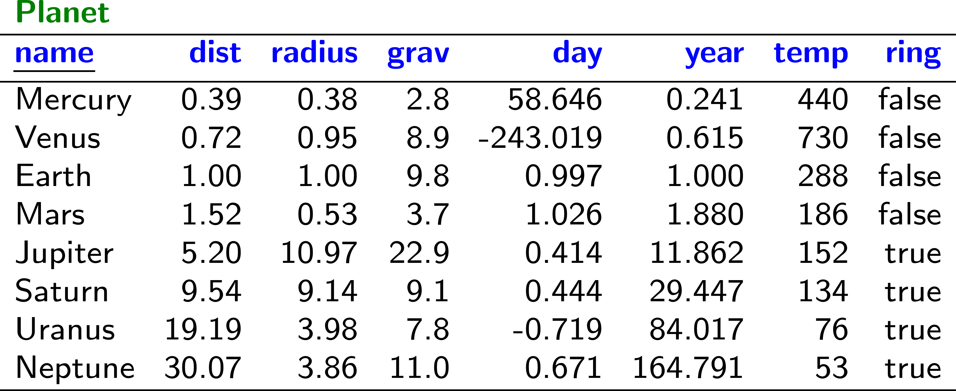
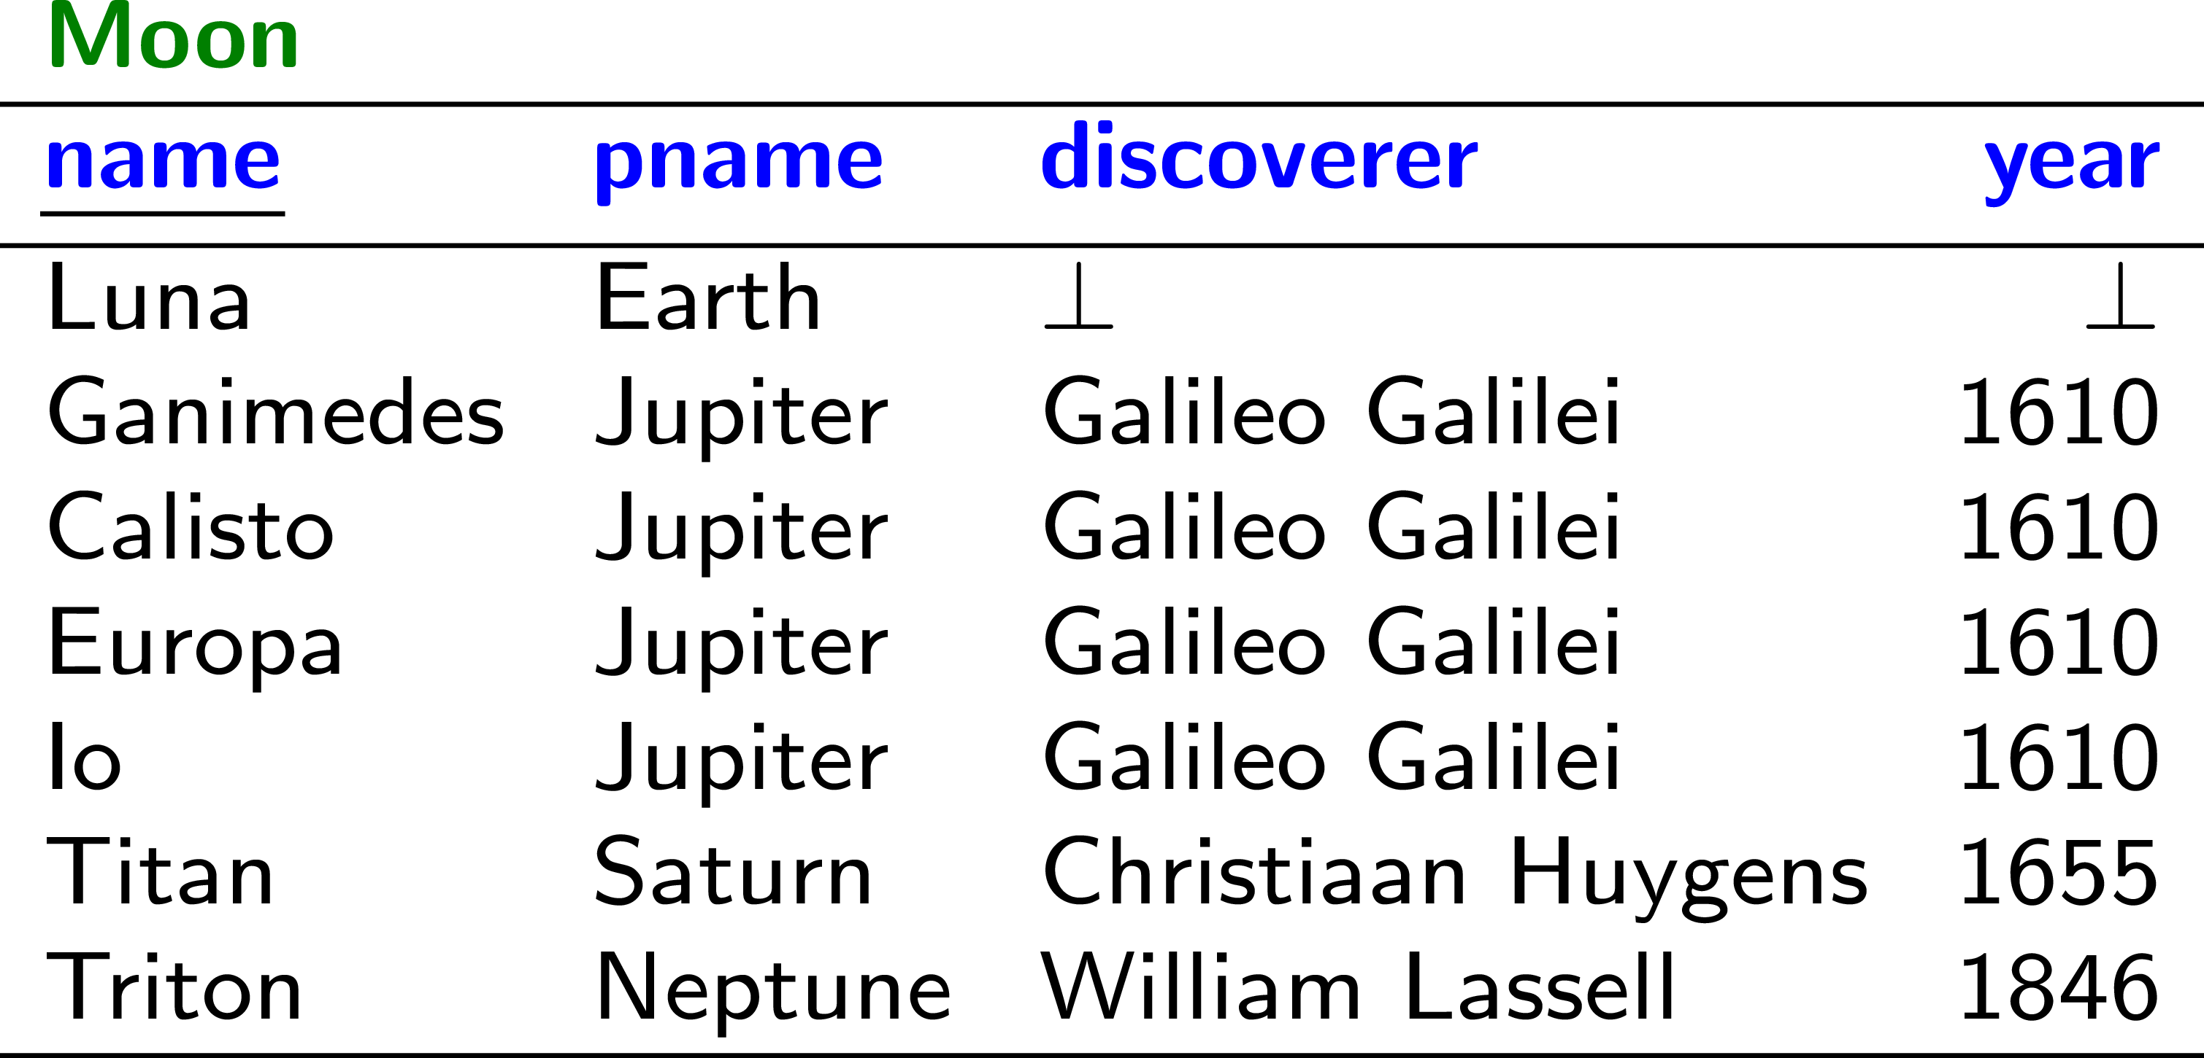
Direct Mapping: Multiple Tables
Anything missing here?
Assume pname is a foreign key
to Planet.name …

Slide 24
Direct Mapping: Foreign Key References

Slide 25
Direct Mapping: Foreign Key References
If table T₁ has a foreign key to table T₂: (fk₁,…,fk_{n}):
http://ex.org/T1#ref-fk1;fk2
(Base IRI http://ex.org/ given as input)
Example: http://ex.org/Moon#ref-pname

Slide 26
Direct Mapping
Anything else missing here?
What should we do with NULL (⊥)??

Slide 27
Direct Mapping: NULL (⊥)
No triples generated for NULL (⊥).
(Semantics of NULL not compatible with RDF)

Slide 28
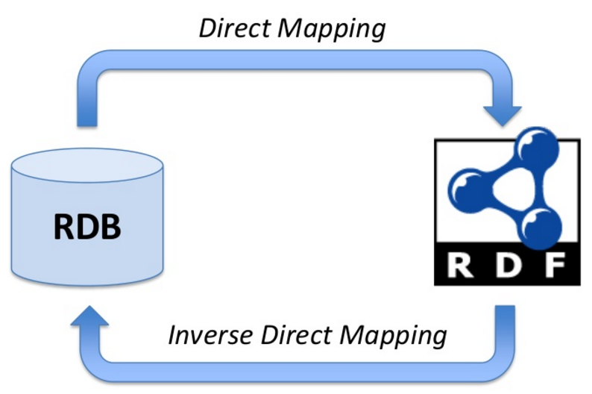
Direct Mapping: Information Preservation

Slide 29
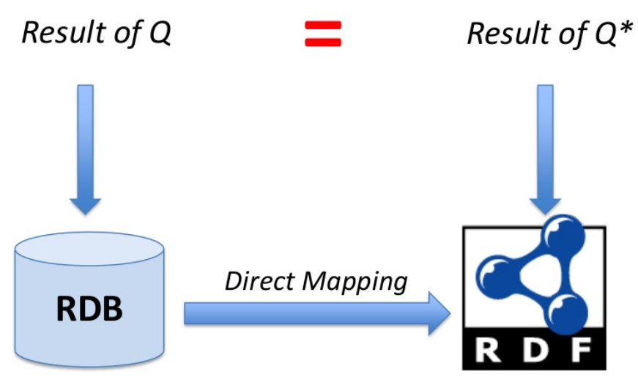
Direct Mapping: Query Preservation

Slide 30
Direct Mapping: Customisation?
What if we want to customise the mapping, e.g., to create a node for people?

Slide 31
R2RML: CUSTOM RDB2RDF MAPPINGS

Slide 33
R2RML: In a nutshell
RDB
R2RML
Mapping
What should we use to specify this R2RML mapping?

Slide 34
R2RML Example: The Direct Mapping

Slide 35
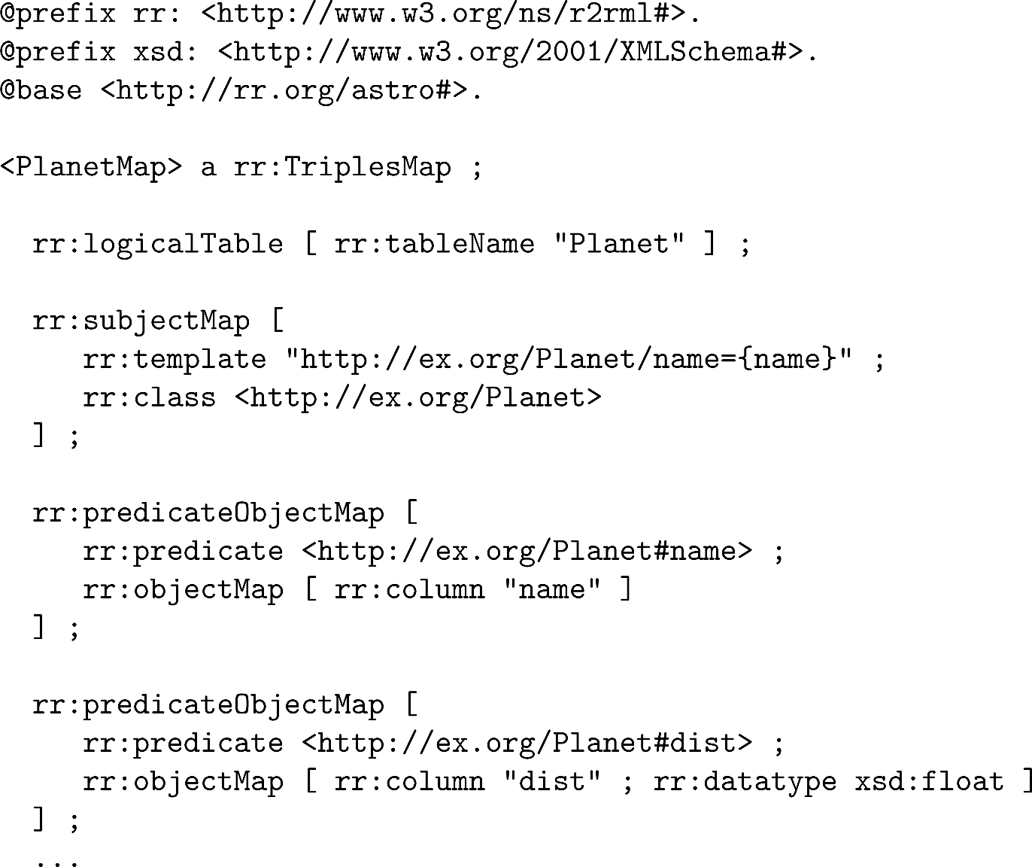
R2RML Example: The Direct Mapping
Triple Mapping
Source Table
Subject Mapping
Predicate-Object Mapping
Predicate-Object Mapping
…

Slide 36
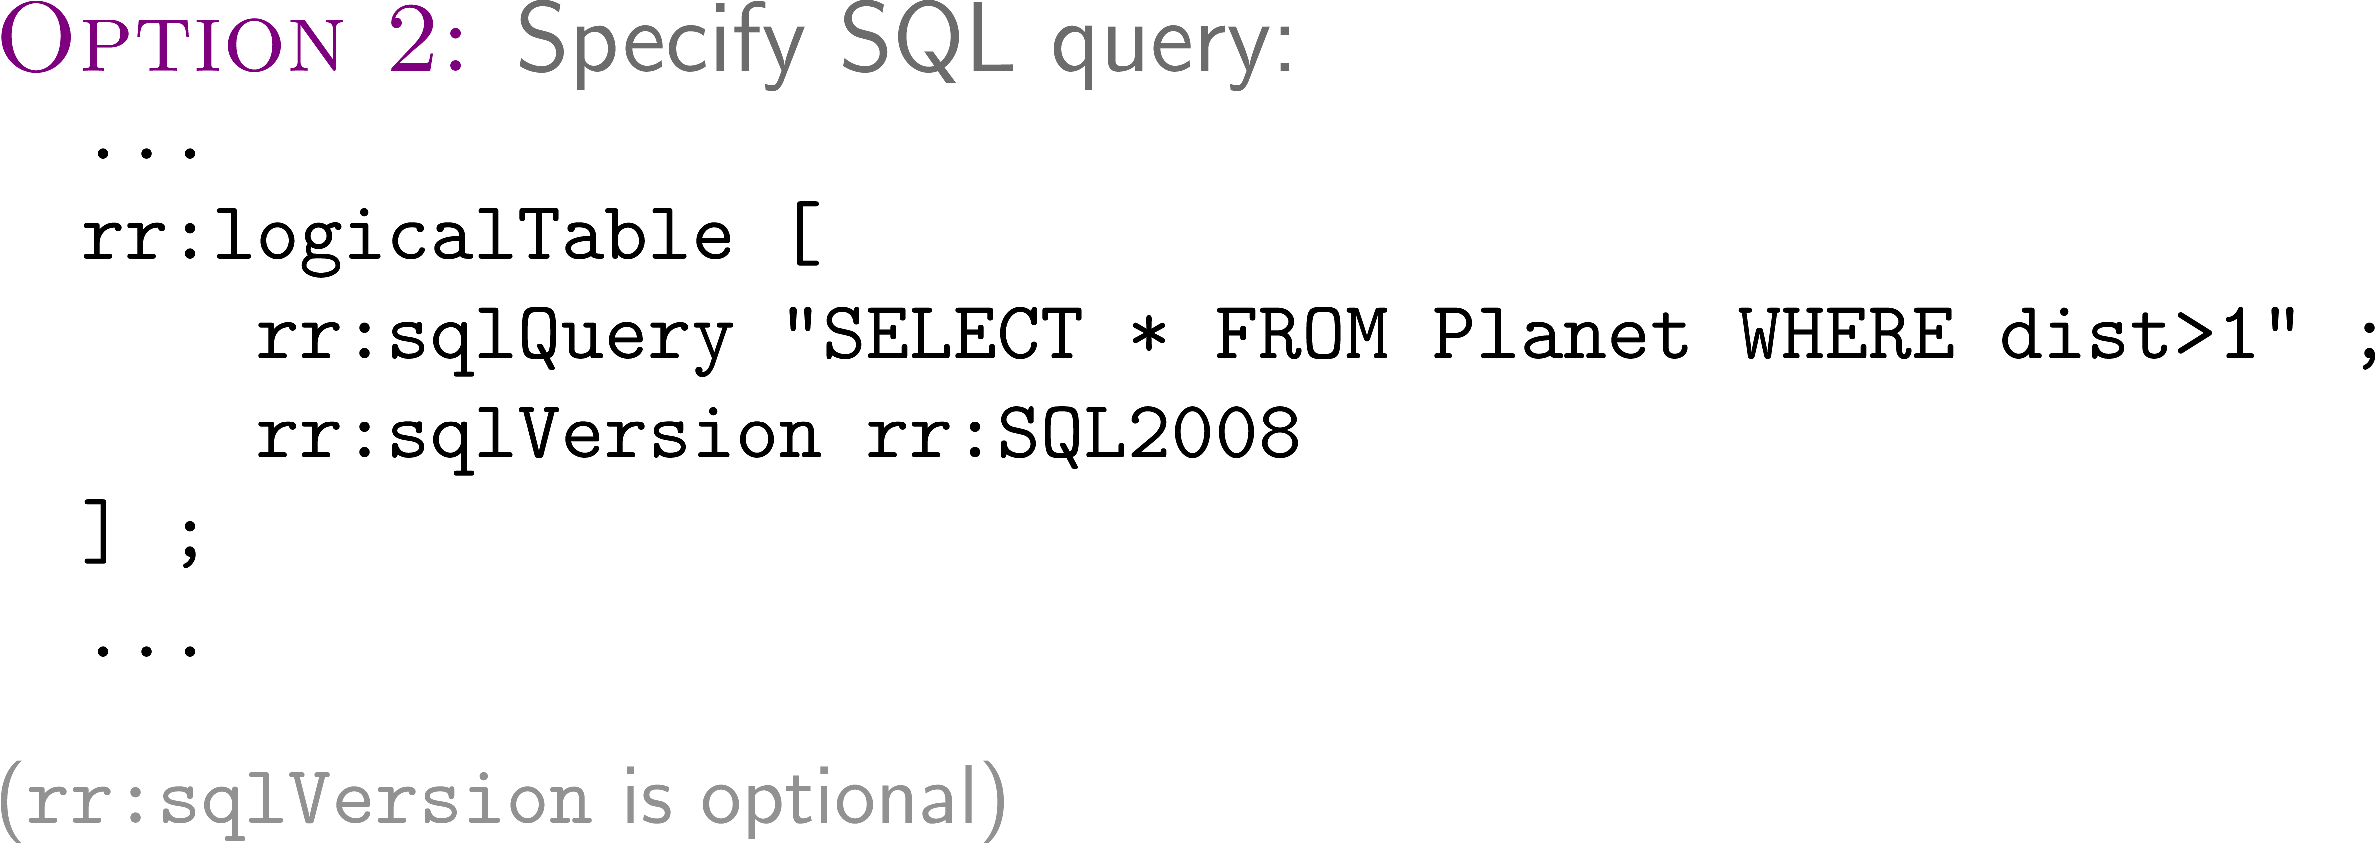
R2RML: Selecting a Logical Table
Triple Mapping
Source Table
Subject Mapping
Predicate-Object Mapping
Predicate-Object Mapping
…

Slide 37
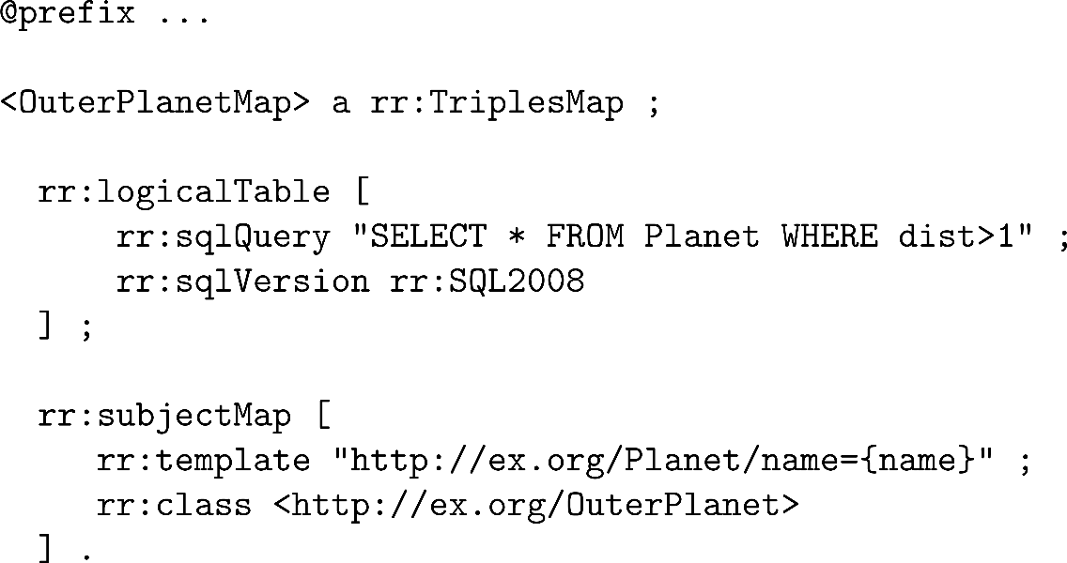
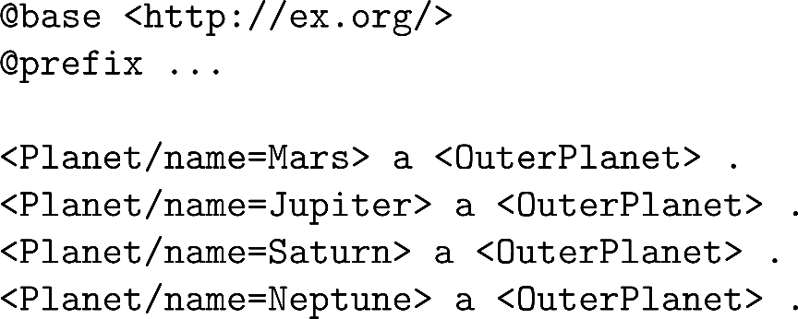
R2RML: Example with SQL Query

Slide 38
R2RML: Term Maps—Creating RDF Terms
Triple Mapping
Source Table
Subject Mapping
Predicate-Object Mapping
Predicate-Object Mapping
…

Slide 39
R2RML: Term Maps—Creating RDF Terms

Slide 40
R2RML: Term Maps—Constants

Slide 41
R2RML: Term Maps—Columns

Slide 42
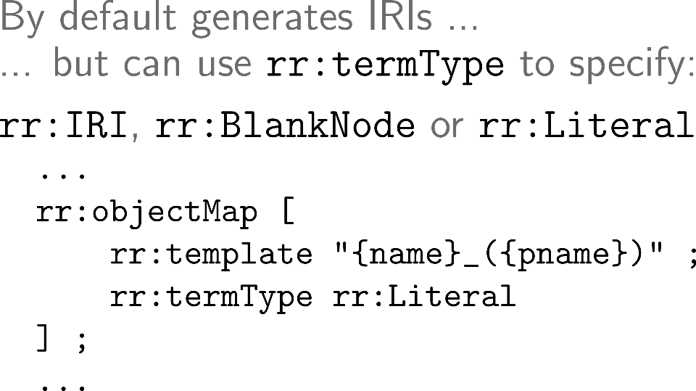
R2RML: Term Maps—Templates

Slide 43
R2RML: Term Maps

Slide 44
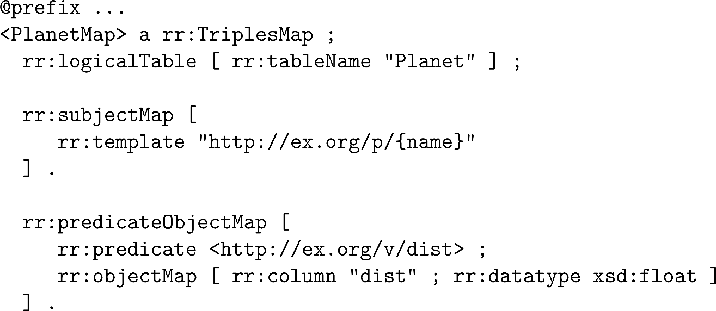
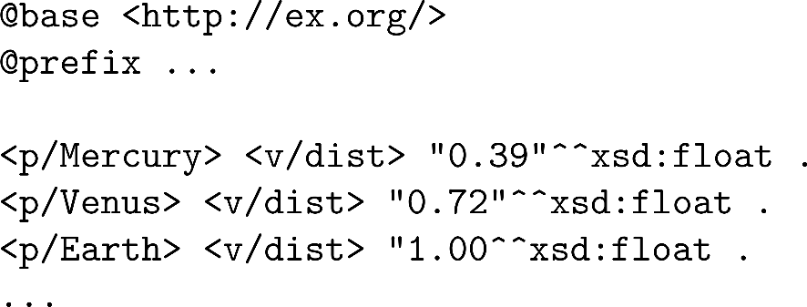
R2RML: Example of Term Maps

Slide 45
R2RML: Subject Map
Triple Mapping
Source Table
Subject Mapping
Predicate-Object Mapping
Predicate-Object Mapping
…

Slide 46
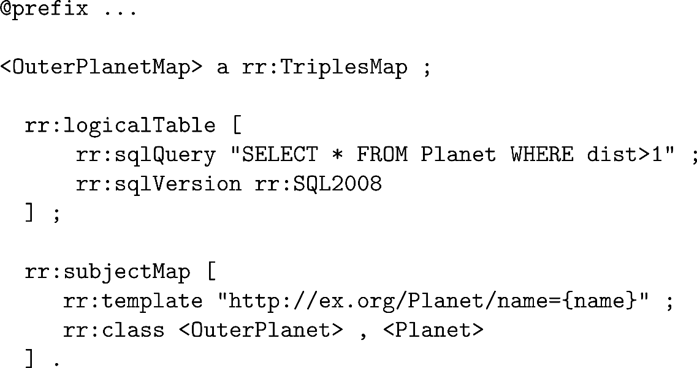
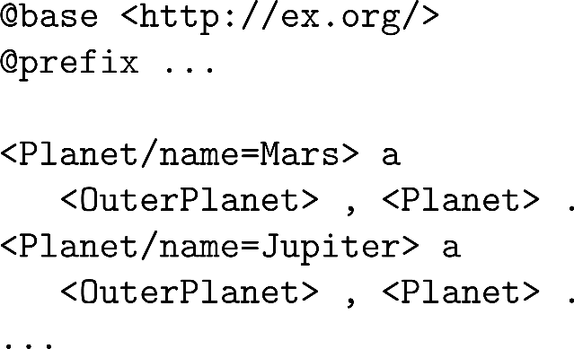
R2RML: Example with multiple types

Slide 47
R2RML: Predicate–Object Map
Triple Mapping
Source Table
Subject Mapping
Predicate–Object Mapping
Predicate–Object Mapping
…

Slide 48
R2RML: Predicate–Object Map
Triple Mapping
Source Table
Subject Mapping
Predicate–Object Mapping
Predicate–Object Mapping
…

Slide 49
R2RML: Reference Object Map

Slide 50
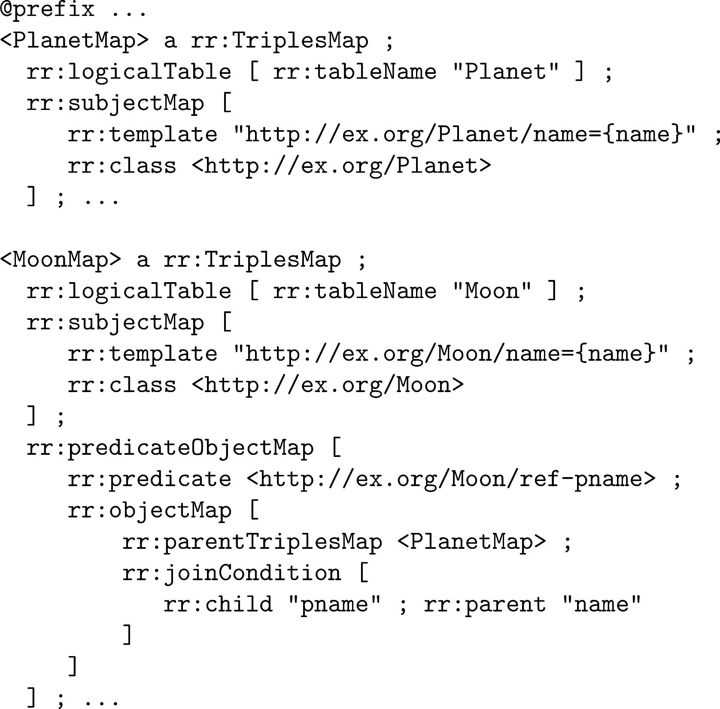
R2RML: Reference Object Map

Slide 51
R2RML: Reference Object Map

Slide 52
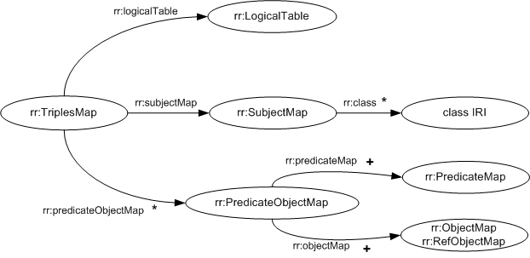
Summary of Triple Map Structure
* zero or more
+ one or more
(otherwise, precisely one)

Slide 53
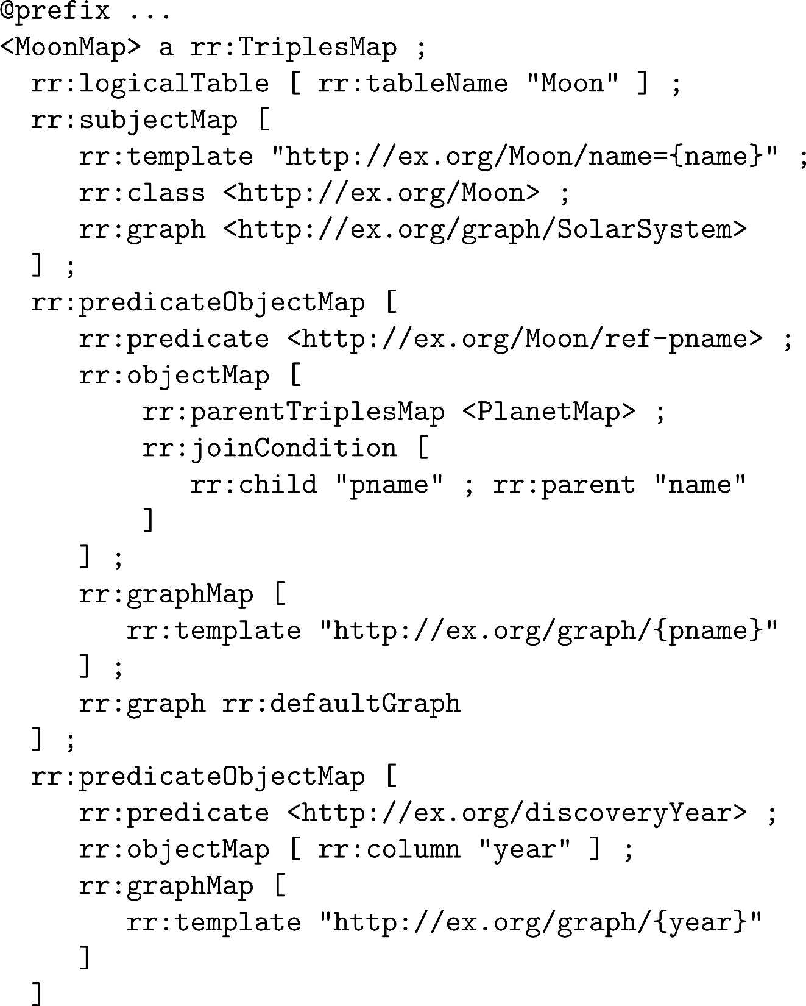
R2RML: Graph Maps

Slide 54
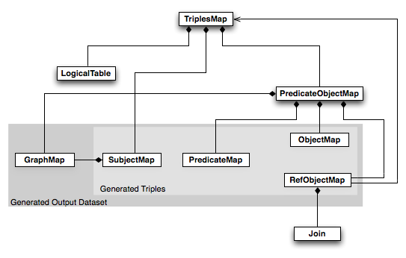
R2RML …

Slide 55
RECAP

Slide 56
RDB2RDF
Lots of legacy data in Relational DataBases
Would be nice if we could map that to RDF ☺
Direct Mapping: Automatic
Automatic term generation
Automatic links based on foreign keys
Not customisable
R2RML: Write custom mappings
Logical tables (table name/SQL query)
Term maps (S/P/O/G)

Slide 57
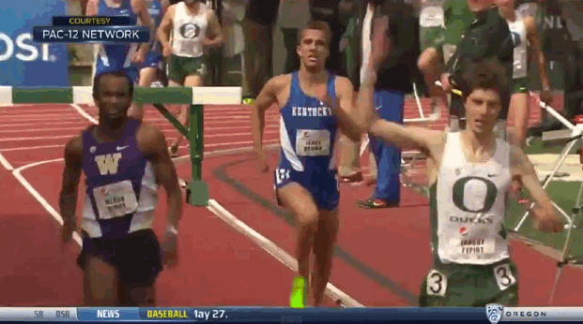
End of new material!

Slide 58
Questions?

