Slide 1
CC6202-1 La Web de Datos Primavera 2015 Lecture 9: Linked Data
Aidan Hogan
aidhog@gmail.com

Slide 2
PREVIOUSLY …

Slide 3
First SPARQL (1.0)
Then SPARQL 1.1

Slide 4
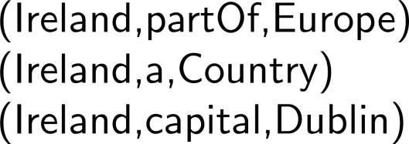
(1) Data, (2) Rules/Ontologies, (3) Query

Slide 5
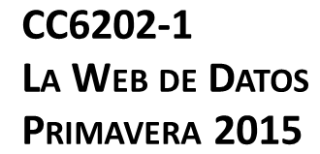
But we have not spoken much about …
… how do we use RDF(S)/OWL/SPARQL
to build a “Web of Data”?

Slide 6
We’ve gotten from here …

Slide 7
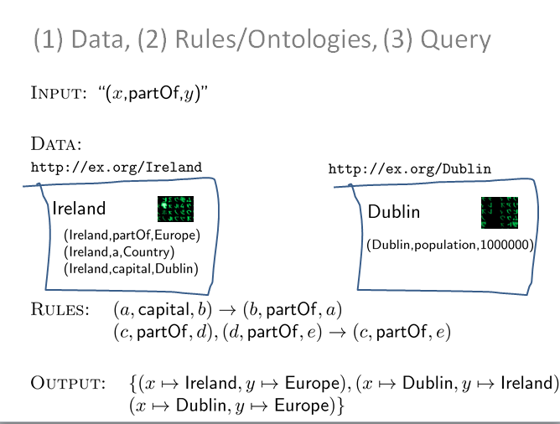
To here …
But what are we missing from here before we can have a “Web of Data”?

Slide 8
We need links!
… can’t have a Web without links!

Slide 9
We need links!
So how can we include links in this picture?

Slide 10
RDF filled with IRIs!
… any IRI could be a link!

Slide 11
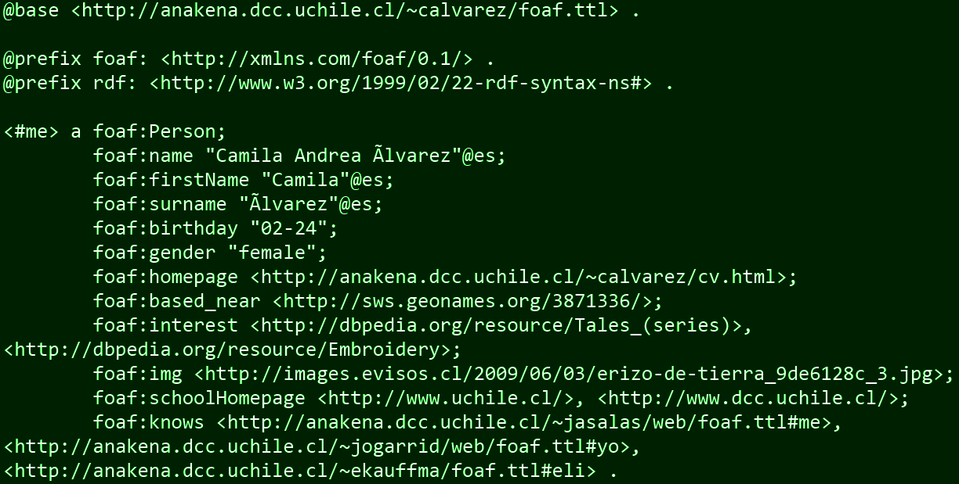
We already saw this in Lab 1 …

Slide 12
These link to other RDF documents …

Slide 13
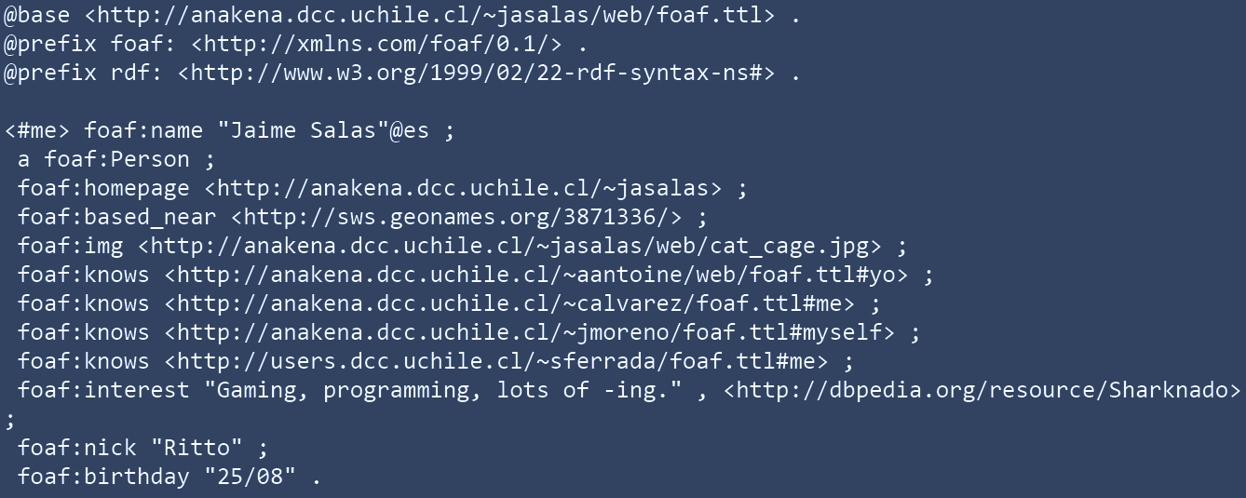
HTTP GET

Slide 14
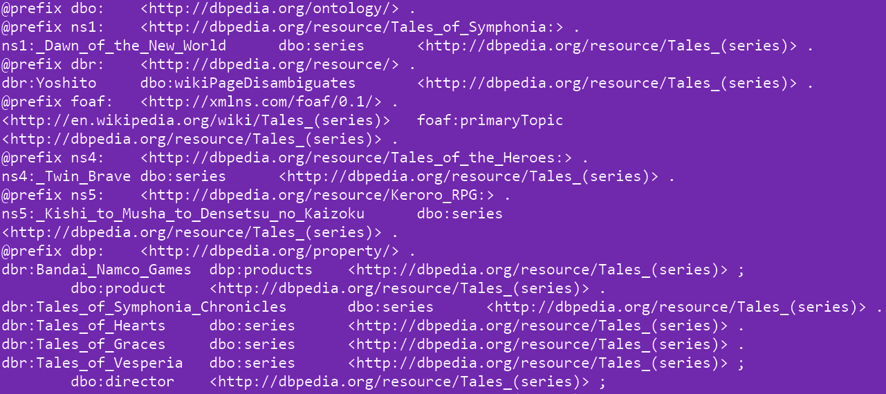
HTTP GET

Slide 15
These also link to other RDF documents …

Slide 16
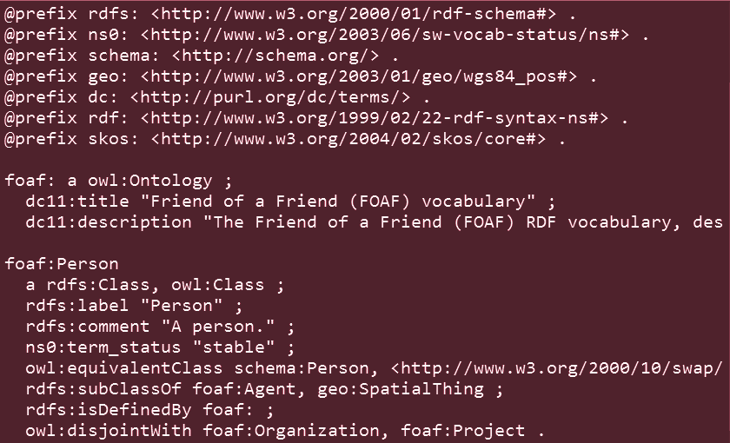
HTTP GET

Slide 17
PRE-Linked DATA …

Slide 18
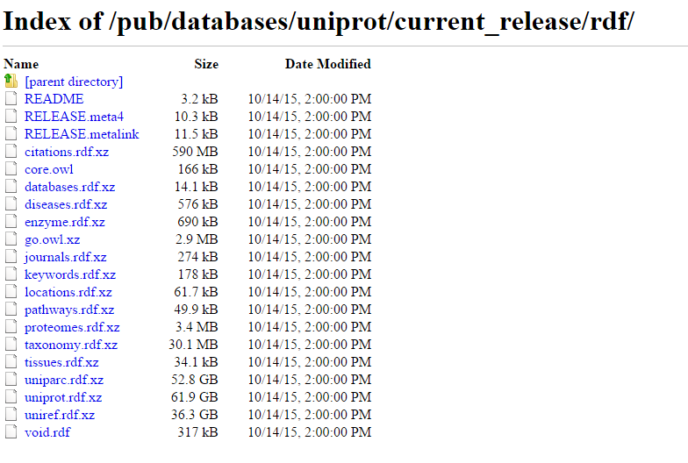
Semantic Web, early days (pre-2006)
Lots of dumps of RDF

Slide 19
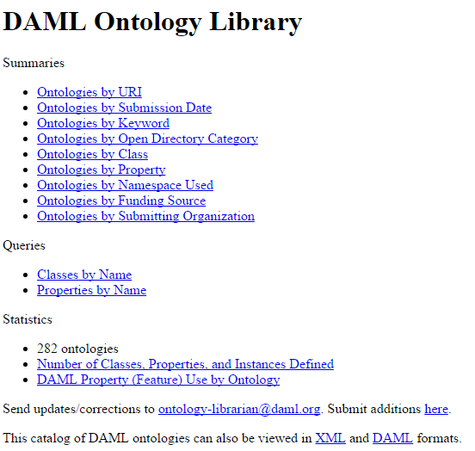
Semantic Web, early days (pre-2006)
Lots of dumps of RDF
Big OWL ontologies (difficult to re-use)

Slide 20
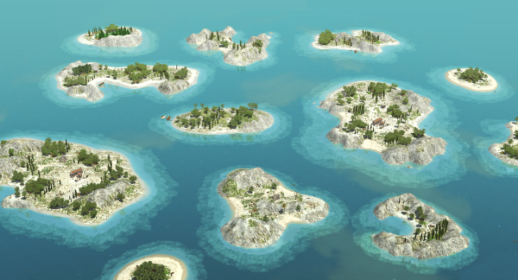
Semantic Web, early days (pre-2006)
Lots of dumps of RDF
Big OWL ontologies (difficult to re-use)
No reuse of IRIs ... no links … no Web!

Slide 21
Semantic Web, early days (pre-2006)
Lots of dumps of RDF
Big OWL ontologies (difficult to re-use)
No reuse of IRIs ... no links … no Web!
Some exceptions, like FOAF
but still, blank nodes used more often than IRIs!

Slide 22
Linked DATA …

Slide 23
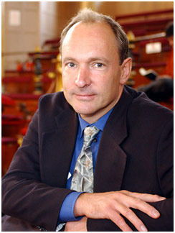
Linked Data … 2006
http://www.w3.org/DesignIssues/LinkedData.html
(I’ll explain the mug later)

Slide 24
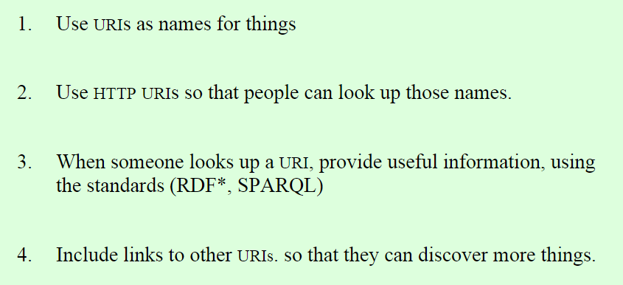
Four Principles of Linked Data
http://www.w3.org/DesignIssues/LinkedData.html

Slide 25
This is Linked Data …

Slide 26
And so we have our “Web of Data”!!!!!

Slide 27
So what’s the catch?

Slide 28
ONE MINOR CATCH … … NAMING THINGS NOT DOCUMENTS

Slide 29
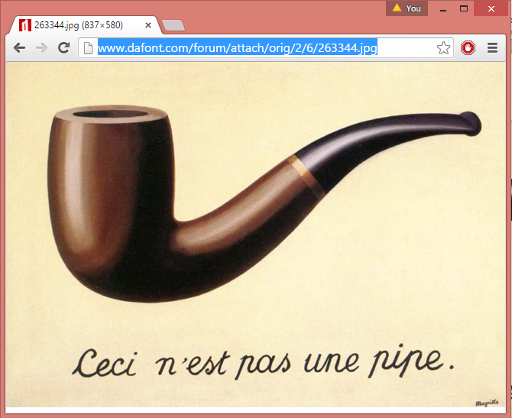
HTTP IRIs usually for documents, not pipes

Slide 30
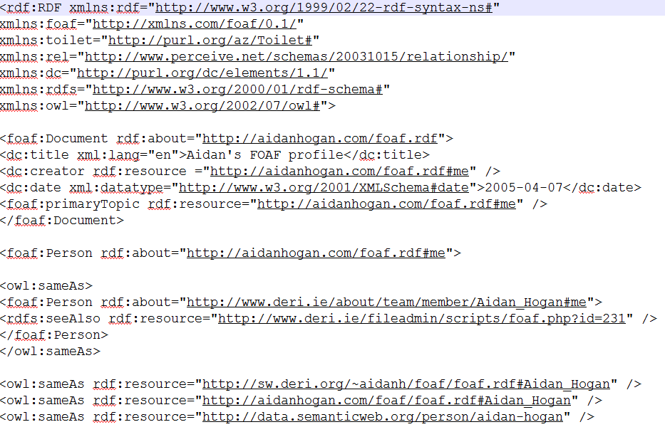
My FOAF file is not me
http://aidanhogan.com/foaf.rdf

Slide 31
How to identify things not documents?
We could invent a new protocol real://?
real://aidanhogan.com/foaf.rdf
Problems?
Solutions?

Slide 32
How to identify things not documents
Hash (aka. fragment identifier)
http://aidanhogan.com/foaf.rdf
Identifies my FOAF file
http://aidanhogan.com/foaf.rdf#me
Identifies me
Look it up with HTTP, you get my FOAF file
GET http://aidanhogan.com/foaf.rdf#me
200 Okay: http://aidanhogan.com/foaf.rdf

Slide 33
How to identify things not documents
Slash (with 303 redirect)
http://dbpedia.org/data/Sharknado.xml
Identifies RDF document about Sharknado
http://dbpedia.org/resource/Sharknado
Identifies the movie Sharknado
Look it up, it redirects with 303 to RDF doc. above
GET http://dbpedia.org/resource/Sharknado
303 See Other: http://dbpedia.org/data/Sharknado.xml
GET http://dbpedia.org/data/Sharknado.xml
200 Okay: http://dbpedia.org/data/Sharknado.xml

Slide 34
Hash vs. Slash
GET http://aidanhogan.com/foaf.rdf#me
200 Okay: http://aidanhogan.com/foaf.rdf
Which is better, hash or slash?
Well, hash has half the number of requests!
GET http://dbpedia.org/resource/Sharknado
303 See Other: http://dbpedia.org/data/Sharknado.xml
GET http://dbpedia.org/data/Sharknado.xml
200 Okay: http://dbpedia.org/data/Sharknado.xml

Slide 35
Why does slash exist then?
Good question
Hash often used to describe multiple resources in one document
Slash often used when there are too many resources to fit in one document
But nothing would stop, e.g.:
http://dbpedia.org/data/Sharknado.xml#this

Slide 36
So … erm … why does slash exist then?
GET http://aidanhogan.com/foaf.rdf#me
200 Okay: http://aidanhogan.com/foaf.rdf
Well, server has more flexibility. It can change which document is returned.
In the hash scenario, the document is fixed in the resource IRI.
GET http://dbpedia.org/resource/Sharknado
303 See Other: http://dbpedia.org/rdf/Sharknado
GET http://dbpedia.org/rdf/Sharknado
200 Okay: http://dbpedia.org/rdf/Sharknado

Slide 37
Content negotiation with hash
ACCEPT: application/rdf+xml
GET http://aidanhogan.com/foaf#me
200 Okay: http://aidanhogan.com/foaf.rdf
ACCEPT: text/html
GET http://aidanhogan.com/foaf#me
200 Okay: http://aidanhogan.com/foaf.html
Can also choose from different RDF formats; e.g., Turtle, RDFa, etc.
(if supported by the server that is!)
Can also specify preferences using q values …

Slide 38
Content negotiation with slash
ACCEPT: application/rdf+xml
GET http://dbpedia.org/resource/Sharknado
303 See Other: http://dbpedia.org/data/Sharknado.xml
GET http://dbpedia.org/data/Sharknado.xml
200 Okay: http://dbpedia.org/data/Sharknado.xml
ACCEPT: text/html
GET http://dbpedia.org/resource/Sharknado
303 See Other: http://dbpedia.org/page/Sharknado
GET http://dbpedia.org/page/Sharknado
200 Okay: http://dbpedia.org/page/Sharknado

Slide 39
LINKING OPEN DATA

Slide 40
Linked Data … 2006
http://www.w3.org/DesignIssues/LinkedData.html
(I’ll explain the mug later)

Slide 41
Open Data, meet Linked Data
We’ve got all these people who want to publish Open Data but how should they publish it on the Web?
We’ve got this new way of publishing Linked Data on the Web but no data to publish …

Slide 42
Linked Open Data
We’ve got this new way of publishing Linked Data on the Web but no data to publish …
Are you thinking what I’m thinking?
We’ve got all these people who want to publish Open Data but how should they publish it on the Web?

Slide 43
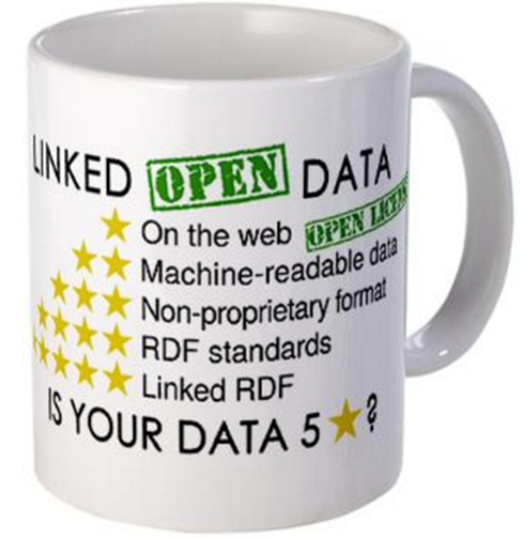
The 5 ★’s of Linked Open Data
★ Publish data under open licence
★★ Make the data “machine readable”
e.g., a Spreadsheet better than a PDF table
★★★ Use non-proprietary formats
e.g., a CSV text file better than Excel
★★★★ Use URIs to name your stuff (hint: RDF)
use unambiguous identifiers that can be linked/looked up
★★★★★ Provide links to other content
so consumers can follow links to find out more

Slide 44
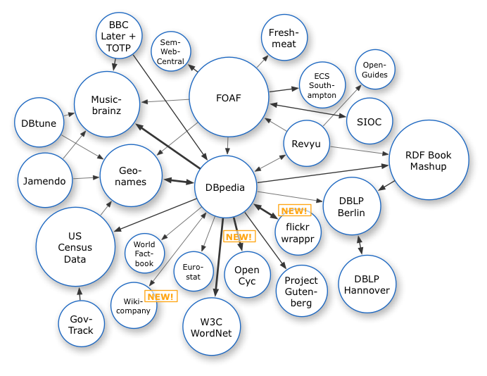
Growth of the Linked Data Cloud
Oct. 2007

Slide 45
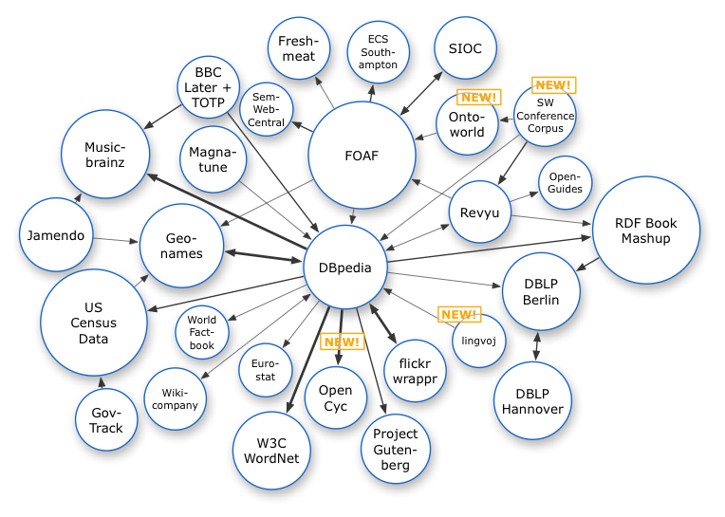
Growth of the Linked Data Cloud
Oct. 2007
Nov. 2007

Slide 46
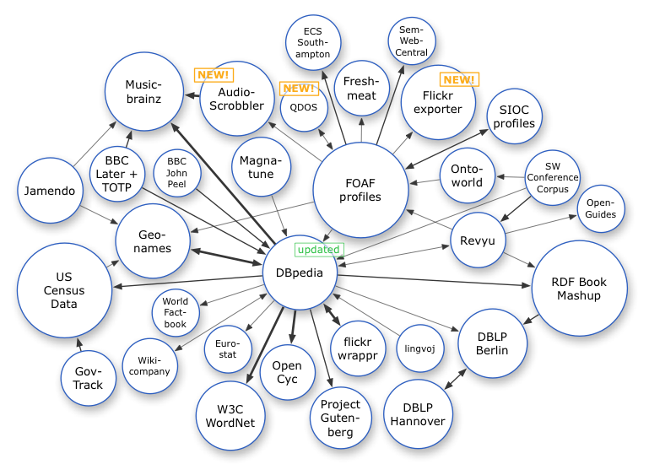
Growth of the Linked Data Cloud
Oct. 2007
Nov. 2007
Feb. 2008

Slide 47
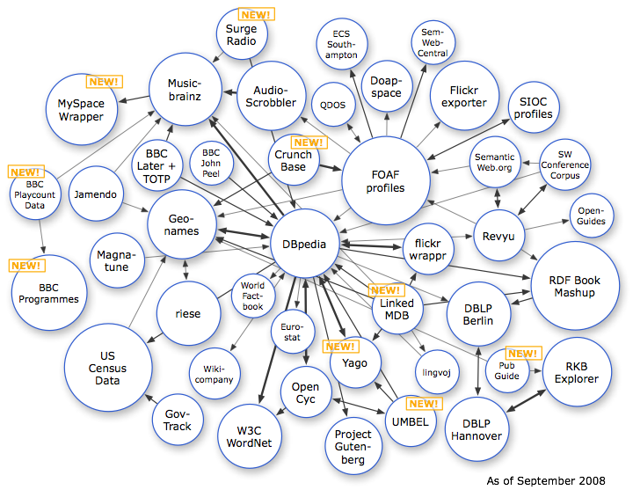
Growth of the Linked Data Cloud
Oct. 2007
Nov. 2007
Feb. 2008
Sep. 2008

Slide 48
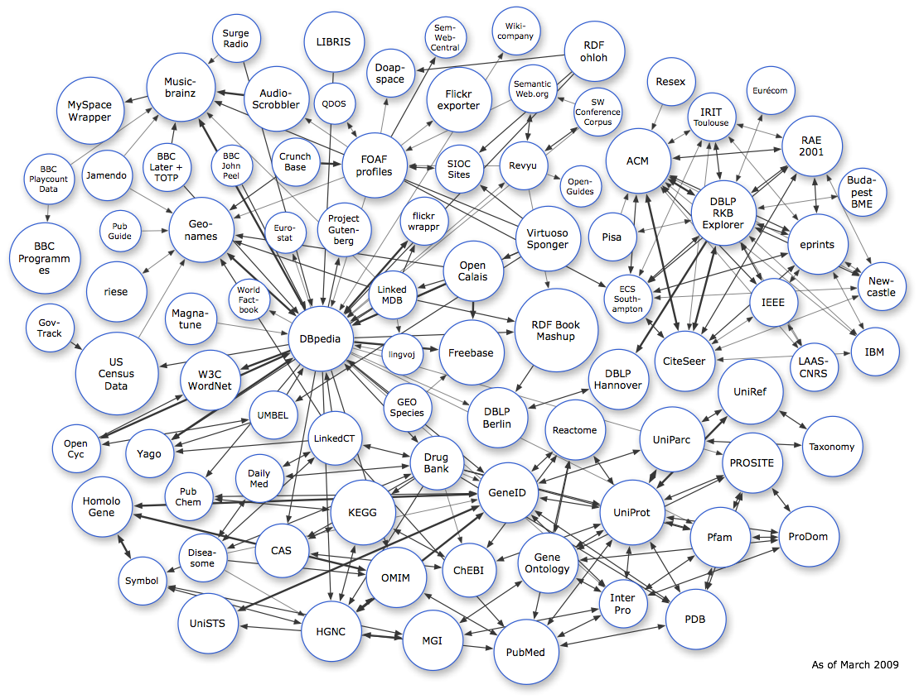
Growth of the Linked Data Cloud
Oct. 2007
Nov. 2007
Feb. 2008
Sep. 2008
Mar. 2009

Slide 49
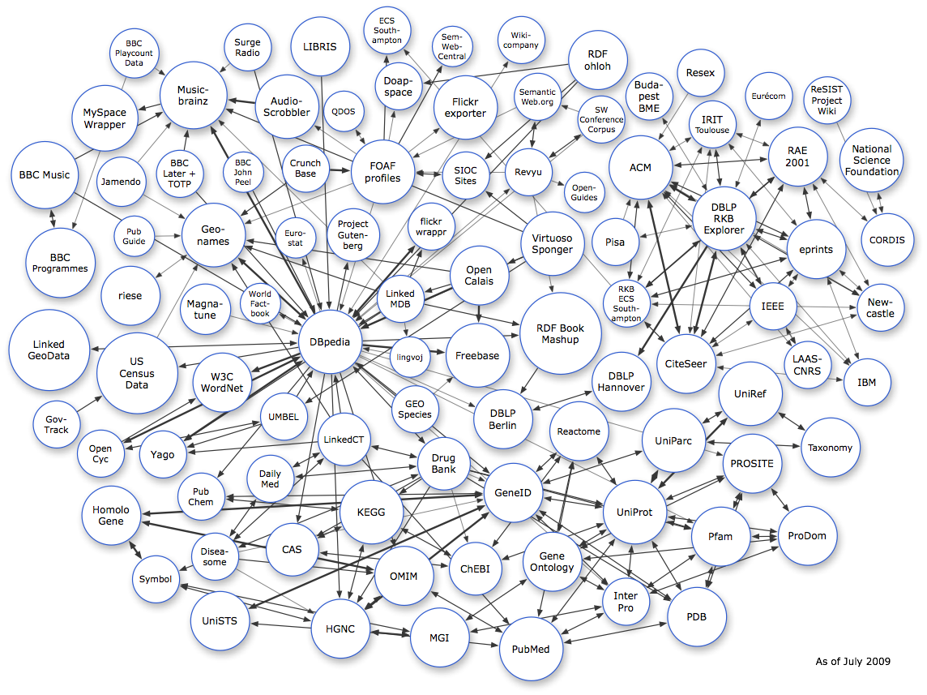
Growth of the Linked Data Cloud
Oct. 2007
Nov. 2007
Feb. 2008
Sep. 2008
Mar. 2009
July 2009

Slide 50
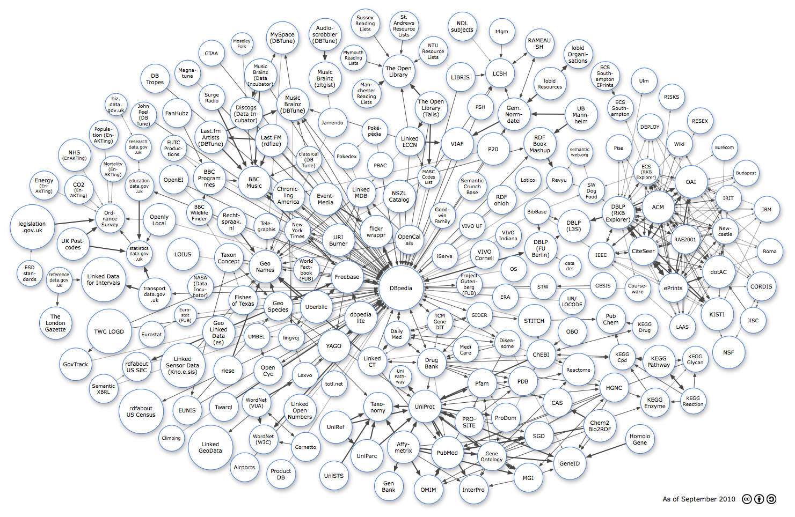
Growth of the Linked Data Cloud
Oct 2007
Oct. 2007
Nov. 2007
Feb. 2008
Sep. 2008
Mar. 2009
July 2009
Sept. 2010

Slide 51
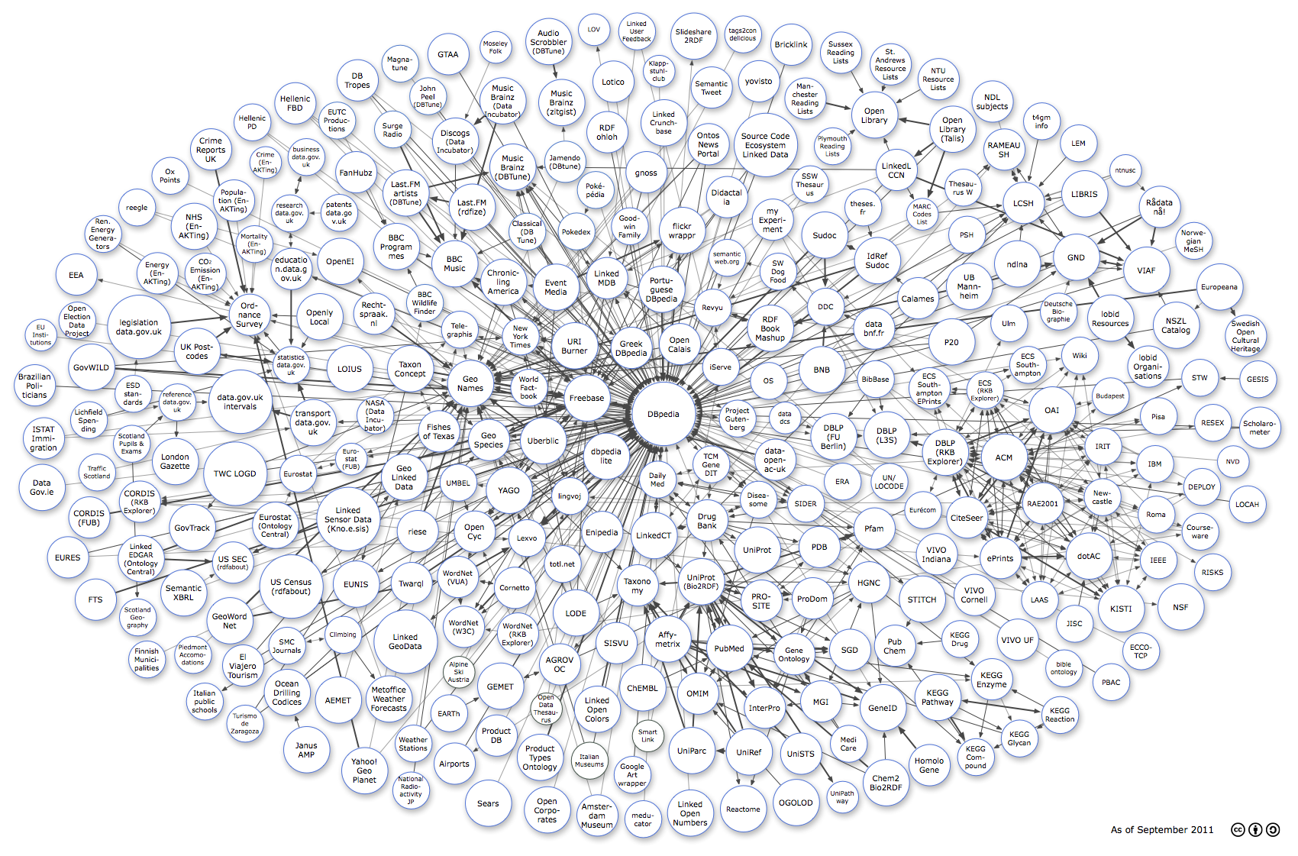
Growth of the Linked Data Cloud
Oct. 2007
Nov. 2007
Feb. 2008
Sep. 2008
Mar. 2009
July 2009
Sept. 2010
Sept. 2011

Slide 52
Growth of the Linked Data Cloud
Oct. 2007
Nov. 2007
Feb. 2008
Sep. 2008
Mar. 2009
July 2009
Sept. 2010
Sept. 2011
Sept. 2012

Slide 53
Growth of the Linked Data Cloud
Oct. 2007
Nov. 2007
Feb. 2008
Sep. 2008
Mar. 2009
July 2009
Sept. 2010
Sept. 2011
Sept. 2012
Sept. 2013

Slide 54
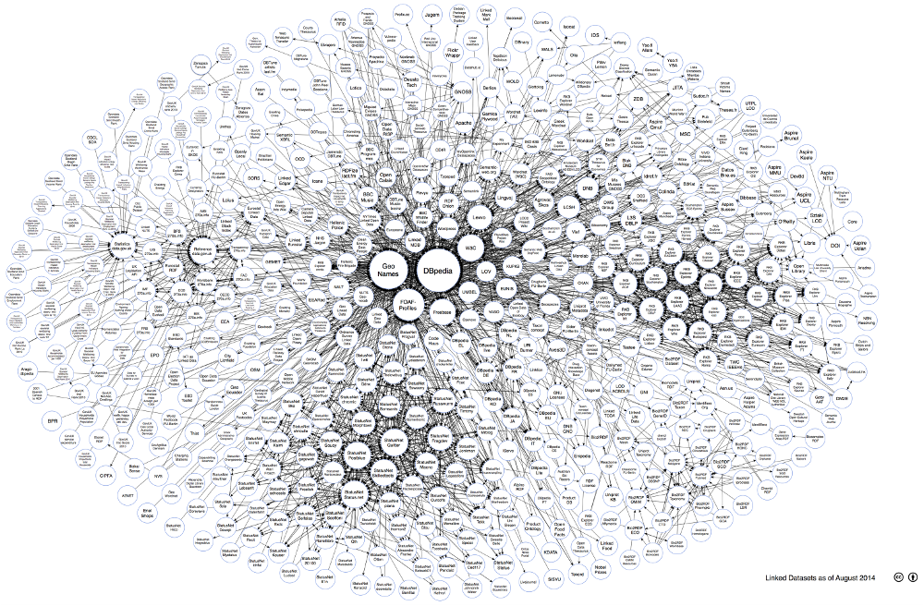
Growth of the Linked Data Cloud (sort of)
Oct. 2007
Nov. 2007
Feb. 2008
Sep. 2008
Mar. 2009
July 2009
Sept. 2010
Sept. 2011
Sept. 2012
Sept. 2013
Aug. 2014

Slide 55
THERE IS A LOT OF LINKED DATA OUT THERE NOW …

Slide 56
DBpedia: An RDF Encyclopaedia

Slide 57
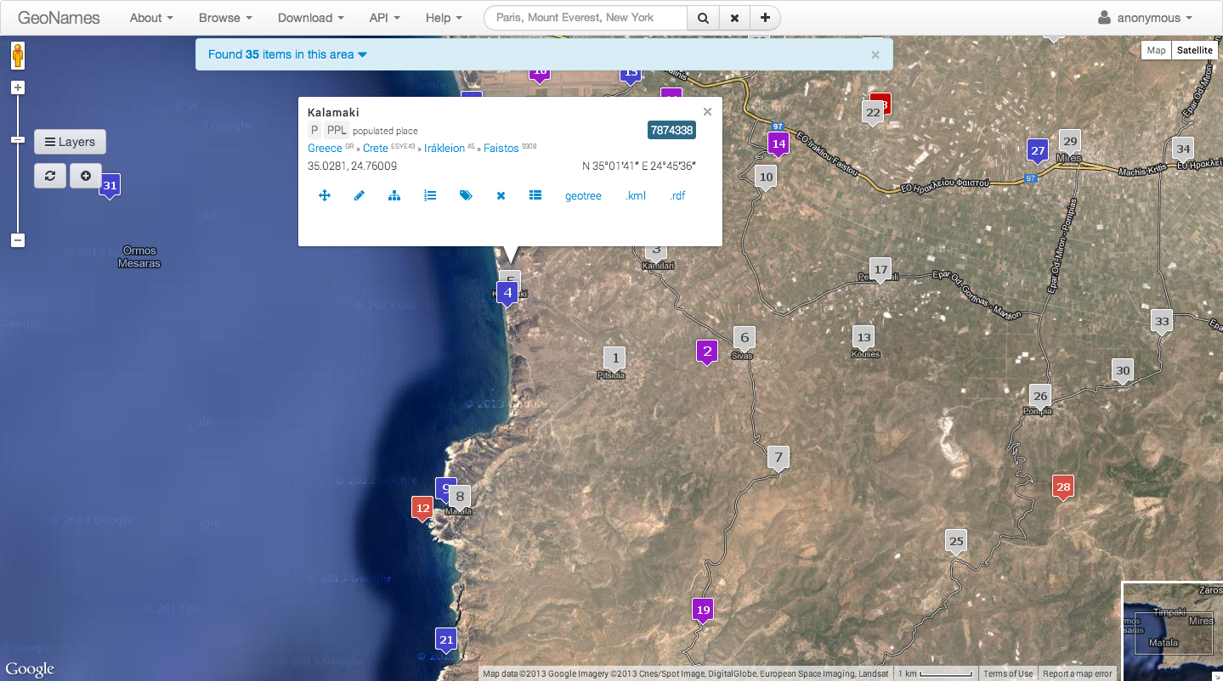
Geographical Data: Geonames

Slide 58
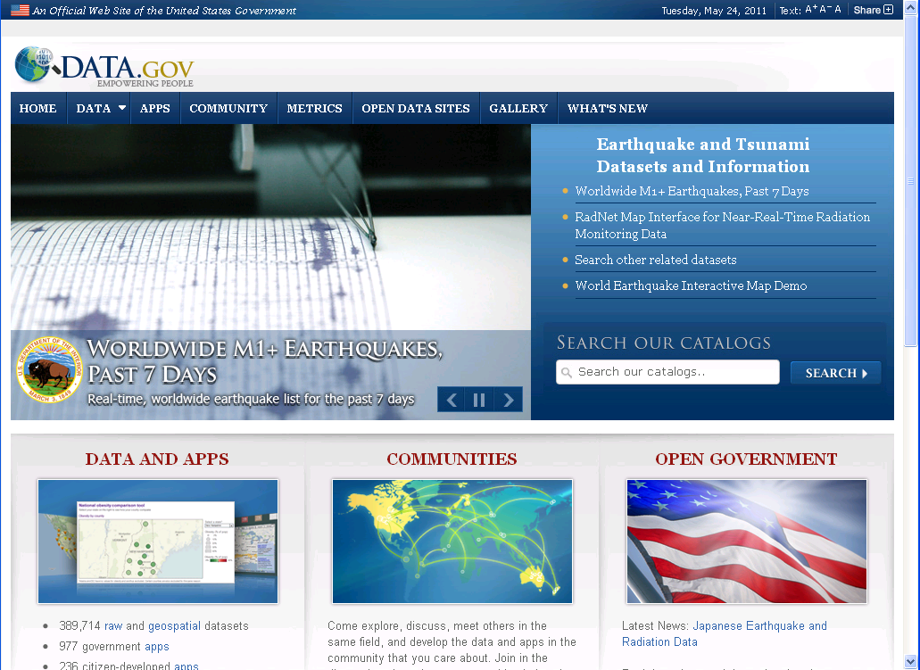
Linked Government Data: data.gov

Slide 59
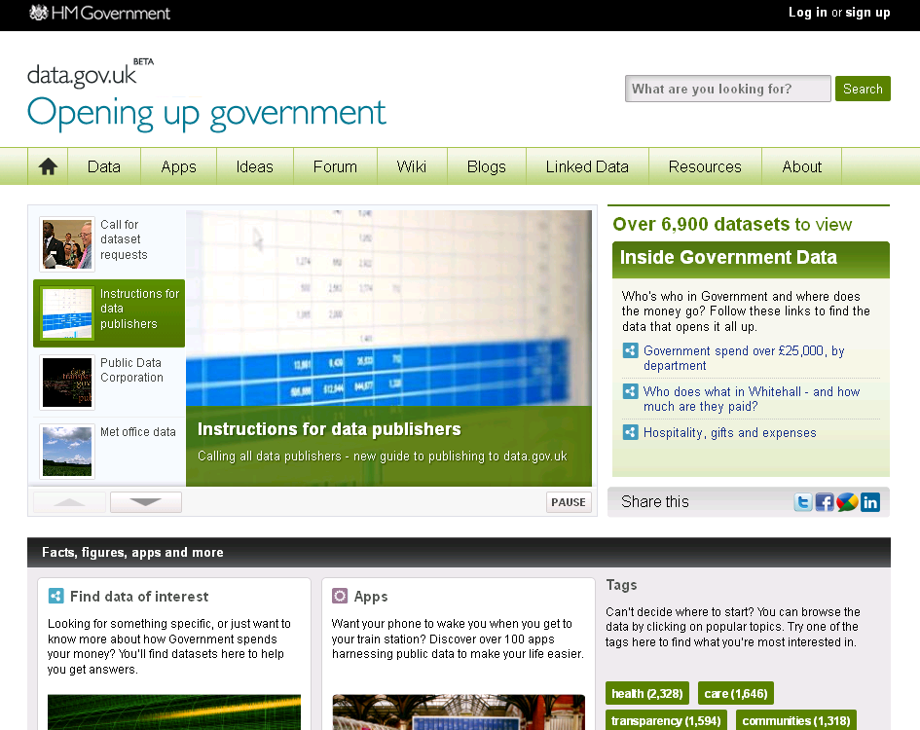
Linked Government Data: data.gov.uk

Slide 60
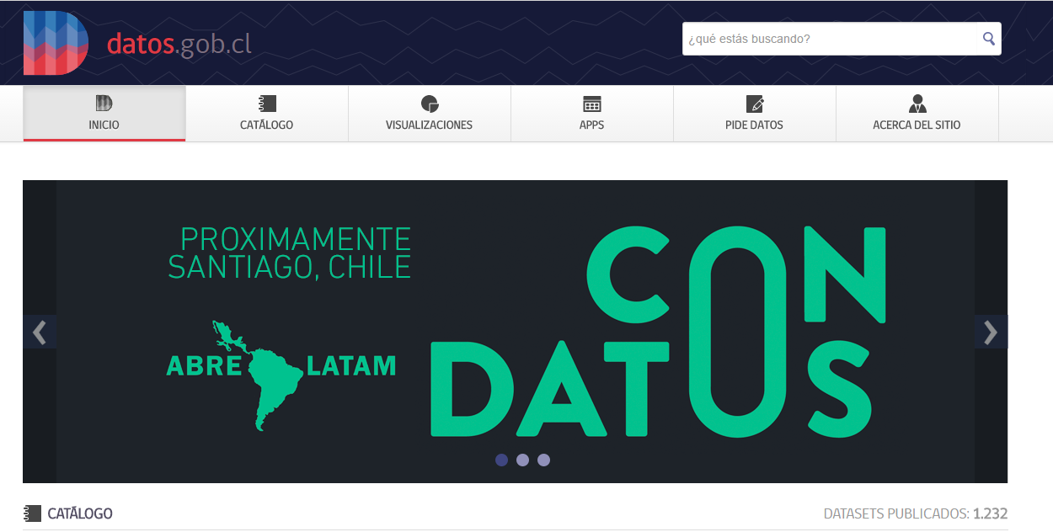
Linked Government Data: datos.gob.cl

Slide 61
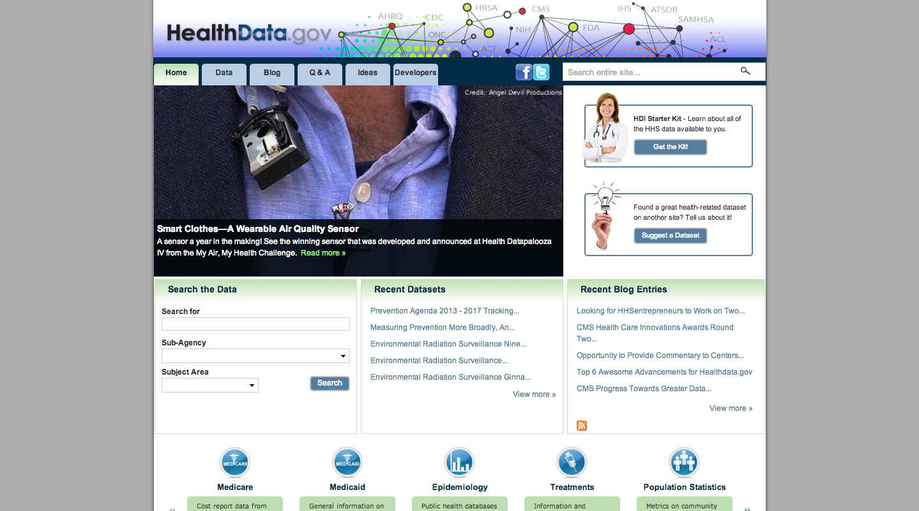
Life Sciences

Slide 62
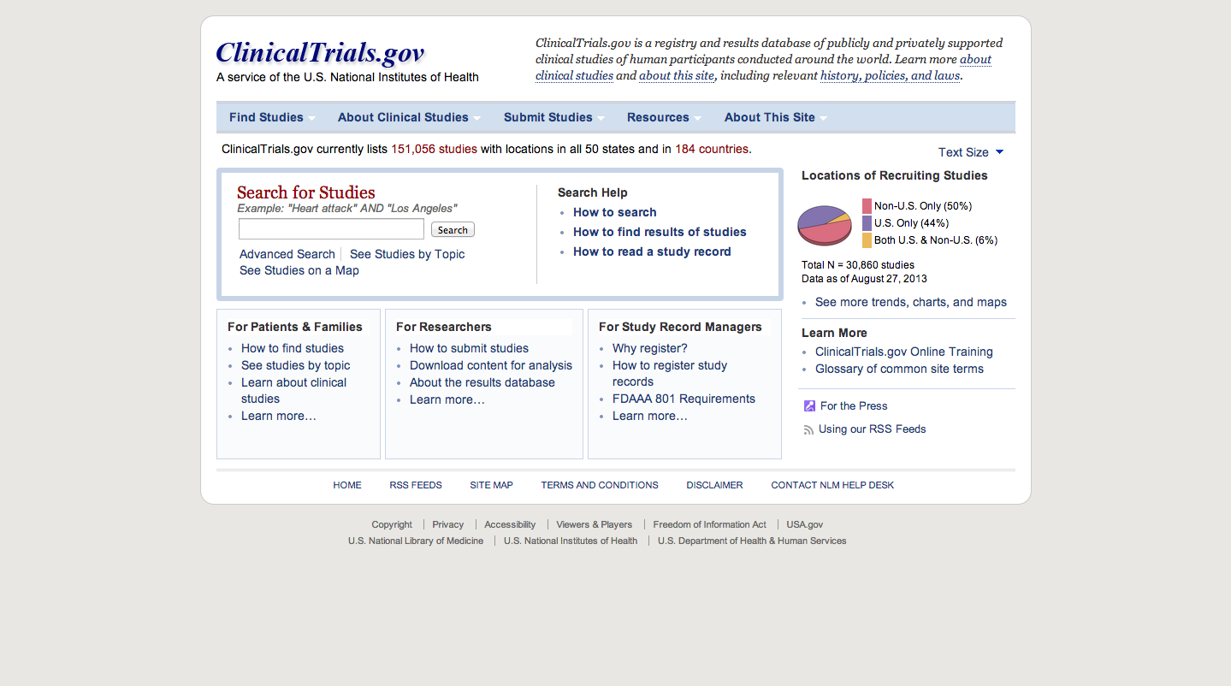
Life Sciences

Slide 63
Life Sciences

Slide 64
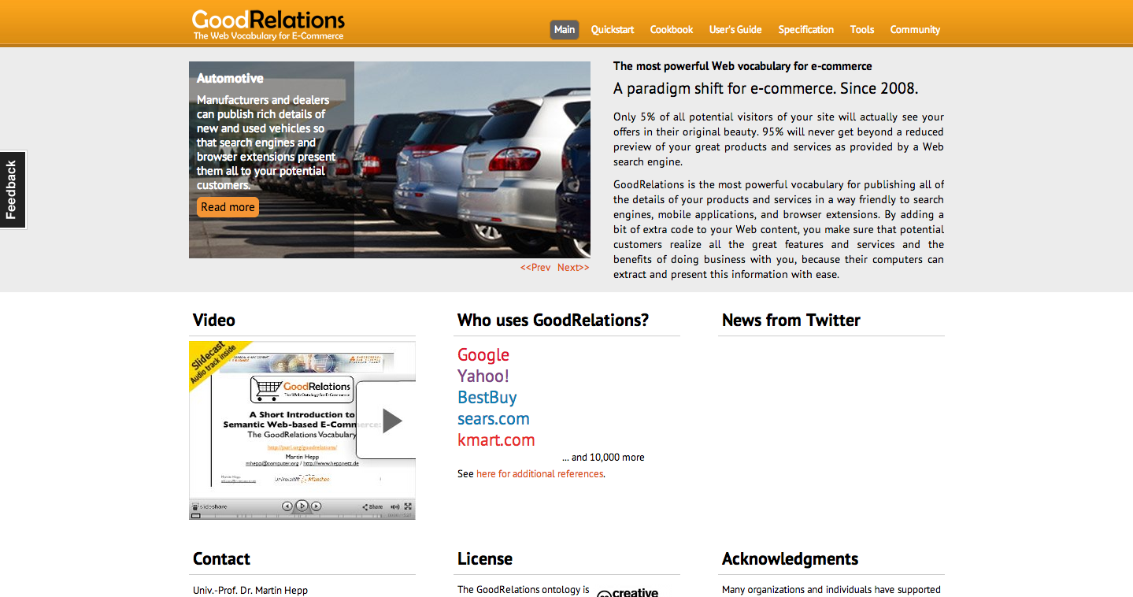
E-Commerce

Slide 65
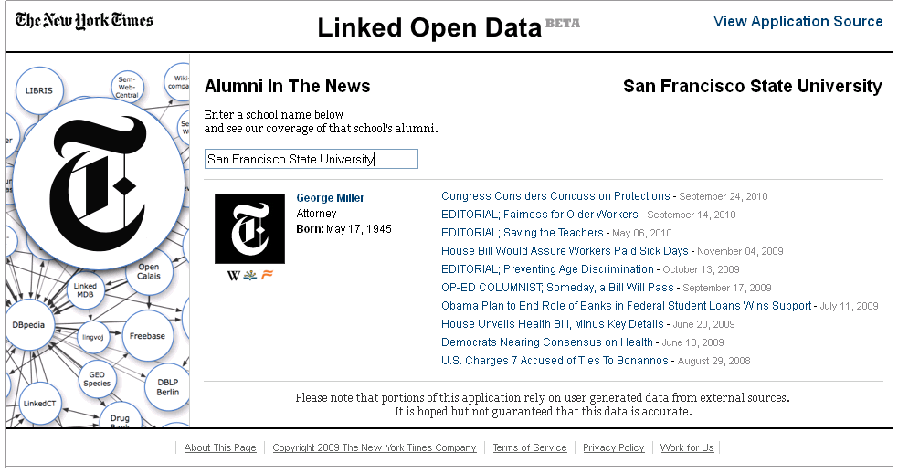
New York Times Meta-data
http://data.nytimes.com/schools/schools.html

Slide 66
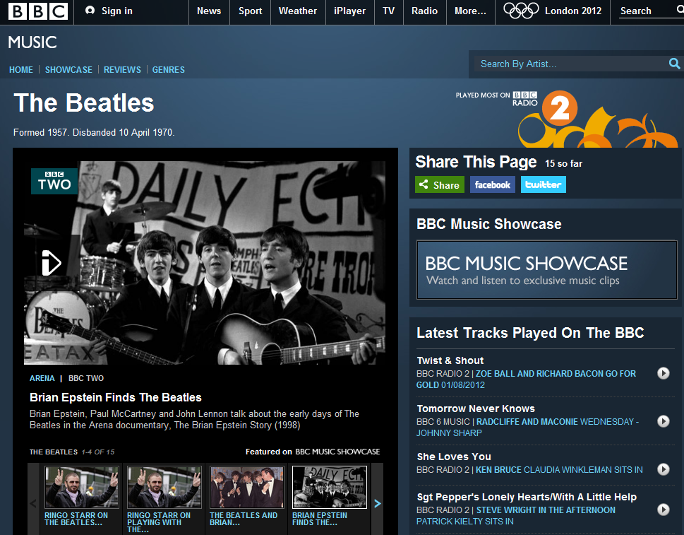
BBC Music

Slide 67
only problem is few people are using the data …

Slide 68
ENTERING UNKNOWN TERRITORY: OPEN RESEARCH QUESTIONS!

Slide 69
catch number 1: INTEGRATION

Slide 70
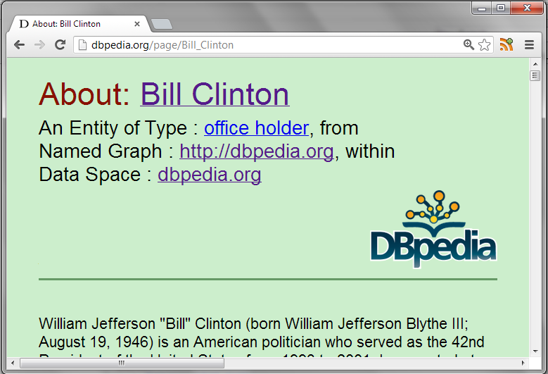
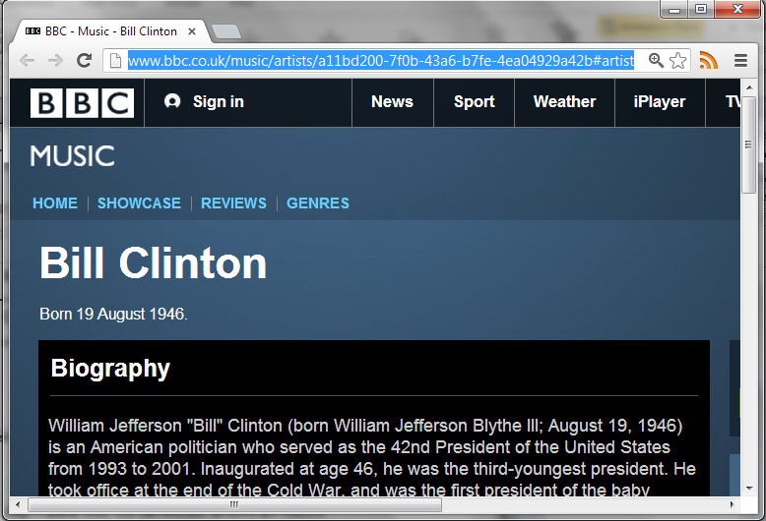
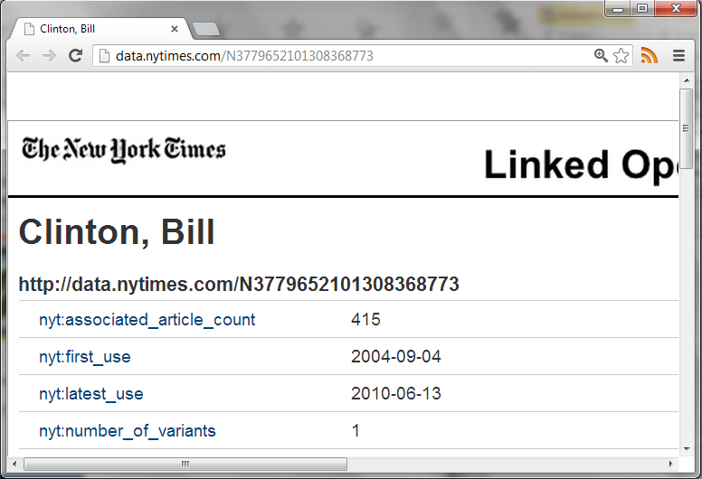
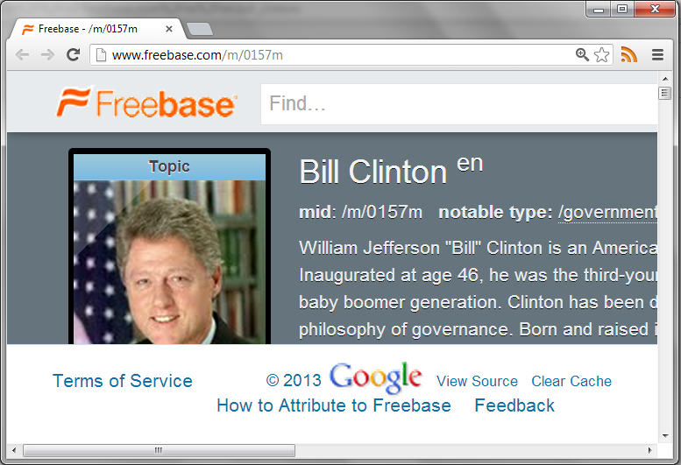
Need for Integration
http://dbpedia.org/resource/Bill_Clinton
http://rdf.freebase.com/ns/en.bill_clinton
http://data.nytimes.com/clinton_bill_per
http://www.bbc.co.uk/music/artists/…
How could OWL help here?
owl:sameAs

Slide 71
A (Hypothetical) Integration Example
SELECT ?a (COUNT(DISTINCT ?p2) AS ?c)
FROM NAMED …
WHERE {
?p1 ex:cites ?p2 .
GRAPH :dblp { ?p1 a :Paper . ?p2 a :Paper }
?p1 ex:writtenBy ?a . ?a ex:basedIn wiki:Chile .
NOT EXISTS {
?p1 ex:writtenBy ?b . ?p2 ex:writtenBy ?b .
}
} GROUP BY ?a ORDER BY DESC(?c)
What is this query asking?
Find the top cited authors based in Chile, only including papers from DBLP, excluding self-citations from the count.

Slide 72
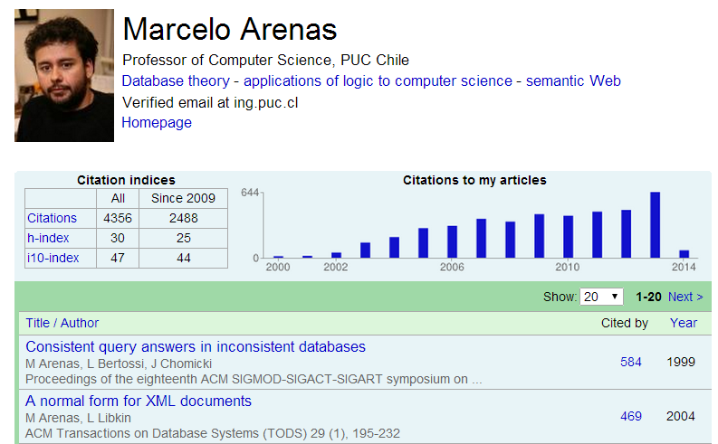
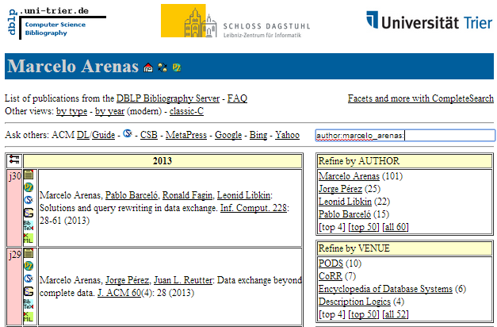
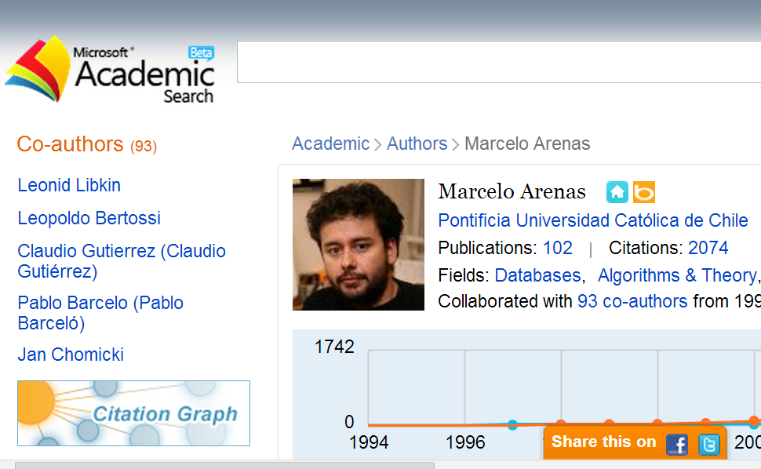
A (Hypothetical) Integration Example

Slide 73
A (Hypothetical) Integration Example
gs:J_Pérez
dblp:Article
107
author
author
citedBy
type
gs:SchemaMap
gs:nSPARQL
dblp:PerezAG10
citedBy
30
author
writtenBy
hIndex
gs:M_Arenas
dblp:ArenasM
4,356
citations
mas:Databases
mas:Arenas,_M
wiki:Chile
field
name
affiliation
cites
country
Marcelo Arenas
2,074
mas:PUC
wiki:PCUC

Slide 74
A (Hypothetical) Integration Example
gs:J_Pérez
dblp:Article
107
author
author
citedBy
type
gs:SchemaMap
gs:nSPARQL
dblp:PerezAG10
citedBy
30
author
writtenBy
hIndex
gs:M_Arenas
dblp:ArenasM
4,356
citations
mas:Databases
mas:Arenas,_M
wiki:Chile
field
name
affiliation
cites
country
Marcelo Arenas
2,074
mas:PUC
wiki:PCUC

Slide 75
A (Hypothetical) Integration Example
gs:J_Pérez
dblp:Article
107
author
author
citedBy
type
gs:SchemaMap
gs:nSPARQL
dblp:PerezAG10
citedBy
30
author
writtenBy
hIndex
gs:M_Arenas
dblp:ArenasM
4,356
citations
mas:Databases
mas:Arenas,_M
wiki:Chile
field
name
affiliation
cites
country
Marcelo Arenas
2,074
mas:PUC
wiki:PCUC

Slide 76
Semantic Web: Tackling Heterogeneity
gs:J_Pérez
dblp:Article
107
author
author
citedBy
type
gs:SchemaMap
gs:nSPARQL
dblp:PerezAG10
citedBy
30
author
writtenBy
hIndex
4,356
gs:M_Arenas
mas:Arenas,_M
dblp:ArenasM
citations
mas:Databases
field
wiki:Chile
name
affiliation
cites
country
Marcelo Arenas
2,074
mas:PUC
wiki:PCUC

Slide 77
A (Hypothetical) Integration Example
gs:J_Pérez
dblp:Article
107
author
author
citedBy
type
gs:SchemaMap
gs:nSPARQL
dblp:PerezAG10
citedBy
30
author
writtenBy
hIndex
4,356
gs:M_Arenas
mas:Arenas,_M
dblp:ArenasM
citations
mas:Databases
field
wiki:Chile
affiliation
name
cites
country
mas:PUC
wiki:PCUC
Marcelo Arenas
2,074

Slide 78
A (Hypothetical) Integration Example
…
gs:J_Pérez
mas:Perez,_J
dblp:PérezJ001
…
…
…
dblp:Article
107
author
author
citedBy
type
gs:SchemaMap
gs:nSPARQL
dblp:PerezAG10
citedBy
30
author
writtenBy
hIndex
4,356
gs:M_Arenas
mas:Arenas,_M
dblp:ArenasM
citations
mas:Databases
field
wiki:Chile
affiliation
name
cites
country
mas:PUC
wiki:PCUC
Marcelo Arenas
2,074

Slide 79
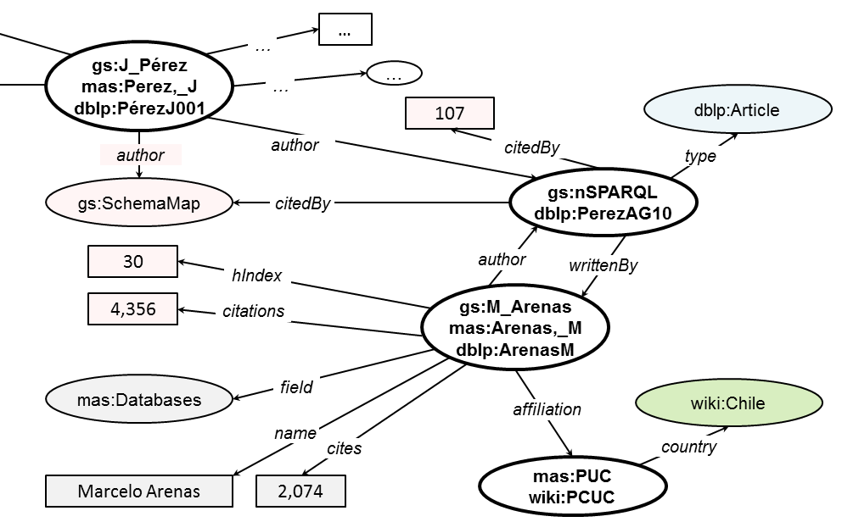
A (Hypothetical) Integration Example

Slide 80
A (Hypothetical) Integration Example
SELECT ?a (COUNT(DISTINCT ?p2) AS ?c)
FROM NAMED …
WHERE {
?p1 ex:citedBy ?p2 .
GRAPH :dblp { ?p1 a :Paper . ?p2 a :Paper }
?p1 ex:writtenBy ?a . ?a ex:basedIn wiki:Chile .
NOT EXISTS {
?p1 ex:writtenBy ?b . ?p2 ex:writtenBy ?b .
}
} GROUP BY ?a ORDER BY DESC(?c)

Slide 81
A (Hypothetical) Integration Example
SELECT ?a (COUNT(DISTINCT ?p2) AS ?c)
FROM NAMED …
WHERE {
?p1 ex:citedBy ?p2 .
GRAPH :dblp { ?p1 a :Paper . ?p2 a :Paper }
?p1 ex:writtenBy ?a . ?a ex:basedIn wiki:Chile .
NOT EXISTS {
?p1 ex:writtenBy ?b . ?p2 ex:writtenBy ?b .
}
} GROUP BY ?a ORDER BY DESC(?c)
dblp:Article
type
gs:nSPARQL
dblp:PerezAG10
dblp:Paper
type
Article ⊑ Paper
dblp:Article rdfs:subClassOf dblp:Paper .

Slide 82
A (Hypothetical) Integration Example
SELECT ?a (COUNT(DISTINCT ?p2) AS ?c)
FROM NAMED …
WHERE {
?p1 ex:citedBy ?p2 .
GRAPH :dblp { ?p1 a :Paper . ?p2 a :Paper }
?p1 ex:writtenBy ?a . ?a ex:basedIn wiki:Chile .
NOT EXISTS {
?p1 ex:writtenBy ?b . ?p2 ex:writtenBy ?b .
}
} GROUP BY ?a ORDER BY DESC(?c)
gs:J_Pérez
author
writtenBy
writtenBy
author
gs:SchemaMap
gs:nSPARQL
dblp:PerezAG10
author ≡ writtenBy ⁻
ex:author owl:inverseOf ex:writtenBy .

Slide 83
A (Hypothetical) Integration Example
SELECT ?a (COUNT(DISTINCT ?p2) AS ?c)
FROM NAMED …
WHERE {
?p1 ex:citedBy ?p2 .
GRAPH :dblp { ?p1 a :Paper . ?p2 a :Paper }
?p1 ex:writtenBy ?a . ?a ex:basedIn wiki:Chile .
NOT EXISTS {
?p1 ex:writtenBy ?b . ?p2 ex:writtenBy ?b .
}
} GROUP BY ?a ORDER BY DESC(?c)
gs:nSPARQL
dblp:PerezAG10
writtenBy
gs:M_Arenas
mas:Arenas,_M
dblp:ArenasM
basedIn
wiki:Chile
affiliation
country
mas:PUC
wiki:PCUC
affiliation ○ country ⊑ basedIn
ex:basedIn owl:propertyChainAxiom( ex:affilition ex:country)

Slide 84
A (Hypothetical) Integration Example
SELECT ?a (COUNT(DISTINCT ?p2) AS ?c)
FROM NAMED …
WHERE {
?p1 ex:citedBy ?p2 .
GRAPH :dblp { ?p1 a :Paper . ?p2 a :Paper }
?p1 ex:writtenBy ?a . ?a ex:basedIn wiki:Chile .
NOT EXISTS {
?p1 ex:writtenBy ?b . ?p2 ex:writtenBy ?b .
}
} GROUP BY ?a ORDER BY DESC(?c)
Article ⊑ Paper
author ≡ writtenBy ⁻
affiliation ○ country ⊑ basedIn

Slide 85
Not clear yet how to do this!
Not clear how to do reasoning on the Web!

Slide 86
Side Note: Fact or Fiction?

Slide 87
BIG CATCH NUMBER 2: DATA ACCESS

Slide 88
Access Methods
Client has a request/query Q
Server has a dataset D
Client issues Q to server
Server computes and returns response Q(D)
D
Q
HTTP
Q(D)

Slide 89
Access Methods
D
Q
D
D
Q
Q
D
Q
Multiple clients / multiple servers (blurred)
Remote, decentralised, uncoordinated
Web scale

Slide 90
Linked Data Access Methods
Dereferencing:
Look up a URI, get an RDF document
Dumps:
Get all data in an archive
SPARQL Queries:
Send a query, get the answers

Slide 91
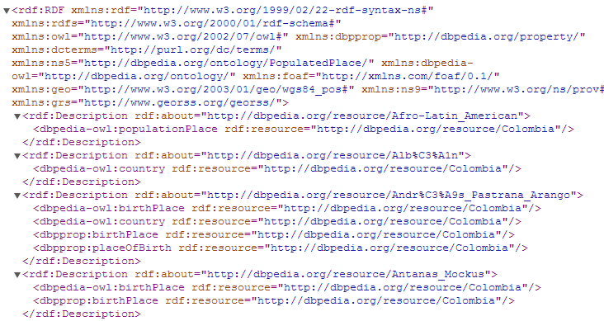
Dereferencing (what is it?)
Q = “http://dbpedia.org/resource/Columbia”
Q(D) =

Slide 92
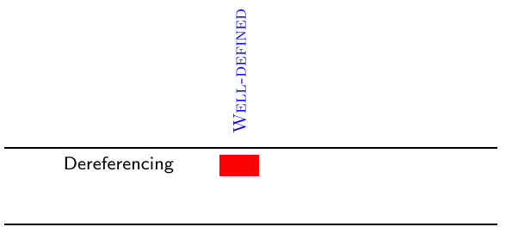
Dereferencing (what’s wrong with it?)
Responses vary from server to server
local triples where URI is subject (83%) vs.
local triples where URI is subject or object (55%)
Well-defined: For a given Q and D, clients and servers agree on what Q(D) should be.

Slide 93
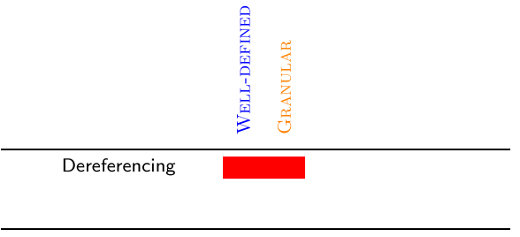
Dereferencing (what’s wrong with it?)
Very coarse:
Give me all capitals of South American countries.
Dereference documents for all country URIs
See which ones are in South America, throw away rest
Throw away triples other than capitals
Granular: The language for Q allows the client to be specific so as to avoid wasting bandwidth

Slide 94
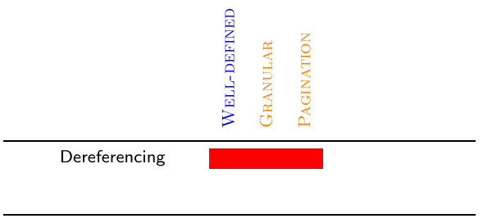
Dereferencing (what’s wrong with it?)
No pagination:
Give me some information about Italy.
Load document with 100,000 triples
Throw away 99,900 triples the user won’t read
Pagination: A large response Q(D) can be split into chunks

Slide 95
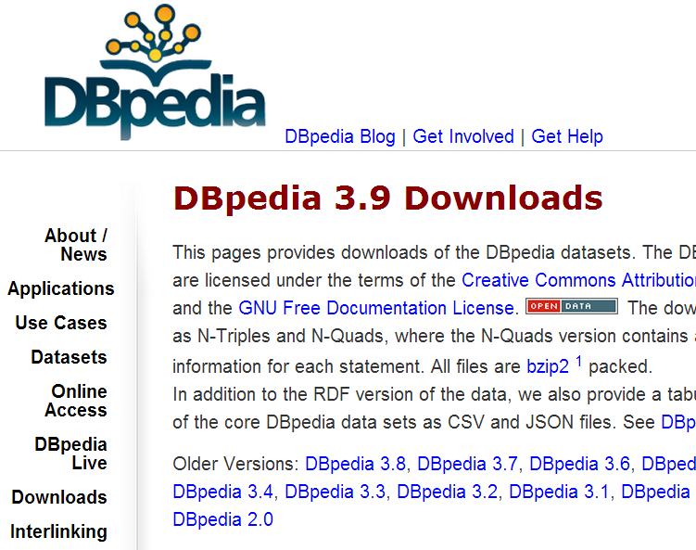
Dumps (what are they?)

Slide 96
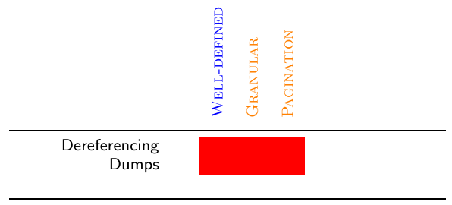
Dumps (what’s wrong with them?)
15× compression for RDF achievable
But same weaknesses as for deref. still apply

Slide 97
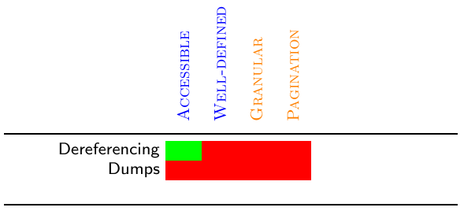
Dumps (what’s wrong with them?)
15× compression for RDF achievable
But same weaknesses as for deref. still apply
Also, no standard access methods:
Various compressions and formats
Linked through generic HTML
Accessible: The protocol and formats are defined for automatic access by software agents

Slide 98
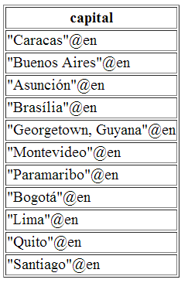
SPARQL (what is it?)
Q =
Q(D) =
PREFIX dbo: <http://dbpedia.org/ontology/>
...
SELECT ?capital
WHERE {
?s a dbo:Country ; dbp:capital ?c ;
dcterms:subject category:Countries_in_South_America .
?c rdfs:label ?capital . FILTER (lang(?capital)="en")
}

Slide 99
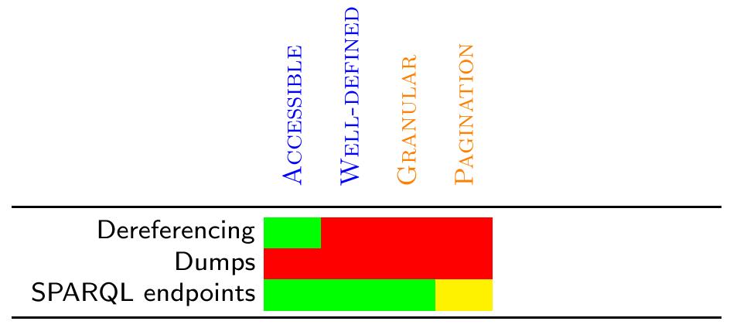
SPARQL (to the rescue?)

Slide 100
SPARQL (what’s wrong with it?)

Slide 101
SPARQL (what’s wrong with it?)

Slide 102
SPARQL (what’s wrong with it?)
Simple Protocol and RDF Query Language
SPARQL evaluation: PSpace-complete

Slide 103
SPARQL (what’s wrong with it?)
Cacheable: Common requests can be cached and re-used. Queries can be anticipated.
Costable: The cost of processing a query can be anticipated before actual processing.

Slide 104
SPARQL (what’s wrong with it?)

Slide 105
SPARQL (what’s wrong with it?)

Slide 106
SPARQL (what’s wrong with it?)
Simple Protocol And RDF Query Language
Protocol always expects a perfect answer
No support for partial results, timeouts, exception handling, pagination …
Robust: Access method can gracefully handle error cases and provide Quality of Service

Slide 107
SPARQL (what’s wrong with it?)
D is a black-box for the user

Slide 108
SPARQL (what’s wrong with it?)
Q =
Q(D) =
PREFIX dbo: <http://dbpedia.org/ontology/>
SELECT (COUNT(?c) as ?count)
WHERE {
?c a dbo:Country .
}
Transparent: The client can determine if a dataset D is relevant and the service sufficient.

Slide 109
Problem Categories
Standardised
Bandwidth-efficient
Server-processing-efficient
Usable by client

Slide 110
Data Access: Open Problem
Data access methods crucial
Access = Protocol + Query Language
But current ones don’t work
→ need something else (or multiple things?)
Open question:

Slide 111
BIG CATCH NUMBER 3: Data quality

Slide 112
Can’t trust everything you read on the Web

Slide 113
Automatic Integration possible …
Tesco
Galway
Galway
outlet
product
livesIn
livesIn
EatMeDriedDates
Jen
contains
allergyInfo
allergy
weightInKg
priceInEuro
type
DriedDates
0.227
2.49
Gluten
Coeliac
DriedDates
ingredient
BlackTea
Soda
ingredient
ingredient
ingredient
DessertRecipe
StickyToffeePudding
type

Slide 114
Automatic Integration possible …
Tesco
Galway
Galway
outlet
product
livesIn
EatMeDriedDates
Jen
contains
allergyInfo
weightInKg
priceInEuro
type
DriedDates
0.227
2.49
Gluten
Coeliac
DriedDates
BlackTea
Soda
ingredient
ingredient
ingredient
DessertRecipe
StickyToffeePudding
type

Slide 115
Automatic Integration possible …
Tesco
Galway
Galway
outlet
product
livesIn
livesIn
long
lat
long
lat
EatMeDriedDates
Jen
−9.0
53.3
−9.0
53.3

Slide 116
Automatic Integration possible …
Tesco
Galway
Galway
outlet
product
livesIn
EatMeDriedDates
Jen
contains
allergyInfo
weightInKg
priceInEuro
type
DriedDates
0.227
2.49
Gluten
Coeliac
DriedDates
BlackTea
Soda
ingredient
ingredient
ingredient
DessertRecipe
StickyToffeePudding
type

Slide 117
Automatic Integration possible …
EatMeDriedDates
Jen
allergyInfo
allergy
type
Gluten
Coeliac
Coeliac
Gluten
equivClass
hasValue
onProperty
allergy
Relationship between Coeliac and Gluten?
Coeliac(Jen) [Jen is a Coeliac]
Coeliac ≡ ∃allergy.{Gluten} [a Coeliac has allergy to Gluten]
∴ allergy(Jen,Gluten) [Jen has allergy to Gluten]

Slide 118
But not everything on the Web is true
Beer
loves
EatMeDriedDates
Jen
allergyInfo
allergy
type
Gluten
Coeliac
Coeliac
Gluten
equivClass
hasValue
onProperty
allergy
Coeliac(Jen) [Jen is a Coeliac]
Coeliac ≡ ∃allergy.{Gluten} [a Coeliac has allergy to Gluten]
∴ allergy(Jen,Gluten) [Jen has allergy to Gluten]

Slide 119
ACTUALLY THERE ARE LOTS OF OPEN ISSUES

Slide 120
Open Issues / Research Questions
How to efficiently access Linked Data?
How to automatically link datasets?
How to reason over Web data?
How to verify/measure quality?
How to deal with deceit?
How to make it all “easy to use”?
How best to model vocabularies for re-use?
How to convert legacy data to Linked Data?
...
None of these problems is a deal-breaker.
All of these problems are subject to research!
Solutions are being proposed!

Slide 121
RECAP

Slide 122
Linked Data
Four principles:
Use URIs (IRIs) to name things
Use HTTP URIs that can be looked up
Return RDF about that thing when looked up
Provide links in the RDF to other RDF documents
Identifying things, not documents:
Hash: use a fragment identifier
Slash: use a 303 See Other redirect

Slide 123
Linked Data
Linked Open Data:
Publishing Open Data as Linked Data
Many open issues:
How to integrate/link data
How to apply reasoning
How to access data efficiently
Dealing with data quality
…

Slide 125
Structure of the course
Marking structure:
40% labs
25% project
5% reading group
30% exam

Slide 126
Speculative Schedule ☺ (NOT DEFINITE!)
Now: Week 10(1)
10(2): Lab
11(1): Reading Group / Project Preparation (maybe short lecture)
11(2): Lab
12(1): Reading Group Presentations
12(2): Project
13(1): Lecture or Project (not sure yet)
13(2): Project
14(1): Lecture or Project (not sure yet)
14(2): Project Presentations
15(1): Lecture (Recap/Revision)
15(2): Informal lab (no marking week 15)

Slide 127
Questions?

