Slide 1
CC6202-1
La Web de Datos
Primavera 2015
Lecture 4: Web Ontology Language (I)
Aidan Hogan
aidhog@gmail.com

Slide 2
PREVIOUSLY ON
“LA WEB DE DATOS”

Slide 3






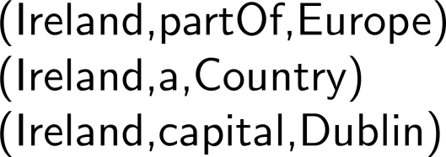
(1) Data, (2) Rules/Ontologies, (3) Query,

Slide 4
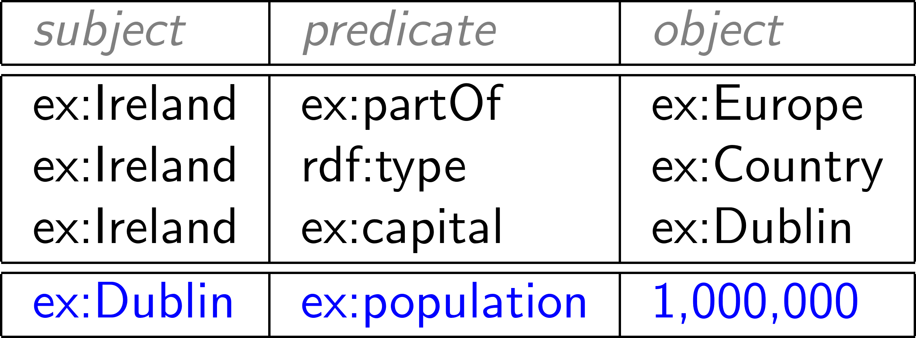

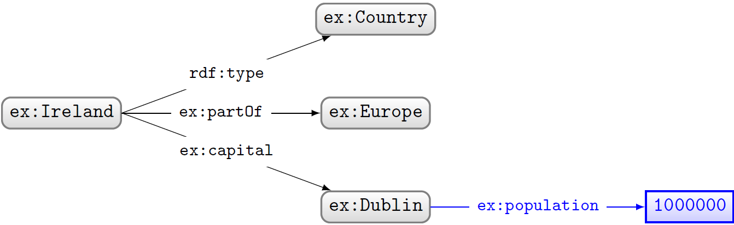
RDF: Resource Description Framework

Slide 5



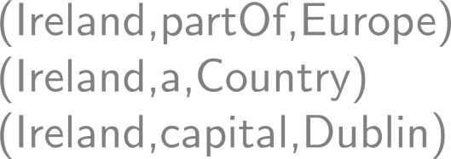
(1) Data, (2) Rules/Ontologies, (3) Query

Slide 6






Class hierarchy
Class c1 is a sub-class of Class c2
  If (x,rdf:type,c1) then (x,rdf:type,c2),
Example: if ex:CapitalCity sub-class of ex:City
  and if (ex:Dublin,rdf:type,ex:CapitalCity)
  then (ex:Dublin,rdf:type,ex:City)
Which classes would be sub-classes of each other?

Slide 7




Property hierarchy
Property p1 is a sub-property of p2
  If (x,p1,y) then (x,p2,y)
Example: if ex:hasCapitalCity sub-property of ex:hasCity
  and if (ex:Ireland,ex:hasCapitalCity,ex:Dublin)
  then (ex:Ireland,ex:hasCity,ex:Dublin)
Which properties would be sub-properties of each other?

Slide 8
Domain of properties
Property p has domain class c
  If (x,p,y) then (x,rdf:type,c)
Example: if foaf:familyName has domain foaf:Person
  and if (ex:Aidan,foaf:familyName,”Hogan”)
  then (ex:Aidan,rdf:type,foaf:Person)
Which properties would have which classes as domain?

Slide 9

Range of properties
Property p has range class c
  If (x,p,y) then (y,rdf:type,c)
Example: if ex:hasCity has range ex:City
  and if (ex:Ireland,ex:hasCity,ex:Dublin)
  then (ex:Dublin,rdf:type,ex:City)
Which properties would have which classes as range?

Slide 10
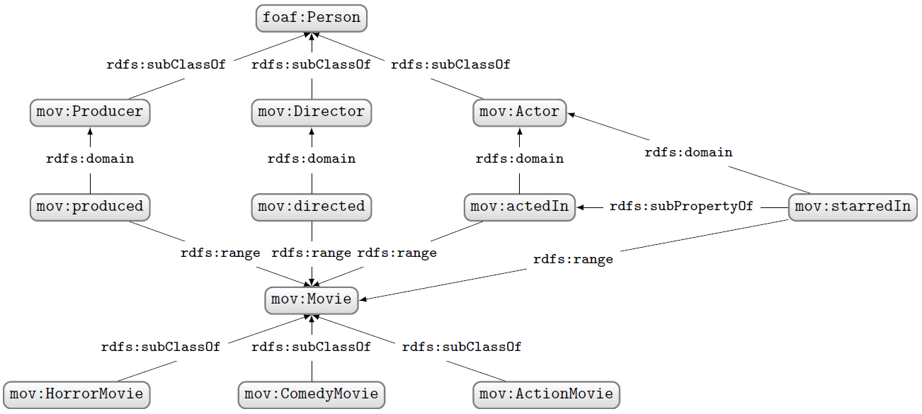
RDF Schema …
Let’s model an RDF Schema for Movies, including different types of movies, some different types of people involved, and how they are related.
(an example)

Slide 11


On a side note
A property can have multiple domains or ranges

Slide 12
TODAY’S TOPIC …

Slide 13
(1) Data, (2) Rules/Ontologies, (3) Query

Slide 14
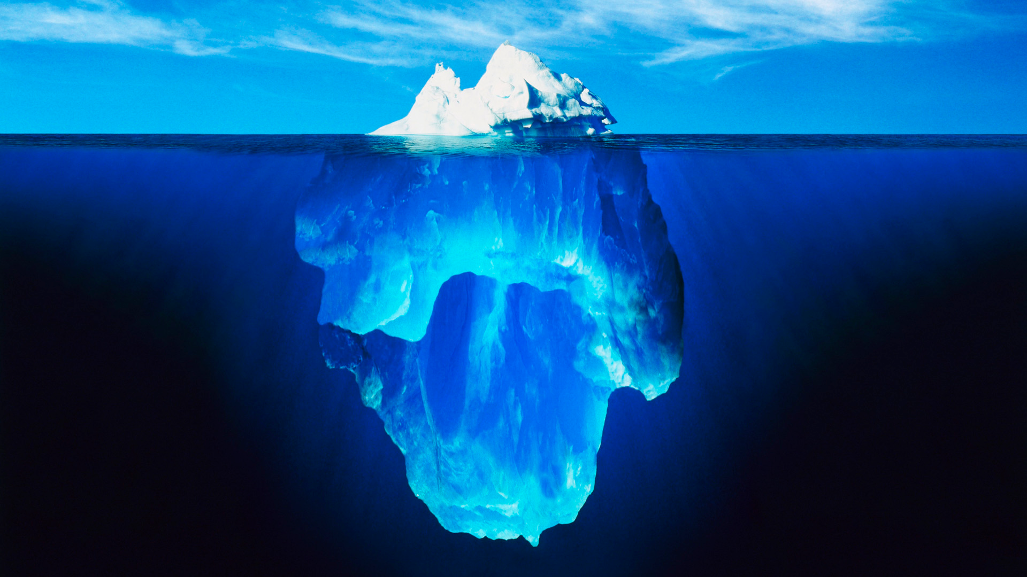



Slide 15
let’s dive into OWL

Slide 16


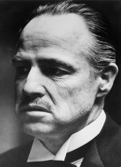
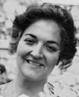

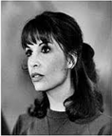
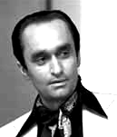


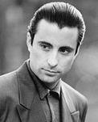

A special family …
ex:Vito
ex:Carmela
ex:Sonny
ex:Connie
ex:Fredo
ex:Michael
ex:Vincent
ex:Mary

Slide 17
first some preliminaries

Slide 18
Open World Assumption (OWA)
How many children
does Vito have according to this RDF?
Vito has 3 children?
Vito has at least 3 children?
ex:Vito
:hasChild
ex:Connie
ex:Sonny
ex:Fredo
ex:Michael
ex:Vito :hasChild ex:Connie, ex:Sonny, ex:Michael .
ex:Vito :hasChild ex:Fredo .
... ?

Slide 19
No Unique Name Assumption (No UNA)
How many children
does Vito have according to this RDF?
Vito has 3 children?
Vito has at least 3 children?
Vito has at least one child!
ex:Vito
:hasChild
ex:Connie
ex:Sonny
ex:Fredo
ex:Michael
ex:Vito :hasChild ex:Connie, ex:Sonny, ex:Michael .
ex:Vito :hasChild ex:Fredo .
... ?

Slide 20
… in words
RDF(S) and OWL:
  Take an Open World Assumption:
    Anything not known is not assumed to be false, simply unknown
    Without further information, Vito may have children that we don’t know about!
  Do not take a Unique Name Assumption:
    Two or more IRIs may refer to the same thing!
    Without further information, the IRIs we know to be Vito’s children may refer to one thing in the real-world!
Why might this be important for the Web?

Slide 21
Let’s start with some RDFS …

Slide 22
rdfs:subPropertyOf
:husbandOf
:spouse
:wifeOf
:spouse
ex:Vito
ex:Carmela
ex:Vito :husbandOf ex:Carmela .
:husbandOf rdfs:subPropertyOf :spouse .
⇒ ex:Vito :spouse ex:Carmela .
ex:Carmela :wifeOf ex:Vito .
:wifeOf rdfs:subPropertyOf :spouse .
⇒ ex:Carmela :spouse ex:Vito .

Slide 23


rdfs:subClassOf
rdf:type
:Woman
rdf:type
ex:Mary
:Person
ex:Mary rdf:type :Woman .
:Woman rdfs:subClassOf :Person .
⇒ ex:Mary rdf:type :Person .

Slide 24
rdfs:domain
:motherOf
ex:Carmela
ex:Fredo
rdf:type
ex:Carmela :motherOf ex:Fredo .
:motherOf rdfs:domain :Female.
⇒ ex:Carmela rdf:type :Female .
:Female

Slide 25

rdfs:range
:hasSon
ex:Carmela
ex:Fredo
rdf:type
ex:Carmela :hasSon ex:Fredo .
:hasSon rdfs:range :Male .
⇒ ex:Fredo rdf:type :Male .
:Male

Slide 26
(IN)EQUALITY IN OWL …

Slide 27
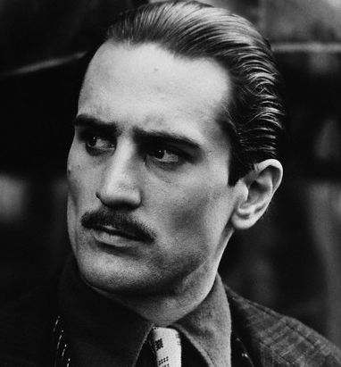
owl:sameAs
owl:sameAs
owl:sameAs
ex:VitoOld
Vito
ex:VitoYoung
:hasGrandson
:granddaugtherOf
:hasGrandson
:granddaugtherOf
ex:Vincent
ex:Mary
ex:VitoOld owl:sameAs ex:VitoYoung .

Slide 28
owl:differentFrom
Vito has at least two children!
ex:Vito
:hasChild
ex:Connie
ex:Sonny
ex:Fredo
ex:Michael
owl:differentFrom
ex:Vito :hasChild ex:Connie, ex:Sonny, ex:Michael, ex:Fredo .
ex:Connie owl:differentFrom ex:Sonny, ex:Michael, ex:Fredo .

Slide 29
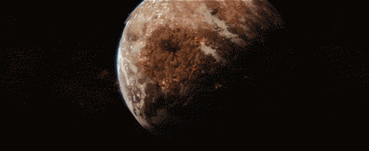
Inconsistency in OWL …
Contradictory statements
owl:sameAs
owl:differentFrom
ex:VitoOld
ex:VitoYoung
ex:VitoOld owl:sameAs ex:VitoYoung .
ex:VitoOld owl:differentFrom ex:VitoYoung .
⇒ FALSE

Slide 30
PROPERTY AXIOMS IN OWL …

Slide 31
owl:equivalentProperty
:parentOf
:hasChild
:hasChild
:parentOf
ex:Vito
ex:Michael
ex:Mary
ex:Vito :parentOf ex:Michael .
ex:Michael :hasChild ex:Mary .
:parentOf owl:equivalentProperty :hasChild .
⇒ ex:Vito :hasChild ex:Michael .
⇒ ex:Michael :parentOf ex:Mary .

Slide 32
owl:inverseOf
:parentOf
:childOf
:childOf
:parentOf
ex:Carmela
ex:Sonny
ex:Vincent
ex:Carmela :parentOf ex:Sonny .
ex:Vincent :childOf ex:Sonny .
:parentOf owl:inverseOf :childOf .
⇒ ex:Sonny :parentOf ex:Vincent .
⇒ ex:Sonny :childOf ex:Carmela .

Slide 33
owl:SymmetricProperty
:sibling
:sibling
ex:Connie
ex:Fredo
ex:Connie :sibling ex:Fredo .
:sibling rdf:type owl:SymmetricProperty .
⇒ ex:Fredo :sibling ex:Connie .

Slide 34
owl:TransitiveProperty
:ancestorOf
:ancestorOf
ex:Carmela
ex:Michael
ex:Mary
:ancestorOf
ex:Carmela :ancestorOf ex:Michael .
ex:Michael :ancestorOf ex:Mary .
:ancestorOf rdf:type owl:TransitiveProperty .
⇒ ex:Carmela :ancestorOf ex:Mary .

Slide 35
owl:propertyChainAxiom
:brotherOf
:fatherOf
ex:Sonny
ex:Michael
ex:Mary
:uncleOf
ex:Sonny :brotherOf ex:Michael .
ex:Michael :fatherOf ex:Mary .
:uncleOf owl:propertyChainAxiom (:brotherOf :fatherOf) .
⇒ ex:Sonny :uncleOf ex:Mary .

Slide 36
owl:ReflexiveProperty
:similarTo
:similarTo
ex:Connie
ex:Fredo
:similarTo rdf:type owl:ReflexiveProperty .
⇒ ex:Connie :similarTo ex:Connie .
ex:Freddie :similarTo ex:Freddie .
(everything :similarTo itself)

Slide 37
owl:FunctionalProperty
:hasFather
ex:Fredo
ex:Vito
ex:VitoYoung
ex:Fredo :hasFather ex:VitoOld .
ex:Fredo :hasFather ex:VitoYoung .
:hasFather rdf:type owl:FunctionalProperty .
⇒ ex:VitoOld owl:sameAs ex:VitoYoung .
ex:VitoOld

Slide 38
owl:InverseFunctionalProperty
:fatherOf
ex:Connie
ex:Vito
ex:VitoYoung
ex:Vito
ex:VitoOld :fatherOf ex:Connie .
ex:VitoYoung :fatherOf ex:Connie .
:fatherOf rdf:type owl:InverseFunctionalProperty .
⇒ ex:VitoOld owl:sameAs ex:VitoYoung .
ex:VitoOld

Slide 39
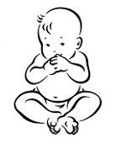


owl:hasKey
:hasMother
ex:Connie
ex:Carmela
rdf:type
:Singleton
:born
ex:Constanza
1922-04-16
ex:Connie a :Singleton ; :hasMother ex:Carmela ; :born “1922-04-16”^^xsd:date .
ex:Constanza a :Singleton ; :hasMother ex:Carmela ; :born “1922-04-16”^^xsd:date .
:Singleton owl:hasKey ( :hasMother :born ) .
⇒ ex:Connie owl:sameAs ex:Constanza .

Slide 40
owl:IrreflexiveProperty
:hasBrother
ex:Fredo
ex:Fredo :hasBrother ex:Fredo .
:hasBrother rdf:type owl:IrreflexiveProperty .
⇒ FALSE

Slide 41
owl:AsymmetricProperty
:hasFather
:hasFather
ex:Fredo
ex:VitoYoung
ex:VitoYoung
ex:Fredo :hasFather ex:VitoYoung .
ex:VitoYoung :hasFather ex:Fredo .
:hasFather rdf:type owl:AsymmetricProperty .
⇒ FALSE

Slide 42
owl:disjointPropertyWith
:hasFather
:hasSon
ex:Sonny
ex:VitoYoung
ex:VitoYoung
ex:Sonny :hasFather ex:VitoYoung .
ex:VitoYoung :hasSon ex:Sonny .
:hasSon owl:disjointPropertyWith :hasFather .
⇒ FALSE

Slide 43
Negative property assertions
¬:hasMother
:hasMother
ex:Fredo
ex:Connie
[] owl:sourceIndividual ex:Fredo ; owl:assertionProperty :hasMother ; owl:targetIndividual ex:Connie .
ex:Fredo :hasMother ex:Connie .
⇒ FALSE

Slide 44
Recap OWL property axioms
What would be the owl:inverseOf the property :fatherOf?
Name an owl:SymmetricProperty for family relations?
Name an owl:TransitiveProperty for family relations?
Give an owl:propertyChainAxiom for :hasNiece?
Name an owl:AsymmetricProperty for family relations?
Name an owl:FunctionalProperty for family relations?

Slide 45
CLASS AXIOMS IN OWL

Slide 46
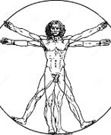
owl:equivalentClass
rdf:type
rdf:type
:Human
rdf:type
rdf:type
ex:Vincent
ex:Mary
:Person
ex:Vincent rdf:type :Human .
ex:Mary rdf:type :Person .
:Human owl:equivalentClass :Person .
⇒ ex:Vincent rdf:type :Person .
ex:Mary rdf:type :Human .

Slide 47

owl:disjointWith
ex:DonCorleone
ex:LawAbiding
rdf:type
rdf:type
ex:Vincent
ex:Vincent rdf:type ex:DonCorleone , ex:LawAbiding .
ex:DonCorleone owl:disjointWith ex:LawAbiding .
⇒ FALSE

Slide 48
owl:disjointWith (ii)
:Man
:Woman
rdf:type
rdf:type
owl:differentFrom
ex:Vincent
ex:Mary
ex:Vincent rdf:type :Man . ex:Mary rdf:type :Woman .
:Man owl:disjointWith :Woman .
⇒ ex:Mary owl:differentFrom ex:Vincent .

Slide 49
CLASS DEFINITIONS IN OWL

Slide 50
Things start to get a little more “tricky”
Property axioms say something about properties
Class axioms say something about classes
Class definitions define new classes
    e.g., the class of humans with at least one human child
  often these classes are not named, but a class axiom is used to relate them to a named class
    e.g., the class of human parent is equivalent to the class of humans with at least one human child
    e.g., the class of human mother is a sub-class of the class of humans with at least one human child
Will become more clear ☺

Slide 51
Some basic Description Logics symbols
Description Logics (DL) a theory underlying OWL
‘≡’ for equivalent class or property
  :Person ≡ :Human
  :hasChild ≡ :parentOf
‘⊑’ for sub-class or sub-property
  :Woman ⊑ :Person
  :hasSon ⊑ :hasChild

Slide 52
Some built in classes and properties
owl:Thing: the class of “everything”
  Relation to rdfs:Resource is complicated … let’s not get into that now ☺
  Symbol: ‘⊤’
owl:Nothing: the empty class
  Symbol: ‘⊥’

Slide 53
owl:unionOf (⊔)
≡
⊔
:Person
:Woman
:Man
rdf:type
rdf:type
ex:Vincent
ex:Vincent rdf:type :Man .
:Person owl:equivalentClass [ owl:unionOf ( :Woman :Man ) ]
⇒ ex:Vincent rdf:type :Person .

Slide 54


owl:intersectionOf (⊓) [i]
⊑
⊓
:Mother
:Female
:Parent
rdf:type
rdf:type
rdf:type
ex:Carmela
ex:Carmela rdf:type :Mother .
:Mother rdfs:subClassOf [ owl:intersectionOf ( :Female :Parent ) ]
⇒ ex:Carmela rdf:type :Female, :Parent .

Slide 55
owl:intersectionOf (⊓) [ii]
≡
⊓
:Mother
:Female
:Parent
rdf:type
rdf:type
rdf:type
ex:Carmela
ex:Carmela rdf:type :Female , :Parent .
:Mother owl:equivalentClass [ owl:intersectionOf ( :Female :Parent ) ]
⇒ ex:Carmela rdf:type :Mother .

Slide 56


owl:complementOf (¬) [i]
≡
¬
:Dead
:Alive
¬rdf:type
rdf:type
ex:Mary
ex:Mary rdf:type :Alive .
:Dead owl:equivalentClass [ owl:complementOf :Alive ]
⇒ [] owl:sourceIndividual ex:Mary ; owl:targetProperty rdf:type ; owl:targetIndividual :Dead .

Slide 57


Slide 58
owl:complementOf (¬) [ii]
≡
¬
:Dead
:Alive
rdf:type
¬ rdf:type
ex:Vito
ex:Vito rdf:type :Dead .
:Dead owl:equivalentClass [ owl:complementOf :Alive ]
⇒ [] owl:sourceIndividual ex:Vito ; owl:targetProperty rdf:type ; owl:targetIndividual :Alive .

Slide 59
owl:oneOf ({})
≡
{
}
,
,
:DonCorleone
ex:Vito
ex:Michael
ex:Vincent
rdf:type
rdf:type
rdf:type
:DonCorleone owl:equivalentClass
[ owl:oneOf (ex:Vito ex:Michael ex:Vincent) ]
⇒ ex:Vito rdf:type :DonCorleone .
⇒ ex:Michael rdf:type :DonCorleone .
⇒ ex:Vincent rdf:type :DonCorleone .

Slide 60
owl:allValuesFrom (∀)
⊑
∀
:hasParent.
:Person
:Person
rdf:type
rdf:type
:hasParent
ex:Mary
ex:Michael
ex:Mary rdf:type :Person ; :hasParent ex:Michael .
:Person rdfs:subClassOf
[ owl:allValuesFrom :Person ; owl:onProperty :hasParent ]
⇒ ex:Michael rdf:type :Person .

Slide 61
owl:someValuesFrom (∃) [i]
≡
∃
:hasChild.
:Parent
:Person
rdf:type
rdf:type
:hasChild
ex:Carmela
ex:Michael
ex:Carmela :hasChild ex:Michael . ex:Michael rdf:type :Person .
:Parent owl:equivalentClass
[ owl:someValuesFrom :Person ; owl:onProperty :hasChild ]
⇒ ex:Carmela rdf:type :Parent .

Slide 62
owl:someValuesFrom (∃) [ii]
⊑
∃
:hasChild.
:Parent
:Person
rdf:type
rdf:type
?
:hasChild
ex:Carmela
?
ex:Carmela rdf:type :Parent .
:Parent rdfs:subClassOf
[ owl:someValuesFrom :Person ; owl:onProperty :hasChild ] .
⇒ ex:Mary :hasChild _:someone . _:someone rdf:type :Person .

Slide 63
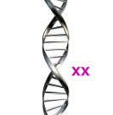
owl:hasValue (∃P.{x}) [i]
⊑
∃
{
}
:hasDNA.
:Mother
:XX
rdf:type
:hasDNA
ex:Carmela
ex:Carmela rdf:type :Mother .
:Mother rdfs:subClassOf
[ owl:hasValue :XX ; owl:onProperty :hasDNA ]
⇒ ex:Carmela :hasDNA :XX .

Slide 64
owl:hasValue (∃P.{x}) [ii]
≡
∃
{
}
:hasDNA.
:Female
:XX
rdf:type
:hasDNA
ex:Carmela
ex:Carmela :hasDNA :XX .
:Female owl:equivalentClass
[ owl:hasValue :XX ; owl:onProperty :hasDNA ]
⇒ ex:Carmela rdf:type :Female .

Slide 65

owl:hasSelf (Self) [i]
⊑
Self(:loves)
:Narcissist
rdf:type
:loves
ex:Vincent
ex:Vincent rdf:type :Narcissist .
:Narcissist rdfs:subClassOf
[ owl:hasSelf true ; owl:onProperty :loves ]
⇒ ex:Vincent :loves ex:Vincent .

Slide 66
owl:hasSelf (Self) [ii]
≡
Self(:loves)
:Narcissist
rdf:type
:loves
ex:Vincent
ex:Vincent :loves ex:Vincent .
:Narcissist owl:equivalentClass
[ owl:hasSelf true ; owl:onProperty :loves ]
⇒ ex:Vincent rdf:type :Narcissist .

Slide 67
Cardinality restrictions (≥, ≤,=)
Define a class with a given number of values for a property:
  Exact:
    :Person ⊑ =2 (:hasParent)
    :Parent rdfs:subClassOf [ owl:cardinality 2 ; owl:onProperty :hasParent ] .
  Max:
    :Monogamist ⊑ ≤ 1 (:currentSpouse)
    :Monogamist rdfs:subClassOf [ owl:maxCardinality 1 ; owl:onProperty :currentSpouse ] .
  Min:
    :Parent ≡ ≥ 1 (:hasChild)
    :Parent owl:equivalentClass [ owl:minCardinality 1 ; owl:onProperty :hasChild ] .

Slide 68
Qualified cardinality restrictions (≥, ≤,=)
Define a class with a given number of values from a given class for a property:
  Exact:
    :Person ≡ =2 (:hasParent.Person)
    :Parent owl:equivalentClass [ owl:qualifiedCardinality 2 ; owl:onProperty :hasParent ; owl:onClass :Person ] .
    Now the values in question must be people!
  Analogous versions of Max and Min.

Slide 69
Recap OWL class axioms/definitions
A class :HumanParent might be equivalent to the owl:unionOf which classes?
What is the difference/relation between owl:complementOf and owl:disjointWith
Give an example use of owl:allValuesFrom for family relations
A ⊑ ( B ⊓ ∃P.C ) ?
Give an example use of owl:someValuesFrom for :Uncle.
How might we codify the semantics of a class :OnlySon in OWL?
How might we codify the semantics of a class
:InSameSexMarriage in OWL?

Slide 70
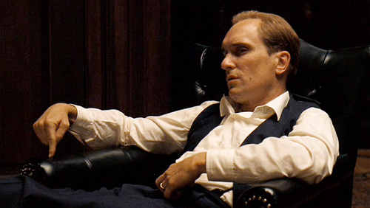
Be careful what you define …
Tom Hagen, the adopted son of Vito
We probably meant biologicalParent, etc.

Slide 71
Slides are examples, not definitions
≡
{
}
,
,
:DonCorleone
ex:Vito
ex:Michael
ex:Vincent
rdf:type
rdf:type
rdf:type
rdf:type
:DonCorleone owl:equivalentClass
[ owl:oneOf (ex:Vito ex:Michael ex:Vincent) ]
⇒ ex:Vito rdf:type :DonCorleone .
⇒ ex:Michael rdf:type :DonCorleone .
⇒ ex:Vincent rdf:type :DonCorleone .
⇒ … ex:VitoYoung must be the same as one of the three guys!
ex:VitoYoung

Slide 72
Slides are examples, not definitions
≡
⊔
:Person
:Woman
:Man
rdf:type
ex:Vincent
ex:Vincent rdf:type :Person .
:Person owl:equivalentClass [ owl:unionOf ( :Woman :Man ) ]
⇒ … ex:Vincent must be either of type :Woman or :Man

Slide 73
RECAP

Slide 74
(1) Data, (2) Rules/Ontologies, (3) Query

Slide 75
RDF(S)/OWL: OWA, no UNA
RDF(S)/OWL
  Take an Open World Assumption
  Do not take a Unique Name Assumption
  On the Web:
    information is incomplete
    having one name for everything would require too much coordination

Slide 76
OWL Features: (In)Equality
owl:sameAs: two names refer to same thing
owl:differentFrom: two names refer to different things

Slide 77
OWL Features: Property Axioms
owl:equivalentProperty: two properties are synonymous
owl:inverseOf: two properties synonymous but in opposite directions
owl:SymmetricProperty: properties that always hold in both directions; i.e., if (a,P,b) then (b,P,a)
owl:TransitiveProperty: if (a,P,b) and (b,P,c) then (a,P,c)

Slide 78
OWL Features: Property Axioms
owl:propertyChainAxiom: define a property as a chain of other properties
owl:ReflexiveProperty: a class of properties that relate everything to itself
owl:FunctionalProperty: if (a,P,x) and (b,P,x) then x = y
owl:InverseFunctionalProperty: if (x,P,a) and (y,P,a) then x = y
owl:hasKey: define complex keys for instances of a given class

Slide 79
OWL Features: Property Axioms
owl:IrreflexiveProperty: can never relate x to x
owl:AsymmetricProperty: can never relate x to y and y to x
owl:disjointPropertyWith: two properties that can never relate the same two things
Negative property assertions: say that something is false

Slide 80
OWL Features: Class Axioms
owl:equivalentClass: relates two classes that are synonymous
owl:disjointWith: relates two classes that cannot share any instances

Slide 81
OWL Features: Class Definitions
owl:unionOf: defines a class that’s the union of one or more other classes
owl:intersectionOf: defines a class that’s the intersection of one or more other classes
owl:complementOf: defines a class that’s the complement of another class
owl:oneOf: defines a class by enumerating precisely all of its instances

Slide 82
OWL Features: Class Definitions
owl:allValuesFrom: defines a class that contains all things that have values for a given property that are all of a certain type
owl:someValuesFrom: defines a class that contains all things that have at least one value for a given property of a certain type
owl:hasValue: defines a class that contains all things that have a specific value for a given property
owl:hasSelf: defines a class that contains all things that have themself as a value for a given property
Cardinality restrictions define classes with a given number of values for a property
Qualified cardinality restrictions define classes with a given number of values for a property in a given class

Slide 83
Some Description Logic symbols
⊑: sub-class/-property
≡: equivalent class/property
⊔: union
⊓: intersection
⊤: top (class of everything)
⊥: bottom (empty class)
∃: exists (someValuesFrom/hasValue)
∀: for all (allValuesFrom)
¬: not (complement, negation)
– (superscript minus): inverse property
{}: enumeration (owl:oneOf)
Self, Trans, Dom, etc.: where symbols not available

Slide 85






Questions?

