Slide 1
CC5212-1 Procesamiento Masivo de Datos Otoño 2020 Lecture 8 Information Retrieval: Ranking
Aidan Hogan
aidhog@gmail.com

Slide 2
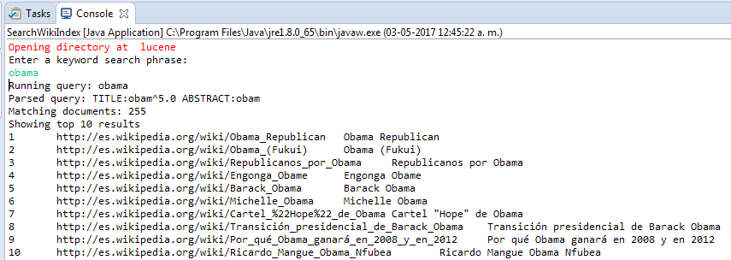
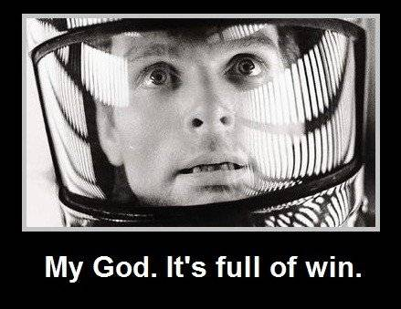
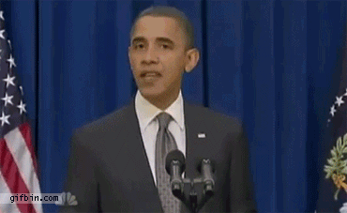
Apache Lucene
Inverted Index
They built one so you don’t have to!
Open Source in Java

Slide 3
Information Retrieval: Ranking

Slide 4
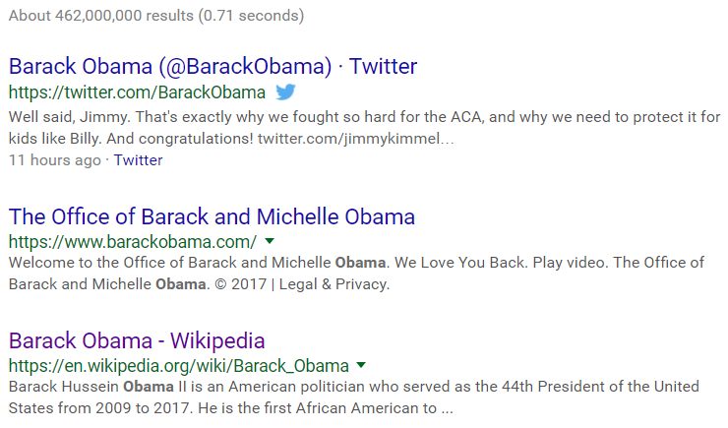
How Does Google Get Such Good Results?
obama

Slide 5
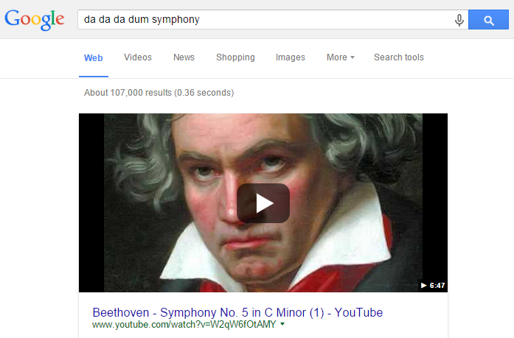
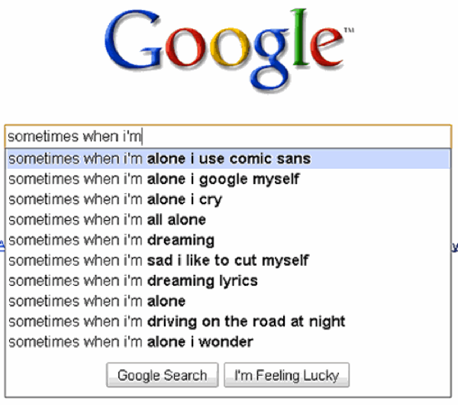
How does Google Get Such Good Results?

Slide 6
Two aspects of ranking: Relevance vs. Importance

Slide 7
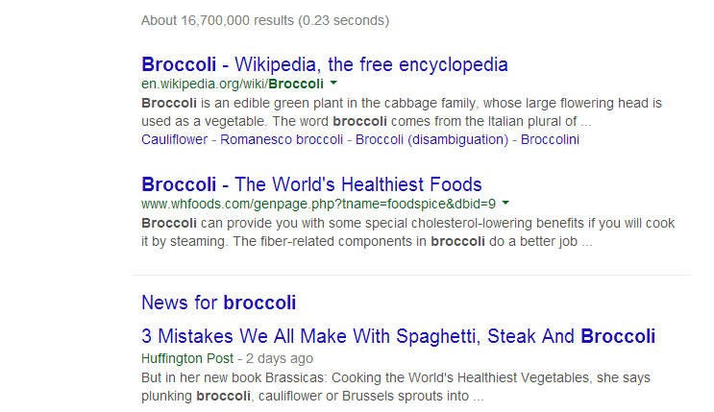
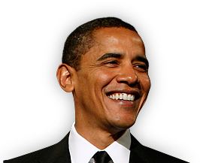
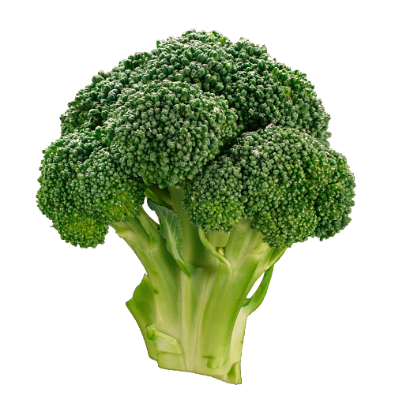
Two Sides to Ranking: Relevance
≠

Slide 8
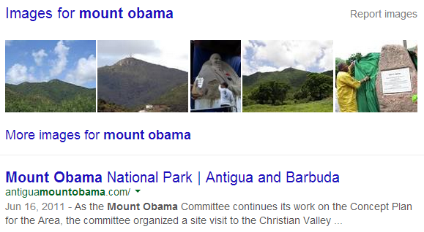
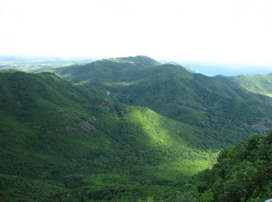
Two Sides to Ranking: Importance
>

Slide 9
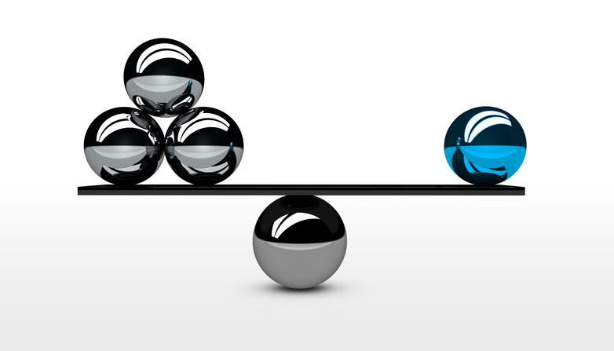
Relevance vs. Importance: A Balancing Act

Slide 10
Ranking: Relevance

Slide 11
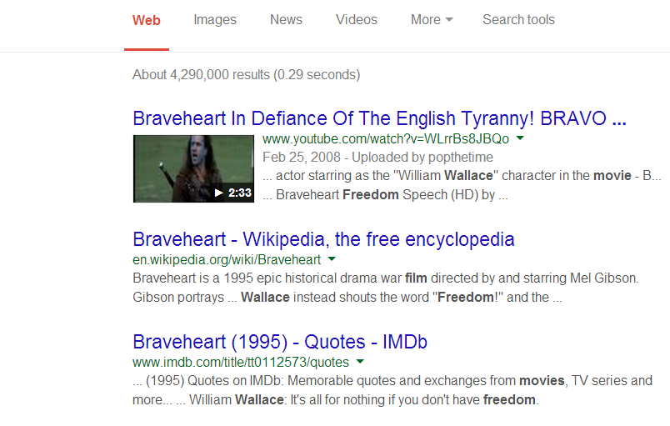
Example Query
Which of these three keyword terms is most “important”?

Slide 12
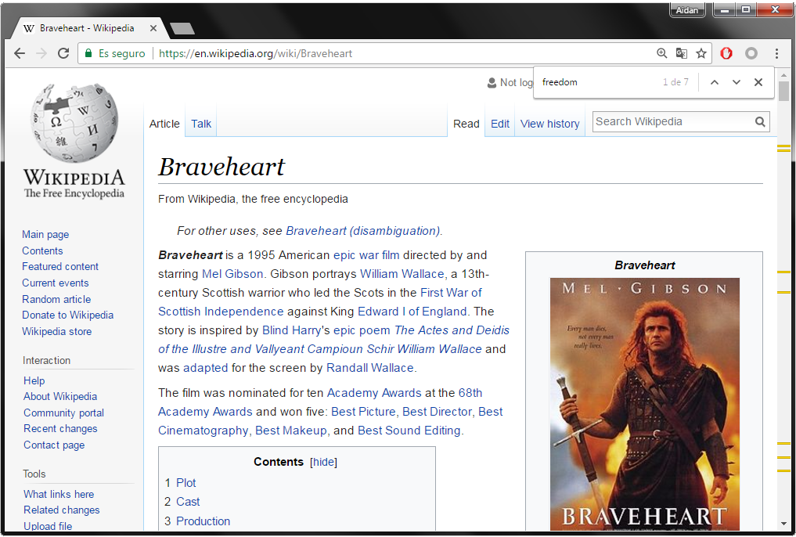
Matches in a Document
freedom
7 occurrences

Slide 13
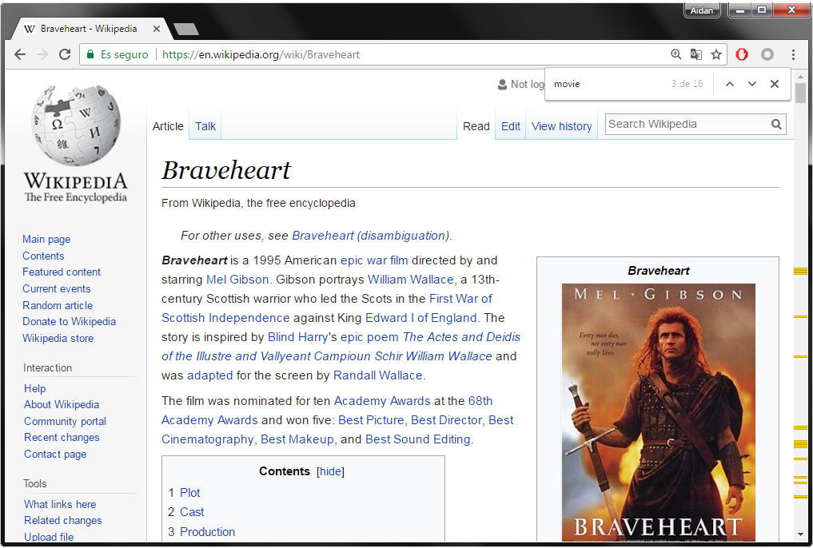
Matches in a Document
freedom
7 occurrences
movie
16 occurrences

Slide 14
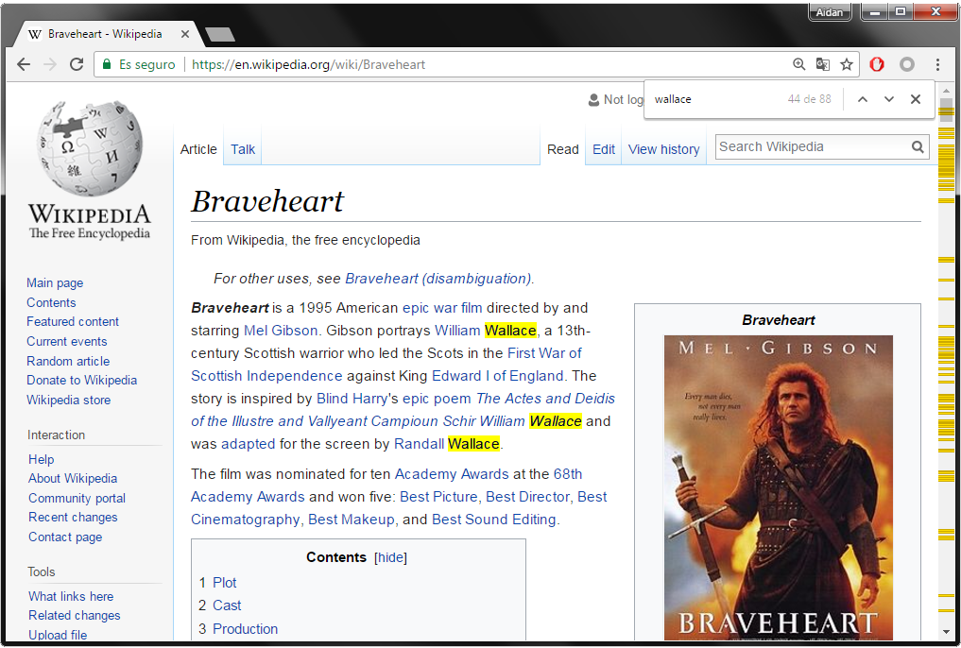
Matches in a Document
freedom
7 occurrences
movie
16 occurrences
wallace
88 occurrences

Slide 15
Usefulness of Words
movie
occurs very frequently
freedom
occurs frequently
wallace
occurs occassionally

Slide 16
Estimating Relevance
Rare words more important than common words
wallace (49M) more important than freedom (198M) more important than movie (835M)
Words occurring more frequently in a document indicate higher relevance
wallace (88) more matches than movie (16) more matches than freedom (7)

Slide 17
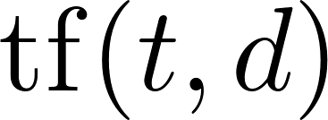
Relevance Measure: TF–IDF
TF: Term Frequency
Measures occurrences of a term in a document
… various options
Raw count of occurrences
Logarithmically scaled
Normalised by document length
A combination / something else ☺

Slide 18
Relevance Measure: TF–IDF
IDF: Inverse Document Frequency
How common a term is across all documents
…
Logarithmically scaled document occurrences
Note: The more rare, the larger the value

Slide 19
Relevance Measure: TF–IDF
TF–IDF: Combine Term Frequency and Inverse Document Frequency:
Score for a query
Let query
Score for a query:
(There are other possibilities)

Slide 20
Relevance Measure: TF–IDF
Term Frequency
Inverse Document Frequency

Slide 21
Relevance Measure: TF–IDF
Term Frequency
Inverse Document Frequency

Slide 22
Relevance Measure: TF–IDF
Term Frequency
Inverse Document Frequency

Slide 23
Relevance Measure: TF–IDF
Term Frequency
Inverse Document Frequency

Slide 24
Relevance Measure: TF–IDF
Term Frequency
Inverse Document Frequency

Slide 25
Relevance Measure: TF–IDF
Term Frequency
Inverse Document Frequency

Slide 26
Relevance Measure: TF–IDF
Term Frequency
Inverse Document Frequency

Slide 27
Vector Space Model (a mention)

Slide 28
Vector Space Model (a mention)

Slide 29
Vector Space Model (a mention)

Slide 30
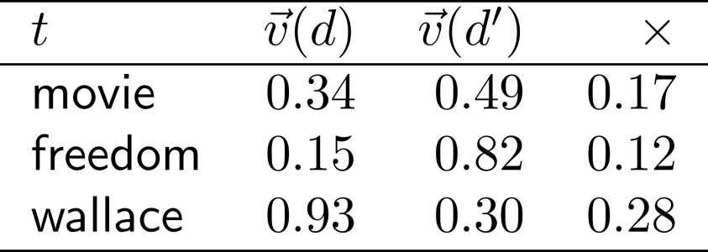
Vector Space Model (a mention)
Cosine Similarity
Note:

Slide 31
Relevance Measure: TF–IDF
TF–IDF: Combine Term Frequency and Inverse Document Frequency:
Score for a query
Let query
Score for a query:
(There are other possibilities)
… we could also use cosine similarity between query and document using TF–IDF weights

Slide 32
Two Sides to Ranking: Relevance
≠

Slide 33
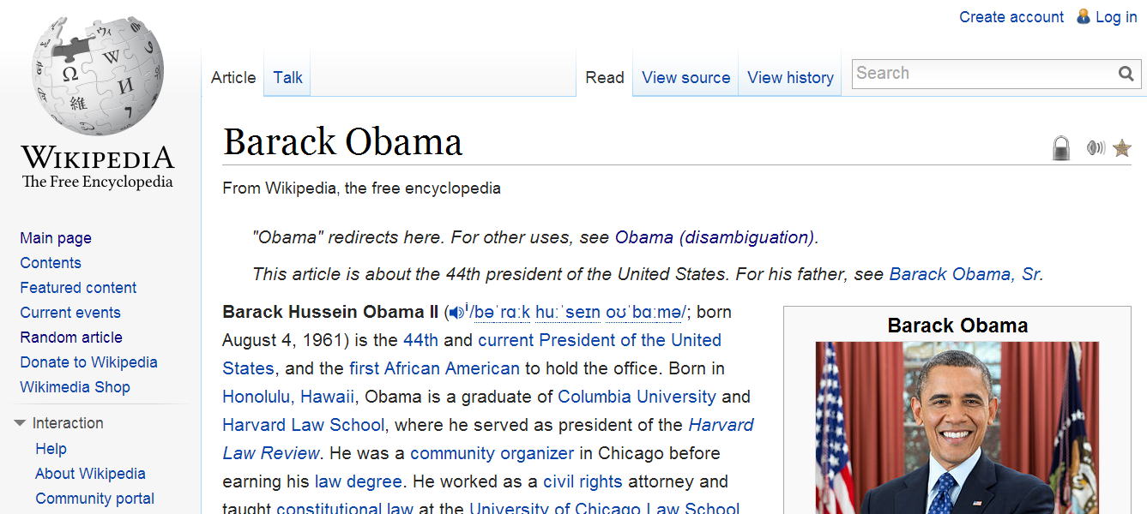
Field-Based Boosting
Not all text is equal: titles, headers, etc.

Slide 34
Anchor Text
See how the Web views/tags a page

Slide 35
Anchor Text
See how the Web views/tags a page

Slide 36
Lucene uses relevance scoring
… and Elasticsearch uses Lucene

Slide 37
Ranking: Importance

Slide 38
Two Sides to Ranking: Importance
How could we determine that Barack Obama is more important
than Mount Obama as a search result for "obama" on the Web?
>

Slide 39
Link Analysis
Which will have more links from other pages?
The Wikipedia article for Mount Obama?
The Wikipedia article for Barack Obama?

Slide 40
Link Analysis
Consider links as votes of confidence in a page
A hyperlink is the open Web’s version of …
(… even if the page is linked in a negative way.)

Slide 41
Link Analysis
So if we just count links to a page we can
determine its importance and we are done?

Slide 42
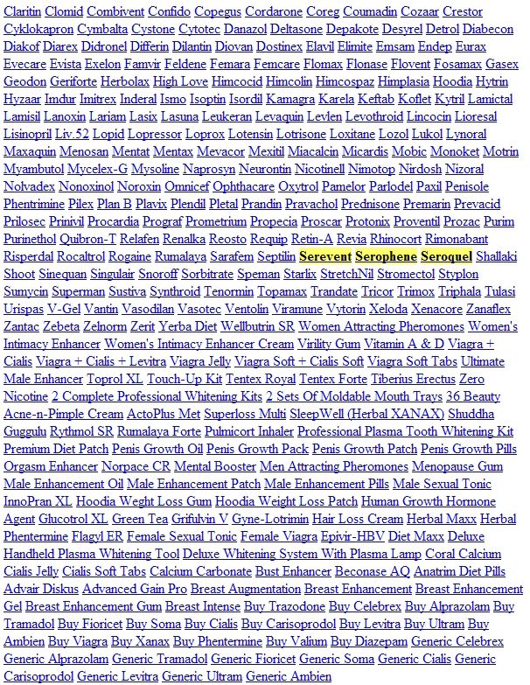
Link Spamming

Slide 43
Link Importance
So which should count for more?
A link from http://en.wikipedia.org/wiki/Barack_Obama?
Or a link from http://blackmagicspecialist.net.in?

Slide 44
PageRank

Slide 45
PageRank: Central Assumption
A page with lots of inlinks from important pages with few outlinks is more important

Slide 46
PageRank: Recursive Definition
A page with lots of inlinks from important pages with few outlinks is more important

Slide 47
PageRank Model
The Web: a directed graph
Vertices
(pages)
Edges
(links)
0.225
0.265
f
a
0.138
0.127
e
b
d
c
Which vertex is most important?
0.172
0.074

Slide 48
PageRank Model
The Web: a directed graph
Vertices
(pages)
Edges
(links)
f
a
e
b
d
c

Slide 49
PageRank Model
Vertices
(pages)
Edges
(links)
f
e
b
d

Slide 50
PageRank Model
Vertices
(pages)
Edges
(links)
f
e
b
d
c

Slide 51
PageRank: Random Surfer Model
= someone surfing the web, clicking links randomly
What is the probability of being at page x after n hops?
f
a
e
b
d
c

Slide 52
PageRank: Random Surfer Model
= someone surfing the web, clicking links randomly
What is the probability of being at page x after n hops?
Initial state: surfer equally likely to start at any node
f
a
e
b
d
c

Slide 53
PageRank: Random Surfer Model
= someone surfing the web, clicking links randomly
What is the probability of being at page x after n hops?
Initial state: surfer equally likely to start at any node
PageRank applied iteratively for each hop: score indicates probability of being at that page after that many hops
f
a
e
b
d
c
What would happen with g
over time?
g

Slide 54
PageRank: Random Surfer Model
= someone surfing the web, clicking links randomly
What is the probability of being at page x after n hops?
Initial state: surfer equally likely to start at any node
PageRank applied iteratively for each hop: score indicates probability of being at that page after that many hops
If the surfer reaches a page without links, the surfer randomly jumps to another page
f
a
e
b
d
c
g

Slide 55
PageRank: Random Surfer Model
= someone surfing the web, clicking links randomly
What is the probability of being at page x after n hops?
Initial state: surfer equally likely to start at any node
PageRank applied iteratively for each hop: score indicates probability of being at that page after that many hops
If the surfer reaches a page without links, the surfer randomly jumps to another page
f
a
e
b
d
c
What would happen with g and i over time?
g
i

Slide 56
PageRank: Random Surfer Model
= someone surfing the web, clicking links randomly
What is the probability of being at page x after n hops?
Initial state: surfer equally likely to start at any node
PageRank applied iteratively for each hop: score indicates probability of being at that page after than many hops
If the surfer reaches a page without out-links, the surfer randomly jumps to another page
f
a
e
b
d
c
What would happen with g and i over time?
g
i

Slide 57
PageRank: Random Surfer Model
= someone surfing the web, clicking links randomly
What is the probability of being at page x after n hops?
Initial state: surfer equally likely to start at any node
PageRank applied iteratively for each hop: score indicates probability of being at that page after than many hops
If the surfer reaches a page without out-links, the surfer randomly jumps to another page
The surfer will jump to a random page at any time with a probability 1 – d … this avoids traps and ensures convergence!
f
a
e
b
d
c
g
i

Slide 58
PageRank Model: Final Version
The Web: a directed graph
Vertices
(pages)
Edges
(links)
f
a
e
b
d
c

Slide 59
PageRank: Benefits
More robust than a simple link count
Fewer ties than link counting
Scalable to approximate (for sparse graphs)
Convergence guaranteed

Slide 60
Two Sides to Ranking: Importance
>

Slide 61
Computing PageRank at scale

Slide 62
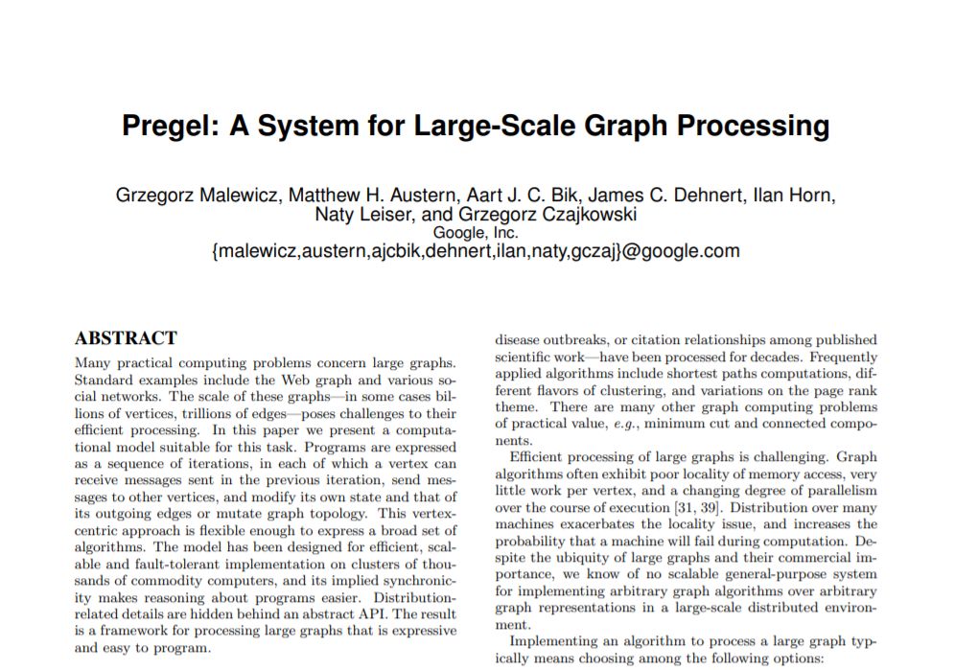
Graph Parallel Frameworks: Pregel

Slide 63
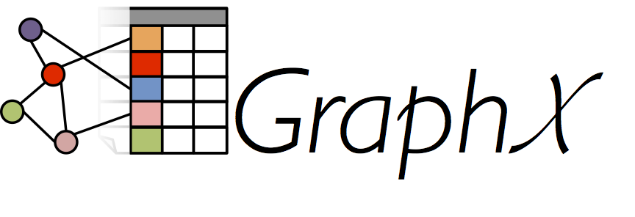
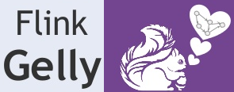
Graph Parallel Frameworks: Open Source

Slide 64
Vertex-Centric Computation
Nodes assigned state
f
a
e
b
d
c

Slide 65
Vertex-Centric Computation
Nodes assigned state
Nodes pass messages (typically along edges)
f
a
e
b
d
c

Slide 66
Vertex-Centric Computation
Nodes assigned state
Nodes pass messages (typically along edges)
Nodes aggregate messages received
f
a
e
b
d
c

Slide 67
Vertex-Centric Computation
Nodes assigned state
Nodes pass messages (typically along edges)
Nodes aggregate messages received
GOTO 2. until some termination criteria are reached
f
a
e
b
d
c

Slide 68
Vertex-Centric Computation: Other Features
Message passing and aggregation done in parallel
Option message passing to non-neighbours
Optional global “aggregation” phase
Optional changes to the graph topology

Slide 69
How does google really rank? An educated guess

Slide 70
How Modern Google ranks results (maybe)
According to survey of SEO experts, not people in Google

Slide 71
How Modern Google ranks results (maybe)
Why so secretive?
According to survey of SEO experts, not people in Google

Slide 72
Ranking: Science or Art?

Slide 73
Questions?

