Slide 1
CC5212-1 Procesamiento Masivo de Datos Otoño 2020 Lecture 6 Streaming: Kafka
Aidan Hogan
aidhog@gmail.com

Slide 2
Files

Slide 3
Files
Batch processing
Querying

Slide 4
Streams

Slide 5
Streams
Event processing
Continuous querying
Real-time response

Slide 6
Applications: Social Media Analytics

Slide 7
Applications: Social Media Analytics
Event processing
Kitten video goes viral
Burst of tweets about earthquakes
Continuous querying
Track sentiment for company's products
Monitor popular users tweeting about me
Real-time response
Put Emergency Services on alert
Schedule Quality Control (QC) review

Slide 8
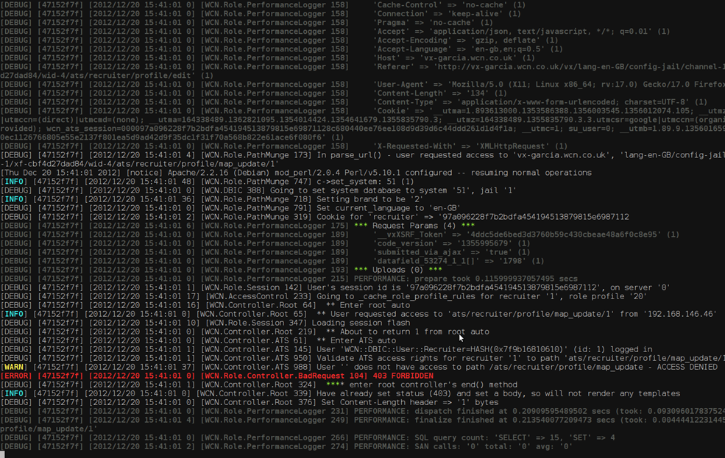
Applications: Log Monitoring

Slide 9
Applications: Log Monitoring
Event processing
Burst of log messages
Critical error message
Continuous querying
Track most critical fixes today
Monitor memory leaks in new release
Real-time response
Disable unsafe feature in a web-site
Automatically fire new developer

Slide 10
Applications: Finance

Slide 11
Applications: Finance
Event processing
Company goes public
Stock drops sharply
Continuous querying
Track stocks with gains of 10% in a day
Create alerts for major buy/sell transactions
Real-time response
BUY BUY BUY
SELL SELL SELL

Slide 12
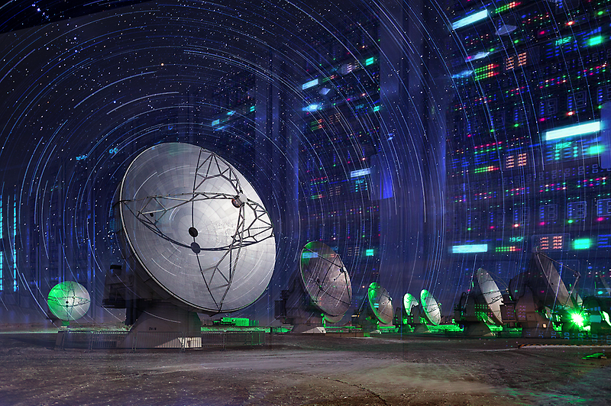
Applications: Astronomy

Slide 13
Applications: Astronomy
Event processing
The telescope moves
A light source flashes
Continuous querying
Find possible supernovae
Track object across the sky
Real-time response
Refocus telescope on important object
Lower data filter thresholds

Slide 14
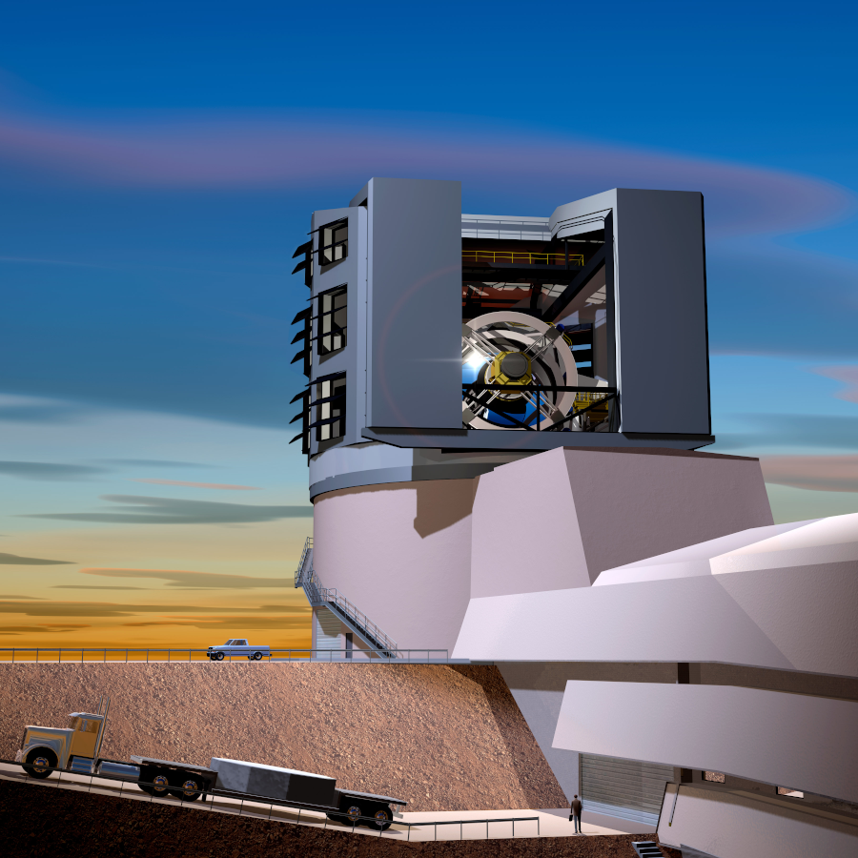
Applications: Astronomy
Event processing
The telescope moves
A light source flashes
Continuous querying
Find possible supernovae
Track object across the sky
Real-time response
Refocus telescope on important object
Lower data filter thresholds

Slide 15
Streams: Internet of Things

Slide 16
Streams: Internet of Things
Event processing
A light turns on
It starts to rain
Continuous querying
Tell me when temperature reaches 30°
Update position of vehicle
Real-time response
Turn off air conditioning
Take another route

Slide 17
Distributed Streaming Platform

Slide 18
Available Frameworks

Slide 19
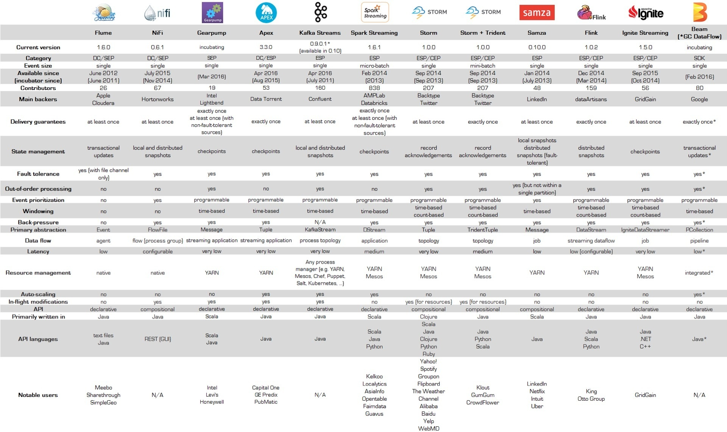
Available Frameworks
https://databaseline.bitbucket.io/an-overview-of-apache-streaming-technologies/

Slide 20
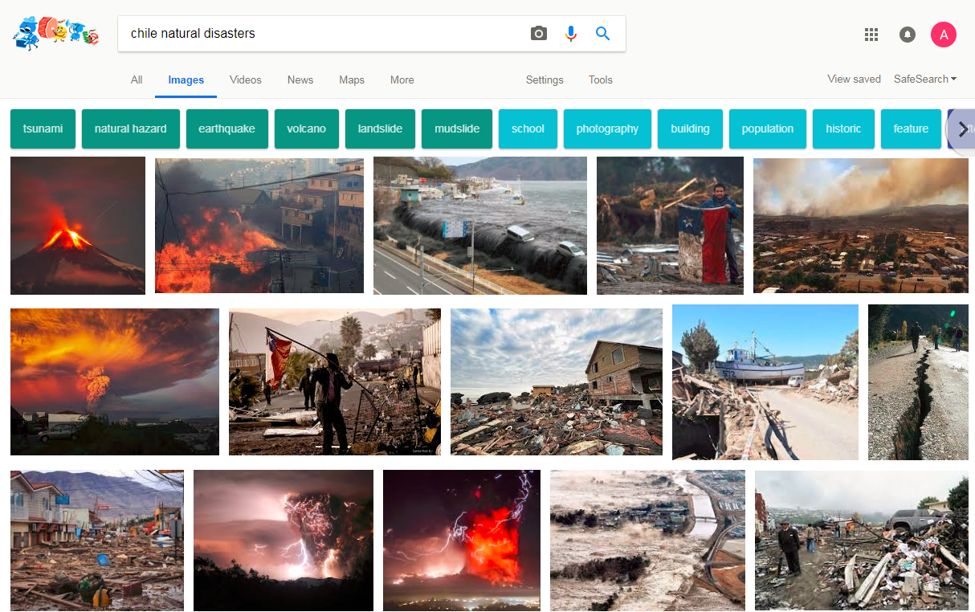
Application: Emergency Response

Slide 21
Real-Time Emergency Response

Slide 22
Real-Time Emergency Response

Slide 23
Real-Time Emergency Response

Slide 24
Apache Kafka

Slide 25
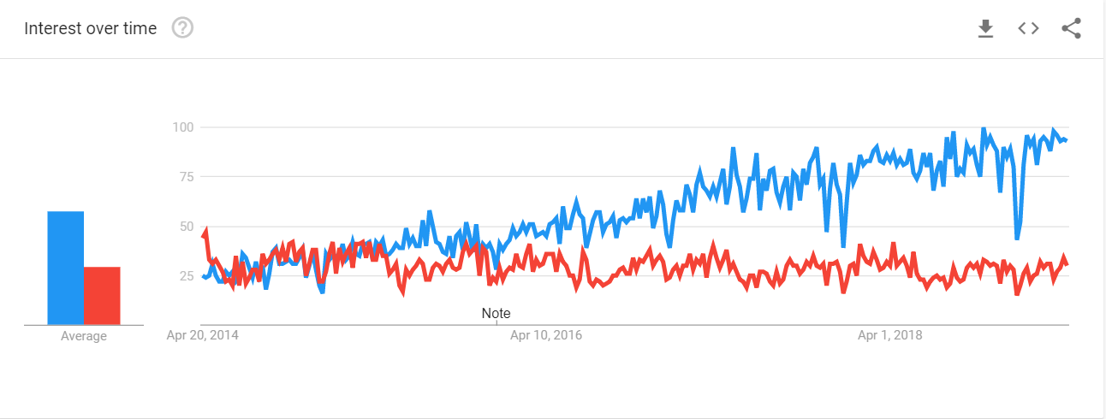
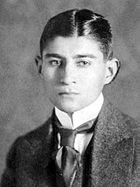
Apache Kafka vs. Franz Kafka

Slide 26
Apache Kafka
Open Source
Scala / Java
Originated in LinkedIn

Slide 27
Kafka Overview
Producers (Push)
Consumers (Pull)

Slide 28
Kafka: Data Model

Slide 29
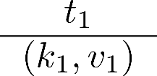
Kafka Record
Producers
1
Consumers

Slide 30
Kafka Record
Producers
Records represent "events"
Records are immutable
Contain id (offset), timestamp, key and value
Timestamp assigned by application or Kafka
1
Consumers

Slide 31
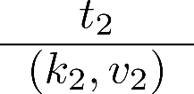
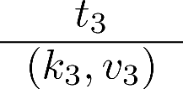
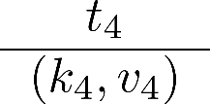
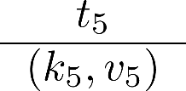
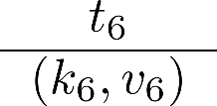
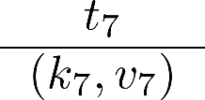
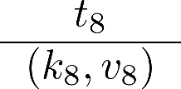
Kafka Ledger
Producers
1
2
3
4
5
6
7
8
...
Consumers

Slide 32
Kafka Ledger
Producers
Producers may only append to ledger
1
2
3
4
5
6
7
8
...
Consumers

Slide 33
Kafka Log
Producers
1
2
3
4
5
6
7
8
...
Consumers

Slide 34
Kafka Log
Producers
Producers may only append to log
Consumers can read from anywhere*
* kind of
1
2
3
4
5
6
7
8
...
Consumers

Slide 35
Kafka: Topics

Slide 36
Kafka Topics
Topic 1:
Disasters
Topic 2:
News
Topic 3:
Traffic

Slide 37
Kafka Topics
Producers
Publish to Topics
Topic 1:
Disasters
Topic 2:
News
Topic 3:
Traffic
Consumers
Subscribe to Topics

Slide 38
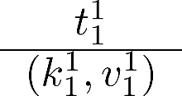
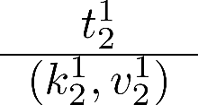
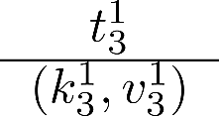
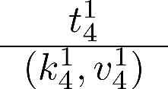
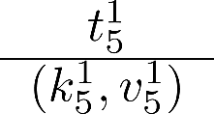
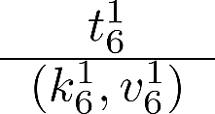
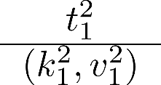
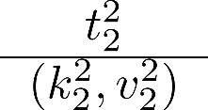
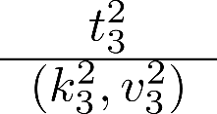
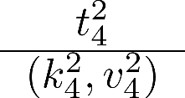
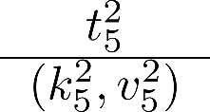
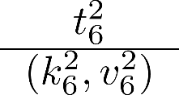
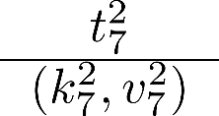
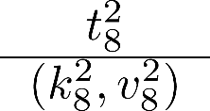
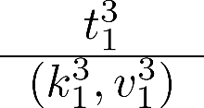
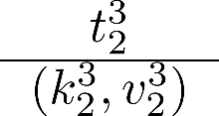
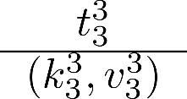
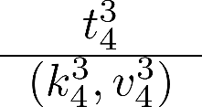
Topic: Default Partitioning by Key
Partition 1
1
2
3
4
5
6
...
Partition 2
1
2
3
4
5
6
7
8
...
Partition 3
1
2
3
4
...

Slide 39
Topic
Partition 1
Topics are persistent (on disk)
Configurable retention policy
Keep everything
Delete once consumed
Keep for a period of time
Use fixed amount of space
1
2
3
4
5
6
...
Partition 2
1
2
3
4
5
6
7
8
Partition 3
1
2
3
4
...

Slide 40
Ordering
Partition 1
1
2
3
4
5
6
Partition 2
1
2
3
4
5
6
7
8
Partition 3
1
2
3
4

Slide 41
Ordering
Partition 1
Ordering (offset) guaranteed per partition
Not across partitions!
For ordering across partitions, use timestamp
...
1
2
3
4
5
6
Partition 2
...
1
2
3
4
5
6
7
8
Partition 3
1
2
3
4

Slide 42
Replication
Partition 2
Topics can be replicated
Choose factor per topic
Automatic load balancing
Partition 3
Partition 2
Partition 2
Partition 3
Problem?
Partition 1
Order?
Partition 1
Partition 1
Partition 3

Slide 43
Leader
Partition 2
Topics can be replicated
Choose factor per topic
Automatic load balancing
One machine is the leader
The others are followers
Leader automatically elected
Ensures order per partition
Reads/writes to leader
Partition 3
Partition 2
Partition 2
Partition 2
Partition 3
Partition 3
Partition 1
Partition 1
Partition 1
Partition 1
Partition 3

Slide 44
Kafka: Write Guarantees

Slide 45
Writes: Asynchronous (No Guarantee)
Partition 2
Producers
Partition 3
Partition 2
Partition 1
Partition 2
Partition 1
Partition 3
Partition 3
Partition 1

Slide 46
Writes: Leader Commit
Partition 2
Producers
Partition 3
Partition 2
Partition 1
Partition 2
Partition 1
Partition 3
Partition 3
Partition 1

Slide 47
Writes: Leader Commit + Quorum (2)
Partition 2
Producers
Partition 3
Partition 2
Partition 1
Partition 2
Partition 1
Partition 3
Partition 3
Partition 1

Slide 48
Write Guarantees
Asynchronous
No guarantee
Very low latency
Leader Commit
Persistent on leader
Medium latency (disk write + network ack)
Leader Commit + Quorum n
Persistent on leader + n machines
High latency (disk writes + network acks)

Slide 49
Kafka: Reads

Slide 50
Kafka tracks consumer offset
C1: 1-2
1
2
3
4
5
6
7
8
...
1
2
C1

Slide 51
Kafka tracks consumer offset
C1: 3-4
1
2
3
4
5
6
7
8
...
1
2
3
4
C1

Slide 52
Kafka tracks consumer offset
C1: 5-6
1
2
3
4
5
6
7
8
...
1
2
3
4
5
6
C1

Slide 53
Failures?
1
2
3
4
5
6
7
8
...
1
2
3
4
5
6
What should we do in the case of a read failure?
C1

Slide 54
Kafka: Read Guarantees

Slide 55
Read Guarantees
At least once
Each value processed at least once
Consumer offset updated on consumer ACK
At most once
Effectively once
Exactly once

Slide 56
Read: At Least Once (Default)
②
C1: 1-2
1
2
3
4
5
6
7
8
...
①
1
2
C1

Slide 57
Read: At Least Once (Default)
C1: 1-2
1
2
3
4
5
6
7
8
...
1
2
C1

Slide 58
Read: At Least Once (Default)
C1: 1-2
1
2
3
4
5
6
7
8
...
①
1
2
3
C1

Slide 59
Read: At Least Once (Default)
C1: 1-2
C1: 3-4
②
1
2
3
4
5
6
7
8
...
①
1
2
3
3
4
C1

Slide 60
Read: At Least Once (Default)
C1: 3-4
C1: 5-6
②
1
2
3
4
5
6
7
8
...
①
1
2
3
3
4
5
6
C1

Slide 61
Read Guarantees
At least once
At most once
Each value processed at most once
Consumer offset updated immediately
Effectively once
Exactly once

Slide 62
Read: At Most Once
①
C1: 1-2
1
2
3
4
5
6
7
8
...
②
1
2
C1

Slide 63
Read: At Most Once
①
C1: 3-4
1
2
3
4
5
6
7
8
...
②
1
2
3
C1

Slide 64
Read: At Most Once
①
C1: 5-6
1
2
3
4
5
6
7
8
...
②
1
2
3
5
6
C1

Slide 65
Read Guarantees
At least once
At most once
Effectively once
At least once but ...
Consumer takes care of duplicates
Exactly once

Slide 66
Read: Effectively Once
②
C1: 1-2
1
2
3
4
5
6
7
8
...
①
1
2
Distinct
C1

Slide 67
Read: Effectively Once
C1: 1-2
1
2
3
4
5
6
7
8
...
1
2
C1

Slide 68
Read: Effectively Once
C1: 1-2
1
2
3
4
5
6
7
8
...
①
1
2
3
Distinct
C1

Slide 69
Read: Effectively Once
C1: 1-2
C1: 3-4
②
1
2
3
4
5
6
7
8
...
①
1
2
3
3
4
Distinct
C1

Slide 70
Read: Effectively Once
C1: 3-4
C1: 5-6
②
1
2
3
4
5
6
7
8
...
①
1
2
3
4
5
6
Distinct
C1

Slide 71
Read Guarantees
At least once
At most once
Effectively once
Exactly once
Data and offset updated as a single transaction

Slide 72
Read: Exactly Once
Transaction 1: ①,②
②
C1: 1-2
1
2
3
4
5
6
7
8
...
①
1
2
C1

Slide 73
Read: Exactly Once
C1: 1-2
1
2
3
4
5
6
7
8
...
1
2
C1

Slide 74
Read: Exactly Once
Transaction 2: ①,②
C1: 1-2
1
2
3
4
5
6
7
8
...
①
1
2
C1

Slide 75
Read: Exactly Once
Transaction 3: ①,②
C1: 1-2
C1: 3-4
②
1
2
3
4
5
6
7
8
...
①
1
2
3
4
C1

Slide 76
Read: Exactly Once
Transaction 4: ①,②
C1: 3-4
C1: 5-6
②
1
2
3
4
5
6
7
8
...
①
1
2
3
4
5
6
C1

Slide 77
Leader Replication and Reads
Partition 2
Producers
Partition 3
Partition 2
Partition 1
Partition 2
Partition 1
Partition 3
Partition 3
Partition 1

Slide 78
Kafka: Consumer Groups

Slide 79
Consumer Groups
Group 1
Producers
Partition 2
Group 2
Partition 1
Partition 3

Slide 80
Consumer Groups
Group 1
Write to one consumer in each group
Allows to partition consumers
Load balancing within each group
Producers
Partition 2
Group 2
Partition 1
Partition 3

Slide 81
Kafka: Streams and Connectors

Slide 82
Kafka Overview
Producers
Conn
ectors
Consumers
Stream

Slide 83
Kafka Overview
Producer API:
Append records to topics (push)
Consumer API:
Read records from topics (pull)
Connector API:
Read/write to external components
For example, a database or other streaming platforms
Stream API (Producer + Consumer):
Read records from input topics
Append records to output topics

Slide 84
Optimisations and Other Features

Slide 85
Kafka Optimisations
Log Compaction
Repeated sequential values are suppressed
Direct Disk-to-Network
When data don't need to be loaded into JVM
Consumer / Producer Quotas
Set limits to avoid saturating the system
...

Slide 86
Kafka Streams API
Aggregation (e.g., count messages)
Joins (e.g., "unify" two streams)
Windowing (define retention period)
Continuous Querying (KSQL)

Slide 87
Available Frameworks
https://databaseline.bitbucket.io/an-overview-of-apache-streaming-technologies/

Slide 88
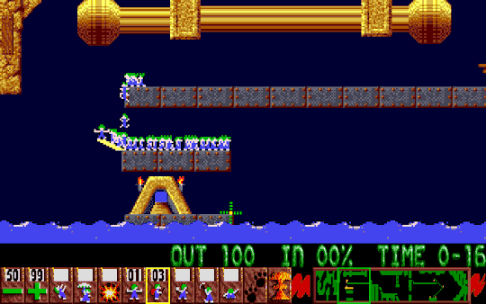
Questions?

