Slide 1
CC5212-1 Procesamiento Masivo de Datos Otoño 2019 Lecture 10 NoSQL: MongoDB
Aidan Hogan
aidhog@gmail.com

Slide 2
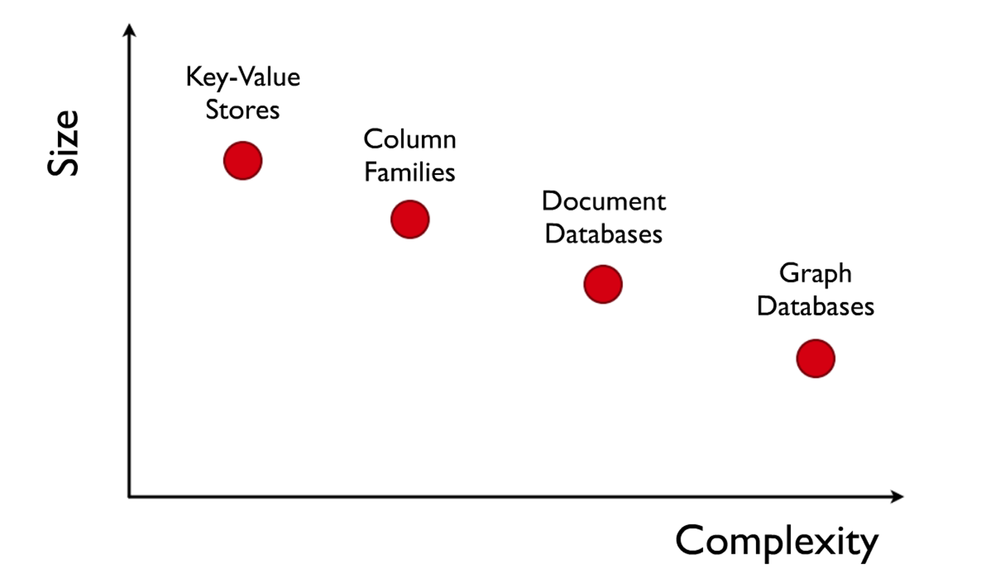
NoSQL

Slide 3
Document Stores

Slide 4
Key–Value: a Distributed Map
Countries
Primary Key | Value
Afghanistan | capital:Kabul,continent:Asia,pop:31108077#2011
… | …
Tabular: Multi-dimensional Maps
Countries
Primary Key | capital | continent | pop-value | pop-year
Afghanistan | Kabul | Asia | 31108077 | 2011
… | … | … | … | …
Document: Value is a document
Countries
Primary Key | Value
Afghanistan | { cap: “Kabul”, con: “Asia”, pop: { val: 31108077, y: 2011 } }
… | …

Slide 6
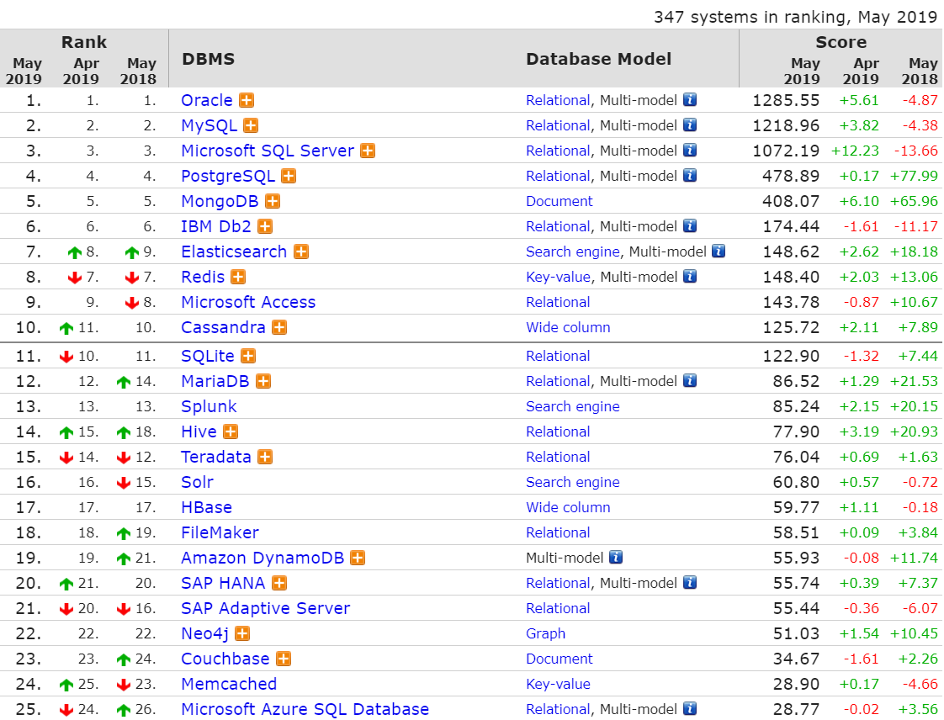

Slide 7
http://cryto.net/~joepie91/blog/2015/07/19/why-you-should-never-ever-ever-use-mongodb/

Slide 9
MongoDB: Data model

Slide 10
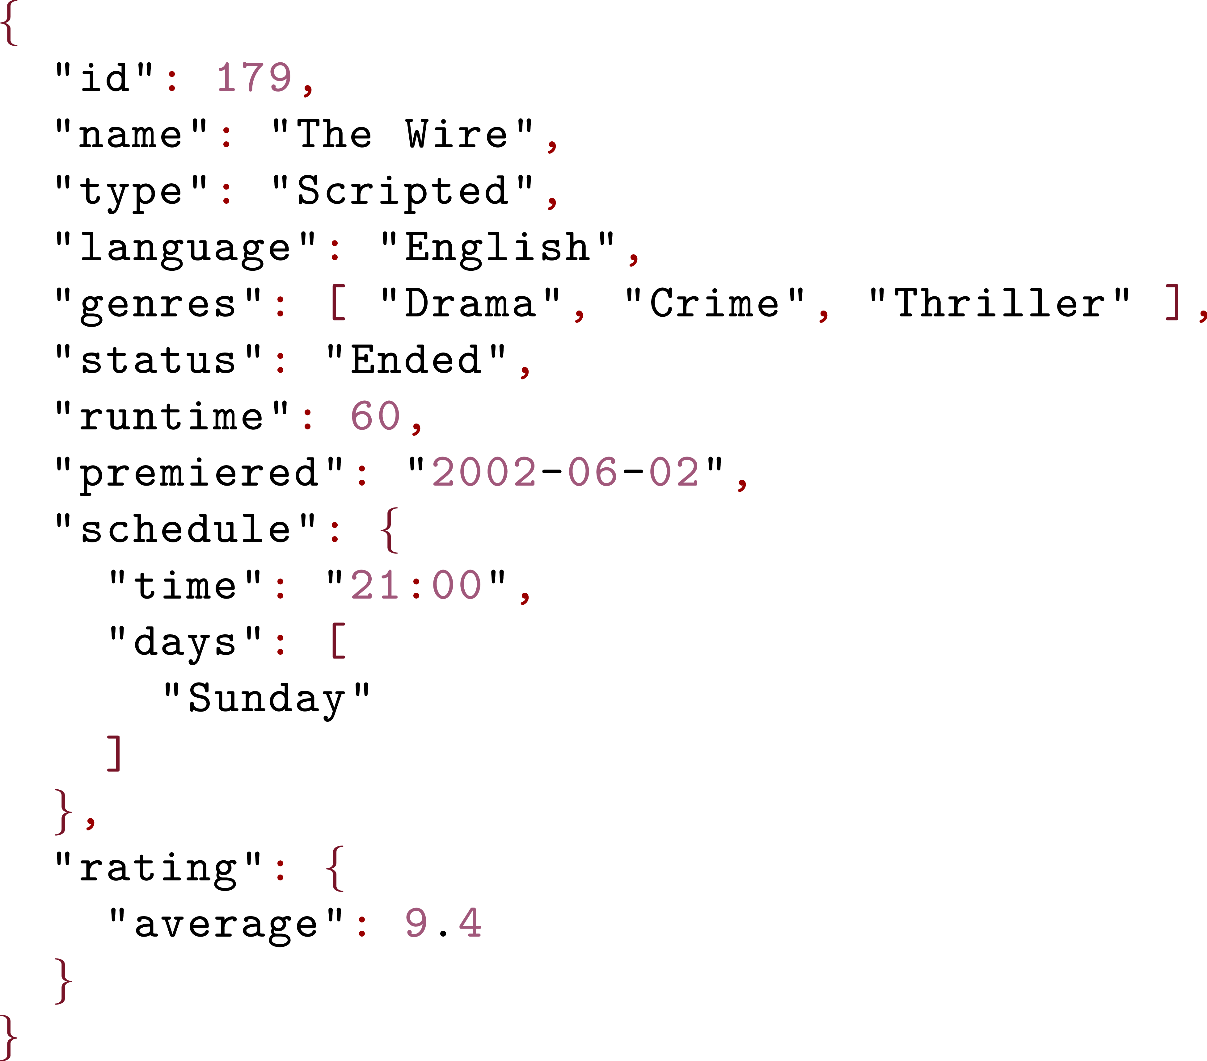
JavaScript Object Notation: JSON

Slide 11
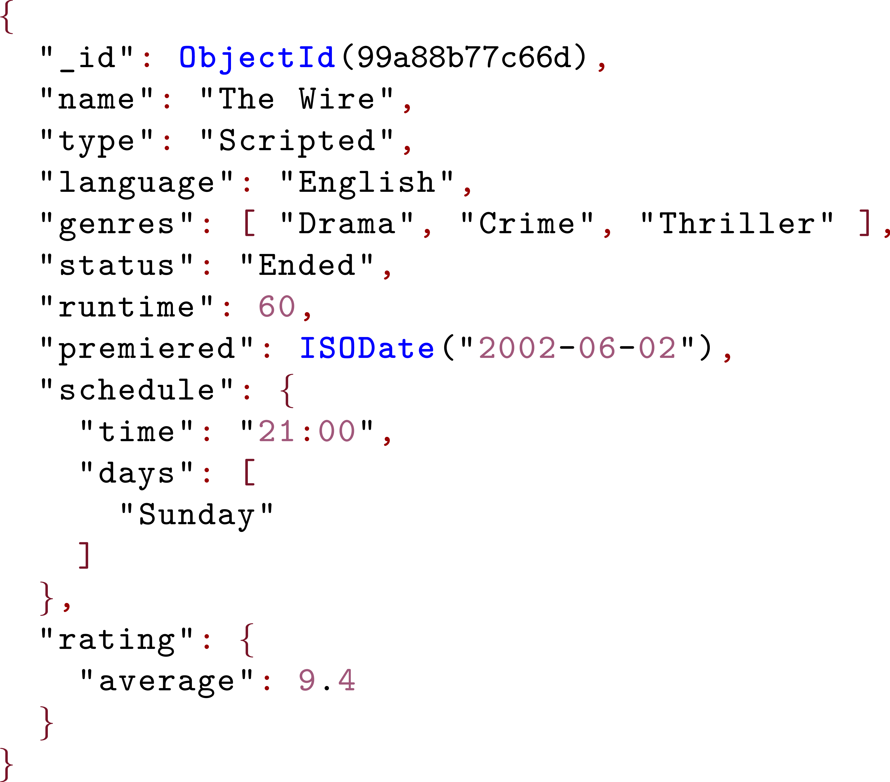
Binary JSON: BSON

Slide 12
MongoDB: Datatypes

Slide 13
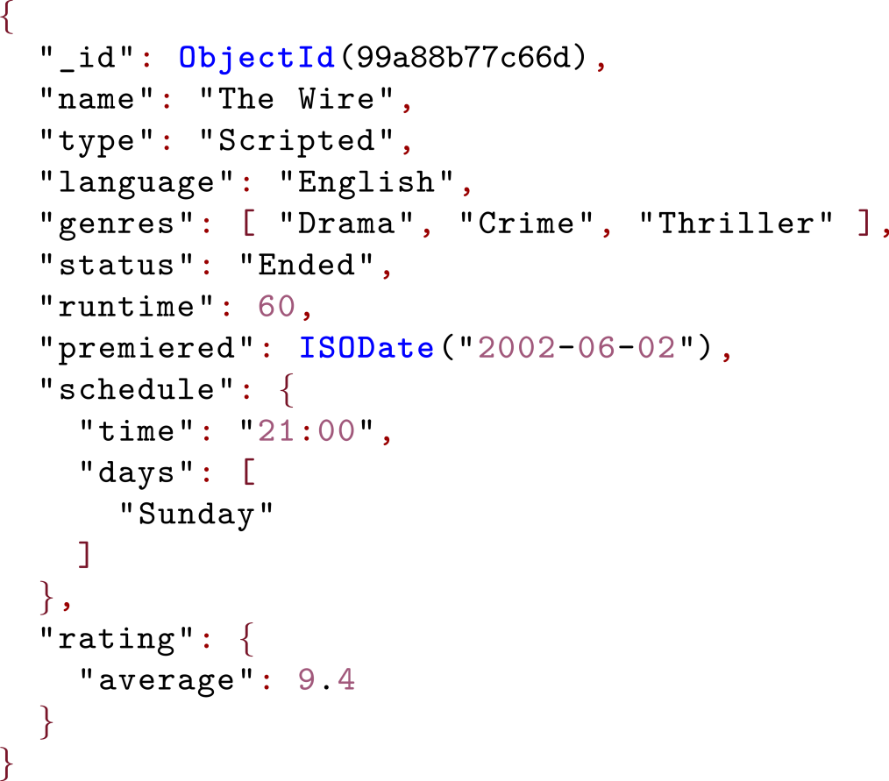
MongoDB: Map from keys to BSON values
TVSeries
Key | BSON Value
99a88b77c66d
… | …

Slide 14
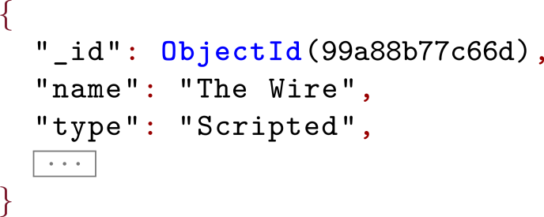
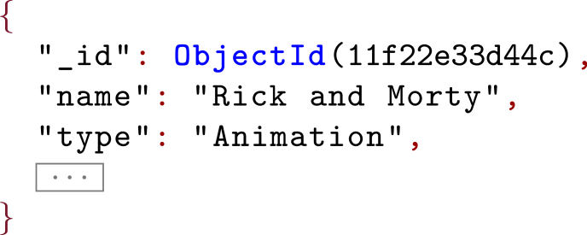
MongoDB Collection: Similar Documents
TVSeries
Key | BSON Value
99a88b77c66d
11f22e33d44c

Slide 15
MongoDB Database: Related Collections
database: TV
TVSeries
Key | BSON Value
… | …
TVEpisodes
Key | BSON Value
… | …
TVNetworks
Key | BSON Value
… | …

Slide 16
Load database tvdb (and create if not exists):
> use tvdb
switched to db tvdb
See all (non-empty) databases (tvdb is empty):
> show dbs
local 0.00001 GB
test 0.00231 GB
See current database:
> db
tvdb
Drop current database:
> db.dropDatabase()
{ "dropped" : "tvdb", "ok" : 1 }

Slide 17
Create collection series:
> db.createCollection("series")
{ "ok" : 1 }
See all collections in current database:
> show collections
series
Drop collection series:
> db.series.drop()
true
Clear all documents from collection series:
> db.series.remove( {} )
WriteResult({ "nRemoved" : 0 })

Slide 18
Create capped collection (keeps only most recent):
> db.createCollection("last100episodes",
{ capped: true, size: 12285600, max: 100 } )
{ "ok" : 1 }
Create collection with default index on _id:
> db.createCollection("cast", { autoIndexId: true } )
{
"note" : "the autoIndexId option is deprecated ...",
"ok" : 1
}

Slide 19
MongoDB: Inserting Data

Slide 20
Insert document: without _id
> db.series.insert(
{
"name": "Black Mirror",
"type": "Scripted",
"runtime": 60,
"genres": [
"Science-Fiction",
"Thriller"
]
})
WriteResult({ "nInserted" : 1 })

Slide 21
Insert document: with _id
> db.series.insert(
{
_id: ObjectId("5951e0b265ad257d48f4a7d5"),
"name": "Black Mirror",
"type": "Scripted",
"runtime": 60,
"genres": [
"Science-Fiction",
"Thriller"
]
})
WriteResult({ "nInserted" : 1 })
… fails if _id already exists
… use update or save to update existing document(s)

Slide 22
Use save and _id to overwrite:
> db.series.insert(
{
_id: ObjectId("5951e0b265ad257d48f4a7d5"),
"name": "Black Mirror",
"type": "Scripted",
"runtime": 60
})
WriteResult({ "nInserted" : 1 })
> db.series.insert(
{
_id: ObjectId("5951e0b265ad257d48f4a7d5"),
"name": "Black Mirror",
"type": "Scripted",
"runtime": 60
})
WriteResult({ "nInserted" : 1 })
> db.series.save(
{
_id: ObjectId("5951e0b265ad257d48f4a7d5"),
"name": "Black Mirror (Overwritten)"
})
WriteResult({ "nMatched" : 1, "nUpserted" : 0, "nModified" : 1 })
… overwrites old document

Slide 23
MongoDB: Queries with Selection

Slide 24
Query documents in a collection with find:
> db.series.insert(
{
_id: ObjectId("5951e0b265ad257d48f4a7d5"),
"name": "Black Mirror",
"type": "Scripted",
"runtime": 60
})
> db.series.find()
{ "_id" : ObjectId("5951e0b265ad257d48f4a7d5"), "name" : "Black Mirror", "type" : "Scripted", "runtime" : 60 }
… use findOne() to return one document

Slide 25
Pretty print results with pretty:
> db.series.insert(
{
_id: ObjectId("5951e0b265ad257d48f4a7d5"),
"name": "Black Mirror",
"type": "Scripted",
"runtime": 60
})
> db.series.find().pretty()
{
"_id" : ObjectId("5951e0b265ad257d48f4a7d5"),
"name" : "Black Mirror",
"type" : "Scripted",
"runtime" : 60
}

Slide 26
Selection: find documents matching σ
> db.series.find(σ)

Slide 27
Selection σ: Equality
> db.series.insert(
{
"name": "Black Mirror",
"type": "Scripted",
"runtime": 60
})
> db.series.insert(
{
"name": "Black Mirror",
"type": "Scripted",
"runtime": 60
})
Equality: { key: value }
> db.series.find( { "type": "Scripted" } )
{ "name" : "Black Mirror", "type" : "Scripted", "runtime" : 60 }
Results would include _id but for brevity, we will omit
this from examples where it is not important.

Slide 28
Selection σ: Nested key
> db.series.insert(
{
"name": "Black Mirror",
"rating": { "avg": 9.4 },
"runtime": 60
})
> db.series.insert(
{
"name": "Black Mirror",
"rating": { "avg": 9.4 },
"runtime": 60
})
Key can access nested values:
> db.series.find( { "rating.avg": 9.4 } )
{ "name" : "Black Mirror", "rating": { "avg": 9.4 }, "runtime" : 60 }

Slide 29
Selection σ: Equality on null
> db.series.insert(
{
"name": "Black Mirror",
"rating": { "avg": null },
"runtime": 60
})
> db.series.insert(
{
"name": "Black Mirror",
"rating": { "avg": null },
"runtime": 60
})
Equality on nested null value:
> db.series.find( { "rating.avg": null } )
{ "name" : "Black Mirror", "rating": { "avg": null }, "runtime" : 60 }
… matches when value is null or ...

Slide 30
Selection σ: Equality on null
> db.series.insert(
{
"name": "Black Mirror",
"rating": { "val": 9.4 },
"runtime": 60
})
> db.series.insert(
{
"name": "Black Mirror",
"rating": { "val": 9.4 },
"runtime": 60
})
Key can access nested values:
> db.series.find( { "rating.avg": null } )
{ "name" : "Black Mirror", "rating": { "val": 9.4 }, "runtime" : 60 }
… when field doesn't exist with key.

Slide 31
Selection σ: Equality on document
> db.series.insert(
{
"name": "Black Mirror",
"rating": { "avg": 9.4 },
"runtime": 60
})
> db.series.insert(
{
"name": "Black Mirror",
"rating": { "avg": 9.4 },
"runtime": 60
})
Value can be an object/document:
> db.series.find( { "rating": { "avg": 9.4 } } )
{ "name" : "Black Mirror", "rating": { "avg": 9.4 }, "runtime" : 60 }

Slide 32
Selection σ: Equality on document
> db.series.insert(
{
"name": "Black Mirror",
"rating": { "avg": 9.4, "votes": 9001 },
"runtime": 60
})
Value can be an object/document:
> db.series.find( { "rating": { "votes":9001 } } )
… no results: needs to match full object.

Slide 33
Selection σ: Equality on document
> db.series.insert(
{
"name": "Black Mirror",
"rating": { "avg": 9.4, "votes": 9001 },
"runtime": 60
})
Value can be an object/document:
> db.series.find( { "rating": { "votes":9001, "avg":9.4 } } )
… no results: order of attributes matters.

Slide 34
Selection σ: Equality on exact array
> db.series.insert(
{
"name": "Black Mirror",
"genres": [ "Science-Fiction", "Thriller" ],
"runtime": 60
})
> db.series.insert(
{
"name": "Black Mirror",
"genres": [ "Science-Fiction", "Thriller" ],
"runtime": 60
})
Equality can match an exact array:
> db.series.find( { "genres": [ "Science-Fiction",
"Thriller" ] } )
{ "name" : "Black Mirror", "genres": [ "Science-Fiction", "Thriller" ], "runtime" : 60 }

Slide 35
Selection σ: Equality on exact array
> db.series.insert(
{
"name": "Black Mirror",
"genres": [ "Science-Fiction", "Thriller" ],
"runtime": 60
})
Equality can match an exact array
> db.series.find( { "genres": [ "Science-Fiction" ] } )
… no results: needs to match full array.

Slide 36
Selection σ: Equality on exact array
> db.series.insert(
{
"name": "Black Mirror",
"genres": [ "Science-Fiction", "Thriller" ],
"runtime": 60
})
Equality can match an exact array
> db.series.find( { "genres": [ "Thriller",
"Science-Fiction" ] } )
… no results: order of elements matters.

Slide 37
Selection σ: Equality matches inside array
> db.series.insert(
{
"name": "Black Mirror",
"genres": [ "Science-Fiction", "Thriller" ],
"runtime": 60
})
> db.series.insert(
{
"name": "Black Mirror",
"genres": [ "Science-Fiction", "Thriller" ],
"runtime": 60
})
Equality matches a value in an array:
> db.series.find( { "genres": "Thriller" } )
{ "name" : "Black Mirror", "genres": [ "Science-Fiction", "Thriller" ], "runtime" : 60 }

Slide 38
Selection σ: Equality matches both
> db.series.insert( { "name": "A" , "val": [ 5, 6 ] } )
> db.series.insert( { "name": "B", "val": 5 } )
> db.series.insert( { "name": "A" , "val": [ 5, 6 ] } )
> db.series.insert( { "name": "B", "val": 5 } )
Equality matches a value inside and outside an array:
> db.series.find( { "val": 5 } )
{ "name": "A" , "val": [ 5, 6 ] }
{ "name": "B" , "val": 5 }
*cough*

Slide 39
Selection σ: Inequalities
Less than: { key: { $lt: value } }
Greater than: { key: { $gt: value } }
Less than or equal: { key: { $lte: value } }
Greater than or equal: { key: { $gte: value } }
Not equals: { key: { $ne: value } }

Slide 40
Selection σ: Less Than
> db.series.insert(
{
_id: ObjectId("5951e0b265ad257d48f4a7d5"),
"name": "Black Mirror",
"genres": [ "Science-Fiction", "Thriller" ],
"runtime": 60
})
> db.series.insert(
{
_id: ObjectId("5951e0b265ad257d48f4a7d5"),
"name": "Black Mirror",
"genres": [ "Science-Fiction", "Thriller" ],
"runtime": 60
})
Less than: { key: { $lt: value } }
> db.series.find({ "runtime": { $lt: 70 } })
{ "name" : "Black Mirror", "genres": [ "Science-Fiction", "Thriller" ], "runtime" : 60 }

Slide 41
Selection σ: Match one of multiple values
Match any value: { key: { $in: [ v1, …, vn ] } }
Match no value: { key: { $nin: [ v1, …, vn ] } }
… also passes if key does not exist.

Slide 42
Selection σ: Match one of multiple values
> db.series.insert(
{
"name": "Black Mirror",
"genres": [ "Science-Fiction", "Thriller" ],
"runtime": 60
})
> db.series.insert(
{
"name": "Black Mirror",
"genres": [ "Science-Fiction", "Thriller" ],
"runtime": 60
})
Match any value: { key: { $in: [ v1, …, vn ] } }
> db.series.find({ "runtime": { $in: [30, 60] } })
{ "name" : "Black Mirror", "genres": [ "Science-Fiction", "Thriller" ], "runtime" : 60 }

Slide 43
Selection σ: Match one of multiple values
> db.series.insert(
{
"name": "Black Mirror",
"genres": [ "Science-Fiction", "Thriller" ],
"runtime": 60
})
> db.series.insert(
{
"name": "Black Mirror",
"genres": [ "Science-Fiction", "Thriller" ],
"runtime": 60
})
Match any value: { key: { $in: [ v1, …, vn ] } }
> db.series.find({ "genres": { $in: ["Noir", "Thriller"] } })
{ "name" : "Black Mirror", "genres": [ "Science-Fiction", "Thriller" ], "runtime" : 60 }
… if key references an array, any value of array
should match any value of $in

Slide 44
Selection σ: Boolean connectives
And: { $and: [ σ , σ′ ] }
Or: { $or: [ σ , σ′ ] }
Not: { $not: [ σ ] }
Nor: { $nor: [ σ , σ′ ] }
… of course, can nest such conditions

Slide 45
Selection σ: And
> db.series.insert(
{
_id: ObjectId("5951e0b265ad257d48f4a7d5"),
"name": "Black Mirror",
"genres": [ "Science-Fiction", "Thriller" ],
"runtime": 60
})
> db.series.insert(
{
_id: ObjectId("5951e0b265ad257d48f4a7d5"),
"name": "Black Mirror",
"genres": [ "Science-Fiction", "Thriller" ],
"runtime": 60
})
And: { $and: [ σ , σ′ ] }
> db.series.find({ $and: [
{ "runtime": { $in: [30, 60] } } ,
{ "name": { $ne: "Lost" } } ] }
)
{ "name" : "Black Mirror", "genres": [ "Science-Fiction", "Thriller" ], "runtime" : 60 }

Slide 46
Selection σ: Attribute (not) exists
Exists: { key: { $exists : true } }
Not Exists: { key: { $exists : false } }

Slide 47
Selection σ: Attribute exists
> db.series.insert(
{
"name": "Black Mirror",
"genres": [ "Science-Fiction", "Thriller" ],
"runtime": 60
})
> db.series.insert(
{
"name": "Black Mirror",
"genres": [ "Science-Fiction", "Thriller" ],
"runtime": 60
})
Exists: { key: { $exists : true } }
> db.series.find({ "name": { $exists : true } })
{ "name" : "Black Mirror", "genres": [ "Science-Fiction", "Thriller" ], "runtime" : 60 }
… checks that the field key exists
(even if value is NULL)

Slide 48
Selection σ: Attribute not exists
> db.series.insert(
{
"name": "Black Mirror",
"genres": [ "Science-Fiction", "Thriller" ],
"runtime": 60
})
Not exists: { key: { $exists : false } }
> db.series.find({ "name": { $exists : false } })
… checks that the field key doesn’t exist
(empty results)

Slide 49
Selection σ: Arrays
All: { key: { $all : [v1, …, vn] } }
Match one: { key: { $elemMatch : {σ1, …, σn } } }
Size: { key: { $size : int } }

Slide 50
Selection σ: Array contains (at least) all elements
> db.series.insert(
{
"name": "Black Mirror",
"genres": [ "Sci-Fi", "Thriller", "Comedy" ],
"runtime": 60
})
> db.series.insert(
{
"name": "Black Mirror",
"genres": [ "Sci-Fi", "Thriller", "Comedy" ],
"runtime": 60
})
All: { key: { $all : [v1, …, vn] } }
> db.series.find(
{ "genres": { $all : [ "Comedy", "Sci-Fi" ] } })
{ "name" : "Black Mirror", "genres": [ "Sci-Fi", "Thriller", "Comedy" ], "runtime" : 60 }
… all values are in the array

Slide 51
Selection σ: Array element matches (with AND)
> db.series.insert(
{
"name": "Black Mirror",
"series": [ 1, 2, 3 ],
"runtime": 60
})
> db.series.insert(
{
"name": "Black Mirror",
"series": [ 1, 2, 3 ],
"runtime": 60
})
Match one: { key: { $elemMatch : {σ1, …, σn } } }
> db.series.find(
{ "series": { $elemMatch : { $gt: 1, $lt: 3 } } })
{ "name" : "Black Mirror", "series": [ 1, 2, 3 ], "runtime" : 60 }
… one element matches all criteria (with AND)

Slide 52
Selection σ: Array with exact size
> db.series.insert(
{
"name": "Black Mirror",
"series": [ 1, 2, 3 ],
"runtime": 60
})
> db.series.insert(
{
"name": "Black Mirror",
"series": [ 1, 2, 3 ],
"runtime": 60
})
Size: { key: { $size : int } }
> db.series.find( { "series": { $size : 3 } })
{ "name" : "Black Mirror", "series": [ 1, 2, 3 ], "runtime" : 60 }
… only possible for exact size of array (not ranges)

Slide 53
Selection σ: Type of value
Type: { key: { $type: typename } }
"timestamp"
"decimal"
"string"
"double"
"binData"
"date"
"object"
"int"
"array"
"long"
"bool"
"undefined"
"objectId"
"null"
"regex"
"dbPointer"
"array"
"javascript"
"number"
…

Slide 54
Selection σ: Type of value
> db.series.insert(
{
"name": "Black Mirror",
"genres": [ "Science-Fiction", "Thriller" ],
"runtime": 60
})
> db.series.insert(
{
"name": "Black Mirror",
"genres": [ "Science-Fiction", "Thriller" ],
"runtime": 60
})
Type: { key: { $type: typename } }
> db.series.find({ "runtime": { $type : "number" } })
{ "name" : "Black Mirror", "genres": [ "Science-Fiction", "Thriller" ], "runtime" : 60 }

Slide 55
Selection σ: Matching an array by type?
> db.series.insert(
{
"name": "Black Mirror",
"genres": [ "Science-Fiction", "Thriller" ],
"runtime": 60
})
Type: { key: { $type: typename } }
> db.series.find({ "genres": { $type : "array" } })
… empty
… passes if any value in the array has that type

Slide 56
Selection σ: Matching an array by type?
https://docs.mongodb.com/manual/reference/operator/query/type/
> db.series.insert(
{
"name": "Black Mirror",
"genres": [ "Science-Fiction", "Thriller" ],
"runtime": 60
})
> db.series.find(
{ "genres": { $elemMatch: { $exists : true } } }
)
{ "name" : "Black Mirror", "genres": [ "Science-Fiction", "Thriller" ], "runtime" : 60 }

Slide 57
Selection σ: Matching an array by type?
https://docs.mongodb.com/manual/reference/operator/query/type/
> db.series.insert(
{
"name": "Black Mirror",
"genres": [ "Science-Fiction", "Thriller" ],
"runtime": 60
})
> db.series.insert(
{
"name": "Black Mirror",
"genres": [],
"runtime": 60
})
> db.series.find(
{ "genres": { $elemMatch { $exists : true } } }
)
{ "name" : "Black Mirror", "genres": [ "Science-Fiction", "Thriller" ], "runtime" : 60 }
> db.series.find(
{ $or: [
{ "genres": { $elemMatch: { $exists: true } } },
{ "genres": [] }
] } )
{ "name" : "Black Mirror", "genres": [], "runtime" : 60 }

Slide 59
Selection σ: Other operators
Mod: { key: { $mod [ div, rem ] } }
Regex: { key: { $regex: pattern } }
Text search: { $text: { $search: terms } }
Where (JS): { $where: javascript_code }
… where is executed over all documents
(and should be avoided where possible)

Slide 60
Selection σ: Geographic features
$near
$geoIntersects
$nearSphere
$geoWithin
…
https://docs.mongodb.com/manual/reference/operator/query-geospatial/

Slide 61
Selection σ: Bitwise features
$bitsAllClear
$bitsAllSet
$bitsAnyClear
$bitsAnySet
…
https://docs.mongodb.com/manual/reference/operator/query-bitwise/

Slide 62
MongoDB: Projection of output values

Slide 63
Projection π: Choose output values
key: 1: Output field(s) with key
key: 0: Suppress field(s) with key
array.$: 1 Project first matching array element I
$elemMatch: Project first matching array element II
$slice: Output first or last slice array values
https://docs.mongodb.com/manual/reference/operator/projection/

Slide 64
Projection π: Output certain fields
> db.series.insert(
{
"name": "Black Mirror",
"series": [ 1, 2, 3 ],
"runtime": 60
})
Project only certain fields: { k1: 1, ..., kn: 1 }
> db.series.find(
{ "runtime": { $gt: 30 } },
{ "name": 1 , "runtime": 1, "network": 1 })
{ "_id" : ObjectId("5951e0b265ad257d48f4a7d5"), "name" : "Black Mirror", "runtime" : 60 }
… outputs what is available; by default also outputs _id field

Slide 65
Projection π: Output embedded fields
> db.series.insert(
{
"name": "Black Mirror",
"rating": { "avg": 9.4 , "votes": 9001 },
"runtime": 60
})
Project (embedded) fields: { k1: 1, ..., kn: 1 }
> db.series.find(
{ "runtime": { $gt: 30 } },
{ "name": 1 , "rating.avg": 1 })
{ "_id" : ObjectId("5951e0b265ad257d48f4a7d5"), "name" : "Black Mirror", "rating" : { "avg": 9.4 } }
… field is still nested in output

Slide 66
Projection π: Output embedded fields in array
> db.series.insert(
{
"name": "Black Mirror",
"reviews": [
{ "user": "jack" , "score": 9.1 },
{ "user": "jill" , "score": 8.3 }
],
"runtime": 60
})
Project (embedded) fields: { k1: 1, ..., kn: 1 }
> db.series.find(
{ "runtime": { $gt: 30 } },
{ "name": 1 , "reviews.score": 1 })
{ "_id" : ObjectId("5951e0b265ad257d48f4a7d5"), "name" : "Black Mirror", "reviews" : [ { "score": 9.1 } , { "score": 8.3 } ] }
… projects from within the array.

Slide 67
Projection π: Suppress certain fields
> db.series.insert(
{
"name": "Black Mirror",
"series": [ 1, 2, 3 ],
"runtime": 60
})
Return all but certain fields: { k1: 0, ..., kn: 0 }
> db.series.find(
{ "runtime": { $gt: 30 } },
{ "series": 0 })
{ "_id" : ObjectId("5951e0b265ad257d48f4a7d5"), "name" : "Black Mirror", "runtime" : 60 }
… cannot combine 0 and 1 except ...

Slide 68
Projection π: Suppress certain fields
> db.series.insert(
{
"name": "Black Mirror",
"series": [ 1, 2, 3 ],
"runtime": 60
})
Suppress ID: { _id: 0, k1: 1, ..., kn: 1 }
> db.series.find(
{ "runtime": { $gt: 30 } },
{ "_id": 0, "name": 1 , "series": 1 })
{ "name" : "Black Mirror", "series" : [ 1, 2, 3 ] }
… 0 suppresses _id when other fields are output

Slide 69
Projection π: Output first matching element
> db.series.insert(
{
"name": "Black Mirror",
"series": [ 1, 2, 3 ],
"runtime": 60
})
Project first matching element: array.$: 1
> db.series.find(
{ "series": { $elemMatch: { $gt: 1 } } },
{ "series.$": 1 } )
{ _id: ..., "series": [ 2 ] }

Slide 70
Projection π: Output first matching element
> db.series.insert(
{
"name": "Black Mirror",
"series": [ 1, 2, 3 ],
"runtime": 60
})
Project first matching element: $elemMatch
> db.series.find(
{ "series": { $elemMatch: { $gt: 1 } } },
{ "series": { $elemMatch: { $lt: 3 } } } )
{ "_id": ..., "series": [ 1 ] }
… allows to separate selection and projection criteria.

Slide 71
Projection π: Output first matching element
> db.series.insert(
{
"name": "Black Mirror",
"series": [ 1, 2, 3 ],
"runtime": 60
})
Project first matching element: $elemMatch
> db.series.find(
{ "series": { $elemMatch: { $gt: 1 } } },
{ "series": { $elemMatch: { $gt: 3 } } } )
{ "_id": ... }
… drops array field entirely if no element is projected.

Slide 72
Projection π: Output first matching element
> db.series.insert(
{
"name": "Black Mirror",
"series": [ 1, 2, 3 ],
"reviews": [
{ "user": "jack" , "score": 9.1 },
{ "user": "jill" , "score": 8.3 }
]
})
Project first matching element: $elemMatch
> db.series.find(
{ "series": { $elemMatch: { $gt: 1 } } },
{ "reviews": { $elemMatch: { "score": { $gt: 8 } } } } )
{ "_id": ..., "reviews": [ { "user": "jack" , "score": 9.1 } ] }
… can match on array of documents.

Slide 73
Projection π: Output some matching elements
> db.series.insert(
{
"name": "Black Mirror",
"series": [ 1, 2, 3 ],
"runtime": 60
})
Return first n elements: $slice: n (where n > 0)
> db.series.find(
{ "series": { $elemMatch: { $gt: 1 } } },
{ "series": { $slice: 2 } } )
{ "_id": ..., "name": "Black Mirror", "series": [ 1, 2 ], "runtime": 60 }

Slide 74
Projection π: Output some matching elements
> db.series.insert(
{
"name": "Black Mirror",
"series": [ 1, 2, 3 ],
"runtime": 60
})
Return last n elements: $slice: n (where n < 0)
> db.series.find(
{ "series": { $elemMatch: { $gt: 1 } } },
{ "series": { $slice: -2 } } )
{ "_id": ..., "name": "Black Mirror", "series": [ 2, 3 ], "runtime": 60 }

Slide 75
Projection π: Output some matching elements
> db.series.insert(
{
"name": "Black Mirror",
"series": [ 1, 2, 3 ],
"runtime": 60
})
Skip n and return m: $slice: [n,m] (n, m > 0)
> db.series.find(
{ "series": { $elemMatch: { $gt: 1 } } },
{ "series": { $slice: [ 2, 1 ] } } )
{ "_id": ..., "name": "Black Mirror", "series": [ 3 ], "runtime": 60 }

Slide 76
Projection π: Output some matching elements
> db.series.insert(
{
"name": "Black Mirror",
"series": [ 1, 2, 3 ],
"runtime": 60
})
From last n, return m: $slice: [n,m] (n < 0, m > 0)
> db.series.find(
{ "series": { $elemMatch: { $gt: 1 } } },
{ "series": { $slice: [ -2, 1 ] } } )
{ "_id": ..., "name": "Black Mirror", "series": [ 2 ], "runtime": 60 }

Slide 77
MongoDB: Updates

Slide 78
Update u: Modify fields in documents
$set: Set the value
$unset: Remove the key and value
$rename: Rename the field (change the key)
$setOnInsert: You don't want to know
$inc: Increment number by inc
$mul: Multiply number by mul
$min: Replace values less than min by min
$max: Replace values greater than max by max
$currentDate: Set to current date
https://docs.mongodb.com/manual/reference/operator/update-field/

Slide 79
Use update with query criteria and update criteria:
> db.series.insert(
{
_id: ObjectId("5951e0b265ad257d48f4a7d5"),
"name": "Black Mirror",
"type": "Scripted",
"language": "English",
})
WriteResult({ "nInserted" : 1 })
> db.series.update(
{ "type": "Scripted" },
{ $set: { "type": "Fiction" } },
{ "multi": true }
)
WriteResult({ "nMatched" : 1, "nUpserted" : 0, "nModified" : 1 })
> db.series.find({ "name": "Black Mirror" })
{ "_id": ObjectId("5951e0b265ad257d48f4a7d5"),
"name": "Black Mirror",
"type": "Fiction",
"language": "English" }

Slide 80
Update u: Modify arrays in documents
$addToSet: Adds value if not already present
$pop: Deletes first or last value
$push: Appends (an) item(s) to the array
$pullAll: Removes values from a list
$pull: Removes values that match a condition
(Sub-)operators used for pushing/adding values:
$: Select first element matching query condition
$each: Add or push multiple values
$slice: After pushing, keep first or last slice values
$sort: Sort the array after pushing
$position: Push values to a specific array index
https://docs.mongodb.com/manual/reference/operator/update-array/

Slide 81
Update u: Modify arrays in documents
> db.series.insert(
{
_id: ObjectId("5951e0b265ad257d48f4a7d5"),
"name": "Black Mirror",
"type": [ "Scripted", "Drama" ],
"languages": [ "English", "Spanish" ],
})
WriteResult({ "nInserted" : 1 })
> db.series.update(
{ "type": "Scripted" },
{ $pull: { "type": { $in: [ "Drama", "Sci-Fi" ] },
"languages": "Spanish" } },
{ "multi": true } )
WriteResult({ "nMatched" : 1, "nUpserted" : 0, "nModified" : 1 })
> db.series.find({ "name": "Black Mirror" })
{ "_id" : ObjectId("5951e0b265ad257d48f4a7d5"),
"name" : "Black Mirror",
"type" : [ "Scripted" ],
"languages" : [ "English" ] }

Slide 82
Update u: Modify arrays in documents
> db.series.insert(
{
_id: ObjectId("5951e0b265ad257d48f4a7d5"),
"name": "Black Mirror",
"ratings": [ 8, 11, 13, 9 ],
"languages": [ "English", "Spanish" ],
})
WriteResult({ "nInserted" : 1 })
> db.series.update(
{ "ratings": { $gt: 10 } },
{ $set: { "ratings.$": 10 } },
{ "multi": true } )
WriteResult({ "nMatched" : 1, "nUpserted" : 0, "nModified" : 1 })
> db.series.find({ "name": "Black Mirror" })
{ "_id" : ObjectId("5951e0b265ad257d48f4a7d5"),
"name" : "Black Mirror",
"ratings" : [ 8, 10, 13, 9 ],
"languages" : [ "English", "Spanish" ] }

Slide 83
Update u: Modify arrays in documents
> db.series.insert(
{
_id: ObjectId("5951e0b265ad257d48f4a7d5"),
"name": "Black Mirror",
"ratings": [ 8, 11, 13, 9 ],
"languages": [ "English", "Spanish" ],
})
WriteResult({ "nInserted" : 1 })
> db.series.update(
{ "ratings": { $gt: 10 } },
{ $push: { "ratings": { $each: [4, 9],
$sort: 1, $slice: 4 } } },
{ "multi": true } )
WriteResult({ "nMatched" : 1, "nUpserted" : 0, "nModified" : 1 })
> db.series.find({ "name": "Black Mirror" })
{ "_id" : ObjectId("5951e0b265ad257d48f4a7d5"),
"name" : "Black Mirror",
"ratings" : [ 4, 8, 9, 9 ],
"languages" : [ "English", "Spanish" ] }

Slide 84
MongoDB: Aggregation and Pipelines

Slide 85
Aggregation: without grouping
db.coll.distinct(key): Array of unique values for that key
db.coll.count(): Count the documents
https://docs.mongodb.com/manual/reference/method/db.collection.distinct/
https://docs.mongodb.com/manual/reference/method/db.collection.count/

Slide 86
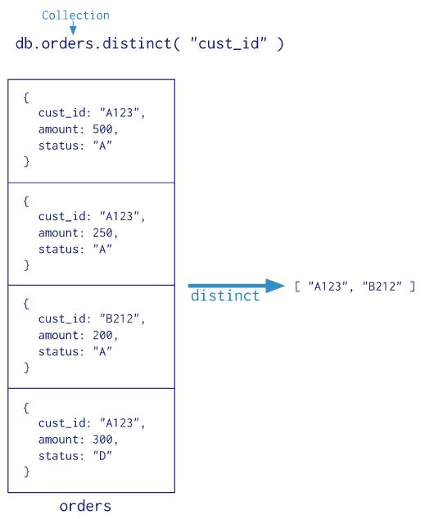
Aggregation: distinct

Slide 87
Pipelines: Transforming Collections
stage1
stage2
stageN-1
Col1
Col2
...
ColN
https://docs.mongodb.com/manual/reference/operator/aggregation/

Slide 88
Pipeline ρ: Stage Operators
$match: Filter by selection criteria σ
$project: Perform a projection π
$group: Group documents by a key/value
[used with $sum, $avg, $first, $last, $max, $min, etc.]
$lookup: Perform left-outer-join with another collection
$unwind: Copy each document for each array value
$collStats: Get statistics about collection
$count: Count the documents in the collection
$sort: Sort documents by a given key (ASC|DESC)
$limit: Return (up to) n first documents
$sample: Return (up to) n sampled documents
$skip: Skip n documents
$out: Save collection to MongoDB
(more besides)
https://docs.mongodb.com/manual/reference/operator/aggregation/

Slide 89
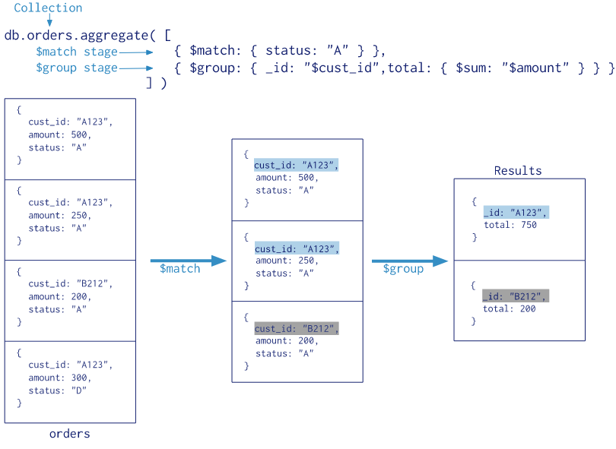
Pipeline Aggregation: $match and $group

Slide 90
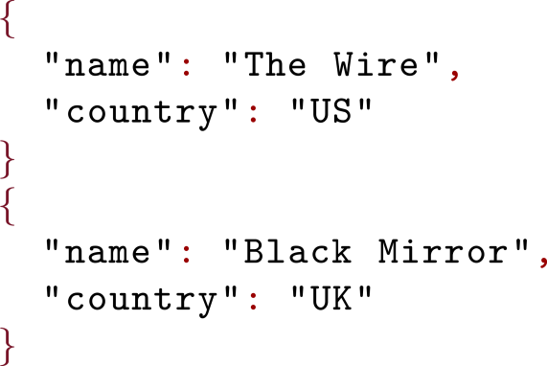
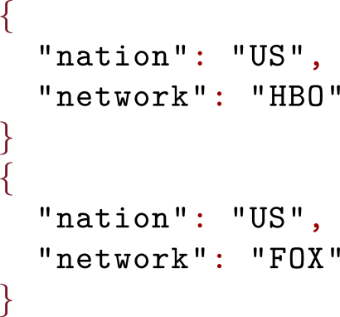
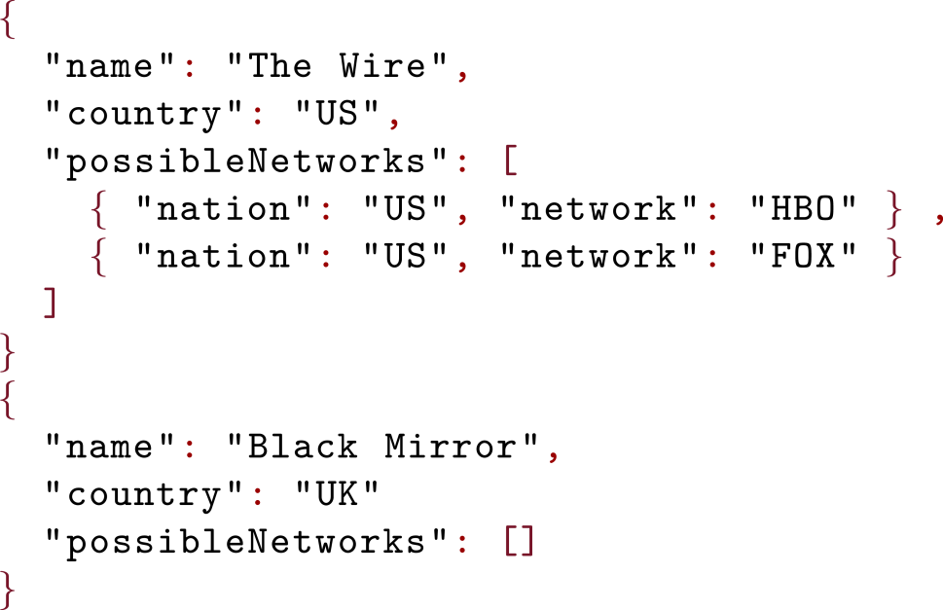
Pipeline Aggregation: $lookup
> db.series.aggregate( [
{ $lookup: { from: "networks", localField: "country",
foreignField: "nation", as: "possibleNetworks" }
} ] )
Notes:
db.createCollection("series")
db.series.insert(
[
{
"name": "The Wire",
"country": "US"
},
{
"name": "Black Mirror",
"country": "UK"
}
]
)
db.createCollection("networks")
db.networks.insert(
[
{
"nation": "US",
"network": "HBO"
},
{
"nation": "US",
"network": "FOX"
}
]
)
db.series.aggregate( [
{ $lookup: { from: "networks", localField: "country",
foreignField: "nation", as: "possibleNetworks" }
} ] )

Slide 91
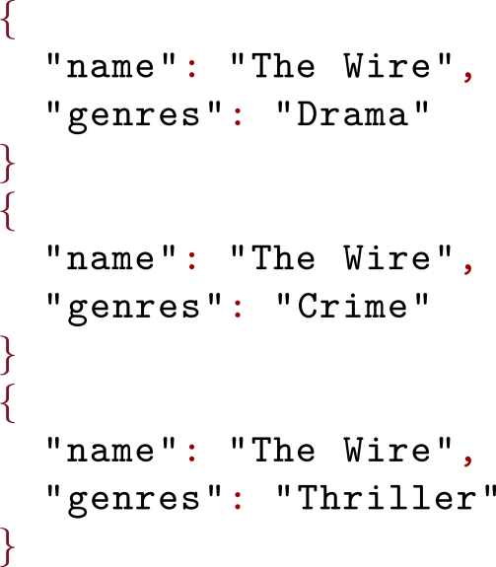
Pipeline Aggregation: $unwind
> db.series.aggregate( [ { $unwind : "$genres" } ] )

Slide 92
MongoDB: Indexing

Slide 93
MongoDB Indexing
Per collection:
_id Index
Single-field Index (sorted)
Compound Index (sorted)
Multikey Index (for arrays)
Geospatial Index
Full-text Index
Hash-based indexing (hashed)

Slide 94
MongoDB: Text Indexing Example
> db.series.insert(
{
_id: ObjectId("5951e0b265ad257d48f4a7d5"),
"name": "Black Mirror",
"summary": "A British sci-fi series with a dystopian setting",
"languages": [ "English", "Spanish" ],
})
WriteResult({ "nInserted" : 1 })
> db.series.createIndex( { summary: "text"})
> db.series.getIndexes()
[ { "v" : 2,
"key" : { "_id" : 1 },
"name" : "_id_",
"ns" : "test.series" },
{ "v" : 2,
"key" : { "fts" : "text", "_ftsx" : 1 },
"name" : "summary_text",
"ns" : "test.series",
"weights" : { "summary" : 1 },
"default_language" : "english",
"language_override" : "language",
"textIndexVersion" : 3 }
]

Slide 95
MongoDB: Text Indexing Example
> db.series.insert(
{
_id: ObjectId("5951e0b265ad257d48f4a7d5"),
"name": "Black Mirror",
"summary": "A British sci-fi series with a dystopian setting",
"languages": [ "English", "Spanish" ],
})
WriteResult({ "nInserted" : 1 })
> db.series.createIndex( { summary: "text"})
> db.series.find(
{ $text: { $search: "dystopia sci-fi" } } )
{ "_id" : ObjectId("5951e0b265ad257d48f4a7d5"),
"name" : "Black Mirror",
"summary" : "A British sci-fi series with a dystopian setting",
"languages" : [
"English",
"Spanish"
] }

Slide 96
MongoDB: Distribution

Slide 97
MongoDB: Distribution
"Sharding":
Hash-based or Horizontal Ranged
(Depends on indexes)
Replication
Replica sets

Slide 98
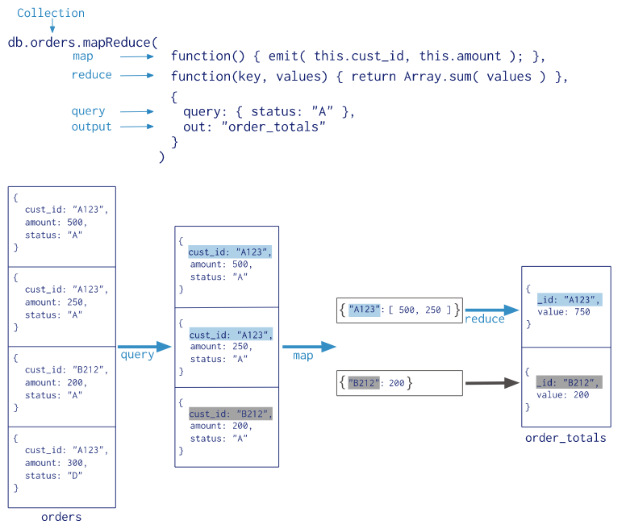
mapreduce

Slide 99
MongoDB: Why is it so popular?

Slide 101
Questions?

