Slide 1
CC5212-1 Procesamiento Masivo de Datos Otoño 2018 Lecture 3: DFS/HDFS + MapReduce/Hadoop
Aidan Hogan
aidhog@gmail.com

Slide 2
Massive Data Processing in Google

Slide 3
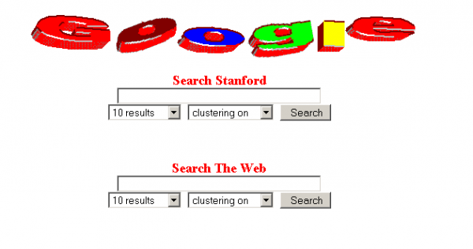
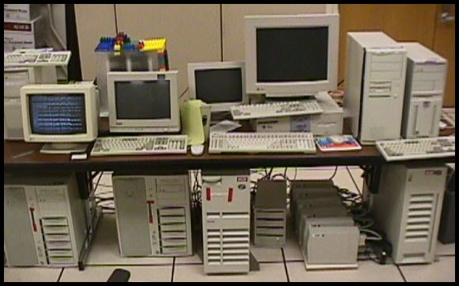
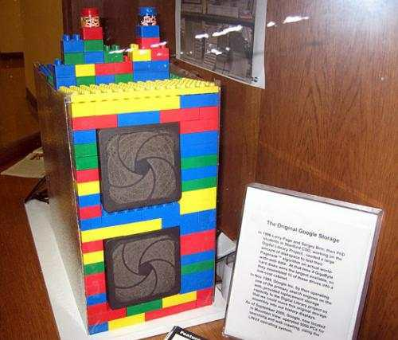
Inside Google circa 1997/98

Slide 4
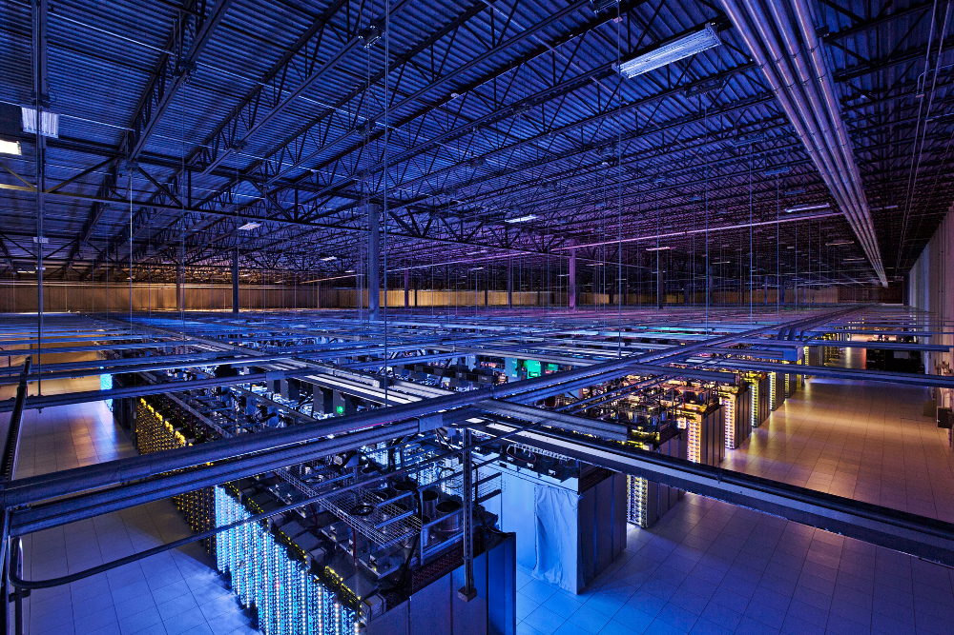
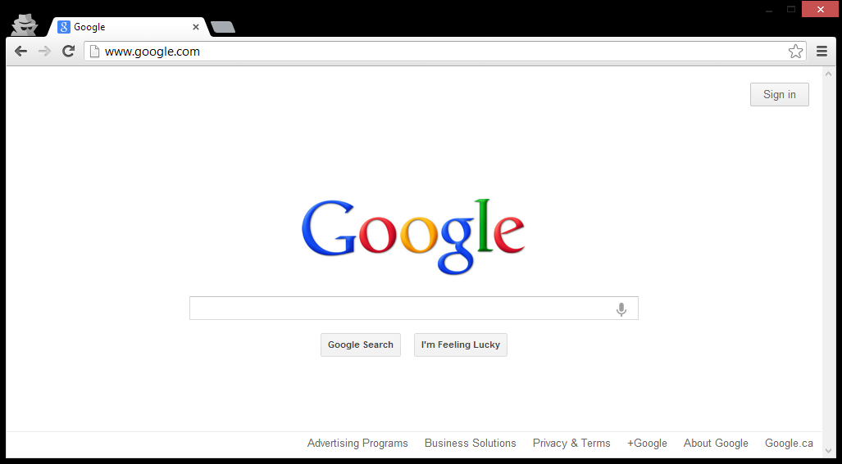
Inside Google circa 2017

Slide 5
Building Google Web-search
What processes/algorithms does Google
need to implement Web search?
Crawling
Parse links from webpages
Schedule links for crawling
Download pages, GOTO 1
Indexing
Parse keywords from webpages
Index keywords to webpages
Manage updates
Ranking
How relevant is a page? (TF-IDF)
How important is it? (PageRank)
How many users clicked it?
...

Slide 6
Building Google Web-search
What processes/algorithms does Google
need to implement Web search?
Google
≈ 100 PB / day
≈ 2,000,000 Wiki / day
(2014, processed)
Crawling
Parse links from webpages
Schedule links for crawling
Download pages, GOTO 1
Indexing
Parse keywords from webpages
Index keywords to webpages
Manage updates
Ranking
How relevant is a page? (TF-IDF)
How important is it? (PageRank)
How many users clicked it?
...

Slide 7
Building Google Web-search
What processes/algorithms does Google
need to implement Web search?
Google
≈ 100 PB / day
≈ 2,000,000 Wiki / day
(2014, processed)
Crawling
Parse links from webpages
Schedule links for crawling
Download pages, GOTO 1
Indexing
Parse keywords from webpages
Index keywords to webpages
Manage updates
Ranking
How relevant is a page? (TF-IDF)
How important is it? (PageRank)
How many users clicked it?
...

Slide 8
Implementing on thousands of machines
Crawling
Parse links from webpages
Schedule links for crawling
Download pages, GOTO 1
Indexing
Parse keywords from webpages
Index keywords to webpages
Manage updates
Ranking
How relevant is a page? (TF-IDF)
How important is it? (PageRank)
How many users clicked it?
...
If we implement each task separately …
… re-implement storage
… re-implement retrieval
… re-implement distributed processing
… re-implement communication
… re-implement fault-tolerance
... and then re-implement those again

Slide 9
Implementing on thousands of machines
Crawling
Parse links from webpages
Schedule links for crawling
Download pages, GOTO 1
Indexing
Parse keywords from webpages
Index keywords to webpages
Manage updates
Ranking
How relevant is a page? (TF-IDF)
How important is it? (PageRank)
How many users clicked it?
...
Build distributed abstractions
write(file f)
read(file f)
delete(file f)
append(file f, data d)

Slide 10
Google File System (GFS)

Slide 11
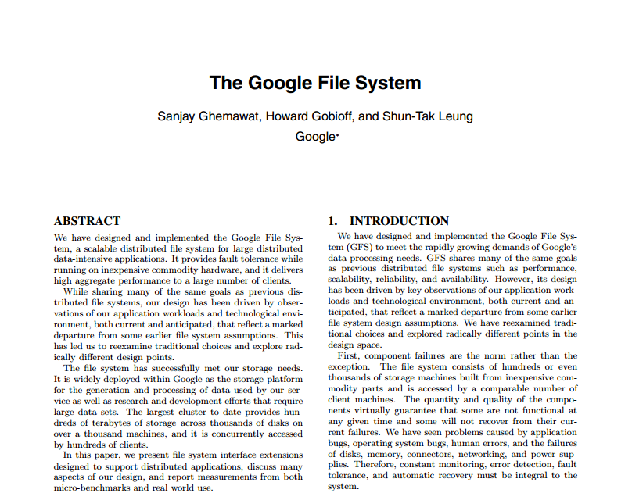
Google File System (GFS): White-Paper

Slide 12
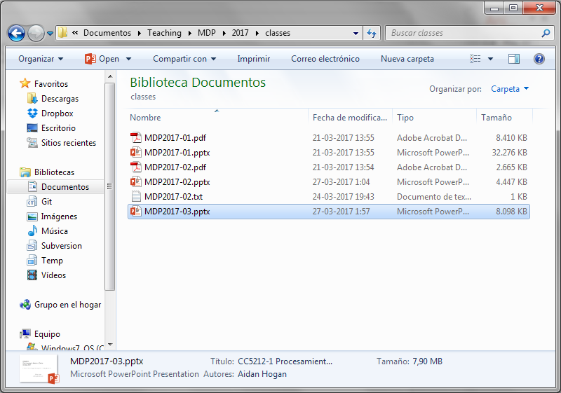
Google File System
What is a “file-system”?

Slide 13
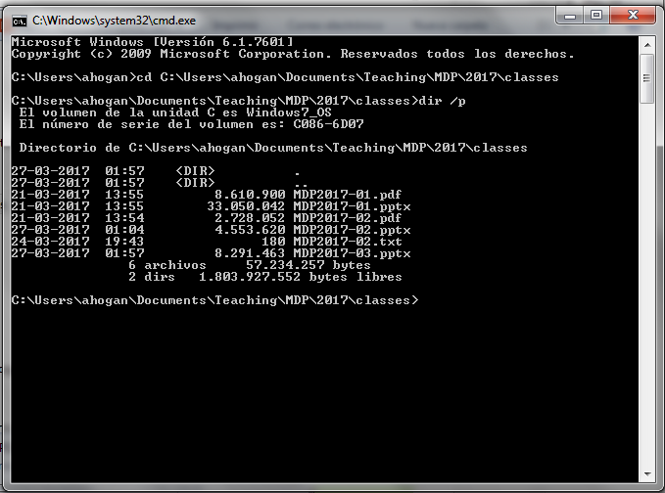
Google File System
What is a “file-system”?

Slide 14
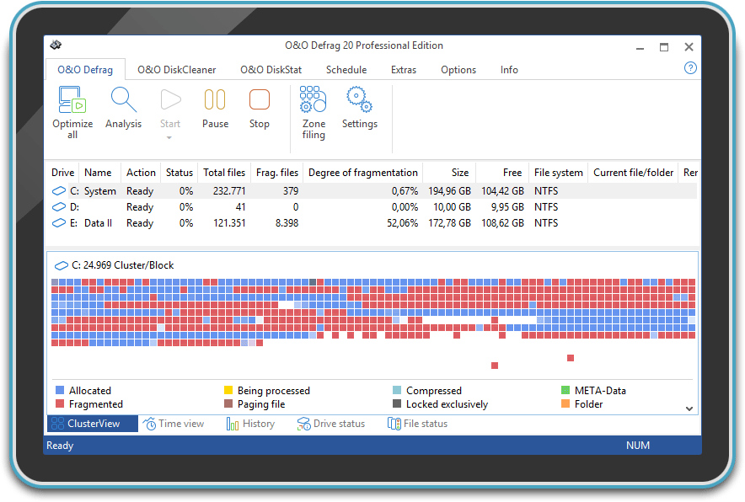
Google File System
What does a “file-system” do?
Splits a file up into chunks (blocks/clusters) of storage
Remembers location and sequence of chunks for a file

Slide 15
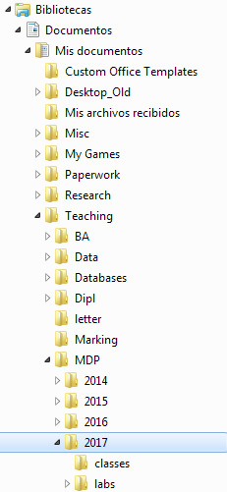
Google File System
What does a “file-system” do?
Splits a file up into chunks (blocks/clusters) of storage
Remembers location and sequence of chunks for a file
Organises a hierarchical directory structure
Tracks sub-directories and files in directories

Slide 16
Google File System
What does a “file-system” do?
Splits a file up into chunks (blocks/clusters) of storage
Remembers location and sequence of chunks for a file
Organises a hierarchical directory structure
Tracks sub-directories and files in directories
Tracks file meta-data
File size, date created, date last modified
Ownership, permissions, locks

Slide 17
Google File System
What does a “file-system” do?
Splits a file up into chunks (blocks/clusters) of storage
Remembers location and sequence of chunks for a file
Organises a hierarchical directory structure
Tracks sub-directories and files in directories
Tracks file meta-data
File size, date created, date last modified
Ownership, permissions, locks
Provides read/write/update/delete interface, etc.

Slide 18
Google File System
What does “Google File System” do?
Splits a file up into chunks (blocks/clusters) of storage
Remembers location and sequence of chunks for a file
Organises a hierarchical directory structure
Tracks sub-directories and files in directories
Tracks file meta-data
File size, date created, date last modified
Ownership, permissions, locks
Provides read/write/update/delete interface, etc.
Same thing, just distributed:

Slide 19
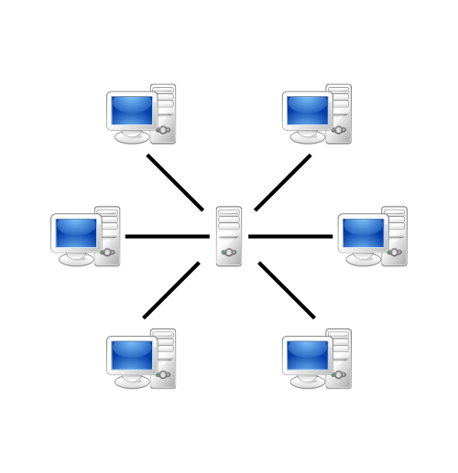
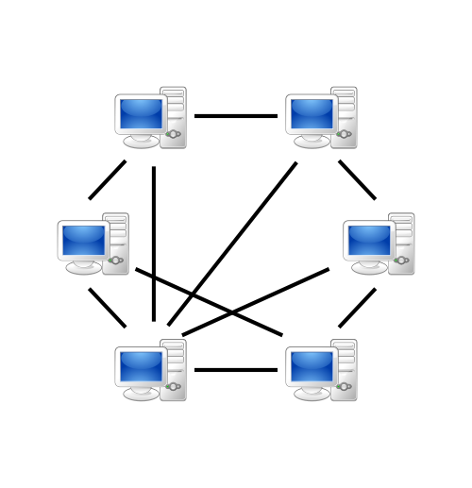
Google File System
So which architecture do you think Google uses?
Client–Server?
Peer-To-Peer?

Slide 20
Google File System
So which architecture do you think Google uses?
Client–Peer-To-Server-To-Peer-Server-Client!

Slide 21
Google File System: Assumptions
Files are huge
Files often read or appended
Concurrency important
Failures are frequent
Streaming important
So how should Google design its Distributed File System?

Slide 22
GFS: Architecture
64 MB per chunk
64 bit label for each chunk
Assume replication factor of 3
File System (In-Memory)
Master
A1
B1
C1
D1
E1
Chunk-servers (slaves)

Slide 23
GFS: Pipelined Writes
64 MB per chunk
64 bit label for each chunk
Assume replication factor of 3
File System (In-Memory)
/blue.txt [3 chunks]
1: {A1, C1, E1}
2: {A1, B1, D1}
3: {B1, D1, E1}
/orange.txt [2 chunks]
1: {B1, D1, E1}
2: {A1, C1, E1}
Master
blue.txt
(150 MB: 3 chunks)
orange.txt (100 MB: 2 chunks)
A1
B1
C1
D1
E1
1
3
3
2
1
1
1
2
1
2
2
3
1
2
2
Chunk-servers (slaves)

Slide 24
GFS: Pipelined Writes
64 MB per chunk
64 bit label for each chunk
Assume replication factor of 3
File System (In-Memory)
/blue.txt [3 chunks]
1: {A1, C1, E1}
2: {A1, B1, D1}
3: {B1, D1, E1}
/orange.txt [2 chunks]
1: {B1, D1, E1}
2: {A1, C1, E1}
Client asks Master to write a file
Master returns a primary chunkserver and secondary chunkservers
Client writes to primary chunkserver and tells it the secondary chunkservers
Primary chunkserver passes data onto secondary chunkserver, which passes on …
When finished, message comes back through the pipeline that all chunkservers have written
Otherwise client sends again
Master
blue.txt
(150 MB: 3 chunks)
orange.txt (100 MB: 2 chunks)
A1
B1
C1
D1
E1
1
3
3
2
1
1
1
2
1
2
2
3
1
2
2
Chunk-servers (slaves)

Slide 25
GFS: Fault Tolerance
64 MB per chunk
64 bit label for each chunk
Assume replication factor of 3
File System (In-Memory)
/blue.txt [3 chunks]
1: {A1, B1, E1}
2: {A1, B1, D1}
3: {B1, D1, E1}
/orange.txt [2 chunks]
1: {B1, D1, E1}
2: {A1, D1, E1}
File System (In-Memory)
/blue.txt [3 chunks]
1: {A1, C1, E1}
2: {A1, B1, D1}
3: {B1, D1, E1}
/orange.txt [2 chunks]
1: {B1, D1, E1}
2: {A1, C1, E1}
Master
blue.txt
(150 MB: 3 chunks)
orange.txt (100 MB: 2 chunks)
A1
B1
C1
D1
E1
1
3
2
3
2
1
1
1
1
2
1
2
2
3
1
2
2
Chunk-servers (slaves)

Slide 26
GFS: Fault Tolerance
64 MB per chunk
64 bit label for each chunk
Assume replication factor of 3
File System (In-Memory)
/blue.txt [3 chunks]
1: {A1, B1, E1}
2: {A1, B1, D1}
3: {B1, D1, E1}
/orange.txt [2 chunks]
1: {B1, D1, E1}
2: {A1, D1, E1}
Master sends regular “Heartbeat” pings
If a Chunkserver doesn’t respond
Master finds out what chunks it had
Master assigns new Chunkserver for each chunk
Master tells new Chunkserver to copy from a specific existing Chunkserver
Chunks are prioritised by number of remaining replicas, then by demand
Master
blue.txt
(150 MB: 3 chunks)
orange.txt (100 MB: 2 chunks)
A1
B1
C1
D1
E1
1
3
2
3
2
1
1
1
2
1
2
3
1
2
2
Chunk-servers (slaves)

Slide 27
GFS: Direct Reads
64 MB per chunk
64 bit label for each chunk
Assume replication factor of 3
I’m looking for /blue.txt
File System (In-Memory)
/blue.txt [3 chunks]
1: {A1, C1, E1}
2: {A1, B1, D1}
3: {B1, D1, E1}
/orange.txt [2 chunks]
1: {B1, D1, E1}
2: {A1, C1, E1}
1
2
3
Master
A1
B1
C1
D1
E1
1
3
3
2
1
1
1
2
1
2
2
3
1
2
2
Chunk-servers (slaves)

Slide 28
GFS: Direct Reads
64 MB per chunk
64 bit label for each chunk
Assume replication factor of 3
I’m looking for /blue.txt
File System (In-Memory)
/blue.txt [3 chunks]
1: {A1, C1, E1}
2: {A1, B1, D1}
3: {B1, D1, E1}
/orange.txt [2 chunks]
1: {B1, D1, E1}
2: {A1, C1, E1}
Client asks Master for file
Master returns locations of chunks
Returns a ranked list of replicas
Client reads chunk directly from Chunkserver
Software makes transparent for client!
1
2
3
Master
A1
B1
C1
D1
E1
1
3
3
2
1
1
1
2
1
2
2
3
1
2
2
Chunk-servers (slaves)

Slide 29
GFS: Primary Replicas
64 MB per chunk
64 bit label for each chunk
Assume replication factor of 3
I want to change block 2 of /blue.txt
File System (In-Memory)
/blue.txt [3 chunks]
1: {A1, C1, E1}
2: {A1, B1, D1}
3: {B1, D1, E1}
/orange.txt [2 chunks]
1: {B1, D1, E1}
2: {A1, C1, E1}
Master
/blue.txt [3 chunks]
2: {A1, B1, D1}
2
COMMIT
ACK
COMMIT
COMMIT
A1
B1
C1
D1
E1
2
ACK
2
ACK
2
1
3
3
2
1
1
1
2
1
2
2
3
1
2
2
Chunk-servers (slaves)

Slide 30
GFS: Primary Replicas
64 MB per chunk
64 bit label for each chunk
Assume replication factor of 3
I want to change block 2 of /blue.txt
File System (In-Memory)
/blue.txt [3 chunks]
1: {A1, C1, E1}
2: {A1, B1, D1}
3: {B1, D1, E1}
/orange.txt [2 chunks]
1: {B1, D1, E1}
2: {A1, C1, E1}
Master
/blue.txt [3 chunks]
2: {A1, B1, D1}
2
A1
B1
C1
D1
E1
2
2
2
1
3
3
2
1
1
1
2
1
2
2
3
1
2
2
Chunk-servers (slaves)

Slide 31
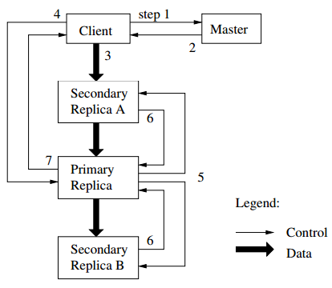
GFS: Primary Replicas
64 MB per chunk
64 bit label for each chunk
Assume replication factor of 3
I want to change block 2 of /blue.txt
File System (In-Memory)
/blue.txt [3 chunks]
1: {A1, C1, E1}
2: {A1, B1, D1}
3: {B1, D1, E1}
/orange.txt [2 chunks]
1: {B1, D1, E1}
2: {A1, C1, E1}
Master assigns leases to one replica: a “primary replica”
Client wants to change a file:
Client asks Master for the replicas (incl. primary)
Master returns replica info to the client
Client sends change data
Client asks primary to commit the changes
Primary asks secondaries to commit the changes
Secondaries acknowledge to primary
Primary acknowledges to client
Master
/blue.txt [3 chunks]
2: {A1, B1, D1}
2
A1
B1
C1
D1
E1
2
2
2
1
3
3
2
1
1
1
2
1
2
2
3
1
Data and control flow kept separate
2
2
Chunk-servers (slaves)

Slide 32
GFS: Rack Awareness

Slide 33
GFS: Rack Awareness
Core
Switch
Core
Switch
Rack A
Switch
Rack B
Switch
Rack C
Switch

Slide 34
GFS: Rack Awareness
Core
Switch
Files:
/orange.txt
1: {A1, A4, B3}
2: {A5, B1, B5}
Rack A
Switch
Rack B
Switch
1
A1
2
B1
Racks:
A: {A1, A2, A3, A4, A5}
B: {B1, B2, B3, B4, B5}
A2
B2
A3
1
B3
1
A4
B4
2
A5
2
B5

Slide 35
GFS: Rack Awareness
Make sure replicas not on same rack
In case rack switch fails!
But communication can be slower:
Within rack: pass one switch (rack switch)
Across racks: pass three switches (two racks and a core)
(Typically) pick two racks
Two nodes in same rack, one node in another rack
(Assuming 3x replication)
Umm, only necessary if more than one rack
Core
Switch
Files:
/orange.txt
1: {A1, A4, B3}
2: {A5, B1, B5}
Rack A
Switch
Rack B
Switch
1
A1
2
B1
Racks:
A: {A1, A2, A3, A4, A5}
B: {B1, B2, B3, B4, B5}
A2
B2
A3
1
B3
1
A4
B4
2
A5
2
B5

Slide 36
GFS: Other Operations
Rebalancing:
Spread storage out evenly
Deletion:
Just rename the file with hidden file name
To recover, rename back to original version
Otherwise, three days later will be wiped
Monitoring Stale Replicas:
Dead slave reappears with old data?
Master keeps version info

Slide 37
GFS: Weaknesses?
What are the main weaknesses of GFS?
Master node single point of failure
Use hardware replication
Logs and checkpoints
Master node is a bottleneck
Use more powerful machine
Minimise master node traffic
Master-node metadata kept in memory
Each chunk needs 64 bytes to address
Chunk data can be queried from each slave
Keep each chunk large (fewer chunks)

Slide 38
Hadoop Distributed File System
Open source version of GFS
HDFS-to-GFS translation guide …
Data-node = Chunkserver/Slave
Name-node = Master
Same idea except …
GFS is proprietary (hidden in Google)
HDFS is open source (Apache!)

Slide 39
Implementing on thousands of machines
Crawling
Parse links from webpages
Schedule links for crawling
Download pages, GOTO 1
Indexing
Parse keywords from webpages
Index keywords to webpages
Manage updates
Ranking
How relevant is a page? (TF-IDF)
How important is it? (PageRank)
How many users clicked it?
...
Build distributed abstractions
write(file f)
read(file f)
delete(file f)
append(file f, data d)
HDFS/GFS
We done?

Slide 40
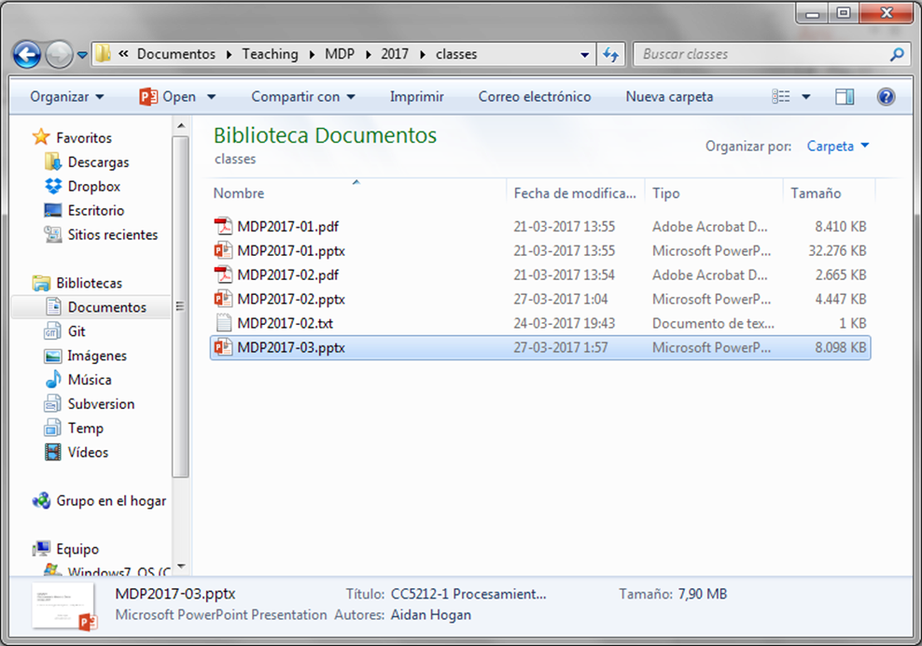
Implementing on thousands of machines

Slide 41
Google’s MapReduce

Slide 42
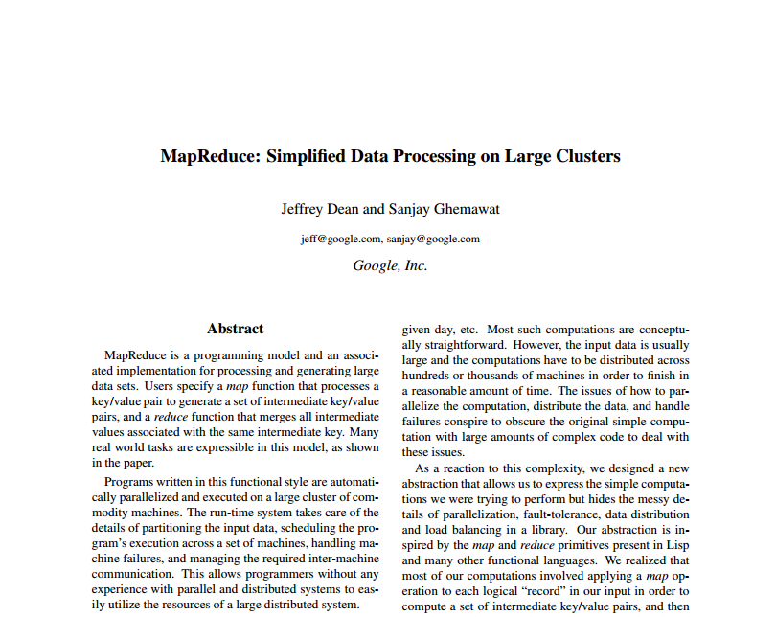
MapReduce: White-Paper

Slide 43
Let’s start with one task
How could we do a distributed word count?
Count parts in memory on different machines and merge?
But if the data don’t fit in memory (e.g., 4-grams)?
And how to do that merge (sum counts for word w across machines)?
Count parts on-disk on different machines and merge?
Again, how to do that merge?

Slide 44
Distributed word count
Input
File on Distr. File System
A1
B1
C1
1
3
2
Partition
Distr. Sort/Count
A1
B1
C1
a-k
l-q
r-z
(a,10023)
(aa,6234)
…
(lab,8123)
(label,983)
…
(rag,543)
(rat,1233)
…
Output
File on Distr. File System
Better partitioning?

Slide 45
Distributed word count
Can we abstract any general framework?
For each unique word computed from some input line,
give me a list of its repetitions on all input lines,
and for the list of repetitions of each unique word,
I will count them to create output

Slide 46
Distributed word count
Can we abstract any general framework?
For each thing computed from some input line,
give me a list of its related-things on all input lines,
and for the list of related-things of each thing,
I will do-something-over them to create the output

Slide 47
Distributed word count
Can we abstract any general framework?
Can we be more specific for reduce?

Slide 48
MapReduce
Can we abstract any general framework?
In general, we must assume bags/multisets (sets with duplicates)

Slide 49
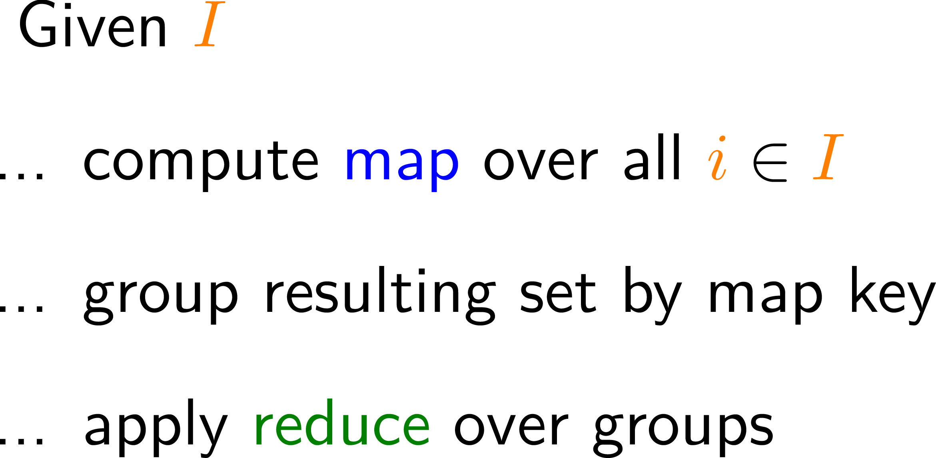
MapReduce: Main Idea
Can we abstract any general framework?
← But how to implement this
part in a distributed system
Partition by map key
Sort (in parallel) by map key
Apply reduce

Slide 50
MapReduce: Word count
Input
File on Distr. File System
A1
B1
C1
1
3
2
Map
Partition
Distr. Sort
A1
B1
C1
%3=0
%3=1
%3=2
Reduce
(a,10023)
(rat,6234)
…
(lab,8123)
(rag,983)
…
(aa,543)
(lab,1233)
…
Output
File on Distr. File System

Slide 51
MapReduce (in more detail)
Input: Read from the cluster (e.g., a DFS)
Chunks raw data for mappers
Maps raw data to initial (key_{in},value_{in}) pairs
Map: For each (key_{in},value_{in}) pair, generate zero-to-many (key_{map},value_{map}) pairs
key_{in} /value_{in} can be diff. type to key_{map} /value_{map}
What might Input contain in the word-count case?
What might Map do in the word-count case?

Slide 52
MapReduce (in more detail)
Partition: Assign sets of key_{map} values to reducer machines
Shuffle: Data are moved from mappers to reducers (e.g., using DFS)
Comparison/Sort: Each reducer sorts the data by key using a comparison function
Sort is taken care of by the framework
How might Partition work in the word-count case?

Slide 53
MapReduce (in more detail)
Reduce: For each key_{map}, takes the bag of value_{map} entries with that key, and produces zero-to-many outputs, i.e., (key_{reduce},value_{reduce}) pairs
Output: Writes the results from the reducers to the distributed file system
How might Reduce work in the word-count case?

Slide 54
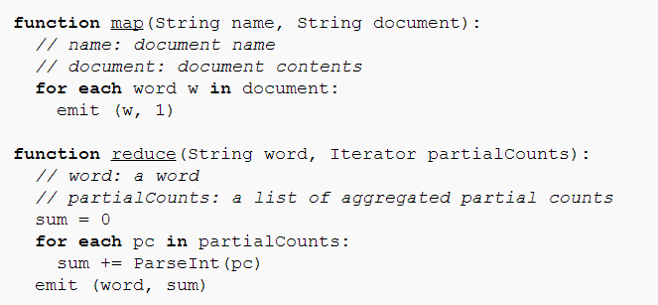
MapReduce: Word count pseudo-code

Slide 55
MapReduce: Under the Hood

Slide 56
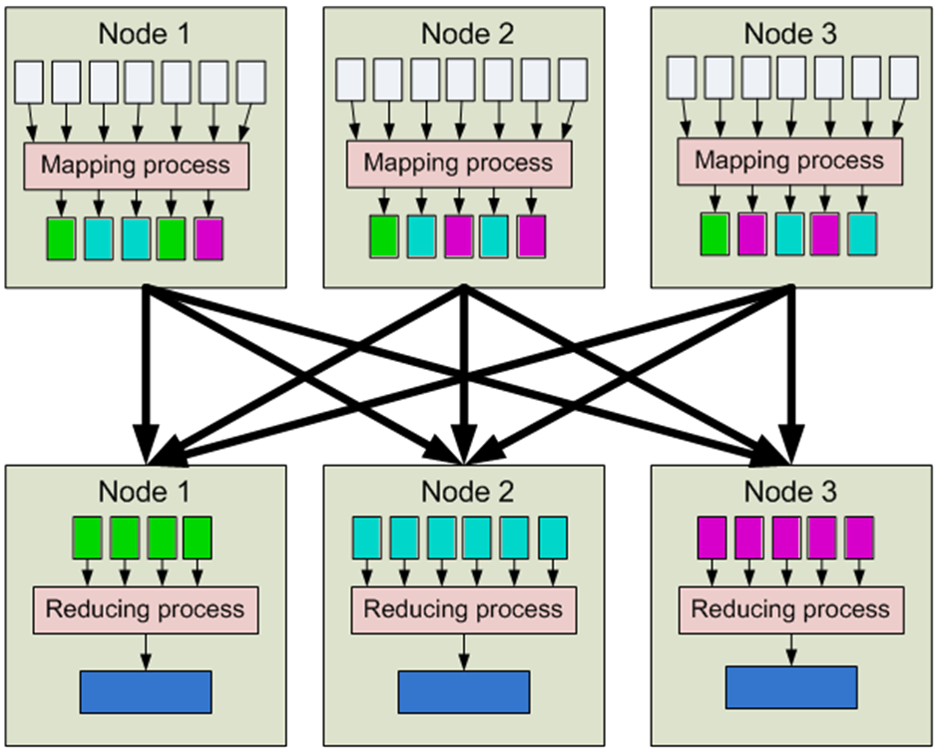
MapReduce
1. Input
2. Map
3. Partition [Sort]
4. Shuffle
5. Merge Sort
6. Reduce
7. Output

Slide 57
MapReduce: Counting Words
Input
Map
Partition /
[Sort]
Shuffle
Merge Sort
Reduce
Output
(0,perro sed que)
(perro,1)
(sed,1)
(que,1)
(sed,1)
(sed,1)
(decir,1)
(sed,1)
(sed,1)
(decir,{1})
(sed,{1,1})
(decir,1)
(sed,2)
(perro,1)
(que,1)
(decir,1)
(sed,1)
(13,que decir que)
(que,1)
(decir,1)
(que,1)
(decir,1)
(perro,1)
(que,1)
(perro,1)
(que,1)
(que,1)
(que,1)
(que,1)
(pero,{1})
(perro,1)
(que,4)
perro sed que
que decir que
la que sed
(que,1)
(que,1)
(que,{1,1,1,1})
(que,1)
(que,1)
(que,1)
(26,la que sed)
(la,1)
(que,1)
(sed,1)
(sed,1)
(la,1)
(la,1)
(la,{1})
(la,1)
(que,1)
(la,1)

Slide 58
MapReduce: Combiner
1. Input
2. Map
3. Partition [Sort]
(“Combine”)
4. Shuffle
5. Merge Sort
6. Reduce
7. Output

Slide 59
MapReduce: Combiner
Input
Map
Partition /
[Sort]
Combine
Shuffle
Merge Sort
Reduce
Output
(0,perro sed que)
(perro,1)
(sed,1)
(que,1)
(sed,1)
(sed,1)
(sed,1)
(decir,1)
(sed,1)
(sed,1)
(decir,{1})
(sed,{1,1})
(decir,1)
(sed,2)
(perro,1)
(que,1)
(perro,1)
(que,1)
(decir,1)
(sed,1)
(13,que decir que)
(que,1)
(decir,1)
(que,1)
(decir,1)
(decir,1)
(perro,1)
(que,1)
(perro,1)
(que,1)
(que,1)
(que,2)
(pero,{1})
(perro,1)
(que,4)
(que,1)
(que,1)
(que,2)
(que,{1,1,2})
(que,2)
(que,1)
(26,la que sed)
(la,1)
(que,1)
(sed,1)
(sed,1)
(sed,1)
(la,1)
(la,1)
(la,{1})
(la,1)
(que,1)
(que,1)
(la,1)
(la,1)

Slide 60
MapReduce: Combiner
1. Input
2. Map
3. Partition [Sort]
(“Combine”)
4. Shuffle
Combiner reduces data shuffled here!
5. Merge Sort
6. Reduce
7. Output

Slide 61
MapReduce: More complex tasks

Slide 62
Supermarket Example
Supermarket boss wants to know:
Do we sell more in the morning hours or the evening hours?

Slide 63
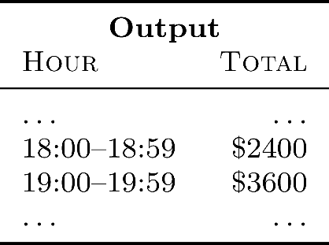
MapReduce: Supermarket Example
Compute total sales per hour of the day?

Slide 64
Implementing on thousands of machines
Crawling
Parse links from webpages
Schedule links for crawling
Download pages, GOTO 1
Indexing
Parse keywords from webpages
Index keywords to webpages
Manage updates
Ranking
How relevant is a page? (TF-IDF)
How important is it? (PageRank)
How many users clicked it?
...
Build distributed abstractions
write(file f)
read(file f)
delete(file f)
append(file f, data d)
mapreduce(function map, function reduce, file in, file out)
We done?

Slide 65
MapReduce: Benefits for Programmers
Takes care of low-level implementation:
Easy to handle inputs and output
No need to handle network communication
No need to write sorts or joins
Abstracts machines (transparency)
Fault tolerance (through heart-beats)
Abstracts physical locations
Add / remove machines
Load balancing

Slide 66
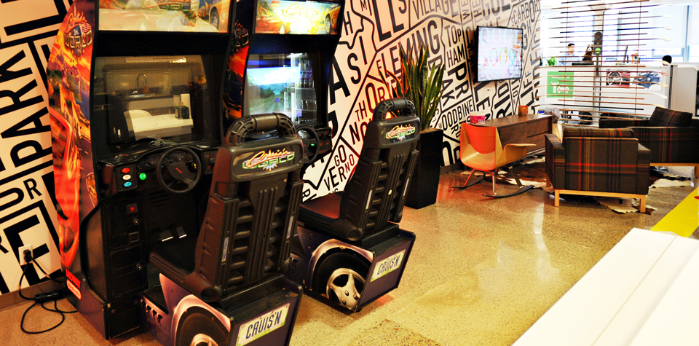
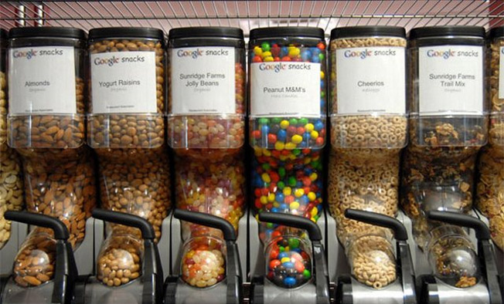
MapReduce: Benefits for Programmers
(Time for more important things)

Slide 67
Hadoop Overview

Slide 68
Hadoop: Open Source MapReduce

Slide 69
HDFS / Hadoop Core Architecture
Client
NameNode
JobTracker
DataNode 1
JobNode 1
DataNode 2
JobNode 2
…
…
DataNode n
JobNode n

Slide 70
HDFS: Traditional / SPOF
NameNode
NameNode appends edits to log file
SecondaryNameNode copies log file and image, makes checkpoint, copies image back
NameNode loads image on start-up and makes remaining edits
SecondaryNameNode not a backup NameNode
copy dfs/blue.txt
rm dfs/orange.txt
rmdir dfs/
mkdir new/
mv new/ dfs/
fsimage
SecondaryNameNode
DataNode 1
…
DataNode n

Slide 71
What is the secondary name-node?
Name-node quickly logs all file-system actions in a sequential (but messy) way
Secondary name-node keeps the main fsimage file up-to-date based on logs
When the primary name-node boots back up, it loads the fsimage file and applies the remaining log to it
Hence secondary name-node helps make boot-ups faster, helps keep file system image up-to-date and takes load away from primary

Slide 72
Hadoop: High Availability
1
2
Active NameNode
Standby NameNode
Active NameNode
JournalManager
JournalManager
fsimage
2
1
JournalNode 1
fs edits
fs edits
2
1
…
1
2
JournalNode n

Slide 73
Programming with hadoop
(REFERENCE MATERIAL FOR LAB)

Slide 74
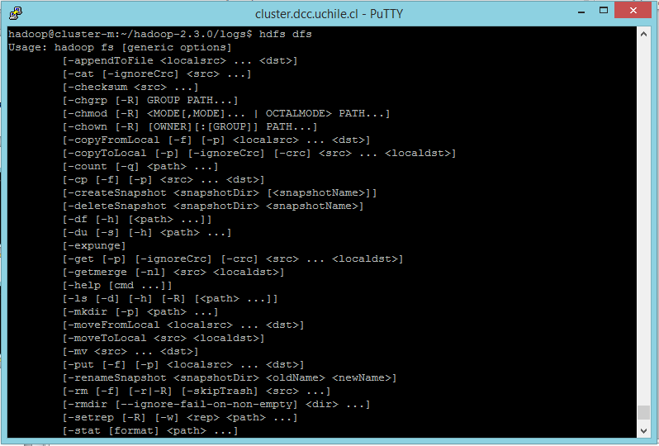
1. Input/Output (cmd)
> hdfs dfs

Slide 75
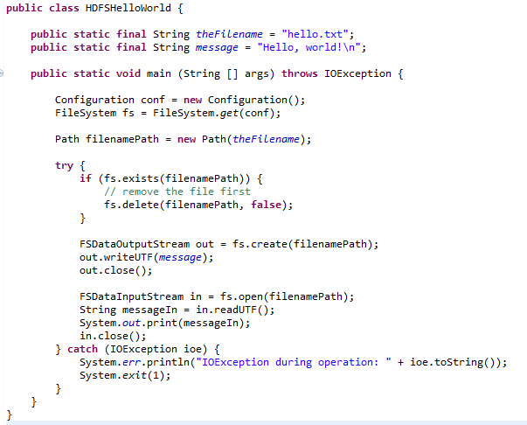
1. Input/Output (Java)
Creates a file system for default configuration
Check if the file exists; if so delete
Create file and write a message
Open and read back

Slide 76
1. Input (Java)

Slide 77
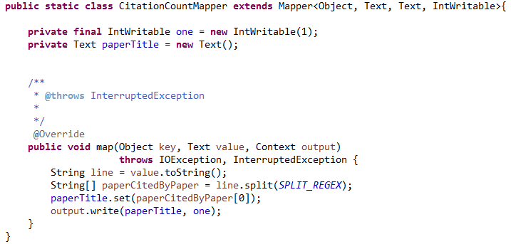
2. Map
Mapper<InputKeyType,
InputValueType,
MapKeyType,
MapValueType>
(input) key: file offset.
(input) value: line of the file.
context: handles output and logging.
Emit output

Slide 78
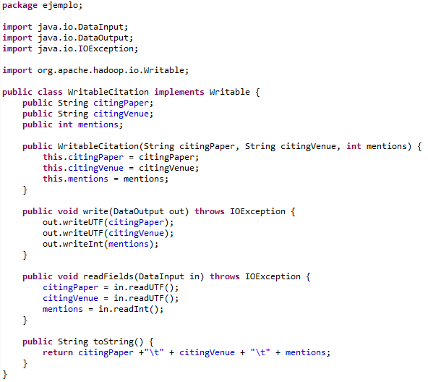
(Writable for values)
Same order
(not needed in the running example)

Slide 79
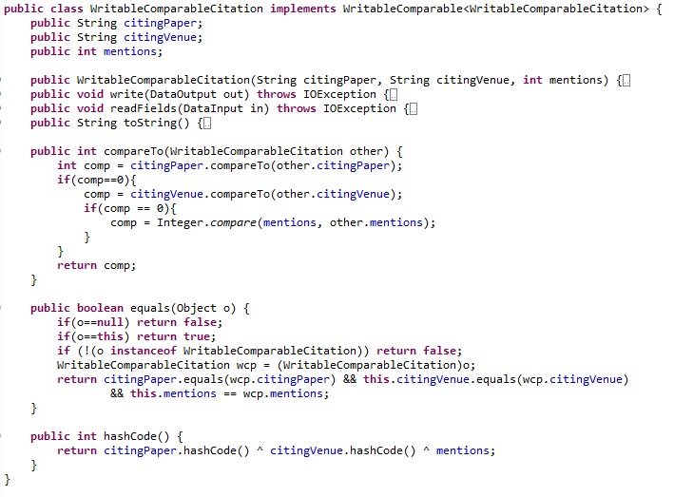
(WritableComparable for keys/values)
New Interface
Same as before
Needed to sort keys
Needed for default partition function
(not needed in the running example)

Slide 80
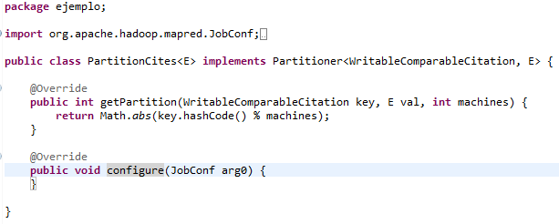
3. Partition
PartitionerInterface
(This happens to be the default partition method!)
(not needed in the running example)

Slide 81
4. Shuffle

Slide 82
5. Sort/Comparison
Methods in WritableComparator
(not needed in the running example)

Slide 83
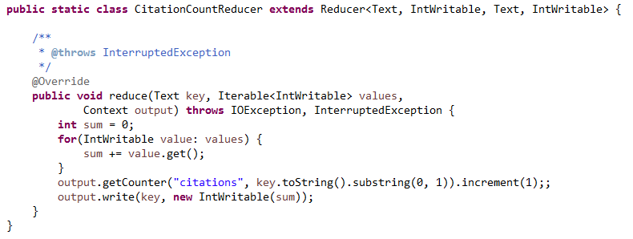
6. Reduce
Reducer<MapKey, MapValue,
OutputKey, OutputValue>
key: as emitted from map
values: iterator over all values for that key
context for output
Write to output

Slide 84
7. Output / Input (Java)
Creates a file system for default configuration
Check if the file exists; if so delete
Create file and write a message
Open and read back

Slide 85
7. Output (Java)

Slide 86
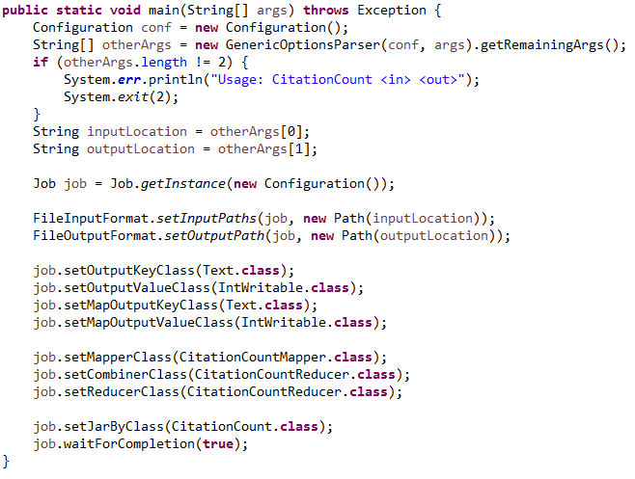
Control Flow
Create a JobClient, a JobConf and pass it the main class
Set input and output paths
Set the type of map and output keys and values in the configuration
Set the mapper class
Set the reducer class
(and optionally “combiner”)
Run and wait for job to complete.

Slide 87
More in Hadoop: Combiner
Map-side “mini-reduction”
Keeps a fixed-size buffer in memory
Reduce within that buffer
e.g., count words in buffer
Lessens bandwidth needs
In Hadoop: can simply use Reducer class ☺

Slide 88
More in Hadoop: Counters
Context has a group of maps of counters

Slide 89
More in Hadoop: Distributed Cache
Some tasks need “global knowledge”
For example, a white-list of conference venues and journals that should be considered in the citation count
Typically small
Use a distributed cache:
Makes data available locally to all nodes
Use sparingly!!

Slide 90
Questions?

