Slide 1
CC5212-1 Procesamiento Masivo de Datos Otoño 2018 Lecture 2: Distributed Systems
Aidan Hogan
aidhog@gmail.com

Slide 2
Processing massive data needs Distributed Systems …

Slide 3
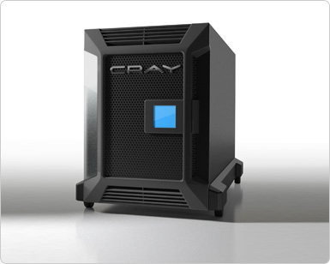
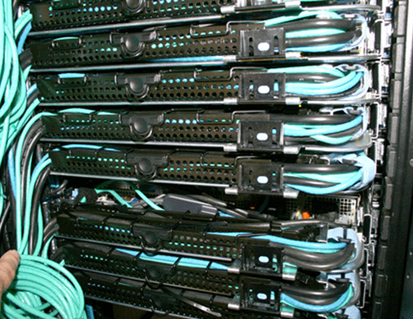
Monolithic vs. Distributed Systems
One machine that’s n times as powerful?
n machines that are equally as powerful?

Slide 4
Parallel vs. Distributed Systems
Parallel System
often shared memory
Distributed System
often shared nothing
Processor
Processor
Processor
Processor
Memory
Processor
Memory
Memory
Processor
Memory

Slide 5
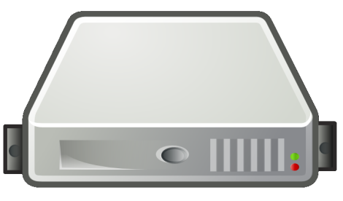
What is a Distributed System?
“A distributed system is a system that enables a collection of independent computers to communicate in order to solve a common goal.”
0010010001011010100
100101110100010001001

Slide 6
Disadvantages of Distributed Systems
(Possible) Advantages
(Possible) Disadvantages
Cost
Better performance/price
Extensibility
Add another machine!
Reliability (ideally)
No central point of failure!
Workload
Balance work automatically
Sharing
Remote access to services
Software
Need specialised programs
Networking
Can be slow
Maintenance
Debugging sw/hw a pain
Security
Multiple remote users
Parallelisation
Not always applicable

Slide 7
What makes a good Distributed System?

Slide 8
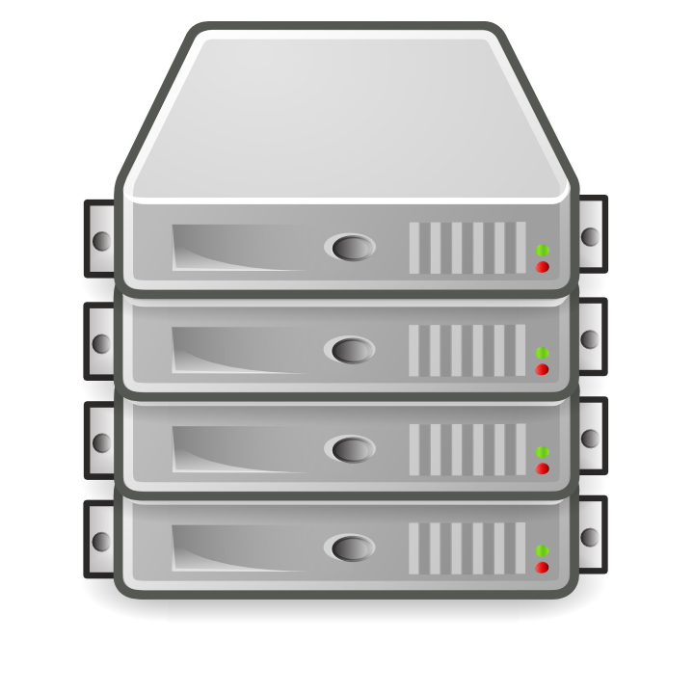
A Good Distributed System …
Transparency
… looks like one system

Slide 9
A Good Distributed System …
Transparency
… looks like one system
Abstract/hide:
Access: How different machines are accessed
Location: Where the machines are physically
Heterogeneity: Different software/hardware
Concurrency: Access by several users
Etc.
How?
Employ abstract addresses, APIs, etc.

Slide 10
A Good Distributed System …
Flexibility
… can add/remove machines quickly and easily

Slide 11
A Good Distributed System …
Flexibility
… can add/remove machines quickly and easily
Avoid:
Downtime: Restarting the distributed system
Complex Config.: 12 admins working 24/7
Specific Requirements: Assumptions of OS/HW
Etc.
How?
Employ: replication, platform-independent SW, bootstrapping, heart-beats, load-balancing

Slide 12
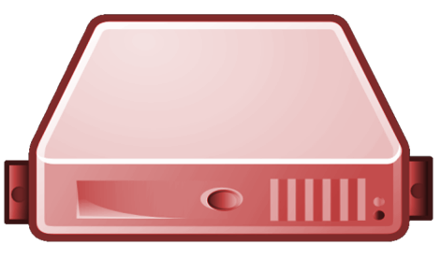
A Good Distributed System …
Reliability
… avoids failure / keeps working in case of failure

Slide 13
A Good Distributed System …
Reliability
… avoids failure / keeps working in case of failure
Avoid:
Downtime: The system going offline
Inconsistency: Verify correctness
How?
Employ: replication, flexible routing, security, Consensus Protocols

Slide 14
A Good Distributed System …
Performance
… does stuff quickly

Slide 15
A Good Distributed System …
Performance
… does stuff quickly
Avoid:
Latency: Time for initial response
Long runtime: Time to complete response
Well, avoid basically
How?
Employ: network optimisation, enough computational resources, etc.

Slide 16
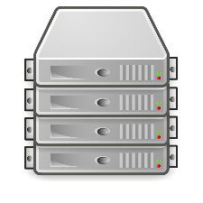
A Good Distributed System …
Scalability
… ensures the infrastructure scales

Slide 17
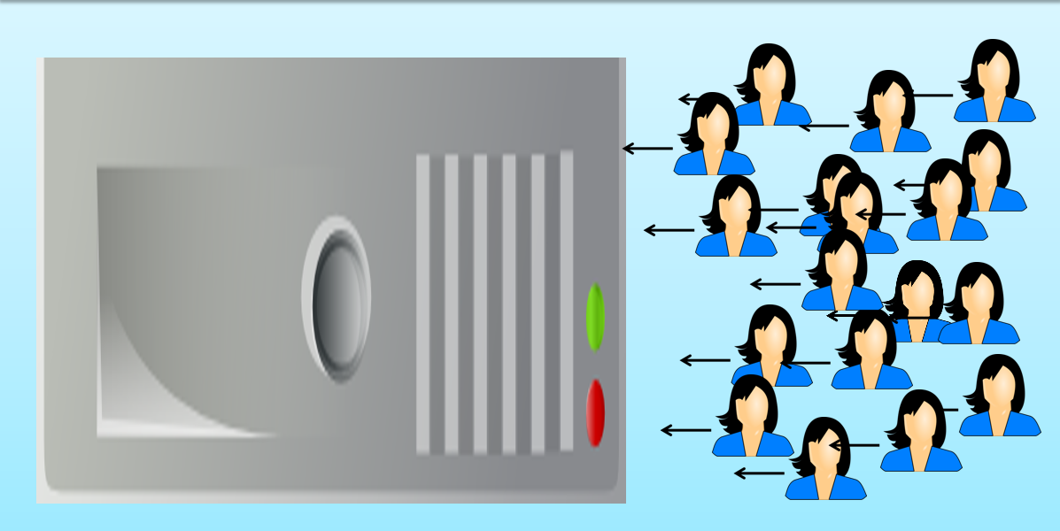
A Good Distributed System …
Scalability
… ensures the infrastructure scales
Avoid:
Bottlenecks: Relying on one part too much
Pair-wise messages: Grows quadratically:
How?
Employ: peer-to-peer, direct communication, distributed indexes, etc.

Slide 18
A Good Distributed System …
Transparency
… looks like one system
Flexibility
… can add/remove machines quickly and easily
Reliability
… avoids failure / keeps working in case of failure
Performance
… does stuff quickly
Scalability
… ensures the infrastructure scales

Slide 19
A Good Distributed System …
Transparency
… looks like one system
Flexibility
… can add/remove machines quickly and easily
Why these five in particular?
Reliability
… avoids failure / keeps working in case of failure
Good question. ¯\_(ツ)_/¯
Performance
… does stuff quickly
Scalability
… ensures the infrastructure scales

Slide 20
Distributed Systems: Client–Server Architecture

Slide 21
Client–Server Model
Client makes request to server
Server acts and responds
For example?
Web, Email, DropBox, …

Slide 22
Client–Server Model
Client makes request to server
Server acts and responds
Server can be a distributed system!
Server ≠ Physical Machine
For example?
Web, Email, DropBox, …

Slide 23
Client–Server: Thin Client
Server does the hard work
(server sends results | client uses few resources)
For example?
Email, Early Web (PHP, etc.)

Slide 24
Client–Server: Fat Client
Client does the hard work
(server sends raw data | client uses more resources)
For example?
Javascript, Mobile Apps, Video

Slide 25
Client–Server: Mirror Machine
Client goes to any mirror machine
(user-facing services are replicated)
User goes to any machine (replicated/mirror)

Slide 26
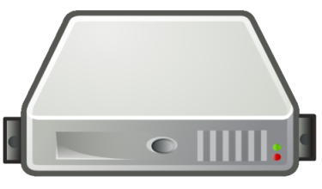
Client–Server: Proxy Machine
Client goes to “proxy” machine
(proxy machine forwards request and response)

Slide 27
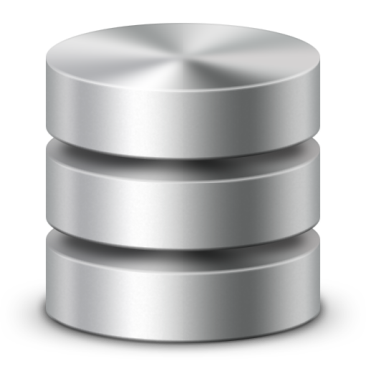
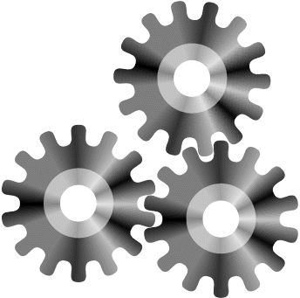
Client–Server: Three-Tier Server
Three Layer Architecture
1. Data | 2. Logic | 3. Presentation
Server
Data
Logic
Presentation
Add all the salaries
Create HTML page
SQL:
Create query:
all salaries
HTTP:
Total salary
of all employees

Slide 28
Distributed Systems: Peer-to-Peer (P2P) Architecture

Slide 29
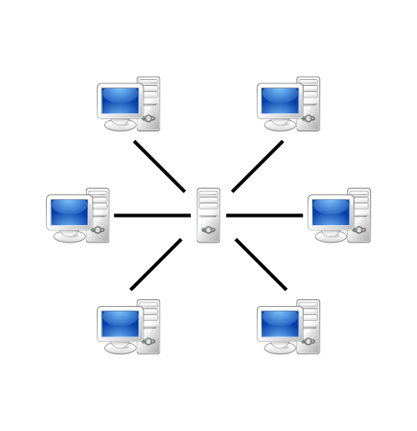
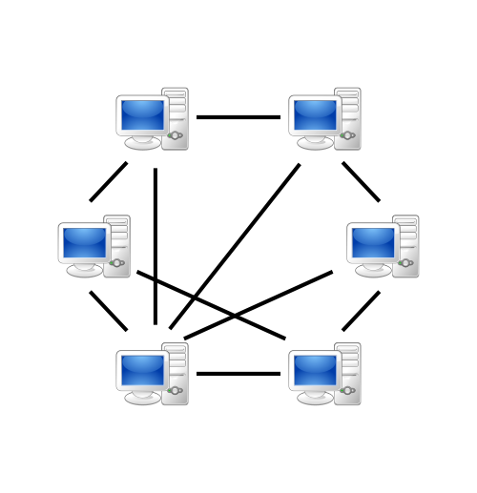
Peer-to-Peer (P2P)
Client–Server
Client interacts directly with server
Peer-to-Peer (P2P)
Peers interact directly with each other

Slide 30
Peer-to-Peer (P2P)
Client–Server
Client interacts directly with server
Peer-to-Peer (P2P)
Peers interact directly with each other
Client
Client
Client
Client
Server
Server
Client
Server
Client
Client
Client
Server
Server
Client
Client
Client
Client
Server
Server

Slide 31
Peer-to-Peer (P2P)
Client–Server
Client interacts directly with server
Peer-to-Peer (P2P)
Peers interact directly with each other
Examples of P2P systems?
Client
Client
Client
Client
Server
Server
Client
Server
Client
Client
Client
Server
Server
Client
Client
Client
Client
Server
Server

Slide 32
Peer-to-Peer (P2P)
File Servers (DropBox):
Clients interact with a central file server
P2P File Sharing (e.g., Bittorrent):
Peers act both as the file server and the client
Client
Client
Client
Client
Server
Server
Client
Server
Client
Client
Client
Server
Server
Client
Client
Client
Client
Server
Server

Slide 33
Peer-to-Peer (P2P)
Online Banking:
Clients interact with a central banking server
Cryptocurrencies (e.g., Bitcoin):
Peers act both as the bank and the client
Client
Client
Client
Client
Server
Server
Client
Server
Client
Client
Client
Server
Server
Client
Client
Client
Client
Server
Server

Slide 34
Peer-to-Peer (P2P)
SVN
Clients interact with a central versioning repository
GIT
Peers have their own repositories, which they sync.
Client
Client
Client
Client
Server
Server
Client
Server
Client
Client
Client
Server
Server
Client
Client
Client
Client
Server
Server

Slide 35
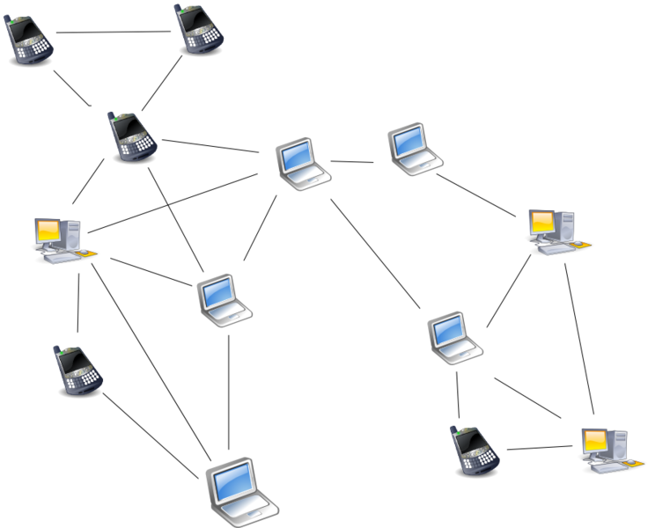
Peer-to-Peer: Unstructured (flooding)
Ricky Martin’s new album?

Slide 36
Peer-to-Peer: Unstructured (flooding)
Pixie’s new album?

Slide 37
Peer-to-Peer: Unstructured (flooding)
Pixie’s new album?
Transparency?
Flexibility?
Reliability?
Performance?
Scalability?

Slide 38
Peer-to-Peer: Structured (Central)
Ricky Martin’s new album?
In central server, each peer registers
Content
Address
Peer requests content from server
Peers connect directly
Advantages / Disadvantages?

Slide 39
Peer-to-Peer: Structured (Central)
In central server, each peer registers
Content
Address
Peer requests content from server
Peers connect directly
Advantages / Disadvantages?

Slide 40
Peer-to-Peer: Structured (Hierarchical)
Super-peers and peers
Super-peers index and organise the content of local peers
Advantages / Disadvantages?

Slide 41
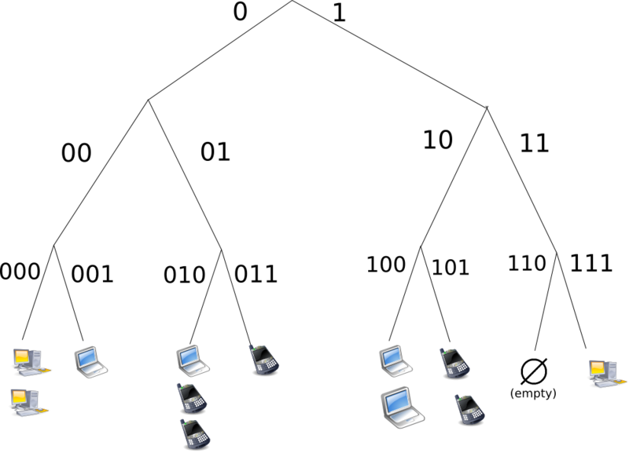
Peer-to-Peer: Structured (Distributed Index)
Often a:
Distributed Hash Table (DHT)
(key,value) pairs
Hash on key
Insert with (key,value)
Peer indexes key range
Hash: 000
Hash: 111
Advantages / Disadvantages?

Slide 42
Peer-to-Peer: Structured (DHT)
Circular DHT:
Only aware of neighbours
O(n) lookups
Shortcuts:
Skips ahead
Enables binary-search-like behaviour
O(log(n)) lookups
111
000
001
110
010
101
011
100
Pixie’s new album? 111

Slide 43
Peer-to-Peer: Structured (DHT)
Handle peers leaving (churn)
Keep n successors
New peers
Fill gaps
Replicate
111
000
001
110
010
101
011
100

Slide 44
Comparison of P2P Systems
1) Central Directory
Search follows directory (1 lookup)
Connections → O(n)
Single point of failure (SPoF)
Control over data
No neighbours
2) Unstructured
3) Structured
Search requires flooding (n lookups)
Connections → O(n²)
No central point of failure
Peers control their data
Peers control neighbours
Search follows structure (log(n) lookups)
Connections → O(n)
No central point of failure
Peers assigned data
Peers assigned neighbours

Slide 45
Dangers of SPoF: not just technical

Slide 46
Dangers of SPoF: not just technical

Slide 47
P2P vs. Client–Server
Advantages / Disadvantages?
Client–Server
Peer-to-Peer
Data lost in failure/deletes
Search easier/faster
Network often faster (to websites on backbones)
Often central host
Data centralised
Remote hosts control data
Bandwidth centralised
Dictatorial
Can be taken off-line
May lose rare data (churn)
Search difficult (churn)
Network often slower (to conventional users)
Multiple hosts
Data decentralised
Users (often) control data
Bandwidth decentralised
Democratic
Difficult to take off-line

Slide 48
P2P vs. Client–Server
Advantages / Disadvantages?
Client–Server
Peer-to-Peer
Data lost in failure/deletes
Search easier/faster
Network often faster (to websites on backbones)
Often central host
Data centralised
Remote hosts control data
Bandwidth centralised
Dictatorial
Can be taken off-line
May lose rare data (churn)
Search difficult (churn)
Network often slower (to conventional users)
Multiple hosts
Data decentralised
Users (often) control data
Bandwidth decentralised
Democratic
Difficult to take off-line
Systems can be hybrid!

Slide 49
Distributed Systems: Hybrid Example (Bittorrent)

Slide 50
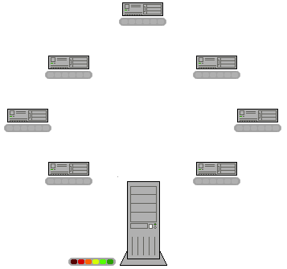
Bittorrent: Search Server
BitTorrent Search
(Server)
“ricky martin”
Client–Server

Slide 51
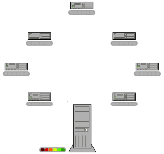
Bittorrent: Tracker
BitTorrent
Peer Tracker
(or DHT)

Slide 52
Bittorrent: File-Sharing

Slide 53
Bittorrent: Hybrid
Uploader
Downloader
Creates torrent file
Uploads torrent file
Announces on tracker
Monitors for downloaders
Connects to downloaders
Sends file parts
Searches torrent file
Downloads torrent file
Announces to tracker
Monitors for peers/seeds
Connects to peers/seeds
Sends & receives file parts
Watches illegal movie
Local / Client–Server / Structured P2P / Direct P2P

Slide 54
Distributed Systems: In the Real World

Slide 55
Physical Location: Cluster Computing
Machines (typically) in a central, local location; e.g., a local LAN in a server room

Slide 56
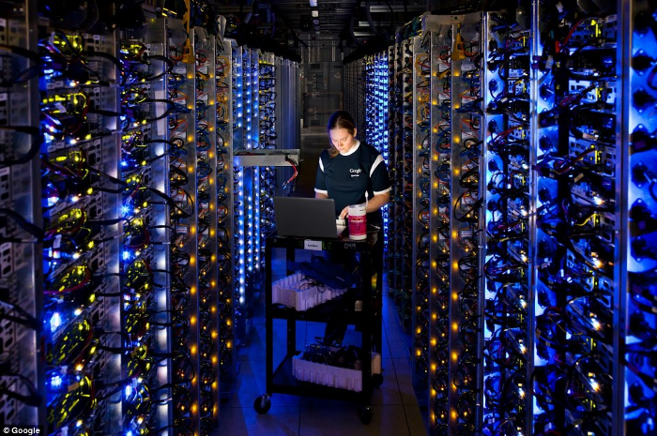
Physical Location: Cluster Computing

Slide 57
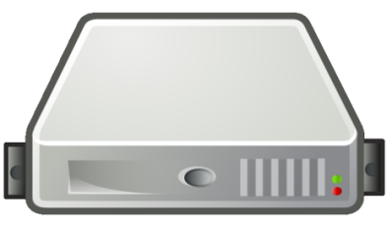
Physical Location: Cloud Computing
Machines (typically) in a central remote location; e.g., Amazon EC2

Slide 58
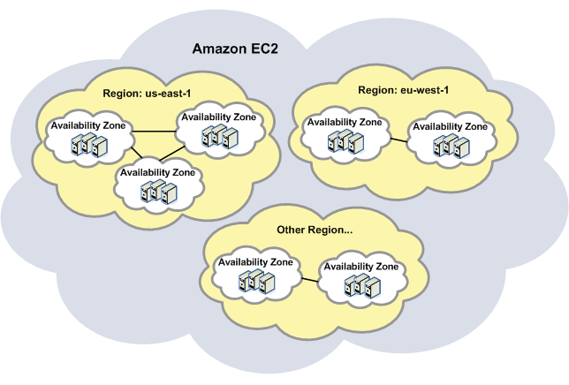
Physical Location: Cloud Computing

Slide 59
Physical Location: Grid Computing
Machines in diverse locations

Slide 60
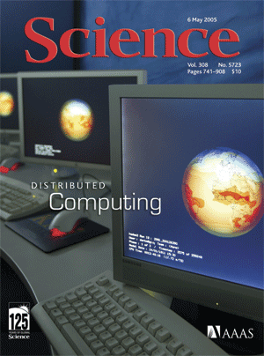
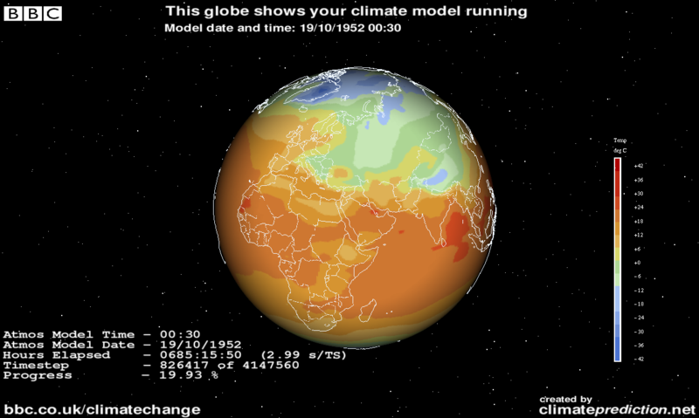
Physical Location: Grid Computing

Slide 61
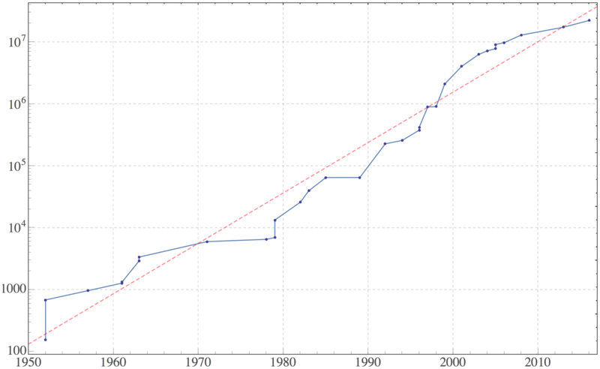
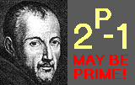
Physical Location: Grid Computing

Slide 62
Physical Locations
Cluster computing:
Typically centralised, local
Cloud computing:
Typically centralised, remote
Grid computing:
Typically decentralised, remote

Slide 63
Eight fallacies of Distributed Computing

Slide 64
Eight Fallacies
By L. Peter Deutsch (1994)
James Gosling (1997)
“Essentially everyone, when they first build a distributed application, makes the following eight assumptions. All prove to be false in the long run and all cause big trouble and painful learning experiences.” — L. Peter Deutsch
Each fallacy is a false statement!

Slide 65
1. The network is reliable
Machines fail, connections fail, firewall eats messages
flexible routing
retry messages
acknowledgements!

Slide 66
2. Latency is zero
There are significant communication delays
avoid “races”
local order ≠ remote order
acknowledgements
minimise remote calls
batch data!
avoid waiting
multiple-threads
M2: Copy X from M1
M1:
Store X
M2
M1

Slide 67
3. Bandwidth is infinite
M1:
Copy X (10GB)
M1:
Copy X (10GB)
Limited in amount of data that can be transferred
avoid resending data
avoid bottlenecks
direct connections
caching!!
M2
M1

Slide 68
4. The network is secure
Network is vulnerable to hackers, eavesdropping, viruses, etc.
send sensitive data directly
isolate hacked nodes
hack one node ≠ hack all nodes
authenticate messages
secure connections
M1:
Send Medical History
M1

Slide 69
5. Topology doesn’t change
How machines are physically connected may change (“churn”)!
avoid fixed routing
next-hop routing?
abstract physical addresses
flexible content structure
M3
M2
M4
M1
Message M5 thru M2, M3, M4
M5

Slide 70
6. There is one administrator
Different machines have different policies!
Beware of firewalls!
Don’t assume most recent version
Backwards compat.

Slide 71
7. Transport cost is zero
It costs money/energy to transport data: not just bandwidth
(Again)
minimise redundant data transfer
avoid shuffling data
caching
direct connection
compression?

Slide 72
8. The network is homogeneous
Devices and connections are not uniform
interoperability!
route for speed
not hops
load-balancing

Slide 73
Eight Fallacies (to avoid)
The network is reliable
Latency is zero
Bandwidth is infinite
The network is secure
Topology doesn’t change
There is one administrator
Transport cost is zero
The network is homogeneous
Severity of fallacies vary in different scenarios!
Within Twitter?
Web?
Bittorrent?

Slide 74
Discussed later: Fault Tolerance

Slide 75
Lab II Preview: Java RMI Overview

Slide 76
Why is Java RMI Important?
We can use it to quickly build distributed systems using some standard Java skills.

Slide 77
What is Java RMI?
RMI = Remote Method Invocation
Remote Procedure Call (RPC) for Java
Predecessor of CORBA (in Java)
Stub / Skeleton model (TCP/IP)
Client
Server
Stub
Network
Skeleton

Slide 78
What is Java RMI?
Stub (Client):
Sends request to skeleton: marshalls/serialises and transfers arguments
Demarshalls/deserialises response and ends call
Skeleton (Server):
Passes call from stub onto the server implementation
Passes the response back to the stub
Client
Server
Stub
Network
Skeleton

Slide 79
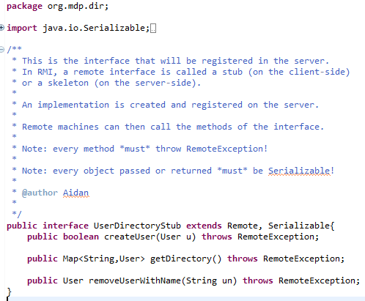
Stub/Skeleton Same Interface!
Client
Server

Slide 80
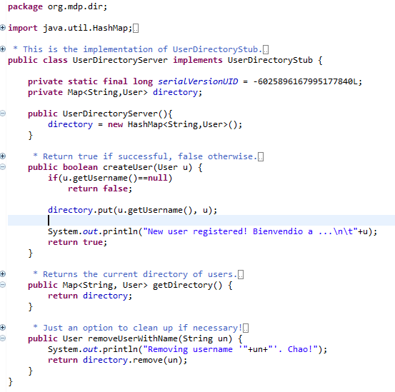
Server Implements Skeleton
Problem?
Synchronisation:
(e.g., should use ConcurrentHashMap)
Server

Slide 81
Server Registry
Server (typically) has a Registry: a Map
Adds skeleton implementations with key (a string)
Server
Registry
“sk3”
SkelImpl3
“sk2”
SkelImpl2
“sk1”
SkelImpl1

Slide 82
Server Creates/Connects to Registry
OR
Server

Slide 83
Server Registers Skeleton Implementation
Server

Slide 84
Client Connecting to Registry
Client connects to registry (port, hostname/IP)!
Retrieves skeleton/stub with key
Server
Network
Client
“sk2”
Registry
“sk3”
SkelImpl3
“sk2”
SkelImpl2
SkelImpl2
Stub2
“sk1”
SkelImpl1

Slide 85
Client Connecting to Registry
Client

Slide 86
Client Calls Remote Methods
Client has stub, calls method, serialises arguments
Server does processing
Server returns answer; client deserialises result
Network
Client
Server
Stub2
concat (“a”,”b”)
SkelImpl2
“ab”

Slide 87
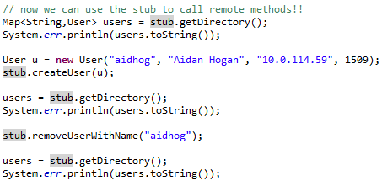
Client Calls Remote Methods
Client

Slide 88
Java RMI: Remember …
Remote calls are pass-by-value, not pass-by-reference (objects not modified directly)
Everything passed and returned must be Serialisable (implement Serializable)
Every stub/skel method must throw a remote exception (throws RemoteException)
Server implementation can only throw RemoteException

Slide 89
Questions?

