Slide 1
CC5212-1 Procesamiento Masivo de Datos Otoño 2017 Lecture 4: MapReduce/Hadoop II
Aidan Hogan
aidhog@gmail.com

Slide 2
Hadoop: in more depth

Slide 3
Why “Hadoop” …
… and why an elephant and not, e.g., a rabbit?

Slide 4
Why “Hadoop” …
… and why an elephant and not, e.g., a rabbit?

Slide 5
… better luck next time, Tiddles.

Slide 6
Hadoop: UNDER THE HOOD

Slide 7
MapReduce Abstraction
Input
File on Distr. File System
A1
B1
C1
Can we abstract any general framework?
1
3
2
Partition
Distr. Sort/Count
A1
B1
C1
a-k
l-q
r-z
(a,10023)
(aa,6234)
…
(lab, 8123)
(label,983)
…
(rag,543)
(rat,1233)
…
Output
File on Distr. File System
In general, we must assume bags/multisets (sets with duplicates)
Better partitioning?

Slide 8
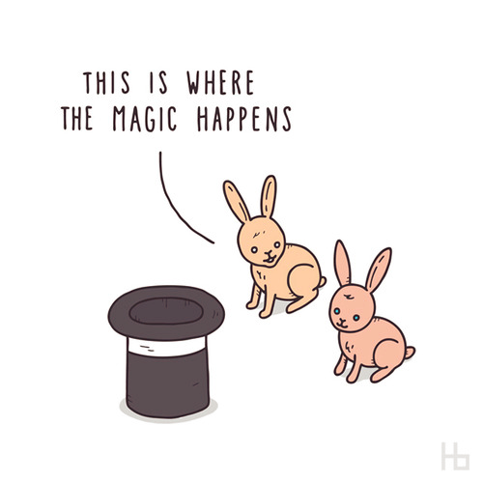
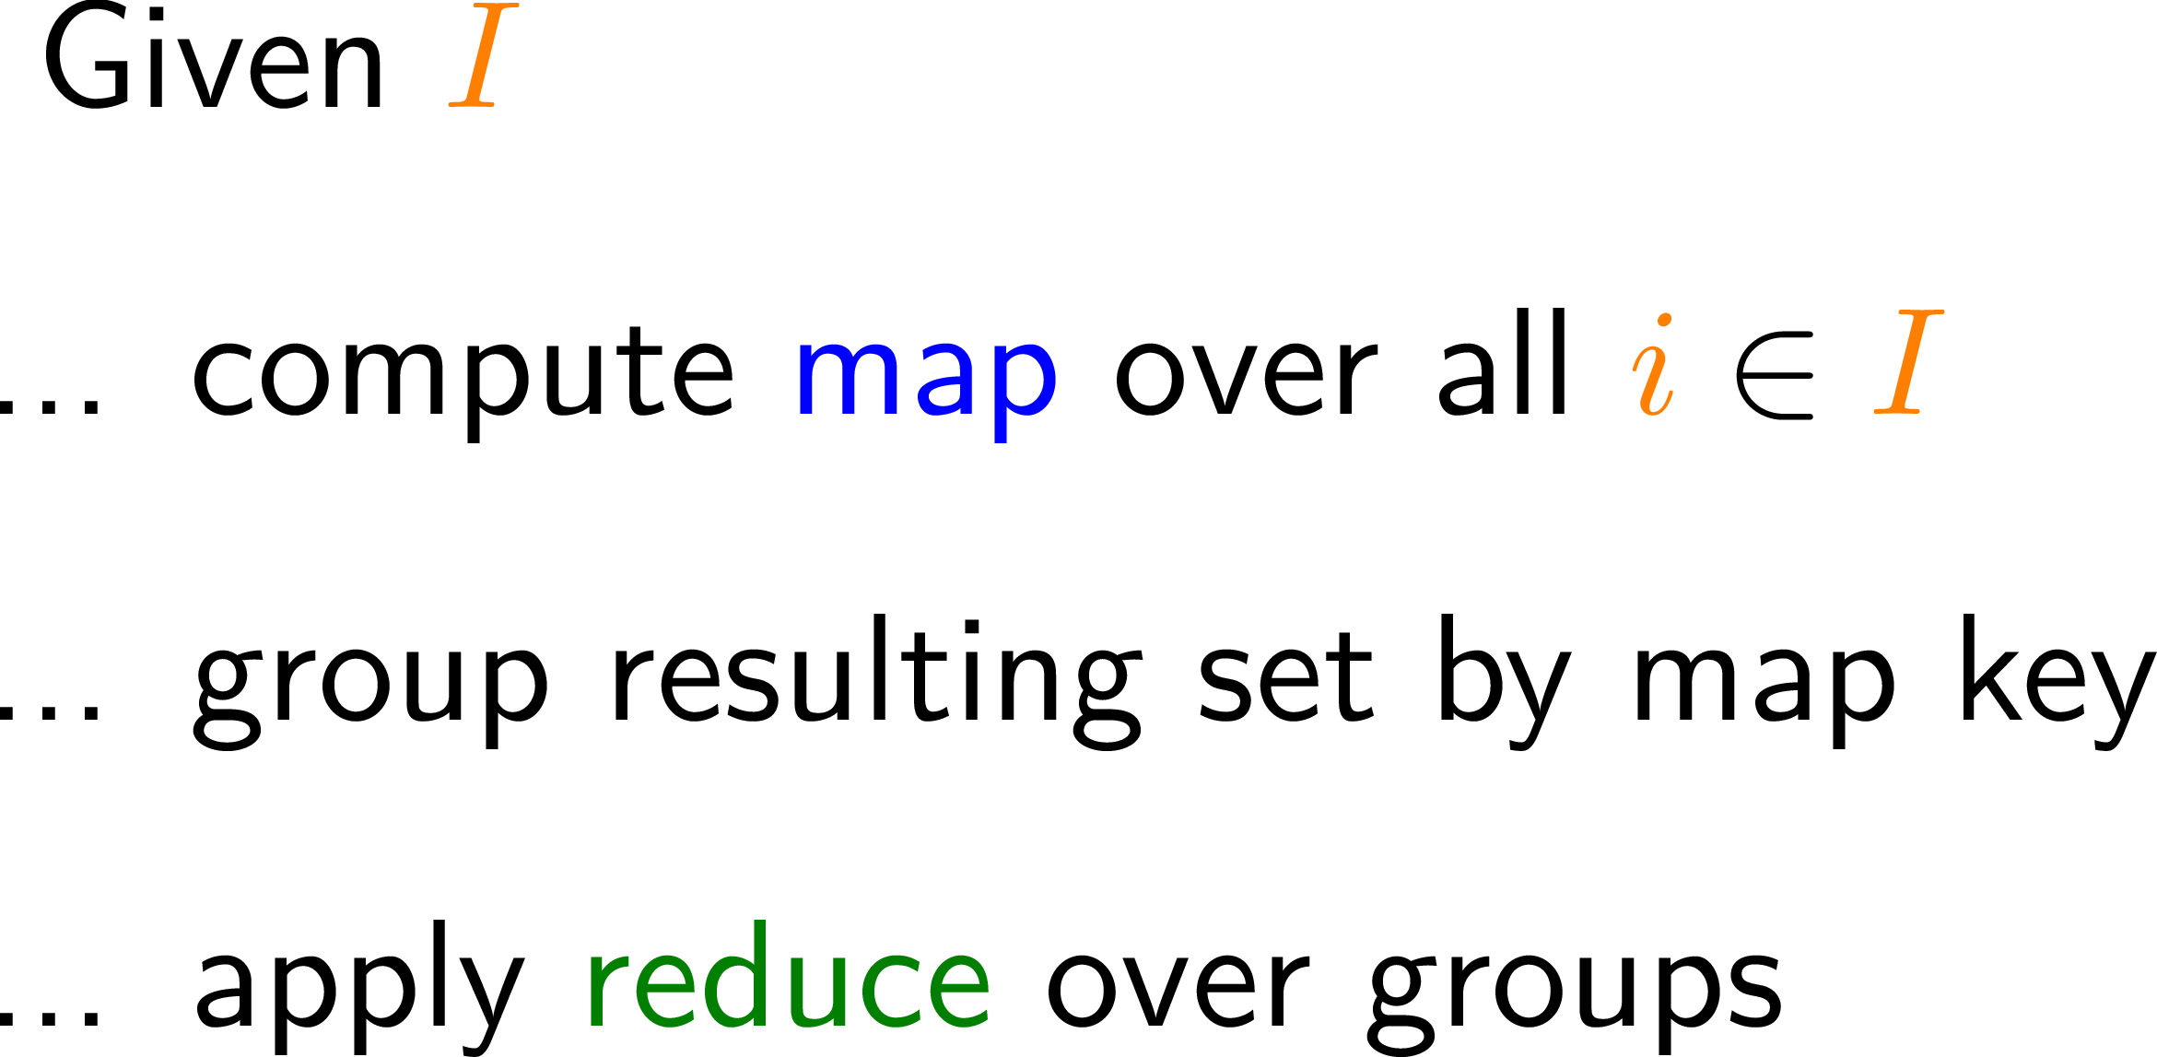
MapReduce: Main Idea
Input
File on Distr. File System
A1
B1
C1
1
3
2
Partition
Distr. Sort/Count
A1
B1
C1
a-k
l-q
r-z
← But how to implement this
part in a distributed system
(a,10023)
(aa,6234)
…
(lab, 8123)
(label,983)
…
(rag,543)
(rat,1233)
…
Output
File on Distr. File System
Partition by map key
Sort (in parallel) by map key
Apply reduce / Profit
… let’s be more specific
Better partitioning?

Slide 9
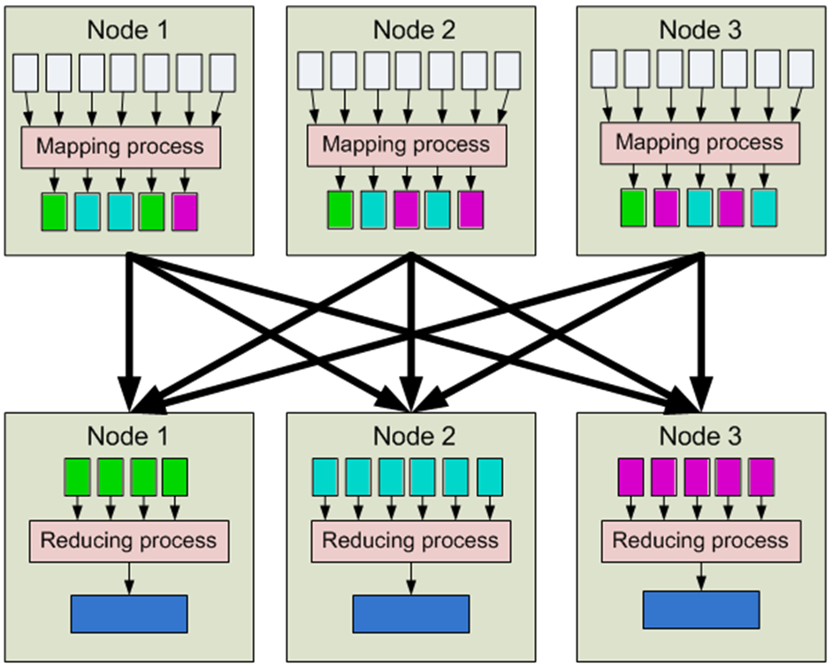
MapReduce/Hadoop
1. Input
2. Map
3. Partition [Sort]
4. Shuffle
5. Merge Sort
6. Reduce
7. Output

Slide 10
MapReduce/Hadoop: Counting Words
Input
Map
Partition /
[Sort]
Shuffle
Merge Sort
Reduce
Output
(0,perro sed que)
(perro,1)
(sed,1)
(que,1)
(sed,1)
(sed,1)
(decir,1)
(sed,1)
(sed,1)
(decir,{1})
(sed,{1,1})
(decir,1)
(sed,2)
(perro,1)
(que,1)
(decir,1)
(sed,1)
(13,que decir que)
(que,1)
(decir,1)
(que,1)
(decir,1)
(perro,1)
(que,1)
(perro,1)
(que,1)
(que,1)
(que,1)
(que,1)
(pero,{1})
(perro,1)
(que,4)
perro sed que
que decir que
la que sed
(que,1)
(que,1)
(que,{1,1,1,1})
(que,1)
(que,1)
(que,1)
(26,la que sed)
(la,1)
(que,1)
(sed,1)
(sed,1)
(la,1)
(la,1)
(la,{1})
(la,1)
(que,1)
(la,1)

Slide 11
MapReduce/Hadoop: Combiner
1. Input
2. Map
3. Partition [Sort]
(“Combine”)
4. Shuffle
5. Merge Sort
6. Reduce
7. Output

Slide 12
MapReduce/Hadoop: Combiner
Input
Map
Partition /
[Sort]
Combine
Shuffle
Merge Sort
Reduce
Output
(0,perro sed que)
(perro,1)
(sed,1)
(que,1)
(sed,1)
(sed,1)
(sed,1)
(decir,1)
(sed,1)
(sed,1)
(decir,{1})
(sed,{1,1})
(decir,1)
(sed,2)
(perro,1)
(que,1)
(perro,1)
(que,1)
(decir,1)
(sed,1)
(13,que decir que)
(que,1)
(decir,1)
(que,1)
(decir,1)
(decir,1)
(perro,1)
(que,1)
(perro,1)
(que,1)
(que,1)
(que,2)
(pero,{1})
(perro,1)
(que,4)
(que,1)
(que,1)
(que,2)
(que,{1,1,2})
(que,2)
(que,1)
(26,la que sed)
(la,1)
(que,1)
(sed,1)
(sed,1)
(sed,1)
(la,1)
(la,1)
(la,{1})
(la,1)
(que,1)
(que,1)
(la,1)
(la,1)

Slide 13
MapReduce/Hadoop: Combiner
1. Input
2. Map
3. Partition [Sort]
(“Combine”)
4. Shuffle
Combiner reduces data shuffled here!
5. Merge Sort
6. Reduce
7. Output

Slide 14
IN-CLASS EXERCISES

Slide 15
Supermarket Example
Supermarket boss wants to know:
Do we sell more in the morning hours or the evening hours?

Slide 16
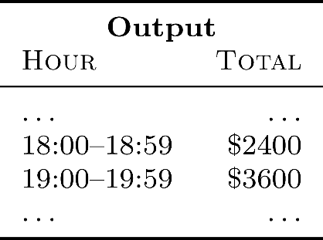
MapReduce: Supermarket Example
Compute total sales per hour of the day?

Slide 17
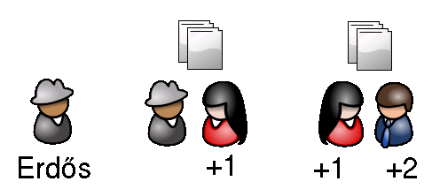
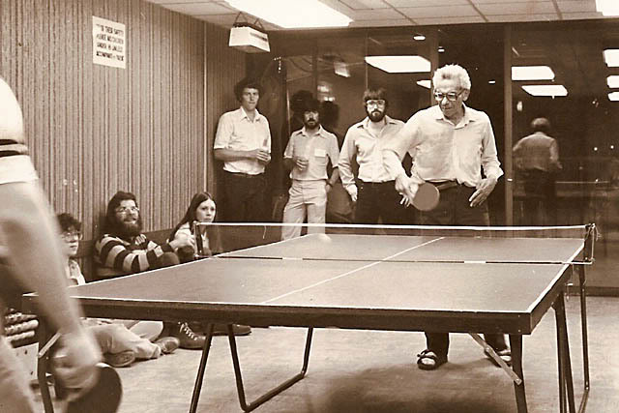
Erdős-number Example
Everybody wants to know:
What’s my Erdős-number?

Slide 18
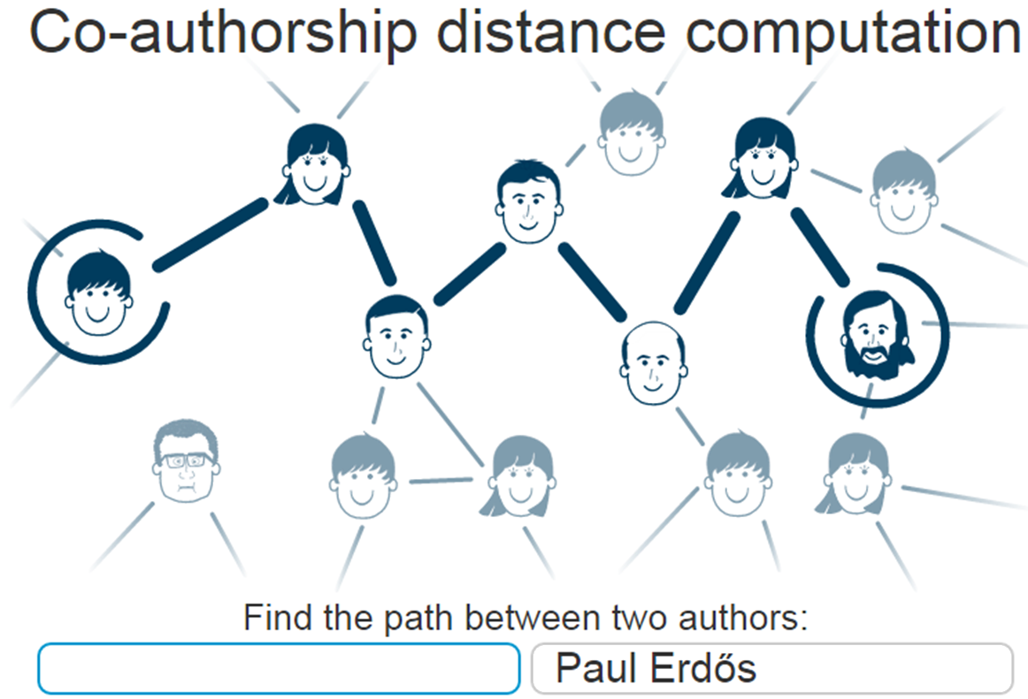

Slide 19
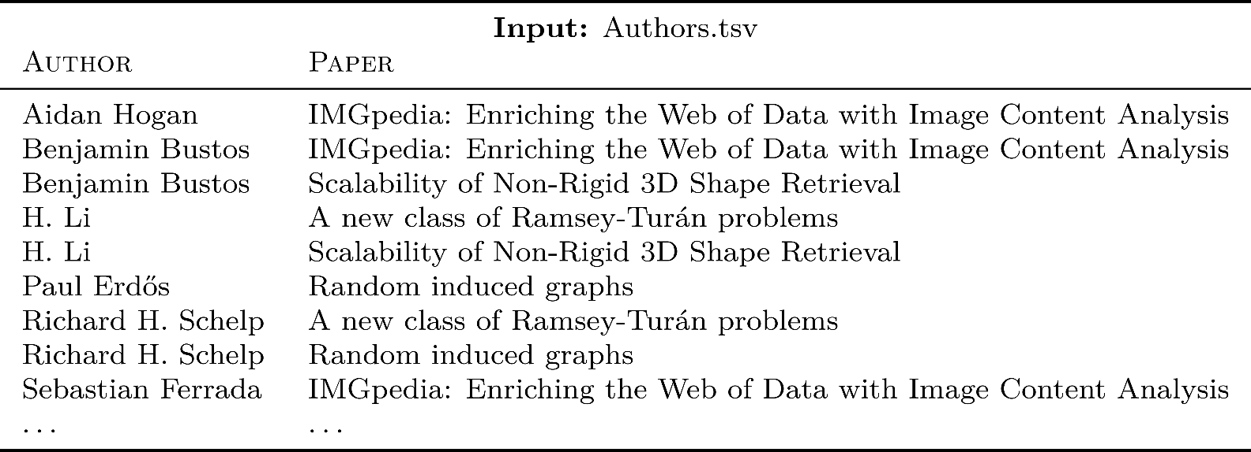
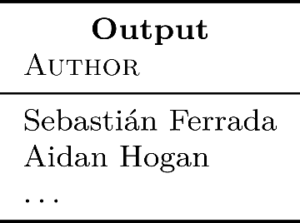
Erdős-number Example
Who has an Erdős-number of 3?

Slide 20
Questions?

