Slide 1
Hola Hadoop

Slide 2
0. Peligro!
Please please please please please please please please please please please please please please please please please please please please please please please please please please please please please please please please please please please please please please please please please please please please please please please please please please please please please please please please please please please please please please please please please please please please please please please please please please please please please please please please please please please please please please please please please please please please please please please please

Slide 3
0. Peligro!
… please please please please please please please please please please please please please please please please please please please please please please please please please please please please please please please please please please please please please please please please please please please please please please please please please please please please please please please please please please please please please please please please please please please please please please please please please please please please please please please please please please please please please please please please please please please please please please please please

Slide 4
Peligro!
… please

Slide 5
Peligro!
… please be careful of what you are doing!
Think twice before:
rm
mv
cp
kill
emacs/vim/… configuration files

Slide 6
Peligro!
… please.

Slide 7
cluster.dcc.uchile.cl

Slide 8
1. Download tools
http://aidanhogan.com/teaching/cc5212-1-2015/tools/
Unzip them somewhere you can find them

Slide 9
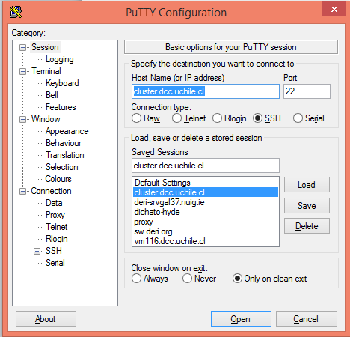
2. Log-in PuTTy
1
2
3

Slide 10
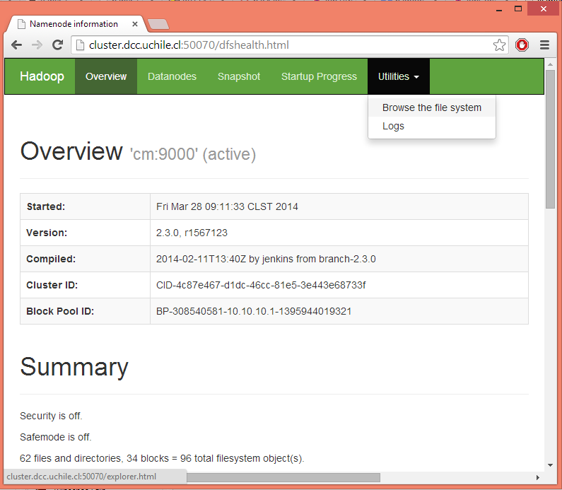
3. Open DFS Browser
http://cluster.dcc.uchile.cl:50070/

Slide 11
4. PuTTy: See state of DFS
hdfs dfsadmin -report

Slide 12
5. PuTTy: Create folder
hdfs dfs -ls /
hdfs dfs -ls /uhadoop
hdfs dfs -mkdir /uhadoop/[username]
[username] = first letter first name, last name (e.g., “ahogan”)

Slide 13
6. PuTTy: Upload Data
cd /data/2014/uhadoop/shared/
Then
hdfs dfs -copyFromLocal /data/2014/uhadoop/shared/es-wiki-abstracts.txt /uhadoop/[username]/
OR
hdfs dfs -copyFromLocal /data/2014/uhadoop/shared/es-wiki-abstracts.txt.gz /uhadoop/[username]/

Slide 14
Note on namespace
If you need to disambiguate local/remote files
HDFS file
hdfs://cm:9000/uhadoop/…
Local file
file:///data/hadoop/...

Slide 15
7. Let’s Build Our First MapReduce Job
Hint: Use Monday’s slides for “inspiration”
http://aidanhogan.com/teaching/cc5212-1-2016/
Also copied in CitationCount.java
Implement map(.,.,.,.) method
Implement reduce(.,.,.,.) method
Implement main(.) method

Slide 16
8. Eclipse: Build jar
Right Click build.xml > dist
(Might need to make a dist folder)

Slide 17
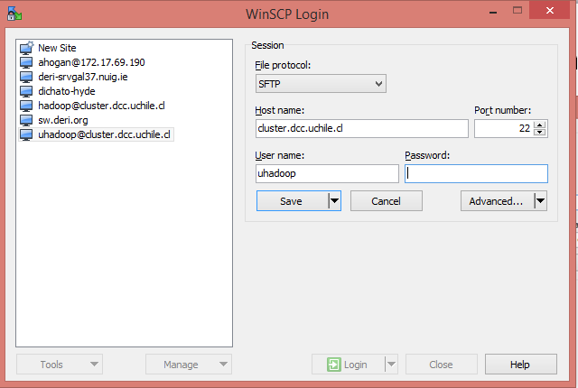
9. WinSCP: Copy .jar to Master Server
1
2
3
Don’t save password!
4

Slide 18
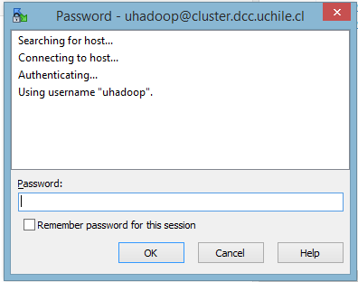
9. WinSCP: Copy .jar to Master Server

Slide 19
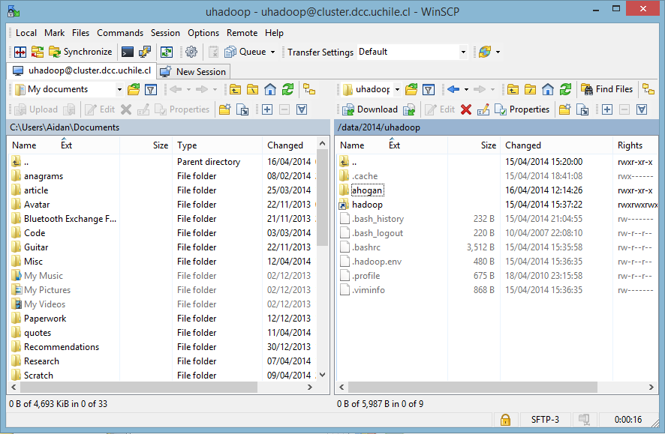
9. WinSCP: Copy .jar to Master Server
Create dir: /data/2014/uhadoop/[username]/
Copy your mdp-lab4.jar into it

Slide 20
10. PuTTy: Run Job
hadoop jar /data/2014/uhadoop/[username]/mdp-lab4.jar WordCount /uhadoop/[username]/es-wiki-abstracts.txt[.gz] /uhadoop/[username]/wc/
All one command!

Slide 21
11. PuTTY: Look at output
hdfs dfs -ls /uhadoop/[username]/wc/
hdfs dfs -cat /uhadoop/[username]/wc/part-r-00000 | more
hdfs dfs -cat /uhadoop/[username]/wc/part-r-00000 | grep -P "^de\t" | more
All one command!
Look for “de” … 4916432
occurrences in local run

Slide 22
12. Look at output through browser
http://cluster.dcc.uchile.cl:50070/

