Slide 1
CC5212-1 Procesamiento Masivo de Datos Otoño 2014
Aidan Hogan
aidhog@gmail.com
Lecture XI: 2014/06/11

Slide 2
Me vs. Google

Slide 3
RECAP: NoSQL

Slide 4
NoSQL

Slide 5
NoSQL vs. Relational Databases
What are the big differences between relational databases and NoSQL systems?
What are the trade-offs?

Slide 6
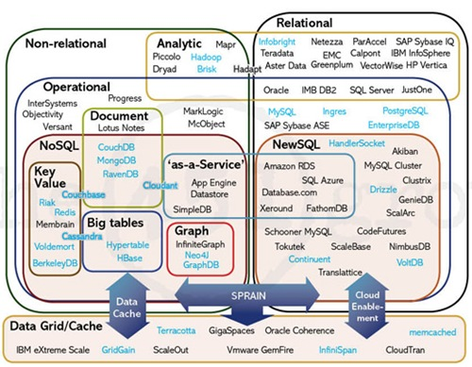
The Database Landscape
Batch analysis of data
Not using the relational model
Using the relational model
Real-time
Stores documents (semi-structured values)
Relational Databases
with focus on scalability to compete with NoSQL
while maintaining ACID
Not only SQL
Maps ☺
Column Oriented
Graph-structured data
Cloud storage
In-Memory

Slide 7
RECAP: KEY–VALUE

Slide 8
Key–Value = a Distributed Map
Key | Value
country:Afghanistan | capital@city:Kabul,continent:Asia,pop:31108077#2011
country:Albania | capital@city:Tirana,continent:Europe,pop:3011405#2013
… | …
city:Kabul | country:Afghanistan,pop:3476000#2013
city:Tirana | country:Albania,pop:3011405#2013
… | …
user:10239 | basedIn@city:Tirana,post:{103,10430,201}
… | …

Slide 9
Amazon Dynamo(DB): Model
Named table with primary key and a value
Primary key is hashed / unordered
Countries
Primary Key | Value
Afghanistan | capital:Kabul,continent:Asia,pop:31108077#2011
Albania | capital:Tirana,continent:Europe,pop:3011405#2013
… | …
Cities
Primary Key | Value
Kabul | country:Afghanistan,pop:3476000#2013
Tirana | country:Albania,pop:3011405#2013
… | …

Slide 10
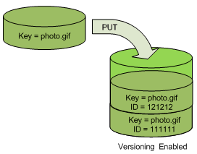
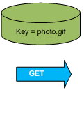
Amazon Dynamo(DB): Object Versioning
Object Versioning (per bucket)
PUT doesn’t overwrite: pushes version
GET returns most recent version

Slide 11
Other Key–Value Stores

Slide 12
RECAP: DOCUMENT STORES

Slide 13
Key–Value Stores: Values are Documents
Key | Value
country:Afghanistan | <country> <capital>city:Kabul</capital> <continent>Asia</continent> <population> <value>31108077</value> <year>2011</year> </population> </country>
… | …
Document-type depends on store
XML, JSON, Blobs, Natural language
Operators for documents
e.g., filtering, inv. indexing, XML/JSON querying, etc.

Slide 14
MongoDB: JSON Based
Key | Value (Document)
6ads786a5a9 | { “_id” : ObjectId(“6ads786a5a9”) , “name” : “Afghanistan” , “capital”: “Kabul” , “continent” : “Asia” , “population” : { “value” : 31108077, “year” : 2011 } }
… | …
o
Can invoke Javascript over the JSON objects
Document fields can be indexed
db.inventory.find({ continent: { $in: [ ‘Asia’, ‘Europe’ ]}})

Slide 15
Document Stores

Slide 16
TABLULAR / COLUMN FAMILY

Slide 17
Key–Value = a Distributed Map
Countries
Primary Key | Value
Afghanistan | capital:Kabul,continent:Asia,pop:31108077#2011
Albania | capital:Tirana,continent:Europe,pop:3011405#2013
… | …
Tabular = Multi-dimensional Maps
Countries
Primary Key | capital | continent | pop-value | pop-year
Afghanistan | Kabul | Asia | 31108077 | 2011
Albania | Tirana | Europe | 3011405 | 2013
… | … | … | … | …

Slide 18
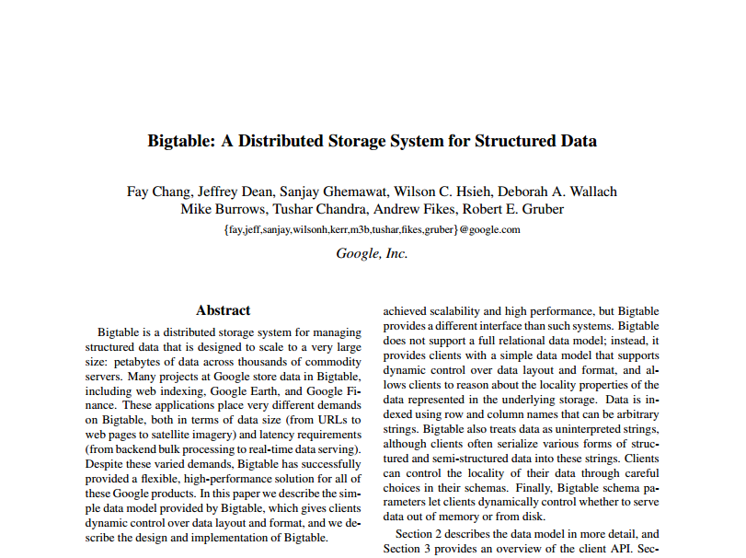
Bigtable: The Original Whitepaper
Why did they write another paper?
MapReduce solves everything, right?
MapReduce
authors

Slide 19
Bigtable: Data Model
“a sparse, distributed, persistent, multi-dimensional, sorted map.”
sparse: not all values form a dense square
distributed: lots of machines
persistent: disk storage (GFS)
multi-dimensional: values with columns
sorted: sorting lexicographically by row key
map: look up a key, get a value

Slide 20
Bigtable: in a nutshell
(row, column, time) → value
row: a row id string
e.g., “Afganistan”
column: a column name string
e.g., “pop-value”
time: an integer (64-bit) version time-stamp
e.g., 18545664
value: the element of the cell
e.g., “31120978”

Slide 21
Bigtable: in a nutshell
(row, column, time) → value
(Afganistan,pop-value,t₄) →
31108077
Primary Key | capital |  | continent |  | pop-value |  | pop-year
Afghanistan | t₁ | Kabul | t₁ | Asia | t₁ | 31143292 | t₁ | 2009
 |  |  |  |  | t₂ | 31120978
 |  |  |  |  | t₄ | 31108077 | t₄ | 2011
Albania | t₁ | Tirana | t₁ | Europe | t₁ | 2912380 | t₁ | 2010
 |  |  |  |  | t₃ | 3011405 | t₃ | 2013
… | … |  | … |  | … |  | …

Slide 22
Bigtable: Sorted Keys
Primary Key | capital |  | pop-value |  | pop-year
Asia:Afghanistan | t₁ | Kabul | t₁ | 31143292 | t₁ | 2009
 |  |  | t₂ | 31120978
 |  |  | t₄ | 31108077 | t₄ | 2011
Asia:Azerbaijan | … | … | … | … | … | …
… | … | … | … | … | … | …
Europe:Albania | t₁ | Tirana | t₁ | 2912380 | t₁ | 2010
 |  |  | t₃ | 3011405 | t₃ | 2013
Europe:Andorra | … | … | … | … | … | …
… | … | … | … | … | … | …
S
O
R
T
E
D
Benefits of sorted keys vs. hashed keys?

Slide 23
Bigtable: Tablets
Take advantage of locality of processing!
Primary Key | capital |  | pop-value |  | pop-year
Asia:Afghanistan | t₁ | Kabul | t₁ | 31143292 | t₁ | 2009
 |  |  | t₂ | 31120978
 |  |  | t₄ | 31108077 | t₄ | 2011
Asia:Azerbaijan | … | … | … | … | … | …
… | … | … | … | … | … | …
Europe:Albania | t₁ | Tirana | t₁ | 2912380 | t₁ | 2010
 |  |  | t₃ | 3011405 | t₃ | 2013
Europe:Andorra | … | … | … | … | … | …
… | … | … | … | … | … | …
A
S
I
A
E
U
R
O
P
E

Slide 24
Bigtable: Distribution
Pros and cons versus hash partitioning?
Horizontal range partitioning
Split by tablet

Slide 25
Bigtable: Column Families
Primary Key | pol:capital |  | demo:pop-value |  | demo:pop-year
Asia:Afghanistan | t₁ | Kabul | t₁ | 31143292 | t₁ | 2009
 |  |  | t₂ | 31120978
 |  |  | t₄ | 31108077 | t₄ | 2011
Asia:Azerbaijan | … | … | … | … | … | …
… | … | … | … | … | … | …
Europe:Albania | t₁ | Tirana | t₁ | 2912380 | t₁ | 2010
 |  |  | t₃ | 3011405 | t₃ | 2013
Europe:Andorra | … | … | … | … | … | …
… | … | … | … | … | … | …
Group logically similar columns together
Accessed efficiently together
Access-control and storage: column family level
If of same type, can be compressed

Slide 26
Bigtable: Versioning
Similar to Apache Dynamo (so no “fancy” slide)
Cell-level
64-bit integer time stamps
Inserts push down current version
Lazy deletions / periodic garbage collection
Two options:
keep last n versions
keep versions newer than t time

Slide 27
Bigtable: SSTable Map Implementation
64k blocks (default) with index in footer (GFS)
Index loaded into memory, allows for seeks
Can be split or merged, as needed
Primary Key | pol:capital |  | demo:pop-value |  | demo:pop-year
Asia:Afghanistan | t₁ | Kabul | t₁ | 31143292 | t₁ | 2009
 |  |  | t₂ | 31120978
 |  |  | t₄ | 31108077 | t₄ | 2011
Asia:Azerbaijan | … | … | … | … | … | …
… | … | … | … | … | … | …
Asia:Japan | … | … | … | … | … | …
Asia:Jordan | … | … | … | … | … | …
… | … | … | … | … | … | …
Block 0 / Offset 0 / Asia:Afghanistan
Block 1 / Offset 65536 / Asia: Japan
0
65536
Index:

Slide 28
Bigtable: Buffered/Batched Writes
Merge-sort
READ
Memtable
In-memory
GFS
Tablet
Tablet log
SSTable1
SSTable2
SSTable3
WRITE

Slide 29
Bigtable: Redo Log
If machine fails, Memtable redone from log
Memtable
In-memory
GFS
Tablet
Tablet log
SSTable1
SSTable2
SSTable3

Slide 30
BigTable: Minor Compaction
When full, write Memtable as SSTable
Memtable
Memtable
In-memory
GFS
Tablet
Tablet log
SSTable1
SSTable2
SSTable3
SSTable4

Slide 31
BigTable: Merge Compaction
Merge some of the SSTables (and the Memtable)
READ
Memtable
Memtable
In-memory
GFS
Tablet
SSTable1
Tablet log
SSTable1
SSTable2
SSTable3
SSTable4

Slide 32
BigTable: Major Compaction
Merge all SSTables (and the Memtable)
READ
Memtable
Memtable
In-memory
GFS
Tablet
SSTable1
SSTable1
SSTable2
SSTable3
Tablet log
SSTable1
SSTable4

Slide 33
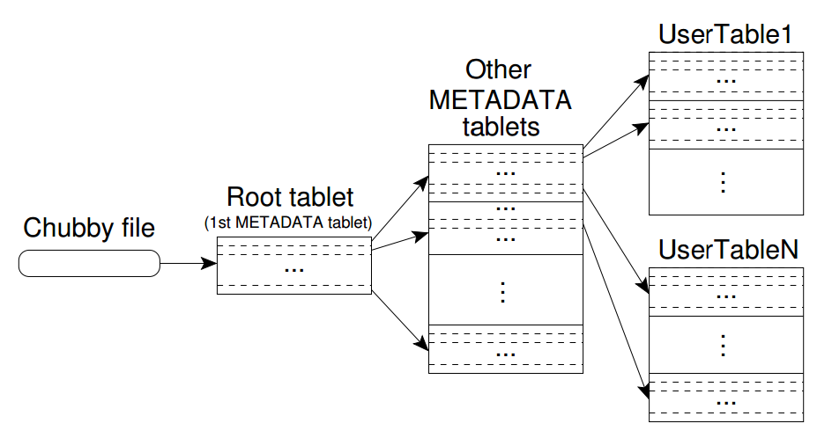
Bigtable: Hierarchical Structure

Slide 34
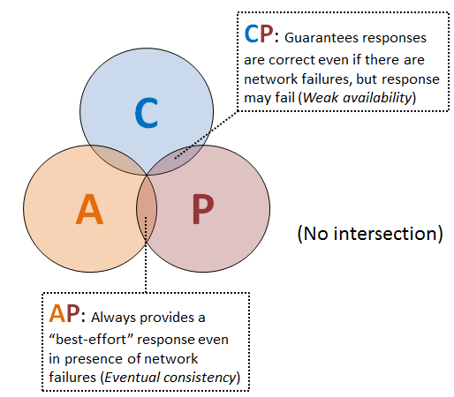
Bigtable: Consistency
CHUBBY: Distributed consensus tool based on PAXOS
Maintains consistent replicas
Five replicas: one master and four slaves
Co-ordinates distributed locks
Stores location of main “root tablet”
Do we think it’s a CP system or an AP system?

Slide 35
Bigtable: A Bunch of Other Things
Locality groups: Group multiple column families together; assigned a separate SSTable
Select storage: SSTables can be persistent or in-memory
Compression: Applied on blocks; custom compression can be chosen
Caches: SSTable-level and block-level
Bloom filters: Find negatives cheaply …

Slide 36
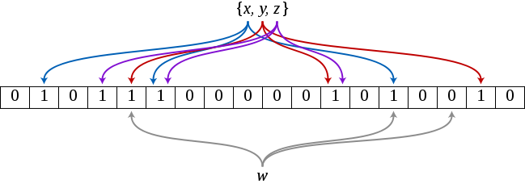
Aside: Bloom Filter
Reject “empty” queries using very little memory!
Create a bit array of length m (init to 0’s)
Create k hash functions that map an object to an index of m (even distribution)
Index o: set m[hash₁(o)], …, m[hash_{k}(o)] to 1
Query o:
any m[hash₁(o)], …, m[hash_{k}(o)] set to 0 = not indexed
all m[hash₁(o)], …, m[hash_{k}(o)] set to 1 = might be indexed

Slide 37
Bigtable: Apache HBase
Open-source implementation of Bigtable ideas

Slide 38
The Database Landscape
Batch analysis of data
Not using the relational model
Using the relational model
Real-time
Stores documents (semi-structured values)
Relational Databases
with focus on scalability to compete with NoSQL
while maintaining ACID
Not only SQL
Maps ☺
Column Oriented
Graph-structured data
Cloud storage
In-Memory

Slide 39
GRAPH DATABASES

Slide 40
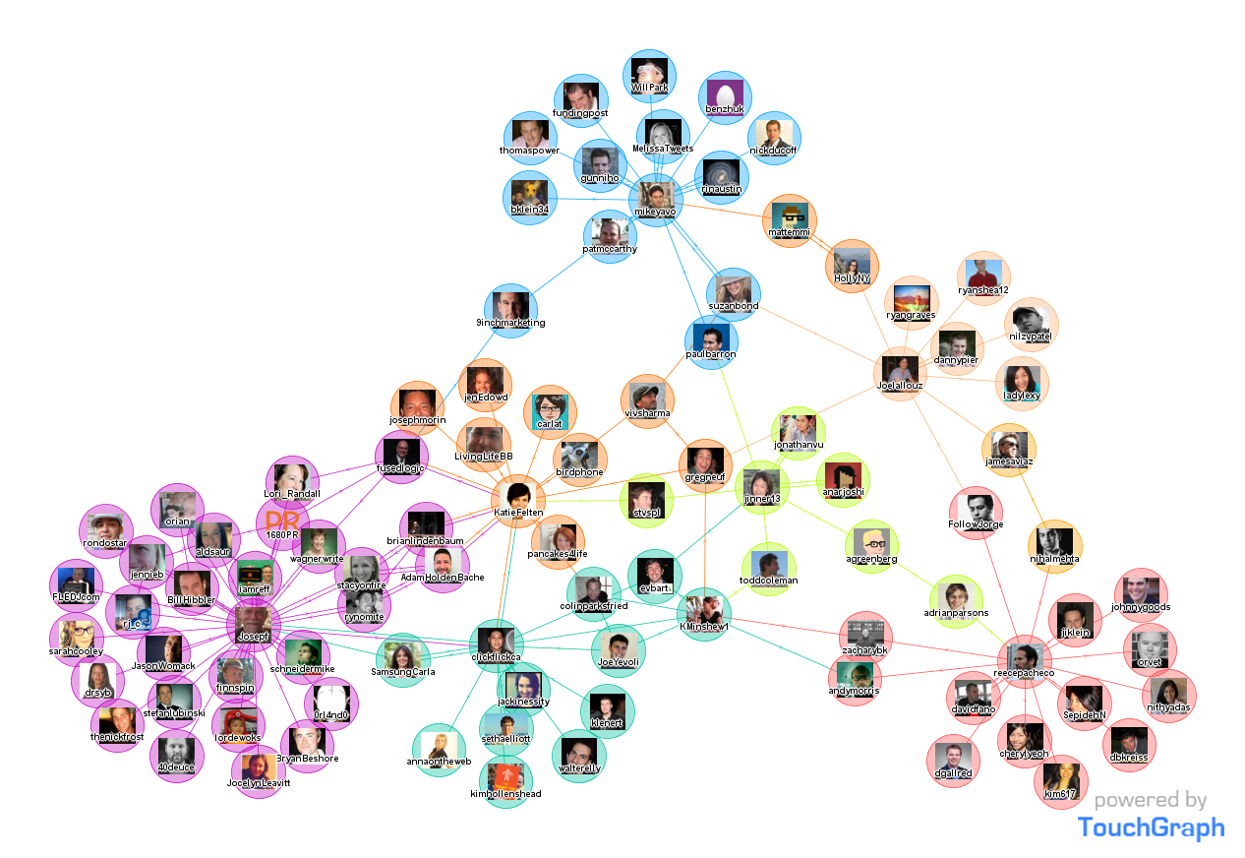

Slide 41
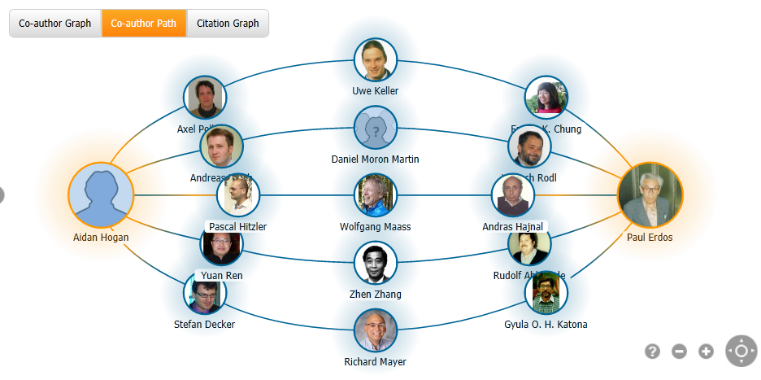

Slide 42
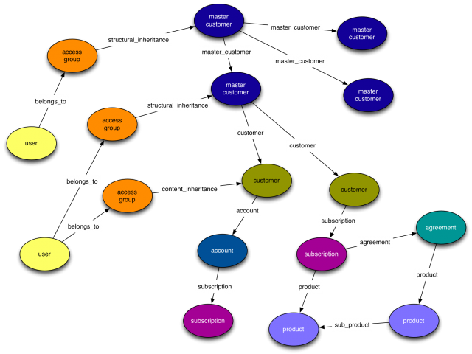

Slide 44
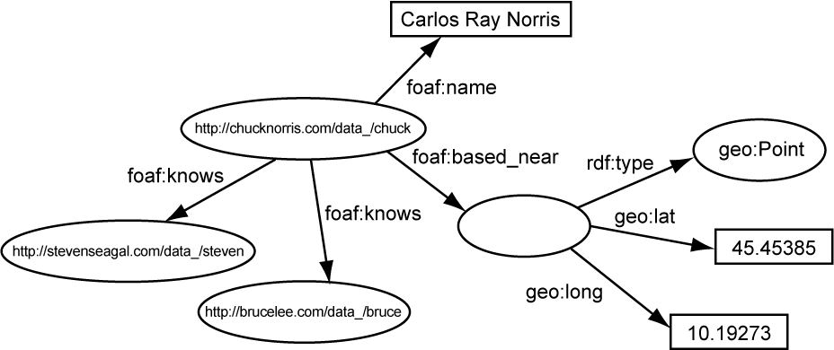

Slide 45
Data = Graph
Any data can be represented as a directed labelled graph (not always neatly)]
When is it a good idea to consider data as a graph?
When you want to answer questions like:
How many social hops is this user away?
What is my Erdős number?
What connections are needed to fly to Perth?
How are Einstein and Godel related?

Slide 46
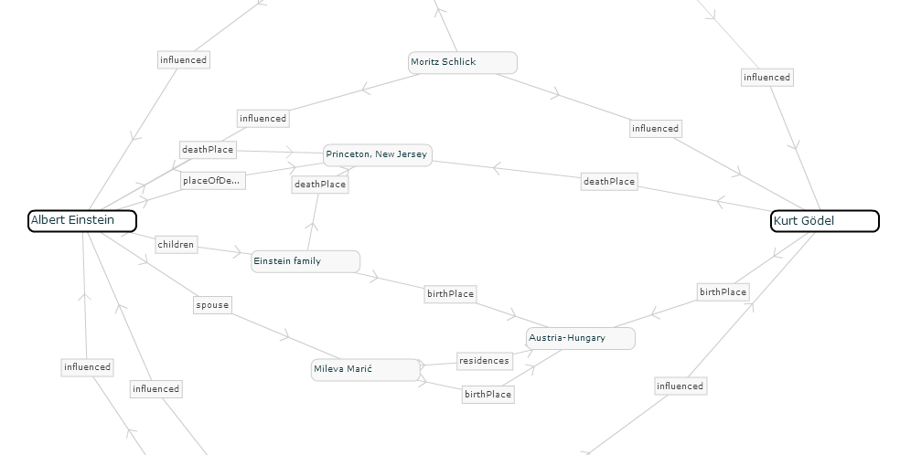
RelFinder

Slide 47
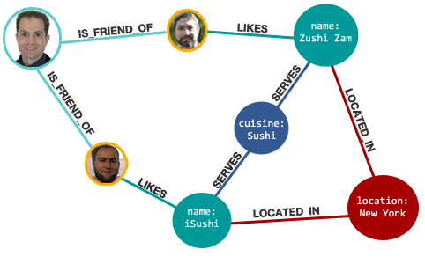
Graph Databases
(Fred,IS_FRIEND_OF,Jim)
(Fred,IS_FRIEND_OF,Ted)
(Ted,LIKES,Zushi_Zam)
(Zuzhi_Zam,SERVES,Sushi)
…

Slide 48
Graph Databases: Index Nodes
(Fred,IS_FRIEND_OF,Jim)
(Jim,LIKES,iSushi)
Fred ->

Slide 49
Graph Databases: Index Relations
(Ted,LIKES,Zushi_Zam)
(Jim,LIKES,iSushi)
LIKES ->

Slide 50
Graph Databases: Graph Queries
(Fred,IS_FRIEND,?friend)
(?friend,LIKES,?place)
(?place,SERVES,?sushi)
(?place,LOCATED_IN,New_York)

Slide 51
Graph Databases: Path Queries
What about scalability?
(Fred,IS_FRIEND*,?friend_of_friend)
(?friend_of_friend,LIKES,Zushi_Zam)

Slide 52
Graph Database: Index-free Adjacency
Ted | LIKES | Zushi Zam
Fred | IS_FRIEND_OF | Ted
Fred | IS_FRIEND_OF | Ted
Fred | IS_FRIEND_OF | Jim
Jim | LIKES | iSushi
Fred | IS_FRIEND_OF | Jim
iSushi | SERVES | Sushi
iSushi | LOCATED_IN | New York
Jim | LIKES | iSushi

Slide 53
Leading Graph Database

Slide 54
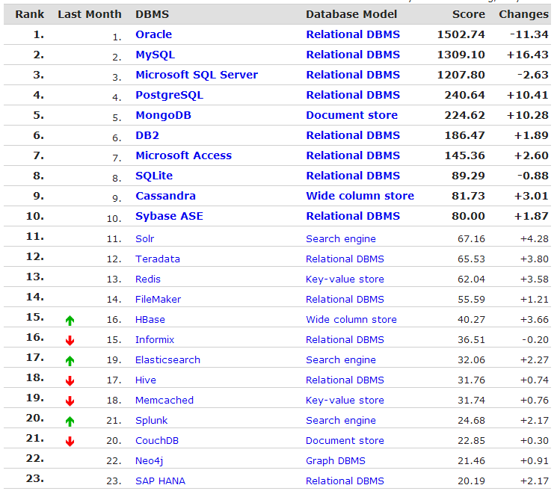
http://db-engines.com/en/ranking

Slide 55
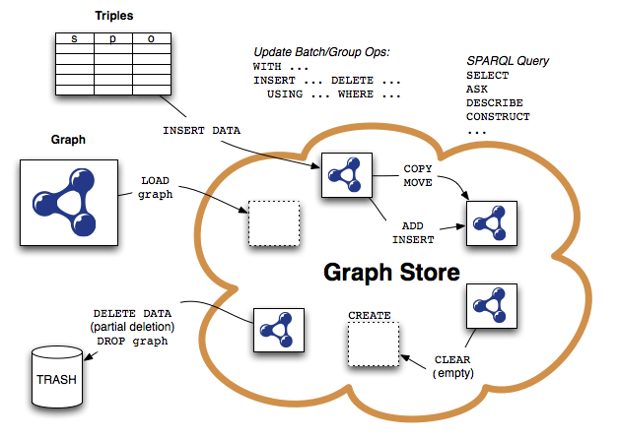
SPARQL

Slide 56
http://db-engines.com/en/ranking

Slide 57
CASSANDRA

Slide 58
http://db-engines.com/en/ranking

Slide 60
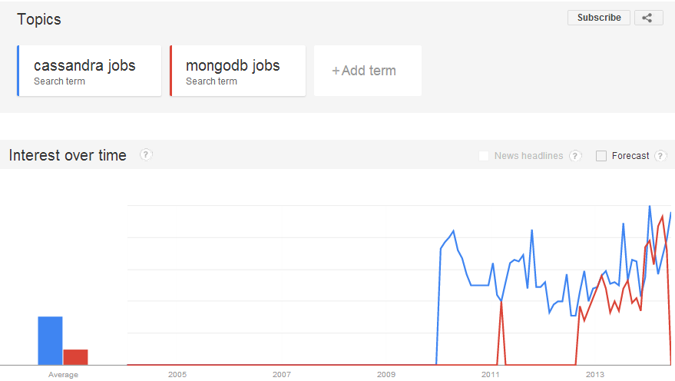

Slide 61
Apache Cassandra: Key–Value or Table?

Slide 62
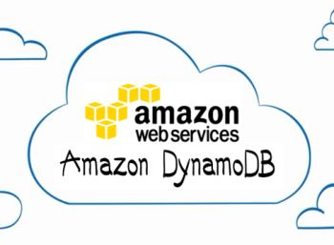
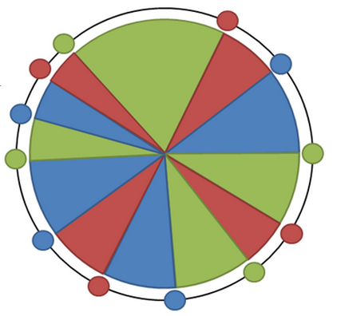
Cassandra: Hashing of Dynamo
Unsorted keys

Slide 63
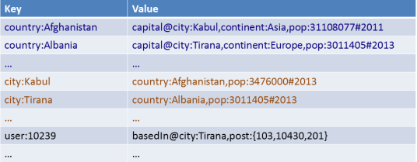
Cassandra: Distribution of Dynamo
Typically hash-based
Or a custom partitioner …

Slide 64
Cassandra: Eventual Consistency of Dynamo
AP: Eventual consistency, High availability
C
A
P
But (like Dynamo), tables are tunable towards CP
AP: If someone cannot be reached, they all go downtown but might not end up at the same place.

Slide 65
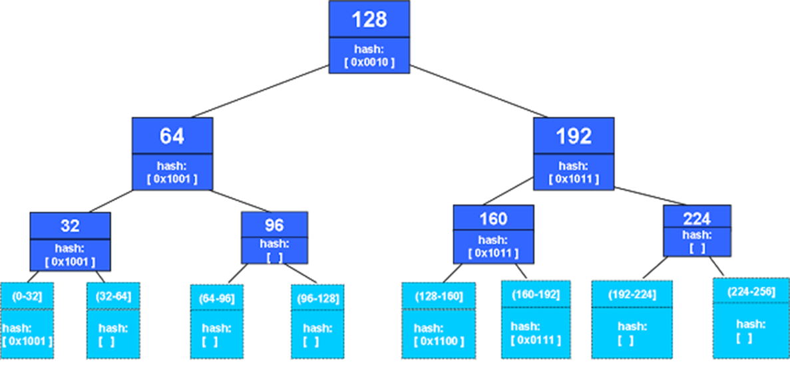
Cassandra: Eventual Consistency using Merkle Trees like Dynamo
Merkle tree is a hash tree
Nodes have hashes of their children
Leaf node hashes from data: keys or ranges

Slide 66
Cassandra: Tuneable Consistency like Dynamo
Tuneable consistency
Write = Commit Log + Memtable
Quorom = Majority of replicas: ⌊R/2⌋+1 for R the replication factor
Hinted handoff: central 3 hour TODO log (not readable)
Higher availability
Level | Explanation
ANY | One replica node or a hinted handoff
ONE | One replica node (hinted handoff not enough)
TWO | Two replica nodes
THREE | Three replica nodes
QUORUM | A quorum of replica nodes
ALL | All replica nodes
Stronger
Consistency

Slide 67
Cassandra: Columns of Bigtable
Primary Key | capital |  | pop-value |  | pop-year
Asia:Afghanistan | t₁ | Kabul | t₁ | 31143292 | t₁ | 2009
 |  |  | t₂ | 31120978
 |  |  | t₄ | 31108077 | t₄ | 2011
Europe:Ireland | … | … | … | … | … | …
… | … | … | … | … | … | …
Europe:Albania | t₁ | Tirana | t₁ | 2912380 | t₁ | 2010
 |  |  | t₃ | 3011405 | t₃ | 2013
SAmerica:Chile | … | … | … | … | … | …
… | … | … | … | … | … | …
U
N
S
O
R
T
E
D
Also allows for indexing columns
Partition key unsorted, but can sort on another key (e.g., population) for range queries

Slide 68
Cassandra: Column Families of Dynamo
Primary Key | pol:capital |  | demo:pop-value |  | demo:pop-year
Asia:Afghanistan | t₁ | Kabul | t₁ | 31143292 | t₁ | 2009
 |  |  | t₂ | 31120978
 |  |  | t₄ | 31108077 | t₄ | 2011
Asia:Azerbaijan | … | … | … | … | … | …
… | … | … | … | … | … | …
Europe:Albania | t₁ | Tirana | t₁ | 2912380 | t₁ | 2010
 |  |  | t₃ | 3011405 | t₃ | 2013
Europe:Andorra | … | … | … | … | … | …
… | … | … | … | … | … | …
Rows can also be “jagged”

Slide 69
Dynamo vs. Bigtable vs. Cassandra
 | Dynamo | Bigtable | Cassandra
Data Model | key–value | table/ multi-dim. map | table/ multi-dim. map
Indexing | hashing | sorted | sorted
Partition | hash/random, etc. | sorted tablets | hash/random, etc.
Consistency | eventual (tuneable) | strong | eventual (tuneable)
Availability | strong | weak | strong
Management | peer-based | hierarchical | peer-based
SPOF? | no | (chubby) | no

Slide 70
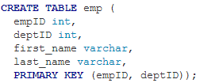
Cassandra Query Language (CQL)
SQL Like:

Slide 71
RECAP

Slide 72
Recap
Relational Databases don’t solve everything
SQL and ACID add overhead
Distribution not so easy
NoSQL: what if you don’t need SQL or ACID?
Something simpler
Something more scalable
Trade efficiency against guarantees

Slide 73
NoSQL: Trade-offs
Simplified transactions (no ACID)
Simplified (or no) query language
Procedural or a subset of SQL
Simplified query alegbra
Often no joins
Simplified data model
Often map-based
Simplified replication
Consistency vs. Availability
Simplifications enable scale to thousands of machines. But a lot of relational database features are lost!

Slide 74
NoSQL Overview Map

Slide 75
Types of NoSQL Store
Key–Value Stores (e.g., Dynamo):
Distributed unsorted maps
Some have secondary indexes
Document Stores (e.g., MongoDB):
Map values are documents (e.g., JSON, XML)
Built-in document functions/indexable fields
Table/Column-Based Stores (e.g., Bigtable):
Distributed multi-dimensional sorted maps
Distribution by Tablets/Column-families
Graph Stores (e.g., Neo4J)
Stores vertices and relations: Index-free adjacency
Query languages for paths, reachability, etc.
Hybrid/mix/other (e.g., Cassandra)

Slide 76
Type of Optimisations
In-memory buffer indexes (memtable)
Commit log used for failures
Intermittent index merging
Hash ring used for dynamic partitions
Merkle trees used for consistency checks
Versioning allows for lazy deletions
Trade consistency for availability by reducing quorum requirements
Bloom filters to find empty queries
Compression, Caches, Locality, Rack Awareness

Slide 77
Questions
?

Slide 78
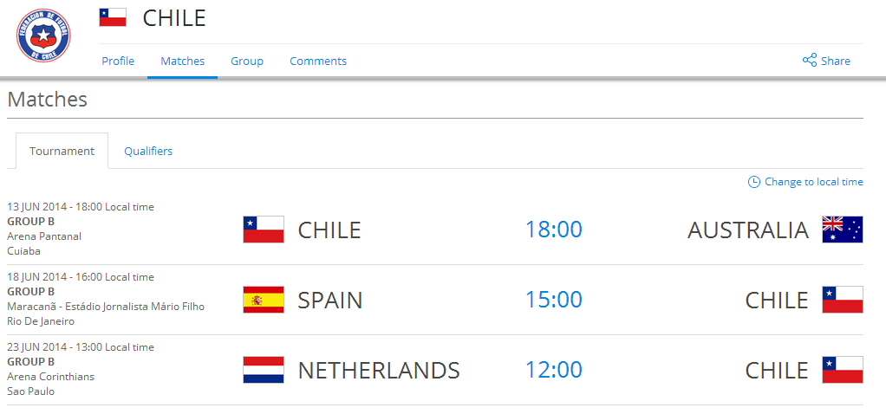
World Cup

