Slide 1
CC5212-1 Procesamiento Masivo de Datos Otoño 2014
Aidan Hogan
aidhog@gmail.com
Lecture VI: 2014/04/14

Slide 2
Why Learn about Hadoop/MadReduce

Slide 3
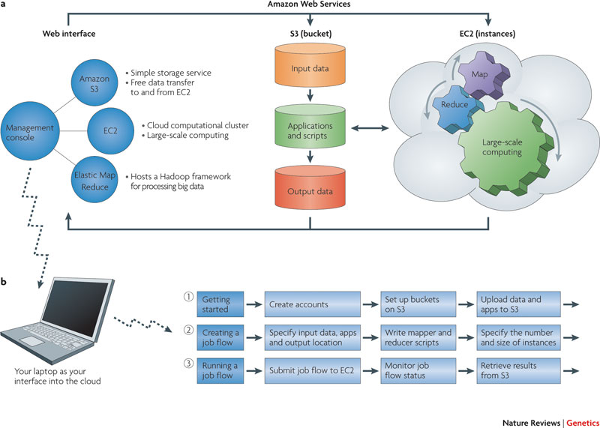
Why Learn about Hadoop/MapReduce

Slide 4
Why Learn about Hadoop/MadReduce

Slide 5
SHORT RECAP

Slide 6
Inside Google

Slide 7
Google Re-Engineering
Google File System (GFS)
MapReduce

Slide 8
GFS: Pipelined Writes
File System (In-Memory)
/blue.txt [3 chunks]
1: {A1, C1, E1}
2: {A1, B1, D1}
3: {B1, D1, E1}
/orange.txt [2 chunks]
1: {B1, D1, E1}
2: {A1, C1, E1}
64MB per chunk
64 bit label for each chunk
Assume replication factor of 3
Master
blue.txt
(150 MB: 3 chunks)
orange.txt (100MB: 2 chunks)
A1
B1
C1
D1
E1
1
3
3
2
1
1
1
2
1
2
2
3
1
2
2
Chunk-servers (slaves)

Slide 9
MapReduce: Word Count
Input
Distr. File Sys.
A1
B1
C1
1
3
2
Map()
A1
B1
C1
(Partition/Shuffle)
(Distr. Sort)
a-k
l-q
r-z
Reduce()
a 10,023
aa 6,234
…
lab 8,123
label 983
…
rag 543
rat 1,233
…
Output

Slide 10
MapReduce
Input
Map
Partition
Shuffle
Comparison/Sort
Reduce
Output

Slide 11
Old Way of Doing “Big Data”
Queries, Applications, BI
Relational Database
Extract, Transform, Load (ETL)
Raw Data Storage
Data Collection
Something Generating Raw Data

Slide 12
Old Way of Doing “Big Data”
Queries, Applications, BI
MapReduce
RDBMS
(ETL)
Raw Data Storage
Data Collection
Something Generating Raw Data

Slide 13
MapReduce Example
You are a data scientist working for Jumbo.
You have all the transaction data.
Your bosses ask you to find out what are the twenty most common items bought with each major newspaper.
How could you do this with MapReduce?

Slide 14
MapReduce vs. RDBMS
Schema-on-Read
Schema-on-Write
Works directly over the raw data
Don’t have to pre-decide schema
Restart (big) job on a node
Works over relational structure
Schema must be decided beforehand
ACID is possible

Slide 15
MapReduce vs. RDBMS
High latency
Bigger throughput
Low latency
Lower throughput

Slide 16
MapReduce Throughput
1 disk: 100MB/s
1 server: 300MB/s
3 servers: 900MB/s
…

Slide 17
HADOOP OVERVIEW

Slide 18
Hadoop Architecture
Client
NameNode
JobTracker
DataNode 1
JobNode 1
DataNode 2
JobNode 2
…
…
DataNode n
JobNode n

Slide 19
HDFS: Traditional / SPOF
NameNode
NameNode appends edits to log file
SecondaryNameNode copies log file and image, makes checkpoint, copies image back
NameNode loads image on start-up and makes remaining edits
SecondaryNameNode not a backup NameNode
copy dfs/blue.txt
rm dfs/orange.txt
rmdir dfs/
mkdir new/
mv new/ dfs/
fsimage
SecondaryNameNode
DataNode 1
…
DataNode n

Slide 20
Hadoop: High Availability
1
2
Active NameNode
Standby NameNode
Active NameNode
JournalManager
JournalManager
fsimage
2
1
JournalNode 1
fs edits
fs edits
2
1
…
1
2
JournalNode n

Slide 21
PROGRAMMING WITH HADOOP

Slide 22
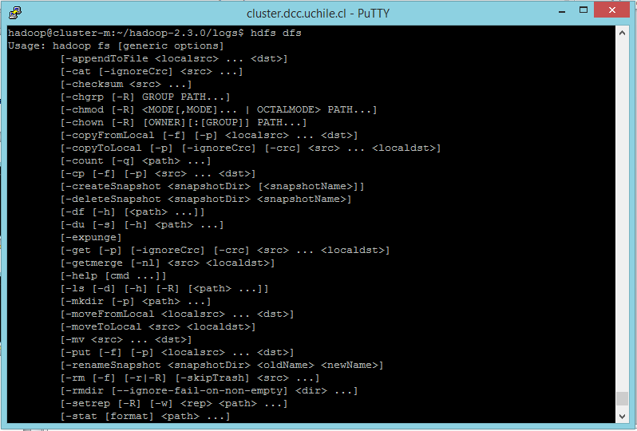
1. Input (cmd)
> hdfs dfs

Slide 23
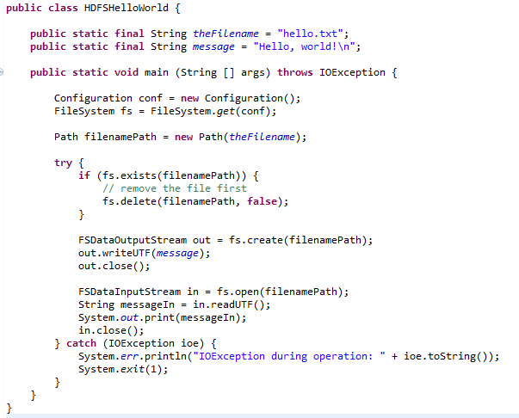
1. Input / Output (Java)
Creates a file system for default configuration
Check if the file exists; if so delete
Create file and write a message
Open and read back

Slide 24
1. Input (Java)

Slide 25
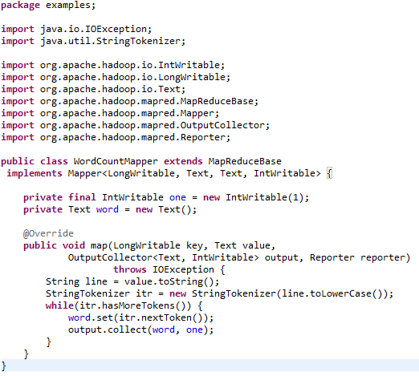
2. Map
Mapper<InputKeyType,
InputValueType,
MapKeyType,
MapValueType>
OutputCollector will collect the Map key/value pairs
“Reporter” can provide counters and progress to client
Emit output

Slide 26
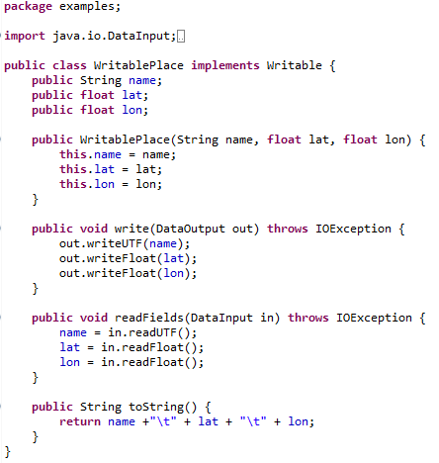
(Writable for values)
Same order

Slide 27
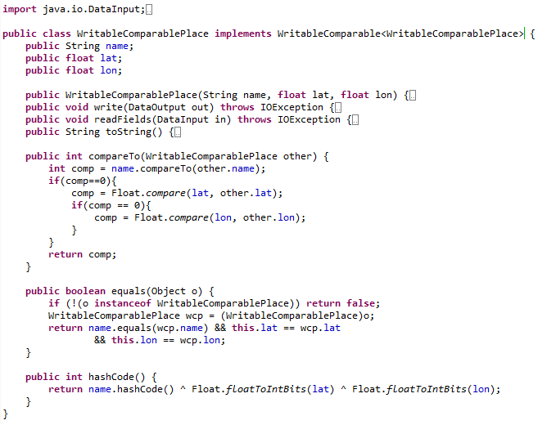
(WritableComparable for keys/values)
New Interface
Same as before
Needed to sort keys
Needed for default partition function

Slide 28
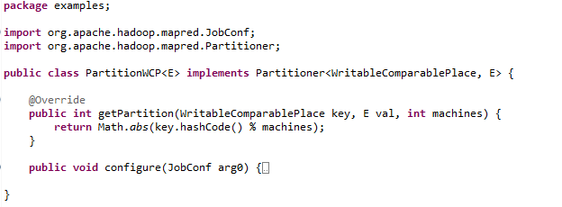
3. Partition
PartitionerInterface
(This is the default partition method!)

Slide 29
4. Shuffle

Slide 30
5. Sort/Comparision
Methods in WritableComparator

Slide 31
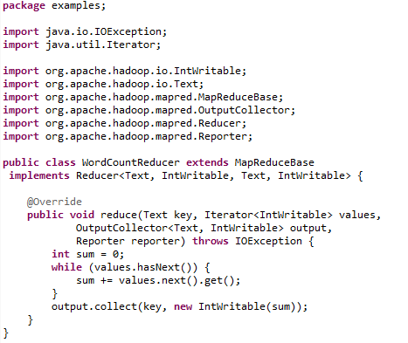
6. Reduce
Reducer<MapKey, MapValue,
OutputKey, OutputValue>
Iterator over values for each key and an output key–value pair collector
Write to output

Slide 32
7. Output / Input (Java)
Creates a file system for default configuration
Check if the file exists; if so delete
Create file and write a message
Open and read back

Slide 33
7. Output (Java)

Slide 34
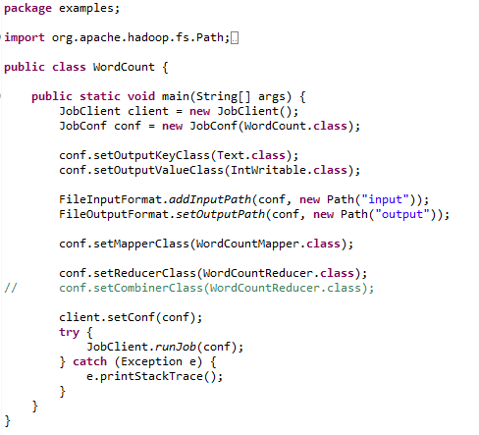
Control Flow
Create a JobClient, a JobConf and pass it the main class
Set the type of output key and value in the configuration
Set input and output paths
Set the mapper class
Set the reducer class
(and optionally “combiner”)
Pass the configuration to the client and run

Slide 35
More in Hadoop: Combiner
Map-side “mini-reduction”
Keeps a fixed-size buffer in memory
Reduce within that buffer
e.g., count words in buffer
Lessens bandwidth needs
In Hadoop: can simply use Reducer class ☺

Slide 36
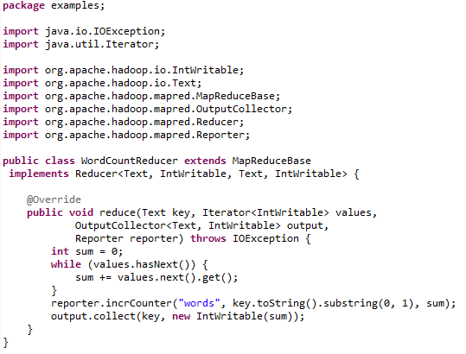
More in Hadoop: Reporter
Reporter has a group of maps of counters

Slide 37
More in Hadoop: Chaining Jobs
Sometimes we need to chain jobs
In Hadoop, can pass a set of Jobs to the client
x.addDependingJob(y)

Slide 38
More in Hadoop: Distributed Cache
Some tasks need “global knowledge”
For example, a white-list of Spanish words that should be considered in the word-count
Typically small
Use a distributed cache:
Makes data available locally to all nodes

Slide 39
RECAP …

Slide 40
MapReduce/GFS Revision
GFS: distributed file system
Implemented as HDFS
MapReduce: distributed processing framework
Implemented as Hadoop

Slide 41
Hadoop
FileSystem
Mapper<InputKey,InputValue,MapKey,MapValue>
OutputCollector<OutputKey,OutputValue>
Writable, WritableComparable<Key>
Partitioner<KeyType,ValueType>
Reducer<MapKey,MapValue,OutputKey,OutputValue>
JobClient/JobConf
…

Slide 42
Why Learn about Hadoop/MadReduce

Slide 43
Questions
?

