Slide 1
CC7220-1 La Web de Datos Primavera 2023 Lecture 2: RDF Model and Syntax
Aidan Hogan
aidhog@gmail.com

Slide 2
The “Semantic Web”

Slide 3
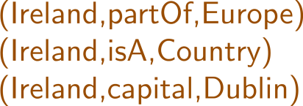
Semantic Web: Data, Logic, Query
* More or less

Slide 4
RDF: Resource Description Framework

Slide 5
RDF (1.1): A Web Standard

Slide 6
Semantic Web: Data
* More or less

Slide 7
Semantic Web: Data

Slide 8
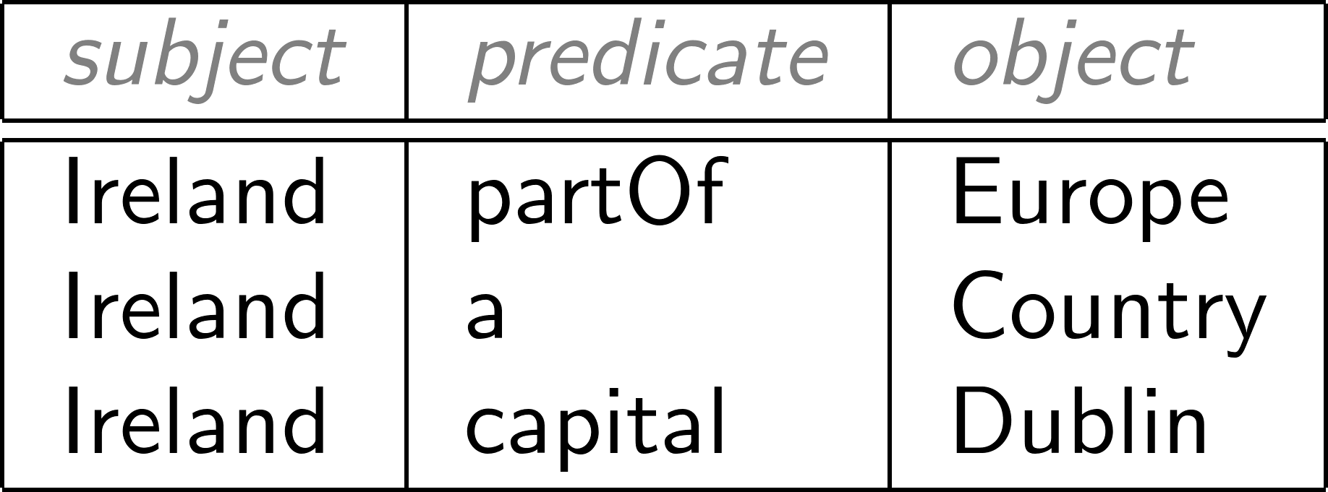
Modelling the world with triples

Slide 9
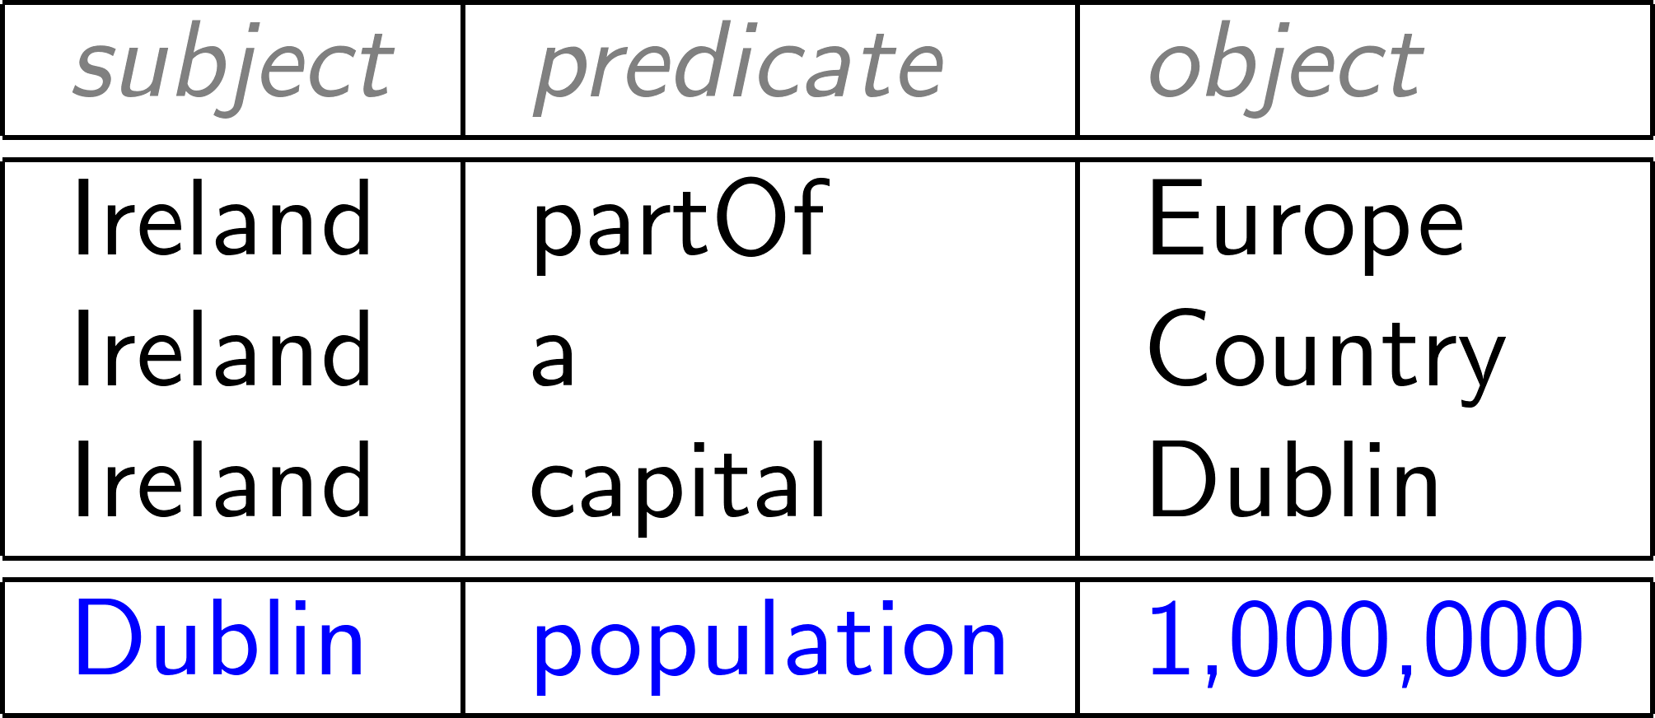
Concatenate to “integrate” new data

Slide 10
RDF often drawn as a (directed, labelled) graph

Slide 11
Set of triples thus called an “RDF Graph”

Slide 12
But why triples?

Slide 13
But why triples?
Why not pairs?

Slide 14
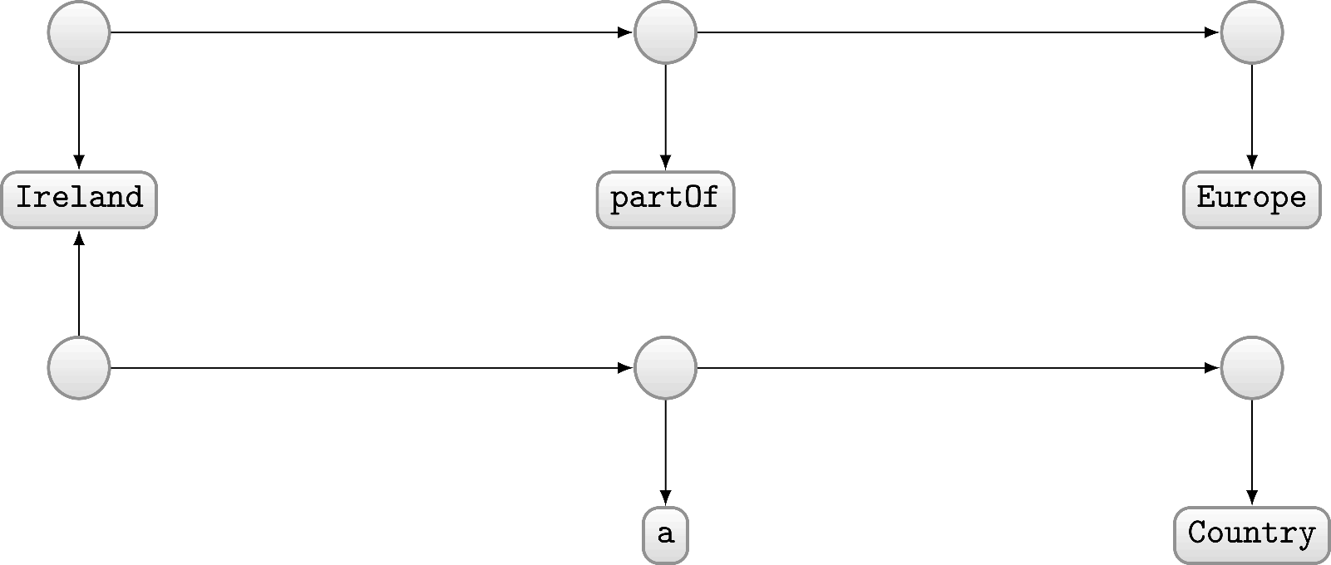
Modelling with pairs (directed unlabelled graph)?
Modelled as pairs?

Slide 15
But why graphs?
Why not (e.g.) tables?

Slide 16
Graphs are flexible

Slide 17
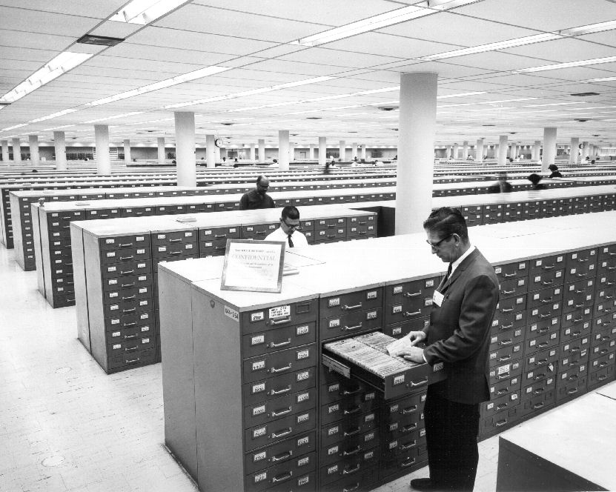
Relational Databases …

Slide 18
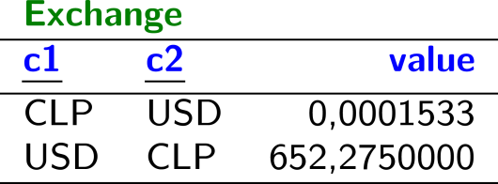
Relational Databases …

Slide 19
Planets / Relational Data

Slide 20
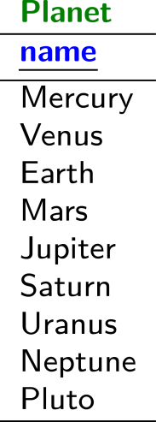
Planets / Relational Data

Slide 21
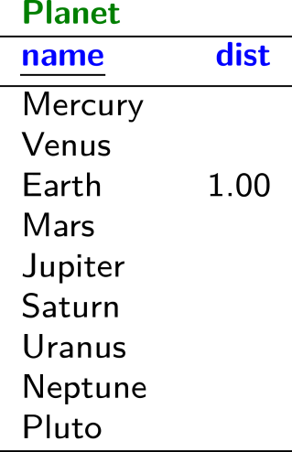
Planets / Relational Data

Slide 22
Planets / Relational Data

Slide 23
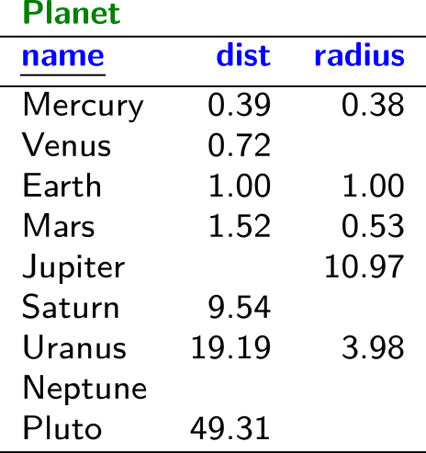
Planets / Relational Data

Slide 24
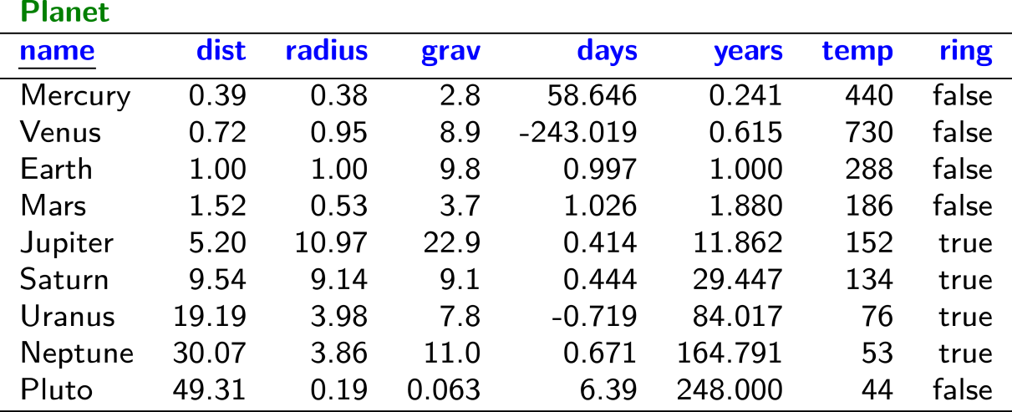
Planets / Relational Data

Slide 25
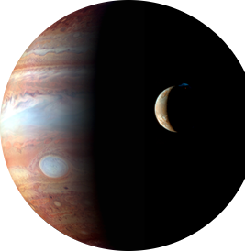
Planets / Relational Data

Slide 26
Planets / Relational Data

Slide 27
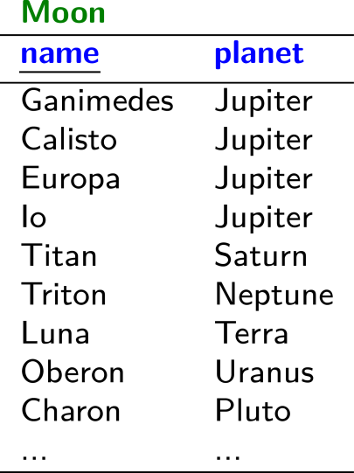
Planets / Relational Data

Slide 28
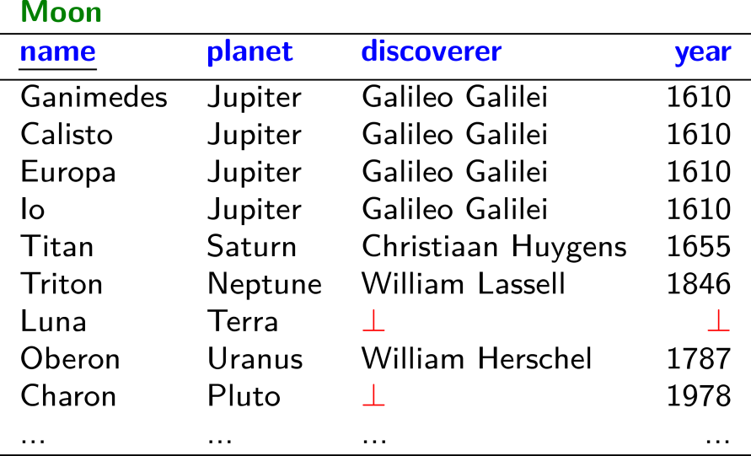
Planets / Relational Data

Slide 29
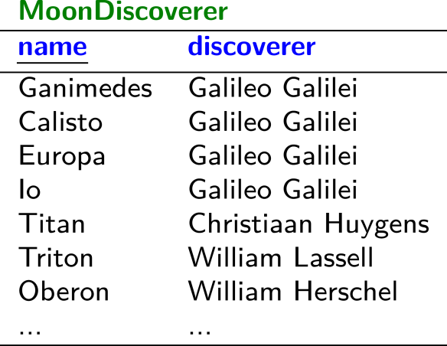
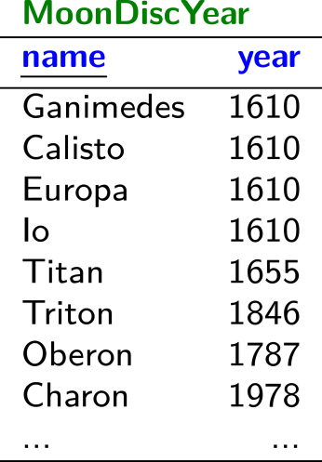
Planets / Relational Data

Slide 30
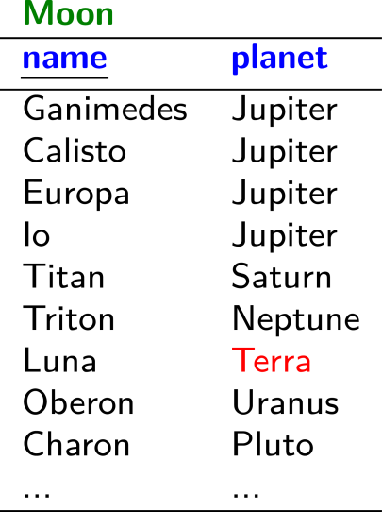
Planets / Relational Data

Slide 31
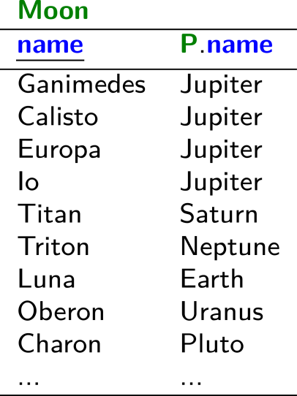
Planets / Relational Data

Slide 32
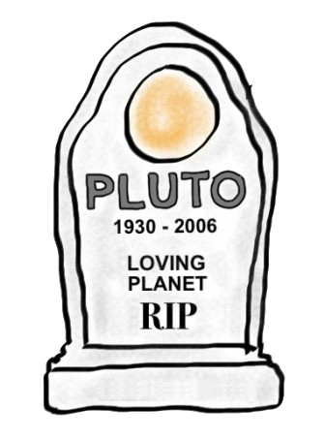
Planets / Relational Data

Slide 33
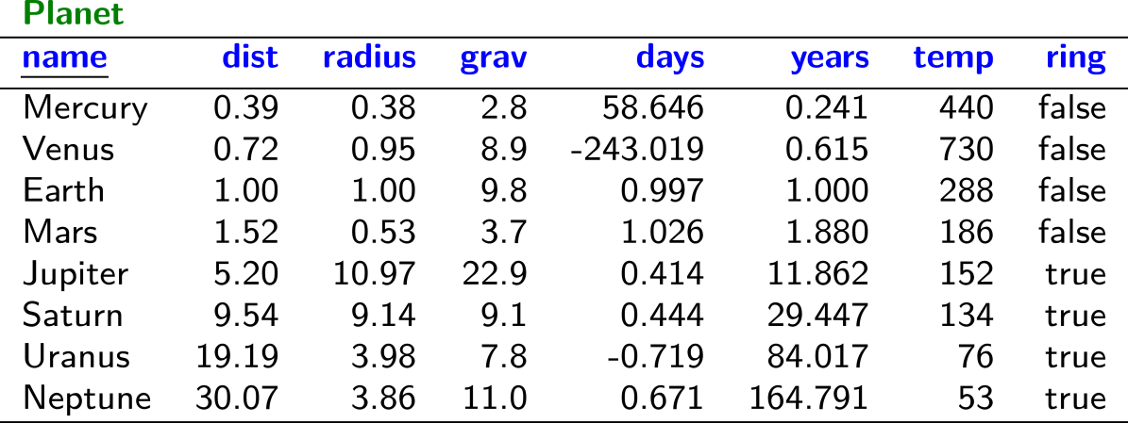
Planets / Relational Data

Slide 34
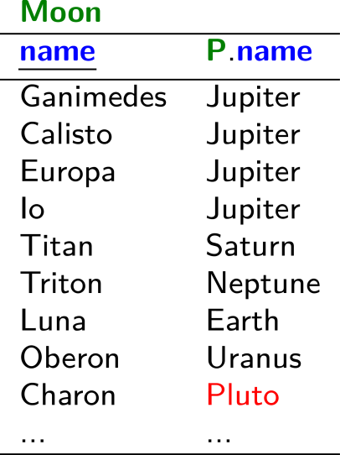
Planets / Relational Data

Slide 35
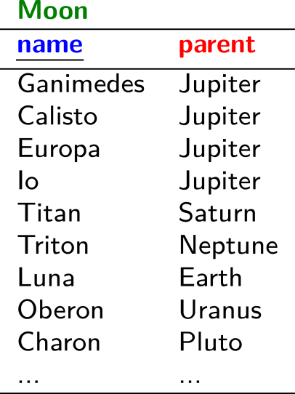
Planets / Relational Data

Slide 36
Planets / Relational Data

Slide 37
Planets / Relational Data
(╯°□°)╯︵ ┻━┻

Slide 38
Planets / Graph Data

Slide 39
Planets / Graph Data

Slide 40
Planets / Graph Data

Slide 41
Planets / Graph Data

Slide 42
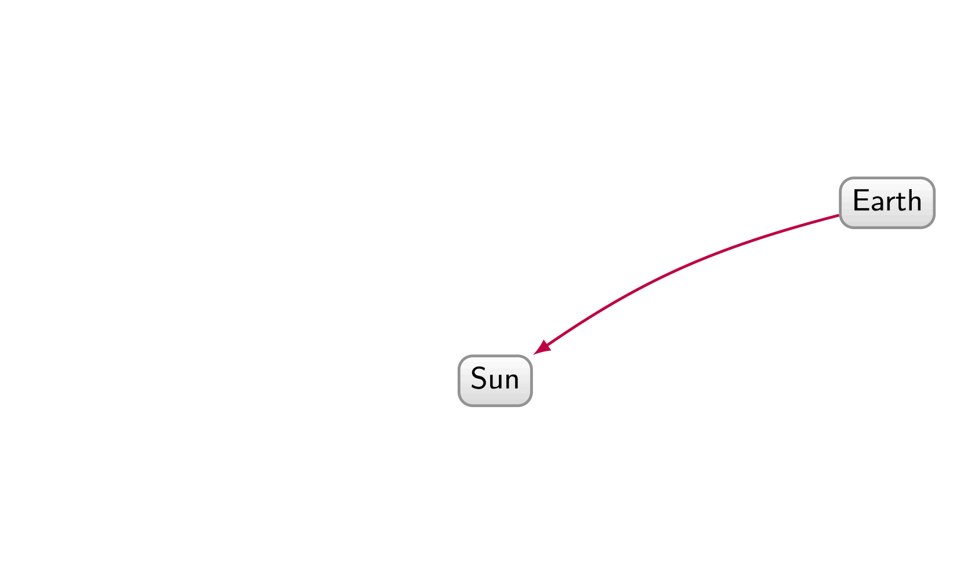
Planets / Graph Data

Slide 43
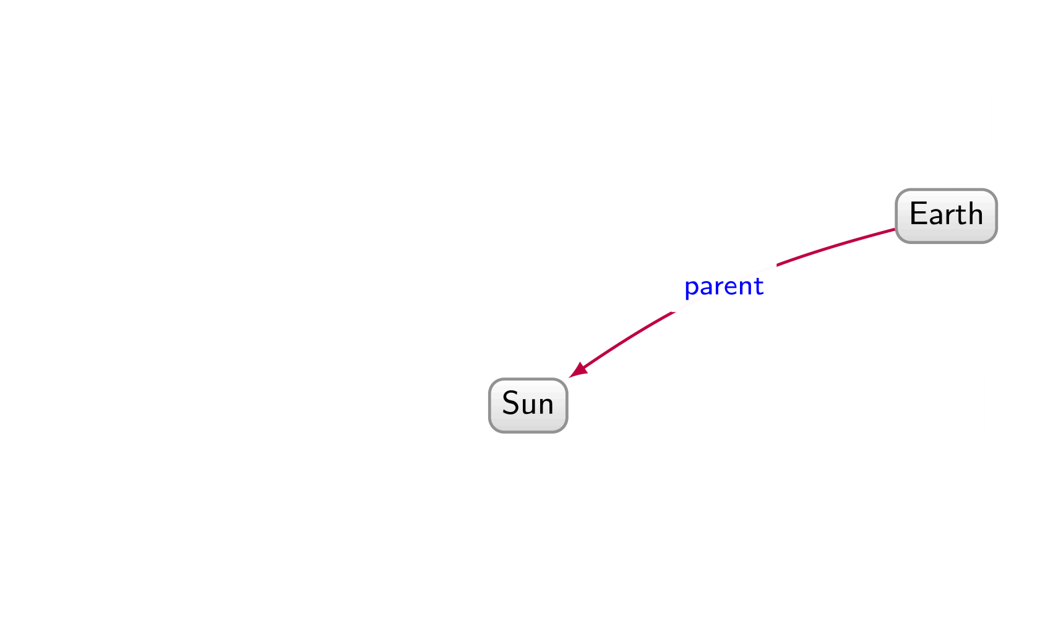
Planets / Graph Data

Slide 44
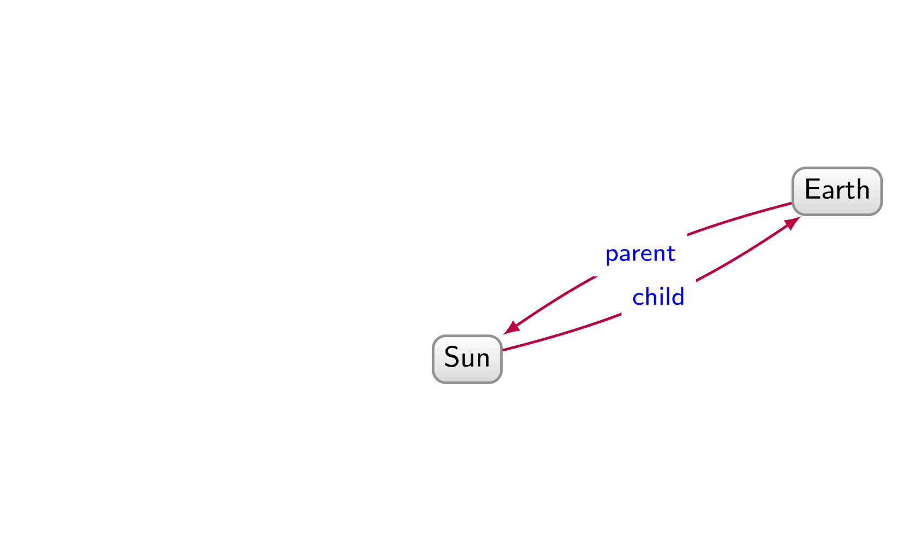
Planets / Graph Data

Slide 45
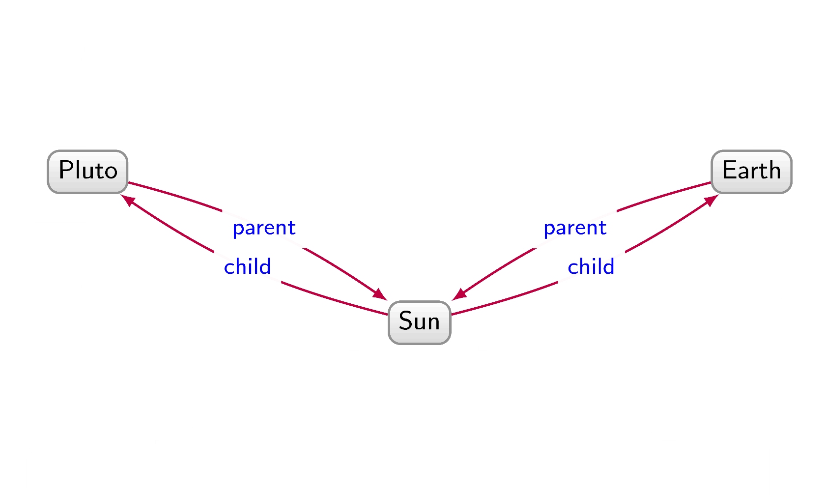
Planets / Graph Data

Slide 46
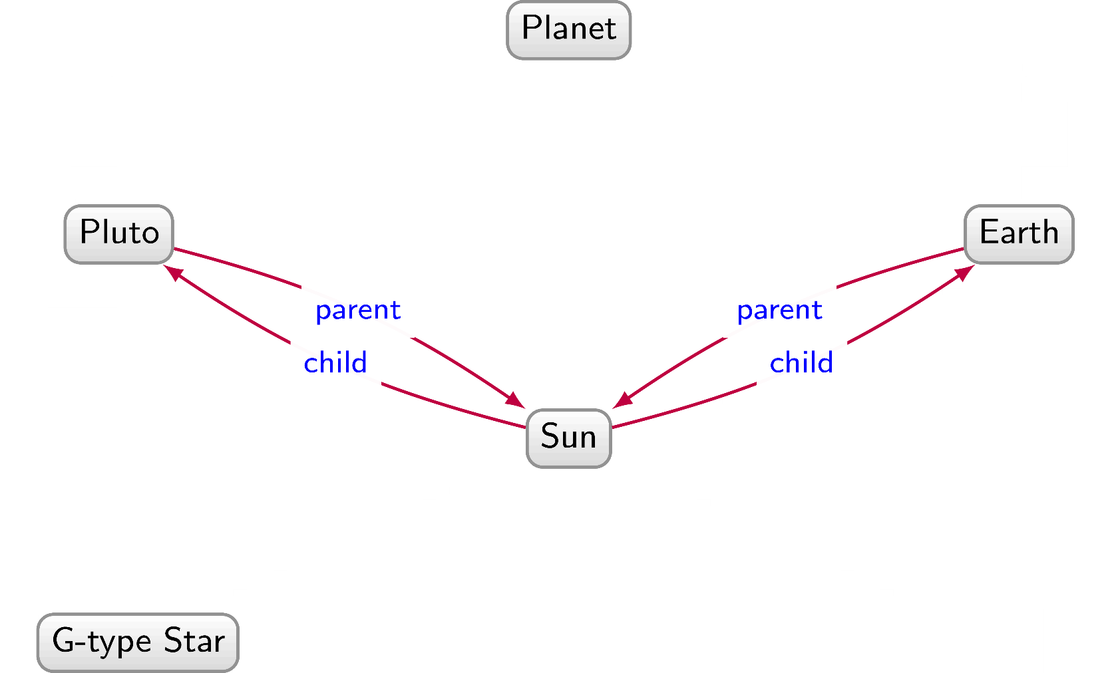
Planets / Graph Data

Slide 47
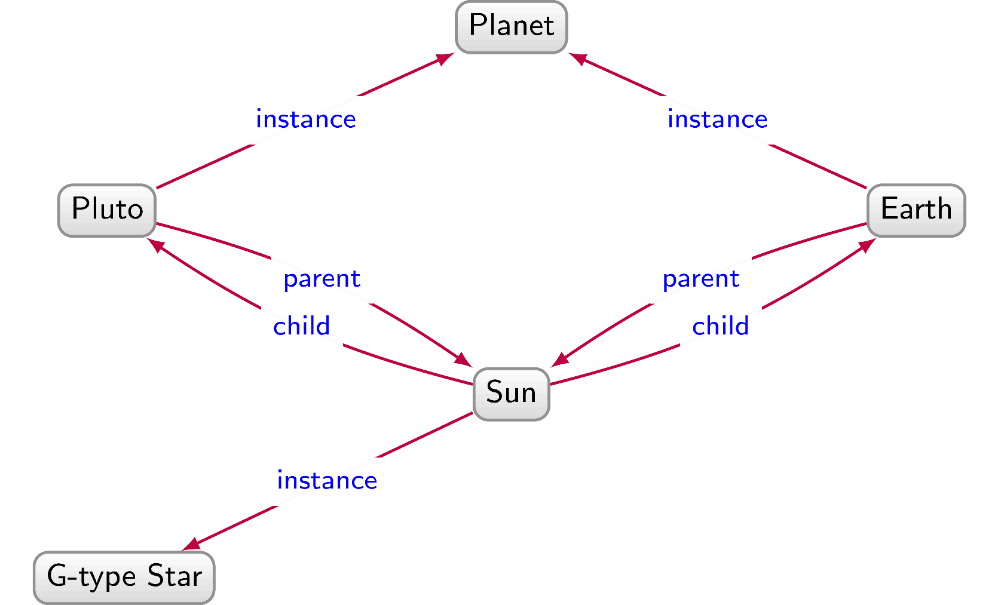
Planets / Graph Data

Slide 48
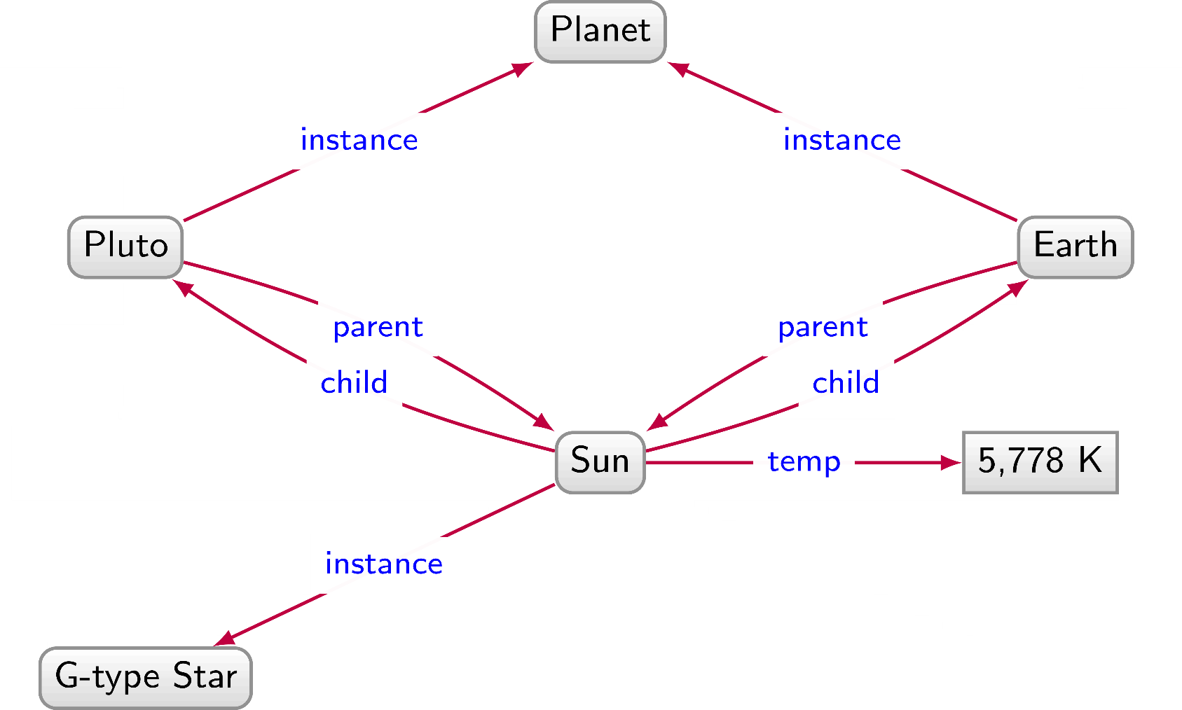
Planets / Graph Data

Slide 49
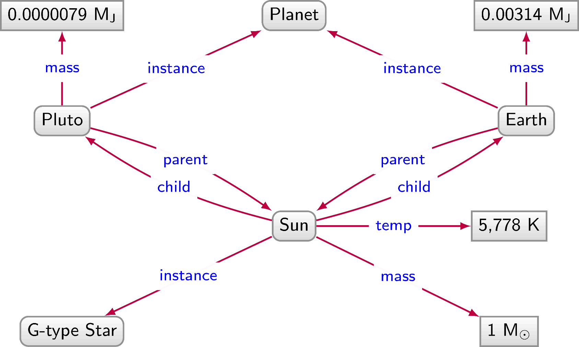
Planets / Graph Data

Slide 50
Planets / Graph Data

Slide 51
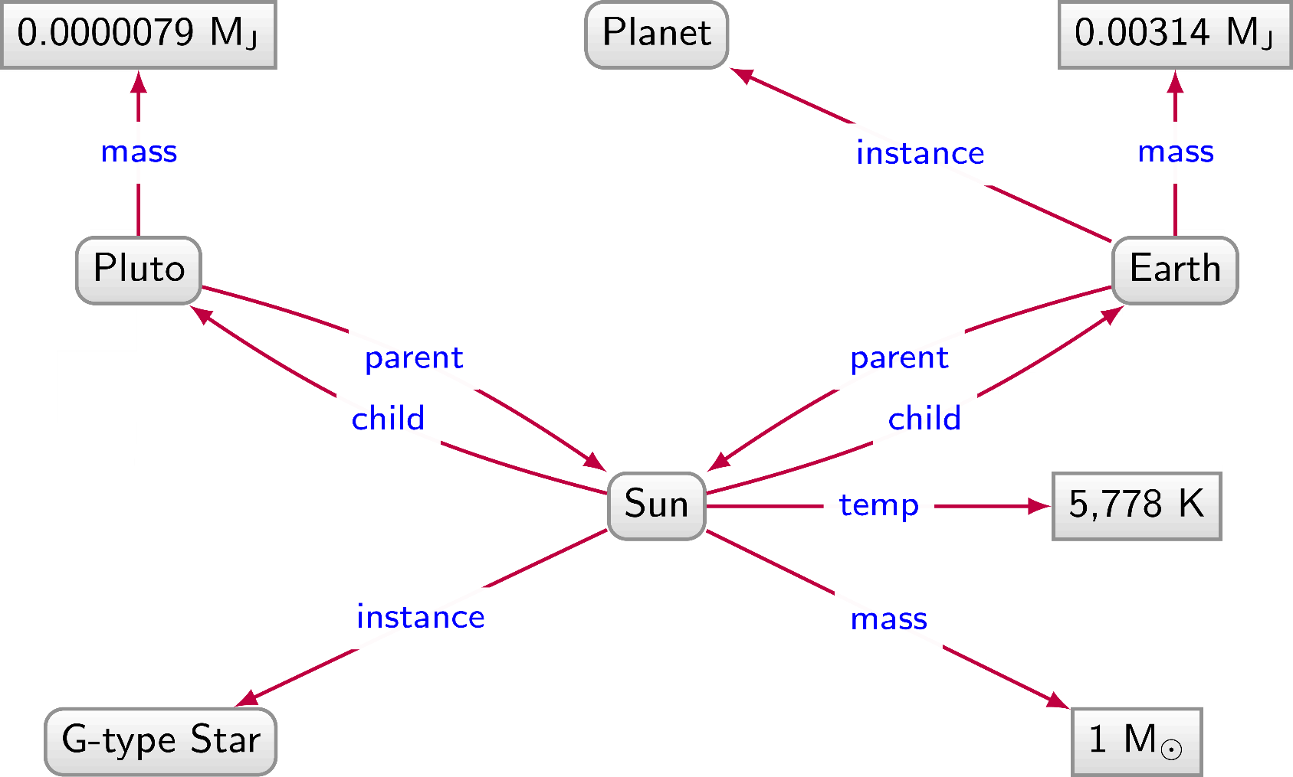
Planets / Graph Data

Slide 52
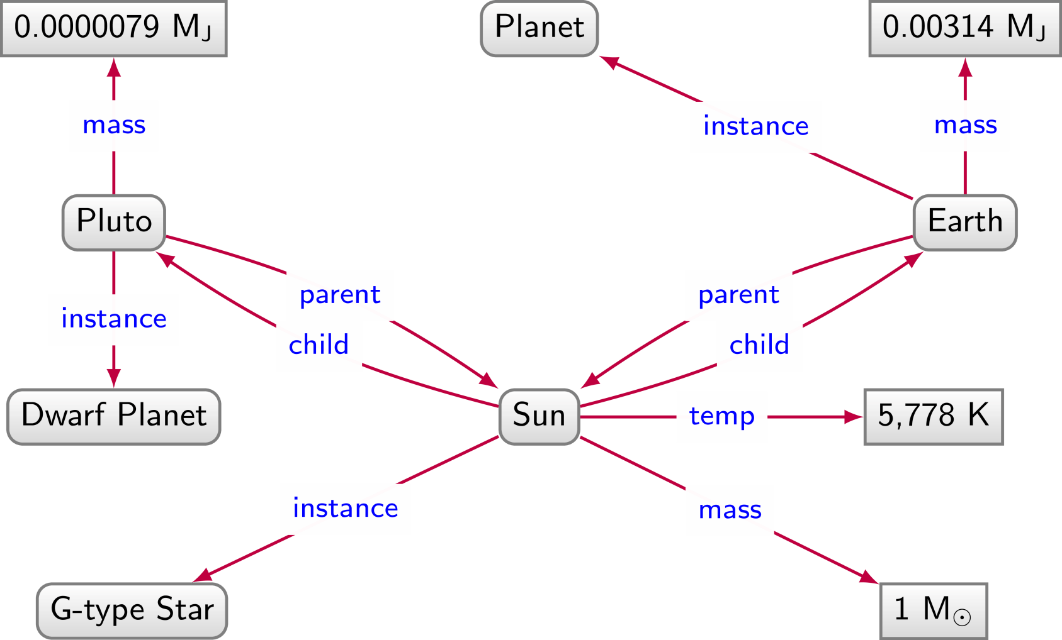
Planets / Graph Data

Slide 53
Planets / Graph Data

Slide 54
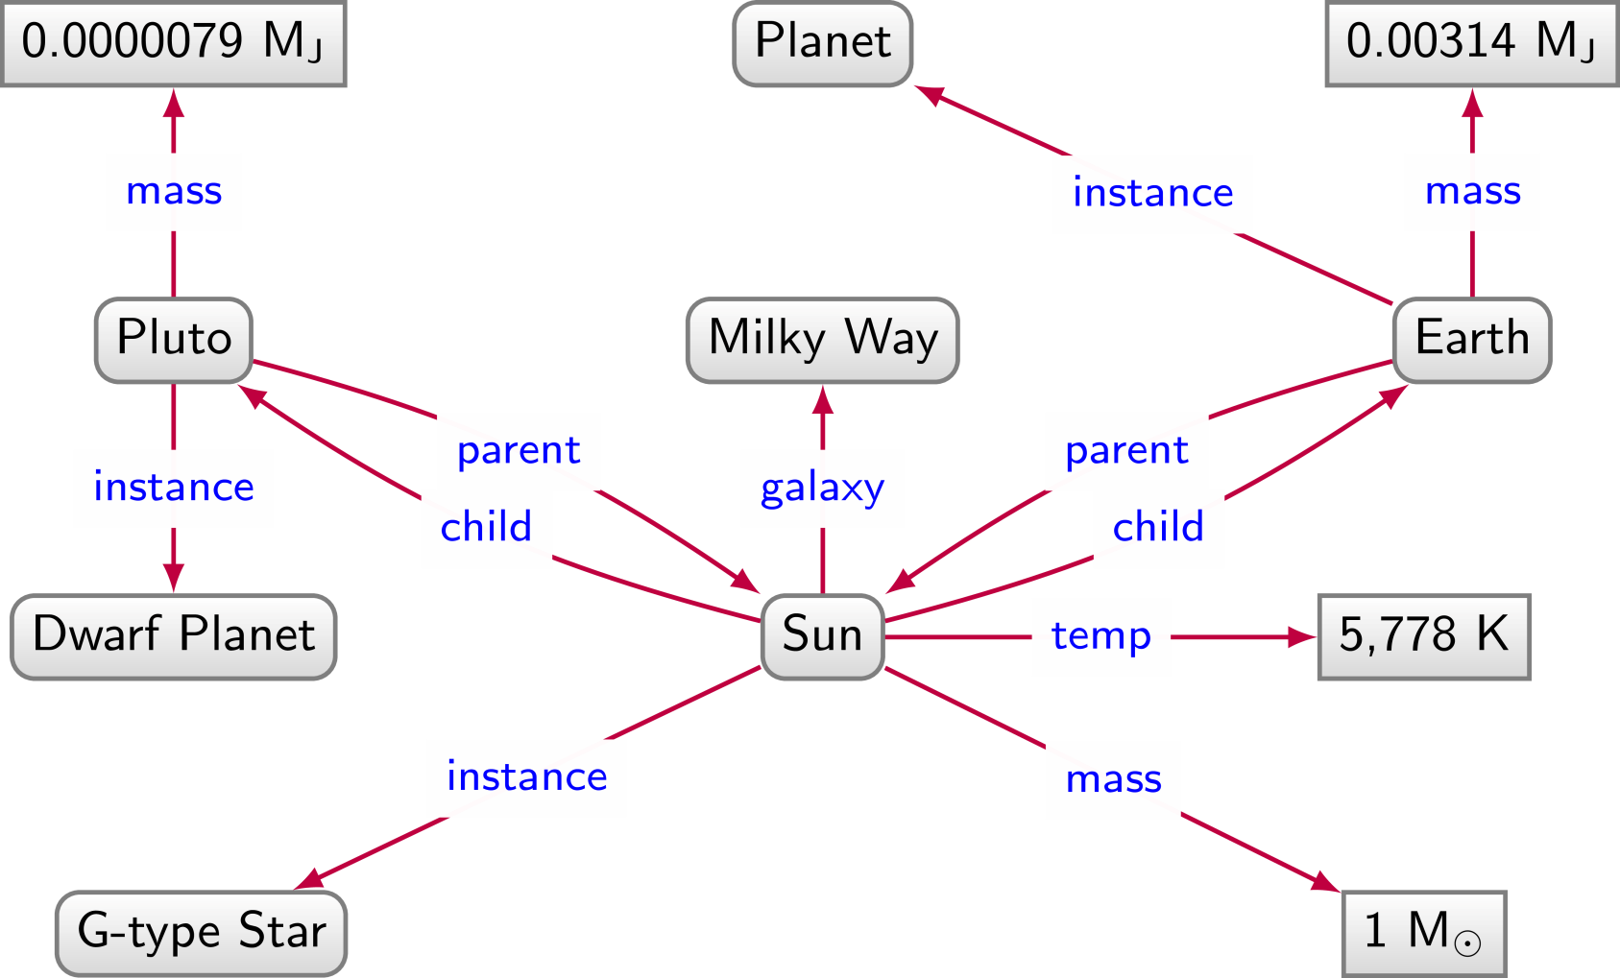
Planets / Graph Data

Slide 55
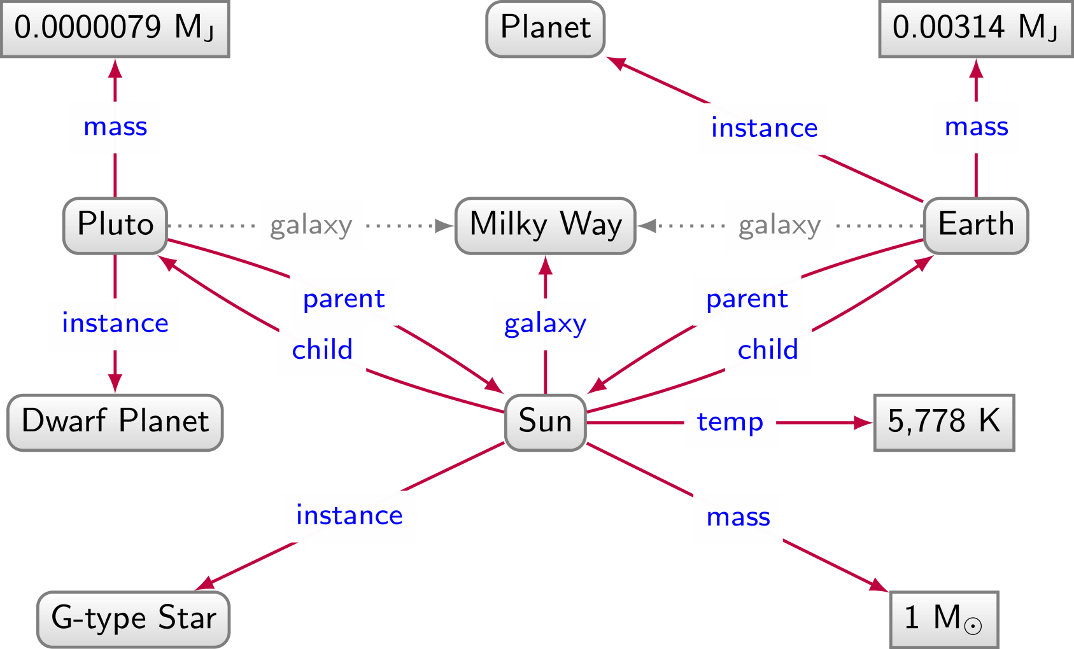
Planets / Graph Data

Slide 56
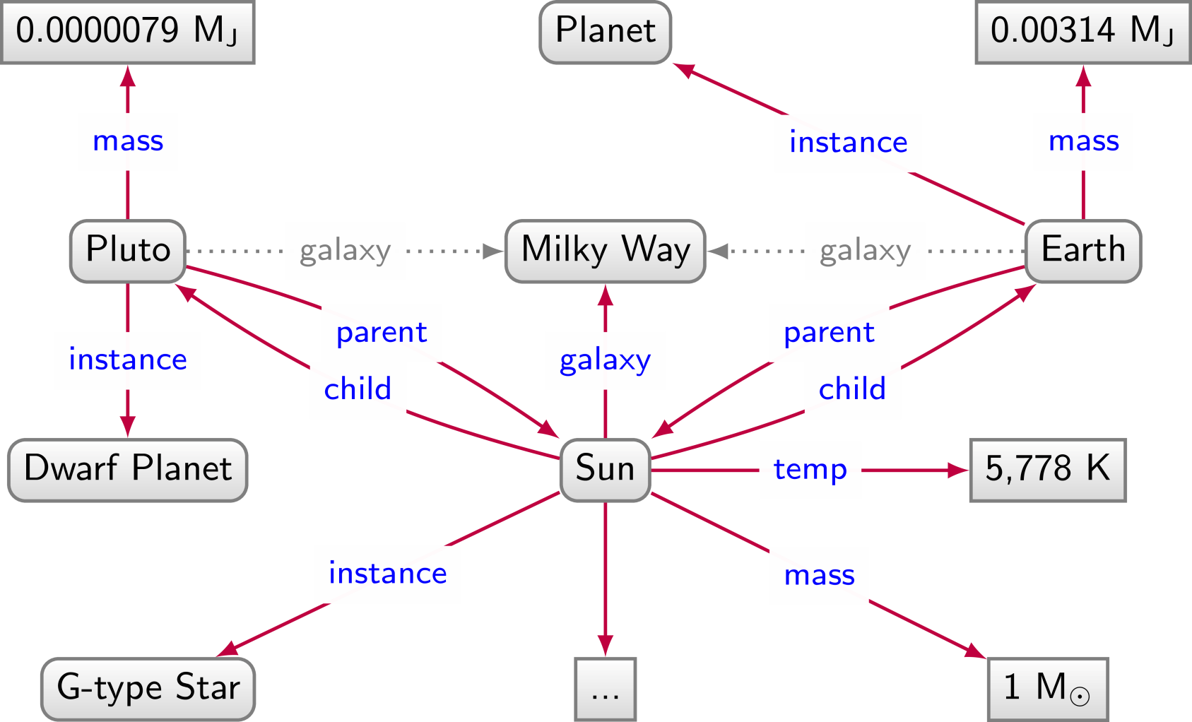
Planets / Graph Data

Slide 57
Relational data: Pros and Cons
We have to impose a
structure (schema)
from the start
We have a
structure (schema) imposed from the start

Slide 58
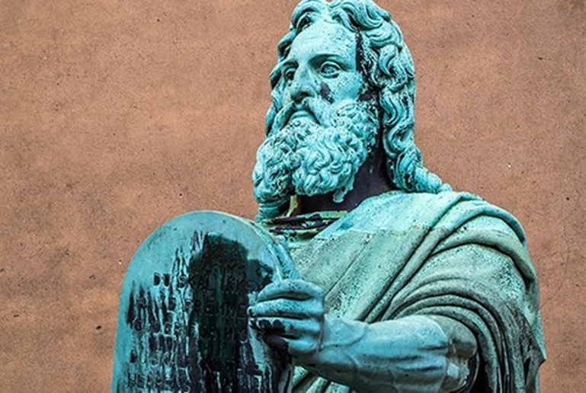

Slide 59
Graph Data: Pros and Cons
We don't have to impose a
structure (schema)
from the start
We don't have a
structure (schema) imposed from the start

Slide 60
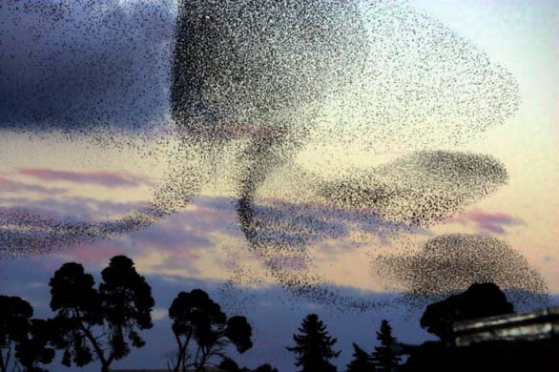

Slide 61
Naming things

Slide 62
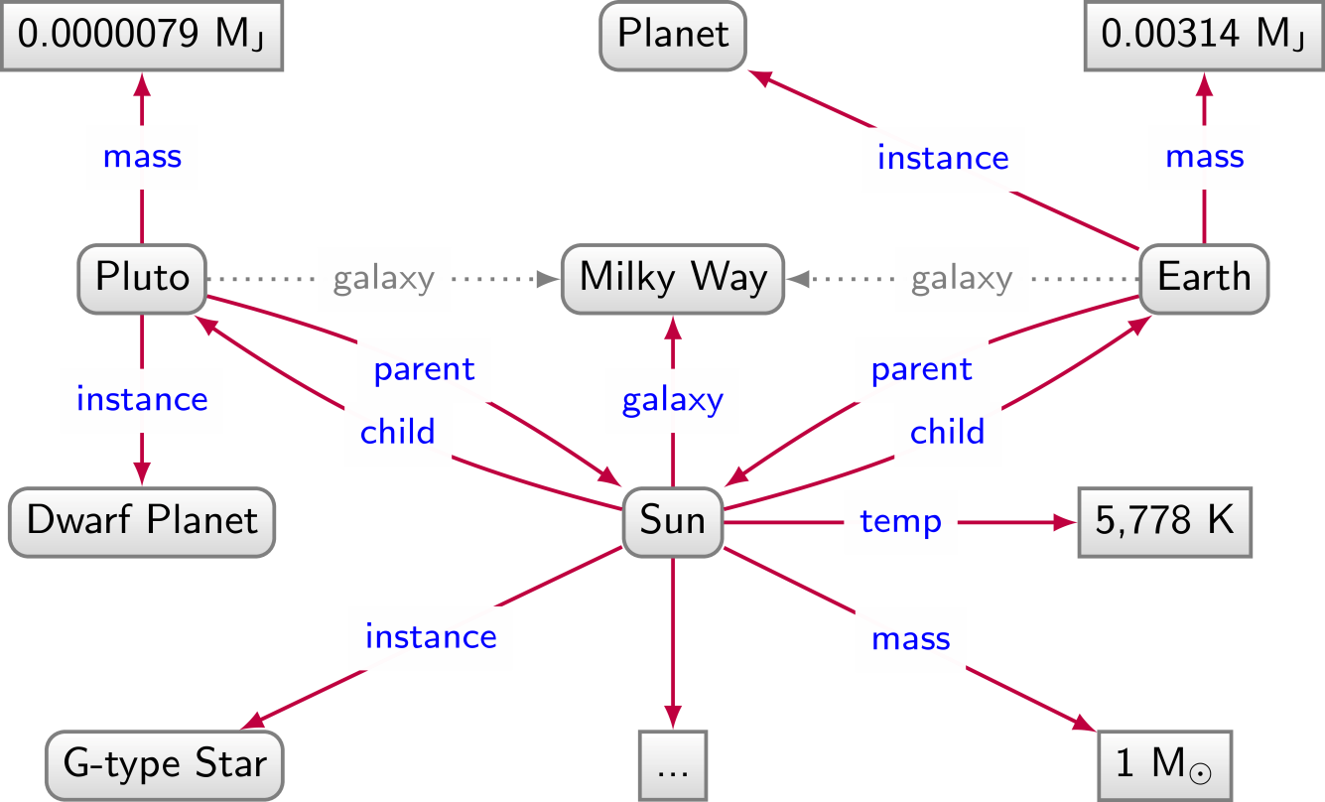
Naming things: Strings not enough

Slide 63
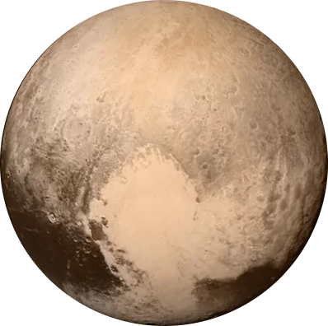
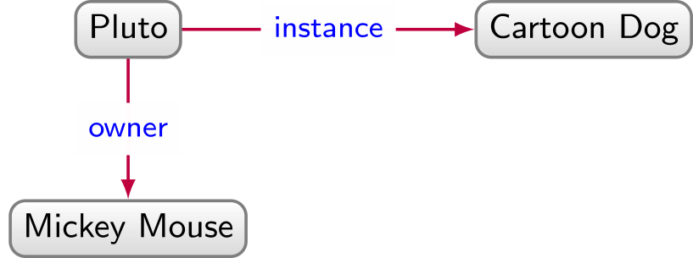
Naming things: Strings not enough

Slide 64
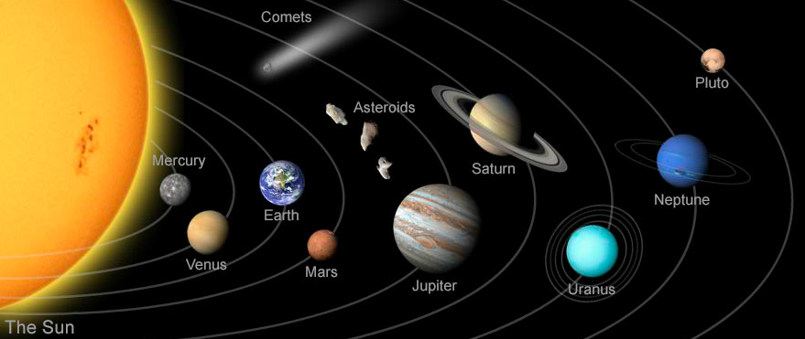
Naming things: Strings not enough

Slide 65
Naming things: Strings not enough

Slide 66
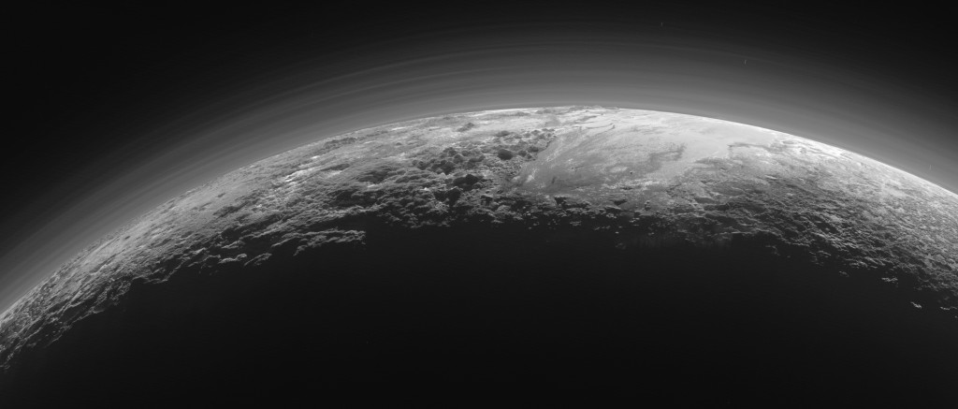
Naming things: Strings not enough

Slide 67
Naming things in RDF: IRIs

Slide 68
Need unambiguous symbols/identifiers
Since we’re on the Web … use Web identifiers
URL: Uniform Resource Location
The location of a resource on the Web
http://ex.org/Dubl%C3%ADn.html
URI: Uniform Resource Identifier (RDF 1.0)
Need not be a location, can also be a name
http://ex.org/Dubl%C3%ADn
IRI: Internationalised Resource Identifier (RDF 1.1)
A URI that allows Unicode characters
http://ex.org/Dublín

Slide 69
We will use IRIs with prefixes
http://ex.org/Dublín ↔ ex:Dublín
“ex:” denotes a prefix for http://ex.org/
“Dublín” is the local name
Frequently used prefixes:

Slide 70
From strings …

Slide 71
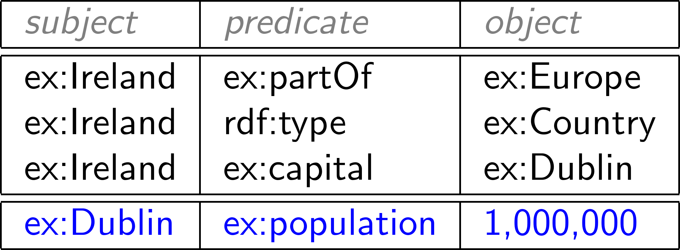
… to IRIs …

Slide 72
Naming things in RDF: Literals

Slide 73
What about numbers?
Should we assign IRIs to numbers, booleans, etc.?

Slide 74
RDF allows “literals” in object position
Literals are for datatype values, like strings, numbers, booleans, dates, times
Only allowed in object position

Slide 75
Datatype literals
"[lexical-string]"^^[datatype-IRI]
"200"^^xsd:int
"2014-12-13"^^xsd:date
"true"^^xsd:boolean
"this is a string"^^xsd:string
If the datatype is omitted, it’s a string
"this is a string"
"200" is a string, not a number!

Slide 76
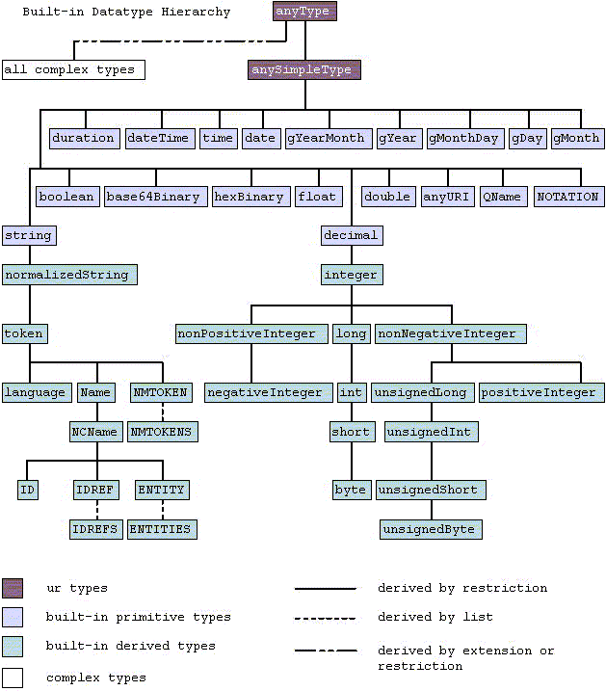
Many datatypes borrowed from XML Schema

Slide 77
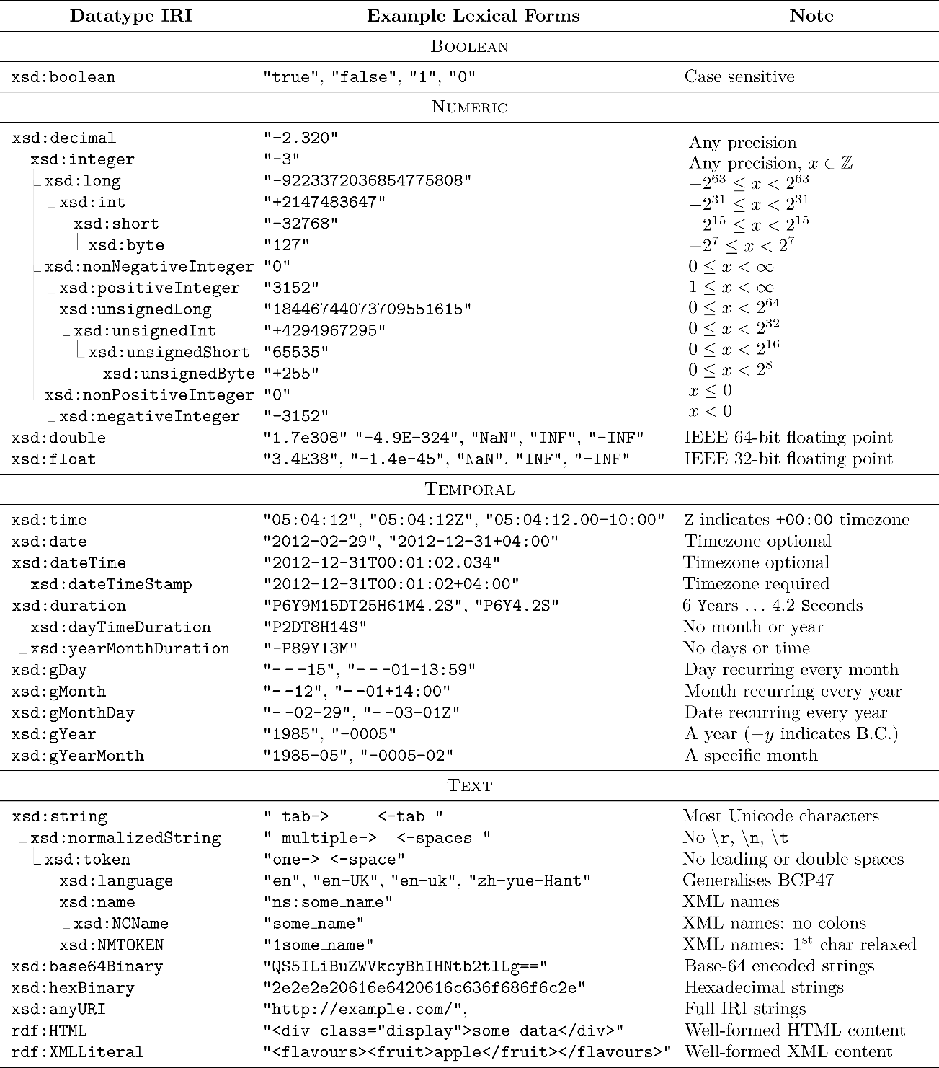

Slide 78
Boolean datatype

Slide 79
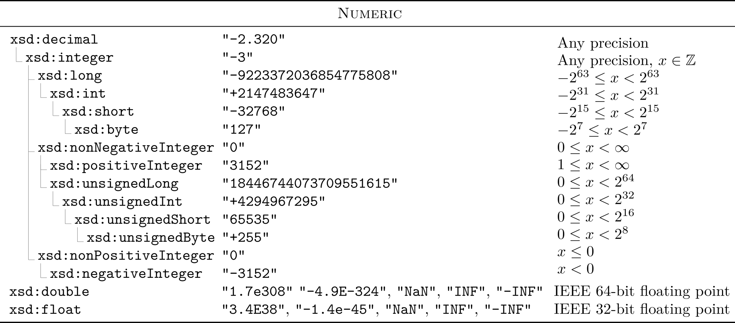
Numeric datatypes

Slide 80
Temporal datatypes

Slide 81
Text/string datatypes

Slide 82
Language-Tagged Strings
Specify that a string is in a given language
"string"@lang-tag
No datatype!

Slide 83
(Not) Naming Things in RDF: Blank Nodes

Slide 84
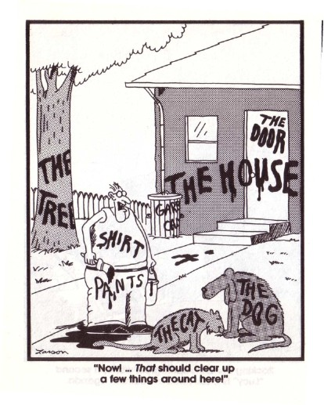
Having to name everything is hard work

Slide 85
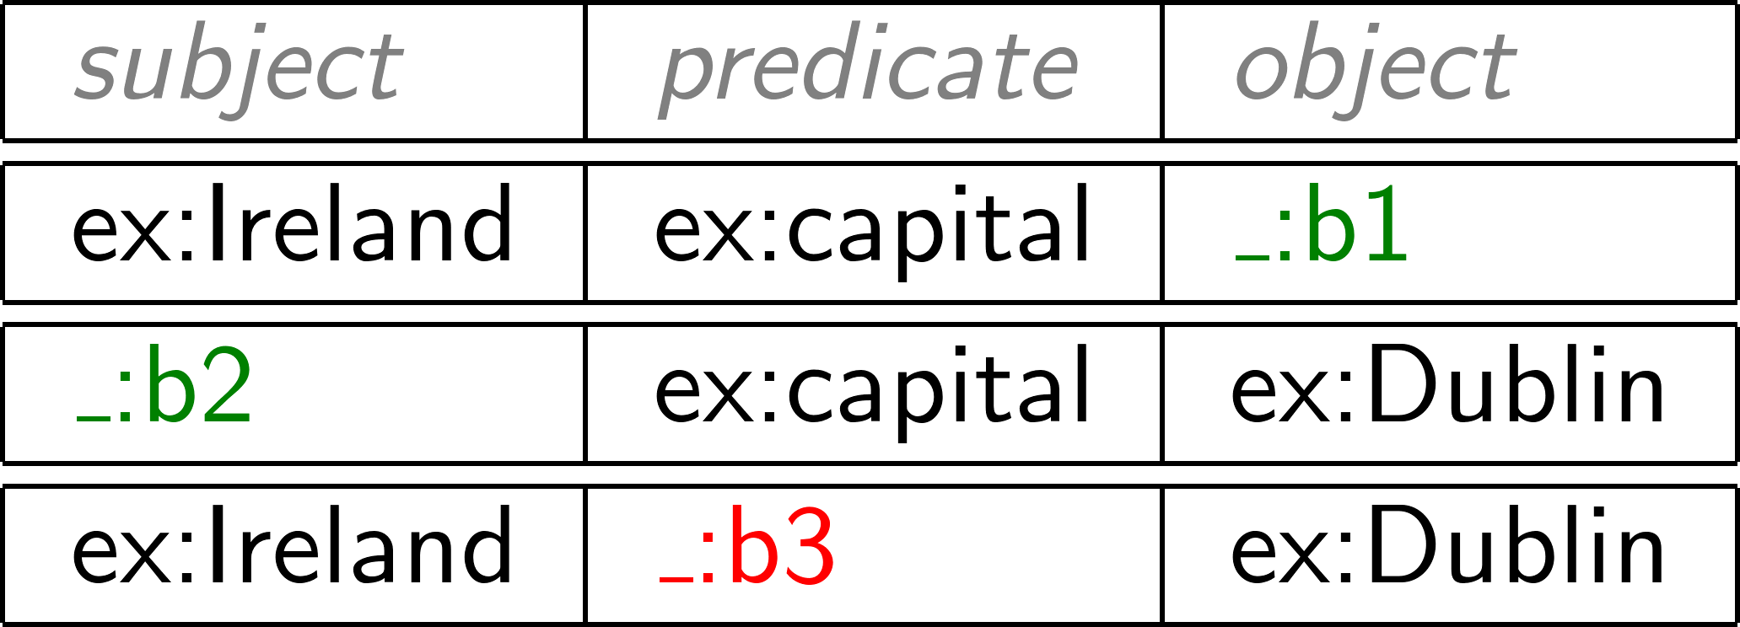
For this reason, RDF gives blank nodes
Syntax: _:blankNode
Represents existence of something
Often used to avoid giving an IRI (e.g., shortcuts)
Can only appear in subject or object position
(More later)

Slide 86
RDF Terms: summary

Slide 87
A Summary of RDF Terms
IRIs (Internationalised Resource Identifiers)
Used to name generic things
Literals
Used to refer to datatype values
Strings may have a language tag
Blank Nodes
Used to avoid naming things
A little mysterious right now

Slide 88
Modelling data in RDF

Slide 89
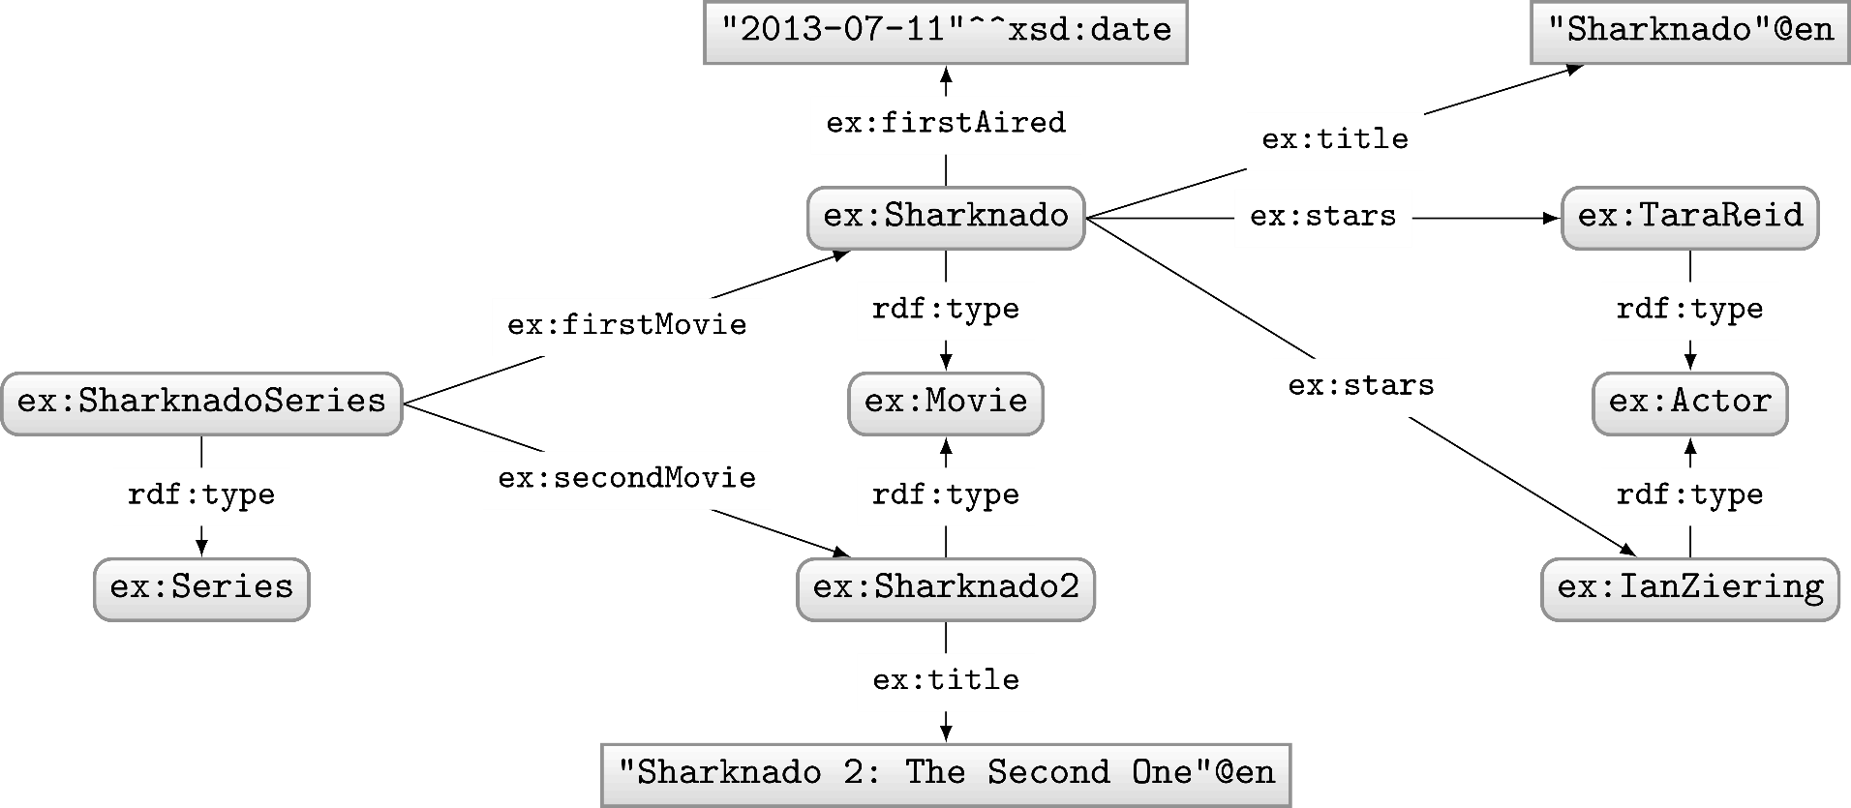
Let’s model something in RDF …
Model the following in RDF:
“Sharknado is the first movie of the Sharknado series. It first aired on July 11, 2013. The movie stars Tara Reid and Ian Ziering. The movie was followed by another called ‘Sharknado 2: The Second One’.”

Slide 90
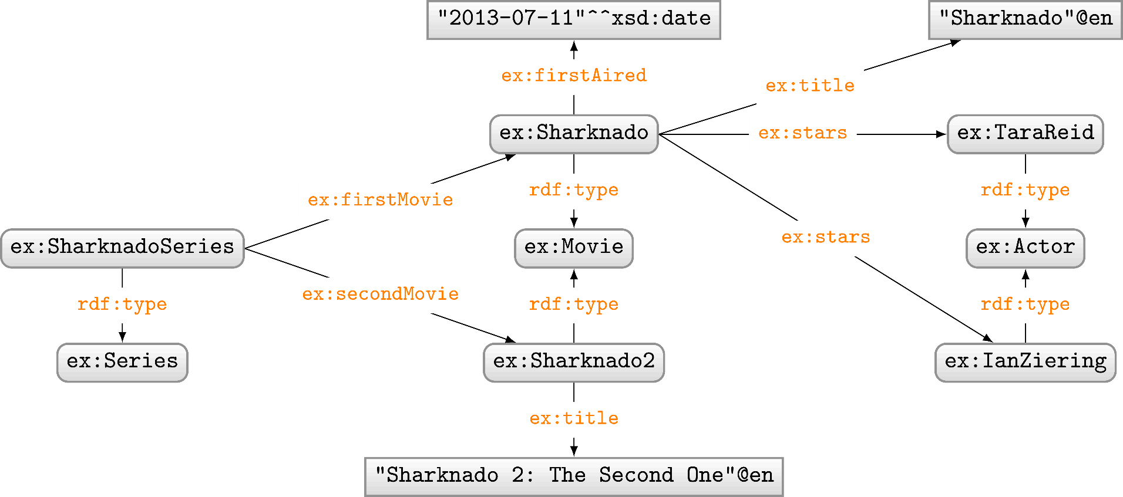
RDF Properties
RDF Terms used as predicate
rdf:type, ex:firstMovie, ex:stars, …

Slide 91
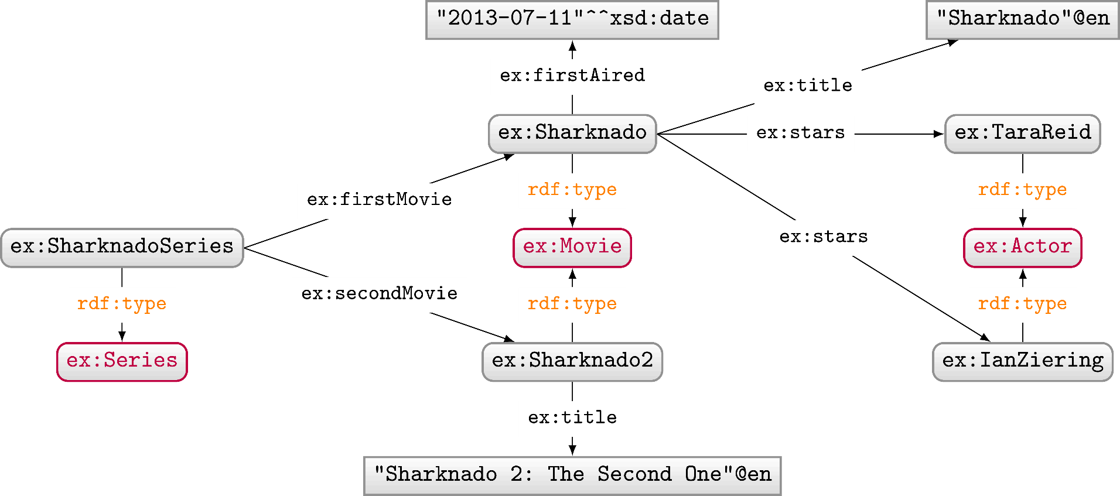
RDF Classes
Used to conceptually group resources
ex:Movie, ex:Actor, ex:Series, etc.
Uses property rdf:type to type a resource

Slide 92
Modelling in RDF not always so simple
Model the following in RDF:
“Sharknado stars Tara Reid in the role of ‘April Wexler’."

Slide 93
Modelling in RDF not always so simple
Model the following in RDF:
“'Batman Returns' stars Michael Keaton in the role of 'Batman'."

Slide 94
Modelling in RDF not always so simple
Model the following in RDF:
"'Batman Returns' stars Michael Keaton in the role of 'Batman'."
"'Batman Begins' stars Christian Bale in the role of 'Batman'."
Problem?

Slide 95
Modelling in RDF not always so simple
Model the following in RDF:
"'Batman Returns' stars Michael Keaton in the role of 'Batman'."
"'Batman Begins' stars Christian Bale in the role of 'Batman'."
Problem?

Slide 96
Modelling in RDF not always so simple
Model the following in RDF:
"'Batman Returns' stars Michael Keaton in the role of 'Batman'."
"'Batman Begins' stars Christian Bale in the role of 'Batman'."
Problem?

Slide 97
Modelling in RDF not always so simple
Model the following in RDF:
"'Batman Returns' stars Michael Keaton in the role of 'Batman'."
"'Batman Begins' stars Christian Bale in the role of 'Batman'."
"'Batman Returns' stars Christian Bale in the role of 'Robin'."*
"'Batman Begins' stars Michael Keaton in the role of 'Robin'."*
* hypothetical ☺
Who played which character in which movie?

Slide 98
Modelling n-Ary Relations
Model the following in RDF:
"'Batman Returns' stars Michael Keaton in the role of 'Batman'."
"'Batman Begins' stars Christian Bale in the role of 'Batman'."

Slide 99
Modelling in RDF not always so simple
Model the following in RDF:
"The first movie in the Sharknado series is ‘Sharknado’.
The second movie is ‘Sharknado 2: The Second One’.
The third movie is ‘Sharknado 3: Oh Hell No!’."
More general way to represent lists as a graph?

Slide 100
RDF Collections: Model Ordered Lists
Standard way to model (linked) lists in RDF
Use rdf:rest to link to rest of list
Use rdf:first to link to current member
Use rdf:nil to end the list

Slide 101
RDF Collections: Generic Modelling
Not just for Sharknado series

Slide 102
RDF Collections: Generic Modelling
Which modelling is better?
If the order of ingredients matters, the collection above is needed.*
Otherwise, the graph below is much simpler (and better).
* Sometimes collections are used for unordered elements to indicate a closed set, but this is not something recommended in general.

Slide 103
Blank nodes add complexity

Slide 104
Blank nodes are local identifiers
How should we combine these two RDF graphs?

Slide 105
Blank nodes are local identifiers
How should we combine these two RDF graphs?

Slide 106
Blank nodes names aren’t important …
(Isomorphic)

Slide 107
Blank nodes names aren’t important …
(Not Isomorphic!)

Slide 108
Are two RDF graphs the “same”?

Slide 109
Are two RDF graphs the “same”?

Slide 110
Are two RDF graphs the “same”?

Slide 111
Are two RDF graphs the “same”?

Slide 112
RDF Syntaxes: Writing RDF down

Slide 113
N-Triples
Line delimited format
No shortcuts

Slide 114
RDF/XML
Legacy format
Difficult to read

Slide 115
RDFa
Embed RDF into HTML
Not so intuitive

Slide 116
JSON-LD
Embed RDF into HTML
Not completely RDF

Slide 117
Turtle
Readable format

Slide 118
Turtle: Collections Shortcut

Slide 119
RDF …

Slide 120
Semantic Web: Data

Slide 121
Broadly adopted
RDF(ish)
https://w3techs.com/technologies/overview/structured_data

Slide 122
Open Graph (RDFa)

Slide 123
Open Graph (RDFa)
https://www.ted.com/talks/gary_marcus_the_urgent_risks_of_runaway_ai_and_what_to_do_about_them

Slide 124
Twitter Cards (RDFa-ish)

Slide 125
Twitter Cards (RDFa-ish)
https://www.triathlon.org/news/article/first_olympic_spots_up_for_grabs_on_the_paris_test_event

Slide 126
JSON-LD (Schema.org)

Slide 127
JSON-LD (Schema.org)
https://www.imdb.com/title/tt2724064/

Slide 128
Questions?

