Slide 1
CC7220-1 La Web de Datos Primavera 2023 Lecture 1: Introduction
Aidan Hogan
aidhog@gmail.com

Slide 2
The Web

Slide 3
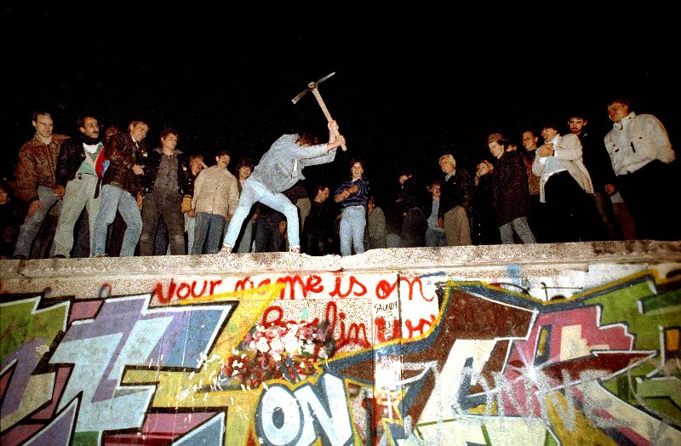
The Web is now 3 decades old

Slide 4
The future of the Web?
What will the Web be like in 3 decades time?

Slide 5
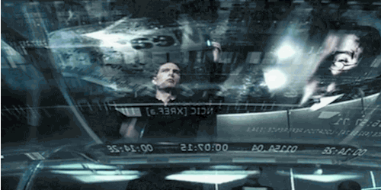
The future of the Web?
What will the Web be like in 3 decades time?

Slide 6
The Semantic Web?

Slide 7
Semantic Web?
semantic web

Slide 8
Semantic Web?
“The Semantic Web will bring structure to the meaningful content of Web pages, creating an environment where software agents roaming from page to page can readily carry out sophisticated tasks for users.”
─ Berners-Lee et al. (2001) “The Semantic Web”
Sci. American. 284(5):34–43.
Consider answering: “What is the Web?”

Slide 9
What’s wrong with the current Web?

Slide 10
The current Web is great!

Slide 11
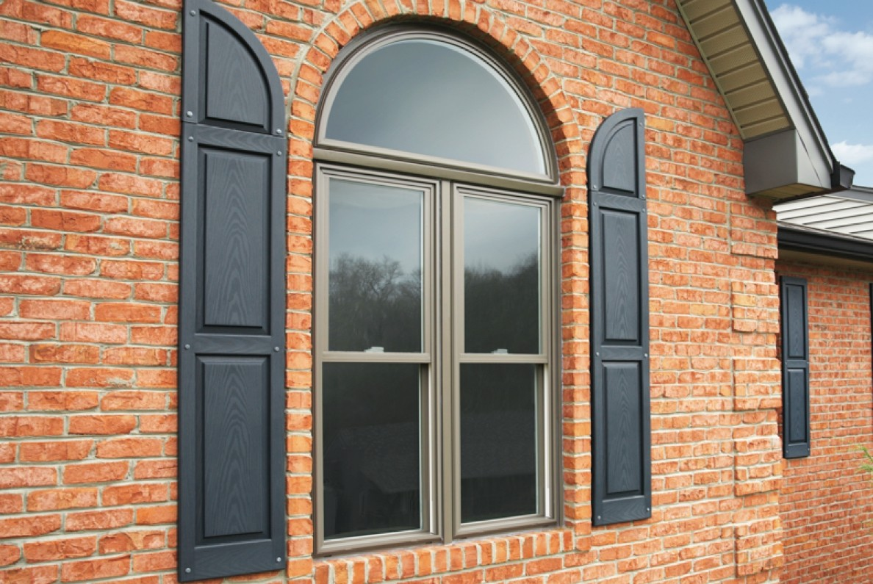
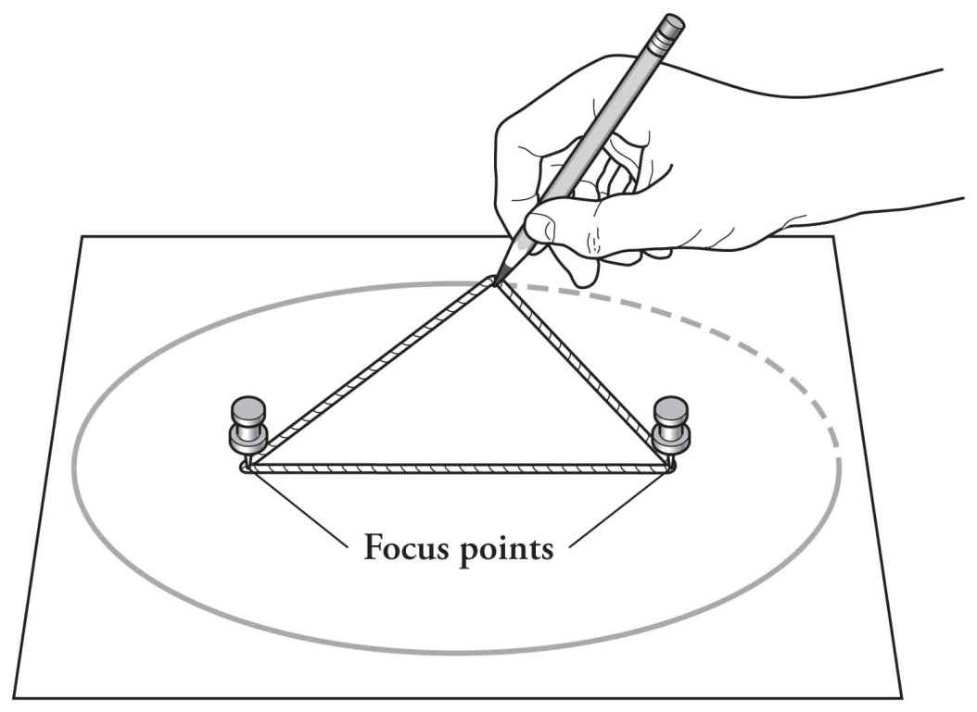
The current Web is great!

Slide 12
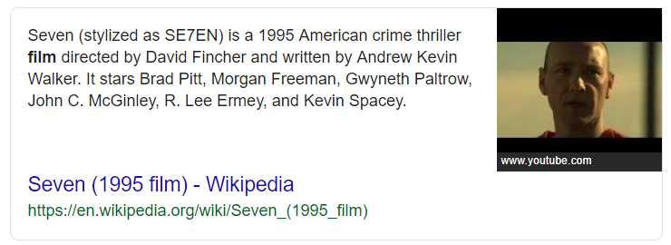
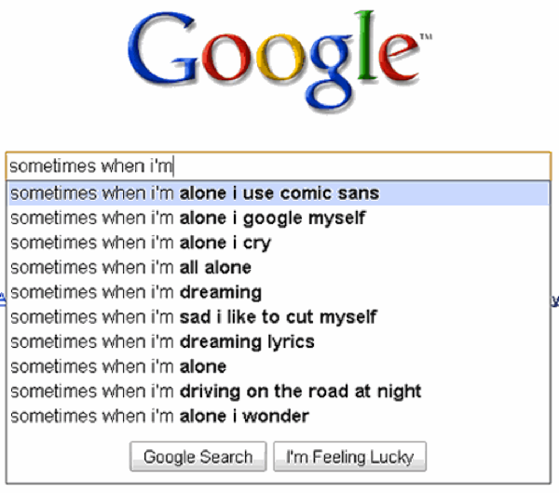
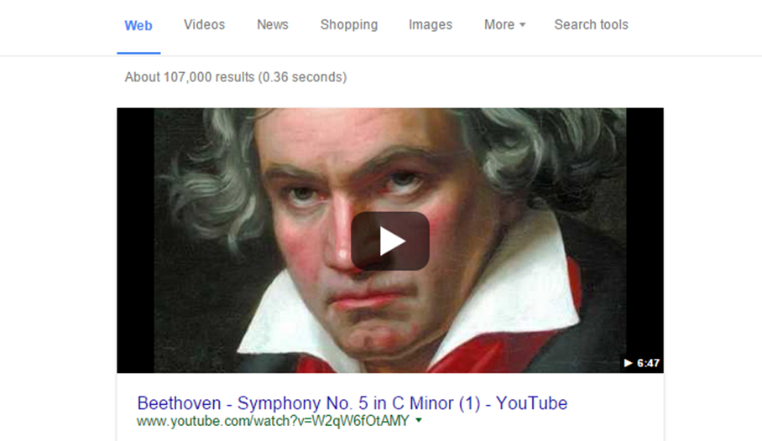
Google is also pretty great

Slide 13
Problem with the current Web: Literature veterans

Slide 14
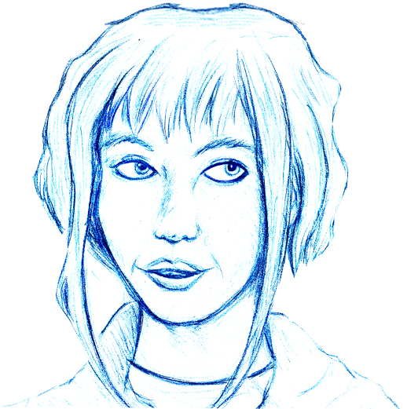
Doing a report for university …
Wants to find all:
Nobel Prize winners in Literature
Who fought in at least one war
The year they won the prize
And the year the war(s) started
… how would you solve this?

Slide 15
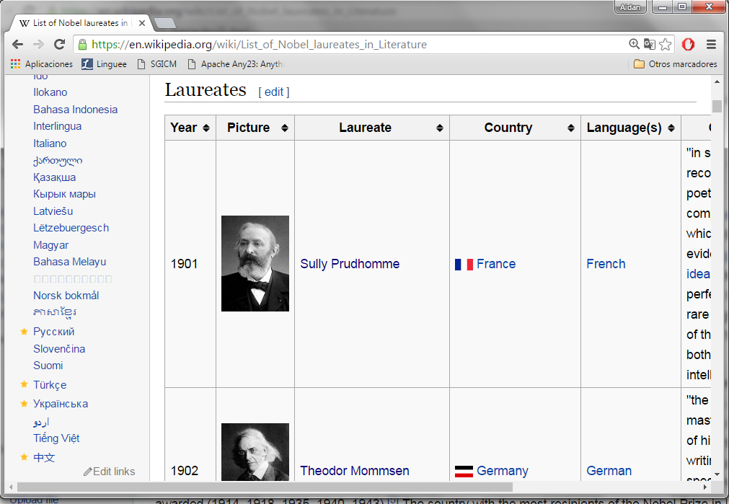
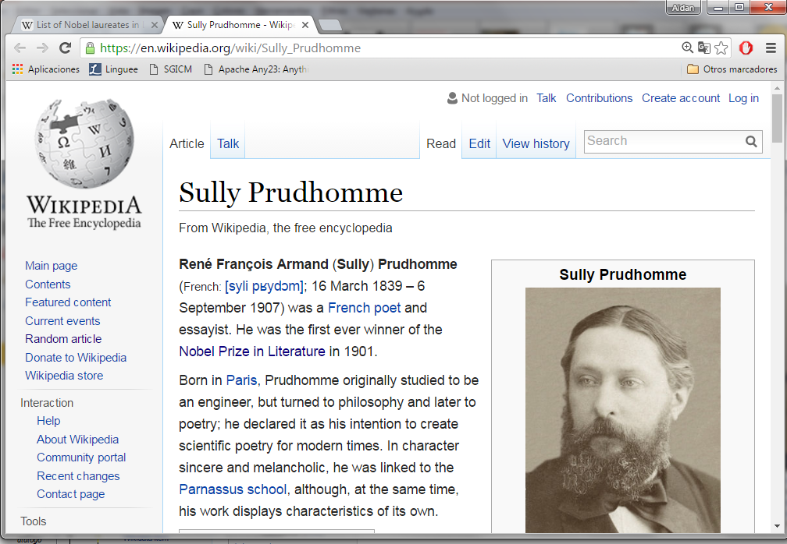
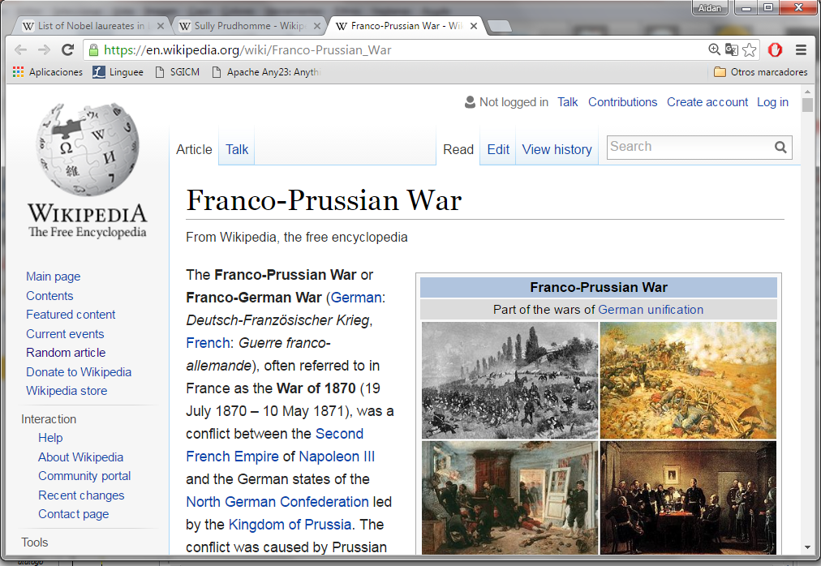
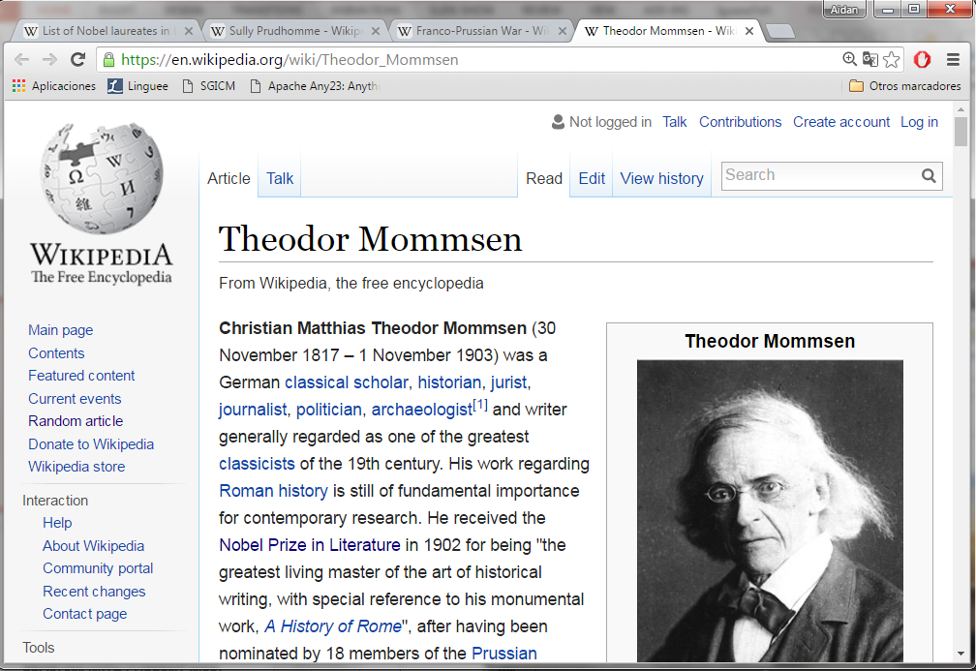
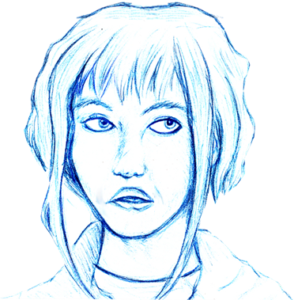
Lots of Wikipedia Tabs …
…

Slide 16
The Laureate Algorithm (3 decades on)
results := ∅
for all nobel-lit-winner in wiki-list
year-prize := year of nobel-lit-winner
wars := search “war”, “conflict”, “battle” in nobel-lit-winner
for all war in wars
year-war := starting year of war
add nobel-lit-winner, year-prize, war, year-war to results
end
end
return results

Slide 17
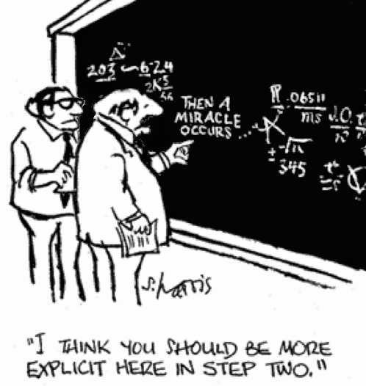
The Laureate Algorithm (6 decades on?)
nobel-lit-winner-and-wars := magical-sem-web-results()
return nobel-lit-winner-and-wars

Slide 18
Doing a report for university …
Wants to find all:
Nobel Prize winners in Literature
Who fought in at least one war
The year they won the prize
And the year the war(s) started
… why is this query hard on the current Web?

Slide 19
Aside: ChatGPT?

Slide 20
Problem with the current Web: Desserts

Slide 21
Going to dinner party …
Looking for a recipe:
Must be a dessert
Must be citrus-free
Ingredients available in local supermarket(s)
Cheap (student)
Must be delicious

Slide 22
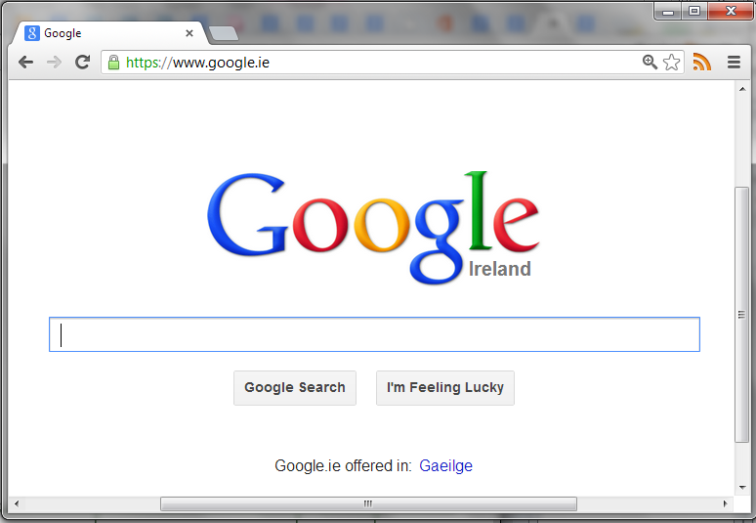
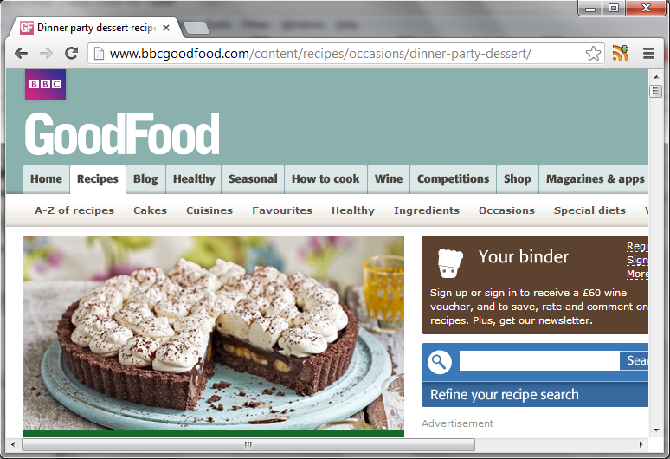
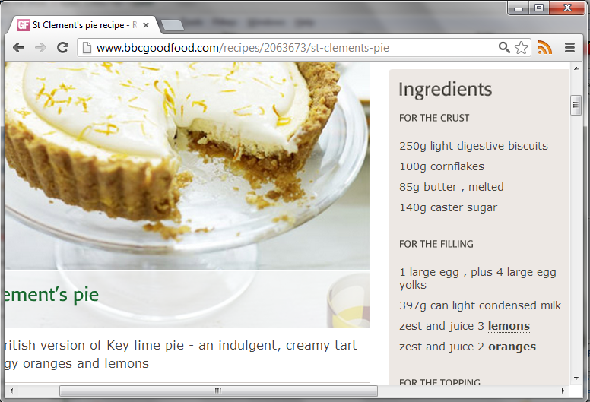
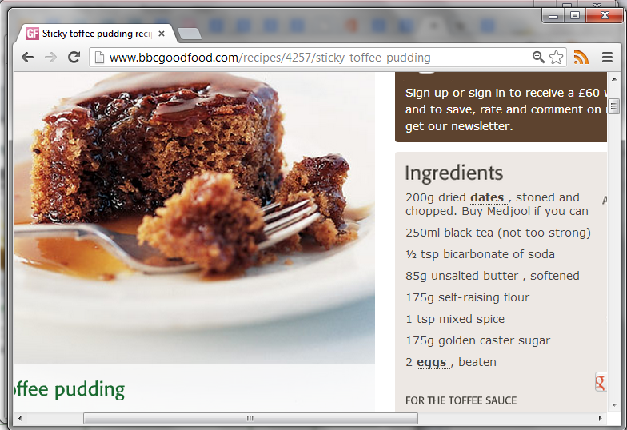
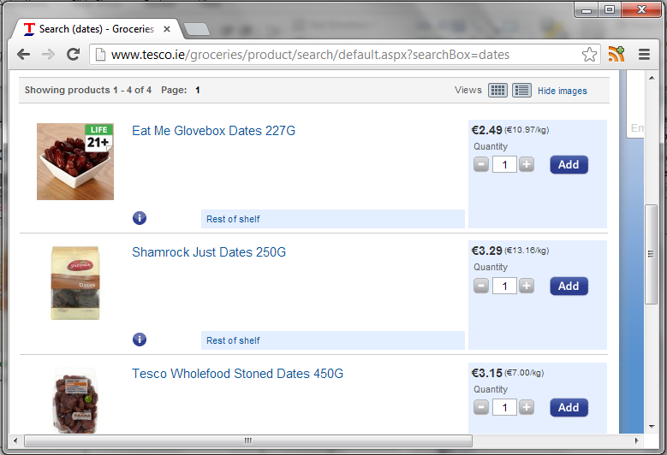
Using the Current Web …

Slide 23
The Dessert Algorithm (30 years on)
candidates := ∅
for all recipe-site in google-results
for all dessert-recipe in recipe-site
if dessert-recipe type looks-delicious
suitable := true
for all ingredient in dessert-recipe
if searchNutrition(ingredient) type lemon or lime …
suitable := false
else if searchShops(ingredient) type null or expensive
suitable := false
end
end
if suitable add dessert-recipe to candidates end
end
end
end
return candidates

Slide 24
The Dessert Algorithm (60 years on?)
candidates := ∅
for all safe-cheap-local-dessert-recipe in magical-sem-web-results()
if safe-cheap-local-dessert-recipe type looks-delicious
add safe-cheap-local-dessert-recipe to candidates end
end
end
return candidates

Slide 25
The Dessert Algorithm (60 years on?)
for all safe-cheap-local-dessert-recipe in magical-sem-web-results()

Slide 26
So what’s the problem …

Slide 27
The current Web is document-centric

Slide 28
The current Web is document-centric

Slide 29
(Most of it) Makes sense to humans

Slide 30
... assuming they speak the language

Slide 31
Even worse for machines

Slide 32
Ytyl nugzy pug mebholyz

Slide 33
So what’s the problem …

Slide 34
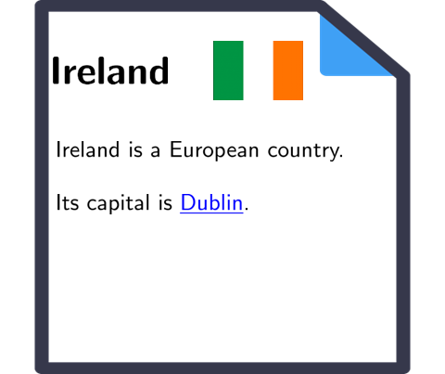
What machines can do: Fetch documents

Slide 35
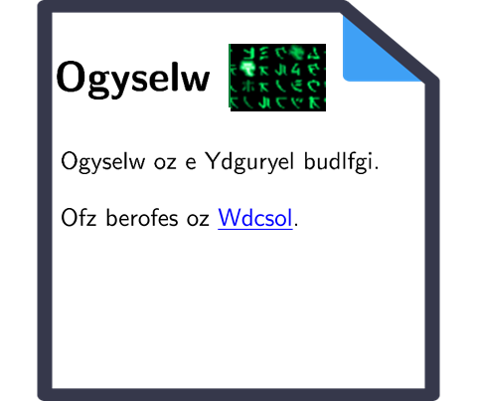
What machines can do: Find documents

Slide 36
What machines cannot do: Combine sources

Slide 37
Towards a semantic web

Slide 38
Machines that “understand” the Web?

Slide 39
Let’s look at this recipe …

Slide 40
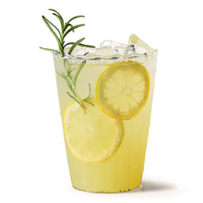
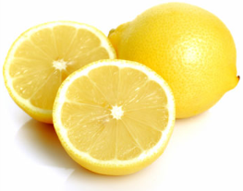
Can machines be taught to "understand"?

Slide 41
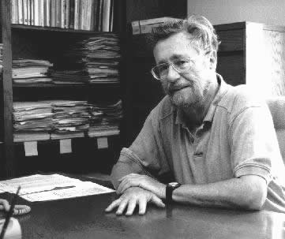
Edsger W. Dijkstra

Slide 42
Searle's Chinese Room

Slide 43
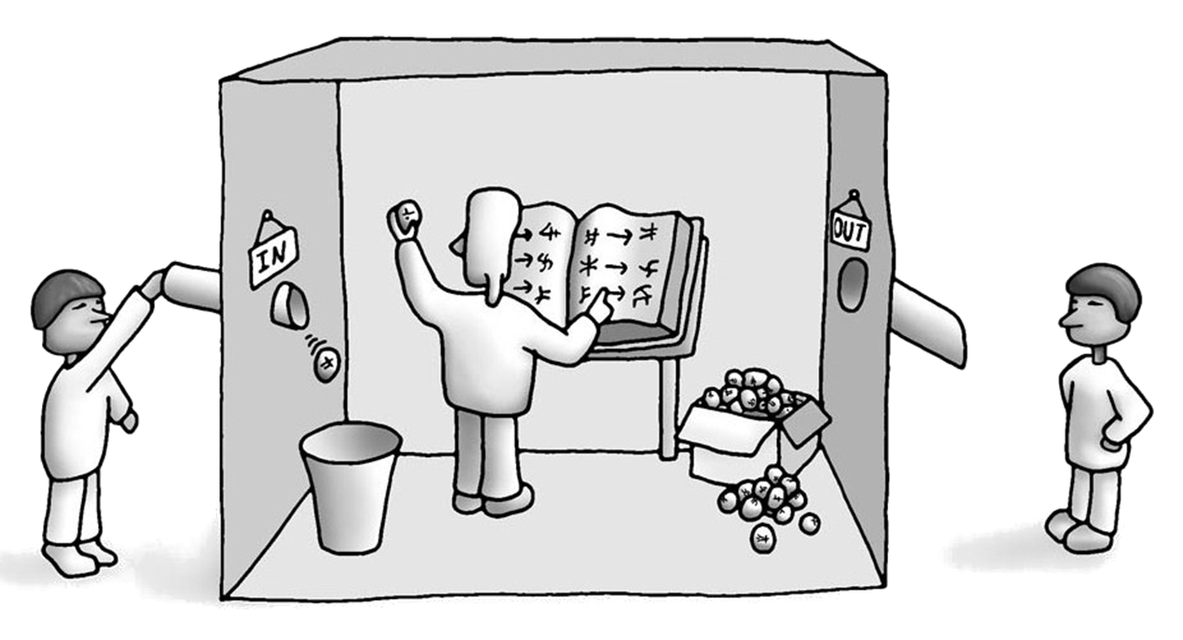
Searle’s Chinese Room …

Slide 44
Searle’s Chinese Room (Natural Language)
… what should the output be?

Slide 45
Multiple names, one thing …

Slide 46
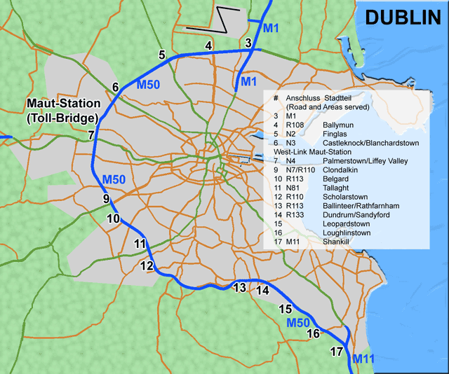
One name, multiple things …

Slide 47
Multiple ways to say the same thing …

Slide 48
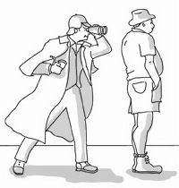
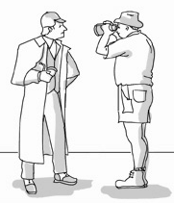
Multiple meanings for the same saying …

Slide 49
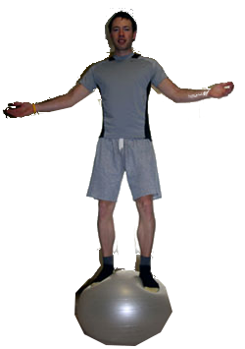
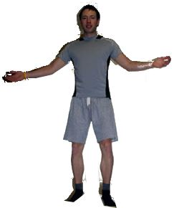
Not saying what is meant …

Slide 51
What if we could “structure” everything …

Slide 52
One symbol, one meaning …

Slide 53
One symbol, one meaning …

Slide 54
One (simple) way to say one thing …

Slide 55
Searle’s Chinese Room (Natural Language)
… what should the output be?

Slide 56
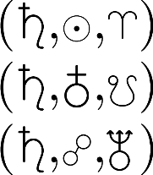
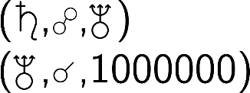
Searle’s Chinese Room (Symbolic)
… what should the output be?

Slide 57
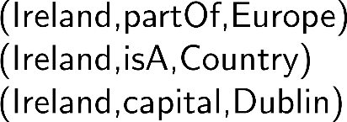
Searle’s Chinese Room (Symbolic)
… what should the output be?

Slide 58
Searle’s Chinese Room II
… what should the output be?

Slide 59
Searle’s Chinese Room II
… what should the output be?

Slide 60
Searle’s Chinese Room II
… what should the output be?

Slide 61
Searle’s Chinese Room II
… what should the output be?

Slide 62
Searle’s Chinese Room II
… what should the output be?

Slide 63
Searle’s Chinese Room II
… what should the output be?

Slide 64
Semantic Web: Data, Logic, Query
* More or less

Slide 65
The Semantic Web now?

Slide 66
The Semantic Web is now about 20 years old
… so where is it then?

Slide 67
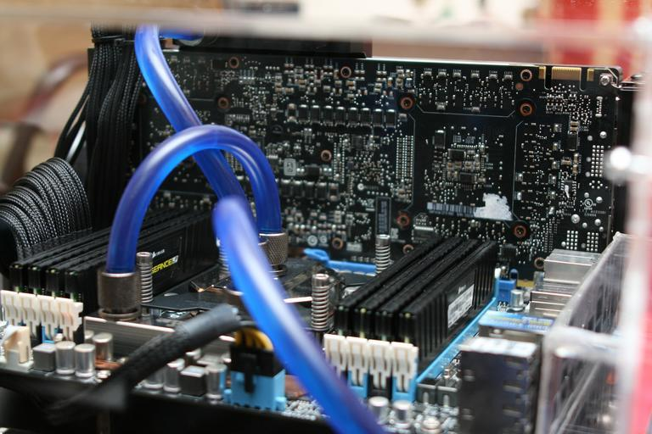
Hidden within the Web ...

Slide 68
Wikidata: A Wikipedia for data

Slide 69
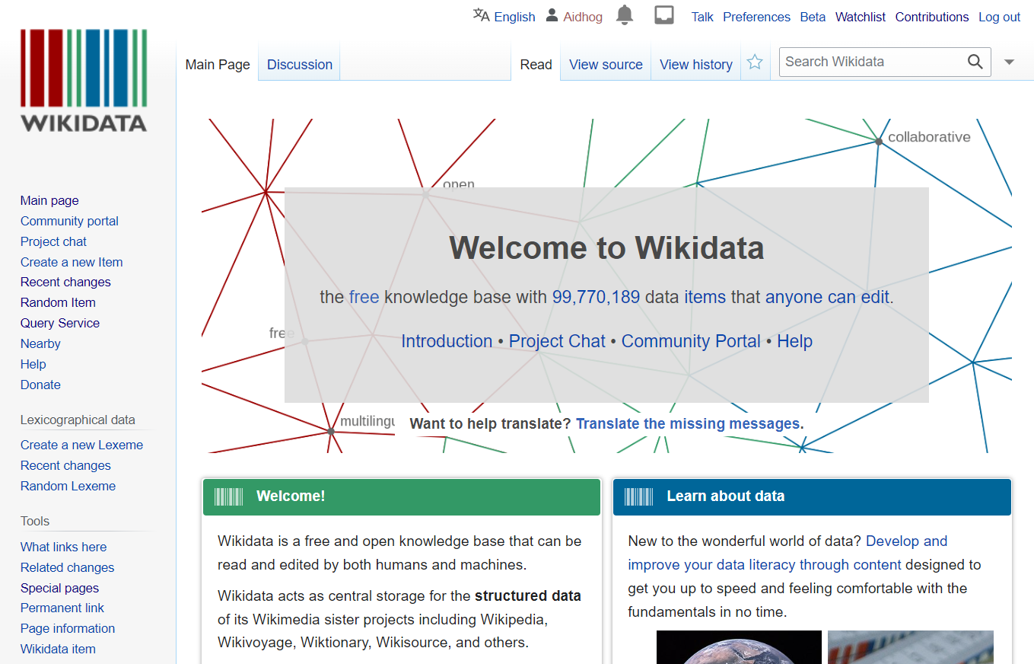
What is Wikidata?

Slide 70
Why is Wikidata?

Slide 71
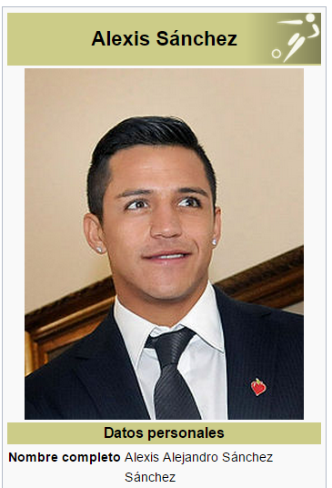
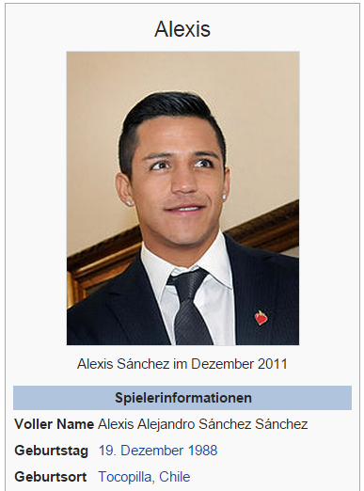
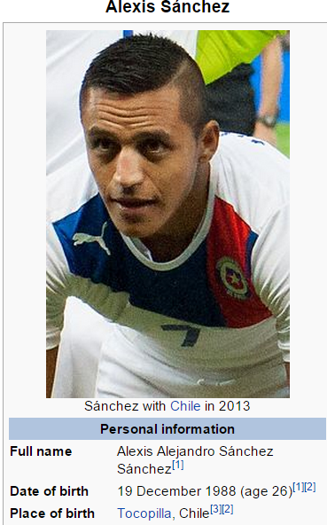
Problem 1: Different language versions manually edited by users

Slide 72
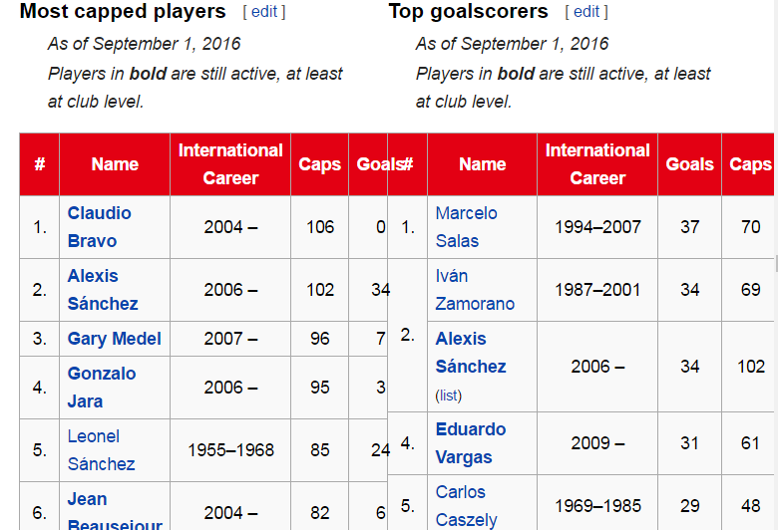
Problem 2: Complex lists of things manually edited by users

Slide 73
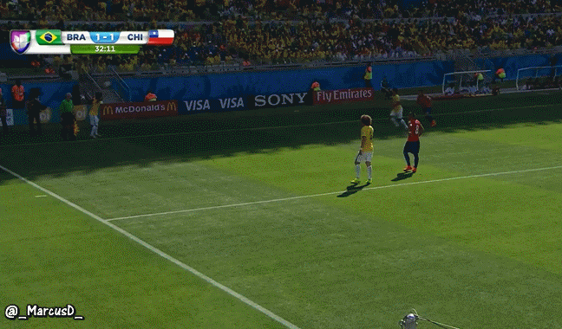
Alexis scores a goal …
Now an army of human editors has to manually update a bunch of articles:
different languages, lists, …

Slide 74
Solution: Wikidata

Slide 75
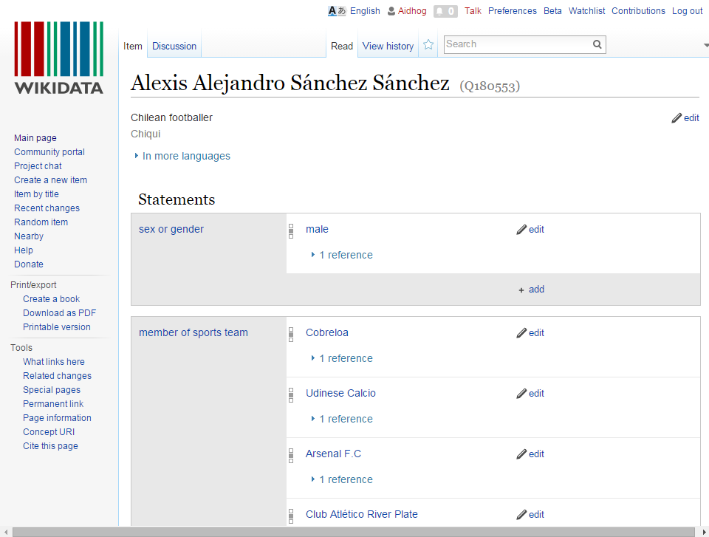

Slide 76
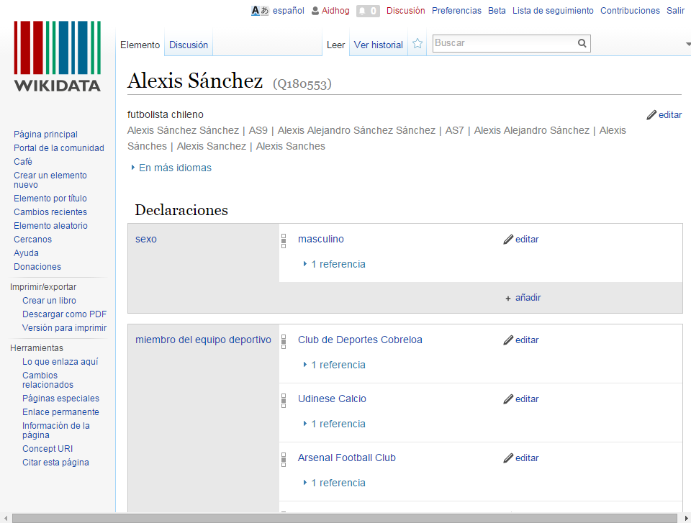

Slide 77
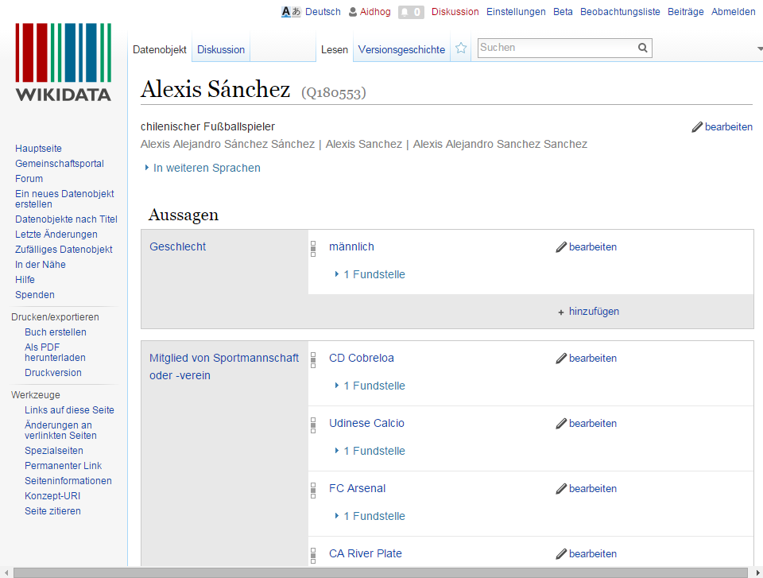

Slide 78
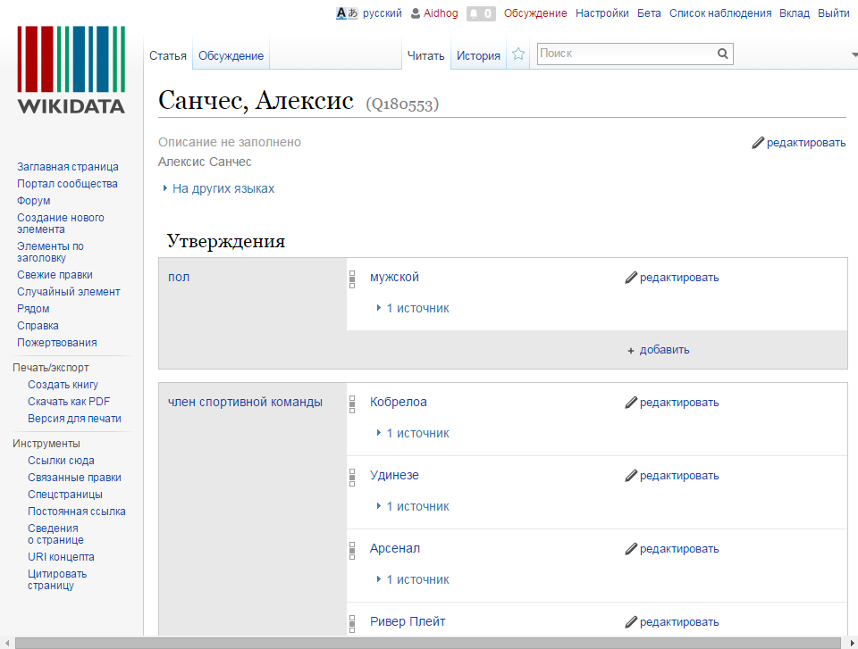

Slide 79
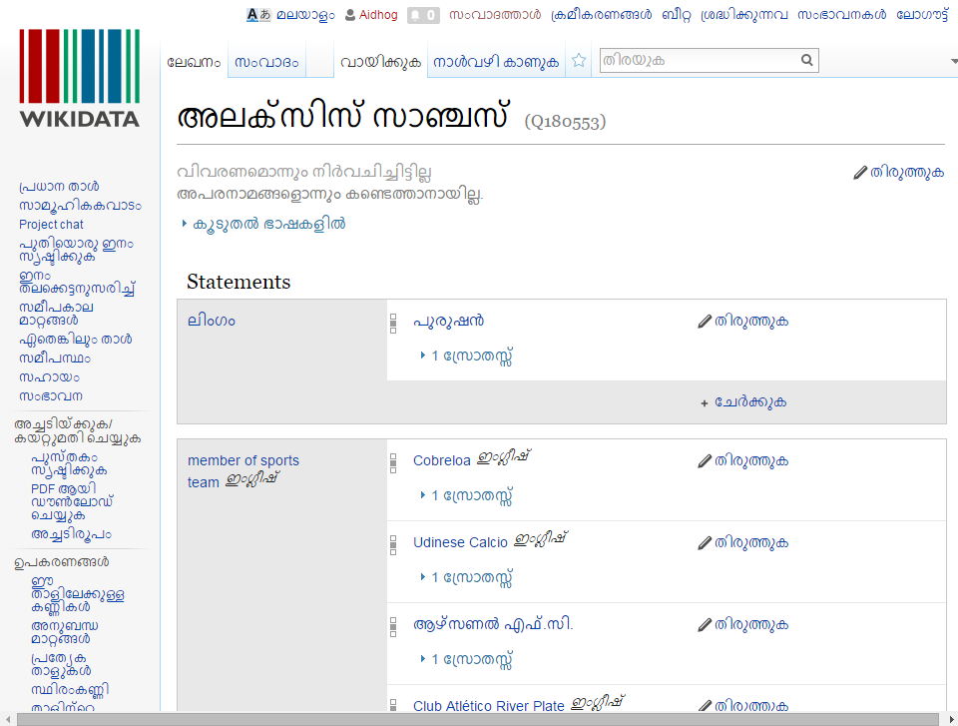

Slide 80
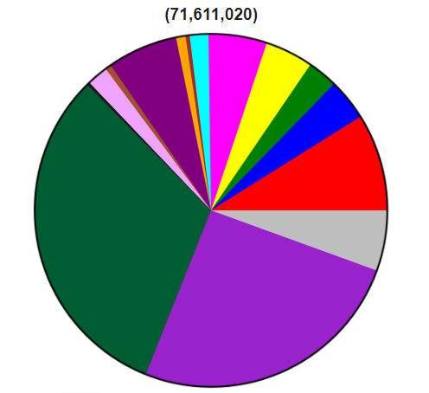
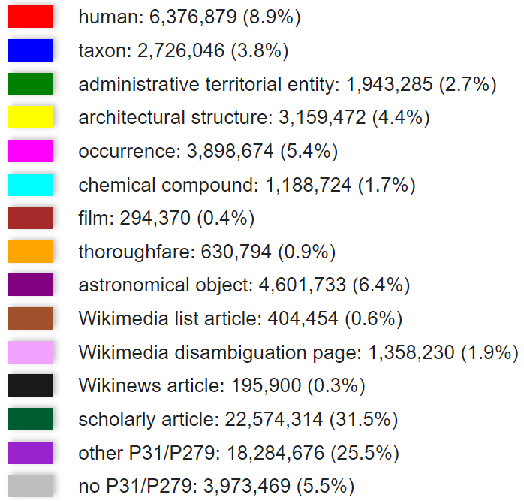
What does Wikidata describe?
22,986 active users
https://www.wikidata.org/wiki/Wikidata:Statistics

Slide 81
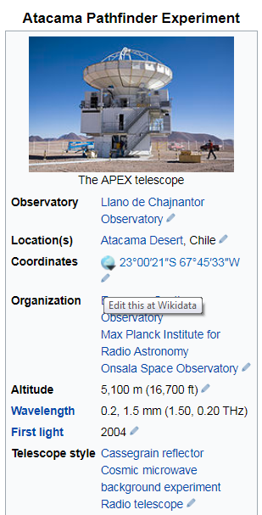
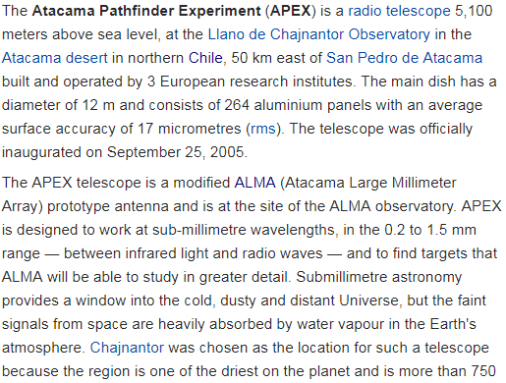
Use-case: Info-Boxes

Slide 82
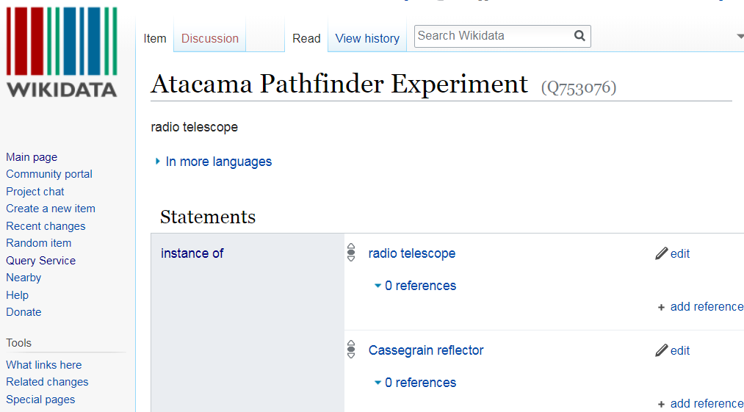
Use-case: Info-Boxes

Slide 83
Use-case: Quality Checks

Slide 84
Use-case: Quality Checks
...

Slide 85
Use-case: Query Service

Slide 86
Use-case: Query Service

Slide 87
(Hidden slide)
PREFIX wd: <http://www.wikidata.org/entity/>
PREFIX wdt: <http://www.wikidata.org/prop/direct/>
PREFIX p: <http://www.wikidata.org/prop/>
PREFIX ps: <http://www.wikidata.org/prop/statement/>
PREFIX pq: <http://www.wikidata.org/prop/qualifier/>
PREFIX rdfs: <http://www.w3.org/2000/01/rdf-schema#>
SELECT DISTINCT ?laureateName ?awardYear ?warName ?warYear
WHERE {
?laureate p:P166 ?award . # Winner of some prize
?award ps:P166 wd:Q37922 . # Prize is Nobel Pr. in Lit.
?award pq:P585 ?awardDate . # Get the date of the award
BIND(YEAR(?awardDate) as ?awardYear) # Get the year of the award
?laureate wdt:P607 ?war . # Find war(s) laureate was in
?war rdfs:label ?warName . # Get name(s) of war(s)
?war wdt:P580 ?warStart . # Get year the war started
BIND(YEAR(?warStart) as ?warYear)
?laureate rdfs:label ?laureateName . # Get name of laureate
FILTER(lang(?warName)="en" # Filter for English
&& lang(?laureateName)="en") # ... names only
} ORDER BY ?awardYear # Order by year or award
https://query.wikidata.org/

Slide 88
Used in Applications like Siri …

Slide 89
Google's Knowledge Graph

Slide 90
Google’s Knowledge Panel

Slide 91
Using Semantic Web knowledge-bases

Slide 92
Google’s Rich Snippets

Slide 93
Fancy-looking search results …
… how does Google know the ratings, minutes, calories …?

Slide 94
Publishers add structured data!
Publishers get more clicks on their results
Google gets data to make fancy results

Slide 95
Standards for Open Data: Linked Open Data

Slide 96
How to publish Open Data?
5-Star Linking Open Data Scheme

Slide 97
The Linked Data Cloud

Slide 98
About the course …

Slide 99
Topics covered
RDF (triple-based data model)
RDFS/OWL (ontological languages)
SPARQL (query language)
Linked Data / Web of Data
RDB2RDF (importing databases to Sem. Web.)
Shapes (validating RDF data)

Slide 100
Research course

Slide 101
Structure of the course
Each week:
Class on Monday (learn concepts)
Lab on Wednesday (see concepts in practice)
Auxiliar session on Friday (Q&A)
Marking structure:
70% labs
20% project
10% reading group

Slide 102
Bibliography

Slide 103
Outcomes: Learn About the Semantic Web!
An ongoing research topic here in the DCC
Apply database, logic, AI, etc., to the Web
Mix of theory and practical exercises
The future of the Web?

Slide 104
Questions?

