Slide 1
CC7220-1 La Web de Datos Primavera 2022 Lecture 11: Conclusion
Aidan Hogan
aidhog@gmail.com

Slide 2
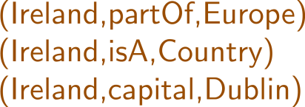
Semantic Web: Data, Logic, Query, Links, Validation
* More or less

Slide 3
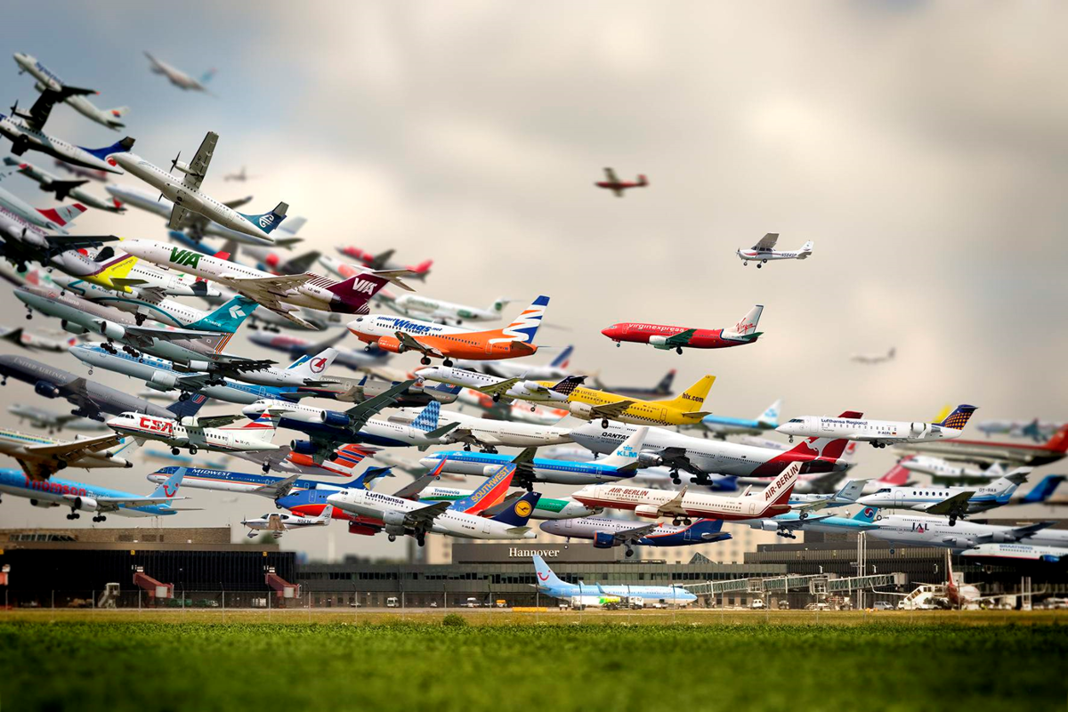
TAKING OFF

Slide 4
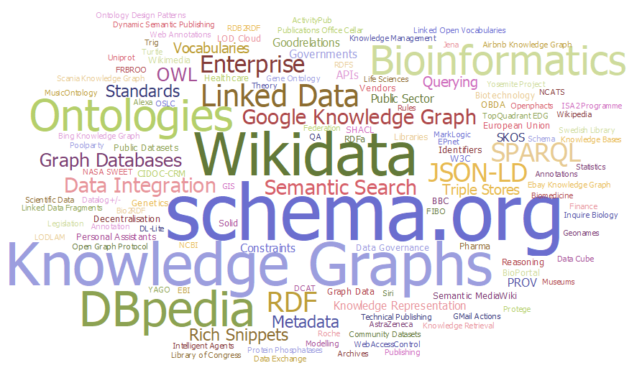
Success stories
http://aidanhogan.com/docs/semantic-web-now.pdf

Slide 5
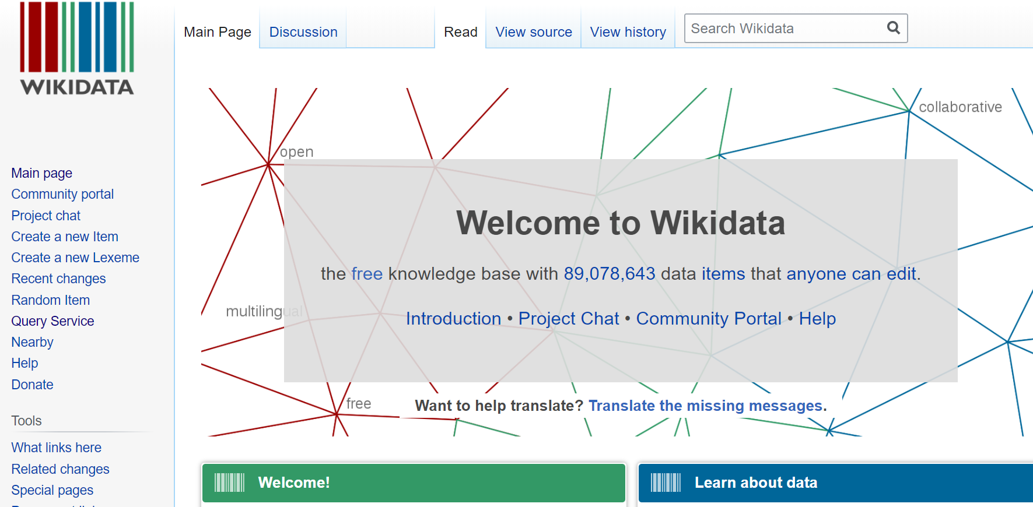
Wikidata

Slide 6
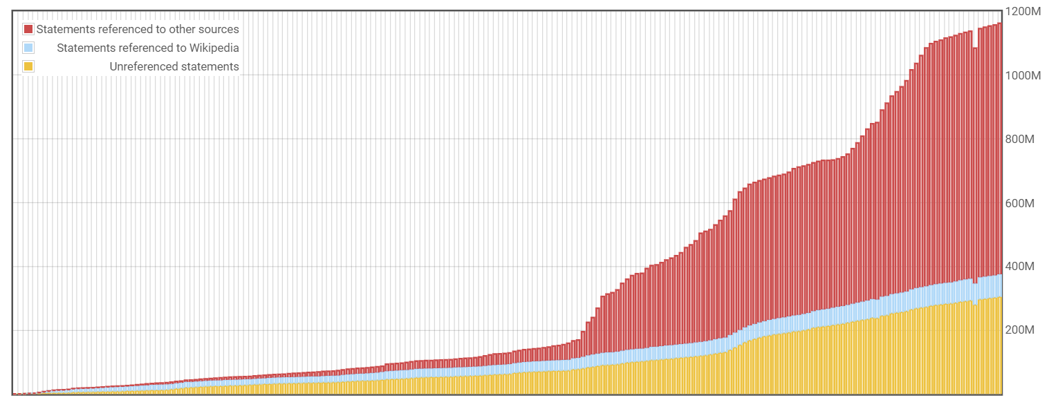
Wikidata

Slide 7
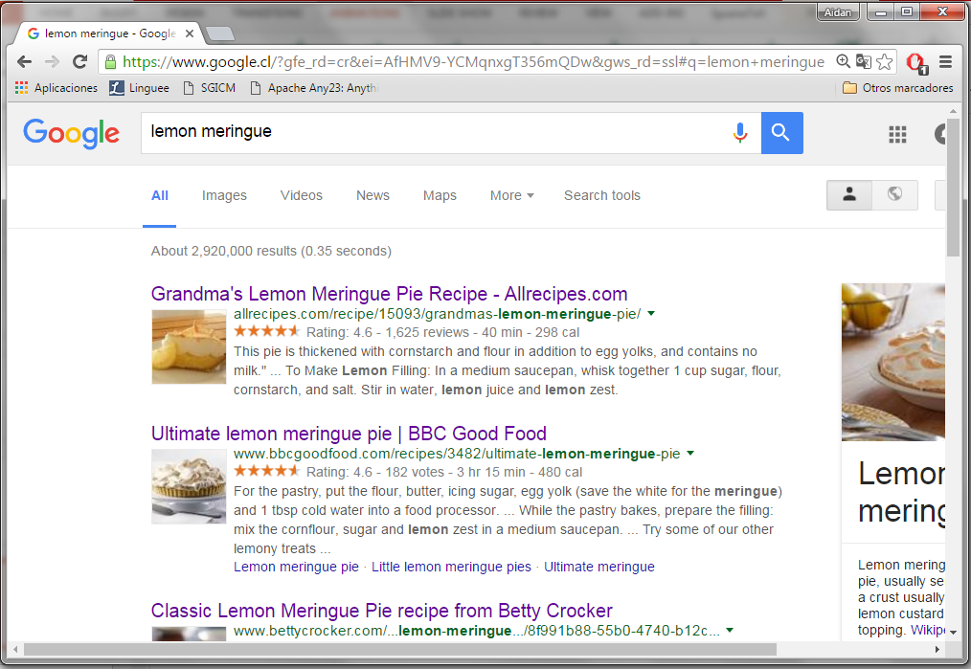
Google’s rich snippets …

Slide 8
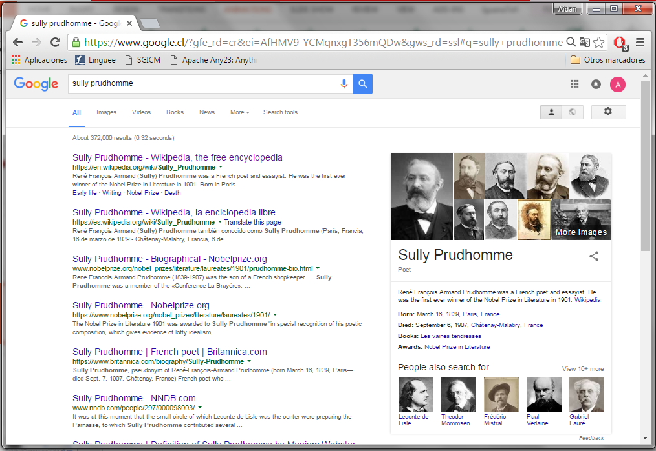
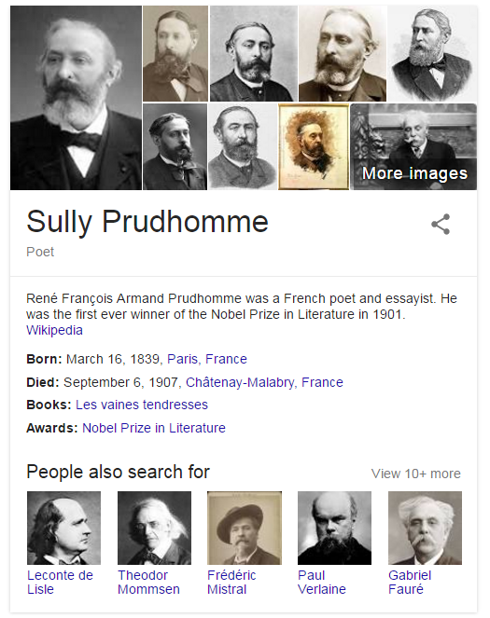
Google’s Knowledge Panel

Slide 9
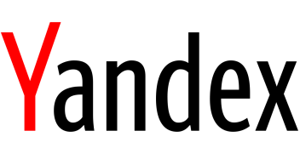
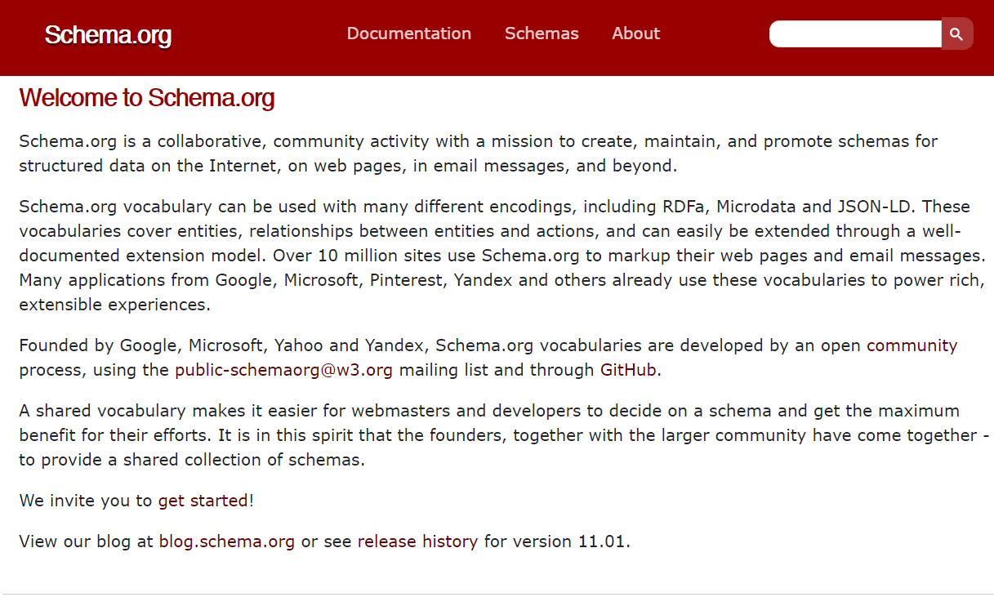
Schema.org

Slide 10
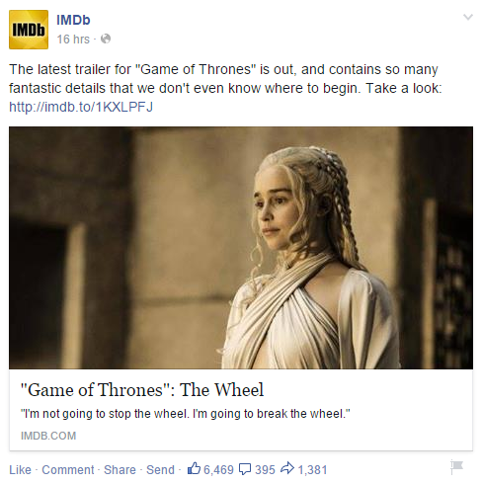
Facebook’s Open Graph

Slide 11
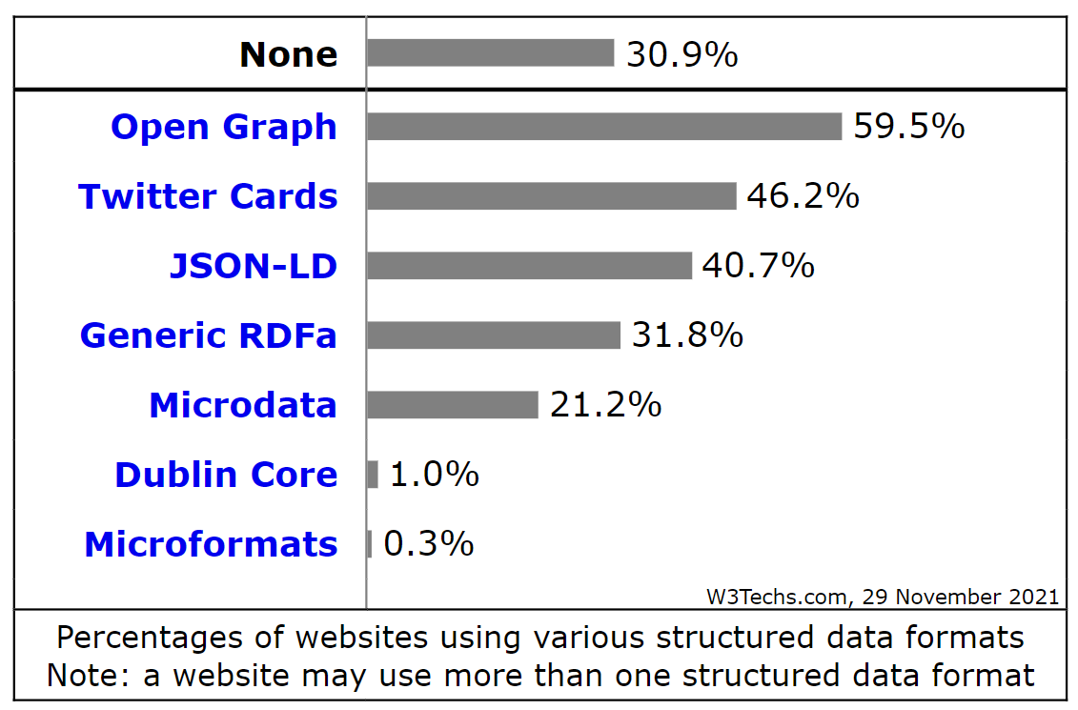
Embedded structured data
https://w3techs.com/technologies/overview/structured_data

Slide 12
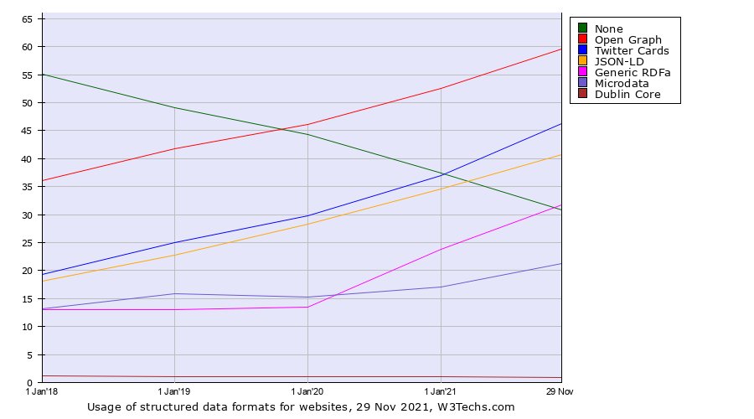
Embedded structured data
https://w3techs.com/technologies/history_overview/structured_data/all/y

Slide 13
Google’s Knowledge Graph

Slide 14
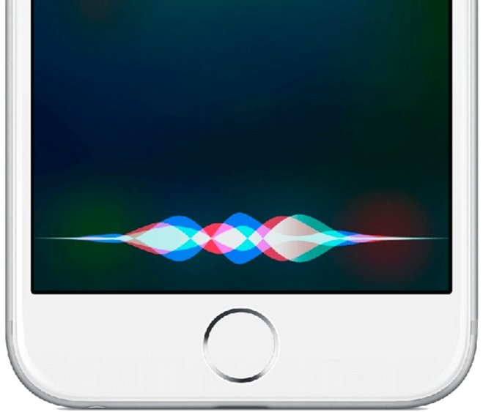
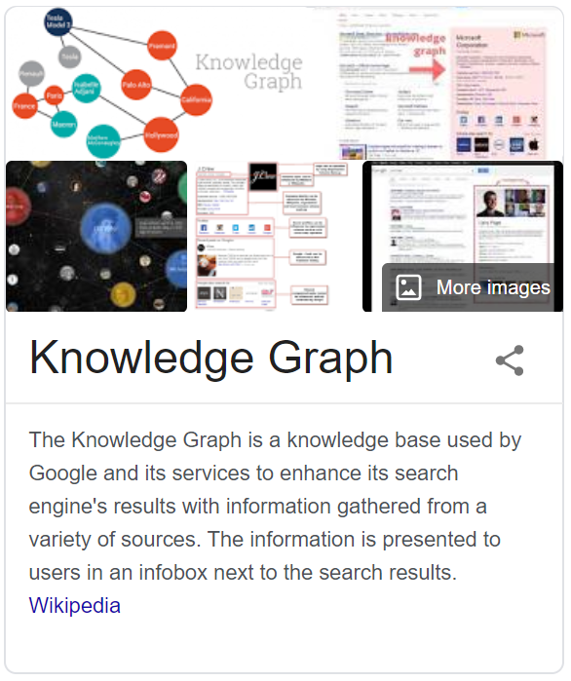
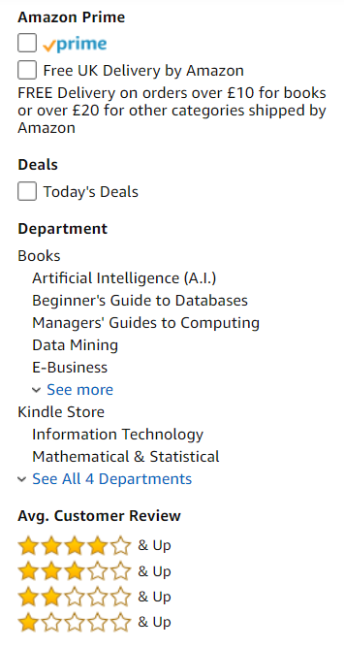
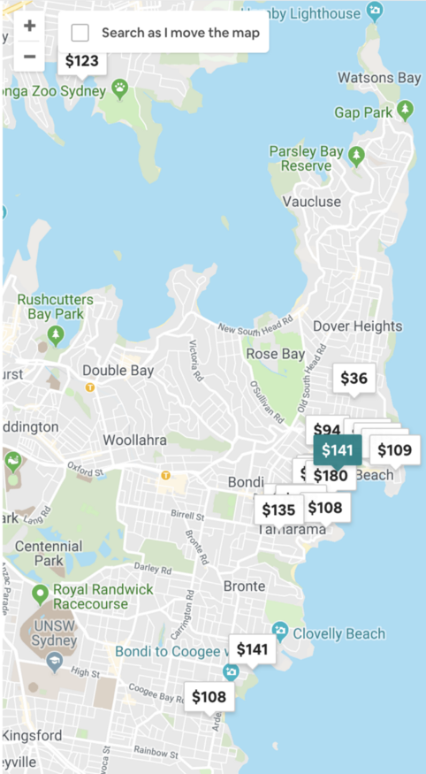
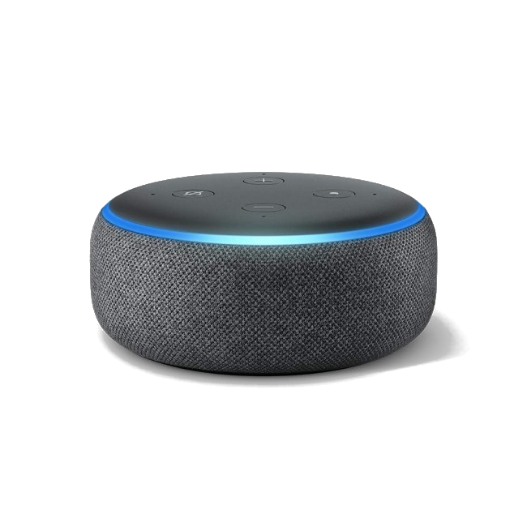
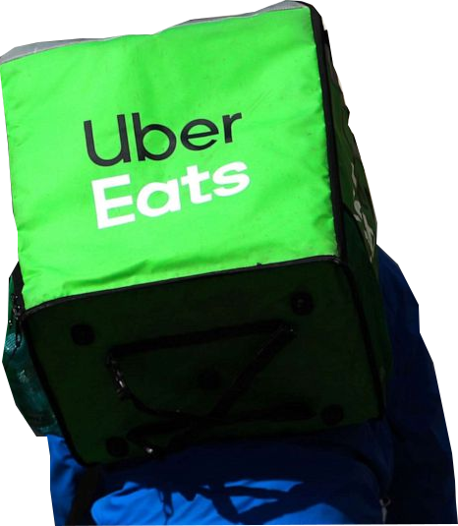

Slide 15
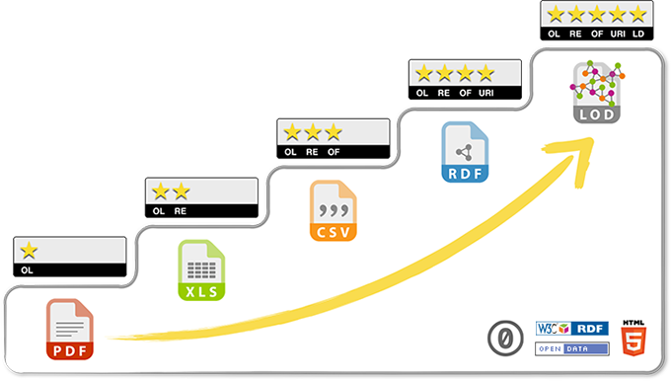
Linked Open Data
5-Star Linking Open Data Scheme

Slide 16
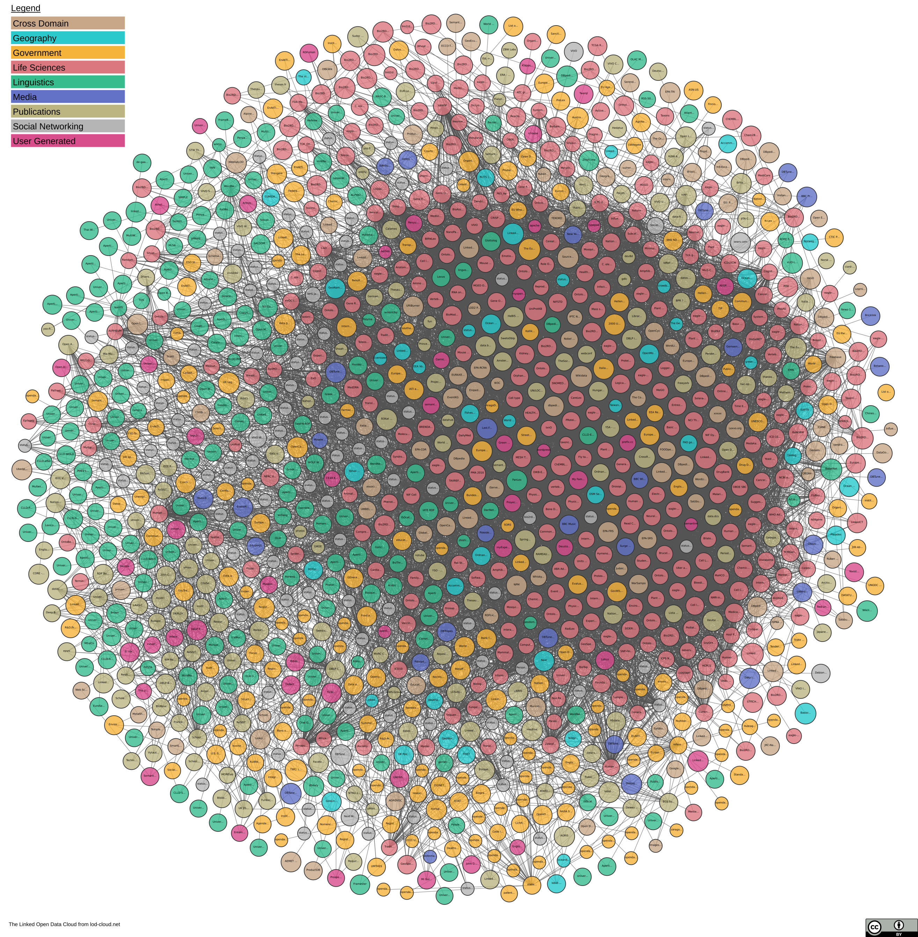

Slide 17
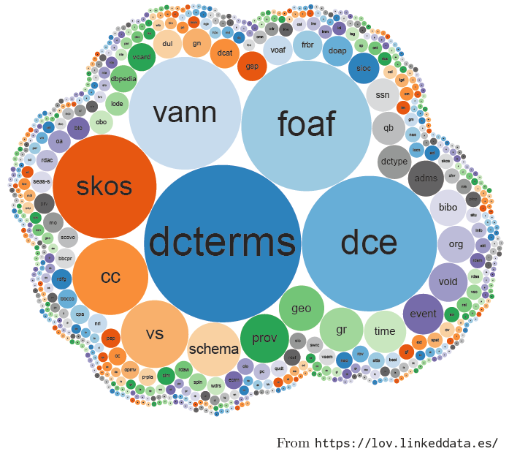
Linked Open Vocabularies

Slide 18
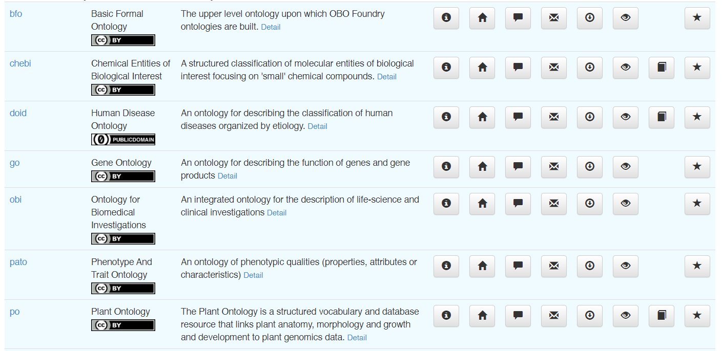
Biomedical ontologies

Slide 19
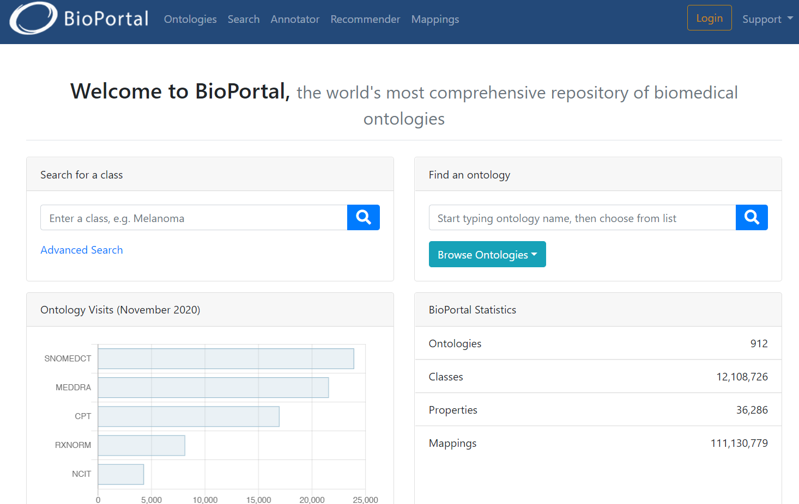
Biomedical ontologies

Slide 20
Ongoing Research

Slide 21
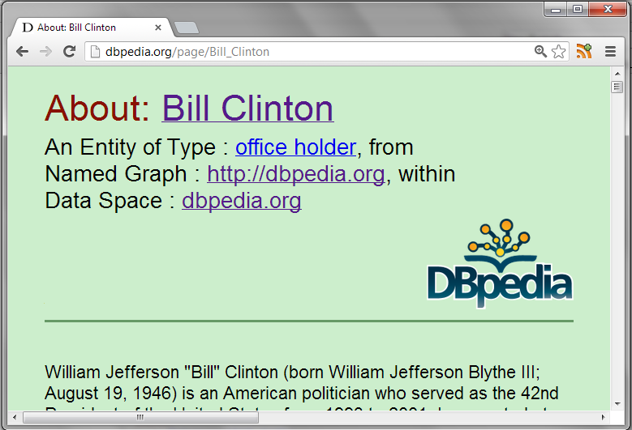
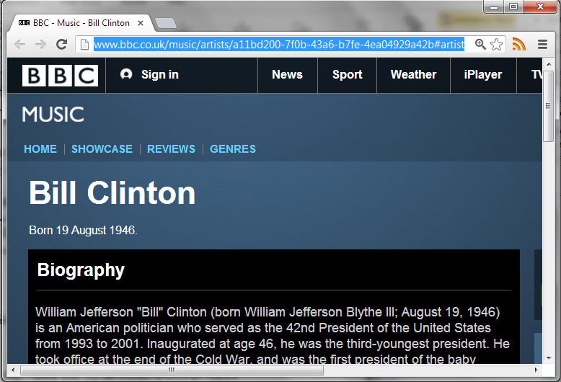
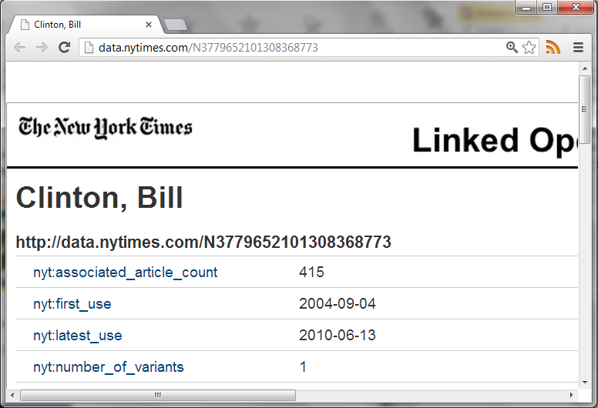
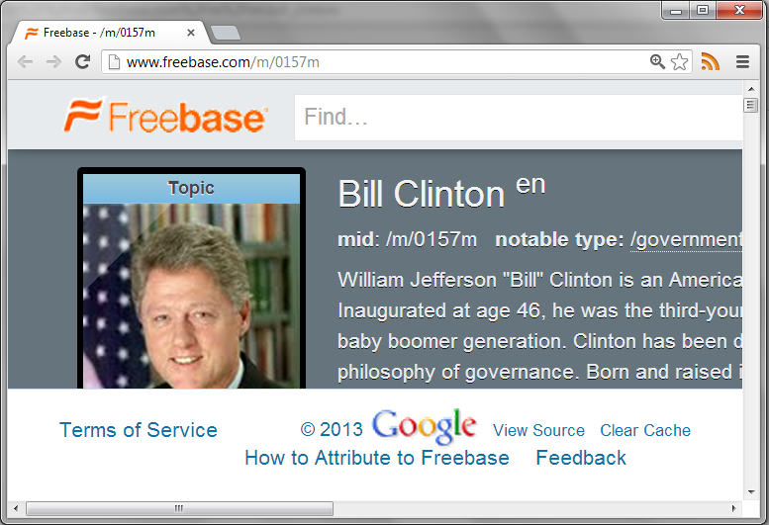
Integrating diverse data
http://dbpedia.org/resource/Bill_Clinton
http://rdf.freebase.com/ns/en.bill_clinton
http://data.nytimes.com/clinton_bill_per
http://www.bbc.co.uk/music/artists/…
How can we integrate data using different identifiers from different sources?

Slide 22
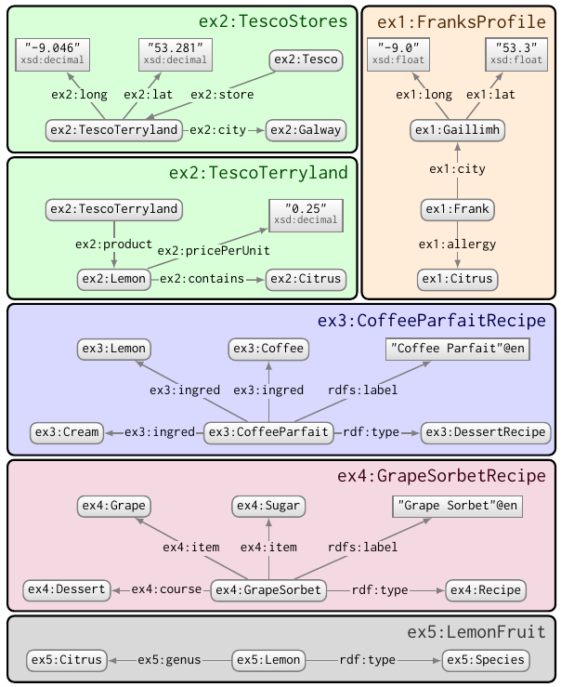
Integrating diverse vocabularies
How can we integrate and write queries against Linked Data using different vocabularies?

Slide 23
Decentralised querying
D
Q
D
D
Q
Q
D
Q
How can we enable decentralised querying over multiple decentralised datasets?

Slide 24
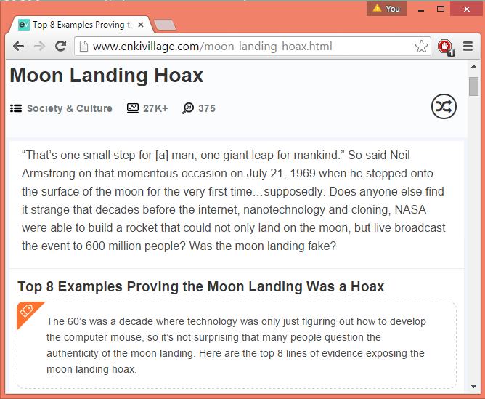
Veracity
How can we deal with incorrect or malicious data and/or ontologies on the Semantic Web?

Slide 25
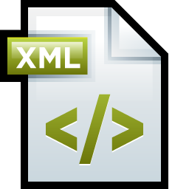
Legacy data
How can we “import” more legacy data into the Semantic Web?
…

Slide 26
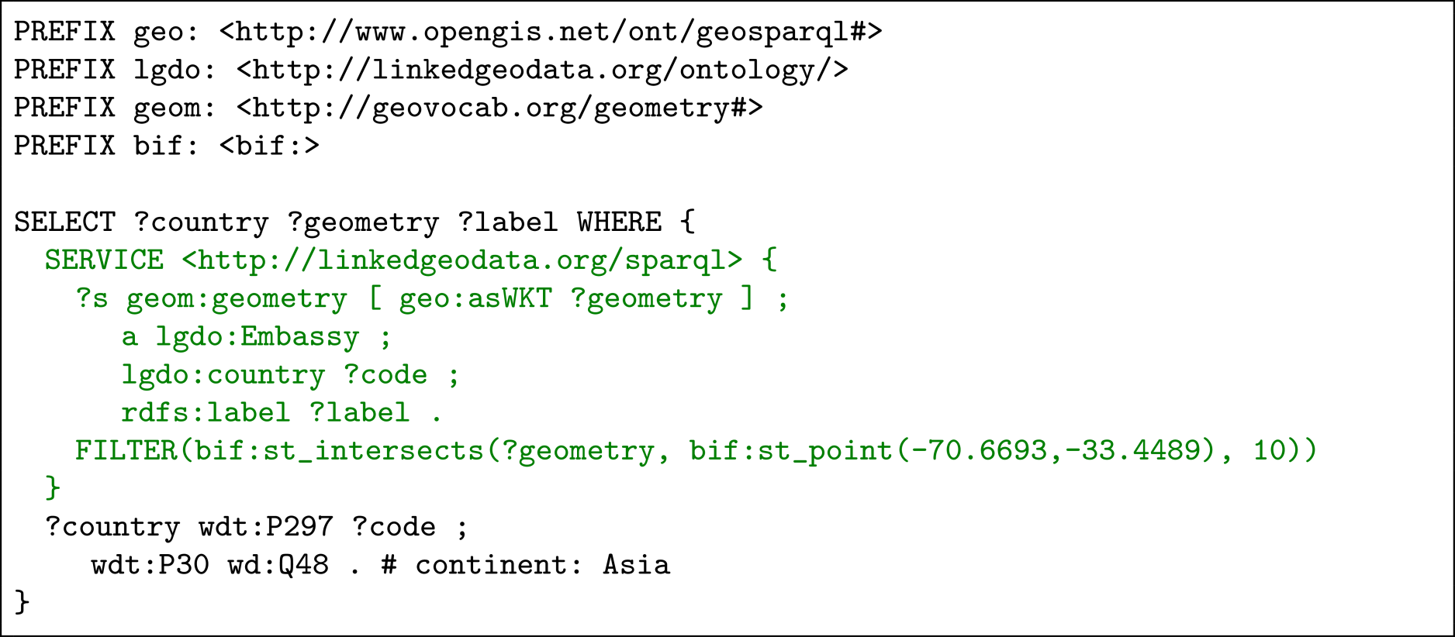
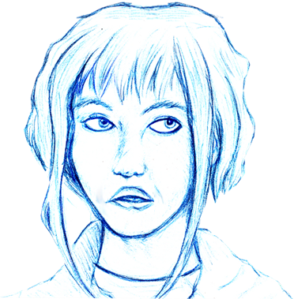
Usability
What kinds of interfaces can help non-expert users to better interact with the Semantic Web?

Slide 28
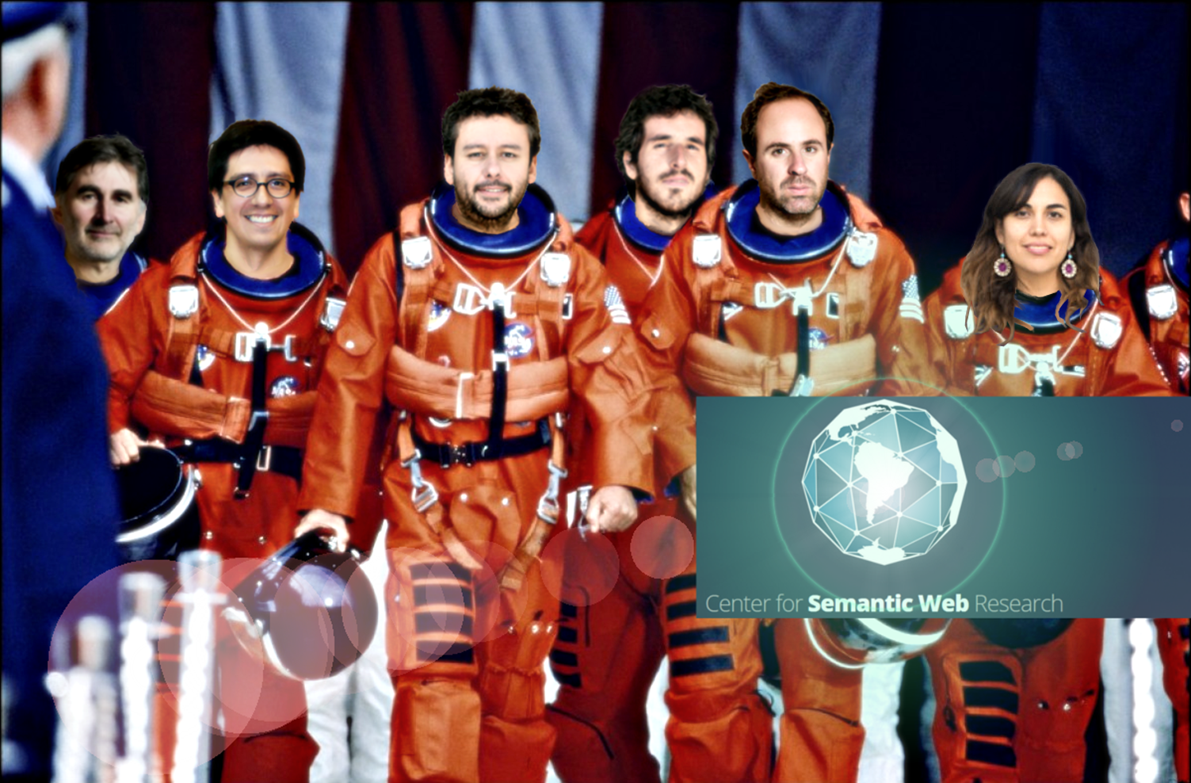
Ongoing research in Chile

Slide 29
That’s all Folks …

Slide 30
Questions?

