Slide 1
CC7220-1 La Web de Datos Primavera 2022 Lecture 9: Linked Data
Aidan Hogan
aidhog@gmail.com

Slide 2
Previously …

Slide 3
Semantic Web: Data, Logic, Query
* More or less

Slide 4
But we have not spoken much about …
CC7220-1 La Web de Datos Primavera 2022
… how do we use RDF(S)/OWL/SPARQL
to build a “Web of Data”?

Slide 5
Semantic Web: Data, Logic, Query
* More or less
What are we missing from here to build a Web of Data?

Slide 6
Semantic Web: Data, Logic, Query, Links
* More or less
How can we add links to this picture?

Slide 7
RDF filled with IRIs!
… any IRI could be a link!

Slide 8
Pre-Linked Data …

Slide 9
Semantic Web, early days (pre-2006)
Lots of dumps of RDF
Big OWL ontologies (difficult to re-use)
No reuse of IRIs ... no links … no Web!

Slide 10
Linked Data …

Slide 11
Linked Data … 2006
http://www.w3.org/DesignIssues/LinkedData.html

Slide 12
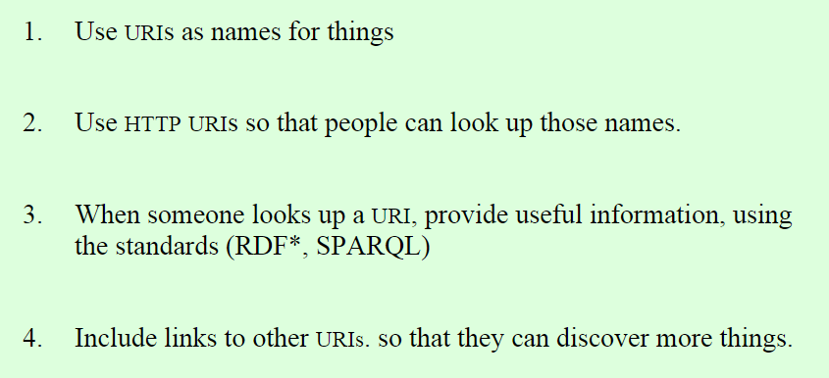
Four Principles of Linked Data
http://www.w3.org/DesignIssues/LinkedData.html

Slide 13
Linked Data examples ...

Slide 15
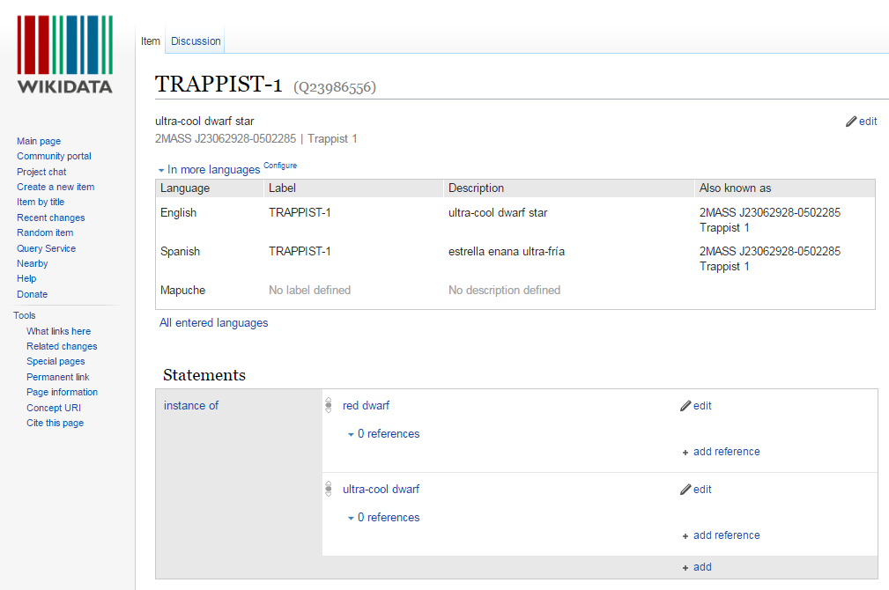

Slide 16
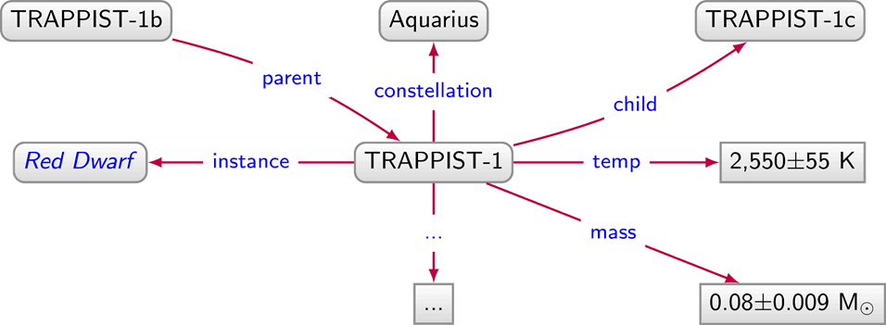
Linked Data Document
http://ex.org/data/TRAPPIST-1

Slide 17
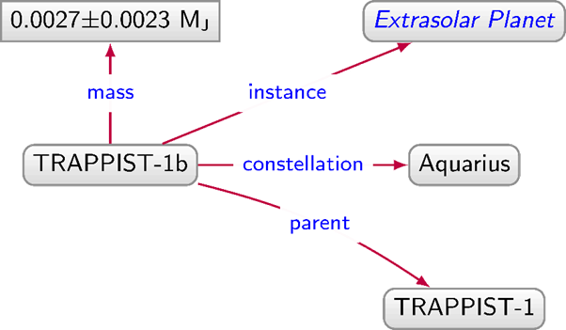
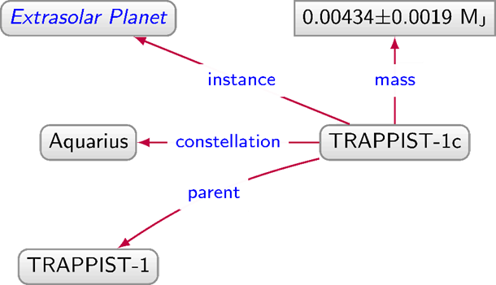
Linked Data Graph
http://ex.org/data/TRAPPIST-1b
http://ex.org/data/TRAPPIST-1c
http://ex.org/data/TRAPPIST-1

Slide 18
Linked Data Graph
http://ex.org/data/TRAPPIST-1b
http://ex.org/data/TRAPPIST-1c
http://ex.org/data/TRAPPIST-1

Slide 19
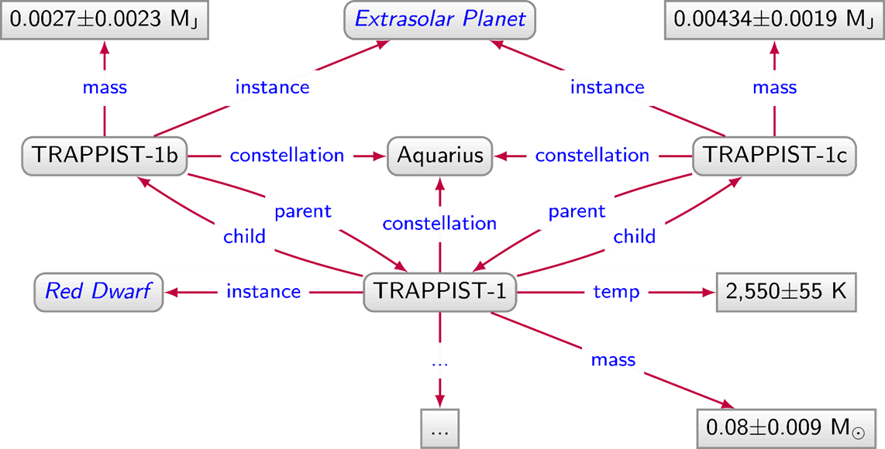
Linked Data Graph

Slide 20
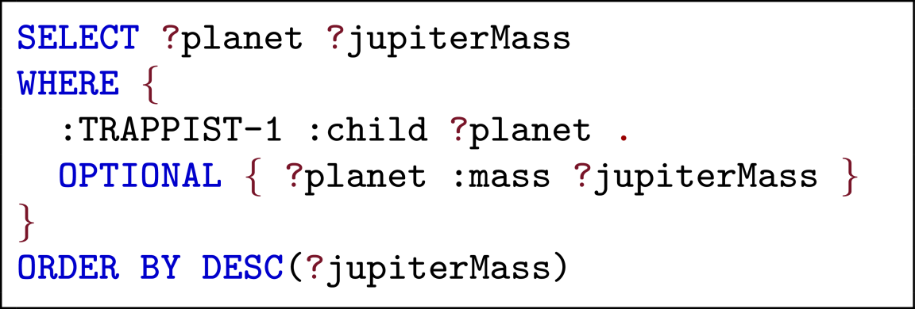
Answer queries over Linked Data using SPARQL

Slide 21
Linked Data Graph
http://ex.org/data/TRAPPIST-1b
http://ex.org/data/TRAPPIST-1c
http://ex.org/data/TRAPPIST-1
How can we implement these links (called "dereferencing")?

Slide 22
Implementing Linked Data…

Slide 23
Three recipes for dereferencing
URL Recipe
Use document URLs to identify things
Hash Recipe
Use fragment identifiers to identify things
Slash Recipe
Use special redirects to identify things

Slide 24
URL Recipe
http://ex.org/data/TRAPPIST-1b
http://ex.org/data/TRAPPIST-1c
http://ex.org/data/TRAPPIST-1
http://ex.org/data/TRAPPIST-1b
http://ex.org/data/TRAPPIST-1c
Easy-peasy. So what's the problem?

Slide 25
URL Recipe: The Problem

Slide 26
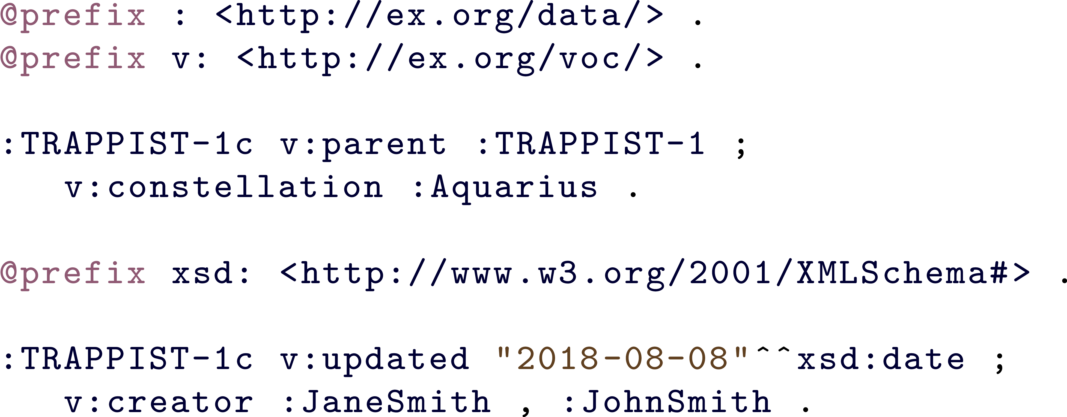
URL Recipe: The Problem
Document URLs should only identify documents!

Slide 27
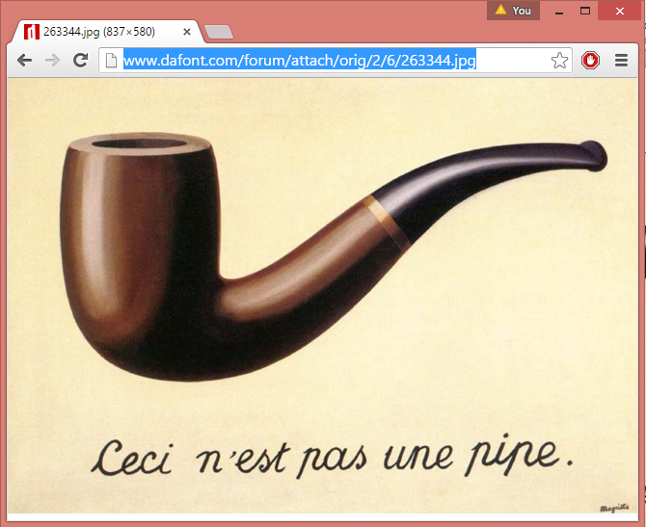
HTTP URLs for documents, not pipes

Slide 28
Three recipes for dereferencing
URL Recipe
Use document URLs to identify things
documents
Hash Recipe
Use fragment identifiers to identify things
Slash Recipe
Use special redirects to identify things

Slide 29
Hash Recipe
http://ex.org/data/TRAPPIST-1b
http://ex.org/data/TRAPPIST-1c
http://ex.org/data/TRAPPIST-1
http://ex.org/data/TRAPPIST-1b#this
http://ex.org/data/TRAPPIST-1c#this

Slide 30
Hash Recipe
http://ex.org/data/TRAPPIST-1c
Identifies the document
http://ex.org/data/TRAPPIST-1c#this
Identifies the planet
Look it up, you get the document
GET: http://ex.org/data/TRAPPIST-1c#me
200 OK: http://ex.org/data/TRAPPIST-1c

Slide 31
Three recipes for dereferencing
URL Recipe
Use document URLs to identify things
documents
Hash Recipe
Use fragment identifiers to identify things
Slash Recipe
Use special redirects to identify things

Slide 32
Slash Recipe
http://ex.org/data/TRAPPIST-1b
http://ex.org/data/TRAPPIST-1c
http://ex.org/data/TRAPPIST-1
http://ex.org/entity/TRAPPIST-1b
http://ex.org/entity/TRAPPIST-1c

Slide 33
Slash Recipe
http://ex.org/data/TRAPPIST-1c
Identifies the document
http://ex.org/entity/TRAPPIST-1c
Identifies the planet
Look it up, redirects to the document
GET: http://ex.org/entity/TRAPPIST-1c
303 See Other: http://ex.org/data/TRAPPIST-1c
GET: http://ex.org/data/TRAPPIST-1c
200 OK: http://ex.org/data/TRAPPIST-1c

Slide 34
Three recipes for dereferencing
URL Recipe
Use document URLs to identify things
documents
Hash Recipe
Use fragment identifiers to identify things
Slash Recipe
Use special redirects to identify things

Slide 35
Hash vs. Slash
GET: http://ex.org/data/TRAPPIST-1c#this
200 OK: http://ex.org/data/TRAPPIST-1c
Which is better, hash or slash?
Well, hash has half the number of requests!
GET: http://ex.org/entity/TRAPPIST-1c
303 See Other: http://ex.org/data/TRAPPIST-1c
GET: http://ex.org/data/TRAPPIST-1c
200 OK: http://ex.org/data/TRAPPIST-1c

Slide 36
Hash vs. Slash
GET: http://ex.org/data/TRAPPIST-1c#this
200 OK: http://ex.org/data/TRAPPIST-1c
Which is better, hash or slash?
But slash decouples document URLs from entity IRIs
GET: http://ex.org/entity/TRAPPIST-1c
303 See Other: http://ex.org/data/TRAPPIST-1c
GET: http://ex.org/data/TRAPPIST-1c
200 OK: http://ex.org/data/TRAPPIST-1c

Slide 37
Content negotiation with hash
ACCEPT: application/rdf+xml
GET: http://ex.org/data/TRAPPIST-1c#this
200 Okay: http://ex.org/data/TRAPPIST-1c.rdf
ACCEPT: text/html
GET: http://ex.org/data/TRAPPIST-1c#this
200 Okay: http://ex.org/data/TRAPPIST-1c.html
Can also choose from different RDF formats; e.g., Turtle, RDFa, etc.
(if supported by the server that is!)

Slide 38
Content negotiation with slash
ACCEPT: application/rdf+xml
GET: http://ex.org/entity/TRAPPIST-1c
303 See Other: http://ex.org/data/TRAPPIST-1c.xml
GET: http://ex.org/data/TRAPPIST-1c.xml
200 Okay: http://ex.org/data/TRAPPIST-1c.xml
ACCEPT: text/html
GET: http://ex.org/entity/TRAPPIST-1c
303 See Other: http://ex.org/data/TRAPPIST-1c.html
GET: http://ex.org/data/TRAPPIST-1c.html
200 Okay: http://ex.org/data/TRAPPIST-1c.html

Slide 39
Linking Open Data

Slide 40
Open Data ...
We’ve got all these people who want to publish Open Data but how should they publish it on the Web?
We’ve got this new way of publishing Linked Data on the Web but no data to publish …
... meets Linked Data

Slide 41
Linked Open Data
We’ve got this new way of publishing Linked Data on the Web but no data to publish …
Linked Open Data
We’ve got all these people who want to publish Open Data but how should they publish it on the Web?

Slide 42
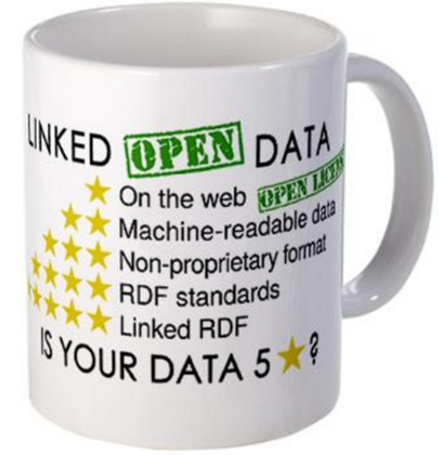
The 5 ★’s of Linked Open Data
★★★★★ Publish data under open licence
★★★★★ Make the data “machine readable”
e.g., a Spreadsheet better than a PDF table
★★★★★ Use non-proprietary formats
e.g., a CSV text file better than Excel
★★★★★ Use URIs to name your stuff (hint: RDF)
use unambiguous identifiers that can be linked/looked up
★★★★★ Provide links to other content (hint: Linked Data)
so consumers can follow links to find out more

Slide 43
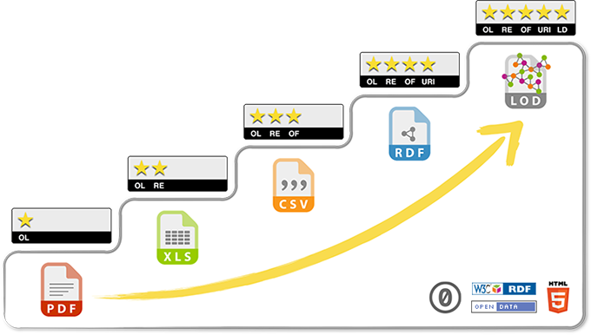
Each star improves interoperability of data

Slide 44
Linked Open Datasets

Slide 45
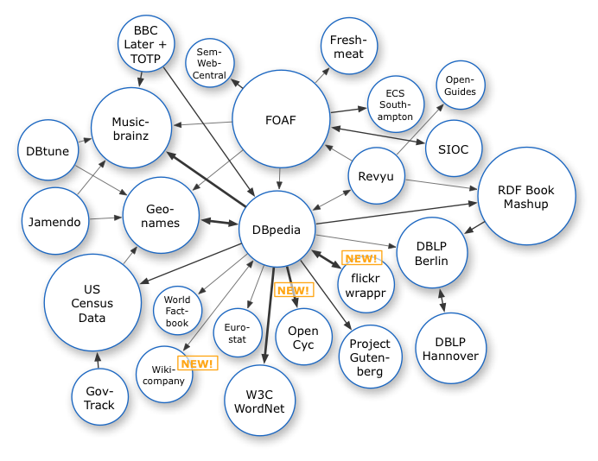
The LOD cloud
Oct. 2007

Slide 46
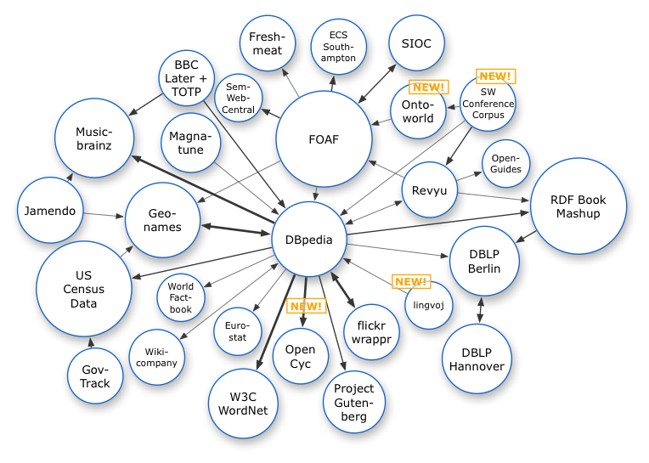
The LOD cloud
Oct. 2007
Nov. 2007

Slide 47
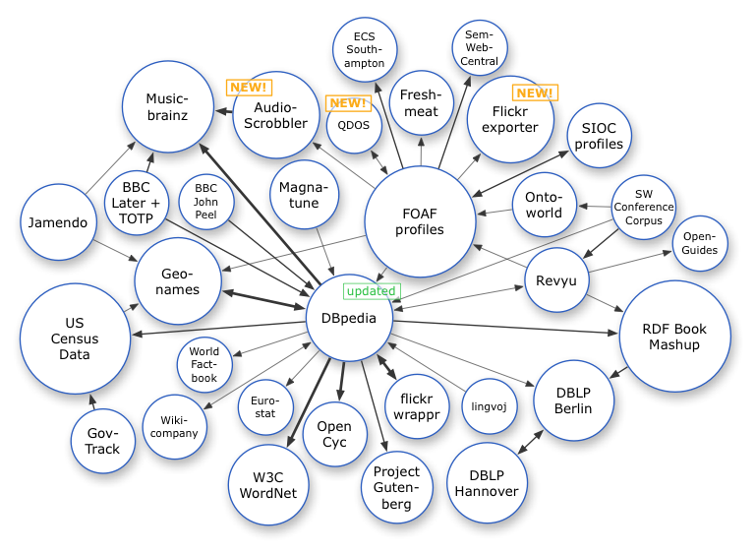
The LOD cloud
Oct. 2007
Nov. 2007
Feb. 2008

Slide 48
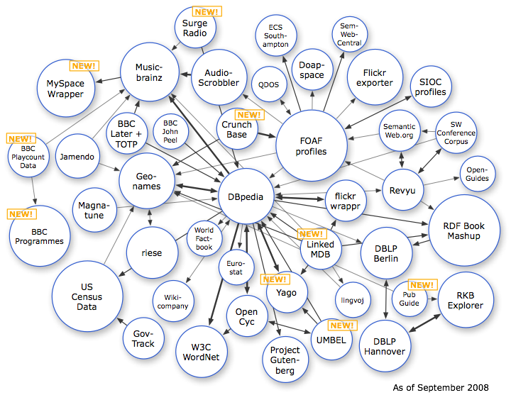
The LOD cloud
Oct. 2007
Nov. 2007
Feb. 2008
Sep. 2008

Slide 49
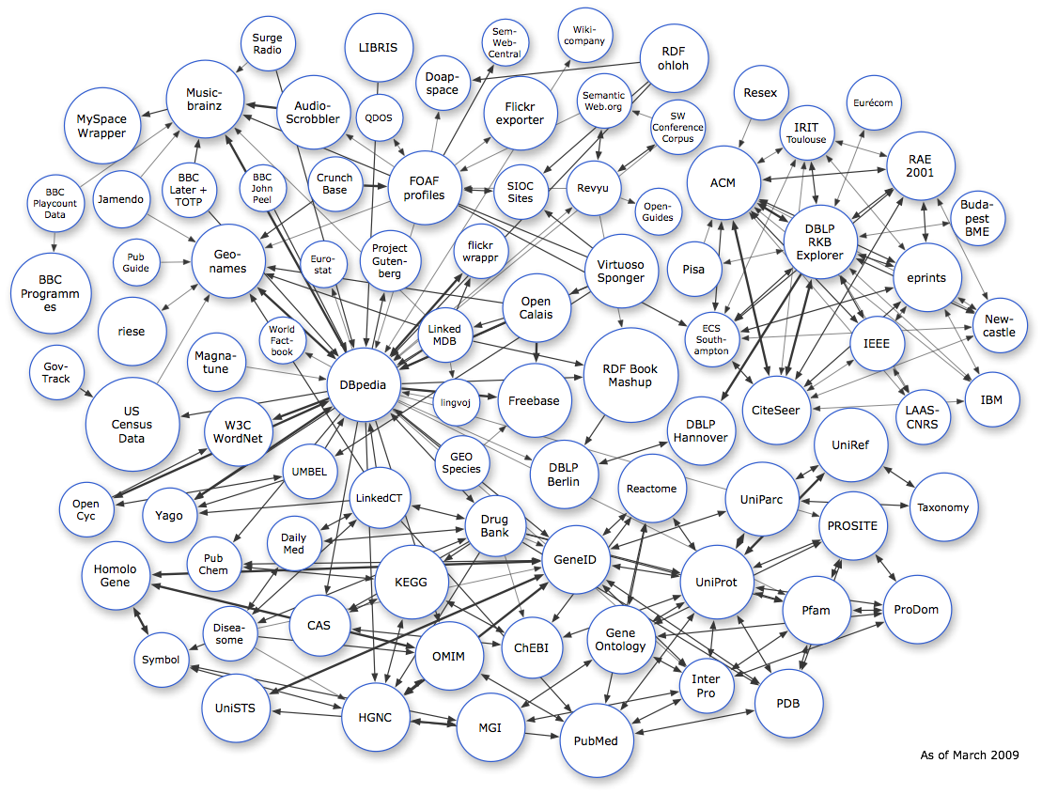
The LOD cloud
Oct. 2007
Nov. 2007
Feb. 2008
Sep. 2008
Mar. 2009

Slide 50
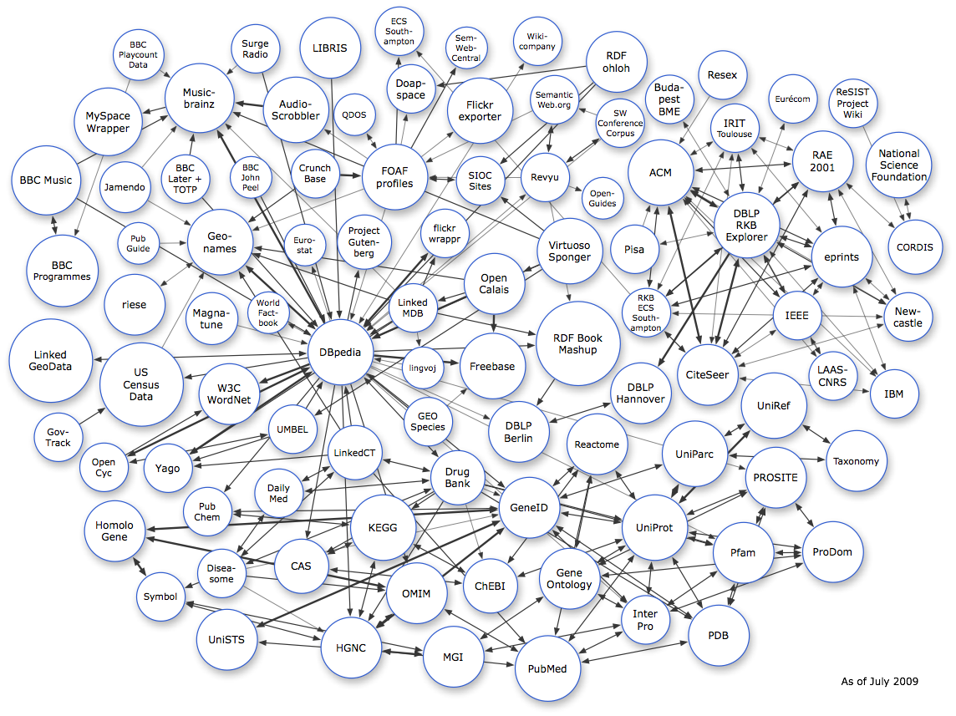
The LOD cloud
Oct. 2007
Nov. 2007
Feb. 2008
Sep. 2008
Mar. 2009
July 2009

Slide 51
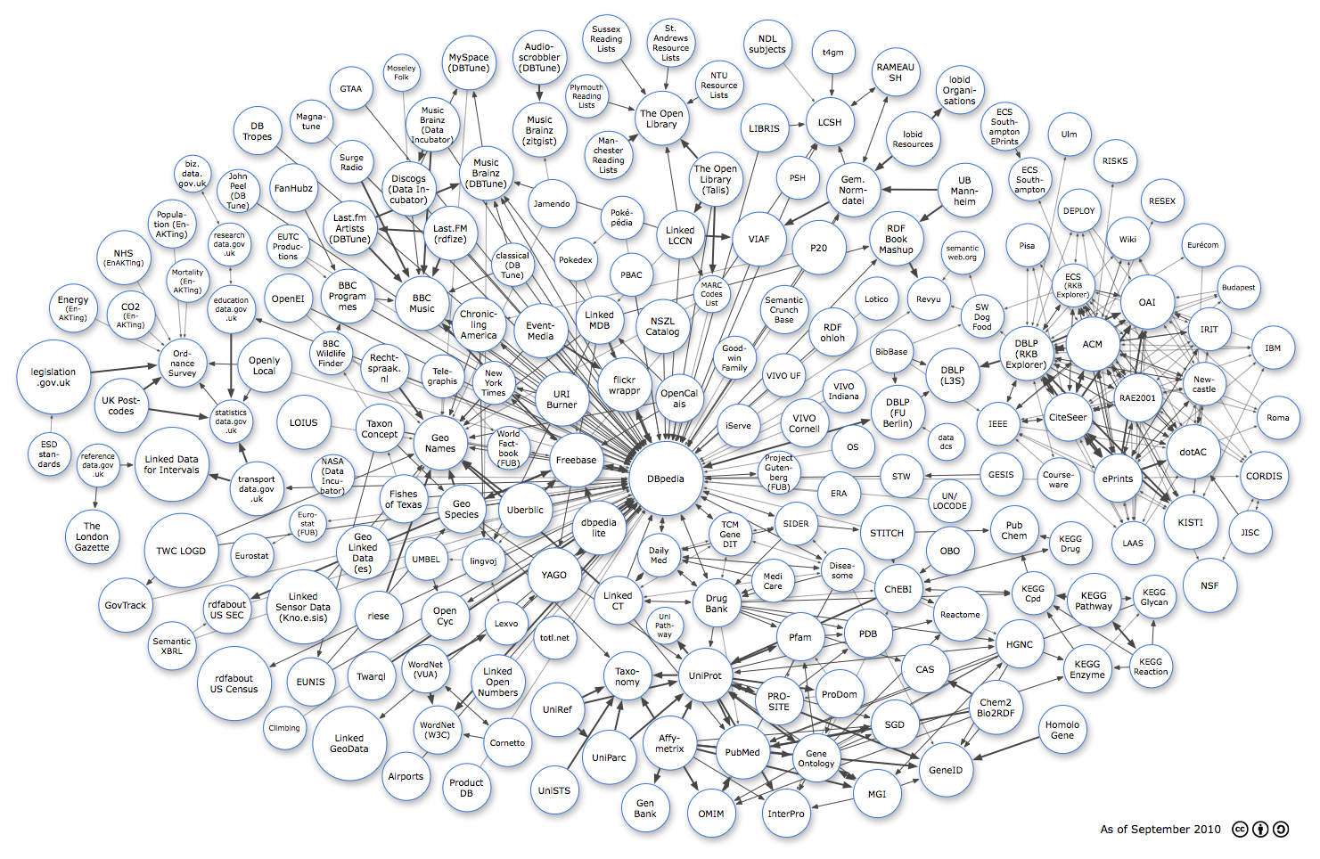
The LOD cloud
Oct 2007
Oct. 2007
Nov. 2007
Feb. 2008
Sep. 2008
Mar. 2009
July 2009
Sept. 2010

Slide 52
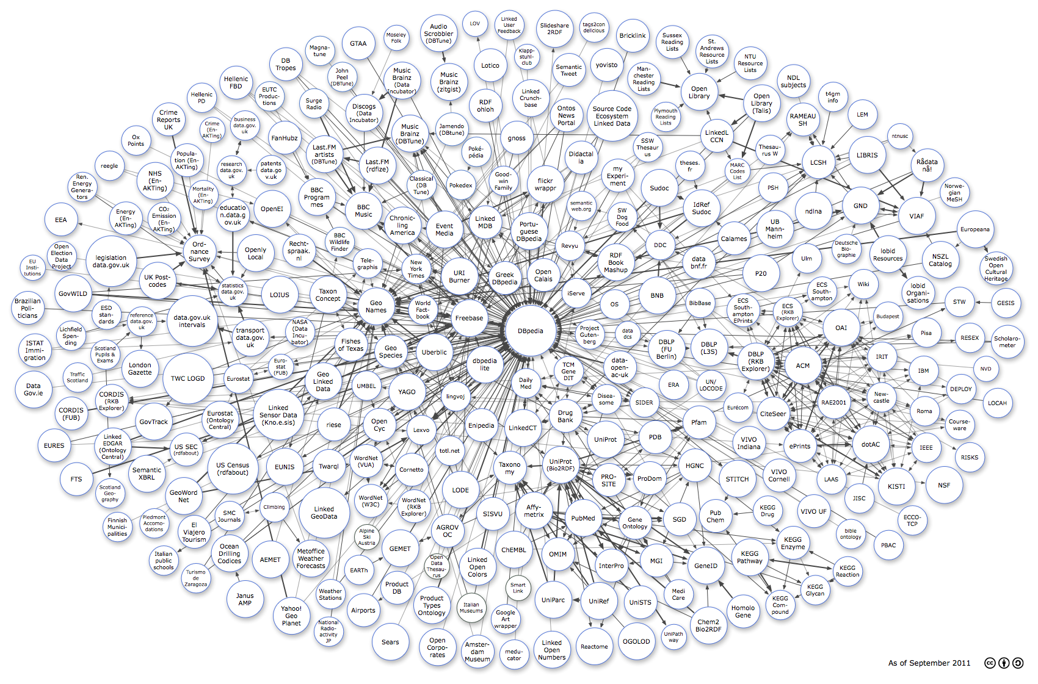
The LOD cloud
Oct. 2007
Nov. 2007
Feb. 2008
Sep. 2008
Mar. 2009
July 2009
Sept. 2010
Sept. 2011

Slide 53
The LOD cloud
Oct. 2007
Nov. 2007
Feb. 2008
Sep. 2008
Mar. 2009
July 2009
Sept. 2010
Sept. 2011
Sept. 2012

Slide 54
The LOD cloud
Oct. 2007
Nov. 2007
Feb. 2008
Sep. 2008
Mar. 2009
July 2009
Sept. 2010
Sept. 2011
Sept. 2012
Sept. 2013

Slide 55
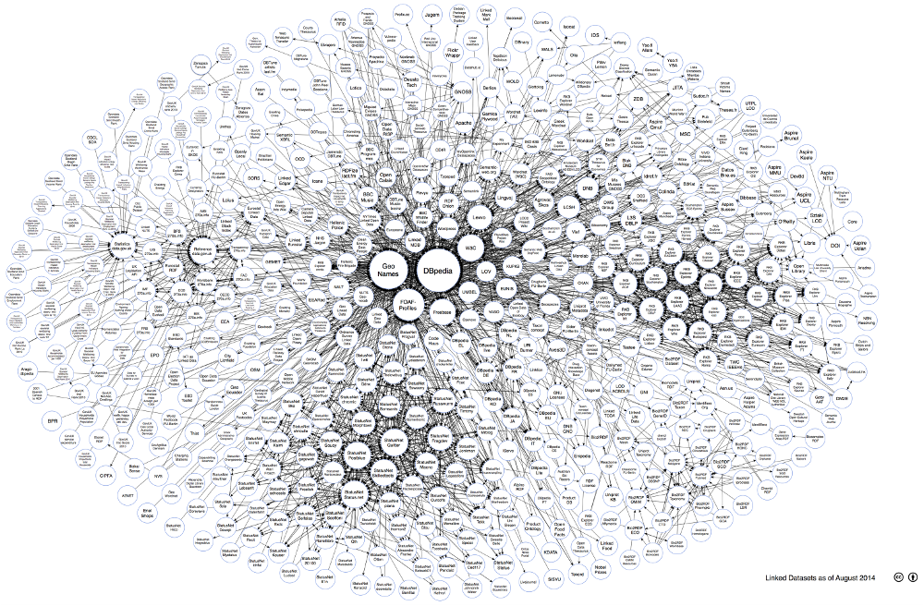
The LOD cloud
Oct. 2007
Nov. 2007
Feb. 2008
Sep. 2008
Mar. 2009
July 2009
Sept. 2010
Sept. 2011
Sept. 2012
Sept. 2013
Aug. 2014

Slide 56
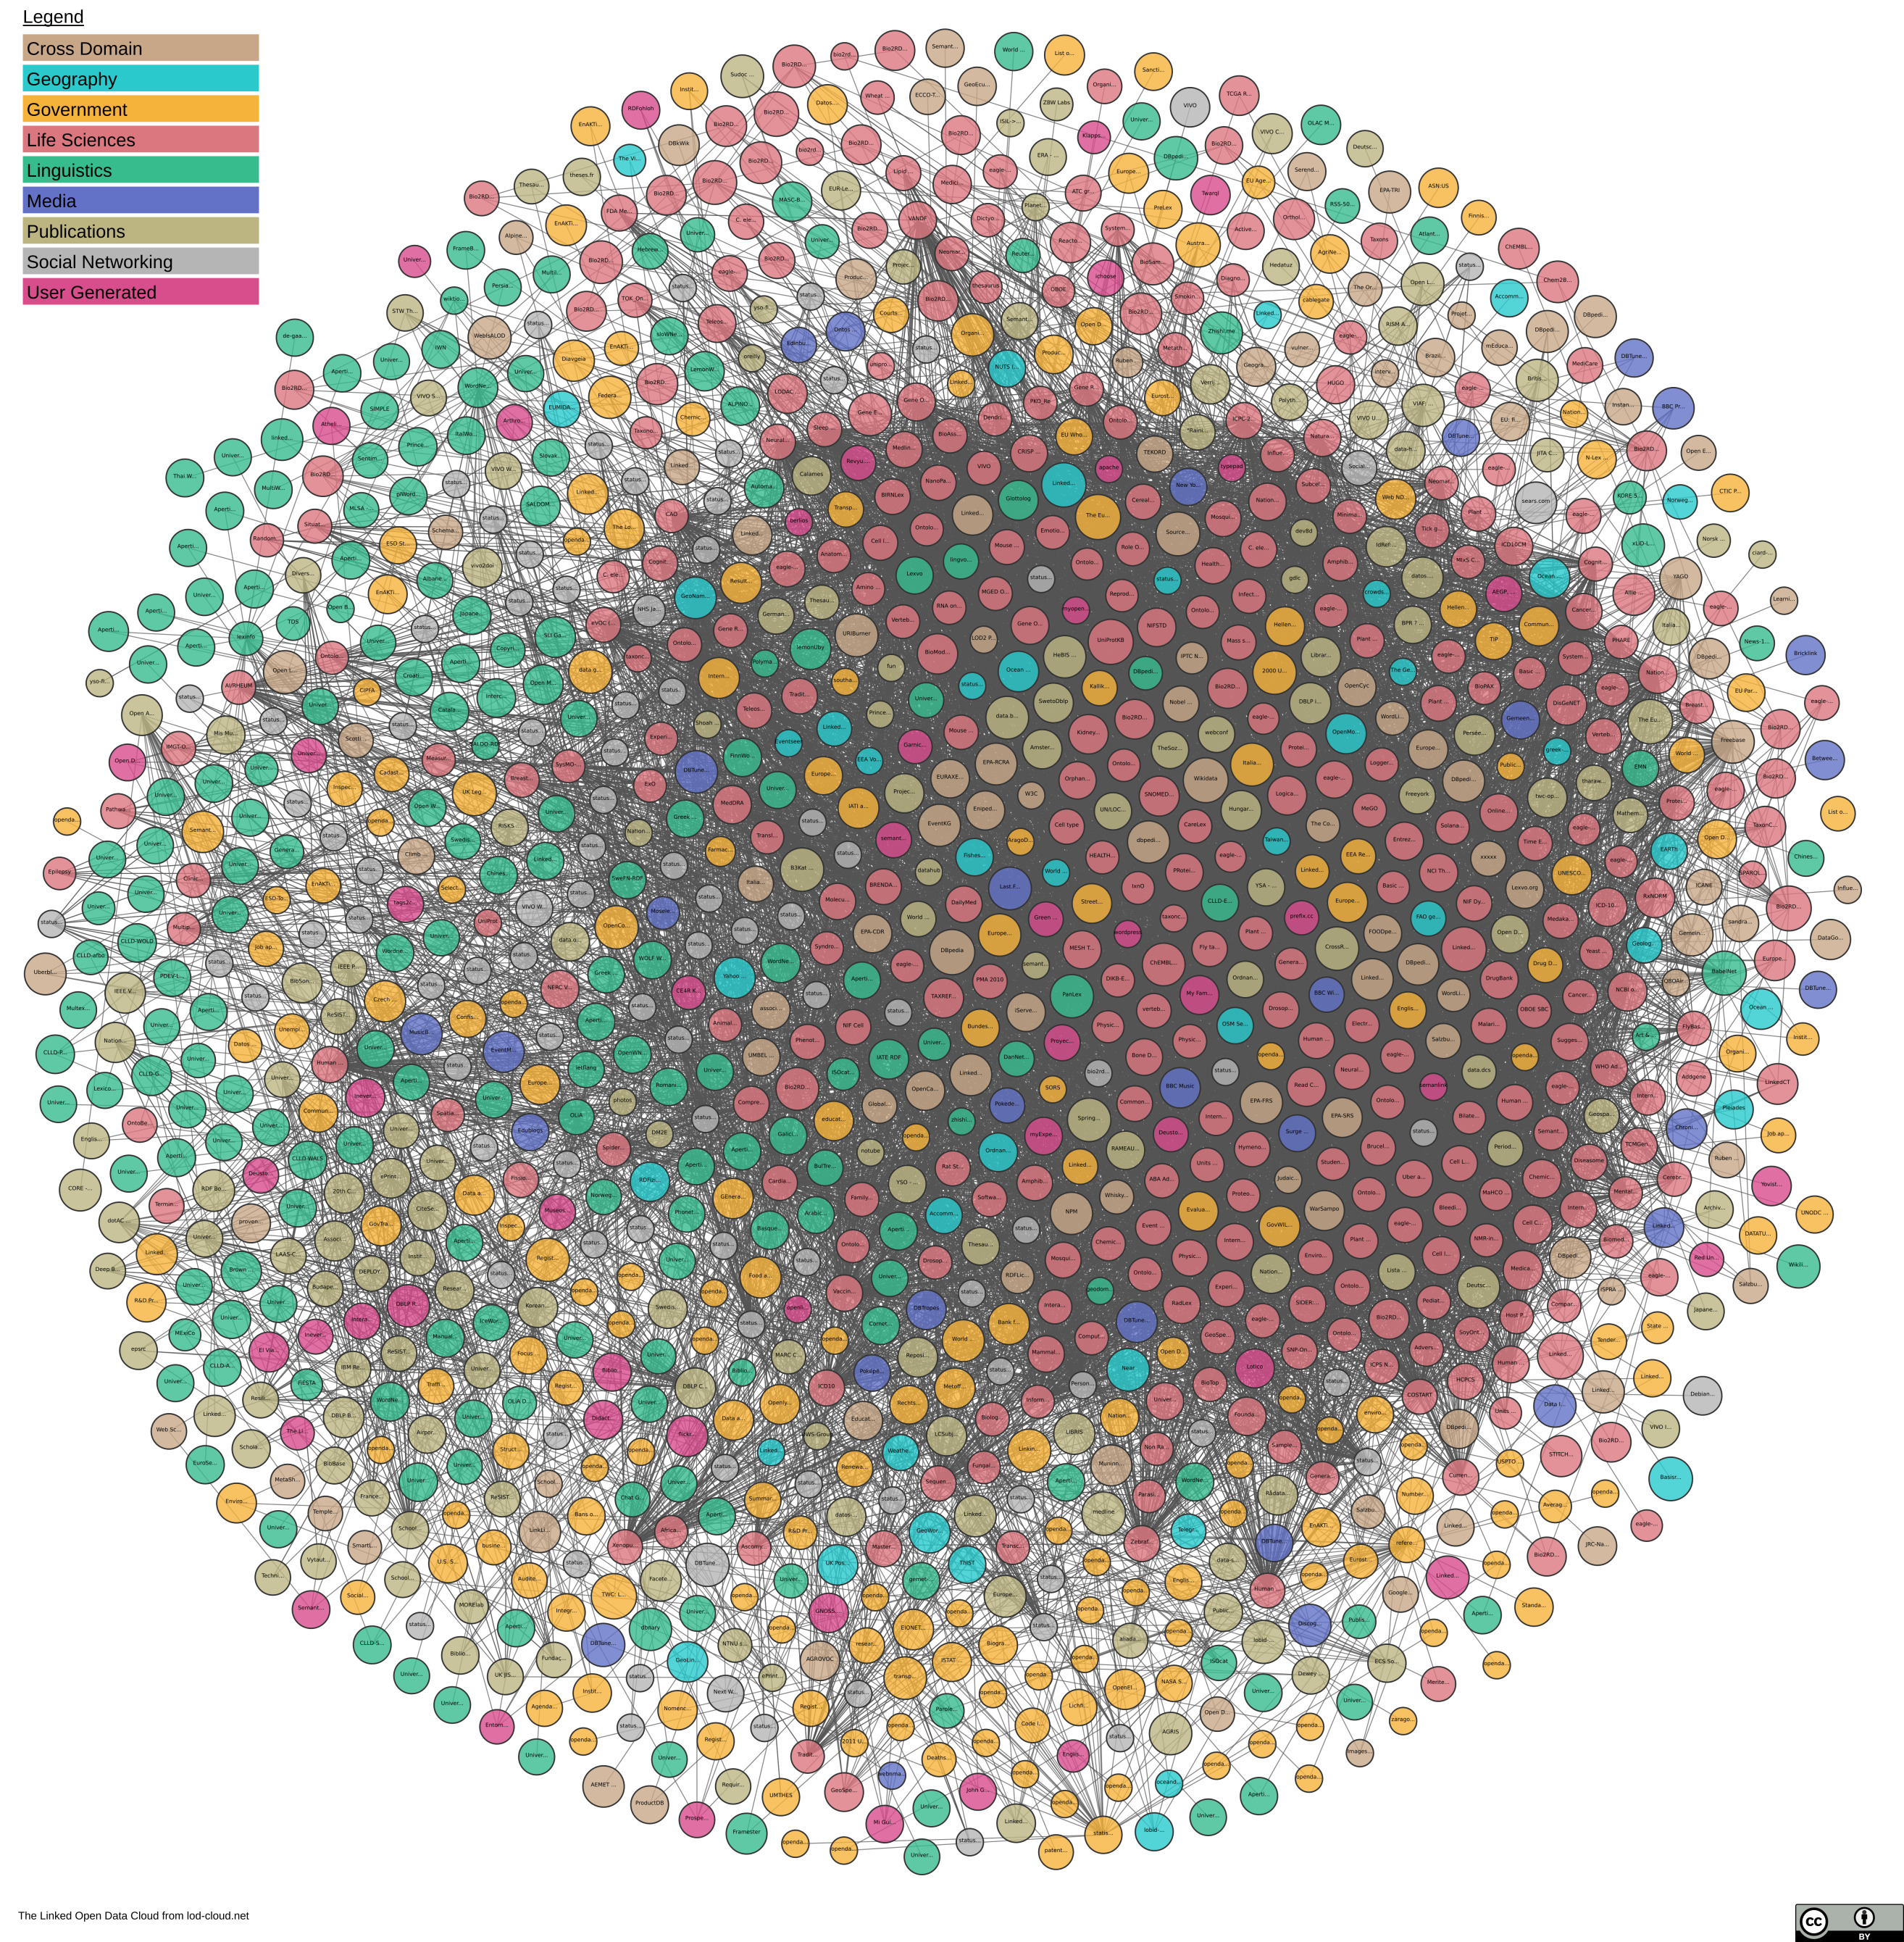
The LOD Cloud
Oct. 2007
Nov. 2007
Feb. 2008
Sep. 2008
Mar. 2009
July 2009
Sept. 2010
Sept. 2011
Sept. 2012
Sept. 2013
Aug. 2014
Nov. 2018

Slide 57
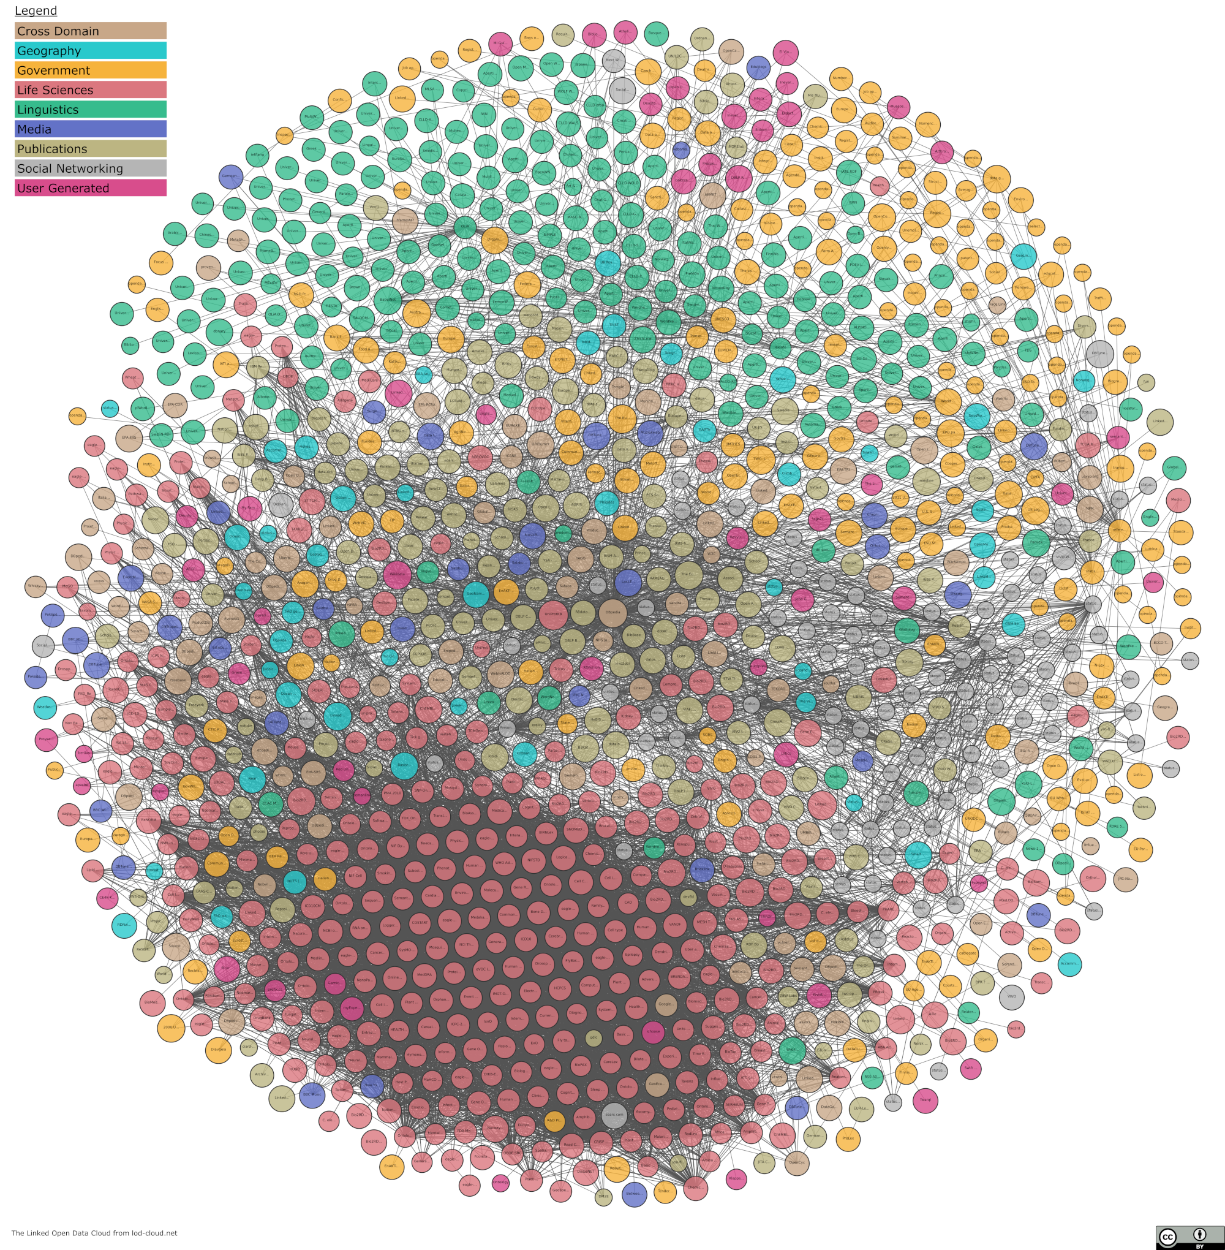
The LOD Cloud
Oct. 2007
Nov. 2007
Feb. 2008
Sep. 2008
Mar. 2009
July 2009
Sept. 2010
Sept. 2011
Sept. 2012
Sept. 2013
Aug. 2014
Nov. 2018
May 2020

Slide 58
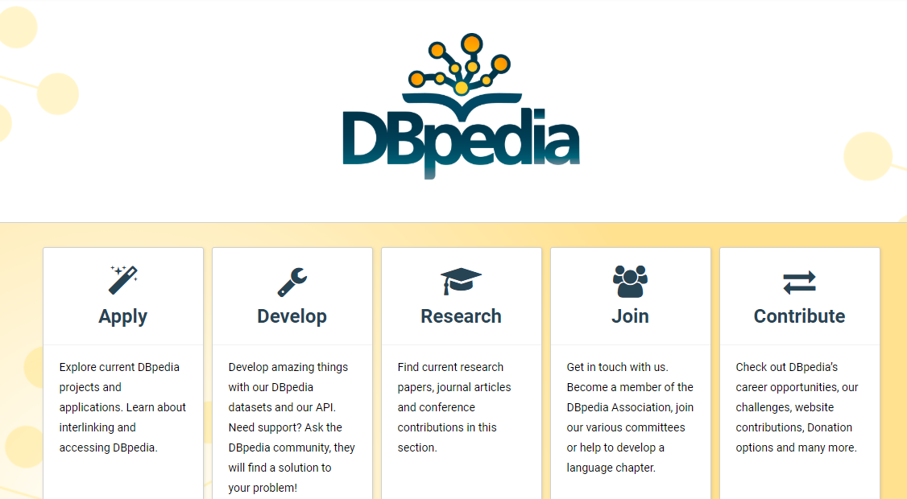
Cross-Domain

Slide 59
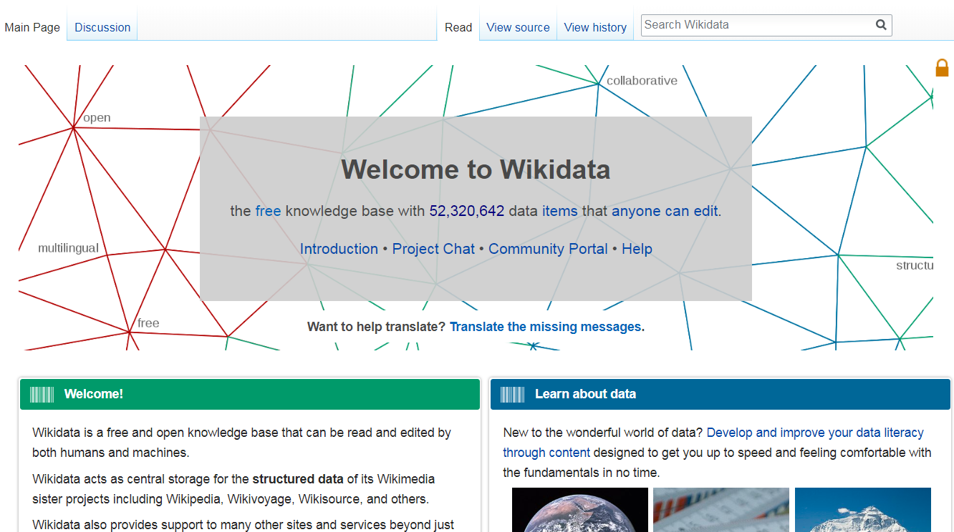
Cross-Domain

Slide 60
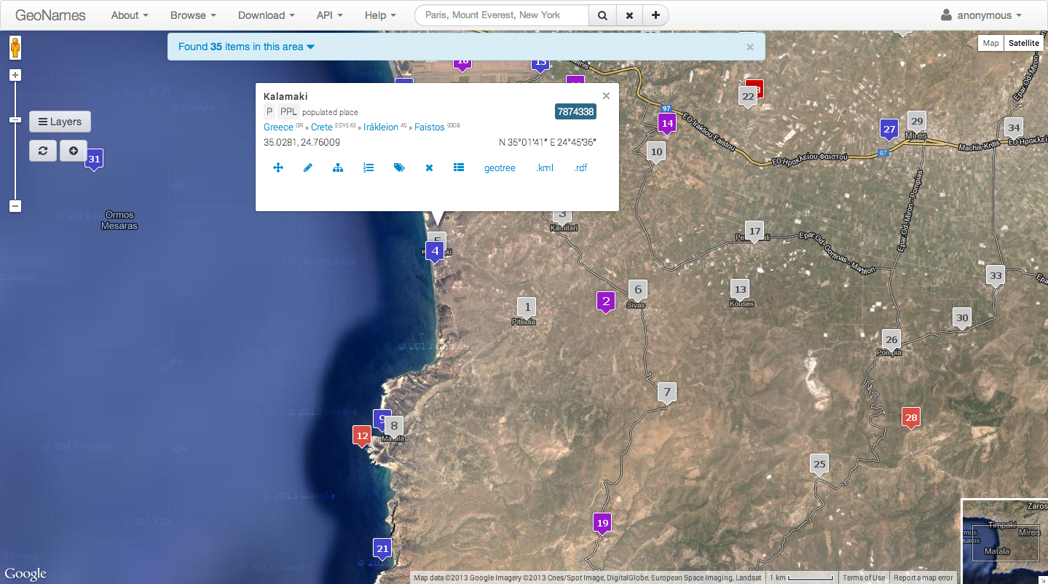
Geographic

Slide 61
Geographic

Slide 62
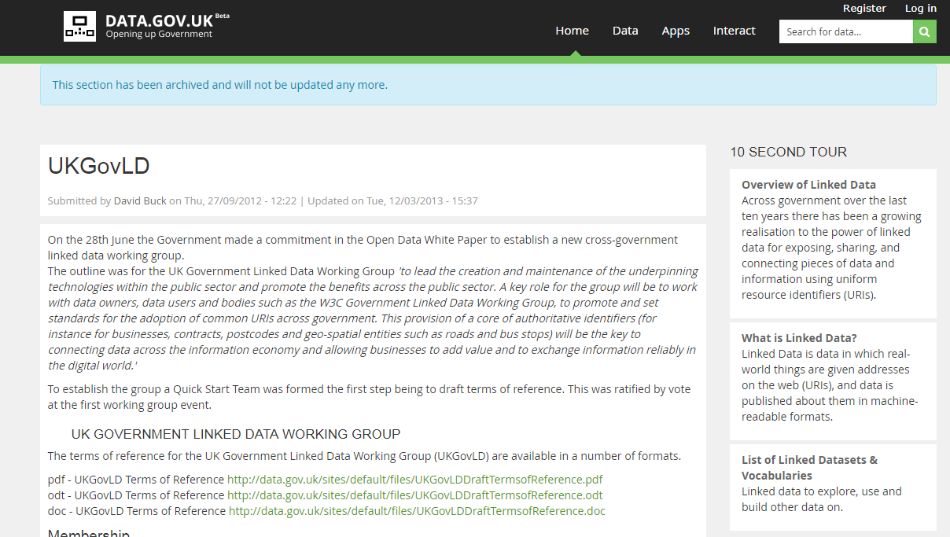
Governmental

Slide 63
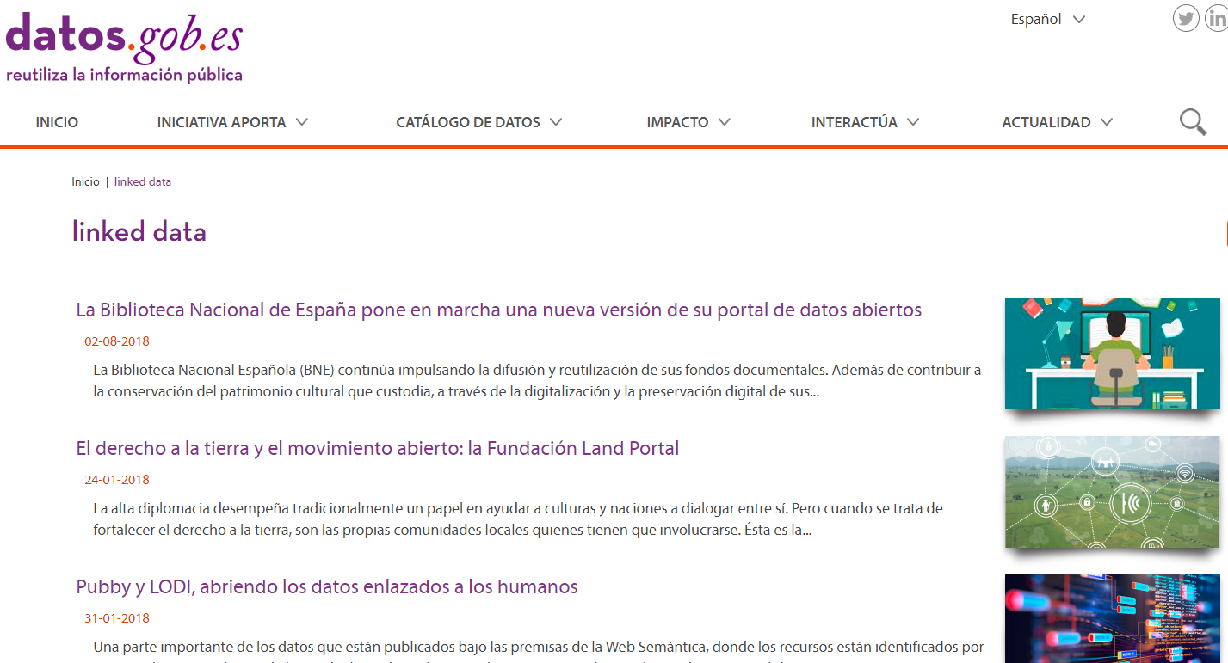
Governmental

Slide 64
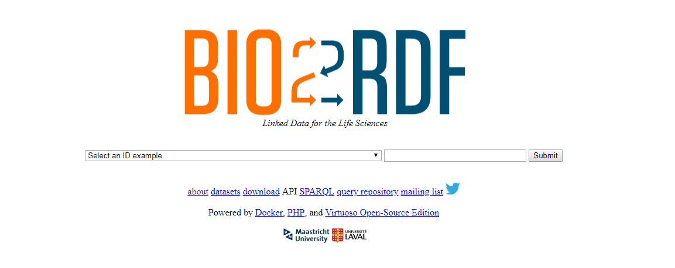
Life Sciences

Slide 65
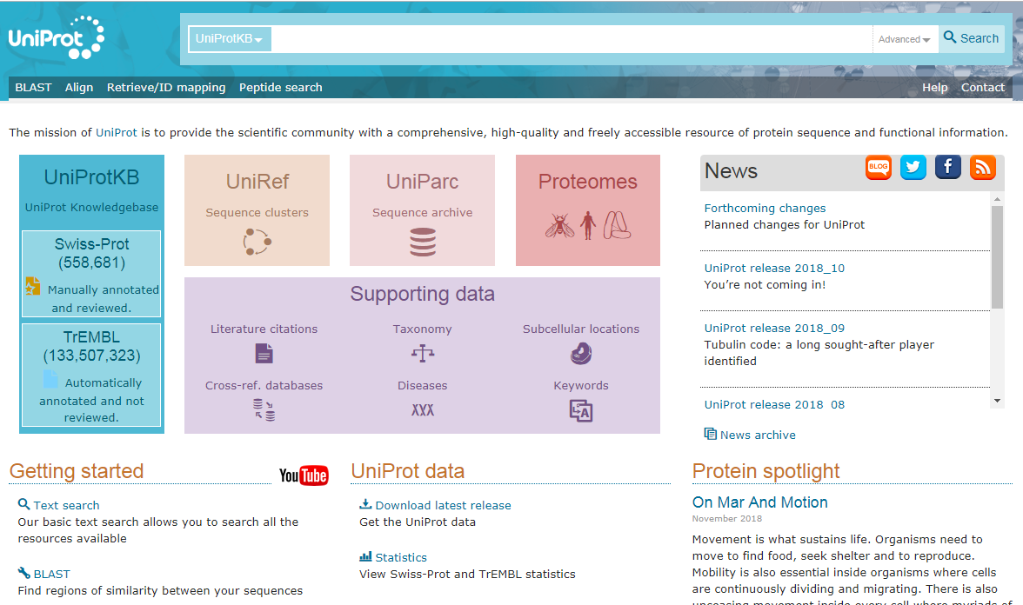
Life Sciences

Slide 66
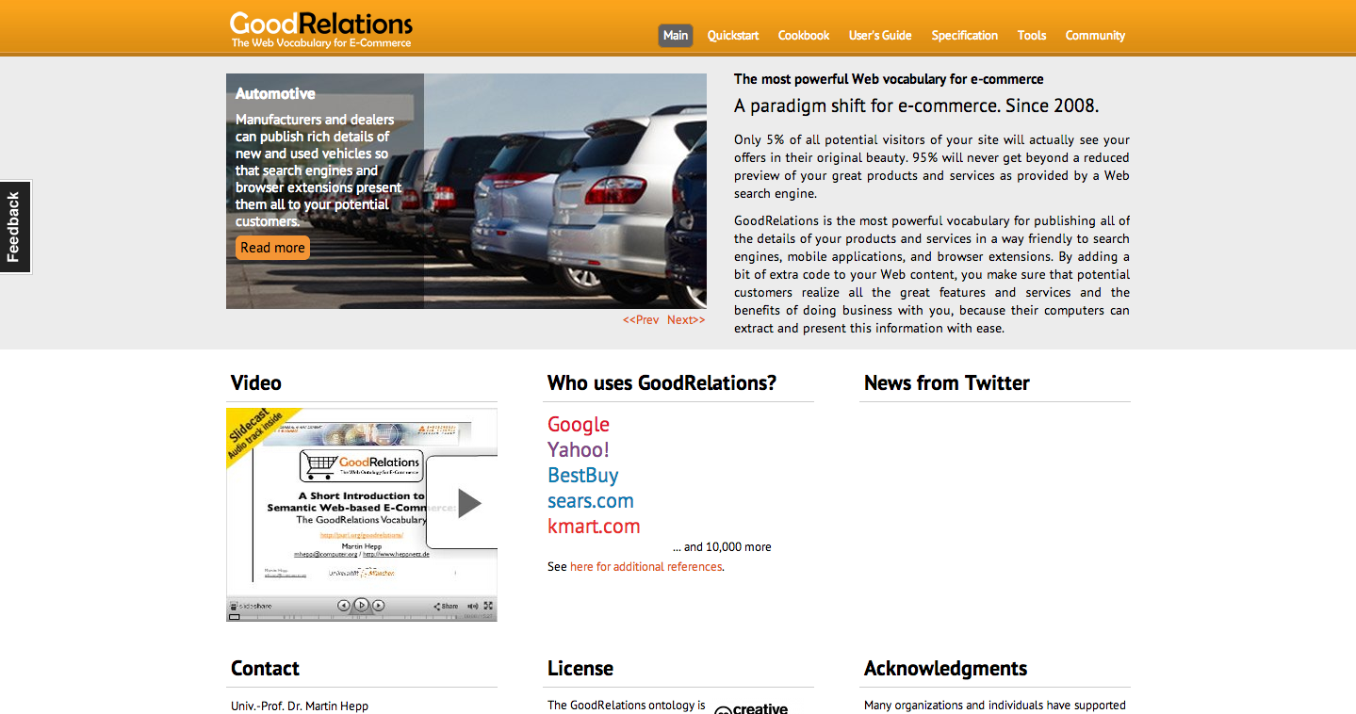
E-Commerce

Slide 67
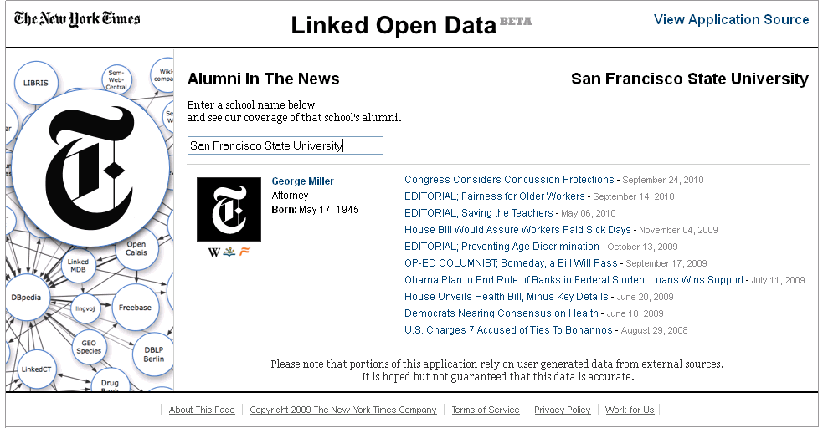
Media

Slide 68
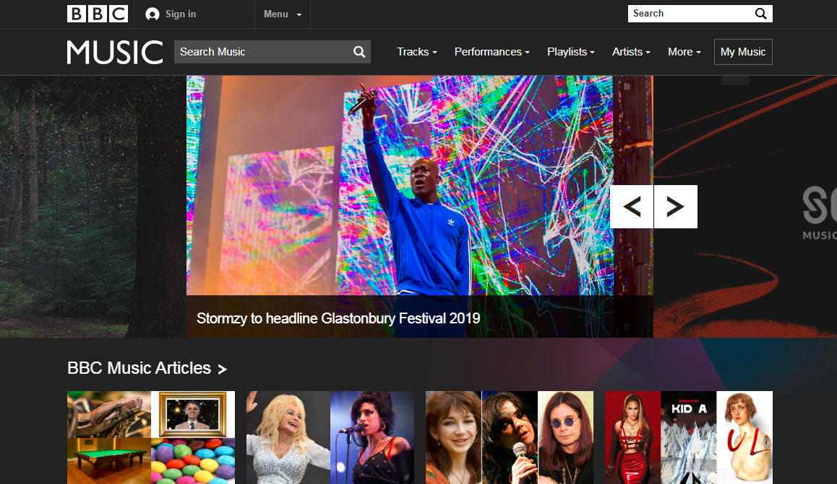
Media

Slide 69
Pokémon

Slide 70
But if every dataset describes data with their own vocabulary
the datasets will be impossible to integrate and query.
How could we address this issue?
Oct. 2007
Nov. 2007
Feb. 2008
Sep. 2008
Mar. 2009
July 2009
Sept. 2010
Sept. 2011
Sept. 2012
Sept. 2013
Aug. 2014
Nov. 2018
May 2020

Slide 71
Linked Open Vocabularies

Slide 72
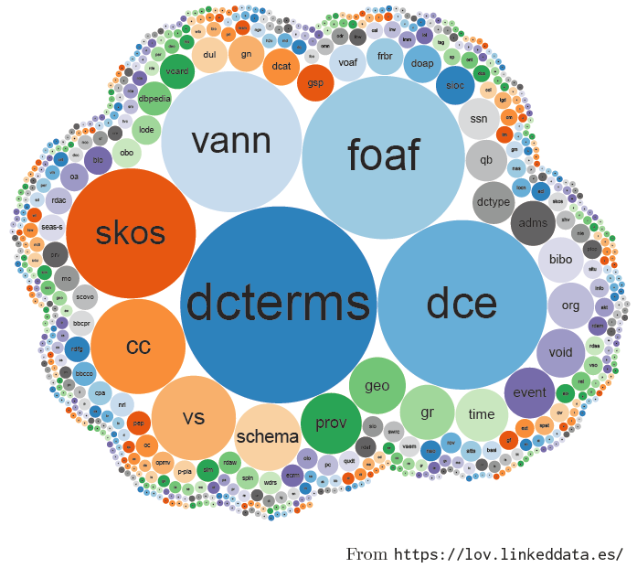
Linked Open Vocabularies
Indexes vocabularies for re-use

Slide 73
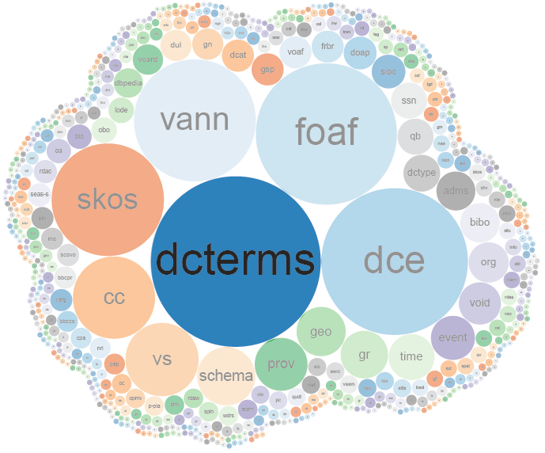
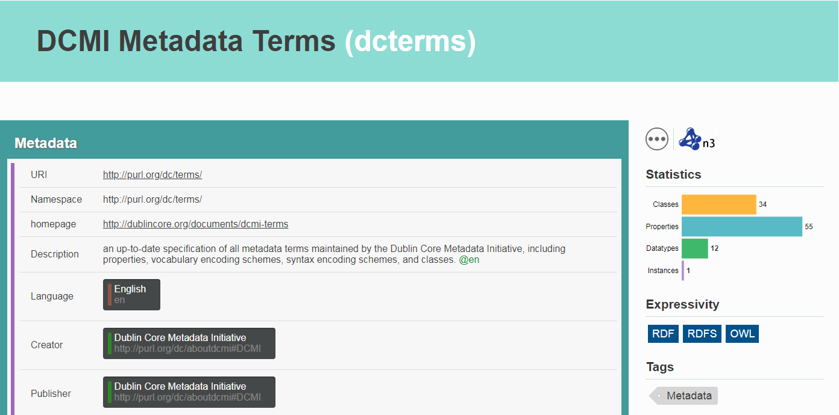
DCTERMS
Describes documents

Slide 74
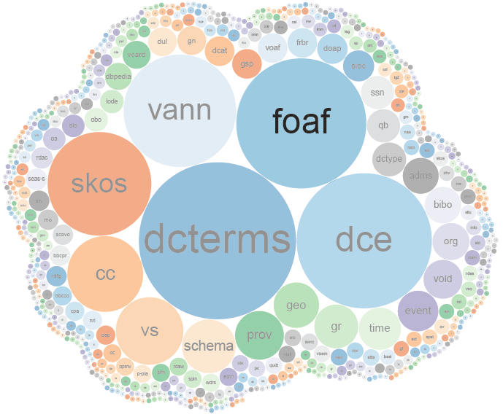
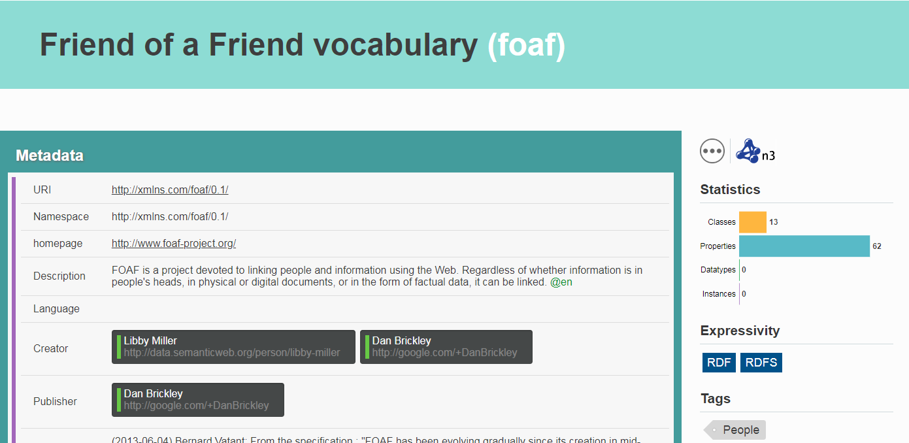
FOAF
Describes people

Slide 75
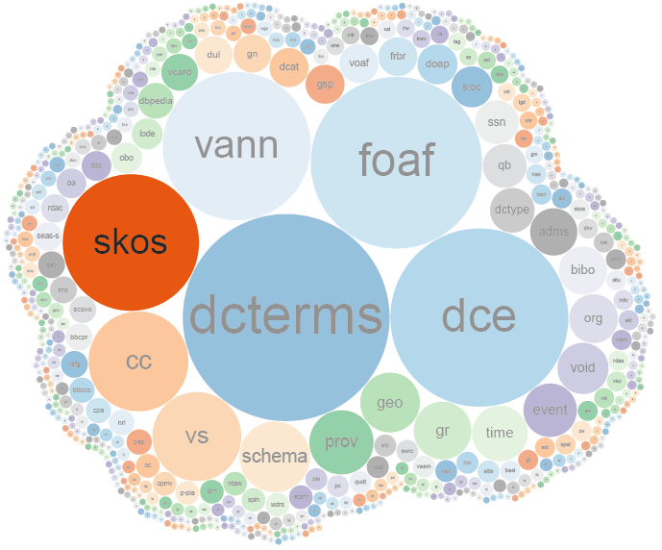
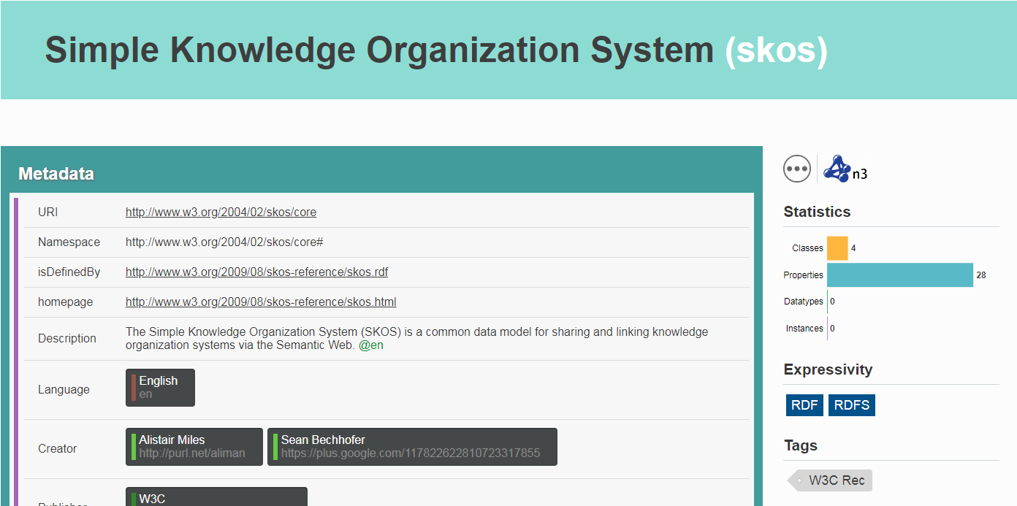
SKOS
Describes taxonomies

Slide 76
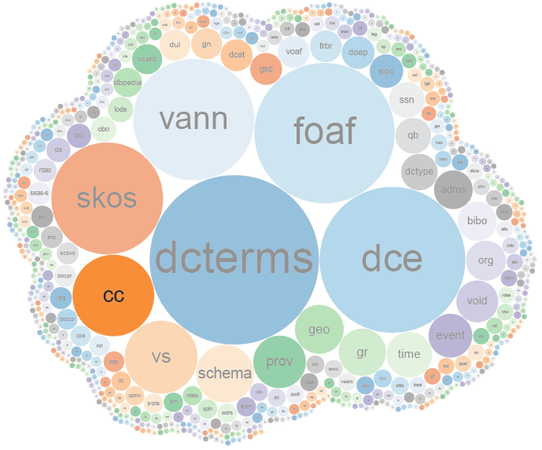
CC
Describes licencing

Slide 77
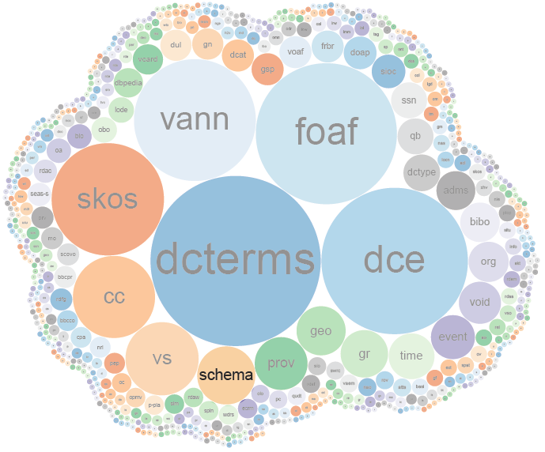
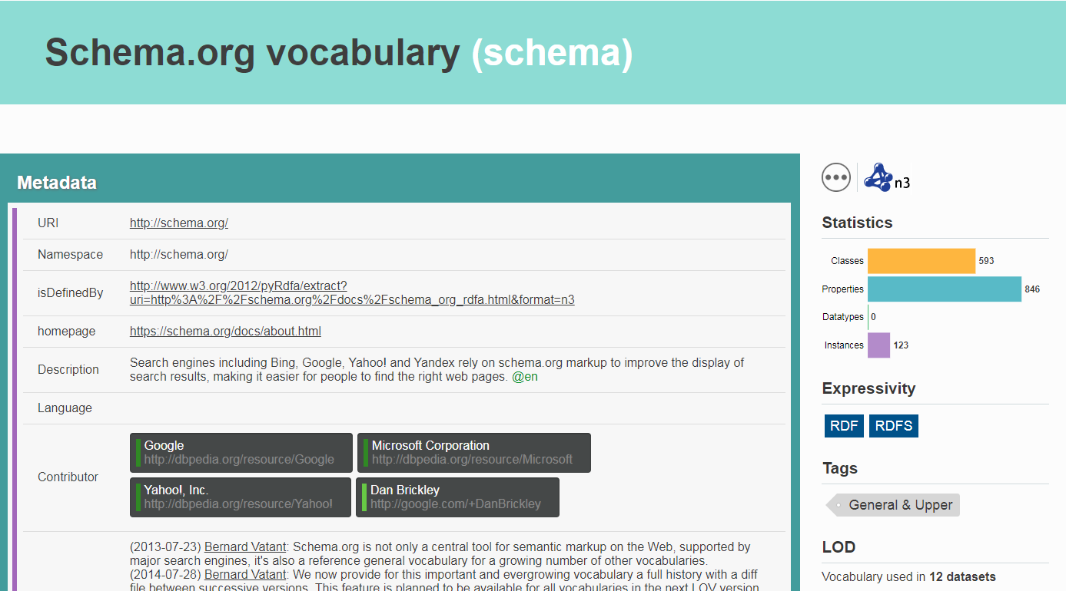
SCHEMA
Describes everything

Slide 78
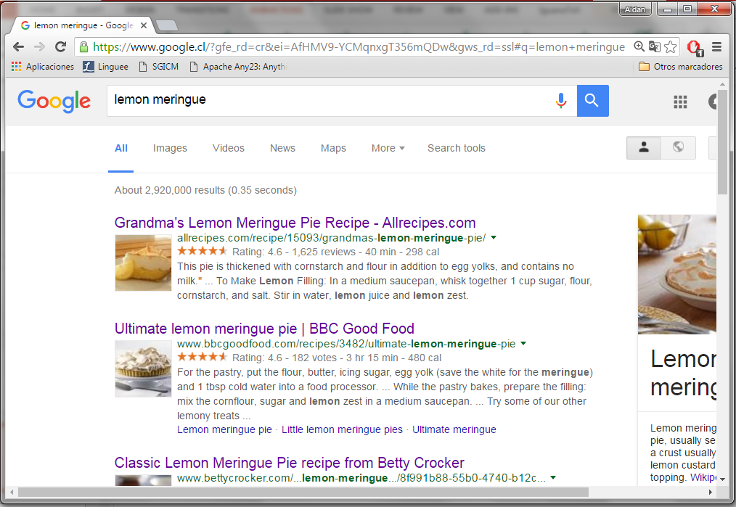
SCHEMA
Describes everything

Slide 79
Linked Data Applications

Slide 80
So who is using these datasets (and for what)?
Oct. 2007
Nov. 2007
Feb. 2008
Sep. 2008
Mar. 2009
July 2009
Sept. 2010
Sept. 2011
Sept. 2012
Sept. 2013
Aug. 2014
Nov. 2018
May 2020

Slide 81
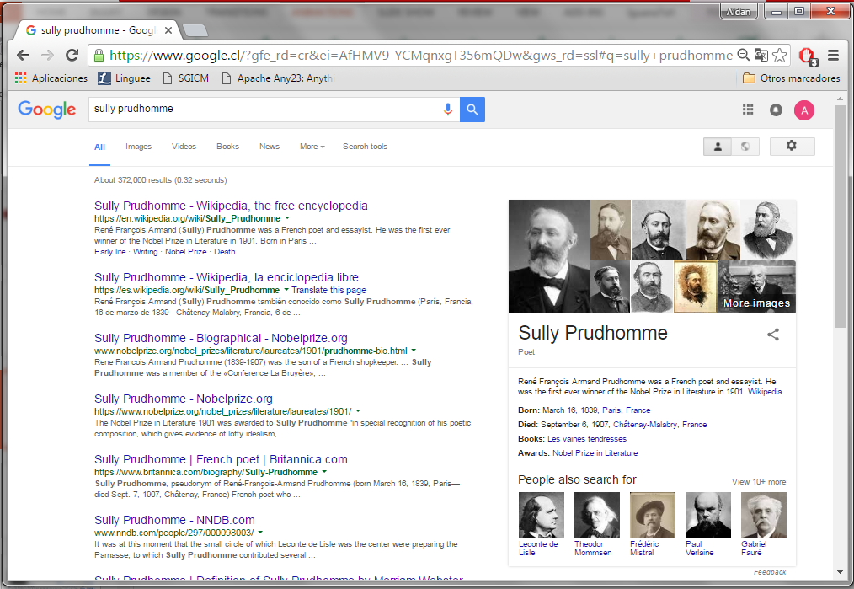
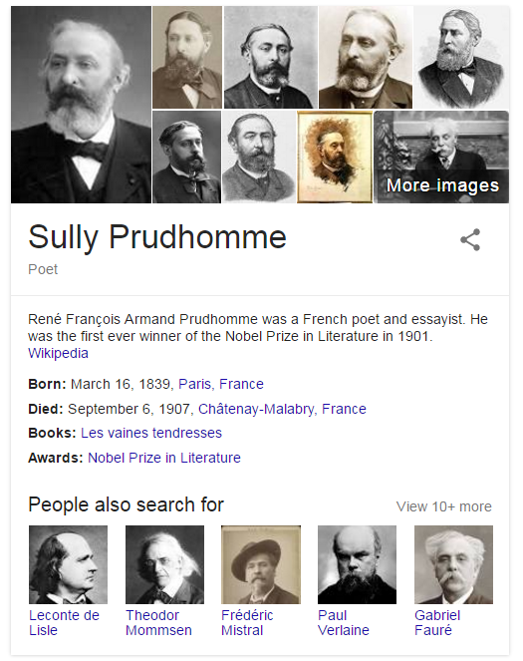
Google’s Knowledge Graph

Slide 82
Apple's Siri

Slide 83
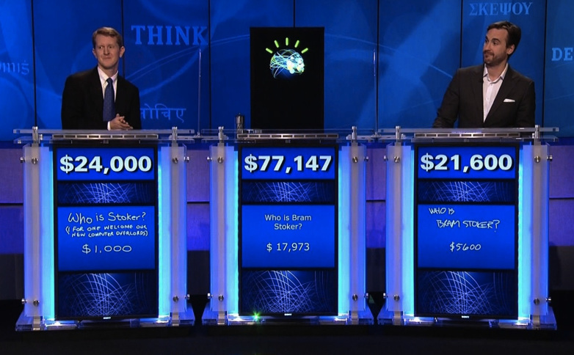
IBM's Watson

Slide 84
Social Linked Data: SOLID

Slide 86
The LOD Cloud
However, these applications use hand-picked Linked Datasets and/or hand-picked Linked Vocabularies!
Hard to find real-world applications that discover Linked Data
Oct. 2007
Nov. 2007
Feb. 2008
Sep. 2008
Mar. 2009
July 2009
Sept. 2010
Sept. 2011
Sept. 2012
Sept. 2013
Aug. 2014
Nov. 2018

Slide 87
Entering Unknown Territory: Open Research Questions!

Slide 88
Open Issue: Linked Data Integration

Slide 89
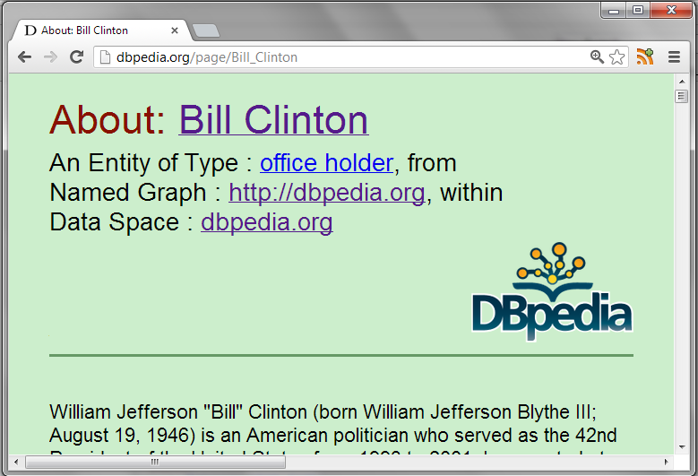
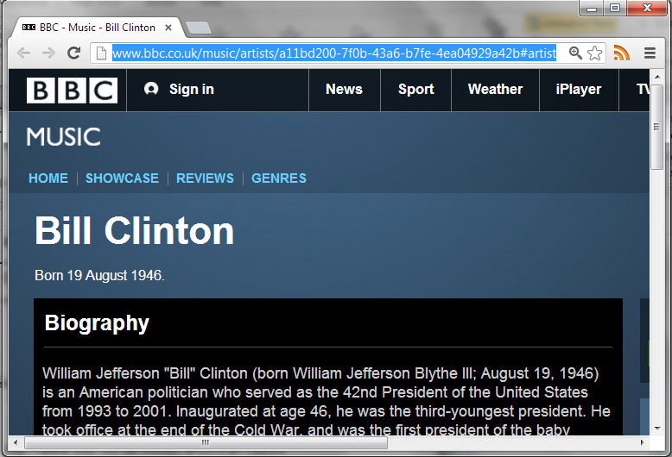
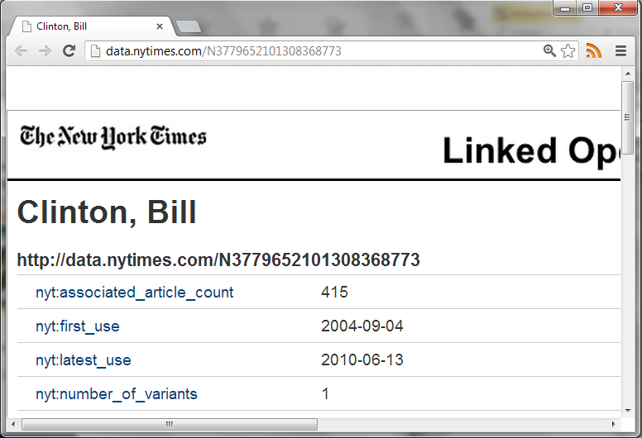
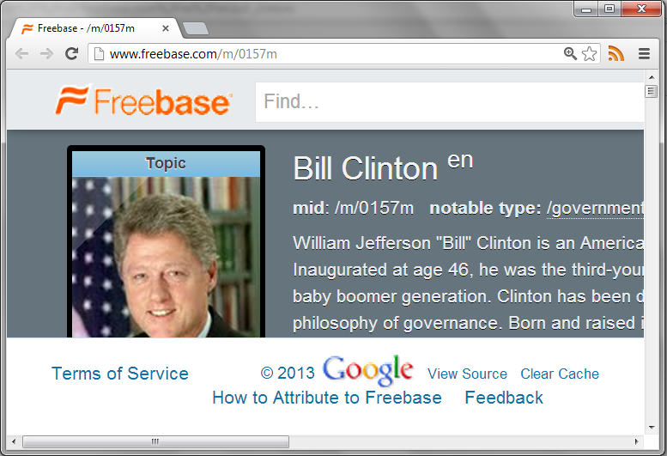
Need for Integration
http://dbpedia.org/resource/Bill_Clinton
http://rdf.freebase.com/ns/en.bill_clinton
http://data.nytimes.com/clinton_bill_per
http://www.bbc.co.uk/music/artists/…
How could OWL help here?
owl:sameAs

Slide 90
Open Issue: Diverse Vocabularies

Slide 91
Diverse vocabularies
How can we integrate and write queries against Linked Data from different sources?

Slide 92
Open Issue: Linked Data Access

Slide 93
Access Methods
D
Q
D
D
Q
Q
D
Q
Multiple clients / multiple servers (blurred)
Remote, decentralised, uncoordinated
Web scale

Slide 94
Open Issue: Linked Data quality

Slide 95
Can’t trust everything you read on the Web
The same is true for on the Web

Slide 96
Open Issue: Legacy data

Slide 97
Most Web (meta-)data in …
… and so on …

Slide 98
From ★★★ to ★★★★ is a big step!!

Slide 99
Questions?

