Slide 1
CC7220-1
La Web de Datos
Primavera 2021
Lecture 4: Web Ontology Language (OWL) [I]
Aidan Hogan
aidhog@gmail.com

Slide 2
Last time …

Slide 3







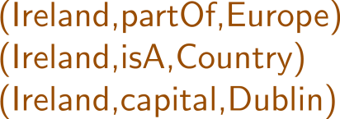


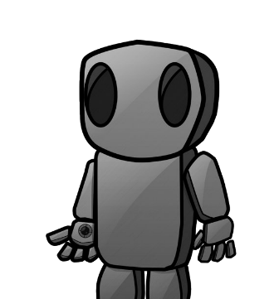
Semantic Web: Logic
* More or less

Slide 4
RDF Schema: RDFS
Class c is a sub-class of Class d
  If (x,rdf:type,c) then (x,rdf:type,d)
Property p is a sub-property of q
  If (x,p,y) then (x,q,y)
Property p has domain class c
  If (x,p,y) then (x,rdf:type,c)
Property p has range class c
  If (x,p,y) then (y,rdf:type,c)

Slide 5
Today's topic ...

Slide 6
Semantic Web: Logic
* More or less

Slide 7
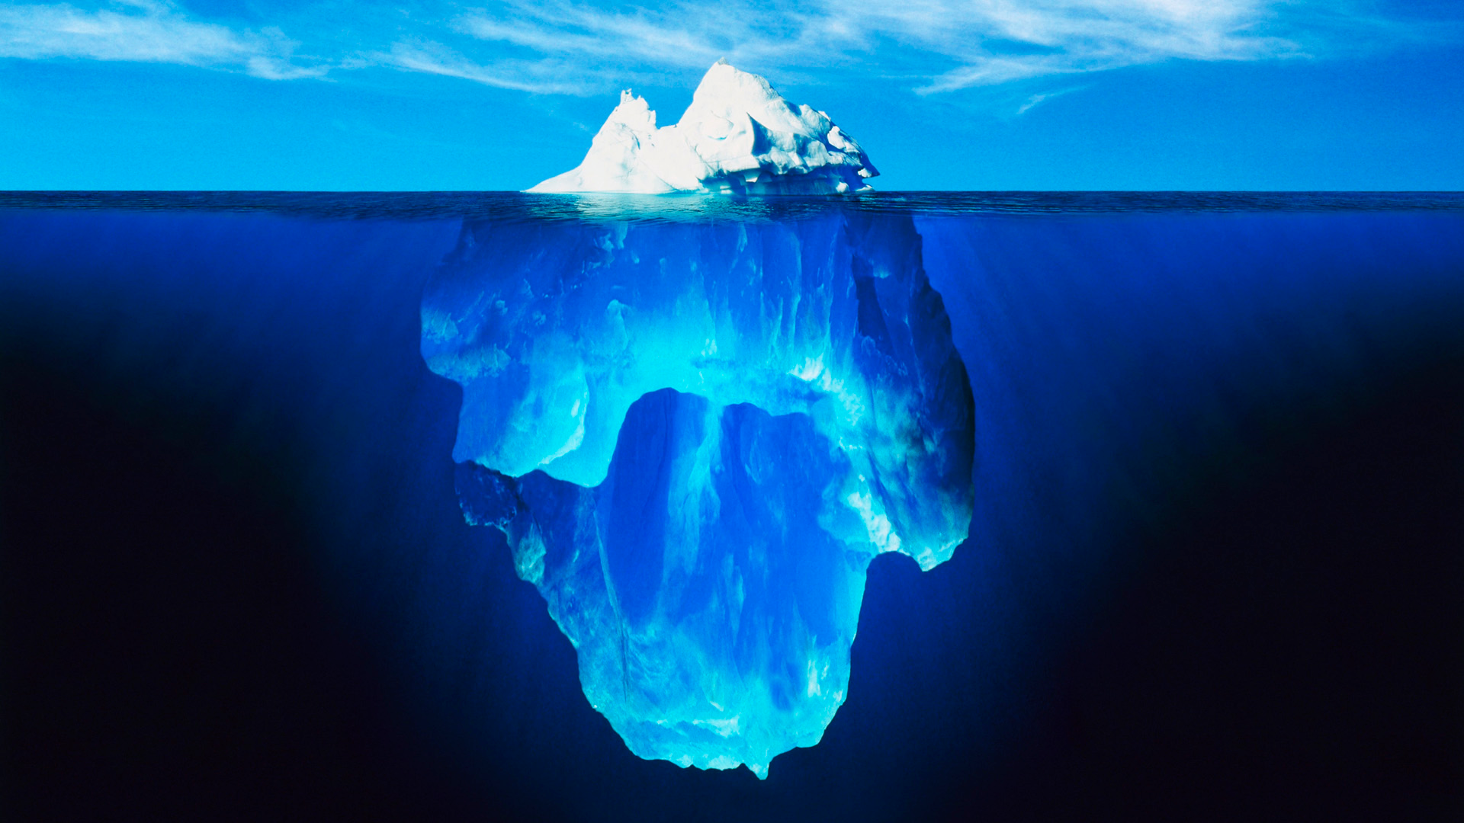


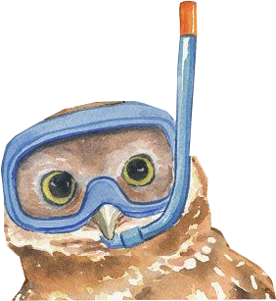

Slide 8
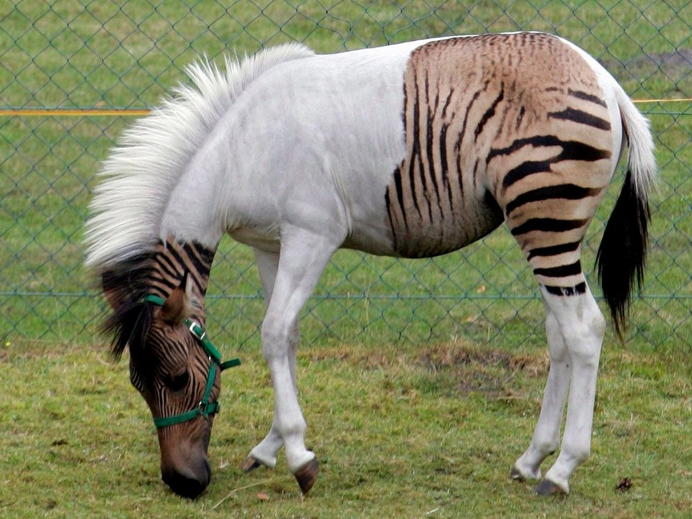

Slide 9
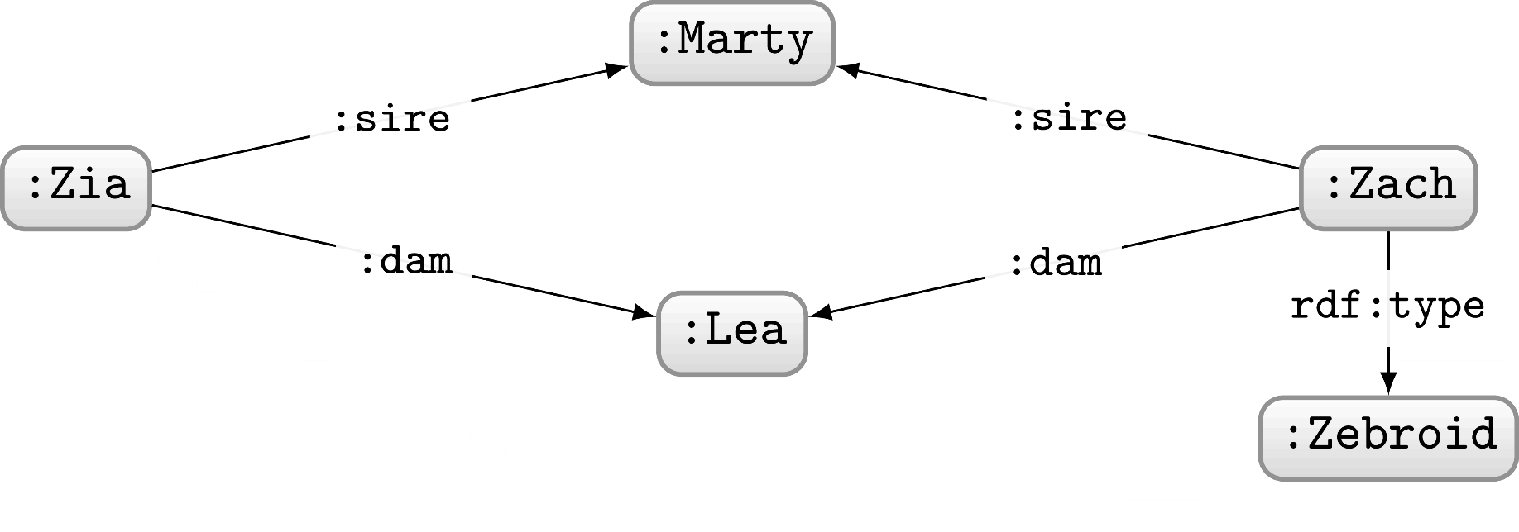

Slide 10
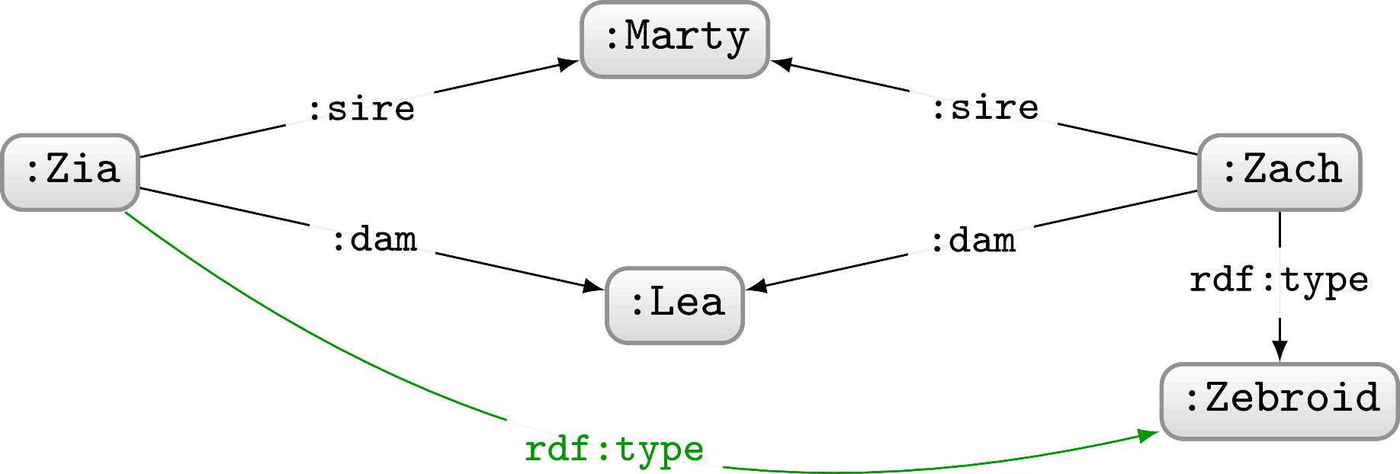

Slide 11
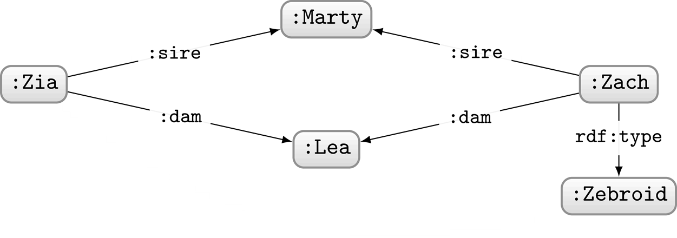
What can we intuitively conclude about Zia?

Slide 12
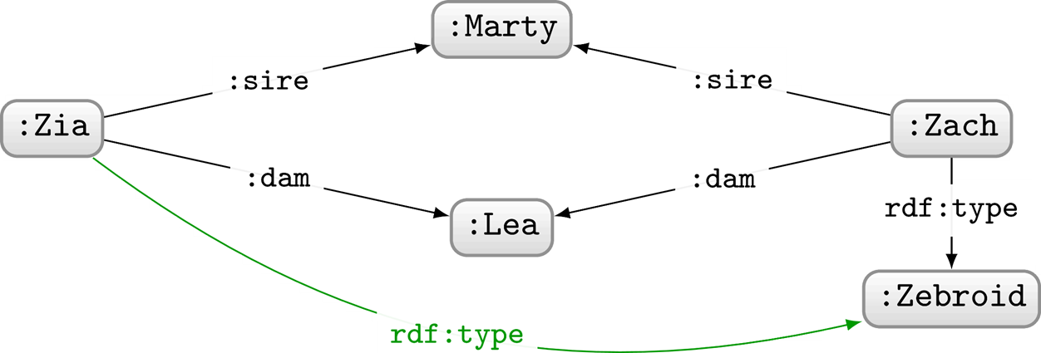
What can we intuitively conclude about Zia?
Zia is also a Zebroid!
What kind of reasoning are we using here?
Deductive (mostly)

Slide 13
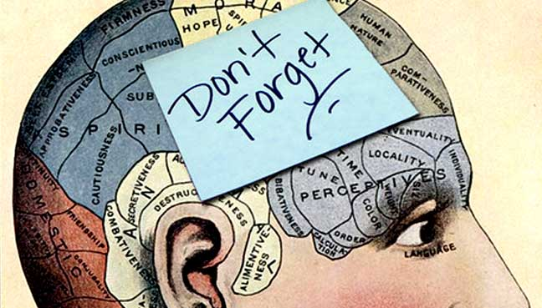
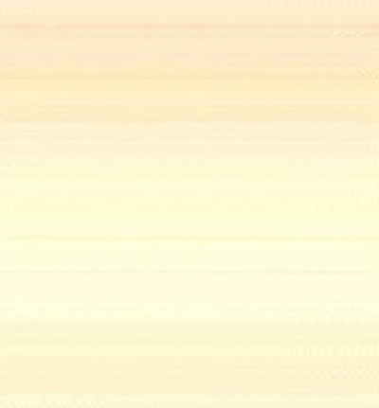
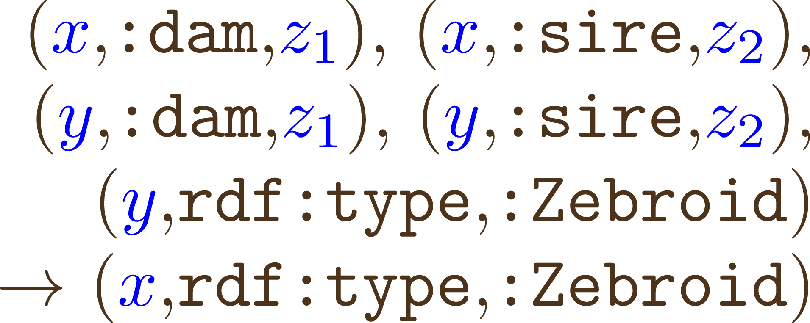

What assumptions do we make to conclude that Zia is a Zebroid?
If x has same sire and dam as y and y is a Zebroid then x is a Zebroid!
Very specific to this example

Slide 14
What assumptions do we make to conclude that Zia is a Zebroid?
sire is a sub-property of parent
dam is a sub-property of parent

Slide 15
What assumptions do we make to conclude that Zia is a Zebroid?
sire is a sub-property of parent
dam is a sub-property of parent
A Zebroid has exactly one parent a Zebra
A Zebroid has exactly one parent a (¬Zebra and a Equine)

Slide 16
What assumptions do we make to conclude that Zia is a Zebroid?
sire is a sub-property of parent
dam is a sub-property of parent
A Zebroid has exactly one parent a Zebra
A Zebroid has exactly one parent a (¬Zebra and a Equine)
A Zebroid is a sub-class of Equine
An Equine has exactly two parents

Slide 17
What assumptions do we make to conclude that Zia is a Zebroid?
sire is a sub-property of parent
dam is a sub-property of parent
A Zebroid has exactly one parent a Zebra
A Zebroid has exactly one parent a (¬Zebra and a Equine)
A Zebroid is a sub-class of Equine
An Equine has exactly two parents
Two things cannot be related by sire and dam at the same time

Slide 18
What assumptions do we make to conclude that Zia is a Zebroid?
sire is a sub-property of parent
dam is a sub-property of parent
A Zebroid has exactly one parent a Zebra
A Zebroid has exactly one parent a (¬Zebra and a Equine)
A Zebroid is a sub-class of Equine
An Equine has exactly two parents
Two things cannot be related by sire and dam at the same time
Which are expressible in RDFS?

Slide 19
What assumptions do we make to conclude that Zia is a Zebroid?
sire is a sub-property of parent
dam is a sub-property of parent
A Zebroid has exactly one parent a Zebra
A Zebroid has exactly one parent a (¬Zebra and a Equine)
A Zebroid is a sub-class of Equine
An Equine has exactly two parents
Two things cannot be related by sire and dam at the same time
Which are expressible in RDFS?

Slide 20
What assumptions do we make to conclude that Zia is a Zebroid?
sire is a sub-property of parent
dam is a sub-property of parent
A Zebroid has exactly one parent a Zebra
A Zebroid has exactly one parent a (¬Zebra and a Equine)
A Zebroid is a sub-class of Equine
An Equine has exactly two parents
Two things cannot be related by sire and dam at the same time
Which are expressible in RDFS?
The rest we can express in OWL

Slide 21
Web Ontology Language: OWL

Slide 22
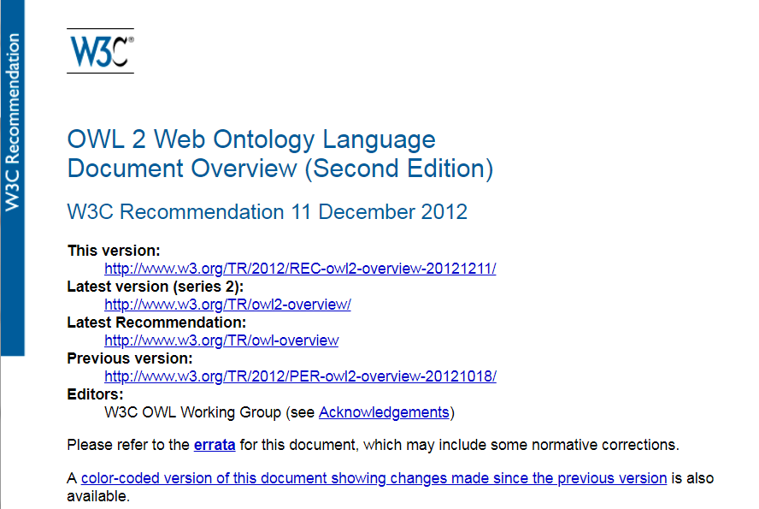
OWL (2): A Web Standard
https://www.w3.org/TR/owl2-overview/

Slide 23
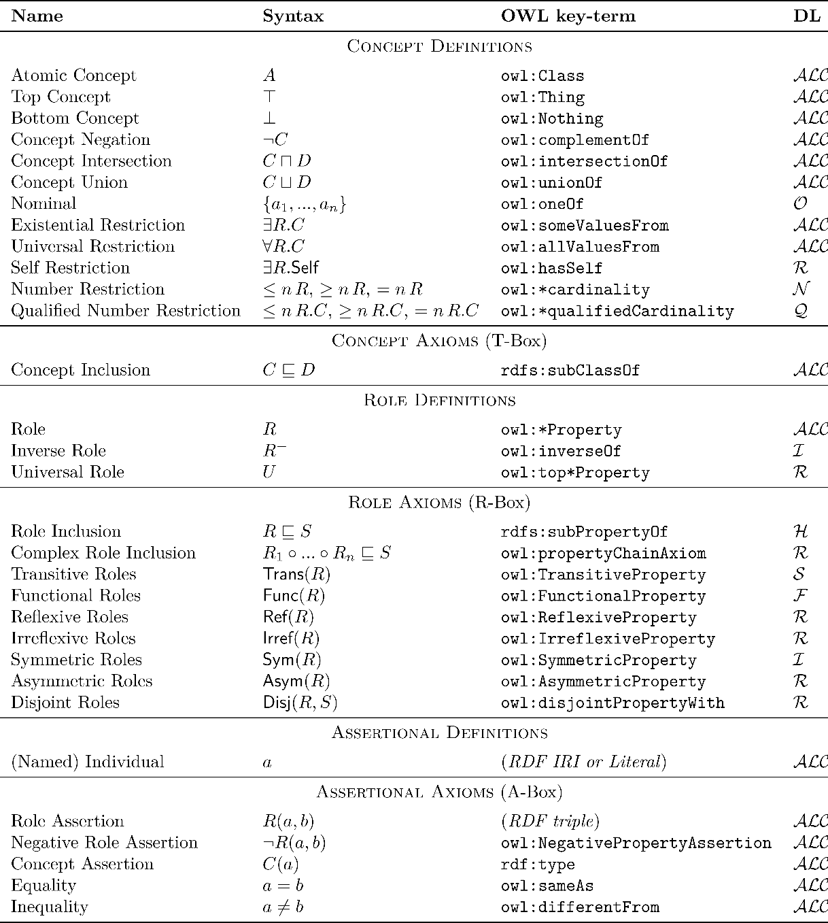
Formal Underpinnings: Description Logics

Slide 24

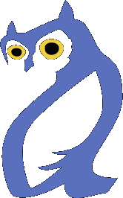
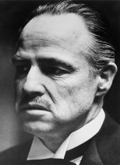
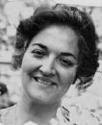

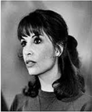
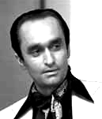
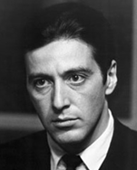


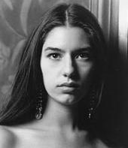
For today: A running example
:Vito
:Carmela
:Sonny
:Connie
:Fredo
:Michael
:Vincent
:Mary

Slide 25
Logical Assumptions

Slide 26
Open World Assumption (OWA)
How many children does
Vito have according
to this RDF graph?
Vito has 3 children?
Vito has at least 3 children?
:Vito
:hasChild
:Connie
:Sonny
:Fredo
:Michael
:Vito :hasChild :Connie , :Sonny , :Michael .
:Vito :hasChild :Fredo .
... ?

Slide 27
Open World Assumption
RDF(S) and OWL:
  Take an Open World Assumption (OWA):
    Anything not known is not assumed to be false, simply unknown
    Without further information, Vito may have children that we don’t know about!
Why might this assumption be important for the Web?
OWA: Assuming Web data to be complete a Bad Idea®.

Slide 28
No Unique Name Assumption (No UNA)
How many children does
Vito have according
to this RDF graph?
Vito has 3 children?
Vito has at least 3 children?
Vito has at least one child!
:Vito
:hasChild
:Connie
:Sonny
:Fredo
:Michael
:Vito :hasChild :Connie , :Sonny , :Michael .
:Vito :hasChild :Fredo .
... ?

Slide 29
No Unique Name Assumption (No UNA)
RDF(S) and OWL:
  Do not take a Unique Name Assumption:
    Two or more IRIs may refer to the same thing!
    Without further information, the IRIs we know to be Vito’s children may refer to one real-world thing!
Why might this assumption be important for the Web?
No UNA: Assuming strict naming agreement on the Web a Bad Idea®.

Slide 30
Which assumptions are needed under the Open World Assumption?
sire is a sub-property of parent
dam is a sub-property of parent
A Zebroid has exactly one parent a Zebra
A Zebroid has exactly one parent a (¬Zebra and a Equine)
A Zebroid is a sub-class of Equine
An Equine has exactly two parents
Two things cannot be related by sire and dam at the same time

Slide 31
Which assumptions are needed under the Open World Assumption?
sire is a sub-property of parent
dam is a sub-property of parent
A Zebroid has exactly one parent a Zebra
A Zebroid has exactly one parent a (¬Zebra and a Equine)
A Zebroid is a sub-class of Equine
An Equine has exactly two parents
Two things cannot be related by sire and dam at the same time

Slide 32
Which assumptions are needed without a Unique Name Assumption?
sire is a sub-property of parent
dam is a sub-property of parent
A Zebroid has exactly one parent a Zebra
A Zebroid has exactly one parent a (¬Zebra and a Equine)
A Zebroid is a sub-class of Equine
An Equine has exactly two parents
Two things cannot be related by sire and dam at the same time

Slide 33
Which assumptions are needed without a Unique Name Assumption?
sire is a sub-property of parent
dam is a sub-property of parent
A Zebroid has exactly one parent a Zebra
A Zebroid has exactly one parent a (¬Zebra and a Equine)
A Zebroid is a sub-class of Equine
An Equine has exactly two parents
Two things cannot be related by sire and dam at the same time

Slide 34
Let’s start with some RDFS …

Slide 35
rdfs:subPropertyOf
:husbandOf
:spouse
:wifeOf
:spouse
:Vito
:Carmela
:Vito :husbandOf :Carmela .
:husbandOf rdfs:subPropertyOf :spouse .
⇒ :Vito :spouse :Carmela .
:Carmela :wifeOf :Vito .
:wifeOf rdfs:subPropertyOf :spouse .
⇒ :Carmela :spouse :Vito .

Slide 36


rdfs:subClassOf
rdf:type
:Woman
rdf:type
:Mary
:Person
:Mary rdf:type :Woman .
:Woman rdfs:subClassOf :Person .
⇒ :Mary rdf:type :Person .

Slide 37
rdfs:domain
:motherOf
:Carmela
:Fredo
rdf:type
:Carmela :motherOf :Fredo .
:motherOf rdfs:domain :Female.
⇒ :Carmela rdf:type :Female .
:Female

Slide 38

rdfs:range
:hasSon
:Carmela
:Fredo
rdf:type
:Carmela :hasSon :Fredo .
:hasSon rdfs:range :Male .
⇒ :Fredo rdf:type :Male .
:Male

Slide 39
(In)Equality in OWL …

Slide 40
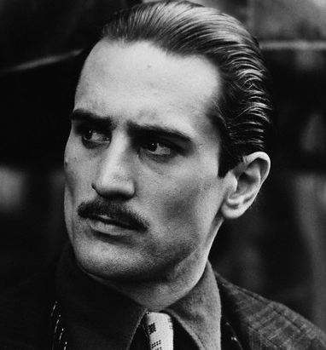
owl:sameAs
owl:sameAs
owl:sameAs
:VitoOld
:VitoOld :VitoYoung
:VitoYoung
:hasGrandson
:granddaughterOf
:hasGrandson
:granddaughterOf
:Vincent
:Mary
:VitoOld owl:sameAs :VitoYoung .

Slide 41
owl:differentFrom
How many children does
Vito have according
to this RDF graph?
Vito has at least two children!
:Vito
:hasChild
:Connie
:Sonny
:Fredo
:Michael
owl:differentFrom
:Vito :hasChild :Connie, :Sonny, :Michael, :Fredo .
:Connie owl:differentFrom :Sonny, :Michael, :Fredo .

Slide 42
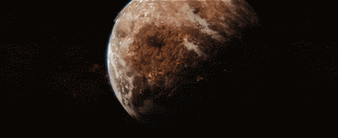
Inconsistency in OWL …
owl:sameAs
owl:differentFrom
:VitoOld
:VitoYoung
:VitoOld owl:sameAs :VitoYoung .
:VitoOld owl:differentFrom :VitoYoung .
⇒ FALSE

Slide 43
Property Axioms in OWL …

Slide 44
owl:equivalentProperty
:parentOf
:hasChild
:hasChild
:parentOf
:Vito
:Michael
:Mary
:Vito :parentOf :Michael .
:Michael :hasChild :Mary .
:parentOf owl:equivalentProperty :hasChild .
⇒ :Vito :hasChild :Michael .
⇒ :Michael :parentOf :Mary .

Slide 45
owl:inverseOf
:parentOf
:childOf
:childOf
:parentOf
:Carmela
:Sonny
:Vincent
:Carmela :parentOf :Sonny .
:Vincent :childOf :Sonny .
:parentOf owl:inverseOf :childOf .
⇒ :Sonny :parentOf :Vincent .
⇒ :Sonny :childOf :Carmela .

Slide 46
owl:SymmetricProperty
:sibling
:sibling
:Connie
:Fredo
:Connie :sibling :Fredo .
:sibling rdf:type owl:SymmetricProperty .
⇒ :Fredo :sibling :Connie .

Slide 47
owl:TransitiveProperty
:ancestorOf
:ancestorOf
:Carmela
:Michael
:Mary
:ancestorOf
:Carmela :ancestorOf :Michael .
:Michael :ancestorOf :Mary .
:ancestorOf rdf:type owl:TransitiveProperty .
⇒ :Carmela :ancestorOf :Mary .

Slide 48
owl:propertyChainAxiom
:brotherOf
:parentOf
:Sonny
:Michael
:Mary
:uncleOf
:Sonny :brotherOf :Michael .
:Michael :parentOf :Mary .
:uncleOf owl:propertyChainAxiom (:brotherOf :parentOf) .
⇒ :Sonny :uncleOf :Mary .

Slide 49
owl:ReflexiveProperty
:similarTo
:similarTo
:Connie
:Fredo
:similarTo rdf:type owl:ReflexiveProperty .
⇒ :Connie :similarTo :Connie .
:Freddie :similarTo :Freddie .
# everything :similarTo itself

Slide 50
owl:FunctionalProperty
:hasBioFather
:Fredo
:VitoYoung
:VitoOld :VitoYoung
:Fredo :hasBioFather :VitoOld .
:Fredo :hasBioFather :VitoYoung .
:hasBioFather rdf:type owl:FunctionalProperty .
⇒ :VitoOld owl:sameAs :VitoYoung .
:VitoOld

Slide 51
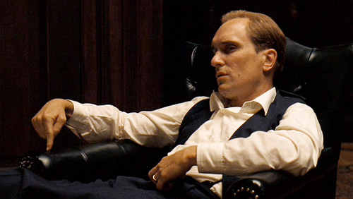
Aside …
What if we said :hasFather was functional?
Tom Hagen, the adopted son of Vito
  Maybe he has two fathers?

Slide 52
owl:InverseFunctionalProperty
:bioFatherOf
:Connie
:VitoYoung
:VitoOld :VitoYoung
:VitoOld :bioFatherOf :Connie .
:VitoYoung :bioFatherOf :Connie .
:bioFatherOf rdf:type owl:InverseFunctionalProperty .
⇒ :VitoOld owl:sameAs :VitoYoung .
:VitoOld

Slide 53
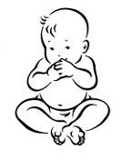


owl:hasKey
:hasBioMother
:Connie
:Carmela
rdf:type
:Singleton
:born
:Constanza
1922-04-16
:Connie a :Singleton ; :hasBioMother :Carmela ; :born “1922-04-16”^^xsd:date .
:Constanza a :Singleton ; :hasBioMother :Carmela ; :born “1922-04-16”^^xsd:date .
:Singleton owl:hasKey ( :hasBioMother :born ) .
⇒ :Connie owl:sameAs :Constanza .

Slide 54
owl:IrreflexiveProperty
:hasBrother
:Fredo
:Fredo :hasBrother :Fredo .
:hasBrother rdf:type owl:IrreflexiveProperty .
⇒ FALSE

Slide 55
owl:AsymmetricProperty
:hasFather
:hasFather
:Fredo
:VitoYoung
:Fredo :hasFather :VitoYoung .
:VitoYoung :hasFather :Fredo .
:hasFather rdf:type owl:AsymmetricProperty .
⇒ FALSE

Slide 56
owl:propertyDisjointWith
:hasFather
:hasSon
:Sonny
:VitoYoung
:Sonny :hasFather :VitoYoung .
:Sonny :hasSon :VitoYoung .
:hasSon owl:propertyDisjointWith :hasFather .
⇒ FALSE

Slide 57
Negative property assertions
¬:hasMother
:hasMother
:Fredo
:Connie
[] owl:sourceIndividual :Fredo ; owl:assertionProperty :hasMother ; owl:targetIndividual :Connie .
:Fredo :hasMother :Connie .
⇒ FALSE

Slide 58
Recap OWL property axioms
What would be the owl:inverseOf the property :fatherOf?
Name an owl:SymmetricProperty for family relations?
Name an owl:TransitiveProperty for family relations?
Give an owl:propertyChainAxiom for :hasNiece?
Name an owl:AsymmetricProperty for family relations?
Name an owl:FunctionalProperty for family relations?

Slide 59
Class Axioms in OWL

Slide 60
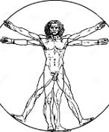
owl:equivalentClass
rdf:type
rdf:type
:Human
rdf:type
rdf:type
:Vincent
:Mary
:Person
:Vincent rdf:type :Human .
:Mary rdf:type :Person .
:Human owl:equivalentClass :Person .
⇒ :Vincent rdf:type :Person .
:Mary rdf:type :Human .

Slide 61

owl:disjointWith
:MafiaBoss
:Lawful
rdf:type
rdf:type
:Vincent
:Vincent rdf:type :MafiaBoss , :Lawful .
:MafiaBoss owl:disjointWith :Lawful .
⇒ FALSE

Slide 62
owl:disjointWith (ii)
:MafiaBoss
:Lawful
rdf:type
rdf:type
owl:differentFrom
:Vincent
:Mary
:Vincent rdf:type :MafiaBoss .
:Mary rdf:type :Lawful .
:MafiaBoss owl:disjointWith :Lawful .
⇒ :Vincent owl:differentFrom :Mary

Slide 63
Class Definitions in OWL

Slide 64
Description Logics

Slide 65


owl:intersectionOf (⊓) [i]
⊑
⊓
:Mother
:Female
:Parent
rdf:type
rdf:type
rdf:type
:Carmela
:Carmela rdf:type :Mother .
:Mother rdfs:subClassOf [ owl:intersectionOf ( :Female :Parent ) ]
⇒ :Carmela rdf:type :Female , :Parent .

Slide 66
owl:intersectionOf (⊓) [ii]
≡
⊓
:Mother
:Female
:Parent
rdf:type
rdf:type
rdf:type
:Carmela
:Carmela rdf:type :Female , :Parent .
:Mother owl:equivalentClass [ owl:intersectionOf ( :Female :Parent ) ]
⇒ :Carmela rdf:type :Mother .

Slide 67

owl:unionOf (⊔) [i]
≡
⊔
:Person
:Criminal
:Lawful
rdf:type
rdf:type
:Vincent
:Vincent rdf:type :Lawful .
:Person owl:equivalentClass [ owl:unionOf ( :Criminal :Lawful ) ]
⇒ :Vincent rdf:type :Person .

Slide 68
owl:unionOf (⊔) [ii]
≡
⊔
:Person
:Criminal
:Lawful
rdf:type
:Vincent
:Vincent rdf:type :Person .
:Person owl:equivalentClass [ owl:unionOf ( :Criminal :Lawful ) ]
⇒ # :Vincent must be either :Lawful or :Criminal (or both)

Slide 69
owl:disjointUnionOf (⊔_{D})
≡
⊔_{D}
:Person
:Criminal
:Lawful
rdf:type
:Vincent
:Vincent rdf:type :Person .
:Person owl:equivalentClass
[ owl:disjointUnionOf ( :Criminal :Lawful ) ]
⇒ # :Vincent must be either :Lawful or :Criminal (not both)

Slide 70


owl:complementOf (¬) [i]
≡
¬
:Dead
:Alive
¬rdf:type
rdf:type
:Mary
:Mary rdf:type :Alive .
:Dead owl:equivalentClass [ owl:complementOf :Alive ]
⇒ [] owl:sourceIndividual :Mary ; owl:targetProperty rdf:type ; owl:targetIndividual :Dead .

Slide 71


Slide 72
owl:complementOf (¬) [ii]
≡
¬
:Dead
:Alive
rdf:type
¬ rdf:type
:Vito
:Vito rdf:type :Dead .
:Dead owl:equivalentClass [ owl:complementOf :Alive ]
⇒ [] owl:sourceIndividual :Vito ; owl:targetProperty rdf:type ; owl:targetIndividual :Alive .

Slide 73
owl:oneOf ({})
≡
{
}
,
,
:Godfather
:Vito
:Michael
:Vincent
rdf:type
rdf:type
rdf:type
:Godfather owl:equivalentClass
[ owl:oneOf (:Vito :Michael :Vincent) ]
⇒ :Vito rdf:type :Godfather .
⇒ :Michael rdf:type :Godfather .
⇒ :Vincent rdf:type :Godfather .

Slide 74
owl:allValuesFrom (∀) [i]
⊑
∀
:hasParent.
:Person
:Person
rdf:type
rdf:type
:hasParent
:Mary
:Michael
:Mary rdf:type :Person ; :hasParent :Michael .
:Person rdfs:subClassOf
[ owl:allValuesFrom :Person ; owl:onProperty :hasParent ]
⇒ :Michael rdf:type :Person .

Slide 75
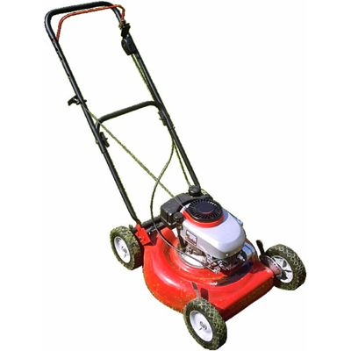

owl:allValuesFrom (∀) [ii]
≡
∀
:hasParent.
:Person
:Person
rdf:type
⊑¬∃
rdf:type
:hasParent
:Choppy
:Lawnmower
Need to be careful using ≡ with owl:allValuesFrom!
If all of X’s parents are :Persons, X is a :Person.
But :Choppy does not have parents, so all its parents are trivially anything!
Thus :Choppy must be a :Person!

Slide 76
owl:someValuesFrom (∃) [i]
≡
∃
:hasChild.
:Parent
:Person
rdf:type
rdf:type
:hasChild
:Michael
:Mary
:Michael :hasChild :Mary . :Mary rdf:type :Person .
:Parent owl:equivalentClass
[ owl:someValuesFrom :Person ; owl:onProperty :hasChild ]
⇒ :Michael rdf:type :Parent .

Slide 77
owl:someValuesFrom (∃) [ii]
≡
∃
:hasChild.
:Parent
:Person
rdf:type
rdf:type
?
:hasChild
:Michael
?
:Michael rdf:type :Parent .
:Parent owl:equivalentClass
[ owl:someValuesFrom :Person ; owl:onProperty :hasChild ]
⇒ :Michael :hasChild _:someone . _:someone rdf:type :Person .

Slide 78
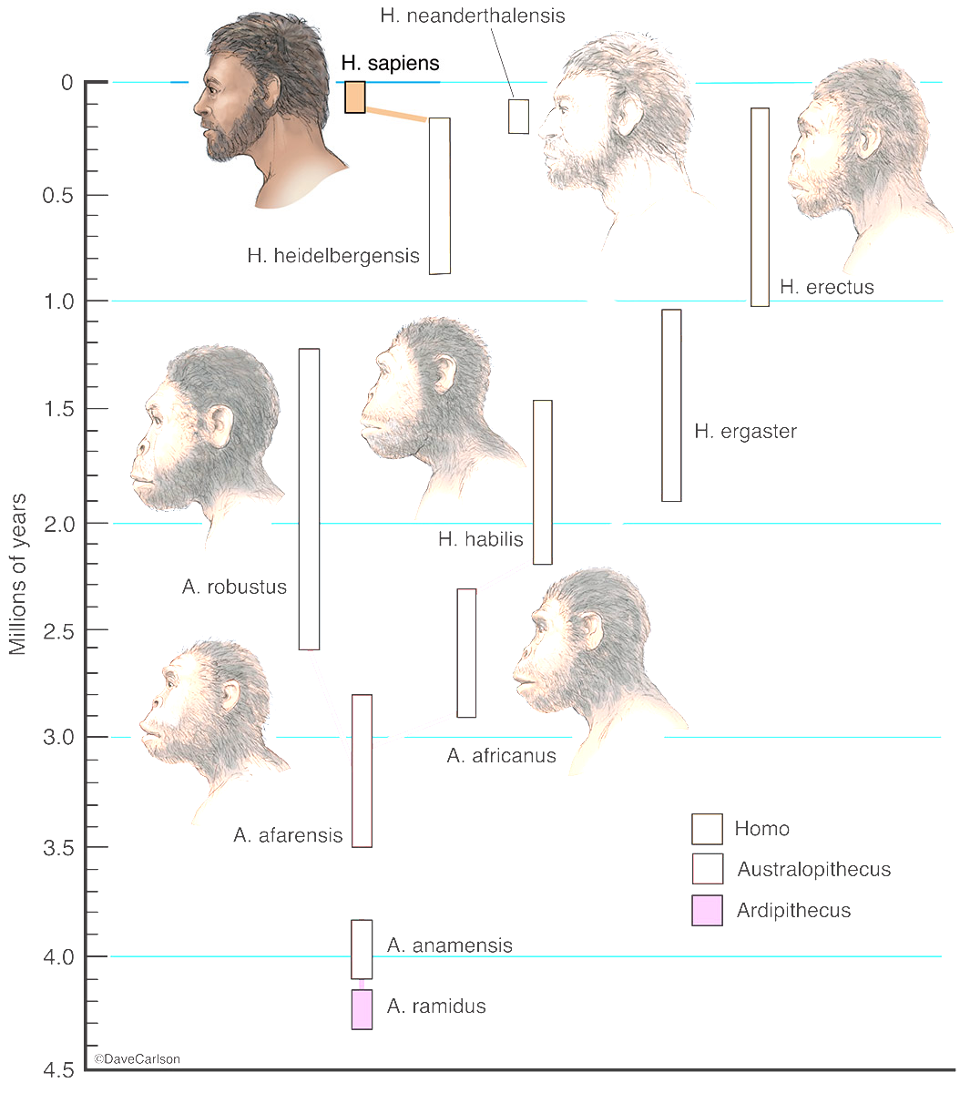
owl:hasValue (∃P.{x}) [i]
⊑
∃
{
}
:species.
:Person
:H.Sapiens
rdf:type
:species
:Mary
:Mary rdf:type :Person .
:Person rdfs:subClassOf
[ owl:hasValue :H.Sapiens ; owl:onProperty :species ]
⇒ :Mary :species :H.Sapiens .

Slide 79
owl:hasValue (∃P.{x}) [i]
≡
∃
{
}
:species.
:Person
:H.Sapiens
rdf:type
:species
:Mary
:Mary :species :H.Sapiens .
:Person owl:equivalentClass
[ owl:hasValue :H.Sapiens ; owl:onProperty :species ]
⇒ :Mary rdf:type :Person .

Slide 80

owl:hasSelf (Self) [i]
⊑
Self(:loves)
:Narcissist
rdf:type
:loves
:Michael
:Michael rdf:type :Narcissist .
:Narcissist rdfs:subClassOf
[ owl:hasSelf true ; owl:onProperty :loves ]
⇒ :Michael :loves :Michael .

Slide 81
owl:hasSelf (Self) [ii]
≡
Self(:loves)
:Narcissist
rdf:type
:loves
:Michael
:Michael :loves :Michael .
:Narcissist owl:equivalentClass
[ owl:hasSelf true ; owl:onProperty :loves ]
⇒ :Michael rdf:type Narcissist .

Slide 82
Cardinality restrictions (≥, ≤,=)
Define a class with a given number of values for a property:
  Exact: :Person ⊑ = 2 (:hasBioParent)
  Max: :Monogamist ⊑ ≤ 1 (:hasCurrentSpouse)
  Min: :Parent ≡ ≥ 1 (:hasChild)
:Person rdfs:subClassOf [ owl:cardinality 2 ;
owl:onProperty :hasBioParent ] .
:Monogamist rdfs:subClassOf [ owl:maxCardinality 1 ;
    owl:onProperty :hasCurrentSpouse ] .
:Parent owl:equivalentClass [ owl:minCardinality 1 ;
owl:onProperty :hasChild ] .

Slide 83
Qualified cardinality restrictions (≥, ≤,=)
Define a class with a given number of values from a given class for a property:
  Exact: :Biped ≡ =2 (:hasLimb.Leg)
  Max: :Mafia ⊑ ≤ 1 (:hasCurrentMember.Godfather)
  Min: :Twin ⊑ ≥ 1 (:sibling.Twin)
:Biped owl:equivalentClass [ owl:qualifiedCardinality 2 ;
owl:onProperty :hasLimb ;
owl:onClass :Leg ] .
:Mafia rdfs:subClassOf [ owl:maxQualifiedCardinality 1 ;
owl:onProperty :hasCurrentMember ;
owl:onClass :Godfather ] .
:Twin rdfs:subClassOf [ owl:minQualifiedCardinality 1 ;
owl:onProperty :sibling ;
owl:onClass :Twin ] .

Slide 84
Recap OWL class axioms/definitions
A class :Equine might be equivalent to the owl:unionOf which classes?
What is the difference/relation between owl:complementOf and owl:disjointWith?
Give an example use of owl:allValuesFrom for offspring of :Equine
Give an example use of owl:someValuesFrom for :Uncle.
How might we codify the semantics of a class :OnlyChild in OWL?

Slide 85
Slides are examples, not definitions
≡
{
}
,
,
:Godfather
:Vito
:Michael
:Vincent
rdf:type
⇒ :VitoYoung must be owl:sameAs :Vito or :Michael or :Vincent
:VitoYoung

Slide 86
sire is a sub-property of parent
dam is a sub-property of parent
A Zebroid has exactly one parent a Zebra
A Zebroid has exactly one parent a (¬Zebra and a Equine)
A Zebroid is a sub-class of Equine
An Equine has exactly two parents
Two things cannot be related by sire and dam at the same time

Slide 88


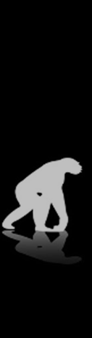

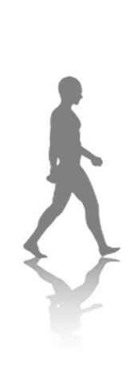
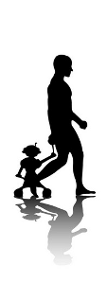
Questions?

