Slide 1
CC7220-1 La Web de Datos Primavera 2018 Lecture 9: Linked Data
Aidan Hogan
aidhog@gmail.com

Slide 2
Previously …

Slide 3
Semantic Web: Data, Logic, Query
* More or less

Slide 4
But we have not spoken much about …
CC7220-1 La Web de Datos Primavera 2018
… how do we use RDF(S)/OWL/SPARQL
to build a “Web of Data”?

Slide 5
Semantic Web: Data, Logic, Query
* More or less
What are we missing from here to build a Web of Data?

Slide 6
Semantic Web: Data, Logic, Query, Links
* More or less
How can we add links to this picture?

Slide 7
RDF filled with IRIs!
… any IRI could be a link!

Slide 8
Pre-Linked Data …

Slide 9
Semantic Web, early days (pre-2006)
Lots of dumps of RDF
Big OWL ontologies (difficult to re-use)
No reuse of IRIs ... no links … no Web!

Slide 10
Linked Data …

Slide 11
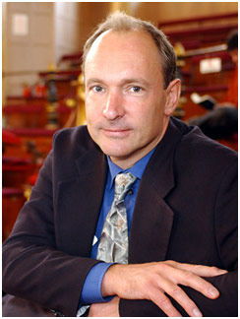
Linked Data … 2006
http://www.w3.org/DesignIssues/LinkedData.html
(The mug is explained later)

Slide 12
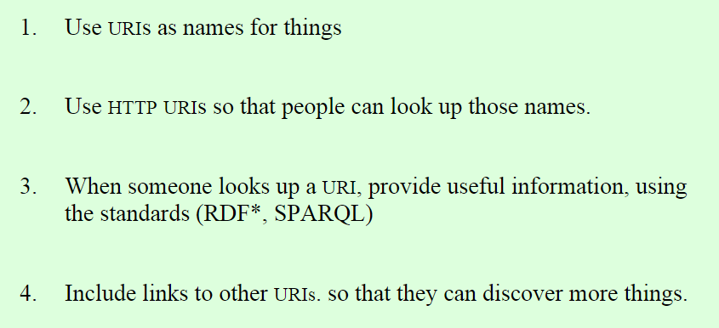
Four Principles of Linked Data
http://www.w3.org/DesignIssues/LinkedData.html

Slide 13
Linked Data examples ...

Slide 15
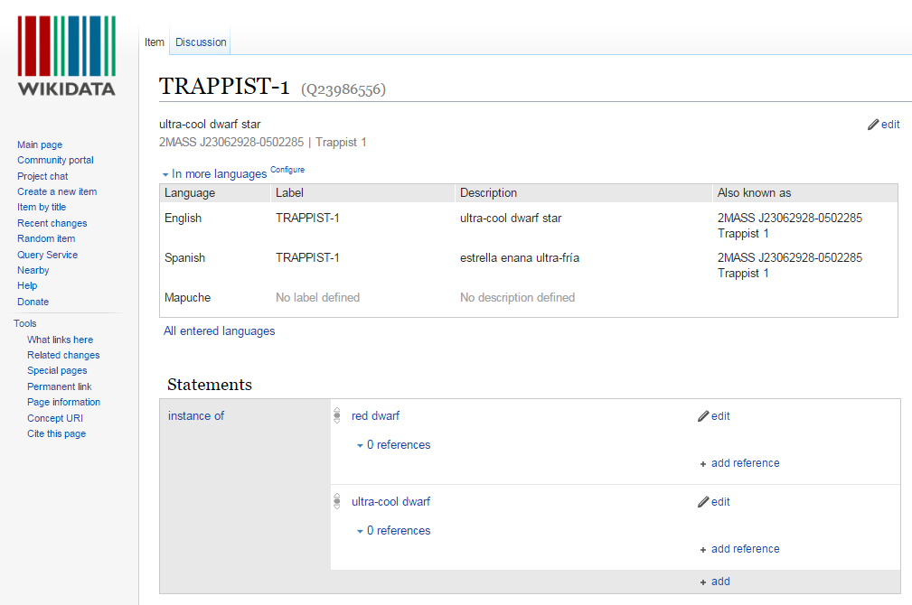

Slide 16
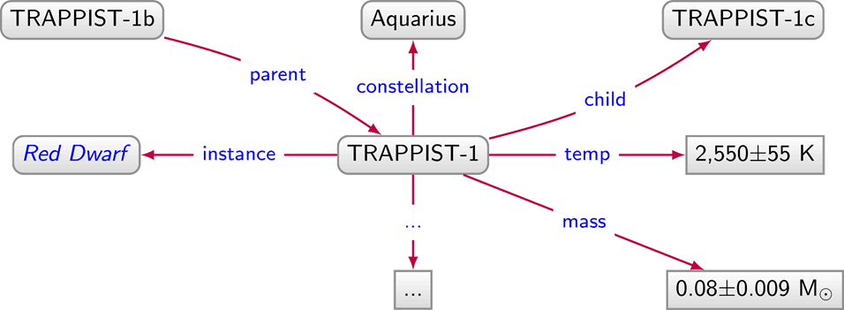
Linked Data Document
http://ex.org/data/TRAPPIST-1

Slide 17
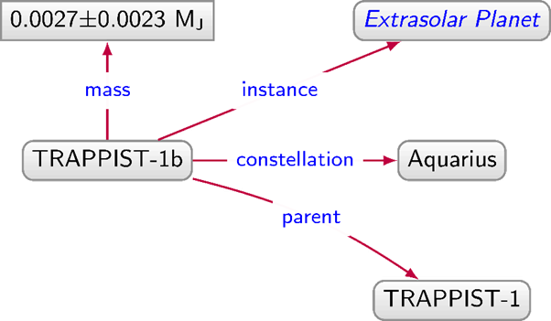
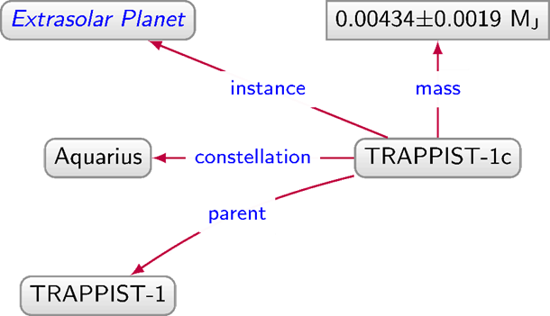
Linked Data Graph
http://ex.org/data/TRAPPIST-1b
http://ex.org/data/TRAPPIST-1c
http://ex.org/data/TRAPPIST-1

Slide 18
Linked Data Graph
http://ex.org/data/TRAPPIST-1b
http://ex.org/data/TRAPPIST-1c
http://ex.org/data/TRAPPIST-1

Slide 19
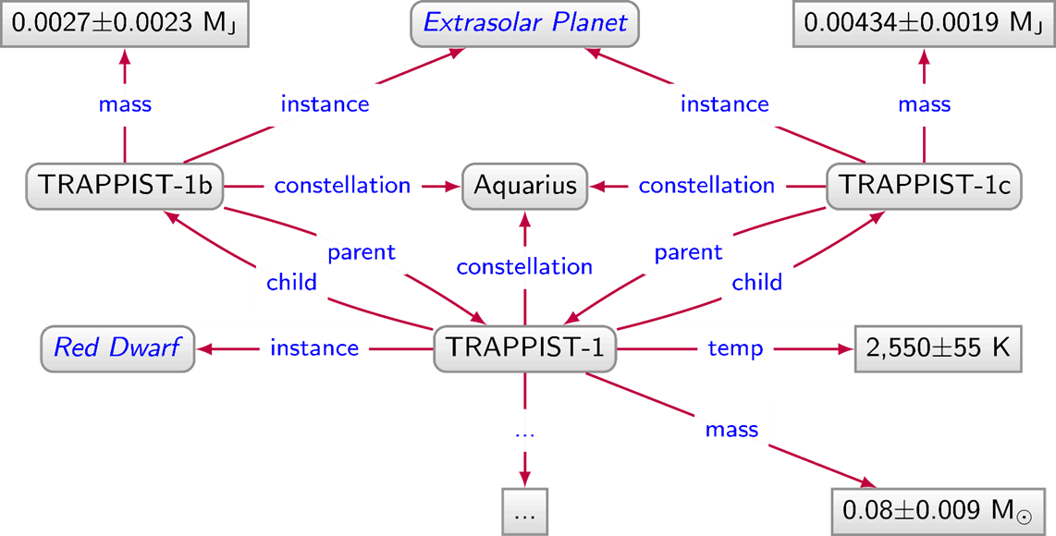
Linked Data Graph

Slide 20
Linked Data Graph

Slide 21
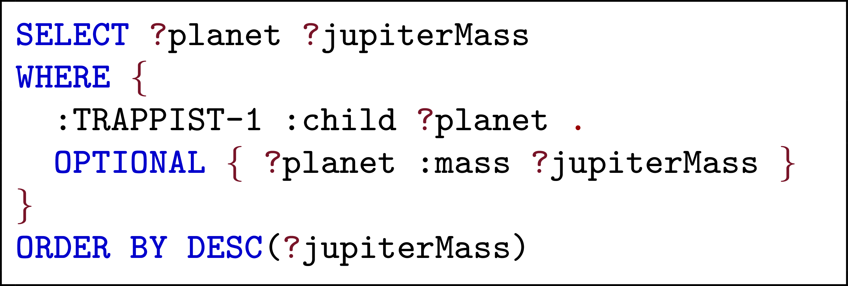
Answer queries over Linked Data using SPARQL

Slide 22
Linked Data Graph
http://ex.org/data/TRAPPIST-1b
http://ex.org/data/TRAPPIST-1c
http://ex.org/data/TRAPPIST-1
How can we implement these links (called "dereferencing")?

Slide 23
Implementing Linked Data…

Slide 24
Three recipes for dereferencing
URL Recipe
Use document URLs to identify things
Hash Recipe
Use fragment identifiers to identify things
Slash Recipe
Use special redirects to identify things

Slide 25
URL Recipe
http://ex.org/data/TRAPPIST-1b
http://ex.org/data/TRAPPIST-1c
http://ex.org/data/TRAPPIST-1
http://ex.org/data/TRAPPIST-1b
http://ex.org/data/TRAPPIST-1c
Easy-peasy. So what's the problem?

Slide 26
URL Recipe: The Problem

Slide 27
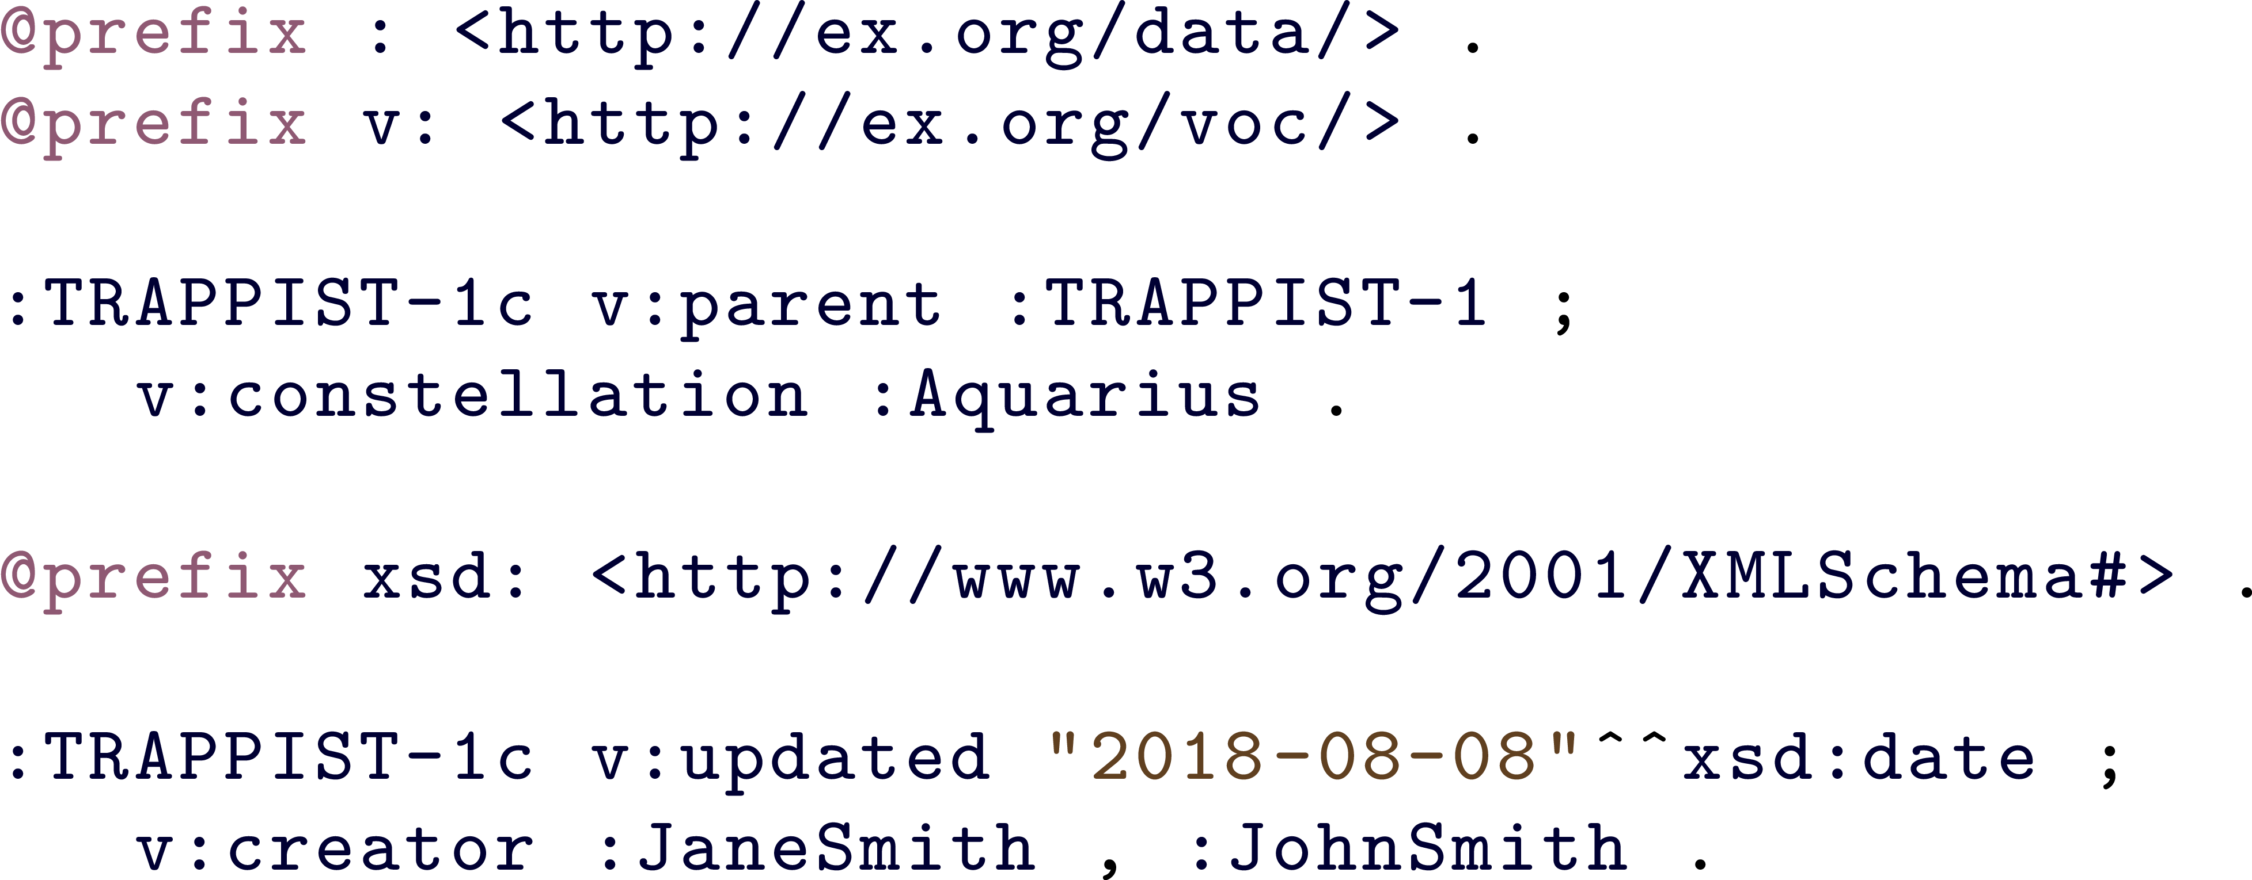
URL Recipe: The Problem
Document URLs should only identify documents!

Slide 28
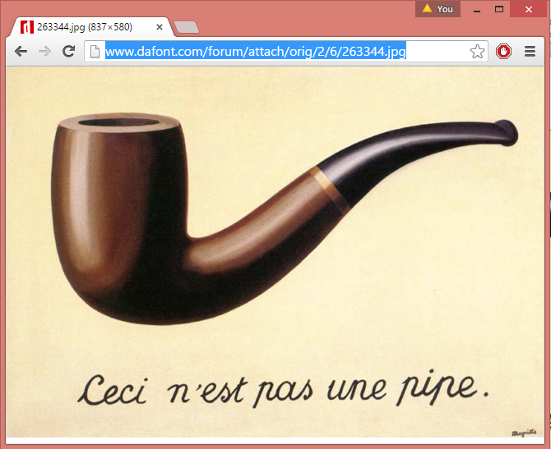
HTTP IRIs usually for documents, not pipes

Slide 29
Three recipes for dereferencing
URL Recipe
Use document URLs to identify things
documents
Hash Recipe
Use fragment identifiers to identify things
Slash Recipe
Use special redirects to identify things

Slide 30
Hash Recipe
http://ex.org/data/TRAPPIST-1b
http://ex.org/data/TRAPPIST-1c
http://ex.org/data/TRAPPIST-1
http://ex.org/data/TRAPPIST-1b#this
http://ex.org/data/TRAPPIST-1c#this

Slide 31
Hash Recipe
http://ex.org/data/TRAPPIST-1c
Identifies the document
http://ex.org/data/TRAPPIST-1c#this
Identifies the planet
Look it up, you get the document
GET: http://ex.org/data/TRAPPIST-1c#me
200 OK: http://ex.org/data/TRAPPIST-1c

Slide 32
Three recipes for dereferencing
URL Recipe
Use document URLs to identify things
documents
Hash Recipe
Use fragment identifiers to identify things
Slash Recipe
Use special redirects to identify things

Slide 33
Slash Recipe
http://ex.org/data/TRAPPIST-1b
http://ex.org/data/TRAPPIST-1c
http://ex.org/data/TRAPPIST-1
http://ex.org/entity/TRAPPIST-1b
http://ex.org/entity/TRAPPIST-1c

Slide 34
Slash Recipe
http://ex.org/data/TRAPPIST-1c
Identifies the document
http://ex.org/entity/TRAPPIST-1c
Identifies the planet
Look it up, redirects to the document
GET: http://ex.org/entity/TRAPPIST-1c
303 See Other: http://ex.org/data/TRAPPIST-1c
GET: http://ex.org/data/TRAPPIST-1c
200 OK: http://ex.org/data/TRAPPIST-1c

Slide 35
Three recipes for dereferencing
URL Recipe
Use document URLs to identify things
documents
Hash Recipe
Use fragment identifiers to identify things
Slash Recipe
Use special redirects to identify things

Slide 36
Hash vs. Slash
GET: http://ex.org/data/TRAPPIST-1c#this
200 OK: http://ex.org/data/TRAPPIST-1c
Which is better, hash or slash?
Well, hash has half the number of requests!
GET: http://ex.org/entity/TRAPPIST-1c
303 See Other: http://ex.org/data/TRAPPIST-1c
GET: http://ex.org/data/TRAPPIST-1c
200 OK: http://ex.org/data/TRAPPIST-1c

Slide 37
Hash vs. Slash
GET: http://ex.org/data/TRAPPIST-1c#this
200 OK: http://ex.org/data/TRAPPIST-1c
Which is better, hash or slash?
But slash decouples document URLs from entity IRIs
GET: http://ex.org/entity/TRAPPIST-1c
303 See Other: http://ex.org/data/TRAPPIST-1c
GET: http://ex.org/data/TRAPPIST-1c
200 OK: http://ex.org/data/TRAPPIST-1c

Slide 38
Content negotiation with hash
ACCEPT: application/rdf+xml
GET: http://ex.org/data/TRAPPIST-1c#this
200 Okay: http://ex.org/data/TRAPPIST-1c.rdf
ACCEPT: text/html
GET: http://ex.org/data/TRAPPIST-1c#this
200 Okay: http://ex.org/data/TRAPPIST-1c.html
Can also choose from different RDF formats; e.g., Turtle, RDFa, etc.
(if supported by the server that is!)

Slide 39
Content negotiation with slash
ACCEPT: application/rdf+xml
GET: http://ex.org/entity/TRAPPIST-1c
303 See Other: http://ex.org/data/TRAPPIST-1c.xml
GET: http://ex.org/data/TRAPPIST-1c.xml
200 Okay: http://ex.org/data/TRAPPIST-1c.xml
ACCEPT: text/html
GET: http://ex.org/entity/TRAPPIST-1c
303 See Other: http://ex.org/data/TRAPPIST-1c.html
GET: http://ex.org/data/TRAPPIST-1c.html
200 Okay: http://ex.org/data/TRAPPIST-1c.html

Slide 40
Linking Open Data

Slide 41
Linked Data … 2006
http://www.w3.org/DesignIssues/LinkedData.html
(The mug is explained now)

Slide 42
Open Data ...
We’ve got all these people who want to publish Open Data but how should they publish it on the Web?
We’ve got this new way of publishing Linked Data on the Web but no data to publish …
... meets Linked Data

Slide 43
Linked Open Data
We’ve got this new way of publishing Linked Data on the Web but no data to publish …
Linked Open Data
We’ve got all these people who want to publish Open Data but how should they publish it on the Web?

Slide 44
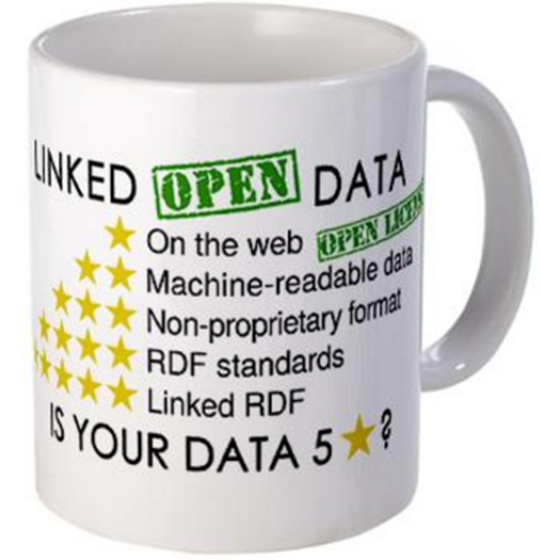
The 5 ★’s of Linked Open Data
★★★★★ Publish data under open licence
★★★★★ Make the data “machine readable”
e.g., a Spreadsheet better than a PDF table
★★★★★ Use non-proprietary formats
e.g., a CSV text file better than Excel
★★★★★ Use URIs to name your stuff (hint: RDF)
use unambiguous identifiers that can be linked/looked up
★★★★★ Provide links to other content (hint: Linked Data)
so consumers can follow links to find out more

Slide 45
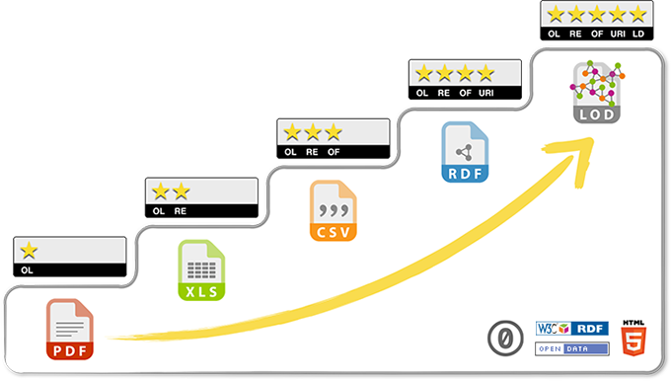
Each star improves interoperability of data

Slide 46
Linked Open Datasets

Slide 47
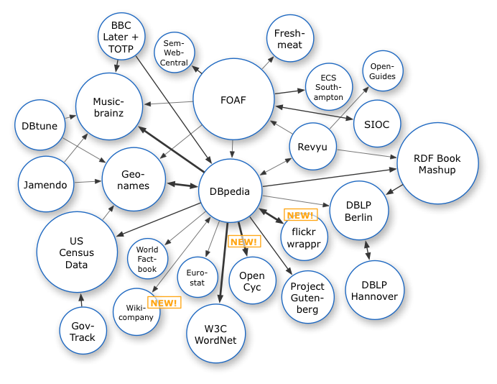
The LOD cloud
Oct. 2007

Slide 48
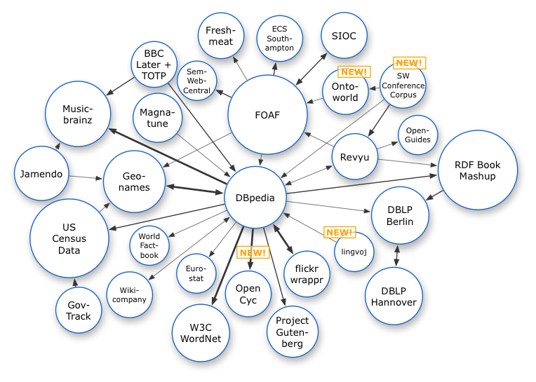
The LOD cloud
Oct. 2007
Nov. 2007

Slide 49
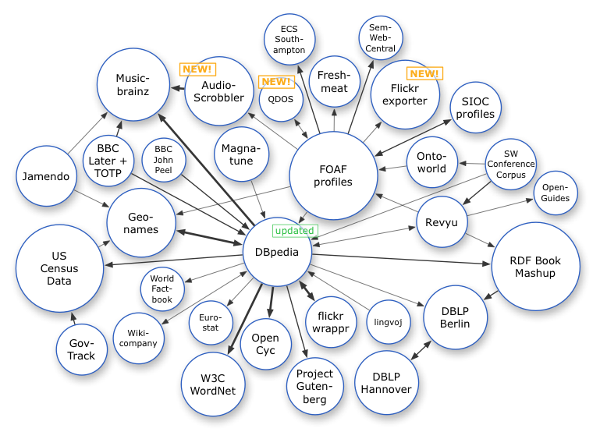
The LOD cloud
Oct. 2007
Nov. 2007
Feb. 2008

Slide 50
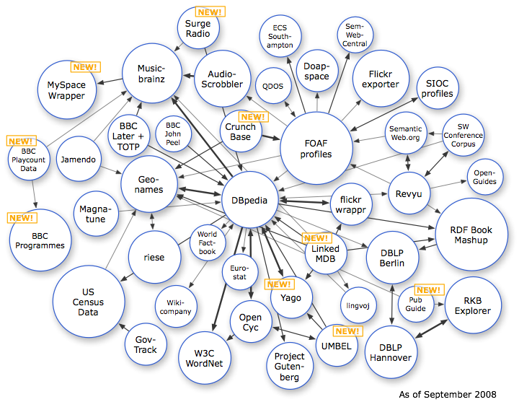
The LOD cloud
Oct. 2007
Nov. 2007
Feb. 2008
Sep. 2008

Slide 51
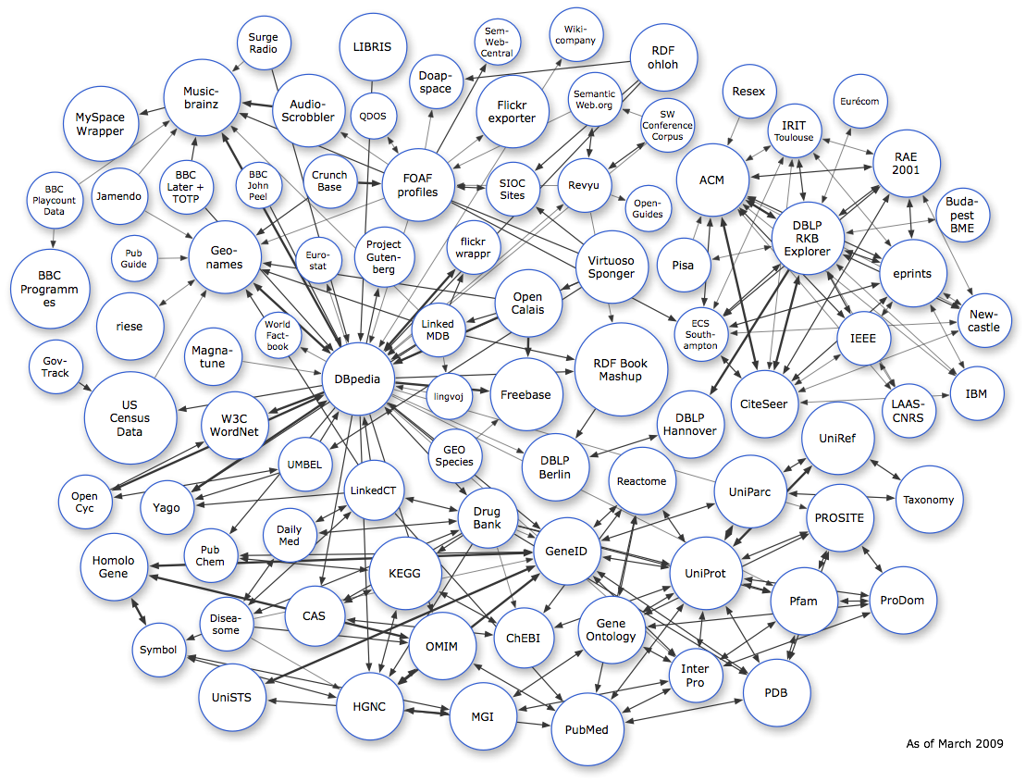
The LOD cloud
Oct. 2007
Nov. 2007
Feb. 2008
Sep. 2008
Mar. 2009

Slide 52
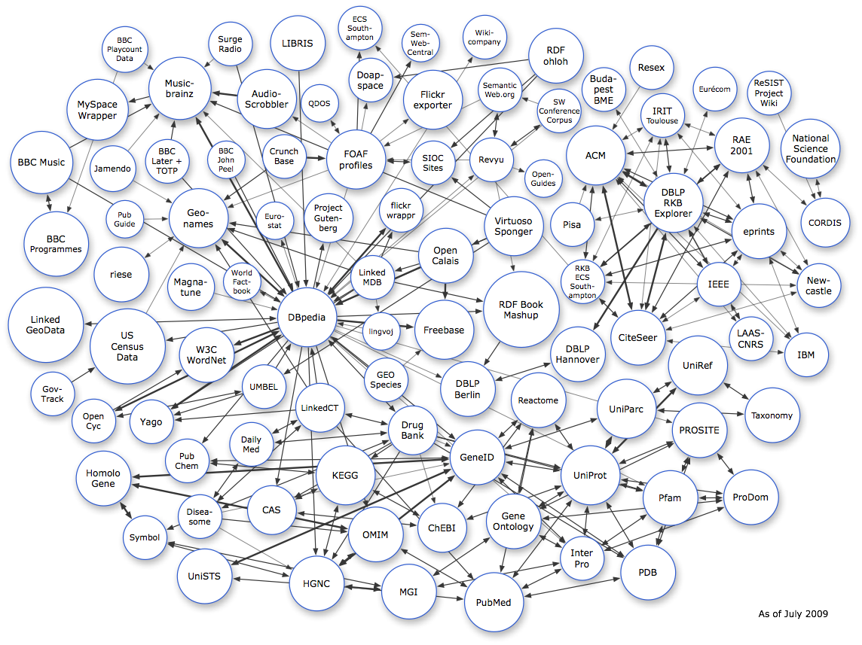
The LOD cloud
Oct. 2007
Nov. 2007
Feb. 2008
Sep. 2008
Mar. 2009
July 2009

Slide 53
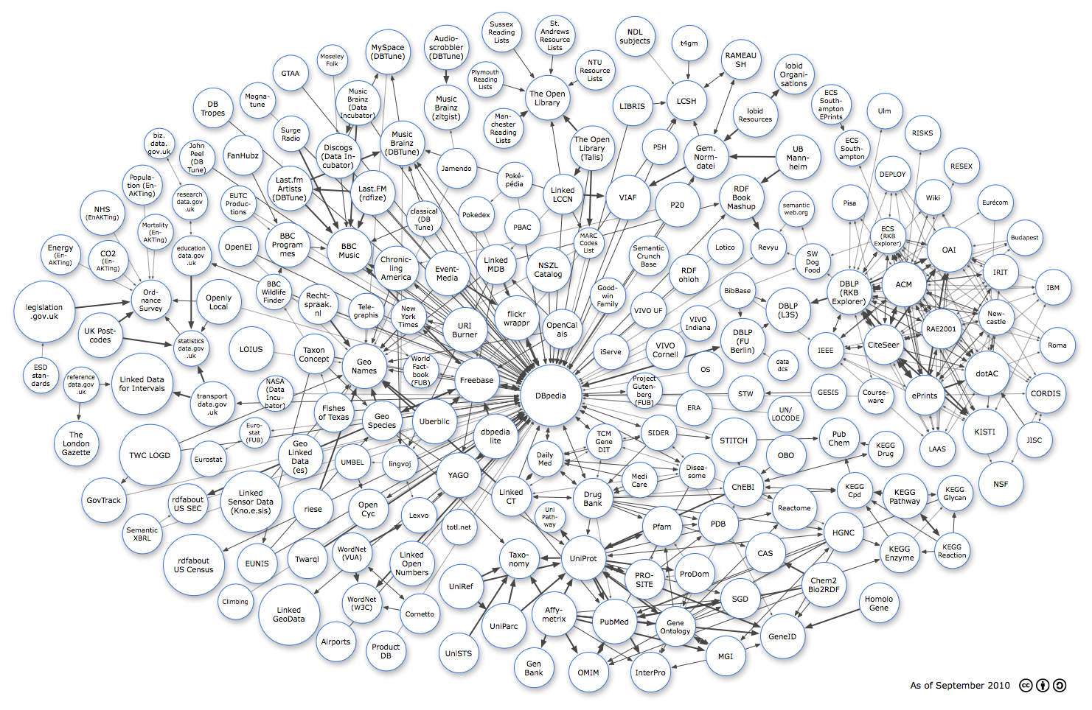
The LOD cloud
Oct 2007
Oct. 2007
Nov. 2007
Feb. 2008
Sep. 2008
Mar. 2009
July 2009
Sept. 2010

Slide 54
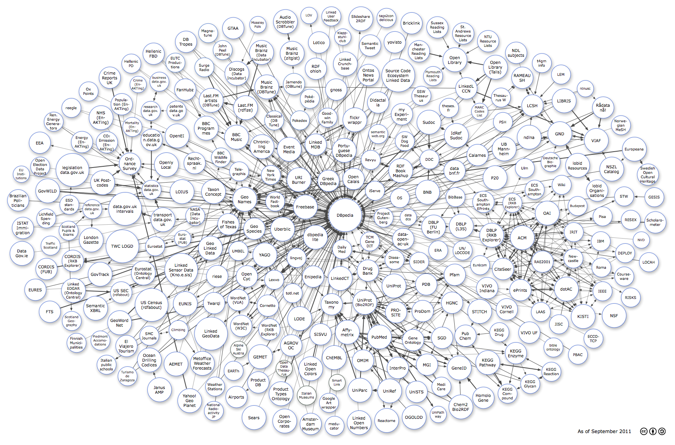
The LOD cloud
Oct. 2007
Nov. 2007
Feb. 2008
Sep. 2008
Mar. 2009
July 2009
Sept. 2010
Sept. 2011

Slide 55
The LOD cloud
Oct. 2007
Nov. 2007
Feb. 2008
Sep. 2008
Mar. 2009
July 2009
Sept. 2010
Sept. 2011
Sept. 2012

Slide 56
The LOD cloud
Oct. 2007
Nov. 2007
Feb. 2008
Sep. 2008
Mar. 2009
July 2009
Sept. 2010
Sept. 2011
Sept. 2012
Sept. 2013

Slide 57
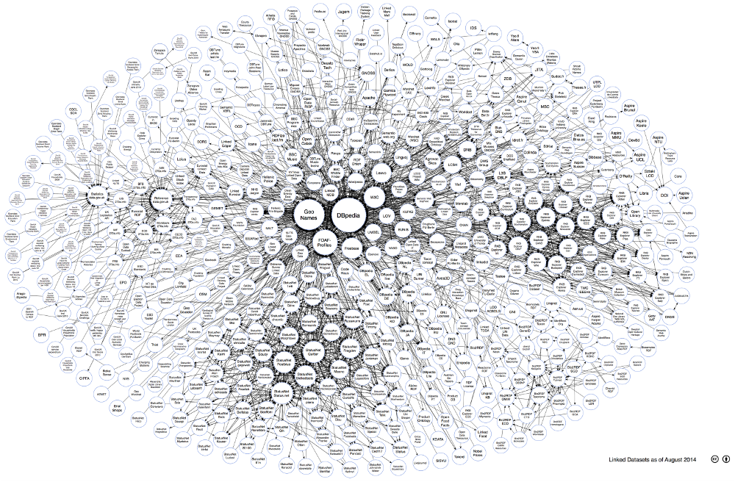
The LOD cloud
Oct. 2007
Nov. 2007
Feb. 2008
Sep. 2008
Mar. 2009
July 2009
Sept. 2010
Sept. 2011
Sept. 2012
Sept. 2013
Aug. 2014

Slide 58
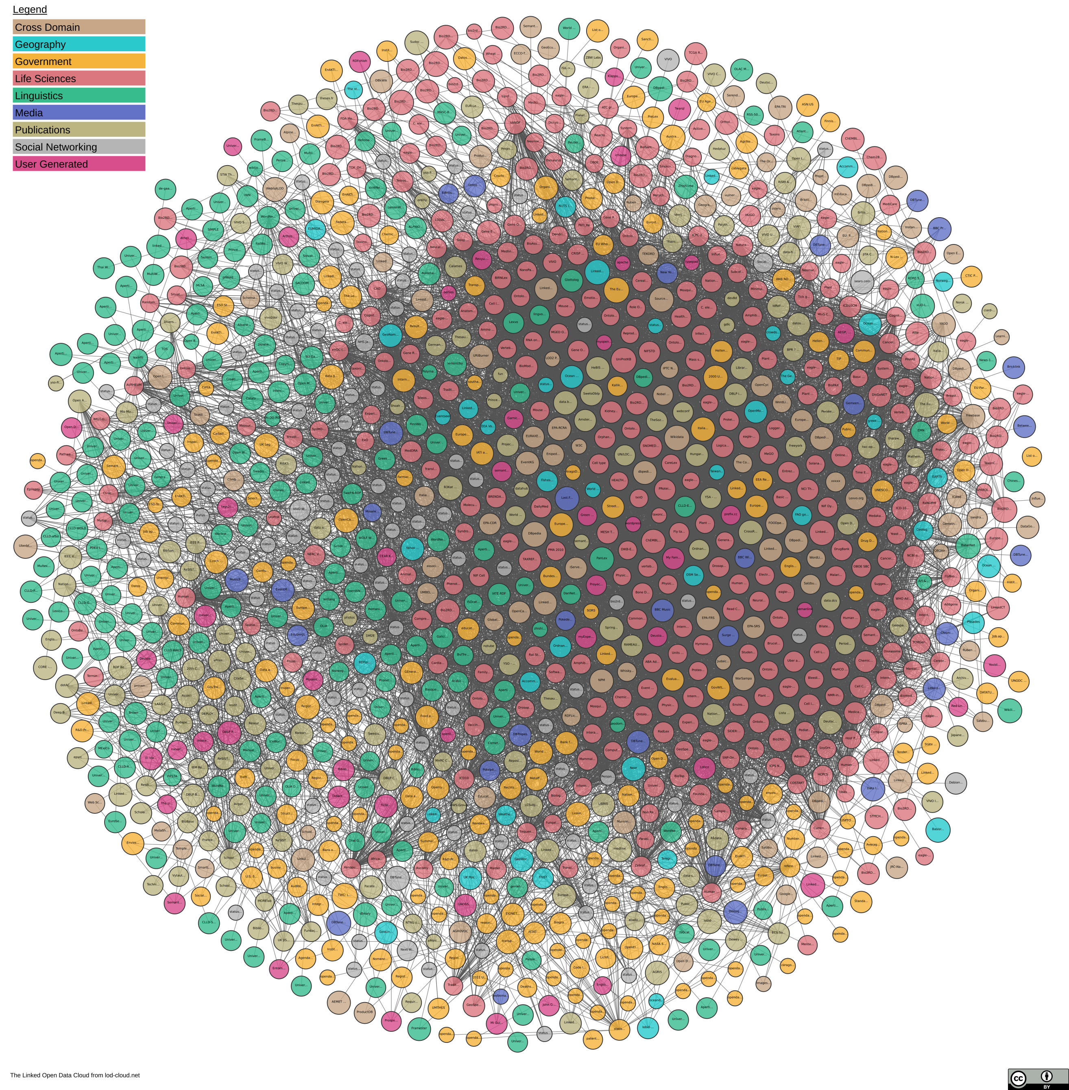
The LOD Cloud
Oct. 2007
Nov. 2007
Feb. 2008
Sep. 2008
Mar. 2009
July 2009
Sept. 2010
Sept. 2011
Sept. 2012
Sept. 2013
Aug. 2014
Nov. 2018

Slide 59
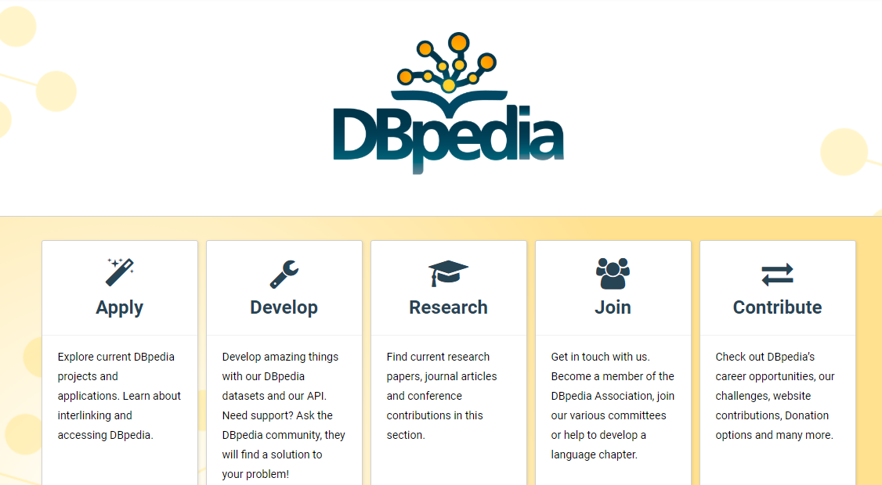
Cross-Domain

Slide 60
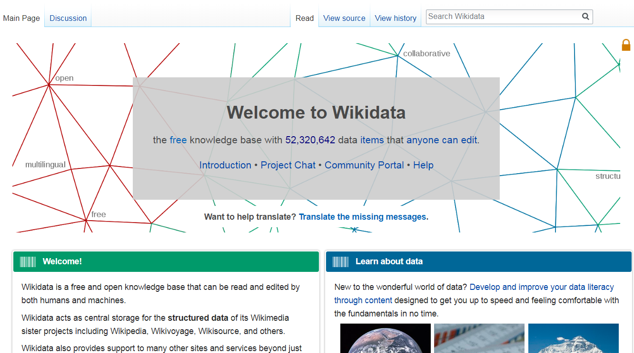
Cross-Domain

Slide 61
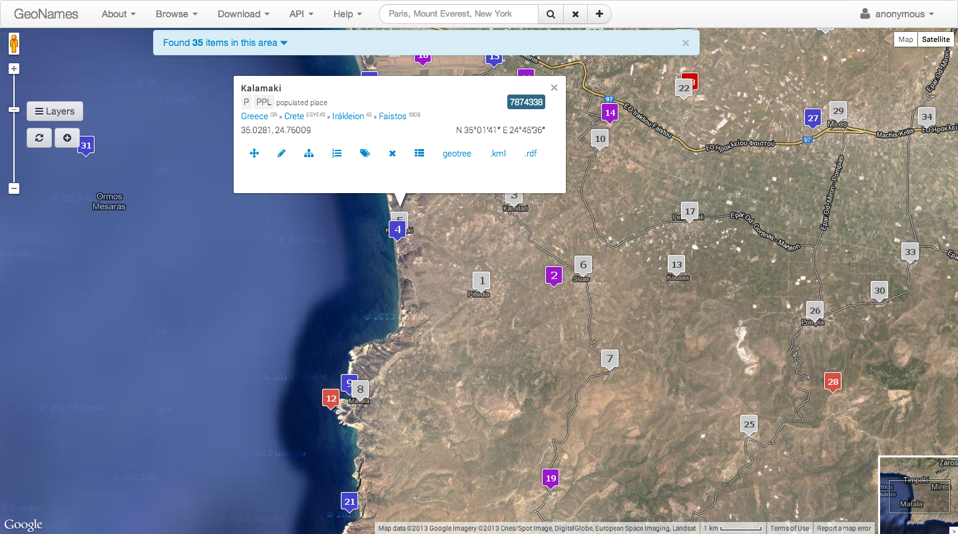
Geographic

Slide 62
Geographic

Slide 63
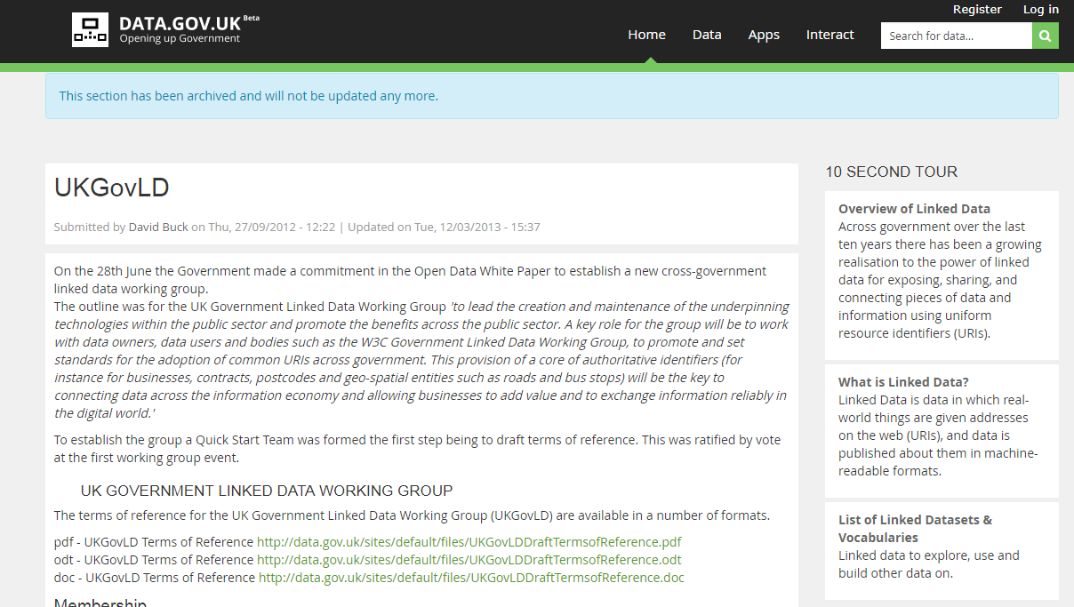
Governmental

Slide 64
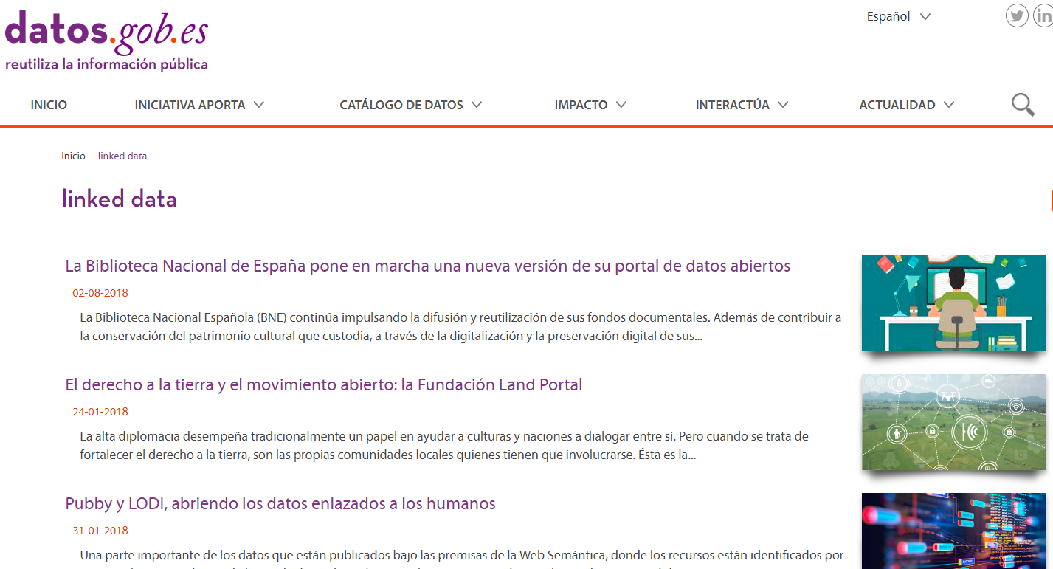
Governmental

Slide 65
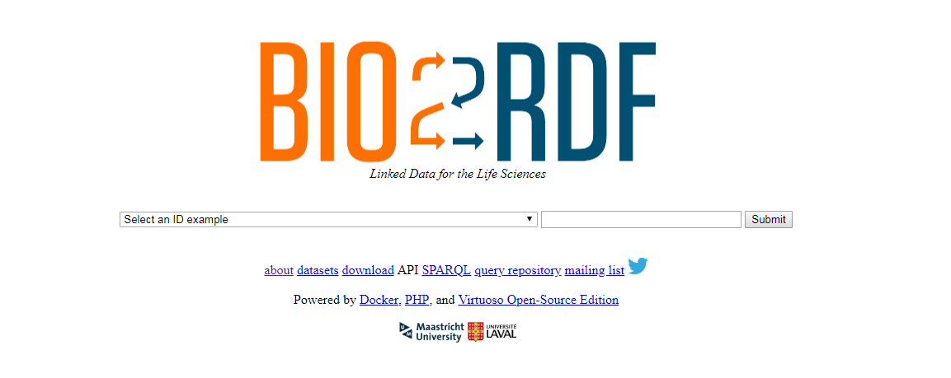
Life Sciences

Slide 66
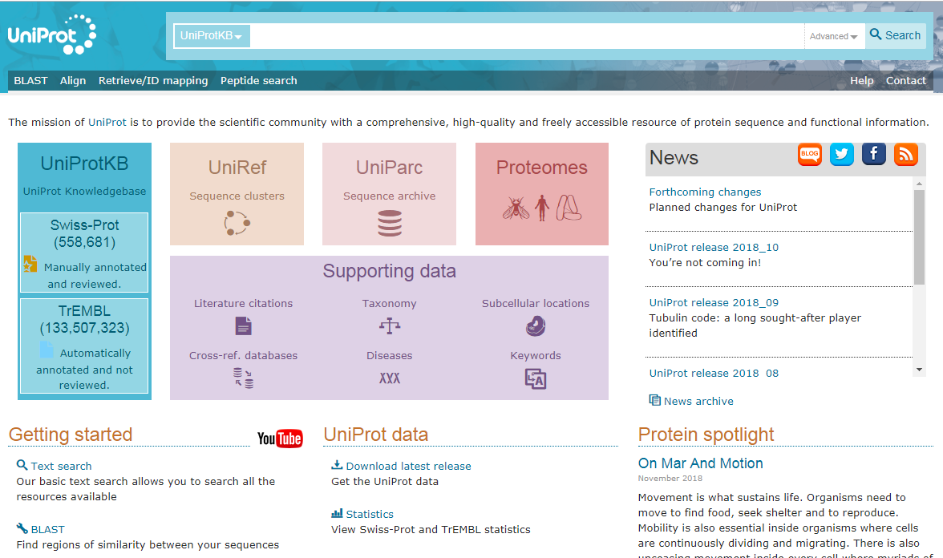
Life Sciences

Slide 67
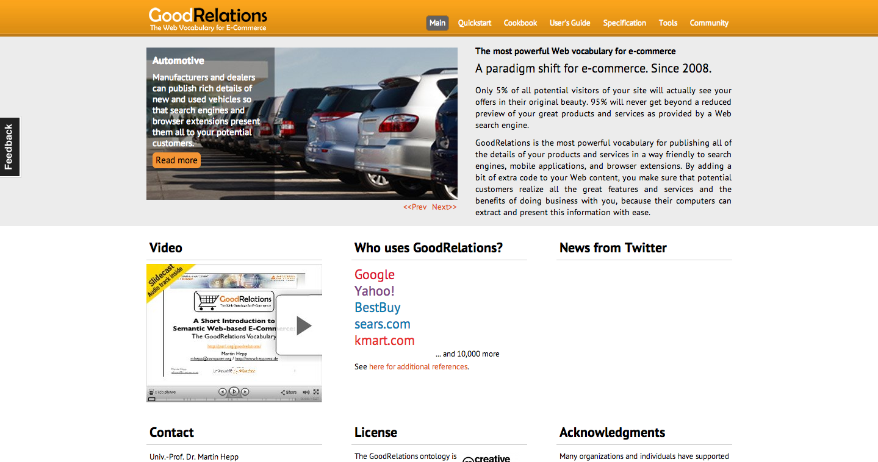
E-Commerce

Slide 68
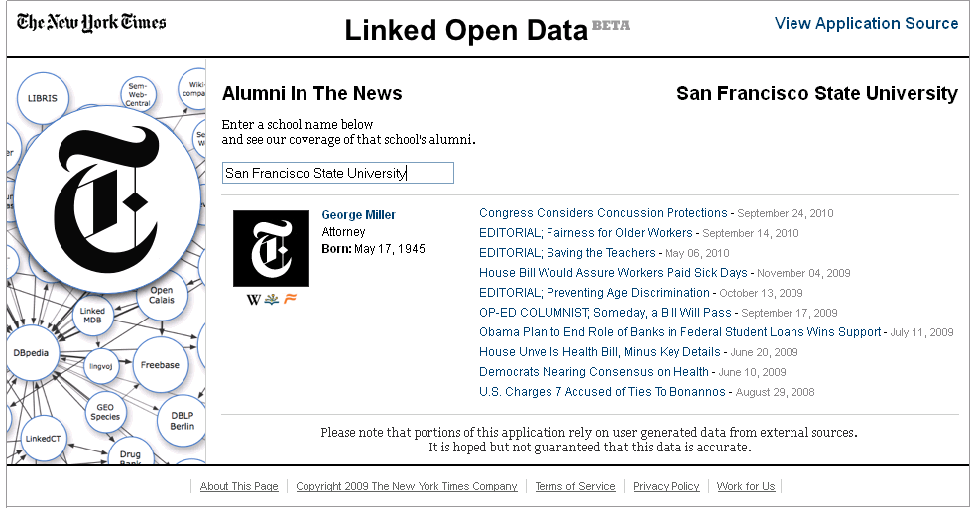
Media

Slide 69
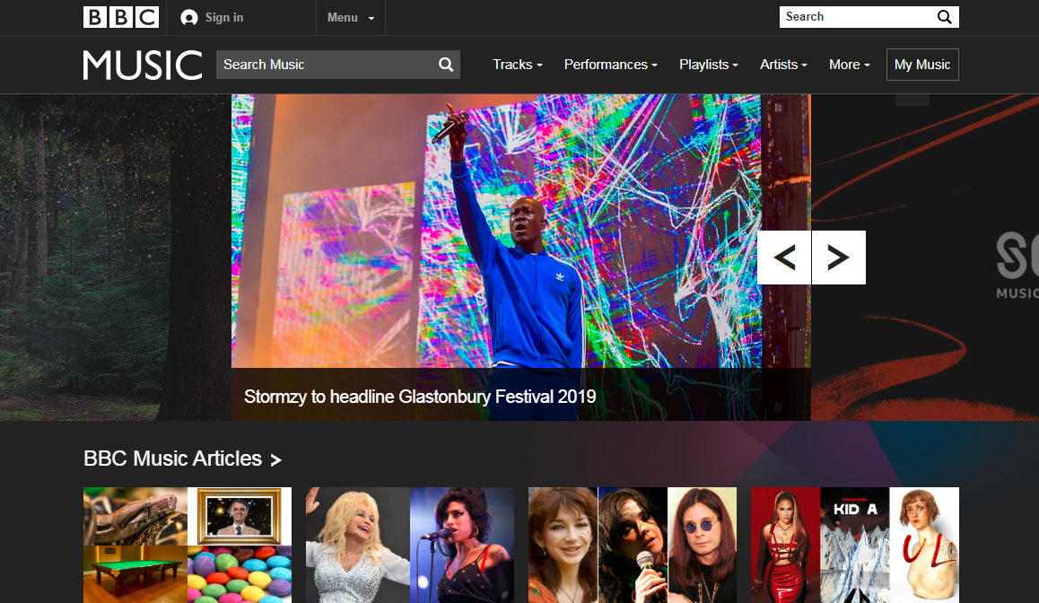
Media

Slide 70
Pokémon

Slide 71
The LOD Cloud
But if every dataset describes data with their own vocabulary
the datasets will be impossible to integrate and query.
How could we address this issue?
Oct. 2007
Nov. 2007
Feb. 2008
Sep. 2008
Mar. 2009
July 2009
Sept. 2010
Sept. 2011
Sept. 2012
Sept. 2013
Aug. 2014
Nov. 2018

Slide 72
Linked Open Vocabularies

Slide 73
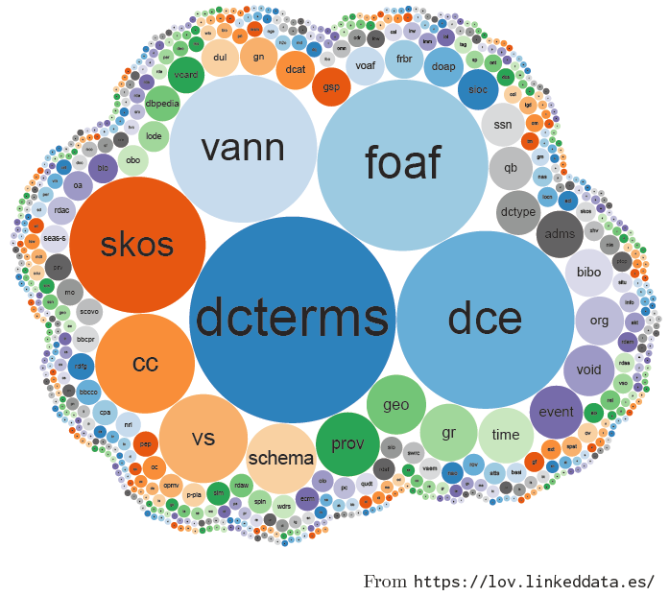
Linked Open Vocabularies
Indexes vocabularies for re-use

Slide 74
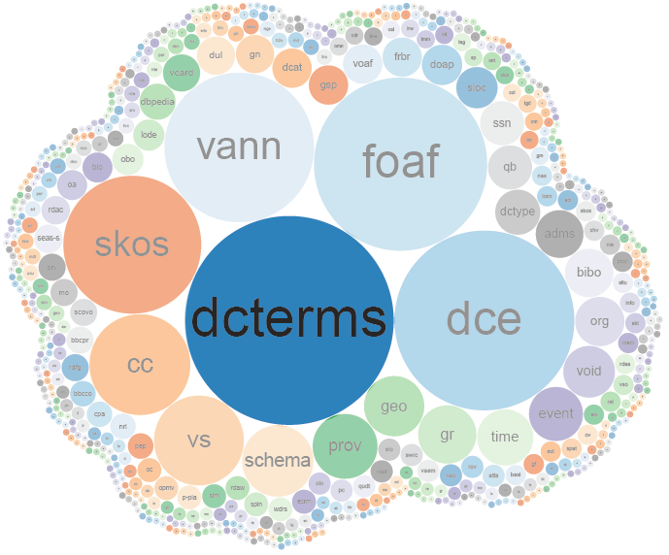
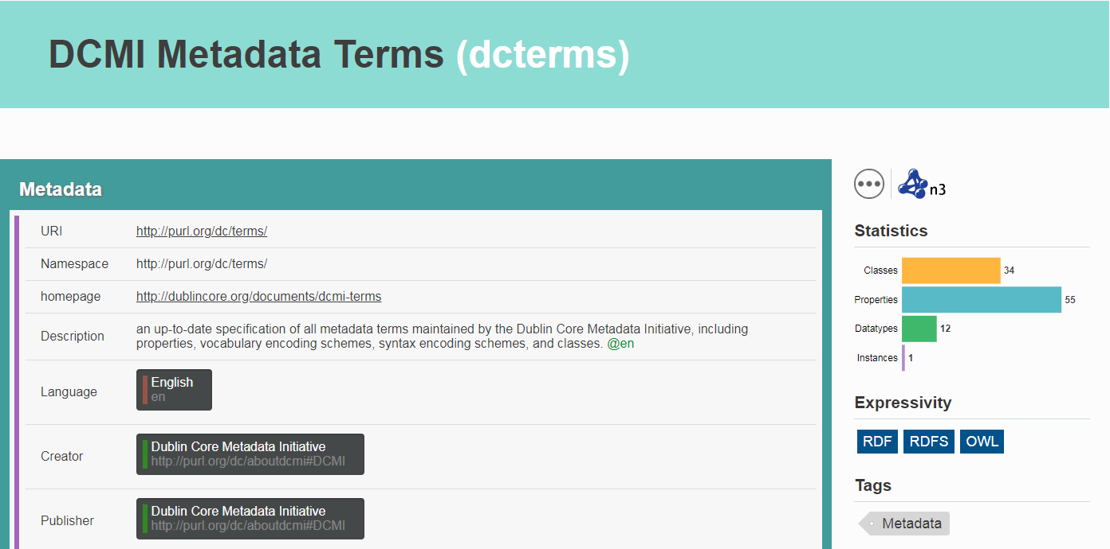
DCTERMS
Describes documents

Slide 75
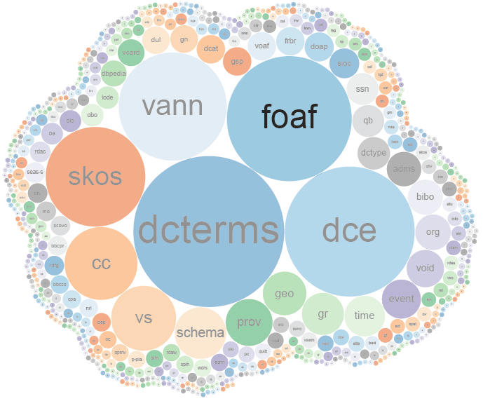
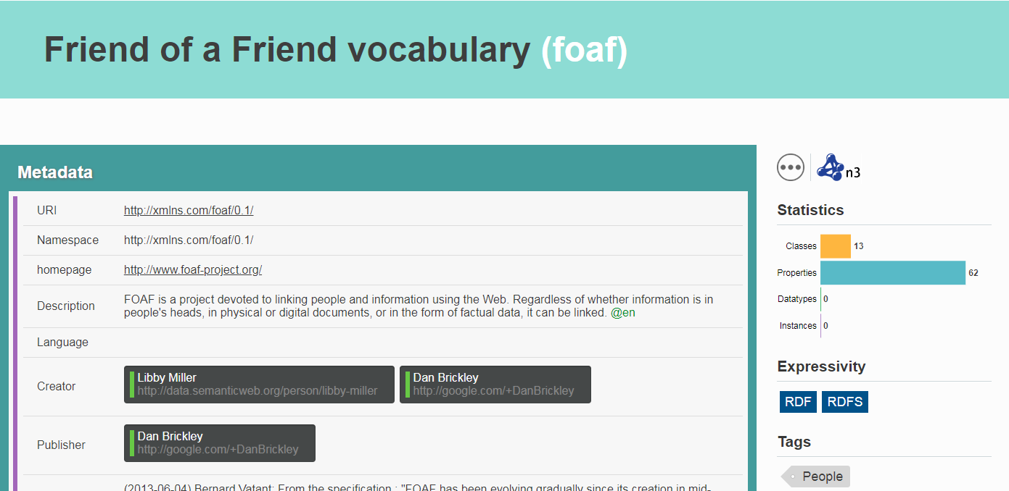
FOAF
Describes people

Slide 76
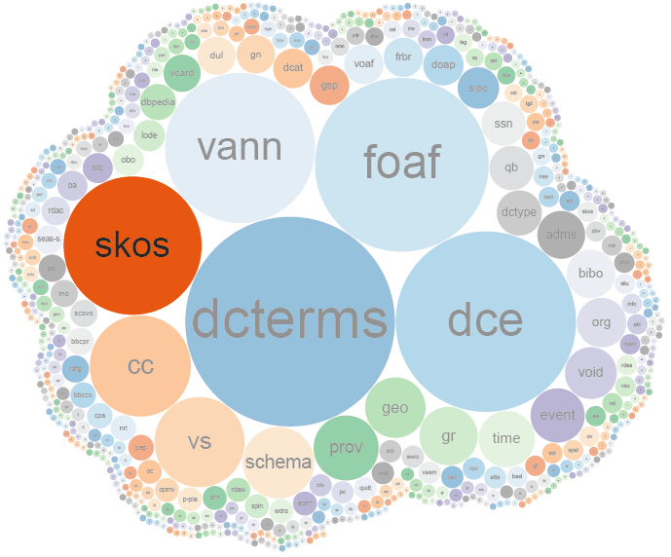
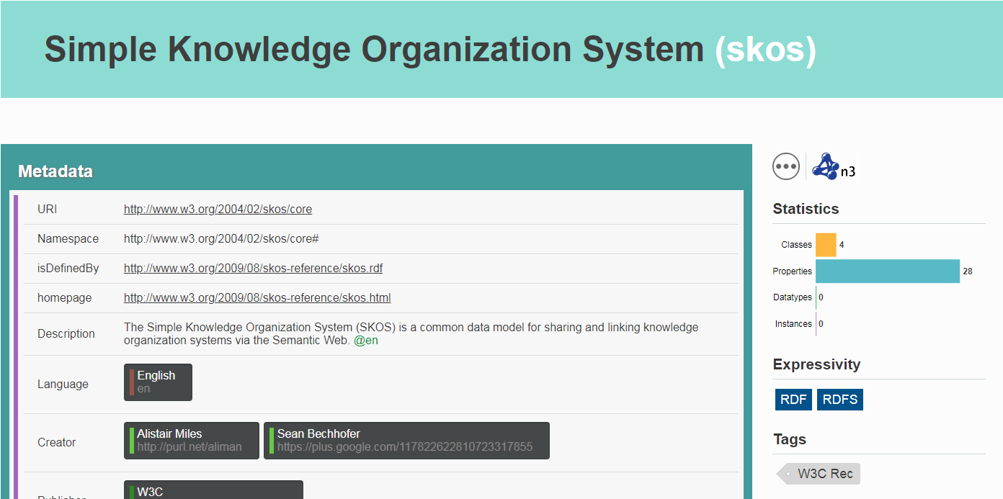
SKOS
Describes taxonomies

Slide 77
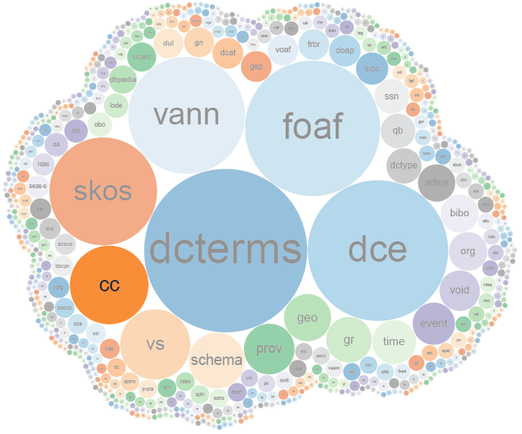
CC
Describes licencing

Slide 78
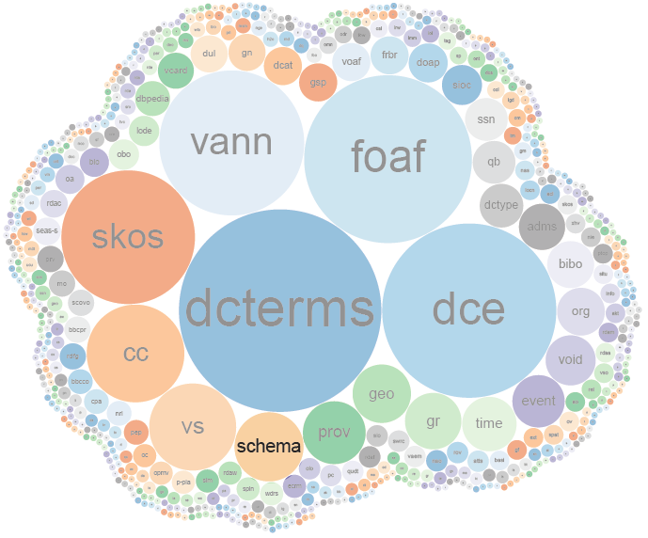
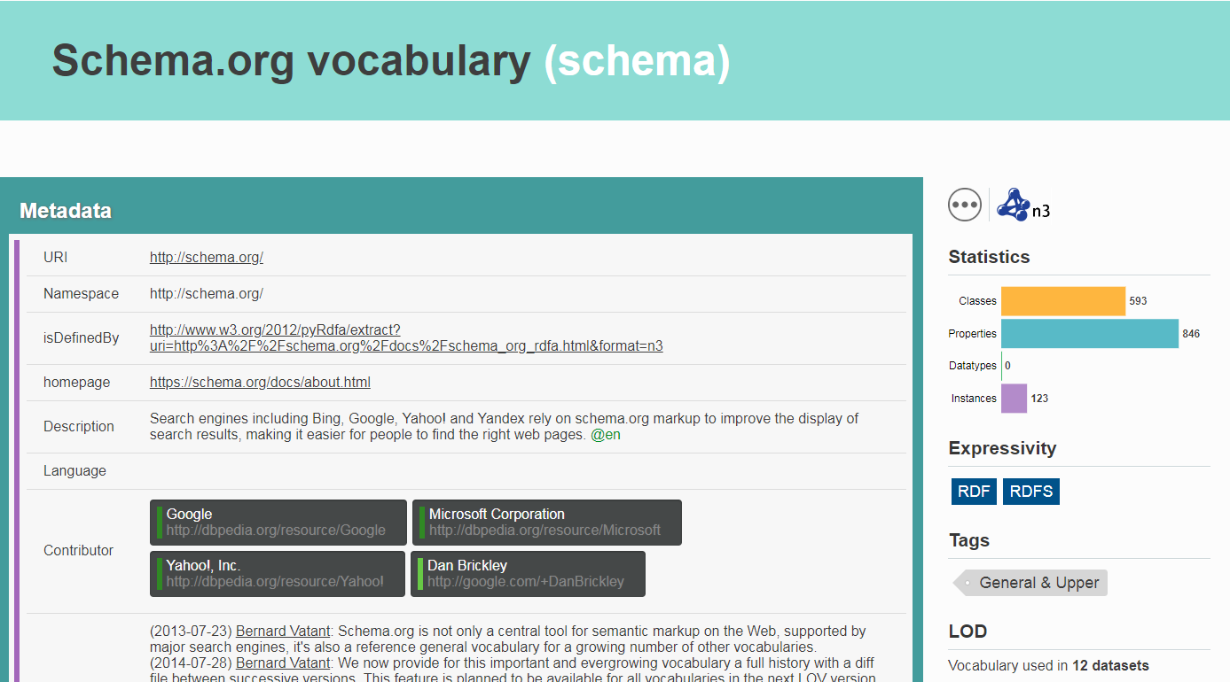
SCHEMA
Describes everything

Slide 79
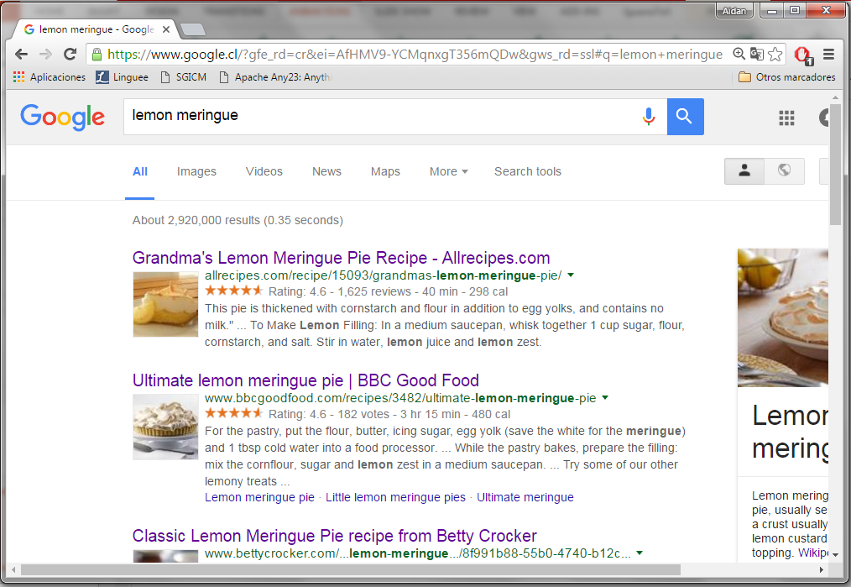
SCHEMA
Describes everything

Slide 80
Linked Data Applications

Slide 81
The LOD Cloud
So who is using these datasets (and for what)?
Oct. 2007
Nov. 2007
Feb. 2008
Sep. 2008
Mar. 2009
July 2009
Sept. 2010
Sept. 2011
Sept. 2012
Sept. 2013
Aug. 2014
Nov. 2018

Slide 82
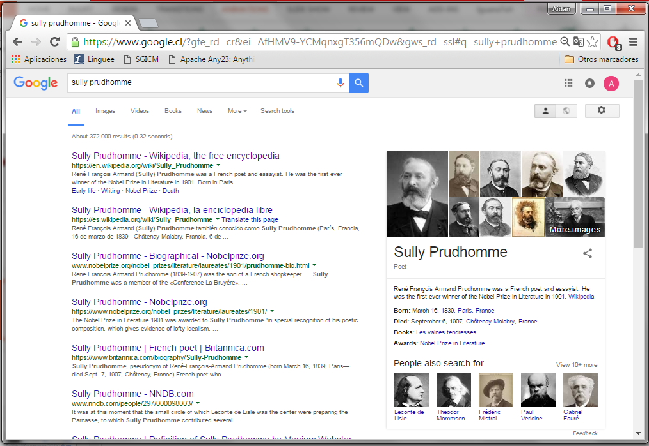
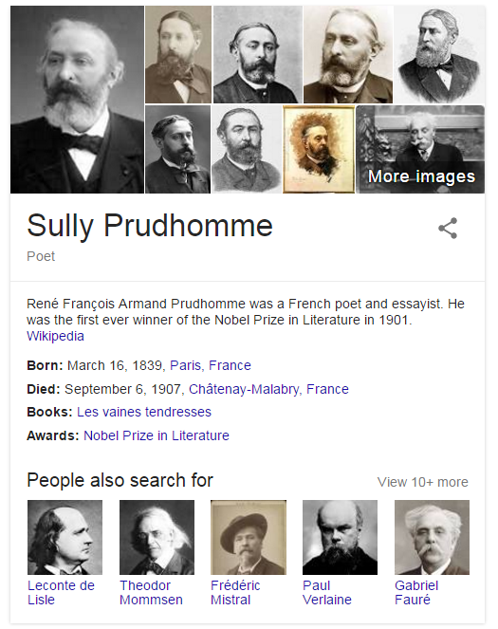
Google’s Knowledge Graph

Slide 83
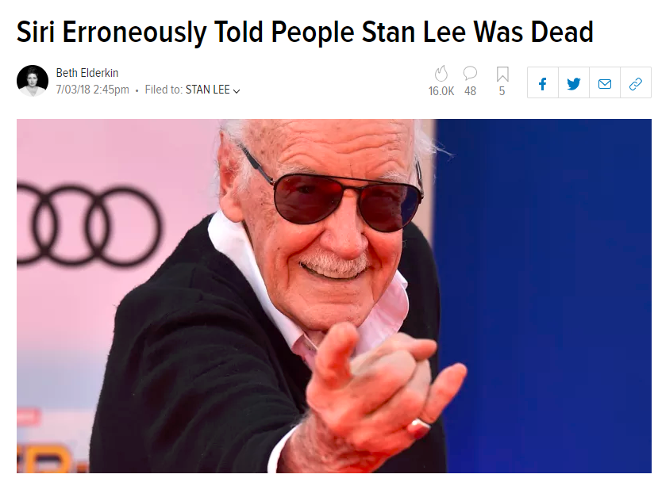
Apple's Siri

Slide 84
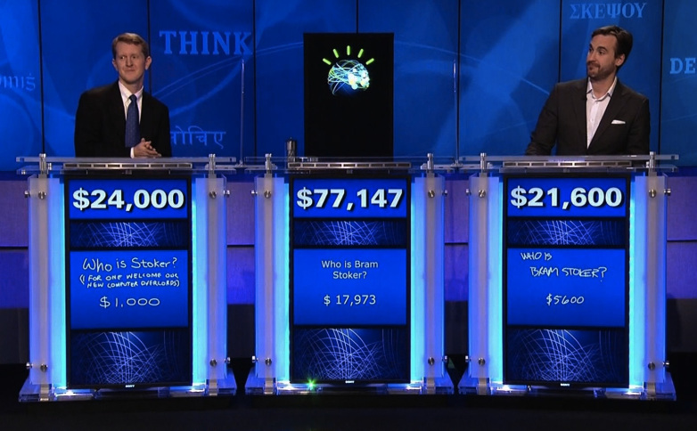
IBM's Watson

Slide 86
The LOD Cloud
However, these applications use hand-picked Linked Datasets!
Hard to find real-world applications that discover Linked Data
Oct. 2007
Nov. 2007
Feb. 2008
Sep. 2008
Mar. 2009
July 2009
Sept. 2010
Sept. 2011
Sept. 2012
Sept. 2013
Aug. 2014
Nov. 2018

Slide 87
Entering Unknown Territory: Open Research Questions!

Slide 88
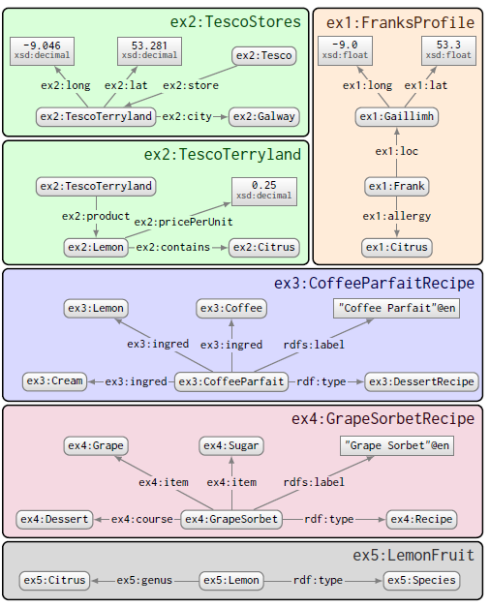
Diversity ...

Slide 89
Open Issue: Linked Data Integration

Slide 90
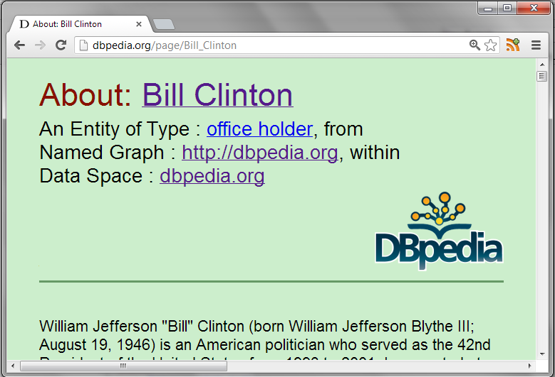
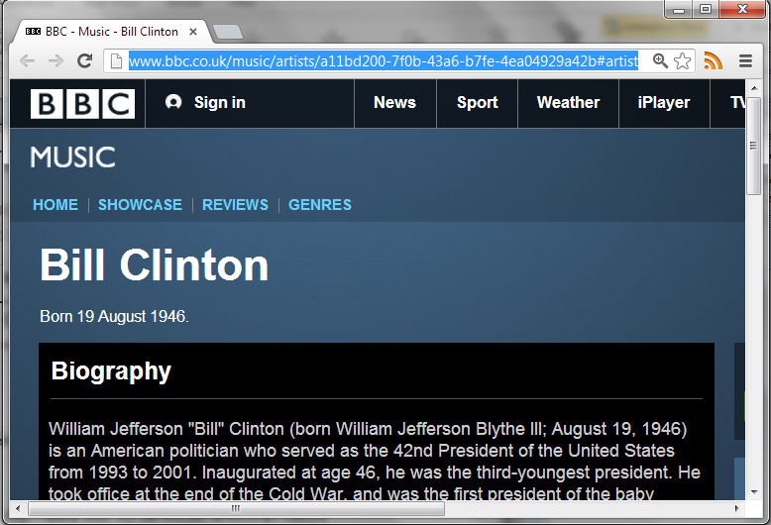
Need for Integration
http://dbpedia.org/resource/Bill_Clinton
http://rdf.freebase.com/ns/en.bill_clinton
http://data.nytimes.com/clinton_bill_per
http://www.bbc.co.uk/music/artists/…
How could OWL help here?
owl:sameAs

Slide 91
A (Hypothetical) Integration Example
SELECT ?a (COUNT(DISTINCT ?p2) AS ?c)
FROM NAMED …
WHERE {
?p1 ex:cites ?p2 .
GRAPH :dblp { ?p1 a :Paper . ?p2 a :Paper }
?p1 ex:writtenBy ?a . ?a ex:basedIn wiki:Chile .
NOT EXISTS {
?p1 ex:writtenBy ?b . ?p2 ex:writtenBy ?b .
}
} GROUP BY ?a ORDER BY DESC(?c)
What is this query asking?
Find the top cited authors based in Chile, only including papers from DBLP, excluding self-citations from the count.

Slide 92
A (Hypothetical) Integration Example

Slide 93
A (Hypothetical) Integration Example
gs:J_Pérez
dblp:Article
107
author
author
citedBy
type
gs:SchemaMap
gs:nSPARQL
dblp:PerezAG10
citedBy
30
author
writtenBy
hIndex
gs:M_Arenas
dblp:ArenasM
4,356
citations
mas:Databases
mas:Arenas,_M
wiki:Chile
field
name
affiliation
cites
country
Marcelo Arenas
2,074
mas:PUC
wiki:PCUC

Slide 94
A (Hypothetical) Integration Example
gs:J_Pérez
dblp:Article
107
author
author
citedBy
type
gs:SchemaMap
gs:nSPARQL
dblp:PerezAG10
citedBy
30
author
writtenBy
hIndex
gs:M_Arenas
dblp:ArenasM
4,356
citations
mas:Databases
mas:Arenas,_M
wiki:Chile
field
name
affiliation
cites
country
Marcelo Arenas
2,074
mas:PUC
wiki:PCUC

Slide 95
A (Hypothetical) Integration Example
gs:J_Pérez
dblp:Article
107
author
author
citedBy
type
gs:SchemaMap
gs:nSPARQL
dblp:PerezAG10
citedBy
30
author
writtenBy
hIndex
gs:M_Arenas
dblp:ArenasM
4,356
citations
mas:Databases
mas:Arenas,_M
wiki:Chile
field
name
affiliation
cites
country
Marcelo Arenas
2,074
mas:PUC
wiki:PCUC

Slide 96
Semantic Web: Tackling Heterogeneity
gs:J_Pérez
dblp:Article
107
author
author
citedBy
type
gs:SchemaMap
gs:nSPARQL
dblp:PerezAG10
citedBy
30
author
writtenBy
hIndex
4,356
gs:M_Arenas
mas:Arenas,_M
dblp:ArenasM
citations
mas:Databases
field
wiki:Chile
name
affiliation
cites
country
Marcelo Arenas
2,074
mas:PUC
wiki:PCUC

Slide 97
A (Hypothetical) Integration Example
gs:J_Pérez
dblp:Article
107
author
author
citedBy
type
gs:SchemaMap
gs:nSPARQL
dblp:PerezAG10
citedBy
30
author
writtenBy
hIndex
4,356
gs:M_Arenas
mas:Arenas,_M
dblp:ArenasM
citations
mas:Databases
field
wiki:Chile
affiliation
name
cites
country
mas:PUC
wiki:PCUC
Marcelo Arenas
2,074

Slide 98
A (Hypothetical) Integration Example
…
gs:J_Pérez
mas:Perez,_J
dblp:PérezJ001
…
…
…
dblp:Article
107
author
author
citedBy
type
gs:SchemaMap
gs:nSPARQL
dblp:PerezAG10
citedBy
30
author
writtenBy
hIndex
4,356
gs:M_Arenas
mas:Arenas,_M
dblp:ArenasM
citations
mas:Databases
field
wiki:Chile
affiliation
name
cites
country
mas:PUC
wiki:PCUC
Marcelo Arenas
2,074

Slide 99
A (Hypothetical) Integration Example

Slide 100
A (Hypothetical) Integration Example
SELECT ?a (COUNT(DISTINCT ?p2) AS ?c)
FROM NAMED …
WHERE {
?p1 ex:citedBy ?p2 .
GRAPH :dblp { ?p1 a :Paper . ?p2 a :Paper }
?p1 ex:writtenBy ?a . ?a ex:basedIn wiki:Chile .
NOT EXISTS {
?p1 ex:writtenBy ?b . ?p2 ex:writtenBy ?b .
}
} GROUP BY ?a ORDER BY DESC(?c)

Slide 101
A (Hypothetical) Integration Example
SELECT ?a (COUNT(DISTINCT ?p2) AS ?c)
FROM NAMED …
WHERE {
?p1 ex:citedBy ?p2 .
GRAPH :dblp { ?p1 a :Paper . ?p2 a :Paper }
?p1 ex:writtenBy ?a . ?a ex:basedIn wiki:Chile .
NOT EXISTS {
?p1 ex:writtenBy ?b . ?p2 ex:writtenBy ?b .
}
} GROUP BY ?a ORDER BY DESC(?c)
dblp:Article
type
gs:nSPARQL
dblp:PerezAG10
dblp:Paper
type
Article ⊑ Paper
dblp:Article rdfs:subClassOf dblp:Paper .

Slide 102
A (Hypothetical) Integration Example
SELECT ?a (COUNT(DISTINCT ?p2) AS ?c)
FROM NAMED …
WHERE {
?p1 ex:citedBy ?p2 .
GRAPH :dblp { ?p1 a :Paper . ?p2 a :Paper }
?p1 ex:writtenBy ?a . ?a ex:basedIn wiki:Chile .
NOT EXISTS {
?p1 ex:writtenBy ?b . ?p2 ex:writtenBy ?b .
}
} GROUP BY ?a ORDER BY DESC(?c)
gs:J_Pérez
author
writtenBy
writtenBy
author
gs:SchemaMap
gs:nSPARQL
dblp:PerezAG10
author ≡ writtenBy ⁻
ex:author owl:inverseOf ex:writtenBy .

Slide 103
A (Hypothetical) Integration Example
SELECT ?a (COUNT(DISTINCT ?p2) AS ?c)
FROM NAMED …
WHERE {
?p1 ex:citedBy ?p2 .
GRAPH :dblp { ?p1 a :Paper . ?p2 a :Paper }
?p1 ex:writtenBy ?a . ?a ex:basedIn wiki:Chile .
NOT EXISTS {
?p1 ex:writtenBy ?b . ?p2 ex:writtenBy ?b .
}
} GROUP BY ?a ORDER BY DESC(?c)
gs:nSPARQL
dblp:PerezAG10
writtenBy
gs:M_Arenas
mas:Arenas,_M
dblp:ArenasM
basedIn
wiki:Chile
affiliation
country
mas:PUC
wiki:PCUC
affiliation ○ country ⊑ basedIn
ex:basedIn owl:propertyChainAxiom( ex:affilition ex:country)

Slide 104
A (Hypothetical) Integration Example
SELECT ?a (COUNT(DISTINCT ?p2) AS ?c)
FROM NAMED …
WHERE {
?p1 ex:citedBy ?p2 .
GRAPH :dblp { ?p1 a :Paper . ?p2 a :Paper }
?p1 ex:writtenBy ?a . ?a ex:basedIn wiki:Chile .
NOT EXISTS {
?p1 ex:writtenBy ?b . ?p2 ex:writtenBy ?b .
}
} GROUP BY ?a ORDER BY DESC(?c)
Article ⊑ Paper
author ≡ writtenBy ⁻
affiliation ○ country ⊑ basedIn

Slide 105
Not clear yet how to do reasoning on the Web!

Slide 106
Side Note: Fact or Fiction?

Slide 107
Open Issue: Linked Data Access

Slide 108
Access Methods
Client has a request/query Q
Server has a dataset D
Client issues Q to server
Server computes and returns response Q(D)
D
Q
HTTP
Q(D)

Slide 109
Access Methods
D
Q
D
D
Q
Q
D
Q
Multiple clients / multiple servers (blurred)
Remote, decentralised, uncoordinated
Web scale

Slide 110
Linked Data Access Methods
Dereferencing:
Look up a URI, get an RDF document
Dumps:
Get all data in an archive
SPARQL Queries:
Send a query, get the answers

Slide 111
Dereferencing (what is it?)
Q = “http://dbpedia.org/resource/Colombia”
Q(D) =

Slide 112
Dereferencing (what’s wrong with it?)
Responses vary from server to server
local triples where URI is subject (83%) vs.
local triples where URI is subject or object (55%)
Well-defined: For a given Q and D, clients and servers agree on what Q(D) should be.

Slide 113
Dereferencing (what’s wrong with it?)
Very coarse:
Give me all capitals of South American countries.
Dereference documents for all country URIs
See which ones are in South America, throw away rest
Throw away triples other than capitals
Granular: The language for Q allows the client to be specific so as to avoid wasting bandwidth

Slide 114
Dereferencing (what’s wrong with it?)
No pagination:
Give me some information about Italy.
Load document with 100,000 triples
Throw away 99,900 triples the user won’t read
Pagination: A large response Q(D) can be split into chunks

Slide 115
Dumps (what are they?)

Slide 116
Dumps (what’s wrong with them?)
15× compression for RDF achievable
But same weaknesses as for deref. still apply

Slide 117
Dumps (what’s wrong with them?)
15× compression for RDF achievable
But same weaknesses as for deref. still apply
Also, no standard access methods:
Various compressions and formats
Linked through generic HTML
Accessible: The protocol and formats are defined for automatic access by software agents

Slide 118
SPARQL (what is it?)
Q =
Q(D) =

Slide 119
SPARQL (to the rescue?)

Slide 120
SPARQL (what’s wrong with it?)

Slide 121
SPARQL (what’s wrong with it?)

Slide 122
SPARQL (what’s wrong with it?)
Simple Protocol and RDF Query Language
SPARQL evaluation: PSpace-complete

Slide 123
SPARQL (what’s wrong with it?)
Cacheable: Common requests can be cached and re-used. Queries can be anticipated.
Costable: The cost of processing a query can be anticipated before actual processing.

Slide 124
SPARQL (what’s wrong with it?)

Slide 125
SPARQL (what’s wrong with it?)

Slide 126
SPARQL (what’s wrong with it?)
Simple Protocol And RDF Query Language
Protocol always expects a perfect answer
No support for partial results, timeouts, exception handling, pagination …
Robust: Access method can gracefully handle error cases and provide Quality of Service

Slide 127
SPARQL (what’s wrong with it?)
D is a black-box for the user

Slide 128
SPARQL (what’s wrong with it?)
Q =
Q(D) =
Transparent: The client can determine if a dataset D is relevant and the service sufficient.

Slide 129
Problem Categories
Standardised
Bandwidth-efficient
Server-processing-efficient
Usable by client

Slide 130
Data Access: Open Problem

Slide 131
Open Issue: Linked Data quality

Slide 132
Can’t trust everything you read on the Web

Slide 133
Automatic Integration possible …
Tesco
Galway
Galway
outlet
product
livesIn
livesIn
EatMeDriedDates
Jen
contains
allergyInfo
allergy
weightInKg
priceInEuro
type
DriedDates
0.227
2.49
Gluten
Coeliac
DriedDates
ingredient
BlackTea
Soda
ingredient
ingredient
ingredient
DessertRecipe
StickyToffeePudding
type

Slide 134
Automatic Integration possible …
Tesco
Galway
Galway
outlet
product
livesIn
EatMeDriedDates
Jen
contains
allergyInfo
weightInKg
priceInEuro
type
DriedDates
0.227
2.49
Gluten
Coeliac
DriedDates
BlackTea
Soda
ingredient
ingredient
ingredient
DessertRecipe
StickyToffeePudding
type

Slide 135
Automatic Integration possible …
Tesco
Galway
Galway
outlet
product
livesIn
livesIn
long
lat
long
lat
EatMeDriedDates
Jen
−9.0
53.3
−9.0
53.3

Slide 136
Automatic Integration possible …
Tesco
Galway
Galway
outlet
product
livesIn
EatMeDriedDates
Jen
contains
allergyInfo
weightInKg
priceInEuro
type
DriedDates
0.227
2.49
Gluten
Coeliac
DriedDates
BlackTea
Soda
ingredient
ingredient
ingredient
DessertRecipe
StickyToffeePudding
type

Slide 137
Automatic Integration possible …
EatMeDriedDates
Jen
allergyInfo
allergy
type
Gluten
Coeliac
Coeliac
Gluten
equivClass
hasValue
onProperty
allergy
Relationship between Coeliac and Gluten?
Coeliac(Jen) [Jen is a Coeliac]
Coeliac ≡ ∃allergy.{Gluten} [a Coeliac has allergy to Gluten]
∴ allergy(Jen,Gluten) [Jen has allergy to Gluten]

Slide 138
But not everything on the Web is true
Beer
loves
EatMeDriedDates
Jen
allergyInfo
allergy
type
Gluten
Coeliac
Coeliac
Gluten
equivClass
hasValue
onProperty
allergy
Coeliac(Jen) [Jen is a Coeliac]
Coeliac ≡ ∃allergy.{Gluten} [a Coeliac has allergy to Gluten]
∴ allergy(Jen,Gluten) [Jen has allergy to Gluten]

Slide 139
Open Issue: Legacy data

Slide 140
Most Web (meta-)data in …
… and so on …

Slide 141
From ★★★ to ★★★★ is a big step!!

Slide 142
Next week: RDB2RDF
From relational databases (RDB) to RDF …

Slide 143
Actually there are lots of open issues

Slide 144
Open Issues / Research Questions
How to efficiently access Linked Data?
How to automatically link datasets?
How to reason over Web data?
How to verify/measure quality?
How to deal with deceit?
How to make it all “easy to use”?
How best to model vocabularies for re-use?
How to convert legacy data to Linked Data?
...
None of these problems is fundamental.
All of these problems are subject to research!
Solutions are being proposed!

Slide 146
Questions?

