Slide 1
CC7220-1
La Web de Datos
Primavera 2018
Lecture 6: Web Ontology Language (OWL) [III]
Aidan Hogan
aidhog@gmail.com

Slide 2
Last time …

Slide 3
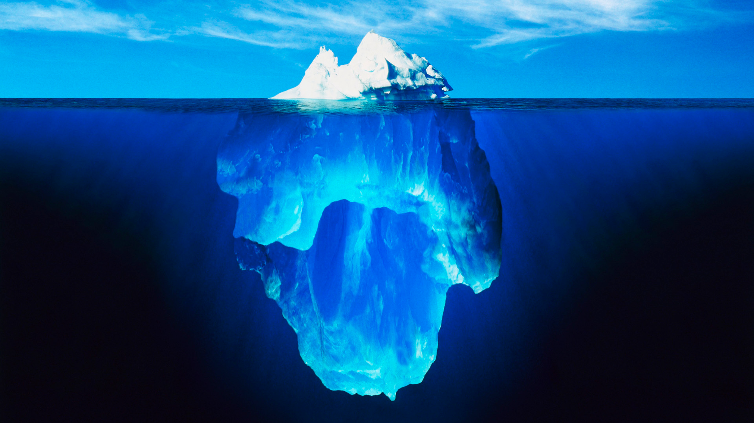




Slide 4
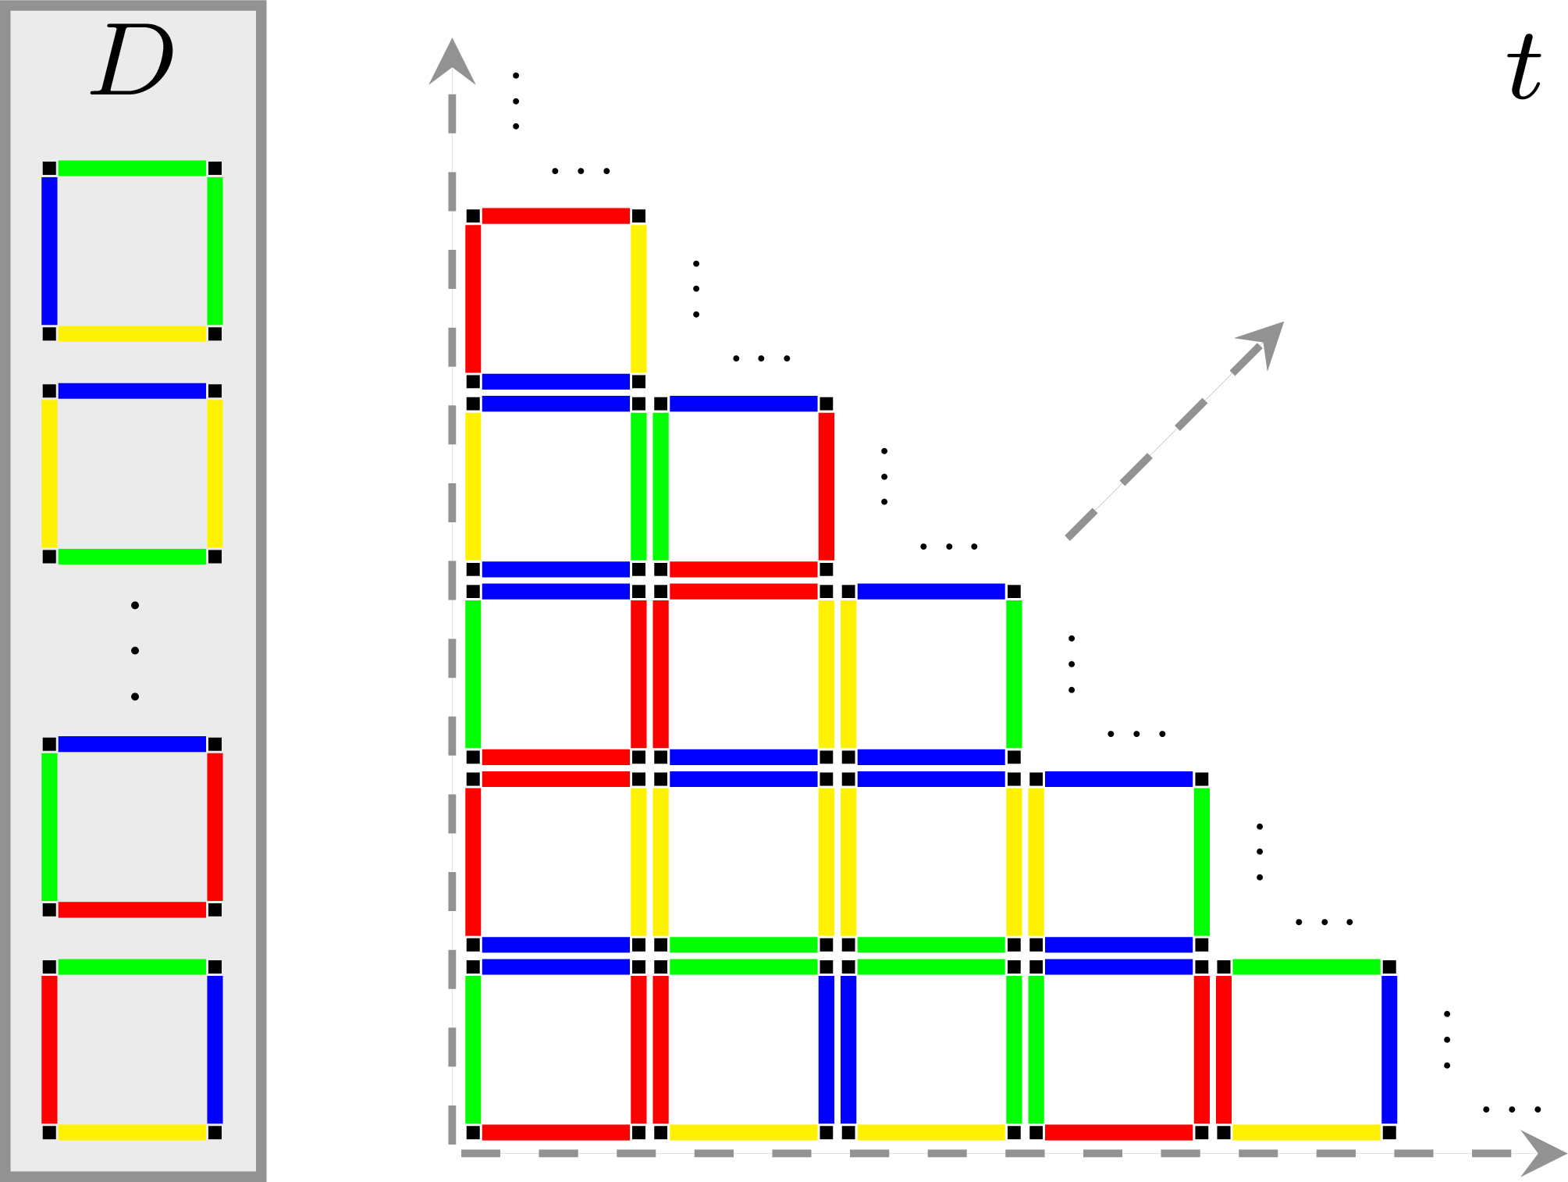
Domino Tiling Problem (Undecidable!)
Input: A set of Dominos (like D)
Output:
  true if there exists a valid infinite tiling (like t)
  false otherwise

Slide 5
Today's Topic

Slide 6
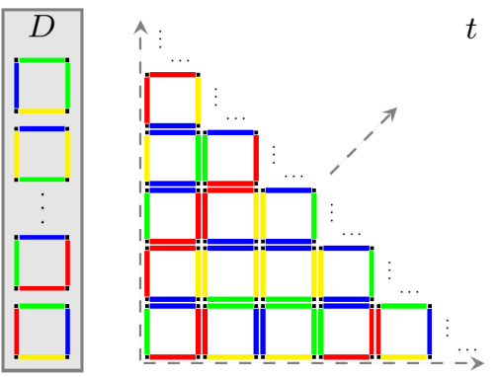



Reduce from Tiling to OWL entailment?
Reduction
Does D have an infinite tiling?
Does OWL ontology O entail O′?
How can we encode a Domino Tiling question into an OWL ontology entailment question?

Slide 7
Some Description Logic symbols
⊑: sub-class/-property
≡: equivalent class/property
⊔: union
⊓: intersection
⊤: top (class of everything)
⊥: bottom (empty class)
∃: exists (someValuesFrom/hasValue)
∀: for all (allValuesFrom)
¬: not (complement, negation)
– (superscript minus): inverse property
{}: enumeration (owl:oneOf)
Self, Trans, Dom, etc.: where symbols not available
∘: property chain
C(x): class membership
P(x,y): a triple (x,P,y)

Slide 8
Domino Tiling Problem (Undecidable!)
Input: A set of Dominos (like D)
Output:
  true if there exists a valid infinite tiling (like t)
  false otherwise

Slide 9




Domino Tiling Problem: Some terminology
Tile: A Piece

Slide 10
Domino Tiling Problem: Some terminology
Tile: A Piece
Domino: Group of Tiles of same colour

Slide 12

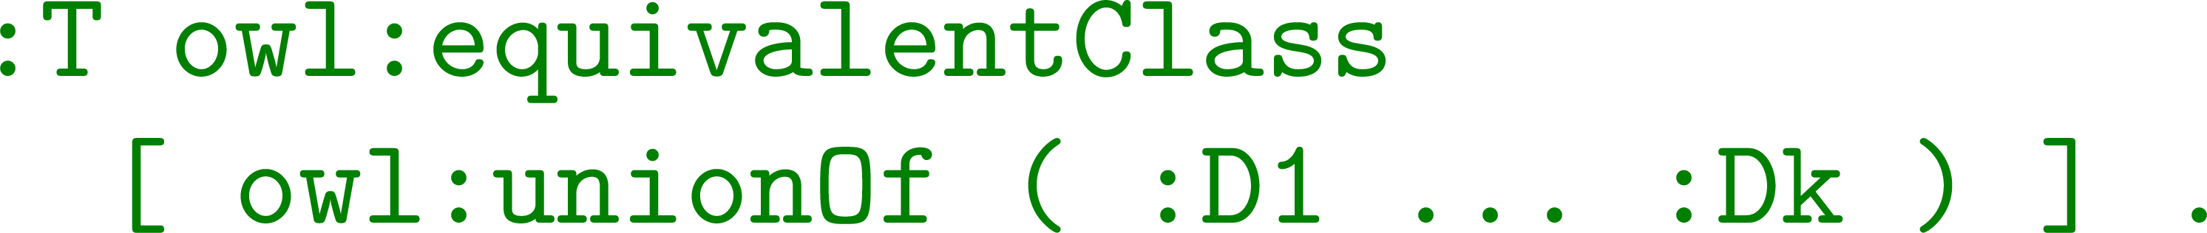
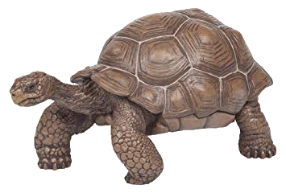
Can reduce from OWL entailment to Tiling
Each tile must have a domino type
  Define tiles as a class T, a union of classes for each domino type:

Slide 13
Can reduce from OWL entailment to Tiling
Each tile must have a domino type
Now what else do we need to encode?

Slide 14
Can reduce from OWL entailment to Tiling
Each tile must have a domino type
Each tile can only be one domino type
How can we encode this in OWL?

Slide 15
Can reduce from OWL entailment to Tiling
Each tile must have a domino type
Each tile can only be one domino type
  Define dominos types as pairwise disjoint:

Slide 16
Can reduce from OWL entailment to Tiling
Each tile must have a domino type
Each tile can only be one domino type
Now what else do we need to encode?

Slide 17
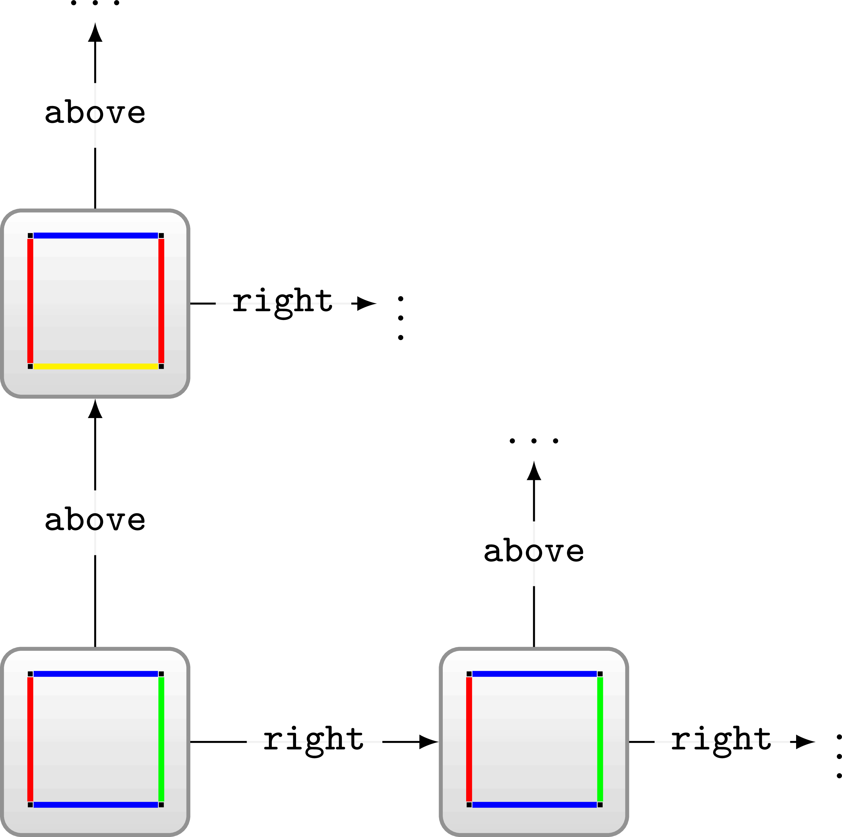
Can reduce from OWL entailment to Tiling
Each tile must have a domino type
Each tile can only be one domino type
Each tile must have a tile to the right and above
How can we encode this in OWL?

Slide 18

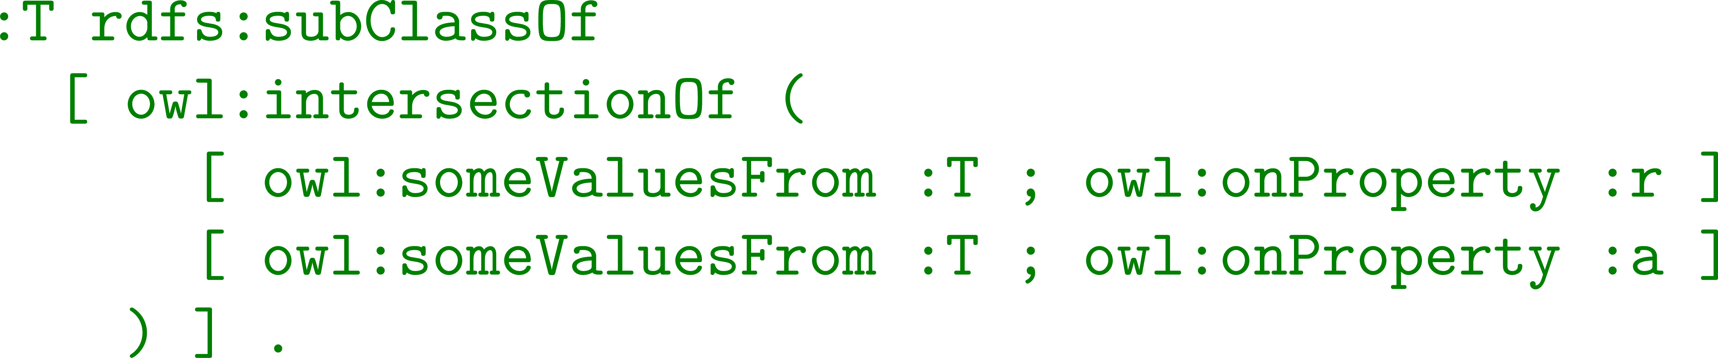
Can reduce from OWL entailment to Tiling
Each tile must have a domino type
Each tile can only be one domino type
Each tile must have a tile to the right and above
  Define that a tile has some values from tile for right/above:

Slide 19
Can reduce from OWL entailment to Tiling
Each tile must have a domino type
Each tile can only be one domino type
Each tile must have a tile to the right and above
Are we there yet?

Slide 20
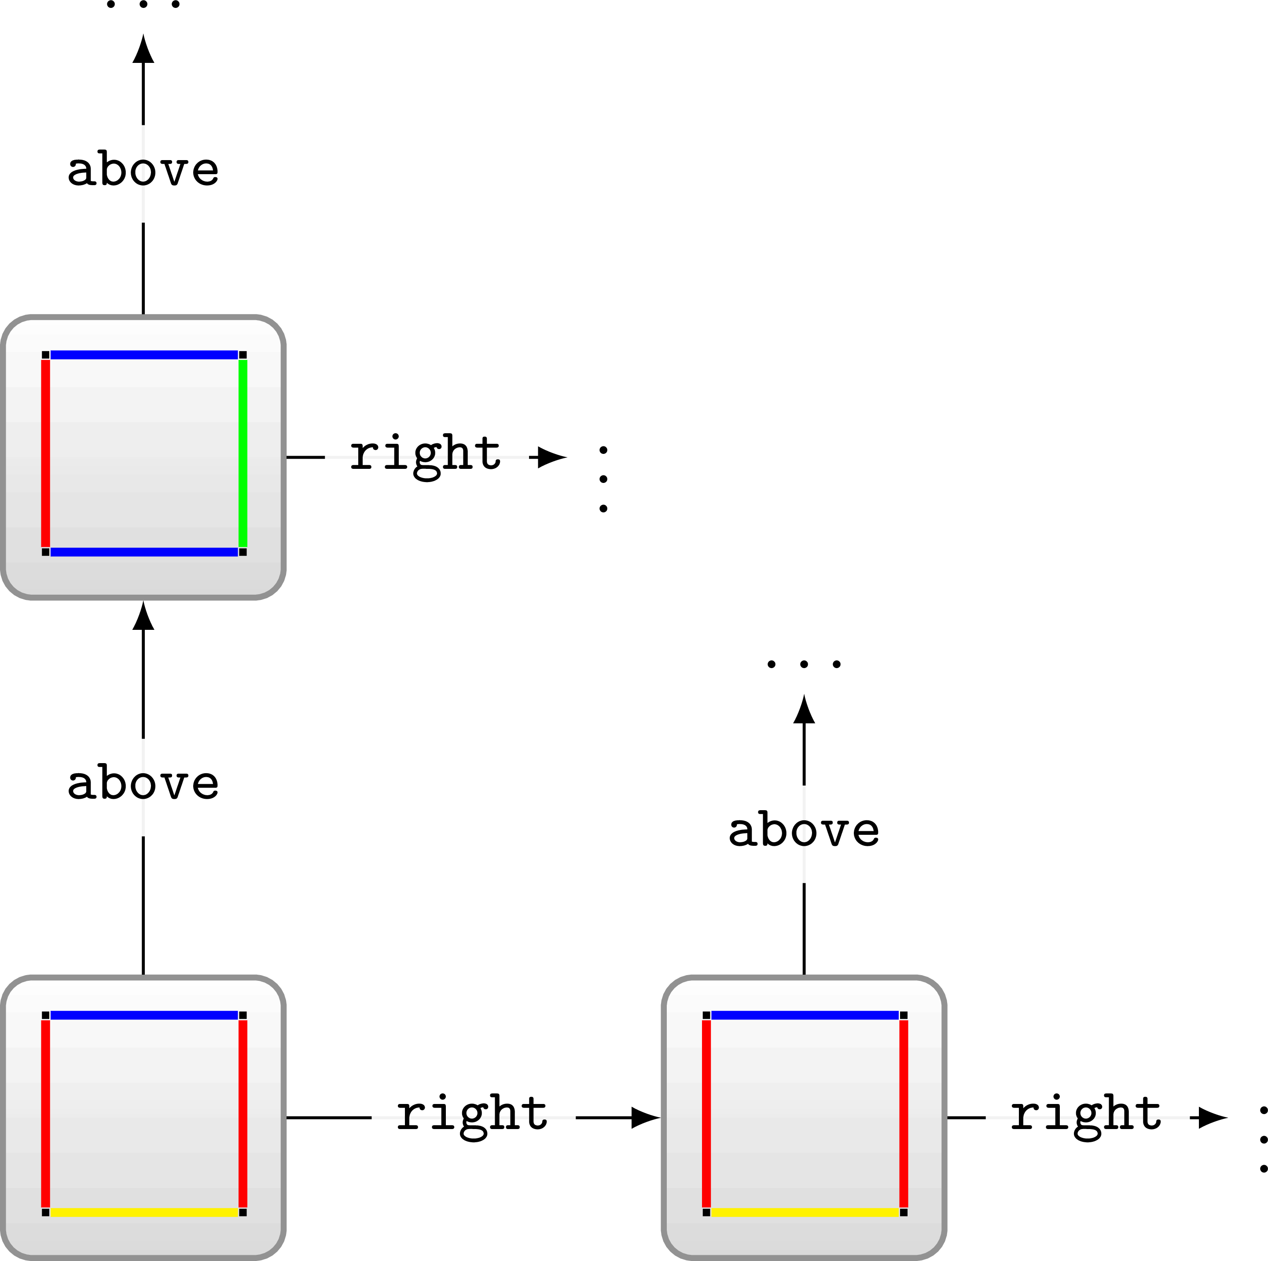
Can reduce from OWL entailment to Tiling
Each tile must have a domino type
Each tile can only be one domino type
Each tile must have a tile to the right and above
Tiles to the right and tiles above must match colour
How can we encode this in OWL?

Slide 21
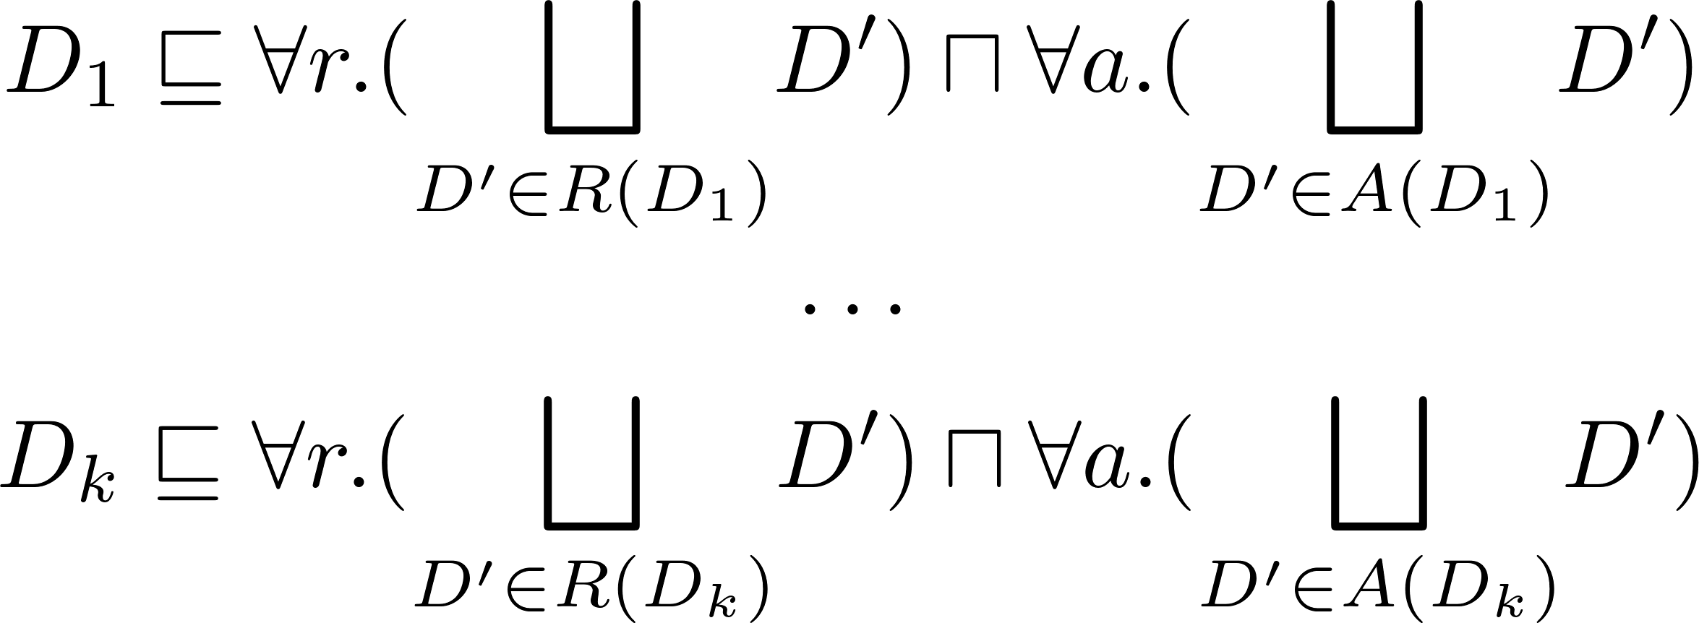
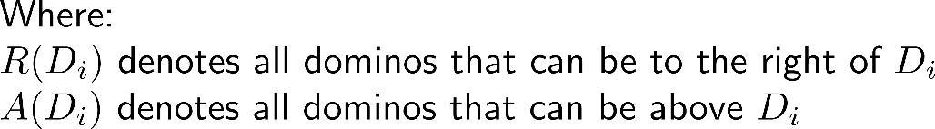
Can reduce from OWL entailment to Tiling
Each tile must have a domino type
Each tile can only be one domino type
Each tile must have a tile to the right and above
Tiles to the right and tiles above must match colour

Slide 22
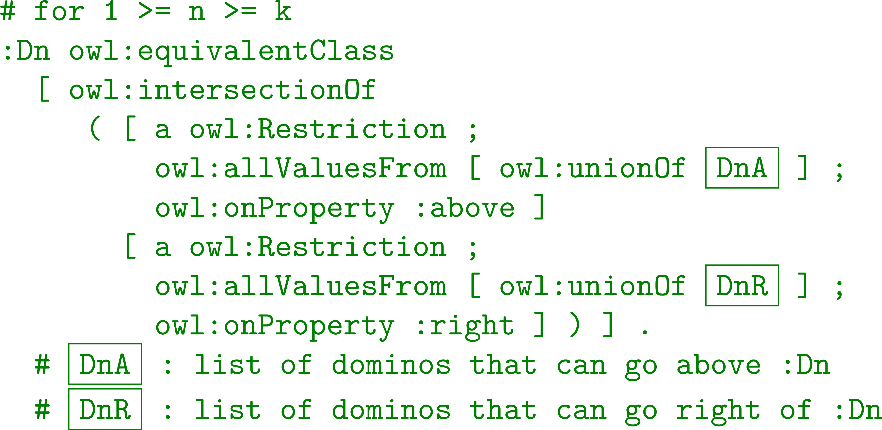
Can reduce from OWL entailment to Tiling
Each tile must have a domino type
Each tile can only be one domino type
Each tile must have a tile to the right and above
Tiles to the right and tiles above must match colour

Slide 23
Can reduce from OWL entailment to Tiling
Each tile must have a domino type
Each tile can only be one domino type
Each tile must have a tile to the right and above
Tiles to the right and tiles above must match colour
Are we there yet?

Slide 24
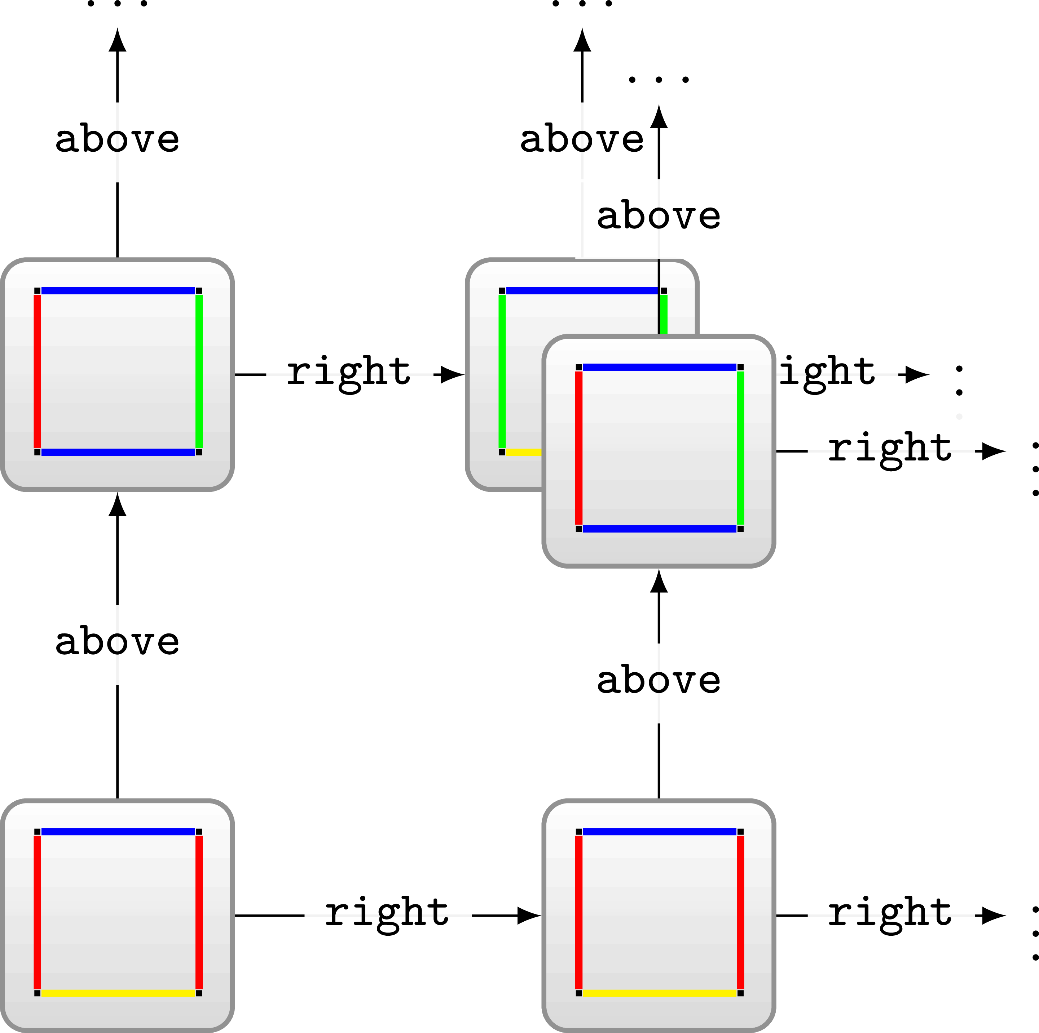
Can reduce from OWL entailment to Tiling
Each tile must have a domino type
Each tile can only be one domino type
Each tile must have a tile to the right and above
Tiles to the right and tiles above must match colour
Are we there yet?

Slide 25
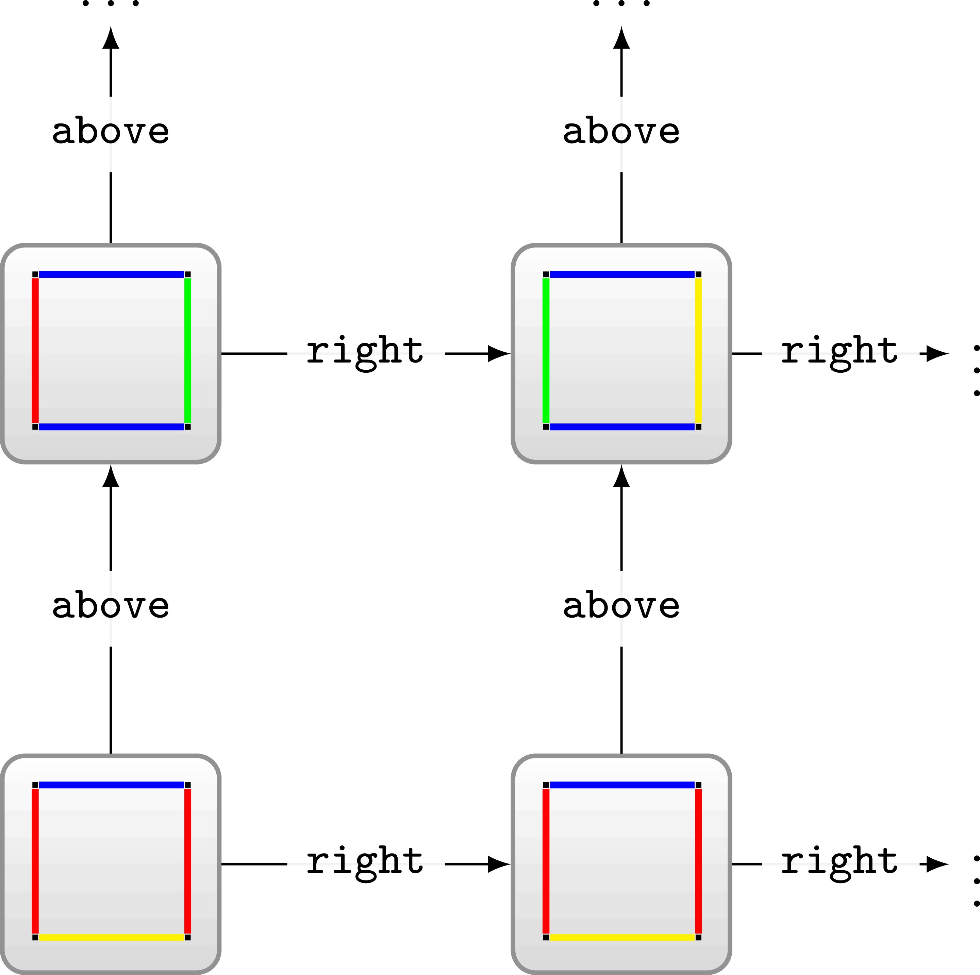
Can reduce from OWL entailment to Tiling
Each tile must have a domino type
Each tile can only be one domino type
Each tile must have a tile to the right and above
Tiles to the right and tiles above must match colour
Tile right then above = Tile above then right
How can we encode this in OWL?

Slide 26
Can reduce from OWL entailment to Tiling
Each tile must have a domino type
Each tile can only be one domino type
Each tile must have a tile to the right and above
Tiles to the right and tiles above must match colour
Tile right then above = Tile above then right
  Define diagonal tile using two property chains (above-right/right-above)
  Declare functional (a tile can only have one such diagonal tile)

Slide 27
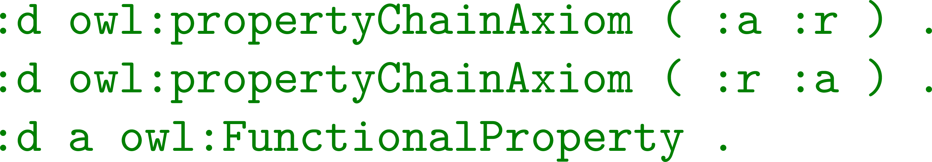
Can reduce from OWL entailment to Tiling
Each tile must have a domino type
Each tile can only be one domino type
Each tile must have a tile to the right and above
Tiles to the right and tiles above must match colour
Tile right then above = Tile above then right
  Define diagonal tile using two property chains (above-right/right-above)
  Declare functional (a tile can only have one such diagonal tile)

Slide 28

Can reduce from OWL entailment to Tiling
Each tile must have a domino type
Each tile can only be one domino type
Each tile must have a tile to the right and above
Tiles to the right and tiles above must match colour
Tile right then above = Tile above then right
Are we there yet?

Slide 29
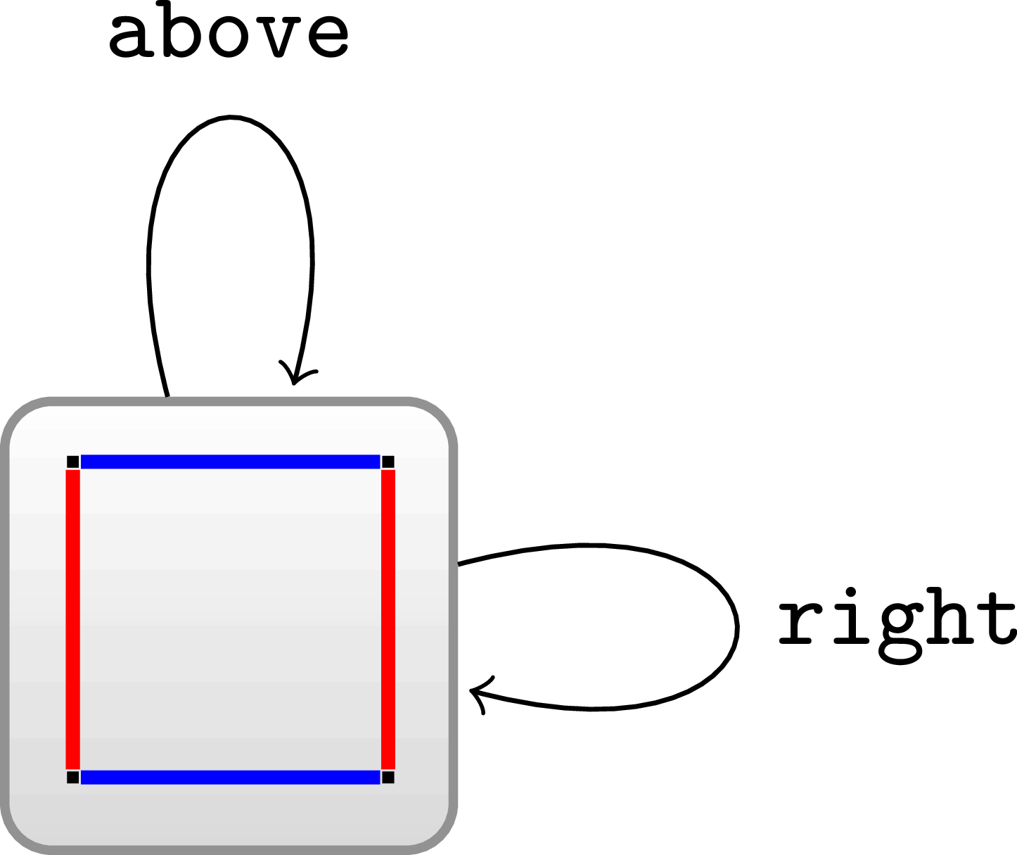
Next time: Models with cycles (i)

Slide 30
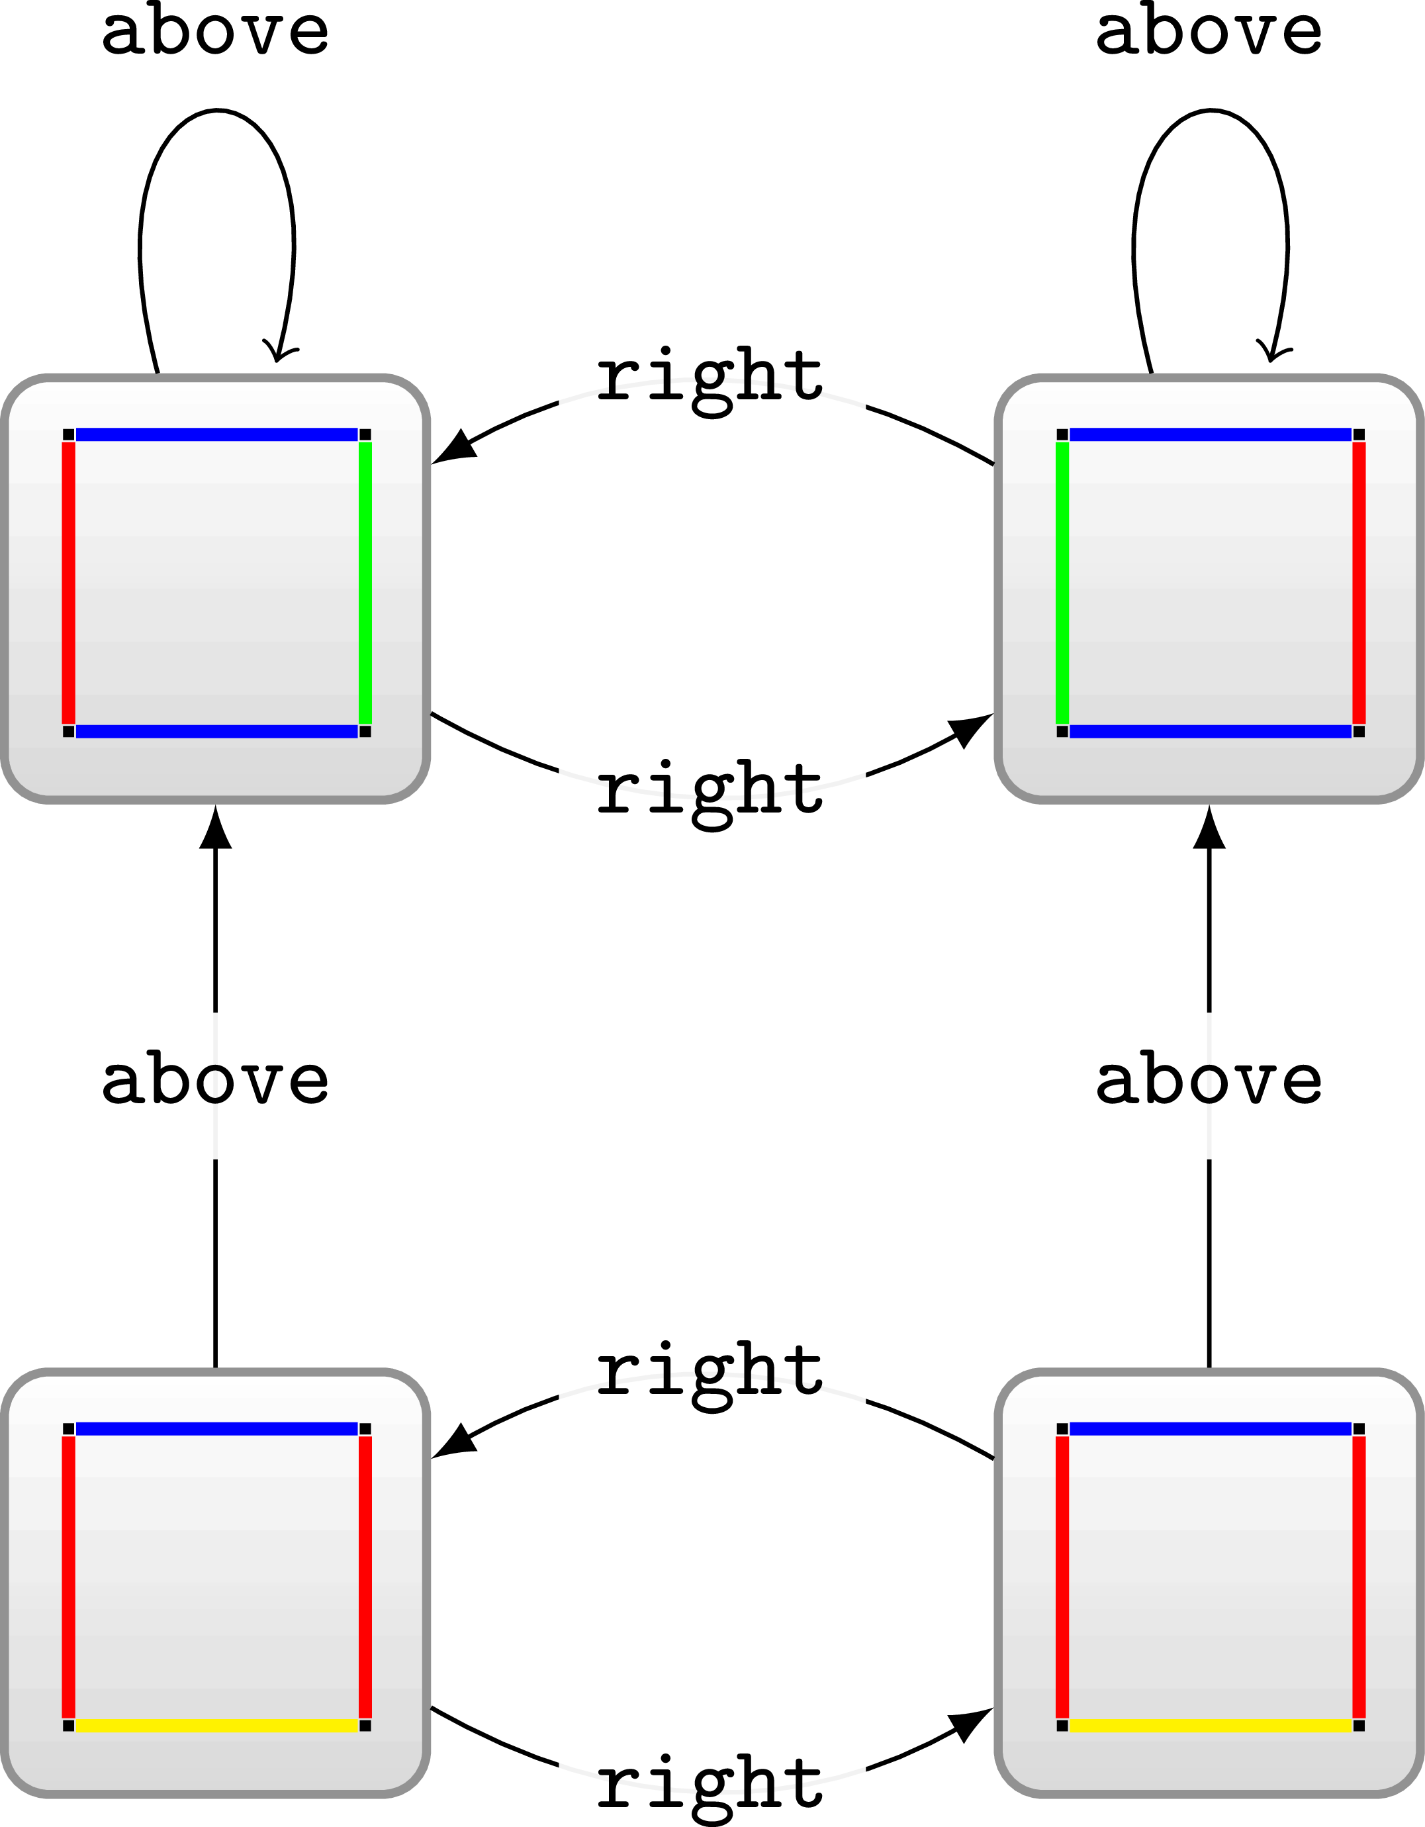
Next time: Models with cycles (II)

Slide 31
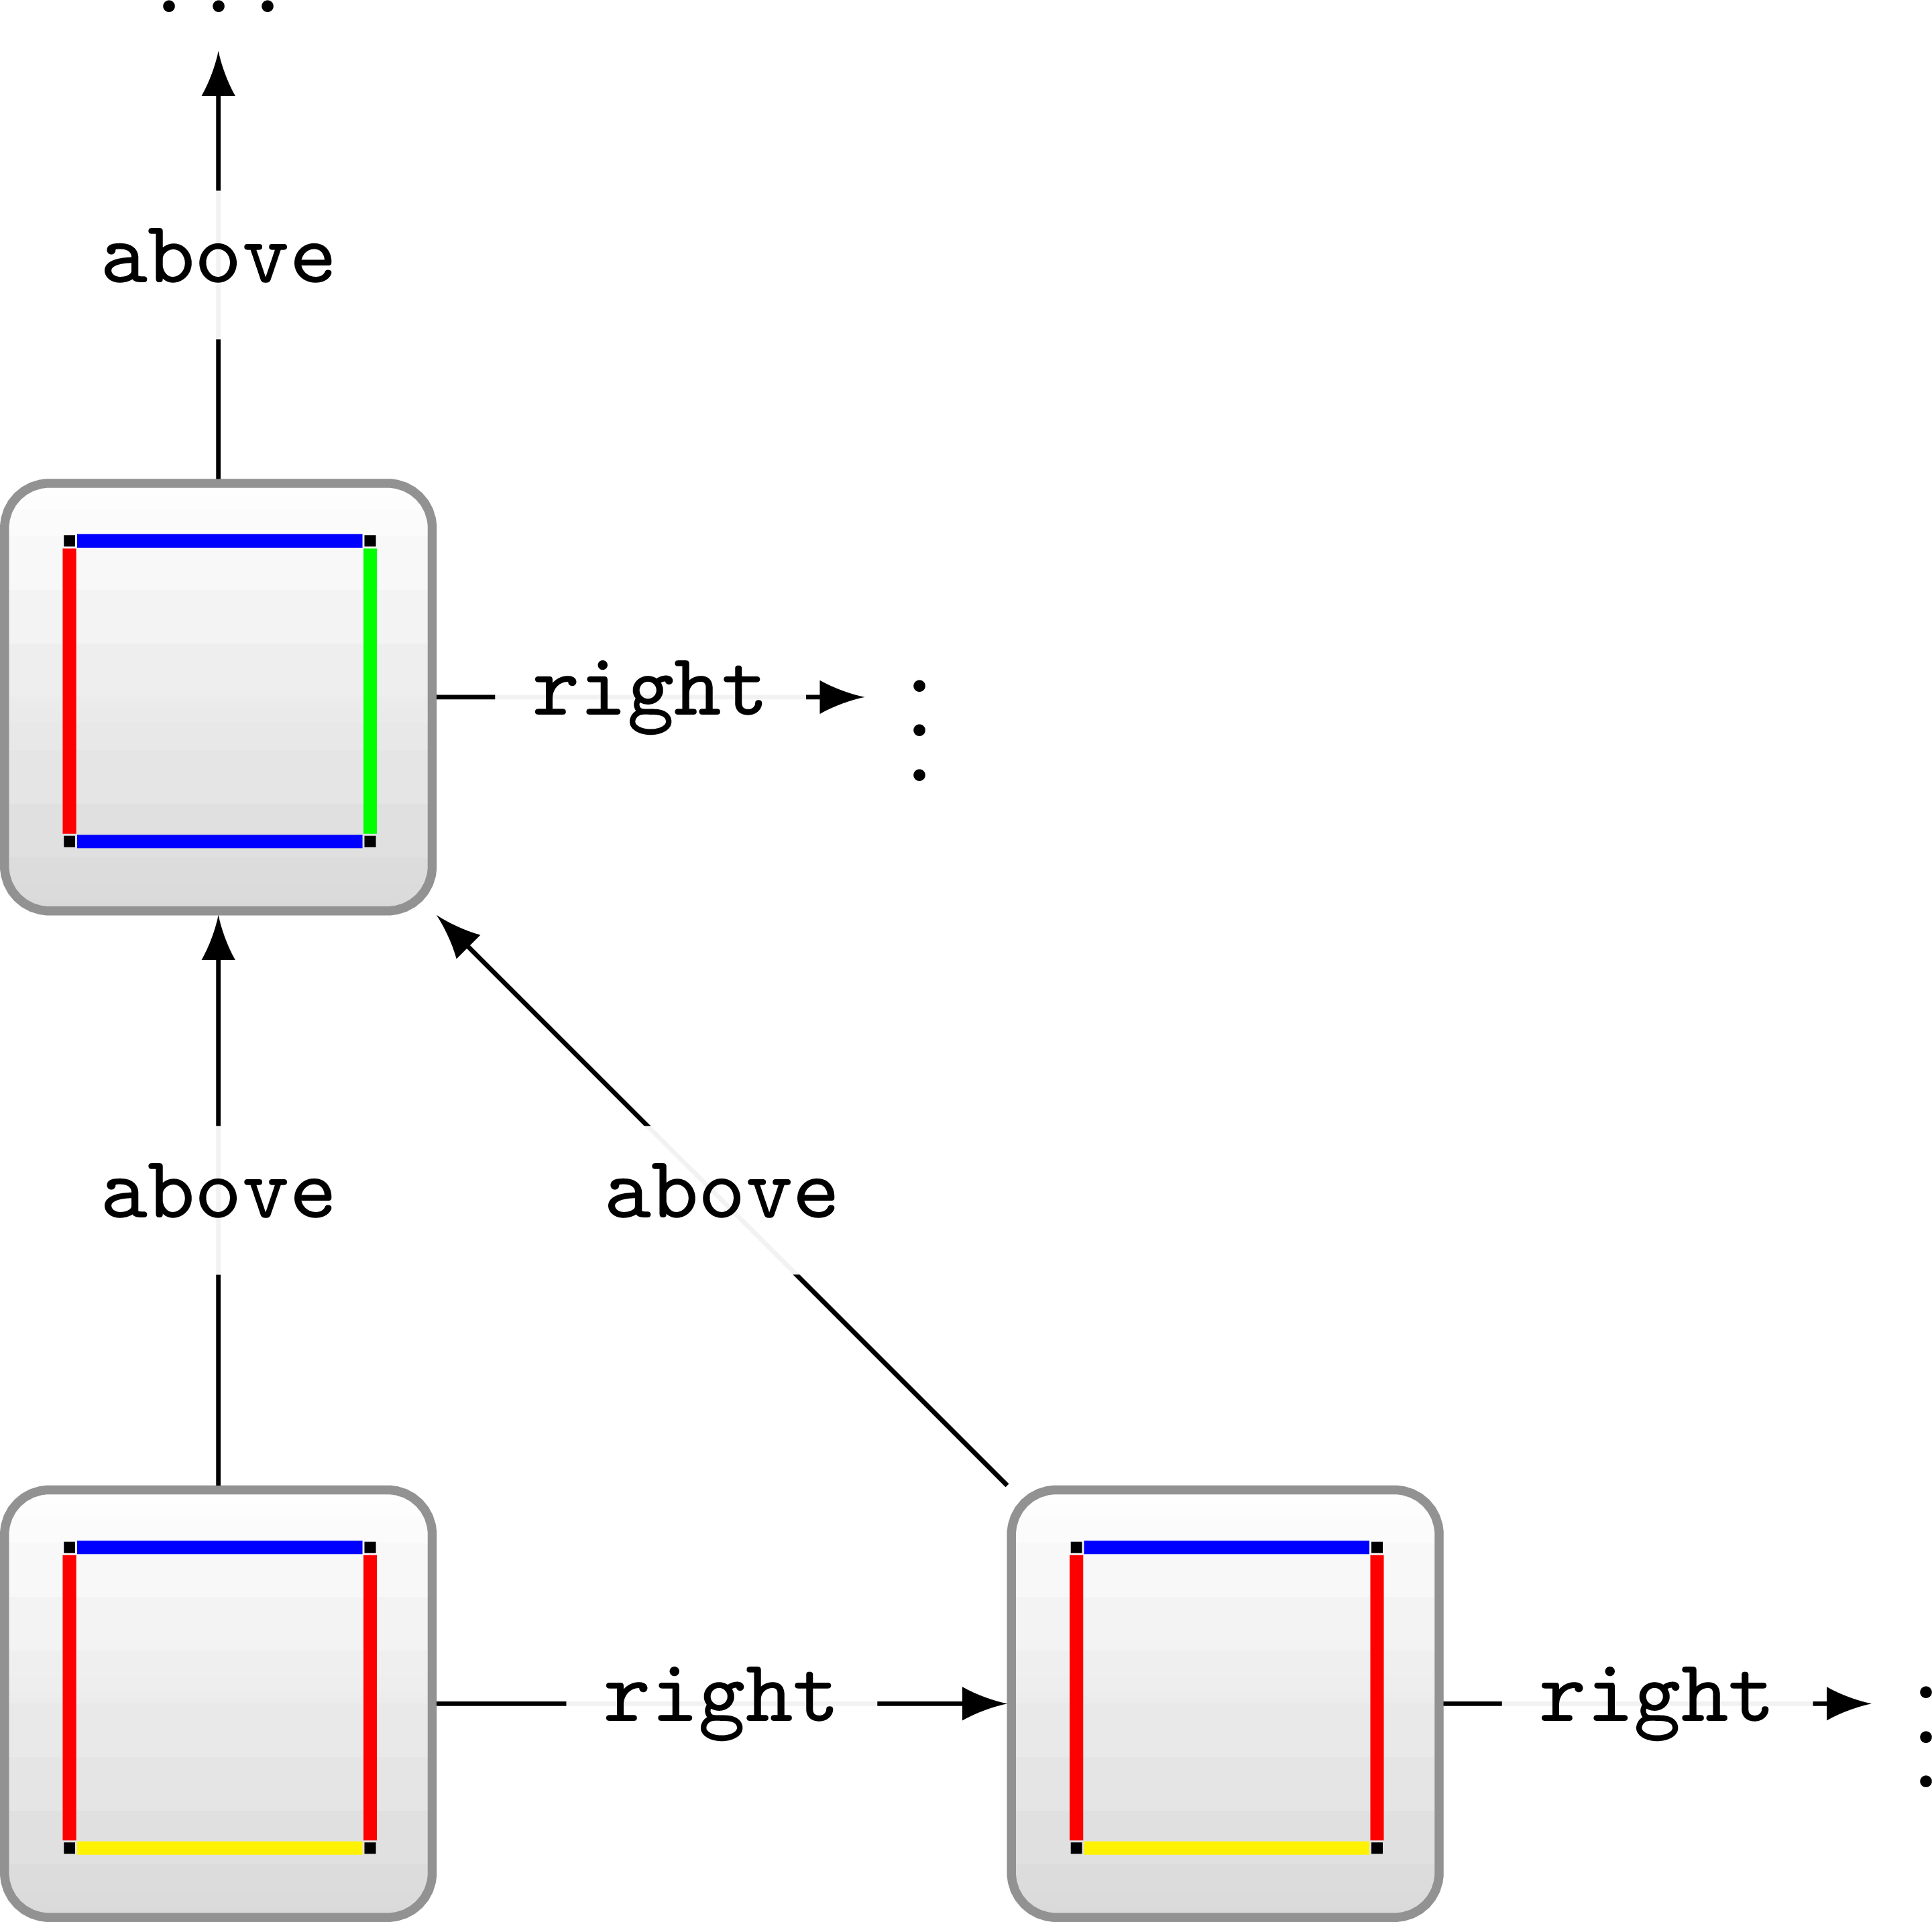
Next time: Check what about this case?
(Also give references)

Slide 32
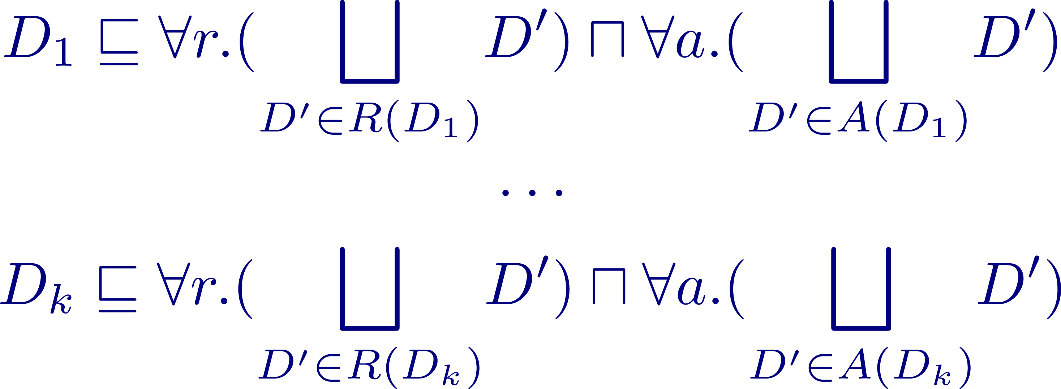
But What’s the entailment question?
What should we
put in O′?
???
Goal: Ontology O entails O′ if and only if D has no infinite tiling

Slide 33

But What’s the entailment question?
Goal: Ontology O entails O′ if and only if D has no infinite tiling
If T can have any member (a “tile”), it must have an infinite tiling!
If T can have no member, it must not have an infinite tiling.

Slide 34

Could also use satisfiability ...
Goal: Ontology O is satisfiable if and only if D has an infinite tiling
Here, x is an arbitrary fresh term

Slide 35
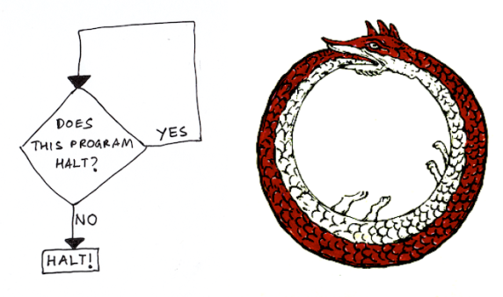

OWL entailment/satisfiability is undecidable!
Reduction
Reduction

Slide 36
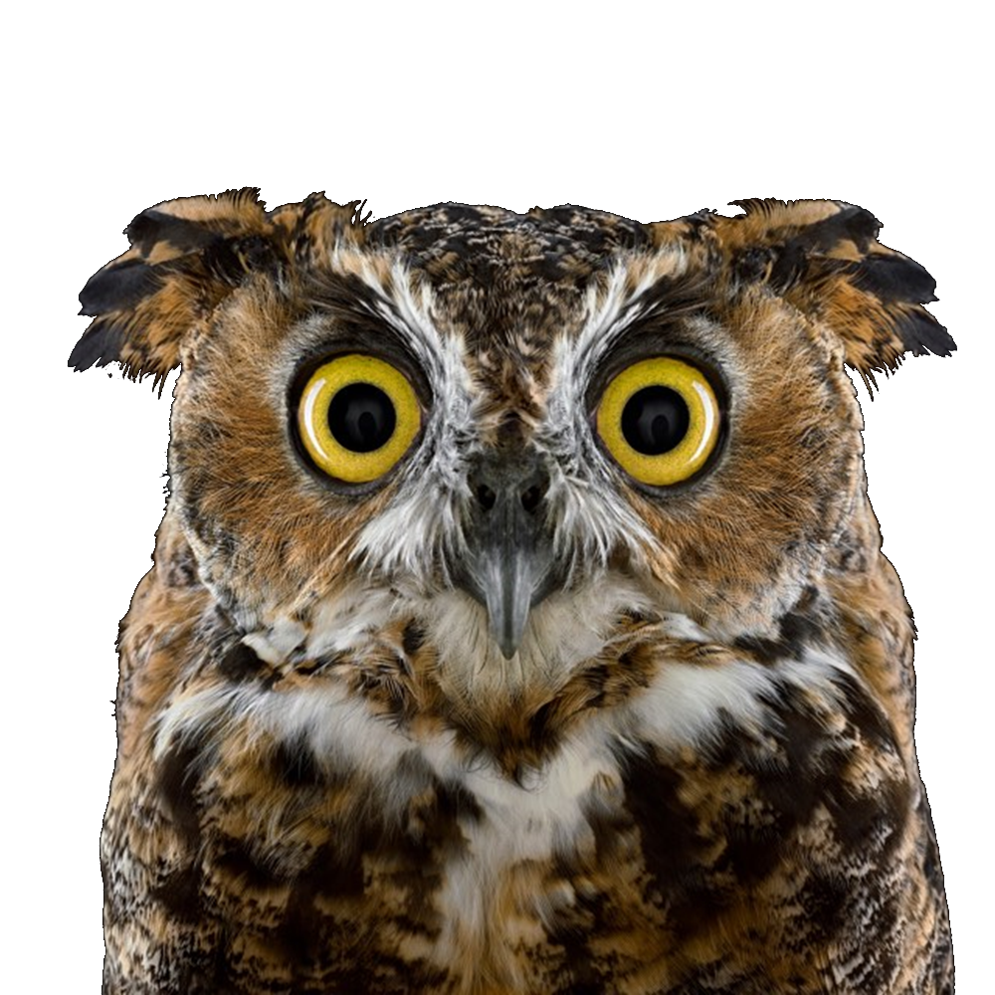

Slide 37

Not just OWL is undecidable ...
Knowledge representation:
Tell machines stuff about the world in a formalism they can (deductively) reason over using automated methods.
But if we tell them everything ...
Reasoning becomes undecidable!

Slide 38
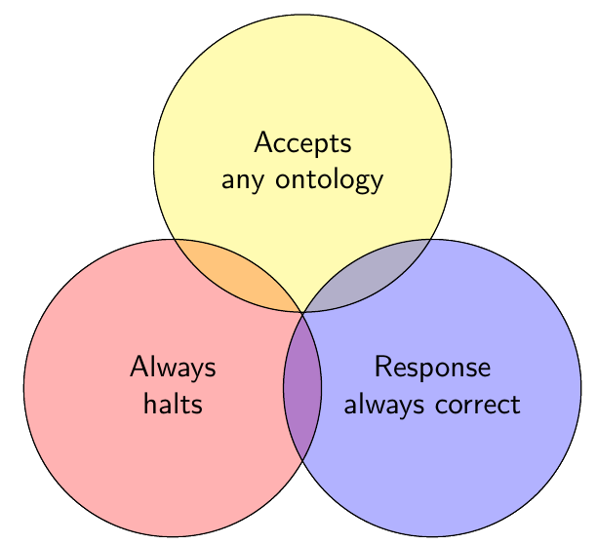
OWL entailment/satisfiability is undecidable …
Well great. What are we supposed to do now?
... choose two

Slide 39
OWL entailment/satisfiability is undecidable …
Well great. What are we supposed to do now?
Accept incomplete reasoners that halt
  Complete language, incomplete reasoning, halts
Accept complete reasoners that may not halt
  Complete language, complete reasoning, may not halt
Restrict OWL so reasoning becomes decidable
  Restricted language, complete reasoning, halts

Slide 40
Incomplete reasoners that halt

Slide 41
Options ...
Accept incomplete reasoners that halt
  Complete language, incomplete reasoning, halts

Slide 42
In the labs …
Data
Reasoner
???
Entailments
Ontology
But what is the reasoner actually doing?

Slide 43
In the labs …
Data
Reasoner
???
Entailments
Ontology
But what is the reasoner actually doing?
Incomplete materialisation using rules.

Slide 44
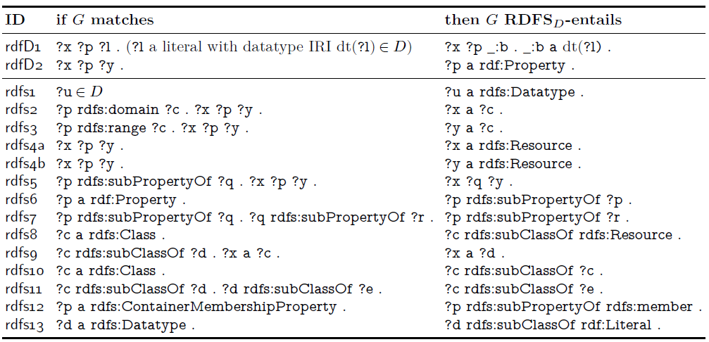
Recall rules for RDFS ...
(Don’t worry about rdfD1, rdfs1, rdfs12, rdfs13)
Now we need rules to cover (some of) OWL ...

Slide 45

Standard set of OWL rules: OWL 2 RL/RDF
https://www.w3.org/TR/owl2-profiles/#Reasoning_in_OWL_2_RL_and_RDF_Graphs_using_Rules

Slide 46
In the labs …
Data
Reasoner
???
Entailments
Ontology
But what is the reasoner actually doing?
Incomplete materialisation using RDFS & OWL 2 RL/RDF rules.

Slide 47
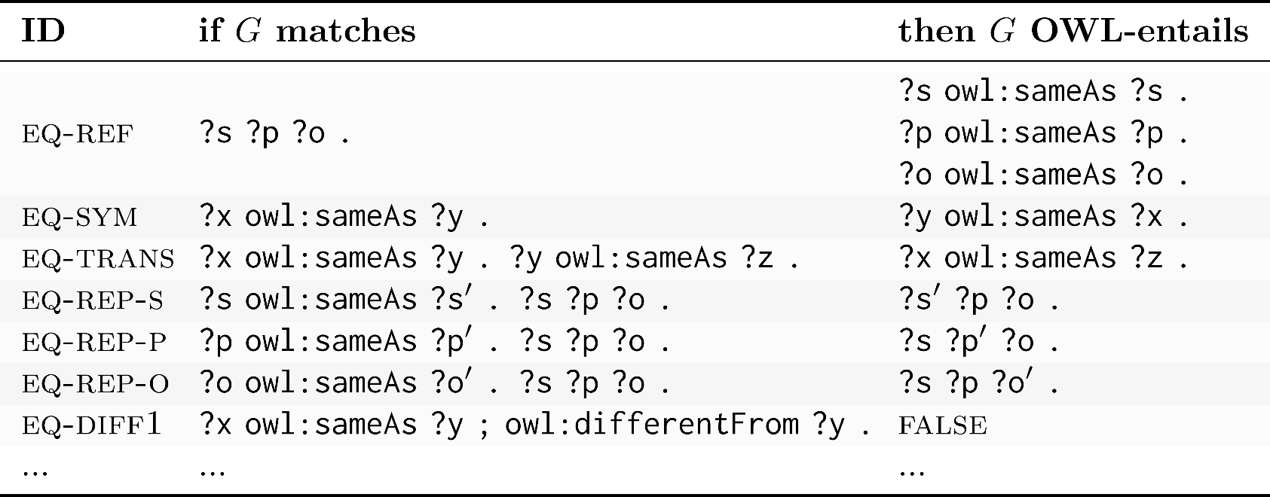
OWL 2 RL/RDF rule examples: Equality
???
???

Slide 48
OWL 2 RL/RDF rule examples: Equality

Slide 49
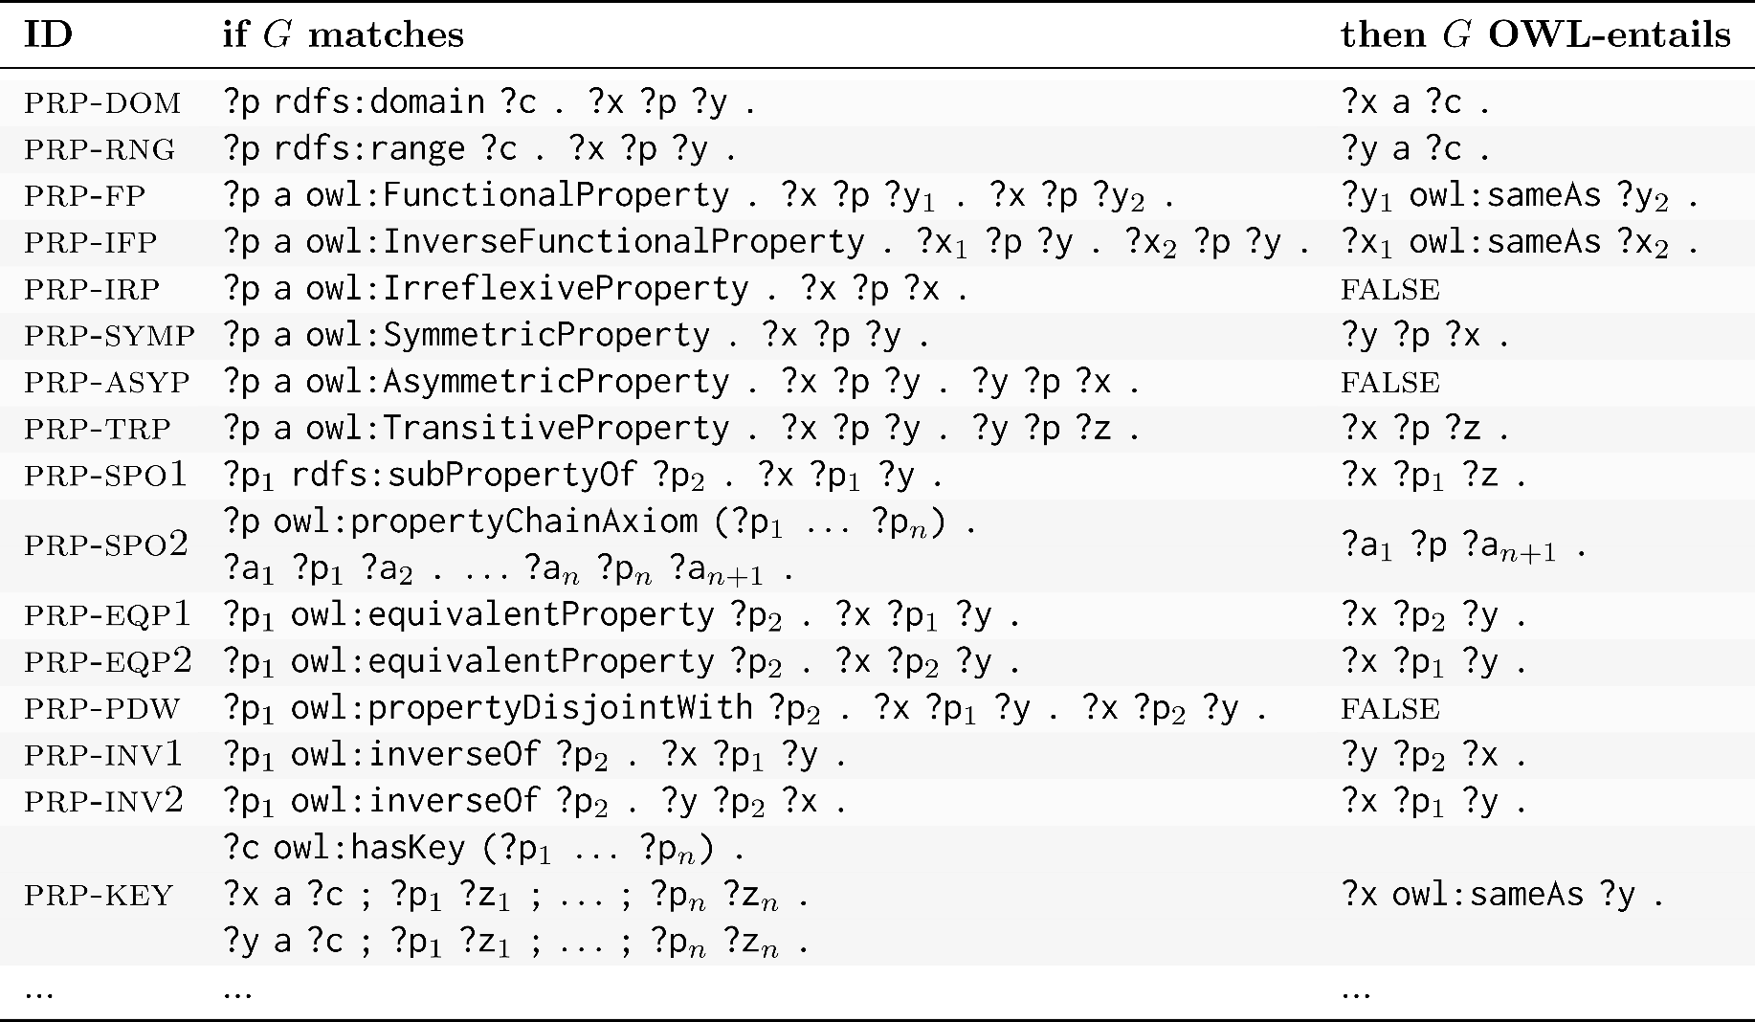
OWL 2 RL/RDF rule examples: Properties
???
???
???
???

Slide 50
OWL 2 RL/RDF rule examples: Properties

Slide 51
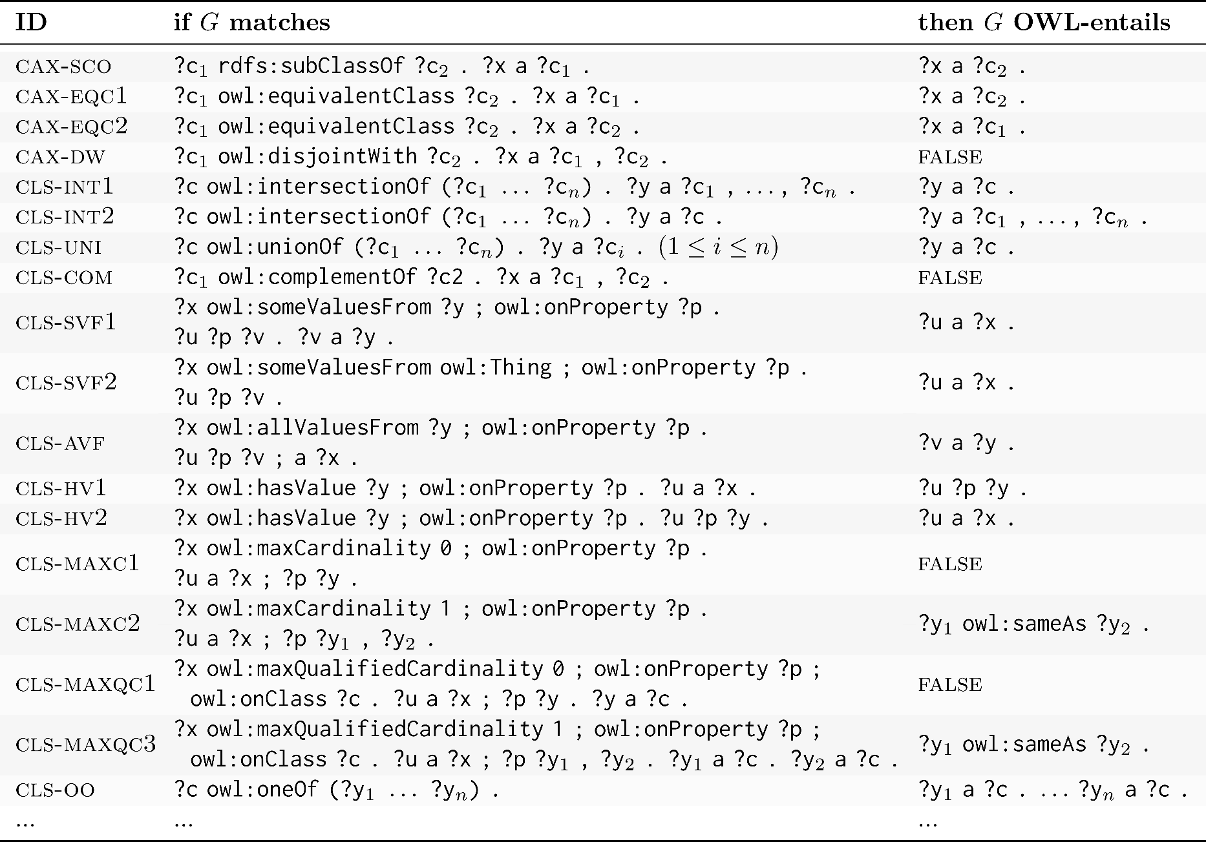
OWL 2 RL/RDF rule examples: Classes
???
???
???
???
???

Slide 52
OWL 2 RL/RDF rule examples: Classes

Slide 53
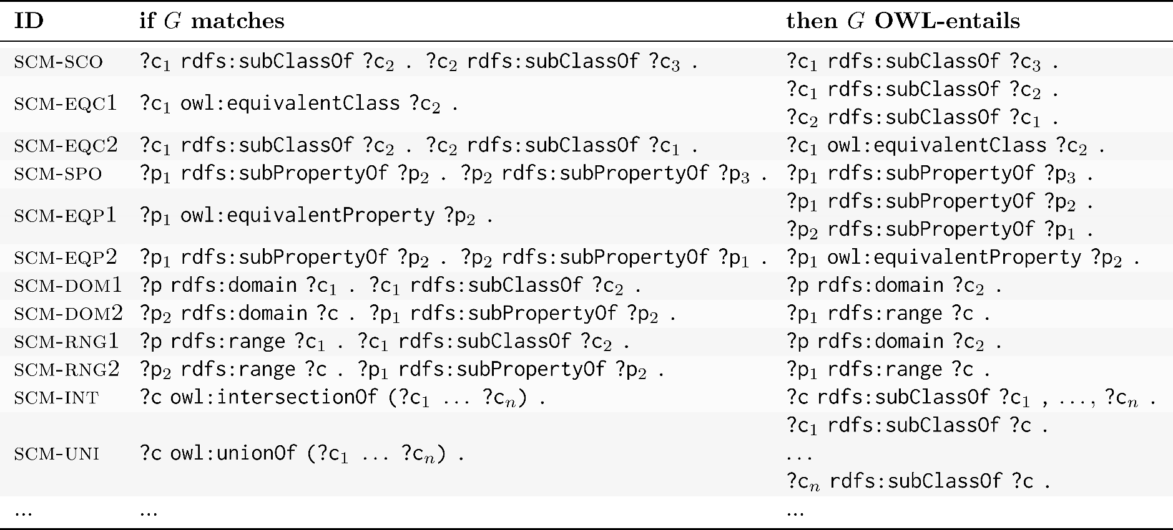
OWL 2 RL/RDF rule examples: Schema
???
???
???
???
???

Slide 54
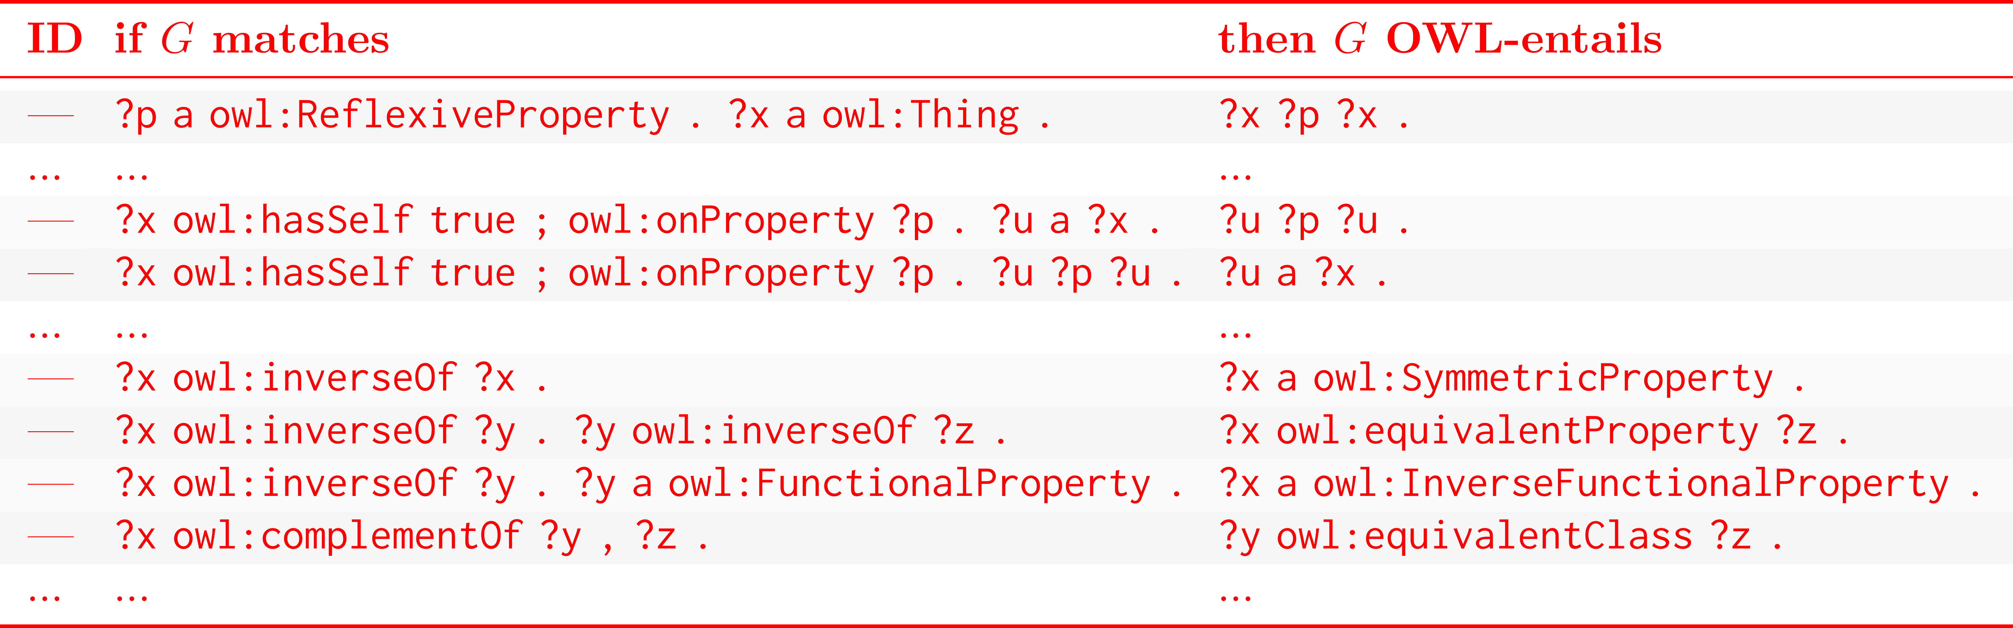
OWL 2 RL/RDF rule examples: Missing
???
???
???
???
???
???
???

Slide 55
OWL 2 RL/RDF rule examples: Missing

Slide 56
Full list of OWL 2 RL/RDF rules (or see the book)
https://www.w3.org/TR/owl2-profiles/#Reasoning_in_OWL_2_RL_and_RDF_Graphs_using_Rules

Slide 57
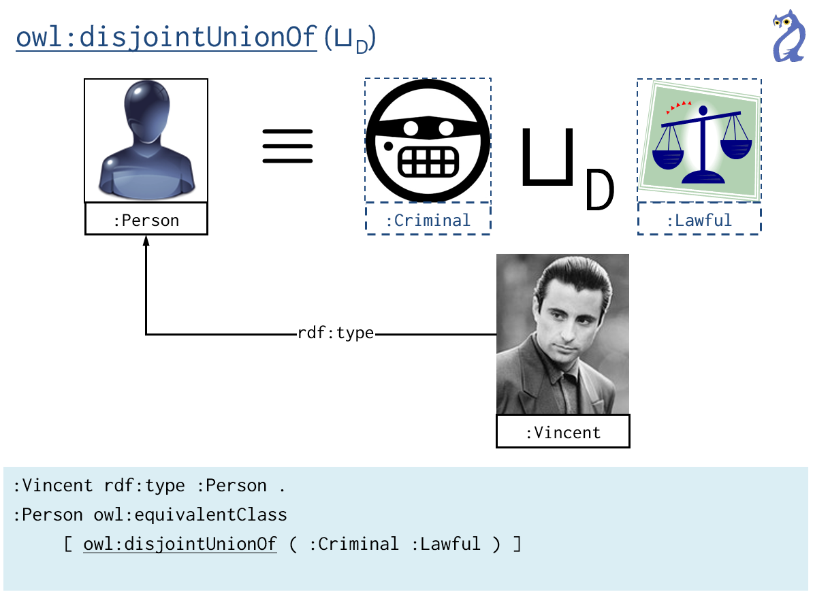
How is OWL2RL/RDF incomplete?

Slide 58
How is OWL2RL/RDF incomplete? Disjunction
:Vincent rdf:type :Person , :Godfather .
:Person owl:equivalentClass
[ owl:disjointUnionOf ( :Criminal :Lawful ) ] .
:Godfather owl:disjointWith :Lawful .
⇒
:Vincent rdf:type :Criminal .
OWL 2 RL/RDF rules will miss this valid inference ...
Misses the information that Vincent is Criminal or Lawful!

Slide 59
How is OWL2RL/RDF incomplete? Negation
:Vincent rdf:type :Person , :Godfather .
:Person owl:equivalentClass
[ owl:disjointUnionOf ( :Criminal :Lawful ) ] .
:Godfather owl:disjointWith :Lawful .
⇒
:Vincent rdf:type :Criminal .
OWL 2 RL/RDF rules will miss this valid inference ...
Misses the information that Vincent is not Lawful!

Slide 60
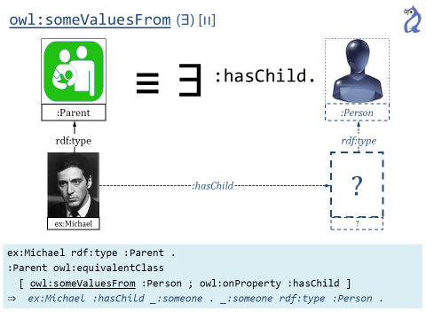
How is OWL2RL/RDF incomplete?

Slide 61
How is OWL2RL/RDF incomplete? existentials
:Michael rdf:type :Parent .
:Parent owl:equivalentClass
[ owl:someValuesFrom :Person ; owl:onProperty :hasChild ]
:hasChild rdfs:domain :Fertile .
⇒
:Michael rdf:type :Fertile .
OWL 2 RL/RDF rules will miss this valid inference ...
Misses the information that Michael has some child!

Slide 62

How is OWL2RL/RDF incomplete? existentials
:Michael rdf:type :Parent .
:Parent owl:equivalentClass
[ owl:someValuesFrom :Person ; owl:onProperty :hasChild ]
:hasChild rdfs:domain :Fertile .
⇒
:Michael rdf:type :Fertile .
Worst Example of the Course Award
OWL 2 RL/RDF rules will miss this valid inference ...
Misses the information that Michael has some child!

Slide 63
How is OWL2RL/RDF incomplete?
Missing features
  owl:ReflexiveProperty, owl:hasSelf, owl:minCardinality …
Problems with disjunction (OR cases)
  owl:unionOf, owl:oneOf, owl:maxCardinality, …
Problems with existentials
  owl:someValuesFrom, owl:minCardinality, ...
Problems with counting
  owl:minCardinality, …
Problems with negation
  owl:disjointWith, owl:propertyDisjointWith, owl:complementOf …
Incomplete “schema” inferences

Slide 64
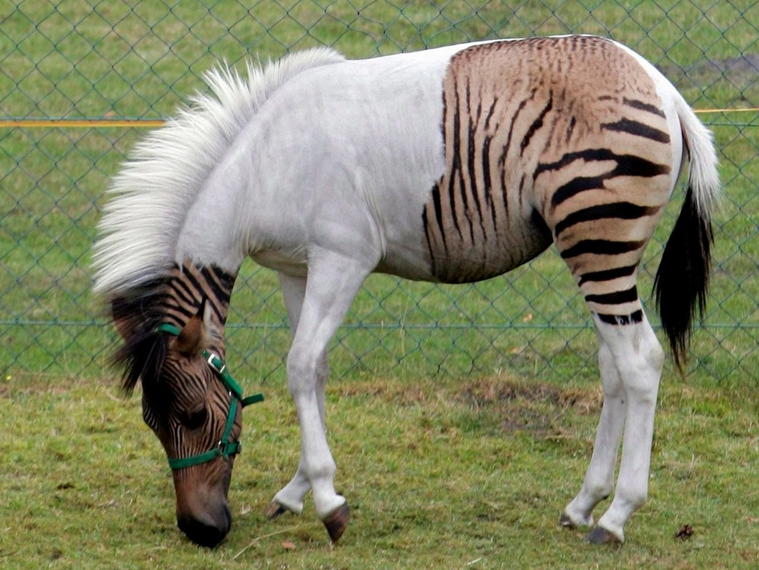
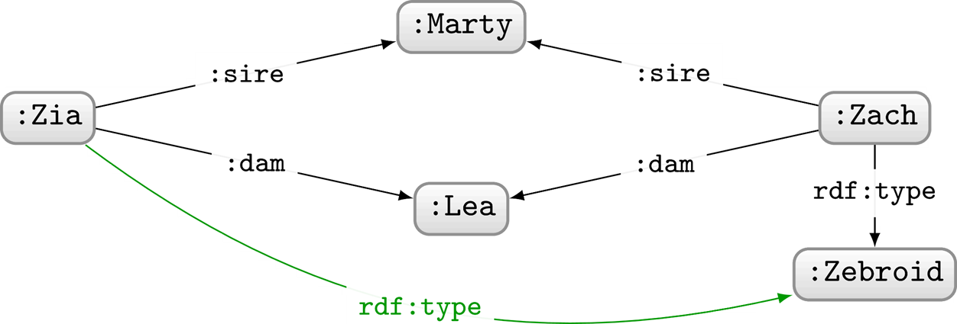
What can we intuitively conclude about Zia?
Zia is also a Zebroid!
But not with OWL 2 RL/RDF ☹

Slide 65
Complete reasoners that may not halt

Slide 66
Options ...
Accept incomplete reasoners that halt
  Complete language, incomplete reasoning, halts
Accept complete reasoners that may not halt
  Complete language, complete reasoning, may not halt

Slide 67
Complete reasoners that may not halt:
Quite Practical!
Cons:
  Erm … reasoner may never halt
Pros:
  Avoid complicated decidability restrictions!
What might the “pros” be in this case?
Imagine restricting C or Java to be decidable
  Don’t allow features like loops/recursion
    But not all programs with loops/recursion fail to halt!
  Restrict how features like loops/recursion can be used
    More detailed restrictions allow more programmes but are more complicated to understand ☹

Slide 68
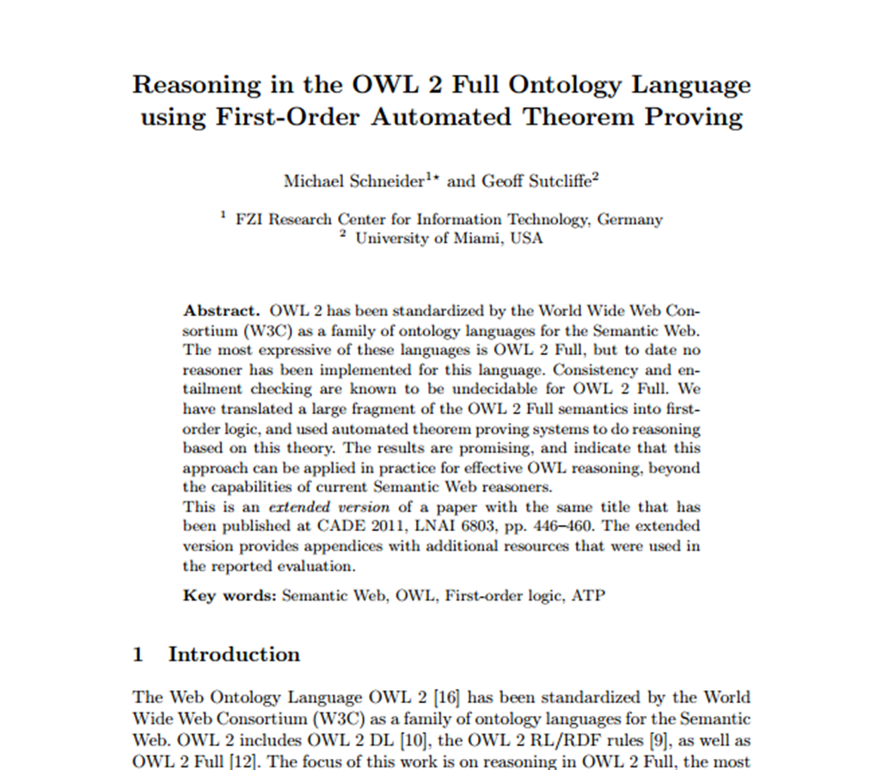
Complete reasoners that may not halt:
Rare in practice
Only line of work on this I know of:

Slide 69
Restrict OWL to guarantee decidability

Slide 70
Options ...
Accept incomplete reasoners that halt
  Complete language, incomplete reasoning, halts
Accept complete reasoners that may not halt
  Complete language, complete reasoning, may not halt
Restrict OWL so reasoning becomes decidable
  Restricted language, complete reasoning, halts

Slide 71
Restrict OWL to guarantee decidability:
How to guarantee decidability?
We’ve seen how to prove that something is undecidable
How can we prove that something is decidable?
Give an algorithm that halts …
Decidable/computable reduction to something decidable ...
...

Slide 72
Restrict OWL to guarantee decidability:
Sublanguages of OWL 2
Description Logic community
  Predates OWL
  Looks at decidable subsets of First Order Logic
  Results can be applied to OWL!
OWL 2 Full: The unrestricted, undecidable language
OWL 2 DL: A restricted, decidable version

Slide 73
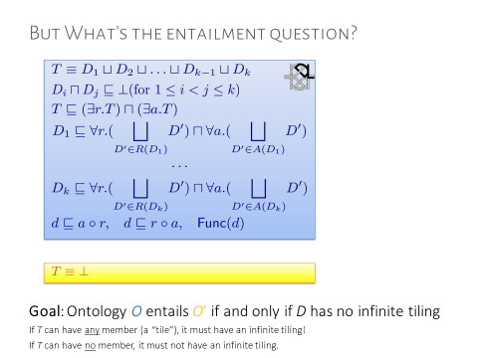
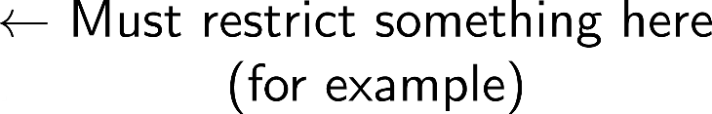
Restrict OWL to guarantee decidability:
Sublanguages of OWL 2
Any ideas what we should restrict to make OWL decidable?

Slide 74
Restrict OWL to guarantee decidability:
Sublanguages of OWL 2
Any ideas what we should restrict to make OWL decidable?
For example, OWL 2 DL restricts functional properties to only be used on "simple properties" (e.g., properties not used in chains)
Is this enough to guarantee decidability?
We don't know. We just know this undecidability proof won't work.
(In fact, there are other proofs not needing functional property chains.)

Slide 75
Restrict OWL to guarantee decidability:
Sublanguages of OWL 2
Any ideas what we should restrict to make OWL decidable?
For example, OWL 2 DL restricts functional properties to only be used on "simple properties" (e.g., properties not used in chains)
In that case how can we guarantee decidability?
Most common way: give a sound and complete algorithm!

Slide 76
Restrict OWL to guarantee decidability:
Sublanguages of OWL 2
OWL 2 DL restricts:
  functional properties to be “simple” (no chains, no transitivity)
  likewise properties used with has-self, cardinalities, inverse functionality, asymmetry and irreflexivity must be simple
  need to follow specific RDF syntax and explicitly declare classes, object properties (with IRI values), datatype properties (with literal values)
  … more (it’s really quite messy ☹)

Slide 77
But in OWL 2 DL ...

Slide 78
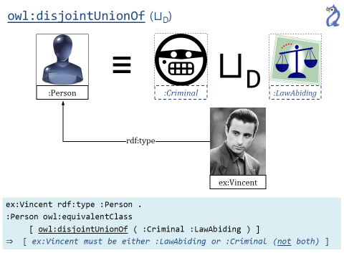
But in OWL 2 Dl, we can get this entailment ...
:Vincent rdf:type :Person , :Godfather .
:Person owl:equivalentClass
[ owl:disjointUnionOf ( :Criminal :Lawful ) ] .
:Godfather owl:disjointWith :Lawful .
⇒
:Vincent rdf:type :Criminal .
Any ideas of how we could implement this?

Slide 79
An algorithm for OWL 2 DL: Tableaux
Tableaux Algorithm (sketch):
  Add ¬O' to O
  Expand knowledge using rules
    Infer low-level assertions
    Branch on all possibilities created by disjunction
    Postulate fresh individuals for existentials
    [...]
  If (and only if) every branch is inconsistent: O ⊧ O′

Slide 80




An algorithm for OWL 2 DL: Tableaux
Disjunction: Expand all possibilities
:Vincent rdf:type :Person , :Godfather .
:Godfather owl:disjointWith :Lawful .
:Person owl:equivalentClass [ owl:disjointUnionOf ( :Lawful :Criminal ) ] .
¬ :Vincent rdf:type :Criminal .
:Vincent rdf:type :Person , :Godfather .
:Godfather owl:disjointWith :Lawful .
:Vincent rdf:type :Lawful .
¬ :Vincent rdf:type :Criminal .
:Vincent rdf:type :Person , :Godfather .
:Godfather owl:disjointWith :Lawful .
:Vincent rdf:type :Criminal .
¬ :Vincent rdf:type :Criminal .

Slide 81
An algorithm for OWL 2 DL: Tableaux
Disjunction: Expand all possibilities
:Vincent rdf:type :Person , :Godfather .
:Godfather owl:disjointWith :Lawful .
:Person owl:equivalentClass [ owl:disjointUnionOf ( :Lawful :Criminal ) ] .
¬ :Vincent rdf:type :Criminal .
:Vincent rdf:type :Person , :Godfather .
:Person owl:equivalentClass
[ owl:disjointUnionOf ( :Criminal :Lawful ) ] .
:Godfather owl:disjointWith :Lawful .
⇒
:Vincent rdf:type :Criminal .
:Vincent rdf:type :Person , :Godfather .
:Godfather owl:disjointWith :Lawful .
:Vincent rdf:type :Lawful .
¬ :Vincent rdf:type :Criminal .
:Vincent rdf:type :Person , :Godfather .
:Godfather owl:disjointWith :Lawful .
:Vincent rdf:type :Criminal .
¬ :Vincent rdf:type :Criminal .

Slide 82
An algorithm for OWL 2 DL: Tableaux
Disjunction: Expand all possibilities
:Vincent rdf:type :Person , :Godfather .
:Godfather owl:disjointWith :Lawful .
:Person owl:equivalentClass [ owl:disjointUnionOf ( :Lawful :Criminal ) ] .
¬ :Vincent rdf:type :Criminal .
:Vincent rdf:type :Person , :Godfather .
:Person owl:equivalentClass
[ owl:disjointUnionOf ( :Criminal :Lawful ) ] .
:Godfather owl:disjointWith :Lawful .
⇒
:Vincent rdf:type :Lawful . # is it entailed ???
:Vincent rdf:type :Person , :Godfather .
:Godfather owl:disjointWith :Lawful .
:Vincent rdf:type :Lawful .
¬ :Vincent rdf:type :Criminal .
:Vincent rdf:type :Person , :Godfather .
:Godfather owl:disjointWith :Lawful .
:Vincent rdf:type :Criminal .
¬ :Vincent rdf:type :Criminal .

Slide 83

An algorithm for OWL 2 DL: Tableaux
Disjunction: Expand all possibilities
:Vincent rdf:type :Person , :Godfather .
:Godfather owl:disjointWith :Lawful .
:Person owl:equivalentClass [ owl:disjointUnionOf ( :Lawful :Criminal ) ] .
¬ :Vincent rdf:type :Lawful.
:Vincent rdf:type :Person , :Godfather .
:Godfather owl:disjointWith :Lawful .
:Vincent rdf:type :Lawful .
¬ :Vincent rdf:type :Lawful .
:Vincent rdf:type :Person , :Godfather .
:Godfather owl:disjointWith :Lawful .
:Vincent rdf:type :Criminal .
¬ :Vincent rdf:type :Lawful .

Slide 84
An algorithm for OWL 2 DL: Tableaux
Disjunction: Expand all possibilities
:Vincent rdf:type :Person , :Godfather .
:Godfather owl:disjointWith :Lawful .
:Person owl:equivalentClass [ owl:disjointUnionOf ( :Lawful :Criminal ) ] .
¬ :Vincent rdf:type :Lawful.
:Vincent rdf:type :Person , :Godfather .
:Person owl:equivalentClass
[ owl:disjointUnionOf ( :Criminal :Lawful ) ] .
:Godfather owl:disjointWith :Lawful .
⇒
:Vincent rdf:type :Lawful . # it is not entailed
:Vincent rdf:type :Person , :Godfather .
:Godfather owl:disjointWith :Lawful .
:Vincent rdf:type :Lawful .
¬ :Vincent rdf:type :Lawful .
:Vincent rdf:type :Person , :Godfather .
:Godfather owl:disjointWith :Lawful .
:Vincent rdf:type :Criminal .
¬ :Vincent rdf:type :Lawful .

Slide 85
An algorithm for OWL 2 DL: Tableaux
:Michael rdf:type :Parent .
:Parent owl:equivalentClass
[ owl:someValuesFrom :Person ; owl:onProperty :hasChild ]
:hasChild rdfs:domain :Fertile .
⇒
:Michael rdf:type :Fertile .

Slide 86
An algorithm for OWL 2 DL: Tableaux
Existentials: Try create fresh individuals
:Michael rdf:type :Parent .
:Parent owl:equivalentClass
[ owl:someValuesFrom :Person ; owl:onProperty :hasChild ]
:hasChild rdfs:domain :Fertile .
¬ :Michael rdf:type :Fertile .
:Michael rdf:type :Parent .
:Michael :hasChild :X .
:X rdf:type :Person .
:Michael rdf:type :Fertile .
¬ :Michael rdf:type :Fertile .

Slide 87
An algorithm for OWL 2 DL: Tableaux
Existentials: Try create fresh individuals
:Michael rdf:type :Parent .
:Parent owl:equivalentClass
[ owl:someValuesFrom :Person ; owl:onProperty :hasChild ]
:hasChild rdfs:domain :Fertile .
¬ :Michael rdf:type :Fertile .
:Michael rdf:type :Parent .
:Parent owl:equivalentClass
[ owl:someValuesFrom :Person ; owl:onProperty :hasChild ]
:hasChild rdfs:domain :Fertile .
⇒
:Michael rdf:type :Fertile .
:Michael rdf:type :Parent .
:Michael :hasChild :X .
:X rdf:type :Person .
:Michael rdf:type :Fertile .
¬ :Michael rdf:type :Fertile .

Slide 88
An algorithm for OWL 2 DL: Tableaux
Tableaux Algorithm (sketch):
  Add ¬O' to O
  Expand knowledge using rules
    Infer low-level assertions
    Branch on all possibilities created by disjunction
    Postulate fresh individuals for existentials
    [...]
  If (and only if) every branch is inconsistent: O ⊧ O′
Tableaux algorithm is just "brute force" checking models of the ontologies.
But optimisations and tricks possible for specific logics (like OWL).

Slide 89
An algorithm for OWL 2 DL: Tableaux
Tableaux Algorithm (sketch):
  Add ¬O' to O
  Expand knowledge using rules
    Infer low-level assertions
    Branch on all possibilities created by disjunction
    Postulate fresh individuals for existentials
    [...]
  If (and only if) every branch is inconsistent: O ⊧ O′
Why do we need to restrict OWL in that case?
To ensure that the tableaux algorithm (with additional tricks) terminates.

Slide 90

An algorithm for OWL 2 DL: Tableaux
Tableaux Algorithm
  We have a complete entailment algorithm that supports a lot of OWL features and terminates

Slide 91
What can we intuitively conclude about Zia?
Zia is also a Zebroid!
And we can entail this OWL 2 DL! ☺
So, any problems here?

Slide 92
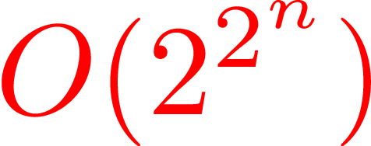
OWL 2 DL: Practical problems
A few practical problems:
  We have to give the entailments to check
    Cannot just ask to compute the entailments
  Restrictions are complicated
    Very complicated
    And often are broken by real-world ontologies
  Tableaux entailment checks are really expensive
    Branch for every disjunction suggests exponential
    If fact, it's N2EXPTIME-complete (!!?!!!)
      on a non-deterministic machine

Slide 93
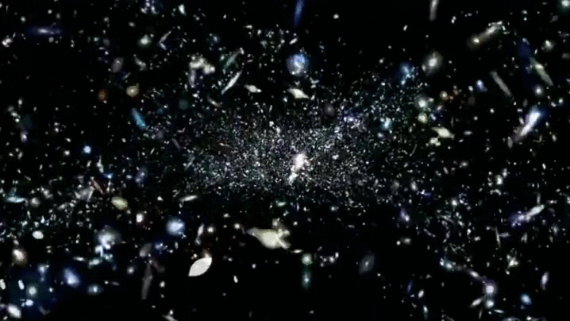

N2EXPTIME-Complete (OWL 2 DL’s small print) …
Checking entailment is guaranteed to halt for OWL 2 DL restricted ontologies*
* halt may not occur before heat death of the universe

Slide 94
OWL 2 DL performance considerations
Not all OWL 2 DL ontologies will run into worst-cases
Entailments will work fine for most small ontologies
Scalability still a real issue in practice
Not all OWL 2 Full ontologies will be undecidable

Slide 95
OWL 2 Profiles (briefly)
More efficient sublanguages of OWL 2 DL
  More restrictions to allow complete reasoning with more efficient algorithms
OWL 2 RL: A restriction of OWL 2 DL such that OWL 2 RL/RDF rules provide complete reasoning
OWL 2 EL: Tractable algorithm for classifying ontologies
OWL 2 QL: Tractable algorithm rewriting SQL queries

Slide 96
Impressions …

Slide 97
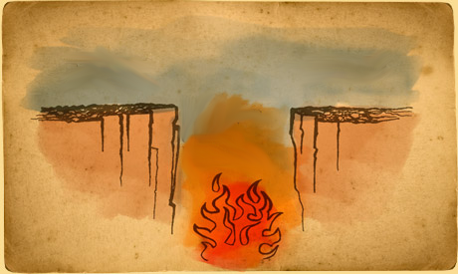

Division between Theory and Practice
Theory
Practice

Slide 98
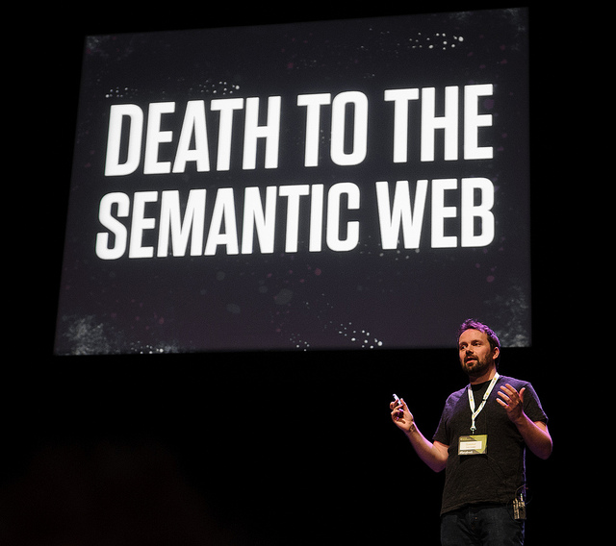
Part of the reason why you see things like …

Slide 99
Is OWL good for the Semantic Web?
It provides formal foundations for semantics
Indicates what’s possible, what’s not with respect to machine-readable semantics
  What’s efficient, what’s not
  Highlights fundamental limits of Knowledge Representation
Offers options: OWL 2 RL/EL/QL/DL/Full
Hard to learn/understand
  Practical motivations muddled
  Difficult cases most difficult to motivate
    Do we need existentials for example?
Can also be messy in theory
Makes lots of naive assumptions for the Web
  Not scalable / hard to implement
  Strict in what it accepts
  Blindly accepting / hard to understand
What do you think?

Slide 100

Knowledge Representation on the Web:
An open research problem

Slide 101
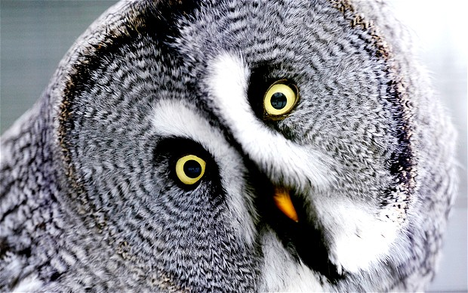
End of OWL classes (labs to come)
Moving on to SPARQL next

Slide 102






Questions?

