Slide 1
CC7220-1
La Web de Datos
Primavera 2018
Lecture 4: Web Ontology Language (OWL) [I]
Aidan Hogan
aidhog@gmail.com

Slide 2
Last time …

Slide 3







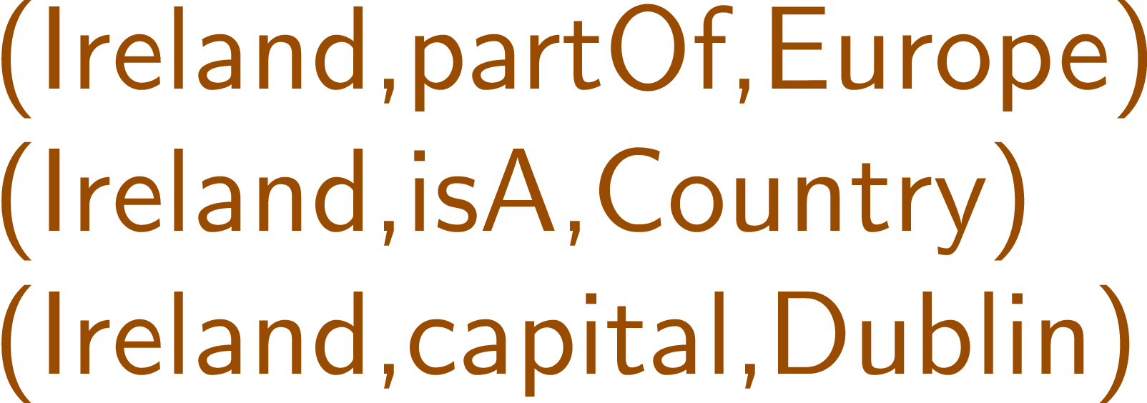
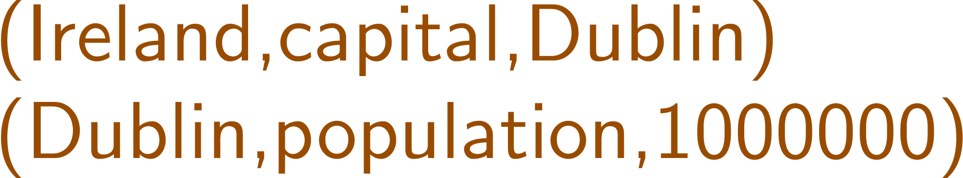
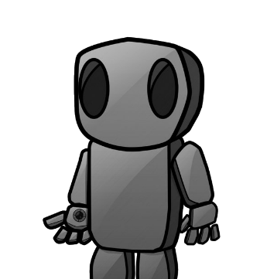
Semantic Web: Data → Rules → Query → Output*
* More or less

Slide 4
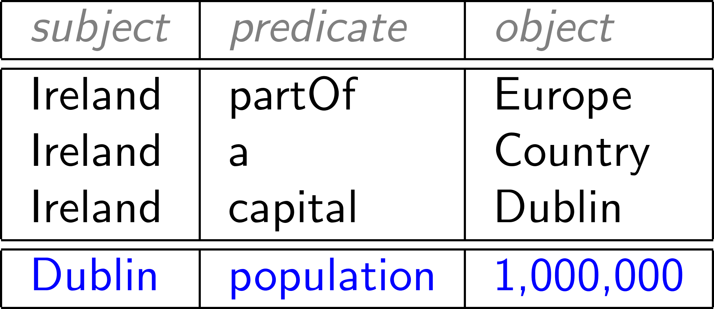

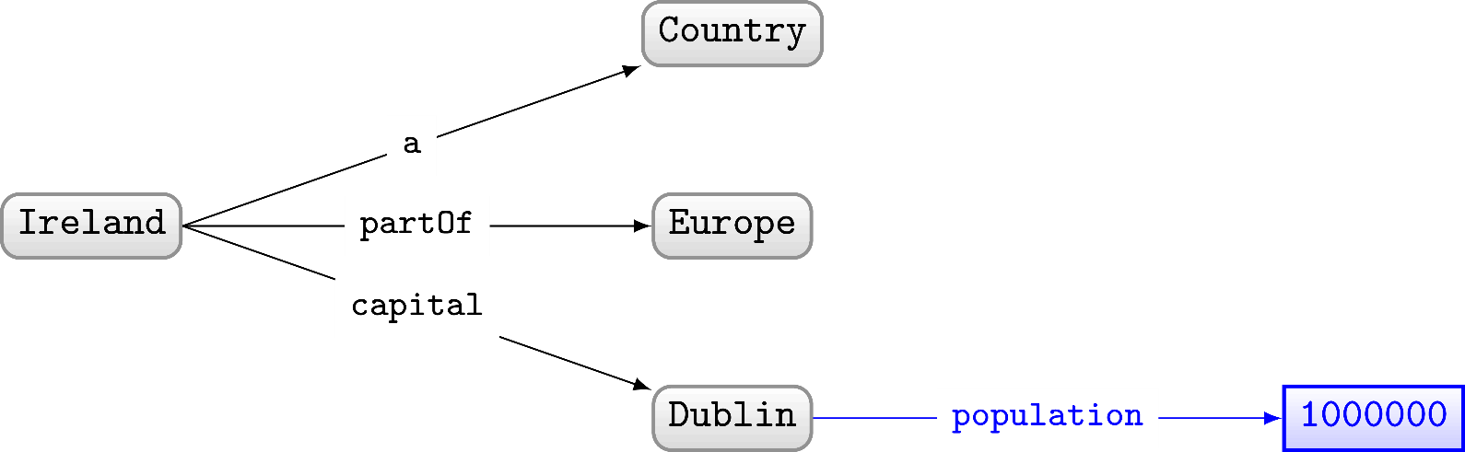
RDF often drawn as a (directed, labelled) graph

Slide 5
Semantic Web: Data → Rules → Query → Output*
* More or less

Slide 6
RDF Schema: RDFS
Class c is a sub-class of Class d
  If (x,rdf:type,c) then (x,rdf:type,d)
Property p is a sub-property of q
  If (x,p,y) then (x,q,y)
Property p has domain class c
  If (x,p,y) then (x,rdf:type,c)
Property p has range class c
  If (x,p,y) then (y,rdf:type,c)

Slide 7
Today's topic ...

Slide 8
Semantic Web: Data → Rules → Query → Output*
* More or less

Slide 9
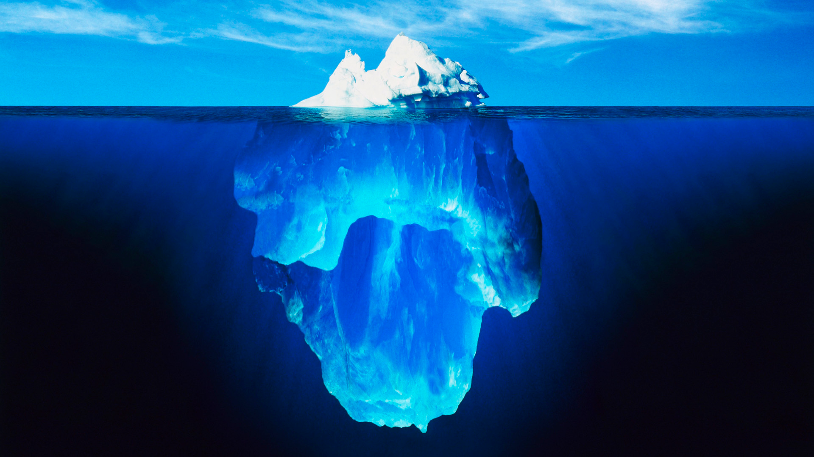


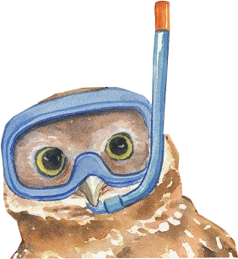

Slide 10
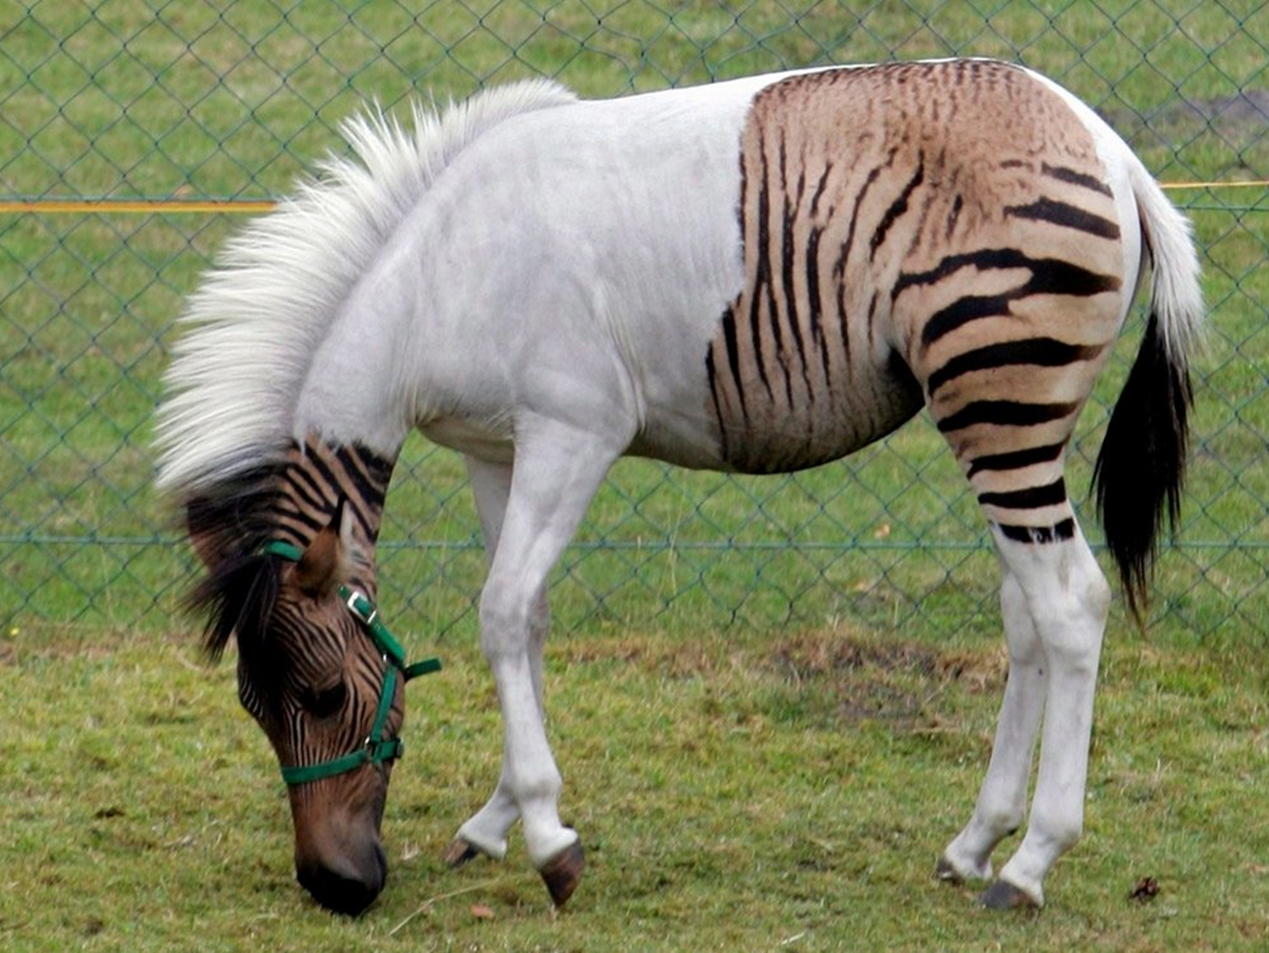

Slide 11
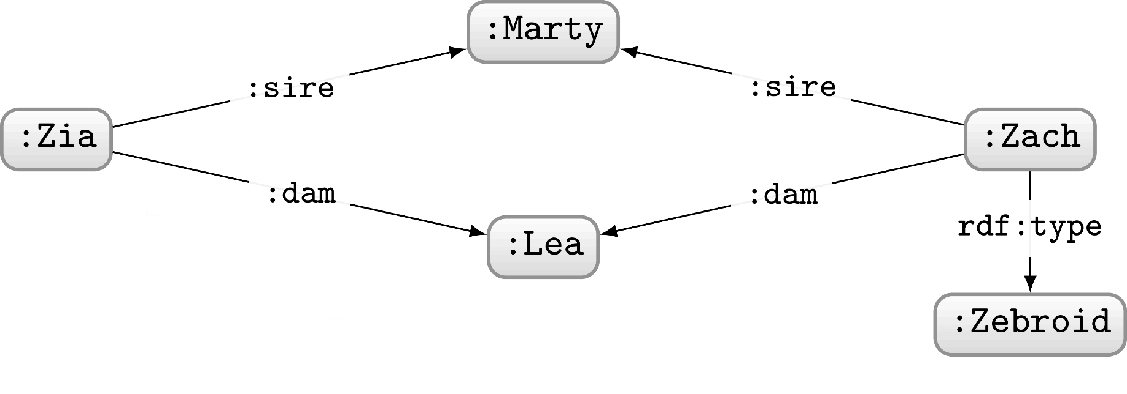

Slide 12
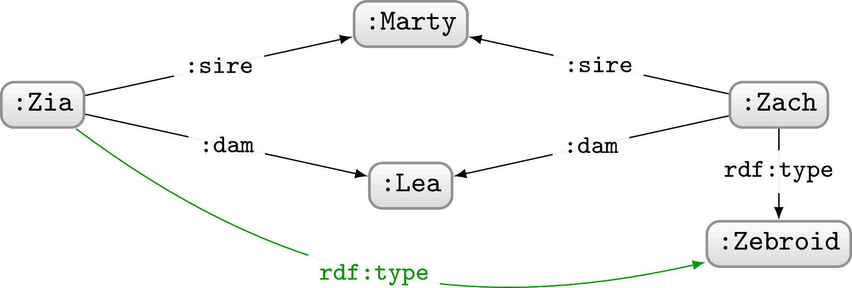

Slide 13
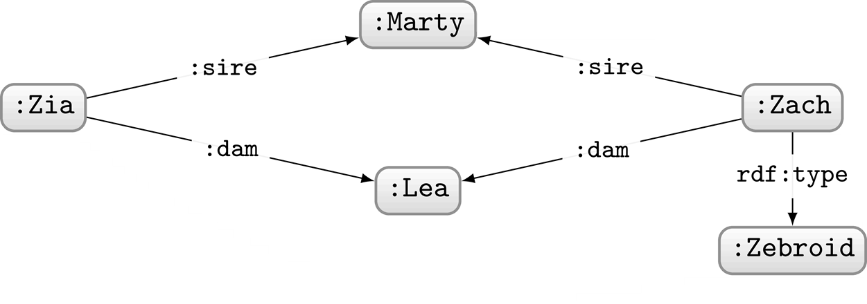
What can we intuitively conclude about Zia?

Slide 14
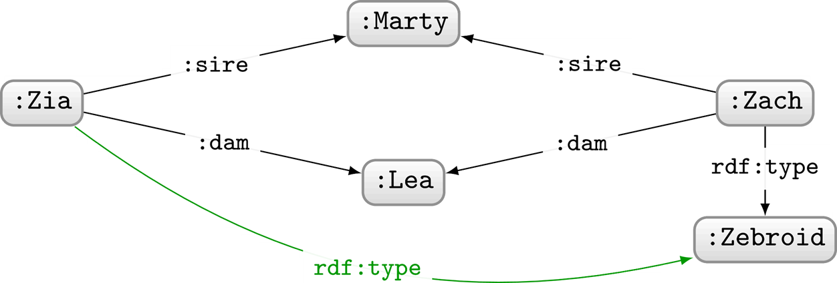
What can we intuitively conclude about Zia?
Zia is also a Zebroid!
What kind of reasoning are we using here?
Deductive

Slide 15
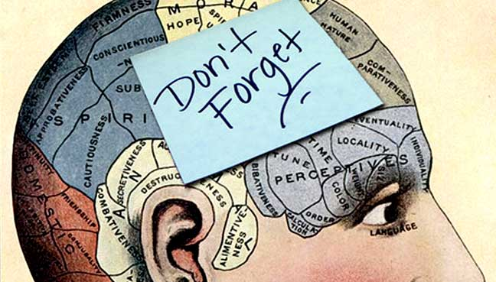
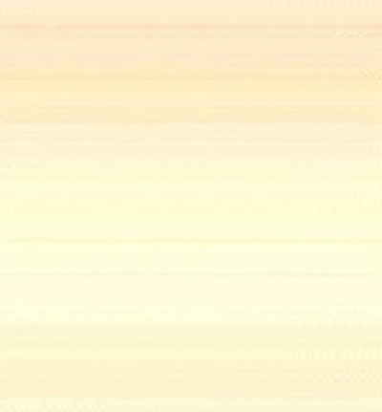
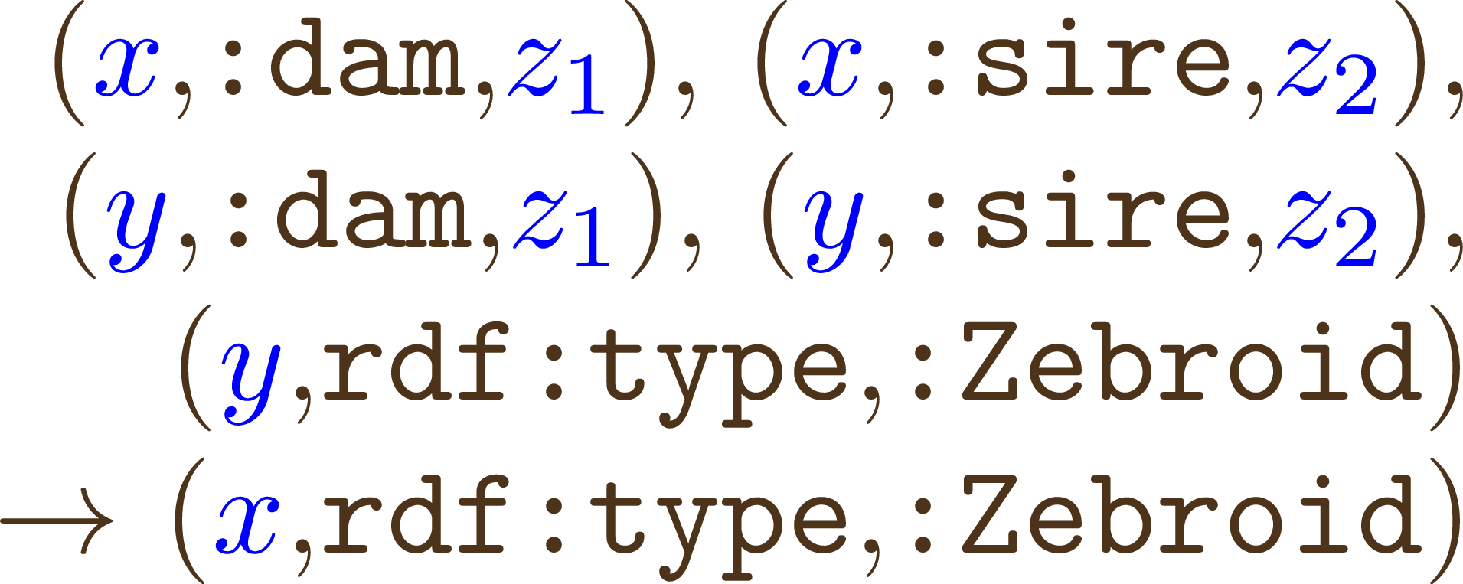

What assumptions do we make to conclude that Zia is a Zebroid?
If x has same sire and dam as y and y is a Zebroid then x is a Zebroid!
Very specific to this example

Slide 16
What assumptions do we make to conclude that Zia is a Zebroid?
sire is a sub-property of parent
dam is a sub-property of parent

Slide 17
What assumptions do we make to conclude that Zia is a Zebroid?
sire is a sub-property of parent
dam is a sub-property of parent
A Zebroid has exactly one parent a Zebra
A Zebroid has exactly one parent a (¬Zebra and a Equine)

Slide 18
What assumptions do we make to conclude that Zia is a Zebroid?
sire is a sub-property of parent
dam is a sub-property of parent
A Zebroid has exactly one parent a Zebra
A Zebroid has exactly one parent a (¬Zebra and a Equine)
A Zebroid is a sub-class of Equine
An Equine has exactly two parents

Slide 19
What assumptions do we make to conclude that Zia is a Zebroid?
sire is a sub-property of parent
dam is a sub-property of parent
A Zebroid has exactly one parent a Zebra
A Zebroid has exactly one parent a (¬Zebra and a Equine)
A Zebroid is a sub-class of Equine
An Equine has exactly two parents
Two things cannot be related by sire and dam at the same time

Slide 20
What assumptions do we make to conclude that Zia is a Zebroid?
sire is a sub-property of parent
dam is a sub-property of parent
A Zebroid has exactly one parent a Zebra
A Zebroid has exactly one parent a (¬Zebra and a Equine)
A Zebroid is a sub-class of Equine
An Equine has exactly two parents
Two things cannot be related by sire and dam at the same time
Which are expressible in RDFS?

Slide 21
What assumptions do we make to conclude that Zia is a Zebroid?
sire is a sub-property of parent
dam is a sub-property of parent
A Zebroid has exactly one parent a Zebra
A Zebroid has exactly one parent a (¬Zebra and a Equine)
A Zebroid is a sub-class of Equine
An Equine has exactly two parents
Two things cannot be related by sire and dam at the same time
Which are expressible in RDFS?

Slide 22
What assumptions do we make to conclude that Zia is a Zebroid?
sire is a sub-property of parent
dam is a sub-property of parent
A Zebroid has exactly one parent a Zebra
A Zebroid has exactly one parent a (¬Zebra and a Equine)
A Zebroid is a sub-class of Equine
An Equine has exactly two parents
Two things cannot be related by sire and dam at the same time
Which are expressible in RDFS?
The rest we can express in OWL

Slide 23
Web Ontology Language: OWL

Slide 24
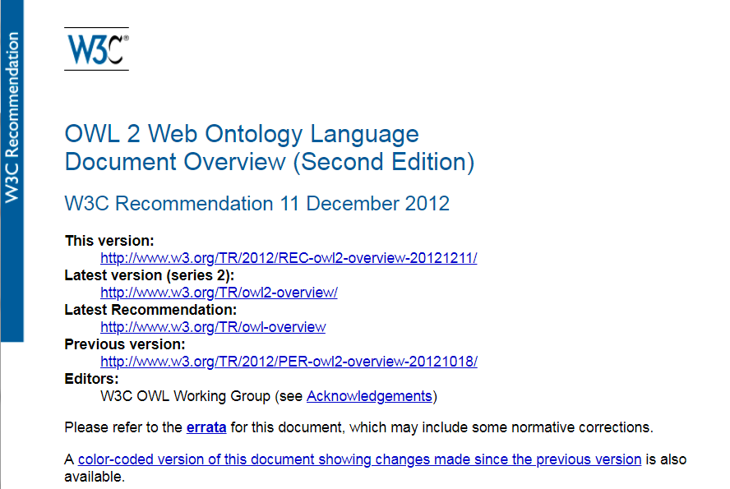
OWL (2): A Web Standard
https://www.w3.org/TR/owl2-overview/

Slide 25
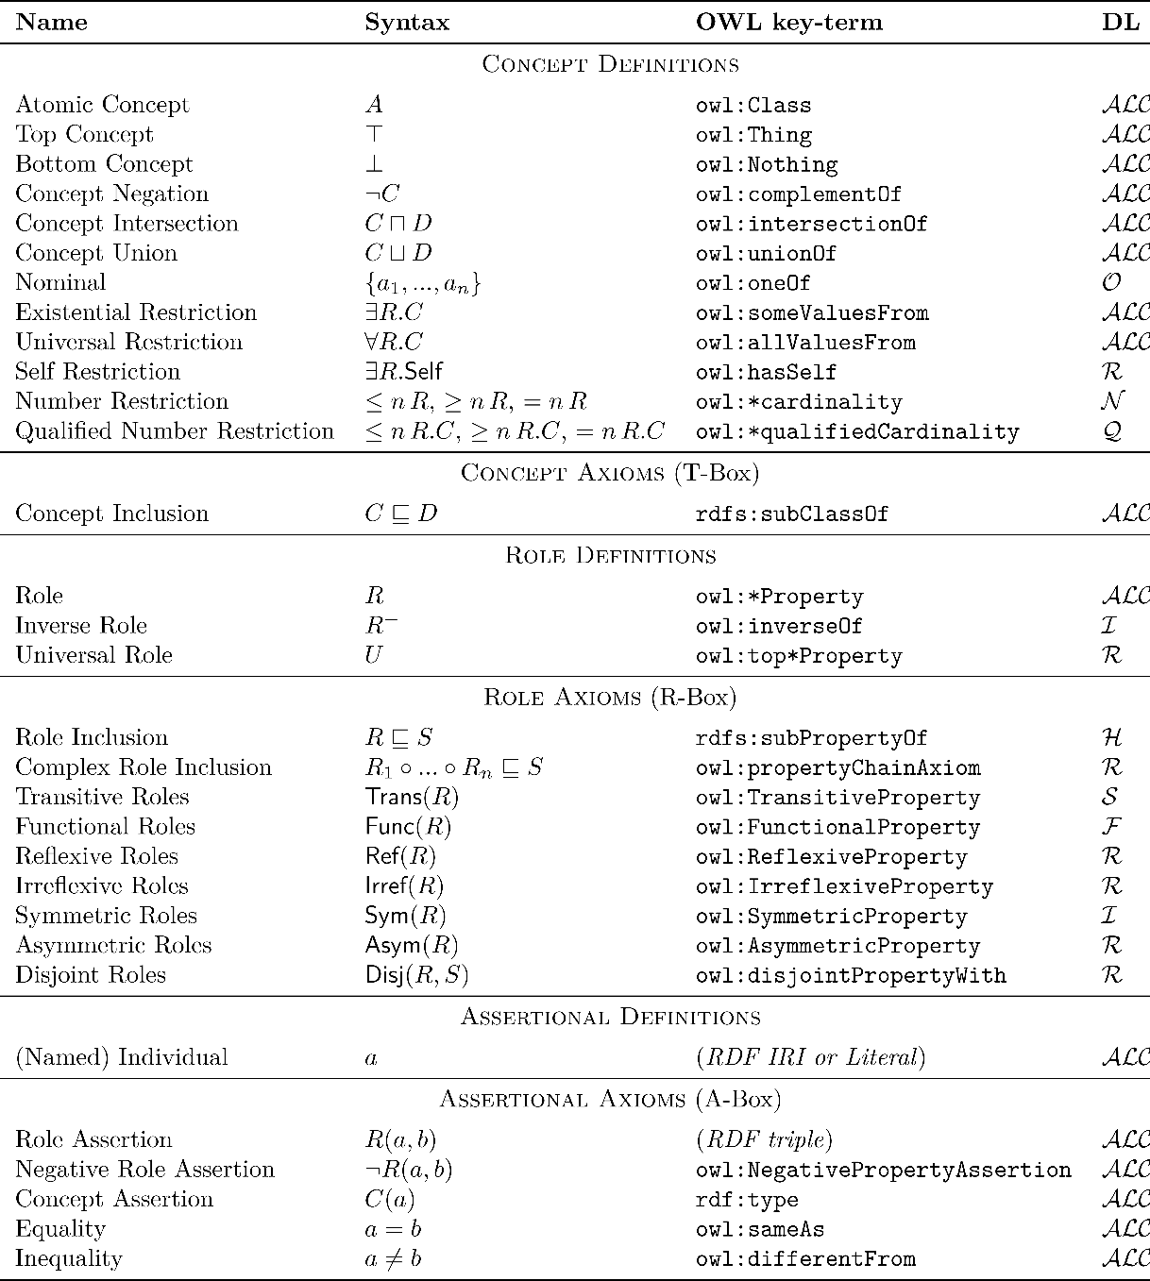
Formal Underpinnings: Description Logics

Slide 26

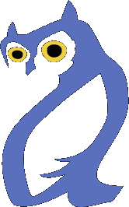
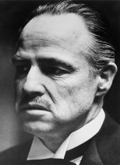
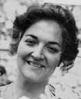

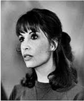
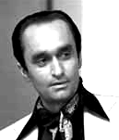
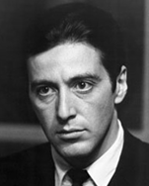

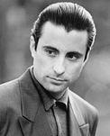
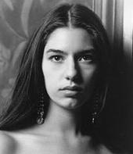
For today: A running example
:Vito
:Carmela
:Sonny
:Connie
:Fredo
:Michael
:Vincent
:Mary

Slide 27
Logical Assumptions

Slide 28
Open World Assumption (OWA)
How many children does
Vito have according
to this RDF graph?
Vito has 3 children?
Vito has at least 3 children?
:Vito
:hasChild
:Connie
:Sonny
:Fredo
:Michael
:Vito :hasChild :Connie , :Sonny , :Michael .
:Vito :hasChild :Fredo .
... ?

Slide 29
Open World Assumption
RDF(S) and OWL:
  Take an Open World Assumption (OWA):
    Anything not known is not assumed to be false, simply unknown
    Without further information, Vito may have children that we don’t know about!
Why might this assumption be important for the Web?
OWA: Assuming Web data to be complete a bad idea

Slide 30
No Unique Name Assumption (No UNA)
How many children does
Vito have according
to this RDF graph?
Vito has 3 children?
Vito has at least 3 children?
Vito has at least one child!
:Vito
:hasChild
:Connie
:Sonny
:Fredo
:Michael
:Vito :hasChild :Connie , :Sonny , :Michael .
:Vito :hasChild :Fredo .
... ?

Slide 31
No Unique Name Assumption (No UNA)
RDF(S) and OWL:
  Do not take a Unique Name Assumption:
    Two or more IRIs may refer to the same thing!
    Without further information, the IRIs we know to be Vito’s children may refer to one real-world thing!
Why might this assumption be important for the Web?
No UNA: Assuming strict naming agreement on the Web a bad idea

Slide 32
Which assumptions are needed under the Open World Assumption?
sire is a sub-property of parent
dam is a sub-property of parent
A Zebroid has exactly one parent a Zebra
A Zebroid has exactly one parent a (¬Zebra and a Equine)
A Zebroid is a sub-class of Equine
An Equine has exactly two parents
Two things cannot be related by sire and dam at the same time

Slide 33
Which assumptions are needed under the Open World Assumption?
sire is a sub-property of parent
dam is a sub-property of parent
A Zebroid has exactly one parent a Zebra
A Zebroid has exactly one parent a (¬Zebra and a Equine)
A Zebroid is a sub-class of Equine
An Equine has exactly two parents
Two things cannot be related by sire and dam at the same time

Slide 34
Which assumptions are needed without a Unique Name Assumption?
sire is a sub-property of parent
dam is a sub-property of parent
A Zebroid has exactly one parent a Zebra
A Zebroid has exactly one parent a (¬Zebra and a Equine)
A Zebroid is a sub-class of Equine
An Equine has exactly two parents
Two things cannot be related by sire and dam at the same time

Slide 35
Which assumptions are needed without a Unique Name Assumption?
sire is a sub-property of parent
dam is a sub-property of parent
A Zebroid has exactly one parent a Zebra
A Zebroid has exactly one parent a (¬Zebra and a Equine)
A Zebroid is a sub-class of Equine
An Equine has exactly two parents
Two things cannot be related by sire and dam at the same time

Slide 36
Let’s start with some RDFS …

Slide 37
rdfs:subPropertyOf
:husbandOf
:spouse
:wifeOf
:spouse
:Vito
:Carmela
:Vito :husbandOf :Carmela .
:husbandOf rdfs:subPropertyOf :spouse .
⇒ :Vito :spouse :Carmela .
:Carmela :wifeOf :Vito .
:wifeOf rdfs:subPropertyOf :spouse .
⇒ :Carmela :spouse :Vito .

Slide 38


rdfs:subClassOf
rdf:type
:Woman
rdf:type
:Mary
:Person
:Mary rdf:type :Woman .
:Woman rdfs:subClassOf :Person .
⇒ :Mary rdf:type :Person .

Slide 39
rdfs:domain
:motherOf
:Carmela
:Fredo
rdf:type
:Carmela :motherOf :Fredo .
:motherOf rdfs:domain :Female.
⇒ :Carmela rdf:type :Female .
:Female

Slide 40

rdfs:range
:hasSon
:Carmela
:Fredo
rdf:type
:Carmela :hasSon :Fredo .
:hasSon rdfs:range :Male .
⇒ :Fredo rdf:type :Male .
:Male

Slide 41
(In)Equality in OWL …

Slide 42
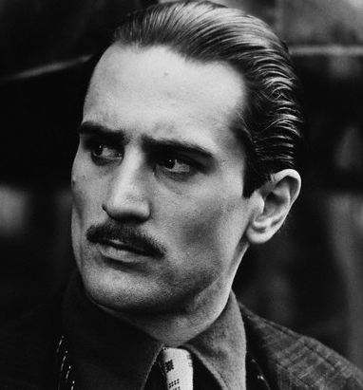
owl:sameAs
owl:sameAs
owl:sameAs
:VitoOld
:VitoOld :VitoYoung
:VitoYoung
:hasGrandson
:granddaugtherOf
:hasGrandson
:granddaugtherOf
:Vincent
:Mary
:VitoOld owl:sameAs :VitoYoung .

Slide 43
owl:differentFrom
How many children does
Vito have according
to this RDF graph?
Vito has at least two children!
:Vito
:hasChild
:Connie
:Sonny
:Fredo
:Michael
owl:differentFrom
:Vito :hasChild :Connie, :Sonny, :Michael, :Fredo .
:Connie owl:differentFrom :Sonny, :Michael, :Fredo .

Slide 44
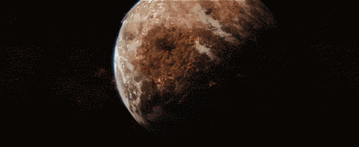
Inconsistency in OWL …
owl:sameAs
owl:differentFrom
:VitoOld
:VitoYoung
:VitoOld owl:sameAs :VitoYoung .
:VitoOld owl:differentFrom :VitoYoung .
⇒ FALSE

Slide 45
Property Axioms in OWL …

Slide 46
owl:equivalentProperty
:parentOf
:hasChild
:hasChild
:parentOf
:Vito
:Michael
:Mary
:Vito :parentOf :Michael .
:Michael :hasChild :Mary .
:parentOf owl:equivalentProperty :hasChild .
⇒ :Vito :hasChild :Michael .
⇒ :Michael :parentOf :Mary .

Slide 47
owl:inverseOf
:parentOf
:childOf
:childOf
:parentOf
:Carmela
:Sonny
:Vincent
:Carmela :parentOf :Sonny .
:Vincent :childOf :Sonny .
:parentOf owl:inverseOf :childOf .
⇒ :Sonny :parentOf :Vincent .
⇒ :Sonny :childOf :Carmela .

Slide 48
owl:SymmetricProperty
:sibling
:sibling
:Connie
:Fredo
:Connie :sibling :Fredo .
:sibling rdf:type owl:SymmetricProperty .
⇒ :Fredo :sibling :Connie .

Slide 49
owl:TransitiveProperty
:ancestorOf
:ancestorOf
:Carmela
:Michael
:Mary
:ancestorOf
:Carmela :ancestorOf :Michael .
:Michael :ancestorOf :Mary .
:ancestorOf rdf:type owl:TransitiveProperty .
⇒ :Carmela :ancestorOf :Mary .

Slide 50
owl:propertyChainAxiom
:brotherOf
:parentOf
:Sonny
:Michael
:Mary
:uncleOf
:Sonny :brotherOf :Michael .
:Michael :parentOf :Mary .
:uncleOf owl:propertyChainAxiom (:brotherOf :parentOf) .
⇒ :Sonny :uncleOf :Mary .

Slide 51
owl:ReflexiveProperty
:similarTo
:similarTo
:Connie
:Fredo
:similarTo rdf:type owl:ReflexiveProperty .
⇒ :Connie :similarTo :Connie .
:Freddie :similarTo :Freddie .
# everything :similarTo itself

Slide 52
owl:FunctionalProperty
:hasBioFather
:Fredo
:VitoYoung
:VitoOld :VitoYoung
:Fredo :hasBioFather :VitoOld .
:Fredo :hasBioFather :VitoYoung .
:hasBioFather rdf:type owl:FunctionalProperty .
⇒ :VitoOld owl:sameAs :VitoYoung .
:VitoOld

Slide 53
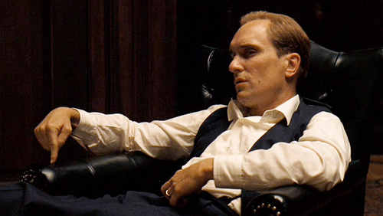
Aside …
Why do we say :hasBioFather and not just :hasFather?
Tom Hagen, the adopted son of Vito
  Maybe he has two fathers?
  Hence :hasBioFather (has biological father)

Slide 54
owl:InverseFunctionalProperty
:bioFatherOf
:Connie
:VitoYoung
:VitoOld :VitoYoung
:VitoOld :bioFatherOf :Connie .
:VitoYoung :bioFatherOf :Connie .
:bioFatherOf rdf:type owl:InverseFunctionalProperty .
⇒ :VitoOld owl:sameAs :VitoYoung .
:VitoOld

Slide 55
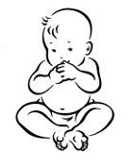
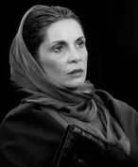

owl:hasKey
:hasBioMother
:Connie
:Carmela
rdf:type
:Singleton
:born
:Constanza
1922-04-16
:Connie a :Singleton ; :hasBioMother :Carmela ; :born “1922-04-16”^^xsd:date .
:Constanza a :Singleton ; :hasBioMother :Carmela ; :born “1922-04-16”^^xsd:date .
:Singleton owl:hasKey ( :hasBioMother :born ) .
⇒ :Connie owl:sameAs :Constanza .

Slide 56
owl:IrreflexiveProperty
:hasBrother
:Fredo
:Fredo :hasBrother :Fredo .
:hasBrother rdf:type owl:IrreflexiveProperty .
⇒ FALSE

Slide 57
owl:AsymmetricProperty
:hasFather
:hasFather
:Fredo
:VitoYoung
:Fredo :hasFather :VitoYoung .
:VitoYoung :hasFather :Fredo .
:hasFather rdf:type owl:AsymmetricProperty .
⇒ FALSE

Slide 58
owl:disjointPropertyWith
:hasFather
:hasSon
:Sonny
:VitoYoung
:Sonny :hasFather :VitoYoung .
:VitoYoung :hasSon :Sonny .
:hasSon owl:disjointPropertyWith :hasFather .
⇒ FALSE

Slide 59
Negative property assertions
¬:hasMother
:hasMother
:Fredo
:Connie
[] owl:sourceIndividual :Fredo ; owl:assertionProperty :hasMother ; owl:targetIndividual :Connie .
:Fredo :hasMother :Connie .
⇒ FALSE

Slide 60
Recap OWL property axioms
What would be the owl:inverseOf the property :fatherOf?
Name an owl:SymmetricProperty for family relations?
Name an owl:TransitiveProperty for family relations?
Give an owl:propertyChainAxiom for :hasNiece?
Name an owl:AsymmetricProperty for family relations?
Name an owl:FunctionalProperty for family relations?

Slide 61
Class Axioms in OWL

Slide 62
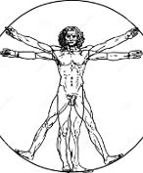
owl:equivalentClass
rdf:type
rdf:type
:Human
rdf:type
rdf:type
:Vincent
:Mary
:Person
:Vincent rdf:type :Human .
:Mary rdf:type :Person .
:Human owl:equivalentClass :Person .
⇒ :Vincent rdf:type :Person .
:Mary rdf:type :Human .

Slide 63

owl:disjointWith
:MafiaBoss
:Lawful
rdf:type
rdf:type
:Vincent
:Vincent rdf:type :MafiaBoss , :Lawful .
:MafiaBoss owl:disjointWith :Lawful .
⇒ FALSE

Slide 64
owl:disjointWith (ii)
:MafiaBoss
:Lawful
rdf:type
rdf:type
owl:differentFrom
:Vincent
:Mary
:Vincent rdf:type :MafiaBoss .
:Mary rdf:type :Lawful .
:MafiaBoss owl:disjointWith : Lawful .
⇒ :Vincent owl:differentFrom :Mary

Slide 65
Class Definitions in OWL

Slide 66
Description Logics

Slide 67


owl:intersectionOf (⊓) [i]
⊑
⊓
:Mother
:Female
:Parent
rdf:type
rdf:type
rdf:type
:Carmela
:Carmela rdf:type :Mother .
:Mother rdfs:subClassOf [ owl:intersectionOf ( :Female :Parent ) ]
⇒ :Carmela rdf:type :Female , :Parent .

Slide 68
owl:intersectionOf (⊓) [ii]
≡
⊓
:Mother
:Female
:Parent
rdf:type
rdf:type
rdf:type
:Carmela
:Carmela rdf:type :Female , :Parent .
:Mother owl:equivalentClass [ owl:intersectionOf ( :Female :Parent ) ]
⇒ :Carmela rdf:type :Mother .

Slide 69

owl:unionOf (⊔) [i]
≡
⊔
:Person
:Criminal
:Lawful
rdf:type
rdf:type
:Vincent
:Vincent rdf:type :Lawful .
:Person owl:equivalentClass [ owl:unionOf ( :Criminal :Lawful ) ]
⇒ :Vincent rdf:type :Person .

Slide 70
owl:unionOf (⊔) [ii]
≡
⊔
:Person
:Criminal
:Lawful
rdf:type
:Vincent
:Vincent rdf:type :Person .
:Person owl:equivalentClass [ owl:unionOf ( :Criminal :Lawful ) ]
⇒ # :Vincent must be either :Lawful or :Criminal (or both)

Slide 71
owl:disjointUnionOf (⊔_{D})
≡
⊔_{D}
:Person
:Criminal
:Lawful
rdf:type
:Vincent
:Vincent rdf:type :Person .
:Person owl:equivalentClass
[ owl:disjointUnionOf ( :Criminal :Lawful ) ]
⇒ # :Vincent must be either :Lawful or :Criminal (not both)

Slide 72


owl:complementOf (¬) [i]
≡
¬
:Dead
:Alive
¬rdf:type
rdf:type
:Mary
:Mary rdf:type :Alive .
:Dead owl:equivalentClass [ owl:complementOf :Alive ]
⇒ [] owl:sourceIndividual :Mary ; owl:targetProperty rdf:type ; owl:targetIndividual :Dead .

Slide 73


Slide 74
owl:complementOf (¬) [ii]
≡
¬
:Dead
:Alive
rdf:type
¬ rdf:type
:Vito
:Vito rdf:type :Dead .
:Dead owl:equivalentClass [ owl:complementOf :Alive ]
⇒ [] owl:sourceIndividual :Vito ; owl:targetProperty rdf:type ; owl:targetIndividual :Alive .

Slide 75
owl:oneOf ({})
≡
{
}
,
,
:Godfather
:Vito
:Michael
:Vincent
rdf:type
rdf:type
rdf:type
:Godfather owl:equivalentClass
[ owl:oneOf (:Vito :Michael :Vincent) ]
⇒ :Vito rdf:type :Godfather .
⇒ :Michael rdf:type :Godfather .
⇒ :Vincent rdf:type :Godfather .

Slide 76
owl:allValuesFrom (∀)
⊑
∀
:hasParent.
:Person
:Person
rdf:type
rdf:type
:hasParent
:Mary
:Michael
:Mary rdf:type :Person ; :hasParent :Michael .
:Person rdfs:subClassOf
[ owl:allValuesFrom :Person ; owl:onProperty :hasParent ]
⇒ :Michael rdf:type :Person .

Slide 77
owl:someValuesFrom (∃) [i]
≡
∃
:hasChild.
:Parent
:Person
rdf:type
rdf:type
:hasChild
:Michael
:Mary
:Michael :hasChild :Mary . :Mary rdf:type :Person .
:Parent owl:equivalentClass
[ owl:someValuesFrom :Person ; owl:onProperty :hasChild ]
⇒ :Michael rdf:type :Parent .

Slide 78
owl:someValuesFrom (∃) [ii]
≡
∃
:hasChild.
:Parent
:Person
rdf:type
rdf:type
?
:hasChild
:Michael
?
:Michael rdf:type :Parent .
:Parent owl:equivalentClass
[ owl:someValuesFrom :Person ; owl:onProperty :hasChild ]
⇒ :Michael :hasChild _:someone . _:someone rdf:type :Person .

Slide 79
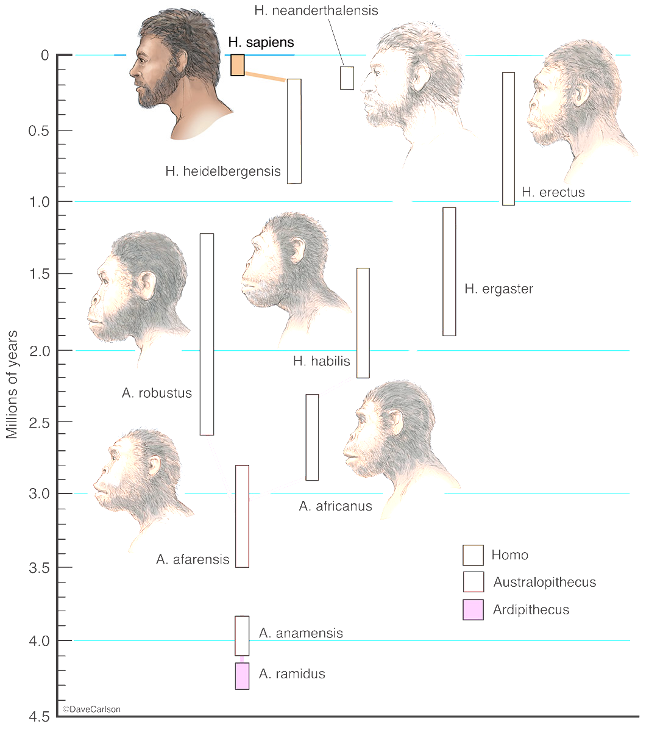
owl:hasValue (∃P.{x}) [i]
⊑
∃
{
}
:species.
:Person
:H.Sapiens
rdf:type
:species
:Mary
:Mary rdf:type :Person .
:Person rdfs:subClassOf
[ owl:hasValue :H.Sapiens ; owl:onProperty :species ]
⇒ :Mary :species :H.Sapiens .

Slide 80
owl:hasValue (∃P.{x}) [i]
≡
∃
{
}
:species.
:Person
:H.Sapiens
rdf:type
:species
:Mary
:Mary :species :H.Sapiens .
:Person owl:equivalentClass
[ owl:hasValue :H.Sapiens ; owl:onProperty :species ]
⇒ :Mary rdf:type :Person .

Slide 81

owl:hasSelf (Self) [i]
⊑
Self(:loves)
:Narcissist
rdf:type
:loves
:Michael
:Michael rdf:type :Narcissist .
:Narcissist rdfs:subClassOf
[ owl:hasSelf true ; owl:onProperty :loves ]
⇒ :Michael :loves :Michael .

Slide 82
owl:hasSelf (Self) [ii]
≡
Self(:loves)
:Narcissist
rdf:type
:loves
:Michael
:Michael :loves :Michael .
:Narcissist owl:equivalentClass
[ owl:hasSelf true ; owl:onProperty :loves ]
⇒ :Michael rdf:type Narcissist .

Slide 83
Cardinality restrictions (≥, ≤,=)
Define a class with a given number of values for a property:
  Exact: :Person ⊑ = 2 (:hasBioParent)
  Max: :Monogamist ⊑ ≤ 1 (:currentSpouse)
  Min: :Parent ≡ ≥ 1 (:hasChild)
:Person rdfs:subClassOf [ owl:cardinality 2 ;
owl:onProperty :hasBioParent ] .
:Monogamist rdfs:subClassOf [ owl:maxCardinality 1 ;
    owl:onProperty :currentSpouse ] .
:Parent owl:equivalentClass [ owl:minCardinality 1 ;
owl:onProperty :hasChild ] .

Slide 84
Qualified cardinality restrictions (≥, ≤,=)
Define a class with a given number of values from a given class for a property:
  Exact: :Person ≡ =2 (:hasParent.Person)
    Now the values in question must be people!
  Analogous versions of Max and Min.
:Person owl:equivalentClass [ owl:qualifiedCardinality 2 ;
owl:onProperty :hasParent ;
owl:onClass :Person ] .

Slide 85
Recap OWL class axioms/definitions
A class :HumanParent might be equivalent to the owl:unionOf which classes?
What is the difference/relation between owl:complementOf and owl:disjointWith?
Give an example use of owl:allValuesFrom
for family relations
A ⊑ ( B ⊓ ∃P.C ) ?
Give an example use of owl:someValuesFrom for :Uncle.
How might we codify the semantics of a class :OnlyChild in OWL?

Slide 86
Slides are examples, not definitions
≡
{
}
,
,
:Godfather
:Vito
:Michael
:Vincent
rdf:type
⇒ :VitoYoung must be owl:sameAs :Vito or :Michael or :Vincent
:VitoYoung

Slide 87
sire is a sub-property of parent
dam is a sub-property of parent
A Zebroid has exactly one parent a Zebra
A Zebroid has exactly one parent a (¬Zebra and a Equine)
A Zebroid is a sub-class of Equine
An Equine has exactly two parents
Two things cannot be related by sire and dam at the same time

Slide 89


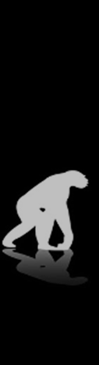

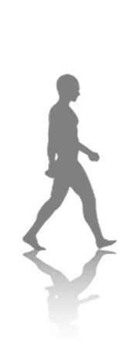
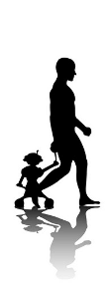
Questions?

