Slide 1
CC6202-1 La Web de Datos Primavera 2016 Lecture 5: Web Ontology Language (II)
Aidan Hogan
aidhog@gmail.com

Slide 2
PREVIOUSLY ON “LA WEB DE DATOS”

Slide 3
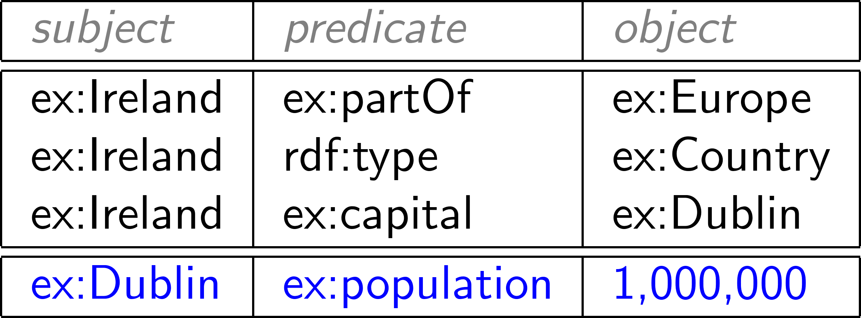
RDF: Resource Description Framework

Slide 4
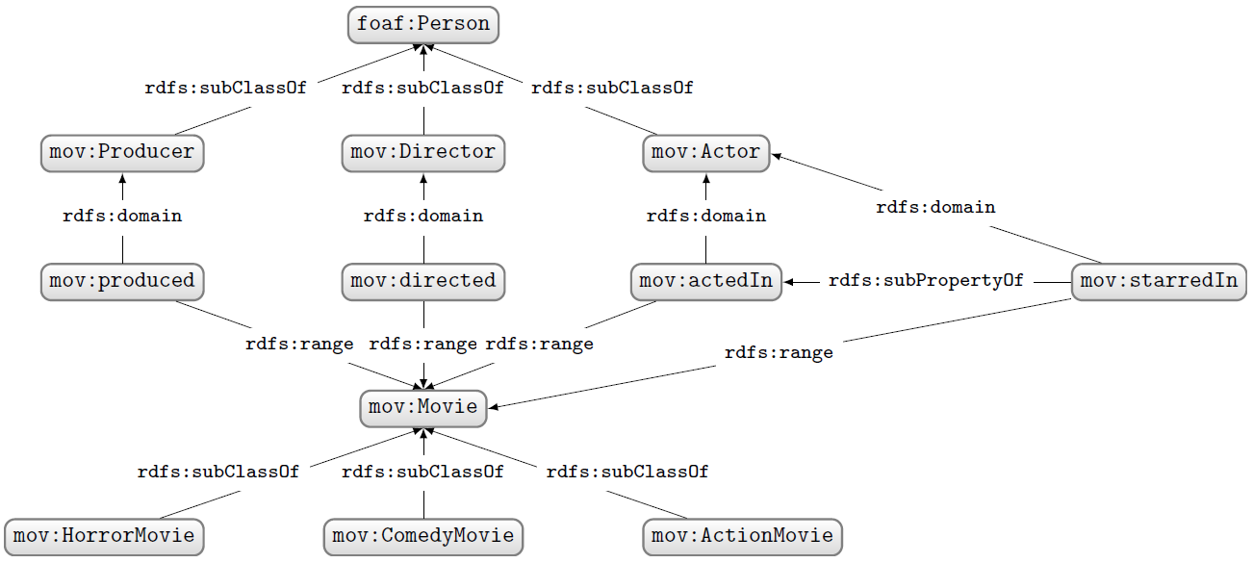
RDF Schema …
(an example)

Slide 5
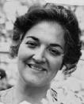
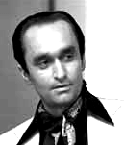
A special family …
ex:Vito
ex:Carmela
ex:Sonny
ex:Connie
ex:Fredo
ex:Michael
ex:Vincent
ex:Mary

Slide 7
TODAY’S TOPIC …

Slide 8
An ontology is just some definitions …
:hasDaughter rdfs:subPropertyOf :hasChild .
:hasChild rdf:type owl:AsymmetricProperty ; owl:inverseOf :hasParent ;
rdfs:subPropertyOf :ancestorOf .
:ancestorOf rdf:type owl:TransitiveProperty .
ex:Carmela :hasChild ex:Michael .
ex:Michael :hasDaughter ex:Mary .
ex:Mary a :Person .
:Person owl:equivalentClass
[ owl:qualifiedCardinality 2 ;
owl:onProperty :hasParent ;
owl:onClass :Person ] .
… but what do they mean?
… and what can we do with ontologies?

Slide 9
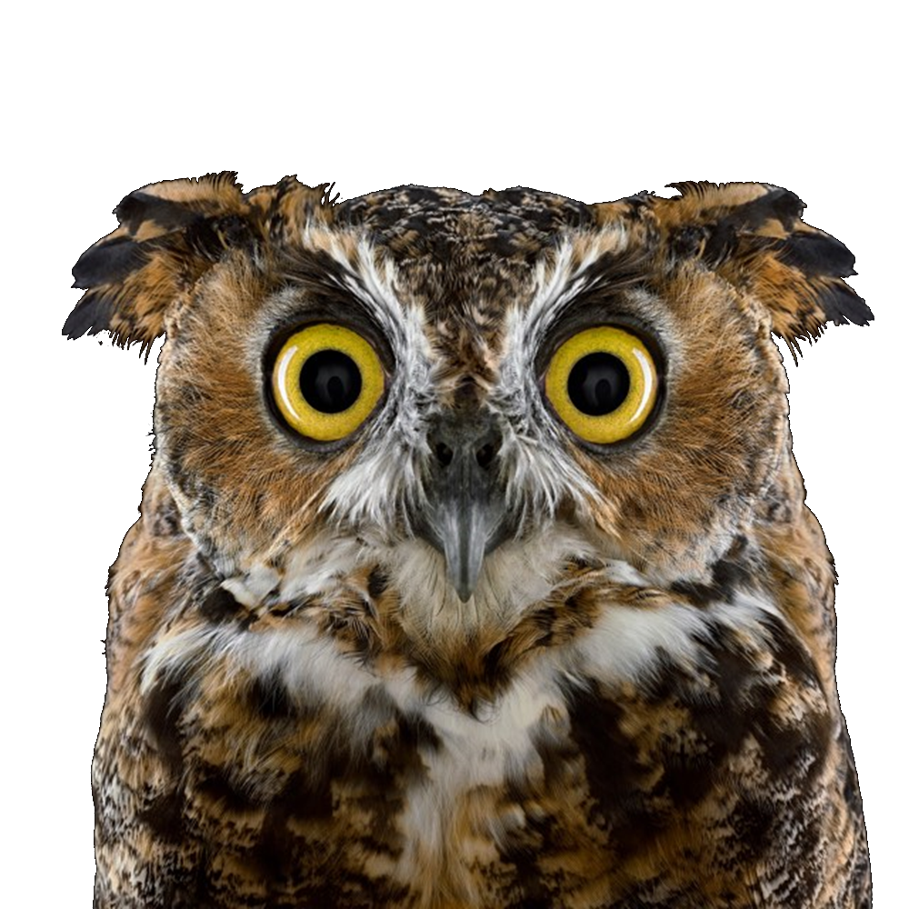
Trying to give a taste of OWL

Slide 10
MODELS …

Slide 11
Models of ontologies
A model is any world that an ontology might describe
:hasDaughter rdfs:subPropertyOf :hasChild .
:hasChild rdfs:subPropertyOf :ancestorOf .
:ancestorOf rdf:type owl:TransitiveProperty .
ex:Carmela :hasChild ex:Michael .
ex:Michael :hasDaughter ex:Mary .
… not a model, since Carmela would need to be an ancestor of Mary

Slide 12
Models of ontologies
A model is any world that an ontology might describe
:hasDaughter rdfs:subPropertyOf :hasChild .
:hasChild rdfs:subPropertyOf :ancestorOf .
:ancestorOf rdf:type owl:TransitiveProperty .
ex:Carmela :hasChild ex:Michael .
ex:Michael :hasDaughter ex:Mary .
… a model
(leaving aside things like OWL definitions, reflexive owl:sameAs, etc.)

Slide 13
Models of ontologies
A model is any world that an ontology might describe
:hasDaughter rdfs:subPropertyOf :hasChild .
:hasChild rdfs:subPropertyOf :ancestorOf .
:ancestorOf rdf:type owl:TransitiveProperty .
ex:Carmela :hasChild ex:Michael .
ex:Michael :hasDaughter ex:Mary .
… also a model
(Under Open World Assumption, Ontology can describe part of the world)

Slide 14
Models of ontologies
A model is any world that an ontology might describe
:hasDaughter rdfs:subPropertyOf :hasChild .
:hasChild rdfs:subPropertyOf :ancestorOf .
:ancestorOf rdf:type owl:TransitiveProperty .
ex:Carmela :hasChild ex:Michael .
ex:Michael :hasDaughter ex:Mary .
… also a model
(Since we don’t know what ex:Cake, ex:Carmela , etc., actually refer to)

Slide 15
Mapping of names to things part of model
(Different names mapped to different things means a different model!)

Slide 16
ENTAILMENT …

Slide 17
Ontology O entails O′ (O ⊧ O′)
:hasDaughter rdfs:subPropertyOf :hasChild .
:hasChild rdf:type owl:AsymmetricProperty ; owl:inverseOf :hasParent ;
rdfs:subPropertyOf :ancestorOf .
:ancestorOf rdf:type owl:TransitiveProperty .
ex:Carmela :hasChild ex:Michael .
ex:Michael :hasDaughter ex:Mary .
ex:Mary a :Person .
:Person owl:equivalentClass
[ owl:qualifiedCardinality 2 ;
owl:onProperty :hasParent ;
owl:onClass :Person ] .
ex:Michael :hasParent ex:Carmela .
ex:Michael :hasChild ex:Mary .
ex:Carmela :ancestorOf ex:Mary .
Any model of O is a model of O′
(O′ forms part of the models of O)
(O′ says nothing new over O)

Slide 18
Entailment symbol: ⊧

Slide 19
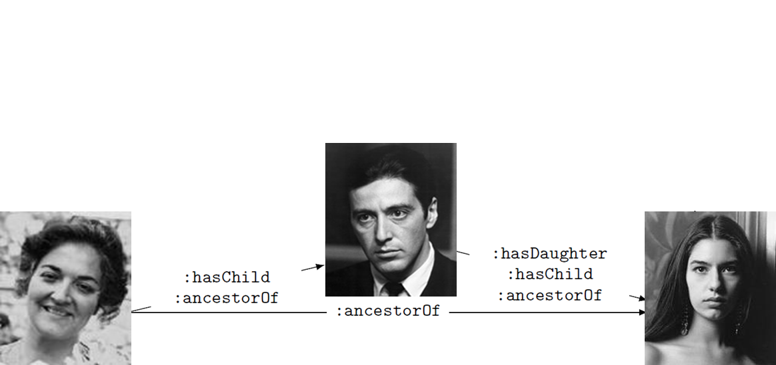
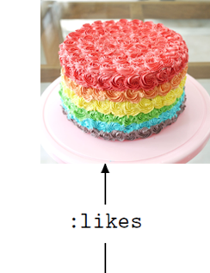
Ontology Entailment
ex:Michael :hasParent ex:Carmela .
ex:Michael :hasChild ex:Mary .
ex:Carmela :ancestorOf ex:Mary .
ex:Carmela :ancestorOf ex:Mary .
ex:Mary :likes ex:Cake .
Does O entail O′ (O ⊧ O′)?
No! There are models of O that are not of O′ …
Mary doesn’t like cake here

Slide 20
REASONING TASKS …

Slide 21
Materialisation: Write down entailments
:hasDaughter rdfs:subPropertyOf :hasChild .
:hasChild rdf:type owl:AsymmetricProperty ; owl:inverseOf :hasParent ;
rdfs:subPropertyOf :ancestorOf .
:ancestorOf rdf:type owl:TransitiveProperty .
ex:Carmela :hasChild ex:Michael .
ex:Michael :hasDaughter ex:Mary .
ex:Mary a :Person .
:Person owl:equivalentClass
[ owl:qualifiedCardinality 2 ;
owl:onProperty :hasParent ;
owl:onClass :Person ] .
ex:Michael :hasParent ex:Carmela .
ex:Michael :hasChild ex:Mary .
ex:Carmela :ancestorOf ex:Mary .
…
Any problems with this?

Slide 22
Materialisation: Write down entailments
:hasDaughter rdfs:subPropertyOf :hasChild .
:hasChild rdf:type owl:AsymmetricProperty ; owl:inverseOf :hasParent ;
rdfs:subPropertyOf :ancestorOf .
:ancestorOf rdf:type owl:TransitiveProperty .
ex:Carmela :hasChild ex:Michael .
ex:Michael :hasDaughter ex:Mary .
ex:Mary a :Person .
:Person owl:equivalentClass
[ owl:qualifiedCardinality 2 ;
owl:onProperty :hasParent ;
owl:onClass :Person ] .
ex:Michael :hasParent ex:Carmela .
ex:Michael :hasChild ex:Mary .
ex:Carmela :ancestorOf ex:Mary .
…
ex:Mary :hasParent _:parent1 . _:parent1 a :Person .
ex:Mary :hasParent _:parent2 . _:parent2 a :Person .
_:parent1 :hasParent _:parent11 . _:parent11 a :Person .
_:parent2 :hasParent _:parent12 . _:parent12 a :Person . ...

Slide 23
Materialisation: Write down entailments
:hasDaughter rdfs:subPropertyOf :hasChild .
:hasChild rdf:type owl:AsymmetricProperty ; owl:inverseOf :hasParent ;
rdfs:subPropertyOf :ancestorOf .
:ancestorOf rdf:type owl:TransitiveProperty .
ex:Carmela :hasChild ex:Michael .
ex:Michael :hasDaughter ex:Mary .
ex:Mary a :Person .
:Person owl:equivalentClass
[ owl:qualifiedCardinality 2 ;
owl:onProperty :hasParent ;
owl:onClass :Person ] .
ex:Michael :hasParent ex:Carmela .
ex:Michael :hasChild ex:Mary .
ex:Carmela :ancestorOf ex:Mary .
…
:Person rdfs:subClassOf [ owl:maxQualifiedCardinality 2 ; owl:onProperty :hasParent ; owl:onClass :Person ] .
:Person rdfs:subClassOf [ owl:maxQualifiedCardinality 3 ; owl:onProperty :hasParent ; owl:onClass :Person ] . ...

Slide 24
Materialisation: Write down entailments
Entailments are infinite …
… which makes it tricky to write them all down …

Slide 25
Ontology Satisfiability: Does O have a “model”?
:Person owl:equivalentClass
[ owl:qualifiedCardinality 2 ; owl:onProperty :hasParent ;
owl:onClass :Person ] .
:FirstPerson a :Person ,
[ owl:qualifiedCardinality 2 ; owl:onProperty :hasParent ;
owl:onClass :Ape ] .
So does O have a model?
YES! Ontology O is Satisfiable!

Slide 26
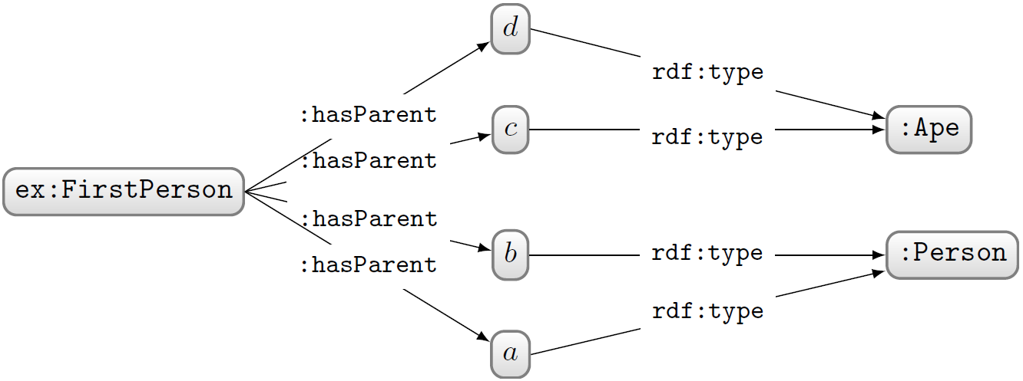
Ontology Satisfiability: Does O have a “model”?
:Person owl:equivalentClass
[ owl:qualifiedCardinality 2 ; owl:onProperty :hasParent ;
owl:onClass :Person ] .
:FirstPerson a :Person ,
[ owl:qualifiedCardinality 2 ; owl:onProperty :hasParent ;
owl:onClass :Ape ] .
:Ape owl:disjointWith :Person .
So does O have a model now?
YES! Ontology O is still Satisfiable!

Slide 27
Ontology Satisfiability: Does O have a “model”?
:Person owl:equivalentClass
[ owl:qualifiedCardinality 2 ; owl:onProperty :hasParent ;
owl:onClass :Person ] .
:FirstPerson a :Person ,
[ owl:qualifiedCardinality 2 ; owl:onProperty :hasParent ;
owl:onClass :Ape ] .
:Ape owl:disjointWith :Person .
What more would we have to add to O to make it Unsatisfiable?
:Person rdfs:subClassOf
[ owl:cardinality 2 ; owl:onProperty :hasParent ] .
OR
:Person owl:equivalentClass
[ owl:allValuesFrom :Person ; owl:onProperty :hasParent ] .
OR
:FirstPerson a :Ape .
OR
:FirstPerson a owl:Nothing .
OR …

Slide 28
Ontology Satisfiability: Does O have a “model”?
:Person owl:equivalentClass
[ owl:qualifiedCardinality 2 ; owl:onProperty :hasParent ;
owl:onClass :Person ] .
:FirstPerson a :Person ,
[ owl:qualifiedCardinality 2 ; owl:onProperty :hasParent ;
owl:onClass :Ape ] .
:Ape owl:disjointWith :Person .
An unsatisfiable ontology cannot model any world!
It is inconsistent!
What more would we have to add to O to make it Unsatisfiable?
:Person rdfs:subClassOf
[ owl:cardinality 2 ; owl:onProperty :hasParent ] .
OR
:Person owl:equivalentClass
[ owl:allValuesFrom :Person ; owl:onProperty :hasParent ] .
OR
:FirstPerson a :Ape .
OR
:FirstPerson a owl:Nothing .
OR …

Slide 29
Entailment checking: Does O entail O′?
:hasDaughter rdfs:subPropertyOf :hasChild .
:hasChild rdf:type owl:AsymmetricProperty ;
owl:inverseOf :hasParent ;
rdfs:subPropertyOf :ancestorOf .
:ancestorOf rdf:type owl:TransitiveProperty .
ex:Carmela :hasChild ex:Michael .
ex:Michael :hasDaughter ex:Mary .
ex:Michael :hasParent ex:Carmela .
ex:Michael :hasChild ex:Mary .
ex:Carmela :ancestorOf ex:Mary .
Alternatively: Are all models of O models of O′ too?

Slide 30
REASONING …

Slide 31
How can we perform reasoning?
Does Ontology O entail O′?
Could instead ask: is “O ∪ ¬O′” unsatisfiable?
Can reduce entailment to unsatisfiability!
:hasDaughter rdfs:subPropertyOf :hasChild .
ex:Michael :hasDaughter ex:Mary .
ex:Michael :hasChild ex:Mary .
:hasDaughter rdfs:subPropertyOf :hasChild .
ex:Michael :hasDaughter ex:Mary .
[] owl:sourceIndividual ex:Michael ;
owl:assertionProperty :hasChild ;
owl:targetIndividual ex:Mary .

Slide 32
So how do we test unsatisfiability then?
(Audrey was clearly
not a Computer Scientist)

Slide 33
UNDECIDABILITY …

Slide 34
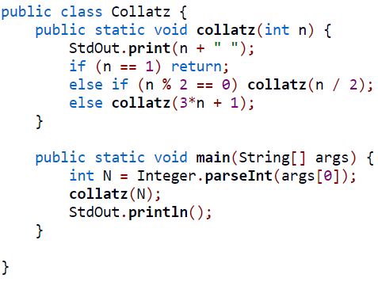
A simple Java program …
In:
6
3
10
5
16
8
4
2
1
(end)
Does this Java program terminate
on all possible (positive) inputs?

Slide 35
A simple Java program …
Collatz conjecture: an unsolved problem in mathematics
If we knew that this program terminates or does not terminate on all natural numbers (not just ints), this problem would be solved!

Slide 36
Halting Problem
Input: a program and an input to that program
Output:
true if the program halts on that input
false otherwise
UNDECIDABLE: a general algorithm to solve the Halting Problem does not exist!
It will not halt for all program–input pairs!
It may halt for some program–input pairs

Slide 37
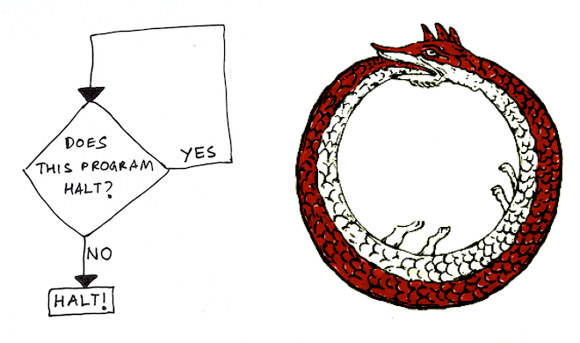
A quick sketch of Halting Problem proof

Slide 38
Problem: Consecutive ‘1’s in π
Input: A natural number n
Output:
true if π contains n consecutive ‘1’s
false otherwise
Is this problem DECIDABLE or UNDECIDABLE?
… i.e., does there exist a program that halts (with the correct answer) for all n?
What if we knew the maximum sequence of consecutive ‘1’s in π?
if (n ≤ MAX) return true; else return false;
• there must exist a MAX sequence of consecutive ‘1’s in π (even if it’s ∞)
∴ there must exist a correct program that halts (even if we don’t know its details)
∴ problem is DECIDABLE!

Slide 39
Problem: Collatz Halting Problem
Input: [none]
Output:
true if Collatz program halts on all inputs
false otherwise
Is this problem DECIDABLE or UNDECIDABLE?
(P1) return true;
(P2) return false;
• either (P1) or (P2) must be correct
∴ there must exist a correct program that halts (even if we don’t know it)
∴ problem is DECIDABLE!
Halting Problem UNDECIDABLE in the general case
(for all programs and inputs)

Slide 40
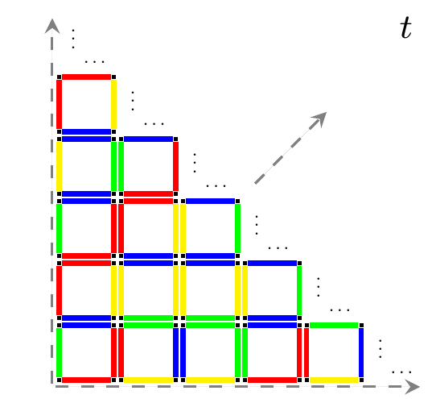
Domino Tiling Problem
Is this problem DECIDABLE or UNDECIDABLE?
Input: A set of Dominos (like D)
Output:
true if there exists a valid infinite tiling (like t)
false otherwise

Slide 41
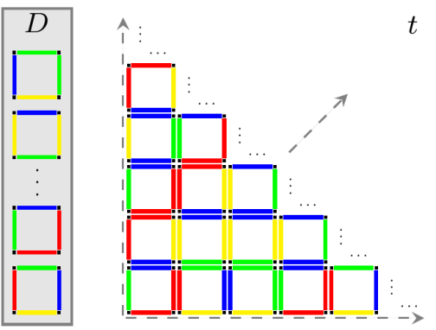
Can reduce from Halting to Tiling
Reduction
It has been shown that there exists a program that can reduce any Halting problem instance into a Domino Tiling problem instance
Now is the Domino Tiling problem DECIDABLE or UNDECIDABLE?
halts(p,in) {
D = reduce(p,in);
return hasTiling(D);
}
• reduce(p,in) is DECIDABLE
∴ if hasTiling(D) were DECIDABLE, then halts(p,in) would be DECIDABLE
• but halts(p,in) is UNDECIDABLE
∴ hasTiling(D) must be UNDECIDABLE!
If we have a decidable reduction from an UNDECIDABLE problem A
to another problem B, then B must be UNDECIDABLE

Slide 42
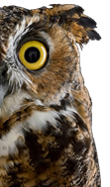
Reduce from Tiling to OWL entailment?
Reduction
Does D have an infinite tiling?
Does OWL ontology O entail O′?
How can we encode a Domino Tiling question into an OWL ontology entailment question?
If we could do this, we could save ourselves trying to code a program to implement OWL entailment since we would know it was UNDECIDABLE

Slide 43
Some Description Logic symbols
⊑: sub-class/-property
≡: equivalent class/property
⊔: union
⊓: intersection
⊤: top (class of everything)
⊥: bottom (empty class)
∃: exists (someValuesFrom/hasValue)
∀: for all (allValuesFrom)
¬: not (complement, negation)
– (superscript minus): inverse property
{}: enumeration (owl:oneOf)
Self, Trans, Dom, etc.: where symbols not available
∘: property chain
C(x): class membership
P(x,y): a triple (x,P,y)

Slide 44
Can reduce from OWL entailment to Tiling
Each tile must be a domino
Define dominos as a class D, a union of classes for each domino type:
Now what else do we need to encode?

Slide 45
Can reduce from OWL entailment to Tiling
Each tile must be a domino
Define dominos as a class D, a union of classes for each domino type:
Each tile can only be one domino type
How can we encode this in OWL?

Slide 46
Can reduce from OWL entailment to Tiling
Each tile must be a domino
Define dominos as a class D, a union of classes for each domino type:
Each tile can only be one domino type
Define dominos types as pairwise disjoint:
What else do we need to encode?

Slide 47
Can reduce from OWL entailment to Tiling
Each tile must be a domino
Define dominos as a class D, a union of classes for each domino type:
Each tile can only be one domino type
Define dominos types as pairwise disjoint:
Each tile must have a tile to the right and above
How can we encode this?

Slide 48
Can reduce from OWL entailment to Tiling
Each tile must be a domino
Define dominos as a class D, a union of classes for each domino type:
Each tile can only be one domino type
Define dominos types as pairwise disjoint:
Each tile must have a tile to the right and above
Define that a domino has some values from domino for right/above:
Are we there yet?

Slide 49
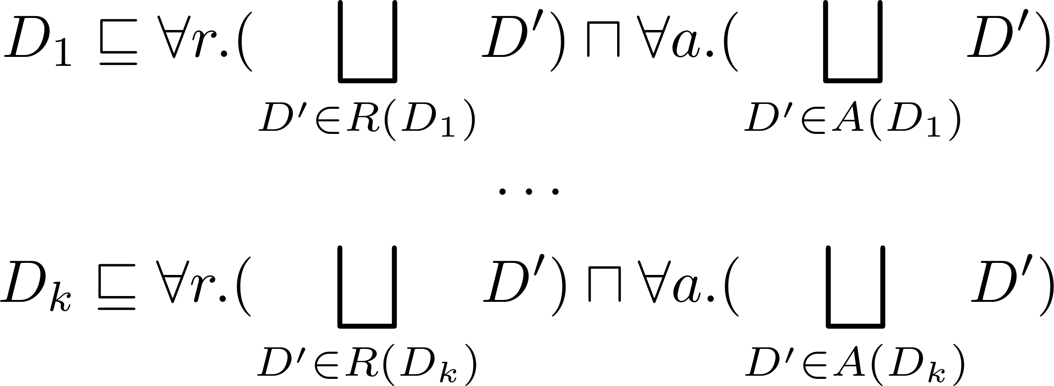
Can reduce from OWL entailment to Tiling
Tiles to the right and tiles above must match colour
Define that a domino has all values from matching tiles right/above:
Are we there yet?

Slide 50
What condition are we missing?
So far we could still have trees as models
Need to state:
Tile above and to the right = Tile to the right and above
How can we encode this?

Slide 51
Can reduce from OWL entailment to Tiling
Tile right then above = Tile above then right
Define diagonal tile using two property chains (above-right/right-above)
Declare functional (a tile can only have one such diagonal tile)
Are we there yet?

Slide 52
What’s the entailment question?
What should we
put in O′?
???
Goal: Ontology O entails O′ if and only if D has an infinite tiling

Slide 53
What’s the entailment question?
Goal: Ontology O entails O′ if and only if D has an infinite tiling
If D has any member (a “tile”), it must have an infinite tiling!
If D has no member, it must not have an infinite tiling.

Slide 54
Could also use satisfiability
Ontology O is satisfiable if and only if D has an infinite tiling
Here, x is an arbitrary fresh term

Slide 55
OWL satisfiability/entailment is powerful
Reduction
OWL satisfiability/entailment also undecidable!
Otherwise could be used to solve Domino Tiling problem …
… and the Halting problem …
… and (given enough time), the Collatz conjecture …
… and a bunch of other stuff
Reduction

Slide 56
PRACTICAL REASONING

Slide 57
Options …
Well great. What are we supposed to do now?
Accept incomplete reasoners that halt
You may not get all the entailments … so what entailments do you get?
Accept complete reasoners that may not halt
Java is a language that lets you write programmes that may not halt
Restrict OWL so we can’t solve Halting/Tiling
Main problem tackled in Description Logics field: find decidable sublanguages of OWL without turning off too many features (and allowing efficient algorithms)
More next week …

Slide 58
RECAP

Slide 60
OWL Definitions
Models
A world that the ontology could be true for
… and a mapping from the terms of the ontology to that world
Not necessarily the real world (just a consistent world)
Can be much larger than the ontology describes
The more detailed the ontology, the fewer its models
Entailment
An ontology O entails another ontology O′ if any model of O is a model of O′
… in which case O′ adds no new information to O
… in which case O′ follow from O

Slide 61
OWL Reasoning Tasks
Materialisation
Write down all the entailments from O′
Unfortunately, they are infinite
Satisfiability
Does an ontology have any model?
If not, it is inconsistent/unsatisfiable
Unfortunately, satisfiability is undecidable
Entailment (checking)
Does an ontology O entail another ontology O′?
If so, O′ follows as a consequence of O
Can be reduced to satisfiability
Unfortunately, entailment checking is also undecidable

Slide 62
Questions?

