Slide 1
CC6202-1 La Web de Datos Primavera 2015 Lecture 6: Web Ontology Language (III)
Aidan Hogan
aidhog@gmail.com

Slide 2
PREVIOUSLY ON “LA WEB DE DATOS”

Slide 3
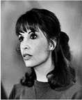
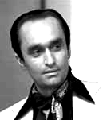
Modelling family relations with OWL
ex:Vito
ex:Carmela
ex:Sonny
ex:Connie
ex:Fredo
ex:Michael
ex:Vincent
ex:Mary

Slide 4
Materialisation: Write down entailments
:hasDaughter rdfs:subPropertyOf :hasChild .
:hasChild rdf:type owl:AsymmetricProperty ; owl:inverseOf :hasParent ;
rdfs:subPropertyOf :ancestorOf .
:ancestorOf rdf:type owl:TransitiveProperty .
ex:Carmela :hasChild ex:Michael .
ex:Michael :hasDaughter ex:Mary .
ex:Mary a :Person .
:Person owl:equivalentClass
[ owl:qualifiedCardinality 2 ;
owl:onProperty :hasParent ;
owl:onClass :Person ] .
ex:Michael :hasParent ex:Carmela .
ex:Michael :hasChild ex:Mary .
ex:Carmela :ancestorOf ex:Mary .
…
ex:Mary :hasParent _:parent1 . _:parent1 a :Person .
ex:Mary :hasParent _:parent2 . _:parent2 a :Person .
_:parent1 :hasParent _:parent11 . _:parent11 a :Person .
_:parent2 :hasParent _:parent12 . _:parent12 a :Person . ...

Slide 5
Ontology Satisfiability: Does O have a “model”?
:Person owl:equivalentClass
[ owl:qualifiedCardinality 2 ; owl:onProperty :hasParent ;
owl:onClass :Person ] .
:FirstPerson a :Person ,
[ owl:qualifiedCardinality 2 ; owl:onProperty :hasParent ;
owl:onClass :Ape ] .
So does O have a model?
YES! Ontology O is Satisfiable!

Slide 6
Entailment checking: Does O entail O′?
:hasDaughter rdfs:subPropertyOf :hasChild .
:hasChild rdf:type owl:AsymmetricProperty ; owl:inverseOf :hasParent ;
rdfs:subPropertyOf :ancestorOf .
:ancestorOf rdf:type owl:TransitiveProperty .
ex:Carmela :hasChild ex:Michael .
ex:Michael :hasDaughter ex:Mary .
ex:Michael :hasParent ex:Carmela .
ex:Michael :hasChild ex:Mary .
ex:Carmela :ancestorOf ex:Mary .
Alternatively: Are all models of O models of O′ too?

Slide 7
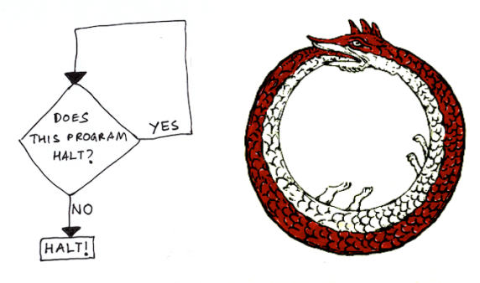
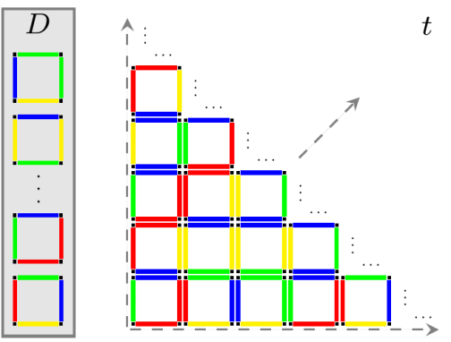
OWL satisfiability/entailment is powerful
Reduction
OWL satisfiability/entailment checking also undecidable!
Otherwise could be used to solve Domino Tiling problem …
… and the Halting problem …
… and (given enough time), the Collatz conjecture …
… and a bunch of other stuff
Reduction

Slide 8
today’s topic …

Slide 9
Options …
Well great. What are we supposed to do now?
Accept incomplete reasoners that halt
You may not get all the entailments … so what entailments do you get?
Accept complete reasoners that may not halt
Java is a language that lets you write programmes that may not halt
Restrict OWL so reasoning tasks become decidable
Main problem tackled in Description Logics field: find decidable sublanguages of OWL without turning off too many features (and allowing efficient algorithms)
More next week …

Slide 10
In the labs …
But what is the reasoner actually doing? …
Data
Reasoner
???
Entailments
Ontology

Slide 11
incomplete reasoners that halt

Slide 12
Incomplete reasoners that halt: Works for materialisation
:hasDaughter rdfs:subPropertyOf :hasChild .
:hasChild rdf:type owl:AsymmetricProperty ; owl:inverseOf :hasParent ;
rdfs:subPropertyOf :ancestorOf .
:ancestorOf rdf:type owl:TransitiveProperty .
ex:Carmela :hasChild ex:Michael .
ex:Michael :hasDaughter ex:Mary .
ex:Mary a :Person .
:Person owl:equivalentClass
[ owl:qualifiedCardinality 2 ;
owl:onProperty :hasParent ;
owl:onClass :Person ] .
ex:Michael :hasParent ex:Carmela .
ex:Michael :hasChild ex:Mary .
ex:Carmela :ancestorOf ex:Mary .
ex:Mary :hasParent _:parent1 . _:parent1 a :Person .
ex:Mary :hasParent _:parent2 . _:parent2 a :Person .
_:parent1 :hasParent _:parent11 . _:parent11 a :Person .
_:parent2 :hasParent _:parent12 . _:parent12 a :Person . ...

Slide 13
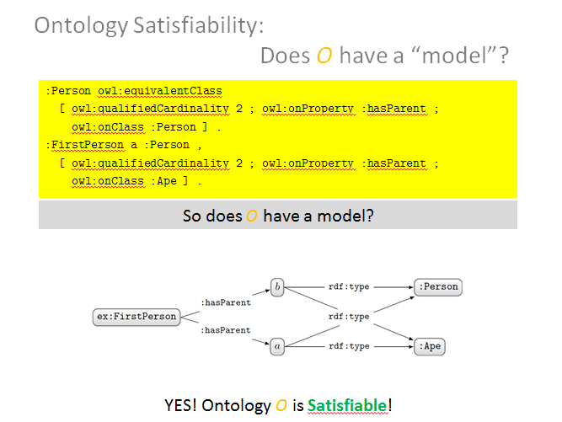
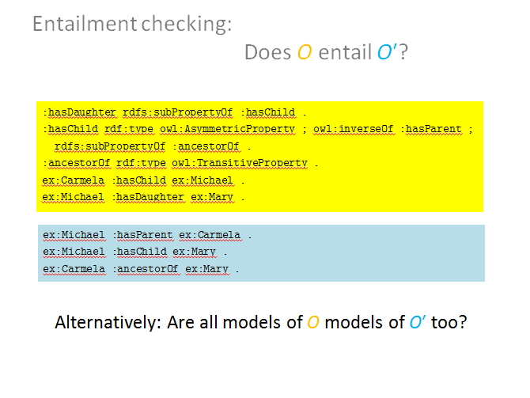
Incomplete reasoners that halt: for Entailment/Satisfiability Checking?
Why can’t we have incomplete satisfiability/entailment checkers?
Both are decision problems (yes/no)
What would an incomplete answer be? (ye/n)

Slide 14
In the labs …
The reasoner is doing (incomplete) materialisation!
Data
Reasoner
???
Entailments
Ontology

Slide 15
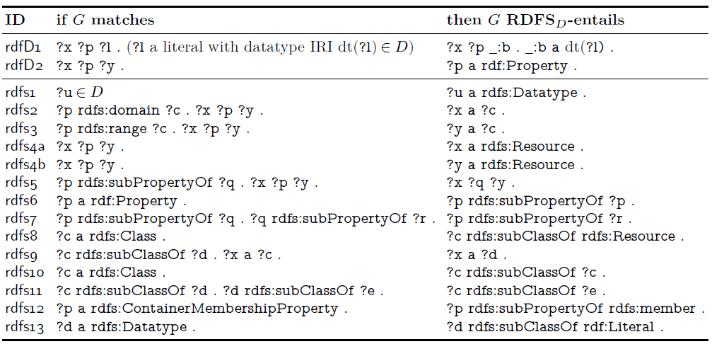
Recall: RDFS reasoning using “rules”
(Don’t worry about rdfD1, rdfs1, rdfs12, rdfs13)

Slide 16
In the labs …
The reasoner is doing (incomplete) materialisation!
Using OWL 2 RL/RDF rules that support RDFS and OWL (2)
http://www.w3.org/TR/owl2-profiles/#Reasoning_in_OWL_2_RL_and_RDF_Graphs_using_Rules
Data
Reasoner
???
Entailments
Ontology

Slide 17
Lots of rules …
Goal: be familiar with idea, not every rule
Useful for reference
Homework: read over them quickly
Let them wash over you ☺

Slide 18
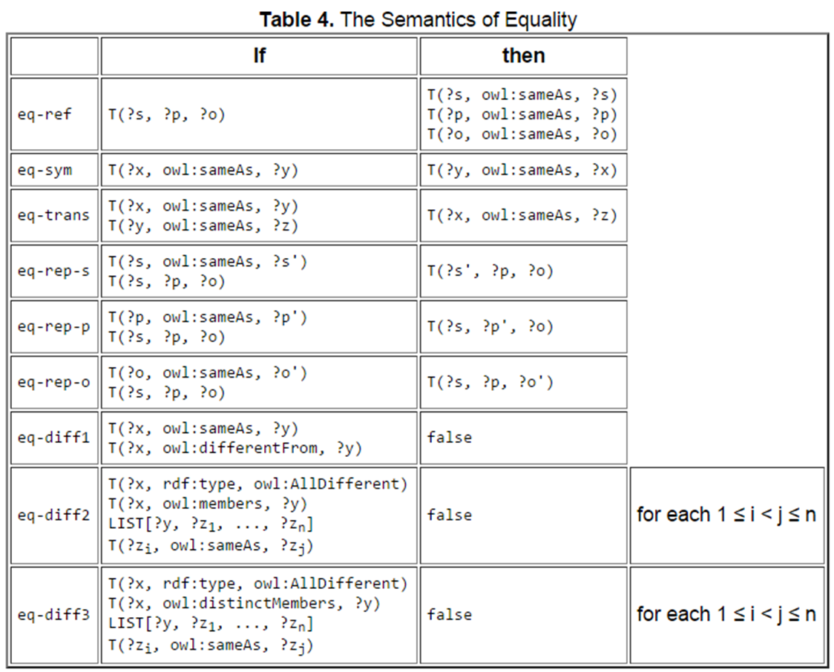
OWL 2 RL/RDF (rules for OWL) Equality

Slide 19
OWL 2 RL/RDF (rules for OWL) [Example] Property Axioms
What rule(s) could we use for owl:inverseOf?

Slide 20
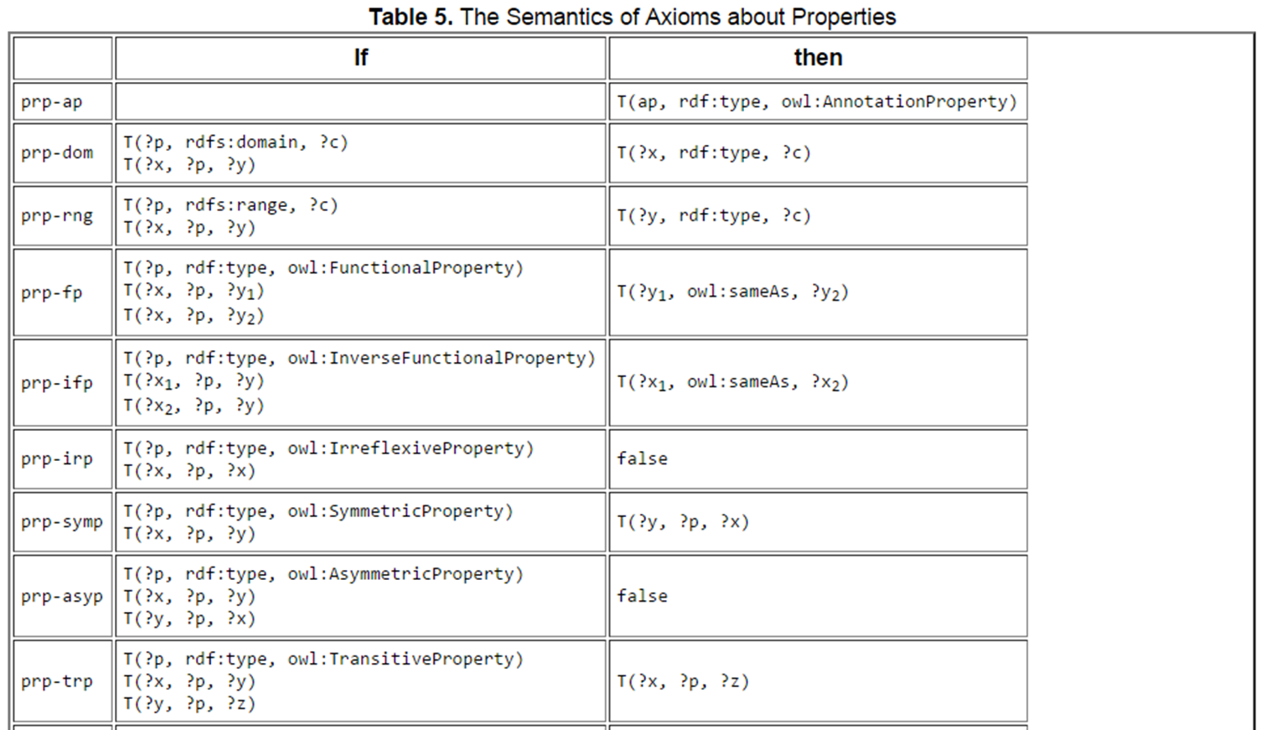
OWL 2 RL/RDF (rules for OWL) Property Axioms
…

Slide 21
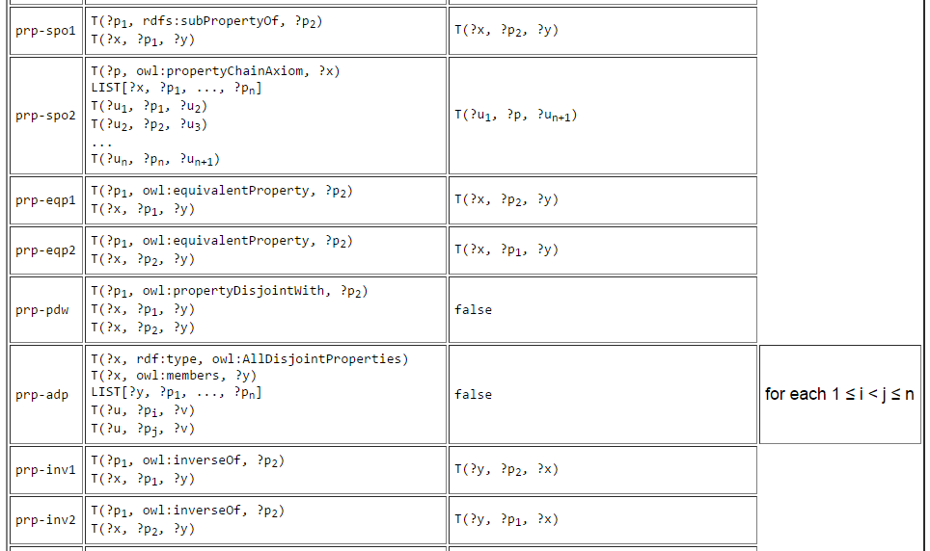
OWL 2 RL/RDF (rules for OWL) Property Axioms
…

Slide 22
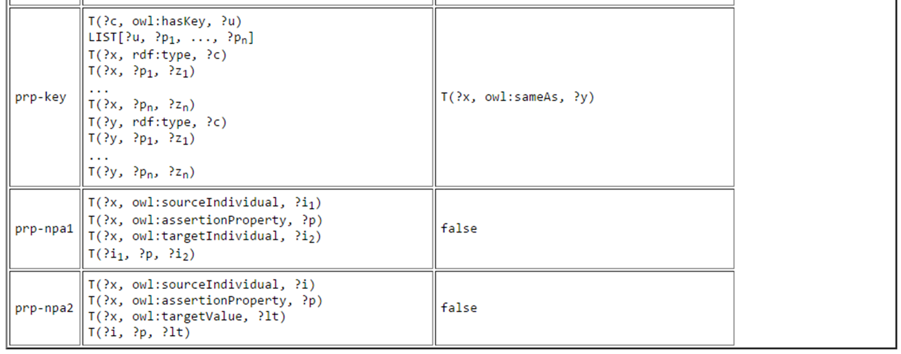
OWL 2 RL/RDF (rules for OWL) Property Axioms

Slide 23
OWL 2 RL/RDF (rules for OWL) [Example] Class Axioms
What rule(s) could we use for owl:disjointWith?
…

Slide 24
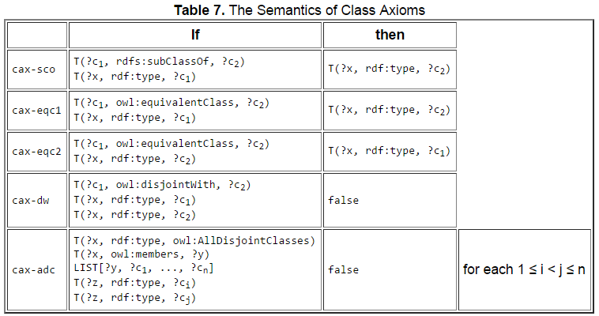
OWL 2 RL/RDF (rules for OWL) Class Axioms
…

Slide 25
OWL 2 RL/RDF (rules for OWL) [Example] Class definitions
What rule(s) could we use for owl:intersectionOf?
What rule(s) could we use for owl:allValuesFrom?

Slide 26
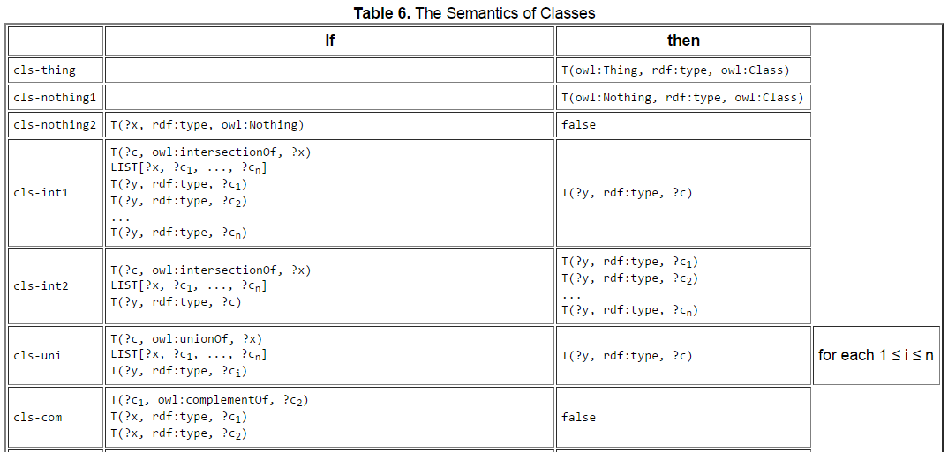
OWL 2 RL/RDF (rules for OWL) Class definitions
…

Slide 27
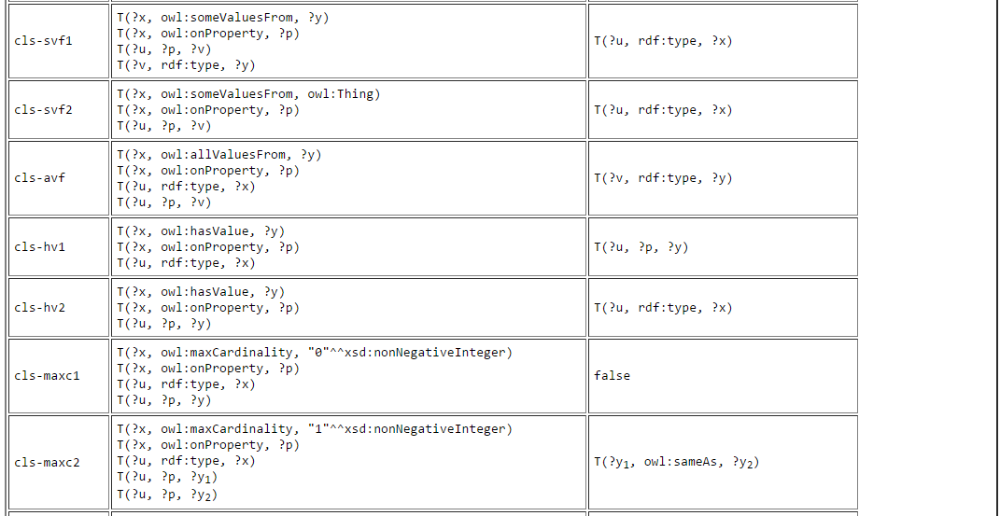
OWL 2 RL/RDF (rules for OWL) Class definitions
…

Slide 28
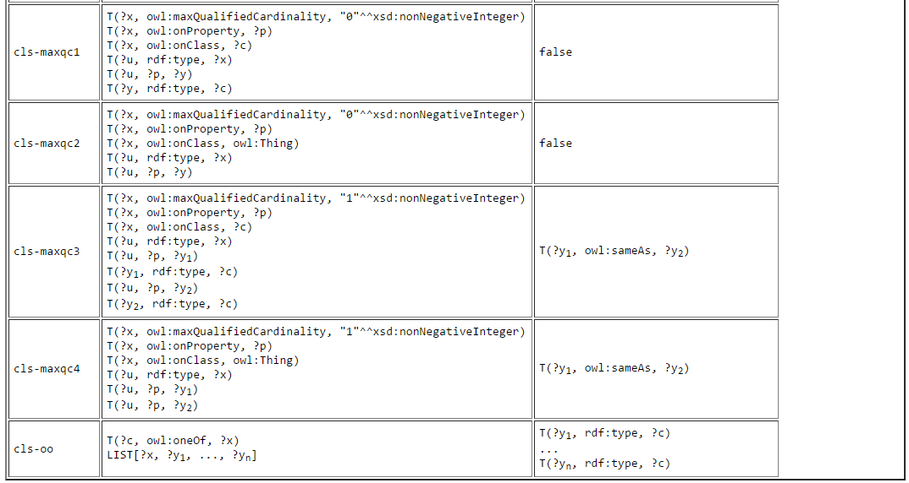
OWL 2 RL/RDF (rules for OWL) Class definitions

Slide 29
OWL 2 RL/RDF (rules for OWL) [Example] Schema
… but what other rule(s) are we missing for rdfs:subClassOf?
…

Slide 30
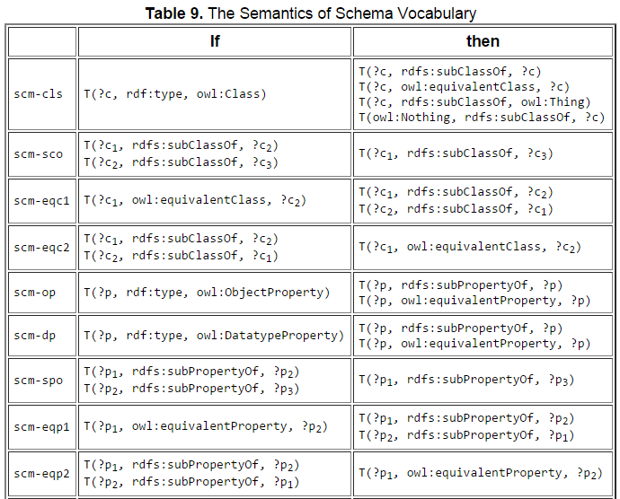
OWL 2 RL/RDF (rules for OWL) Schema
…

Slide 31
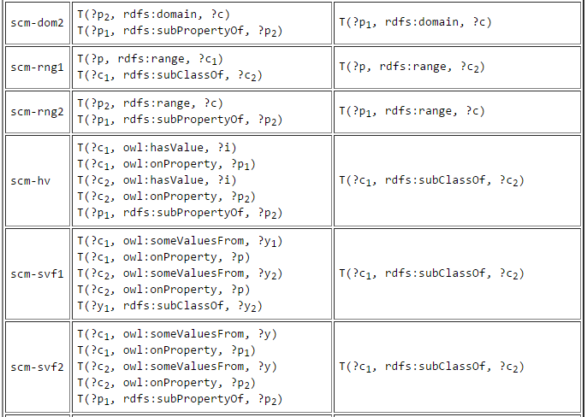
OWL 2 RL/RDF (rules for OWL) Schema
…

Slide 32
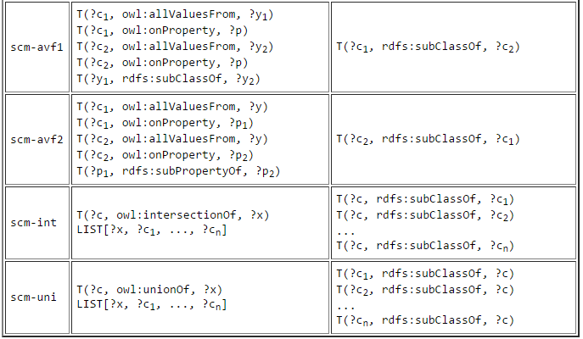
OWL 2 RL/RDF (rules for OWL) Schema

Slide 33
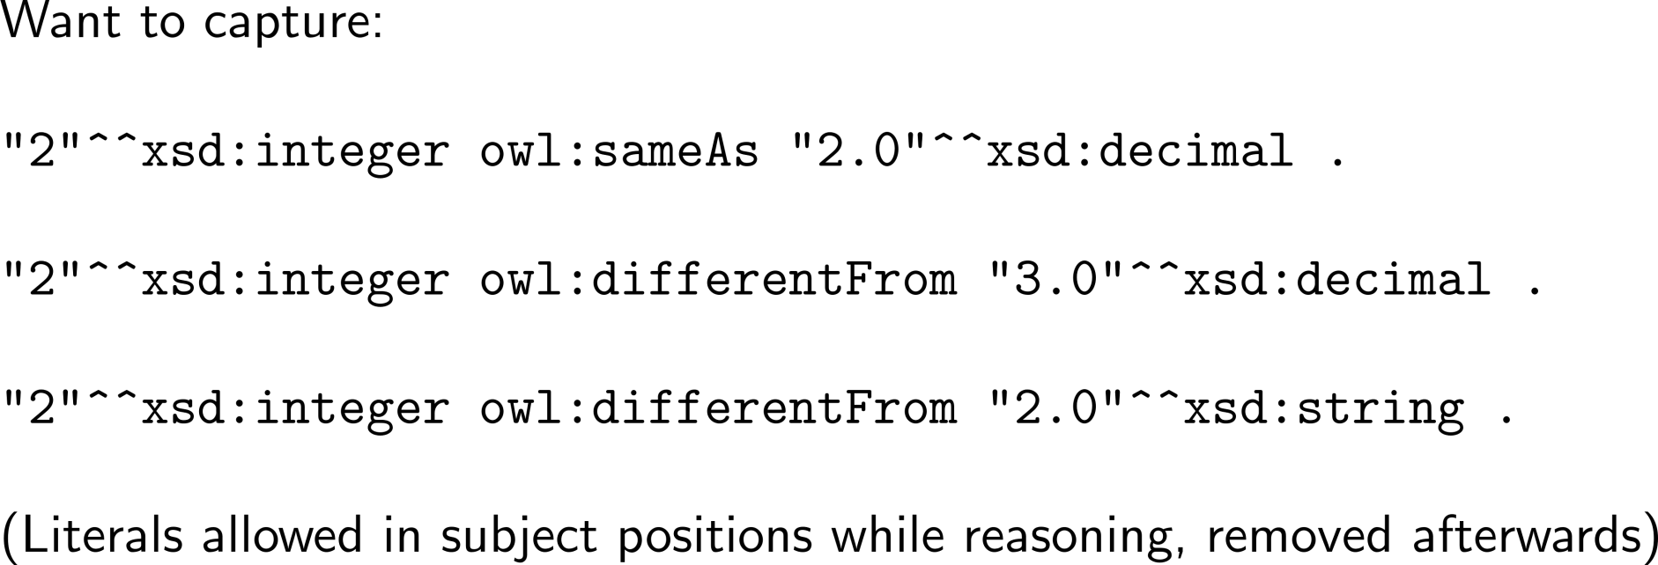
OWL 2 RL/RDF (rules for OWL) Datatypes

Slide 34
OWL 2 RL/RDF (rules for OWL) Datatypes

Slide 35
In the labs …
Applies these OWL 2 RL/RDF rules recursively until nothing new is found
http://www.w3.org/TR/owl2-profiles/#Reasoning_in_OWL_2_RL_and_RDF_Graphs_using_Rules
Data
Reasoner
(OWL 2 RL/RDF)
Entailments
Ontology

Slide 36
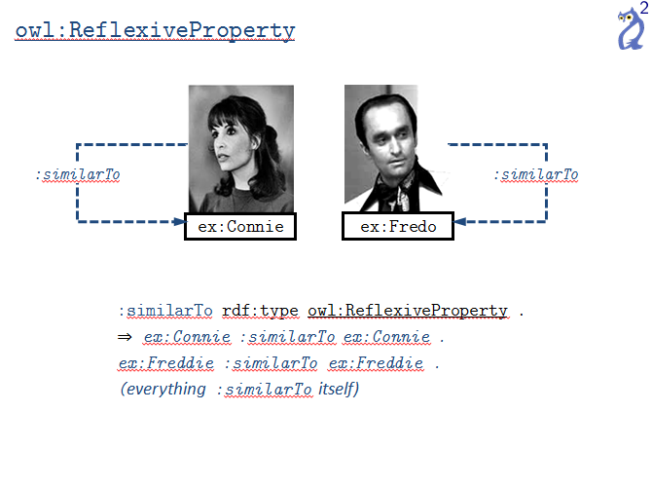
Why Incomplete? Missing Features

Slide 37
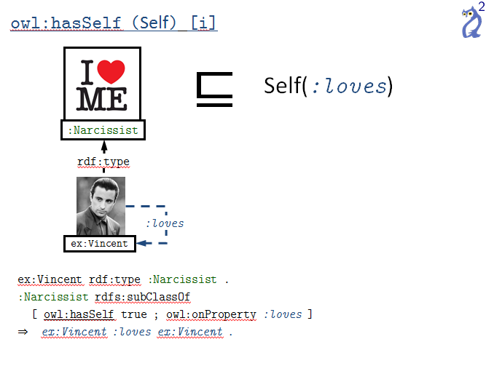
Why Incomplete? Missing Features

Slide 38
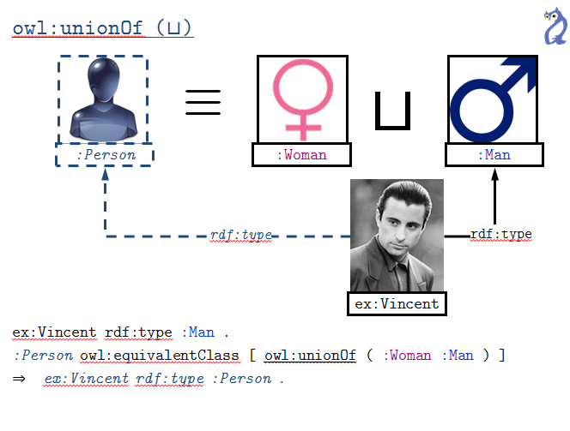
Why Incomplete? Incomplete for some Features

Slide 39
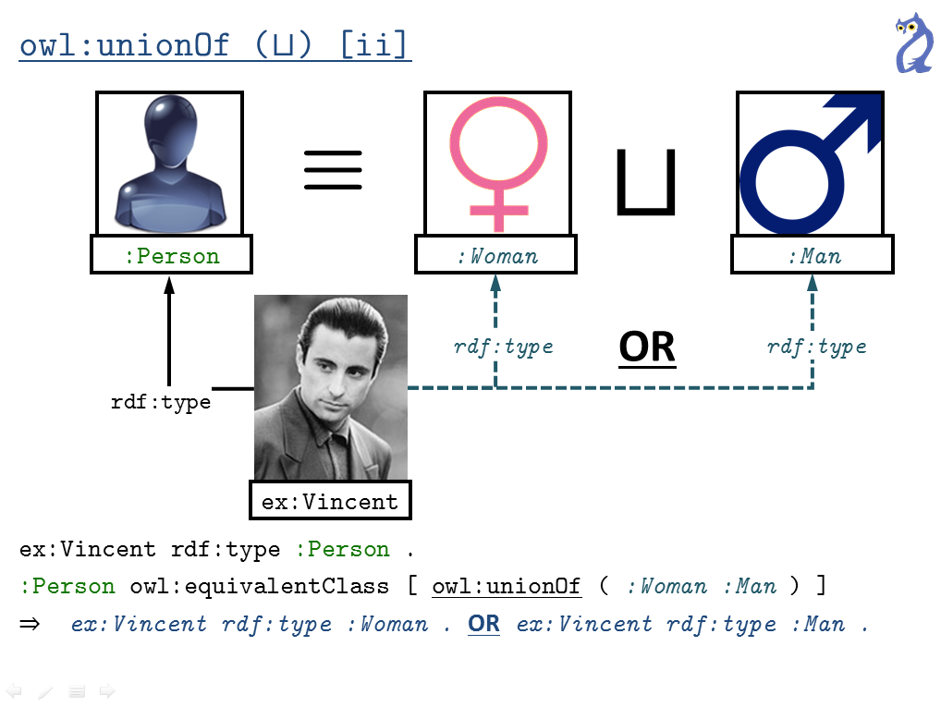
Why Incomplete? Incomplete for some Features

Slide 40
Why Incomplete? Incomplete for some Features
ex:Vincent rdf:type :Person , :Godfather .
:Godfather owl:disjointWith :Woman .
:Person owl:equivalentClass [ owl:unionOf ( :Woman :Man ) ]
⇒ ex:Vincent rdf:type :Man .

Slide 41
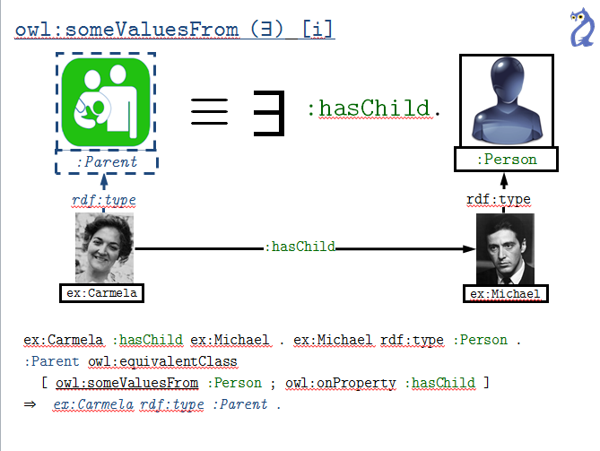
Why Incomplete? Incomplete for some Features

Slide 42
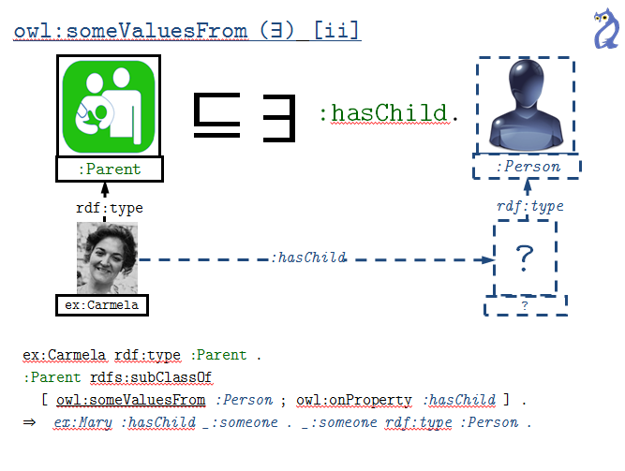
Why Incomplete? Incomplete for some Features

Slide 43
Why Incomplete? Incomplete for some Features
Worst Example of the Lecture Award
ex:Carmela rdf:type :Parent .
:Parent rdfs:subClassOf
[ owl:someValuesFrom :Person ; owl:onProperty :hasChild ] .
:hasChild rdfs:domain :PostPuberty .
⇒ ex:Carmela rdf:type :PostPuberty .

Slide 44
Why Incomplete? Incomplete for some Features
No support for min-cardinality
ex:Carmela :hasChild ex:Sonny , ex:Connie , ex:Fredo , ex:Michael .
ex:Sonny :dateOfBirth “1916-07-23”^^xsd:date .
ex:Connie :dateOfBirth “1922-04-18”^^xsd:date .
ex:Fredo :dateOfBirth “1919-01-08”^^xsd:date .
ex:Michael :dateOfBirth “1920-11-15”^^xsd:date .
:dateOfBirth rdf:type owl:FunctionalProperty .
[ owl:minCardinality 3 ; owl:onProperty :hasChild ] rdfs:subClassOf :StressedParent .
⇒ ex:Carmela rdf:type :StressedParent .

Slide 45
Why Incomplete? Incomplete for some Features
Limited support for max-cardinality
ex:Vincent rdf:type :Person ; :hasParent ex:Lucy, ex:Sonny, ex:Santino .
:Person rdfs:subClassOf [ owl:maxCardinality 2 ; owl:onProperty :hasParent ] .
ex:Lucy a :Woman . ex:Sonny a :Man . ex:Santino a :Man .
:Man owl:disjointWith :Woman .
⇒ ex:Sonny owl:sameAs ex:Santino .

Slide 46
Why Incomplete? Incomplete for some Features
No support for exact cardinality
Support also limited for qualified cardinalities

Slide 47
Why Incomplete? Missing Schema Inferences
Just some missing examples for inverse-of:
?a owl:inverseOf ?b . ⇒ ?b owl:inverseOf ?a .
?a owl:inverseOf ?a . ⇒ ?a rdf:type owl:SymmetricProperty .
?a rdf:type owl:SymmetricProperty . ⇒ ?a owl:inverseOf ?a .
?a owl:inverseOf ?b . ?b owl:inverseOf ?a . ⇒ ?a owl:equivalentProperty ?b .
?a owl:inverseOf ?b . ?b rdf:type owl:TransitiveProperty . ⇒ ?a rdf:type owl:TransitiveProperty .
?a owl:inverseOf ?b . ?b rdf:type owl:FunctionalProperty . ⇒ ?b rdf:type owl:InverseFunctionalProperty .
?a owl:inverseOf ?b . ?b rdfs:domain ?c . ⇒ ?a rdfs:range ?c .
…

Slide 48
owl:unionOf (⊔) [ii]
≡
⊔
:Person
:Woman
:Man
OR
rdf:type
rdf:type
rdf:type
ex:Vincent
ex:Vincent rdf:type :Person .
:Person owl:equivalentClass [ owl:unionOf ( :Woman :Man ) ]
⇒ ex:Vincent rdf:type :Woman . OR ex:Vincent rdf:type :Man .

Slide 49
Why is OWL 2 RL/RDF Incomplete?
Missing features:
owl:ReflexiveProperty, owl:hasSelf, owl:minCardinality …
Problems with disjunction (OR cases)
owl:unionOf, owl:oneOf, owl:maxCardinality, …
Problems with existentials
owl:someValuesFrom, owl:minCardinality, ...
Problems with counting
owl:minCardinality, …
Problems with negation
owl:disjointWith, owl:propertyDisjointWith, owl:complementOf …
Incomplete “schema” inferences

Slide 50
Finite rules not enough
Could write a rule for any non-existential case
Infinite such rules (have to stop somewhere)
ex:Vincent rdf:type :Person ; :hasParent ex:Lucy, ex:Sonny, ex:Santino .
:Person rdfs:subClassOf [ owl:maxCardinality 2 ; owl:onProperty :hasParent ] .
ex:Lucy a :Woman . ex:Sonny a :Man . ex:Santino a :Man .
:Man owl:disjointWith :Woman .
⇒ ex:Sonny owl:sameAs ex:Santino .
?w rdf:type ?c ; ?p ?x , ?y , ?z .
?c owl:maxCardinality 2 ; owl:onProperty ?p .
?x owl:differentFrom ?y , ?z .
⇒ ?y owl:sameAs ?z .

Slide 51
Existential rules are dangerous
Could write rules for existential cases too
Might lead to materialising ∞ entailments
(In this case if ?x rdf:type ?d . ⇒ ?x rdf:type ?c .)
ex:Mary rdf:type :Person .
:Person rdfs:subClassOf [ owl:someValuesFrom :Person ; owl:onProperty :hasParent ] .
⇒ ex:Mary :hasParent _:x1 . _:x1 rdf:type :Person .
_:x1 :hasParent _:x2 . _:x2 rdf:type :Person .
… ∞
?x rdf:type ?c .
?c owl:someValuesFrom ?d ; owl:onProperty ?p .
⇒ ?x ?p _:b . _:b rdf:type ?d .

Slide 52
complete reasoners that MAY NOT halt

Slide 53
Complete reasoners that may not halt: Quite Practical!
Cons:
Erm … reasoner may never halt
Pros:
Avoid complicated decidability restrictions!
What might the “pros” be in this case?
Imagine restricting C or Java to be decidable
Don’t allow features like loops/recursion
But not all programs with loops/recursion fail to halt!
Restrict how features like loops/recursion can be used
More detailed restrictions allow more programmes but are more complicated to understand ☹

Slide 54
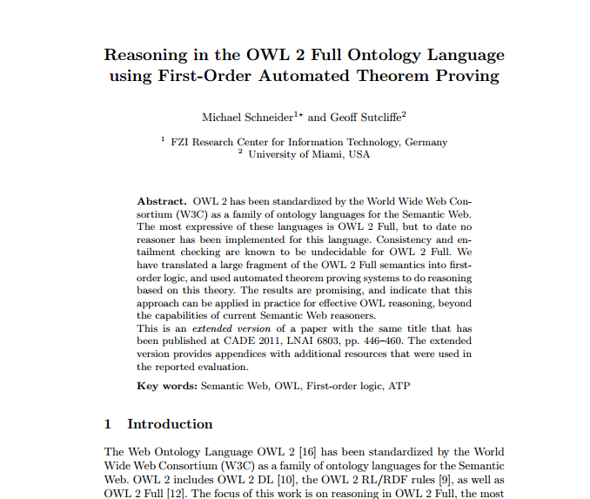
Complete reasoners that may not halt: Rare in practice
Only line of work on this I know of:
not going to talk about this but good to know about! ☺

Slide 55
RESTRICT OWL TO GUARANTEE DECIDABILITY

Slide 56
Recap …
Accept incomplete reasoners that halt
Complete language, incomplete reasoning, halts
Accept complete reasoners that may not halt
Complete language, complete reasoning, may not halt
Restrict OWL so reasoning becomes decidable
Restricted language, complete reasoning, halts
Core idea:
Restrict OWL so that complete reasoning is decidable over
any ontology written within those restrictions

Slide 57
Restrict OWL to guarantee decidability: How to guarantee decidability?
We’ve seen how to prove that something is undecidable
Most commonly: give an algorithm that halts …
How can we prove that something is decidable?

Slide 58
Restrict OWL to guarantee decidability: How to guarantee decidability?
Focus on satisfiability/entailment checking
Recall: Can (usually) reduce entailment to satisfiability
(So long as we can do negation in the language)

Slide 59
Restrict OWL to guarantee decidability: Sublanguages of OWL 2
Description Logic community
Predates OWL
Looks at decidable subsets of First Order Logic
Results can be applied to OWL!
OWL 2 Full: The unrestricted, undecidable language
OWL 2 DL: A restricted, decidable version

Slide 60
Restrict OWL to guarantee decidability: Sublanguages of OWL 2
What is restricted?

Slide 61
Restrict OWL to guarantee decidability: Sublanguages of OWL 2
What is restricted?
For example, OWL 2 DL restricts:
functional properties to be “simple” (no chains, no transitivity)

Slide 62
Restrict OWL to guarantee decidability: Sublanguages of OWL 2
What is restricted?
For example, OWL 2 DL restricts:
functional properties to be “simple” (no chains, no transitivity)
likewise properties used with hasSelf, cardinalities, inverse functionality, asymmetry and irreflexivity must be simple
inverse functional properties must be object properties
need to follow specific RDF syntax and explicitly declare classes, object properties (with IRI values), datatype properties (with literal values)
… more (it’s really quite messy ☹)

Slide 63
Restrict OWL to guarantee decidability: On the plus side …
OWL 2 DL still supports disjunction, existentials, counting, negation!
ex:Vincent rdf:type :Person , :Godfather .
:Godfather owl:disjointWith :Woman .
:Person owl:equivalentClass [ owl:unionOf ( :Woman :Man ) ] .
⊧ ex:Vincent rdf:type :Man .

Slide 64
Restrict OWL to guarantee decidability: On the plus side …
OWL 2 DL still supports disjunction, existentials, counting, negation!
ex:Carmela rdf:type :Parent .
:Parent rdfs:subClassOf
[ owl:someValuesFrom :Person ; owl:onProperty :hasChild ] .
:hasChild rdfs:domain :PostPuberty .
⊧ ex:Carmela rdf:type :PostPuberty .

Slide 65
Restrict OWL to guarantee decidability: On the plus side …
OWL 2 DL still supports disjunction, existentials, counting, negation!
ex:Carmela :hasChild ex:Sonny , ex:Connie , ex:Fredo , ex:Michael .
ex:Sonny :dateOfBirth “1916-07-23”^^xsd:date .
ex:Connie :dateOfBirth “1922-04-18”^^xsd:date .
ex:Fredo :dateOfBirth “1919-01-08”^^xsd:date .
ex:Michael :dateOfBirth “1920-11-15”^^xsd:date .
:dateOfBirth rdf:type owl:FunctionalProperty .
[ owl:minCardinality 3 ; owl:onProperty :hasChild ] rdfs:subClassOf :StressedParent .
⊧ ex:Carmela rdf:type :StressedParent .

Slide 66
Restrict OWL to guarantee decidability: An algorithm for OWL 2 DL
What sort of algorithm can we use?
One answer: Tableau (positive sketch below)
ex:Vincent rdf:type :Person , :Godfather .
:Godfather owl:disjointWith :Woman .
:Person owl:equivalentClass [ owl:unionOf ( :Woman :Man ) ] .
⊧ ex:Vincent rdf:type :Man .

Slide 67
Restrict OWL to guarantee decidability: An algorithm for OWL 2 DL
What sort of algorithm can we use?
One answer: Tableau (positive sketch below)
ex:Vincent rdf:type :Person , :Godfather .
:Godfather owl:disjointWith :Woman .
:Person owl:equivalentClass [ owl:unionOf ( :Woman :Man ) ] .
¬ ex:Vincent rdf:type :Man .
ex:Vincent rdf:type :Person , :Godfather .
:Godfather owl:disjointWith :Woman .
ex:Vincent rdf:type Man .
¬ ex:Vincent rdf:type :Man .
ex:Vincent rdf:type :Person , :Godfather .
:Godfather owl:disjointWith :Woman .
ex:Vincent rdf:type Woman .
¬ ex:Vincent rdf:type :Man .

Slide 68
Restrict OWL to guarantee decidability: An algorithm for OWL 2 DL
What sort of algorithm can we use?
One answer: Tableau (negative sketch below)
ex:Vincent rdf:type :Person , :Godfather .
:Godfather owl:disjointWith :Woman .
:Person owl:equivalentClass [ owl:unionOf ( :Woman :Man ) ] .
⊧ ex:Vincent rdf:type :Woman .

Slide 69
Restrict OWL to guarantee decidability: An algorithm for OWL 2 DL
What sort of algorithm can we use?
One answer: Tableau (negative sketch below)
ex:Vincent rdf:type :Person , :Godfather .
:Godfather owl:disjointWith :Woman .
:Person owl:equivalentClass [ owl:unionOf ( :Woman :Man ) ] .
¬ ex:Vincent rdf:type :Woman .
ex:Vincent rdf:type :Person , :Godfather .
:Godfather owl:disjointWith :Woman .
ex:Vincent rdf:type Man .
¬ ex:Vincent rdf:type :Woman .
ex:Vincent rdf:type :Person , :Godfather .
:Godfather owl:disjointWith :Woman .
ex:Vincent rdf:type Woman .
¬ ex:Vincent rdf:type :Woman .

Slide 70
Restrict OWL to guarantee decidability: An algorithm for OWL 2 DL!
We have a complete algorithm that halts and that supports a lot of the OWL features!

Slide 71
Restrict OWL to guarantee decidability: An algorithm for OWL 2 DL!
A few problems:
We have to give the entailments to check
Cannot just ask to compute the entailments
Restrictions are complicated
Very complicated
And often are broken by real-world ontologies
Tableau reasoning is really expensive
Branch for every disjunction suggests exponential
N2EXPTIME-complete (!!?!!!)
on a non-deterministic machine
…

Slide 72
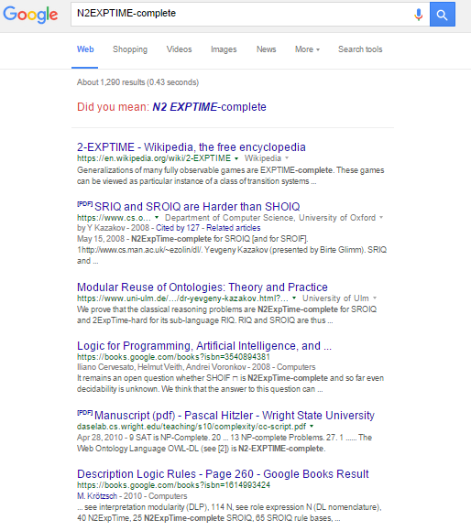
N2EXPTIME-Complete so nasty …
The only results returned by Google relate to OWL

Slide 73
N2EXPTIME-Complete (OWL 2 DL’s small print) …
Checking entailment is guaranteed to halt for OWL 2 DL restricted ontologies*
* halt may not occur before heat death of the universe

Slide 74
OWL 2 DL performance considerations
Not all OWL 2 DL ontologies will run into worst-cases
Entailments will work fine for most small ontologies
Scalability still a real issue in practice

Slide 75
OWL 2 Profiles (briefly)
More efficient sublanguages of OWL 2 DL
More restrictions to allow complete reasoning with more efficient algorithms
OWL 2 RL: A restriction of OWL 2 DL such that OWL 2 RL/RDF rules provide complete reasoning (in some sense we won’t get into)
OWL 2 EL: Tractable algorithm for classifying ontologies
OWL 2 QL: Tractable algorithm based on rewriting SQL queries

Slide 76
IMPRESSIONS …

Slide 77
Opinion of lots of people in the Semantic Web with respect to OWL …

Slide 78
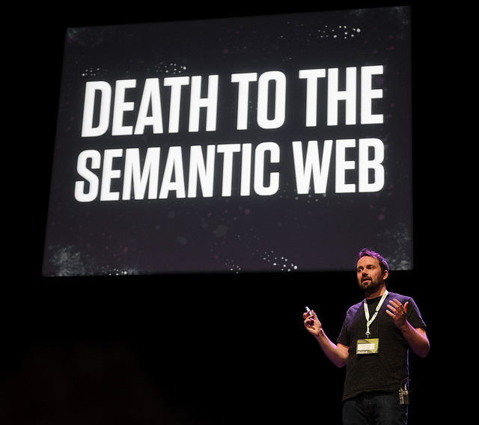
Also perhaps part of the reason why you see things like …

Slide 79
Is OWL good for the Semantic Web?
It provides formal foundations for semantics
Indicates what’s possible, what’s not with respect to machine-readable semantics
What’s efficient, what’s not
Offers options: OWL 2 RL/EL/QL/DL/Full
Drives many applied/practical people crazy
Some theoretical folks also consider it to have poor aesthetic
Makes lots of bad assumptions for the Web
Not scalable
Strict in what it accepts
Blindly accepting
What do you think?

Slide 80
If we have time …
Let’s model a domain …

Slide 81
RECAP …

Slide 82
Coping with undecidability (reasoning) …
Accept incomplete reasoners that halt
Complete language, incomplete reasoning, halts
e.g., OWL 2 RL/RDF rules can be applied on any RDF data using any OWL features in any way, but may not get all inferences
Accept complete reasoners that may not halt
Complete language, complete reasoning, may not halt
e.g., can use a first-order-theorem prover, but it may run forever on some input ontologies
Restrict OWL so reasoning becomes decidable
Restricted language, complete reasoning, halts
e.g., can restrict the OWL 2 Full language to sublanguages that have decidable/tractable reasoning algorithms

Slide 83
OWL 2 RL/RDF rules
What we’ve been using in the labs
Rules supporting a lot of OWL
but incomplete
Can be run over any RDF/OWL data
no restrictions needed!
Can materialise entailments
Relatively efficient in practice
Easy to implement, not so hard to understand

Slide 84
OWL 2 Full / Complete reasoning
Not a lot of work
One proposal using a First-Order-Logic theorem prover

Slide 85
OWL 2 DL
Restrict OWL 2 Full to make entailment/satisfiability checking decidable
Complete reasoning with respect to ontologies following restrictions
Supports some pretty complex entailments
Will always halt with a correct answer eventually
Very bad worst-case: 2NEXPTIME-Complete
May not halt before end of universe
Worst-cases might be rare, but scalability and compute times still often encountered in practice
Need to ask if something specific is entailed
Cannot materialise “all” entailments
Restrictions make the whole thing nasty to understand

Slide 86
OWL 2 Profiles
More efficient sublanguages of OWL 2 DL
More restrictions to allow complete reasoning with more efficient algorithms
OWL 2 RL: A restriction of OWL 2 DL such that OWL 2 RL/RDF rules provide complete reasoning (in some sense)
OWL 2 EL: Tractable algorithm for classifying ontologies
OWL 2 QL: Tractable algorithm based on rewriting SQL queries

Slide 87
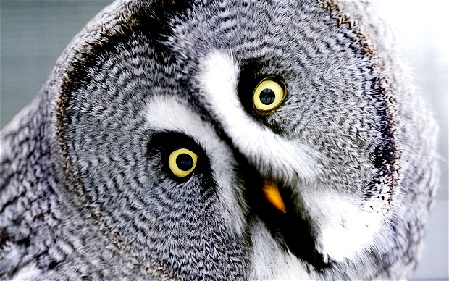
End of main OWL part (after next lab)
… rest of material should be easier / more applied
(but I hope you learned something about why telling machines stuff about the world is hard)

Slide 88
No lecture/lab next week (Oct. 12/14)

Slide 89
Questions?

