Slide 1
CC5212-1 Procesamiento Masivo de Datos Otoño 2023 Lecture 12 Conclusion
Aidan Hogan
aidhog@gmail.com

Slide 2
Distributed Static
Data Processing
Distributed Dynamic
Data Processing
Distr. Unstructured
Data Management
Distr. (Semi-)structured
Data Management
Distributed Data Processing
Distributed Data Management
Distributed Systems
Local Data Processing

Slide 3
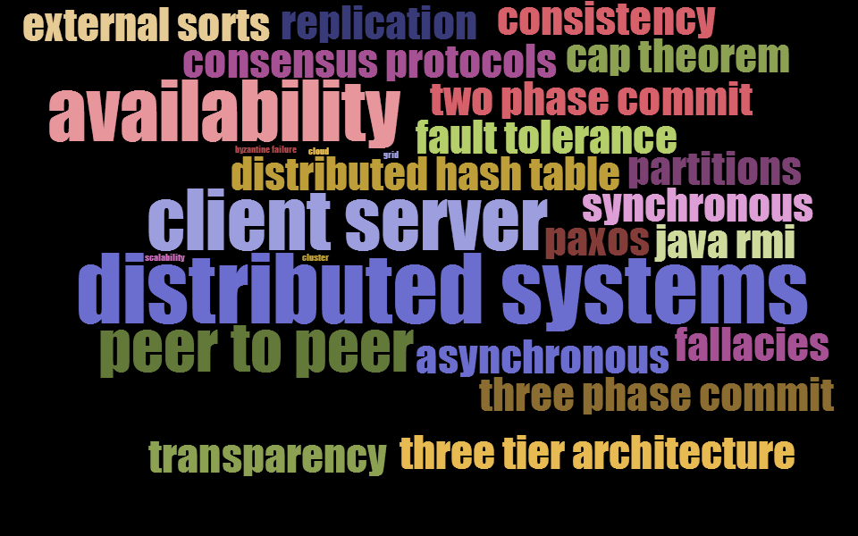
Distributed Systems

Slide 4
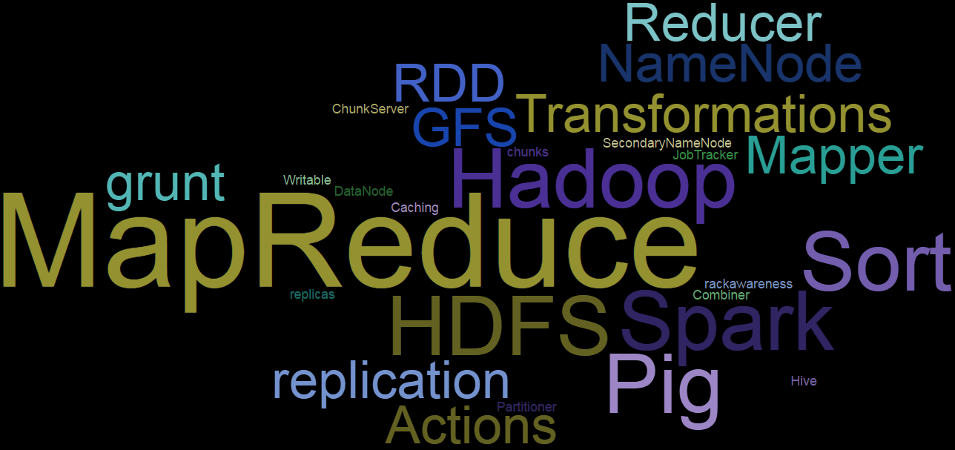
Hadoop/MapReduce/Pig/Spark: Processing Un/Structured Information

Slide 5
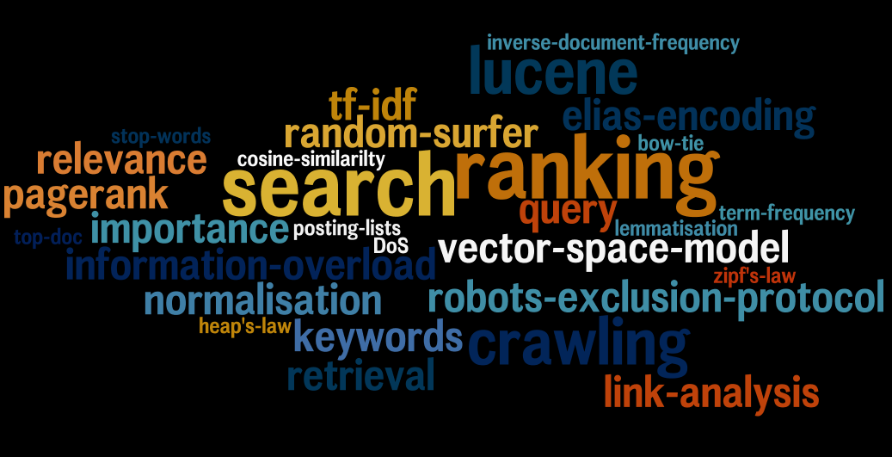
Information Retrieval: Storing Unstructured Information

Slide 6
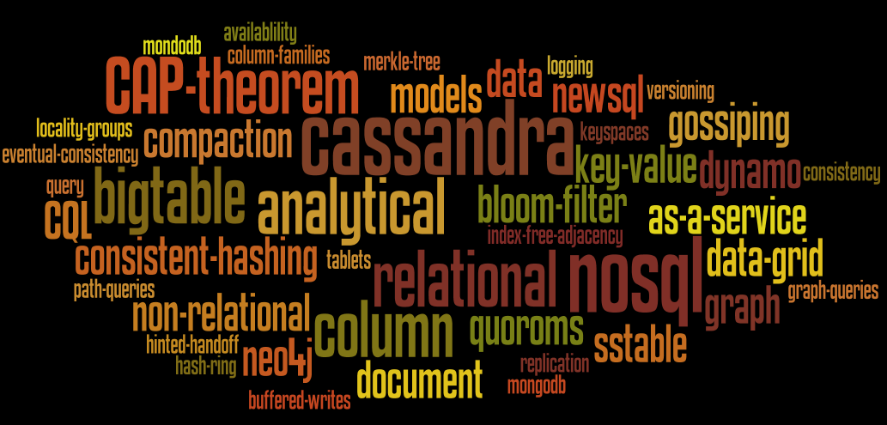
NoSQL: Storing (Semi-)Structured Information

Slide 7
Full-Circle

Slide 8
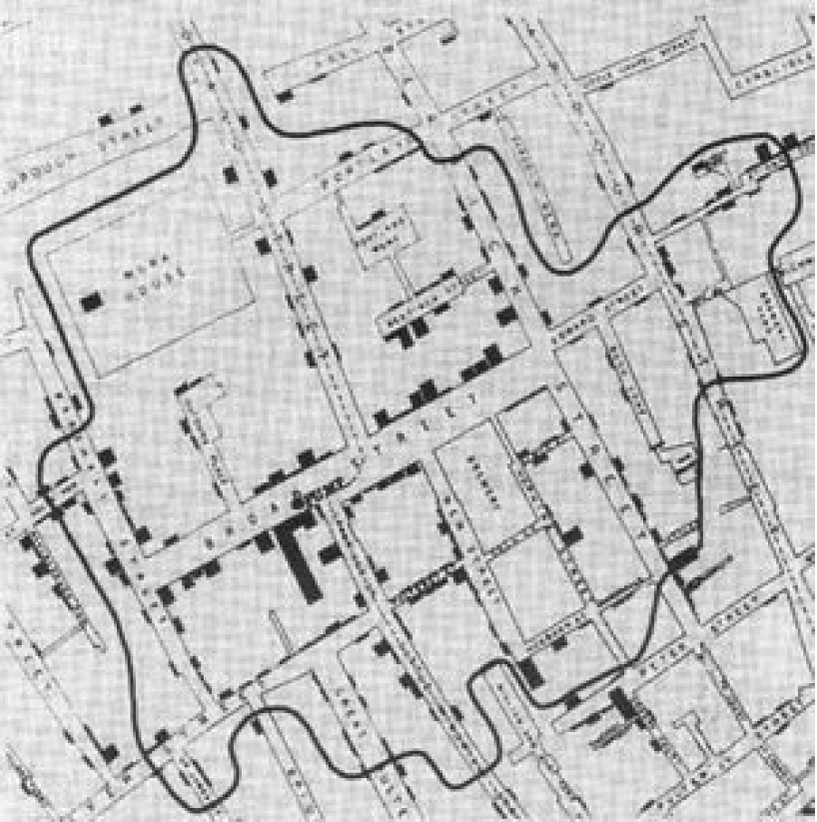
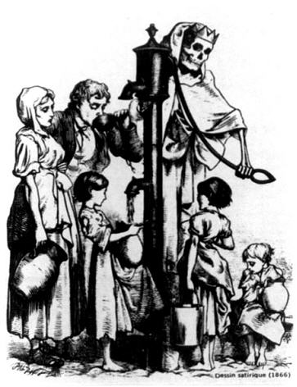
The value of data …

Slide 9
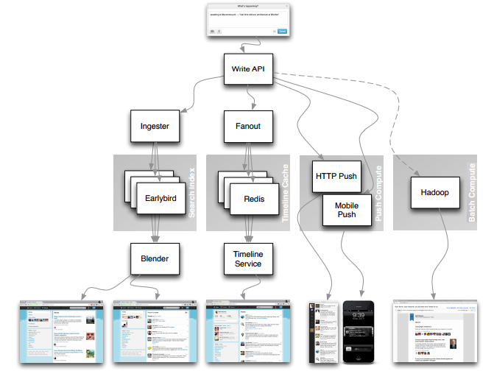
Twitter architecture

Slide 10
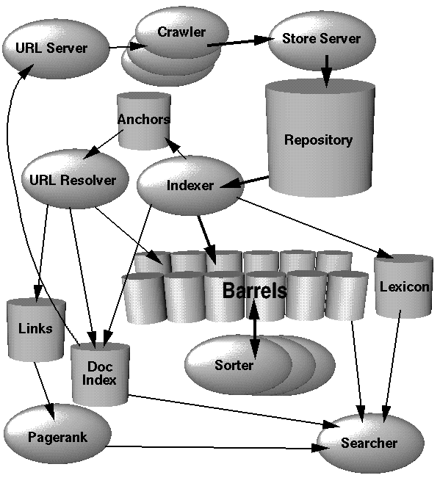
Google architecture

Slide 11
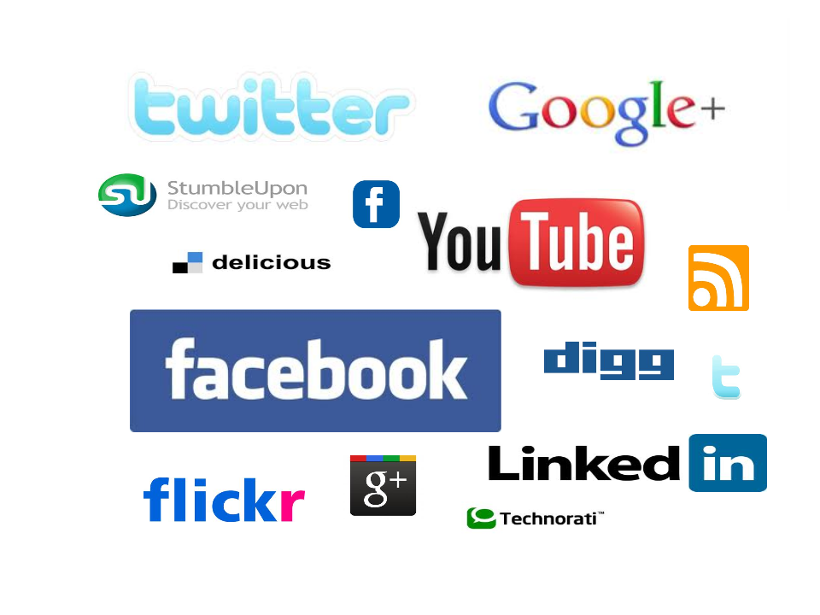
Generalise concepts to …

Slide 12
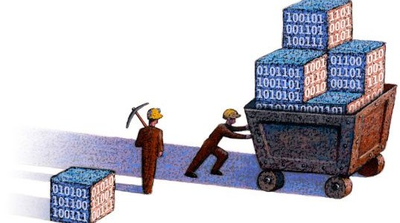
Working with large datasets

Slide 13
Value and challenges of distribution

Slide 14
Frameworks
For Distrib. Processing
For Distrib. Storage

Slide 15
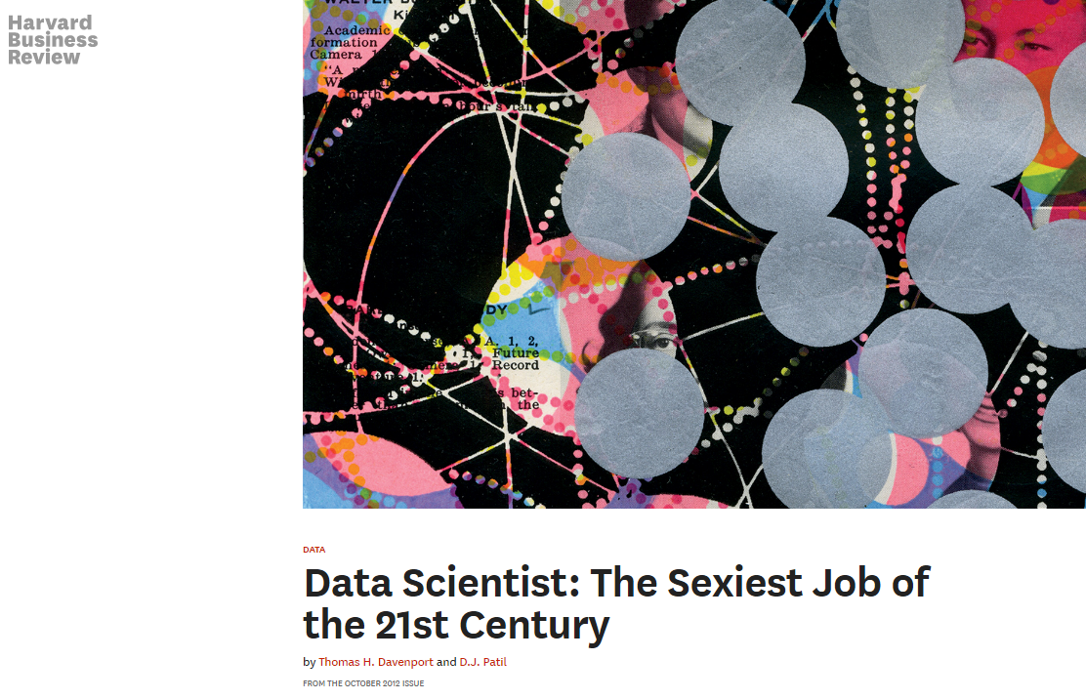
"Data Science"

Slide 16
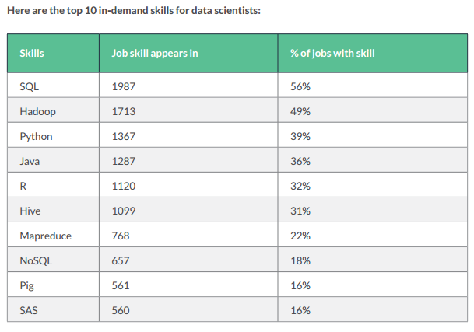
“Data Scientist” Job Postings (2016)
http://visit.crowdflower.com/rs/416-ZBE-142/images/CrowdFlower_DataScienceReport_2016.pdf

Slide 17
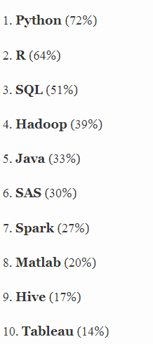
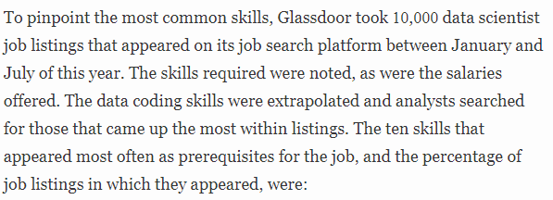
“Data Scientist” Job Postings (2017)
https://www.forbes.com/sites/karstenstrauss/2017/09/21/becoming-a-data-scientist-the-skills-that-can-make-you-the-most-money/

Slide 18
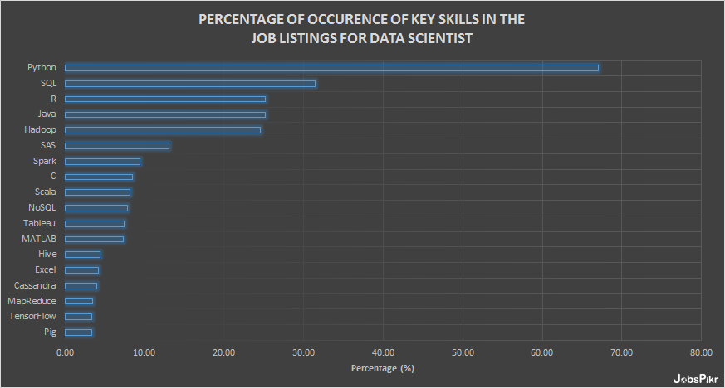
“Data Scientist” Job Postings (2018)
https://www.jobspikr.com/blog/job-data-analysis-reveals-top-skills-required-for-data-science-role/

Slide 19
“Data Scientist” Job Postings (2019)
https://towardsdatascience.com/the-most-in-demand-tech-skills-for-data-scientists-d716d10c191d/

Slide 20
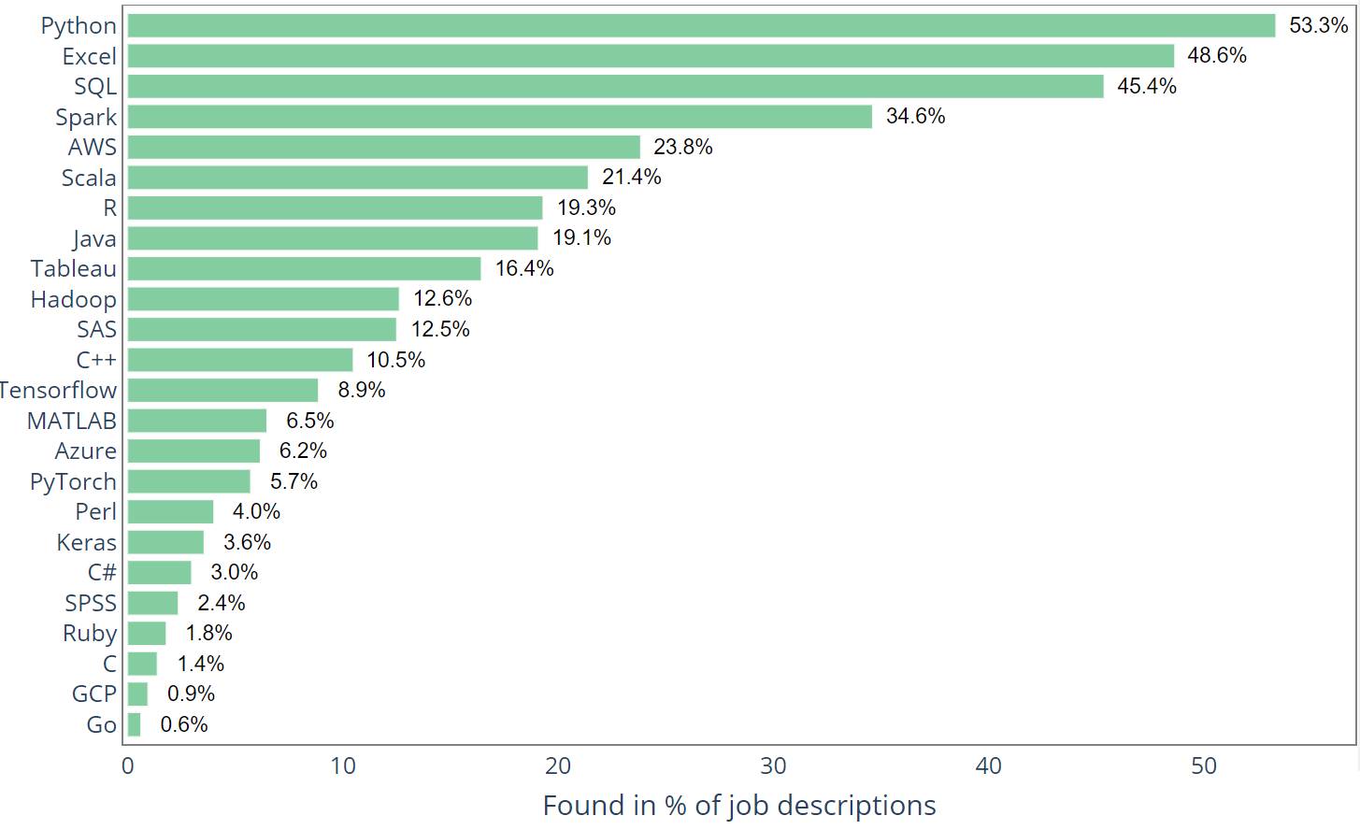
“Data Scientist” Job Postings (2020)
https://medium.com/@chihhsulin/5-500-data-scientist-jobs-report-2020-adefe1d364d3

Slide 21
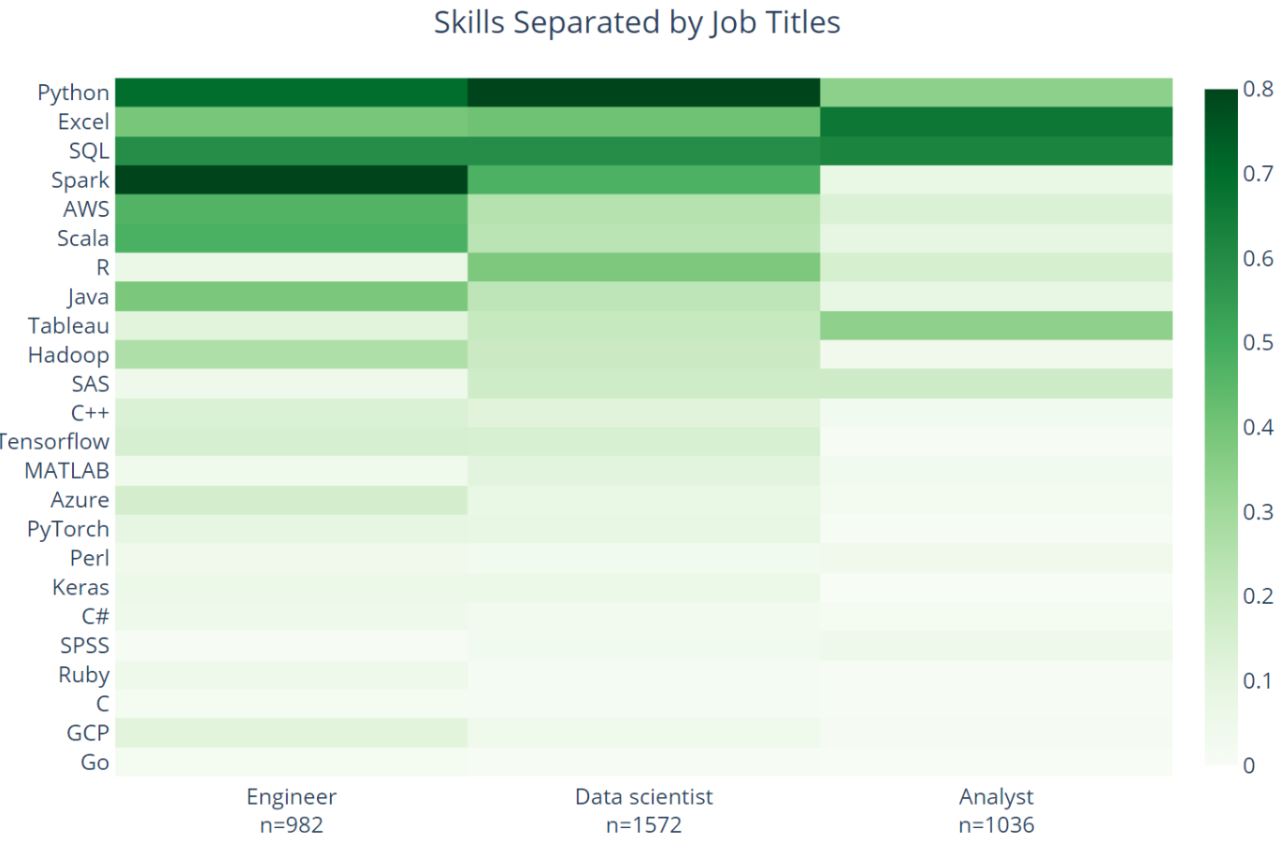
“Data Scientist” Job Postings (2020)
https://medium.com/@chihhsulin/5-500-data-scientist-jobs-report-2020-adefe1d364d3

Slide 22
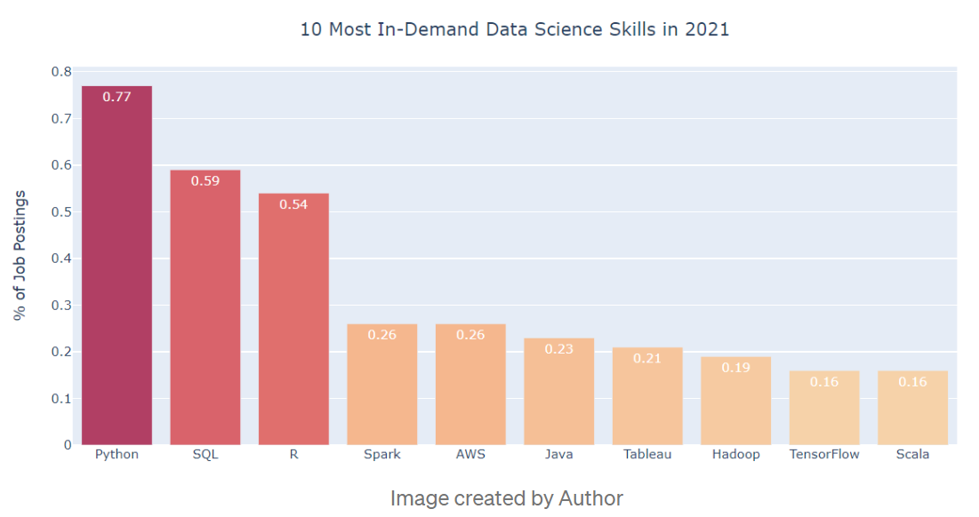
“Data Scientist” Job Postings (2021)

Slide 23
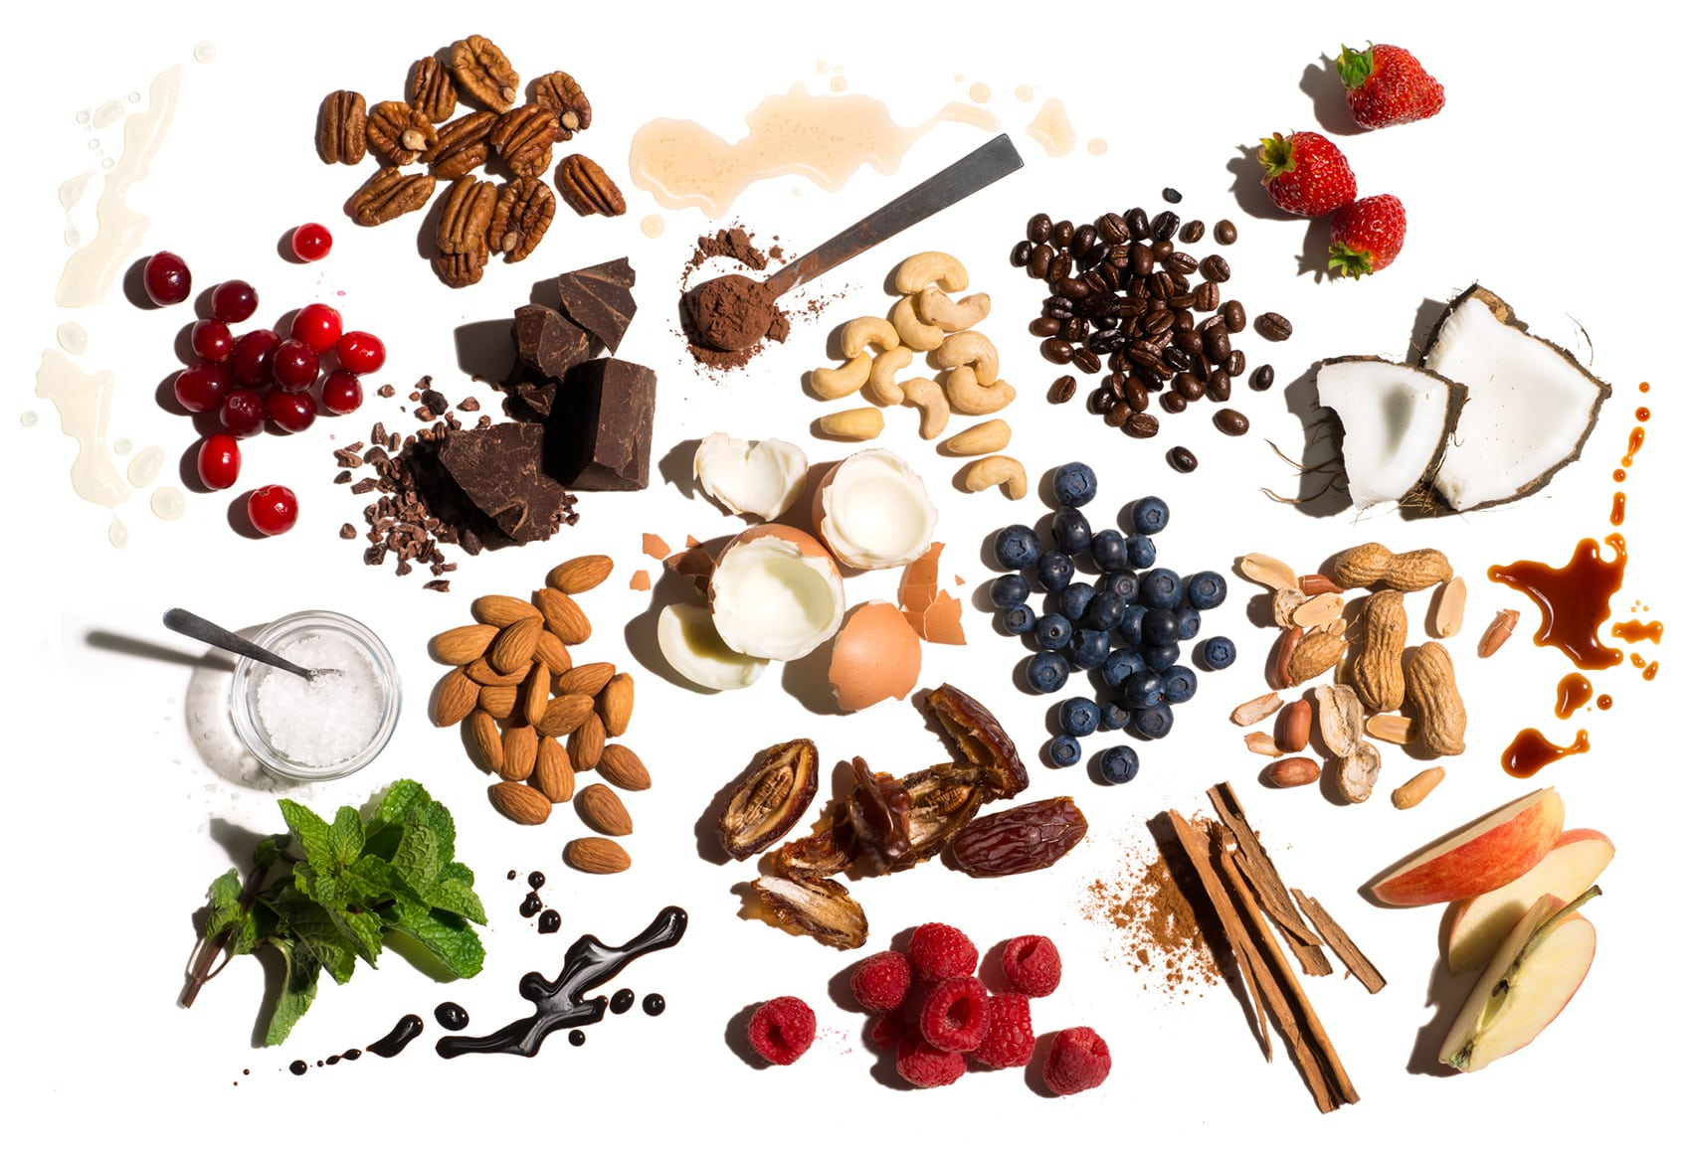

Slide 24
Important goal ...

Slide 25
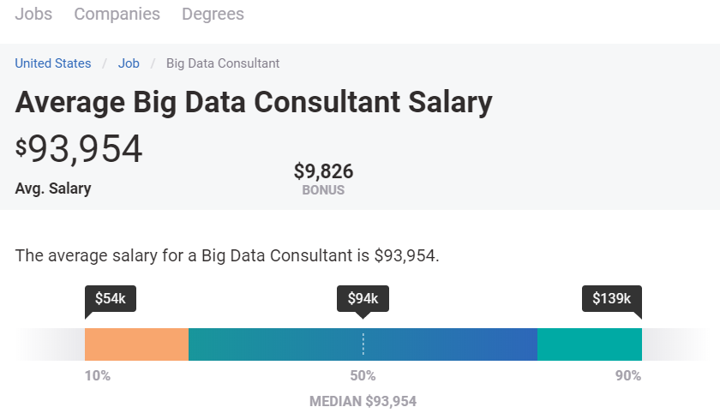

Slide 26
I have crawled thirty million job postings.
I want to perform a word count.
What should I use?
Should fit in memory, no problem!
Local machine, in memory
Otherwise: Spark
It would be slower on MapReduce

Slide 27
My website has 120 million users.
Each user has personal profile data, photos, and friends.
I have 12 machines available.
What should I use to answer queries for generating my site’s webpages?
Requests will be of a standard type. Replication and scale is important!
NoSQL Key-Value/Document (e.g., Cassandra, MongoDB)

Slide 28
My company has 30,000 employees.
We need to store and query info about bank accounts, insurance, etc.
What should I use?
Scale is not an issue. Queries might be quite diverse. Reliability/ACID important!
Relational Database Management System (e.g., MySQL, Postgres, etc.)

Slide 29
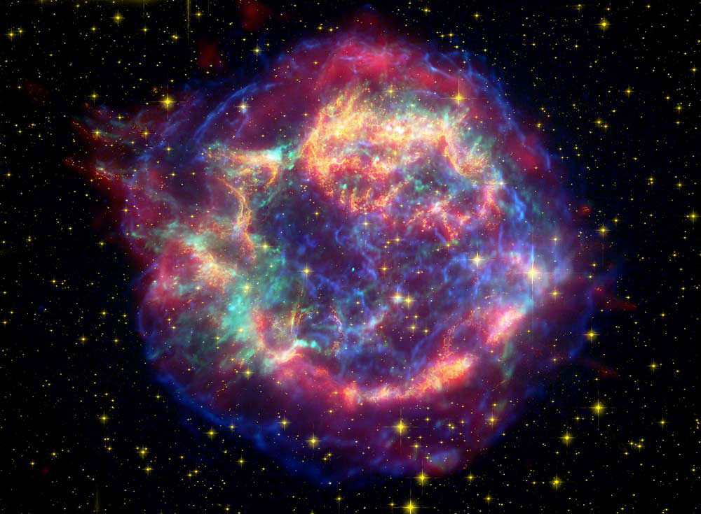
My telescope is generating millions of images of the sky every night, but I'm
only interested in finding some images that may indicate supernovae.
What should I use?
We need to process, filter and redirect dynamic data to the right place.
Streaming platform (e.g., Kafka)

Slide 30
I am scraping data about video games and their characters from various wikis.
In total I have scraped information from about one million pages and now I want to be able to search over what I have, for example, to find all non-human characters in a particular video game, or platforming games featuring plumbers.
What should I use?
Need flexible schema but also expressive query language.
Document store (e.g., MongoDB, Elasticsearch)
Graph database (e.g., Neo4j)

Slide 31
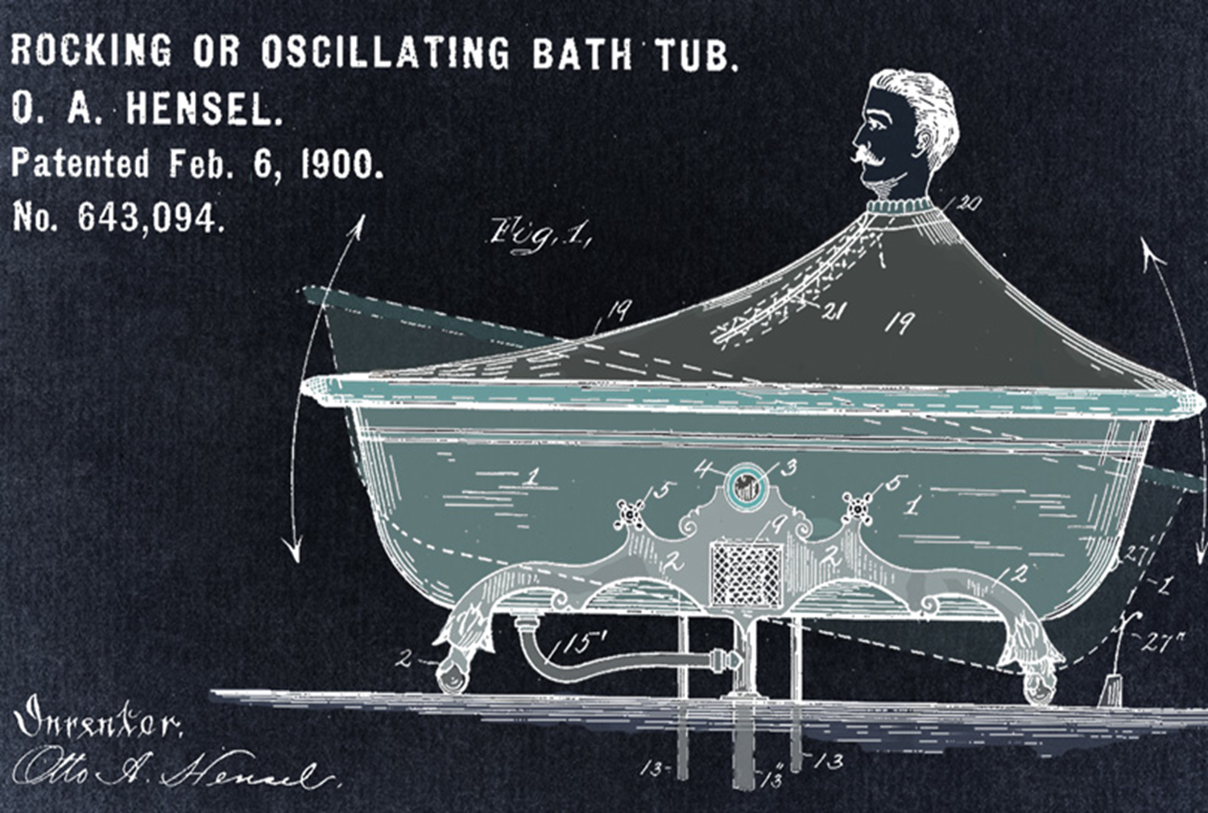
I have descriptions of millions of patents and I want to create a system to find the key patents relating to a given technology or application.
We need keyword search with ranking!
Inverted Indexes (e.g., Lucene, Elasticsearch, Solr)
Relevance ranking (TF-IDF)
Importance ranking (PageRank)

Slide 32
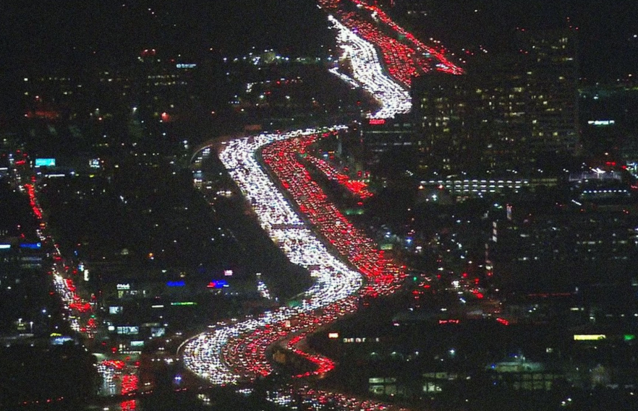
Given GPS/billing info of mobile phones, weather updates, accident reports, time
of day, historical data and city maps, I want to plan the best routes from A to B.
What should I use?
We need to process various sources of both static and dynamic data!
Streaming platform (e.g., Kafka)

Slide 33
I have information about tens of millions of papers and millions of movies and
I want to compute the Erdős–Bacon numbers for all people.
What should I use?
We need to process a large graph. It would be good to use multiple machines.
MapReduce, Spark (better Spark as the process is recursive)
Or even better a graph processing framework (e.g., Giraph, GraphX)

Slide 34
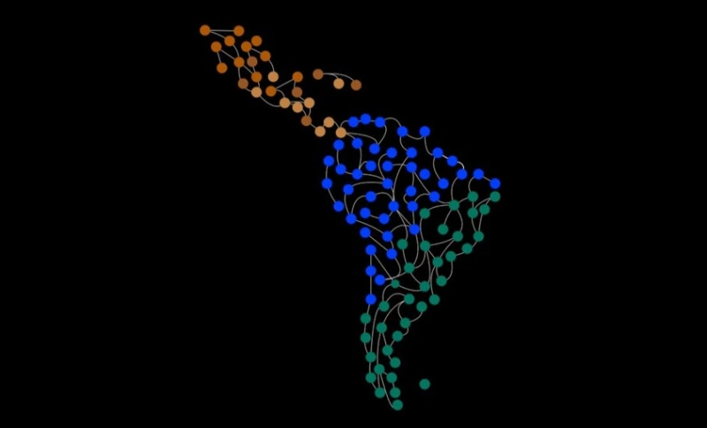
I am collecting information about research networks in Latin America.
I have information about author affiliations, publications, topics, etc.
Given a particular user, I want to recommend collaborators in the region based on the coauthor network of that user.
What should I use?
Sounds like we might need to search for paths between specific entities.
NoSQL Graph database (e.g., Neo4j)

Slide 35
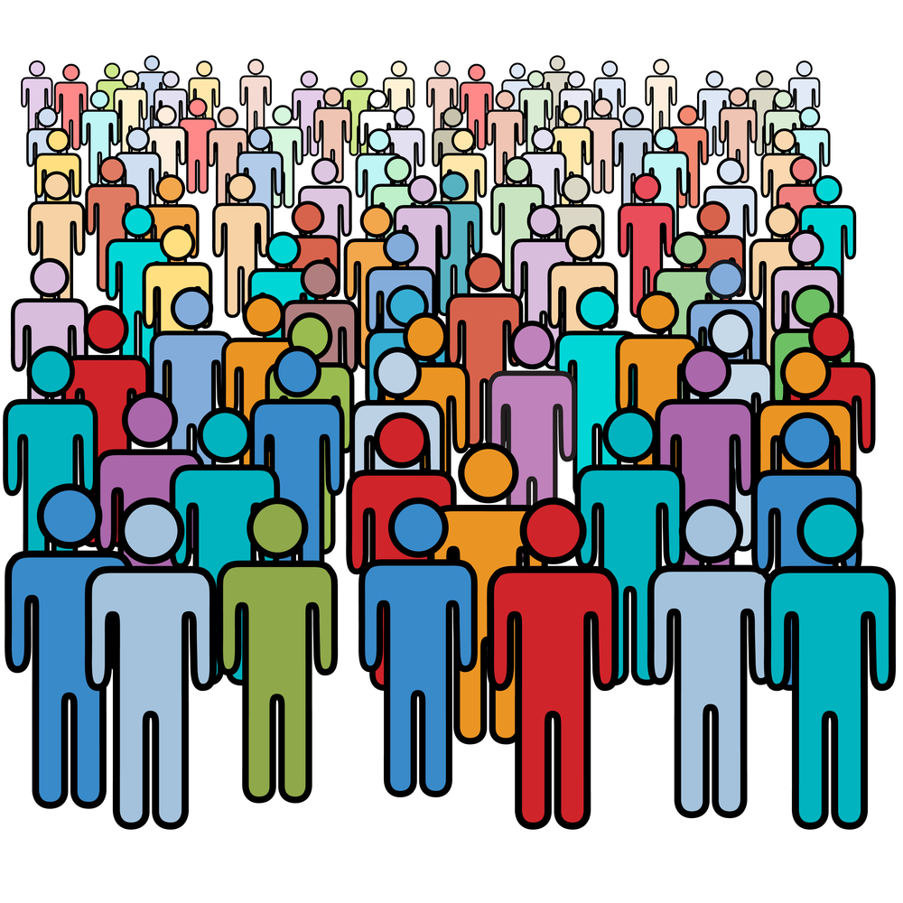
I am working with a company that has a Web application used by more than a gazillion users every second. Sometimes new software is deployed that can have bugs, turning some users away. I want to monitor and search over logs for recurring errors that might be affecting our user experience.
What should I use?
We need to monitor dynamic data and also provide search capability.
Streaming platform (e.g., Kafka) to detect and redirect important events
Distributed Inverted Indexes (e.g., Elasticsearch, Solr) to index and search events

Slide 36
I’m working at a cinema.
Given a large collection of movie data (like IMDb), I want to compute profiles for people who work in movies (actors, directors, etc.), including how many movies they have directed or starred in, what are the average ratings of the movies, their most frequent collaborators, awards won, and so forth.
Afterwards when a user visits the cinema webpage, they can hover their mouse over any person to view that person’s profile.
What should I use?
Sounds like we need to aggregate and index data for querying.
MapReduce/Spark to compute profiles
NoSQL Key-Value/Document (e.g., Cassandra, MongoDB) to index them

Slide 37
Final Exam ...

Slide 38
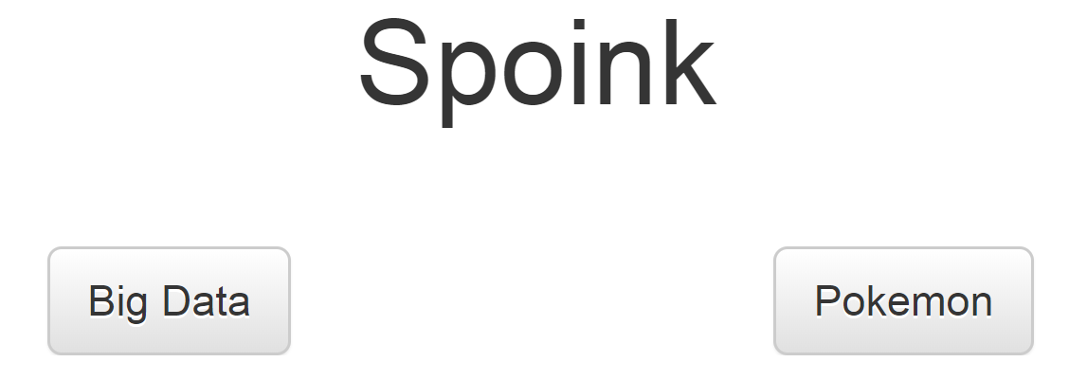
Final Exam
https://pixelastic.github.io/pokemonorbigdata/

Slide 39
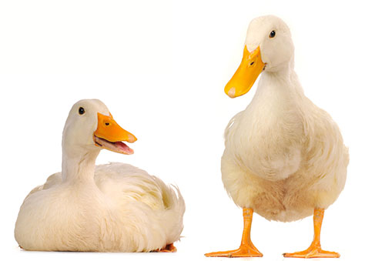
Eso.

