Slide 1
CC5212-1 Procesamiento Masivo de Datos Otoño 2023 Lecture 11 NoSQL: Neo4J
Aidan Hogan
aidhog@gmail.com

Slide 2
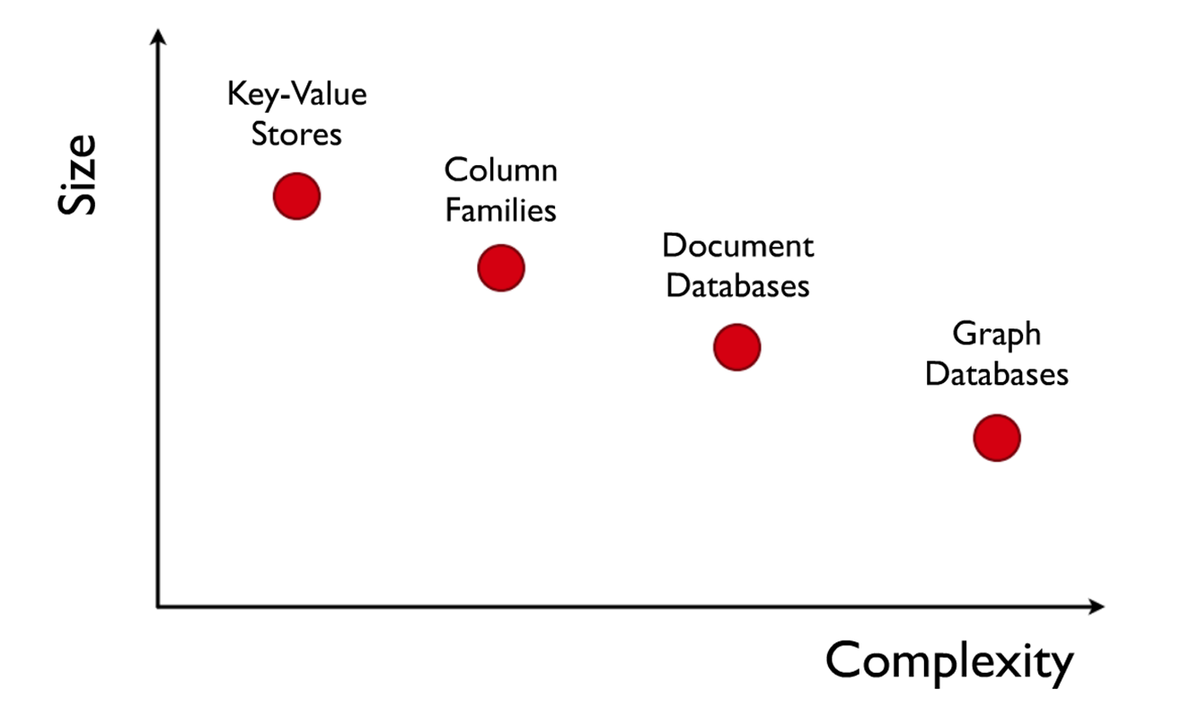
NoSQL

Slide 3
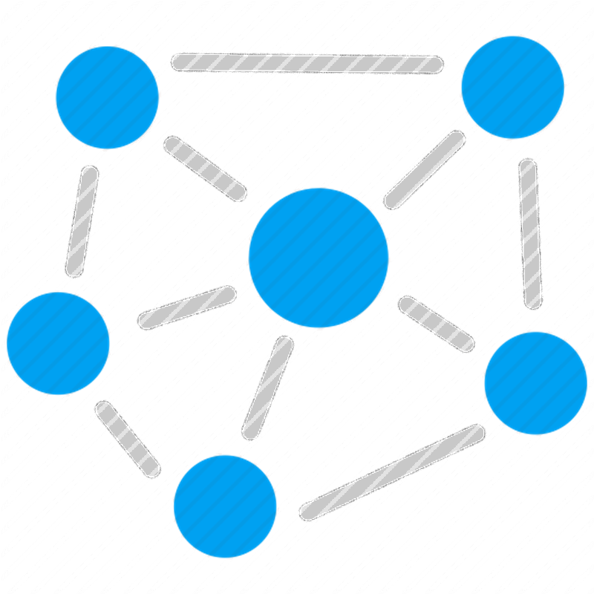

Slide 4
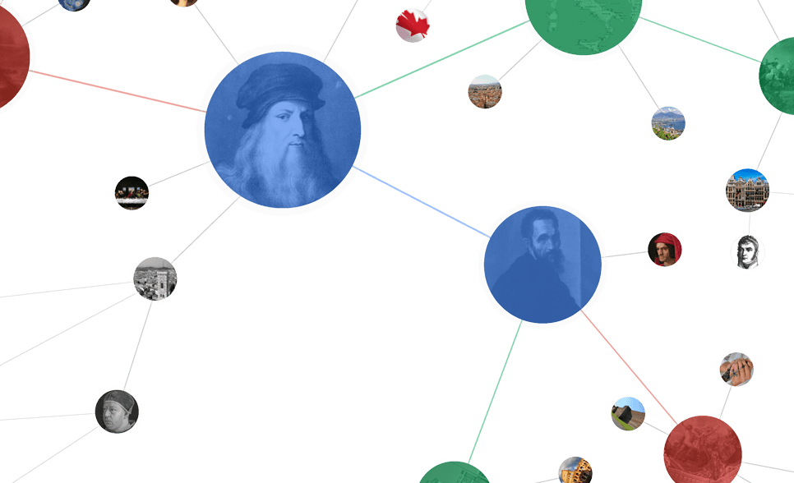
Knowledge
Graph

Slide 6
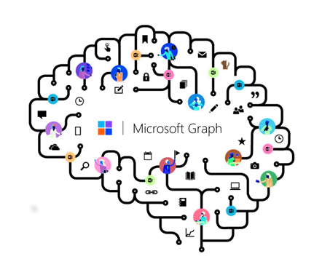
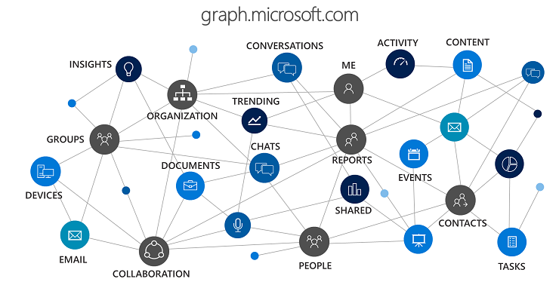

Slide 9
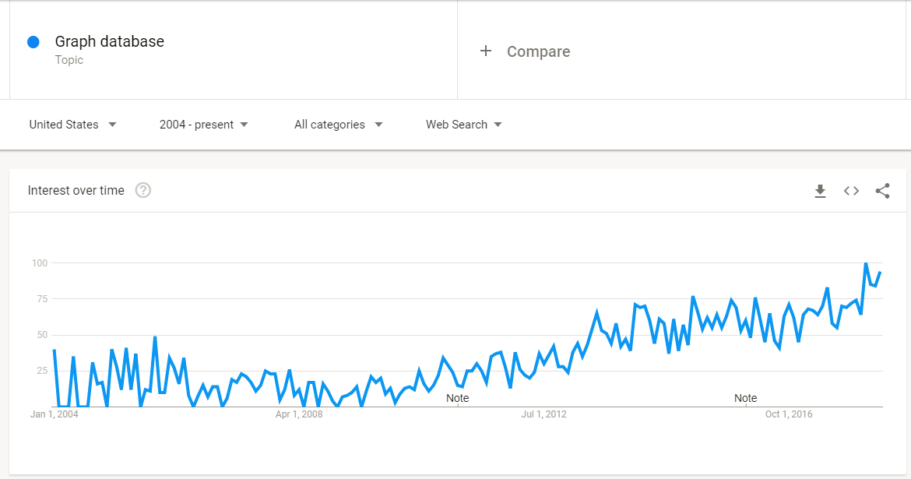

Slide 10
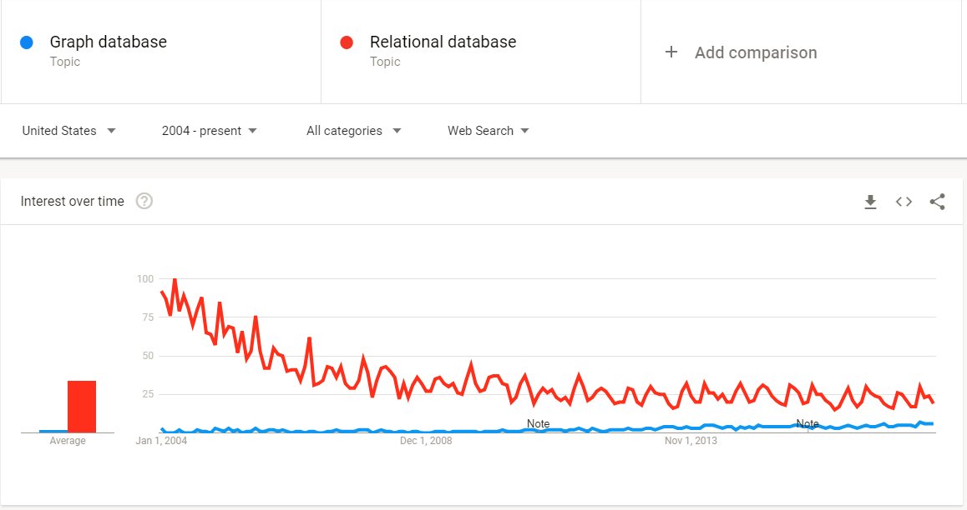

Slide 12
What is a Graph Database?

Slide 13
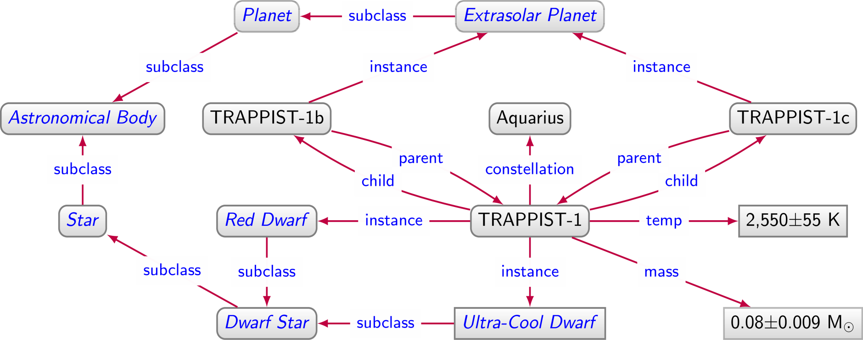
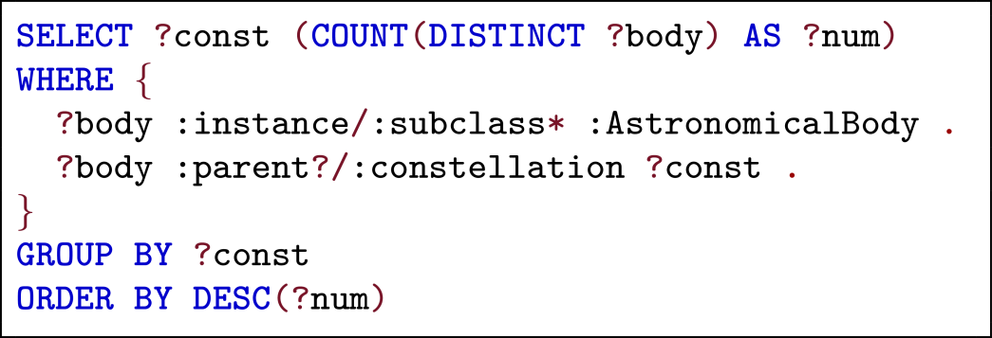
Directed edge-labelled graph

Slide 14
Property graph

Slide 15
Property graph
Directed edge-labelled graph

Slide 16
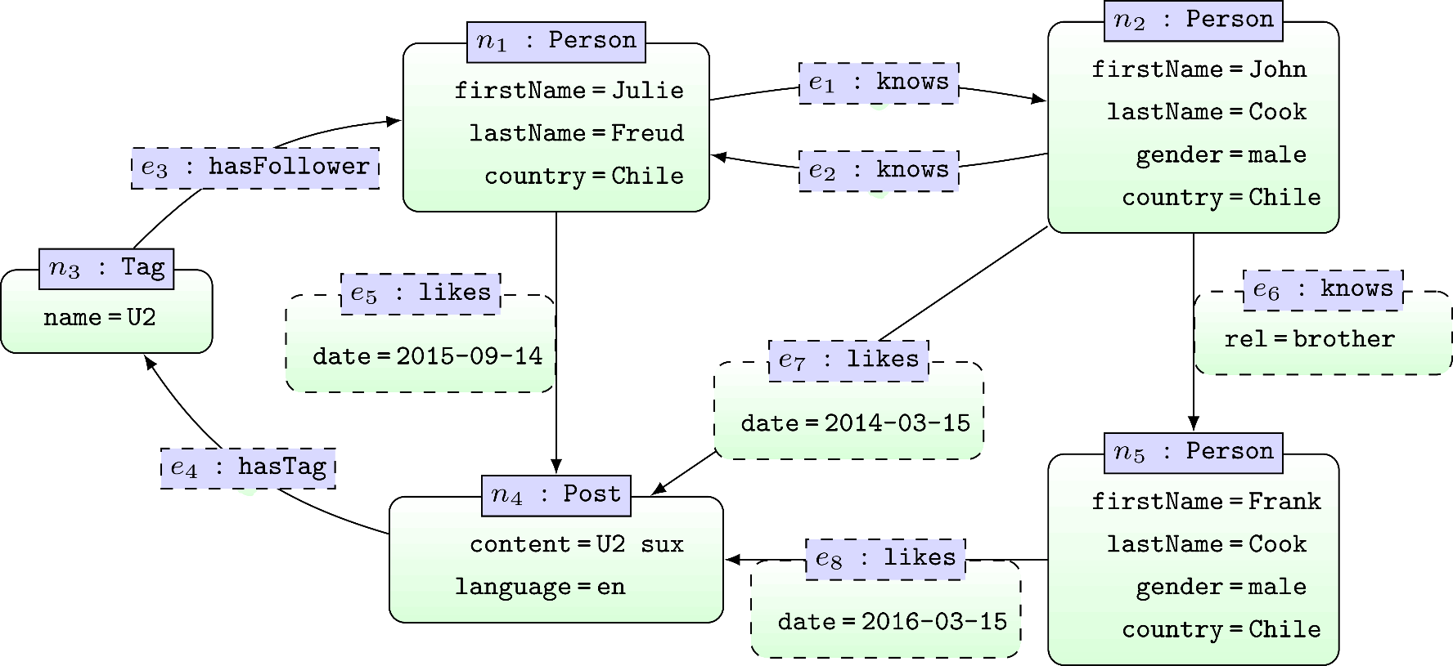
Property Graph

Slide 17
Why do we need Graph Databases?

Slide 18
Why do we need Graph Databases? Flexibility

Slide 19
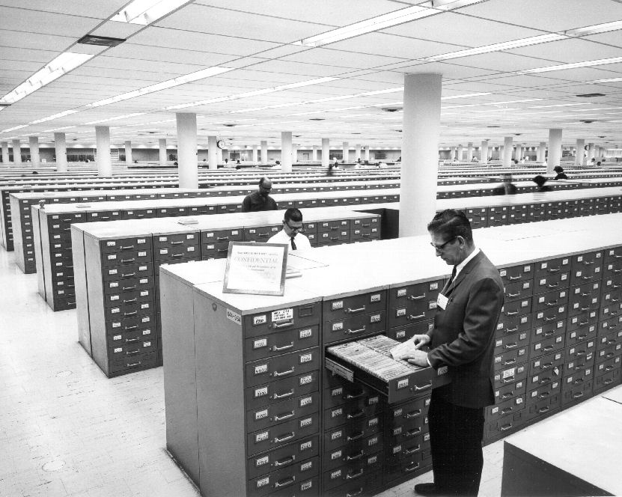
Relational Databases …

Slide 20
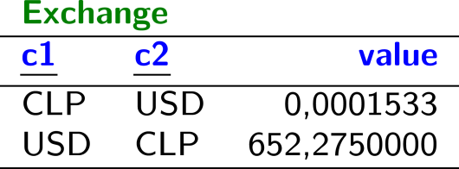
Relational Databases …

Slide 21
Planets / Relational Database

Slide 22
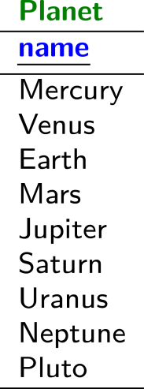
Planets / Relational Database

Slide 23
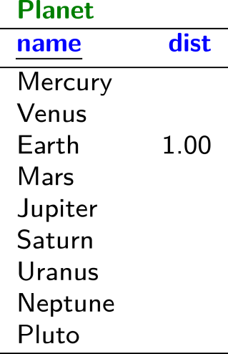
Planets / Relational Database

Slide 24
Planets / Relational Database

Slide 25
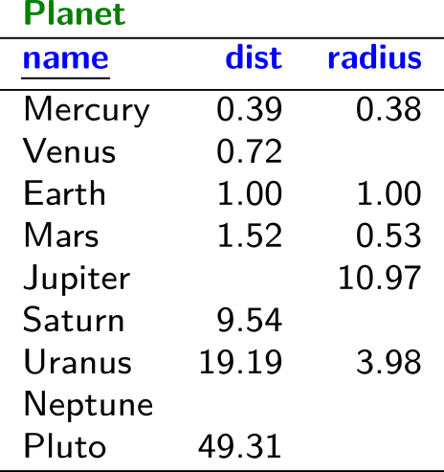
Planets / Relational Database

Slide 26
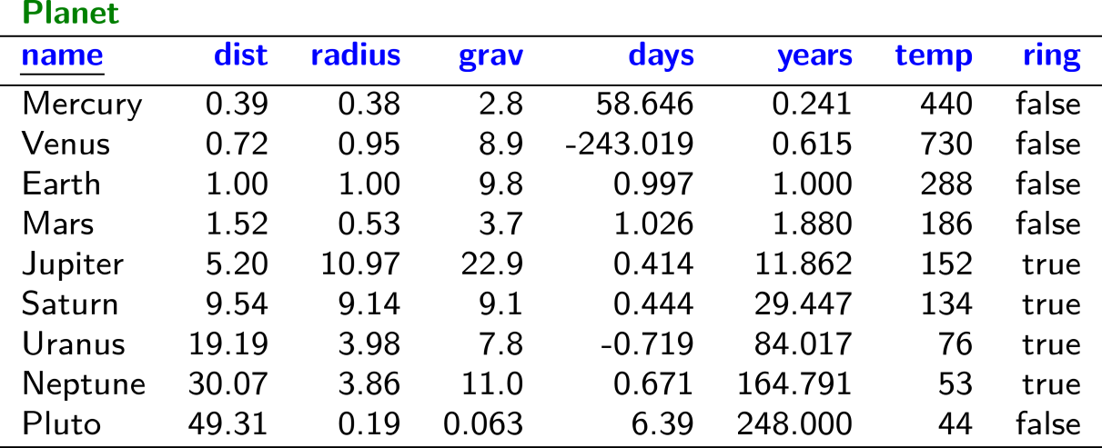
Planets / Relational Database

Slide 27
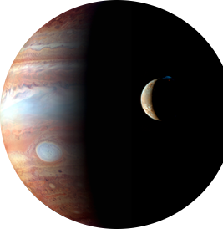
Planets / Relational Database

Slide 28
Planets / Relational Database

Slide 29
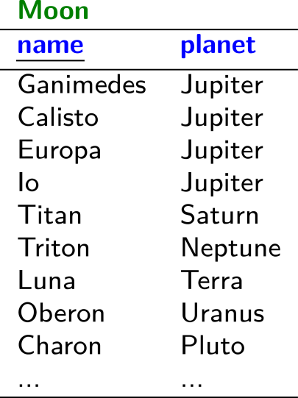
Planets / Relational Database

Slide 30
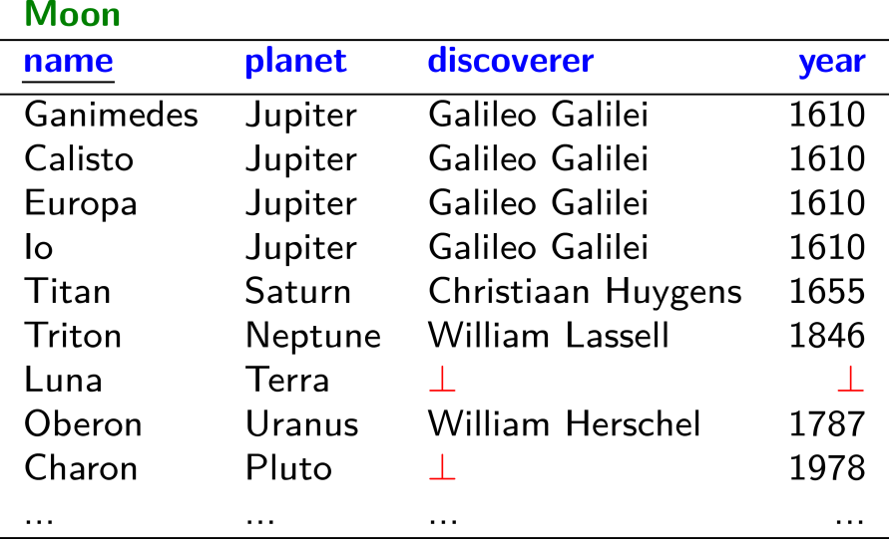
Planets / Relational Database

Slide 31
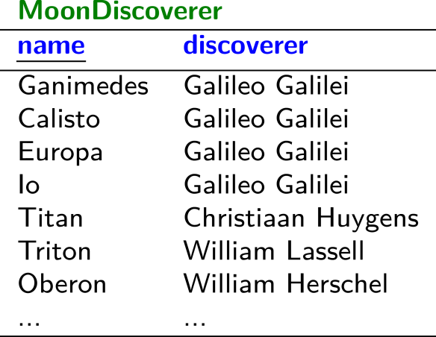
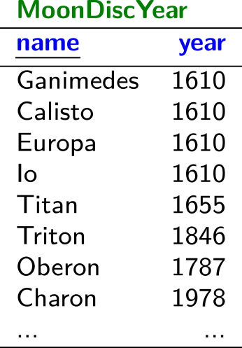
Planets / Relational Database

Slide 32
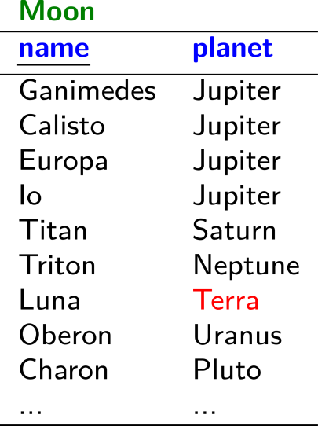
Planets / Relational Database

Slide 33
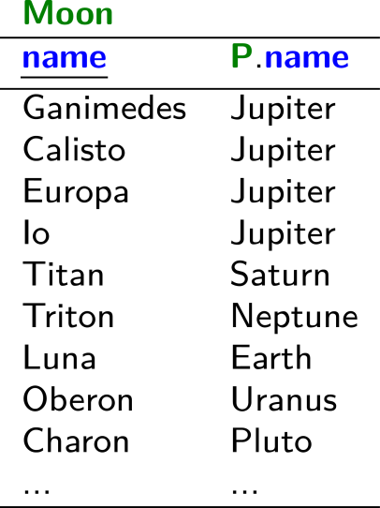
Planets / Relational Database

Slide 34
Planets / Relational Database

Slide 35
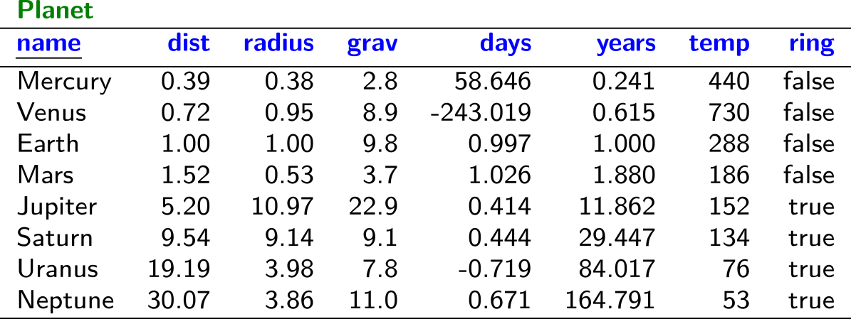
Planets / Relational Database

Slide 36
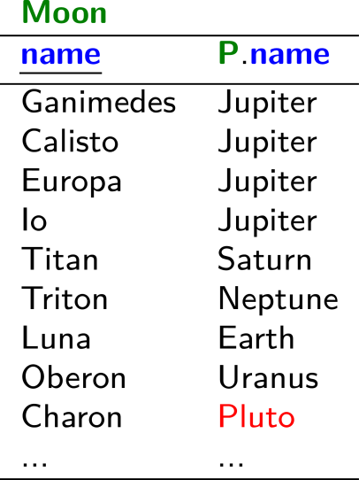
Planets / Relational Database

Slide 37
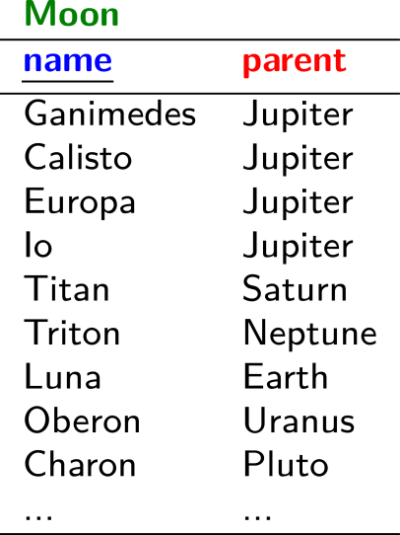
Planets / Relational Database

Slide 38
Planets / Relational Database

Slide 39
Planets / Relational Database
(╯°□°)╯︵ ┻━┻

Slide 40
Planets / Graph Database

Slide 41
Planets / Graph Database

Slide 42
Planets / Graph Database

Slide 43
Planets / Graph Database

Slide 44
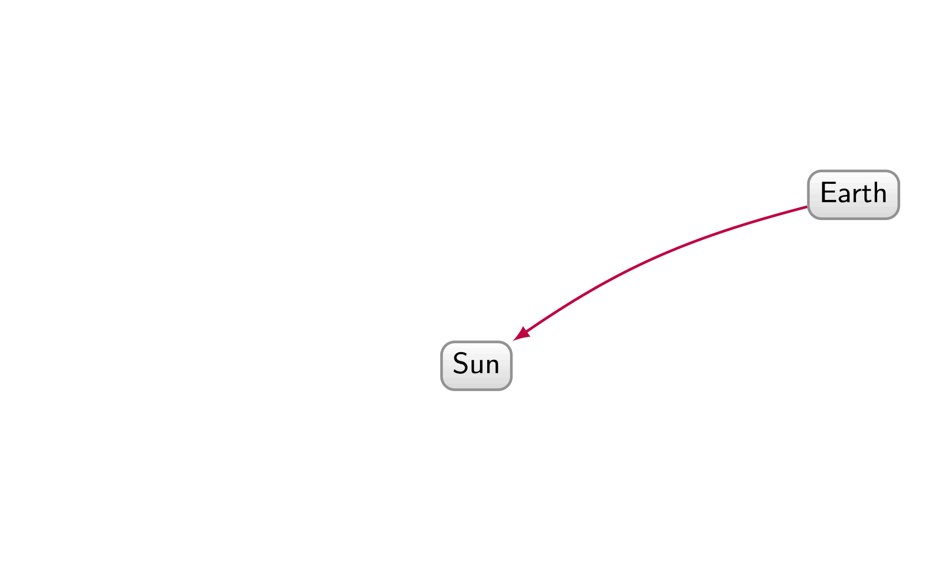
Planets / Graph Database

Slide 45
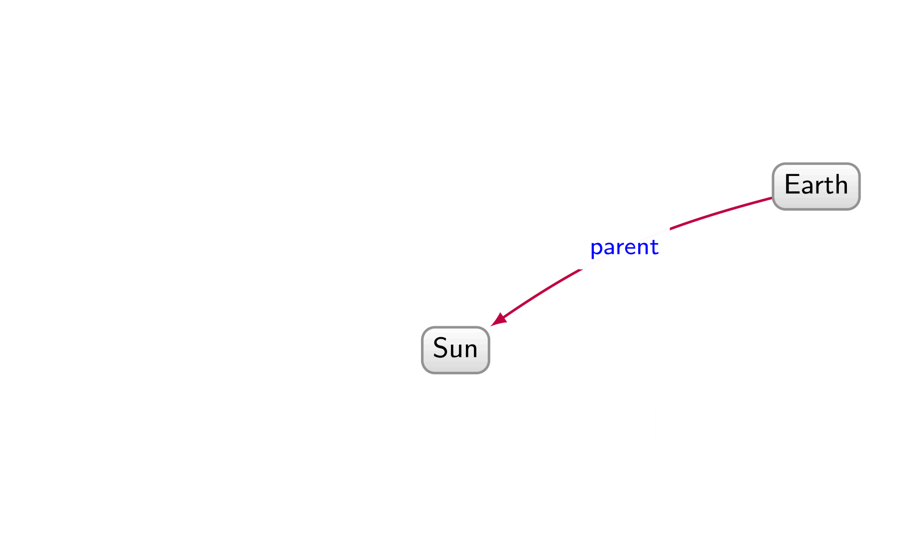
Planets / Graph Database

Slide 46
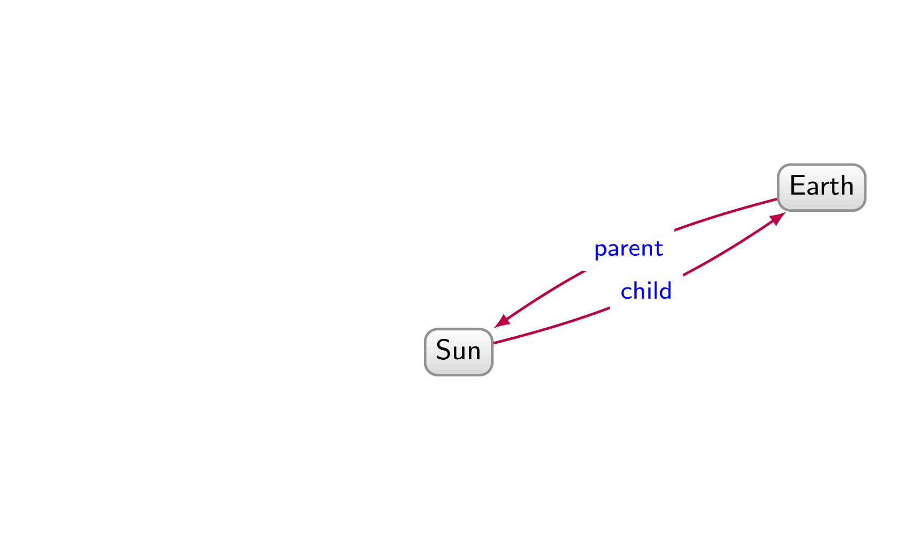
Planets / Graph Database

Slide 47
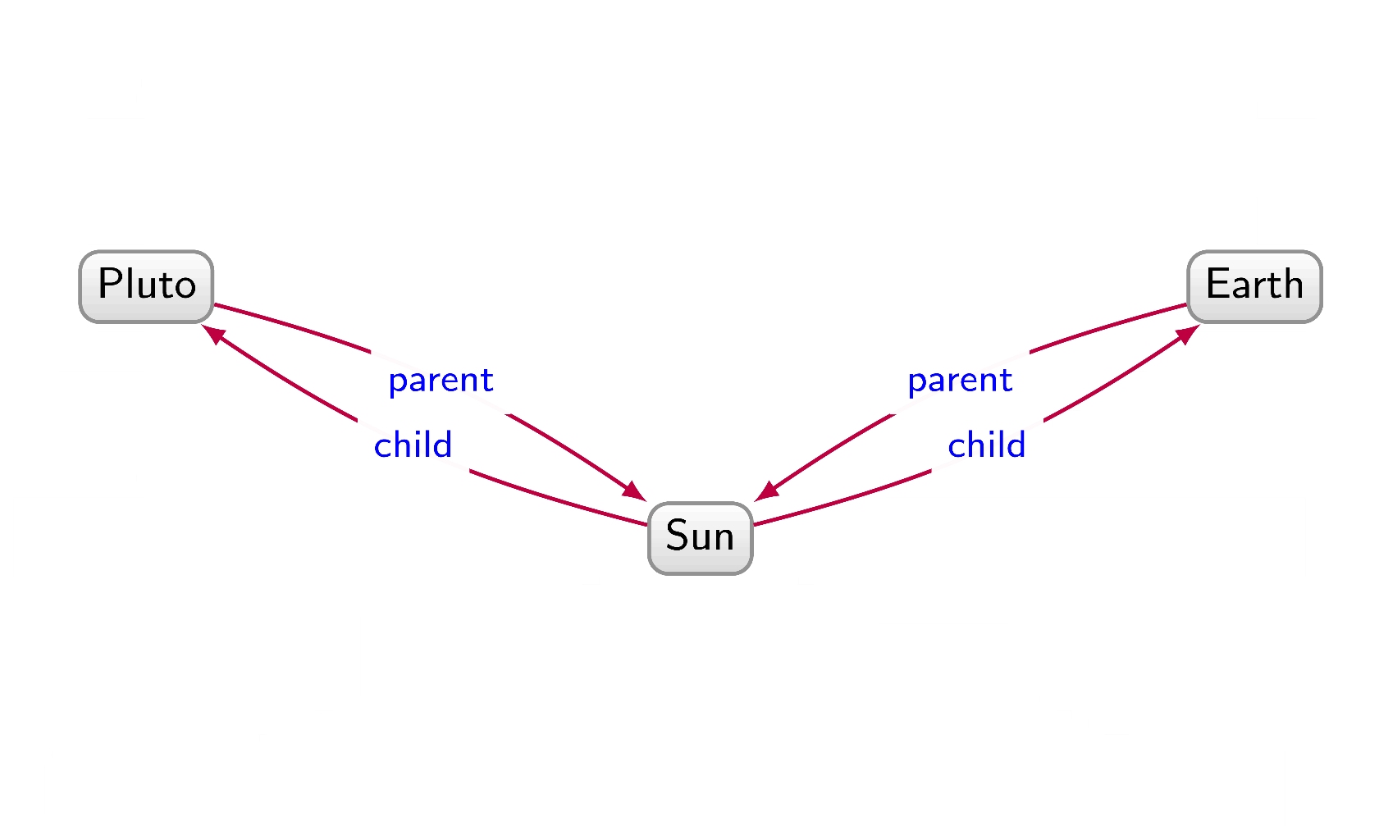
Planets / Graph Database

Slide 48
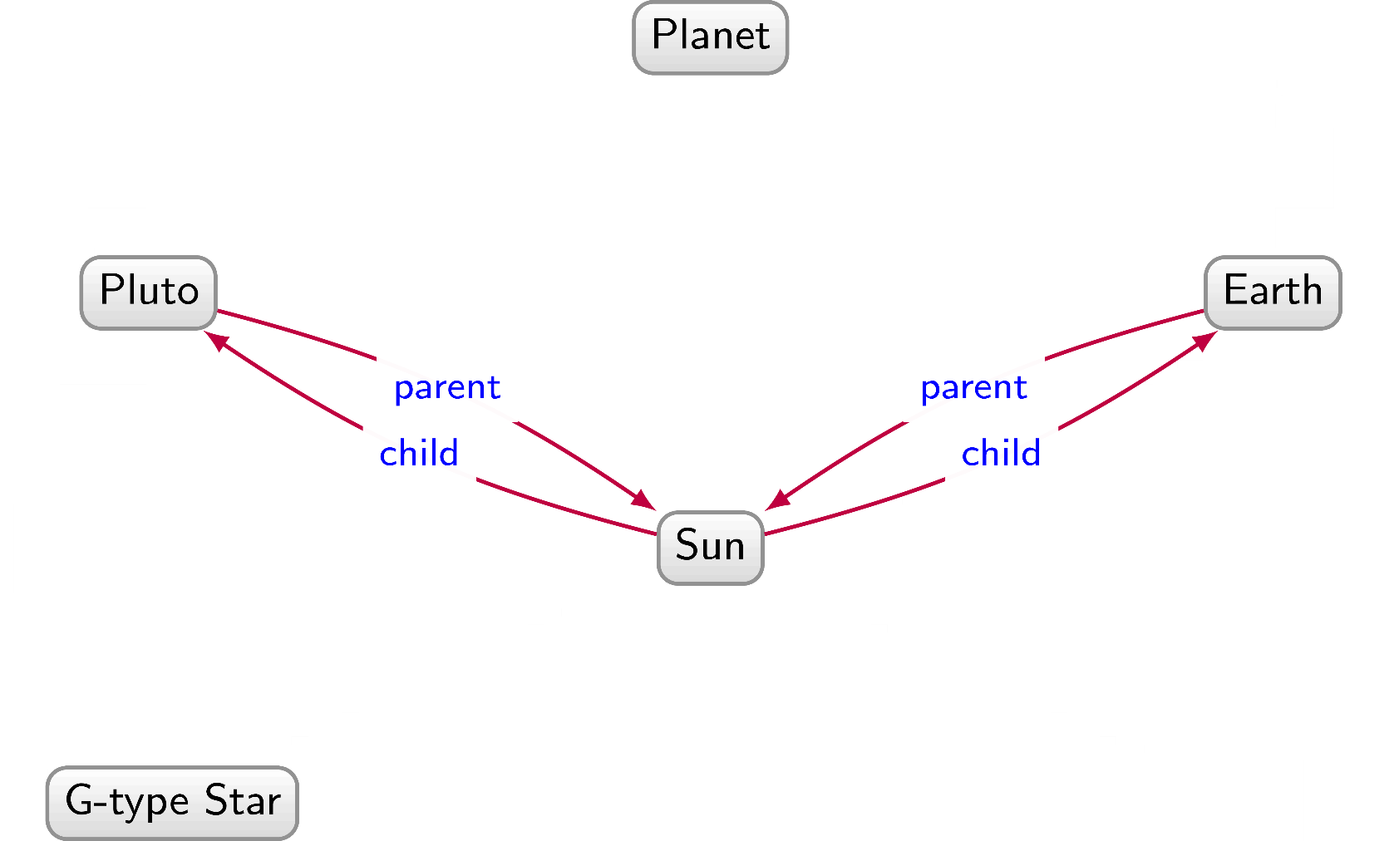
Planets / Graph Database

Slide 49
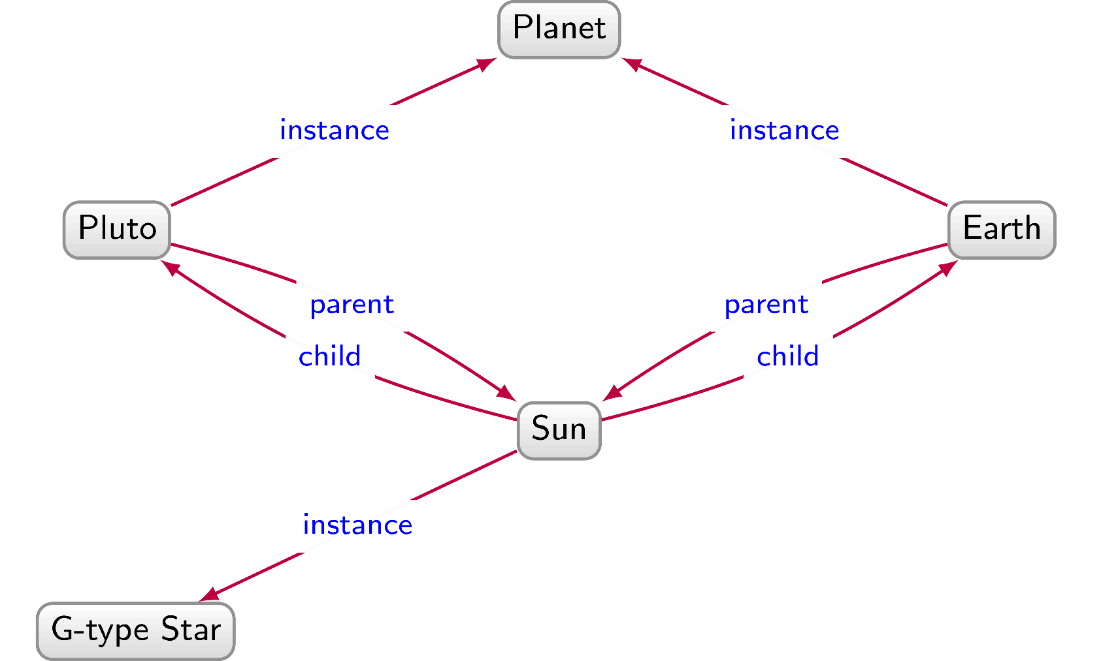
Planets / Graph Database

Slide 50
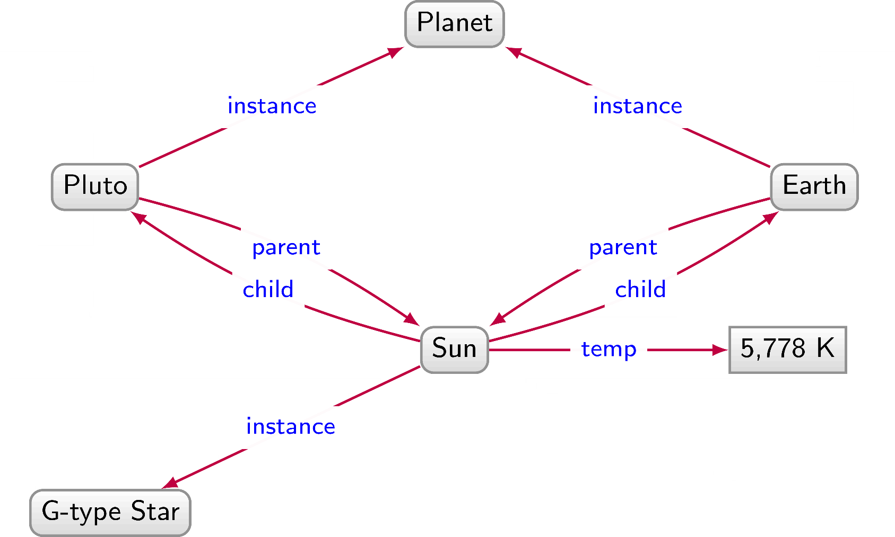
Planets / Graph Database

Slide 51
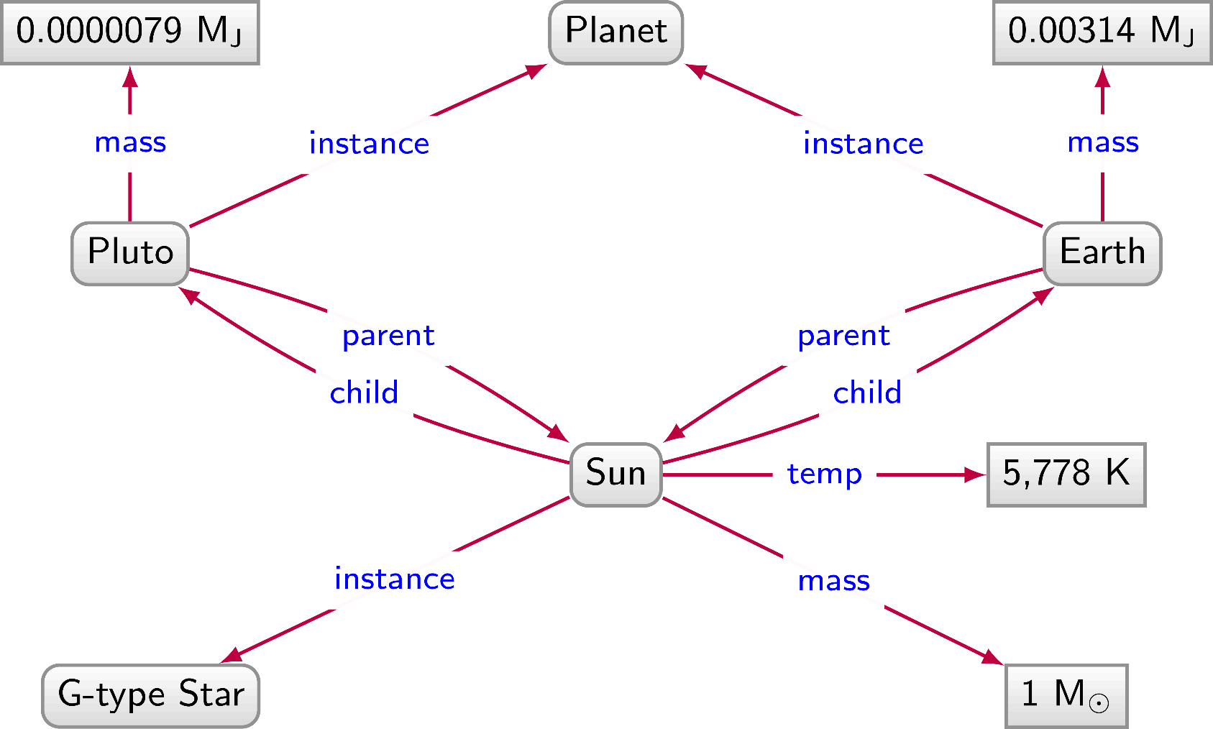
Planets / Graph Database

Slide 52
Planets / Graph Database

Slide 53
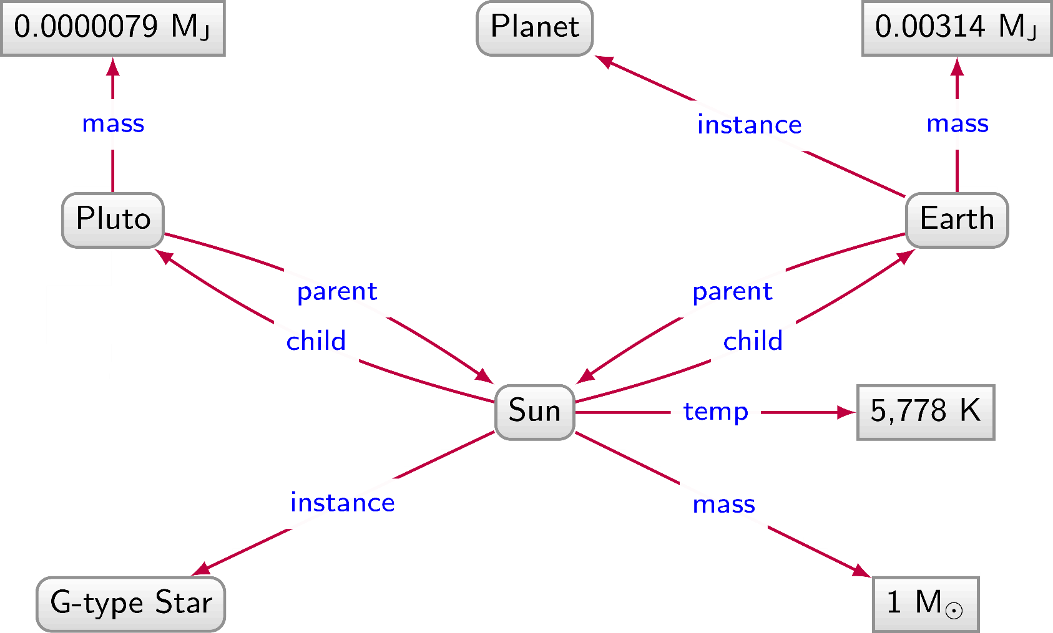
Planets / Graph Database

Slide 54
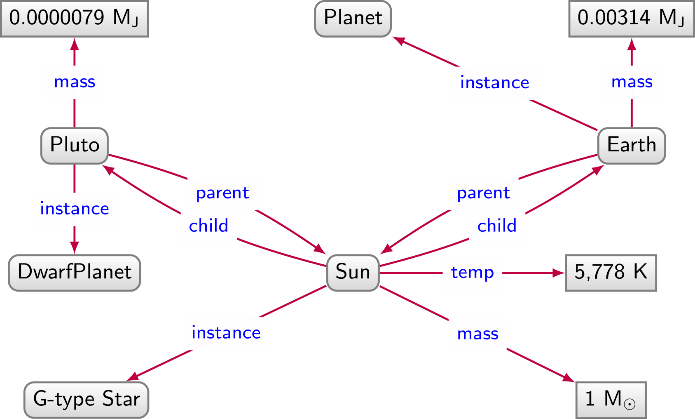
Planets / Graph Database

Slide 55
Planets / Graph Database

Slide 56
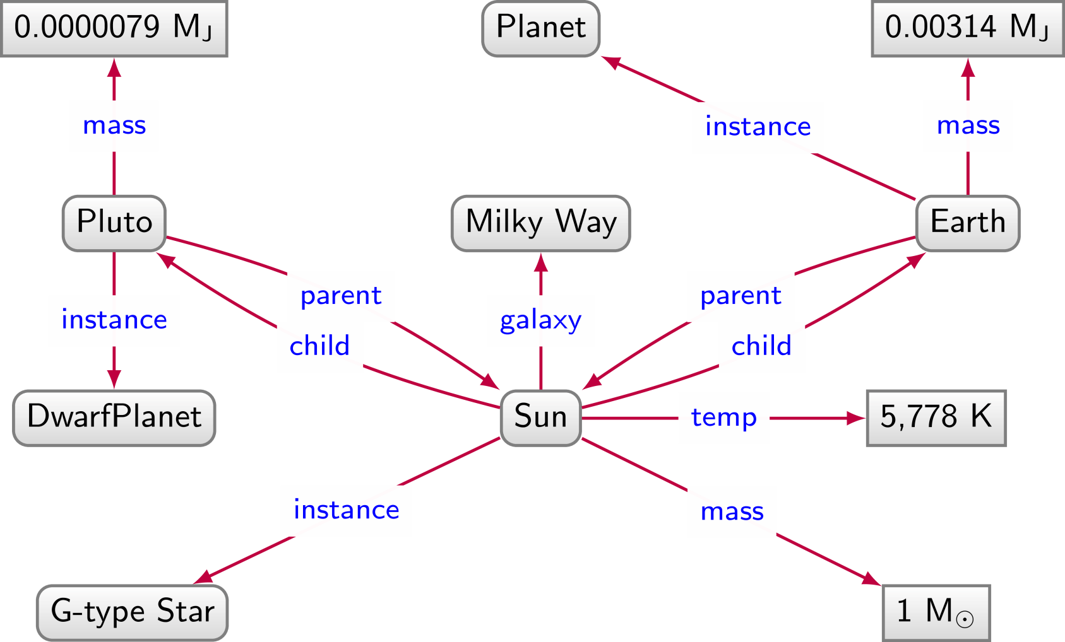
Planets / Graph Database

Slide 57
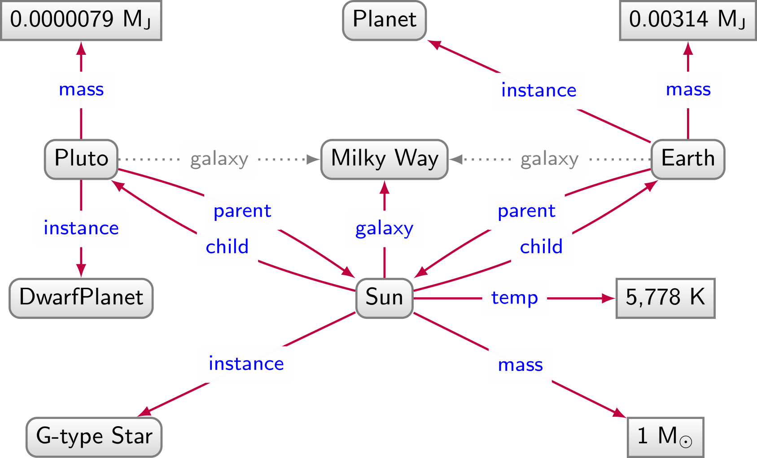
Planets / Graph Database

Slide 58
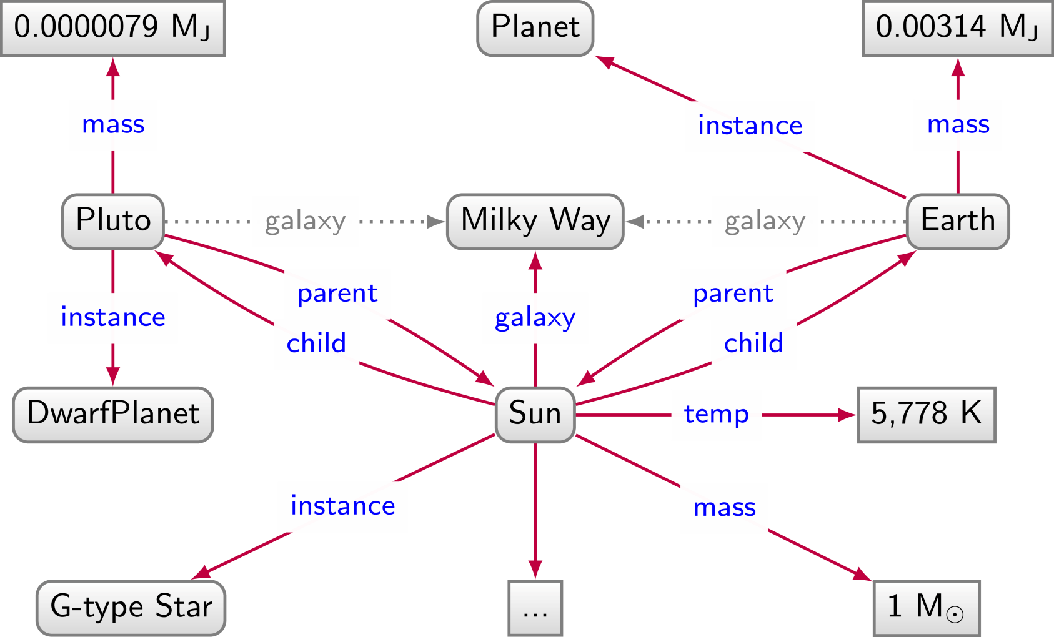
Planets / Graph Database

Slide 59
Relational databases: Pros and Cons
We have to impose a
structure (schema)
from the start
We have a
structure (schema) imposed from the start

Slide 60
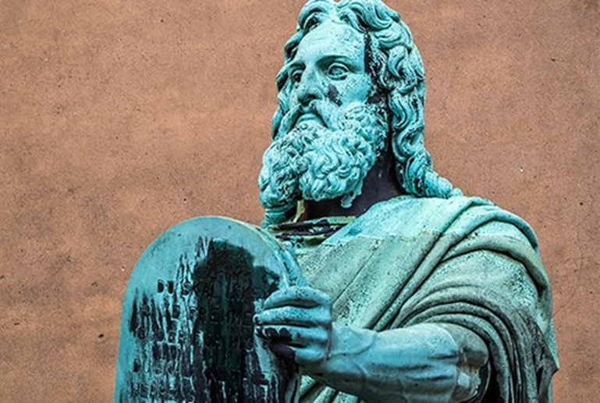

Slide 61
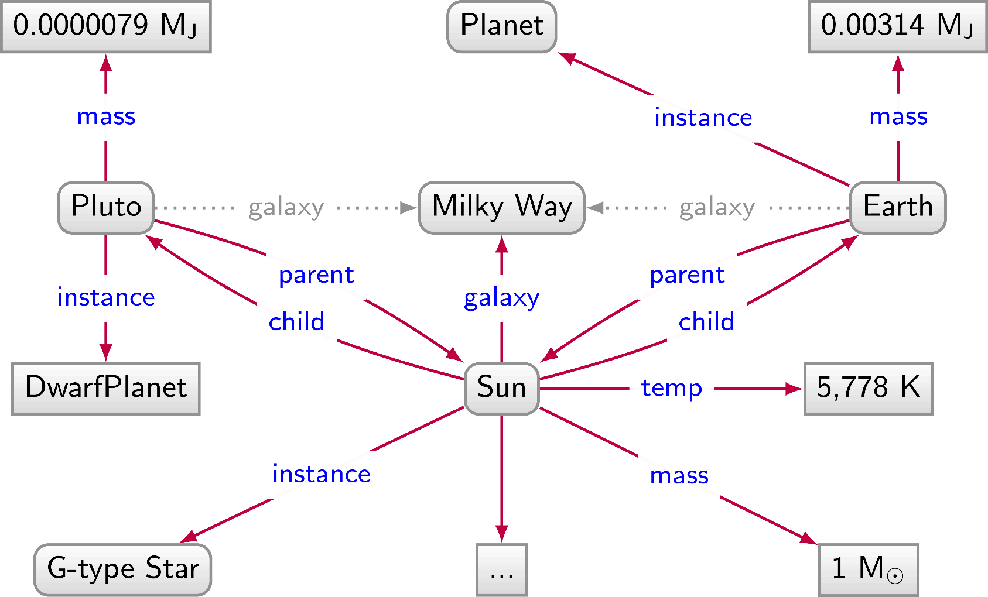
Graph Databases: Pros and Cons
We don't have to impose a
structure (schema)
from the start
We don't have a
structure (schema) imposed from the start

Slide 62
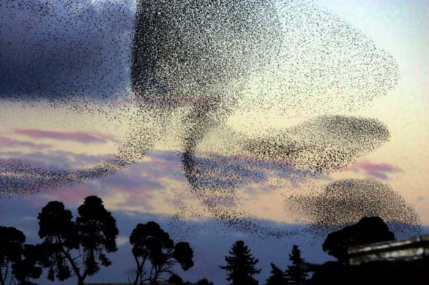

Slide 63
Why do we need Graph Databases? Path Queries

Slide 64
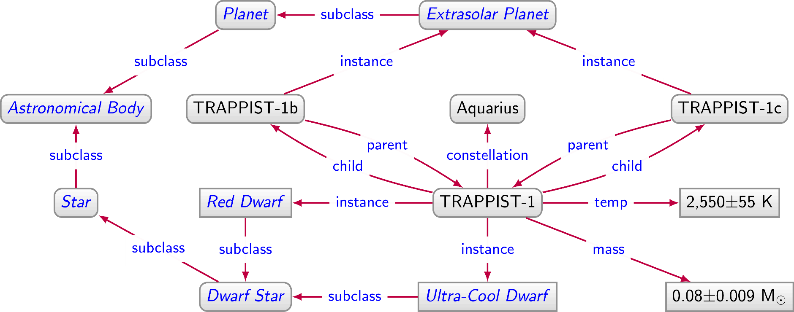
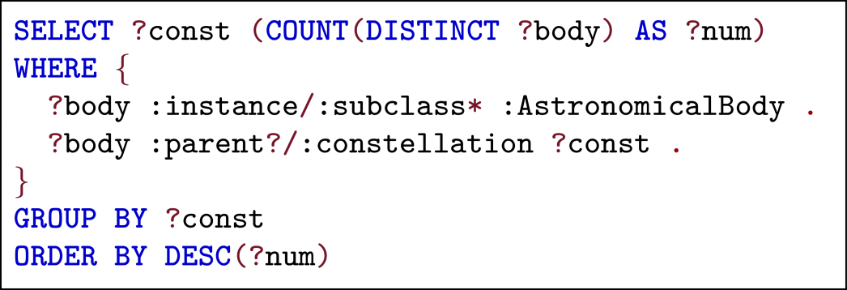
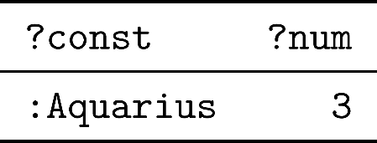
Directed Edge-labelled Graph

Slide 65
Property Graph
???

Slide 66
Why do we need Property Graphs?

Slide 67
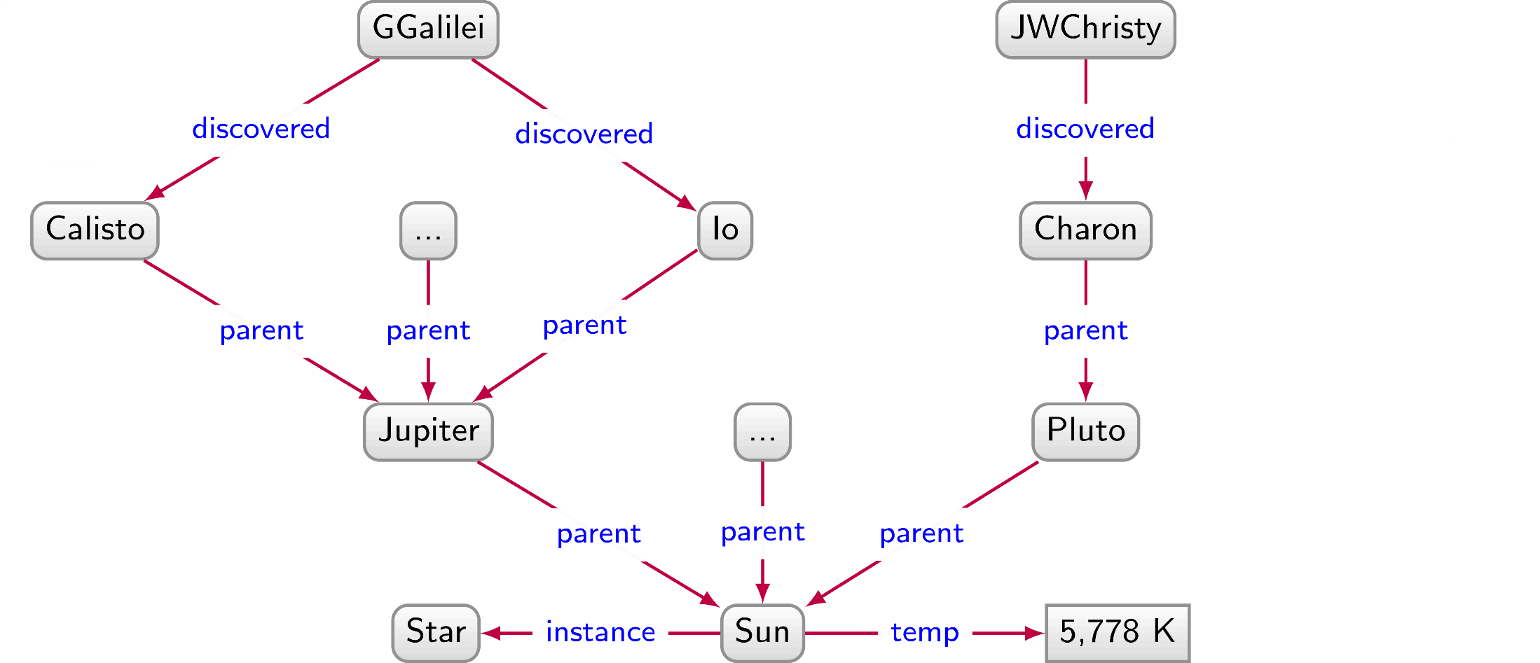
Directed Labelled Graph
How can we say that Galileo Galilei discovered Calisto and Io in 1610 while James W. Christy discovered Charon in 1978?

Slide 68
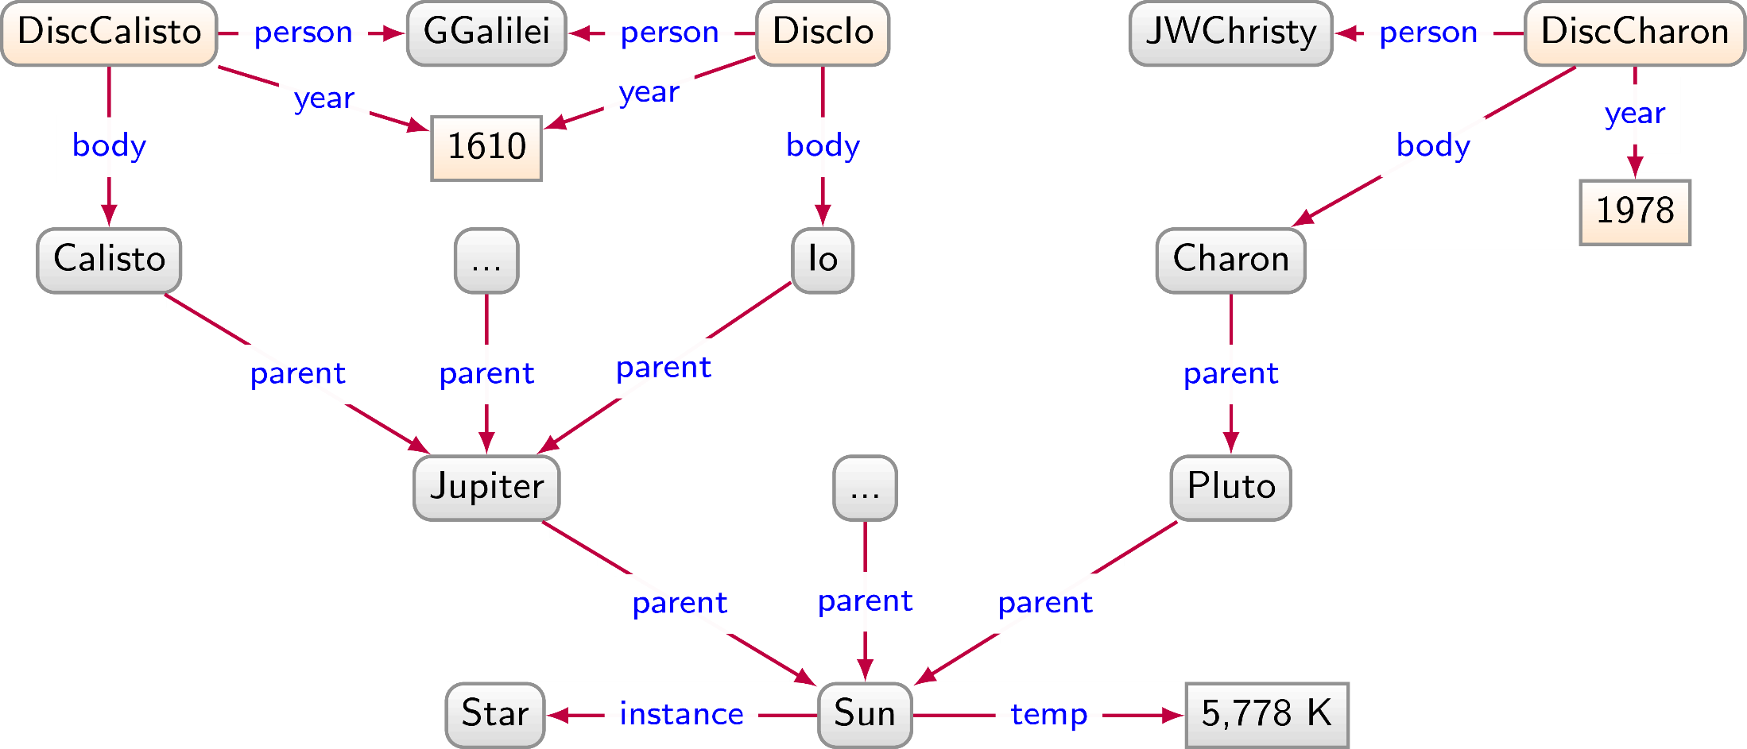
Directed Labelled Graph

Slide 69
Wouldn't it have been nice to simply ...

Slide 70
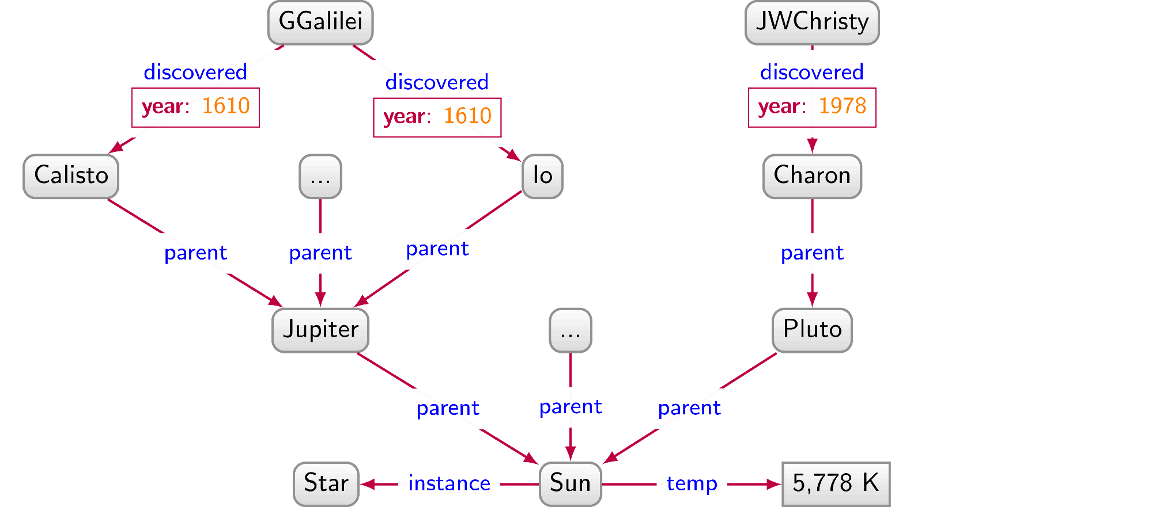
Wouldn't it have been nice to simply ...

Slide 71
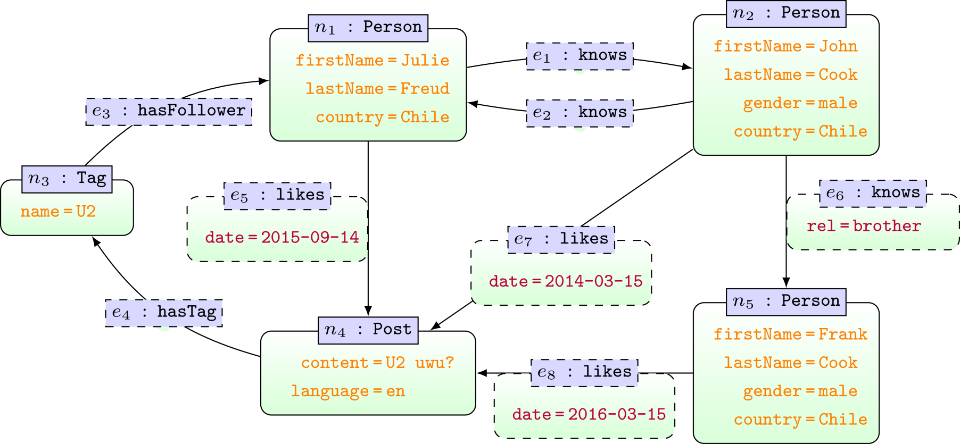
Property Graphs ...
... attributes on nodes and edges

Slide 72
Property Graphs
... attributes on nodes and edges
... IDs on nodes and edges

Slide 73
Property Graphs
... attributes on nodes and edges
... IDs on nodes and edges
... labels on nodes and edges

Slide 74
Popular Graph Databases

Slide 75
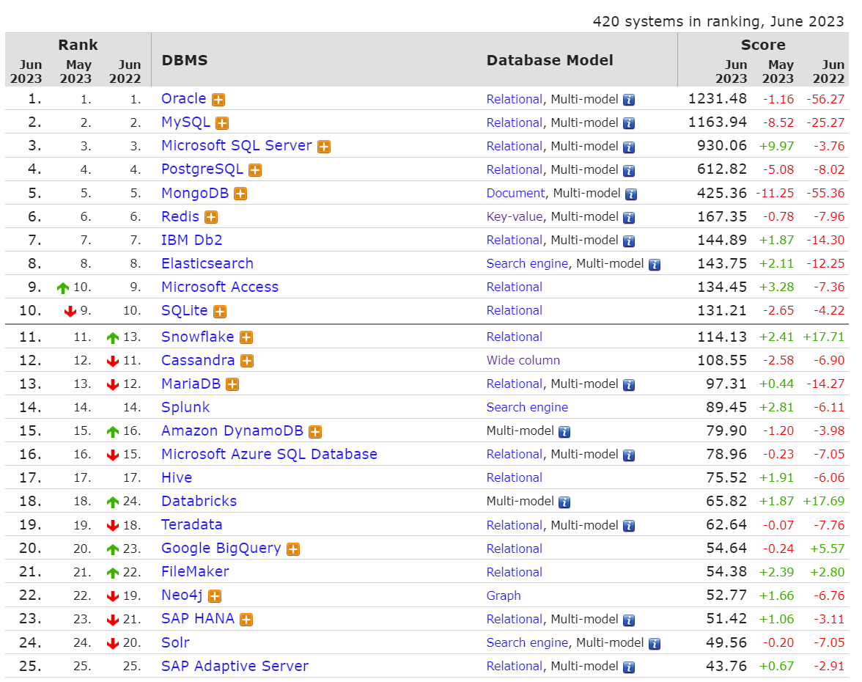
http://db-engines.com/en/ranking

Slide 76
http://db-engines.com/en/ranking

Slide 77
Neo4j

Slide 78
Neo4j Graph Database
Data Model: Property Graphs
Query Language: Cypher
Scripting Language: Gremlin
Licence: Open Source (Single Machine)
Commercial (Cluster Edition)

Slide 79
Cypher: MATCH/RETURN
https://neo4j.com/docs/developer-manual/3.4/cypher/clauses/match/

Slide 80
MATCH/RETURN

Slide 81
MATCH/RETURN

Slide 82
MATCH/RETURN

Slide 83
MATCH/RETURN
... matching nodes returned with blank attributes

Slide 84
MATCH/RETURN

Slide 85
MATCH/RETURN

Slide 86
MATCH/RETURN
... multiplicity of results corresponds to number of matches

Slide 87
MATCH/RETURN
... multiplicity of results corresponds to number of matches

Slide 88
MATCH/RETURN
... RETURN DISTINCT removes duplicates

Slide 89
MATCH/RETURN

Slide 90
MATCH/RETURN

Slide 91
MATCH/RETURN

Slide 92
MATCH/RETURN
... MATCH will not match the same edge twice

Slide 93
MATCH/RETURN
... MATCH will match same node twice

Slide 94
MATCH/RETURN

Slide 95
MATCH/RETURN

Slide 96
MATCH/RETURN

Slide 97
MATCH/RETURN
... AS renames columns in results

Slide 98
MATCH/RETURN
... use multiple MATCH to match same edge multiple times

Slide 99
MATCH/RETURN

Slide 100
MATCH/RETURN

Slide 101
Cypher: MATCH (Paths)
https://neo4j.com/docs/developer-manual/3.4/cypher/clauses/where/

Slide 102
MATCH (Paths)
... paths of length one-or-more

Slide 103
MATCH (Paths)
Otherwise ...
... we could have infinite paths!
... paths visit each edge at most once!
... paths visit each edge at most once!

Slide 104
MATCH (Paths)
... can set minimum path length (no. of edges traversed)

Slide 105
MATCH (Paths)
... or range of path length

Slide 106
MATCH (Paths)
... or maximum path length

Slide 107
MATCH (Paths)
... 0-length path is the node itself; will match any node

Slide 108
MATCH (Paths)
... can return a full path

Slide 109
MATCH (Paths)
... can return a full path

Slide 110
MATCH (Paths)
... can return a full path

Slide 111
MATCH (Paths)
... returns any shortest path (matching criteria)

Slide 112
MATCH (Paths)
... returns all shortest paths (matching criteria)

Slide 113
MATCH (Paths)

Slide 114
MATCH (Paths)
... returns a shortest path for each matching pair of nodes

Slide 115
MATCH (Paths)

Slide 116
MATCH (Paths)

Slide 117
Cypher: WHERE
https://neo4j.com/docs/developer-manual/3.4/cypher/clauses/where/

Slide 118
WHERE
Boolean:
AND, OR, XOR, NOT
(In)equalities:
<, >, <>, <=, >=
Exists attribute property:
EXISTS
String:
STARTS WITH, ENDS WITH, CONTAINS, =~ (Regex)

Slide 119
WHERE

Slide 120
WHERE

Slide 121
WHERE

Slide 122
WHERE

Slide 123
Cypher: ORDER BY/SKIP/LIMIT
https://neo4j.com/docs/developer-manual/3.4/cypher/clauses/order-by/
https://neo4j.com/docs/developer-manual/3.4/cypher/clauses/skip/
https://neo4j.com/docs/developer-manual/3.4/cypher/clauses/limit/

Slide 124
ORDER BY

Slide 125
Cypher: OPTIONAL MATCH
https://neo4j.com/docs/developer-manual/3.4/cypher/clauses/optional-match/

Slide 126
OPTIONAL MATCH
... OPTIONAL MATCH acts like a left join

Slide 127
Cypher: UNION (ALL)
https://neo4j.com/docs/developer-manual/3.4/cypher/clauses/optional-match/

Slide 128
UNION
... column names have to be the same in the UNION

Slide 129
UNION
... UNION applies set union

Slide 130
UNION ALL
... UNION ALL applies bag union

Slide 131
Cypher: Aggregation
https://neo4j.com/docs/developer-manual/current/cypher/functions/aggregating/

Slide 132
Aggregation
count
max/min
avg
percentileCont/percentileDisc
Computes percentile of some value w.r.t. some list
(continuous: interpolates / discrete: rounds)
stDev/stDevP
Computes standard deviation (sample/population)

Slide 133
COUNT
... GROUP BY implicit on non-aggregated columns

Slide 134
COUNT
... removes duplicate results, not count arguments

Slide 135
COUNT
... removes duplicate count arguments

Slide 136
Cypher: Other Functions
https://neo4j.com/docs/developer-manual/current/cypher/functions/

Slide 137
https://neo4j.com/docs/developer-manual/current/cypher/functions/

Slide 138
LENGTH (Path)
https://neo4j.com/docs/developer-manual/current/cypher/functions/

Slide 139
LENGTH (Path)
https://neo4j.com/docs/developer-manual/current/cypher/functions/

Slide 140
Cypher: Update Graphs CREATE/REMOVE/...

Slide 141
Update graphs
CREATE nodes and relationships
https://neo4j.com/docs/developer-manual/current/cypher/clauses/create/
DELETE nodes and relationships
https://neo4j.com/docs/developer-manual/current/cypher/clauses/delete/
DETACH DELETE nodes with relationships
https://neo4j.com/docs/developer-manual/current/cypher/clauses/delete/
SET update labels and attributes
https://neo4j.com/docs/developer-manual/current/cypher/clauses/set/
REMOVE remove labels and attributes
https://neo4j.com/docs/developer-manual/current/cypher/clauses/remove/

Slide 142
Update graphs
Create the nodes we've seen
Create the edges (sample) we've seen
Drop all nodes and edges

Slide 143
/Core of Cypher /Part of Neo4j

Slide 144
Neo4j Graph Database
Data Model: Property Graphs
Query Language: Cypher
Scripting Language: Gremlin
Licence: Open Source (Single Machine)
Commercial (Cluster Edition)

Slide 145
Property Graph: Cypher

Slide 146
Property Graph: Gremlin

Slide 147
Gremlin: Graph Queries + Processing

Slide 148
Graph Processing: Abstraction (in brief)

Slide 150
Aka. Systolic Computation, Asynchronous Actor Model, Vertex-Centric Computation, ...
Graph Parallel Computation

Slide 151
Graph Parallel Computation
Graph

Slide 152
Graph Parallel Computation
Graph
Vertexes have state

Slide 153
Graph Parallel Computation
Graph
Vertexes have state
Vertexes compute messages from state and neighbours

Slide 154
Graph Parallel Computation
Graph
Vertexes have state
Vertexes compute messages from state and neighbours
Vertexes send messages to neighbours

Slide 155
Graph Parallel Computation
Graph
Vertexes have state
Vertexes compute messages from state and neighbours
Vertexes send messages to neighbours
Vertexes receive messages and compute new state

Slide 156
Graph Parallel Computation
Graph
Vertexes have state
Vertexes compute messages from state and neighbours
Vertexes send messages to neighbours
Vertexes receive messages and compute new state
... recursively
... (in parallel)

Slide 157
Example: PageRank (simplified)

Slide 158
Example: PageRank (simplified)

Slide 159
Example: PageRank (simplified)

Slide 160
Example: PageRank (simplified)

Slide 161
Example: PageRank (simplified)
…

Slide 162
Other algorithms ...
Shortest paths / path queries
Clustering (k-means, label prop.)
Inferencing (class/property hierarchies)
Conway's game of life
Centrality (PageRank, ...)
Neural Networks
Turing Machine ☺
...

Slide 163
What the framework offers ...
Communication abstraction
Distribution/parallel abstraction
Topological abstraction

Slide 164
Ongoing Research ...
Pregel: A System for Large-Scale Graph Processing
Malewicz et al., SIGMOD 2010 [2938 citations]
Shark: SQL and Rich Analytics at Scale
Xin et al. , SIGMOD 2013 [442 citations]
GraphLab: A New Framework for Parallel Machine Learning
Low et al., arXiV 2014 [843 citations]
GraphX: graph processing in a distributed dataflow framework
Gonzalez et al., OSDI 2014 [538 citations]
GraphFrames: An Integrated API for Mixing Graph and Relational Queries
Dave et al., GRADES 2016 [25 citations]
Signal/Collect
Stutz et al., SWJ 2018 [0 citations]

Slide 165
/Graphs

Slide 166
Gremlin: Graph Queries + Processing

Slide 167
Questions?

