Slide 1
CC5212-1 Procesamiento Masivo de Datos Otoño 2023 Lecture 9 NoSQL: Overview
Aidan Hogan
aidhog@gmail.com

Slide 2
Distributed Static
Data Processing
Distributed Dynamic
Data Processing
Distr. Unstructured
Data Management
Distr. (Semi-)structured
Data Management
Distributed Data Processing
Distributed Data Management
Distributed Systems
Local Data Processing

Slide 3
Big Data: Storing Structured Information

Slide 4
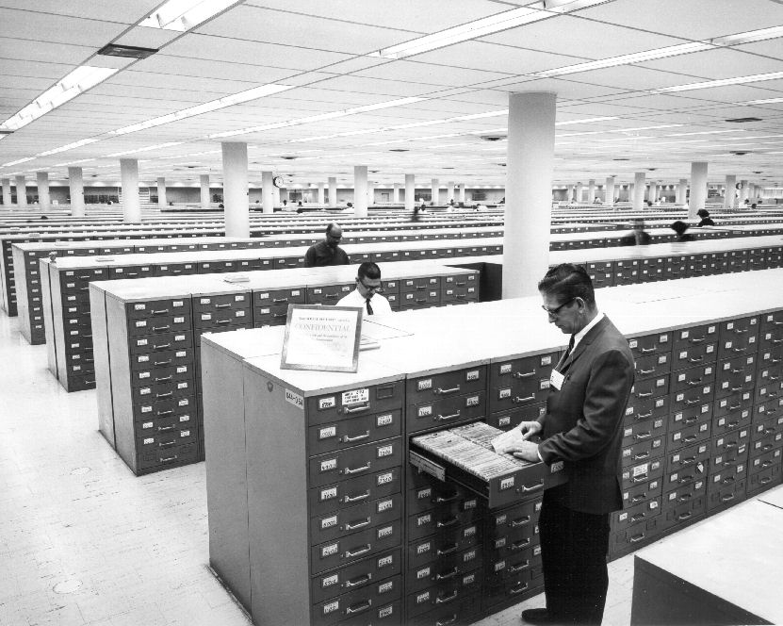
Relational Databases

Slide 6
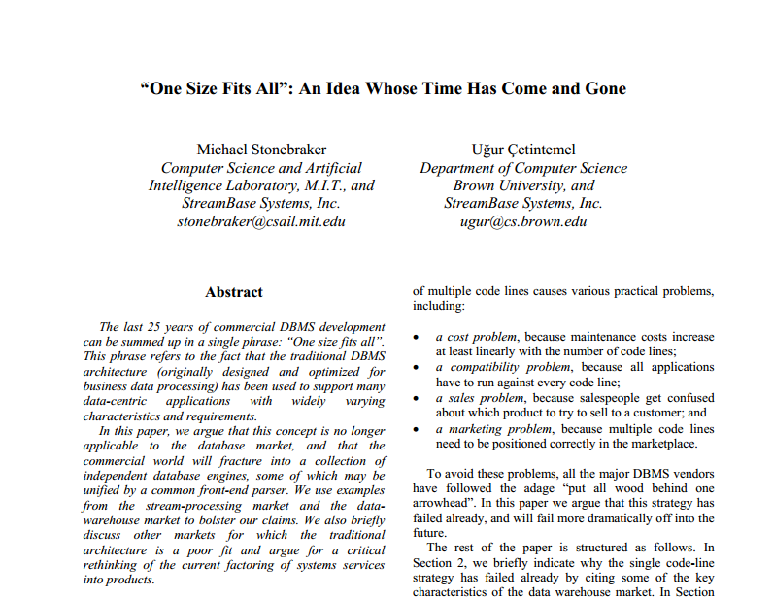
Relational Databases: One Size Fits All?

Slide 7
SQL
Difficult to optimise
Difficult to distribute
Declarative language
Expressive
ACID
Costly to implement
Difficult to distribute
Guarantees correct behaviour
Support transactions

Slide 8
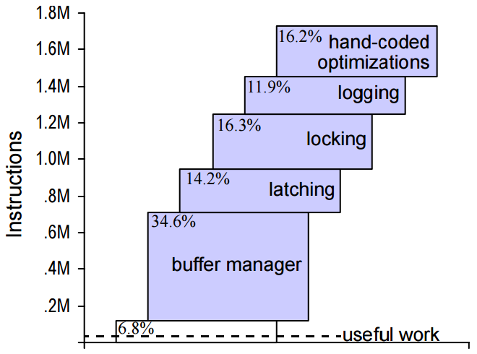
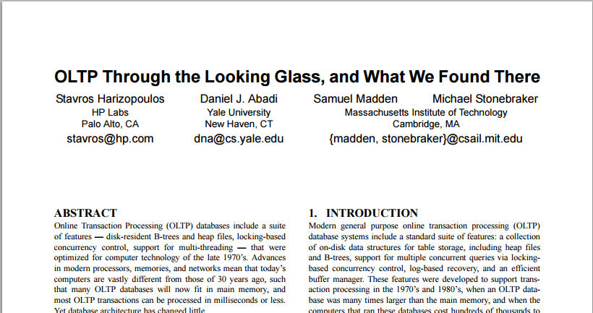
Transactional overhead: the cost of ACID
640 transactions per second for system with full transactional support (ACID)
12,700 transactions per second for system without logs, transactions or lock scheduling

Slide 9
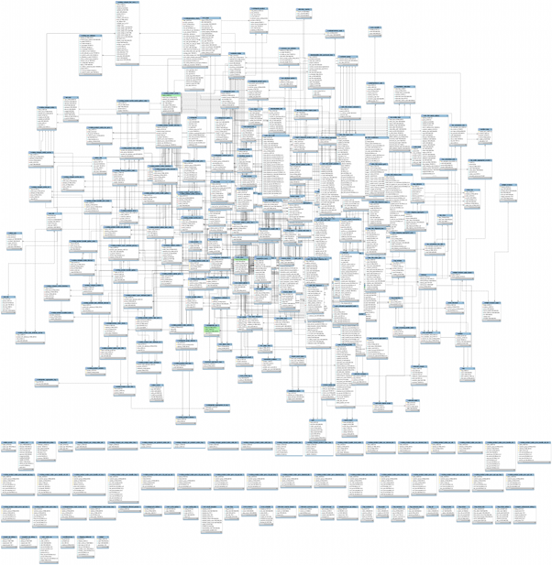
RDBMS: Complexity

Slide 10
Alternatives to Relational Databases For Big Data?

Slide 11
NoSQL
Anybody know anything about NoSQL?

Slide 12
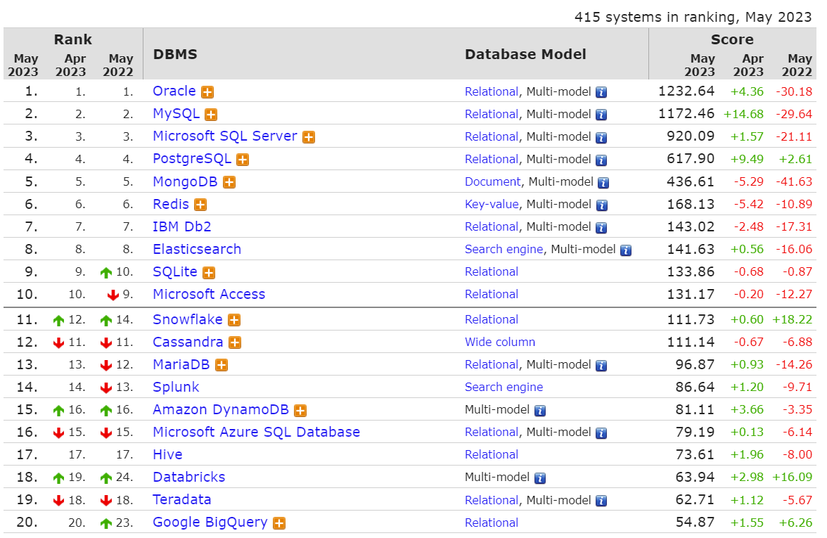
http://db-engines.com/en/ranking

Slide 13
NoSQL: features vs. scale/performance

Slide 14
NoSQL: common characteristics
Often distributed
Often simpler languages than SQL
Different flavours (for different scenarios)

Slide 15
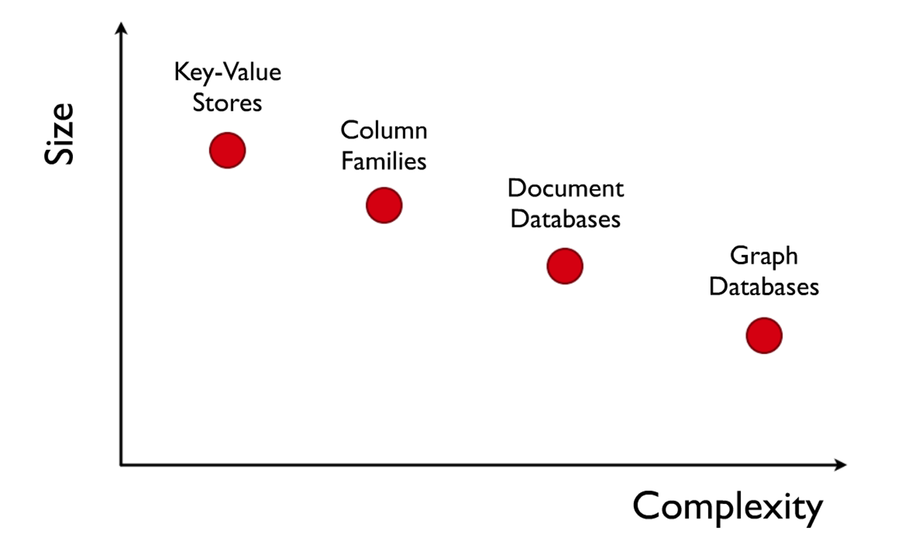
NoSQL: four main flavours

Slide 16
Limitations of distributed computing: CAP Theorem

Slide 17
But first … ACID
For traditional (non-distributed) databases …
Atomicity:
Transactions all or nothing: fail cleanly
Consistency:
Doesn’t break constraints/rules
Isolation:
Parallel transactions act as if sequential
Durability
System remembers changes

Slide 18
What is CAP?
Three guarantees a distributed sys. could make
Consistency:
All nodes have a consistent view of the system
Availability:
Every read/write is acted upon
Partition-tolerance:
The system works even if messages are lost
CA in CAP not the same as CA in ACID!!

Slide 19
A Distributed System (with Replication)
F–J
K–S
A–E
T–Z
T–Z
A–E
F–J
K–S

Slide 20
Consistency
F–J
K–S
A–E
T–Z
There’s 891 users in ‘M’
There’s 891 users in ‘M’
T–Z
A–E
F–J
K–S

Slide 21
Availability
891
F–J
K–S
A–E
T–Z
T–Z
A–E
F–J
K–S
How many users start with ‘M’

Slide 22
Partition tolerance
891
F–J
K–S
A–E
T–Z
T–Z
A–E
F–J
K–S
How many users start with ‘M’

Slide 23
The CAP Question
Can a distributed system guarantee
consistency (all nodes have the same up-to-date view),
availability (every read/write is acted upon) and
partition-tolerance (the system works if messages are lost)
at the same time?
What do you think?

Slide 24
The CAP Answer

Slide 25
The CAP Theorem
A distributed system cannot guarantee
consistency (all nodes have the same up-to-date view),
availability (every read/write is acted upon) and
partition-tolerance (the system works if messages are lost)
at the same time!

Slide 26
The CAP “Proof”
891
There’s 891 users in ‘M’
F–J
K–S
A–E
T–Z
T–Z
A–E
F–J
There’s 892 users in ‘M’
K–S
There’s 891 users in ‘M’
How many users start with ‘M’

Slide 27
The CAP “Proof” (in boring words)
Consider machines m₁ and m₂ on either side of a partition:
If an update is allowed on m₂ (Availability), then m₁ cannot see the change: (loses Consistency)
To make sure that m₁ and m₂ have the same, up-to-date view (Consistency), neither m₁ nor m₂ can accept any requests/updates (lose Availability)
Thus, only when m₁ and m₂ can communicate (lose Partition tolerance) can Availability and Consistency be guaranteed

Slide 28
The CAP Triangle
C
Choose
Two
A
P

Slide 29
CAP Systems
CA: Guarantees to give a correct response but only while network works fine
(Centralised / Traditional)
CP: Guarantees responses are correct even if there are network failures, but response may fail (Weak availability)
C
A
P
(No intersection)
AP: Always provides a “best-effort” response even in presence of network failures (Eventual consistency)

Slide 30
CA System
892
There’s 892 users in ‘M’
There’s 891 users in ‘M’
F–J
K–S
A–E
T–Z
T–Z
A–E
F–J
There’s 892 users in ‘M’
K–S
There’s 891 users in ‘M’
How many users start with ‘M’

Slide 31
CP System
Error
There’s 891 users in ‘M’
F–J
K–S
A–E
T–Z
T–Z
A–E
F–J
There’s 892 users in ‘M’
K–S
There’s 891 users in ‘M’
How many users start with ‘M’

Slide 32
AP System
891
There’s 891 users in ‘M’
F–J
K–S
A–E
T–Z
T–Z
A–E
F–J
There’s 892 users in ‘M’
K–S
There’s 891 users in ‘M’
How many users start with ‘M’

Slide 33
BASE (AP)
Basically Available
Almost always “up”
Soft State
Replicated, cached data
Eventual Consistency
Stale data tolerated, for a while
In what way does Twitter act as a BASE (AP) system?

Slide 34
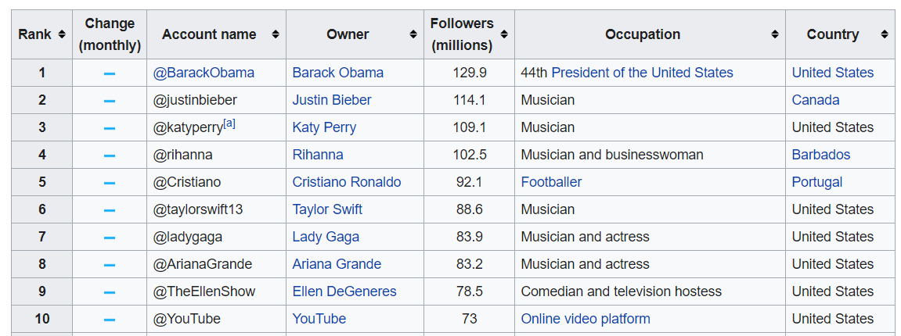
High-fanout creates a “partition”
Users may see retweets of celebrity tweets
before the original tweet.
Later when the original tweet arrives the
timeline will be reordered and made consistent.

Slide 35
CAP in practical distributed systems
C
Fix P
Choose trade-off point between C and A
A
P

Slide 36
Partition Tolerance

Slide 37
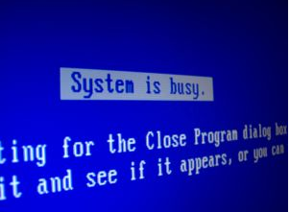
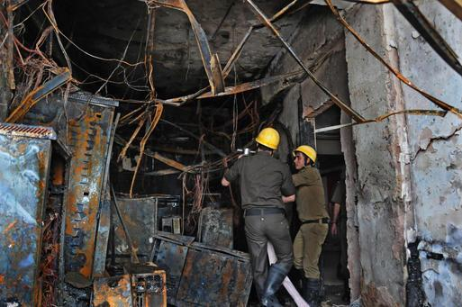
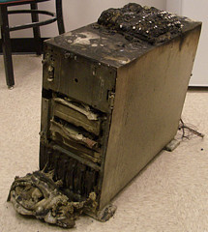
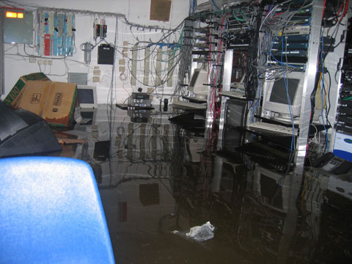
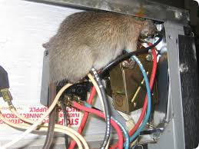
Faults

Slide 38
Fail–Stop Fault
A machine fails to respond or times-out
often hardware or load
need at least f + 1 replicated machines
f = number of fail-stop failures
Word
Count
de 4.575.144
la 2.160.185
en 2.073.216
el 1.844.613
y 1.479.936
…

Slide 39
Byzantine Fault
A machine responds incorrectly/maliciously
How many working machines do we need in the general case to be
robust against Byzantine faults?
?
Word
Count
el 4.575.144
po 2.160.185
sé 2.073.216
ni 1.844.613
al 1.479.936
…
de 4.575.144
la 2.160.185
en 2.073.216
el 1.844.613
y 1.479.936
…
de 4.575.144
la 2.160.185
en 2.073.216
el 1.844.613
y 1.479.936
…

Slide 40
Byzantine Fault
A machine responds incorrectly/maliciously
Need at least 2f +1 replicated machines
f = number of (possibly Byzantine) failures
?
Word
Count
el 4.575.144
po 2.160.185
sé 2.073.216
ni 1.844.613
al 1.479.936
…
de 4.575.144
la 2.160.185
en 2.073.216
el 1.844.613
y 1.479.936
…
de 4.575.144
la 2.160.185
en 2.073.216
el 1.844.613
y 1.479.936
…

Slide 41
Distributed Consensus

Slide 42
Distributed Consensus
Colour of the dress?

Slide 43
Distributed Consensus
Strong consensus: All nodes need to agree
Blue
Blue
Blue
Blue
Blue
Consensus.

Slide 44
Distributed Consensus
Strong consensus: All nodes need to agree
Blue
Blue
White
Blue
Blue
No consensus.

Slide 45
Distributed Consensus
Majority consensus: A majority of nodes need to agree
White
Blue
White
Blue
Blue
Consensus.

Slide 46
Distributed Consensus
Majority consensus: A majority of nodes need to agree
White
Blue
White
Blue
White
Consensus.

Slide 47
Distributed Consensus
Majority consensus: A majority of nodes need to agree
White
Blue
White
Blue
Green
No consensus.

Slide 48
Distributed Consensus
Plurality consensus: A plurality of nodes need to agree
Orange
Blue
White
Blue
Green
Consensus.

Slide 49
Distributed Consensus
Plurality consensus: A plurality of nodes need to agree
White
Blue
White
Blue
Green
No consensus.

Slide 50
Distributed Consensus
Quorum consensus: n nodes need to agree
White
Blue
White
Blue
Blue
n = 3 Consensus.
n = 4 No consensus.

Slide 51
Distributed Consensus
Quorum consensus: n nodes need to agree
White
Blue
White
Blue
Green
n = 2 Consensus.
(First 2 machines asked, but not unique!)

Slide 52
Distributed Consensus
Quorum consensus: n nodes need to agree
White
Blue
White
Blue
Green
Value of n needed for unique consensus with N nodes?
n > N/2

Slide 53
Distributed Consensus
Consensus off: Take first answer
Orange
Blue
White
Blue
Green
Consensus.

Slide 54
Distributed Consensus
CP vs. AP?
Strong consensus: All nodes need to agree
Majority consensus: A majority of nodes need to agree
Plurality consensus: A plurality of nodes need to agree
Quorom consensus: “Fixed” n nodes need to agree
Consensus off: Take first answer
CP
AP

Slide 55
Distributed Consensus
Scale?
Strong consensus: All nodes need to agree
Majority consensus: A majority of nodes need to agree
Plurality consensus: A plurality of nodes need to agree
Quorom consensus: “Fixed” n nodes need to agree
Consensus off: Take first answer
More replication
Less replication

Slide 56
Distributed Consensus
Strong consensus: All nodes need to agree
Majority consensus: A majority of nodes need to agree
Plurality consensus: A plurality of nodes need to agree
Quorom consensus: “Fixed” n nodes need to agree
Consensus off: Take first answer
Choice is application dependent:
Many NoSQL stores allow you to choose
level of consensus/replication

Slide 57
NoSQL: Key–Value stores

Slide 58
NoSQL: Key–Value Stores

Slide 59
Key–Value Store Model
It’s just a Map / Associate Array / Dictionary ☺
put(key,value)
get(key)
delete(key)
Key | Value
Afghanistan | Kabul
Albania | Tirana
Algeria | Algiers
Andorra la Vella | Andorra la Vella
Angola | Luanda
Antigua and Barbuda | St. John’s
… | …

Slide 60
But You Can Do a Lot With a Map
Key | Value
country:Afghanistan | capital@city:Kabul,continent:Asia,pop:31108077#2011
country:Albania | capital@city:Tirana,continent:Europe,pop:3011405#2013
… | …
city:Kabul | country:Afghanistan,pop:3476000#2013
city:Tirana | country:Albania,pop:3011405#2013
… | …
user:10239 | basedIn@city:Tirana,post:{103,10430,201}
… | …
… actually you can model any data in a map (but possibly with a lot of redundancy and inefficient lookups if unsorted).

Slide 61
The Case of Amazon

Slide 62
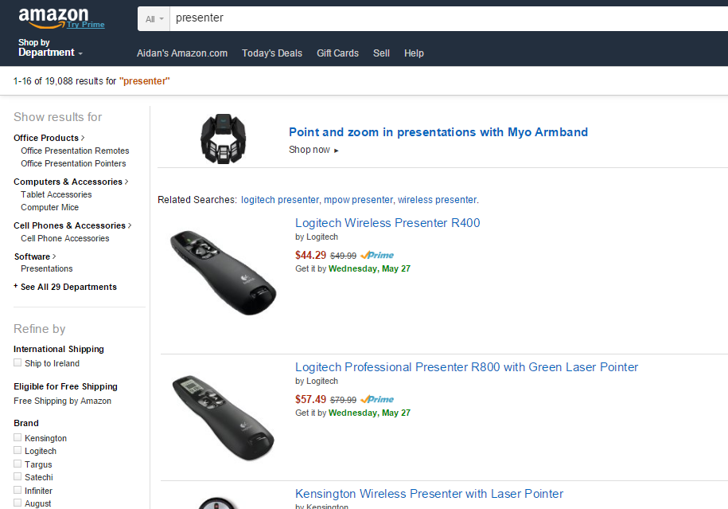
The Amazon Scenario
Products Listings: prices, details, stock

Slide 63
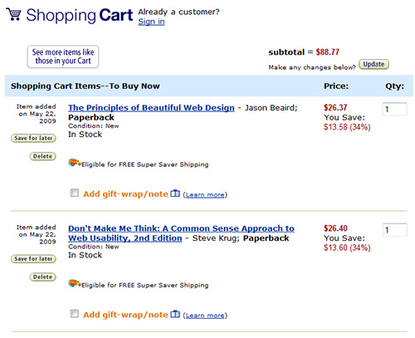
The Amazon Scenario
Customer info: shopping cart, account, etc.

Slide 64
The Amazon Scenario
Recommendations, etc.:

Slide 65
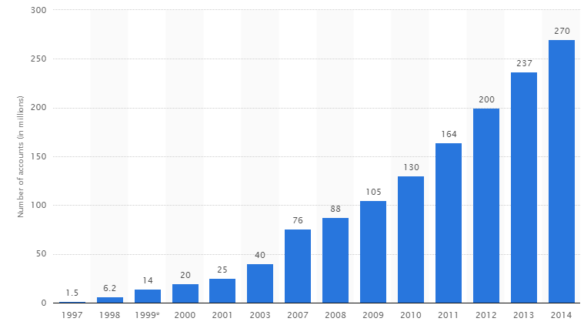
The Amazon Scenario
Amazon customers:

Slide 66
The Amazon Scenario

Slide 67
The Amazon Scenario
Databases struggling …
But many Amazon services don’t need:
SQL (a simple map often enough)
or even:
transactions, strong consistency, etc.

Slide 68
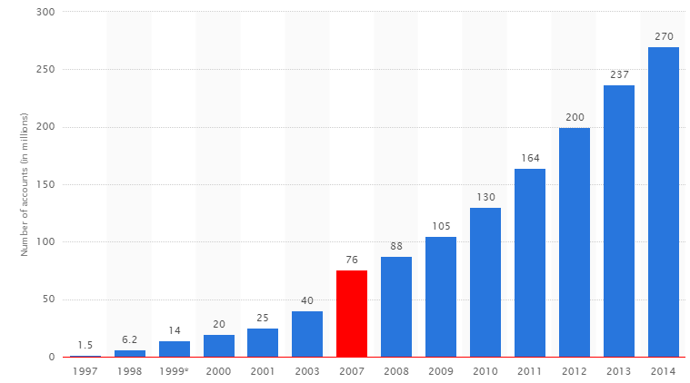
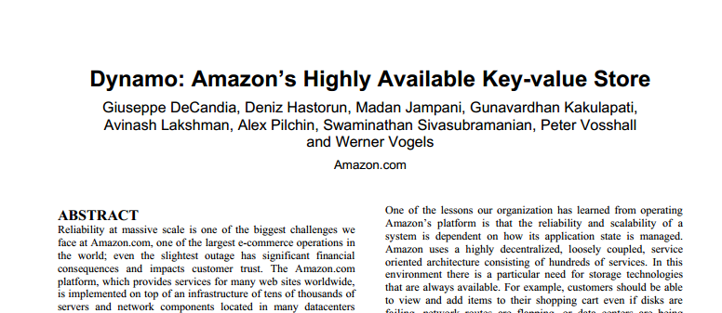
Key–Value Store: Amazon Dynamo(DB)
Goals:
Scalability (able to grow)
High availability (reliable)
Performance (fast)
Don’t need full SQL, don’t need full ACID

Slide 69
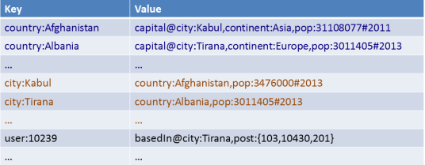
Key–Value Store: Distribution
How might we distribute a key–value store over multiple machines?

Slide 70
Key–Value Store: Distribution
What happens if a machine leaves or joins afterwards?
How can we avoid rehashing everything?

Slide 71
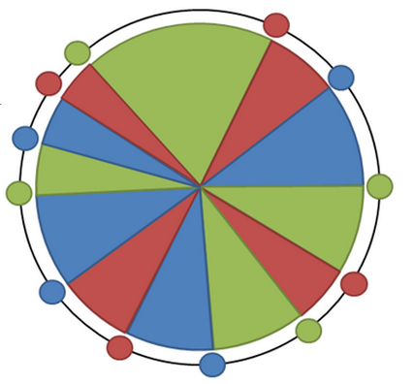
Consistent Hashing
Avoid re-hashing everything
Hash using a ring
Each machine picks n pseudo-random points on the ring
Machine responsible for arc after its point
Objects mapped to ring
If a machine leaves, its range moves to previous machine
If a machine joins, it picks new points

Slide 72
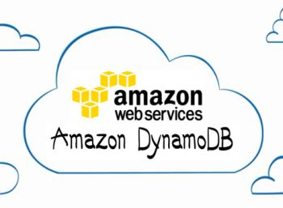
Amazon Dynamo: Hashing
Consistent Hashing (128-bit MD5)

Slide 73
Amazon Dynamo: Replication
A set replication factor (e.g., 3)
Commonly primary / secondary replicas
Primary replica elected from secondary replicas in the case of failure of primary
A1
B1
C1
D1
E1
k
v
k
v
k
v
k
v
k
v
k
v

Slide 74
Amazon Dynamo: Replication
Replication factor of n?
Easy: pick n next buckets (different machines!)

Slide 75
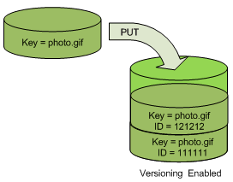
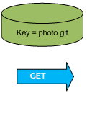
Amazon Dynamo: Object Versioning
Object Versioning (per bucket)
PUT doesn’t overwrite: pushes version
GET returns most recent version

Slide 76
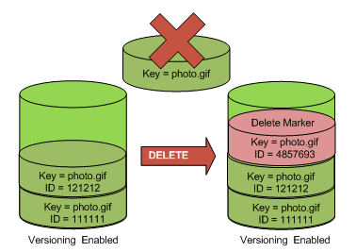
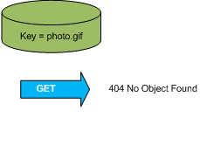
Amazon Dynamo: Object Versioning
Object Versioning (per bucket)
DELETE doesn’t wipe
GET will return not found

Slide 77
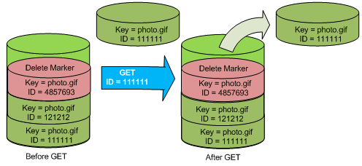
Amazon Dynamo: Object Versioning
Object Versioning (per bucket)
GET by version

Slide 78
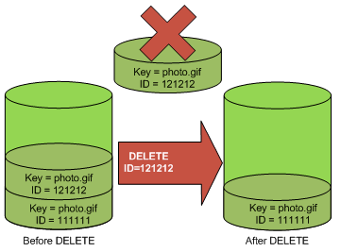
Amazon Dynamo: Object Versioning
Object Versioning (per bucket)
PERMANENT DELETE by version … wiped

Slide 79
Amazon Dynamo: Model
Named table with primary key and a value
Primary key is hashed / unordered
Countries
Primary Key | Value
Afghanistan | capital:Kabul,continent:Asia,pop:31108077#2011
Albania | capital:Tirana,continent:Europe,pop:3011405#2013
… | …
Cities
Primary Key | Value
Kabul | country:Afghanistan,pop:3476000#2013
Tirana | country:Albania,pop:3011405#2013
… | …

Slide 80
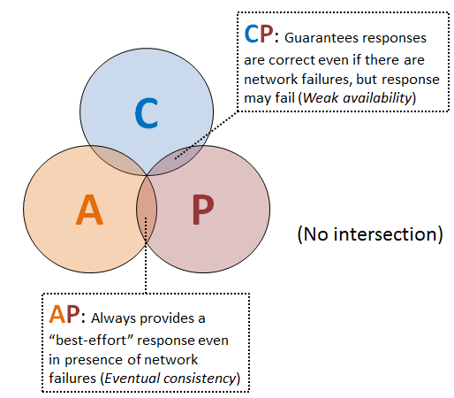
Amazon Dynamo: CAP
Two options for each table:
AP: Eventual consistency, High availability
CP: Strong consistency, Lower availability
What’s a CP system again?
What’s an AP system again?

Slide 81
Amazon Dynamo: Consistency
Gossiping
Keep-alive messages sent between nodes with state
Dynamo largely decentralised (no master node)
Quorums:
Multiple nodes responsible for a read (R) or write (W)
At least R or W nodes acknowledge for success
Higher R or W = Higher consistency, lower availability
Hinted Handoff
For transient failures
A node “covers” for another node while it is down

Slide 82
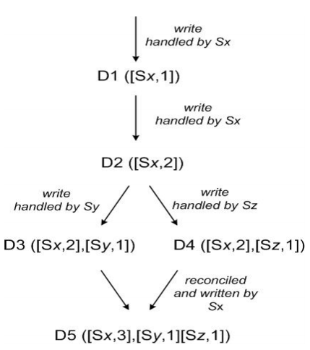
Amazon Dynamo: Consistency
Vector Clock:
A list of pairs indicating a node and operation count
Used to track branches of revisions

Slide 83
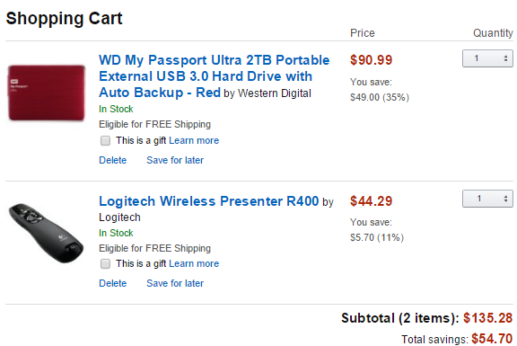
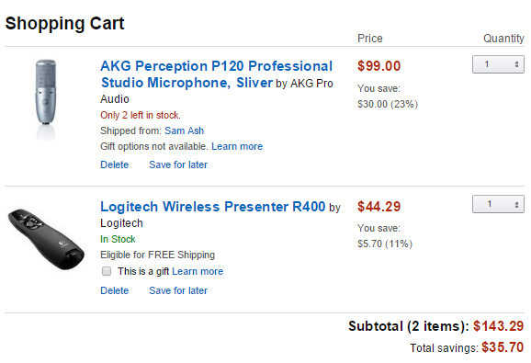
Amazon Dynamo: Consistency
Two versions of one shopping cart:
How best to merge multiple conflicting versions of a value
(known as reconciliation)?
Application knows best
(… and must support multiple versions being returned)

Slide 84
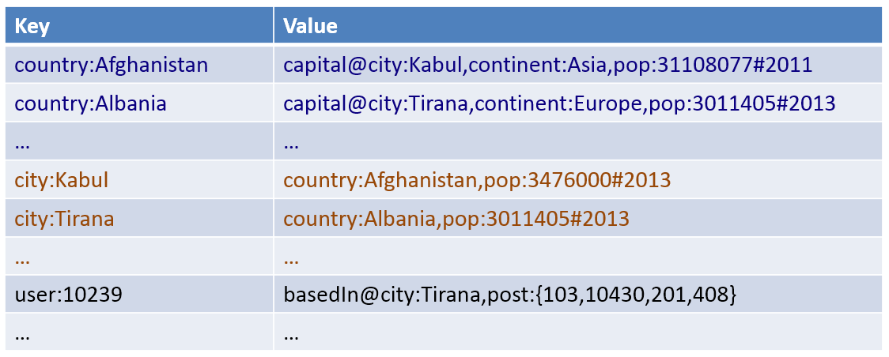
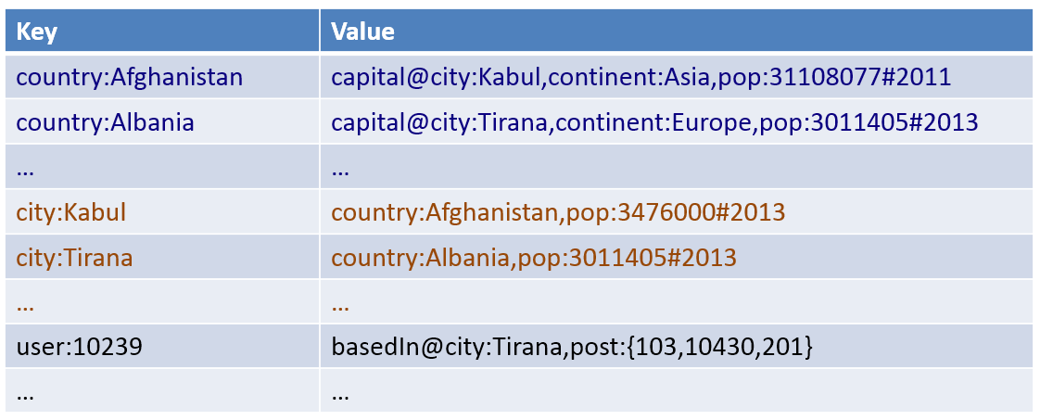
Amazon Dynamo: Consistency
How can we efficiently verify that two copies of a block of
data are the same (and find where the differences are)?

Slide 85
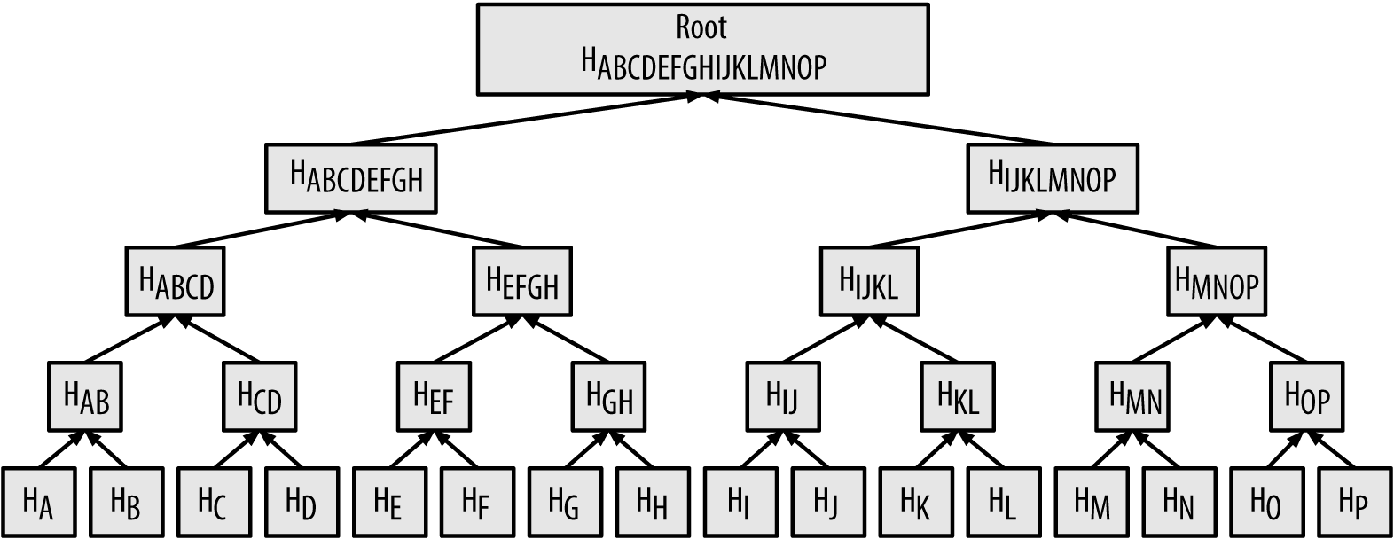
Amazon Dynamo: Merkle Trees
Merkle tree: A hash tree
Leaf node compute hashes from data
Non-leaf nodes have hashes of their children
Find differences between two trees level-by-level

Slide 86
Read More …

Slide 87
Other Key–Value stores

Slide 88
Other Key–Value Stores

Slide 89
Other Key–Value Stores

Slide 90
Other Key–Value Stores

Slide 91
Other Key–Value Stores
Evolved into a
tabular store …

Slide 92
Tabular / Column Family

Slide 93
NoSQL: Column Family Stores

Slide 94
Key–Value = a Distributed Map
Countries
Primary Key | Value
Afghanistan | capital:Kabul,continent:Asia,pop:31108077#2011
Albania | capital:Tirana,continent:Europe,pop:3011405#2013
… | …
Tabular = Multi-dimensional Maps
Countries
Primary Key | capital | continent | pop-value | pop-year
Afghanistan | Kabul | Asia | 31108077 | 2011
Albania | Tirana | Europe | 3011405 | 2013
… | … | … | … | …

Slide 95
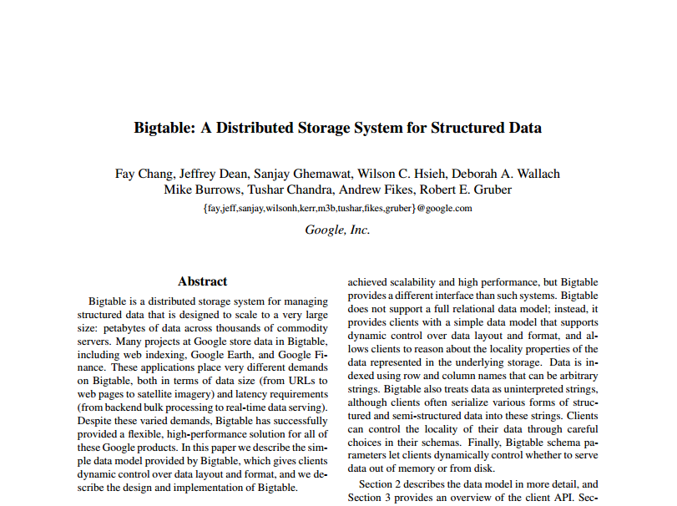
Bigtable: The Original Whitepaper
MapReduce
authors

Slide 96
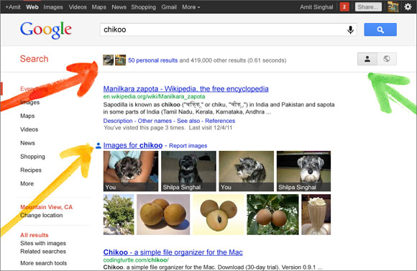
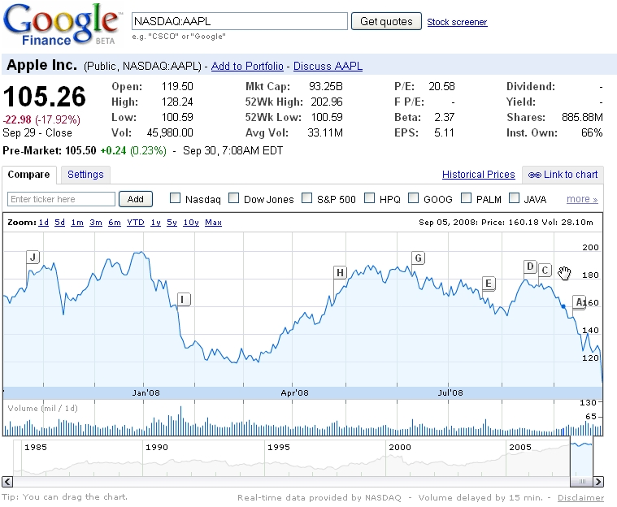
Bigtable used for …
…

Slide 97
Bigtable: Data Model
“a sparse, distributed, persistent, multi-dimensional, sorted map.”
sparse: not all values form a dense square
distributed: lots of machines
persistent: disk storage (GFS)
multi-dimensional: values with columns
sorted: sorting lexicographically by row key
map: look up a key, get a value

Slide 98
Bigtable: in a nutshell
(row, column, time) → value
row: a row id string
e.g., “Afganistan”
column: a column name string
e.g., “pop-value”
time: an integer (64-bit) version time-stamp
e.g., 18545664
value: the element of the cell
e.g., “31120978”

Slide 99
Bigtable: in a nutshell
Primary Key value only!
(row, column, time) → value
(Afganistan,pop-value,t₄) →
31108077
Primary Key | capital |  | continent |  | pop-value |  | pop-year
Afghanistan | t₁ | Kabul | t₁ | Asia | t₁ | 31143292 | t₁ | 2009
 |  |  |  |  | t₂ | 31120978
 |  |  |  |  | t₄ | 31108077 | t₄ | 2011
Albania | t₁ | Tirana | t₁ | Europe | t₁ | 2912380 | t₁ | 2010
 |  |  |  |  | t₃ | 3011405 | t₃ | 2013
… | … |  | … |  | … |  | …

Slide 100
Bigtable: Sorted Keys
Primary Key | capital |  | pop-value |  | pop-year
Asia:Afghanistan | t₁ | Kabul | t₁ | 31143292 | t₁ | 2009
 |  |  | t₂ | 31120978
 |  |  | t₄ | 31108077 | t₄ | 2011
Asia:Azerbaijan | … | … | … | … | … | …
… | … | … | … | … | … | …
Europe:Albania | t₁ | Tirana | t₁ | 2912380 | t₁ | 2010
 |  |  | t₃ | 3011405 | t₃ | 2013
Europe:Andorra | … | … | … | … | … | …
… | … | … | … | … | … | …
S
O
R
T
E
D
Benefits of sorted vs. hashed keys?
Range queries and …

Slide 101
Bigtable: Tablets
Primary Key | capital |  | pop-value |  | pop-year
Asia:Afghanistan | t₁ | Kabul | t₁ | 31143292 | t₁ | 2009
 |  |  | t₂ | 31120978
 |  |  | t₄ | 31108077 | t₄ | 2011
Asia:Azerbaijan | … | … | … | … | … | …
… | … | … | … | … | … | …
Europe:Albania | t₁ | Tirana | t₁ | 2912380 | t₁ | 2010
 |  |  | t₃ | 3011405 | t₃ | 2013
Europe:Andorra | … | … | … | … | … | …
… | … | … | … | … | … | …
A
S
I
A
E
U
R
O
P
E
Benefits of sorted vs. hashed keys?
Range queries and …
... locality of processing

Slide 102
A real-world example of locality/sorting
Primary Key | language |  | title |  | links
com.imdb | t₁ | en | t₁ | IMDb Home | t₁ | …
 |  |  | t₂ | IMDB - Movies
 |  |  | t₄ | IMDb | t₄ | …
com.imdb/title/tt2724064/ | t₁ | en | t₂ | Sharknado | t₂ | …
com.imdb/title/tt3062074/ | t₁ | en | t₂ | Sharknado II | t₂
… | … | … | … | … | … | …
org.wikipedia | t₁ | multi | t₁ | Wikipedia | t₁ | …
 |  |  | t₃ | Wikipedia Home | t₃ | …
org.wikipedia.ace | t₁ | ace | t₁ | Wikipèdia bahsa Acèh | … | …
… | … | … | … | … | … | …

Slide 103
Bigtable: Distribution
Horizontal range partitioning
Split by tablet

Slide 104
Bigtable: Column Families
Primary Key | pol:capital |  | demo:pop-value |  | demo:pop-year
Asia:Afghanistan | t₁ | Kabul | t₁ | 31143292 | t₁ | 2009
 |  |  | t₂ | 31120978
 |  |  | t₄ | 31108077 | t₄ | 2011
Asia:Azerbaijan | … | … | … | … | … | …
… | … | … | … | … | … | …
Europe:Albania | t₁ | Tirana | t₁ | 2912380 | t₁ | 2010
 |  |  | t₃ | 3011405 | t₃ | 2013
Europe:Andorra | … | … | … | … | … | …
… | … | … | … | … | … | …
Group logically similar columns together
Accessed efficiently together
Access-control and storage: column family level
If of same type, can be compressed

Slide 105
Bigtable: Versioning
Similar to Apache Dynamo
Cell-level
64-bit integer time stamps
Inserts push down current version
Lazy deletions / periodic garbage collection
Two options:
keep last n versions
keep versions newer than t time

Slide 106
Bigtable: SSTable Map Implementation
64k blocks (default) with index in footer (GFS)
Index loaded into memory, allows for seeks
Can be split or merged, as needed
Writes?
Primary Key | pol:capital |  | demo:pop-value |  | demo:pop-year
Asia:Afghanistan | t₁ | Kabul | t₁ | 31143292 | t₁ | 2009
 |  |  | t₂ | 31120978
 |  |  | t₄ | 31108077 | t₄ | 2011
Asia:Azerbaijan | … | … | … | … | … | …
… | … | … | … | … | … | …
Asia:Japan | … | … | … | … | … | …
Asia:Jordan | … | … | … | … | … | …
… | … | … | … | … | … | …
Block 0 / Offset 0 / Asia:Afghanistan
Block 1 / Offset 65536 / Asia: Japan
0
65536
Index:

Slide 107
Bigtable: Buffered/Batched Writes
What’s the danger?
Merge-sort
READ
Memtable
In-memory
GFS
Tablet
Tablet log
SSTable1
SSTable2
SSTable3
WRITE

Slide 108
Bigtable: Redo Log
If machine fails, Memtable redone from log
Memtable
In-memory
GFS
Tablet
Tablet log
SSTable1
SSTable2
SSTable3

Slide 109
Bigtable: Minor Compaction
When full, write Memtable as SSTable
Problem with performance?
Memtable
Memtable
In-memory
GFS
Tablet
Tablet log
SSTable1
SSTable2
SSTable3
SSTable4

Slide 110
Bigtable: Merge Compaction
Merge some of the SSTables (and the Memtable)
READ
Memtable
Memtable
In-memory
GFS
Tablet
SSTable1
Tablet log
SSTable1
SSTable2
SSTable3
SSTable4

Slide 111
Bigtable: Major Compaction
Merge all SSTables (and the Memtable)
Makes reads more efficient!
READ
Memtable
In-memory
GFS
Tablet
SSTable1
SSTable1
SSTable2
SSTable3
Tablet log
SSTable1
SSTable4

Slide 112
Bigtable: A Bunch of Other Things
Hierarchy and locks: how to find and lock tablets
Locality groups: Group multiple column families together; assigned a separate SSTable
Select storage: SSTables can be persistent or in-memory
Compression: Applied on SSTable blocks; custom compression can be chosen
Caches: SSTable-level and block-level
Bloom filters: Find negatives cheaply …

Slide 113
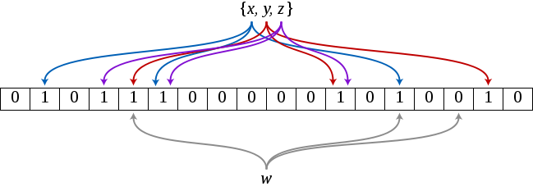
Aside: Bloom Filter
Create a bit array of length m (init to 0’s)
Create k hash functions that map an object to an index of m
Index x: set m[hash₁(x)], …, m[hash_{k}(x)] to 1

Slide 114
Aside: Bloom Filter
Create a bit array of length m (init to 0’s)
Create k hash functions that map an object to an index of m
Index x: set m[hash₁(x)], …, m[hash_{k}(x)] to 1
Query w:
any m[hash₁(w)], …, m[hash_{k}(w)] set to 0 ⇒ not indexed
all m[hash₁(w)], …, m[hash_{k}(w)] set to 1 ⇒ might be indexed

Slide 115
Aside: Bloom Filter
Reject “empty” queries using very little memory!
Create a bit array of length m (init to 0’s)
Create k hash functions that map an object to an index of m
Index x: set m[hash₁(x)], …, m[hash_{k}(x)] to 1
Query w:
any m[hash₁(w)], …, m[hash_{k}(w)] set to 0 ⇒ not indexed
all m[hash₁(w)], …, m[hash_{k}(w)] set to 1 ⇒ might be indexed

Slide 116
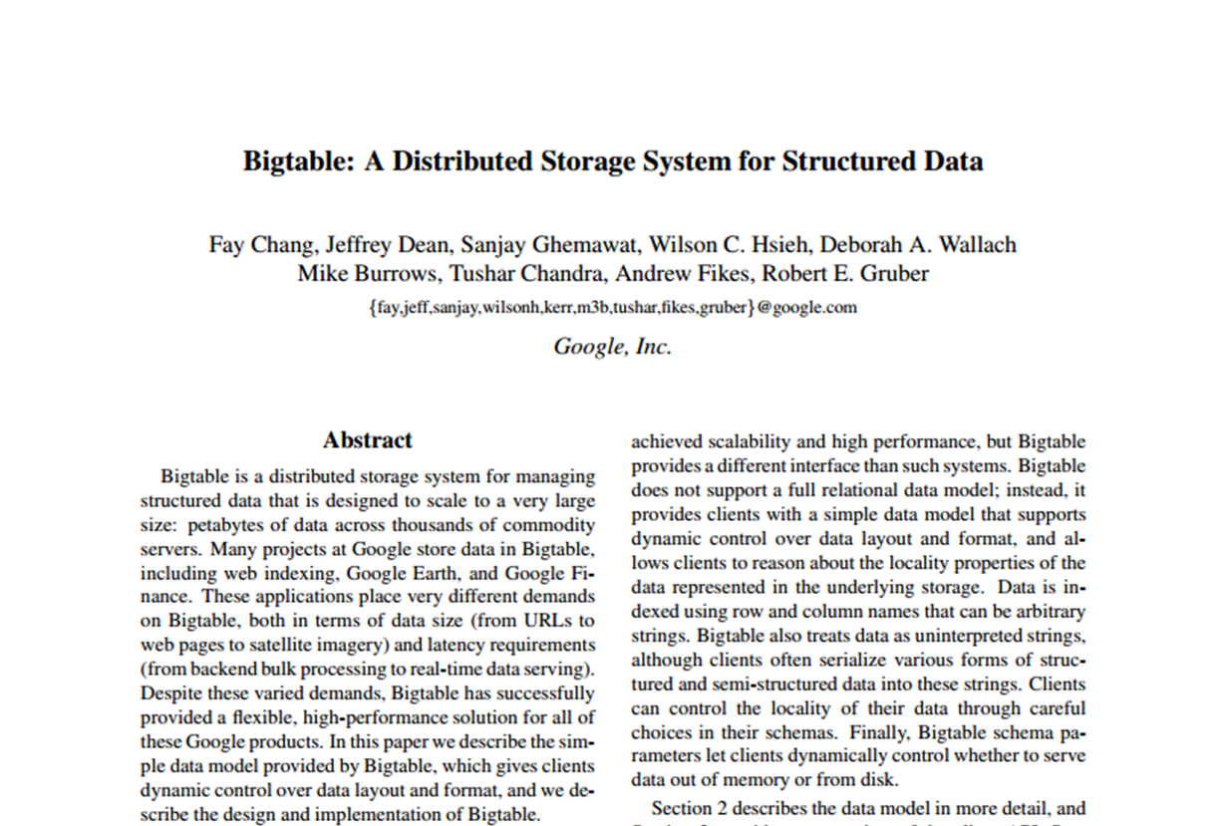
Read More …

Slide 117
Tabular Store: Apache HBase

Slide 118
Tabular Store: Cassandra

Slide 119
Cassandra

Slide 120
Tabular Store
Sales
product | store | client | date | value
1L_Leche | Santiago | 412 | 2020-03-31T08:47:57Z | 900
La_Tercera | Providencia | 413 | 2020-03-31T08:47:59Z | 2000
Nescafe | Providencia | 413 | 2020-03-31T08:47:59Z | 3500
Nescafe | Providencia | 413 | 2020-03-31T08:48:00Z | 3500
Comfort | Valparaíso | 414 | 2020-03-31T08:48:04Z | 2300
Nescafe | Providencia | 415 | 2020-03-31T08:48:04Z | 3500
Comfort | Valparaíso | 416 | 2020-03-31T08:48:07Z | 2300
1L_Leche | Valparaíso | 416 | 2020-03-31T08:48:07Z | 800
Nescafe | Santiago | 412 | 2020-03-31T08:48:08Z | 3700
La_Tercera | Santiago | 412 | 2020-03-31T08:48:08Z | 2000
Comfort | Santiago | 412 | 2020-03-31T08:48:08Z | 2500
… | … | … | … | …

Slide 121
Cassandra Query Language (CQL)
SELECT [ JSON | DISTINCT ] ( select_clause | '*' )
FROM table_name
[ WHERE where_clause ]
[ GROUP BY group_by_clause ]
[ ORDER BY ordering_clause ]
[ PER PARTITION LIMIT (integer | bind_marker) ]
[ LIMIT (integer | bind_marker) ]
[ ALLOW FILTERING ]
JSON: Return results in JSON format
PER PARTITION LIMIT: Limit the number of rows per partition
ALLOW FILTERING: Allow queries that need to post-filter rows read
https://cassandra.apache.org/doc/latest/cql/index.html

Slide 122
Cassandra Query Language (CQL)
Sales
product | store | client | date | value
1L_Leche | Santiago | 412 | 2020-03-31T08:47:57Z | 900
La_Tercera | Providencia | 413 | 2020-03-31T08:47:59Z | 2000
Nescafe | Providencia | 413 | 2020-03-31T08:47:59Z | 3500
Nescafe | Providencia | 413 | 2020-03-31T08:48:00Z | 3500
Confort | Valparaíso | 414 | 2020-03-31T08:48:04Z | 2300
Nescafe | Providencia | 415 | 2020-03-31T08:48:04Z | 3500
Confort | Valparaíso | 416 | 2020-03-31T08:48:07Z | 2300
1L_Leche | Valparaíso | 416 | 2020-03-31T08:48:07Z | 800
Nescafe | Santiago | 412 | 2020-03-31T08:48:08Z | 3700
La_Tercera | Santiago | 412 | 2020-03-31T08:48:08Z | 2000
Comfort | Santiago | 412 | 2020-03-31T08:48:08Z | 2500
… | … | … | … | …
SELECT * FROM Sales WHERE product = ‘Confort’ AND value < 2500;

Slide 123
Primary key (more accurately, super key)
Partition
Clustering
Sales(product,store,date,client,value)
product | store | date | client | value
1L_Leche | Santiago | 2020-03-31T08:47:57Z | 412 | 900
Confort | Valparaíso | 2020-03-31T08:48:04Z | 414 | 2300
Confort | Valparaíso | 2020-03-31T08:48:07Z | 416 | 2300
product | store | date | client | value
La_Tercera | Providencia | 2020-03-31T08:47:59Z | 413 | 2000
Confort | Santiago | 2020-03-31T08:48:08Z | 412 | 2500
product | store | date | client | value
Nescafe | Providencia | 2020-03-31T08:47:59Z | 413 | 3500
Nescafe | Providencia | 2020-03-31T08:48:00Z | 413 | 3500
Nescafe | Providencia | 2020-03-31T08:48:04Z | 415 | 3500
…

Slide 124
Questions?

