Slide 1
CC5212-1 Procesamiento Masivo de Datos Otoño 2023 Lecture 7 Information Retrieval: Crawling & Indexing
Aidan Hogan
aidhog@gmail.com

Slide 2
Distributed Static
Data Processing
Distributed Dynamic
Data Processing
Distr. Unstructured
Data Management
Distr. (Semi-)structured
Data Management
Distributed Data Processing
Distributed Data Management
Distributed Systems
Local Data Processing

Slide 3
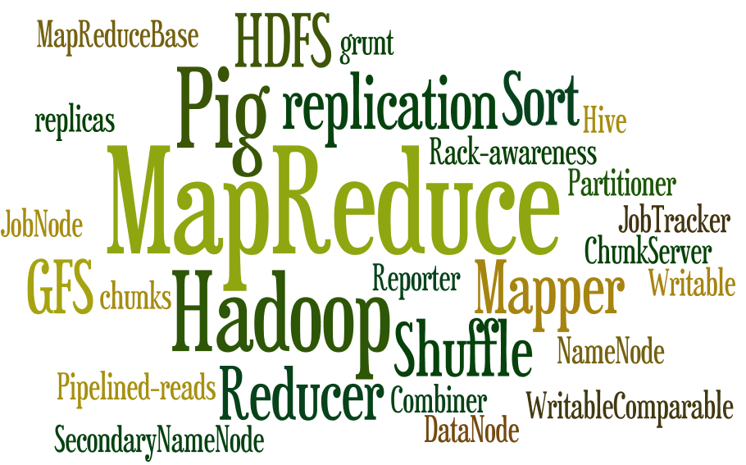

Slide 4
Managing text data

Slide 5
Information Overload

Slide 6
If we didn’t have search …
Contains all books with
25 unique characters
80 characters per line
40 lines per page
410 pages
410 x 40 x 80 = 1,312,000 chars
${25}^{1,312,000}$ books
Would contain any book imaginable
Including a book with the location of useful books
All information = Zero information

Slide 7
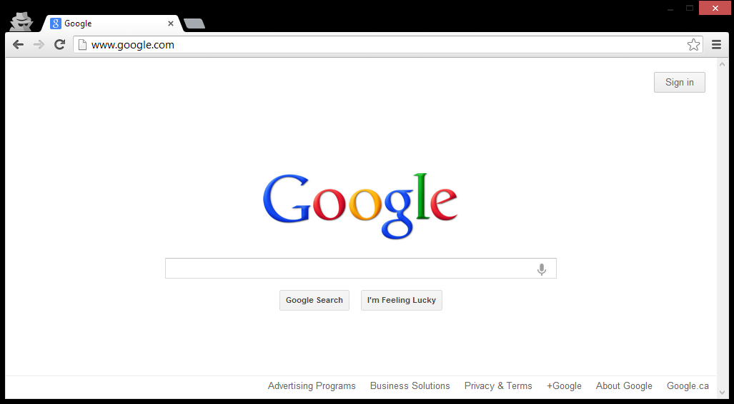
The book that indexes the library

Slide 8
Web Search/Retrieval

Slide 9
Building Google Web-search

Slide 10
Building Google Web-search
What processes/algorithms does Google
need to implement Web search?
Crawling
Parse links from webpages
Schedule links for crawling
Download pages, GOTO 1
Indexing
Parse keywords from webpages
Index keywords to webpages
Manage updates
Ranking
How relevant is a page? (TF-IDF)
How important is it? (PageRank)
How many users clicked it?
...

Slide 11
Information Retrieval: Crawling

Slide 12
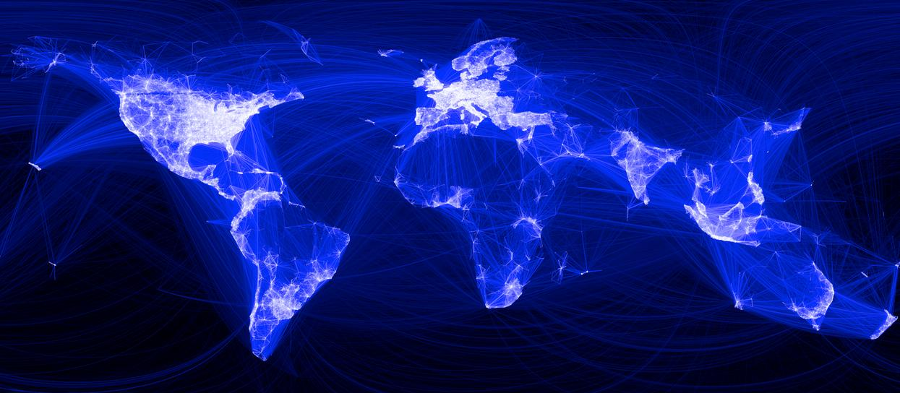
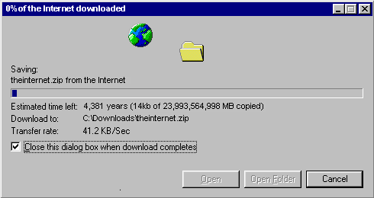
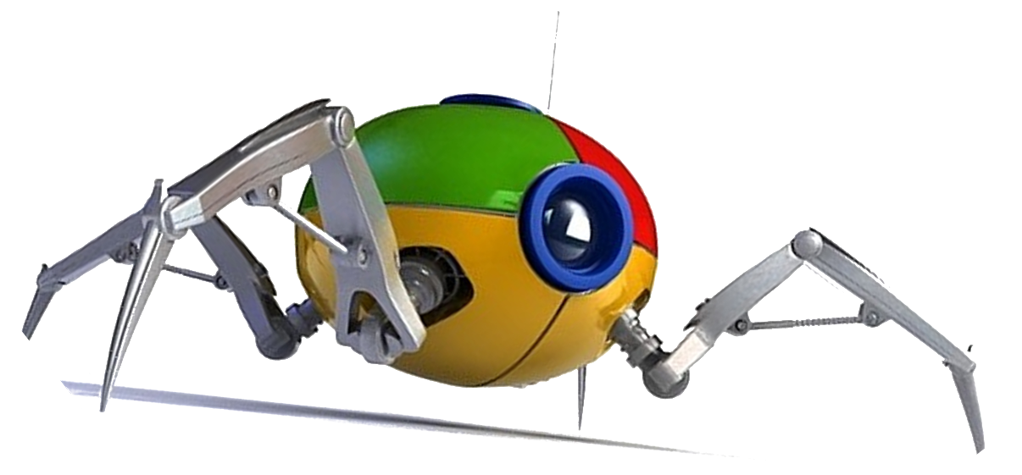
How does Google know about the Web?

Slide 13
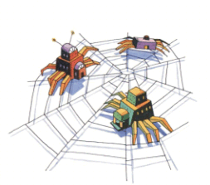
Crawling
Download the Web. ☺
crawl(list seedUrls)
frontier_i = seedUrls
while !frontier_i.isEmpty()
new list frontier_i+1
for url : frontier_i
page = downloadPage(url)
frontier_i+1.addAll(extractUrls(page))
store(page)
i++
What’s missing?

Slide 14
Crawling: Avoid Cycles
Download the Web. ☺
crawl(list seedUrls)
frontier_i = seedUrls
new set urlsSeen
while !frontier_i.isEmpty()
new list frontier_i+1
for url : frontier_i
page = downloadPage(url)
urlsSeen.add(url)
frontier_i+1.addAll(extractUrls(page).removeAll(urlsSeen))
store(page)
i++
Performance?

Slide 15
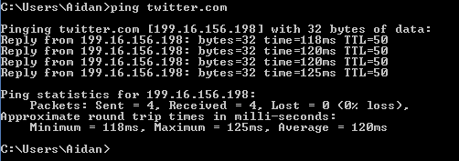
Crawling: Performance
Download the Web. ☺
crawl(list seedUrls)
frontier_i = seedUrls
new set urlsSeen
while !frontier_i.isEmpty()
new list frontier_i+1
for url : frontier_i
page = downloadPage(url)
urlsSeen.add(url)
frontier_i+1.addAll(extractUrls(page).removeAll(urlsSeen))
store(page)
i++
Majority of time spent waiting for connection
Disk/CPU usage will be near 0
Bandwidth will not be maximised
Performance?

Slide 16
Crawling: Performance
Download the Web. ☺
crawl(list seedUrls)
frontier_i = seedUrls
new set urlsSeen
while !frontier_i.isEmpty()
new list frontier_i+1
for url : frontier_i
page = downloadPage(url)
urlsSeen.add(url)
frontier_i+1.addAll(extractUrls(page).removeAll(urlsSeen))
store(page)
i++
Solution?

Slide 17
Crawling: Multi-threading Important
crawl(list seedUrls)
frontier_i = seedUrls
new set urlsSeen
while !frontier_i.isEmpty()
new list frontier_i+1
new list threads
for url : frontier_i
thread = new DownloadThread.run(url,urlsSeen,frontier_i+1)
threads.add(thread)
threads.poll()
i++
DownloadThread: run(url,urlsSeen,frontier_i+1)
page = downloadPage(url)
synchronised: urlsSeen.add(url)
synchronised: frontier_i+1.addAll(extractUrls(page).removeAll(urlsSeen))
synchronised: store(page)

Slide 18
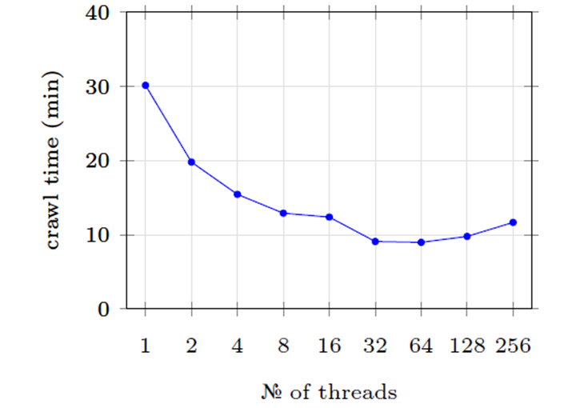
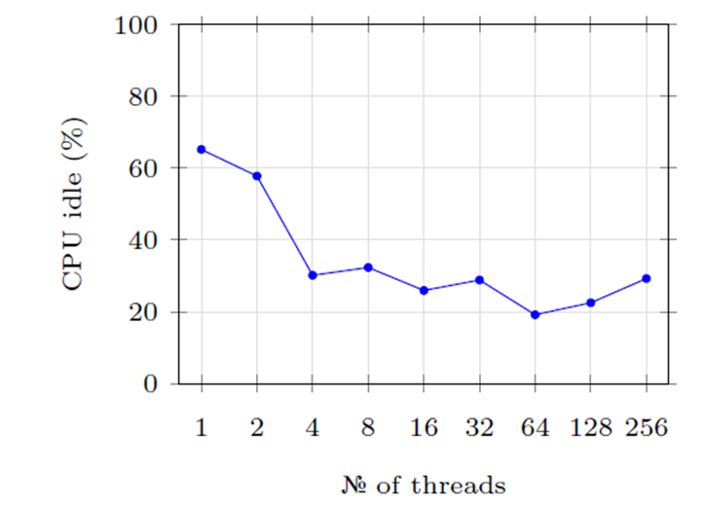
Crawling: Multi-threading Important
Crawl 1,000 URLs …

Slide 19
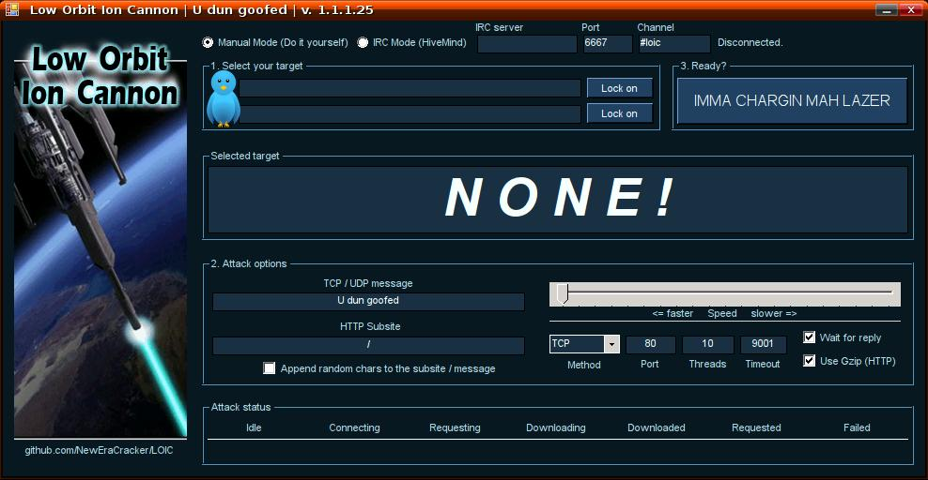
Crawling: Important to be Polite!
(Distributed) Denial of Server Attack: (D)DoS

Slide 20
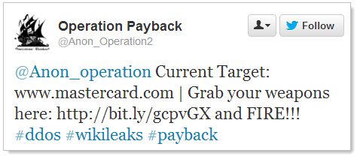
Crawling: Avoid (D)DoSing
… more likely your IP range will be banned
Christopher Weatherhead
18 months prison

Slide 21
Crawling: Web-site Scheduler
crawl(list seedUrls)
frontier_i = seedUrls
new set urlsSeen
while !frontier_i.isEmpty()
new list frontier_i+1
new list threads
for url : schedule(frontier_i) # maximise gap between requests to one site
thread = new DownloadThread.run(url,urlsSeen,frontier_i+1)
threads.add(thread)
threads.poll()
i++
DownloadThread: run(url,urlsSeen,frontier_i+1)
page = downloadPage(url)
synchronised: urlsSeen.add(url)
synchronised: frontier_i+1.addAll(extractUrls(page).removeAll(urlsSeen))
synchronised: store(page)

Slide 22
Robots Exclusion Protocol
http://website.com/robots.txt
User-agent: *
Disallow: /
No bots allowed on the website.
User-agent: *
Disallow: /user/
Disallow: /main/login.html
No bots allowed in /user/ sub-folder or login page.
User-agent: googlebot
Disallow: /
Ban only the bot with “user-agent” googlebot.

Slide 23
Robots Exclusion Protocol (non-standard)
User-agent: googlebot
Crawl-delay: 10
Tell the googlebot to only crawl a page from this host no more than once every 10 seconds.
User-agent: *
Disallow: /
Allow: /public/
Ban everything but the /public/ folder for all agents
User-agent: *
Sitemap: http://example.com/main/sitemap.xml
Tell user-agents about your site-map

Slide 24
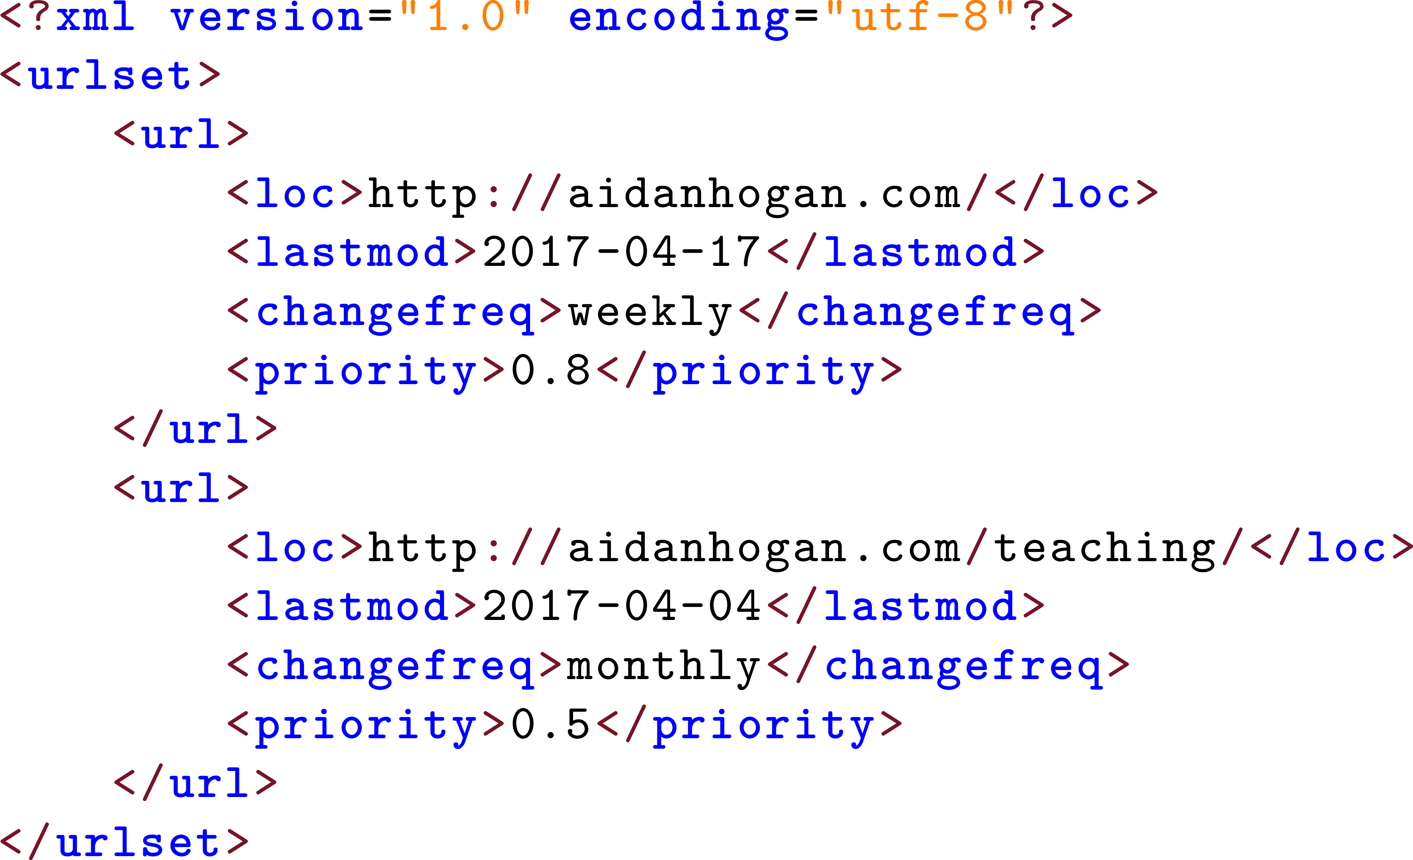
Site-Map: Additional crawler information

Slide 25
Crawling: Important Points
Seed-list: Entry point for crawling
Frontier: Extract links from current pages for next round
Seen-list: Avoid cycles
Threading: Keep machines busy
Politeness: Don’t annoy web-sites
Set delay between crawling pages on the same web-site
Stick to what’s stated in the robots.txt file
Check for a site-map

Slide 26
Crawling: Distribution
How might we implement a distributed crawler?
for url : frontier_i-1
map(url,count)
1
2
3
4
5
Similar benefits to multi-threading
What will be the bottleneck as machines increase?
Bandwidth or politeness delays

Slide 27
Crawling: All the Web?
Can we crawl all the Web?

Slide 28
Crawling: All the Web?
Can we crawl all the Web?
Can Google crawl all the Web?

Slide 29
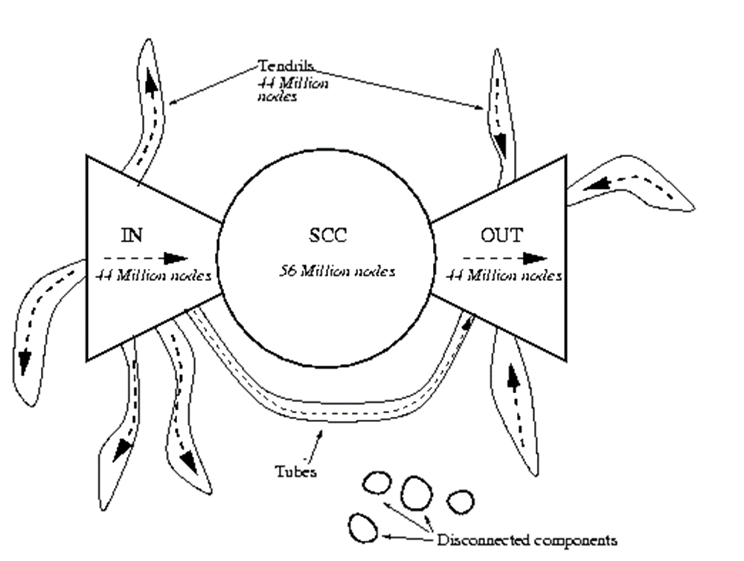
Crawling: Inaccessible (Bow-Tie)
Broder et al. “Graph structure in the web,” Comput. Networks, vol. 33, no. 1-6, pp. 309–320, 2000

Slide 30
Crawling: Inaccessible (Deep Web)
What is the Deep Web?

Slide 31
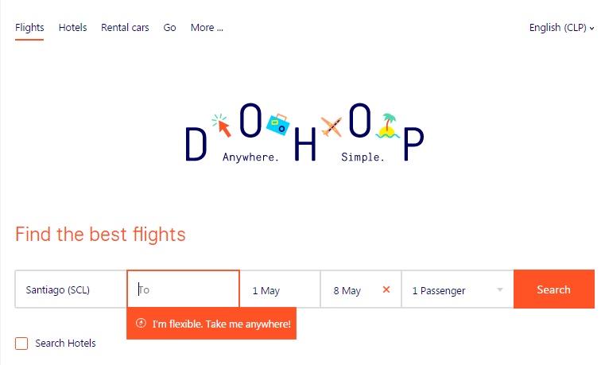
Crawling: Inaccessible (Deep Web)
What is the Deep Web?
Dynamically-generated content

Slide 32
Crawling: Inaccessible (Deep Web)
What is the Deep Web?
Dynamically-generated content
Password-protected

Slide 33
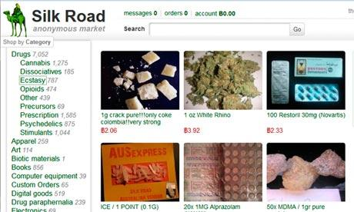
Crawling: Inaccessible (Deep Web)
What is the Deep Web?
Dynamically-generated content
Password-protected
Dark Web

Slide 34
Crawling: Inaccessible (Deep Web)
What is the Deep Web?
Dynamically-generated content
Password-protected
Dark Web
46% of statistics made up on the spot

Slide 35
Crawling: All the Web?
Can we crawl all the Web?
Can Google crawl all the Web?
Can Google crawl itself?

Slide 36
Apache Nutch
Open-source crawling framework!
Compatible with Hadoop!
https://nutch.apache.org/

Slide 37
Information Retrieval: Inverted Indexing

Slide 38
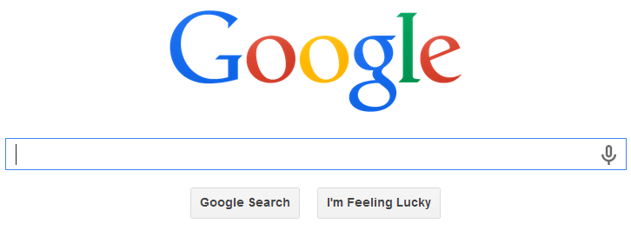
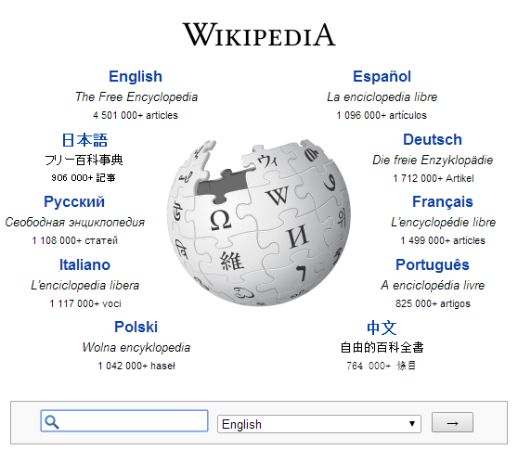
Inverted Index
Inverted Index: A map from words to documents
“Inverted” because usually documents map to words
Examples of applications?

Slide 39
Inverted Index: Example
1
Fruitvale Station is a 2013 American drama film written and directed by Ryan Coogler.
Term List | Posting List
a | (1,2,…)
american | (1,5,…)
and | (1,2,…)
by | (1,2,…)
directed | (1,2,…)
drama | (1,16,…)
… | …
Inverted index:

Slide 40
Inverted Index: Example Search
american drama
AND: Intersect posting lists
OR: Union posting lists
PHRASE: ???
How should we implement PHRASE?
Term List | Posting List
a | (1,2,…)
american | (1,5,…)
and | (1,2,…)
by | (1,2,…)
directed | (1,2,…)
drama | (1,16,…)
… | …
Inverted index:

Slide 41
Inverted Index: Example
1
1 10 18 21 23 28 37 43 48 56 60 69 72 77
Fruitvale Station is a 2013 American drama film written and directed by Ryan Coogler.
Term List | Posting List
a | (1,[21,96,103,…]), (2,[…]), …
american | (1,[28,123]), (5,[…]), …
and | (1,[56,139,…]), (2,[…]), …
by | (1,[69,157,…]), (2,[…]), …
directed | (1,[60,212,…]), (4,[…]), …
drama | (1,[37,87,…]), (16,[…]), …
… | …
Inverted index:

Slide 42
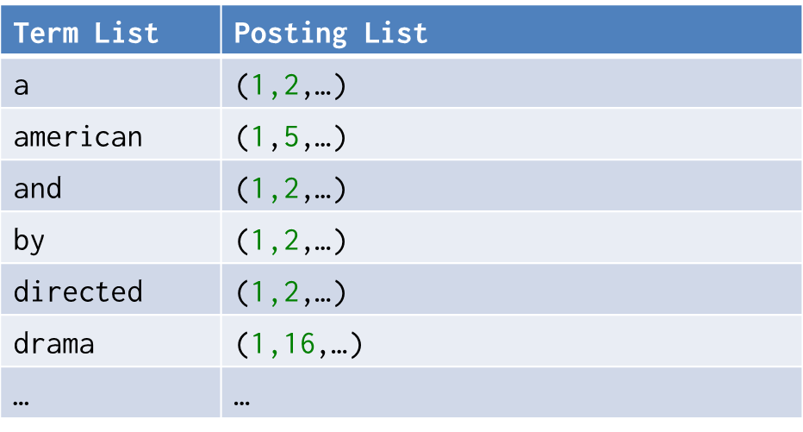
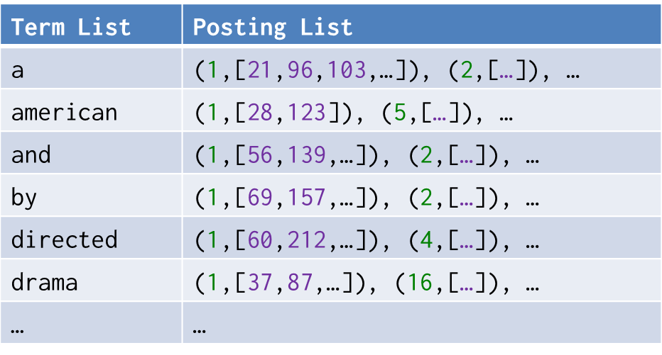
Inverted Index: Flavours
Record-level inverted index:
Maps words to documents without positional information
Word-level inverted index:
Additionally maps words with positional information

Slide 43
Inverted Index: Word Normalisation
drama america
How can we solve this problem?
Term List | Posting List
a | (1,[21,96,103,…]), (2,[…]), …
american | (1,[28,123]), (5,[…]), …
and | (1,[56,139,…]), (2,[…]), …
by | (1,[69,157,…]), (2,[…]), …
directed | (1,[60,212,…]), (4,[…]), …
drama | (1,[37,87,…]), (16,[…]), …
… | …
Inverted index:

Slide 44
Inverted Index: Word Normalisation
drama america
How can we solve this problem?
Normalise words:
Stemming cuts the ends off of words using generic rules:
{ America , American , americas , americanise } → { america }
Term List | Posting List
a | (1,[21,96,103,…]), (2,[…]), …
american | (1,[28,123]), (5,[…]), …
and | (1,[56,139,…]), (2,[…]), …
by | (1,[69,157,…]), (2,[…]), …
directed | (1,[60,212,…]), (4,[…]), …
drama | (1,[37,87,…]), (16,[…]), …
… | …
Inverted index:

Slide 45
Inverted Index: Word Normalisation
drama america
How can we solve this problem?
Normalise words:
Stemming cuts the ends off of words using generic rules:
{ America , American , americas , americanise } → { america }
Lemmatisation uses knowledge of the word to normalise:
{ better , goodly , best } → { good }
Term List | Posting List
a | (1,[21,96,103,…]), (2,[…]), …
american | (1,[28,123]), (5,[…]), …
and | (1,[57,139,…]), (2,[…]), …
by | (1,[70,157,…]), (2,[…]), …
directed | (1,[61,212,…]), (4,[…]), …
drama | (1,[38,87,…]), (16,[…]), …
… | …
Inverted index:

Slide 46
Inverted Index: Word Normalisation
drama america
How can we solve this problem?
Normalise words:
Stemming cuts the ends off of words using generic rules:
{ America , American , americas , americanise } → { america }
Lemmatisation uses knowledge of the word to normalise:
{ better , goodly , best } → { good }
Synonym expansion
{ film , movie } → { movie }
Term List | Posting List
a | (1,[21,96,103,…]), (2,[…]), …
american | (1,[28,123]), (5,[…]), …
and | (1,[57,139,…]), (2,[…]), …
by | (1,[70,157,…]), (2,[…]), …
directed | (1,[61,212,…]), (4,[…]), …
drama | (1,[38,87,…]), (16,[…]), …
… | …
Inverted index:

Slide 47
Inverted Index: Word Normalisation
drama america
How can we solve this problem?
Normalise words:
Stemming cuts the ends off of words using generic rules:
{ America , American , americas , americanise } → { america }
Lemmatisation uses knowledge of the word to normalise:
{ better , goodly , best } → { good }
Synonym expansion
{ film , movie } → { movie }
Term List | Posting List
a | (1,[21,96,103,…]), (2,[…]), …
american | (1,[28,123]), (5,[…]), …
and | (1,[57,139,…]), (2,[…]), …
by | (1,[70,157,…]), (2,[…]), …
directed | (1,[61,212,…]), (4,[…]), …
drama | (1,[38,87,…]), (16,[…]), …
… | …
Inverted index:
Language specific!
Use same normalisation on query and document!

Slide 48
Inverted Index: Space
Record-level inverted index:
Maps words to documents without positional information
Space?
Word-level inverted index:
Additionally maps words with positional information
Space?

Slide 49
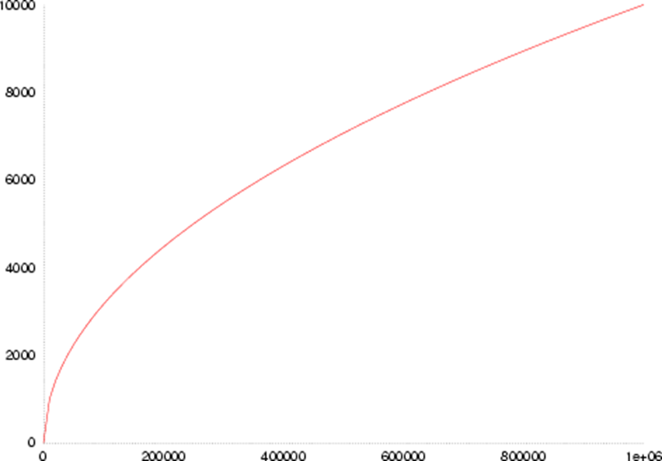
Inverted Index: Unique Words
Not so many unique words …
Heap’s law:
English text
K ∈ [10,100]
β ∈ [0.4,0.6]
Raw words versus unique words
Number of unique words in text
Number of words in text

Slide 50
Inverted Index: Space
Record-level inverted index:
Maps words to documents without positional information
Space?
Word-level inverted index:
Additionally maps words with positional information
Space?

Slide 51
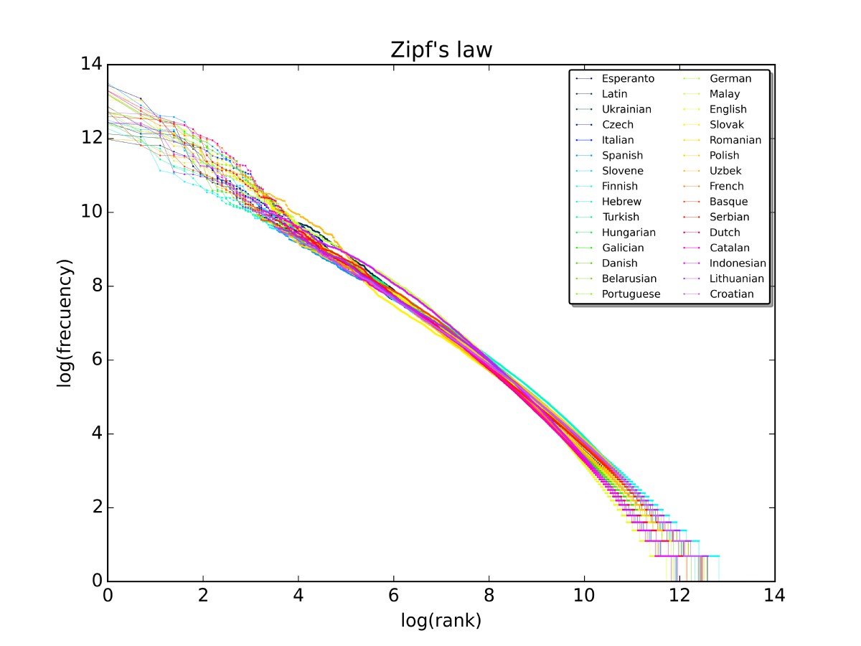
Inverted Index: Common Words
Many occurrences of few words
/ Few occurrences of many words
Zipf’s law
In English text:
“the” 7%
“of” 3.5%
“and” 2.7%
135 words cover half of all occurrences
Zipf’s law: the most popular word will occur twice as often as the second most popular word, thrice as often as the third most popular word, n times as often as the n-most popular word.

Slide 52
Inverted Index: Common Words
Many occurrences of few words
/ Few occurrences of many words
Zipf’s law
In English text:
“the” 7%
“of” 3.5%
“and” 2.7%
135 words cover half of all occurrences
Expect long posting lists for common words
Zipf’s law: the most popular word will occur twice as often as the second most popular word, thrice as often as the third most popular word, n times as often as the n-most popular word.

Slide 53
Inverted Index: Common Words
Perhaps implement stop-words?
Most common words contain least information
the drama in america

Slide 54
Inverted Index: Common Words
Perhaps implement stop-words?
Perhaps implement block-addressing?
Fruitvale Station is a 2013 American drama film written and directed by Ryan Coogler.
Block 1
Block 2
Term List | Posting List
a | (1,[1,…]), (2,[…]), …
american | (1,[1,…]), (5,[…]), …
and | (1,[2, …]), (2,[…]), …
by | (1,[2, …]), (2,[…]), …
… | …
What is the effect on phrase search?
Small blocks ~ okay
Big blocks ~ not okay

Slide 55
Inverted Index: Common Words
Many occurrences of few words
/ Few occurrences of many words
Zipf’s law
In English text:
“the” 7%
“of” 3.5%
“and” 2.7%
135 words cover half of all occurrences
Expect long posting lists for common words
Expect more queries with common words
Zipf’s law: the most popular word will occur twice as often as the second most popular word, thrice as often as the third most popular word, n times as often as the n-most popular word.

Slide 56
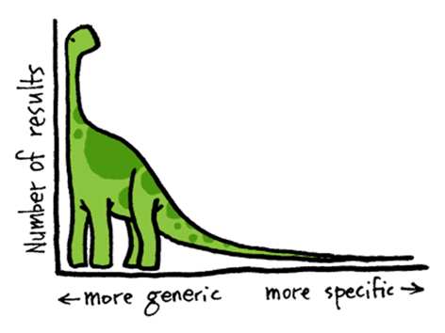
The Long Tail of Search

Slide 57
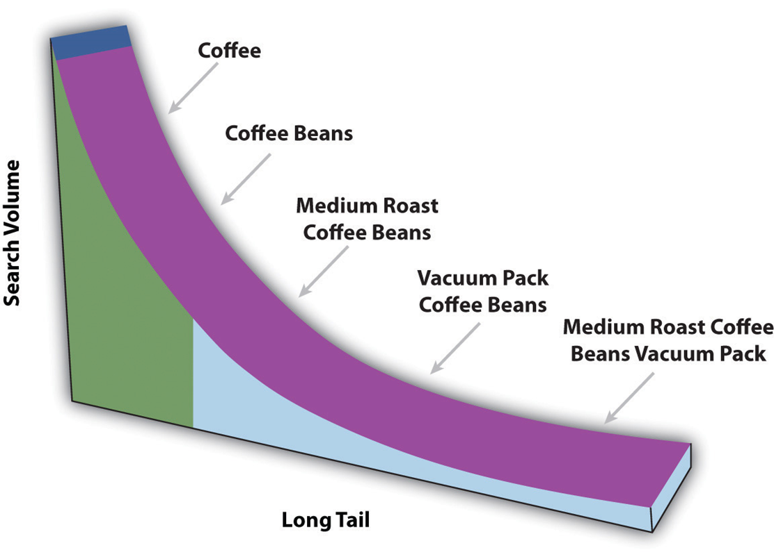
The Long Tail of Search
How to optimise for this?
Caching for common queries like “coffee”

Slide 58
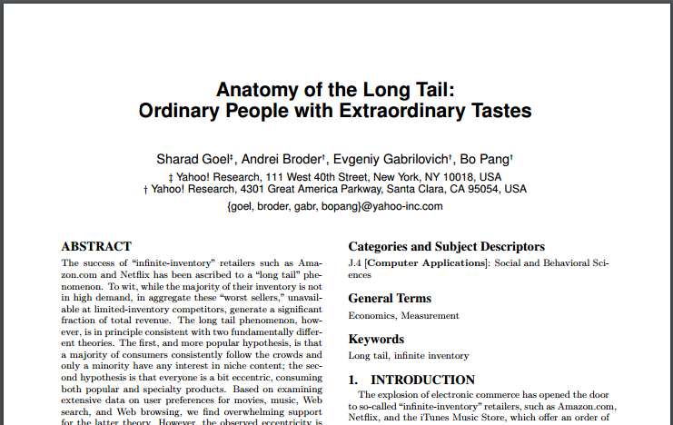
If interested …

Slide 59
Search Implementation
Vocabulary keys:
Hashing: O(1) lookups (assuming ideal hashing)
no range queries
Sorting/B-Tree: O(log(u)) lookups, u unique words
range queries
Tries: O(l) lookups, l length of the word
range queries, compression
Tries?

Slide 60
Trie
a
b
g
l
a
e
e
o
e
b
c
d
n
y
k
t
s

Slide 61
Memory Sizes
Term list (vocabulary keys) small:
Often will fit in memory (with compression …)!
Posting lists larger:
On disk / Hot regions cached
Term List | Posting List
a | (1,[21,96,103,…]), (2,[…]), …
american | (1,[28,123]), (5,[…]), …
and | (1,[57,139,…]), (2,[…]), …
by | (1,[70,157,…]), (2,[…]), …
directed | (1,[61,212,…]), (4,[…]), …
drama | (1,[38,87,…]), (16,[…]), …
… | …

Slide 62
Compression techniques
Numeric compression important
Term List | Posting List
country | (1), (2), (3), (4), (6), (7), …
… | …

Slide 63
Compression techniques: High Level
Interval indexing
Example for record-level indexing
Could also be applied for block-level indexing, etc.
Term List | Posting List
country | (1), (2), (3), (4), (6), (7), …
… | …
Term List | Posting List
country | (1–4), (6–7),
… | …

Slide 64
Compression techniques: High Level
Gap indexing
Example for record-level indexing
Could also be applied for block-level indexing, etc.
Term List | Posting List
country | (1), (3), (4), (8), (9), …
… | …
Term List | Posting Lists
country | (1), 2, 1, 4, 1
… | …
Benefit?
Repeated small numbers easier to compress!

Slide 65
Compression techniques: Bit Level
Variable length coding: bit-level techniques
For example, Elias γ (gamma) encoding
Assumes many small numbers
z: integer to encode | n = ⌊log₂(z)⌋ coded in unary | a zero marker | next n binary numbers | final Elias γ code
1 | 0 |  |  | 0
2 | 1 | 0 | 0 | 100
3 | 1 | 0 | 1 | 101
4 | 11 | 0 | 00 | 11000
5 | 11 | 0 | 01 | 11001
6 | 11 | 0 | 10 | 11010
7 | 11 | 0 | 11 | 11011
8 | 111 | 0 | 000 | 1110000
… | … | … | … | …
Can you decode “01000011000111000011001”?
<1,2,1,1,4,8,5>

Slide 66
Compression techniques: Bit Level
Variable length coding: bit-level techniques
For example, Elias δ (delta) encoding
Better for some distributions
z: integer to encode | ⌊log₂(z)⌋ + 1 coded in Elias γ | next ⌊log₂(z)⌋ binary numbers | final Elias δ code
1 | 0 |  | 0
2 | 100 | 0 | 1000
3 | 100 | 1 | 1001
4 | 101 | 00 | 10100
5 | 101 | 01 | 10101
6 | 101 | 10 | 10110
7 | 101 | 11 | 10111
8 | 11000 | 000 | 11000000
… | … | … | …
Can you decode “0110000011001011001001”?
<1,9,3,1,17>

Slide 67
Compression techniques: Bit Level
Previous methods “non-parametric”
Don’t take an input value
Other compression techniques parametric:
for example, Golomb-3 code:
z: integer to encode | n = ⌊(z-1)/3⌋ coded in unary | zero separator | remainder | final Golomb-3 code
1 | 0 |  | 0 | 00
2 | 0 |  | 10 | 010
3 | 0 |  | 11 | 011
4 | 1 | 0 | 0 | 100
5 | 1 | 0 | 10 | 1010
6 | 1 | 0 | 11 | 1011
7 | 11 | 0 | 0 | 1100
8 | 11 | 0 | 10 | 11010
… | … |  | … | …

Slide 68
Comparison
Small values
Larger values
z: input integer | Elias γ code | Elias δ code | Golomb-3 code
1 | 0 | 0 | 00
2 | 100 | 1000 | 010
3 | 101 | 1001 | 011
4 | 11000 | 10100 | 100
5 | 11001 | 10101 | 1010
6 | 11010 | 10110 | 1011
7 | 11011 | 10111 | 1100
8 | 1110000 | 11000000 | 11010
z: input integer | Elias γ code | Elias δ code | Golomb-3 code
100 | 1111110100100 | 10110100100 | 1111111...101
… |  |  | …

Slide 69
Compression techniques: Byte Level
Use variable length byte codes
Use last bit of byte to indicate if the number ends
For example:
00100100
10100010
00000101
00100100
18
81
274

Slide 70
Other Optimisations
Top-Doc: Order posting lists to give likely “top documents” first: good for top-k results
Selectivity: Load the posting lists for the most rare keywords first; apply thresholds
Sharding: Distribute over multiple machines [...]

Slide 71
Extremely Scalable/Efficient
When engineered correctly ☺

Slide 72
Distributing an inverted index

Slide 73
Inverted Index: Distribution
Term | Posting
and | 1,3,4,5,6
ate | 1,2,3
cat | 3,4,6
dog | 3,5,6,7
the | 1,2,3,4,5,6,7
vet | 4
How might we distribute an inverted index?
Split by word
1
2
3
4
Term | Posting
dog | 3,5,6,7
Term | Posting
and | 1,3,4,5,6
vet | 4
Term | Posting
ate | 1,2,3
the | 1,2,3,4,5,6,7
Term | Posting
cat | 3,4,6
Possible disadvantages?
Complications for load balancing given common words
AND or PHRASE search within each document involves multiple machines
Difficult to store statistics, etc., for a document (not usually a big issue)

Slide 74
Inverted Index: Distribution
Term | Posting
and | 1,3,4,5,6
ate | 1,2,3
cat | 3,4,6
dog | 3,5,6,7
the | 1,2,3,4,5,6,7
vet | 4
How might we distribute an inverted index?
Split by document
1
2
3
4
Term | Posting
ate | 2
cat | 6
dog | 6
the | 2,6
Term | Posting
and | 3,5
ate | 3
cat | 3
dog | 5
the | 3,5
Term | Posting
and | 1
ate | 1
the | 1
Term | Posting
and | 4
cat | 4
dog | 7
the | 7
vet | 4
Possible disadvantages?
All searches require unions over multiple machines
Might be load balancing issues for large documents (not usually a big issue)
Longer term lists per machine (not usually a big issue)

Slide 75
Lucene: Text Indexing

Slide 76
Apache Lucene
Inverted Index
They built one so you don’t have to!
Open Source in Java
Single machine

Slide 77
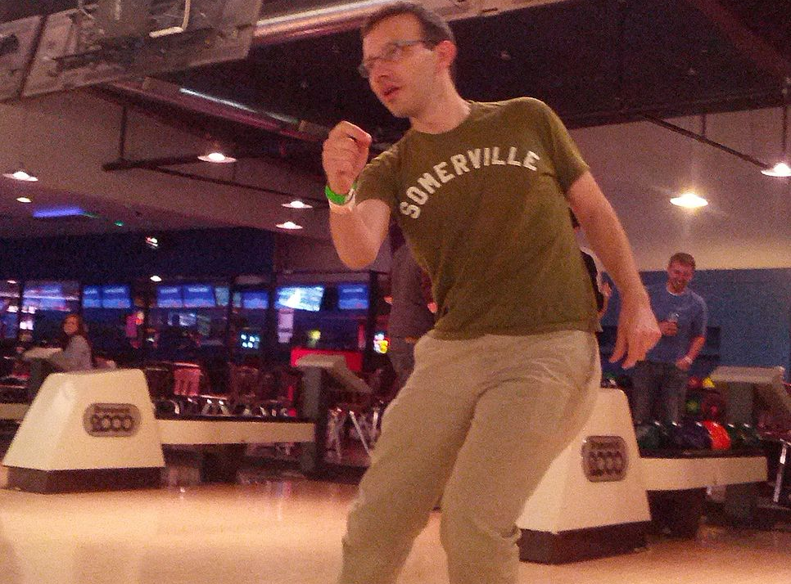
Doug Cutting (above) & Mike Cafarella (below)

Slide 78
Apache Solr
Inverted Index
Based on Apache Lucene
Higher-level interfaces (and richer features)
Distributed by document …
Elasticsearch
Inverted Index
Based on Apache Lucene
Higher-level interfaces (and richer features)
Distributed by document …

Slide 79
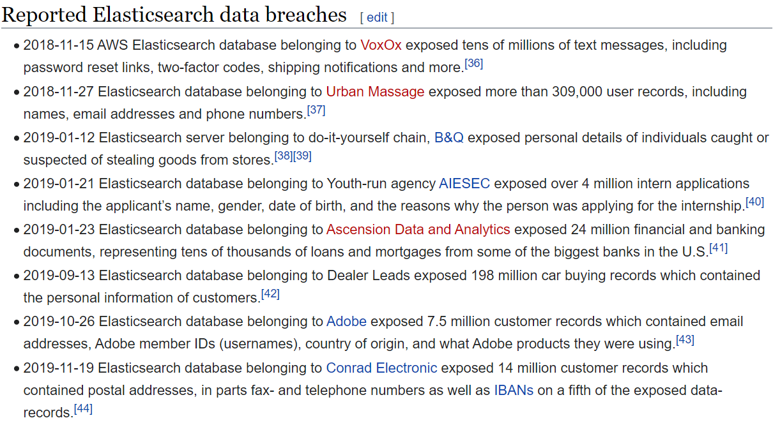
Elasticsearch: a word of warning
https://en.wikipedia.org/wiki/Elasticsearch

Slide 80
Questions?

