Slide 1
CC5212-1 Procesamiento Masivo de Datos Otoño 2023 Lecture 6 Streaming: Kafka
Aidan Hogan
aidhog@gmail.com

Slide 2
Distributed Static
Data Processing
Distributed Dynamic
Data Processing
Distr. Unstructured
Data Management
Distr. (Semi-)structured
Data Management
Distributed Data Processing
Distributed Data Management
Distributed Systems
Local Data Processing

Slide 3
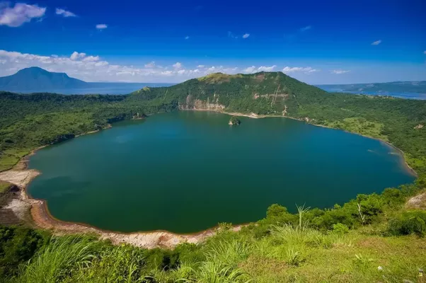
Files

Slide 4
Files
Batch processing
Querying

Slide 5
Streams

Slide 6
Streams
Event processing
Continuous querying
Real-time response

Slide 7
Applications: Social Media Analytics

Slide 8
Applications: Social Media Analytics
Event processing
Kitten video goes viral
Burst of tweets about earthquakes
Continuous querying
Track sentiment for company's products
Monitor popular users tweeting about me
Real-time response
Put Emergency Services on alert
Schedule Quality Control (QC) review

Slide 9
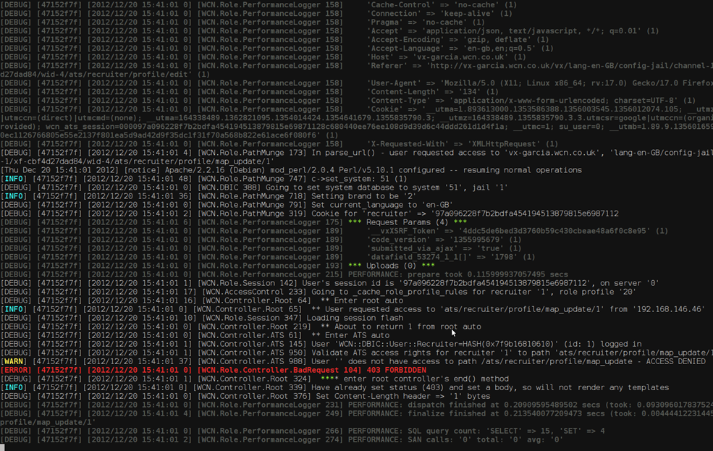
Applications: Log Monitoring

Slide 10
Applications: Log Monitoring
Event processing
Burst of log messages
Critical error message
Continuous querying
Track most critical fixes today
Monitor memory leaks in new release
Real-time response
Disable unsafe feature in a web-site
Automatically fire new developer

Slide 11
Applications: Finance

Slide 12
Applications: Finance
Event processing
Company goes public
Stock drops sharply
Continuous querying
Track stocks with gains of 10% in a day
Create alerts for major buy/sell transactions
Real-time response
BUY BUY BUY
SELL SELL SELL

Slide 13
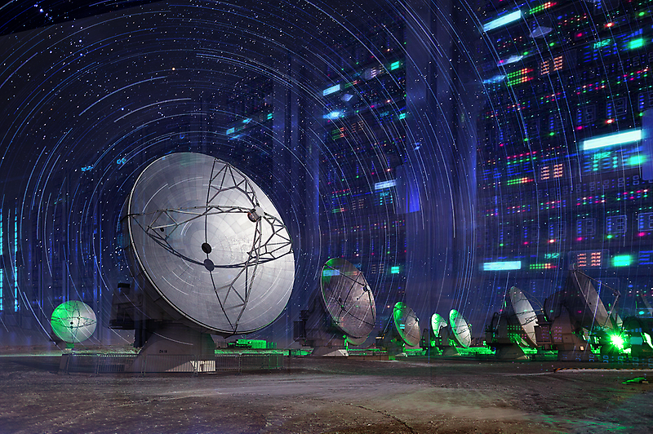
Applications: Astronomy

Slide 14
Applications: Astronomy
Event processing
The telescope moves
A light source flashes
Continuous querying
Find possible supernovae
Track object across the sky
Real-time response
Refocus telescope on important object
Lower data filter thresholds

Slide 15
Applications: Astronomy
Event processing
The telescope moves
A light source flashes
Continuous querying
Find possible supernovae
Track object across the sky
Real-time response
Refocus telescope on important object
Lower data filter thresholds

Slide 16
Streams: Internet of Things

Slide 17
Streams: Internet of Things
Event processing
A light turns on
It starts to rain
Continuous querying
Tell me when temperature reaches 30°
Update position of vehicle
Real-time response
Turn off air conditioning
Take another route

Slide 18
Distributed Streaming Platform

Slide 19
Available Frameworks

Slide 20
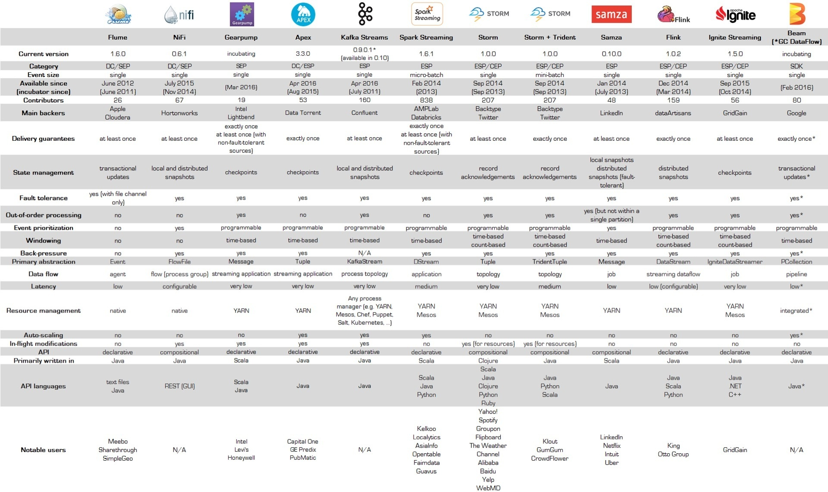
Available Frameworks
https://databaseline.bitbucket.io/an-overview-of-apache-streaming-technologies/

Slide 21
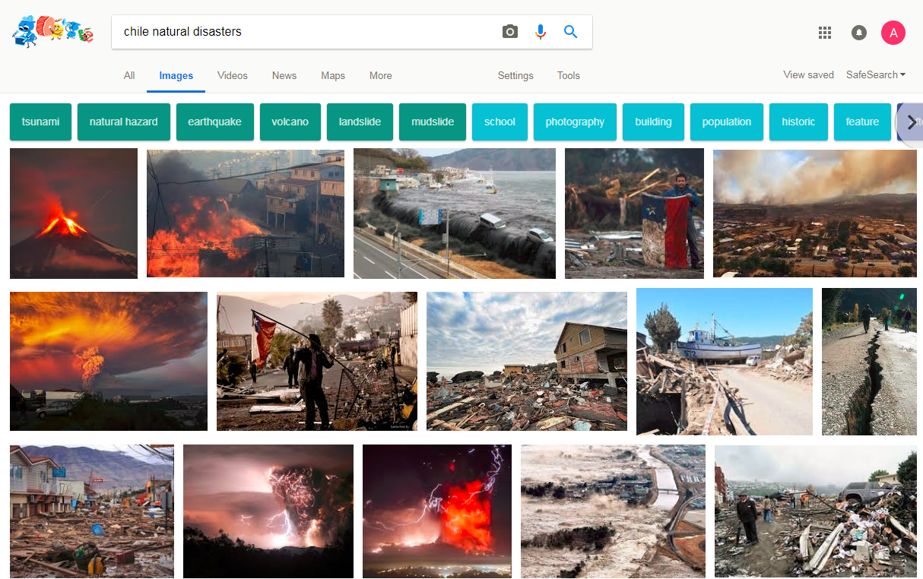
Application: Emergency Response

Slide 22
Real-Time Emergency Response

Slide 23
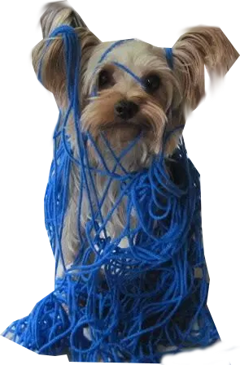
Real-Time Emergency Response

Slide 24
Real-Time Emergency Response

Slide 25
Apache Kafka

Slide 26
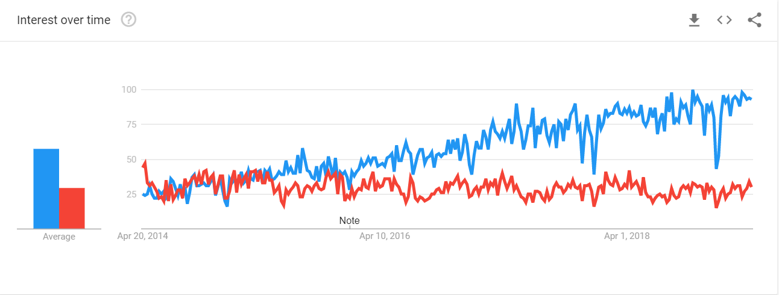
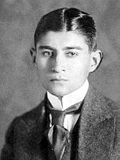
Apache Kafka vs. Franz Kafka

Slide 27
Apache Kafka
Open Source
Scala / Java
Originated in LinkedIn

Slide 28
Kafka Overview
Producers (Push)
Consumers (Pull)

Slide 29
Kafka: Data Model

Slide 30
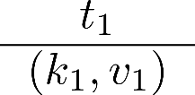
Kafka Record
Producers
1
Consumers

Slide 31
Kafka Record
Producers
Records represent "events"
Records are immutable
Contain id (offset), timestamp, key and value
Timestamp assigned by application or Kafka
1
Consumers

Slide 32
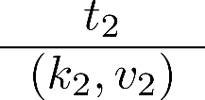
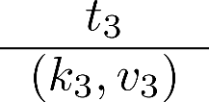
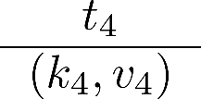
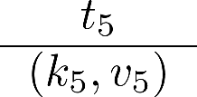
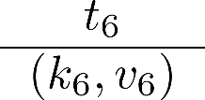
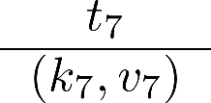
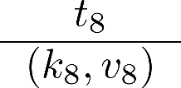
Kafka Ledger
Producers
1
2
3
4
5
6
7
8
...
Consumers

Slide 33
Kafka Ledger
Producers
Producers may only append to ledger
1
2
3
4
5
6
7
8
...
Consumers

Slide 34
Kafka Ledger
Producers
1
2
3
4
5
6
7
8
...
Consumers

Slide 35
Kafka Ledger
Producers
Producers may only append to ledger
Consumers can read from anywhere*
* kind of
1
2
3
4
5
6
7
8
...
Consumers

Slide 36
Kafka: Topics

Slide 37
Kafka Topics
Topic 1:
Disasters
Topic 2:
News
Topic 3:
Traffic

Slide 38
Kafka Topics
Producers
Publish to Topics
Topic 1:
Disasters
Topic 2:
News
Topic 3:
Traffic
Consumers
Subscribe to Topics

Slide 39
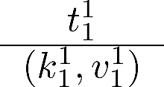
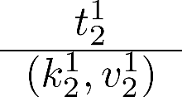
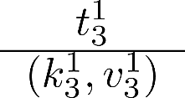
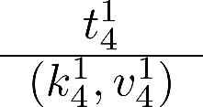
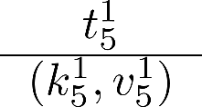
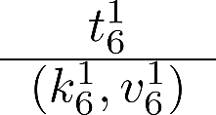
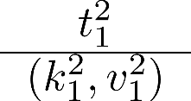
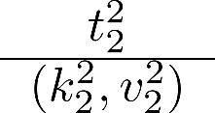
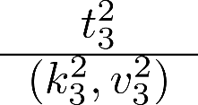
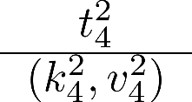
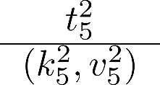
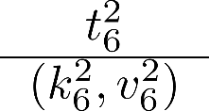
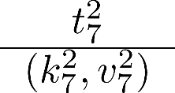
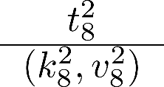
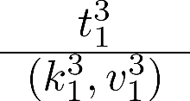
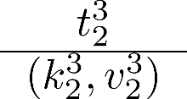
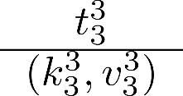
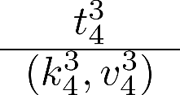
Topic
Partition 1
Topics are persistent (on disk)
Configurable retention policy
Keep everything
Delete once consumed
Keep for a period of time
Use fixed amount of space
1
2
3
4
5
6
...
Partition 2
1
2
3
4
5
6
7
8
Partition 3
1
2
3
4
...

Slide 40
Topic: Default Partitioning by Key
Partition 1
1
2
3
4
5
6
...
Partition 2
1
2
3
4
5
6
7
8
...
Partition 3
1
2
3
4
...

Slide 41
Topic: Default Partitioning by Key
Partition 1
Ordering (offset) guaranteed per partition
Not across partitions!
For ordering across partitions, use timestamp
1
2
3
4
5
6
...
Partition 2
1
2
3
4
5
6
7
8
...
Partition 3
1
2
3
4
...

Slide 42
Ordering
Partition 1
1
2
3
4
5
6
Partition 2
1
2
3
4
5
6
7
8
Partition 3
1
2
3
4

Slide 43
Replication
Partition 2
Topics can be replicated
Choose factor per topic
Automatic load balancing
Partition 3
Partition 2
Partition 2
Partition 3
Problem?
Partition 1
Order?
Partition 1
Partition 1
Partition 3

Slide 44
Leader
Partition 2
Topics can be replicated
Choose factor per topic
Automatic load balancing
One machine is the leader
The others are followers
Leader automatically elected
Ensures order per partition
Reads/writes to leader
Partition 3
Partition 2
Partition 2
Partition 2
Partition 3
Partition 3
Partition 1
Partition 1
Partition 1
Partition 1
Partition 3

Slide 45
Kafka: Write Guarantees

Slide 46
Writes: Asynchronous (No Guarantee)
Partition 2
Producers
Partition 3
Partition 2
Partition 1
Partition 2
Partition 1
Partition 3
Partition 3
Partition 1

Slide 47
Writes: Leader Commit
Partition 2
Producers
Partition 3
Partition 2
Partition 1
Partition 2
Partition 1
Partition 3
Partition 3
Partition 1

Slide 48
Writes: Leader Commit + Quorum (2)
Partition 2
Producers
Partition 3
Partition 2
Partition 1
Partition 2
Partition 1
Partition 3
Partition 3
Partition 1

Slide 49
Write Guarantees
Asynchronous
No guarantee
Very low latency
Leader Commit
Persistent on leader
Medium latency (disk write + network ack)
Leader Commit + Quorum n
Persistent on leader + n machines
High latency (disk writes + network acks)

Slide 50
Kafka: Reads

Slide 51
Kafka tracks consumer offset
C1: 1-2
1
2
3
4
5
6
7
8
...
1
2
C1

Slide 52
Kafka tracks consumer offset
C1: 3-4
1
2
3
4
5
6
7
8
...
1
2
3
4
C1

Slide 53
Kafka tracks consumer offset
C1: 5-6
1
2
3
4
5
6
7
8
...
1
2
3
4
5
6
C1

Slide 54
Failures?
1
2
3
4
5
6
7
8
...
1
2
3
4
5
6
What should we do in the case of a read failure?
C1

Slide 55
Kafka: Read Guarantees

Slide 56
Read Guarantees
At least once
Each value processed at least once
Consumer offset updated on consumer ACK
At most once
Effectively once
Exactly once

Slide 57
Read: At Least Once (Default)
②
C1: 1-2
1
2
3
4
5
6
7
8
...
①
1
2
C1

Slide 58
Read: At Least Once (Default)
C1: 1-2
1
2
3
4
5
6
7
8
...
1
2
C1

Slide 59
Read: At Least Once (Default)
C1: 1-2
1
2
3
4
5
6
7
8
...
①
1
2
3
C1

Slide 60
Read: At Least Once (Default)
C1: 1-2
C1: 3-4
②
1
2
3
4
5
6
7
8
...
①
1
2
3
3
4
C1

Slide 61
Read: At Least Once (Default)
C1: 3-4
C1: 5-6
②
1
2
3
4
5
6
7
8
...
①
1
2
3
3
4
5
6
C1

Slide 62
Read Guarantees
At least once
At most once
Each value processed at most once
Consumer offset updated immediately
Effectively once
Exactly once

Slide 63
Read: At Most Once
①
C1: 1-2
1
2
3
4
5
6
7
8
...
②
1
2
C1

Slide 64
Read: At Most Once
①
C1: 3-4
1
2
3
4
5
6
7
8
...
②
1
2
3
C1

Slide 65
Read: At Most Once
①
C1: 5-6
1
2
3
4
5
6
7
8
...
②
1
2
3
5
6
C1

Slide 66
Read Guarantees
At least once
At most once
Effectively once
At least once but ...
Consumer takes care of duplicates
Exactly once

Slide 67
Read: Effectively Once
②
C1: 1-2
1
2
3
4
5
6
7
8
...
①
1
2
Distinct
C1

Slide 68
Read: Effectively Once
C1: 1-2
1
2
3
4
5
6
7
8
...
1
2
C1

Slide 69
Read: Effectively Once
C1: 1-2
1
2
3
4
5
6
7
8
...
①
1
2
3
Distinct
C1

Slide 70
Read: Effectively Once
C1: 1-2
C1: 3-4
②
1
2
3
4
5
6
7
8
...
①
1
2
3
3
4
Distinct
C1

Slide 71
Read: Effectively Once
C1: 3-4
C1: 5-6
②
1
2
3
4
5
6
7
8
...
①
1
2
3
4
5
6
Distinct
C1

Slide 72
Read Guarantees
At least once
At most once
Effectively once
Exactly once
Data and offset updated as a single transaction

Slide 73
Read: Exactly Once
Transaction 1: ①,②
②
C1: 1-2
1
2
3
4
5
6
7
8
...
①
1
2
C1

Slide 74
Read: Exactly Once
C1: 1-2
1
2
3
4
5
6
7
8
...
1
2
C1

Slide 75
Read: Exactly Once
Transaction 2: ①,②
C1: 1-2
1
2
3
4
5
6
7
8
...
①
1
2
C1

Slide 76
Read: Exactly Once
Transaction 3: ①,②
C1: 1-2
C1: 3-4
②
1
2
3
4
5
6
7
8
...
①
1
2
3
4
C1

Slide 77
Read: Exactly Once
Transaction 4: ①,②
C1: 3-4
C1: 5-6
②
1
2
3
4
5
6
7
8
...
①
1
2
3
4
5
6
C1

Slide 78
Leader Replication and Reads
Partition 2
Producers
Partition 3
Partition 2
Partition 1
Partition 2
Partition 1
Partition 3
Partition 3
Partition 1

Slide 79
Kafka: Consumer Groups

Slide 80
Consumer Groups
Group 1
Producers
Partition 2
Group 2
Partition 1
Partition 3

Slide 81
Consumer Groups
Group 1
Write to one consumer in each group
Allows for partitioning consumers
Load balancing within each group
Producers
Partition 2
Group 2
Partition 1
Partition 3

Slide 82
Kafka: Streams and Connectors

Slide 83
Kafka Overview
Producers
Conn
ectors
Consumers
Stream

Slide 84
Kafka Overview
Producer API:
Append records to topics (push)
Consumer API:
Read records from topics (pull)
Connector API:
Read/write to external components
For example, a database or other streaming platforms
Stream API (Producer + Consumer):
Read records from input topics
Append records to output topics

Slide 85
Optimisations and Other Features

Slide 86
Kafka Optimisations
Log Compaction
Repeated sequential values are suppressed
Direct Disk-to-Network
When data don't need to be loaded into JVM
Consumer / Producer Quotas
Set limits to avoid saturating the system
...

Slide 87
Kafka Streams API
Aggregation (e.g., count messages)
Joins (e.g., "unify" two streams)
Windowing (define retention period)
Continuous Querying (KSQL)

Slide 88
Available Frameworks

Slide 89
Available Frameworks
https://databaseline.bitbucket.io/an-overview-of-apache-streaming-technologies/

Slide 90
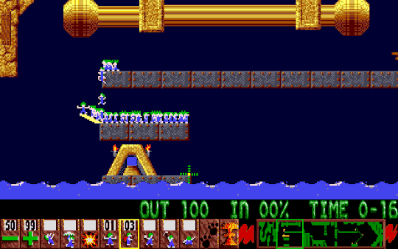
Questions?

Slide 91
Class Projects

Slide 92
Course Marking
80% for Weekly Labs
11 labs total
Best 9 labs count
20% for Class Project
Assignments each week
Working in groups
Hands-on each week!
Working in groups!

Slide 93
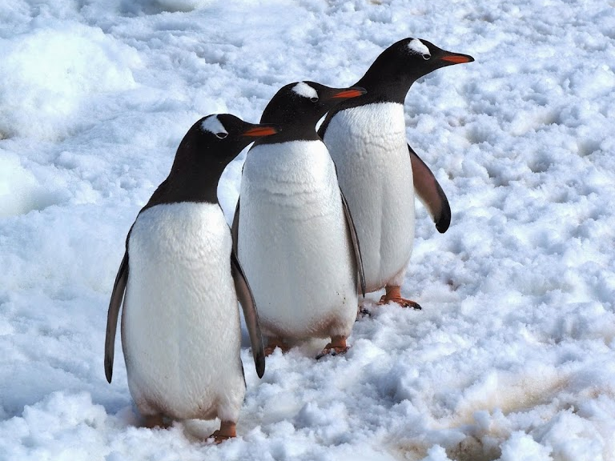
Class Project
Done in threes
Goal: Use what you’ve learned to do something cool/fun (hopefully)
Process:
We will assign groups tomorrow
Start thinking up topics / find interesting datasets!
Register topic
Work on projects during semester
Deliverables: 4 minute presentation (video), code repository with documentation in README
Marked on: Difficulty, appropriateness, scale, good use of techniques, presentation, coolness, creativity, value
Ambition is appreciated, even if you don’t succeed

Slide 94
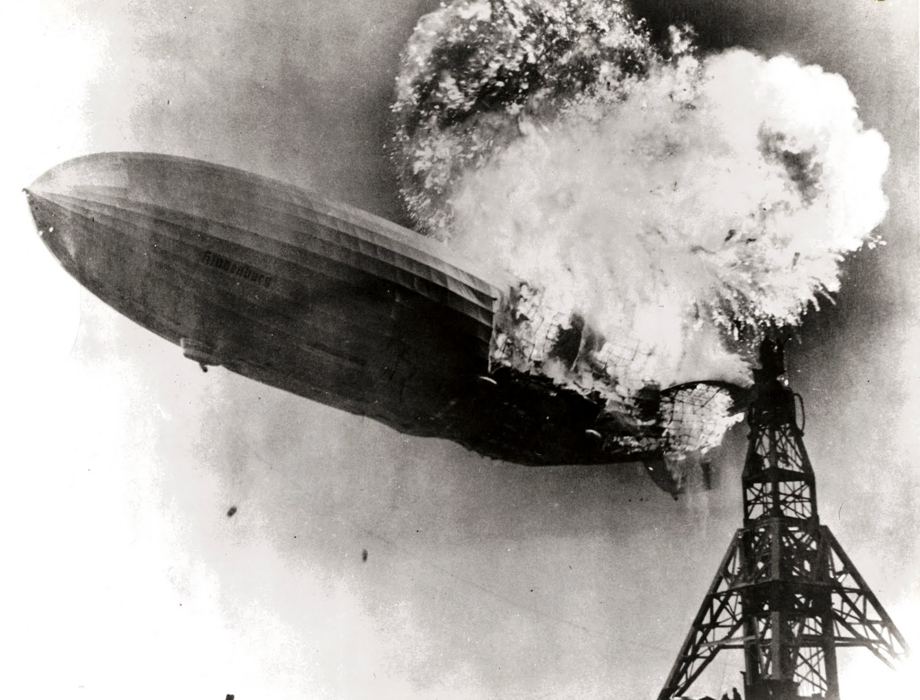

Slide 95
Desiderata for project
Must focus around some technique from the course!
Expected difficulty: similar to a lab, but without any instructions
Data not too small:
Should have >1,000,000 tuples/entries
Data not too large:
Should have <250,000,000 tuples/entries
If very large, perhaps take a sample?

Slide 96
Where to find/explore data?
Kaggle:
https://www.kaggle.com/
Google Dataset Search:
https://datasetsearch.research.google.com/
Datos Abiertos de Chile:
https://datos.gob.cl/
https://es.datachile.io/
…

