Slide 1
CC5212-1 Procesamiento Masivo de Datos Otoño 2023 Lecture 5 Apache Spark (Core)
Aidan Hogan
aidhog@gmail.com

Slide 2
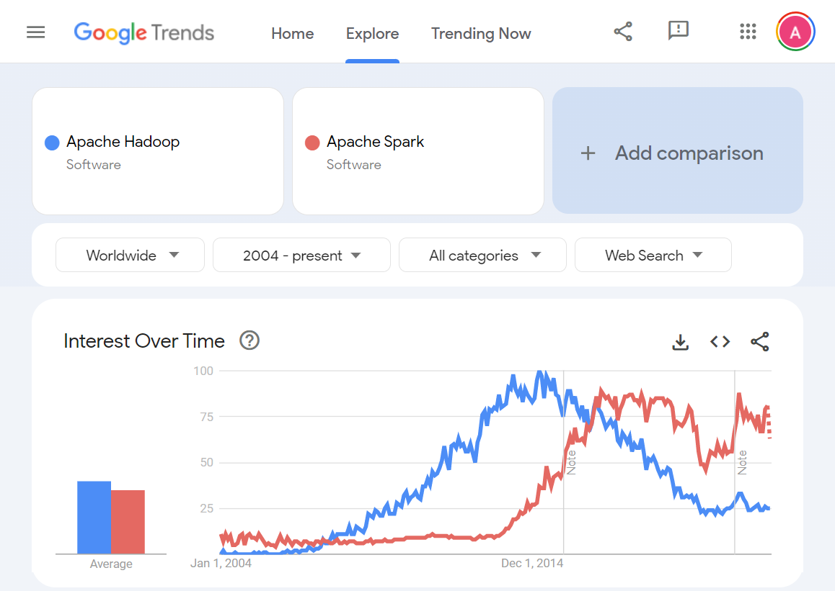
Spark vs. Hadoop
What is the main weakness of Hadoop?
Let’s see …

Slide 3
Data Transport Costs
(throughput)
30 GB/s
600 MB/s
100 MB/s
125 MB/s
10 MB/s
Main
Memory
Solid-state
Disk
Hard-disk
Network
(same rack)
Network
(across racks)
50–150 ns
10–100 μs
5–15 ms
10–100 μs
100–500 μs
(access)

Slide 4
MapReduce/Hadoop
Input
Map
Partition /
[Sort]
Combine
Shuffle
Merge Sort
Reduce
Output
(0,perro sed que)
(perro,1)
(sed,1)
(que,1)
(sed,1)
(sed,1)
(sed,1)
(decir,1)
(sed,1)
(sed,1)
(decir,{1})
(sed,{1,1})
(decir,1)
(sed,2)
(perro,1)
(que,1)
(perro,1)
(que,1)
(decir,1)
(sed,1)
(13,que decir que)
(que,1)
(decir,1)
(que,1)
(decir,1)
(decir,1)
(perro,1)
(que,1)
(perro,1)
(que,1)
(que,1)
(que,2)
(pero,{1})
(perro,1)
(que,4)
(que,1)
(que,1)
(que,2)
(que,{1,1,2})
(que,2)
(que,1)
(26,la que sed)
(la,1)
(que,1)
(sed,1)
(sed,1)
(sed,1)
(la,1)
(la,1)
(la,{1})
(la,1)
(que,1)
(que,1)
(la,1)
(la,1)

Slide 5
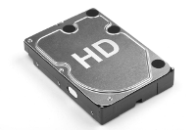
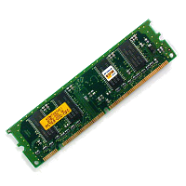
R
W
R|W
R
W
Input
Map
Partition /
[Sort]
Combine
Shuffle
Merge Sort
Reduce
Output
(0,perro sed que)
(perro,1)
(sed,1)
(que,1)
(sed,1)
(sed,1)
(sed,1)
(decir,1)
(sed,1)
(sed,1)
(decir,{1})
(sed,{1,1})
(decir,1)
(sed,2)
(perro,1)
(que,1)
(perro,1)
(que,1)
(decir,1)
(sed,1)
(13,que decir que)
(que,1)
(decir,1)
(que,1)
(decir,1)
(decir,1)
(perro,1)
(que,1)
(perro,1)
(que,1)
(que,1)
(que,2)
(pero,{1})
(perro,1)
(que,4)
(que,1)
(que,1)
(que,2)
(que,{1,1,2})
(que,2)
(que,1)
(26,la que sed)
(la,1)
(que,1)
(sed,1)
(sed,1)
(sed,1)
(la,1)
(la,1)
(la,{1})
(la,1)
(que,1)
(que,1)
(la,1)
(la,1)

Slide 6
R
W
R|W
R
W
Input
Map
Partition /
[Sort]
Combine
Shuffle
Merge Sort
Reduce
Output
MapReduce/Hadoop always coordinates
between phases (Map → Shuffle → Reduce)
and between tasks (e.g., Count → Order)
using the hard-disk.
(0,perro sed que)
(perro,1)
(sed,1)
(que,1)
(sed,1)
(sed,1)
(sed,1)
(decir,1)
(sed,1)
(sed,1)
(decir,{1})
(sed,{1,1})
(decir,1)
(sed,2)
(perro,1)
(que,1)
(perro,1)
(que,1)
(decir,1)
(sed,1)
(13,que decir que)
(que,1)
(decir,1)
(que,1)
(decir,1)
(decir,1)
(perro,1)
(que,1)
(perro,1)
(que,1)
(que,1)
(que,2)
(pero,{1})
(perro,1)
(que,4)
…
(que,1)
(que,1)
(que,2)
(que,{1,1,2})
(HDFS)
(que,2)
(HDFS)
(que,1)
(26,la que sed)
(la,1)
(que,1)
(sed,1)
(sed,1)
(sed,1)
(la,1)
(la,1)
(la,{1})
(la,1)
(que,1)
(que,1)
(la,1)
(la,1)

Slide 7
R
W
R|W
R
W
Input
Map
Partition /
[Sort]
Combine
Shuffle
Merge Sort
Reduce
Output
MapReduce/Hadoop always coordinates
between phases (Map → Shuffle → Reduce)
and between tasks (e.g., Count → Order)
using the hard-disk.
(0,perro sed que)
(perro,1)
(sed,1)
(que,1)
(sed,1)
(sed,1)
(sed,1)
(decir,1)
(sed,1)
(sed,1)
(decir,{1})
(sed,{1,1})
(decir,1)
(sed,2)
(perro,1)
(que,1)
(perro,1)
(que,1)
(decir,1)
(sed,1)
(13,que decir que)
(que,1)
(decir,1)
(que,1)
(decir,1)
(decir,1)
(perro,1)
(que,1)
(perro,1)
(que,1)
(que,1)
(que,2)
(pero,{1})
(perro,1)
(que,4)
…
We saw this already counting words …
In memory on one machine: seconds
On disk on one machine: minutes
Over MapReduce: minutes
(que,1)
(que,1)
(que,2)
(que,{1,1,2})
(HDFS)
(que,2)
(HDFS)
(que,1)
(26,la que sed)
(la,1)
(que,1)
(sed,1)
(sed,1)
(sed,1)
(la,1)
(la,1)
(la,{1})
(la,1)
Any alternative to these options?
(que,1)
(que,1)
In memory on multiple machines: ???
(la,1)
(la,1)

Slide 8
Simple case: Unique words fit in memory
Input
Count
Reduce / Collect
Output
(0,perro sed que)
(perro,1)
(que,1)
(sed,1)
(perro,1)
(la,1)
(que,4)
(sed,2)
(decir,1)
(perro,1)
(la,1)
(que,4)
(sed,2)
(decir,1)
(13,que decir que)
(que,2)
(decir,1)
(26,la que sed)
(la,1)
(que,1)
(sed,1)

Slide 9
R
W
Input
Count
Reduce / Collect
Output
(0,perro sed que)
(perro,1)
(que,1)
(sed,1)
(perro,1)
(la,1)
(que,4)
(sed,2)
(decir,1)
(perro,1)
(la,1)
(que,4)
(sed,2)
(decir,1)
(13,que decir que)
(que,2)
(decir,1)
(26,la que sed)
(la,1)
(que,1)
(sed,1)
If unique words don’t fit in memory?
…

Slide 10
Apache Spark

Slide 11
Main idea: Program with main memory
…
(HDFS)
(HDFS)
…

Slide 12
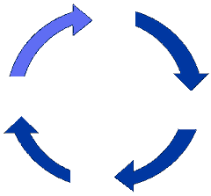
Main idea: Program (recursively) with main memory
…
(HDFS)
(HDFS)
…

Slide 13
Spark storage: Resilient Distributed Dataset
(HDFS)
RDD
Like HDFS, RDD abstracts distribution, fault-tolerance, etc., …
… but RDD can also abstract hard-disk / main-memory

Slide 14
R
W
Input
Count
Reduce / Collect
Output
(0,perro sed que)
(perro,1)
(que,1)
(sed,1)
(perro,1)
(la,1)
(que,4)
(sed,2)
(decir,1)
(perro,1)
(la,1)
(que,4)
(sed,2)
(decir,1)
RDD
(13,que decir que)
(que,2)
(decir,1)
(26,la que sed)
(la,1)
(que,1)
(sed,1)
If unique words don’t fit in memory?
RDD
RDDs can fall back to disk

Slide 15
Spark storage: Resilient Distributed Dataset
Resilient: Fault-tolerant
Distributed: Partitioned
Dataset: Umm, a set of data

Slide 16
RDDs can have multiple virtual partitions on one machine
Input
Count
(0,perro sed que)
(perro,1)
(que,1)
(sed,1)
(13,que decir que)
(que,2)
(decir,1)
(26,la que sed)
(que,1)
(sed,1)
(la,1)
RDD

Slide 17
Types of RDDs in Spark
HadoopRDD
FilteredRDD
MappedRDD
PairRDD
ShuffledRDD
UnionRDD
PythonRDD
DoubleRDD
JdbcRDD
JsonRDD
SchemaRDD
VertexRDD
EdgeRDD
CassandraRDD
GeoRDD
EsSpark
Specific types of RDDs permit specific operations
PairRDD of particular importance for M/R style operators

Slide 18
Apache Spark: Example

Slide 19
Spark: Products by Hour
customer412 1L_Leche 2014-03-31T08:47:57Z $900
customer412 Nescafe 2014-03-31T08:47:57Z $2.000
customer412 Nescafe 2014-03-31T08:47:57Z $2.000
customer413 400g_Zanahoria 2014-03-31T08:48:03Z $1.240
customer413 El_Mercurio 2014-03-31T08:48:03Z $3.000
customer413 Gillette_Mach3 2014-03-31T08:48:03Z $3.000
customer413 Santo_Domingo 2014-03-31T08:48:03Z $2.450
customer413 Nescafe 2014-03-31T08:48:03Z $2.000
customer414 Rosas 2014-03-31T08:48:24Z $7.000
customer414 400g_Zanahoria 2014-03-31T08:48:24Z $9.230
customer414 Nescafe 2014-03-31T08:48:24Z $2.000
customer415 1L_Leche 2014-03-31T08:48:35Z $900
customer415 300g_Frutillas 2014-03-31T08:48:35Z $830
…
Number of customers buying each premium item per hour of the day

Slide 20
Spark: Products by Hour
c1 i1 08 900
c1 i2 08 2000
c1 i2 08 2000
c2 i3 09 1240
c2 i4 09 3000
c2 i5 09 3000
c2 i6 09 2450
c2 i2 09 2000
c3 i7 08 7000
c3 i8 08 9230
c3 i2 08 2000
c4 i1 23 900
c4 i9 23 830
…
Number of customers buying each premium item per hour of the day

Slide 21
load
filter(p>1000)
coalesce(3)
…
c1,i1,08,900
c1,i2,08,2000
c1,i2,08,2000
c1,i1,08,900
c1,i2,08,2000
c1,i2,08,2000
c1,i2,08,2000
c1,i2,08,2000
c1,i2,08,2000
c1,i2,08,2000
c4,i1,23,900
c4,i9,23,830
c4,i1,23,900
c4,i9,23,830
c2,i3,09,1240
c2,i4,09,3000
c2,i5,09,3000
c2,i6,09,2450
c2,i2,09,2000
c2,i3,09,1240
c2,i4,09,3000
c2,i5,09,3000
c2,i6,09,2450
c2,i2,09,2000
c2,i3,09,1240
c2,i4,09,3000
c2,i5,09,3000
c2,i6,09,2450
c2,i2,09,2000
c2,i3,09,1240
c2,i4,09,3000
c2,i5,09,3000
c2,i6,09,2450
c2,i2,09,2000
c3,i7,08,7000
c3,i8,08,9230
c3,i2,08,2000
c3,i7,08,7000
c3,i8,08,9230
c3,i2,08,2000
c3,i7,08,7000
c3,i8,08,9230
c3,i2,08,2000
c3,i7,08,7000
c3,i8,08,9230
c3,i2,08,2000
RDD
RDD
RDD

Slide 22
coalesce(3)
distinct
map((i,h),1)
reduceByKey(Σ)
save
c1,i2,08,2000
c1,i2,08,2000
c1,i2,08,2000
c1,i2,08,2000
c1,i2,08,2000
(i2,08),1
(i3,09),1
(i4,09),1
(i5,09),1
(i3,09),1
(i4,09),1
(i5,09),1
c2,i3,09,1240
c2,i4,09,3000
c2,i5,09,3000
c2,i6,09,2450
c2,i2,09,2000
c2,i3,09,1240
c2,i4,09,3000
c2,i5,09,3000
c2,i6,09,2450
c2,i2,09,2000
c2,i3,09,1240
c2,i4,09,3000
c2,i5,09,3000
c2,i6,09,2450
c2,i2,09,2000
(i3,09),1
(i4,09),1
(i5,09),1
(i6,09),1
(i2,09),1
(i2,08),2
(i7,08),1
(i8,08),1
(i2,08),2
(i7,08),1
(i8,08),1
c3,i7,08,7000
c3,i8,08,9230
c3,i2,08,2000
c3,i7,08,7000
c3,i8,08,9230
c3,i2,08,2000
c3,i7,08,7000
c3,i8,08,9230
c3,i2,08,2000
(i7,08),1
(i8,08),1
(i2,08),1
(i6,09),1
(i2,09),1
(i6,09),1
(i2,09),1
RDD
RDD
RDD
RDD
RDD

Slide 23
Apache Spark: Transformations & Actions

Slide 24
Spark: Transformations vs. Actions
Transformations are run lazily …
… they result in “virtual” RDDs
… they are only run to complete an action
… for example:
… are not run immediately
load
filter(p>1000)
coalesce(3)
RDD
RDD
RDD
RDD

Slide 25
Transformations
R.transform()
f = function argument
S = RDD argument
. = simple argument
R.map(f) | R.intersection(S) | R.cogroup(S)
R.flatMap(f) | R.distinct() | R.cartesian(S)
R.filter(f) | R.groupByKey() | R.pipe(.)
R.mapPartitions(f) | R.reduceByKey(f) | R.coalesce(.)
R.mapPartitionsWithIndex(f) | R.aggregateByKey(f) | R.repartition(.)
R.sample(.,.,.) | R.sortByKey() | ...
R.union(S) | R.join(S) | ...
Any guesses why some are underlined?
They require a shuffle
https://spark.apache.org/docs/latest/programming-guide.html#transformations

Slide 26
Transformations
R.transform()
f = function argument
S = RDD argument
x = simple argument
Transformation | Description | Example / Note
R.map(f) | Maps an element from R to one output value | f : (a,b,c) ↦ (a,c)
R.flatMap(f) | Maps an element from R to zero-or more output values | f : (a,b,c) ↦ {(a,b),(a,c)}
R.filter(f) | Maps every element of R that satisfies f to the output | f : a > b
R.mapPartitions(f) | Maps all elements of R to the output, calling f once per partition | f : R → π_{a,c}(R)
R.mapPartitionsWithIndex(f) | Like mapPartitions but f has as an argument the index of the partition | f(i) : R → π_{a,c,i}(R)
R.sample(w,f,s) | Takes a sample of R | w: with replacement f: fraction s: seed

Slide 27
Transformations
R.transform()
f = function argument
S = RDD argument
x = simple argument
R.union(S) | R ∪ S
R.intersection(S) | R ∩ S
R.distinct() | Remove duplicates

Slide 28
Transformations
R.transform()
f = function argument
S = RDD argument
x = simple argument
Requiring a PairRDD ...
R.groupByKey() | Groups values by key
R.reduceByKey(f) | Groups values by key and calls f to combine and reduce values with the same key | f : (a,b) ↦ a + b
R.aggregateByKey(c,fc,fr) | Groups values by key using c as an initial value, fc as a combiner and fr as a reducer | c: initial value fc: combiner fr: reducer
R.sortByKey([a]) | Order by key | a: true ascending false descending
R.join(S) | R ⨝ S, join by key | Also: leftOuterJoin, rightOuterJoin, and fullOuterJoin
R.cogroup(S) | Group values by key in R and S together

Slide 29
Transformations
R.transform()
f = argumento de función
S = argumento de RDD
x = argumento simple
R.cartesian(S) | R × S, Cartesian (cross) product
R.pipe(c) | Creates a "pipe" from stdin to process data using the command c such as grep, awk, perl, etc. The result is an RDD with the output
R.coalesce(n) | Merges various partitions into at most n partitions
R.repartition(n) | Partitions the data again (often to rebalance) creating (at most) n partitions
... | ... | ...

Slide 30
Spark: Transformations vs. Actions
Actions are where things execute …
… they result in “materialised” RDDs
… all ancestor transformations are run
… for example:
… all steps are now run
… but intermediate RDDs are not kept
load
filter(p>1000)
coalesce(3)
save
RDD
RDD
RDD
RDD
HDFS

Slide 31
Actions
R.action()
f = function argument
. = simple argument
R.reduce(f) | R.saveToCassandra()
R.collect() | R.saveAsTextFile(.)
R.count() | R.saveAsSequenceFile(.)
R.first() | R.saveAsObjectFile(.)
R.take(.) | R.countByKey()
R.takeSample(.,.) | R.foreach(f)
R.takeOrdered(.) | ...
https://spark.apache.org/docs/latest/programming-guide.html#actions

Slide 32
Actions
R.action()
f = function argument
x = simple argument
Actions | Description | Example / Notes
R.reduce(f) | Reduces all data to one value/tuple (not by key!) | f : (a,b) ↦ a + b
R.collect() | Loads R as an array into the local application
R.count() | Counts the elements of R
R.first() | Get the first tuple of R
R.take(n) | Loads an array of n values from R into the local application
R.takeSample(w,n,s) | Loads a sample of n values from R into the local application | w: with replacement n: number s: seed
https://spark.apache.org/docs/latest/programming-guide.html#actions

Slide 33
Actions
R.action()
f = function argument
x = simple argument
R.saveAsTextFile(d) | Save the data to the file system as a plain text file | d: directory
R.saveAsSequenceFile(d) | Save the data to the file system with the format SequenceFile for Hadoop | d: directory
R.saveAsObjectFile(d) | Save the data to the file system using native Java serialisation | d: directory
R.countByKey() | Count the values for each key returning the answer locally | Only for PairRDD
R.foreach(f) | Execute the function f for every element of R, typically to interact with something external | f : println(r)
https://spark.apache.org/docs/latest/programming-guide.html#actions

Slide 34
Apache Spark: transformations for PairRDD

Slide 35
Transformations
R.transform()
f = function argument
S = RDD argument
x = simple argument
Requiring a PairRDD ...
R.groupByKey() | Groups values by key
R.reduceByKey(f) | Groups values by key and calls f to combine and reduce values with the same key | f : (a,b) ↦ a + b
R.aggregateByKey(c,fc,fr) | Groups values by key using c as an initial value, fc as a combiner and fr as a reducer | c: initial value fc: combiner fr: reducer
R.sortByKey([a]) | Order by key | a: true ascending false descending
R.join(S) | R ⨝ S, join by key | Also: leftOuterJoin, rightOuterJoin, and fullOuterJoin
R.cogroup(S) | Group values by key in R y S together
How are the above different?

Slide 36
Transformations
R.transform()
f = function argument
S = RDD argument
x = simple argument
R.groupByKey() | Groups values by key
R.reduceByKey(f) | Groups values by key and calls f to combine and reduce values with the same key | f : (a,b) ↦ a + b
R.aggregateByKey(c,fc,fr) | Groups values by key using c as an initial value, fc as a combiner and fr as a reducer | c: initial value fc: combiner fr: reducer
To sum all values for each key in R?
(1) R.groupByKey().map((k,{v1,...,vn}) ↦ (k,sum({v1,...,vn})));
(2) R.reduceByKey((u,v) ↦ u + v);
(3) R.aggregateByKey(0, (u,v) ↦ u + v, (u,v) ↦ u + v);
(2) uses a combiner! (3) does the same, but is less concise. So (2) is best!

Slide 37
Transformations
R.transform()
f = function argument
S = RDD argument
x = simple argument
R.groupByKey() | Groups values by key
R.reduceByKey(f) | Groups values by key and calls f to combine and reduce values with the same key | f : (a,b) ↦ a + b
R.aggregateByKey(c,fc,fr) | Groups values by key using c as an initial value, fc as a combiner and fr as a reducer | c: initial value fc: combiner fr: reducer
To average all values for each key in R?
(1) R.groupByKey().map((k,{v1,...,vn}) ↦ (k,avg({v1,...,vn})));
(2) R1 = R.reduceByKey((u,v) ↦ u + v);
R2 = R.map((k,v) ↦ (k,1)).reduceByKey((u,v) ↦ u + v);
R3 = R1.join(R2).map((k,(s,c)) ↦ (k,s/c));
(3) R.aggregateByKey((0,0), ((s,c),v) ↦ (s+v,c+1),
((s1,c1),(s2,c2)) ↦ (s1+s2,c1+c2))
.map((k,(s,c)) ↦ (k,s/c));
(3) has a combiner and only needs one shuffle. So (3) is best!

Slide 38
aggregateBykey
map
p1,30
p2,25
p2,30
p1,{30}
p2,{25,30}
p1,(30,1)
p2,(55,2)
p1,{(30,1),(10,1),(20,2)}
p3,{(80,1),(120,3)}
p1,(60,4)
p3,(200,4)
p1,15
p3,50
p2,10
p3,80
p2,{10}
p3,{80}
p2,(10,1)
p3,(80,1)
p3,40
p3,20
p1,10
p3,60
p3,{40,20,60}
p1,{10}
p3,(120,3)
p1,(10,1)
p2,15
p1,10
p1,10
p2,{15}
p1,{10,10}
p2,(15,1)
p1,(20,2)
p2,{(55,2),(10,1),(15,1)}
p2,(80,4)
p2,20
RDD
RDD
RDD
(3) R.aggregateByKey((0,0), ((s,c),v) ↦ (s+v,c+1),
((s1,c1),(s2,c2)) ↦ (s1+s2,c1+c2))
.map((k,(s,c)) ↦ (k,s/c));

Slide 39
aggregateBykey
map
p1,30
p2,25
p2,30
p1,{30}
p2,{25,30}
p1,(30,1)
p2,(55,2)
p1,{(30,1),(10,1),(20,2)}
p3,{(80,1),(120,3)}
p1,(60,4)
p3,(200,4)
p1,15
p3,50
p2,10
p3,80
p2,{10}
p3,{80}
p2,(10,1)
p3,(80,1)
Combiner: (0,0), ((s,c),v) ↦ (s+v,c+1)
{30}:
((0,0),30) ↦ (30,1)
{25,30}:
((0,0),25) ↦ (25,1)
((25,1),30) ↦ (55,2)
p3,40
p3,20
p1,10
p3,60
p3,{40,20,60}
p1,{10}
p3,(120,3)
p1,(10,1)
p2,15
p1,10
p1,10
p2,{15}
p1,{10,10}
p2,(15,1)
p1,(20,2)
p2,{(55,2),(10,1),(15,1)}
p2,(80,4)
p2,20
RDD
RDD
RDD
(3) R.aggregateByKey((0,0), ((s,c),v) ↦ (s+v,c+1),
((s1,c1),(s2,c2)) ↦ (s1+s2,c1+c2))
.map((k,(s,c)) ↦ (k,s/c));

Slide 40
aggregateBykey
map
p1,30
p2,25
p2,30
p1,{30}
p2,{25,30}
p1,(30,1)
p2,(55,2)
p1,{(30,1),(10,1),(20,2)}
p3,{(80,1),(120,3)}
p1,(60,4)
p3,(200,4)
p1,15
p3,50
p2,10
p3,80
p2,{10}
p3,{80}
p2,(10,1)
p3,(80,1)
Reducer: ((s1,c1),(s2,c2)) ↦ (s1+s2,c1+c2)
{(30,1),(10,1),(20,2)}
((0,0),(30,1)) ↦ (30,1)
((30,1),(10,1)) ↦ (40,2)
((40,2),(20,2)) ↦ (60,4)
{(80,1),(120,3)}
((0,0),(80,1)) ↦ (80,1)
((80,1),(120,3)) ↦ (200,4)
p3,40
p3,20
p1,10
p3,60
p3,{40,20,60}
p1,{10}
p3,(120,3)
p1,(10,1)
p2,15
p1,10
p1,10
p2,{15}
p1,{10,10}
p2,(15,1)
p1,(20,2)
p2,{(55,2),(10,1),(15,1)}
p2,(80,4)
p2,20
RDD
RDD
RDD
(3) R.aggregateByKey((0,0), ((s,c),v) ↦ (s+v,c+1),
((s1,c1),(s2,c2)) ↦ (s1+s2,c1+c2))
.map((k,(s,c)) ↦ (k,s/c));

Slide 41
aggregateBykey
map
p1,30
p2,25
p2,30
p1,{30}
p2,{25,30}
p1,(30,1)
p2,(55,2)
p1,{(30,1),(10,1),(20,2)}
p3,{(80,1),(120,3)}
p1,(60,4)
p3,(200,4)
p1,15
p3,50
p2,10
p3,80
p2,{10}
p3,{80}
p2,(10,1)
p3,(80,1)
p3,40
p3,20
p1,10
p3,60
p3,{40,20,60}
p1,{10}
p3,(120,3)
p1,(10,1)
p2,15
p1,10
p1,10
p2,{15}
p1,{10,10}
p2,(15,1)
p1,(20,2)
p2,{(55,2),(10,1),(15,1)}
p2,(80,4)
p2,20
RDD
RDD
RDD
(3) R.aggregateByKey((0,0), ((s,c),v) ↦ (s+v,c+1),
((s1,c1),(s2,c2)) ↦ (s1+s2,c1+c2))
.map((k,(s,c)) ↦ (k,s/c));

Slide 42
Apache Spark: "Directed Acyclic Graph" ("DAG")

Slide 43
Spark: Products by Hour
receipts.txt
c1 i1 08 900
c1 i2 08 2000
c1 i2 08 2000
c2 i3 09 1240
c2 i4 09 3000
c2 i5 09 3000
c2 i6 09 2450
c2 i2 09 2000
c3 i7 08 7000
c3 i8 08 9230
c3 i2 08 2000
c4 i1 23 900
c4 i9 23 830
…
Number of customers buying each premium item per hour of the day

Slide 44
Spark: Directed Acyclic Graph (DAG)
load
RDD
filter
RDD
RDD
distinct
RDD
coalesce
map
RDD
countByKey
RDD

Slide 45
Spark: Products by Hour
receipts.txt
customer.txt
c1 i1 08 900
c1 i2 08 2000
c1 i2 08 2000
c2 i3 09 1240
c2 i4 09 3000
c2 i5 09 3000
c2 i6 09 2450
c2 i2 09 2000
c3 i7 08 7000
c3 i8 08 9230
c3 i2 08 2000
c4 i1 23 900
c4 i9 23 830
…
c1 female 40
c2 male 24
c3 non-b 73
c4 female 21
…
Number of customers buying each premium item per hour of the day
Also … № of females older than 30 buying each premium item per hour of the day

Slide 46
Spark: Directed Acyclic Graph (DAG)
Problem?
Solution?
receipts.txt
load
RDD
filter
RDD
RDD
distinct
RDD
coalesce
RDD
RDD
RDD
RDD
countByKey
map
countByKey
map
join
RDD
map
RDD
countByKey
RDD
customer.txt
load
RDD
filter
RDD

Slide 47
Spark: Directed Acyclic Graph (DAG)
Problem?
Solution?
Materialise
re-used RDD
receipts.txt
load
RDD
filter
RDD
cache
RDD
distinct
RDD
coalesce
RDD
RDD
RDD
RDD
RDD
countByKey
map
countByKey
map
join
RDD
map
RDD
countByKey
RDD
customer.txt
load
RDD
filter
RDD

Slide 48
Spark: Directed Acyclic Graph (DAG)
Cache (aka. persist)
Is lazy (still needs an action to run)
Can use memory and/or disk (default memory only)
cache
https://spark.apache.org/docs/latest/programming-guide.html#rdd-persistence

Slide 49
Apache Spark: Core Summary

Slide 50
SPARK Lifecycle
Transform
Action
Transform
Action
Input
Transform
Cache
…
Transform
Action

Slide 51
SPARK Lifecycle
Transform
Cache
Transform
Action
Cache
Transform
Action
…
Transform
Action
Transform
Action
Input
Transform
Cache
…
Transform
Action

Slide 52
SPARK Lifecycle
Input RDDs
Transform RDDs
Cache (aka. persist) reused RDDs
Perform an Action (launching execution)
Output to file/database/local terminal

Slide 53
Spark: Beyond the core

Slide 54
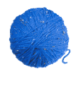
Hadoop vs. Spark
vs
YARN
Mesos
Tachyon

Slide 55
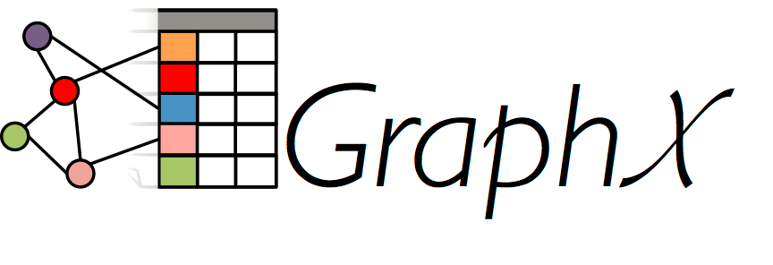
Hadoop vs. Spark: SQL, ML, Streams, …
vs
YARN
Mesos
Tachyon
SQL
MLlib
Streaming

Slide 56
Spark vs. Hadoop

Slide 57
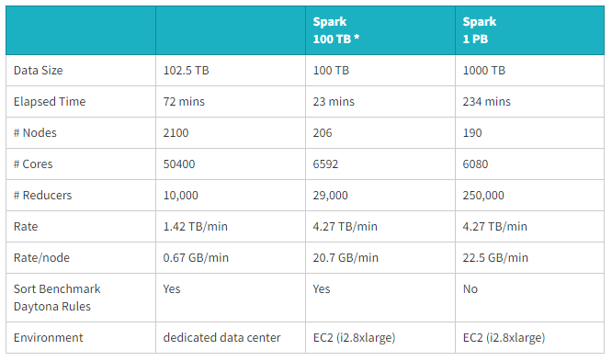
Spark can use the disk
(according to Spark)
https://databricks.com/blog/2014/10/10/spark-petabyte-sort.html

Slide 58
Spark vs. Hadoop

Slide 59
Questions?

