Slide 1
CC5212-1 Procesamiento Masivo de Datos Otoño 2023 Lecture 3 DFS/HDFS + MapReduce/Hadoop
Aidan Hogan
aidhog@gmail.com

Slide 2
Distributed Static
Data Processing
Distributed Dynamic
Data Processing
Distr. Unstructured
Data Management
Distr. (Semi-)structured
Data Management
Distributed Data Processing
Distributed Data Management
Distributed Systems
Local Data Processing

Slide 3
Distributed Static
Data Processing
Distributed Dynamic
Data Processing
Distr. Unstructured
Data Management
Distr. (Semi-)structured
Data Management
Distributed Data Processing
Distributed Data Management
Distributed Systems
Local Data Processing

Slide 4
Massive Data Processing in Google

Slide 5
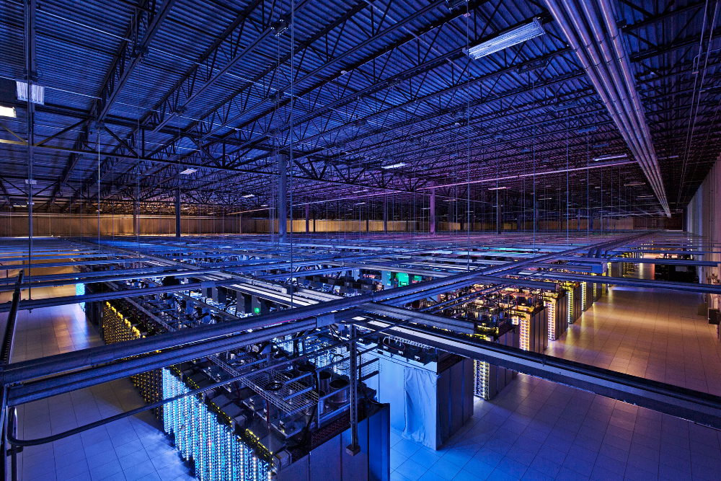
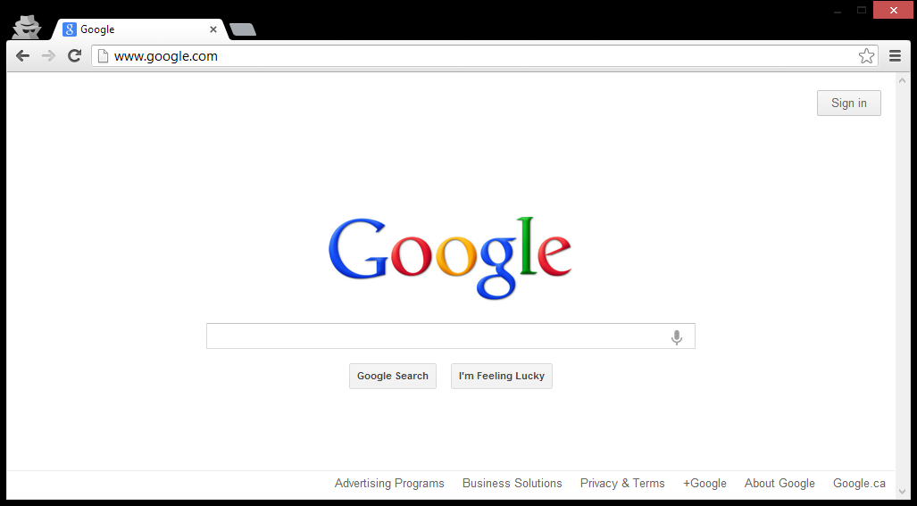
Distributed Computing in Google

Slide 6
Building Google Web-search
What processes/algorithms does Google
need to implement Web search?
Crawling
Parse links from webpages
Schedule links for crawling
Download pages, GOTO 1
Indexing
Parse keywords from webpages
Index keywords to webpages
Manage updates
Ranking
How relevant is a page? (TF-IDF)
How important is it? (PageRank)
How many users clicked it?
...

Slide 7
Building Google Web-search
What processes/algorithms does Google
need to implement Web search?
Google
≈ 100 PB / day
≈ 2,000,000 Wiki / day
(2014, processed)
Crawling
Parse links from webpages
Schedule links for crawling
Download pages, GOTO 1
Indexing
Parse keywords from webpages
Index keywords to webpages
Manage updates
Ranking
How relevant is a page? (TF-IDF)
How important is it? (PageRank)
How many users clicked it?
...

Slide 8
Building Google Web-search
What processes/algorithms does Google
need to implement Web search?
Google
≈ 100 PB / day
≈ 2,000,000 Wiki / day
(2014, processed)
Crawling
Parse links from webpages
Schedule links for crawling
Download pages, GOTO 1
Indexing
Parse keywords from webpages
Index keywords to webpages
Manage updates
Ranking
How relevant is a page? (TF-IDF)
How important is it? (PageRank)
How many users clicked it?
...

Slide 9
Implementing on thousands of machines
Crawling
Parse links from webpages
Schedule links for crawling
Download pages, GOTO 1
Indexing
Parse keywords from webpages
Index keywords to webpages
Manage updates
Ranking
How relevant is a page? (TF-IDF)
How important is it? (PageRank)
How many users clicked it?
...
If we implement each task separately …
… re-implement storage
… re-implement retrieval
… re-implement distributed processing
… re-implement communication
… re-implement fault-tolerance
... and then re-implement those again

Slide 10
Implementing on thousands of machines
Crawling
Parse links from webpages
Schedule links for crawling
Download pages, GOTO 1
Indexing
Parse keywords from webpages
Index keywords to webpages
Manage updates
Ranking
How relevant is a page? (TF-IDF)
How important is it? (PageRank)
How many users clicked it?
...
Build distributed abstractions
write(file f)
read(file f)
delete(file f)
append(file f, data d)

Slide 11
Google File System (GFS)

Slide 12
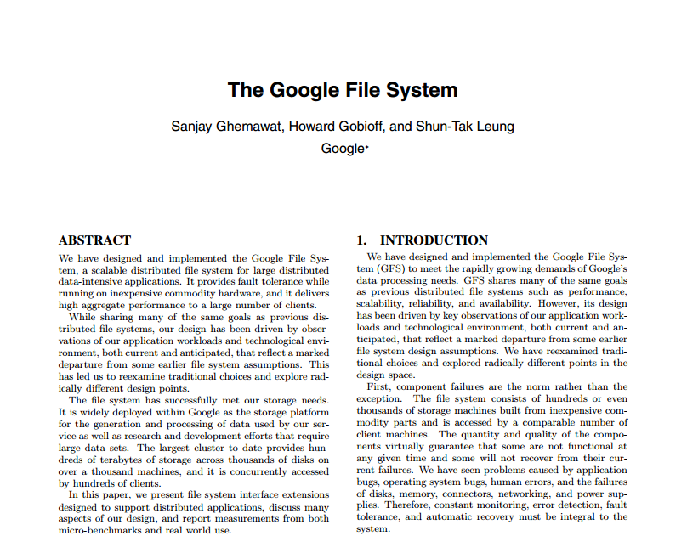
Google File System (GFS): White-Paper

Slide 13
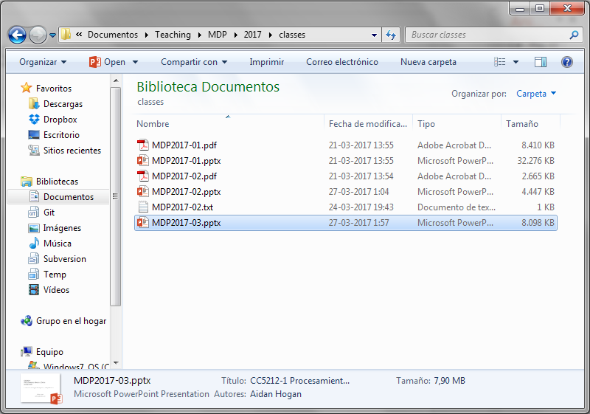
Google File System
What is a “file-system”?

Slide 14
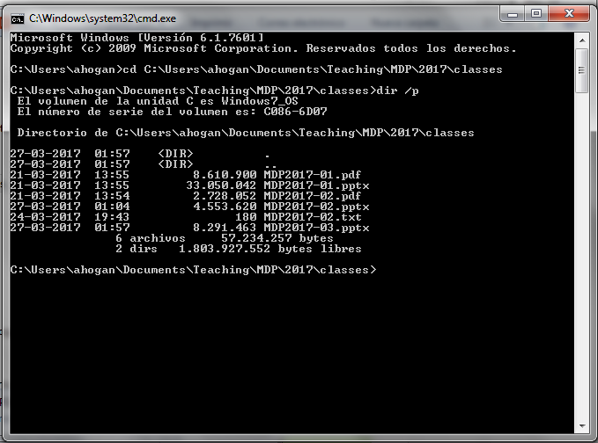
Google File System
What is a “file-system”?

Slide 15
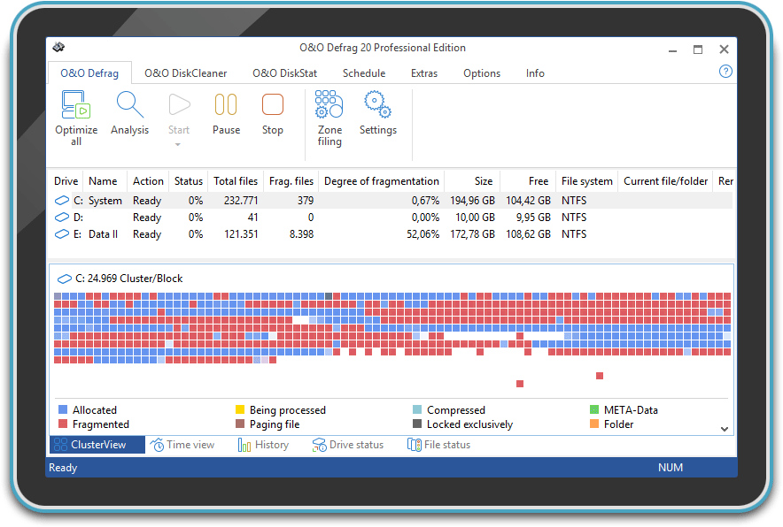
Google File System
What does a “file-system” do?
Splits a file up into chunks (blocks/clusters) of storage
Remembers location and sequence of chunks for a file

Slide 16
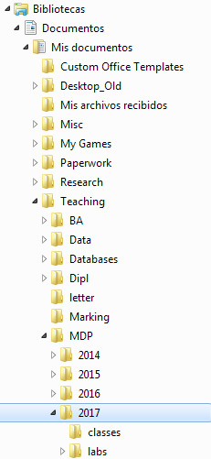
Google File System
What does a “file-system” do?
Splits a file up into chunks (blocks/clusters) of storage
Remembers location and sequence of chunks for a file
Organises a hierarchical directory structure
Tracks sub-directories and files in directories

Slide 17
Google File System
What does a “file-system” do?
Splits a file up into chunks (blocks/clusters) of storage
Remembers location and sequence of chunks for a file
Organises a hierarchical directory structure
Tracks sub-directories and files in directories
Tracks file meta-data
File size, date created, date last modified
Ownership, permissions, locks

Slide 18
Google File System
What does a “file-system” do?
Splits a file up into chunks (blocks/clusters) of storage
Remembers location and sequence of chunks for a file
Organises a hierarchical directory structure
Tracks sub-directories and files in directories
Tracks file meta-data
File size, date created, date last modified
Ownership, permissions, locks
Provides read/write/update/delete interface, etc.

Slide 19
Google File System
What does “Google File System” do?
Splits a file up into chunks (blocks/clusters) of storage
Remembers location and sequence of chunks for a file
Organises a hierarchical directory structure
Tracks sub-directories and files in directories
Tracks file meta-data
File size, date created, date last modified
Ownership, permissions, locks
Provides read/write/update/delete interface, etc.
Same thing, just distributed:

Slide 20
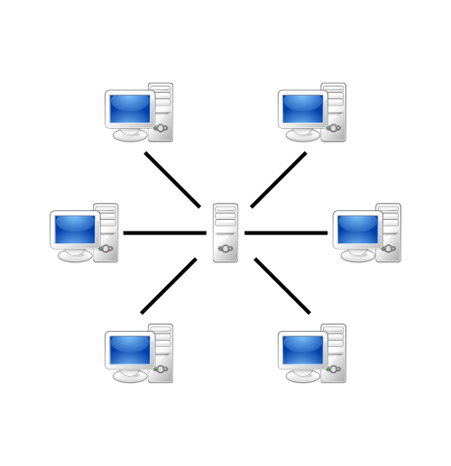
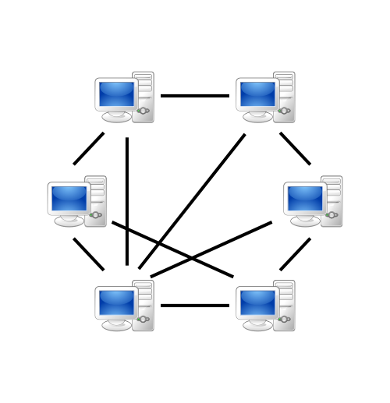
Google File System
So which architecture do you think Google uses?
Client–Server?
Peer-To-Peer?

Slide 21
Google File System
So which architecture do you think Google uses?
Client–Peer-To-Server-To-Peer-Server-Client!

Slide 22
Google File System: Assumptions
Files are huge
Files often read or appended
Concurrency important
Failures are frequent
Streaming important
So how should Google design its Distributed File System?

Slide 23
GFS: Architecture
64 MB per chunk
64 bit label for each chunk
Assume replication factor of 3
File System (In-Memory)
Master
A1
B1
C1
D1
E1
Chunk-servers

Slide 24
GFS: Pipelined Writes
64 MB per chunk
64 bit label for each chunk
Assume replication factor of 3
File System (In-Memory)
/blue.txt [3 chunks]
1: {A1, C1, E1}
2: {A1, B1, D1}
3: {B1, D1, E1}
/orange.txt [2 chunks]
1: {B1, D1, E1}
2: {A1, C1, E1}
Master
blue.txt
(150 MB: 3 chunks)
orange.txt (100 MB: 2 chunks)
A1
B1
C1
D1
E1
1
3
3
2
1
1
1
2
1
2
2
3
1
2
2
Chunk-servers

Slide 25
GFS: Pipelined Writes
64 MB per chunk
64 bit label for each chunk
Assume replication factor of 3
File System (In-Memory)
/blue.txt [3 chunks]
1: {A1, C1, E1}
2: {A1, B1, D1}
3: {B1, D1, E1}
/orange.txt [2 chunks]
1: {B1, D1, E1}
2: {A1, C1, E1}
Client asks Master to write a file
Master returns a primary chunkserver and secondary chunkservers
Client writes to primary chunkserver and tells it the secondary chunkservers
Primary chunkserver passes data onto secondary chunkserver, which passes on …
When finished, message comes back through the pipeline that all chunkservers have written
Otherwise client sends again
Master
blue.txt
(150 MB: 3 chunks)
orange.txt (100 MB: 2 chunks)
A1
B1
C1
D1
E1
1
3
3
2
1
1
1
2
1
2
2
3
1
2
2
Chunk-servers

Slide 26
GFS: Fault Tolerance
64 MB per chunk
64 bit label for each chunk
Assume replication factor of 3
File System (In-Memory)
/blue.txt [3 chunks]
1: {A1, B1, E1}
2: {A1, B1, D1}
3: {B1, D1, E1}
/orange.txt [2 chunks]
1: {B1, D1, E1}
2: {A1, D1, E1}
File System (In-Memory)
/blue.txt [3 chunks]
1: {A1, C1, E1}
2: {A1, B1, D1}
3: {B1, D1, E1}
/orange.txt [2 chunks]
1: {B1, D1, E1}
2: {A1, C1, E1}
Master
blue.txt
(150 MB: 3 chunks)
orange.txt (100 MB: 2 chunks)
A1
B1
C1
D1
E1
1
3
2
3
2
1
1
1
1
2
1
2
2
3
1
2
2
Chunk-servers

Slide 27
GFS: Fault Tolerance
64 MB per chunk
64 bit label for each chunk
Assume replication factor of 3
File System (In-Memory)
/blue.txt [3 chunks]
1: {A1, B1, E1}
2: {A1, B1, D1}
3: {B1, D1, E1}
/orange.txt [2 chunks]
1: {B1, D1, E1}
2: {A1, D1, E1}
Master sends regular “Heartbeat” pings
If a Chunkserver doesn’t respond
Master finds out what chunks it had
Master assigns new Chunkserver for each chunk
Master tells new Chunkserver to copy from a specific existing Chunkserver
Chunks are prioritised by number of remaining replicas, then by demand
Master
blue.txt
(150 MB: 3 chunks)
orange.txt (100 MB: 2 chunks)
A1
B1
C1
D1
E1
1
3
2
3
2
1
1
1
2
1
2
3
1
2
2
Chunk-servers

Slide 28
GFS: Direct Reads
64 MB per chunk
64 bit label for each chunk
Assume replication factor of 3
I’m looking for /blue.txt
File System (In-Memory)
/blue.txt [3 chunks]
1: {A1, C1, E1}
2: {A1, B1, D1}
3: {B1, D1, E1}
/orange.txt [2 chunks]
1: {B1, D1, E1}
2: {A1, C1, E1}
1
2
3
Master
A1
B1
C1
D1
E1
1
3
3
2
1
1
1
2
1
2
2
3
1
2
2
Chunk-servers

Slide 29
GFS: Direct Reads
64 MB per chunk
64 bit label for each chunk
Assume replication factor of 3
I’m looking for /blue.txt
File System (In-Memory)
/blue.txt [3 chunks]
1: {A1, C1, E1}
2: {A1, B1, D1}
3: {B1, D1, E1}
/orange.txt [2 chunks]
1: {B1, D1, E1}
2: {A1, C1, E1}
Client asks Master for file
Master returns locations of chunks
Returns a ranked list of replicas
Client reads chunk directly from Chunkserver
Software makes transparent for client!
1
2
3
Master
A1
B1
C1
D1
E1
1
3
3
2
1
1
1
2
1
2
2
3
1
2
2
Chunk-servers

Slide 30
GFS: Primary Replicas
64 MB per chunk
64 bit label for each chunk
Assume replication factor of 3
I want to change block 2 of /blue.txt
File System (In-Memory)
/blue.txt [3 chunks]
1: {A1, C1, E1}
2: {A1, B1, D1}
3: {B1, D1, E1}
/orange.txt [2 chunks]
1: {B1, D1, E1}
2: {A1, C1, E1}
Master
/blue.txt [3 chunks]
2: {A1, B1, D1}
2
COMMIT
ACK
COMMIT
COMMIT
A1
B1
C1
D1
E1
2
ACK
2
ACK
2
1
3
3
2
1
1
1
2
1
2
2
3
1
2
2
Chunk-servers

Slide 31
GFS: Primary Replicas
64 MB per chunk
64 bit label for each chunk
Assume replication factor of 3
I want to change block 2 of /blue.txt
File System (In-Memory)
/blue.txt [3 chunks]
1: {A1, C1, E1}
2: {A1, B1, D1}
3: {B1, D1, E1}
/orange.txt [2 chunks]
1: {B1, D1, E1}
2: {A1, C1, E1}
Master
/blue.txt [3 chunks]
2: {A1, B1, D1}
2
A1
B1
C1
D1
E1
2
2
2
1
3
3
2
1
1
1
2
1
2
2
3
1
2
2
Chunk-servers

Slide 32
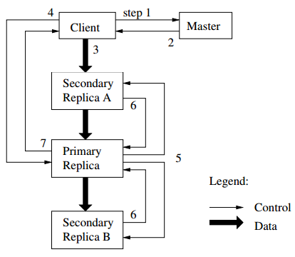
GFS: Primary Replicas
64 MB per chunk
64 bit label for each chunk
Assume replication factor of 3
I want to change block 2 of /blue.txt
File System (In-Memory)
/blue.txt [3 chunks]
1: {A1, C1, E1}
2: {A1, B1, D1}
3: {B1, D1, E1}
/orange.txt [2 chunks]
1: {B1, D1, E1}
2: {A1, C1, E1}
Master assigns leases to one replica: a “primary replica”
Client wants to change a file:
Client asks Master for the replicas (incl. primary)
Master returns replica info to the client
Client sends change data
Client asks primary to commit the changes
Primary asks secondaries to commit the changes
Secondaries acknowledge to primary
Primary acknowledges to client
Master
/blue.txt [3 chunks]
2: {A1, B1, D1}
2
A1
B1
C1
D1
E1
2
2
2
1
3
3
2
1
1
1
2
1
2
2
3
1
Data and control flow kept separate
2
2
Chunk-servers

Slide 33
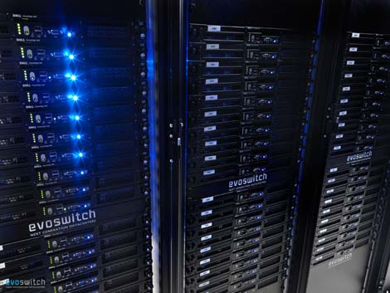
GFS: Rack Awareness

Slide 34
GFS: Rack Awareness
Core
Switch
Core
Switch
Rack A
Switch
Rack B
Switch
Rack C
Switch

Slide 35
GFS: Rack Awareness
Core
Switch
Files:
/orange.txt
1: {A1, A4, B3}
2: {A5, B1, B5}
Rack A
Switch
Rack B
Switch
1
A1
2
B1
Racks:
A: {A1, A2, A3, A4, A5}
B: {B1, B2, B3, B4, B5}
A2
B2
A3
1
B3
1
A4
B4
2
A5
2
B5

Slide 36
GFS: Rack Awareness
Make sure replicas not on same rack
In case rack switch fails!
But communication can be slower:
Within rack: pass one switch (rack switch)
Across racks: pass three switches (two racks and a core)
(Typically) pick two racks
Two nodes in same rack, one node in another rack
(Assuming 3x replication)
Umm, only necessary if more than one rack
Core
Switch
Files:
/orange.txt
1: {A1, A4, B3}
2: {A5, B1, B5}
Rack A
Switch
Rack B
Switch
1
A1
2
B1
Racks:
A: {A1, A2, A3, A4, A5}
B: {B1, B2, B3, B4, B5}
A2
B2
A3
1
B3
1
A4
B4
2
A5
2
B5

Slide 37
GFS: Other Operations
Rebalancing:
Spread storage out evenly
Deletion:
Just rename the file with hidden file name
To recover, rename back to original version
Otherwise, three days later will be wiped
Monitoring Stale Replicas:
Dead chunkserver reappears with old data?
Master keeps version info

Slide 38
GFS: Weaknesses?
What are the main weaknesses of GFS?
Master node single point of failure
Use hardware replication
Logs and checkpoints
Master node is a bottleneck
Use more powerful machine
Minimise master node traffic
Master-node metadata kept in memory
Each chunk needs 64 bytes to address
Chunk data can be queried from each chunkserver
Keep each chunk large (fewer chunks)

Slide 39
Hadoop Distributed File System
Open source version of GFS
HDFS-to-GFS translation guide …
Data-node = Chunkserver
Name-node = Master
Same idea except …
GFS is proprietary (hidden in Google)
HDFS is open source (Apache!)

Slide 40
Implementing on thousands of machines
Crawling
Parse links from webpages
Schedule links for crawling
Download pages, GOTO 1
Indexing
Parse keywords from webpages
Index keywords to webpages
Manage updates
Ranking
How relevant is a page? (TF-IDF)
How important is it? (PageRank)
How many users clicked it?
...
Build distributed abstractions
write(file f)
read(file f)
delete(file f)
append(file f, data d)
HDFS/GFS
We done?

Slide 41
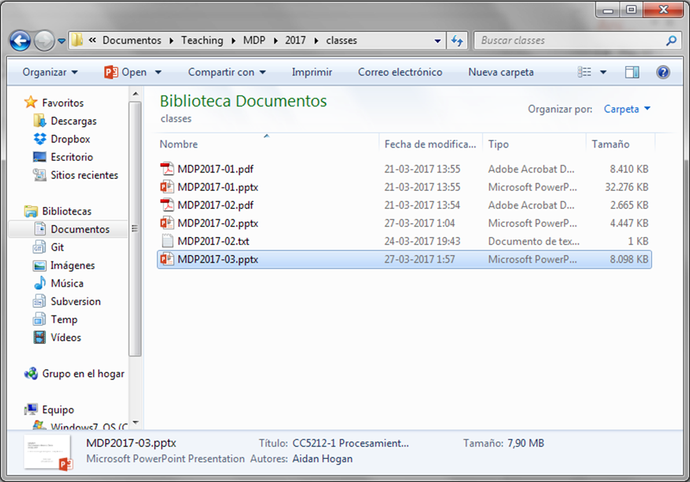
Implementing on thousands of machines

Slide 42
Google’s MapReduce

Slide 43
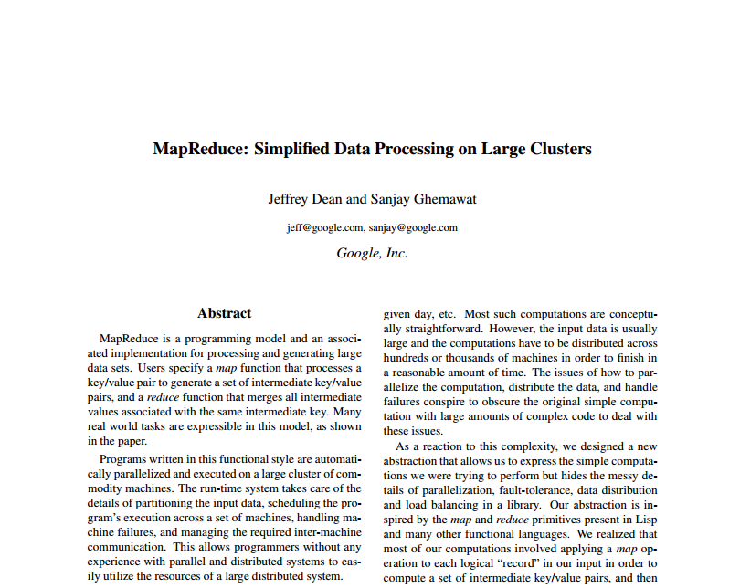
MapReduce: White-Paper

Slide 44
You
Worker 1
Worker 2
Worker 3
Worker 4
2♠×391, 3♠×192, 4♠×266, ..., Q♥×123, K♥×321, A♥×402

Slide 45
Moving to word count ...
How could we do a distributed word count?
Count parts in memory on different machines and merge?
But if the data don’t fit in memory (e.g., 4-grams)?
And how to do that merge (sum counts for word w across machines)?
Count parts on-disk on different machines and merge?
Again, how to do that merge?

Slide 46
Distributed word count
Input
File on Distr. File System
A1
B1
C1
1
3
2
Partition
Distr. Sort/Count
A1
B1
C1
a-k
l-q
r-z
(a,10023)
(aa,6234)
…
(lab,8123)
(label,983)
…
(rag,543)
(rat,1233)
…
Output
File on Distr. File System
Better partitioning?

Slide 47
Distributed word count
Can we abstract any general framework?
Can we be more specific for reduce?

Slide 48
MapReduce
Can we abstract any general framework?
In general, we must assume bags/multisets (sets with duplicates)

Slide 49
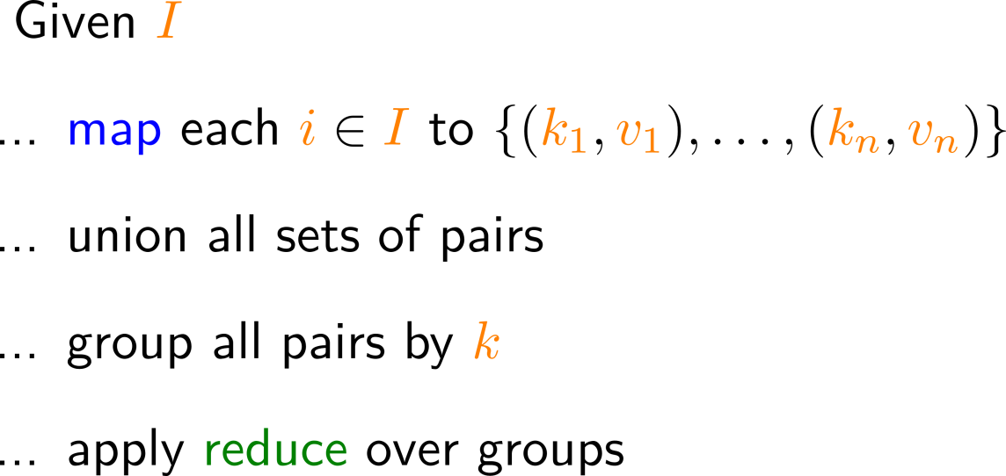
MapReduce: Main Idea
Can we abstract any general framework?
← But how to implement this
part in a distributed system
Partition by map key
Sort (in parallel) by map key
Apply reduce

Slide 50
MapReduce: Word count
Input
File on Distr. File System
A1
B1
C1
1
3
2
Map
Partition
Distr. Sort
A1
B1
C1
%3=0
%3=1
%3=2
Reduce
(a,10023)
(abba,6234)
…
(abs,8123)
(acad,983)
…
(about,543)
(add,1233)
…
Output
File on Distr. File System

Slide 51
MapReduce (in more detail)
Input: Read from the cluster (e.g., a DFS)
Chunks raw data for mappers
Maps raw data to initial (key_{in},value_{in}) pairs
Map: For each (key_{in},value_{in}) pair, generate zero-to-many (key_{map},value_{map}) pairs
key_{in} /value_{in} can be diff. type to key_{map} /value_{map}
What might Input contain in the word-count case?
What might Map do in the word-count case?

Slide 52
MapReduce (in more detail)
Partition: Assign sets of key_{map} values to reducer machines
Shuffle: Data are moved from mappers to reducers (e.g., using DFS)
Comparison/Sort: Each reducer sorts the data by key using a comparison function
Sort is taken care of by the framework
How might Partition work in the word-count case?

Slide 53
MapReduce (in more detail)
Reduce: For each key_{map}, takes the bag of value_{map} entries with that key, and produces zero-to-many outputs, i.e., (key_{reduce},value_{reduce}) pairs
Output: Writes the results from the reducers to the distributed file system
How might Reduce work in the word-count case?

Slide 54
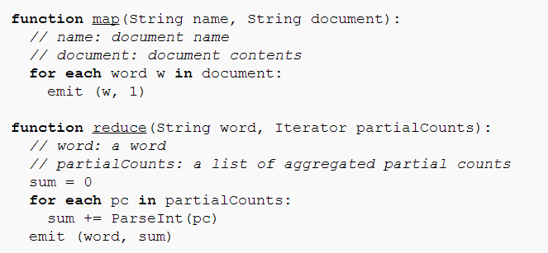
MapReduce: Word count pseudo-code

Slide 55
MapReduce: Under the Hood

Slide 56
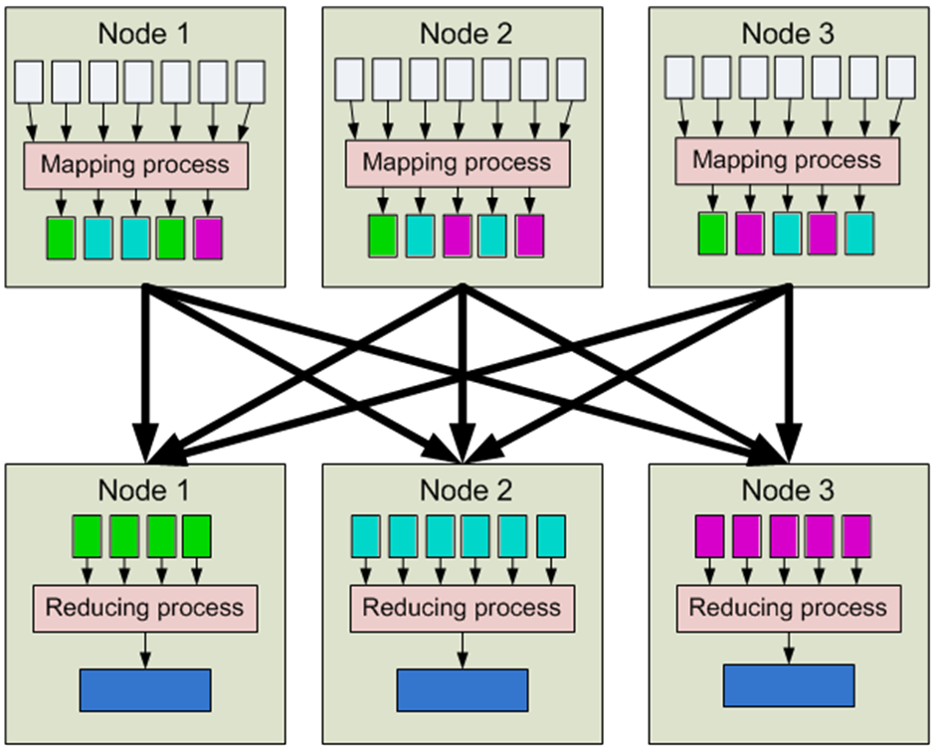
MapReduce
1. Input
2. Map
3. Partition [Sort]
4. Shuffle
5. Merge Sort
6. Reduce
7. Output

Slide 57
MapReduce: Counting Words
Input
Map
Partition /
[Sort]
Shuffle
Merge Sort
Reduce
Output
(0,perro sed que)
(perro,1)
(sed,1)
(que,1)
(sed,1)
(sed,1)
(decir,1)
(sed,1)
(sed,1)
(decir,{1})
(sed,{1,1})
(decir,1)
(sed,2)
(perro,1)
(que,1)
(decir,1)
(sed,1)
(13,que decir que)
(que,1)
(decir,1)
(que,1)
(decir,1)
(perro,1)
(que,1)
(perro,1)
(que,1)
(que,1)
(que,1)
(que,1)
(pero,{1})
(perro,1)
(que,4)
perro sed que
que decir que
la que sed
(que,1)
(que,1)
(que,{1,1,1,1})
(que,1)
(que,1)
(que,1)
(26,la que sed)
(la,1)
(que,1)
(sed,1)
(sed,1)
(la,1)
(la,1)
(la,{1})
(la,1)
(que,1)
(la,1)

Slide 58
MapReduce: Combiner
1. Input
2. Map
3. Partition [Sort]
(“Combine”)
4. Shuffle
5. Merge Sort
6. Reduce
7. Output

Slide 59
MapReduce: Combiner
Input
Map
Partition /
[Sort]
Combine
Shuffle
Merge Sort
Reduce
Output
(0,perro sed que)
(perro,1)
(sed,1)
(que,1)
(sed,1)
(sed,1)
(sed,1)
(decir,1)
(sed,1)
(sed,1)
(decir,{1})
(sed,{1,1})
(decir,1)
(sed,2)
(perro,1)
(que,1)
(perro,1)
(que,1)
(decir,1)
(sed,1)
(13,que decir que)
(que,1)
(decir,1)
(que,1)
(decir,1)
(decir,1)
(perro,1)
(que,1)
(perro,1)
(que,1)
(que,1)
(que,2)
(pero,{1})
(perro,1)
(que,4)
(que,1)
(que,1)
(que,2)
(que,{1,1,2})
(que,2)
(que,1)
(26,la que sed)
(la,1)
(que,1)
(sed,1)
(sed,1)
(sed,1)
(la,1)
(la,1)
(la,{1})
(la,1)
(que,1)
(que,1)
(la,1)
(la,1)

Slide 60
MapReduce: Combiner
1. Input
2. Map
3. Partition [Sort]
(“Combine”)
4. Shuffle
Combiner reduces data shuffled here!
5. Merge Sort
6. Reduce
7. Output

Slide 61
MapReduce: More complex tasks

Slide 62
Supermarket Example
Supermarket boss wants to know:
Do we sell more in the morning hours or the evening hours?

Slide 63
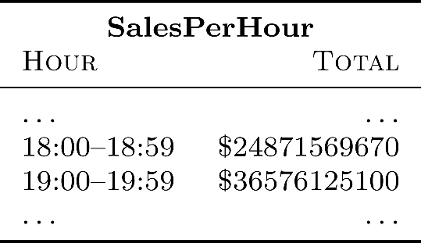
MapReduce: Supermarket Example
Compute total sales per hour of the day?

Slide 64
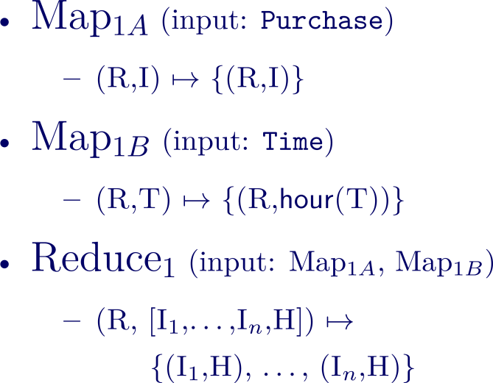
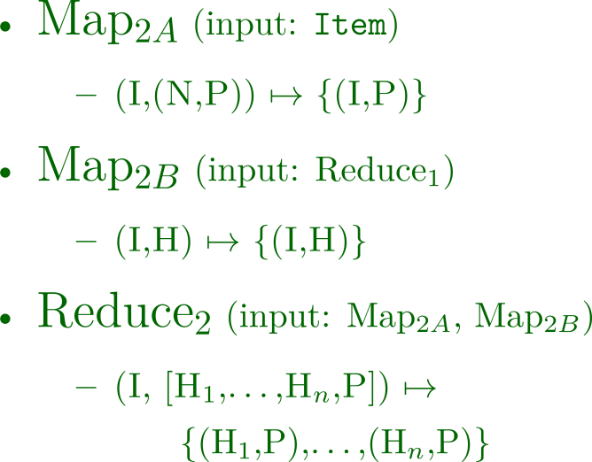
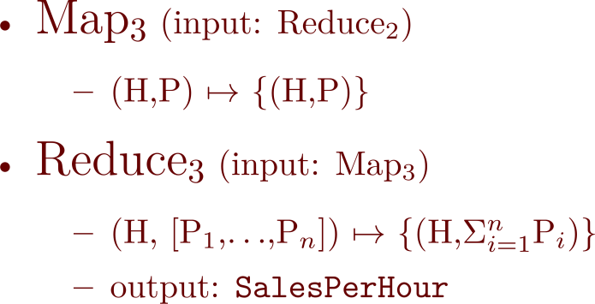
MapReduce: Supermarket Example
... one possible solution.

Slide 65
Implementing on thousands of machines
Crawling
Parse links from webpages
Schedule links for crawling
Download pages, GOTO 1
Indexing
Parse keywords from webpages
Index keywords to webpages
Manage updates
Ranking
How relevant is a page? (TF-IDF)
How important is it? (PageRank)
How many users clicked it?
...
Build distributed abstractions
write(file f)
read(file f)
delete(file f)
append(file f, data d)
mapreduce(function map, function reduce, file in, file out)

Slide 66
MapReduce: Benefits for Programmers
Takes care of low-level implementation:
Easy to handle inputs and output
No need to handle network communication
No need to write sorts or joins
Abstracts machines (transparency)
Fault tolerance (through heart-beats)
Abstracts physical locations
Add / remove machines
Load balancing

Slide 67
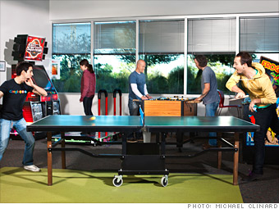
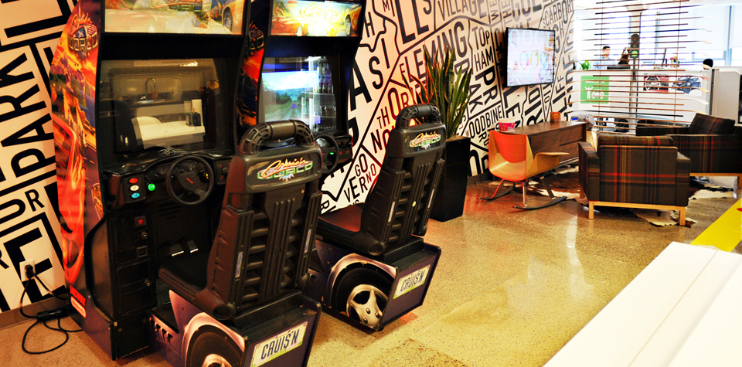
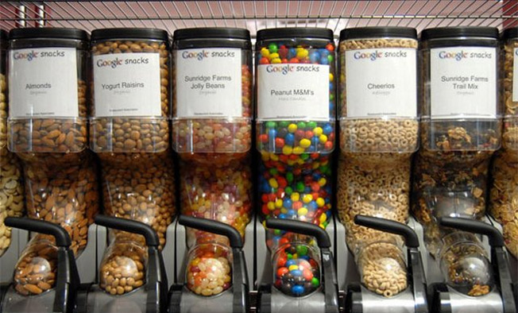
MapReduce: Benefits for Programmers
(Time for more important things)

Slide 68
HDFS/Hadoop Overview

Slide 69
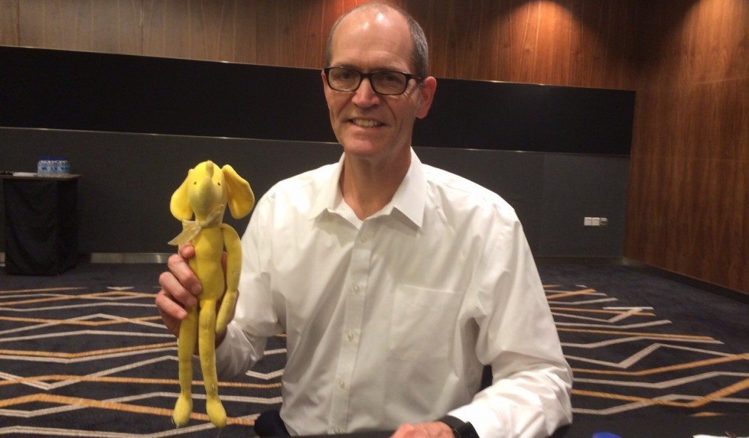
Hadoop: Open Source MapReduce

Slide 70
HDFS / Hadoop Core Architecture
Client
NameNode
JobTracker
DataNode 1
JobNode 1
DataNode 2
JobNode 2
…
…
DataNode n
JobNode n

Slide 71
HDFS: Traditional / SPOF
NameNode
NameNode appends edits to log file
SecondaryNameNode copies log file and image, makes checkpoint, copies image back
NameNode loads image on start-up and makes remaining edits
SecondaryNameNode not a backup NameNode
copy dfs/blue.txt
rm dfs/orange.txt
rmdir dfs/
mkdir new/
mv new/ dfs/
fsimage
SecondaryNameNode
DataNode 1
…
DataNode n

Slide 72
What is the secondary name-node?
Name-node quickly logs all file-system actions in a sequential (but messy) way
Secondary name-node keeps the main fsimage file up-to-date based on logs
When the primary name-node boots back up, it loads the fsimage file and applies the remaining log to it
Hence secondary name-node helps make boot-ups faster, helps keep file system image up-to-date and takes load away from primary

Slide 73
Hadoop: High Availability
1
2
Active NameNode
Standby NameNode
Active NameNode
JournalManager
JournalManager
fsimage
2
1
JournalNode 1
fs edits
fs edits
2
1
…
1
2
JournalNode n

Slide 74
Programming with hadoop
(REFERENCE MATERIAL FOR LAB)

Slide 75
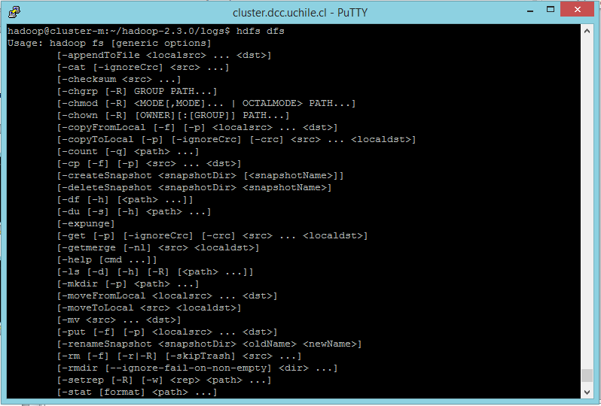
1. Input/Output (cmd)
> hdfs dfs

Slide 76
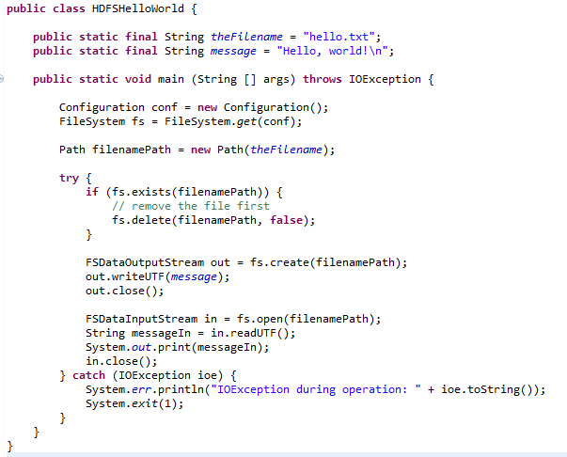
1. Input (Java)
Creates a file system for default configuration
Check if the file exists; if so delete
Create file and write a message
Open and read back

Slide 77
1. Input (Java)

Slide 78
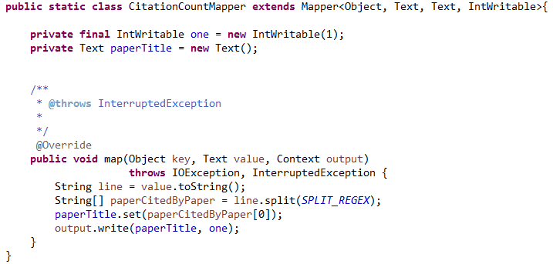
2. Map
Mapper<InputKeyType,
InputValueType,
MapKeyType,
MapValueType>
Handles the input for you!
(input) key: file offset.
(input) value: line of the file.
context: handles output and logging.
Emit output

Slide 79
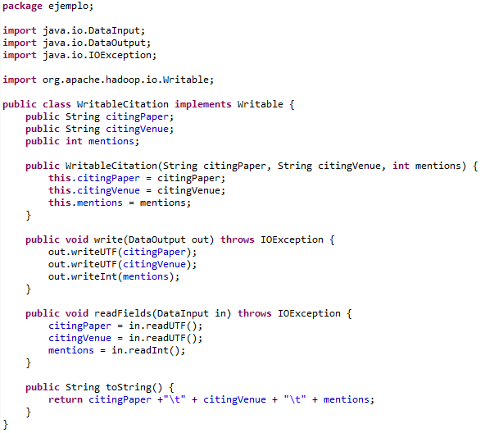
(Writable for values)
Same order
(not needed in the running example)

Slide 80
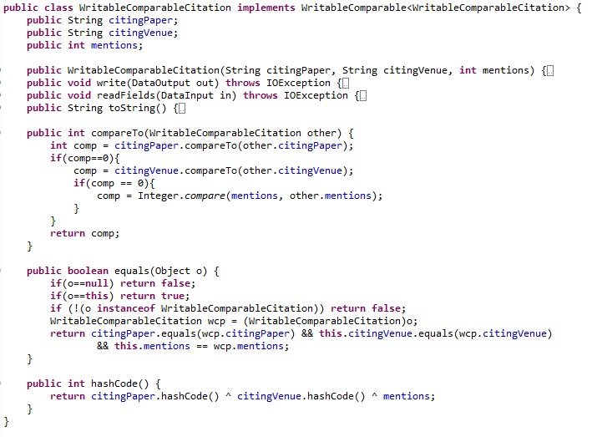
(WritableComparable for keys/values)
New Interface
Same as before
Needed to sort keys
Needed for default partition function
(not needed in the running example)

Slide 81
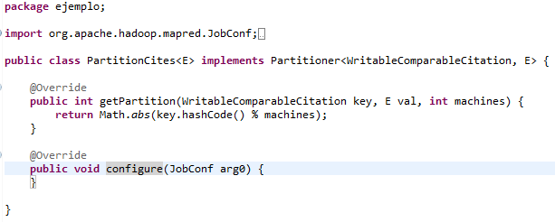
3. Partition
PartitionerInterface
(This happens to be the default partition method!)
(not needed in the running example)

Slide 82
4. Shuffle

Slide 83
5. Sort/Comparison
Methods in WritableComparator
(not needed in the running example)

Slide 84
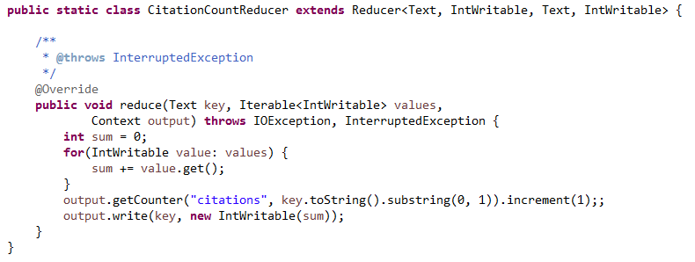
6. Reduce
Reducer<MapKey, MapValue,
OutputKey, OutputValue>
Handles the output for you!
key: as emitted from map
values: iterator over all values for that key
context for output
Write to output

Slide 85
7. Output / Input (Java)
Creates a file system for default configuration
Check if the file exists; if so delete
Create file and write a message
Open and read back

Slide 86
7. Output (Java)

Slide 87
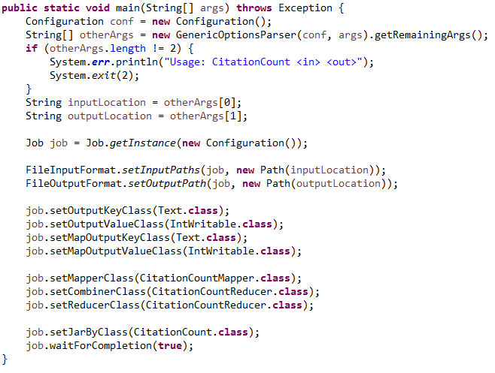
Control Flow
Create a JobClient, a JobConf and pass it the main class
Set input and output paths
Set the type of map and output keys and values in the configuration
Set the mapper class
Set the reducer class
(and optionally “combiner”)
Run and wait for job to complete.
Can use a reducer as a combiner!

Slide 88
More in Hadoop

Slide 89
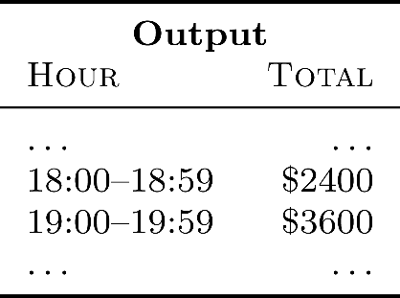
Hadoop: Supermarket Example
Compute total sales per hour of the day?

Slide 90
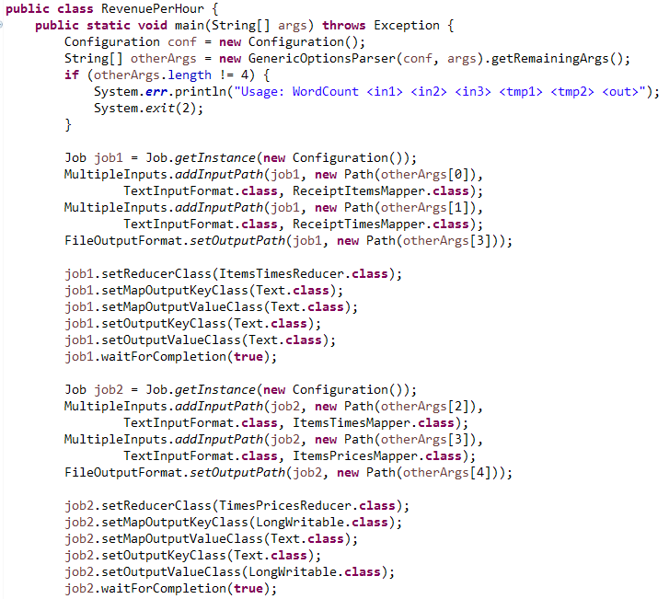
More in Hadoop: Multiple Inputs
Multiple inputs, different map for each
One reducer

Slide 91
More in Hadoop: Chaining Jobs
Run and wait
Output of Job1 set to Input of Job2

Slide 92
Number of Reducers
Set number of parallel reducer tasks for the job
Why would we ask for 1 reduce task?
Output requires a merge on one machine
(for example, sorting, top-k)

Slide 93
More in Hadoop: Counters
Context has a group of maps of counters

Slide 94
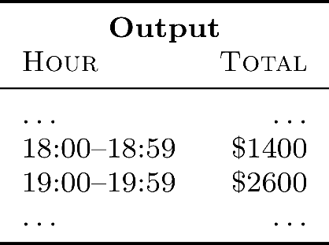
Hadoop: Filtered Supermarket Example
Compute total sales per hour of the day …
but exclude certain item IDs passed as an input file?

Slide 95
More in Hadoop: Distributed Cache
Some tasks need “global knowledge”
Use a distributed cache:
Makes global data available locally to all nodes
On the local hard-disk of each machine
Should be used sparingly, for small data volumes

Slide 96
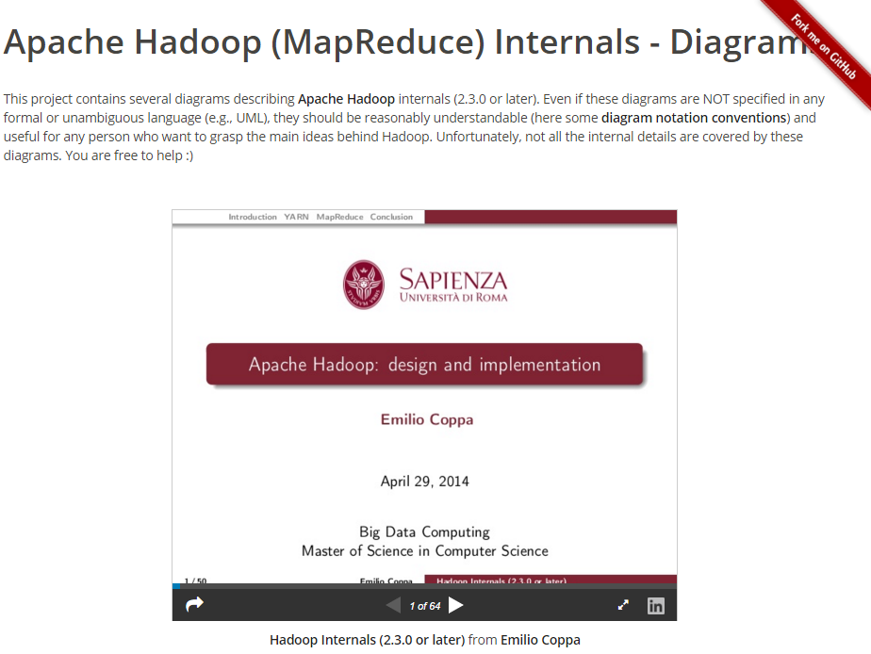
Apache Hadoop … Internals (if interested)
http://ercoppa.github.io/HadoopInternals/

Slide 97
Questions?

