Slide 1
CC5212-1 Procesamiento Masivo de Datos Otoño 2023 Lecture 1 Introduction
Aidan Hogan
aidhog@gmail.com

Slide 2
The value of data

Slide 3
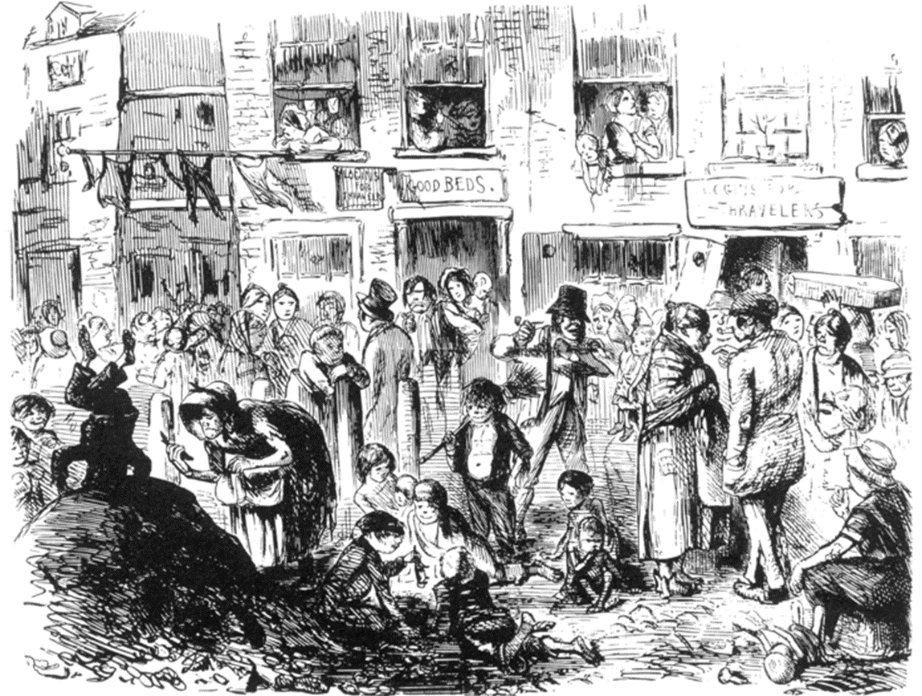
Soho, London, 1854

Slide 4
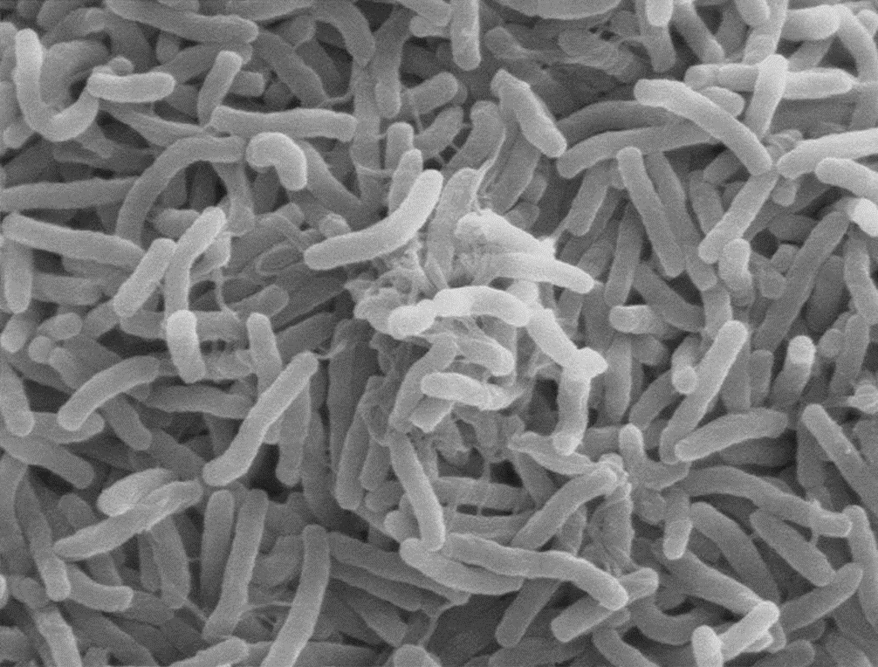
Cholera: What we know now …

Slide 5
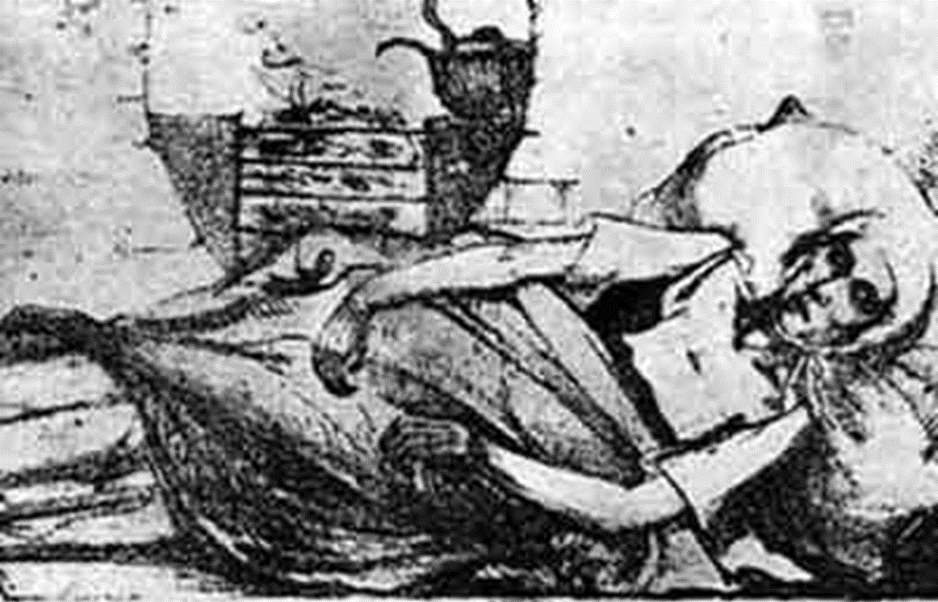
Cholera: What we knew in 1854

Slide 6
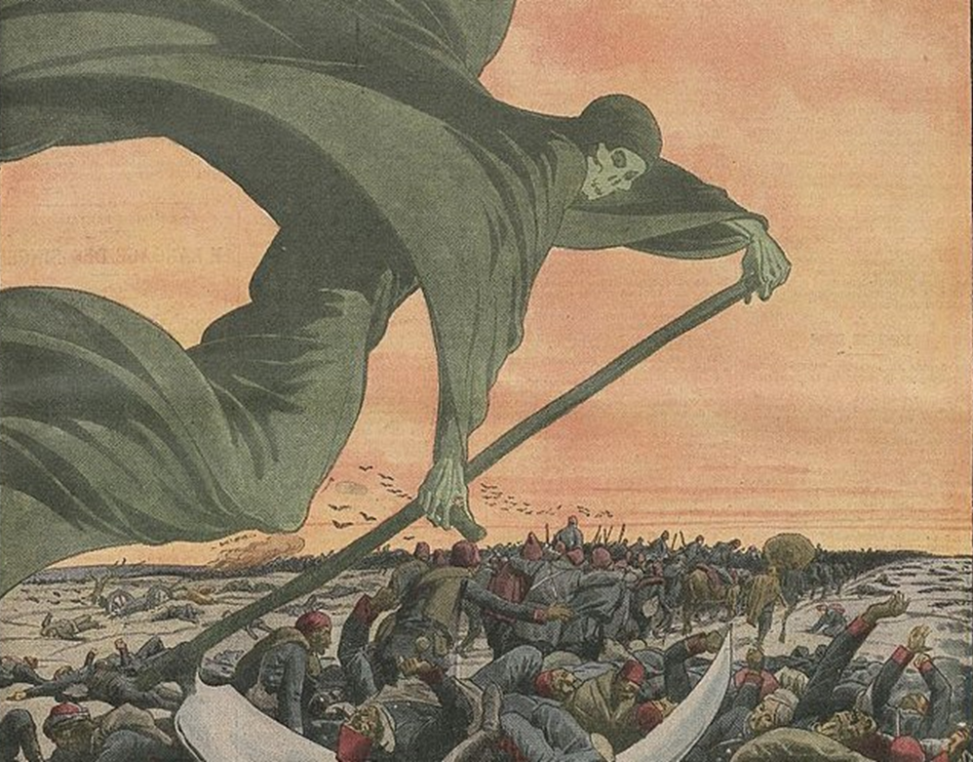
1854: Galen’s miasma theory of cholera

Slide 7
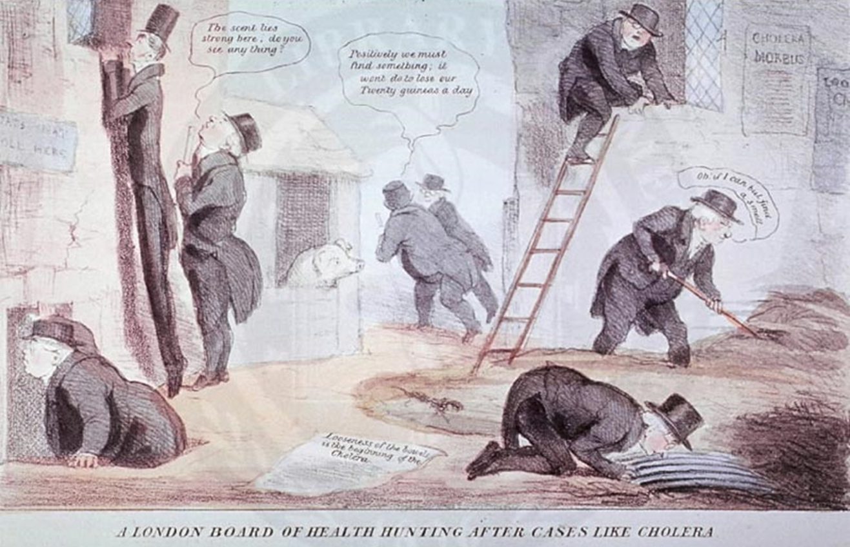
1854: The hunt for the invisible cholera

Slide 8
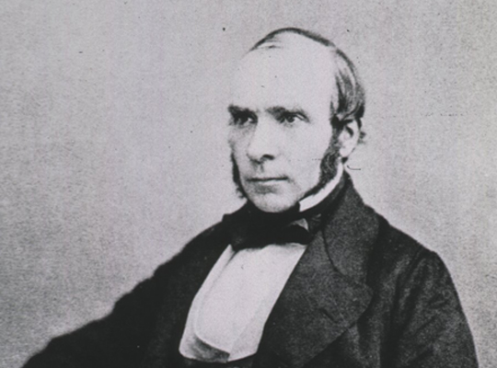
John Snow: 1813–1858

Slide 9
John Snow: 1813–1858

Slide 10
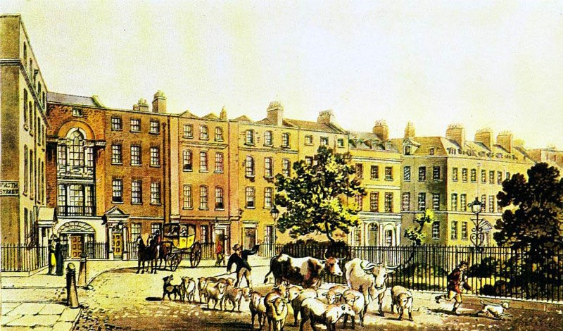
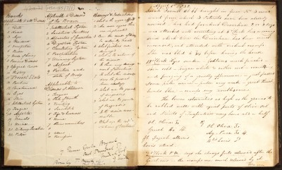
The survey of Soho

Slide 11
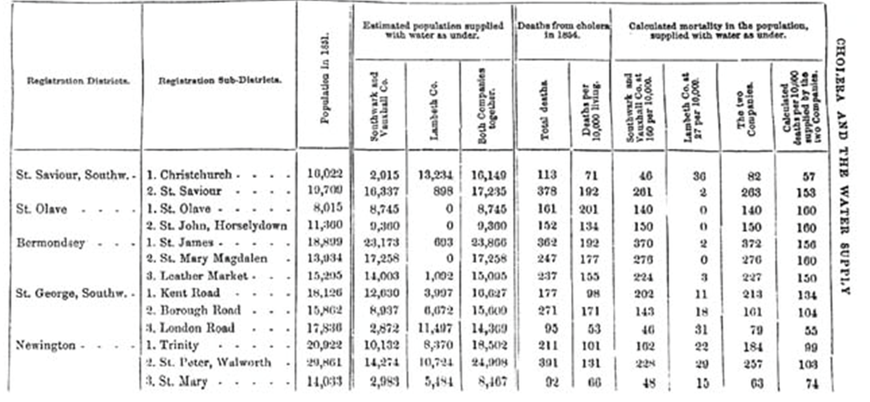
The survey of Soho

Slide 12
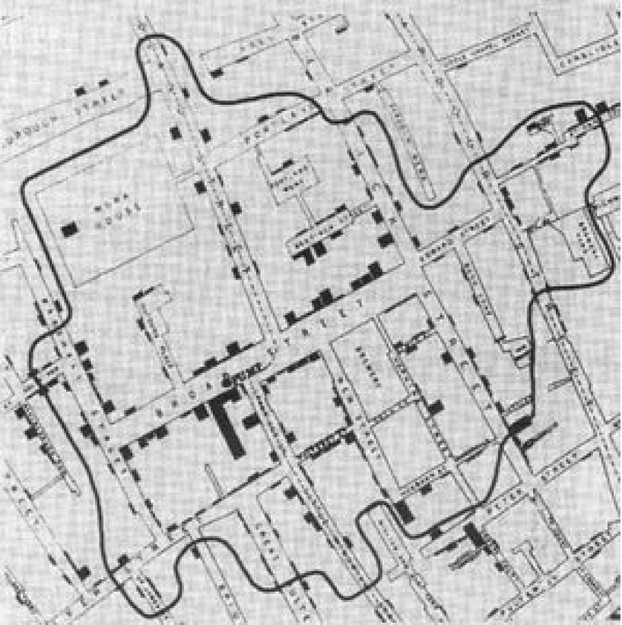
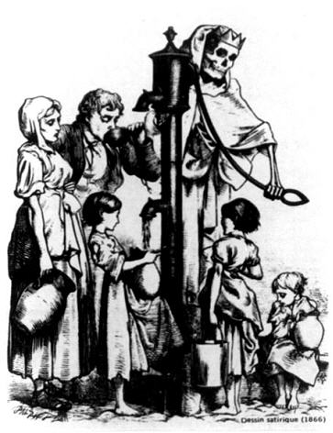
What the data showed …

Slide 13
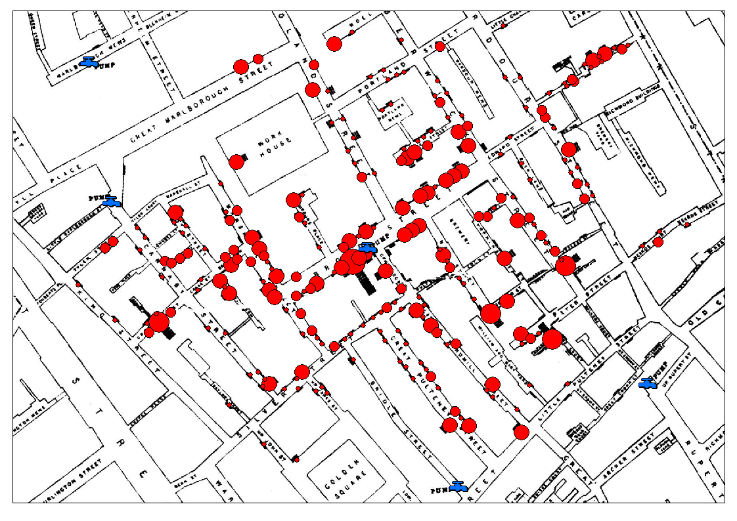
What the data showed …

Slide 14
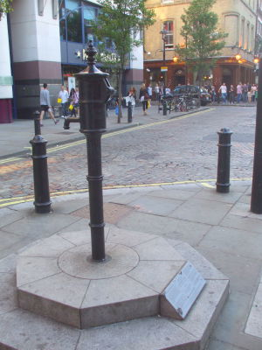
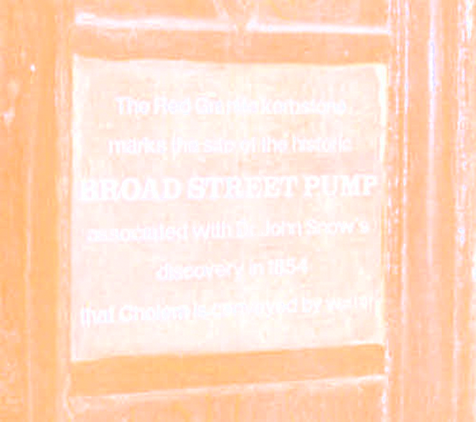
616 deaths, 8 days later …

Slide 15
Cholera: What we knew in 1855

Slide 16
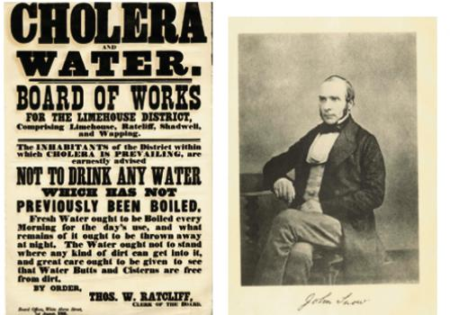
Cholera boil notice ca. 1866

Slide 17
Cholera boil notice ca. 1866

Slide 18
Thirty years before discovery of V. cholerae

Slide 19
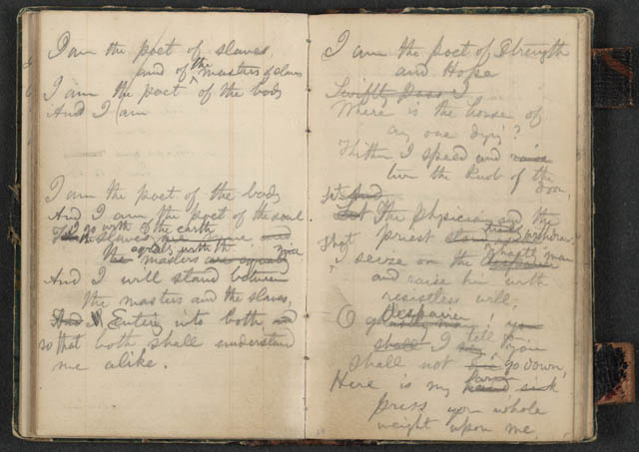
John Snow: Father of Epidemiology

Slide 20
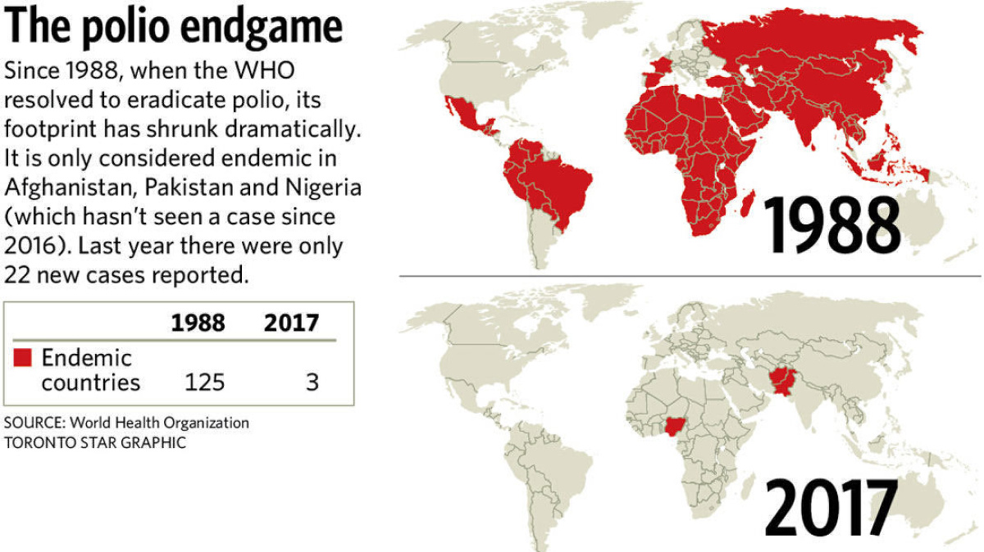
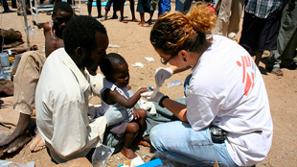
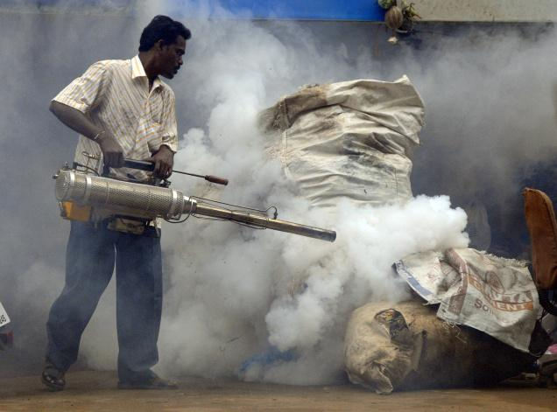
Epidemiology’s Success Stories

Slide 21
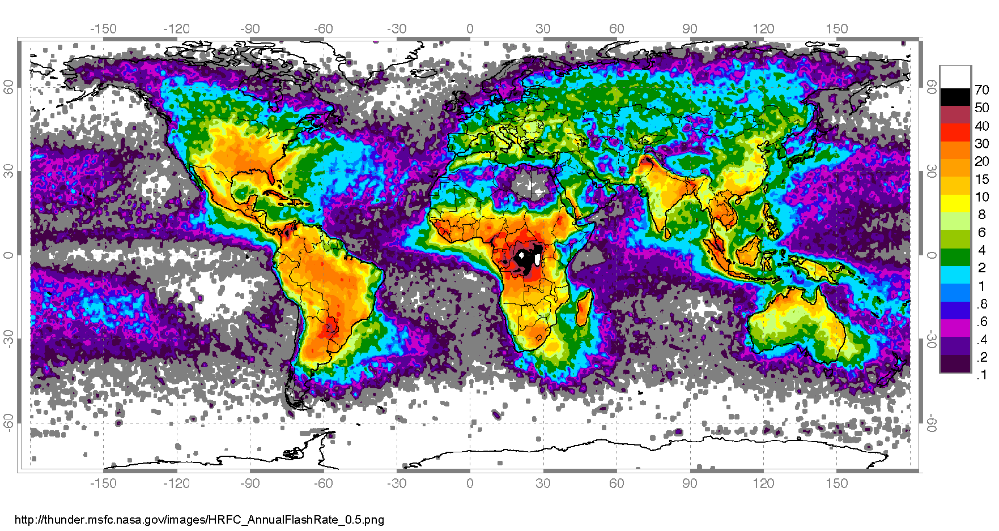
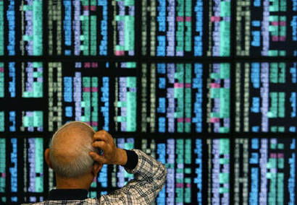
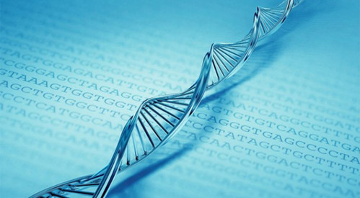
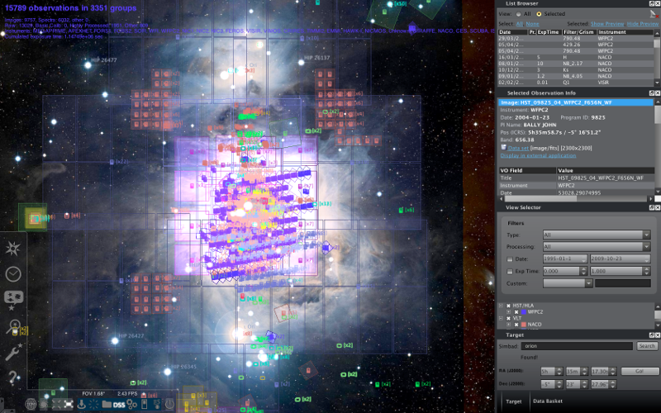
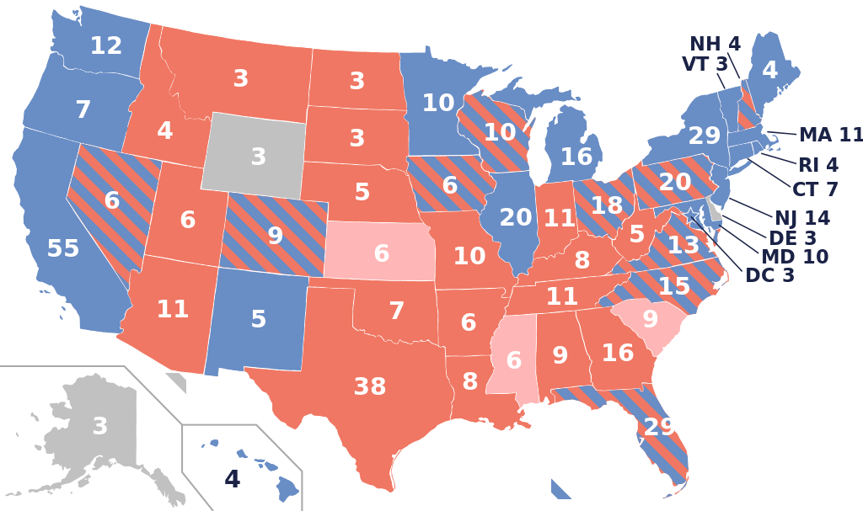
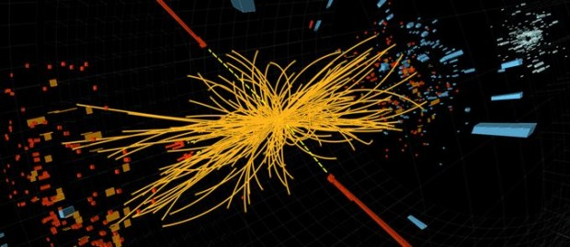
Value of data: Not just epidemiology

Slide 22
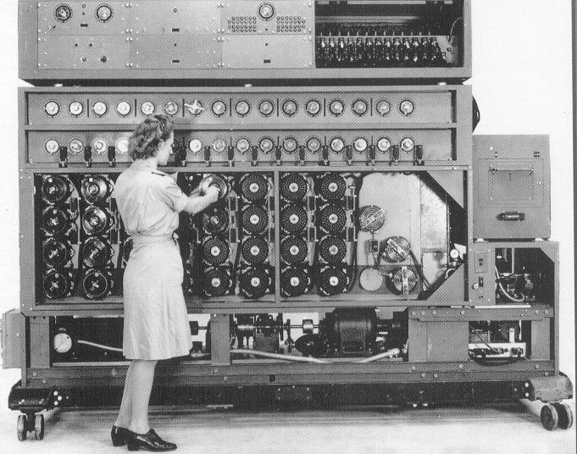
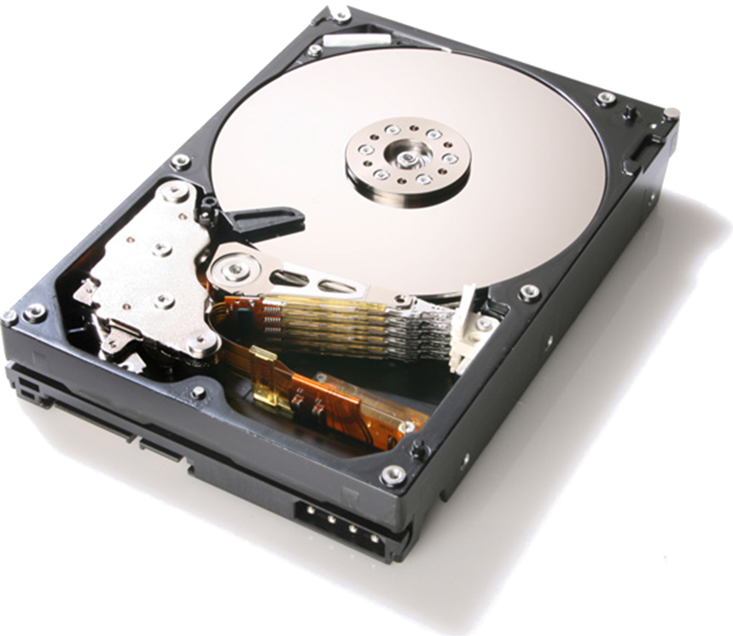
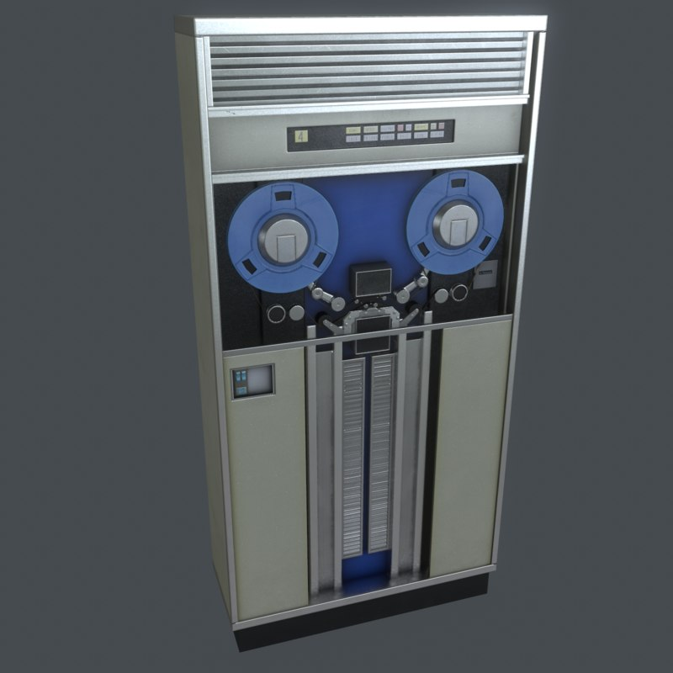
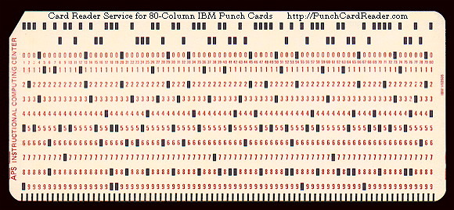
(Paper) Notebooks no longer good enough

Slide 23
The Growth of Data

Slide 24
“Big Data”
English Wikipedia
≈ 51 GB of data
(2015 dump)
(Text; No edit history)
(XML, uncompressed)
1 Wiki = 1 Wikipedia

Slide 25
“Big Data”
Wikimedia Commons
≈ 24 TB of data
≈ 470.6 Wiki
(2014 dump)

Slide 26
“Big Data”
Twitter
≈ 8 TB / day
≈ 157 Wiki / day
(2013, generated)

Slide 27
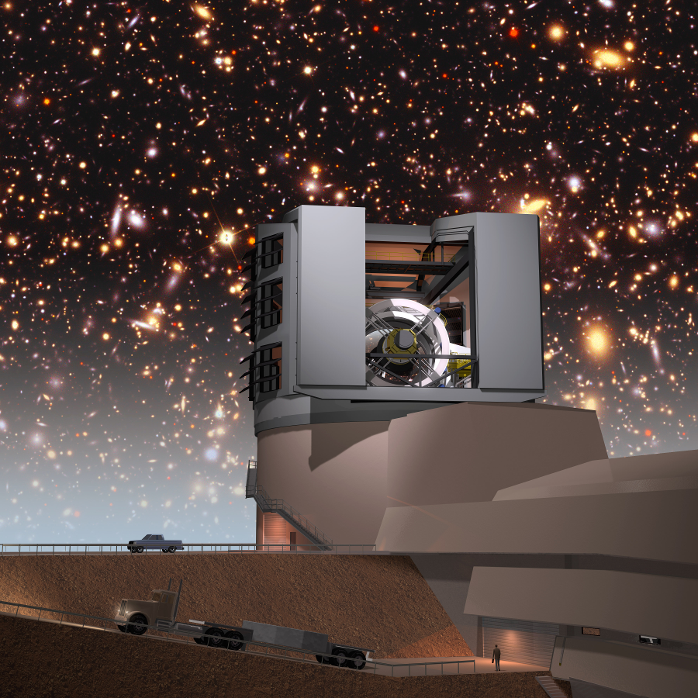
“Big Data”
Large Synoptic Survey Telescope
≈ 15 TB / day (night)
≈ 294 Wiki / day
(2020, generated)

Slide 28
“Big Data”
Facebook
≈ 600 TB / day
≈ 11,764 Wiki / day
(2014, incoming Hive data)

Slide 29
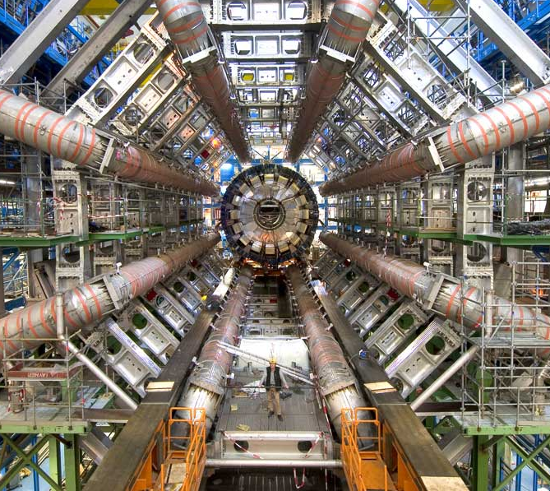
“Big Data”
Large Hadron Collider
≈ 1 PB / day
≈ 19,607 Wiki / day
(2017, filtered data)

Slide 30
“Big Data”
PRISM: NSA Surveillance
≈ 29 PB / day
≈ 568,627 Wiki / day
(2013, processed)

Slide 31
“Big Data”
Google
≈ 100 PB / day
≈ 2,000,000 Wiki / day
(2014, processed)

Slide 32
“Big Data”
Internet Traffic
≈ 2.4 EB / day
≈ 47,000,000 Wiki / day
(2014, Cisco estimates)

Slide 33
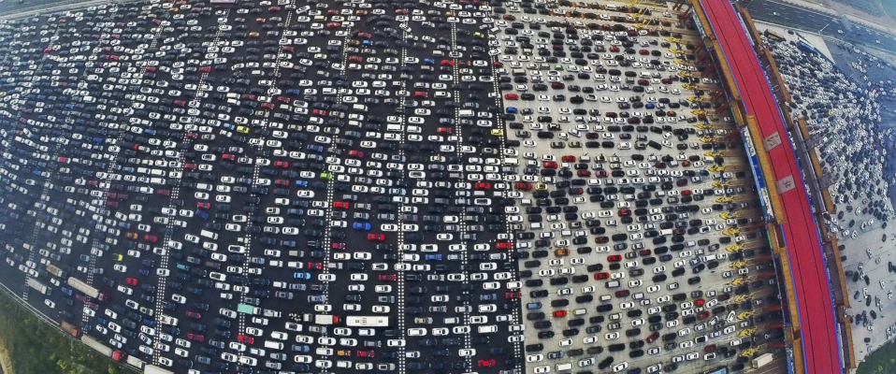
Data: A Modern-day Bottleneck?

Slide 34
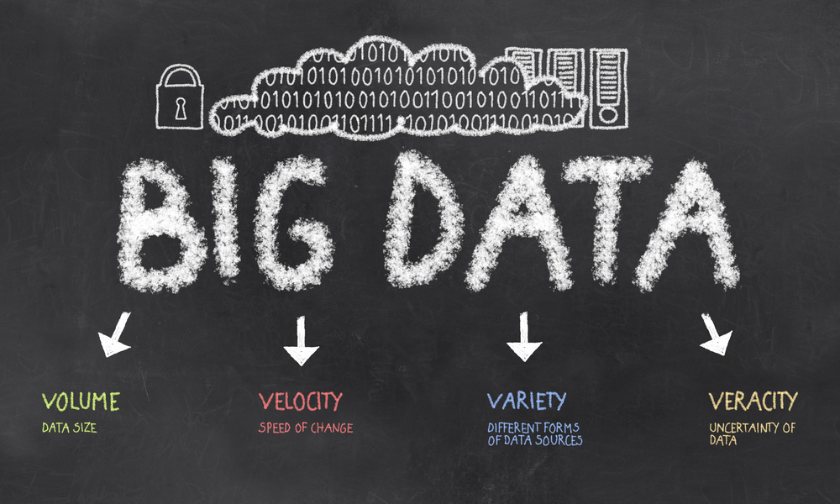
The ‘V’s of “Big Data”

Slide 35
“Big Data” in action …

Slide 36
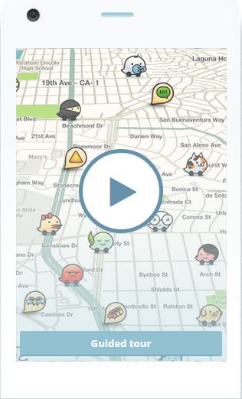
Getting Home (Waze)
“What’s the fastest route to get home right now?”
Processes journeys as background knowledge
“Participatory Sensing”

Slide 37
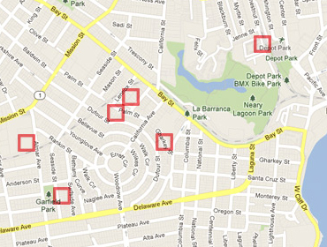
Predicting Pre-crime (PredPol)
“What areas of the city are most need of police patrol at 13:55 on Mondays?”
PredPol system used by Santa Cruz (US) police patrols
Predictions based on 8 years of historical crime data

Slide 38
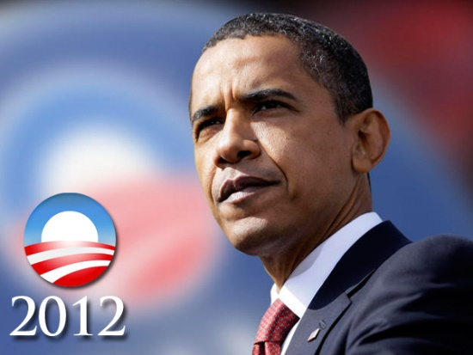
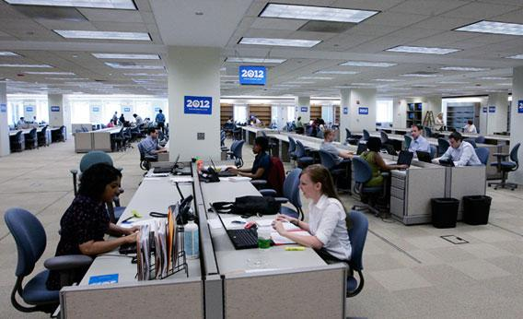
Getting Elected President (Narwhal)
“Who are the undecided voters and how can I convince them to vote for me?”
User profiles built and integrated from online sources
Targeted messages sent to voters based on profile

Slide 39
Getting Elected President (Narwhal)
“Who are the undecided voters and how can I convince them to vote for me?”
User profiles built and integrated from online sources
Targeted messages sent to voters based on profile

Slide 40
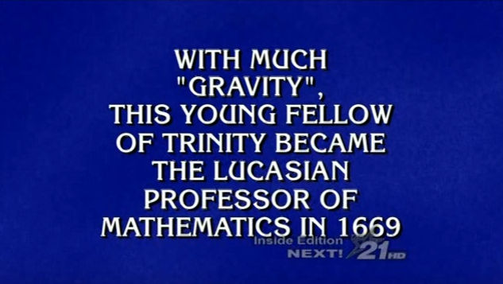
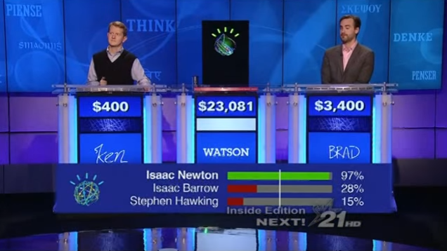
Winning Jeopardy (IBM Watson)
“Can a computer beat human experts at Jeopardy?”
Indexed 200 million pages of content
An ensemble of 100 processing techniques

Slide 41
Surveying the Night Sky (LSST)
“What astronomic bodies are changing in the sky?”
Surveys the visible sky each week (15 TB / day)
Queries external catalogues for known information

Slide 42
Processing lots of data ...

Slide 43
Every Application is Different …
Data can be
(Semi-)Structured data
(Relational DBs, JSON, XML, CSV, HTML form data)
Unstructured data
(text document, comments, tweets)
And everything in-between!

Slide 44
Every Application is Different …
Processing can involve:
Data Management
(indexing, querying, joins, aggregation)
Natural Language Processing
(keyword search, topic extraction, entity recognition, machine translation, etc.)
Data Mining and Statistics
(pattern recognition, classification, regression, recommendations, etc.)
Or something else / A mix

Slide 45
So where to start?

Slide 46
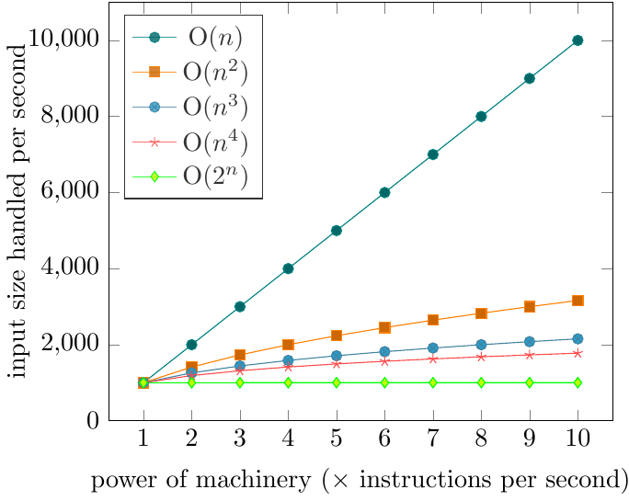
Scale is a Common Factor …
I have an algorithm.
I have a machine that can process 1,000 input items in an hour.
If I buy a machine that is n times as powerful, how many input items can I process in an hour?
Quadratic O(n²)
often too much
Depends on what the algorithm is!!
Note: Not the
same machine!

Slide 47
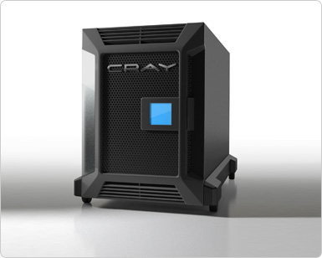
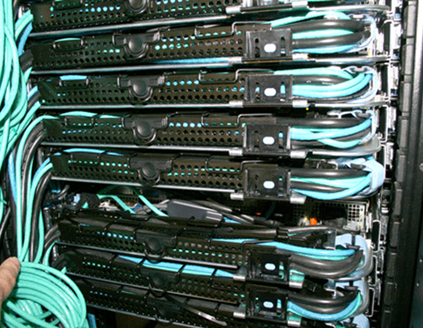
Scale is a Common Factor …
One machine that’s n times as powerful?
n machines that are equally as powerful?
vs.

Slide 48
Scale is a Common Factor …
Data-intensive
Inexpensive algorithms / Large inputs
e.g., Google, Facebook, Twitter
Compute-intensive
More expensive algorithms / Smaller inputs
e.g., climate simulations, chess games, combinatorials
No black and white!

Slide 49
Distributed Computing …

Slide 50
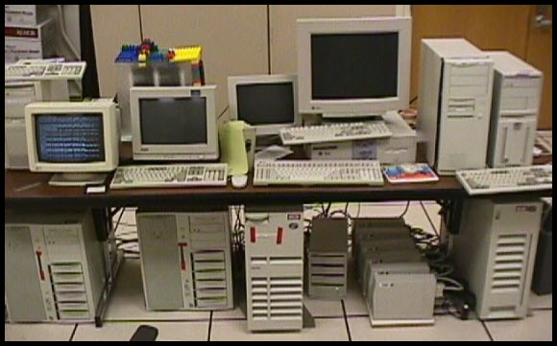
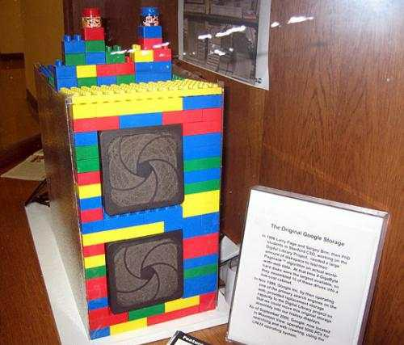
Distributed Computing
Lots of data? Need more than one machine!
Google ca. 1998:

Slide 51
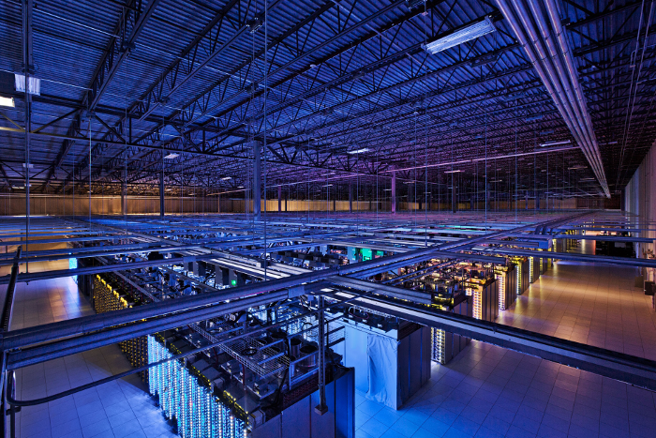
Distributed Computing
Lots of data? Need more than one machine!
Google ca. 2014:

Slide 52
Data Transport Costs (typical figures)
Important to minimise the network overhead!
The network gives additional cost
The network is shared across many machines
(bandwidth)
30 GB/s
600 MB/s
100 MB/s
1.25 GB/s
5 GB/s
Main Memory
Solid State Disk
Hard-disk
Network
(same rack)
Network
(across racks)
50–150 ns
10–100 μs
5–15 ms
300–600 ns
1–15 μs
(latency)

Slide 53
Data Placement
Need to think carefully about where to put what data!
I have four machines to run a website. I have 10 million users.
Each user has personal profile data, photos, friends and games.
How should I split the data up over the machines?
Depends on the application!
But some general principles and design choices apply.

Slide 54
Network/Node Failures
Need to think about failures!

Slide 55
Network/Node Failures
Need to think (even more!) carefully about where to put what data!
I have four machines to run a website. I have 10 million users.
Each user has personal profile data, photos, friends and games.
How should I split the data up over the machines?
(Again)
Depends on the application!
But some general principles and design choices apply.

Slide 56
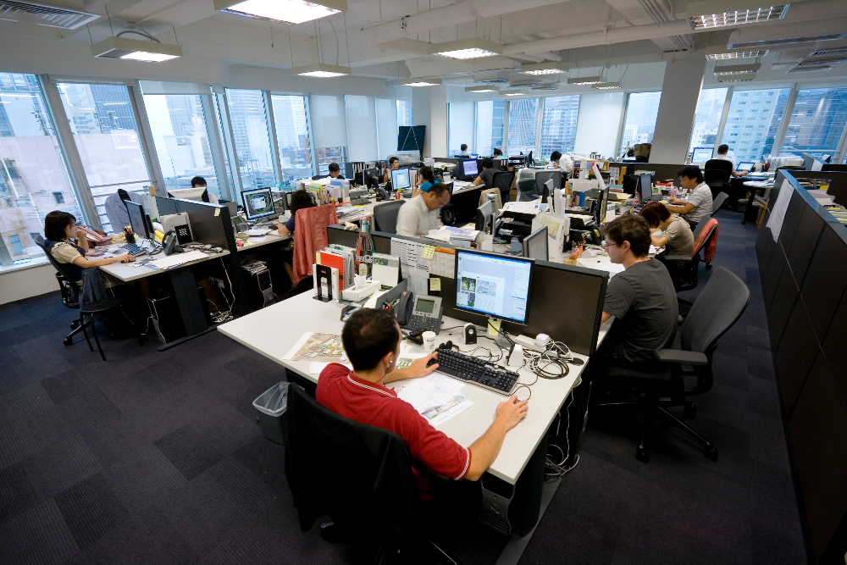
Human Distributed Computation

Slide 57
Distribution Not Always Applicable!

Slide 58
Distributed Development Difficult
Distributed systems can be complex
Multiple machines; need to take care of
Data in different locations
Logs and messages in different places
Different users with different priorities
Different network capabilities
Need to balance load!
Need to handle failures!
Tasks may take a long time!
Bugs may not become apparent for hours
Lots of data = lots of counter-examples

Slide 59
Frameworks/Abstractions can Help
For Distrib. Processing
For Distrib. Storage

Slide 60
Inside Twitter ...

Slide 61
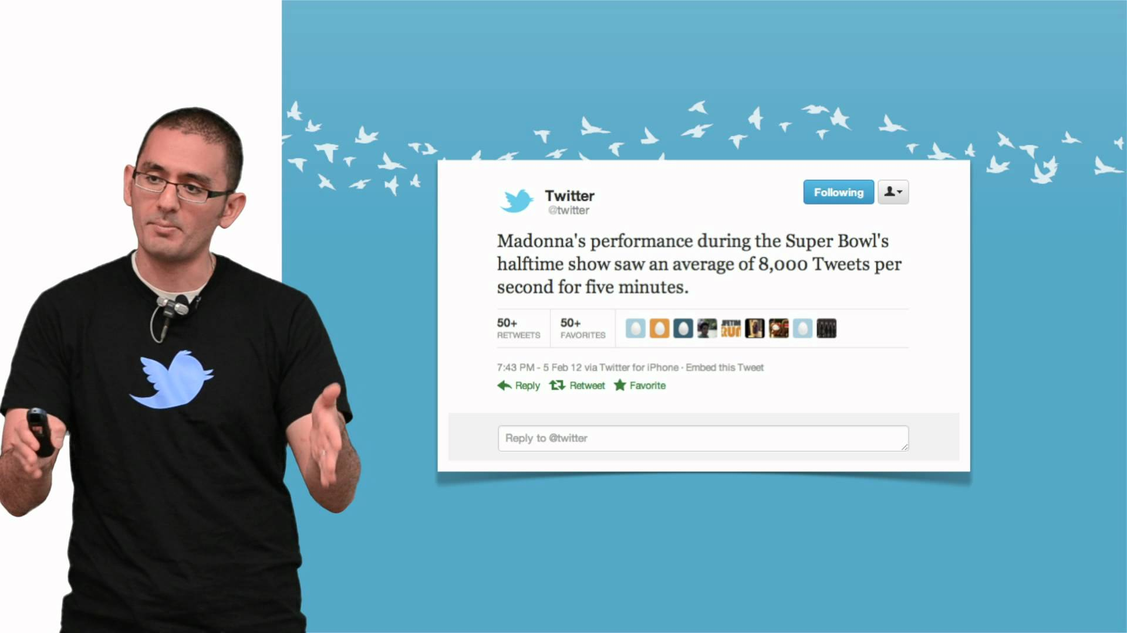
Based on 2013 slides by Twitter lead architect: Raffi Krikorian
“Twitter Timelines at Scale”

Slide 62
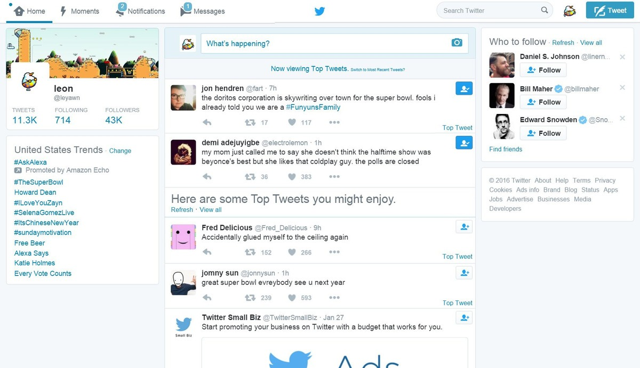
Twitter Timeline

Slide 63
Big Data at Twitter
150 million active worldwide users
400 million tweets written per day
mean: 4,600 tweets/second
max: 150,000 tweets/second
300,000 queries/second for user timelines
6,000 queries/second for custom search
Which aspect is most
important to optimise?

Slide 64
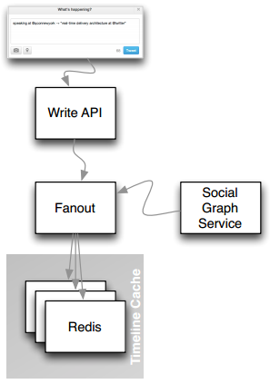
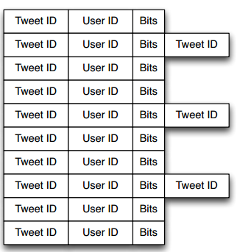
Supporting timelines: Write
mean: 4,000 tweets/second

Slide 65
High-fanout

Slide 66
Supporting timelines: Read
300,000 queries/second
1ms @p50
4ms @p99

Slide 67
Supporting text search
Information retrieval
Earlybird: Lucene clone
Write once
Query many

Slide 68
Timeline vs. Search
4,600 requests/sec
300,000 requests/sec
4,600 requests/sec
6,000 requests/sec

Slide 69
Twitter: Full architecture

Slide 70
Twitter en 2023 2017?
https://blog.twitter.com/engineering/en_us/topics/infrastructure/2017/the-infrastructure-behind-twitter-scale.html

Slide 71
In-memory vs. Disk processing

Slide 72
Task: Count words and phrases
Find the most frequent words and phrases in all of Wikipedia
How would you do this?

Slide 73
Count words/phrases
INPUT: file (input text file), k (print top-k most frequent)
map = new Map()
for(word w: file)
count = map.get(w)
if(count is null)
map.put(w,1)
else
map.put(w,count+1)
list = sortByValueDescending(map)
print(list[1,k])
Any issues?

Slide 74
Count words in-memory
We can count words over very large corpora in memory
Heap’s law:
Number of unique words
Number of total words

Slide 75
And if the phrases don’t fit in memory?
What can we do then?

Slide 76
Count words/phrases on disk
INPUT: file (input text file), k (print top-k most frequent)
map = new Map()
for(word w: file)
count = map.get(w)
if(count is null)
map.put(w,1)
else
map.put(w,count+1)
list = sortByValueDescending(map)
print(list[1,k])
← random access
← random access
← random access
Can we do the same storing the map on-disk?

Slide 77
Physical disk arm
Takes time to physically move the arm
Needed for random accesses
Around 10 ms seek time
About 3 hours to do one million seeks
Can we count words/phrases on-disk using more sequential access and less random access?

Slide 78
Order the words
tengo
que
aprender
más
español
tan
pronto
que
puedo
y
tengo
que
tomar
cada
oportunidad
para
practicar
como
ahora
ahora
aprender
cada
como
español
más
oportunidad
para
practicar
pronto
puedo
que
que
que
tan
tengo
tengo
tomar
y
ahora 1
aprender 1
cada 1
como 1
español 1
más 1
oportunidad 1
para 1
practicar 1
pronto 1
puedo 1
que 3
tan 1
tengo 2
tomar 1
y 1
que 3
tengo 2
ahora 1
aprender 1
cada 1
como 1
español 1
más 1
oportunidad 1
para 1
practicar 1
pronto 1
puedo 1
tan 1
tomar 1
y 1
How can we order the words on disk?

Slide 79
External Sort 1: Sort Batches
Order the data in batches
Input (disk)
(Size: n)
Order (in memory)
(Batch size: b)
Intermediate output (disk)
(⌈n/b⌉ batches)
es que
de la
por qué
de la
ha sido
no hay
de la
y de
ha sido
de la
así es
ha sido
de la
de la
es que
por qué
de la
de la
es que
por qué
de la
ha sido
no hay
y de
así es
de la
ha sido
ha sido
de la
ha sido
no hay
y de
así es
de la
ha sido
ha sido

Slide 80
External Sort 2: Merge-sort Batches
Intermediate output (disk)
(⌈n/b⌉ batches)
Order (in memory)
(Size: ⌈n/b⌉)
Output (disk)
(Size: n)
de la
de la
es que
por qué
así es
de la
de la
de la
de la
es que
ha sido
ha sido
ha sido
no hay
por qué
y de
[1]
así es [3]
de la [1]
de la [2]
de la [1]
de la [2]
de la [1]
de la [2]
de la [3]
de la [2]
de la [3]
de la [1]
de la [2]
de la [3]
de la [2]
de la [3]
de la [2]
de la [3]
es que [1]
de la [3]
es que [1]
de la [3]
es que [1]
ha sido [2]
es que [1]
ha sido [2]
es que [1]
ha sido [2]
ha sido [3]
ha sido [2]
ha sido [3]
ha sido [2]
ha sido [3]
por qué [1]
ha sido [3]
por qué [1]
ha sido [3]
no hay [2]
por qué [1]
no hay [2]
por qué [1]
ha sido [3]
no hay [2]
por qué [1]
no hay [2]
por qué [1]
no hay [2]
por qué [1]
por qué [1]
por qué [1]
y de [2]
y de [2]
y de [2]
de la
ha sido
no hay
y de
[2]
así es
de la
ha sido
ha sido
[3]

Slide 81
Count
If we want, we can order again by frequency using the same method on-disk
así es
de la
de la
de la
de la
es que
ha sido
ha sido
ha sido
no hay
por qué
y de
así es, 1
de la, 4
es que, 1
ha sido, 3
no hay, 1
por qué, 1
y de, 1

Slide 82
Scale further?

Slide 83
About the course …

Slide 84
What the Course Is/Is Not
Data-intensive not compute-intensive
Distributed tasks not networking
Commodity hardware not supercomputers
General methods not specific algorithms
Practical methods with a little theory

Slide 85
What the Course Is
Distributed Computing [1 week]
Distributed Processing Frameworks [5 weeks]
Information Retrieval [2 weeks]
Distributed Databases [3 weeks]
Projects [1–2 weeks]

Slide 86
Course Structure
Mondays: Lecture
Wednesdays: Lab
You can work in groups if you attend the session
Otherwise you must work alone
Fridays: Auxiliar
Continuation of the labs
Resolve questions/doubts
http://aidanhogan.com/teaching/cc5212-1-2023/

Slide 87
Course Marking
80% for Weekly Labs
11 labs total, best 9 count
20% for Class Project
Assignments each week
Working in groups
Hands-on each week!
Working in groups!

Slide 88
Outcomes!

Slide 89
Outcomes!

Slide 90
Outcomes!

Slide 91
Outcomes!

Slide 92
Questions?

