Slide 1
CC5212-1 Procesamiento Masivo de Datos Otoño 2017 Lecture 1: Introduction
Aidan Hogan
aidhog@gmail.com

Slide 2
THE VALUE OF DATA

Slide 3
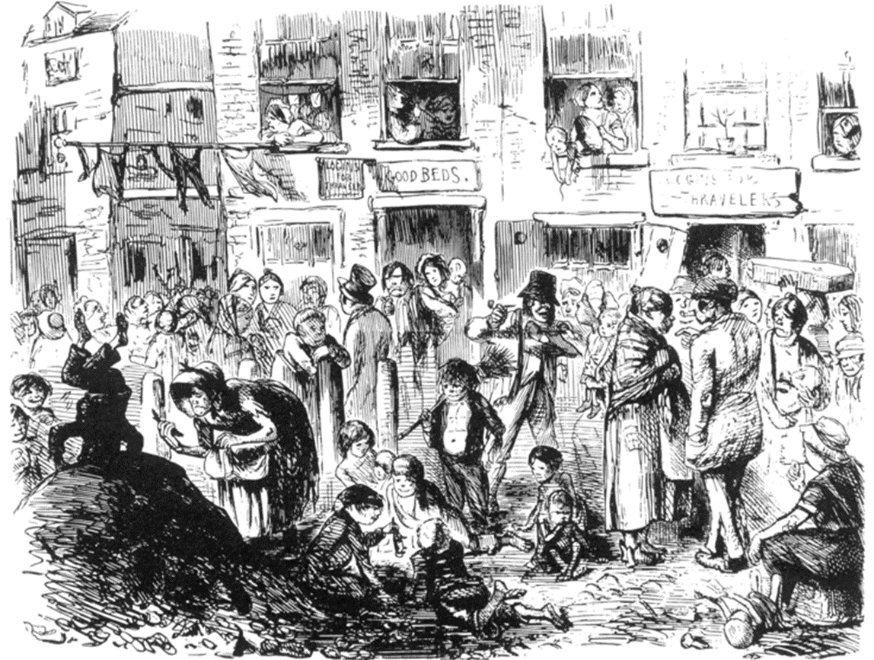
Soho, London, 1854

Slide 4
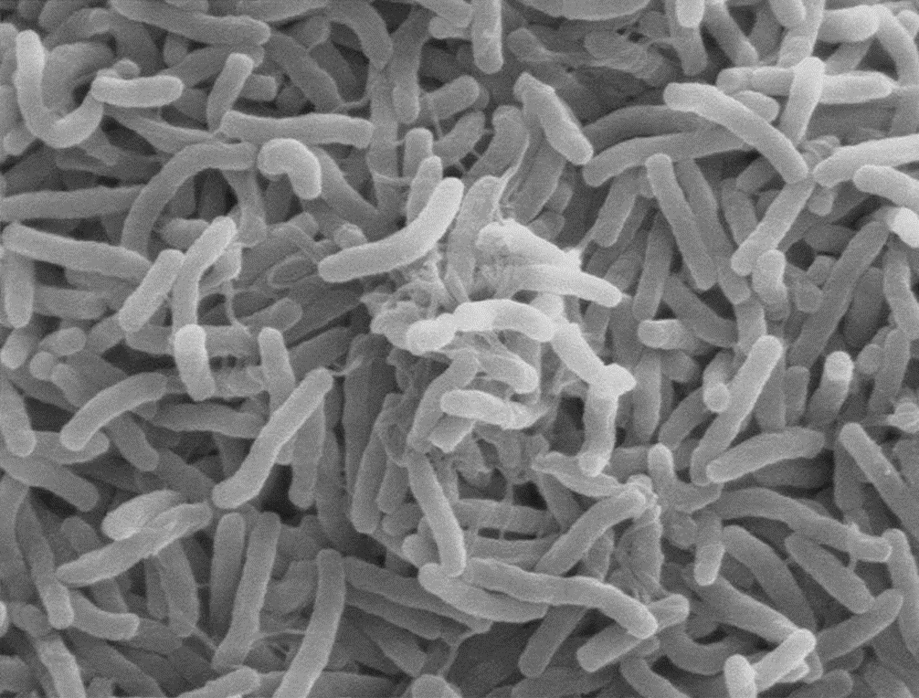
Cholera: What we know now …

Slide 5
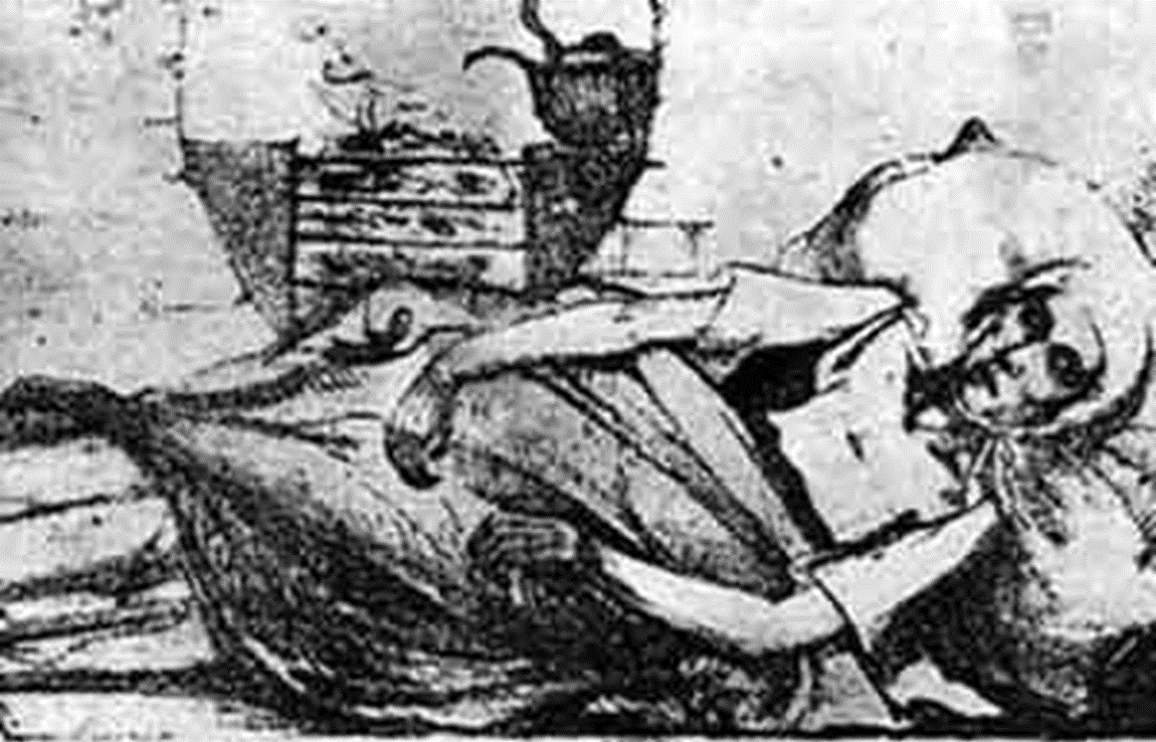
Cholera: What we knew in 1854

Slide 6
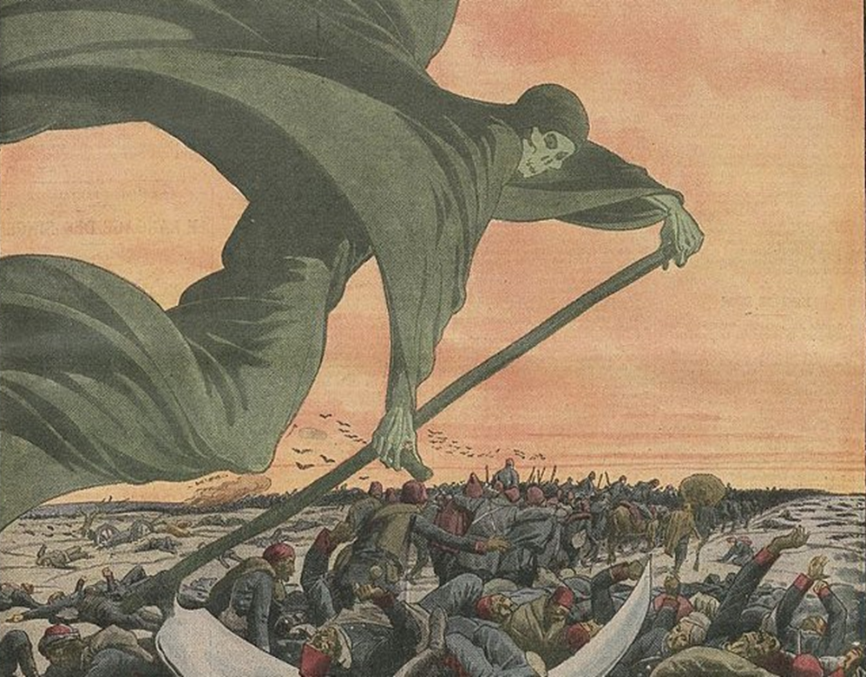
1854: Galen’s miasma theory of cholera

Slide 7
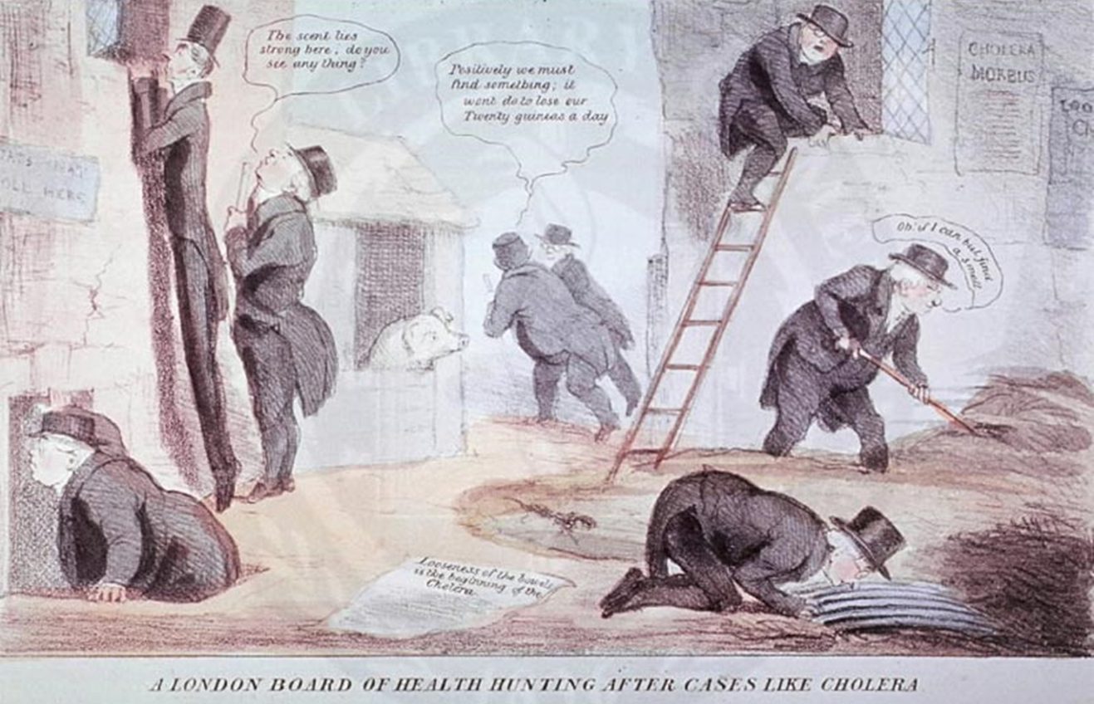
1854: The hunt for the invisible cholera

Slide 8
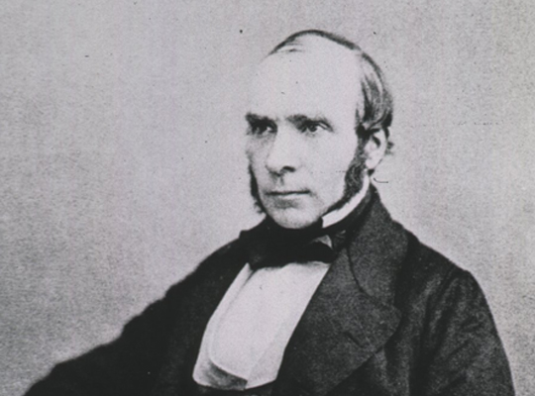
John Snow: 1813–1858

Slide 9
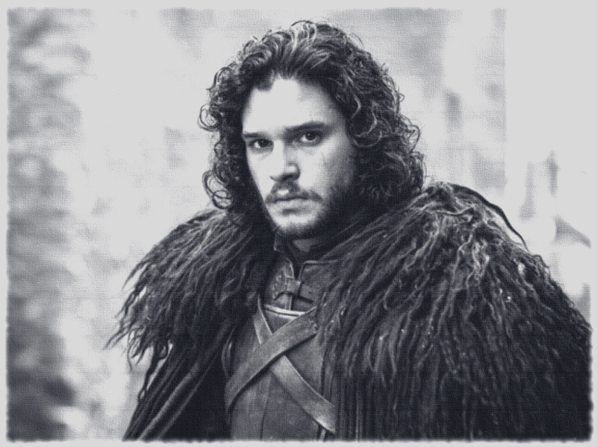
John Snow: 1813–1858

Slide 10
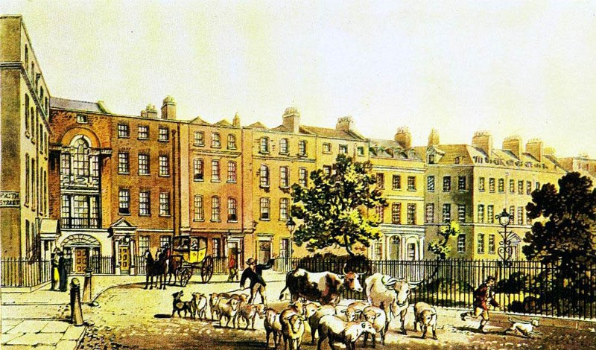
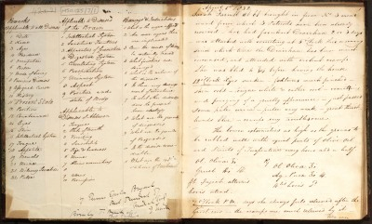
The Survey of Soho

Slide 11
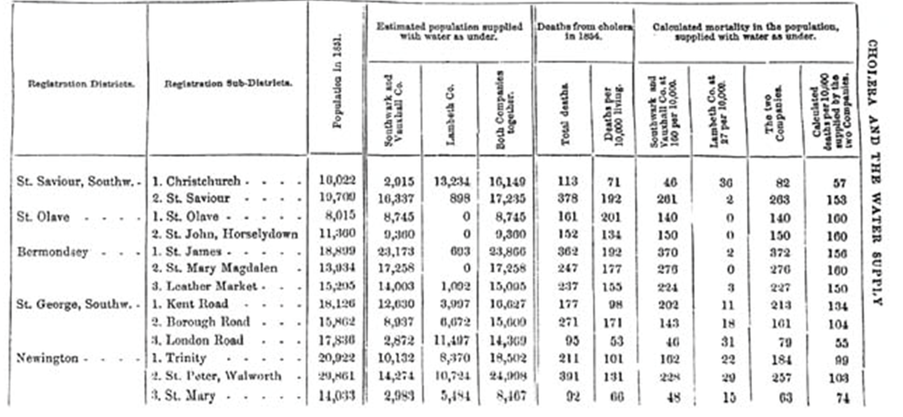
The Survey of Soho

Slide 12
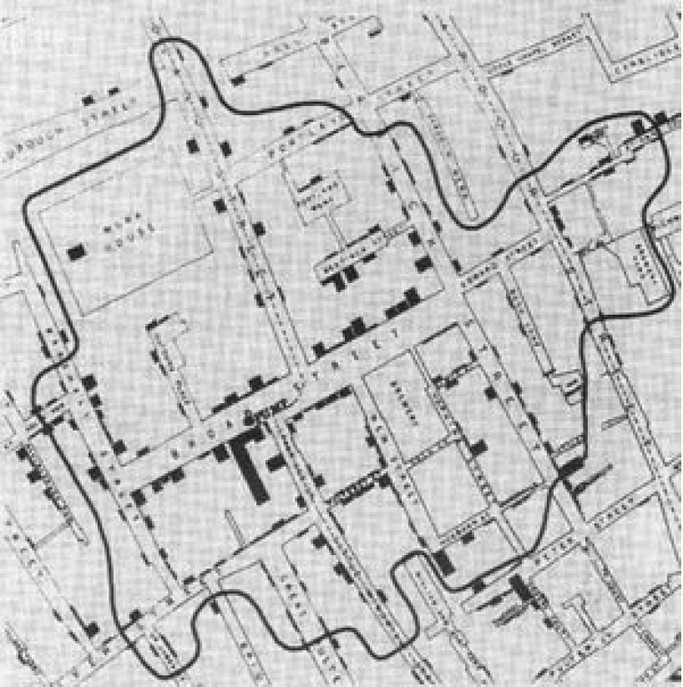
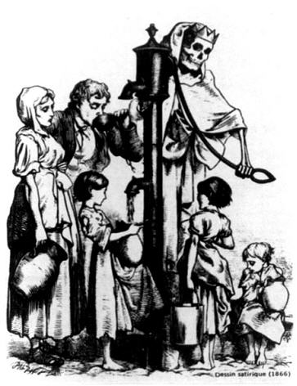
What the data showed …

Slide 13
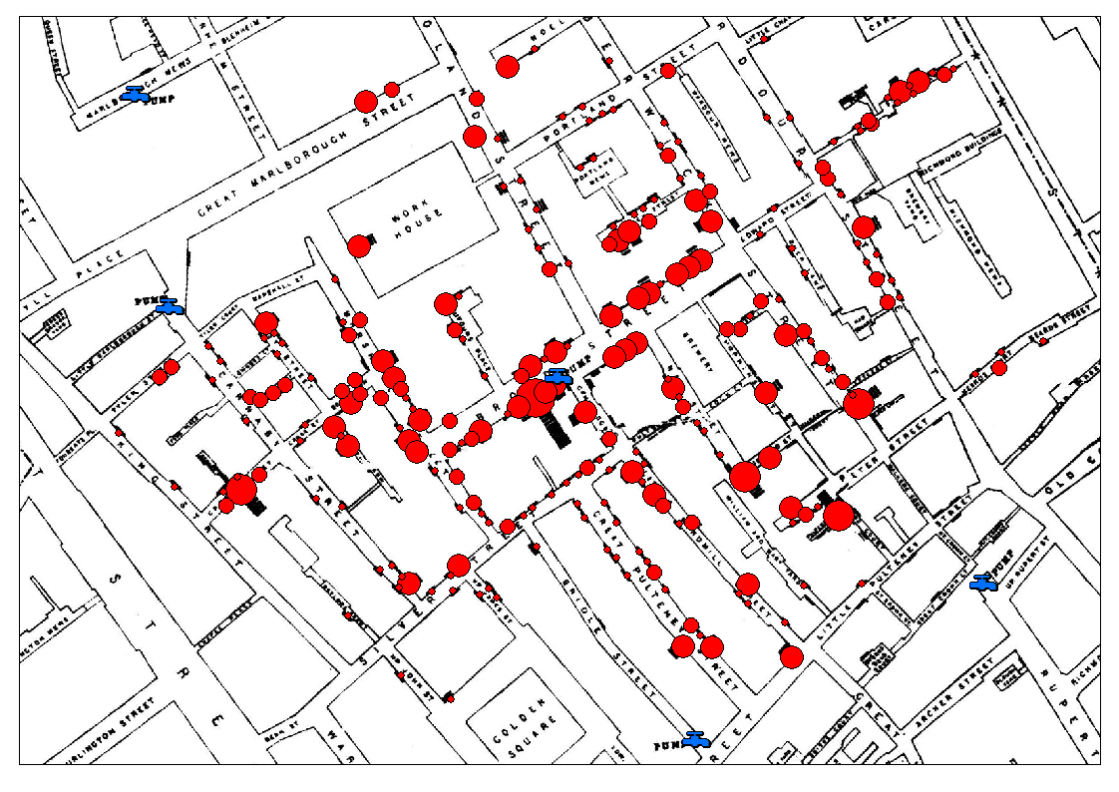
What the data showed …

Slide 14
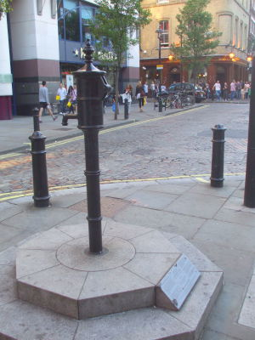
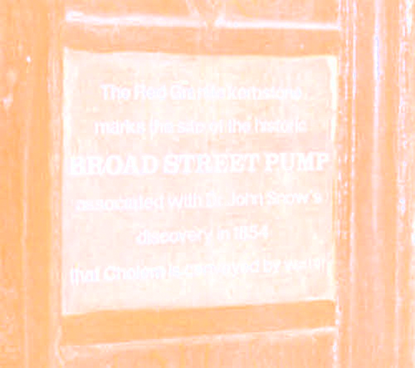
616 deaths, 8 days later …

Slide 15
Cholera: What we knew in 1855

Slide 16
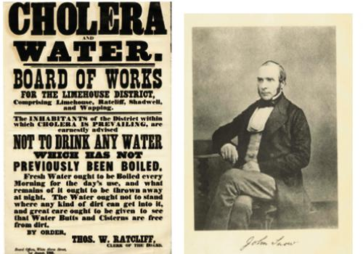
Cholera boil notice ca. 1866

Slide 17
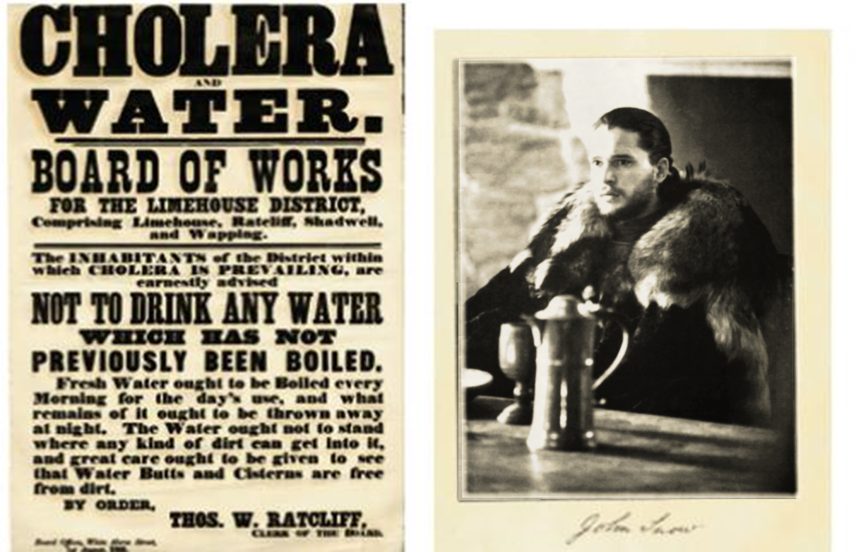
Cholera boil notice ca. 1866

Slide 18
Thirty years before discovery of V. cholerae

Slide 19
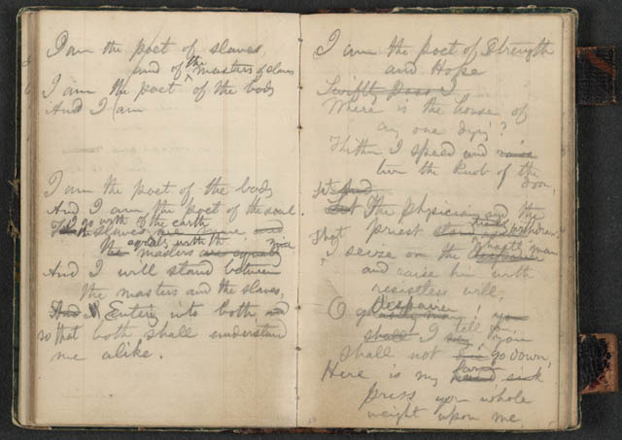
John Snow: Father of Epidemiology

Slide 20
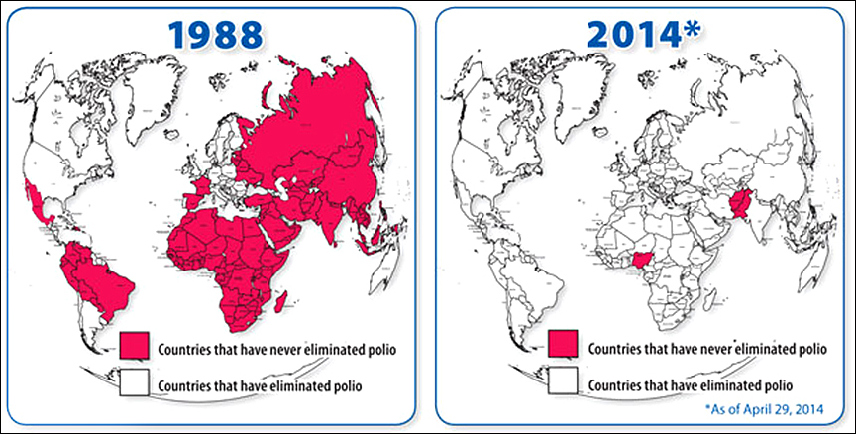
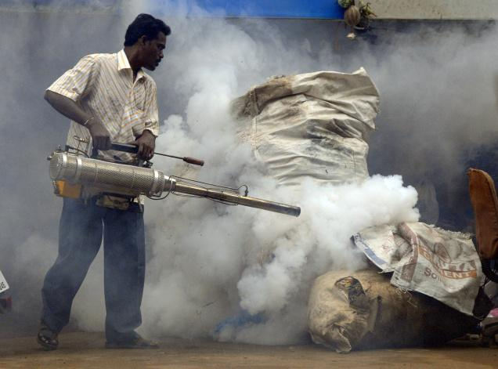
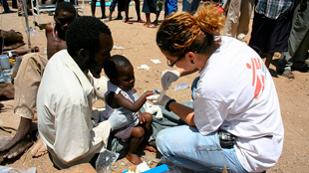
Epidemiology’s Success Stories

Slide 21
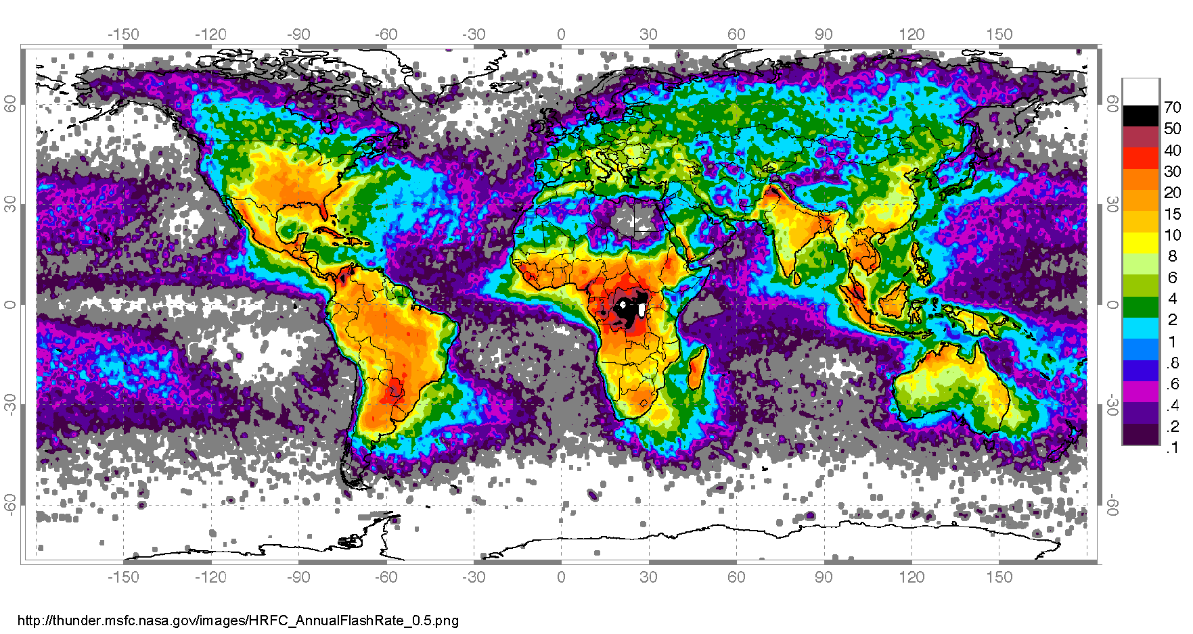
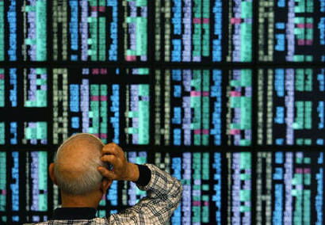
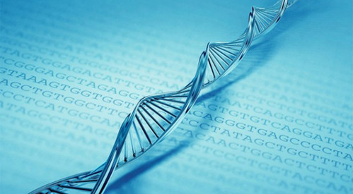
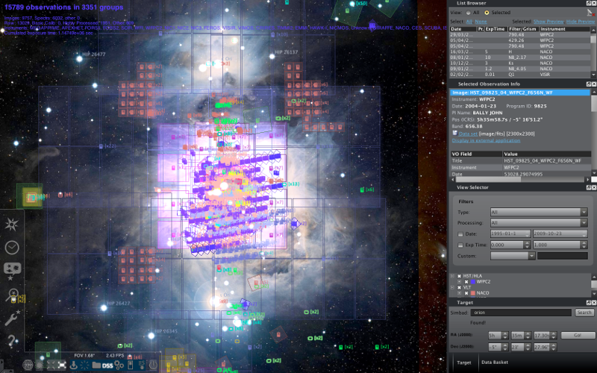
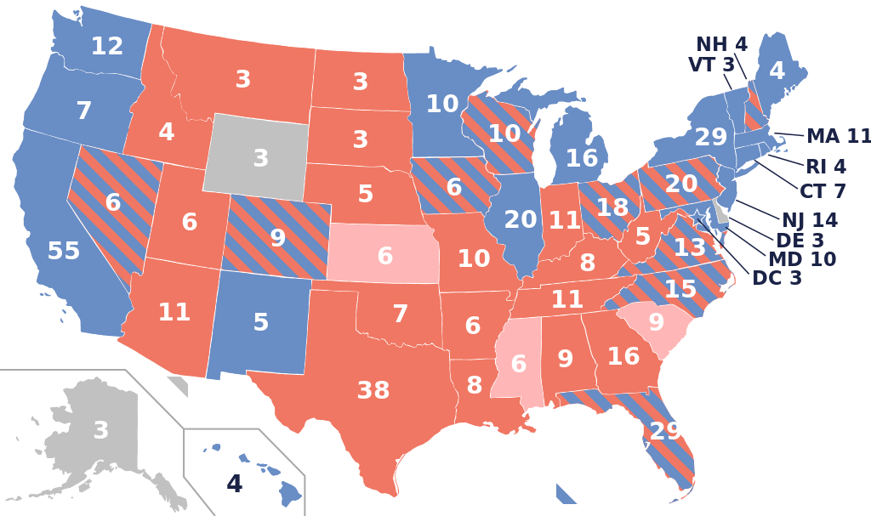
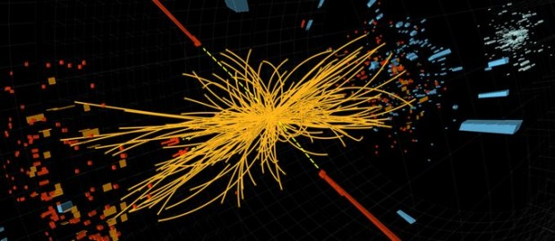
Value of data: Not just epidemiology

Slide 22
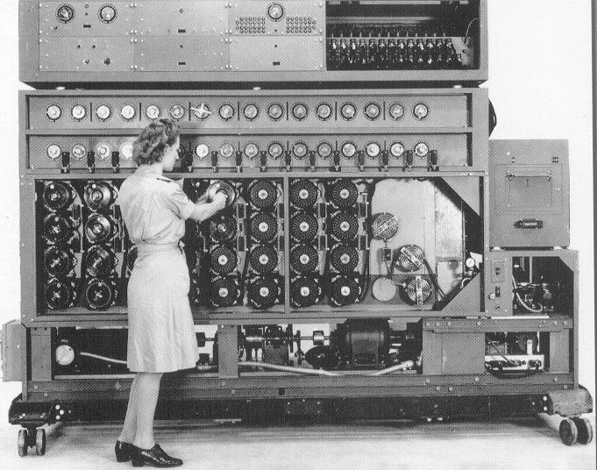
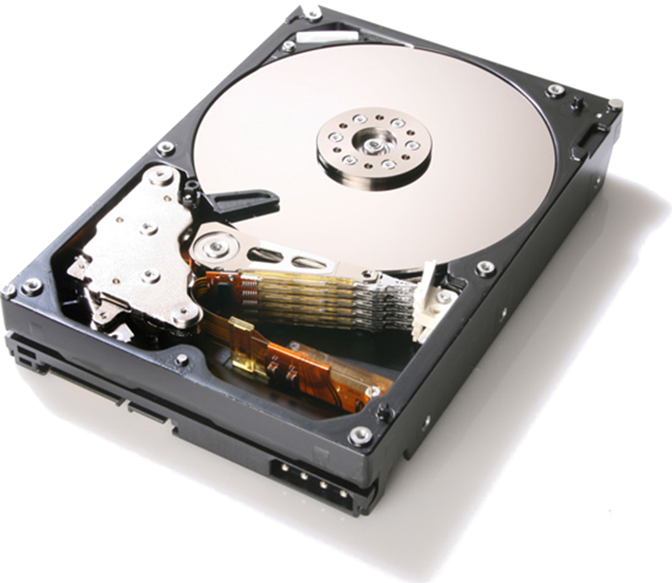
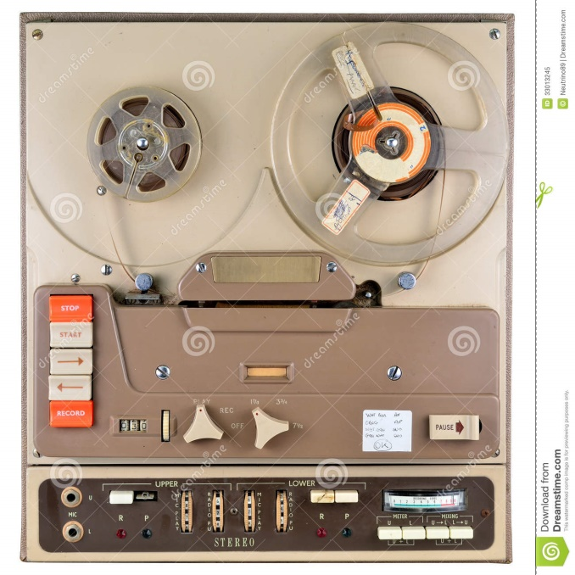
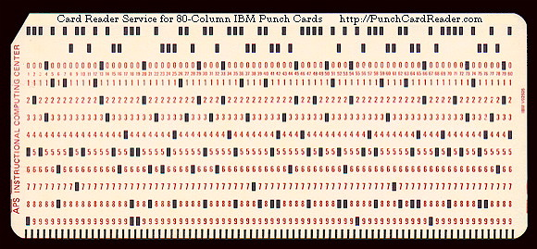
(Paper) Notebooks no longer good enough

Slide 23
THE GROWTH OF DATA

Slide 24
“Big Data”
English Wikipedia
≈ 51 GB of data
(2015 dump)
(Text; No edit history)
(XML, uncompressed)
1 Wiki = 1 Wikipedia

Slide 25
“Big Data”
Wikimedia Commons
≈ 24 TB of data
≈ 470.6 Wiki
(2014 dump)

Slide 26
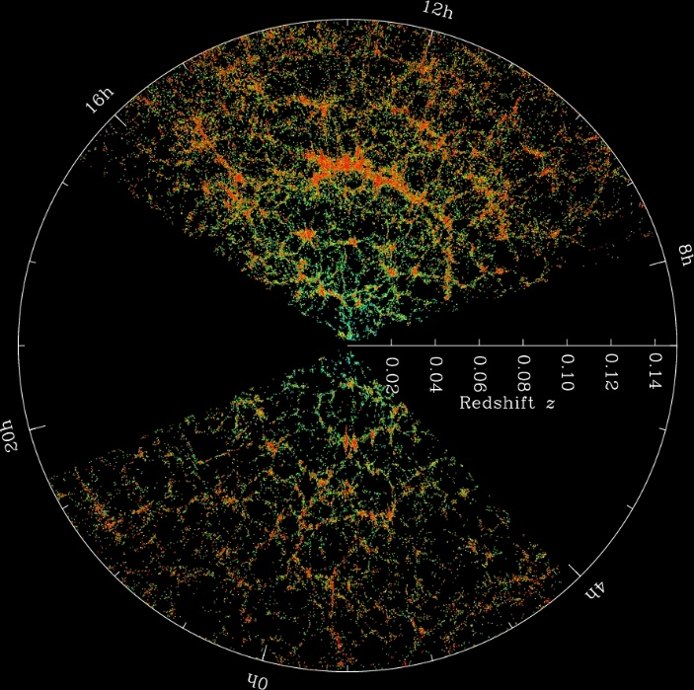
“Big Data”
Sloan Digital Sky Survey
≈ 200 GB / day
≈ 4 Wiki / day
(2013, generated by SDSS)

Slide 27
“Big Data”
Twitter
≈ 8 TB / day
≈ 157 Wiki / day
(2013, generated)

Slide 28
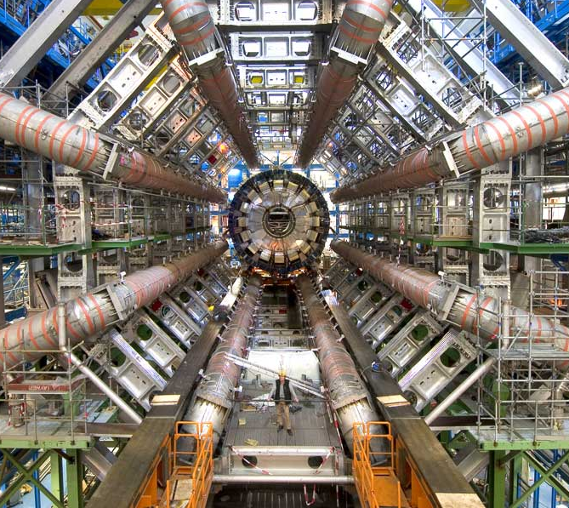
“Big Data”
Large Hadron Collider
≈ 68 TB / day
≈ 1,370 Wiki / day
(2012, collision data generated)

Slide 29
“Big Data”
Facebook
≈ 600 TB / day
≈ 11,764 Wiki / day
(2014, incoming Hive data)

Slide 30
“Big Data”
NSA Surveillance
≈ 29 PB / day
≈ 568,627 Wiki / day
(2013, processed)

Slide 31
“Big Data”
Google
≈ 100 PB / day
≈ 2,000,000 Wiki / day
(2014, processed)

Slide 32
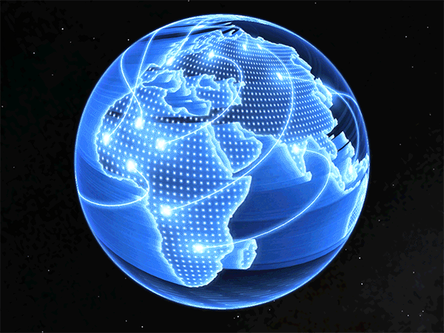
“Big Data”
Internet Traffic
≈ 2,417 PB / day
≈ 47,000,000 Wiki / day
(2014, Cisco estimates)

Slide 33
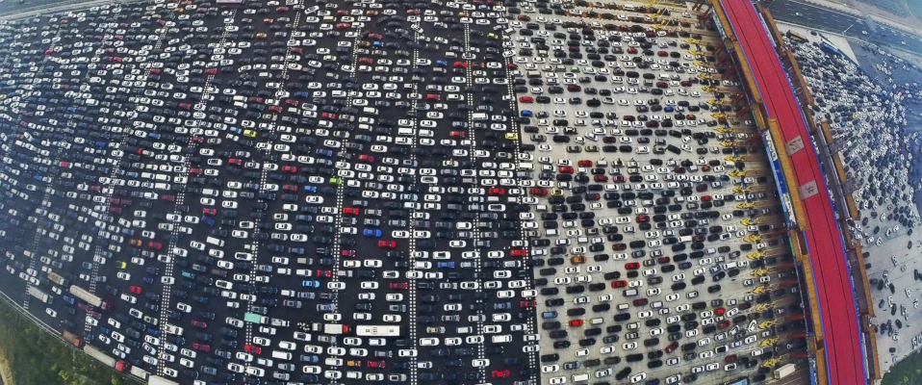
Data: A Modern-day Bottleneck?

Slide 34
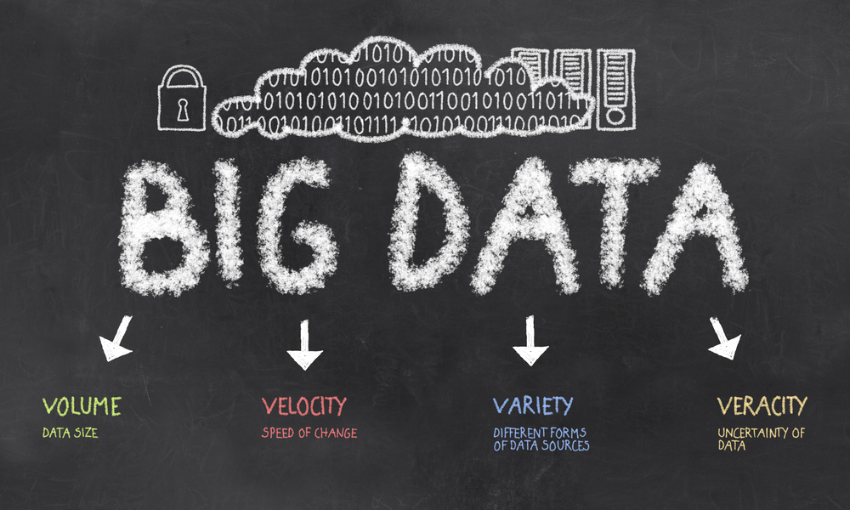
The ‘V’s of “Big Data”

Slide 35
“BIG DATA” IN ACTION …

Slide 36
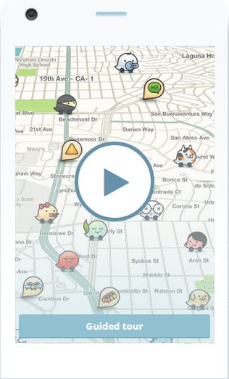
Getting Home (Waze)
“What’s the fastest route to get home right now?”
Processes journeys as background knowledge
“Participatory Sensing”

Slide 37
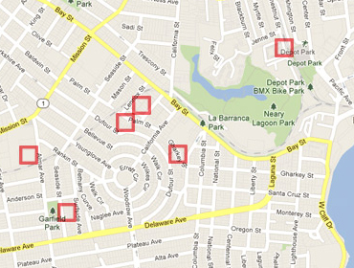
Predicting Pre-crime (PredPol)
“What areas of the city are most need of police patrol at 13:55 on Mondays?”
PredPol system used by Santa Cruz (US) police patrols
Predictions based on 8 years of historical crime data

Slide 38
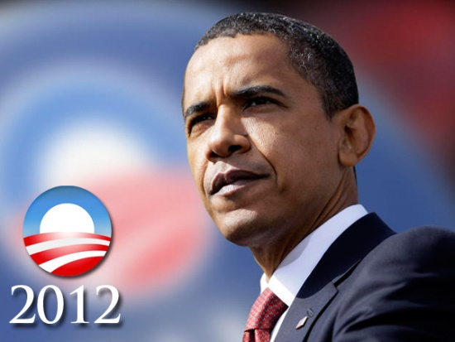
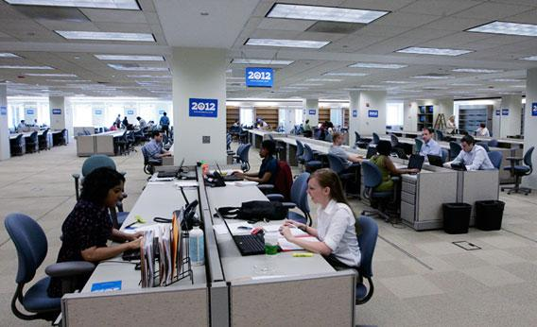
Getting Elected President (Narwhal)
“Who are the undecided voters and how can I convince them to vote for me?”
User profiles built and integrated from online sources
Targeted messages sent to voters based on profile

Slide 39
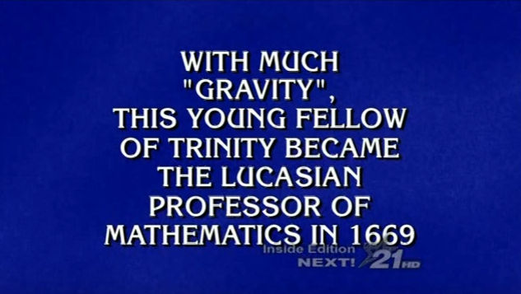
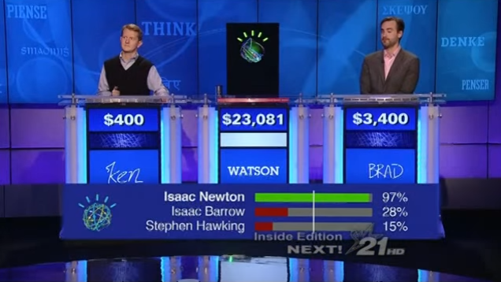
Winning Jeopardy (IBM Watson)
“Can a computer beat human experts at Jeopardy?”
Indexed 200 million pages of content
An ensemble of 100 processing techniques

Slide 40
“BIG DATA” needs “MASSIVE DATA PROCESSING” …

Slide 41
Every Application is Different …
Data can be
(Semi-)Structured data
(Relational DBs, JSON, XML, CSV, HTML form data)
Unstructured data
(text document, comments, tweets)
And everything in-between!

Slide 42
Every Application is Different …
Processing can involve:
Database Management/Analytics
(indexing, querying, joins, aggregation)
Natural Language Processing
(keyword search, topic extraction, entity recognition, machine translation, sentiment analysis, etc.)
Data Mining and Statistics
(pattern recognition, classification, event detection, recommendations, etc.)
Or something else / A mix

Slide 43
So where to start?

Slide 44
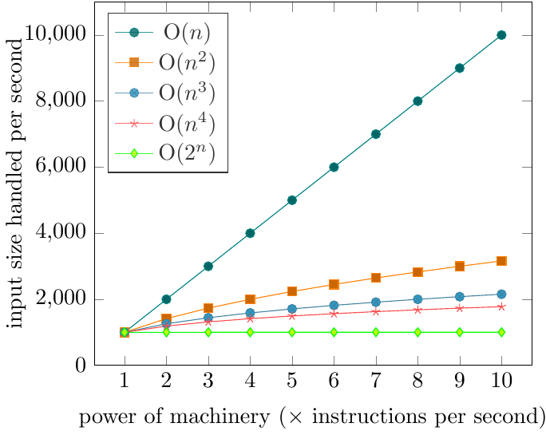
Scale is a Common Factor …
I have an algorithm.
I have a machine that can process 1,000 input items in an hour.
If I buy a machine that is n times as powerful, how many input items can I process in an hour?
Quadratic O(n²)
often too much
Depends on what the algorithm is!!
Note: Not the
same machine!

Slide 45
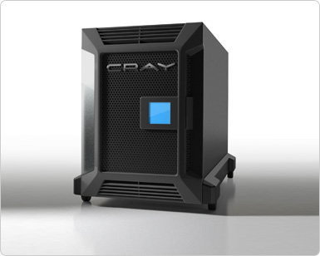
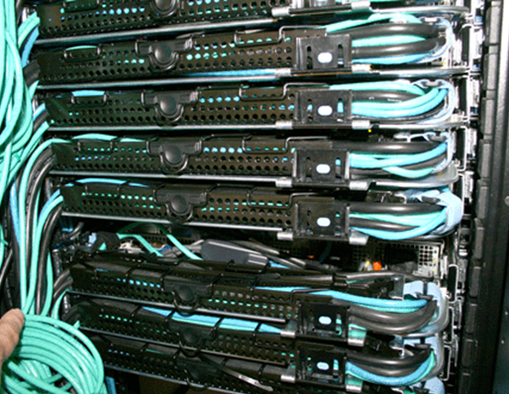
Scale is a Common Factor …
One machine that’s n times as powerful?
n machines that are equally as powerful?
vs.

Slide 46
Scale is a Common Factor …
Data-intensive (our focus!)
Inexpensive algorithms / Large inputs
e.g., Google, Facebook, Twitter
Compute-intensive (not our focus!)
More expensive algorithms / Smaller inputs
e.g., climate simulations, chess games, combinatorials
No black and white!

Slide 47
“MASSIVE DATA PROCESSING” NEEDS “DISTRIBUTED COMPUTING” …

Slide 48
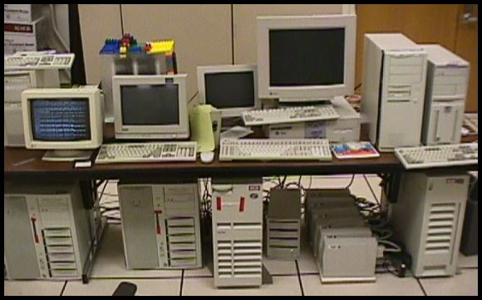
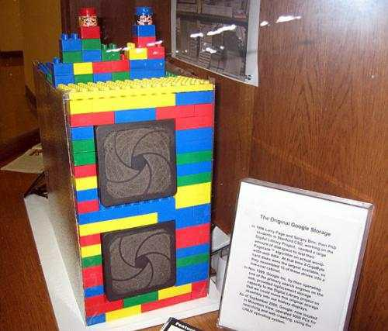
Distributed Computing
Need more than one machine!
Google ca. 1998:

Slide 49
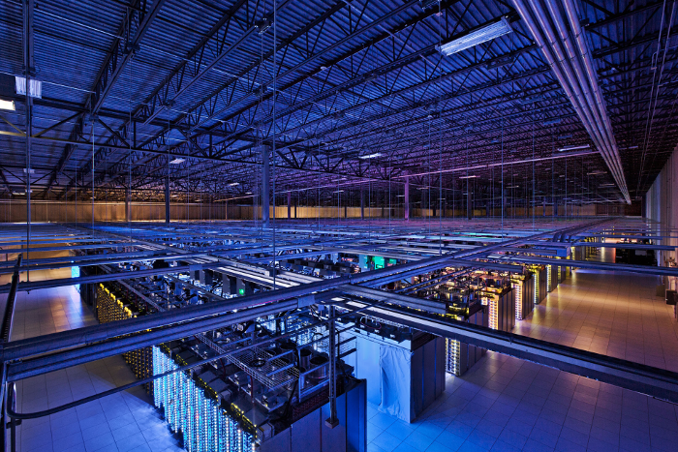
Distributed Computing
Need more than one machine!
Google ca. 2014:

Slide 50
Data Transport Costs
Need to divide tasks over many machines
Machines need to communicate
… but not too much!
Data transport costs (simplified):
Need to minimise network costs!
Main
Memory
Solid-state
Disk
Hard-disk
Network

Slide 51
Data Placement
Need to think carefully about where to put what data!
I have four machines to run a website. I have 10 million users.
Each user has personal profile data, photos, friends and games.
How should I split the data up over the machines?
Depends on the application!
But some general principles and design choices apply.

Slide 52
Network/Node Failures
Need to think about failures!

Slide 53
Network/Node Failures
Need to think (even more!) carefully about where to put what data!
I have four machines to run a website. I have 10 million users.
Each user has personal profile data, photos, friends and games.
How should I split the data up over the machines?
(Again)
Depends on the application!
But some general principles and design choices apply.

Slide 54
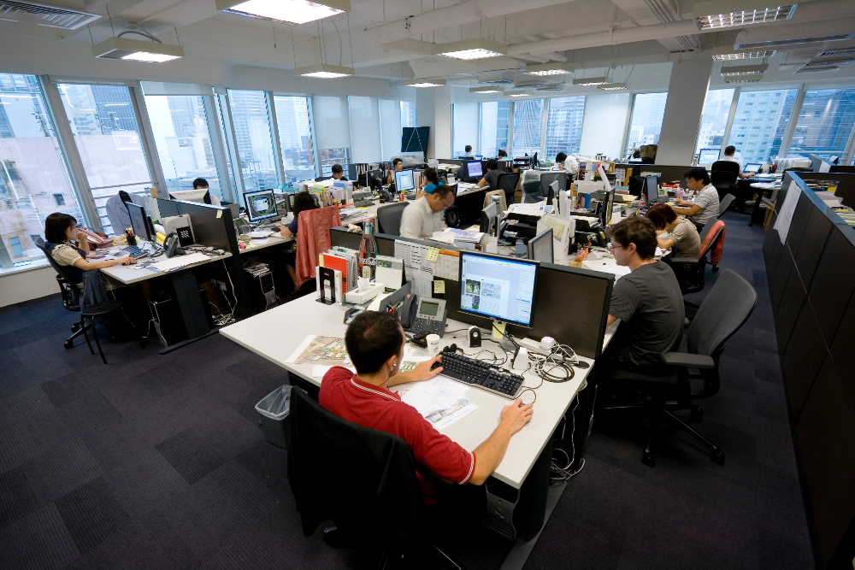
Human Distributed Computation

Slide 55
“DISTRIBUTED COMPUTING” LIMITS & CHALLENGES …

Slide 56
Distribution Not Always Applicable!

Slide 57
Distributed Development Difficult
Distributed systems can be complex
Multiple machines; need to take care of
Data in different locations
Logs and messages in different places
Different users with different priorities
Different network capabilities
Need to balance load!
Need to handle failures!
Tasks may take a long time!
Bugs may not become apparent for hours
Lots of data = lots of counter-examples

Slide 58
Frameworks/Abstractions can Help
For Distrib. Processing
For Distrib. Storage

Slide 59
HOW DOES TWITTER WORK?

Slide 60
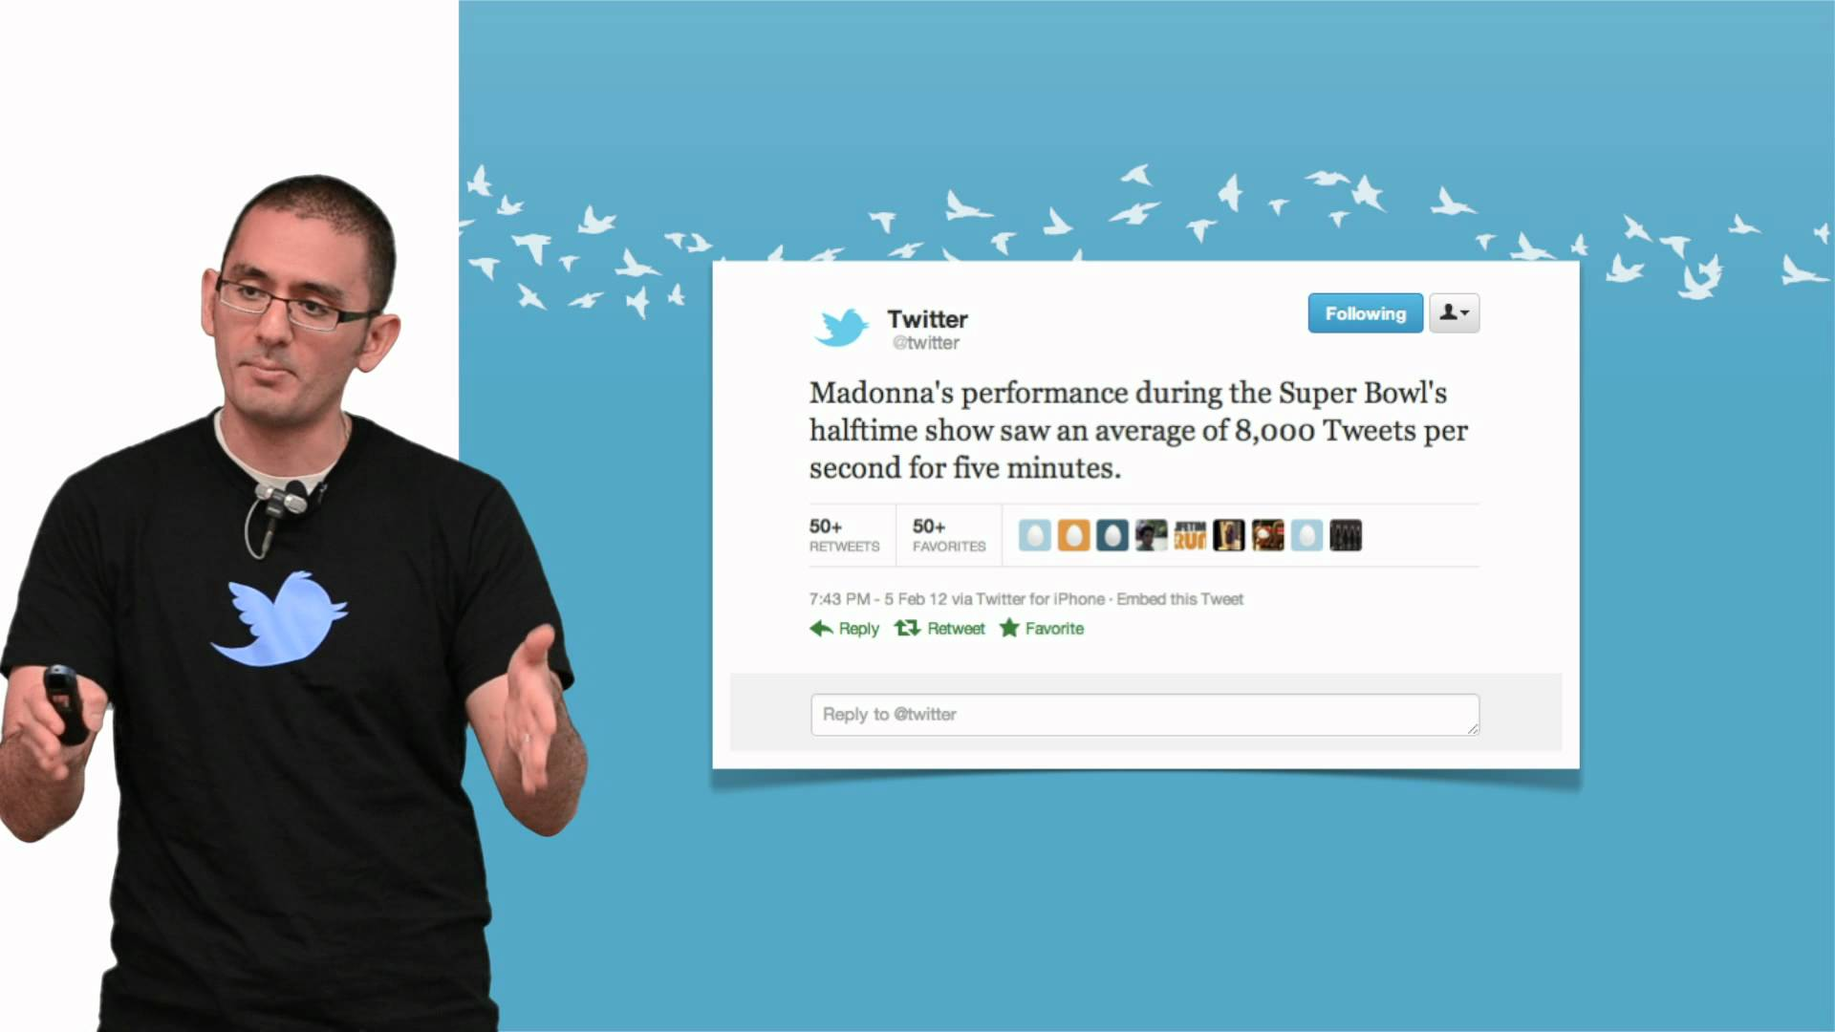
Based on 2013 slides by Twitter lead architect: Raffi Krikorian
“Twitter Timelines at Scale”

Slide 61
Big Data at Twitter
150 million active worldwide users
400 million tweets per day
mean: 4,600 tweets/second
max: 150,000 tweets/second
300,000 queries/second for user timelines
6,000 queries/second for custom search
Which aspect is most
important to optimise?

Slide 62
Supporting timelines: write
mean: 4,000 tweets/second

Slide 63
High-fanout

Slide 64
Supporting timelines: read
300,000 queries/second
1ms @p50
4ms @p99

Slide 65
Supporting text search
Information retrieval
Earlybird: Lucene clone
Write once
Query many

Slide 66
Timeline vs. Search
4,600 requests/sec
300,000 requests/sec
4,600 requests/sec
6,000 requests/sec

Slide 67
Twitter: Full Architecture

Slide 68
“Procesamiento Masivo de Datos” About the course …

Slide 69
What the Course Is/Is Not
Data-intensive not compute-intensive
Distributed tasks not networking
Commodity hardware not supercomputers
General methods not specific algorithms
Practical methods with a little theory

Slide 70
What the Course Is
Principles of Distributed Computing [1 week]
Distributed Processing Frameworks [4 weeks]
Information Retrieval [3 weeks]
Principles of Distributed Databases [3 weeks]
Projects [1–2 weeks]

Slide 71
Course Structure
~1.5 hours of lectures per week [Monday]
1.5 hours of labs per week [Wednesday]
To be turned in by next Monday evening
Mostly Java
In B08; on laptops
http://aidanhogan.com/teaching/cc5212-1-2017/

Slide 72
Course Marking
50% for Weekly Labs (~5% a lab!)
15% for Small Class Project
35% for Exam(s)

Slide 73
Outcomes!

Slide 74
Outcomes!

Slide 75
Outcomes!

Slide 76
Outcomes!

Slide 77
Outcomes!

Slide 78
Questions?

