Slide 1
CC5212-1 Procesamiento Masivo de Datos Otoño 2016 Lecture 11: NoSQL II
Aidan Hogan
aidhog@gmail.com

Slide 2
RECAP: NoSQL

Slide 3
NoSQL

Slide 4
NoSQL vs. Relational Databases
What are the big differences between relational databases and NoSQL systems?
What are the trade-offs?

Slide 5
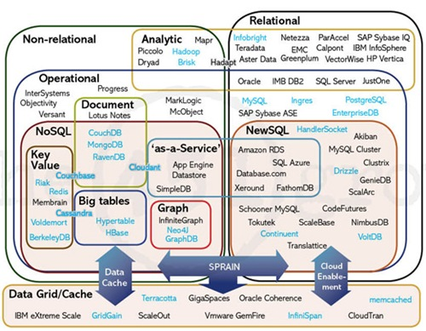
The Database Landscape
Batch analysis of data
Not using the relational model
Using the relational model
Real-time
Stores documents (semi-structured values)
Relational Databases
with focus on scalability to compete with NoSQL
while maintaining ACID
Not only SQL
Maps ☺
Column Oriented
Graph-structured data
Cloud storage
In-Memory

Slide 6
RECAP: KEY–VALUE

Slide 7
Key–Value = a Distributed Map
Key | Value
country:Afghanistan | capital@city:Kabul,continent:Asia,pop:31108077#2011
country:Albania | capital@city:Tirana,continent:Europe,pop:3011405#2013
… | …
city:Kabul | country:Afghanistan,pop:3476000#2013
city:Tirana | country:Albania,pop:3011405#2013
… | …
user:10239 | basedIn@city:Tirana,post:{103,10430,201}
… | …

Slide 8
Amazon Dynamo(DB): Model
Named table with primary key and a value
Countries
Primary Key | Value
Afghanistan | capital:Kabul,continent:Asia,pop:31108077#2011
Albania | capital:Tirana,continent:Europe,pop:3011405#2013
… | …
Cities
Primary Key | Value
Kabul | country:Afghanistan,pop:3476000#2013
Tirana | country:Albania,pop:3011405#2013
… | …

Slide 9
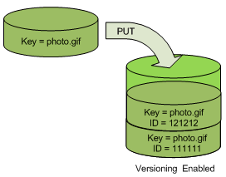
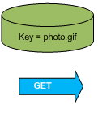
Amazon Dynamo(DB): Object Versioning
Object Versioning (per bucket)
PUT doesn’t overwrite: pushes version
GET returns most recent version

Slide 10
Other Key–Value Stores

Slide 11
RECAP: DOCUMENT STORES

Slide 12
Key–Value Stores: Values are Documents
Key | Value
country:Afghanistan | <country> <capital>city:Kabul</capital> <continent>Asia</continent> <population> <value>31108077</value> <year>2011</year> </population> </country>
… | …
Document-type depends on store
XML, JSON, Blobs, Natural language
Operators for documents
e.g., filtering, inv. indexing, XML/JSON querying, etc.

Slide 13
MongoDB: JSON Based
Key | Value (Document)
6ads786a5a9 | { “_id” : ObjectId(“6ads786a5a9”) , “name” : “Afghanistan” , “capital”: “Kabul” , “continent” : “Asia” , “population” : { “value” : 31108077, “year” : 2011 } }
… | …
o
Can invoke Javascript over the JSON objects
Document fields can be indexed
db.inventory.find({ continent: { $in: [ ‘Asia’, ‘Europe’ ]}})

Slide 14
Document Stores

Slide 15
TABLULAR / COLUMN FAMILY

Slide 16
Key–Value = a Distributed Map
Countries
Primary Key | Value
Afghanistan | capital:Kabul,continent:Asia,pop:31108077#2011
Albania | capital:Tirana,continent:Europe,pop:3011405#2013
… | …
Tabular = Multi-dimensional Maps
Countries
Primary Key | capital | continent | pop-value | pop-year
Afghanistan | Kabul | Asia | 31108077 | 2011
Albania | Tirana | Europe | 3011405 | 2013
… | … | … | … | …

Slide 17
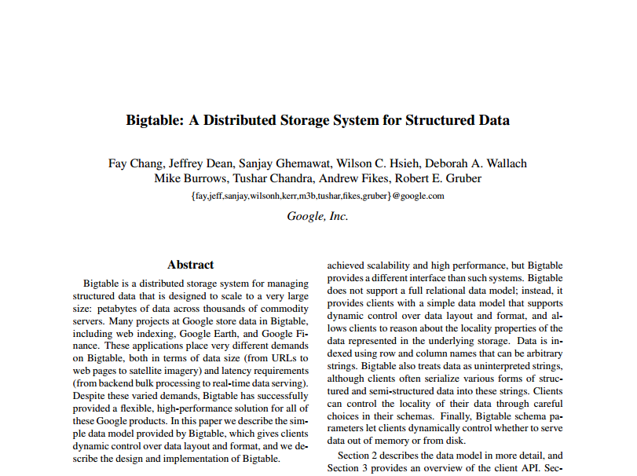
Bigtable: The Original Whitepaper
Why did they write another paper?
MapReduce solves everything, right?
MapReduce
authors

Slide 18
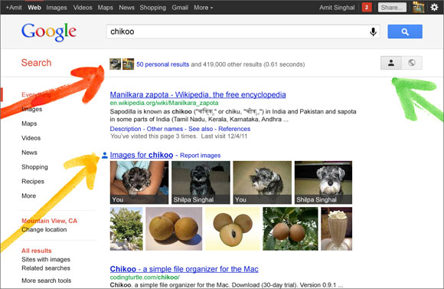
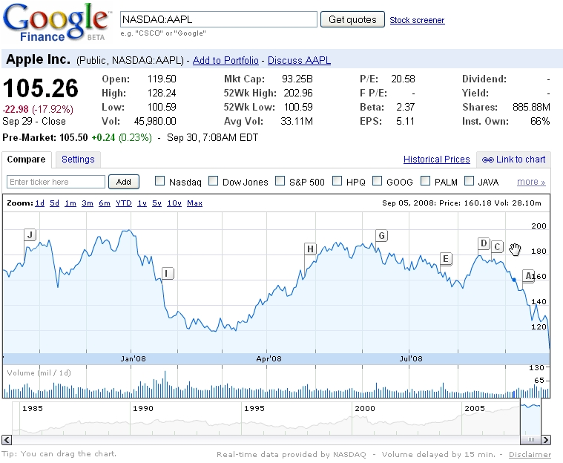
Bigtable used for …
…

Slide 19
Bigtable: Data Model
“a sparse, distributed, persistent, multi-dimensional, sorted map.”
sparse: not all values form a dense square
distributed: lots of machines
persistent: disk storage (GFS)
multi-dimensional: values with columns
sorted: sorting lexicographically by row key
map: look up a key, get a value

Slide 20
Bigtable: in a nutshell
(row, column, time) → value
row: a row id string
e.g., “Afganistan”
column: a column name string
e.g., “pop-value”
time: an integer (64-bit) version time-stamp
e.g., 18545664
value: the element of the cell
e.g., “31120978”

Slide 21
Bigtable: in a nutshell
(row, column, time) → value
(Afganistan,pop-value,t₄) →
31108077
Primary Key | capital |  | continent |  | pop-value |  | pop-year
Afghanistan | t₁ | Kabul | t₁ | Asia | t₁ | 31143292 | t₁ | 2009
 |  |  |  |  | t₂ | 31120978
 |  |  |  |  | t₄ | 31108077 | t₄ | 2011
Albania | t₁ | Tirana | t₁ | Europe | t₁ | 2912380 | t₁ | 2010
 |  |  |  |  | t₃ | 3011405 | t₃ | 2013
… | … |  | … |  | … |  | …

Slide 22
Bigtable: Sorted Keys
Primary Key | capital |  | pop-value |  | pop-year
Asia:Afghanistan | t₁ | Kabul | t₁ | 31143292 | t₁ | 2009
 |  |  | t₂ | 31120978
 |  |  | t₄ | 31108077 | t₄ | 2011
Asia:Azerbaijan | … | … | … | … | … | …
… | … | … | … | … | … | …
Europe:Albania | t₁ | Tirana | t₁ | 2912380 | t₁ | 2010
 |  |  | t₃ | 3011405 | t₃ | 2013
Europe:Andorra | … | … | … | … | … | …
… | … | … | … | … | … | …
S
O
R
T
E
D
Benefits of sorted keys vs. hashed keys?

Slide 23
Bigtable: Tablets
Take advantage of locality of processing!
Primary Key | capital |  | pop-value |  | pop-year
Asia:Afghanistan | t₁ | Kabul | t₁ | 31143292 | t₁ | 2009
 |  |  | t₂ | 31120978
 |  |  | t₄ | 31108077 | t₄ | 2011
Asia:Azerbaijan | … | … | … | … | … | …
… | … | … | … | … | … | …
Europe:Albania | t₁ | Tirana | t₁ | 2912380 | t₁ | 2010
 |  |  | t₃ | 3011405 | t₃ | 2013
Europe:Andorra | … | … | … | … | … | …
… | … | … | … | … | … | …
A
S
I
A
E
U
R
O
P
E

Slide 24
A real-world example of locality/sorting
Primary Key | language |  | title |  | links
com.imdb | t₁ | en | t₁ | IMDb Home | t₁ | …
 |  |  | t₂ | IMDB - Movies
 |  |  | t₄ | IMDb | t₄ | …
com.imdb/title/tt2724064/ | t₁ | en | t₂ | Sharknado | t₂ | …
com.imdb/title/tt3062074/ | t₁ | en | t₂ | Sharknado II | t₂
… | … | … | … | … | … | …
org.wikipedia | t₁ | multi | t₁ | Wikipedia | t₁ | …
 |  |  | t₃ | Wikipedia Home | t₃ | …
org.wikipedia.ace | t₁ | ace | t₁ | Wikipèdia bahsa Acèh | … | …
… | … | … | … | … | … | …

Slide 25
Bigtable: Distribution
Pros and cons versus hash partitioning?
Horizontal range partitioning
Split by tablet

Slide 26
Bigtable: Column Families
Primary Key | pol:capital |  | demo:pop-value |  | demo:pop-year
Asia:Afghanistan | t₁ | Kabul | t₁ | 31143292 | t₁ | 2009
 |  |  | t₂ | 31120978
 |  |  | t₄ | 31108077 | t₄ | 2011
Asia:Azerbaijan | … | … | … | … | … | …
… | … | … | … | … | … | …
Europe:Albania | t₁ | Tirana | t₁ | 2912380 | t₁ | 2010
 |  |  | t₃ | 3011405 | t₃ | 2013
Europe:Andorra | … | … | … | … | … | …
… | … | … | … | … | … | …
Group logically similar columns together
Accessed efficiently together
Access-control and storage: column family level
If of same type, can be compressed

Slide 27
Bigtable: Versioning
Similar to Apache Dynamo
Cell-level
64-bit integer time stamps
Inserts push down current version
Lazy deletions / periodic garbage collection
Two options:
keep last n versions
keep versions newer than t time

Slide 28
Bigtable: SSTable Map Implementation
How to handle writes?
64k blocks (default) with index in footer (GFS)
Index loaded into memory, allows for seeks
Can be split or merged, as needed
Primary Key | pol:capital |  | demo:pop-value |  | demo:pop-year
Asia:Afghanistan | t₁ | Kabul | t₁ | 31143292 | t₁ | 2009
 |  |  | t₂ | 31120978
 |  |  | t₄ | 31108077 | t₄ | 2011
Asia:Azerbaijan | … | … | … | … | … | …
… | … | … | … | … | … | …
Asia:Japan | … | … | … | … | … | …
Asia:Jordan | … | … | … | … | … | …
… | … | … | … | … | … | …
Block 0 / Offset 0 / Asia:Afghanistan
Block 1 / Offset 65536 / Asia: Japan
0
65536
Index:

Slide 29
Bigtable: Buffered/Batched Writes
What’s the danger here?
Merge-sort
READ
Memtable
In-memory
GFS
Tablet
Tablet log
SSTable1
SSTable2
SSTable3
WRITE

Slide 30
Bigtable: Redo Log
If machine fails, Memtable redone from log
Memtable
In-memory
GFS
Tablet
Tablet log
SSTable1
SSTable2
SSTable3

Slide 31
Bigtable: Minor Compaction
When full, write Memtable as SSTable
What’s the problem here?
Memtable
Memtable
In-memory
GFS
Tablet
Tablet log
SSTable1
SSTable2
SSTable3
SSTable4

Slide 32
Bigtable: Merge Compaction
Merge some of the SSTables (and the Memtable)
READ
Memtable
Memtable
In-memory
GFS
Tablet
SSTable1
Tablet log
SSTable1
SSTable2
SSTable3
SSTable4

Slide 33
Bigtable: Major Compaction
Merge all SSTables (and the Memtable)
Makes reads more efficient!
READ
Memtable
In-memory
GFS
Tablet
SSTable1
SSTable1
SSTable2
SSTable3
Tablet log
SSTable1
SSTable4

Slide 34
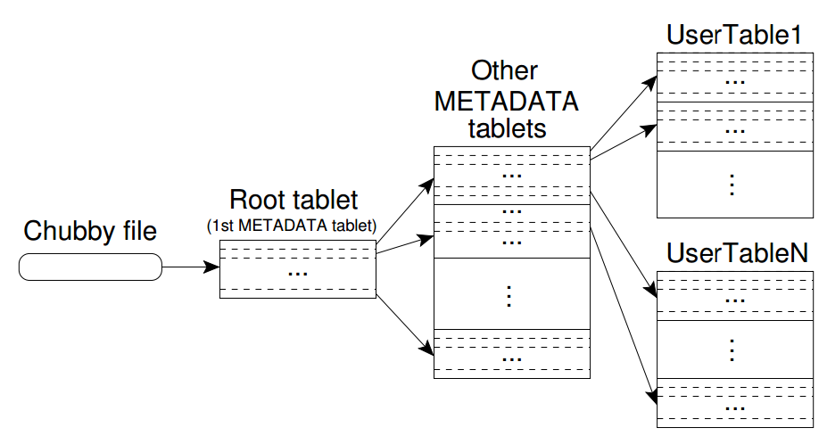
Bigtable: Hierarchical Structure
We’re not using hashing, so how do we know which tablet went where?
How do we choose the location of the Root tablet?

Slide 35
Bigtable: Hierarchical Structure

Slide 36
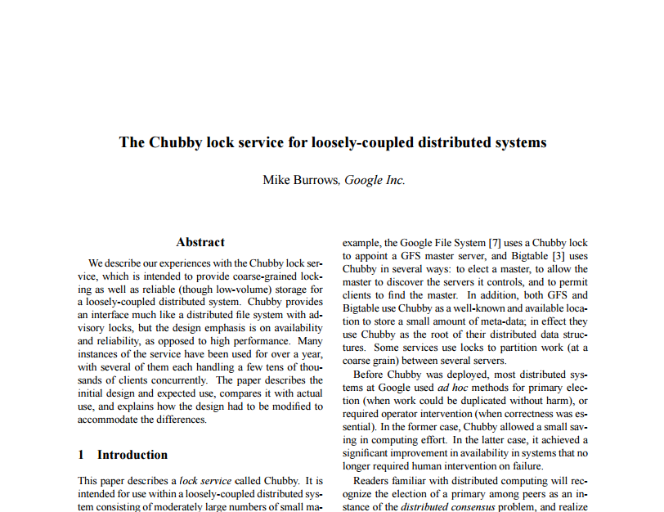
Bigtable: Consistency
CHUBBY: Distributed consensus tool based on PAXOS
Quorum of five:
one master (chosen automatically) and four slaves
Co-ordinates distributed locks
Stores location of main “root tablet”
Holds other global state information (e.g., active servers)

Slide 37
Bigtable: A Bunch of Other Things
Locality groups: Group multiple column families together; assigned a separate SSTable
Select storage: SSTables can be persistent or in-memory
Compression: Applied on SSTable blocks; custom compression can be chosen
Caches: SSTable-level and block-level
Bloom filters: Find negatives cheaply …

Slide 38
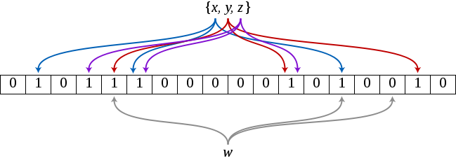
Aside: Bloom Filter
Reject “empty” queries using very little memory!
Create a bit array of length m (init to 0’s)
Create k hash functions that map an object to an index of m (even distribution)
Index o: set m[hash₁(o)], …, m[hash_{k}(o)] to 1
Query o:
any m[hash₁(o)], …, m[hash_{k}(o)] set to 0 = not indexed
all m[hash₁(o)], …, m[hash_{k}(o)] set to 1 = might be indexed

Slide 39
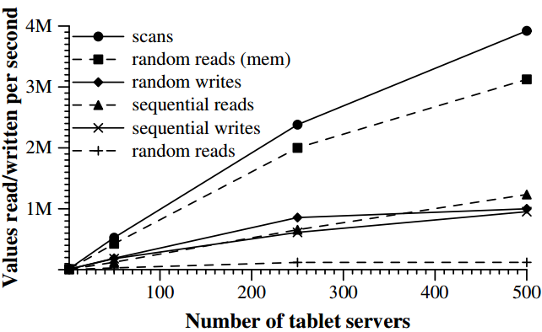
Bigtable: an idea of performance [2006]
Values are 1 Kb in size (blocks 64 Kb)
Values are aggregate over all machines
Why are random (disk) reads so slow?
The read sizes are 1 kb, but a different 64 kb block must be sent over the network (almost) every time

Slide 40
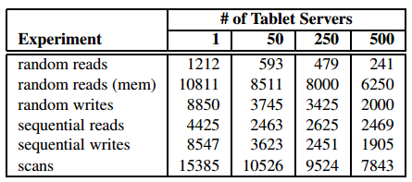
Bigtable: an idea of performance [2006]
Values are 1 Kb in size (blocks 64 Kb)
Average values/second per server:
Adding more machines does add a cost!
But overall performance does increase

Slide 41
Bigtable: examples in Google [2006]

Slide 42
Bigtable: Apache HBase
Open-source implementation of Bigtable ideas

Slide 43
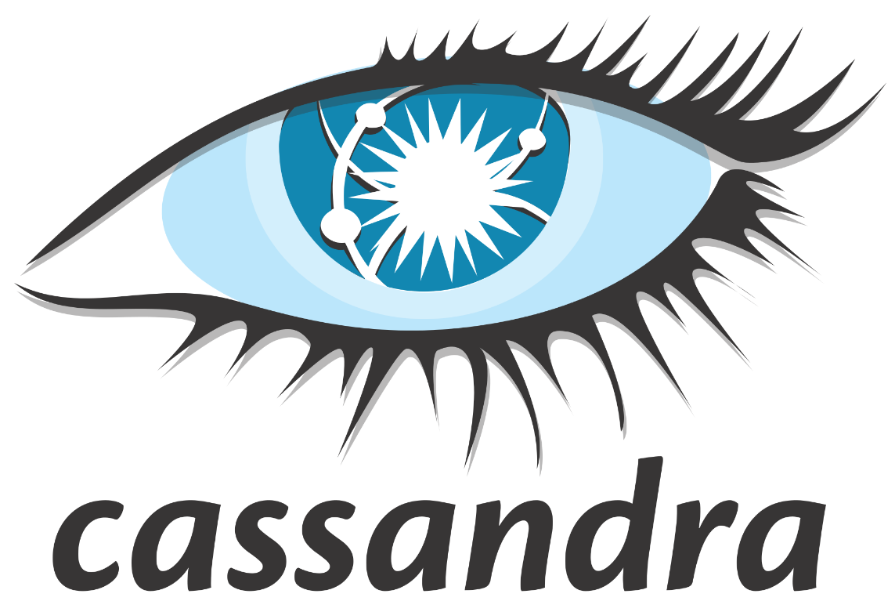
Similar ideas in Cassandra

Slide 44
The Database Landscape
Batch analysis of data
Not using the relational model
Using the relational model
Real-time
Stores documents (semi-structured values)
Relational Databases
with focus on scalability to compete with NoSQL
while maintaining ACID
Not only SQL
Maps ☺
Column Oriented
Graph-structured data
Cloud storage
In-Memory

Slide 45
GRAPH DATABASES

Slide 46
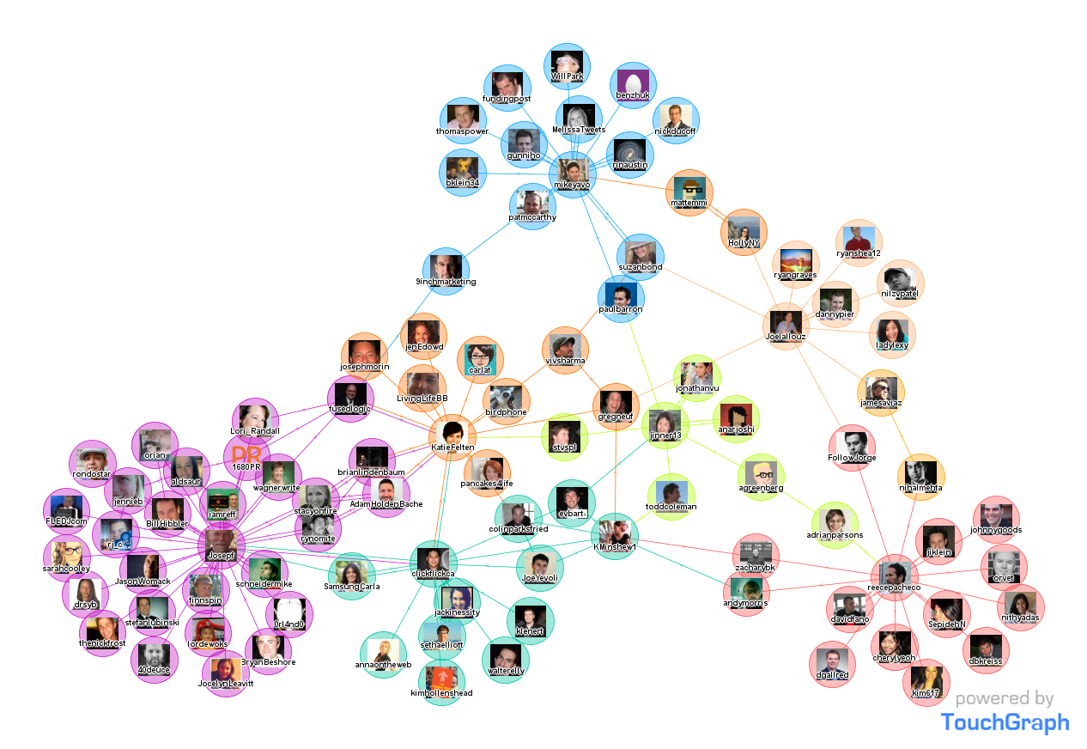

Slide 47
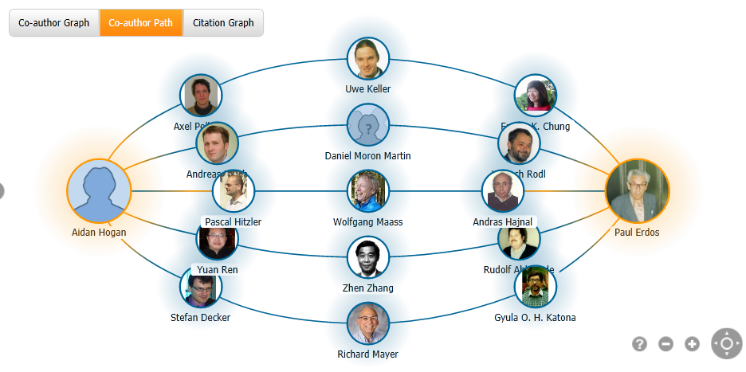

Slide 48
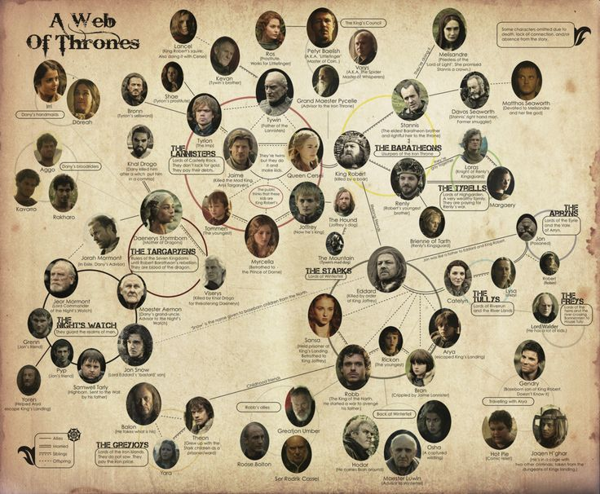

Slide 49
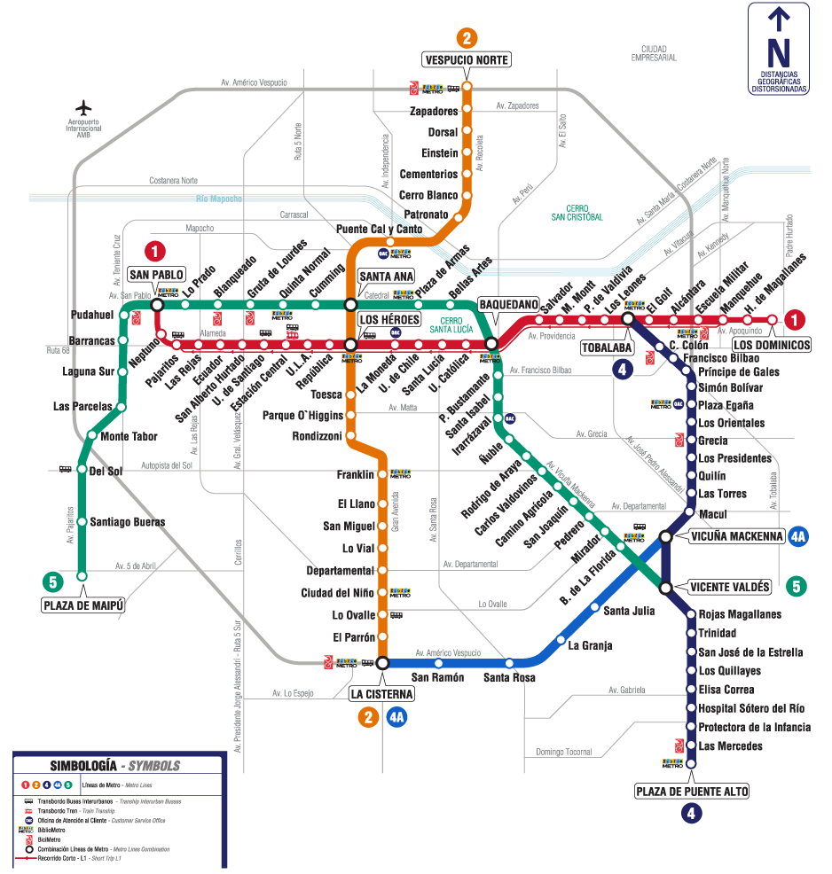

Slide 50
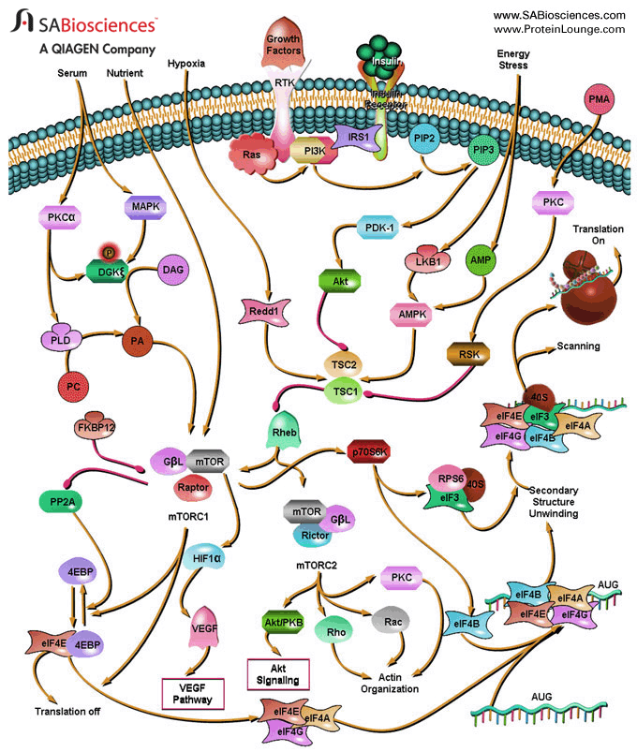

Slide 52
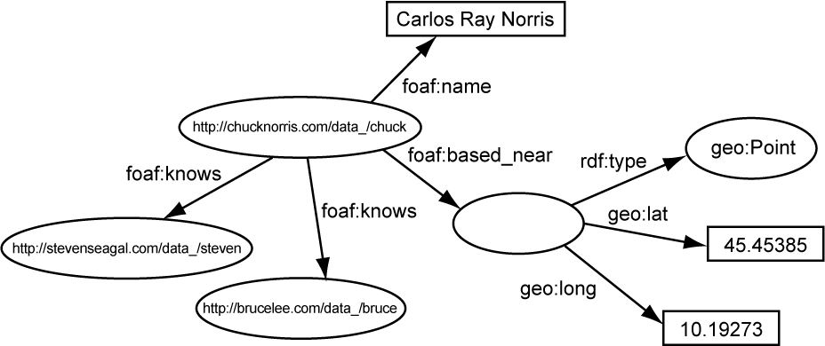

Slide 53
Data = Graph
Any data can be represented as a directed labelled graph (not always neatly)]
When is it a good idea to consider data as a graph?
When you want to answer questions like:
How many social hops is this user away?
What is my Erdős number?
What connections are needed to fly to Perth?
How are Einstein and Godel related?

Slide 54
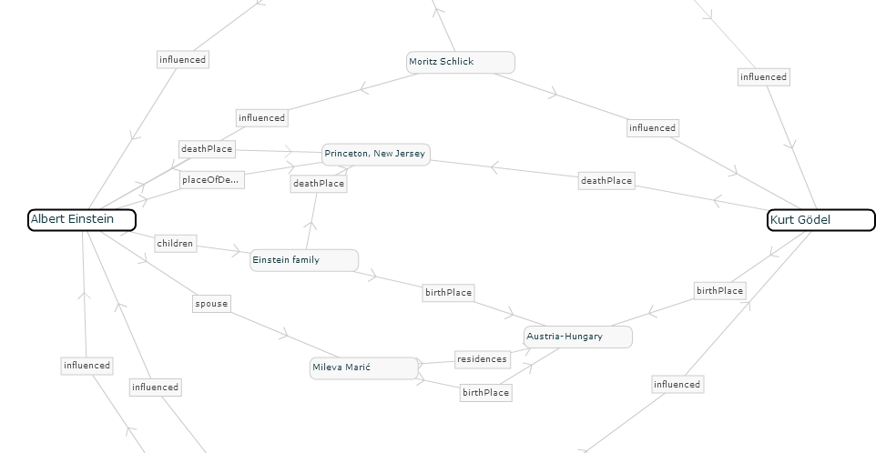
RelFinder

Slide 55
Leading Graph Database

Slide 56
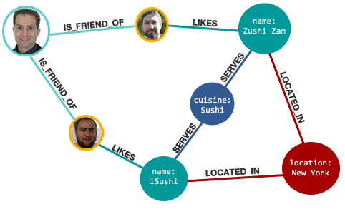
Graph Databases
(Fred,IS_FRIEND_OF,Jim)
(Fred,IS_FRIEND_OF,Ted)
(Ted,LIKES,Zushi_Zam)
(Zuzhi_Zam,SERVES,Sushi)
…

Slide 57
Graph Databases: Index Nodes
(Fred,IS_FRIEND_OF,Jim)
(Fred,IS_FRIEND_OF,Ted)
Fred ->

Slide 58
Graph Databases: Index Relations
(Ted,LIKES,Zushi_Zam)
(Jim,LIKES,iSushi)
LIKES ->

Slide 59
Graph Databases: Graph Queries
(Fred,IS_FRIEND,?friend)
(?friend,LIKES,?place)
(?place,SERVES,?sushi)
(?place,LOCATED_IN,New_York)

Slide 60
Graph Databases: Path Queries
What about scalability?
(Fred,IS_FRIEND*,?friend_of_friend)
(?friend_of_friend,LIKES,Zushi_Zam)

Slide 61
Graph Database: Index-free Adjacency
Ted | LIKES | Zushi Zam
Fred | IS_FRIEND_OF | Ted
Fred | IS_FRIEND_OF | Ted
Fred | IS_FRIEND_OF | Jim
Jim | LIKES | iSushi
Fred | IS_FRIEND_OF | Jim
iSushi | SERVES | Sushi
iSushi | LOCATED_IN | New York
Jim | LIKES | iSushi

Slide 62
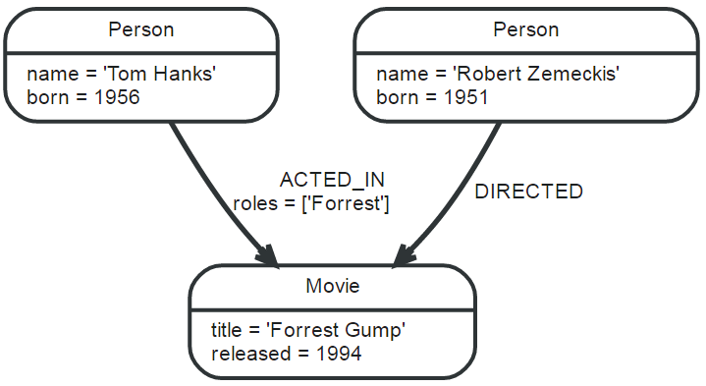
Property Graph Model
Graph nodes and edges can have
Multiple attributes like name, born, roles
Multiple labels like Person, Actor, Movie

Slide 63
Query Language: Cypher
What will this return?

Slide 64
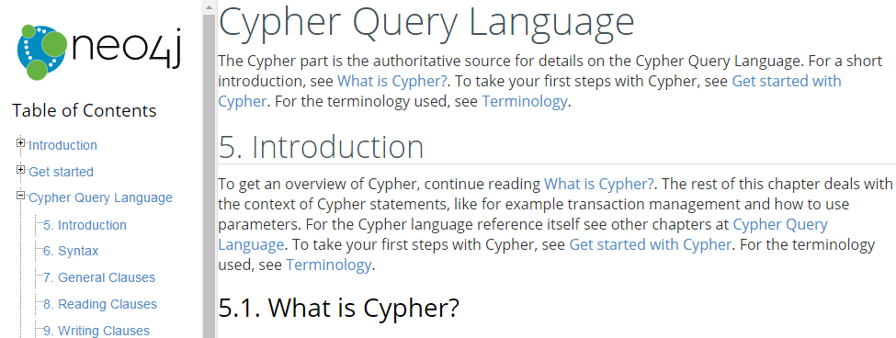
Query Language: Cypher
Relational query features (UNION, FILTER, ORDER BY, GROUP BY, COUNT, etc.)
Path query features (*, 1..5, etc.)
http://neo4j.com/docs/developer-manual/current/#cypher-query-lang

Slide 65
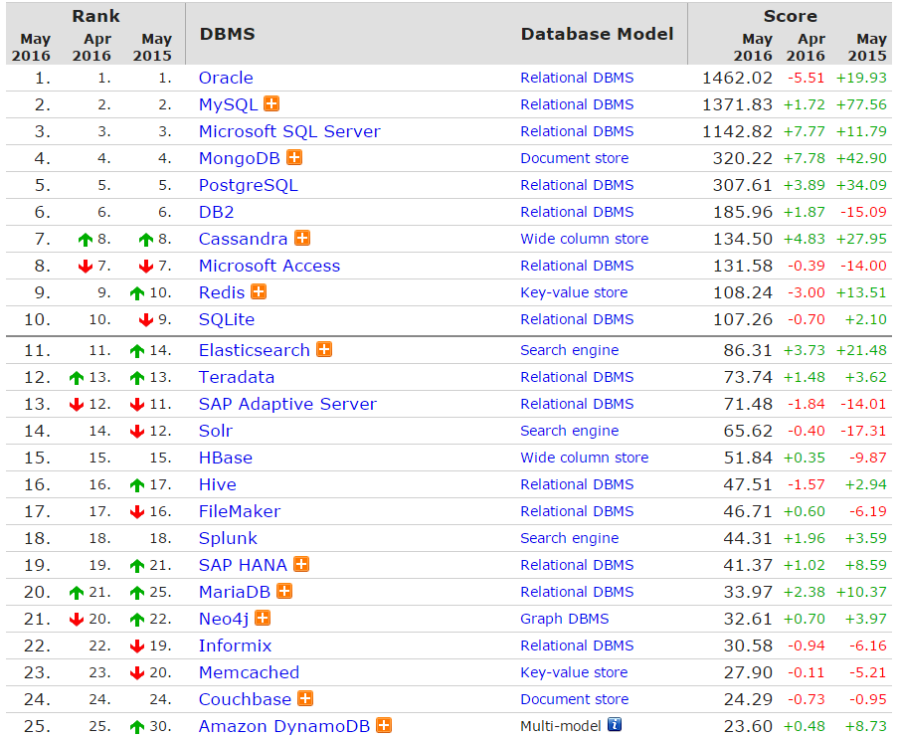
http://db-engines.com/en/ranking

Slide 66
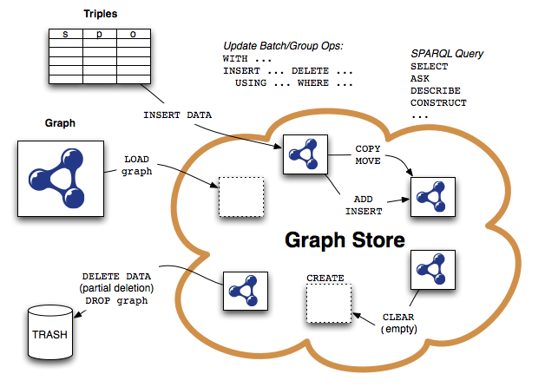
SPARQL

Slide 67
http://db-engines.com/en/ranking

Slide 68
RECAP

Slide 69
Recap
Relational Databases don’t solve everything
SQL and ACID add overhead
Distribution not so easy
NoSQL: what if you don’t need SQL or ACID?
Something simpler
Something more scalable
Trade efficiency against guarantees

Slide 70
NoSQL: Trade-offs
Simplified transactions (no ACID)
Simplified (or no) query language
Procedural or a subset of SQL
Simplified query alegbra
Often no joins
Simplified data model
Often map-based
Simplified replication
Consistency vs. Availability
Simplifications enable scale to thousands of machines. But a lot of relational database features are lost!

Slide 71
NoSQL Overview Map

Slide 72
Types of NoSQL Store
Key–Value Stores (e.g., Dynamo):
Distributed unsorted maps
Some have secondary indexes
Document Stores (e.g., MongoDB):
Map values are documents (e.g., JSON, XML)
Built-in document functions/indexable fields
Table/Column-Based Stores (e.g., Bigtable):
Distributed multi-dimensional sorted maps
Distribution by Tablets/Column-families
Graph Stores (e.g., Neo4J)
Stores vertices and relations: Index-free adjacency
Query languages for paths, reachability, etc.
Hybrid/mix/other
Categories are far from clean. But aside from graph stores, most NoSQL stores are just fancy (distributed) maps. ☺

Slide 73
Bigtable
Column family store: (row, column, time) → value
Sorted map, range partitioned
PAXOS for locks, root table
Tablets: horizontal table splits
Column family: logical grouping of columns stored close together
Locality groups: grouping of column families
SSTable: sequence of 64k blocks
Batch writes
Compactions: merge SSTables

Slide 74
Graph stores
Indexes on nodes, relations, (attributes)
Relational-style queries
Path-style queries
Index-free adjacency
Neo4J:
Property graph data model
Cypher query language

Slide 75
Questions
?

