Slide 1
CC5212-1 Procesamiento Masivo de Datos Otoño 2016 Lecture 4: DFS & MapReduce I
Aidan Hogan
aidhog@gmail.com

Slide 2
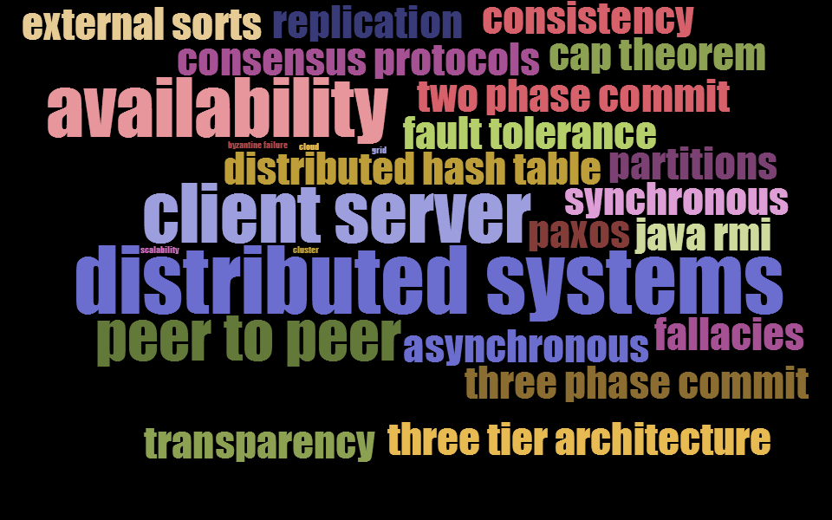
Fundamentals of Distributed Systems

Slide 3
MASSIVE DATA PROCESSING (THE GOOGLE WAY …)

Slide 4
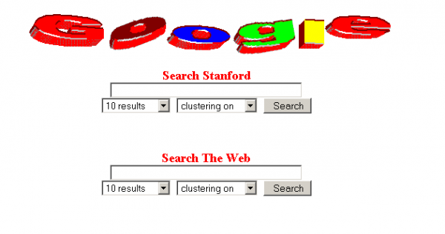
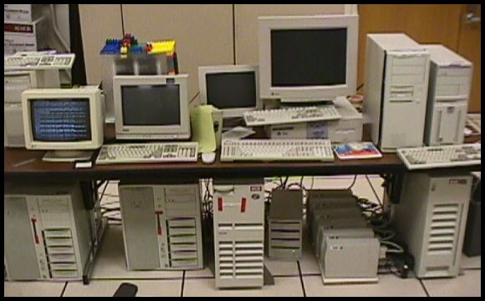
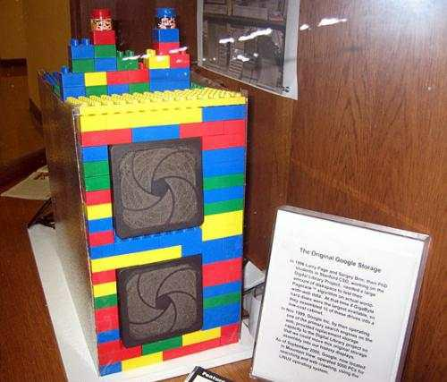
Inside Google circa 1997/98

Slide 5
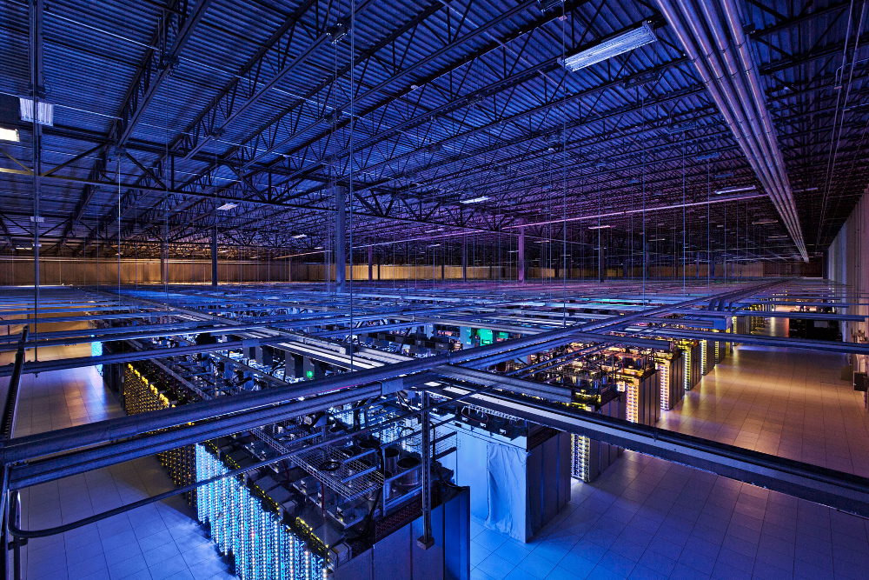
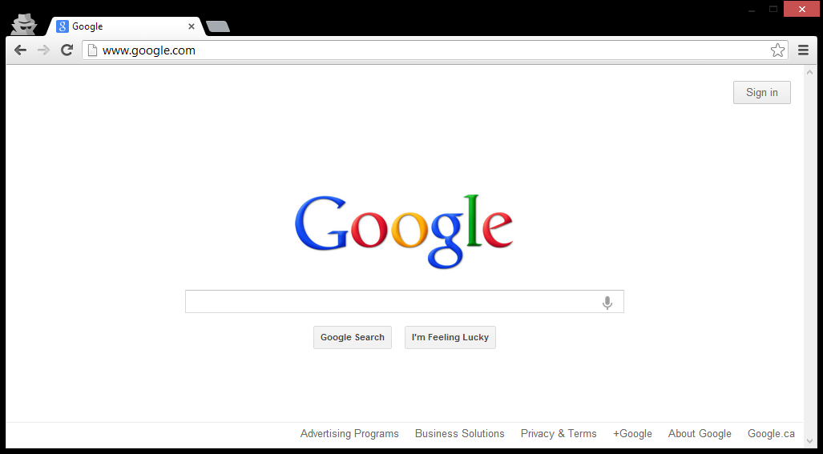
Inside Google circa 2015

Slide 6
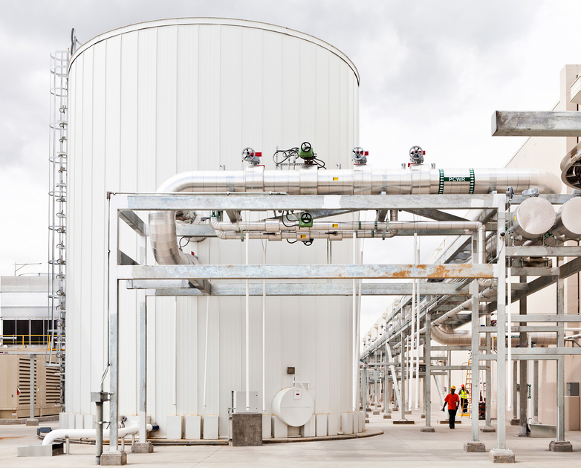
Google’s Cooling System

Slide 7
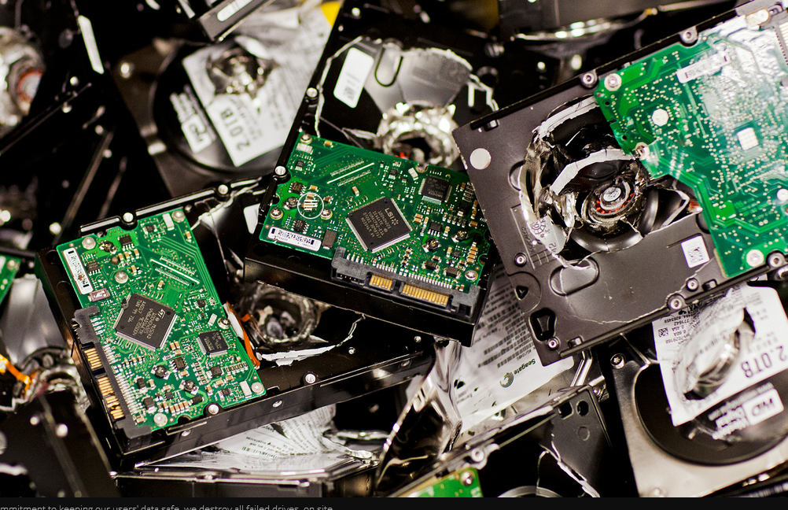
Google’s Recycling Initiative

Slide 8
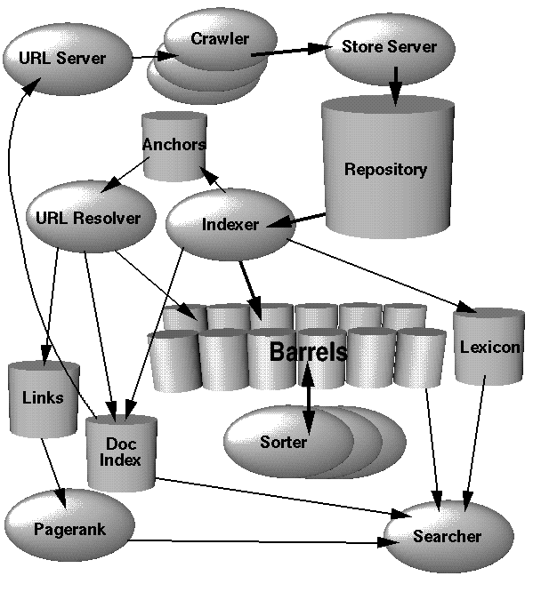
Google Architecture (ca. 1998)
Information Retrieval
Crawling
Inverted indexing
Word-counts
Link-counts
greps/sorts
PageRank
Updates
…

Slide 9
Google Engineering
Massive amounts of data
Each task needs communication protocols
Each task needs fault tolerance
Multiple tasks running concurrently
Ad hoc solutions would repeat the same code

Slide 10
Google Engineering
Google File System
Store data across multiple machines
Transparent Distributed File System
Replication / Self-healing
MapReduce
Programming abstraction for distributed tasks
Handles fault tolerance
Supports many “simple” distributed tasks!
BigTable, Pregel, Percolator, Dremel …

Slide 11
Google Re-Engineering
Google File System (GFS)
MapReduce
BigTable

Slide 12
GOOGLE FILE SYSTEM (GFS)

Slide 13
What is a File-System?
Breaks files into chunks (or clusters)
Remembers the sequence of clusters
Records directory/file structure
Tracks file meta-data
File size
Last access
Permissions
Locks

Slide 14
What is a Distributed File-System
Same thing, but distributed
Transparency: Like a normal file-system
Flexibility: Can mount new machines
Reliability: Has replication
Performance: Fast storage/retrieval
Scalability: Can store a lot of data / support a lot of machines
What would transparency / flexibility / reliability / performance / scalability mean for a distributed file system?

Slide 15
Google File System (GFS)
Files are huge
Files often read or appended
Writes in the middle of a file not (really) supported
Concurrency important
Failures are frequent
Streaming important

Slide 16
GFS: Pipelined Writes
File System (In-Memory)
/blue.txt [3 chunks]
1: {A1, C1, E1}
2: {A1, B1, D1}
3: {B1, D1, E1}
/orange.txt [2 chunks]
1: {B1, D1, E1}
2: {A1, C1, E1}
64MB per chunk
64 bit label for each chunk
Assume replication factor of 3
Master
blue.txt
(150 MB: 3 chunks)
orange.txt (100MB: 2 chunks)
A1
B1
C1
D1
E1
1
3
3
2
1
1
1
2
1
2
2
3
1
2
2
Chunk-servers (slaves)

Slide 17
GFS: Pipelined Writes (In Words)
Client asks Master to write a file
Master returns a primary chunkserver and secondary chunkservers
Client writes to primary chunkserver and tells it the secondary chunkservers
Primary chunkserver passes data onto secondary chunkserver, which passes on …
When finished, message comes back through the pipeline that all chunkservers have written
Otherwise client sends again

Slide 18
GFS: Fault Tolerance
File System (In-Memory)
/blue.txt [3 chunks]
1: {A1, B1, E1}
2: {A1, B1, D1}
3: {B1, D1, E1}
/orange.txt [2 chunks]
1: {B1, D1, E1}
2: {A1, D1, E1}
64MB per chunk
64 bit label for each chunk
Assume replication factor of 3
Master
blue.txt
(150 MB: 3 chunks)
orange.txt (100MB: 2 chunks)
A1
B1
C1
D1
E1
1
3
2
3
2
1
1
1
1
2
1
2
2
3
1
2
2
Chunk-servers (slaves)

Slide 19
GFS: Fault Tolerance (In Words)
Master sends regular “Heartbeat” pings
If a chunkserver doesn’t respond
Master finds out what chunks it had
Master assigns new chunkserver for each chunk
Master tells new chunkserver to copy from a specific existing chunkserver
Chunks are prioritised by number of remaining replicas, then by demand

Slide 20
GFS: Direct Reads
I’m looking for /blue.txt
File System (In-Memory)
/blue.txt [3 chunks]
1: {A1, C1, E1}
2: {A1, B1, D1}
3: {B1, D1, E1}
/orange.txt [2 chunks]
1: {B1, D1, E1}
2: {A1, C1, E1}
1
2
3
Master
Client
A1
B1
C1
D1
E1
1
3
3
2
1
1
1
2
1
2
2
3
1
2
2
Chunk-servers (slaves)

Slide 21
GFS: Direct Reads (In Words)
Client asks Master for file
Master returns location of a chunk
Returns a ranked list of replicas
Client reads chunk directly from chunkserver
Client asks Master for next chunk
Software makes transparent for client!

Slide 22
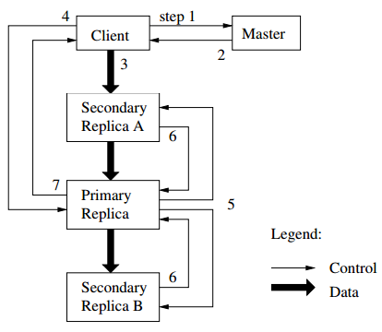
GFS: Modification Consistency
Masters assign leases to one replica: a “primary replica”
Client wants to change a file:
Client asks Master for the replicas (incl. primary)
Master returns replica info to the client
Client sends change data
Client asks primary to execute the changes
Primary asks secondaries to change
Secondaries acknowledge to primary
Primary acknowledges to client
Data & Control Decoupled

Slide 23
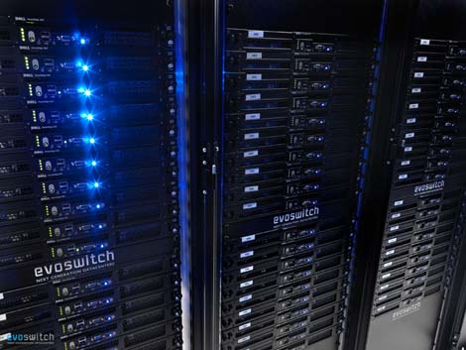
GFS: Rack Awareness

Slide 24
GFS: Rack Awareness
Core
Switch
Core
Switch
Rack A
Switch
Rack B
Switch
Rack C
Switch

Slide 25
GFS: Rack Awareness
Core
Switch
Files:
/orange.txt
1: {A1, A4, B3}
2: {A5, B1, B5}
Rack A
Switch
Rack B
Switch
1
A1
2
B1
Racks:
A: {A1, A2, A3, A4, A5}
B: {B1, B2, B3, B4, B5}
A2
B2
A3
1
B3
1
A4
B4
2
A5
2
B5

Slide 26
GFS: Rack Awareness (In Words)
Make sure replicas not on same rack
In case rack switch fails!
But communication can be slower:
Within rack: pass one switch (rack switch)
Across racks: pass three switches (two racks and a core)
(Typically) pick two racks with low traffic
Two nodes in same rack, one node in another rack
(Assuming 3x replication)
Only necessary if more than one rack! ☺

Slide 27
GFS: Other Operations
Rebalancing: Spread storage out evenly
Deletion:
Just rename the file with hidden file name
To recover, rename back to original version
Otherwise, three days later will be wiped
Monitoring Stale Replicas: Dead slave reappears with old data: master keeps version info and will recycle old chunks

Slide 28
GFS: Weaknesses?
What do you see as the core weaknesses of the Google File System?
Master node single point of failure
Use hardware replication
Logs and checkpoints!
Master node is a bottleneck
Use more powerful machine
Minimise master node traffic
Master-node metadata kept in memory
Each chunk needs 64 bytes
Chunk data can be queried from each slave

Slide 29
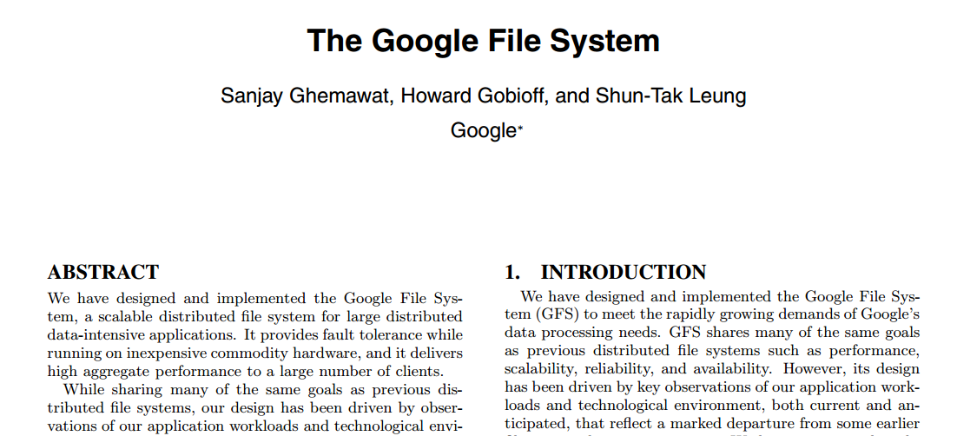
GFS: White-Paper

Slide 30
HaDOOP DISTRIBUTED FILE SYSTEM (HDFS)

Slide 31
Google Re-Engineering
Google File System (GFS)

Slide 32
HDFS
HDFS-to-GFS
Data-node = Chunkserver/Slave
Name-node = Master
HDFS does not support modifications
Otherwise pretty much the same except …
GFS is proprietary (hidden in Google)
HDFS is open source (Apache!)

Slide 33
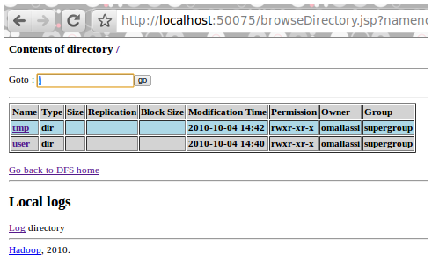
HDFS Interfaces

Slide 34
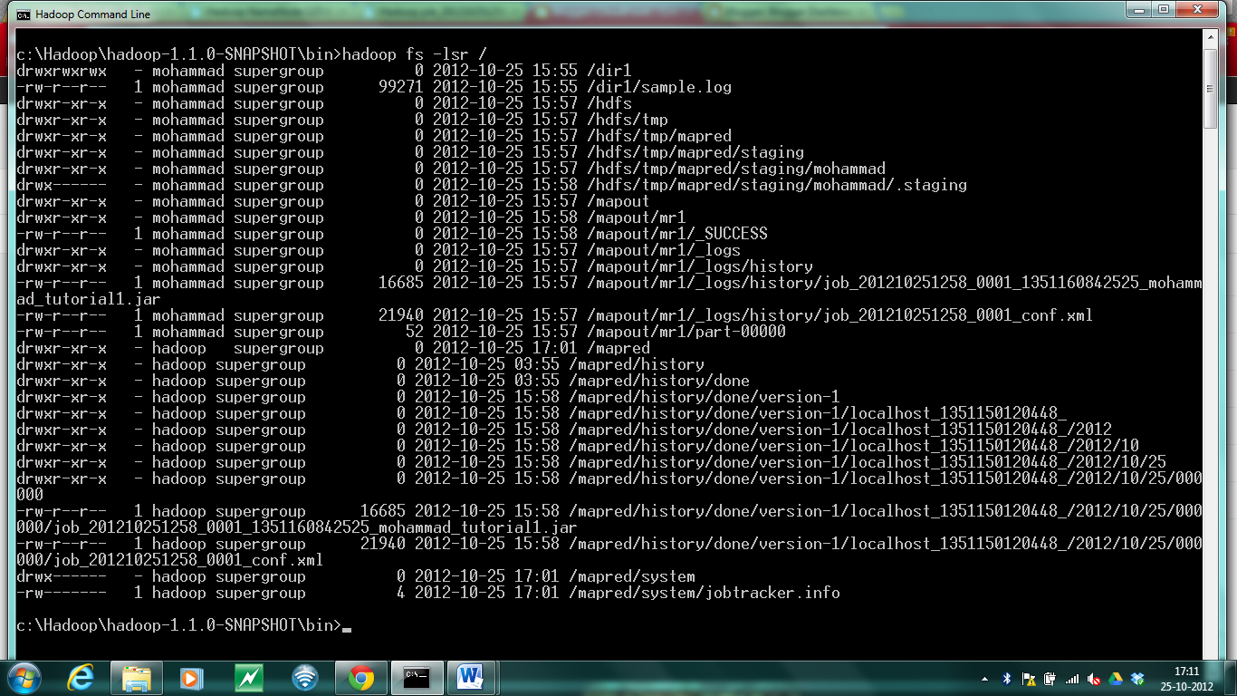
HDFS Interfaces

Slide 35
GOOGLE’S MAP-REDUCE

Slide 36
Google Re-Engineering
Google File System (GFS)
MapReduce

Slide 37
MapReduce in Google
Divide & Conquer:
Word count
Total searches per user
PageRank
Inverted-indexing
…
How could we do a distributed top-k word count?

Slide 38
MapReduce: Word Count
Better partitioning
method?
Input
Distr. File Sys.
A1
B1
C1
1
3
2
Map()
A1
B1
C1
(Partition/Shuffle)
(Distr. Sort)
a-k
l-q
r-z
Reduce()
a 10,023
aa 6,234
…
lab 8,123
label 983
…
rag 543
rat 1,233
…
Output

Slide 39
MapReduce (in more detail)
Input: Read from the cluster (e.g., a DFS)
Chunks raw data for mappers
Maps raw data to initial (key_{in}, value_{in}) pairs
Map: For each (key_{in}, value_{in}) pair, generate zero-to-many (key_{map}, value_{map}) pairs
key_{in} /value_{in} can be diff. type to key_{map} /value_{map}
What might Input do in the word-count case?
What might Map do in the word-count case?

Slide 40
MapReduce (in more detail)
Partition: Assign sets of key_{map} values to reducer machines
Shuffle: Data are moved from mappers to reducers (e.g., using DFS)
Comparison/Sort: Each reducer sorts the data by key using a comparison function
Sort is taken care of by the framework
How might Partition work in the word-count case?

Slide 41
MapReduce
Reduce: Takes a bag of (key_{map}, value_{map}) pairs with the same key_{map} value, and produces zero-to-many outputs for each bag
Typically zero-or-one outputs
Output: Merge-sorts the results from the reducers / writes to stable storage
How might Reduce work in the word-count case?

Slide 42
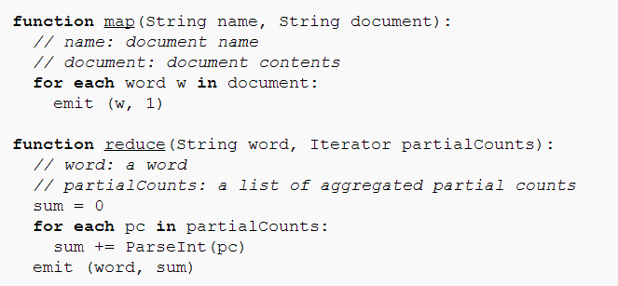
MapReduce: Word Count PseudoCode

Slide 43
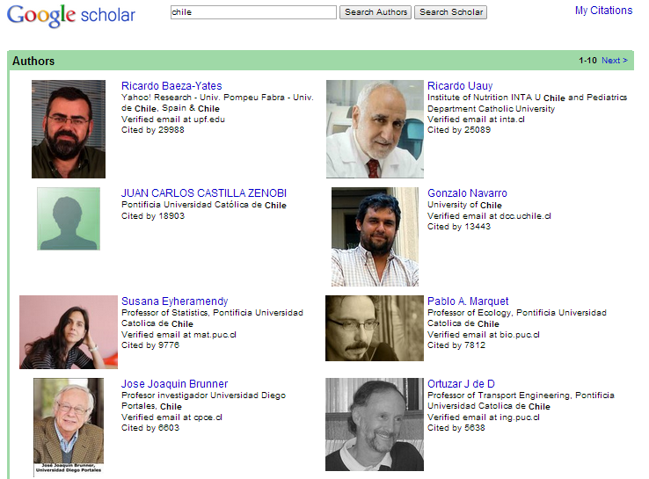
MapReduce: Scholar Example

Slide 44
MapReduce: Scholar Example
Assume that in Google Scholar we have inputs like:
paper_{A} citedBy paper_{B}
How can we use MapReduce to count the total incoming citations per paper?

Slide 45
MapReduce as a Dist. Sys.
Transparency: Abstracts physical machines
Flexibility: Can mount new machines; can run a variety of types of jobs
Reliability: Tasks are monitored by a master node using a heart-beat; dead jobs restart
Performance: Depends on the application code but exploits parallelism!
Scalability: Depends on the application code but can serve as the basis for massive data processing!

Slide 46
MapReduce: Benefits for Programmers
Takes care of low-level implementation:
Easy to handle inputs and output
No need to handle network communication
No need to write sorts or joins
Abstracts machines (transparency)
Fault tolerance (through heart-beats)
Abstracts physical locations
Add / remove machines
Load balancing

Slide 47
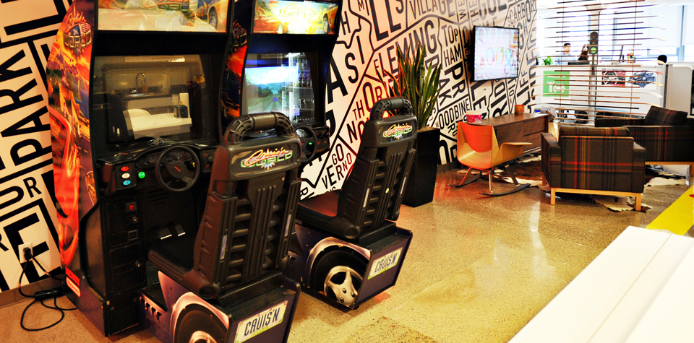
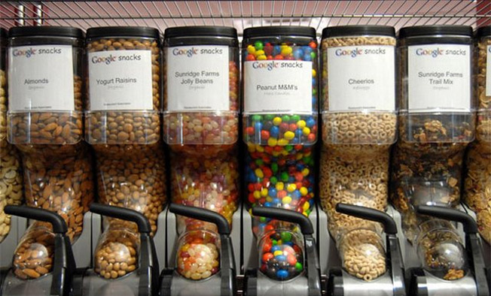
MapReduce: Benefits for Programmers
Time for more important things …

Slide 48
HADOOP OVERVIEW

Slide 49
Hadoop Architecture
Client
NameNode
JobTracker
DataNode 1
JobNode 1
DataNode 2
JobNode 2
…
…
DataNode n
JobNode n

Slide 50
HDFS: Traditional / SPOF
NameNode
NameNode appends edits to log file
SecondaryNameNode copies log file and image, makes checkpoint, copies image back
NameNode loads image on start-up and makes remaining edits
SecondaryNameNode not a backup NameNode
copy dfs/blue.txt
rm dfs/orange.txt
rmdir dfs/
mkdir new/
mv new/ dfs/
fsimage
SecondaryNameNode
DataNode 1
…
DataNode n

Slide 51
What is the secondary name-node?
Name-node quickly logs all file-system actions in a sequential (but messy) way
Secondary name-node keeps the main fsimage file up-to-date based on logs
When the primary name-node boots back up, it loads the fsimage file and applies the remaining log to it
Hence secondary name-node helps make boot-ups faster, helps keep file system image up-to-date and takes load away from primary

Slide 52
Hadoop: High Availability
1
2
Active NameNode
Standby NameNode
Active NameNode
JournalManager
JournalManager
fsimage
2
1
JournalNode 1
fs edits
fs edits
2
1
…
1
2
JournalNode n

Slide 53
PROGRAMMING WITH HADOOP

Slide 54
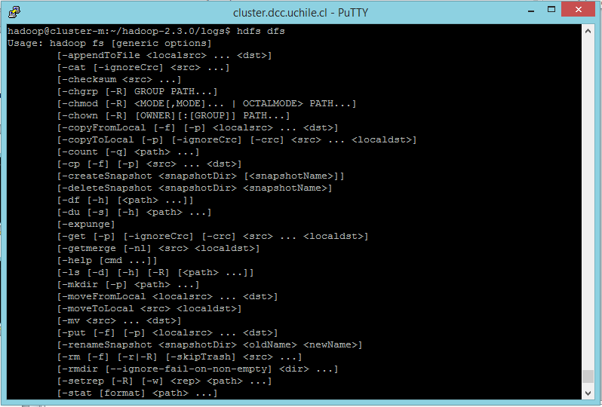
1. Input/Output (cmd)
> hdfs dfs

Slide 55
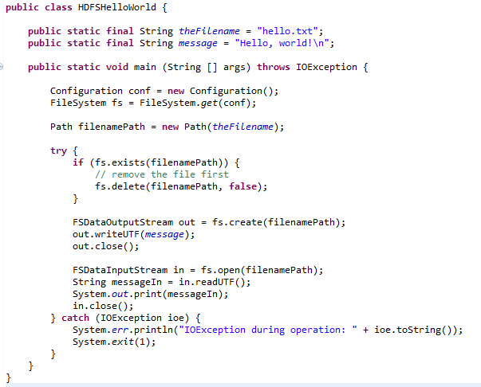
1. Input/Output (Java)
Creates a file system for default configuration
Check if the file exists; if so delete
Create file and write a message
Open and read back

Slide 56
1. Input (Java)

Slide 57
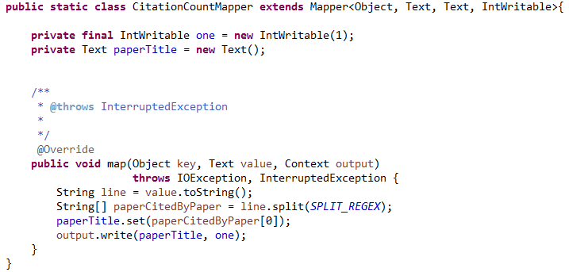
2. Map
Mapper<InputKeyType,
InputValueType,
MapKeyType,
MapValueType>
(input) key: file offset.
(input) value: line of the file.
context: handles output and logging.
Emit output

Slide 58
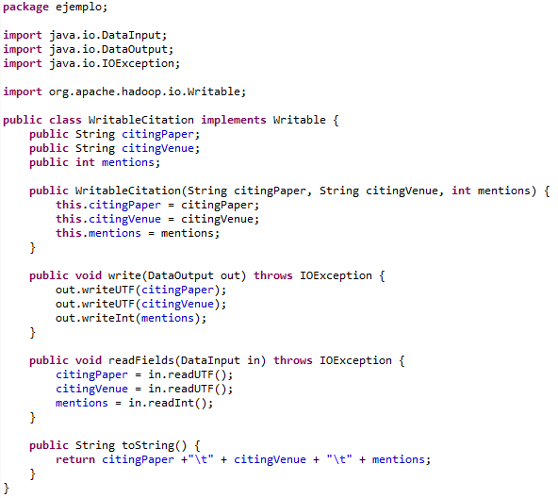
(Writable for values)
Same order
(not needed in the running example)

Slide 59
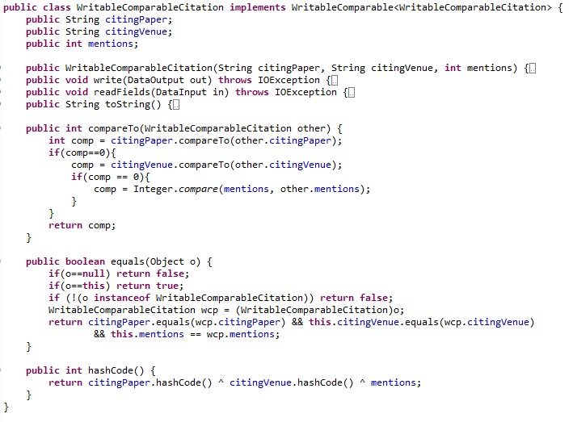
(WritableComparable for keys/values)
New Interface
Same as before
Needed to sort keys
Needed for default partition function
(not needed in the running example)

Slide 60
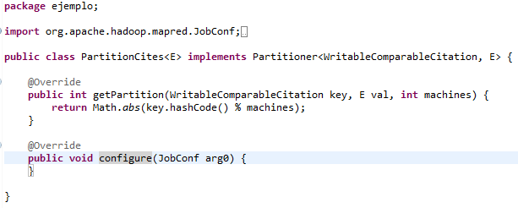
3. Partition
PartitionerInterface
(This happens to be the default partition method!)
(not needed in the running example)

Slide 61
4. Shuffle

Slide 62
5. Sort/Comparision
Methods in WritableComparator
(not needed in the running example)

Slide 63
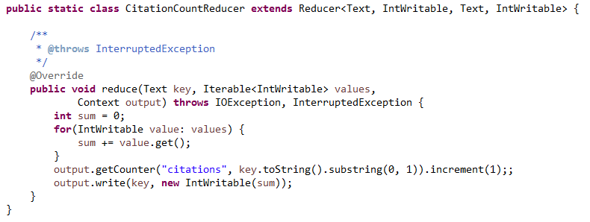
6. Reduce
Reducer<MapKey, MapValue,
OutputKey, OutputValue>
key: as emitted from map
values: iterator over all values for that key
context for output
Write to output

Slide 64
7. Output / Input (Java)
Creates a file system for default configuration
Check if the file exists; if so delete
Create file and write a message
Open and read back

Slide 65
7. Output (Java)

Slide 66
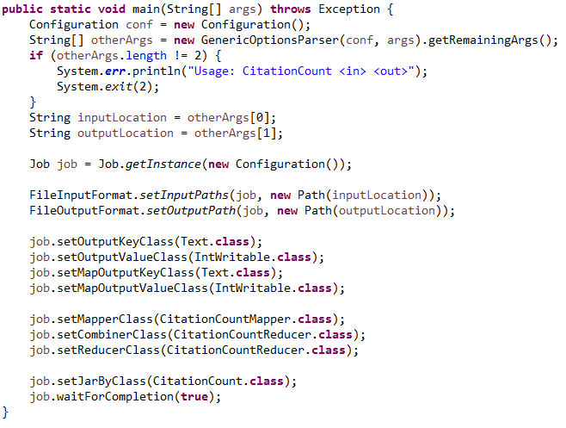
Control Flow
Create a JobClient, a JobConf and pass it the main class
Set input and output paths
Set the type of map and output keys and values in the configuration
Set the mapper class
Set the reducer class
(and optionally “combiner”)
Run and wait for job to complete.

Slide 67
More in Hadoop: Combiner
Map-side “mini-reduction”
Keeps a fixed-size buffer in memory
Reduce within that buffer
e.g., count words in buffer
Lessens bandwidth needs
In Hadoop: can simply use Reducer class ☺

Slide 68
More in Hadoop: Counters
Context has a group of maps of counters

Slide 69
More in Hadoop: Chaining Jobs
Sometimes we need to chain jobs
In Hadoop, can pass a set of Jobs to the client
x.addDependingJob(y)

Slide 70
More in Hadoop: Distributed Cache
Some tasks need “global knowledge”
For example, a white-list of conference venues and journals that should be considered in the citation count
Typically small
Use a distributed cache:
Makes data available locally to all nodes

Slide 71
IF WE HAVE TIME …

Slide 72
MapReduce: Scholar Example
Assume that in Google Scholar we have two inputs like:
How can we use MapReduce to count the total incoming citations per author?
paper_{A} citedBy paper_{B}
paper_{A} citedBy paper_{D}
paper_{C} citedBy paper_{D}
paper_{D} citedBy paper_{B}
paper_{A} author₁ author₂ author₃
paper_{A} author₂ author₁
paper_{C} author₄ author₂ author₅
paper_{D} author₆

Slide 73
RECAP

Slide 74
Distributed File Systems
Google File System (GFS)
Master and Chunkslaves
Replicated pipelined writes
Direct reads
Minimising master traffic
Fault-tolerance: self-healing
Rack awareness
Consistency and modifications
Hadoop Distributed File System
NameNode and DataNodes

Slide 75
MapReduce
Input
Map
Partition
Shuffle
Comparison/Sort
Reduce
Output

Slide 76
MapReduce/GFS Revision
GFS: distributed file system
Implemented as HDFS
MapReduce: distributed processing framework
Implemented as Hadoop

Slide 77
Hadoop
FileSystem
Mapper<InputKey,InputValue,MapKey,MapValue>
OutputCollector<OutputKey,OutputValue>
Writable, WritableComparable<Key>
Partitioner<KeyType,ValueType>
Reducer<MapKey,MapValue,OutputKey,OutputValue>
JobClient/JobConf
…

