Slide 1
CC5212-1 Procesamiento Masivo de Datos Otoño 2016 Lecture 1: Introduction
Aidan Hogan
aidhog@gmail.com

Slide 2
THE VALUE OF DATA

Slide 3
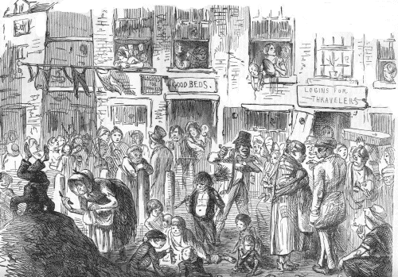
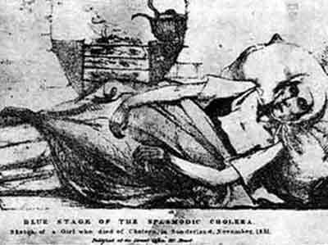
Soho, London, 1854

Slide 4
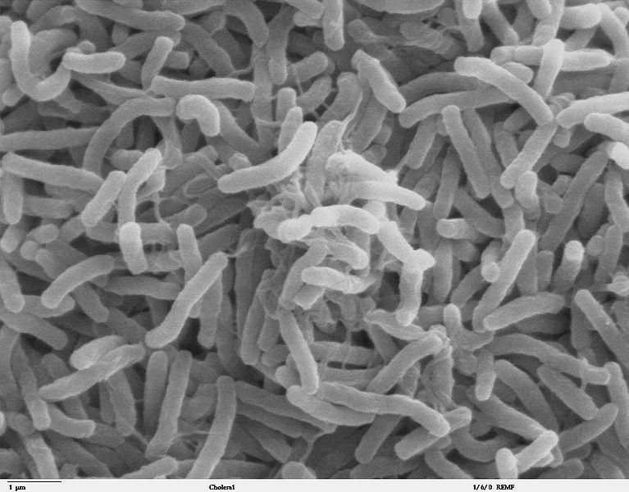
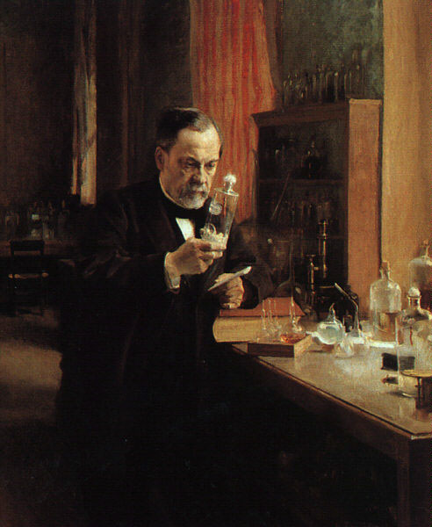
The mystery of cholera

Slide 5
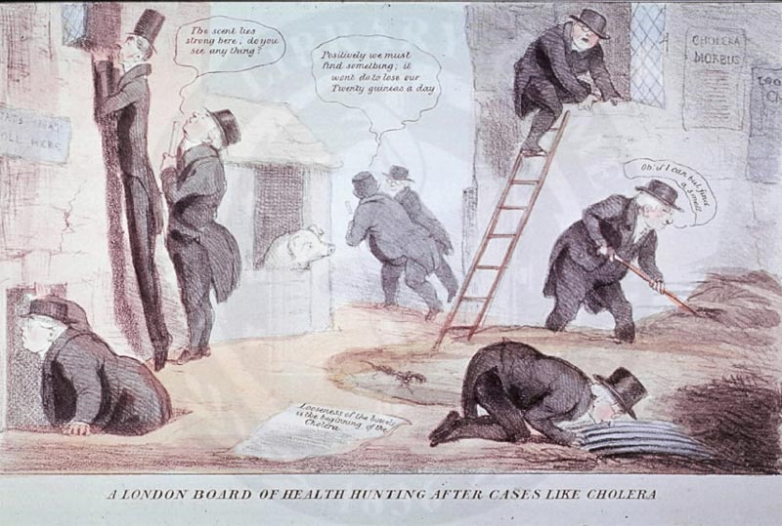
The hunt for the invisible cholera

Slide 6
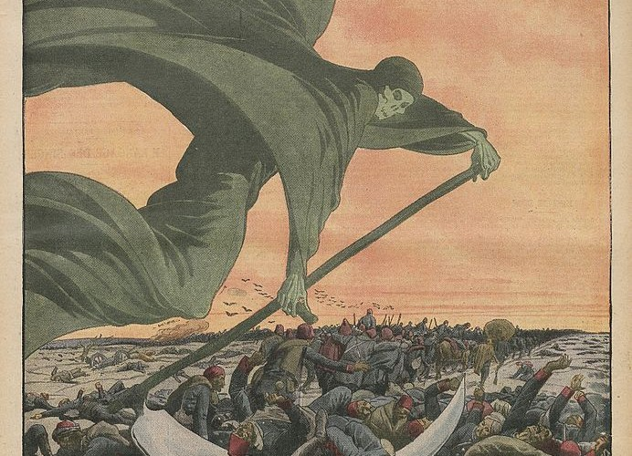
Cholera: Galen’s miasma theory

Slide 7
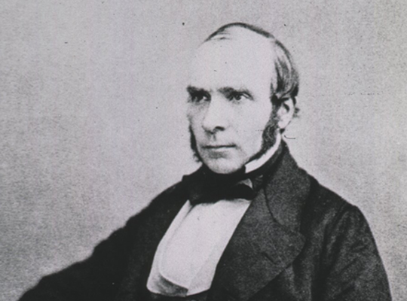
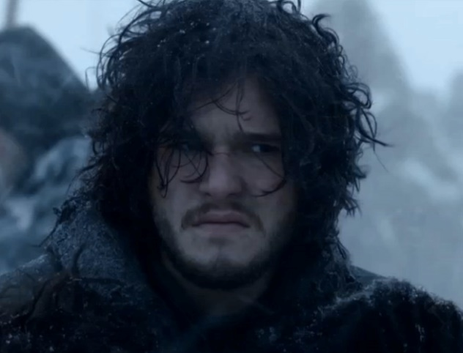
John Snow: 1813–1858

Slide 8
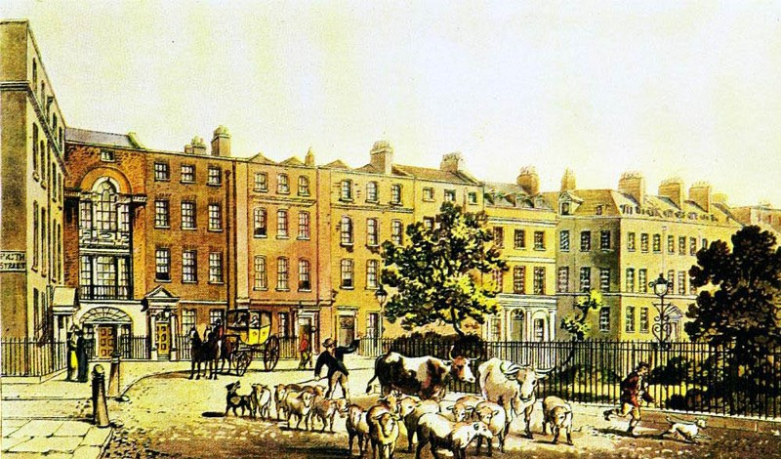
The Survey of Soho

Slide 9
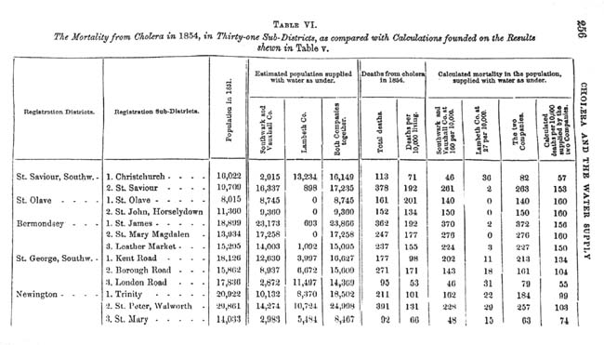
Data collection

Slide 10
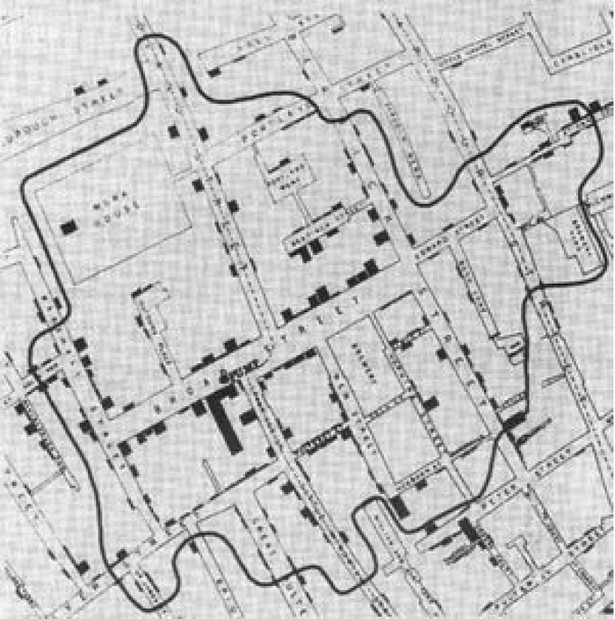
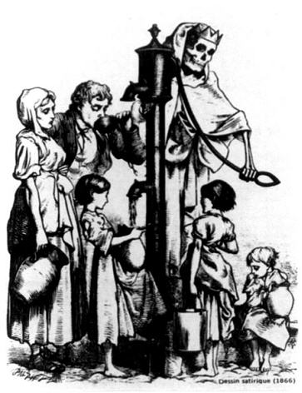
What the data showed …

Slide 11
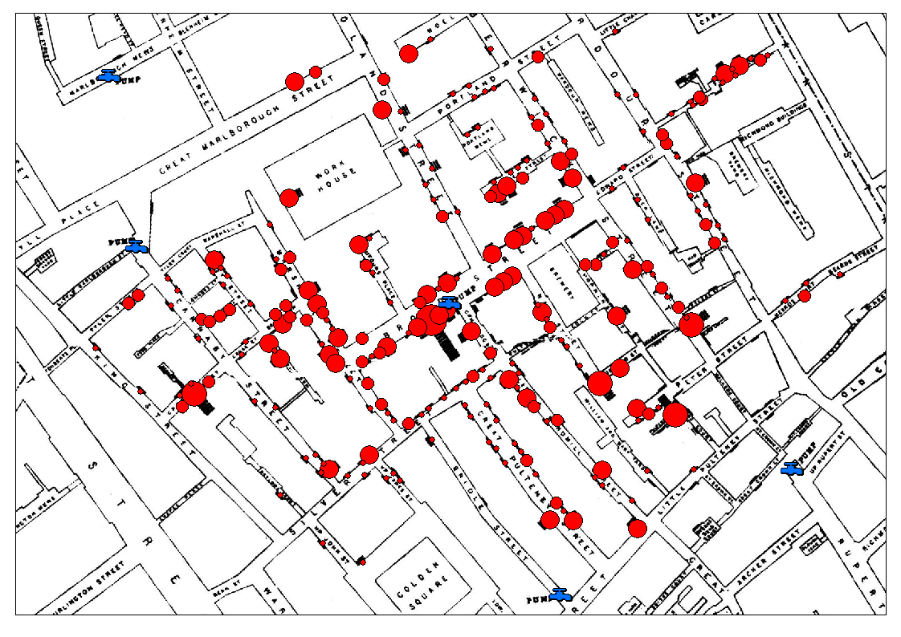
What the data showed …

Slide 12
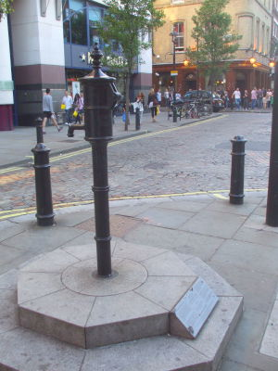
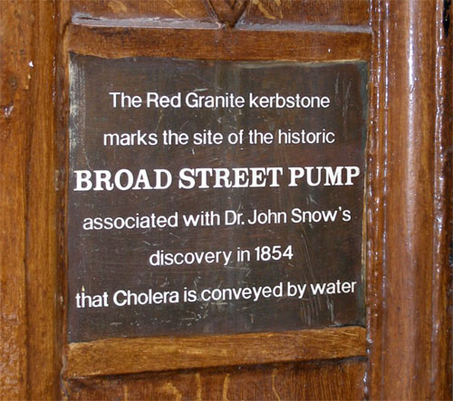
616 deaths, 8 days later …

Slide 13
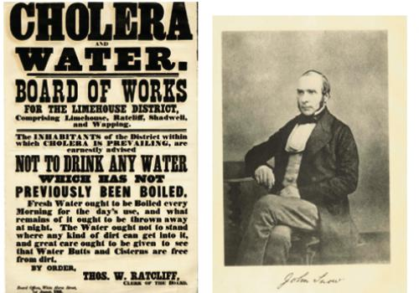
Cholera notice ca. 1866

Slide 14
Thirty years before discovery of V. cholerae

Slide 15
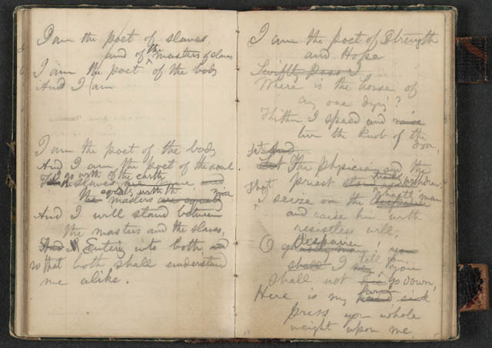
John Snow: Father of Epidemiology

Slide 16
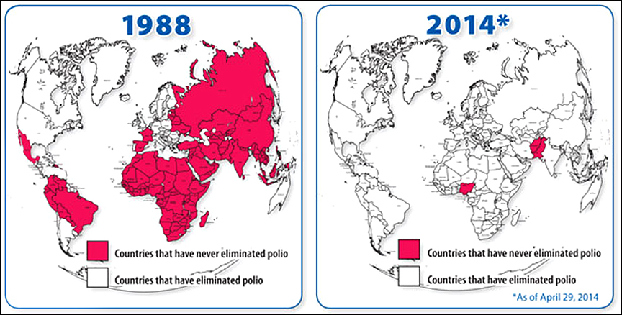
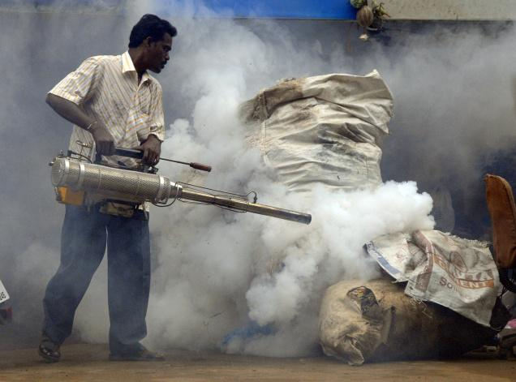
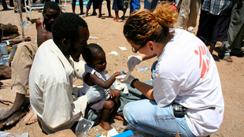
Epidemiology’s Success Stories

Slide 17
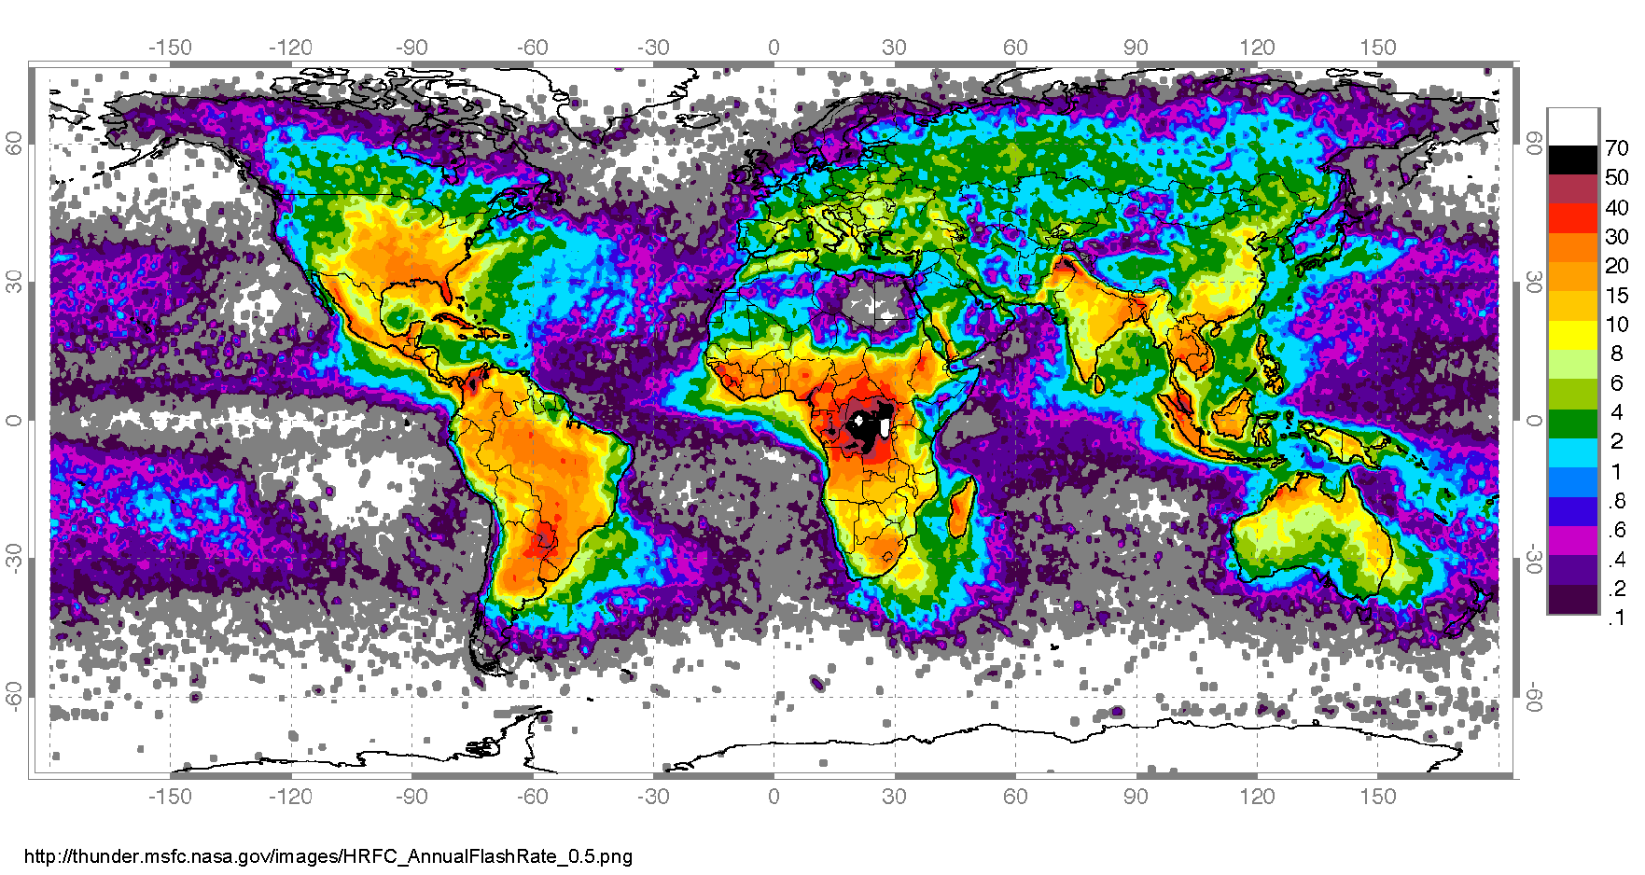
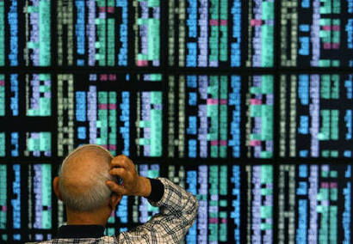
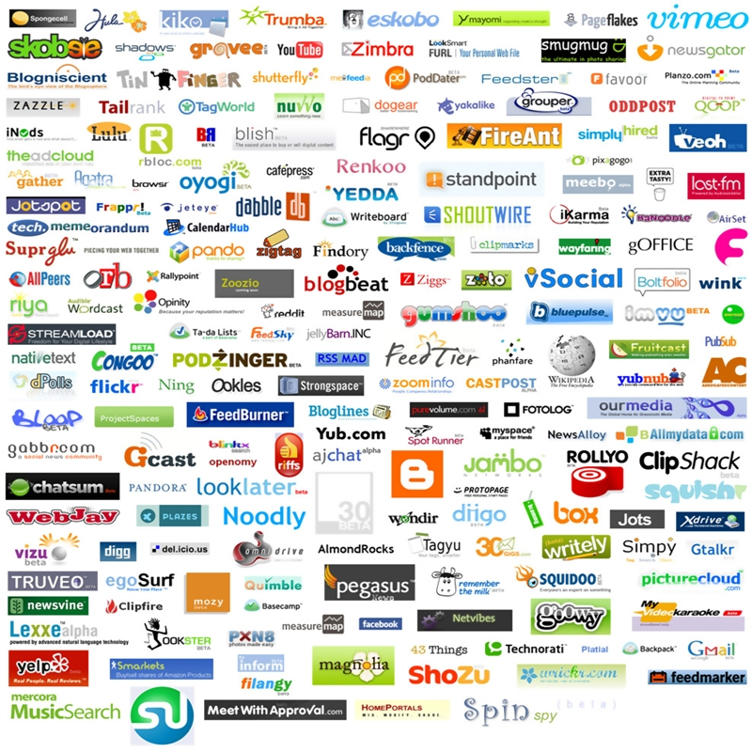
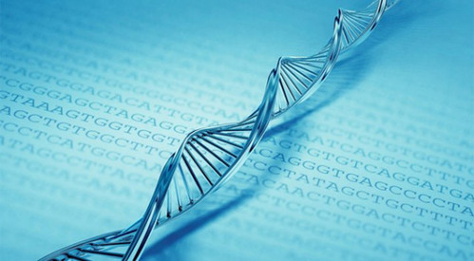
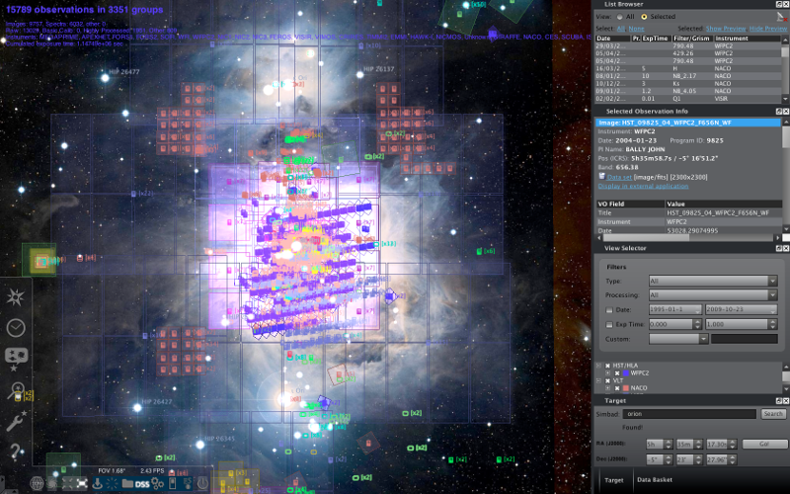
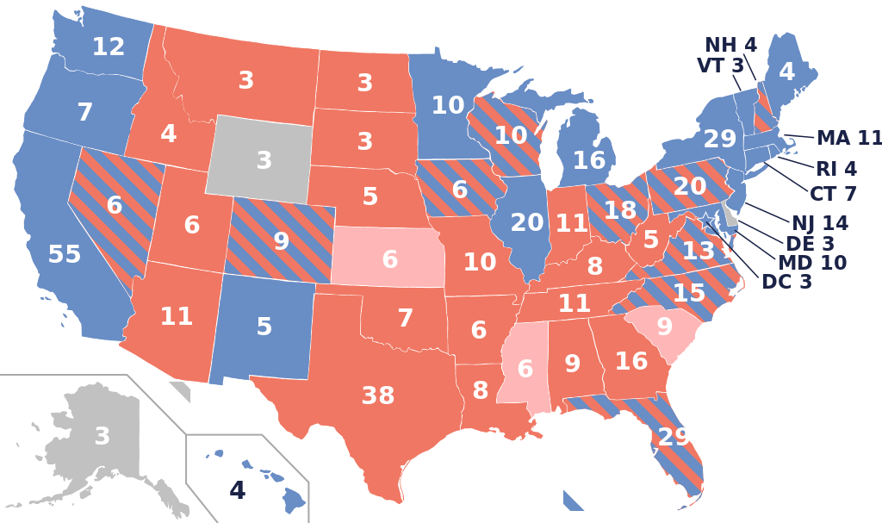
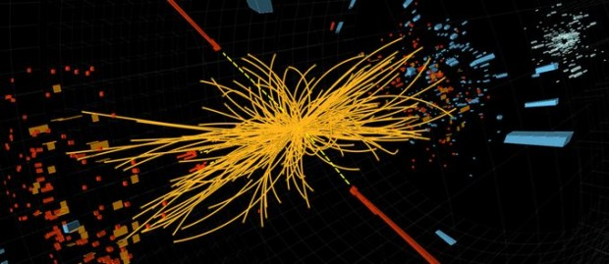
Value of data: Not just epidemiology

Slide 18
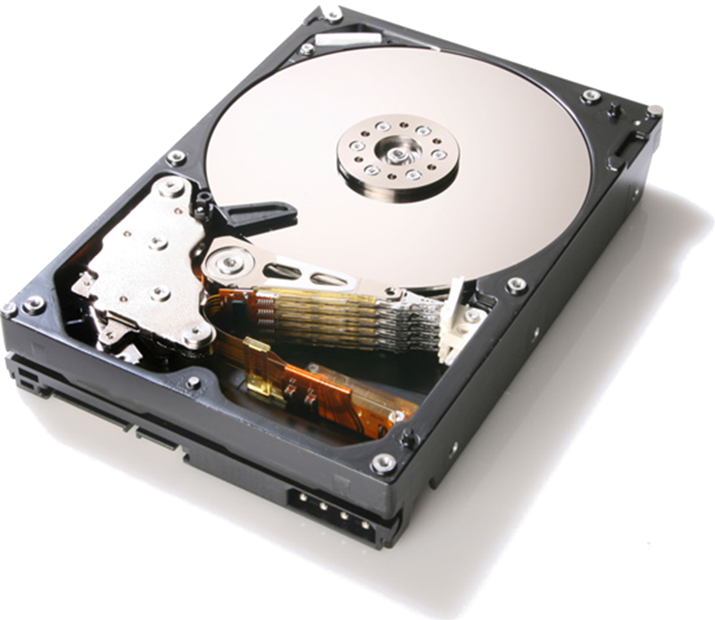
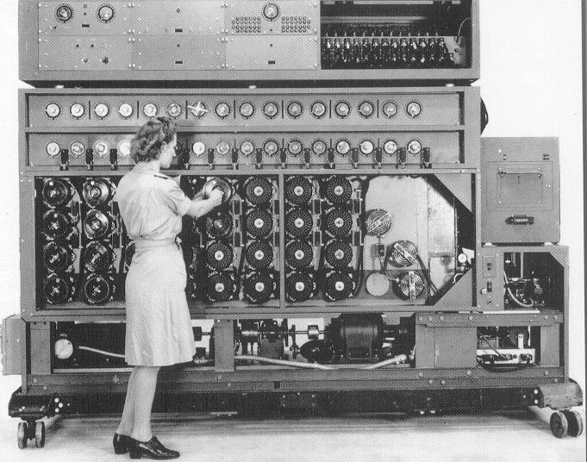
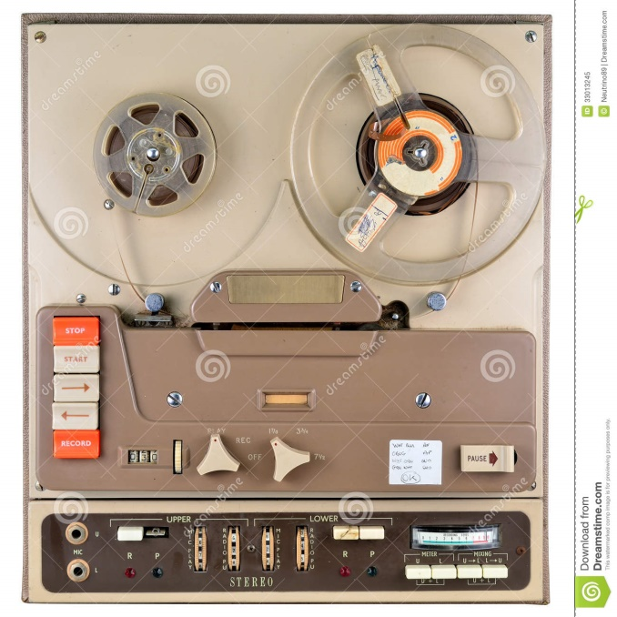
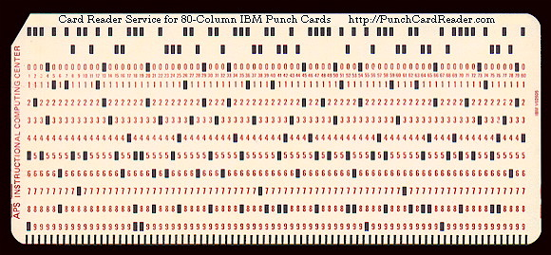
(Paper) notebooks no longer good enough

Slide 19
THE GROWTH OF DATA

Slide 20
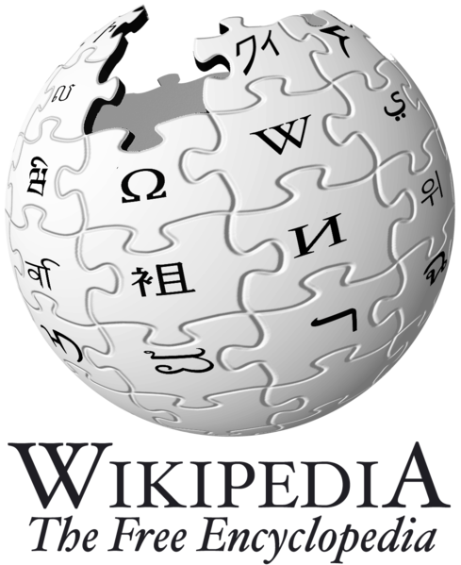
“Big Data”
Wikipedia
≈ 5.9 TB of data
(Jan. 2010 Dump)
1 Wiki = 1 Wikipedia

Slide 21
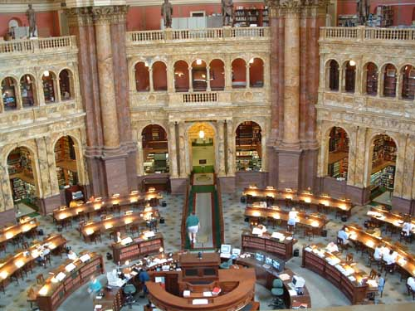
“Big Data”
US Library of Congress
≈ 235 TB archived
≈ 40 Wiki

Slide 22
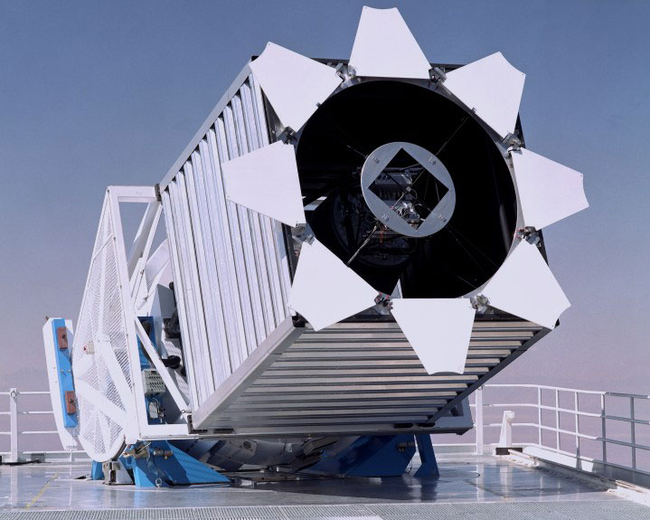
“Big Data”
Sloan Digital Sky Survey
≈ 200 GB/day
≈ 73 TB/year
≈ 12 Wiki/year

Slide 23
“Big Data”
NASA Center for
Climate Simulation
≈ 32 PB archived
≈ 5,614 Wiki

Slide 24
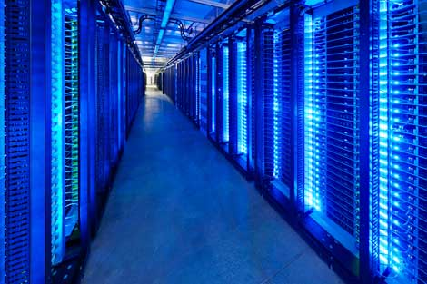
“Big Data”
Facebook
≈ 100 TB/day added
≈ 17 Wiki/day
≈ 6,186 Wiki/year
(as of Mar. 2010)

Slide 25
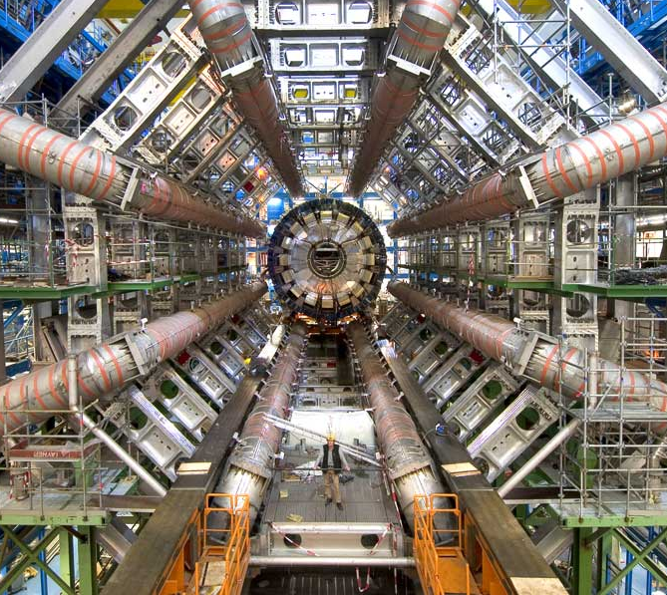
“Big Data”
Large Hadron Collider
≈ 15 PB/year
≈ 2,542 Wikipedias/year

Slide 26
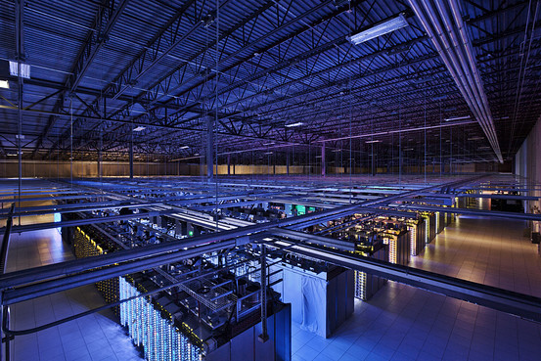
“Big Data”
Google
≈ 20 PB/day processed
≈ 3,389 Wiki/day
≈ 7,300,000 Wiki/year
(Jan. 2010)

Slide 27
“Big Data”
Internet (2016)
≈ 1.3 ZB/year
≈ 220,338,983 Wiki/year
(2016 IP traffic; Cisco est.)

Slide 28
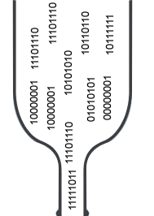
Data: A Modern-day Bottleneck?
← Rate at which data are produced
← Rate at which data can be understood

Slide 29
BIG DATA

Slide 30
“Big Data”
A buzz-word: no precise definition?
Data that are too big to process by “conventional means”
A call for Computer Scientists to produce new techniques to crunch even more data
Storage, processing, querying, analytics, data mining, applications, visualisations …

Slide 31
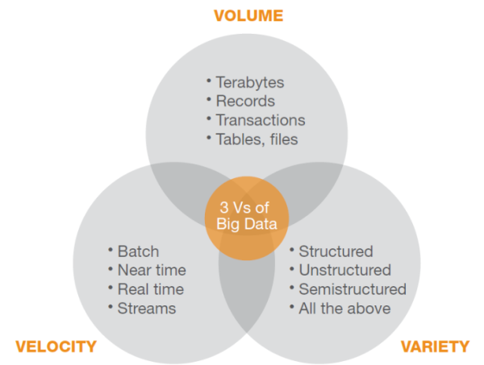
How many V’s in “Big Data”?
Three ‘V’s:
Volume (large amounts of data)
Velocity (rapidly changing data)
Variety (different data sources and formats)
Maybe more (Value, Veracity)

Slide 32
“BIG DATA” IN ACTION …

Slide 33
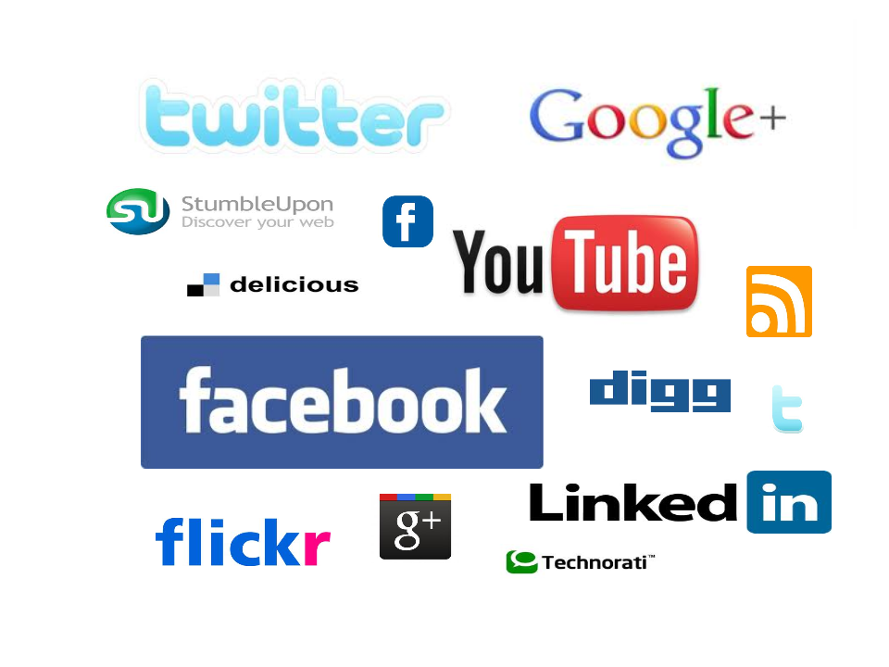
Social Media

Slide 34
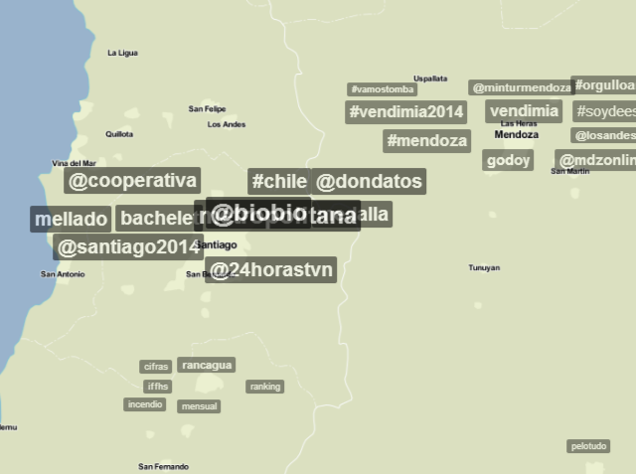
What’s happening here? (Trendsmap)
“What are the hot topics of discussion in an area”
Analyse tags of geographical tweets

Slide 35
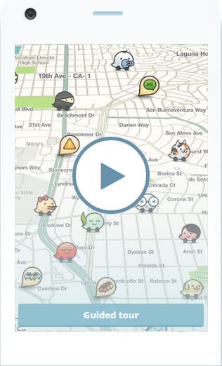
What’s the fastest route? (Waze)
“What’s the fastest route to get home right now?”
Processes real journeys to build background knowledge
“Participatory Sensing”

Slide 36
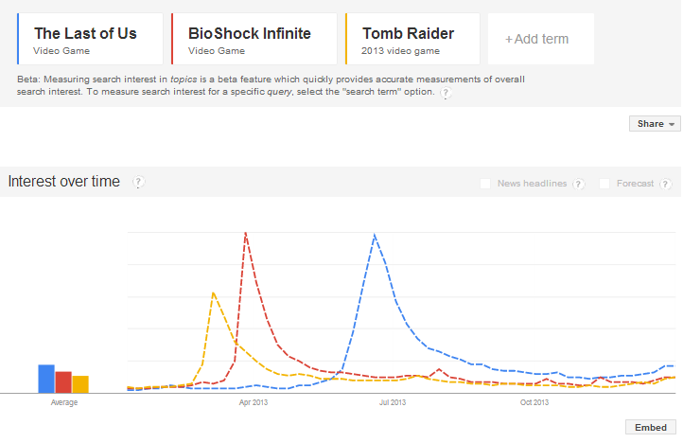
Christmas Predictions for Stores
“What will be the hot items to stock up on this Christmas? We don’t want to sell out!”
Analyse product hype on Twitter, Search Engines and Social Networks
Analyse transaction histories

Slide 37
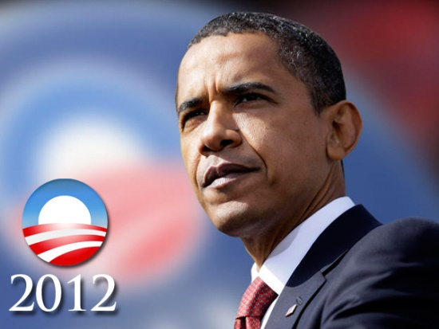
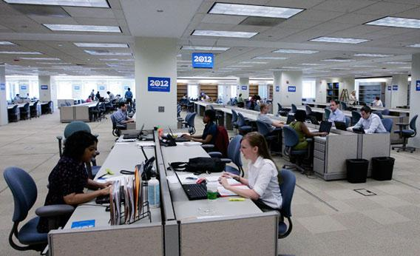
Get Elected President (Narwhal)
“Who are the undecided voters and how can I convince them to vote for me?”
User profiles built and integrated from online sources
Targeted emails sent to voters based on profile

Slide 38
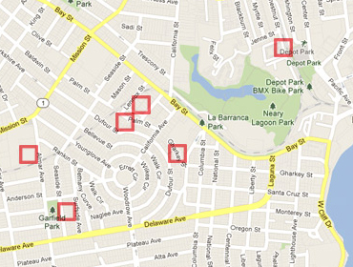
Predicting Pre-crime (PredPol)
“What areas of the city are most need of police patrol at 13:55 on Mondays?”
PredPol system used by Santa Cruz (US) police to target patrols
Predictions based on analysis of 8 years of historical crime data
Minority Report!

Slide 39
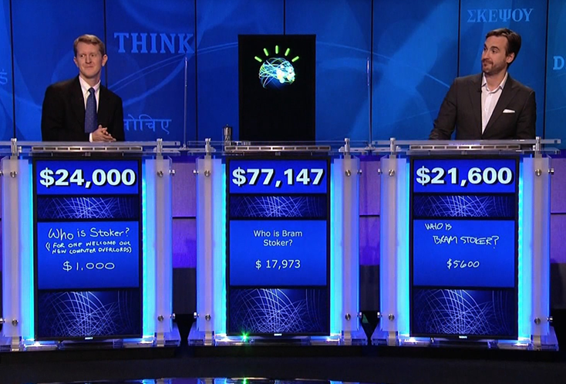
IBM Watson: Jeopardy Winner
“William Wilkinson's "An Account of the Principalities of Wallachia and Moldavia" inspired this author's most famous novel.”
Indexed 200 million pages of structured and unstructured content
An ensemble of 100 techniques simulating AI-like behaviour
Check it out on YouTube!

Slide 40
“BIG DATA” needs “MASSIVE DATA PROCESSING” …

Slide 41
Every Application is Different …
Data can be
Structured data (JSON, XML, CSV, Relational Databases, HTML form data)
Unstructured data (text document, comments, tweets)
And everything in-between!
Often a mix!

Slide 42
Every Application is Different …
Processing can involve:
Natural Language Processing (sentiment analysis, topic extraction, entity recognition, etc.)
Machine Learning and Statistics (pattern recognition, classification, event detection, regression analysis, etc.)
Even inference! (Datalog, constraint checking, etc.)
And everything in-between!
Often a mix!

Slide 43
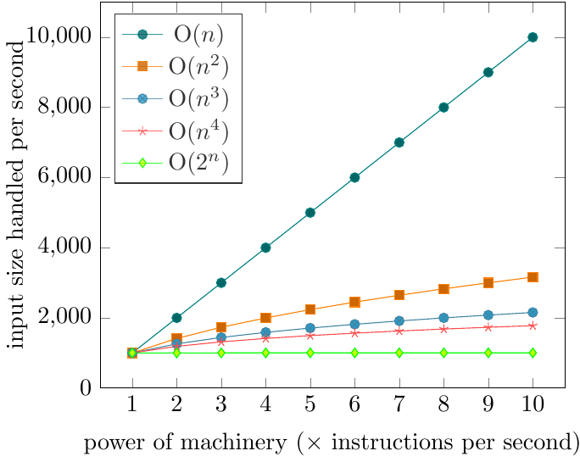
Scale is a Common Factor …
Cannot run expensive algorithms
I have an algorithm.
I have a machine that can process 1,000 input items in an hour.
If I buy a machine that is n times as powerful, how many input items can I process in an hour?
Depends on algorithm complexity of course!
Quadratic O(n²)
often too much
Note: Not the
same machine!

Slide 44
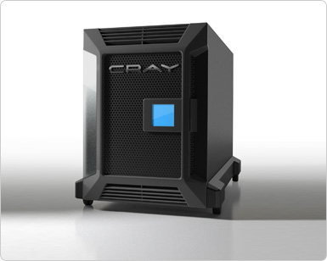
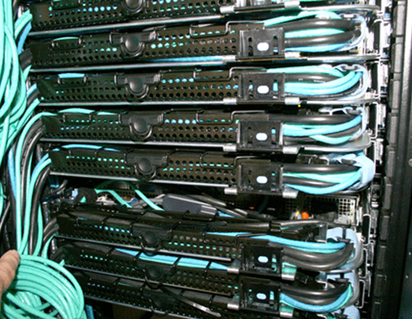
Scale is a Common Factor …
One machine that’s n times as powerful?
n machines that are equally as powerful?
vs.

Slide 45
Scale is a Common Factor …
Data-intensive (our focus!)
Inexpensive algorithms / Large inputs
e.g., Google, Facebook, Twitter
Compute-intensive (not our focus!)
More expensive algorithms / Smaller inputs
e.g., climate simulations, chess games, combinatorials
No black and white!

Slide 46
“MASSIVE DATA PROCESSING” NEEDS “DISTRIBUTED COMPUTING” …

Slide 47
Distributed Computing
Need more than one machine!
Google ca. 1998:

Slide 48
Distributed Computing
Need more than one machine!
Google ca. 2014:

Slide 49
Data Transport Costs
Need to divide tasks over many machines
Machines need to communicate
… but not too much!
Data transport costs (simplified):
Need to minimise network costs!
Main
Memory
Solid-state
Disk
Hard-disk
Network

Slide 50
Data Placement
Need to think carefully about where to put what data!
I have four machines to run my website. I have 10 million users.
Each user has personal profile data, photos, friends and games.
How should I split the data up over the machines?
Depends on application of course!
(But good design principles apply universally!)

Slide 51
Network/Node Failures
Need to think about failures!
Lot of machines: likely one will break!

Slide 52
Network/Node Failures
Need to think (even more!) carefully about where to put what data!
I have four machines to run my website. I have 10 million users.
Each user has a personal profile, photos, friends and apps.
How should I split the data up over the machines?
Depends on application of course!
(But good design principles apply universally!)

Slide 53
Human Distributed Computation
Similar Principles!

Slide 54
“DISTRIBUTED COMPUTING” LIMITS & CHALLENGES …

Slide 55
Distribution Not Always Applicable!

Slide 56
Distributed Development Difficult
Distributed systems can be complex
Tasks take a long time!
Bugs may not become apparent for hours
Lots of data = lots of counter-examples
Need to balance load!
Multiple machines to take care of
Data in different locations
Logs and messages in different places
Need to handle failures!

Slide 57
Frameworks/Abstractions can Help
For Distrib. Processing
For Distrib. Storage

Slide 58
HOW DOES TWITTER WORK?

Slide 59
Based on 2013 slides by Twitter lead architect: Raffi Krikorian
“Twitter Timelines at Scale”

Slide 60
Big Data at Twitter
150 million active worldwide users
400 million tweets per day
mean: 4,600 tweets per second
max: 143,199 tweets per second
300 thousand queries/sec for user timelines
6 thousand queries/sec for custom search
What should be the priority for optimisation?

Slide 61
Supporting timelines:write
300 thousand queries per second

Slide 62
High-fanout

Slide 63
Supporting timelines: read
300 thousand queries per second
1ms @p50
4ms @p99

Slide 64
Supporting text search
Information retrieval
Earlybird: Lucene clone
Write once
Query many

Slide 65
Timeline vs. Search
4,600 requests/sec
300,000 requests/sec
4,600 requests/sec
6,000 requests/sec

Slide 66
Twitter: Full Architecture

Slide 67
Big Data at Twitter
150 million active worldwide users
400 million tweets per day
4,600 tweets per second
max: 143,199 tweets per second
300 thousand queries/sec for user timelines
6 thousand queries/sec for custom search

Slide 68
“Procesamiento Masivo de Datos” About the course …

Slide 69
What the Course Is/Is Not
Data-intensive not Compute-intensive
Distributed tasks not networking
Commodity hardware not big supercomputers
General methods not specific algorithms
Practical methods with a little theory

Slide 70
What the Course Is!
Principles of Distributed Computing [2 weeks]
Distributed Processing Frameworks [3 weeks]
Information Retrieval [3 weeks]
Principles of Distributed Databases [3 weeks]
Projects [2 weeks]

Slide 71
Course Structure
~1.5 hours of lectures per week [Monday]
1.5 hours of labs per week [Wednesday]
To be turned in by Friday evening
Mostly Java
In Lab on 3rd floor, edificio norte
http://aidanhogan.com/teaching/cc5212-1-2016/

Slide 72
Course Marking
45% for Weekly Labs (~3% a lab!)
20% for Small Class Project
35% for Final Exam [more challenging]

Slide 73
Outcomes!

Slide 74
Outcomes!

Slide 75
Outcomes!

Slide 76
Outcomes!

Slide 77
Outcomes!

Slide 78
Outcomes!

Slide 79
Questions?

