Slide 1
CC5212-1 Procesamiento Masivo de Datos Otoño 2015 Lecture 9: NoSQL I
Aidan Hogan
aidhog@gmail.com

Slide 2
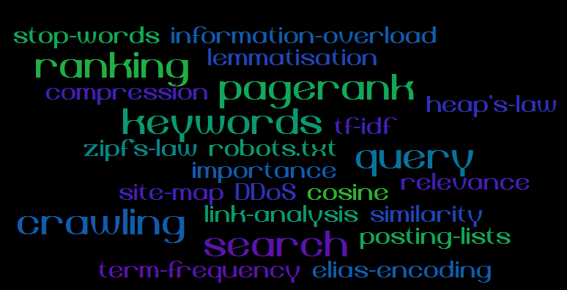
Information Retrieval: Storing Unstructured Information

Slide 3
BIG DATA: STORING STRUCTURED INFORMATION

Slide 4
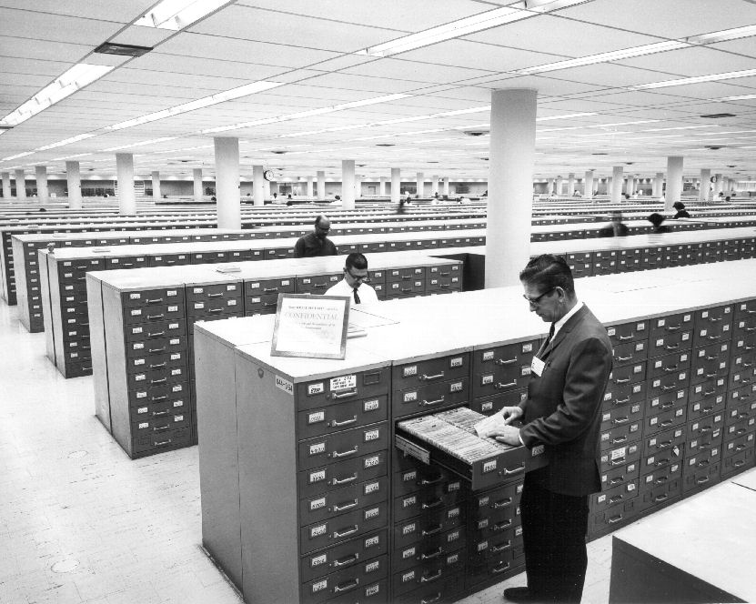
Relational Databases

Slide 5
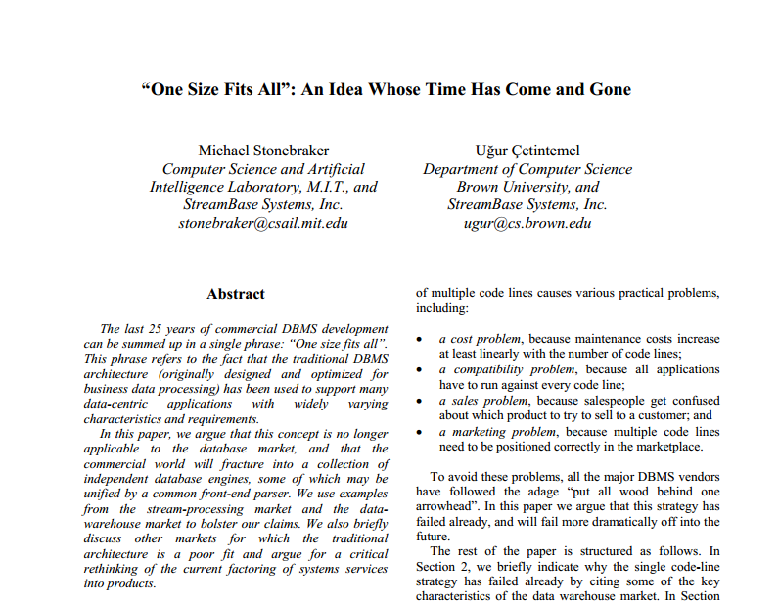
Relational Databases: One Size Fits All?

Slide 7
RDBMS: Performance Overheads
Structured Query Language (SQL):
Declarative Language
Lots of Rich Features
Difficult to Optimise!
Atomicity, Consistency, Isolation, Durability (ACID):
Makes sure your database stays correct
Even if there’s a lot of traffic!
Transactions incur a lot of overhead
Multi-phase locks, multi-versioning, write ahead logging
Distribution not straightforward

Slide 8
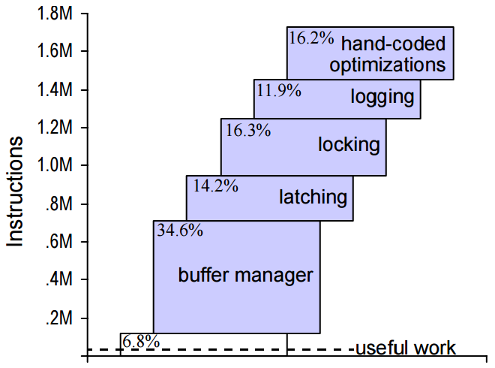
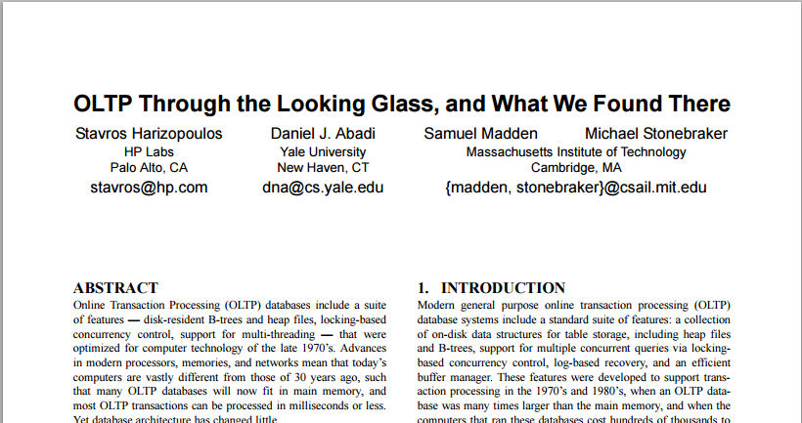
Transactional overhead: the cost of ACID
640 tps for system with transactional support
12,700 tps for system without logs, transactions or lock scheduling

Slide 9
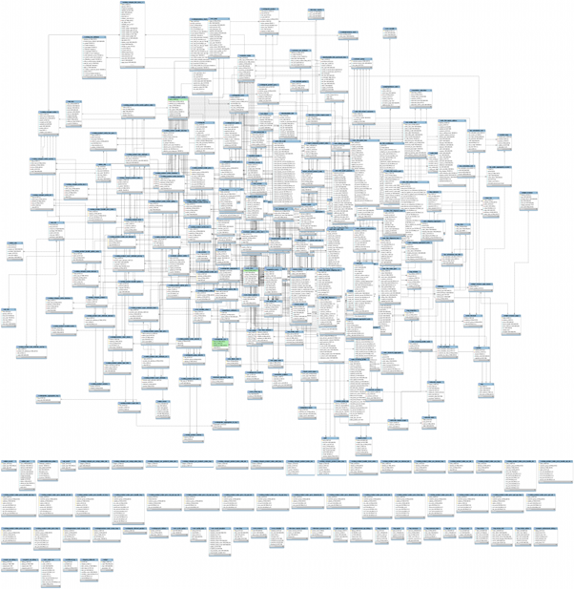
RDBMS: Complexity

Slide 10
ALTERNATIVES TO RELATIONAL DATABASES FOR querying big structured data?

Slide 11
NoSQL
What do you guys know about NoSQL?

Slide 12
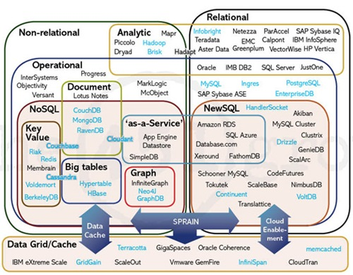
The Database Landscape
Batch analysis of data
Not using the relational model
Using the relational model
Real-time
Stores documents (semi-structured values)
Relational Databases
with focus on scalability to compete with NoSQL
while maintaining ACID
Not only SQL
Maps ☺
Column Oriented
Graph-structured data
Cloud storage
In-Memory

Slide 13
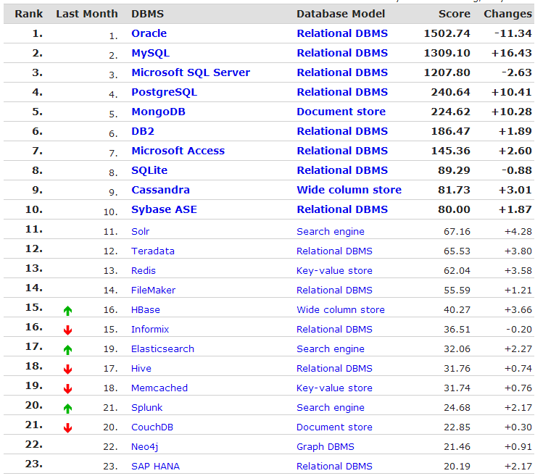
http://db-engines.com/en/ranking

Slide 14
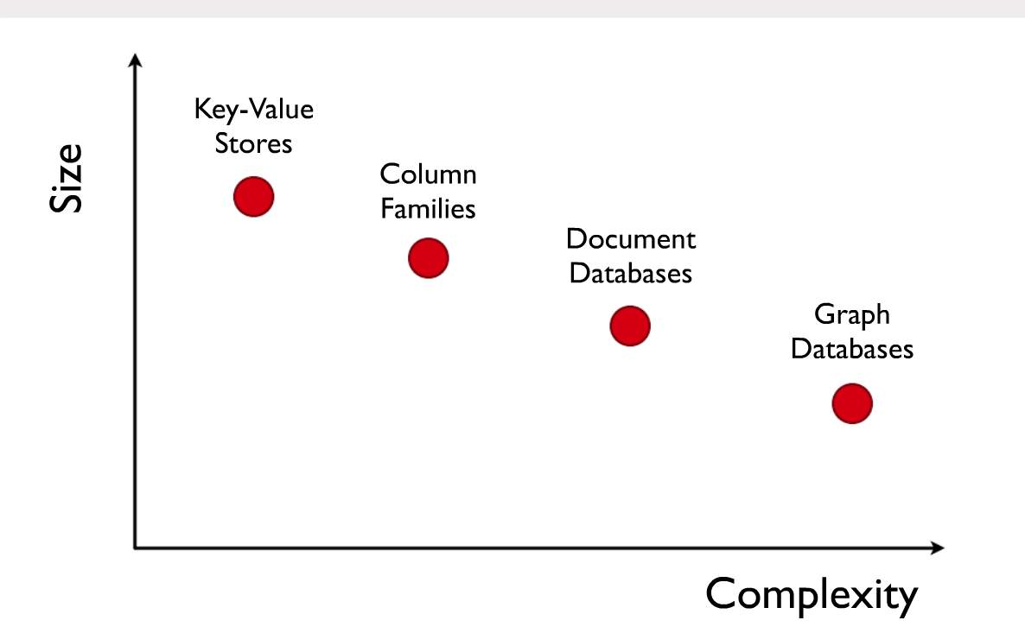
NoSQL

Slide 15
NoSQL: CAP (not ACID)
CA: Guarantees to give a correct response but only while network works fine
(Centralised / Traditional)
CP: Guarantees responses are correct even if there are network failures, but response may fail (Weak availability)
C
A
P
(No intersection)
AP: Always provides a “best-effort” response even in presence of network failures (Eventual consistency)

Slide 16
NoSQL
Distributed!
Sharding: splitting data over servers “horizontally”
Replication
Lower-level than RDBMS/SQL
Simpler ad hoc APIs
But you build the application (programming not querying)
Operations simple and cheap
Different flavours (for different scenarios)
Different CAP emphasis
Different scalability profiles
Different query functionality
Different data models

Slide 17
NoSQL: KEY–VALUE STORE

Slide 18
The Database Landscape
Batch analysis of data
Not using the relational model
Using the relational model
Real-time
Stores documents (semi-structured values)
Relational Databases
with focus on scalability to compete with NoSQL
while maintaining ACID
Not only SQL
Maps ☺
Column Oriented
Graph-structured data
Cloud storage
In-Memory

Slide 19
Key–Value Store Model
It’s just a Map / Associate Array ☺
put(key,value)
get(key)
delete(key)
Key | Value
Afghanistan | Kabul
Albania | Tirana
Algeria | Algiers
Andorra la Vella | Andorra la Vella
Angola | Luanda
Antigua and Barbuda | St. John’s
… | ….

Slide 20
But You Can Do a Lot With a Map
Key | Value
country:Afghanistan | capital@city:Kabul,continent:Asia,pop:31108077#2011
country:Albania | capital@city:Tirana,continent:Europe,pop:3011405#2013
… | …
city:Kabul | country:Afghanistan,pop:3476000#2013
city:Tirana | country:Albania,pop:3011405#2013
… | …
user:10239 | basedIn@city:Tirana,post:{103,10430,201}
… | …
… actually you can model any data in a map (but possibly with a lot of redundancy and inefficient lookups if unsorted).

Slide 21
THE CASE OF AMAZON

Slide 22
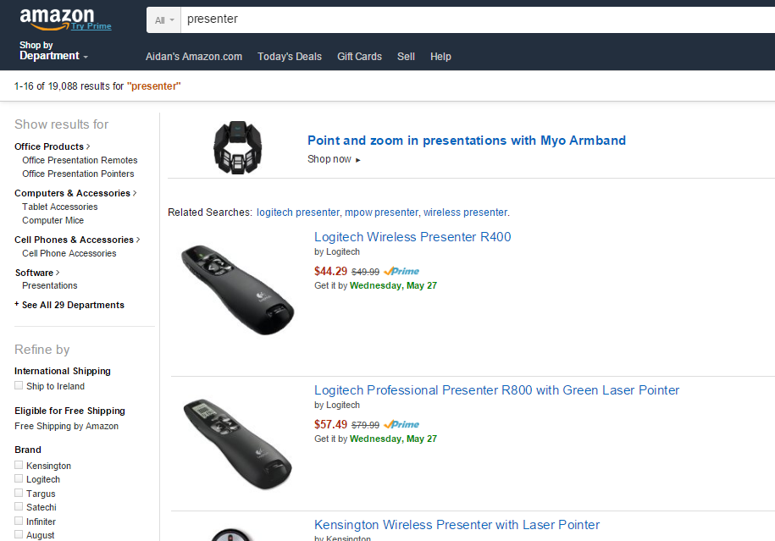
The Amazon Scenario
Products Listings: prices, details, stock

Slide 23
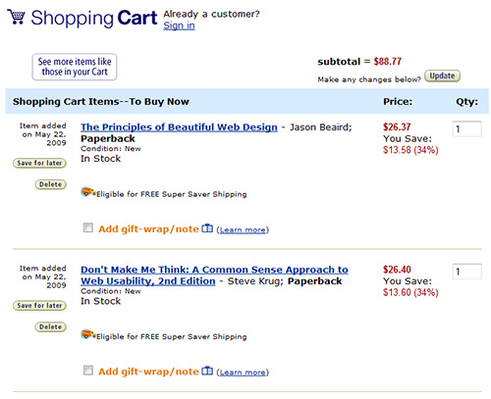
The Amazon Scenario
Customer info: shopping cart, account, etc.

Slide 24
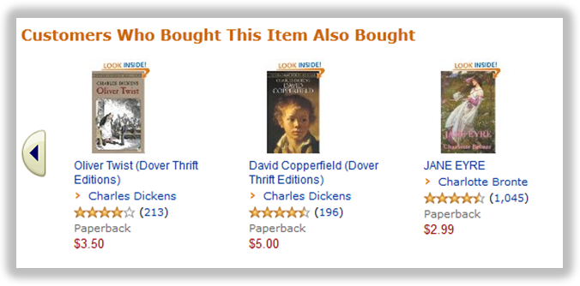
The Amazon Scenario
Recommendations, etc.:

Slide 25
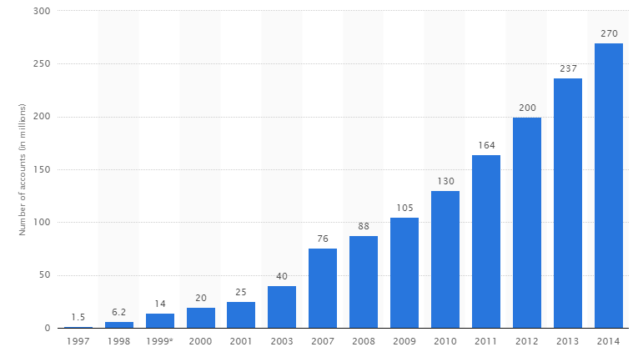
The Amazon Scenario
Amazon customers:

Slide 26
The Amazon Scenario

Slide 27
The Amazon Scenario
Databases struggling …
But many Amazon services don’t need:
SQL (a simple map often enough)
or even:
transactions, strong consistency, etc.

Slide 28
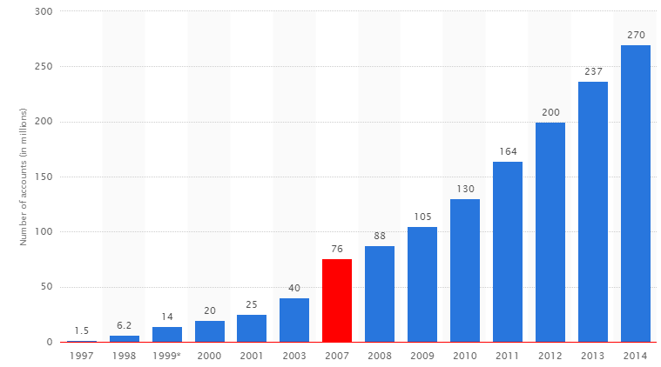
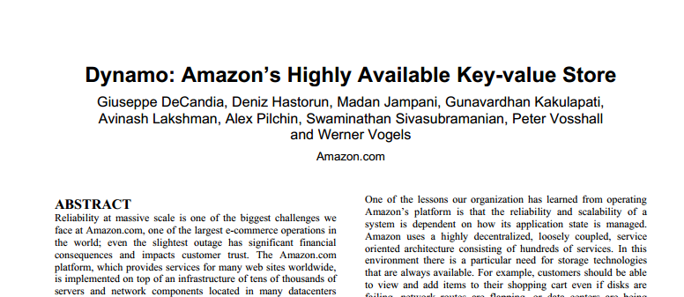
Key–Value Store: Amazon Dynamo(DB)
Goals:
Scalability (able to grow)
High availability (reliable)
Performance (fast)
Don’t need full SQL, don’t need full ACID

Slide 29
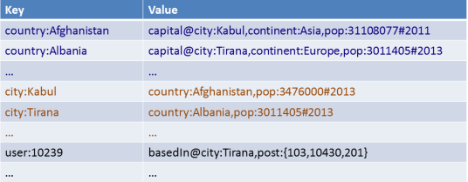
Key–Value Store: Distribution
How might a key–value store be distributed over multiple machines?
Or a custom partitioner …

Slide 30
Key–Value Store: Distribution
What happens if a machine joins or leaves half way through?
Or a custom partitioner …

Slide 31
Key–Value Store: Distribution
How can we solve this?
Or a custom partitioner …

Slide 32
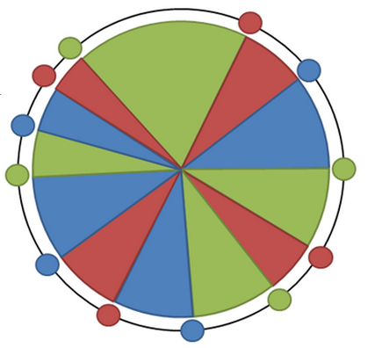
Consistent Hashing
Avoid re-hashing everything
Hash using a ring
Each machine picks n psuedo-random points on the ring
Machine responsible for arc after its point
If a machine leaves, its range moves to previous machine
If machine joins, it picks new points
Objects mapped to ring ☺
How many keys (on average) need to be moved if a machine joins or leaves?

Slide 33
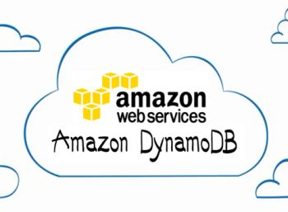
Amazon Dynamo: Hashing
Consistent Hashing (128-bit MD5)

Slide 34
Key–Value Store: Replication
A set replication factor (here 3)
Commonly primary / secondary replicas
Primary replica elected from secondary replicas in the case of failure of primary
A1
B1
C1
D1
E1
k
v
k
v
k
v
k
v
k
v
k
v

Slide 35
Amazon Dynamo: Replication
Replication factor of n
Easy: pick n next buckets (different machines!)

Slide 36
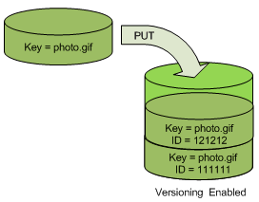
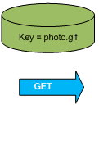
Amazon Dynamo: Object Versioning
Object Versioning (per bucket)
PUT doesn’t overwrite: pushes version
GET returns most recent version

Slide 37
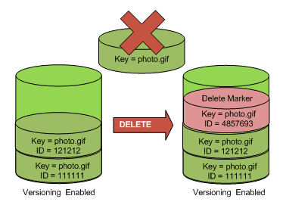
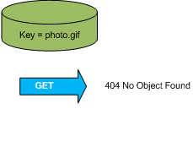
Amazon Dynamo: Object Versioning
Object Versioning (per bucket)
DELETE doesn’t wipe
GET will return not found

Slide 38
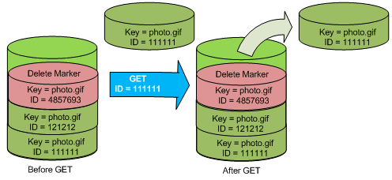
Amazon Dynamo: Object Versioning
Object Versioning (per bucket)
GET by version

Slide 39
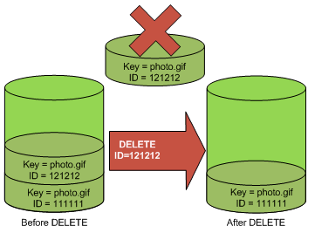
Amazon Dynamo: Object Versioning
Object Versioning (per bucket)
PERMANENT DELETE by version … wiped

Slide 40
Amazon Dynamo: Model
Named table with primary key and a value
Primary key is hashed / unordered
Countries
Primary Key | Value
Afghanistan | capital:Kabul,continent:Asia,pop:31108077#2011
Albania | capital:Tirana,continent:Europe,pop:3011405#2013
… | …
Cities
Primary Key | Value
Kabul | country:Afghanistan,pop:3476000#2013
Tirana | country:Albania,pop:3011405#2013
… | …

Slide 41
Amazon Dynamo: Model
Dual primary key also available:
Hash: unordered
Range: ordered
Countries
Hash Key | Range Key | Value
Vatican City | 839 | capital:Vatican City,continent:Europe
Nauru | 9945 | capital:Yaren,continent:Oceania
… |  | …

Slide 42
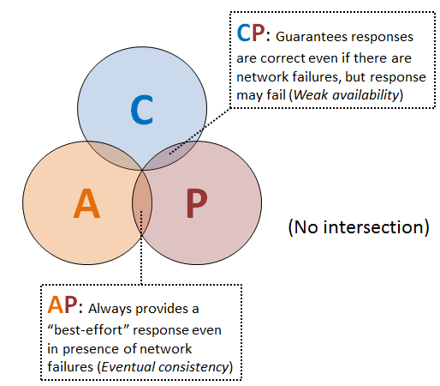
Amazon Dynamo: CAP
Two options for each table:
AP: Eventual consistency, High availability
CP: Strong consistency, Lower availability
What’s a CP system again?
What’s an AP system again?

Slide 43
Amazon Dynamo: Consistency
Gossiping
Keep alive messages sent between nodes with state
Quorums:
N nodes responsible for a read write
Multiple nodes acknowledge read/write for success
At the cost of availability!
Hinted Handoff
For transient failures
A node “covers” for another node while its down

Slide 44
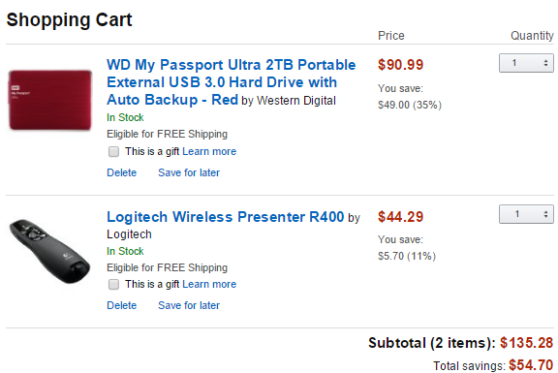
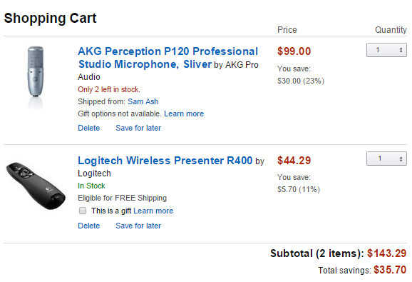
Amazon Dynamo: Consistency
Two versions of one shopping cart:
How best to handle multiple conflicting versions of a value (knowing as reconciliation)?
Application knows best (… and must support multiple versions being returned)

Slide 45
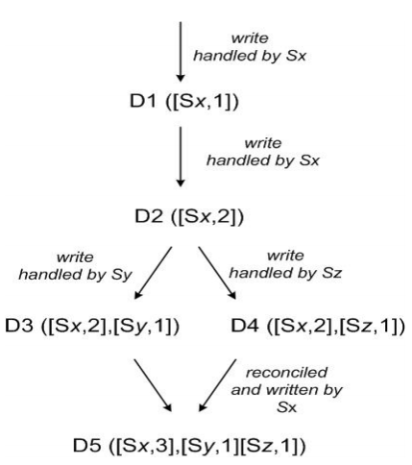
Amazon Dynamo: Vector Clocks
Vector Clock: A list of pairs indicating a node (i.e., a server) and a time stamp
Used to track/order versions

Slide 46
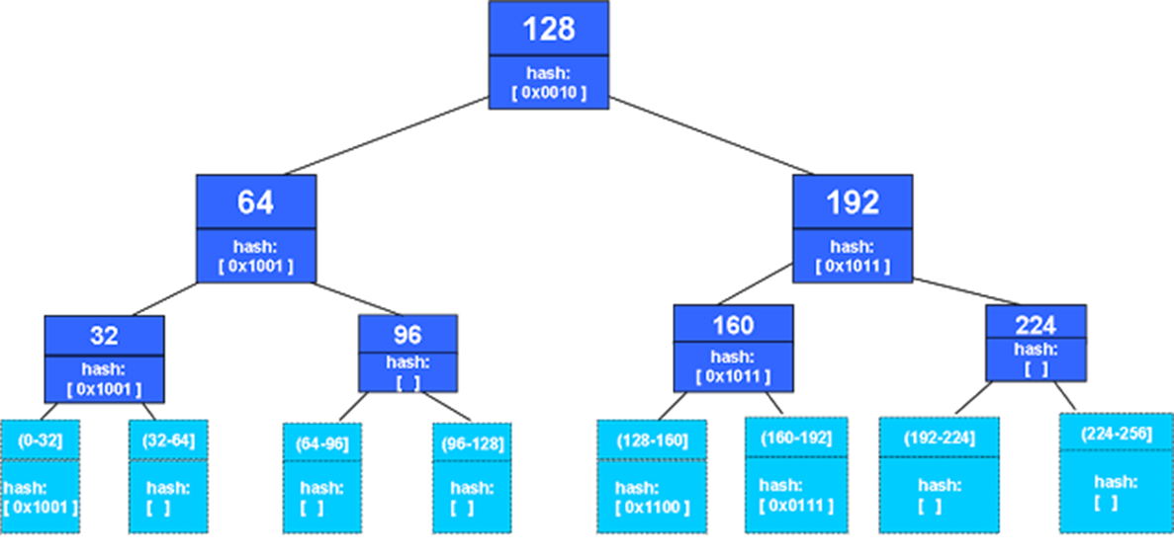
Amazon Dynamo: Eventual Consistency using Merkle Trees
Merkle tree is a hash tree
Nodes have hashes of their children
Leaf node hashes from data: keys or ranges

Slide 47
Amazon Dynamo: Eventual Consistency using Merkle Trees
Easy to verify regions of the Map
Can compare level-at-a-time

Slide 48
Amazon Dynamo: Budgeting
Assign throughput per table: allocate resources
Reads (4 KB resolution):
Writes (1 KB resolution)

Slide 49
Read More …

Slide 50
OTHER KEY–VALUE STORES

Slide 51
Other Key–Value Stores

Slide 52
Other Key–Value Stores

Slide 53
Other Key–Value Stores

Slide 54
NoSQL: DOCUMENT STORE

Slide 55
The Database Landscape
Batch analysis of data
Not using the relational model
Using the relational model
Real-time
Stores documents (semi-structured values)
Relational Databases
with focus on scalability to compete with NoSQL
while maintaining ACID
Not only SQL
Maps ☺
Column Oriented
Graph-structured data
Cloud storage
In-Memory

Slide 56
Key–Value Stores: Values are Documents
Key | Value
country:Afghanistan | <country> <capital>city:Kabul</capital> <continent>Asia</continent> <population> <value>31108077</value> <year>2011</year> </population> </country>
… | …
Document-type depends on store
XML, JSON, Blobs, Natural language
Operators for documents
e.g., filtering, inv. indexing, XML/JSON querying, etc.

Slide 57
MongoDB: JSON Based
Key | Value (Document)
6ads786a5a9 | { “_id” : ObjectId(“6ads786a5a9”) , “name” : “Afghanistan” , “capital”: “Kabul” , “continent” : “Asia” , “population” : { “value” : 31108077, “year” : 2011 } }
… | …
o
Can invoke Javascript over the JSON objects
Document fields can be indexed

Slide 58
Document Stores

Slide 59
RECAP

Slide 60
Recap
Relational Databases don’t solve everything
SQL and ACID add overhead
Distribution not so easy
NoSQL: what if you don’t need SQL or ACID?
Something simpler
Something more scalable
Trade efficiency against guarantees

Slide 61
Recap

Slide 62
Recap
Key–value stores inspired by Amazon Dynamo
Distributed maps
Hash keys and range keys
Table names
Consistent hashing
Replication
Object versioning / vector clocks
Gossiping / Quorums / Hinted Hand-offs
Merkle trees
Budgeting
Document stores: documents as values
Support for JSON, XML values, field indexing, etc.

Slide 63
Questions
?

