Slide 1
Cassandra

Slide 2
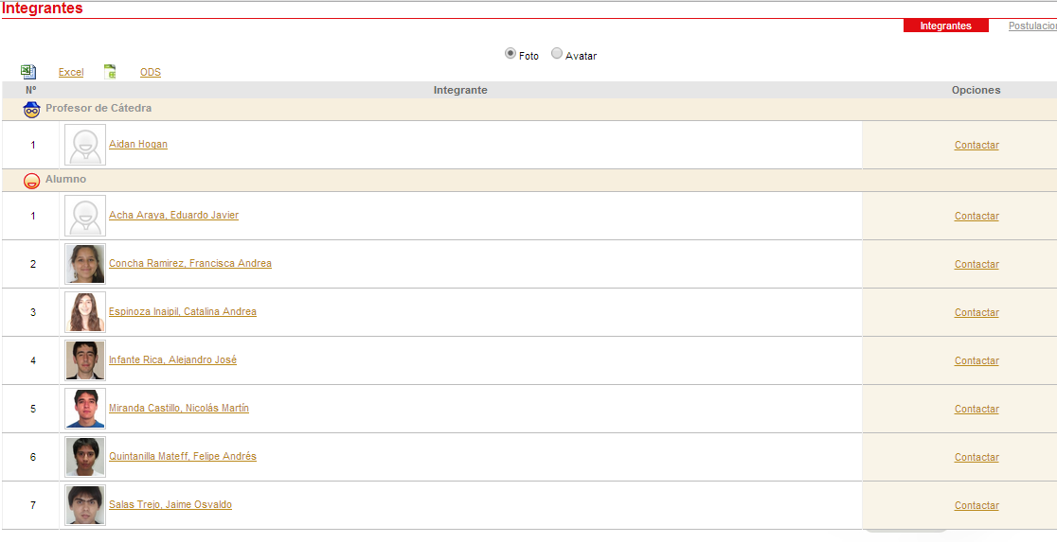
Estudiantes

Slide 3
Documentation
http://cassandra.apache.org/doc/cql3/CQL.html

Slide 4
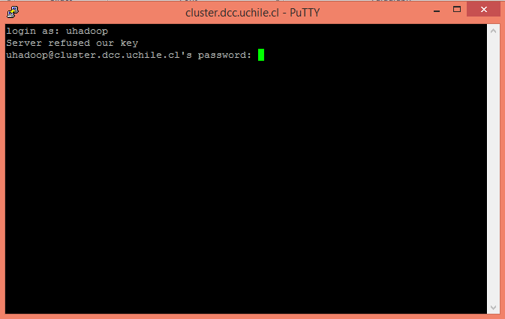
Step 1: Open Session
cluster.dcc.uchile.cl
username: uhadoop
password: [on the board]

Slide 5
Step 2: Follow Me
Important: Copy every command you make to a text file
Important: Don’t try to copy everything I do!

Slide 6
Step 3: Load your own table
COPY interests2 (name , age, color, top5bands, movieratings) FROM 'interests.csv';
Create your own table that you will copy data into (pay attention to queries you’ll need)
CREATE TABLE interests[firstname] …
COPY interests[firstname] …
Query for info of person “beside” you
Query for their favourite colour
Query for all people with the same age as you
(May need to build an index … no joins!)
Delete people who like ‘black’

Slide 7
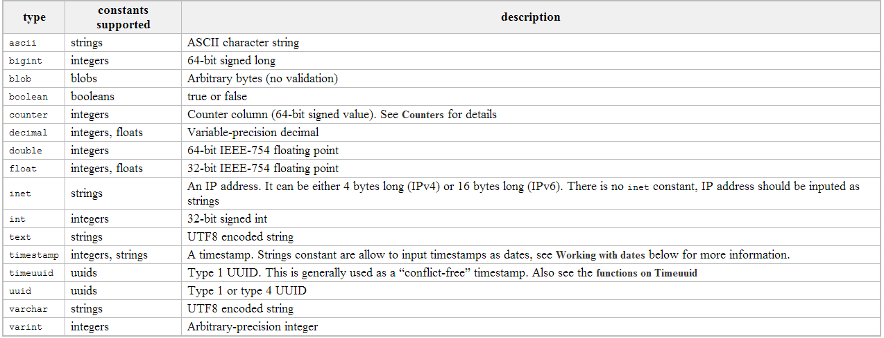
Types

Slide 8
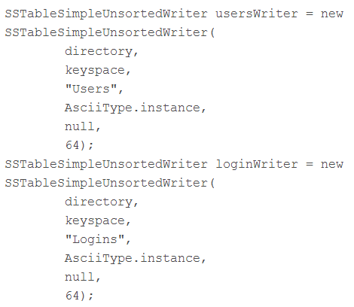
Bulk Load
Can use ‘LOAD’ in CQL or …
Can write SSTables manually and load them
Load with sstableloader
Create with Java code (or copy from existing index) …

Slide 9
Questions
?

Slide 10
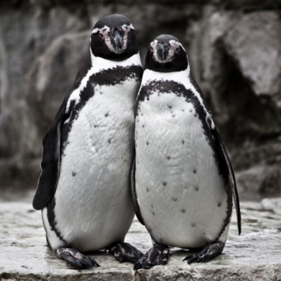
Class Project
Done in pairs (Except Alejandro/Mauricio :P)
Goal: Use what you’ve learned to do something cool (basically)
Expected difficulty: More than a lab’s worth
But from scratch / without my help!
Marked on: Difficulty, appropriateness, scale, good use of techniques, presentation, coolness
Ambition is appreciated, even if you don’t succeed: feel free to bite off more than you can chew!
Process:
Pair up (default random) by Wednesday
Decide on a topic (by June 9th) or let me assign one ☺
If you need data or get stuck, I will (try to) help out
Deliverables: 10 minute presentation (June 23rd) & 4-page report
2 weeks!

