Slide 1
CC5212-1 Procesamiento Masivo de Datos Otoño 2014
Aidan Hogan
aidhog@gmail.com
Lecture IX: 2014/05/05

Slide 2
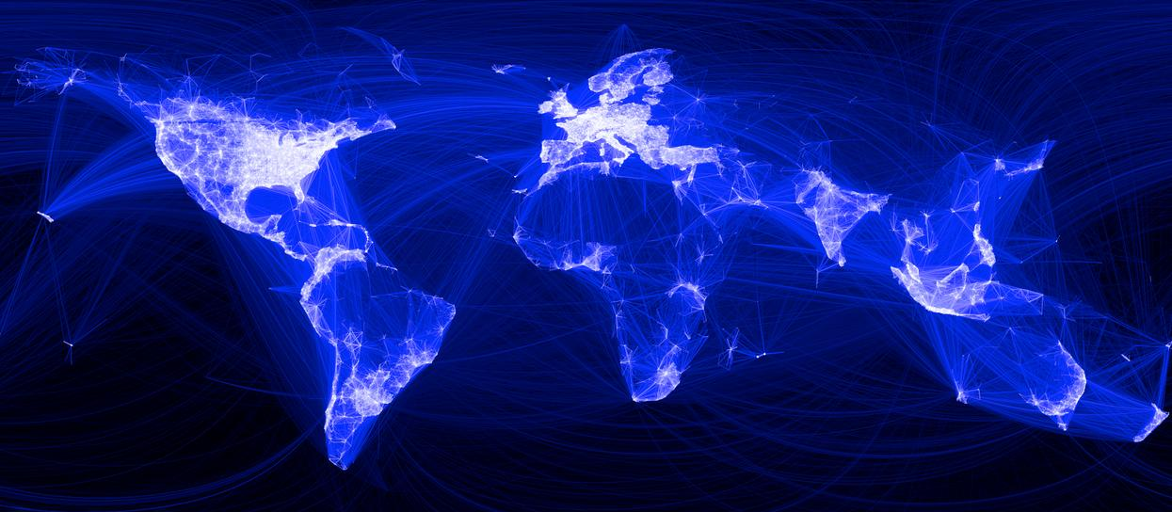
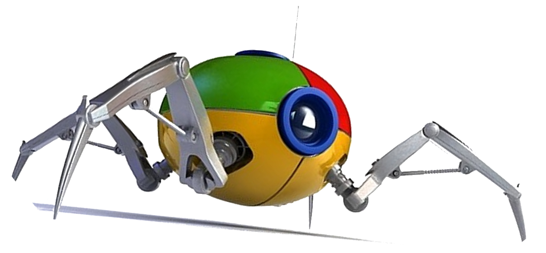
How does Google crawl the Web?

Slide 3
Inverted Indexing
1
1 10 18 21 23 28 37 43 47 55 59 68 71 76
Fruitvale Station is a 2013 American drama film written and directed by Ryan Coogler.
Term List | Posting Lists
a | (1,[21,96,103,…]), (2,[…]), …
american | (1,[28,123]), (5,[…]), …
and | (1,[57,139,…]), (2,[…]), …
by | (1,[70,157,…]), (2,[…]), …
directed | (1,[61,212,…]), (4,[…]), …
drama | (1,[38,87,…]), (16,[…]), …
… | …
Inverted index:

Slide 4
INFORMATIOn RETRIEVAL: RANKING

Slide 5
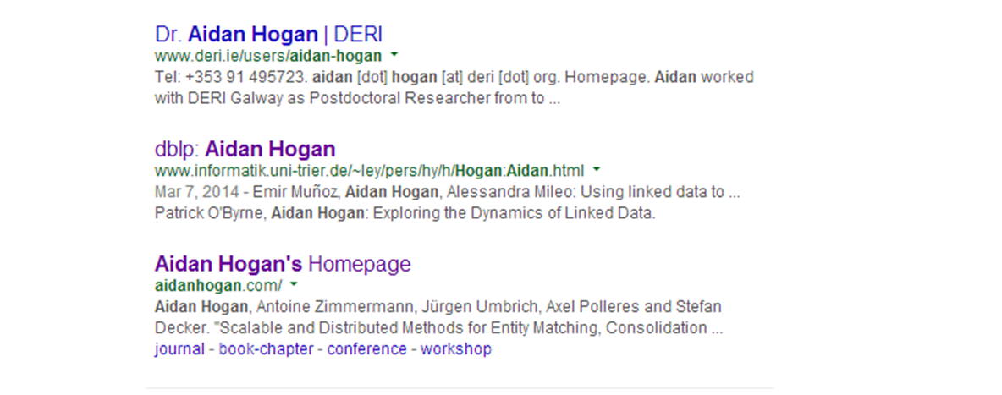
How Does Google Get Such Good Results?

Slide 6
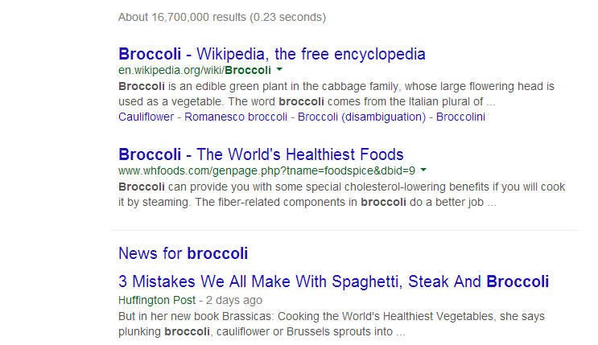
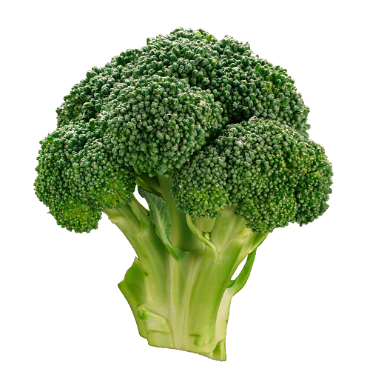
Two Sides to Ranking: Relevance
≠

Slide 7
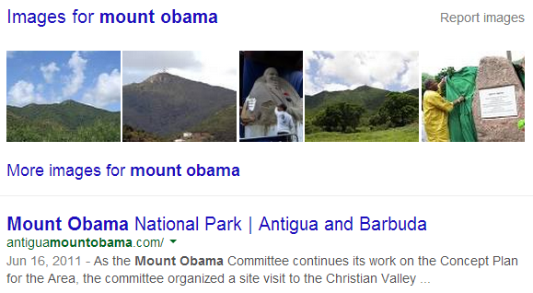
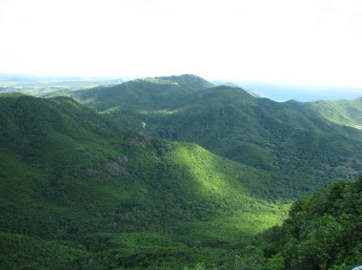
Two Sides to Ranking: Importance
>

Slide 8
RANKING: RELEVANCE

Slide 9
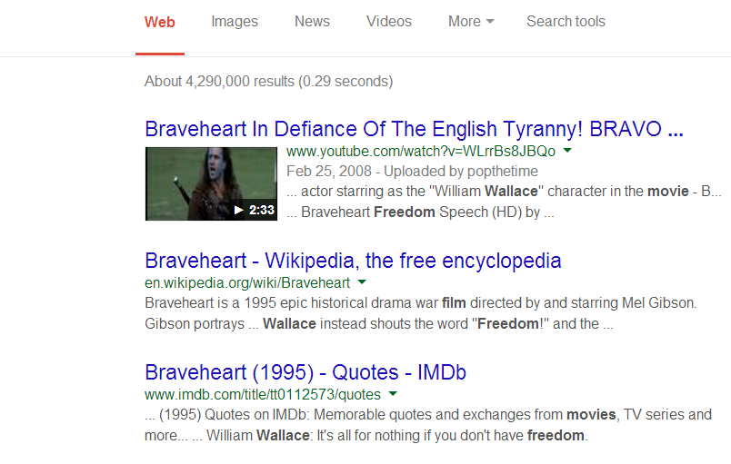
Example Query

Slide 10
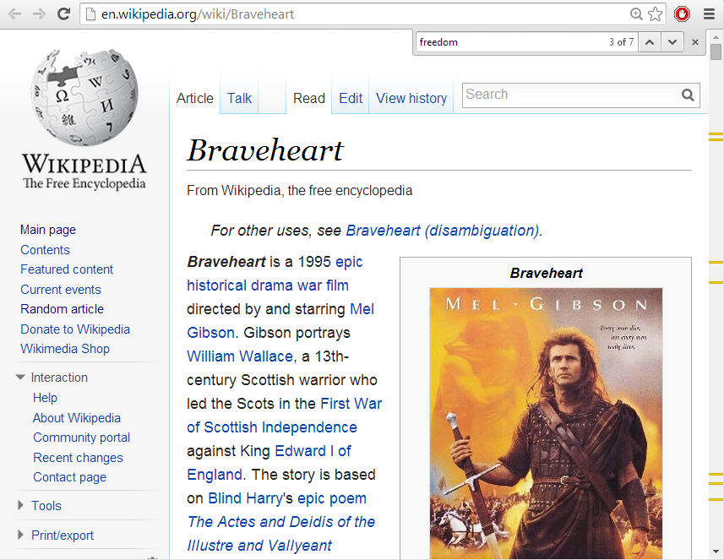
Matches in a Document
freedom
7 occurrences

Slide 11
Matches in a Document
freedom
7 occurrences
movie
16 occurrences

Slide 12
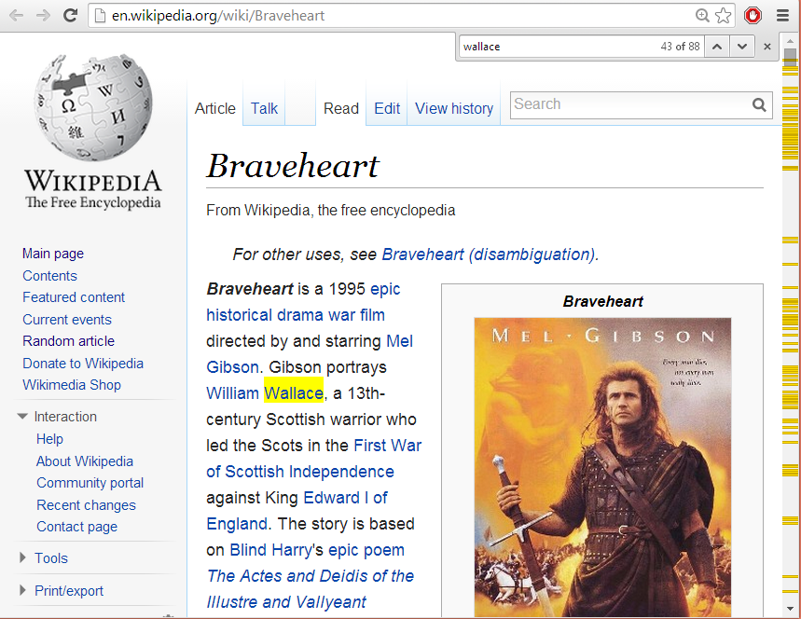
Matches in a Document
freedom
7 occurrences
movie
16 occurrences
wallace
88 occurrences

Slide 13
Usefulness of Words
movie
occurs very frequently
freedom
occurs frequently
wallace
occurs occassionally

Slide 14
Estimating Relevance
Rare words more important than common words
wallace (49M) more important than freedom (198M) more important than movie (835M)
Words occurring more frequently in a document indicate higher relevance
wallace (88) more matches than movie (16) more matches than freedom (7)

Slide 15
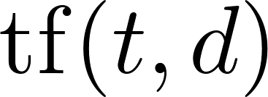
Relevance Measure: TF–IDF
TF: Term Frequency
Measures occurrences of a term in a document
… various options
Raw count of occurrences
Logarithmically scaled
Normalised by document length
A combination / something else ☺

Slide 16
Relevance Measure: TF–IDF
IDF: Inverse Document Frequency
Measures how rare/common a term is across all documents
…
Logarithmically scaled document occurrences

Slide 17
Relevance Measure: TF–IDF
TF–IDF: Combine Term Frequency and Inverse Document Frequency:
Score for a query
Let query
Score for a query:

Slide 18
Relevance Measure: TF–IDF
Term Frequency
Inverse Document Frequency

Slide 19
Relevance Measure: TF–IDF
Term Frequency
Inverse Document Frequency

Slide 20
Relevance Measure: TF–IDF
Term Frequency
Inverse Document Frequency

Slide 21
Relevance Measure: TF–IDF
Term Frequency
Inverse Document Frequency

Slide 22
Relevance Measure: TF–IDF
Term Frequency
Inverse Document Frequency

Slide 23
Relevance Measure: TF–IDF
Term Frequency
Inverse Document Frequency

Slide 24
Relevance Measure: TF–IDF
Term Frequency
Inverse Document Frequency

Slide 25
Vector Space Model (a mention)

Slide 26
Vector Space Model (a mention)

Slide 27
Vector Space Model (a mention)

Slide 28
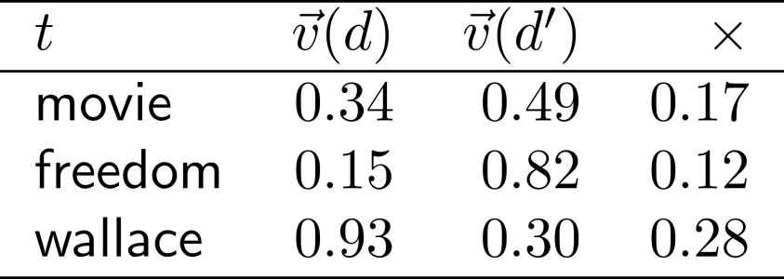
Vector Space Model (a mention)
Cosine Similarity
Note:

Slide 29
Two Sides to Ranking: Relevance
≠

Slide 30
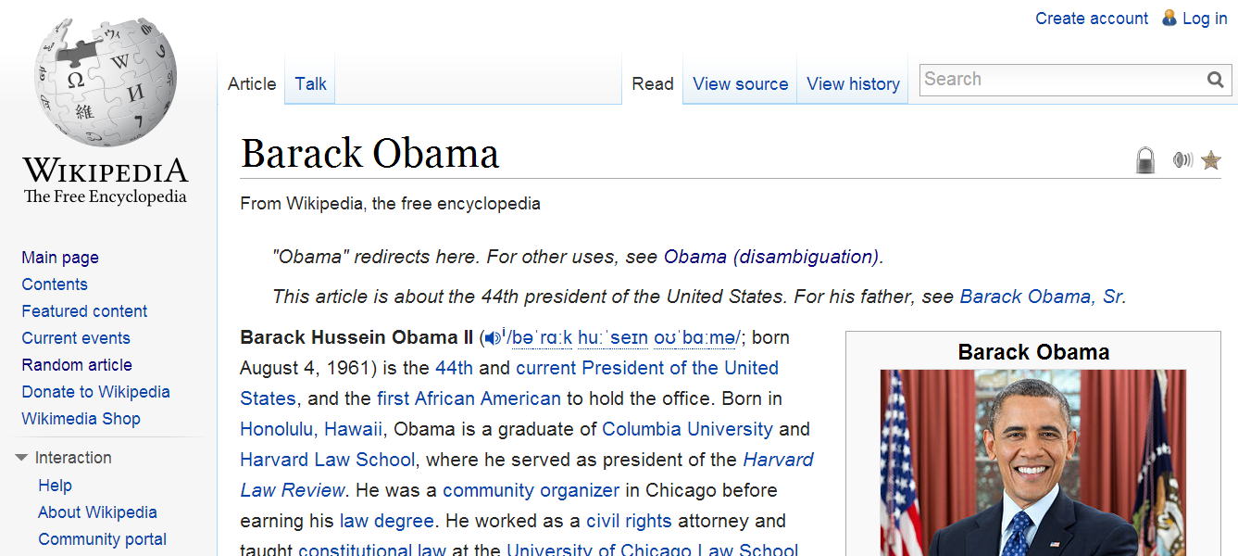
Field-Based Boosting
Not all text is equal: titles, headers, etc.

Slide 31
Anchor Text
See how the Web views/tags a page

Slide 32
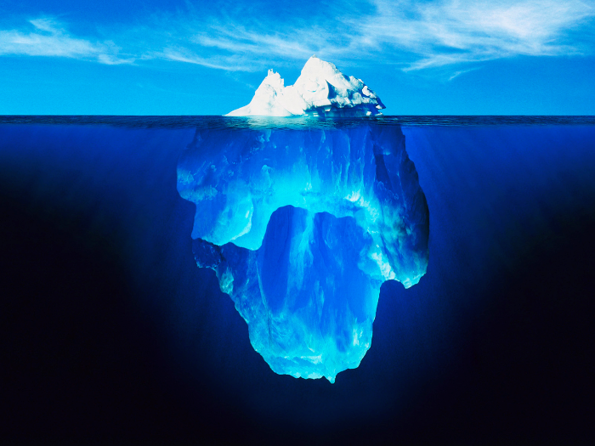
Information Retrieval & Relevance

Slide 33
Apache to the rescue again!
Lucene: An Inverted Index Engine
Open Source Java Project
Will play with it in the labs

Slide 34
RANKING: IMPORtANCE

Slide 35
Two Sides to Ranking: Importance
>

Slide 36
Link Analysis
Which will have more links:
Barack Obama’s Wikipedia Page or
Mount Obama’s Wikipedia Page?

Slide 37
Link Analysis
Consider links as votes of confidence in a page
A hyperlink is the open Web’s version of …
(… even if the page is linked in a negative way.)

Slide 38
Link Analysis
So if we just count the number of inlinks a web-page receives we know its importance, right?

Slide 39
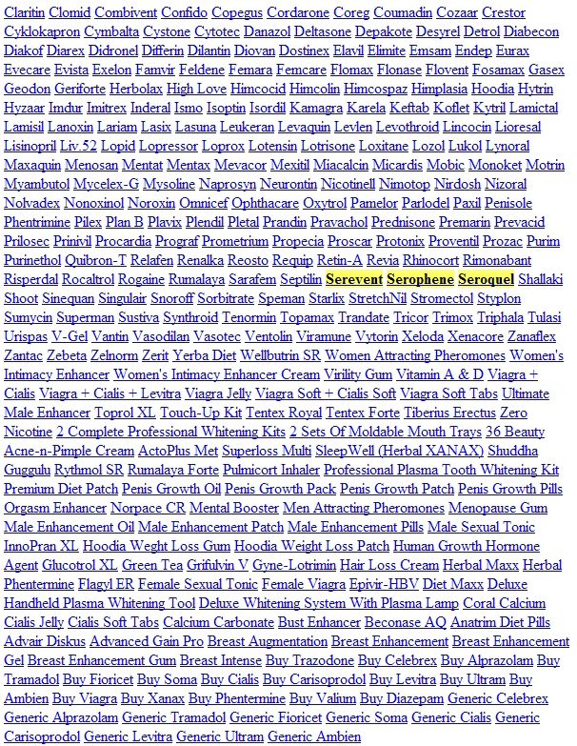
Link Spamming

Slide 40
Link Importance
Which is more important: a link from Barack Obama’s Wikipedia page or a link from buyv1agra.com?

Slide 41
PageRank

Slide 42
PageRank
Not just a count of inlinks
A link from a more important page is more important
A link from a page with fewer links is more important
∴ A page with lots of inlinks from important pages (which have few outlinks) is more important

Slide 43
PageRank is Recursive

Slide 44
PageRank Model
The Web: a directed graph
Vertices
(pages)
Edges
(links)
0.225
0.265
f
a
0.138
0.127
e
b
Which is the most “important” vertex?
d
c
0.172
0.074

Slide 45
PageRank Model
The Web: a directed graph
Vertices
(pages)
Edges
(links)
f
a
e
b
d
c

Slide 46
PageRank Model
Vertices
(pages)
Edges
(links)
f
e
b
d

Slide 47
PageRank Model
Vertices
(pages)
Edges
(links)
f
a
e
b
d
c

Slide 48
PageRank: Random Surfer Model
= someone surfing the web, clicking links randomly
What is the probability of being at page x after n hops?
f
a
e
b
d
c

Slide 49
PageRank: Random Surfer Model
= someone surfing the web, clicking links randomly
What is the probability of being at page x after n hops?
Initial state: surfer equally likely to start at any node
f
a
e
b
d
c

Slide 50
PageRank: Random Surfer Model
= someone surfing the web, clicking links randomly
What is the probability of being at page x after n hops?
Initial state: surfer equally likely to start at any node
PageRank applied iteratively for each hop: score indicates probability of being at that page after than many hops
f
a
e
b
d
c
What would happen with g
over time?
g

Slide 51
PageRank: Random Surfer Model
= someone surfing the web, clicking links randomly
What is the probability of being at page x after n hops?
Initial state: surfer equally likely to start at any node
PageRank applied iteratively for each hop: score indicates probability of being at that page after than many hops
If the surfer reaches a page without links, the surfer randomly jumps to another page
f
a
e
b
d
c
g

Slide 52
PageRank: Random Surfer Model
= someone surfing the web, clicking links randomly
What is the probability of being at page x after n hops?
Initial state: surfer equally likely to start at any node
PageRank applied iteratively for each hop: score indicates probability of being at that page after than many hops
If the surfer reaches a page without links, the surfer randomly jumps to another page
f
a
e
b
d
c
What would happen with g and i over time?
g
i

Slide 53
PageRank: Random Surfer Model
= someone surfing the web, clicking links randomly
What is the probability of being at page x after n hops?
Initial state: surfer equally likely to start at any node
PageRank applied iteratively for each hop: score indicates probability of being at that page after than many hops
If the surfer reaches a page without links, the surfer randomly jumps to another page
f
a
e
b
d
c
What would happen with g and i over time?
g
i

Slide 54
PageRank: Random Surfer Model
= someone surfing the web, clicking links randomly
What is the probability of being at page x after n hops?
Initial state: surfer equally likely to start at any node
PageRank applied iteratively for each hop: score indicates probability of being at that page after than many hops
If the surfer reaches a page without links, the surfer randomly jumps to another page
The surfer will jump to a random page at any time with a probability d … this ensures convergence!
f
a
e
b
d
c
g
i

Slide 55
PageRank Model: Final Version
The Web: a directed graph
Vertices
(pages)
Edges
(links)
f
a
e
b
d
c
s

Slide 56
PageRank: Benefits
More robust than a simple link count
Scalable to approximate (for sparse graphs)
Convergence guaranteed

Slide 57
Two Sides to Ranking: Importance
>

Slide 58
INFORMATIOn RETRIEVAL: RECAP

Slide 59
How Does Google Get Such Good Results?

Slide 60
Ranking in Information Retrieval
Relevance: Is the document relevant for the query?
Term Frequency * Inverse Document Frequency
Touched on Cosine similarity
Importance: Is the document an important/prominent one?
Links analysis
PageRank

Slide 61
Information Retrieval & Relevance

Slide 62
Questions
?

Slide 63
No Lab This Week
Last week’s lab due on Wednesday

