Slide 1
CC5212-1 Procesamiento Masivo de Datos Otoño 2014
Aidan Hogan
aidhog@gmail.com
Lecture VIII: 2014/04/28

Slide 2
HALF WAY MARK …

Slide 3
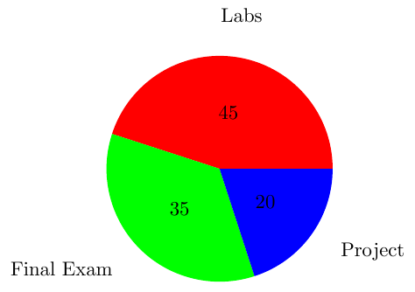
Course Marking
45% for Weekly Labs (~3% a lab!)
35% for Final Exam
20% for Small Class Project

Slide 4
BIG DATA NEEDS SEARCH

Slide 5
Information Overload
Generalised form:
Getting information from Big Data is like taking a drink from a fire hydrant.

Slide 6
Where would we be without search?

Slide 7
All Information = No Information

Slide 8
SEARCH, QUERY, RETRIEVAL

Slide 9
Search, Query & Retrieval
Search: the goal/aim of the user
Query: the expression of a search
Retrieval: the machine method to “solve” a query
… roughly speaking

Slide 10
Retrieval
Machine has a bunch of information resources of some sort (let’s call it a set I)
e.g., documents, movie pages, actor descriptions
A user search wants to find some subset of I
e.g., Irish actors, documents about Hadoop
User expresses search criteria as a query Q
e.g., “irish actors”, “hadoop”, “SELECT ?movie …”
Retrieval engine returns results: R is a minimal subset of I relevant to Q
Results R may be ordered by a ranking
e.g., by most famous Irish actors

Slide 11
Data Retrieval
Retrieval over “structured data”
Typical of databases
I is a dataset, e.g., a set of relations
Q is a structured query, e.g., SQL
R is a list of tuples, possibly ordered
SELECT * FROM actor WHERE country = “Ireland” ORDER BY earnings;

Slide 12
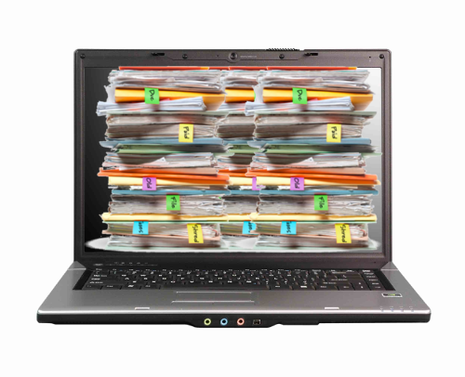
Information Retrieval
Retrieval over “unstructured data” or textual data
Typical of web search
I is a set of text documents, e.g., web pages
Q is a keyword query
R is a list of documents, e.g., relevant pages
“most famous Irish actors”

Slide 13
WEB SEARCH/RETRIEVAL

Slide 14
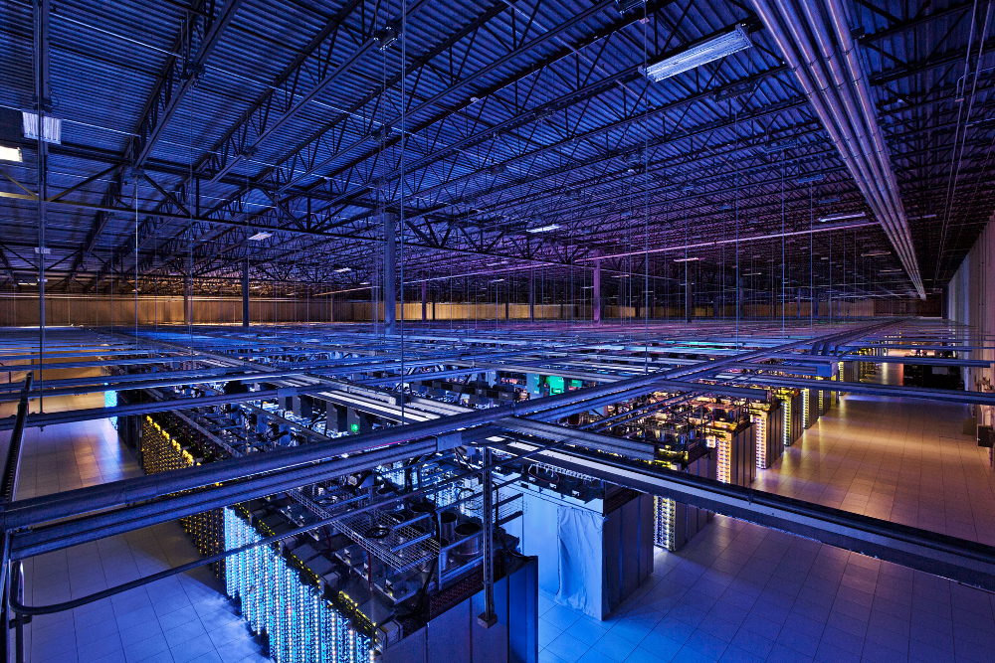
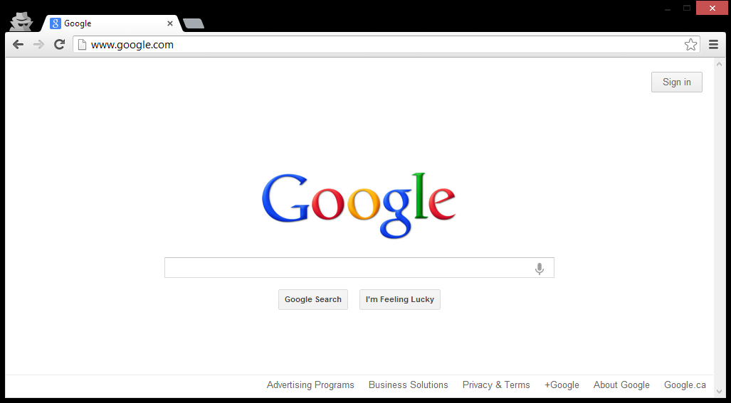
Inside Google

Slide 15
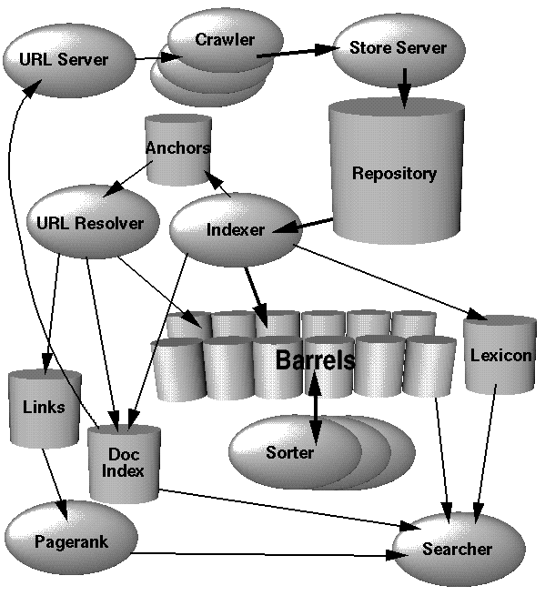
Google Architecture (ca. 1998)
Information Retrieval
Crawling
Inverted indexing
PageRank

Slide 16
INFORMATION RETRIEVAL: CRAWLING

Slide 17
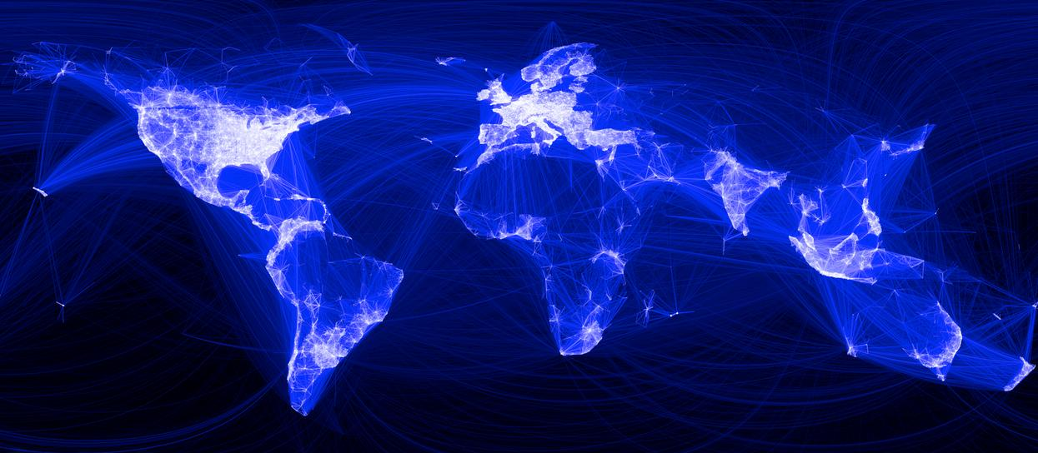
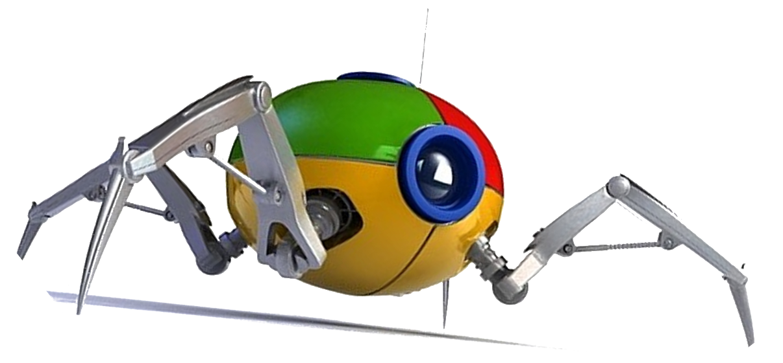
How does Google know about the Web?

Slide 18
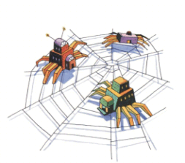
Crawling
Download the Web. ☺
crawl(list seedUrls)
frontier_i = seedUrls
while(!frontier_i .isEmpty())
new list frontier_i+1
for url : frontier_i
page = downloadPage(seedUrl)
frontier_i+1.addAll(extractUrls(page))
store(page)
i++
What’s missing from this code?

Slide 19
Crawling: Avoid Cycles
Download the Web. ☺
crawl(list seedUrls)
frontier_i = seedUrls
new set urlsSeen
while(!frontier_i .isEmpty())
new list frontier_i+1
for url : frontier_i
page = downloadPage(url)
urlsSeen.add(url)
frontier_i+1.addAll(extractUrls(page) .removeAll(urlsSeen))
store(page)
i++
What about the performance of this code?

Slide 20
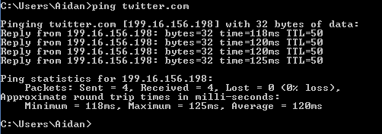
Crawling: Catering for Slow Network
page = downloadPage(url)
Majority of the time spent will be spent waiting for connection
Disk and CPU of crawling machine barely occupied
Bandwidth will not be maximised (stop / start)

Slide 21
Crawling: Multi-threading Important
crawl(list seedUrls)
frontier_i = seedUrls
new set urlsSeen
while(!frontier_i .isEmpty())
new list frontier_i+1
new list threads
for url : frontier_i
thread = new DownloadPageThread.run(url,urlsSeen,fronter_i+1)
threads.add(thread)
threads.poll()
i++
DownloadPageThread: run(url,urlsSeen,frontier_i+1)
page = downloadPage(url)
synchronised: urlsSeen.add(url)
synchronised: frontier_i+1.addAll(extractUrls(page) .removeAll(urlsSeen))
synchronised: store(page)

Slide 22
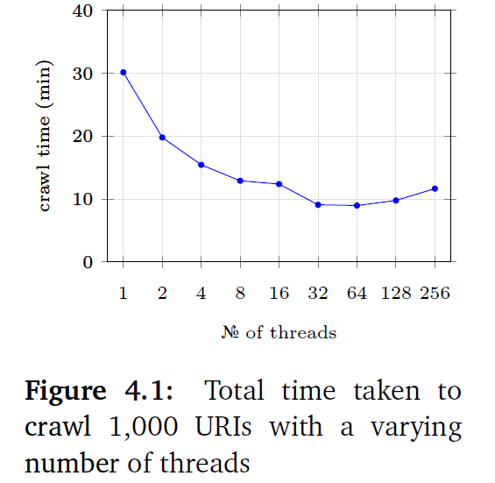
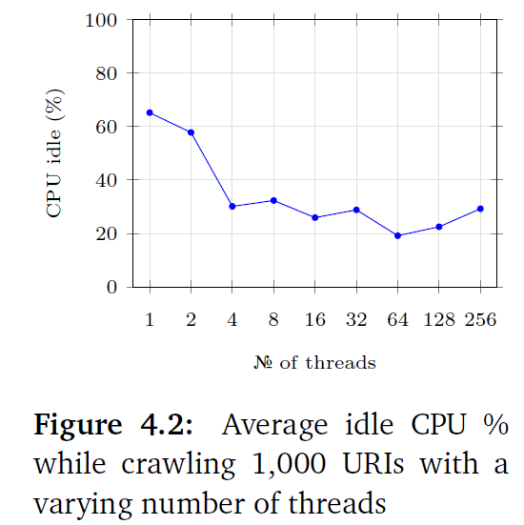
Crawling: Multi-threading Important

Slide 23
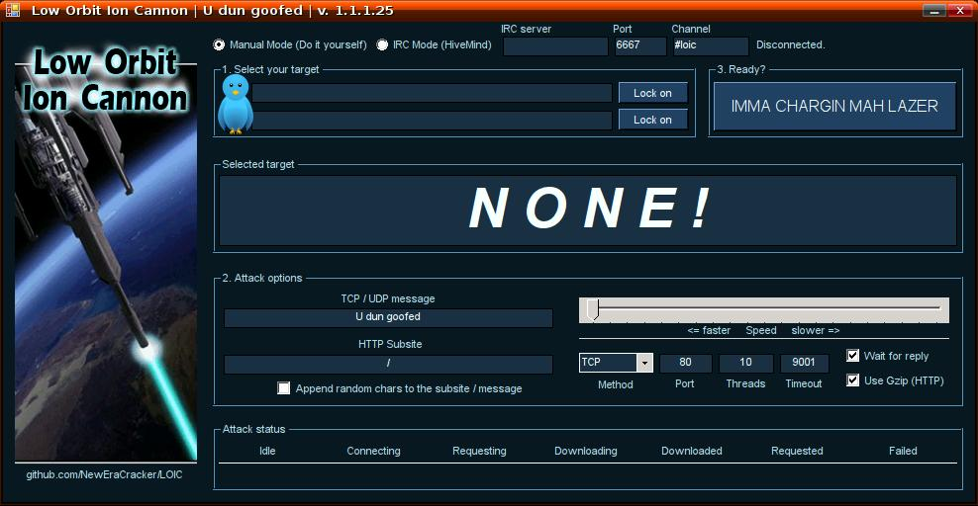
Crawling: Important to be Polite!
(Distributed) Denial of Server Attack: (D)DoS

Slide 24
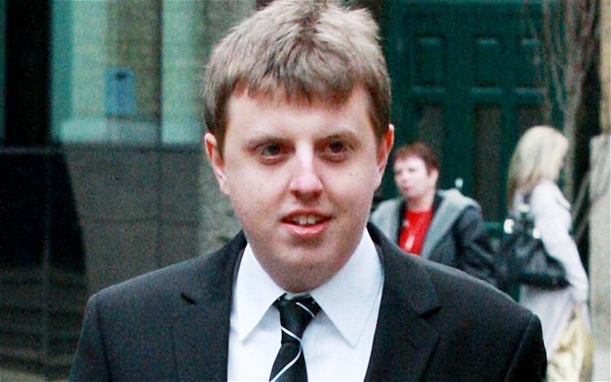
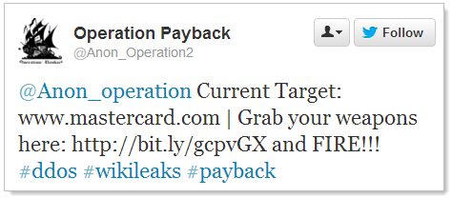
Crawling: Avoid (D)DoSing
But more likely your IP range will be banned by the web-site (DoS attack)
Christopher Weatherhead
Imprisoned for 18 months!

Slide 25
Crawling: Web-site Scheduler
crawl(list seedUrls)
frontier_i = seedUrls
new set urlsSeen
while(!frontier_i .isEmpty())
new list frontier_i+1
new list threads
for url : schedule(frontier_i)
thread = new DownloadPageThread.run(url,urlsSeen,fronter_i+1)
threads.add(thread)
threads.poll()
i++
DownloadPageThread: run(url,urlsSeen,frontier_i+1)
page = downloadPage(url)
synchronised: urlsSeen.add(url)
synchronised: frontier_i+1.addAll(extractUrls(page) .removeAll(urlsSeen))
synchronised: store(page)

Slide 26
Robots Exclusion Protocol
http://website.com/robots.txt
User-agent: *
Disallow: /
No bots allowed on the website.
User-agent: *
Disallow: /user/
Disallow: /main/login.html
No bots allowed in /user/ sub-folder or login page.
User-agent: googlebot
Disallow: /
Ban only the bot with “user-agent” googlebot.

Slide 27
Robots Exclusion Protocol (non-standard)
User-agent: googlebot
Crawl-delay: 10
Tell the googlebot to only crawl a page from this host no more than once every 10 seconds.
User-agent: *
Disallow: /
Allow: /public/
Ban everything but the /public/ folder for all agents
User-agent: *
Sitemap: http://example.com/main/sitemap.xml
Tell user-agents about your site-map

Slide 28
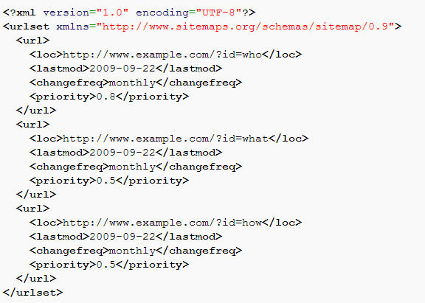
Site-Map

Slide 29
Crawling: Important Points
Seed-list: Entry point for crawling
Frontier: Extract links from current pages for next round
Threading: Keep machines busy; mitigate waits for connection
Seen-list: Avoid cycles
Politeness: Don’t annoy web-sites
Set a politeness delay between crawling pages on the same web-site
Stick to what’s stated in the robots.txt file
Check for a site-map

Slide 30
Crawling: Distribution
Similar benefits to multi-threading
Local frontier and seen-URL list!
How might we implement a distributed crawler?
for url : frontier_i-1
map(url,count)
1
2
3
4
5
What will be the bottleneck as machines increase?

Slide 31
Crawling: Other Options
Breadth-first: As per the pseudo-code, crawl in rounds
Extract one-hop from seed URLs …
Extract n-hop from seed URLs
Depth-first: Follow first link in first page, first link in second page, etc.
Best/topic-first: Rank the URLs according to topic, number of in-links, etc.
Hybrid: A mix of strategies

Slide 32
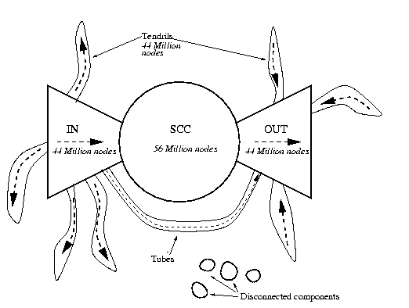
Crawling: Inaccessible (Bow-Tie)
A. Broder, R. Kumar, F. Maghoul, P. Raghavan, S. Rajagopalan, R. Stata, A. Tomkins, and J. Wiener, “Graph structure in the web,” Comput. Networks, vol. 33, no. 1-6, pp. 309–320, 2000

Slide 33
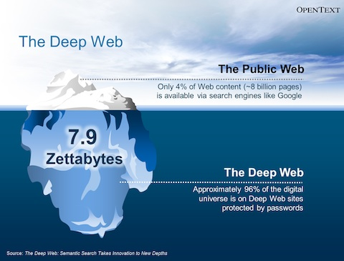
Crawling: Inaccessible (Deep-Web)
Deep-web:
Dynamically-generated content
Password protected / firewalled
Dark Web
Image from http://www.legaltechnology.com/wp-content/uploads/2013/07/OpenText-EIM-Summary.pdf

Slide 34
Apache Nuche
Open-source crawling framework!
Compatible with Hadoop!
https://nutch.apache.org/

Slide 35
INFORMATION RETRIEVAL: INVERTED-INDEXING

Slide 36
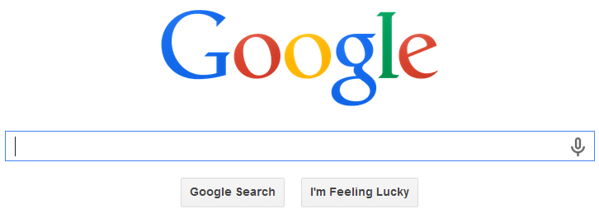
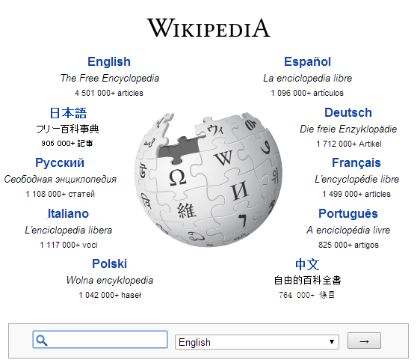
Inverted Index
Inverted Index: A map from words to documents
“Inverted” because usually documents map to words
At the core of all keyword search applications

Slide 37
Inverted Index: Example
1
1 10 18 21 23 28 37 43 47 55 59 68 71 76
Fruitvale Station is a 2013 American drama film written and directed by Ryan Coogler.
Term List | Posting Lists
a | (1,[21,96,103,…]), (2,[…]), …
american | (1,[28,123]), (5,[…]), …
and | (1,[57,139,…]), (2,[…]), …
by | (1,[70,157,…]), (2,[…]), …
directed | (1,[61,212,…]), (4,[…]), …
drama | (1,[38,87,…]), (16,[…]), …
… | …
Inverted index:

Slide 38
Inverted Index: Example Search
american drama
AND: Posting lists intersected (optimised!)
OR: Posting lists unioned
PHRASE: AND + check locations
Word | Posting Lists
a | (1,[21,96,103,…]), (2,[…]), …
american | (1,[28,123]), (5,[…]), …
and | (1,[57,139,…]), (2,[…]), …
by | (1,[70,157,…]), (2,[…]), …
directed | (1,[61,212,…]), (4,[…]), …
drama | (1,[38,87,…]), (16,[…]), …
… | …
Inverted index:

Slide 39
Inverted Index Flavours
Record-level inverted index: Maps words to documents without positional information
Word-level inverted index: Additionally maps words with positional information

Slide 40
Inverted Index: Word Normalisation
drama america
Word normalisation: grammar removal, case, lemmatisation, accents, etc.
Query side and/or index side
Term List | Posting Lists
a | (1,[21,96,103,…]), (2,[…]), …
american | (1,[28,123]), (5,[…]), …
and | (1,[57,139,…]), (2,[…]), …
by | (1,[70,157,…]), (2,[…]), …
directed | (1,[61,212,…]), (4,[…]), …
drama | (1,[38,87,…]), (16,[…]), …
… | …
Inverted index:

Slide 41
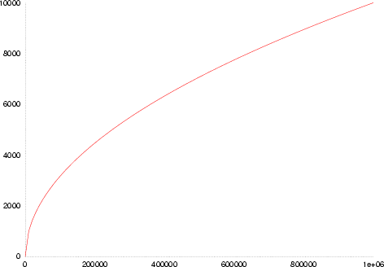
Inverted Index: Space
Not so many unique words …
but lots of new proper nouns
Heap’s law:
UW(n) ≈ Kn^{β}
English text
K ≈ 10
β ≈ 0.6
Number of unique words in text
Number of words in text

Slide 42
Inverted Index: Space
As text size grows (n words) …
Unique words (i.e., inverted index keys) grow sub-linearly: O(n^{β}) for β ≈ 0.6
Positional occurrences grows linearly O(n)

Slide 43
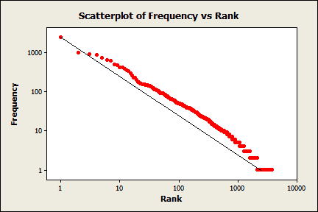
Inverted Index: Common Words
Many occurrences of few words
Few occurrences of many words
Zipf’s law
In English text:
“the” 7%
“of” 3.5%
“and” 2.7%
135 words cover half of all occurrences
Zipf’s law: the most popular word will occur twice as often as the second most popular word, thrice as often as the third most popular word, n times as often as the n-most popular word.

Slide 44
Inverted Index: Common Words
Expect long posting lists for common words
Also expect more queries for common words

Slide 45
Inverted Index: Common Words
Perhaps implement stop-words?
Most common words contain least information
Perhaps implement block-addressing?
the drama in america
Fruitvale Station is a 2013 American drama film written and directed by Ryan Coogler.
Block 1
Block 2
Term List | Posting Lists
a | (1,[1,…]), (2,[…]), …
american | (1,[1,…]), (5,[…]), …
and | (1,[2, …]), (2,[…]), …
by | (1,[2, …]), (2,[…]), …
… | …
What is the effect on phrase search?

Slide 46
Search Implementation
Vocabulary keys:
Hashing: O(1) lookups
no range queries
relatively easy to update (though rehashing expensive!)
Sorting/B-Tree: O(log(u)) lookups, u unique words
range queries
tricky to update (standard methods for B-trees)
Tries: O(l) lookups, l length of the word
range queries, compressed, auto-completion!
referencing becomes tricky (esp. on disk)

Slide 47
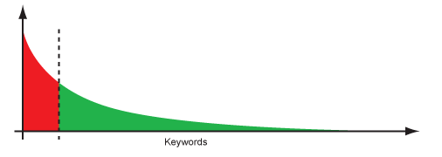
Memory Sizes
Vocabulary keys:
Often will fit in memory!
Posting lists may be kept on disk
(hot regions cached)
The long-tail of search:

Slide 48
Compression techniques: High Level
Interval indexing
Example for record-level indexing
Could be applied for block-level indexing
Term List | Posting Lists
country | (1), (2), (3), (4), (6), (7), …
… | …
Term List | Posting Lists
country | (1–4), (6–7),
… | …

Slide 49
Compression techniques: Low Level
Variable length coding: bit-level techniques
For example, Elias encoding
Assumes many small numbers
z: integer to encode | n = ⌊log₂(z)⌋ coded in unary | a zero marker | next n binary numbers | final Elias code
1 | 0 |  |  | 0
2 | 1 | 0 | 0 | 100
3 | 1 | 0 | 1 | 101
4 | 11 | 0 | 00 | 11000
5 | 11 | 0 | 01 | 11001
6 | 11 | 0 | 10 | 11010
7 | 11 | 0 | 11 | 11011
8 | 111 | 0 | 000 | 1110000
… | … | … | … | …
For example, “01000011000111000011001” = <1,2,1,1,4,8,5>

Slide 50
Other Optimisations
Top-Doc: Order posting lists to give likely “top documents” first: good for top-k results
Selectivity: Load the posting lists for the most rare keywords first; apply thresholds
Sharding: Distribute an index over multiple machines
How might an inverted index be split over multiple machines?

Slide 51
Extremely Scalable/Efficient
When engineered correctly ☺

Slide 52
Recap
Information overload in Big Data
Search: user intent
Query: user expression of search
Retrieval: machine methods to execute search

Slide 53
Recap
Crawling:
Avoid cycles, multi-threading, politeness, DDoS, robots exclusion, sitemaps, distribution, breadth-first, topical crawlers, deep web
Inverted Indexing:
boolean queries, record-level vs. word-level vs. block-level, word normalisation, lemmatisation, space, Heap’s law, Zipf’s law, stop-words, tries, hashing, long tail, compression, interval coding, variable length encoding, Elias encoding, top doc, sharding, selectivity

Slide 54
Questions
?

